Slide 1
First results from LLRB MD
Y. Papaphilippou, A. Rossi, G. Sterbini for the MD2202 team
TCC, 13 July 2017

Slide 2
Outline
Introduction
Overview of the MD
Results of the compensation
Summary and 2017 plans

Slide 3
Introduction
After the installation of the BBCWs (prototypes of the beam-beam wire compensators) during last EYETS and parasitic tests at injections of top energy, an MD took place on the 1st July.
Layout of the BBCW compensation: use 2 DC wires to compensate on the B2 the effect of the B1.

Slide 4
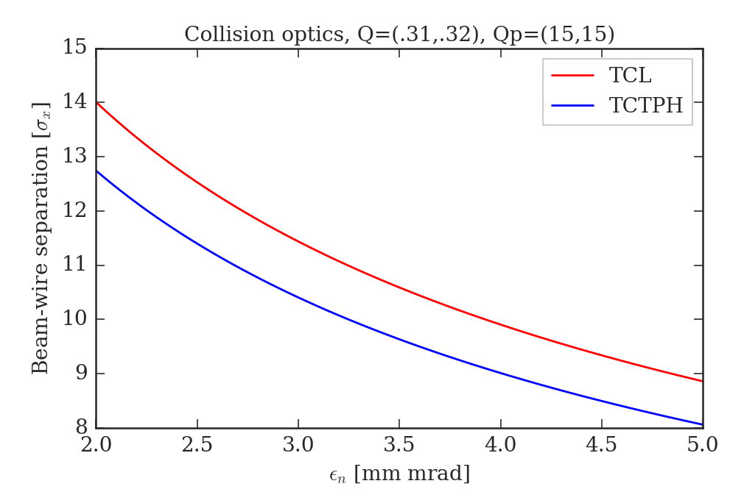
Introduction
Assuming the jaws at 6 σ_{coll}
Wire at 6.92 mm
Jaws at 3.92 mm
Wire at 7.95 mm
Jaws at 4.95 mm
The wires are embedded in tertiary collimators. There are precise limits in the positioning of the wire with respect to the beams.

Slide 5
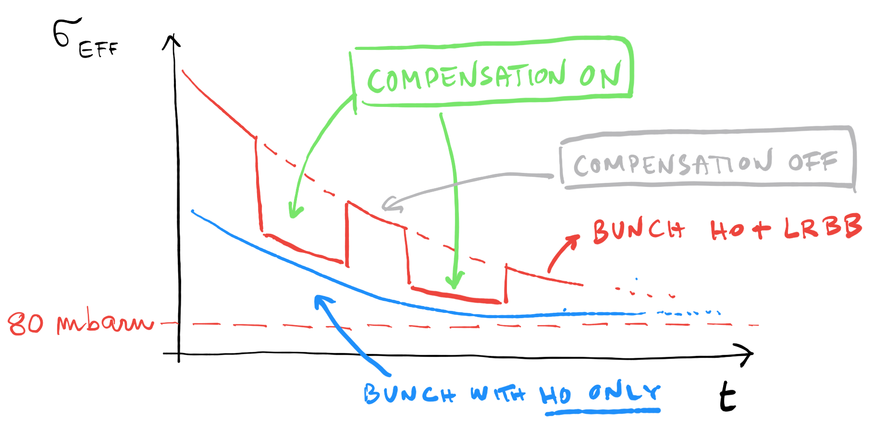
Objectives of the MD
Test with beam the different setting-up procedures
Prove the beneficial effect of the wires compensation on the bunches suffering long-range beam-beam (partial compensation due to the presence of wires only in IP5 and to the limit of the beam-wire distance due to the collimator constraints).

Slide 6
MD2202
10 h MD.
The FILL5898 was dumped (RF on B1, RF experts suggest a glitch on the interlock). Half-RF detuning.
The observations we report concern the FILL5900. Full-RF detuning.

Slide 7
Asymmetric filling scheme
To approach the wire to the beam the B2 has to be <3e11 p (safe limit).
We will main concentrate on the two bunches of B2 (Only HO and HO+BBLR).

Slide 8
STEP 1: Alignment of the two wires
Important vertical offset (up to 5 mm) as to be taking into account with the vertical alignment procedure. This is not a trivial procedure (no V PU).

Slide 9
STEP 2: H emittance blow-up
To increase the LRBB effect, the B2 was blown up to 5-6 mm mrad and tune were set to (0.31, 0.32).

Slide 10
STEP 3: Crossing angle reduction
To increase the BBLR the X-ing angle was reduced. Great synergy with the OP tools developed for the crossing angle anti-leveling.

Slide 11
Finally: powering the wires
During the powering of the wires the tunes of the beam (and its position) has to be controlled. The wires can move the Q of 0.01: dipolar and quadrupolar contributions of the wires are compensated with feed-forward trims.

Slide 12
Sanity checks on H-position
The H-position of the beam is under control.

Slide 13
Sanity checks on V-position
The wires are vertically aligned.

Slide 14
Sanity checks on tunes
Very good control of the tunes when powering the wires.

Slide 15
Result on the compensation (I)
From the FBCT signals ompensation on the losses [credit to M. Hostettler].
Clear effect of the BBWC.

Slide 16
Result on the compensation (II)
Compensation on the burn-off losses [credit to N. Karastathis].
Clear effect on the BBCW when switching-off.

Slide 17
Result on the compensation (III)
Using dBLM signals to compute the cross-section [credit to A. Poyet].
Improved time resolution.
Further checks on calibration needed.

Slide 18
Summary and next steps
During the MD2202 it was observed for the first time the effect of a compensation of the BBCW. The setting-up procedures were tested and validated.
The HW (interlock, PCs, jaws temperature/cooling…) worked smoothly.
There are still margin of improvement: beta-beating/tune feedforward and a smoother orchestration of the feedforward trims.
NEXT STEPS in 2017: we asked for 8h MD in the MD3 block:
  Explore the I_{WIRE} and beam-wire distance parameters space.
  Investigate the effect of octupoles and chromaticity.
  Use the coronagraph imaging to observe the tails of the bunches.
  Put more energy in the tracking studies.

Slide 19
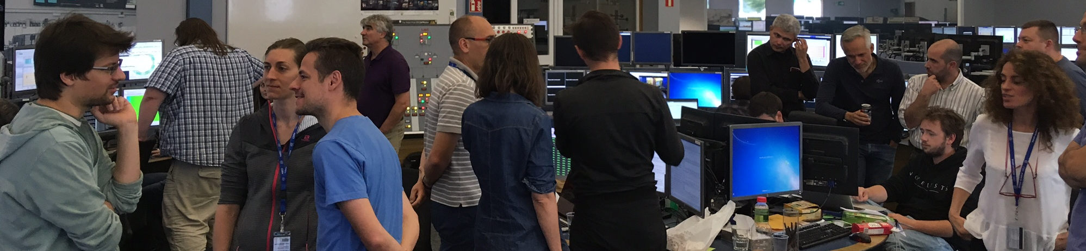
Thank you for your attention.
MD2202 team (random order): K. Skoufaris, Y. Papaphilippou, A. Rossi, S. Fartoukh, D. Pellegrini, K. Karastatis, A. Poyet, A. Valishev, S. Kostoglou, G. Sterbini, S. Papadopoulou, M. Fitterer, M. Solfaroli, M. Pojer, M. Hostettler, B. Salvachua, L. Carver, X. Buffat, P. Zisopoulos, H. Bartosik, N. Fuster, S. Redaelli, R. Bruce, M. Gonzales, G. Trad, M. Gasior, C. Zamatzas, J. Olexa, T. Levens, C. Xu, A. Gorzawski, D. Valuch, D. Amorim, I. Lamas Garcia, G. Cattenoz, E. Effinger, L. Poncet, D. Mirarchi, R. Tomas, D. Kaltchev, R. Jones, F. Schmidt…

Slide 20
BACK-UP SLIDES

Slide 21
Optimizing HO collision

Slide 22
Positioning the collimation jaws

Slide 24
MD2202: Q trims

Slide 25
MD2202: dipolar trims

Slide 26
MD2202: instability of B2

Slide 27
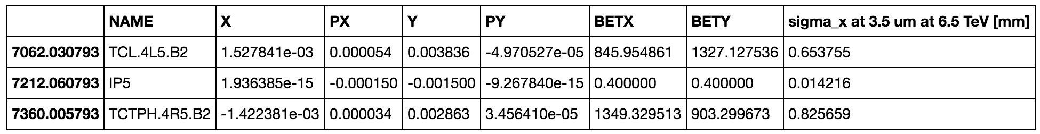
MD2202: Optics

Slide 28
End of FILL test

