Slide 1
RFD - USLARP
Courtesy: S. de Silva et al.

Slide 2
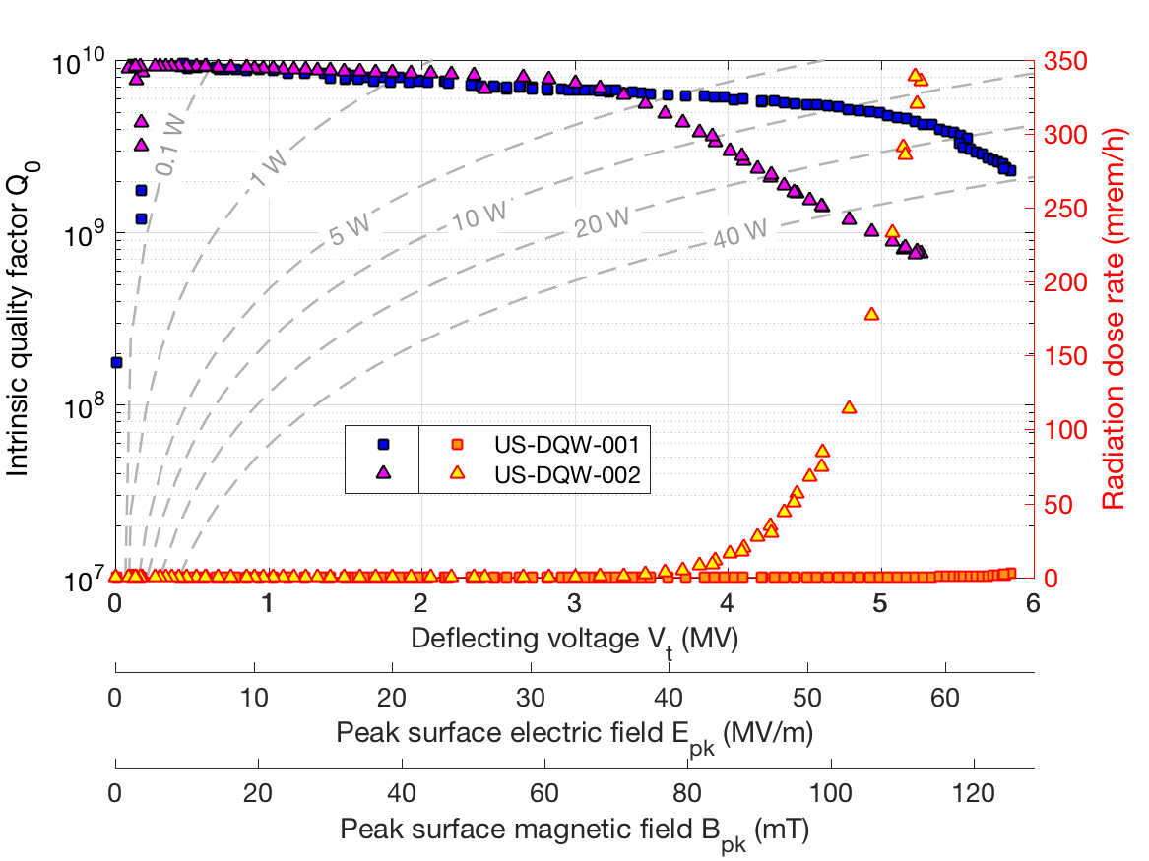
DQW - USLARP
Courtesy: S. Verdu et al.

Slide 3
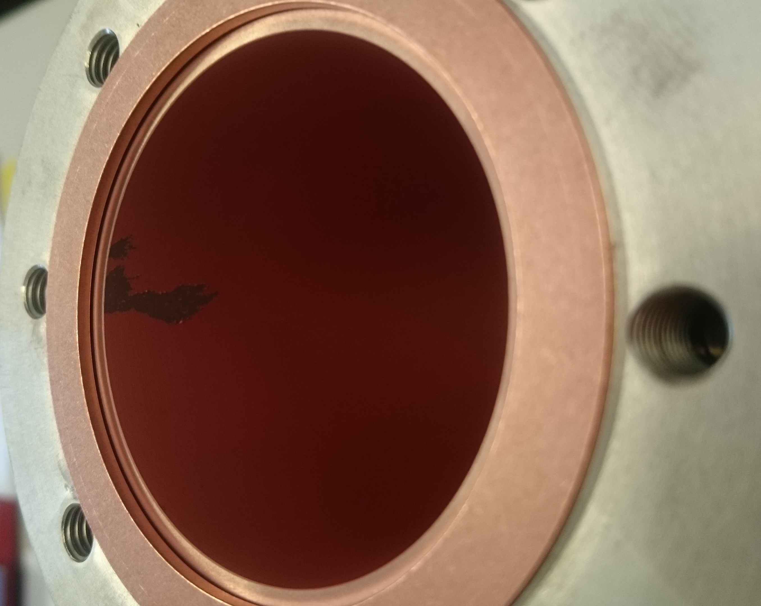
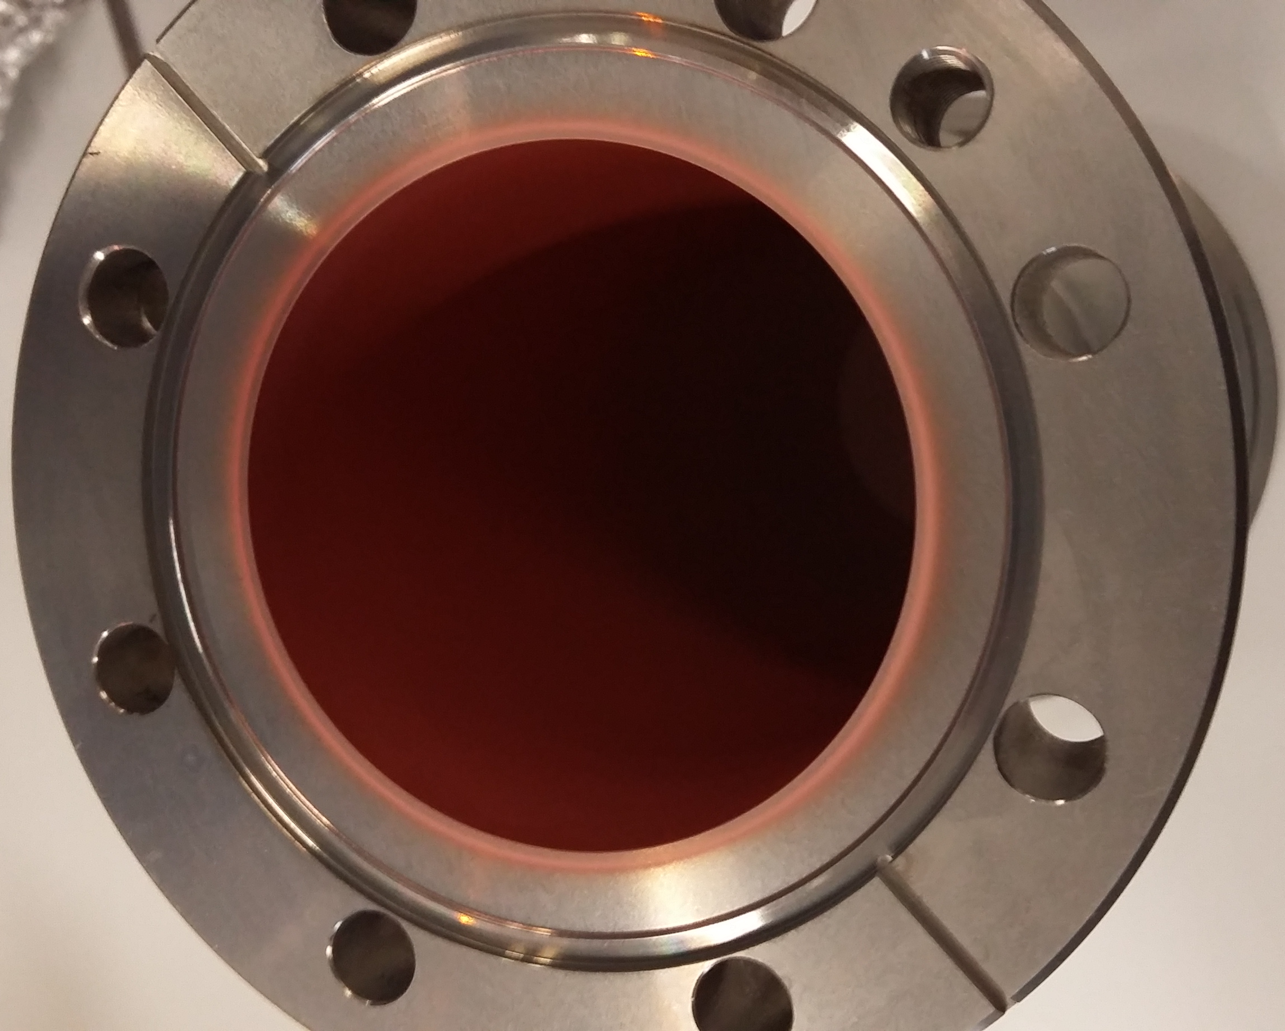
Cu-Coating Double Wall Tube
Sputtered Cu on NEG
Peeling off during high pressure tests
Galvanic Process of Cu on Au
After strong ultrasonic + 77K shock tests
Thanks to RF-PM & TE-VSC to implement this in less than 2 weeks
Total of 3 tubes available in SM18

Slide 4
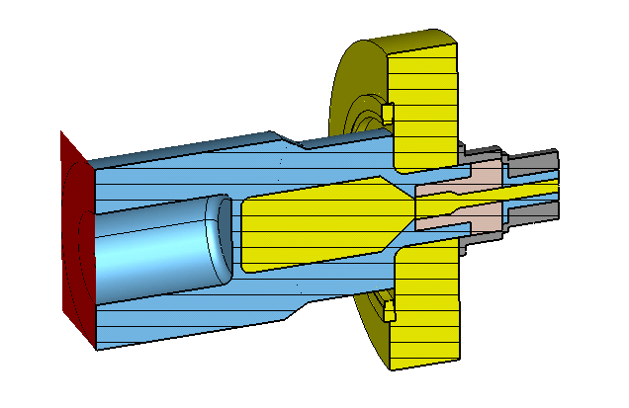
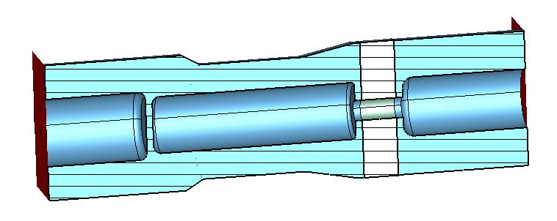
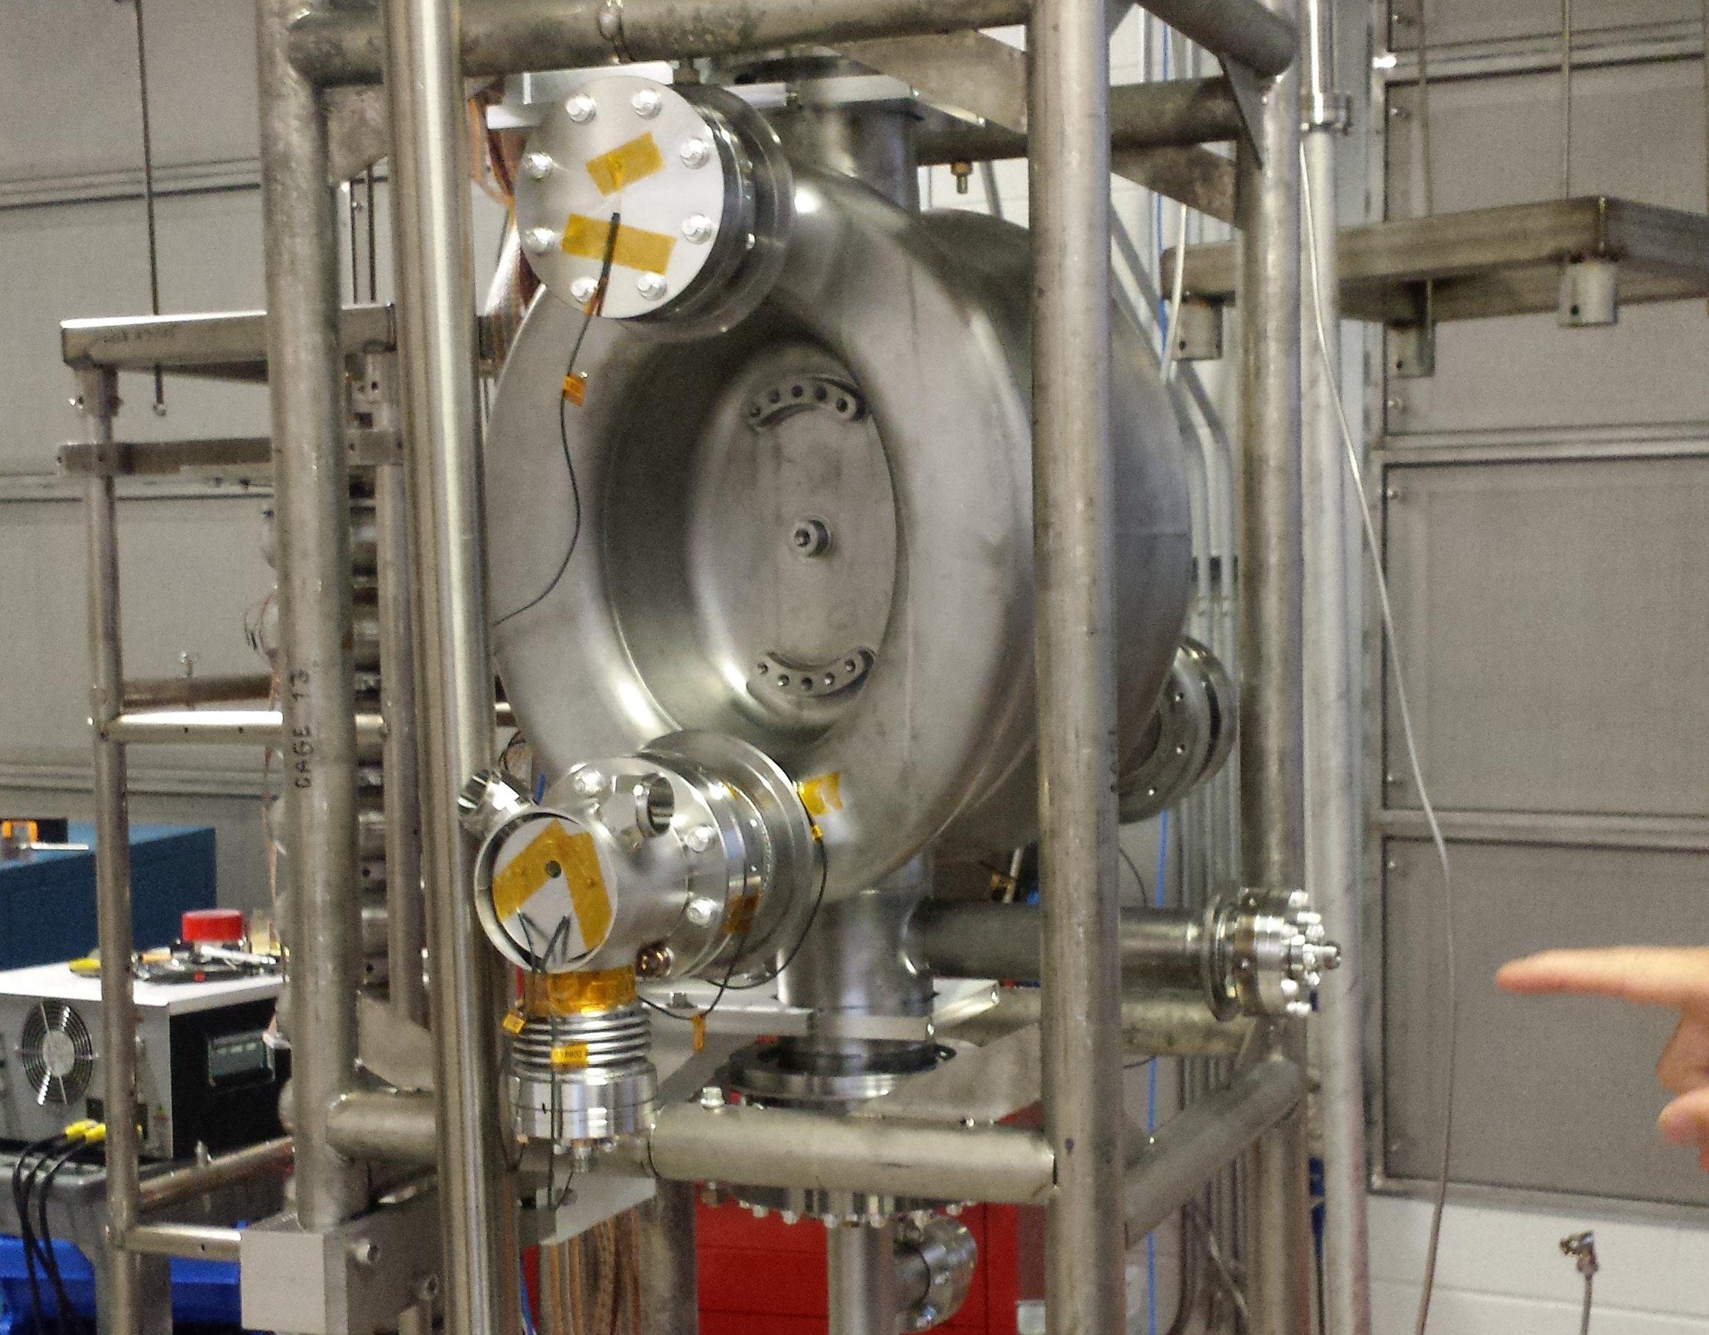
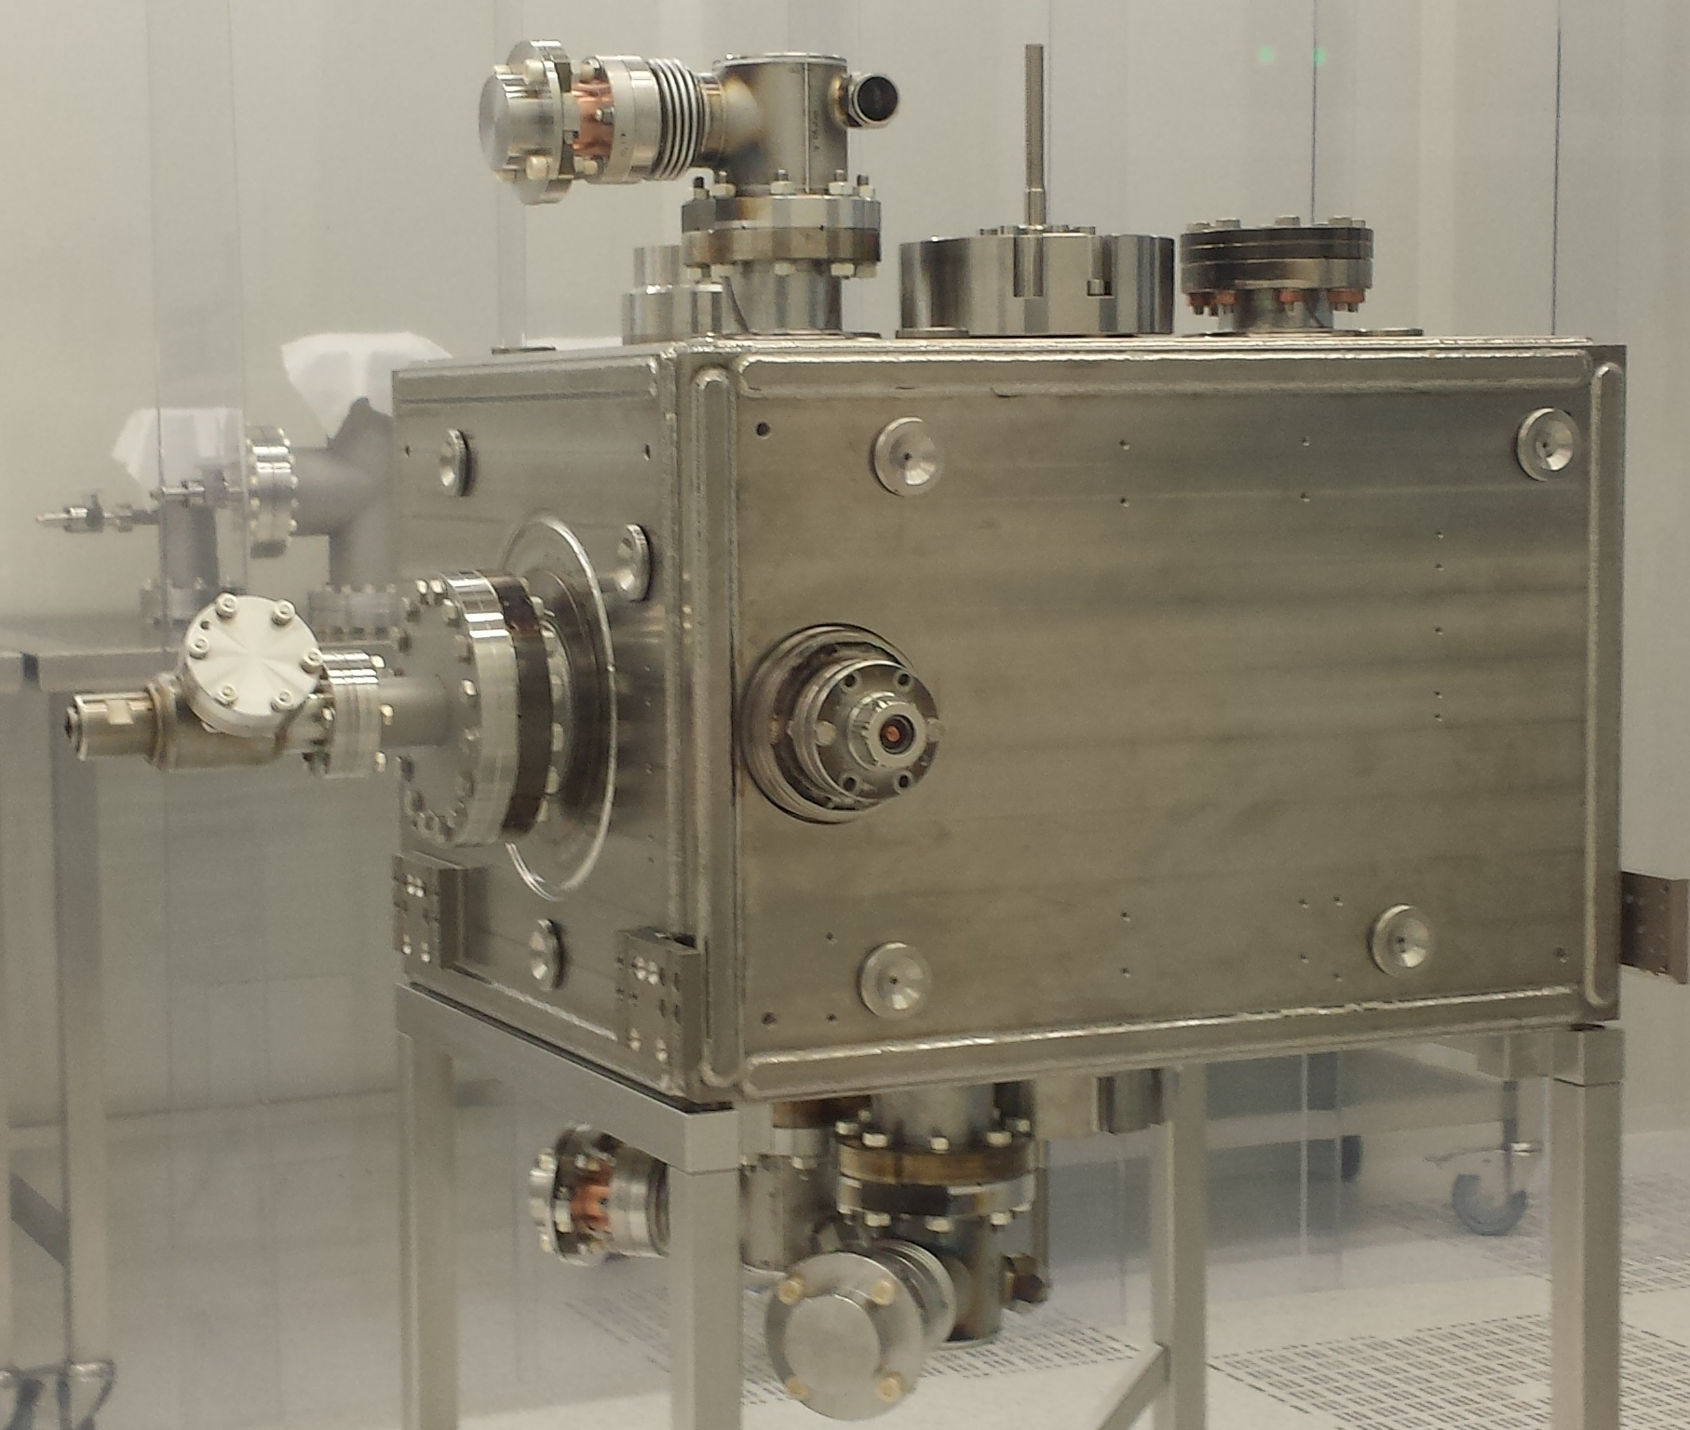
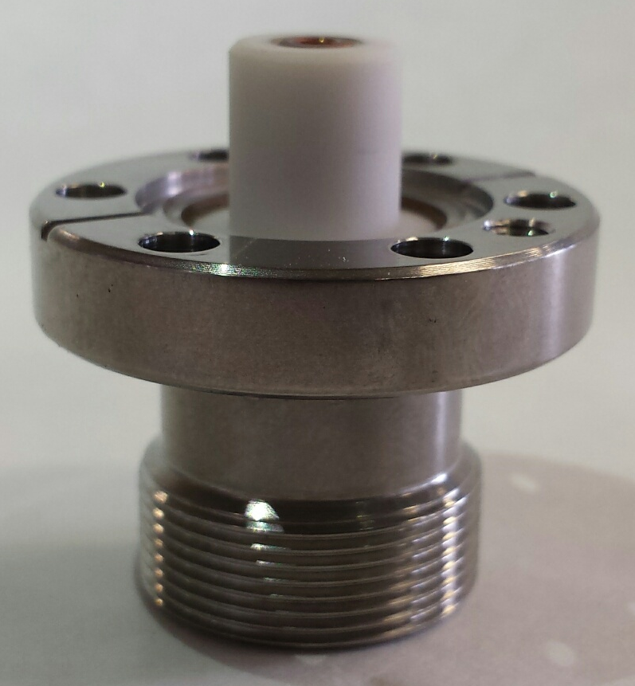
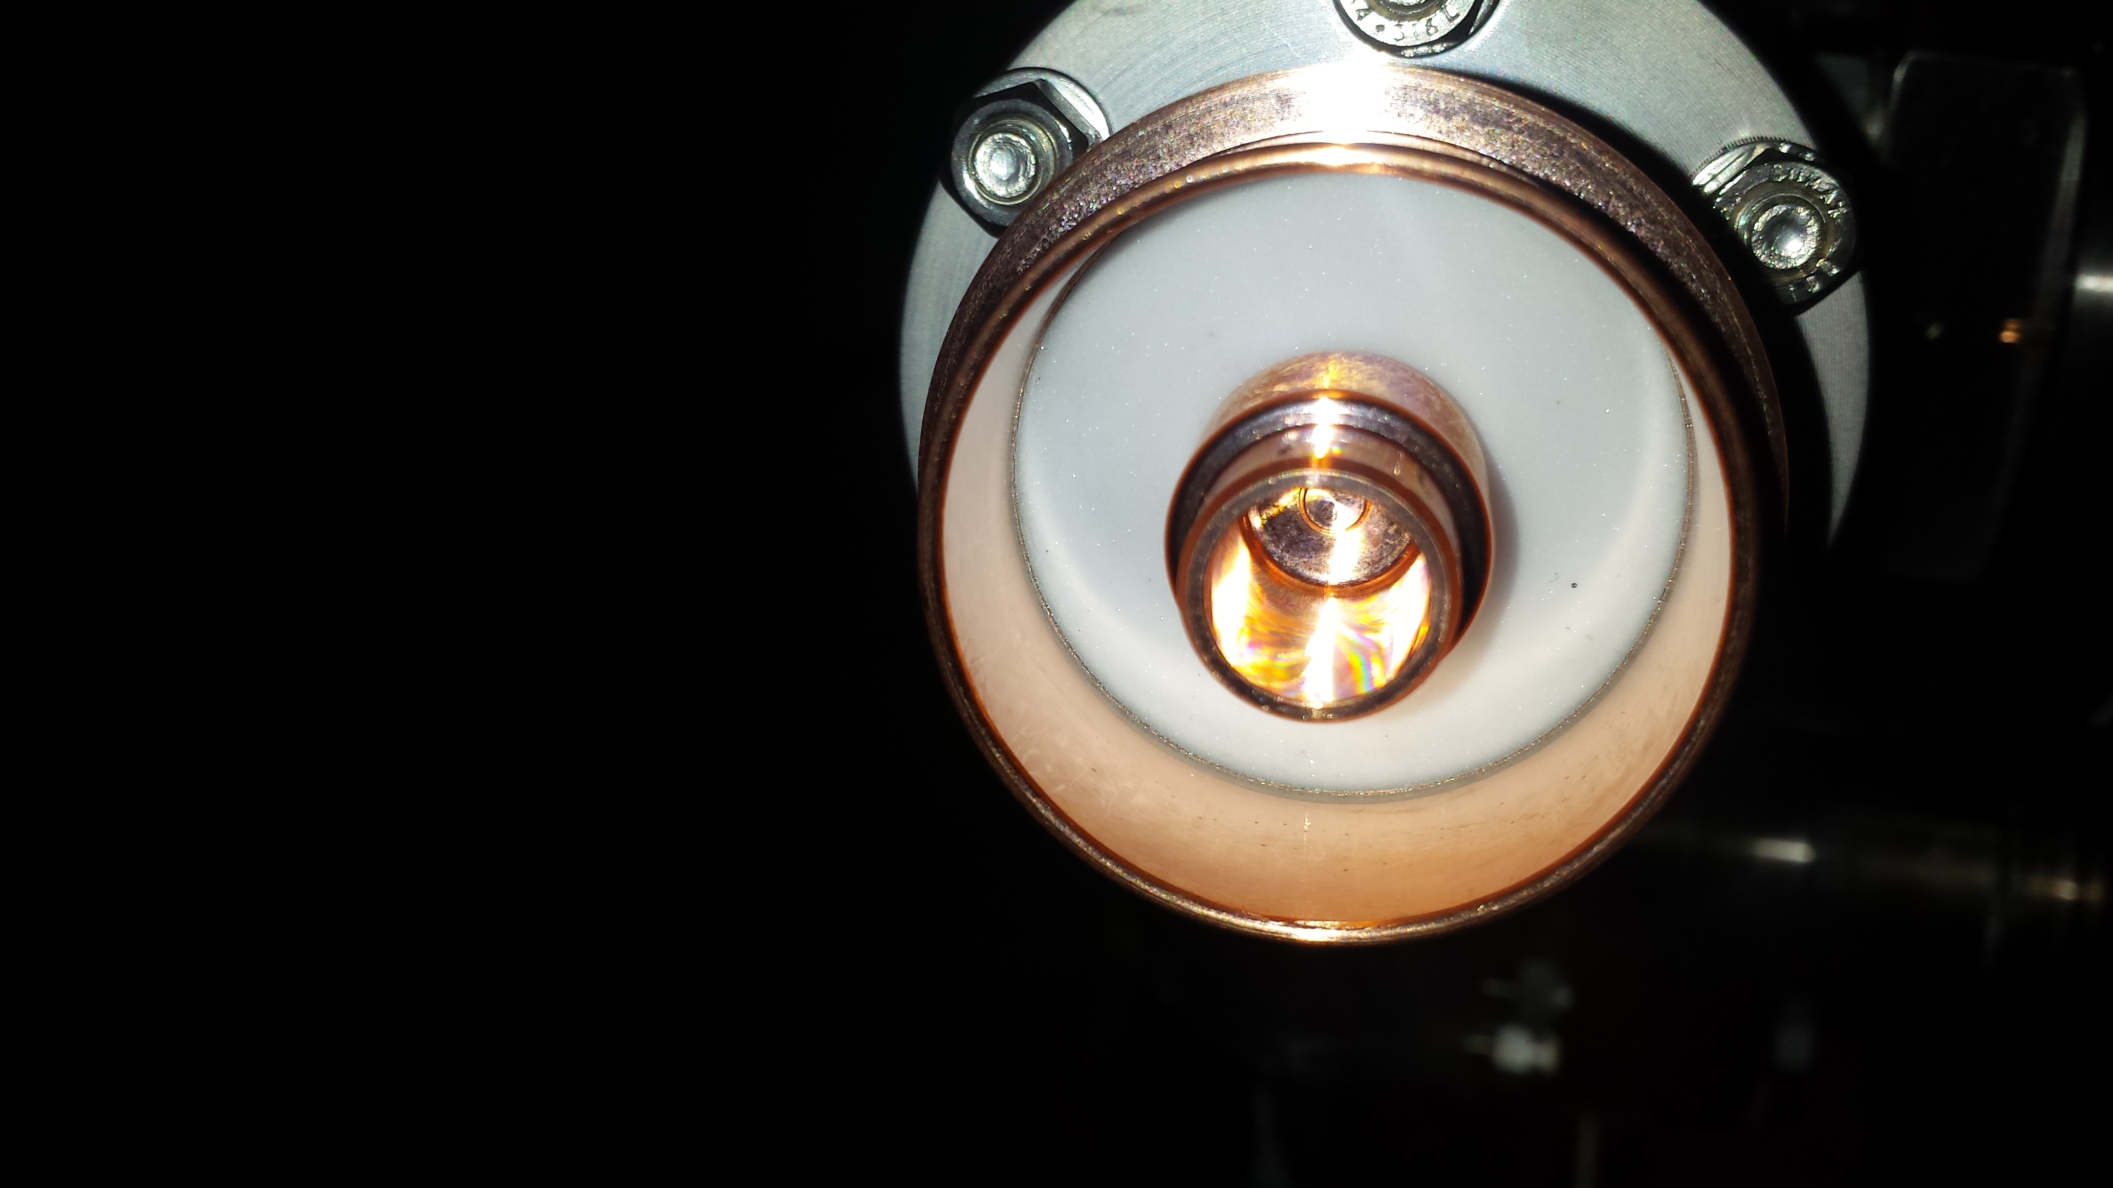
HOM Feedthrough Leaks
Original feedthrough
~ 1kW HOM power
Replacement feedthrough
~ 200 W HOM power
2 out three leak during warm up

Slide 5
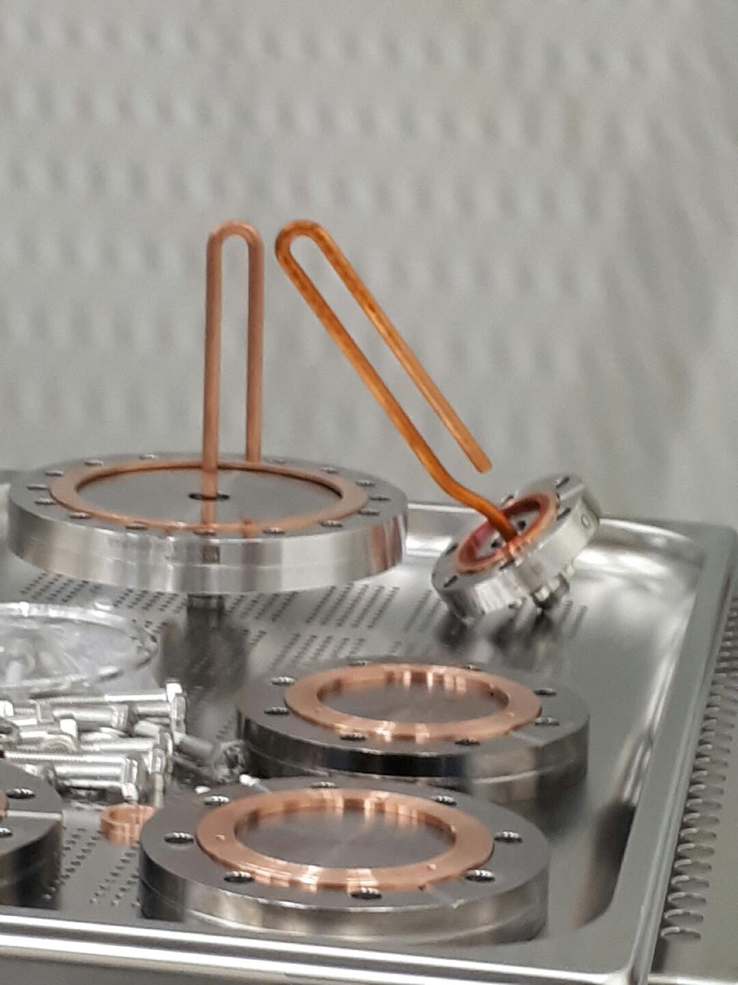
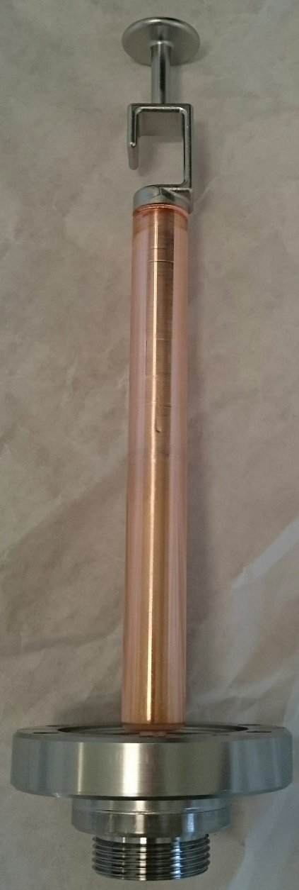
Pickup Antenna Feedthrough
First 2 of PUs damaged*, 2 new PUs in place, under testing \
In parallel, preparing a back up using similar LEP like feedthroughs (+loops)
Consequence is lower power from PU antenna (x10 or lower) + no damping of 1.7GHz modes
Original PU
Replacement
*Improper thermal shock test

