Slide 1
Update on HL-LHC IR stripline BPM design
T. Lefevre, M. Krupa, C. Boccard, R. jones, G. Schneider BE/BI
N. Chritin, A. Demougeot, EN/MME
January 30th 2017

Slide 2
Outline
Update on BPM design and cost
Futures Plans

Slide 3
WP13.4 budget profile
40 BPMs in Q1 to Q5 regions of LSS1 and LSS5
3 BPM Types identified : Cost 600kCHF
  Tungsten Shielded Cryogenic Stripline BPMs (4+24units), Warm stripline and button BPMs
Development of dedicated electronics optimised for use with directional striplines

Slide 4
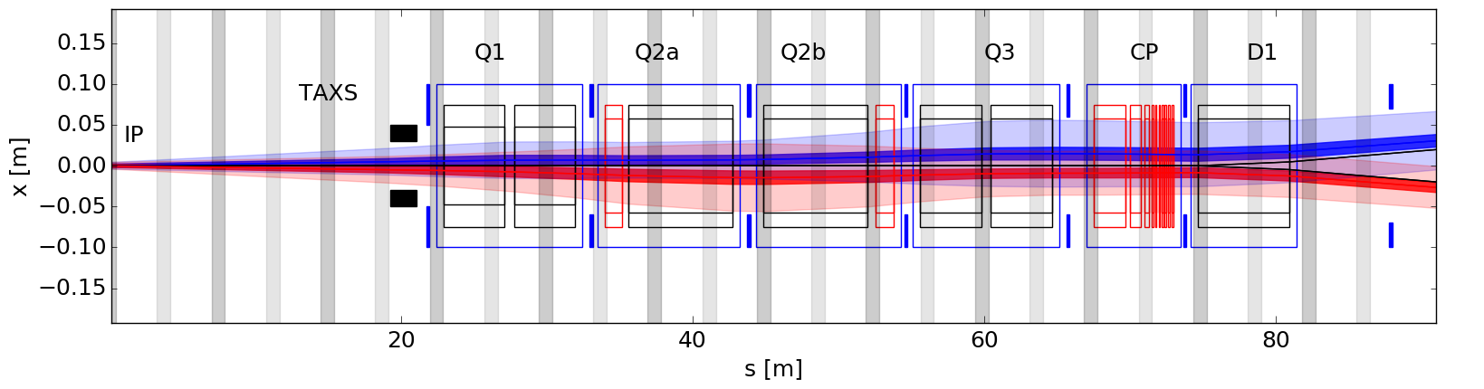
Layout and BPM Specifications
All layout moved by 8 cm towards the IP. L*=22.92
Q1a-Q1b and Q3a-Q3b distance reduced by 4 cm.
All BPMs (BPMQT) are further LR encounters by >57 cm
Design with EN/MME of BPMQT located in interconnects of Q2a/b, Q3, CP, D1

Slide 5
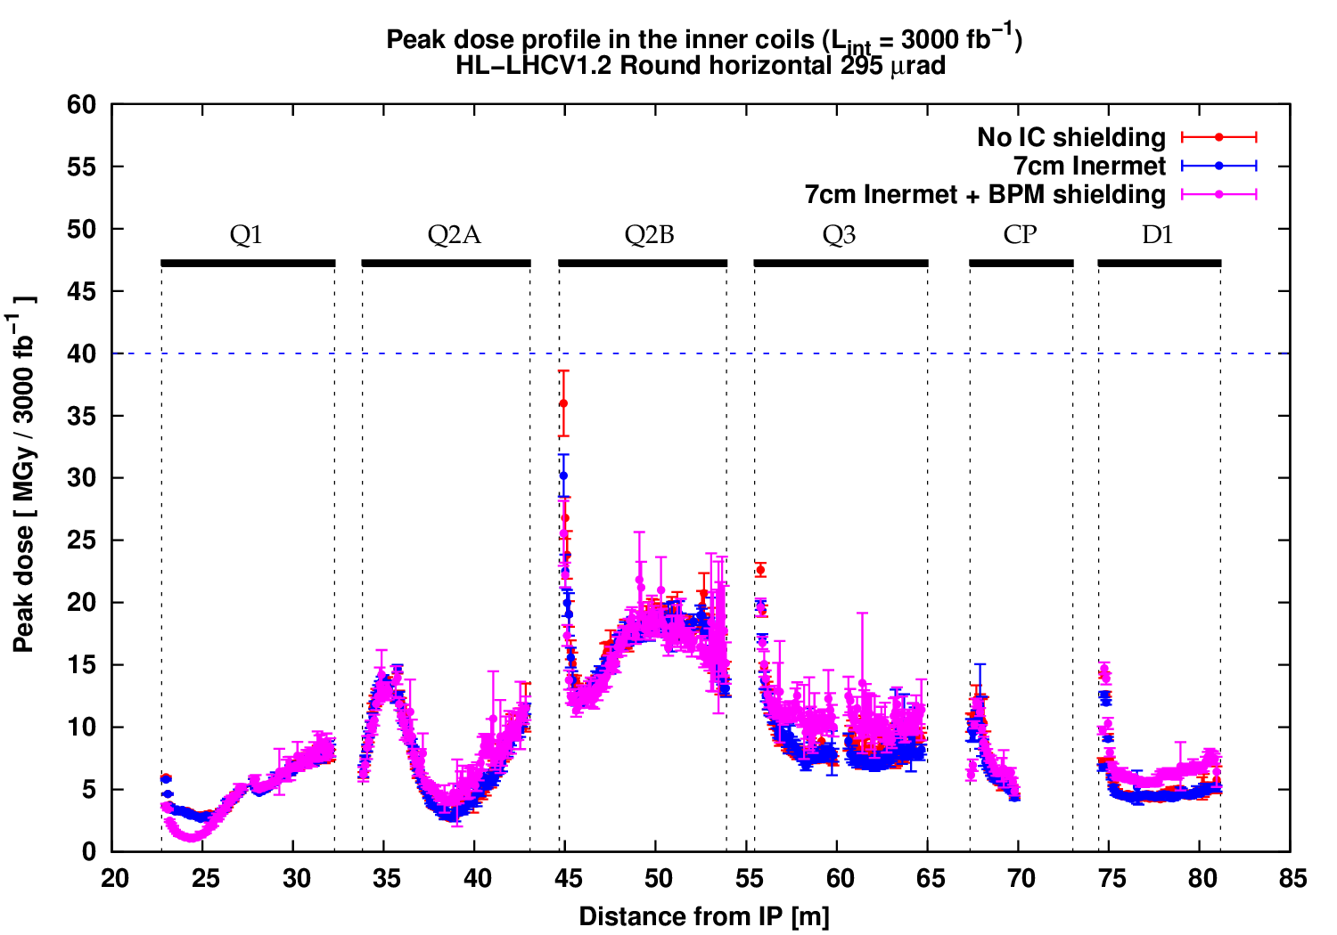
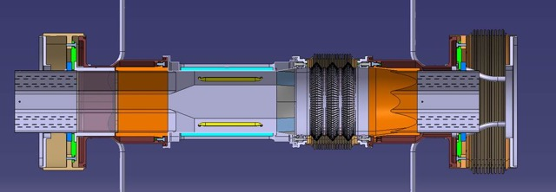
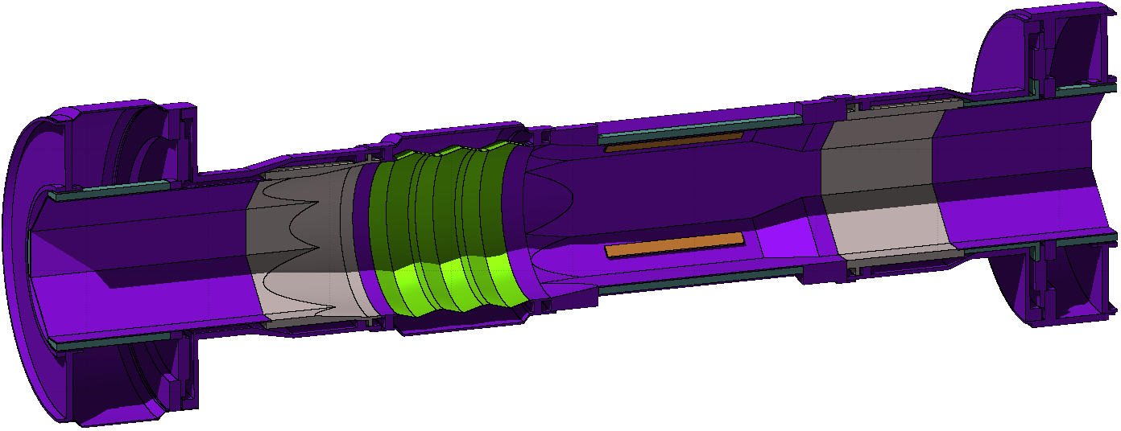
Update on IR BPM design/spec.
36MGy
30MGy
26MGy
15% reduction of the peak with 7cm insert
Further 15% reduction with octagonal shielded BPM
Total reduction of ~30% (compared to BS gap of 70.8cm)

Slide 6
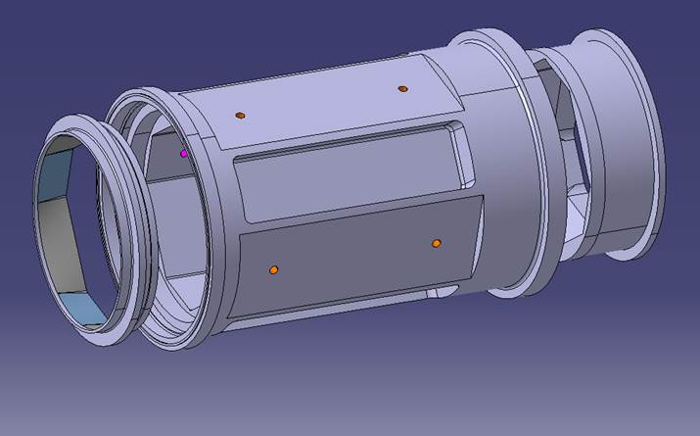
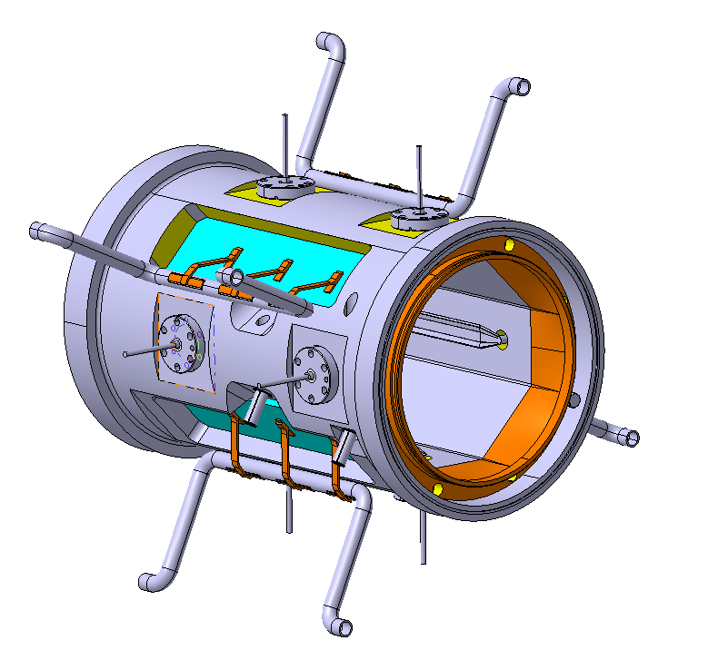
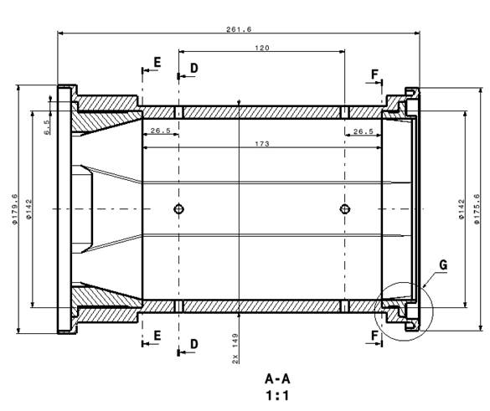
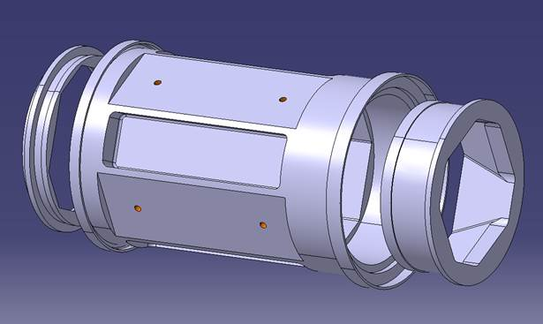
Update on IR BPM design/spec.
Since then, reviewed the BPM design and fabrication constrains
… to an improved version aiming for
simpler manufacturing with inserts for transitions

Slide 7
Update on IR BPM design/spec.
Open question : Building BPM out of Inermet ?
  Not a valid option today !
  R&D would be needed Vacuum tightness and fabrication technique
    Would be interesting to follow up possibly in synergy with FCC
  Cost of raw material (x3), machining (x10) compared to 316LN : 80-100kCHF/BPM

Slide 8
BPM costing
Budget of 600k for 40 BPMs : 15kCHF based on our estimates few years ago
Recent Costing of Strip-line BPM for ELENA : 15k
  Mechanics 11k
  Feedthrough 2.5k
  Cleaning and Coating 1.5k
HL-LHC additional costs per BPM : 6k estimates
  Inermet absorbers 2k
  Cooling channel 1k
  Adaptation piece (taper) 1k
  Higher precision (striplines/feedthrough) 2k
Hilumi BPM cost estimated around 20kCHF : How much discount do we get for a production of 28 units ? 20%?

Slide 9
Plans for 2017 and Beyond
Finalization of the BPMQT design (alignment, thermal simulations and cooling circuitry) in 2017
  Manufacturing a prototype in 2018 – test at cold, vacuum test (welding test), integration test in interconnect
Functional specifications of IR BPM
  To be completed by end of this year
High directivity electrode design and validation
  Design in 2017, Manufacturing and test in 2018
Should aim for having a validated design of BPM by mid 2019 in order to produce for the IR magnet string test in 2021
  Question of budget for BPM in the string test ?

Slide 10
Thanks for your attention

Slide 11
Heat deposition and transfer
  The static heat load for the BPM cables was estimated to be 58 mW per cable for a 1.25m cable going from the cold BPM at 25K to the cryostat flange. (for a 0.141” Outer jacket°)
  The dynamic heat load added by BPM signal was estimated to 50mW/cable for HL-LHC bunch intensities
  Heat load from collision debris will be 1-2W on BPM body, 100mW on striplines
Need to cool BPM body : Next step in the design

