Slide 1
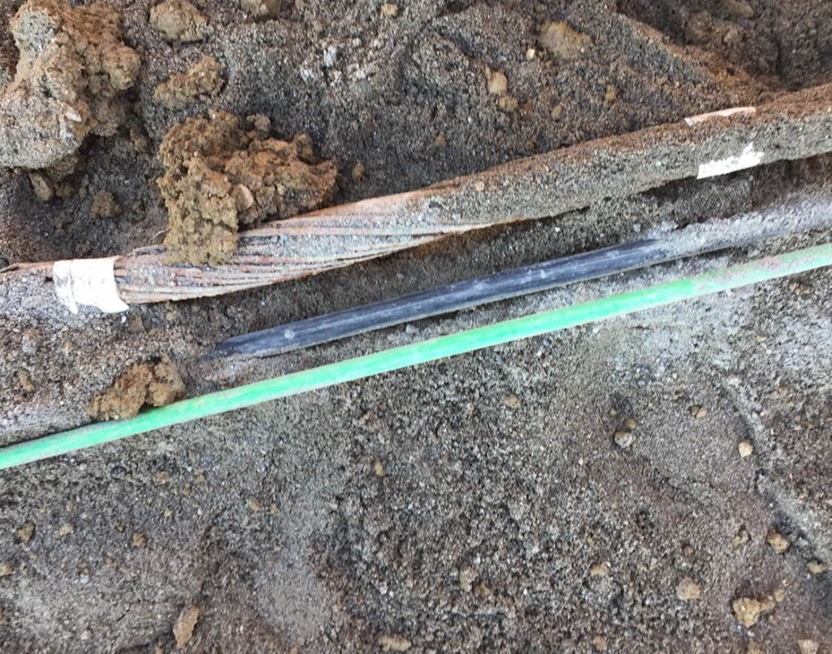
Findings
1 cable identified at the exit of BA6 identified arriving to BA5: cable 1009
  It is a backup cable for the LVL3 Alarm Transmission
Distance between BA5 and BA6 ~ 1 km
The unknown cable is now identified: it is part of the 1009 cable, confirmed with electrical measurements
Mission accomplished for the project, BUT
  It is cut somewhere in the fields between Point 1 and BA5
  There is no point for HL-LHC to reroute at Point 1 a broken cable
  However is SPS needing a backup?
  If yes then it becomes a different matter and the cable needs to be restored and correctly routed, it is not a HL-LHC action
There is no request of the HL-LHC project to increase the YETS length because of this cable, finally identified

