Slide 1
Beam screen/cold bore tolerances and RF finger design for the triplet magnets
Cedric Garion, TE-VSC-DLM, WP12
Outline
Reminder:
  Beam screen/cold bore concept
  Nominal dimensions and tolerances as presented end 2016
Update:
  Cold bore
  Beam screen tolerances
  RF bridge
Conclusions
33rd HL-LHC TCC– 13 July 2017

Slide 2
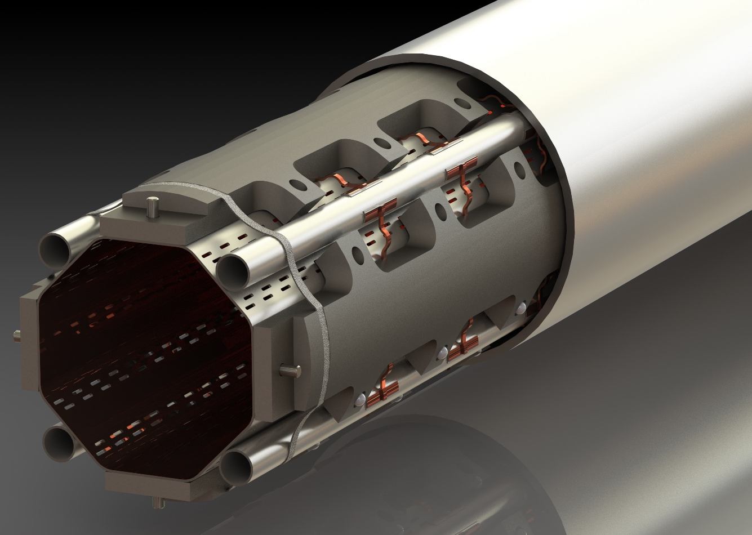
Concept
Beam screen tube (BS) at ~ 50 K:
Perforated tube (~2%) in High Mn High N stainless steel (1740 l/s/m (H2 at 50K))
Internal copper layer (75 μm) for impedance
a-C coating (as a baseline) for e- cloud mitigation
Laser treatments under investigation
Thermal links:
In copper
Connected to the absorbers and the cooling tubes or beam screen tube
Cold bore (CB) at 1.9 K:
4 mm thick tube in 316LN
Tungsten alloy blocks:
Chemical composition: 95% W, ~3.5% Ni, ~ 1.5% Cu
Mechanically connected to the beam screen tube: positioned with pins and titanium elastic rings
Heat load: 15-25 W/m
40 cm long
Cooling tubes:
Outer Diameter: 10 or 16 mm
Laser welded on the beam screen tube
Elastic supporting system:
Low heat leak to the cold bore tube at 1.9K
Ceramic ball with titanium spring

Slide 3
Nominal dimensions as presented 10/2016
Cold bore
Nominal values of the beam screen aperture are defined by:
Cold Bore:
1. The coil inner radius at 1.9 K is 74.350 mm [P. Ferracin]
  a. The insulated cable inner radius position at room temperature, with no stress, is 75 mm.
  b. The deformation due to pre-load and cool-down is 0.400 mm
  c. Quench heaters and insulation: 0.1 mm + 0.15 mm
2. Gap coil/insulated cold bore at 1.9 K:1.5 mm [R. Van Weelderen]
3. Cold bore insulation: 0.2 mm [P. Ferracin]
4. Tolerance on the cold bore outer diameter (thickness): 0/+0.5 mm
→ Nominal cold bore outer radius at 1.9 K: 72.15 mm
Nominal cold bore outer radius at room temperature: 72.35 mm
Nominal cold bore inner radius (thickness 4 mm for Q1 to D1) at room temperature: 68.35 mm
Magnet coil
Beam screen:
Gap w.r.t cold bore: 1.5 mm
Shielding thickness Q1: 16mm , Q2-D1: 6 mm
Beam screen wall thickness: 1 mm
 | Nominal aperture H(V);+/-45 °
Q1 | 99.7; 99.7
Q2-D1 | 119.7; 110.7
➔

Slide 4
Summary table as presented 10/2016
 | Cold bore |  | Beam screen
 | Inner diameter | Thickness | Nominal aperture* H(V);+/-45 ° | Vertical tolerance |  | Horizontal tolerance |  | Cooling tube Nb * OD * thickness | Shielding maximum height
 |  |  |  | Shape | Positioning** | Shape | Positioning**
Q1 | 136.7 H8 | 4 0/+0.5 | 99.7; 99.7 | +/-1.15 | -1.23/0 | +/-1.1 | +/- 0.65 | 4 * 16 * 1 | 16
Q2a | 136.7 H8 | 4 0/+0.5 | 119.7; 110.7 | +/-1.15 | -1.05/+0.11 | +/-1.1 | +/- 0.65 | 4 * 10 * 1 | 6
Q2b | 136.7 H8 | 4 0/+0.5 | 119.7; 110.7 | +/-1.15 | -1.05/+0.11 | +/-1.1 | +/- 0.65 | 4 * 10 * 1 | 6
Q3 | 136.7 H8 | 4 0/+0.5 | 119.7; 110.7 | +/-1.15 | -1.05/+0.11 | +/-1.1 | +/- 0.65 | 4 * 10 * 1 | 6
CP | 136.7 H8 | 4 0/+0.5 | 119.7; 110.7 | +/-1.15 | -1.05/+0.11 | +/-1.1 | +/- 0.65 | 4 * 10 * 1 | 6
D1 | 136.7 H8 | 4 0/+0.5 | 119.7; 110.7 | +/-1.15 | -1.05/+0.11 | +/-1.1 | +/- 0.65 | 4 * 10 * 1 | 6
* Cu layer thickness, thermal contraction, self weight deformation not accounted
** 1 additional support, 0.25 mm radial clearance between the support and the cold bore.
Notes:
For Q2-D1, it takes into account the 2*0.5 mm reduction in the +/- 45 planes (needed to increase the filling factor of absorbers and the strength of the extension)

Slide 5
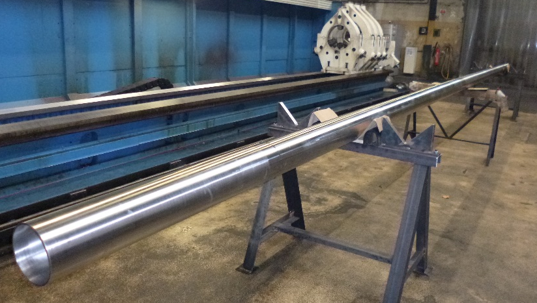
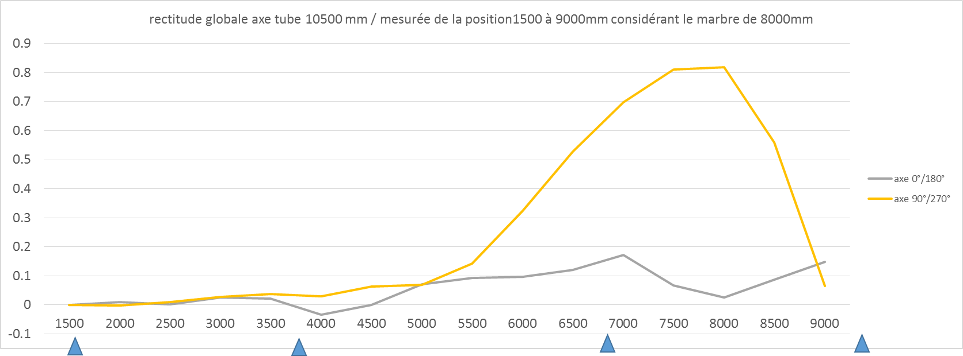
Cold bore prototypes
Tolerance on the cold bore, manufacturer #1:
Present baseline: 4 0/+0.5 mm
Specification for the prototypes, 1*10.5m, 2*2.5 m:
  4 0/+0.25 mm
  Straightness: 0.3 mm/m

Slide 6
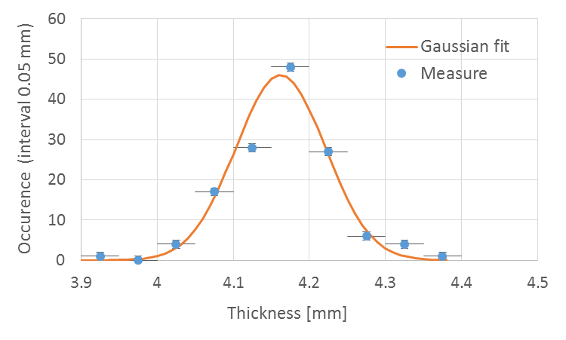
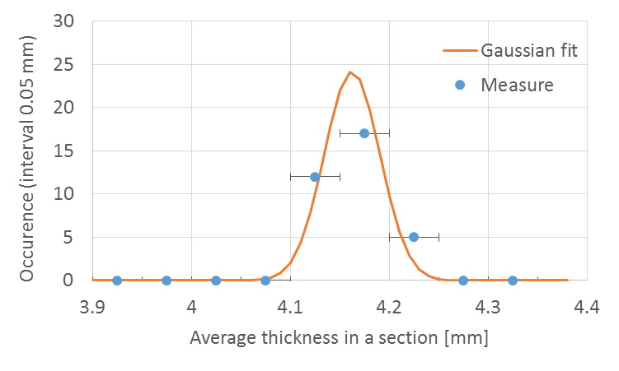
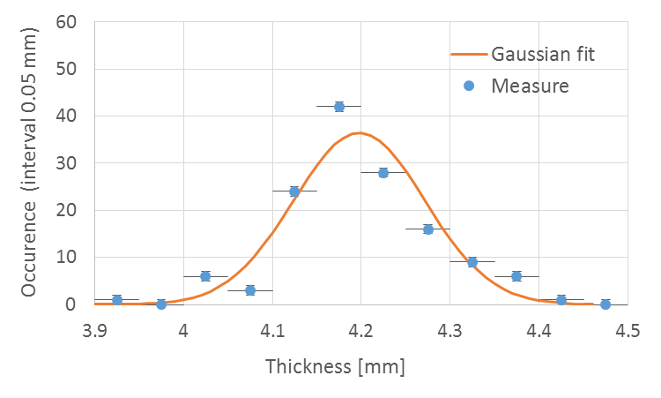
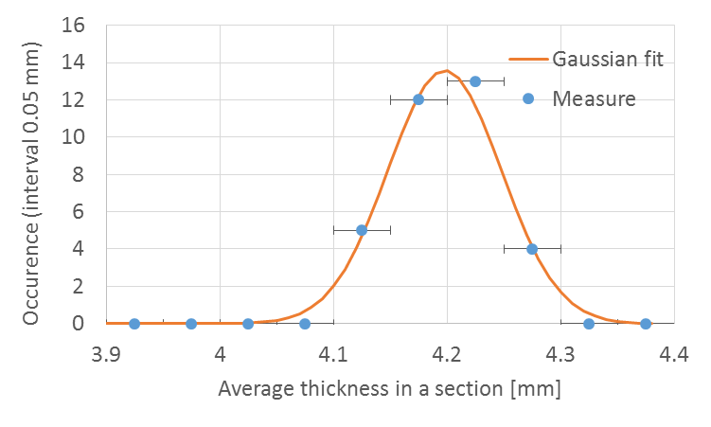
Cold bore prototypes
Tolerance on the cold bore thickness, manufacturer #1 :
Present baseline: 4 0/+0.5 mm
Specification for the prototypes, 1*10.5m, 2*2.5 m: 4 0/+0.25 mm
Measurements by the manufacturer
Deviation: 0.059 mm
Average: 4.162 mm
Deviation: 0.028 mm
Measurements at CERN
Average: 4.197 mm
Deviation: 0.074 mm
Deviation: 0.05 mm

Slide 7
Cold bore prototypes
Based on the cold bore prototype metrology, a tolerance of 0/+0.35 mm is proposed on the cold bore thickness for the definition of the aperture.
Discussions are ongoing with two other potential suppliers for the production of two cold bore prototypes.

Slide 8
Nominal dimensions
Cold bore
Nominal values of the beam screen aperture are defined by:
Cold Bore:
1. The coil inner radius at 1.9 K is 74.350 mm [P. Ferracin]
  a. The insulated cable inner radius position at room temperature, with no stress, is 75 mm.
  b. The deformation due to pre-load and cool-down is 0.400 mm
  c. Quench heaters and insulation: 0.1 mm + 0.15 mm
2. Gap coil/insulated cold bore at 1.9 K:1.5 mm [R. Van Weelderen]
3. Cold bore insulation: 0.2 mm [P. Ferracin]
4. Tolerance on the cold bore outer diameter (thickness): 0/+0.5 mm
→ Nominal cold bore outer radius at 1.9 K: 72.15 mm
Nominal cold bore outer radius at room temperature: 72.35 mm
Nominal cold bore inner radius (thickness 4 mm for Q1 to D1) at room temperature: 68.35 mm
74.20 mm
0.550 mm
0/+0.35 mm
Magnet coil
→ Nominal cold bore dimensions remain unchanged.

Slide 9
Beam screen shape tolerance
Feasibility confirmed: ☺
Cold Bore (machined):
Inner diameter 0/+0.1 (specified H8)
No long prototype available: ☹
ü
Beam screen (sheet metal work):
Shape tolerance: +/- 1 mm (values from manufacturer)
Tolerance on the thickness neglected
Aperture
 | Beam screen 1 | Beam screen 2
Minimal value | 103.62 | 103.92
Maximal value | 104.29 | 104.4
Standard deviation | 0.22 | 0.15
Measurement of the external dimension (nominal 104 mm) obtained on 2 short prototypes (1.2 m, 5 sections of measurements, 20 measures in total per screens):
→ +/- 0.5 mm retained for the analysis
First prototype manufactured: 😐
Tungsten blocks (machined):
Shape +/- 0.1
Ceramic balls :
diameter: +/- 0.0002 (neglected)
Titanium spring (3D printed):
Length: +/- 0.2 mm
☺
First prototype manufactured: 😐

Slide 10
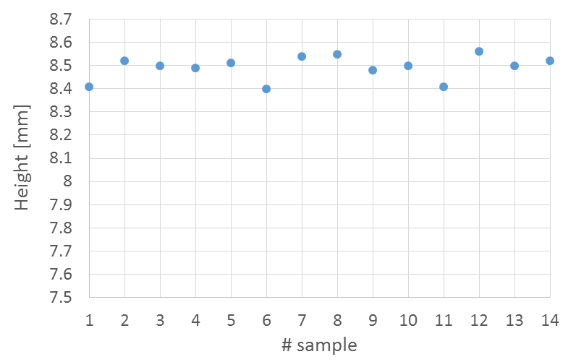
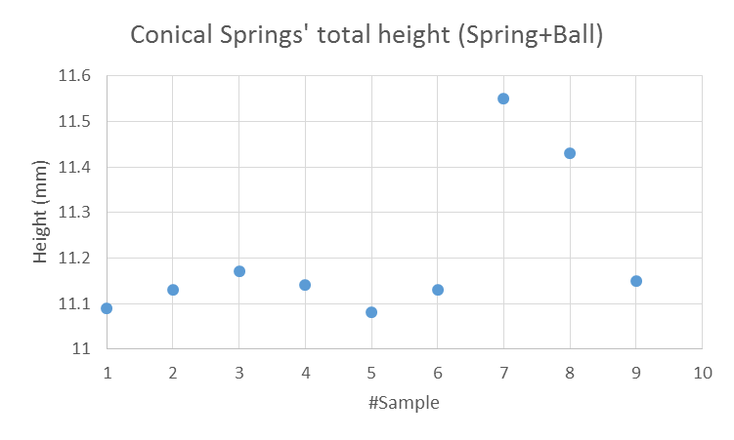
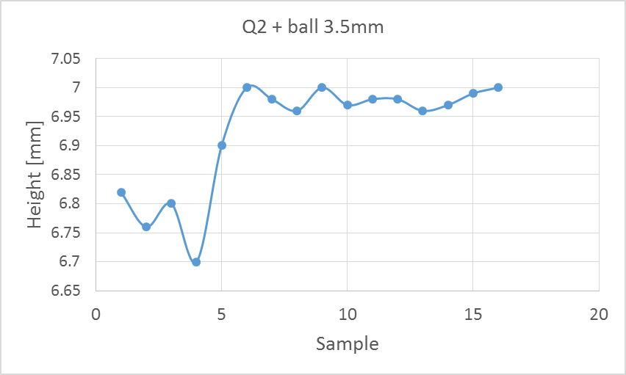
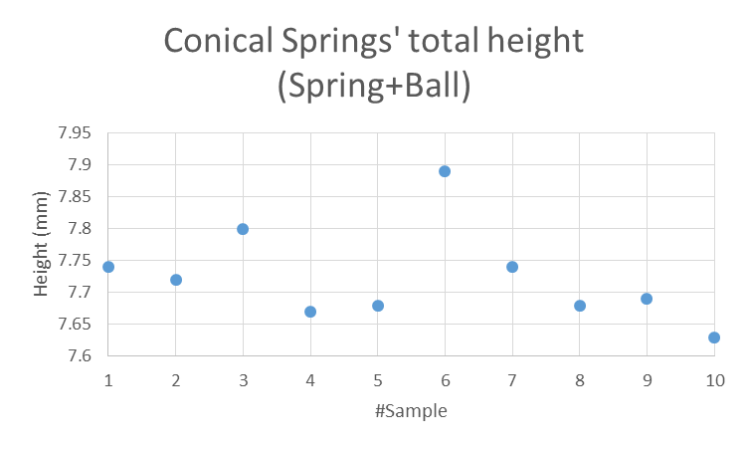
Beam screen shape tolerance
Q1 type
Nominal 8.5 mm
Nominal 11 mm
Batch #1
Batch #2
Q2 type
Nominal 7 mm
Nominal 7.6 mm
Batch #1
Batch #2
Scattering on 3D printed springs height is around 0.2 mm (+/- 0.1 mm) but average height changes from one batch to the other.

Slide 11
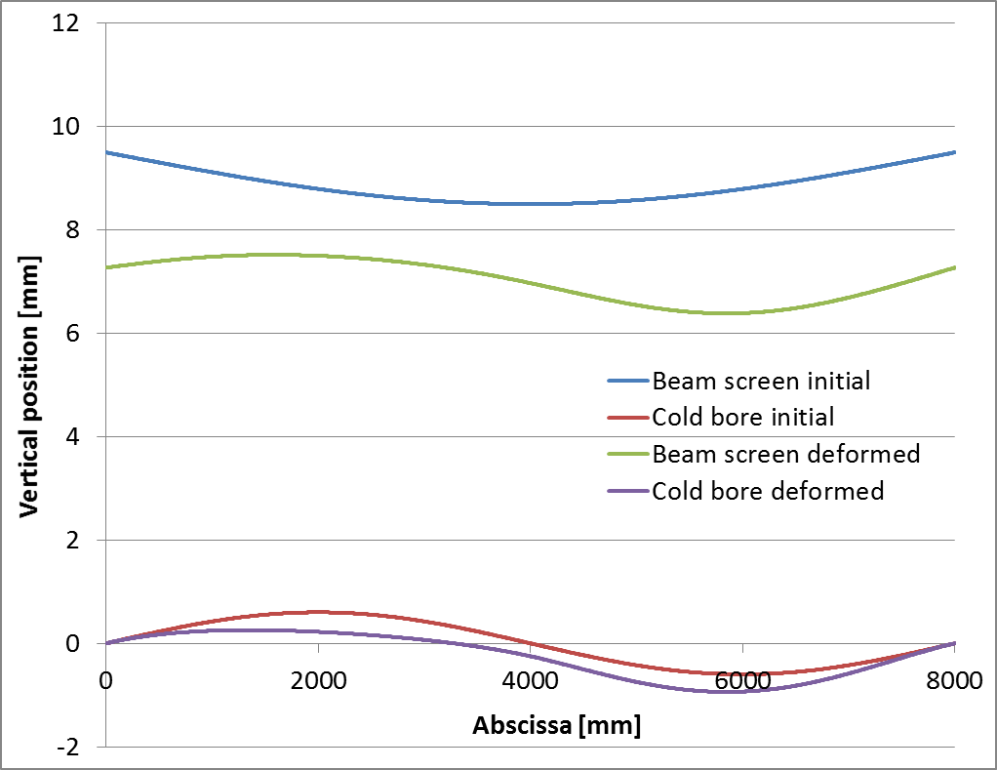
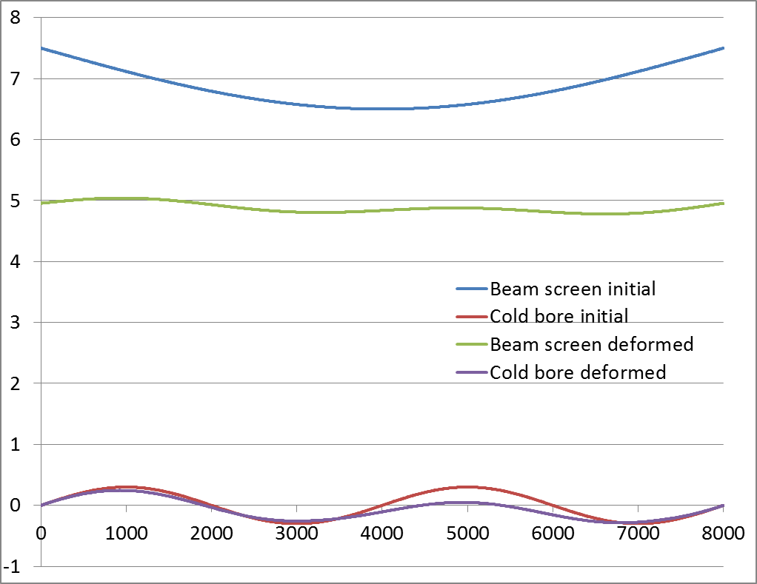
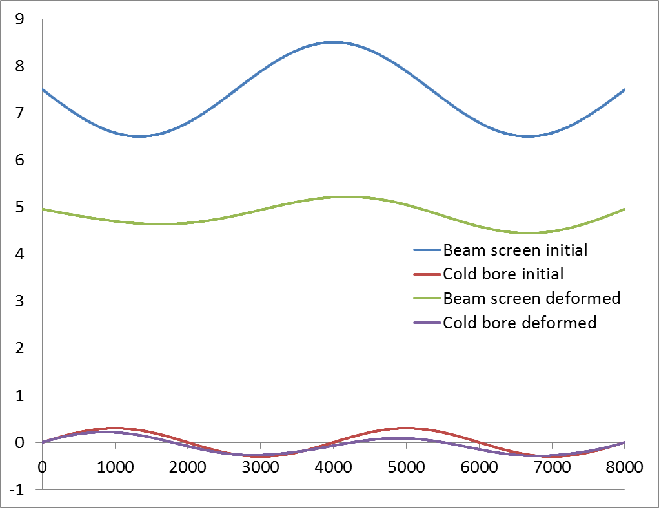
Vertical positioning tolerance
Beam screen;
1 mm thick, I ~ 4.5.10⁵ mm⁴
17.5 kg/m
Straightness +/-1 mm
Q2-D1
Spring:
Equivalent 31.5 N/mm;
every 10 cm
Free length 5.5 mm
Cold bore;
OD 144.7; 4 mm thick
Clamped at the extremities
Additional supports along the cold bore, every 800 mm, nominal radial gap 0.25 mm [H. Prin]
Straightness: 0.3 mm/m
Previous analysis
Ongoing analysis (preliminary results)
Δy: -0.2/+0.1
Δy: -0.51/+0.26
Position of the BS % nominal Δy: -1.1/+0.25
→ Supporting system of the cold bore is under study. Present proposal may lead to significant reduction of the positioning tolerance.

Slide 12
Summary table
 | Cold bore |  | Beam screen
 | Inner diameter | Thickness | Nominal aperture* H(V);+/-45 ° | Vertical tolerance |  | Horizontal tolerance |  | Cooling tube Nb * OD * thickness | Shielding maximum height
 |  |  |  | Shape | Positioning** | Shape | Positioning**
Q1 | 136.7 H8 | 4 0/+0.35 | 99.7; 99.7 | +/-1.15 | -1.23/0 | +/-1.1 | +/- 0.65 | 4 * 16 * 1 | 16
Q2a | 136.7 H8 | 4 0/+0.35 | 119.7; 110.7 | +/-1.15 | -1.05/+0.11 | +/-1.1 | +/- 0.65 | 4 * 10 * 1 | 6
Q2b | 136.7 H8 | 4 0/+0.35 | 119.7; 110.7 | +/-1.15 | -1.05/+0.11 | +/-1.1 | +/- 0.65 | 4 * 10 * 1 | 6
Q3 | 136.7 H8 | 4 0/+0.35 | 119.7; 110.7 | +/-1.15 | -1.05/+0.11 | +/-1.1 | +/- 0.65 | 4 * 10 * 1 | 6
CP | 136.7 H8 | 4 0/+0.35 | 119.7; 110.7 | +/-1.15 | -1.05/+0.11 | +/-1.1 | +/- 0.65 | 4 * 10 * 1 | 6
D1 | 136.7 H8 | 4 0/+0.35 | 119.7; 110.7 | +/-1.15 | -1.05/+0.11 | +/-1.1 | +/- 0.65 | 4 * 10 * 1 | 6
Unchanged
Unchanged
Improvement expected with the proposed supporting system of the cold bore in the magnet
* Cu layer thickness, thermal contraction, self weight deformation not accounted
** 1 additional support, 0.25 mm radial clearance between the support and the cold bore.
Notes:
For Q2-D1, it takes into account the 2*0.5 mm reduction in the +/- 45 planes (needed to increase the filling factor of absorbers and the strength of the extension)

Slide 13
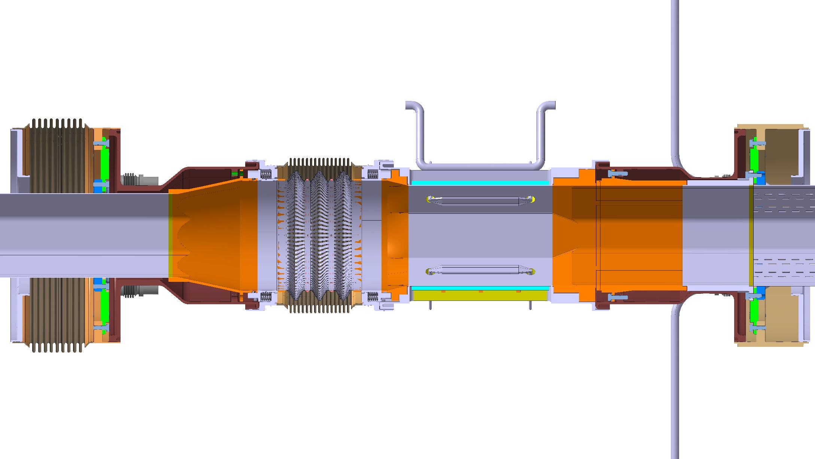
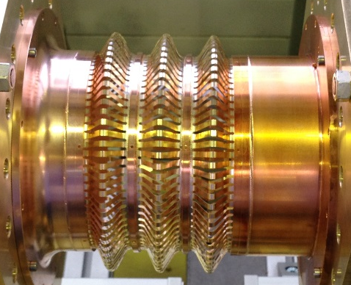
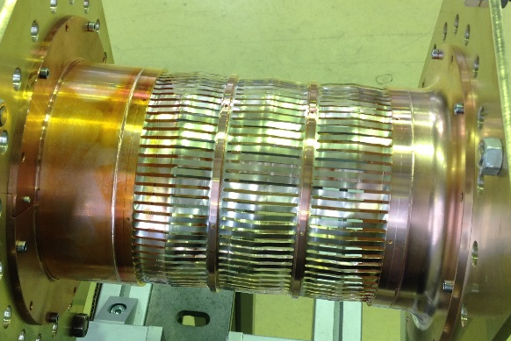
Beam vacuum interconnections
Beam screen fixed point on the IP side of the magnet
Courtesy N. Chritin, R. Fernandez Gomez
Tungsten absorber integrated on the IP side
as installed
in operation
Deformable RF fingers

Slide 14
Compensation system requirements
The thermal expansion coefficients of the cold masses and the beam screen tube have been assumed equal to those measured during the string II operation. [B. Calcagno, EDMS 434135].
The stroke, in mm, of the compensation system has been evaluated for different cooling/warm-up scenarii, validated on string II:
 | RF fingers / PIM bellows
 | C/W transition Q1 | Q1-Q2a | Q2a-Q2b | Q2b-Q3 | Q3-CP | CP-D1 | C/W Transition D1 (1)
Nominal conditions | ~ 18 | 27.5 | 27.3 | 27.7 | 18.5 | 18.4 | 15
Cool down |  | -11.2 | -10.9 | -10.9 | -11.2 | -3 | -3.5
Warm-up |  | 32.6 | 32 | 32.3 | 26.3 | 17.1 | 15.5
Exceptional 1 |  | -0.4 | 0 | 0.5 | -9.4 | 0.8 | -5
Exceptional 2 |  | 21.6 | 21 | 21.1 | 21.6 | 13.6 | 15.5
Design value for the bellows | -11.2/32.6
Nominal design value for RF fingers | 18.5 | 27.7 |  |  | 18.5
(1) Preliminary estimations
Update of the cold mass length and change of the beam screen temperature from 50 to 70K.
Minor change for the compensation system requirements.

Slide 15

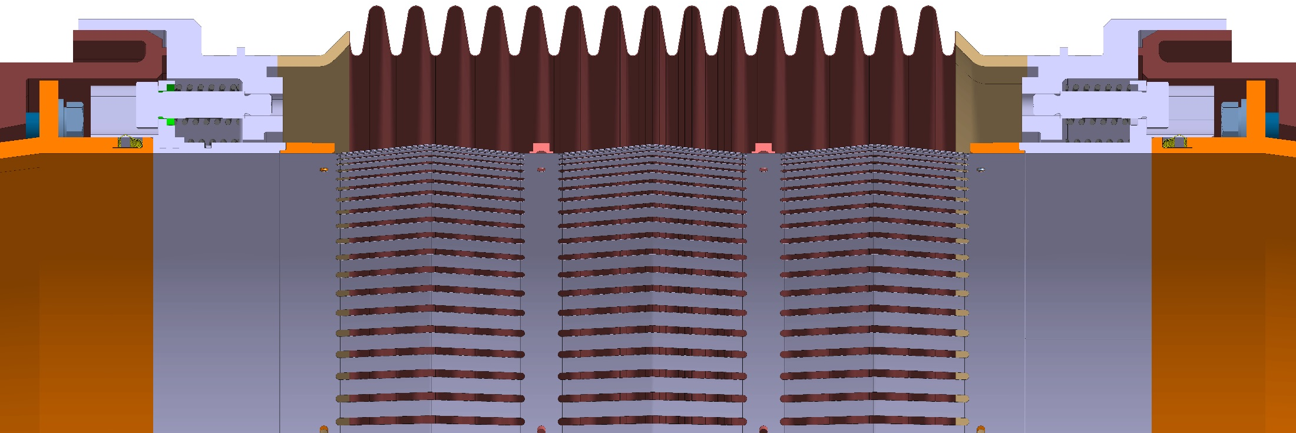
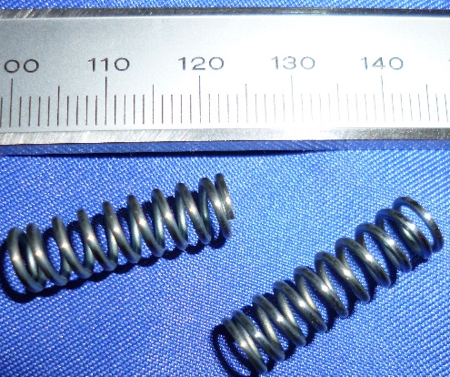
RF finger design in triplet area
Copper Beryllium deformable RF fingers:
Circular aperture
C17410
0.1 mm thick, 3 mm width, gap: 1.4 mm
3 convolutions
Static RF fingers
Copper insert
Plug-In module in operation
Longitudinal constraint, due to the finger extension limitation, is reduced thanks to the static RF fingers and the springs.
Titanium spring (total prestress: ~360 N)

Slide 16
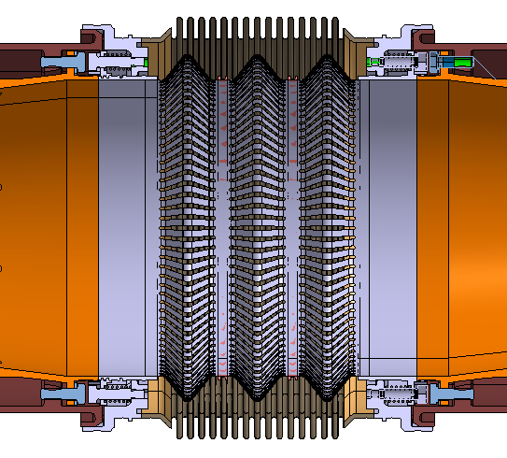
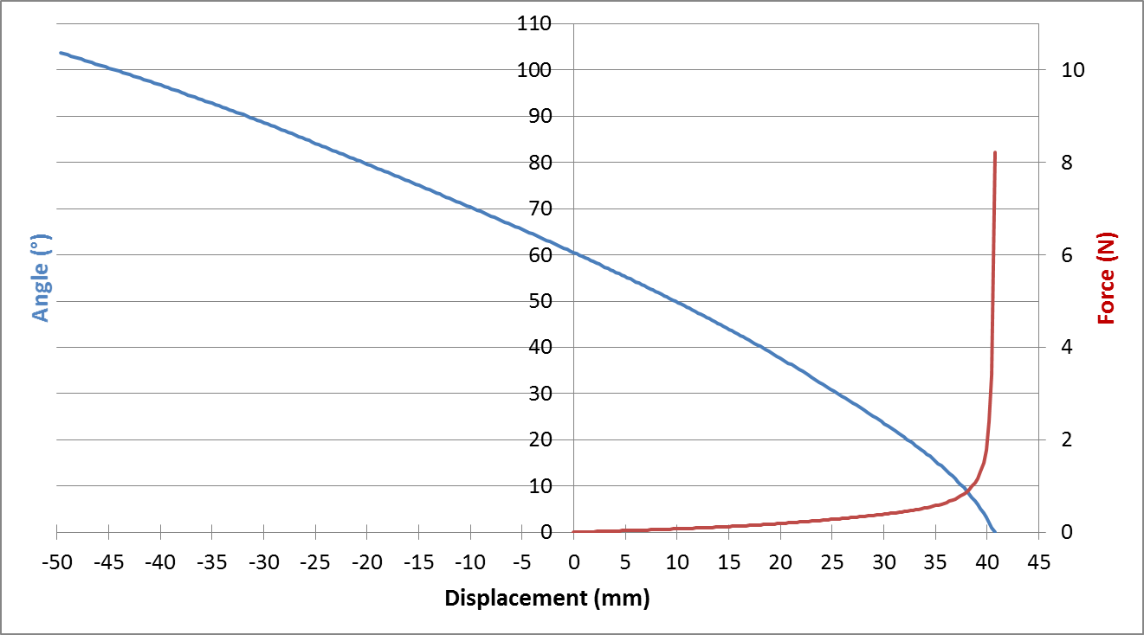
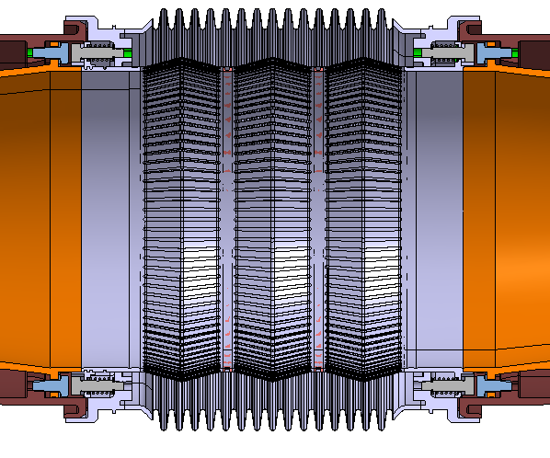
RF finger configurations
The operation conditions are defined by an extension (w.r.t. to installation position) of 27.7 mm, corresponding to an angle of 15°.
As built (free)
As installed: RF fingers elongated by 7.5 mm
27.7
15°
Nominal operation: RF fingers elongated by 35.2 mm

Slide 17
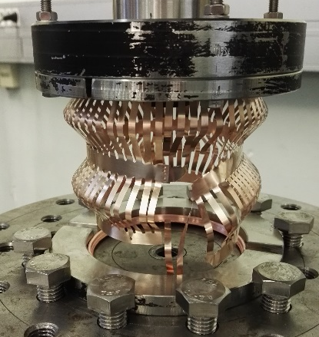
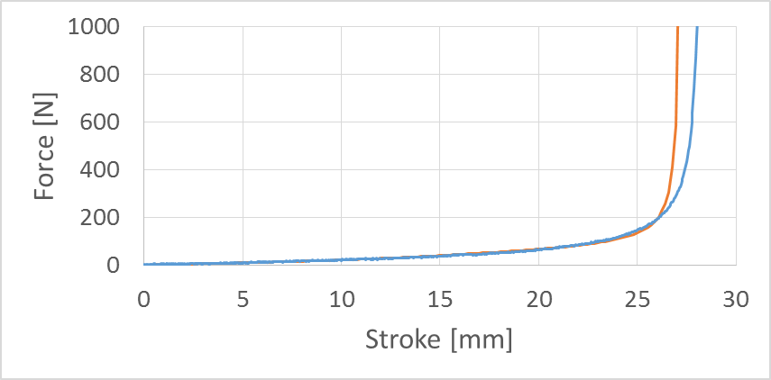
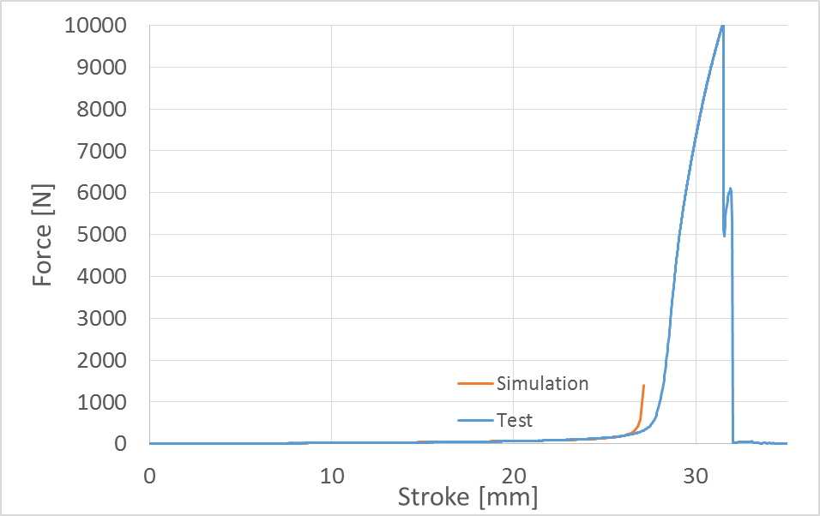
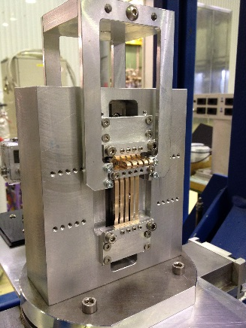
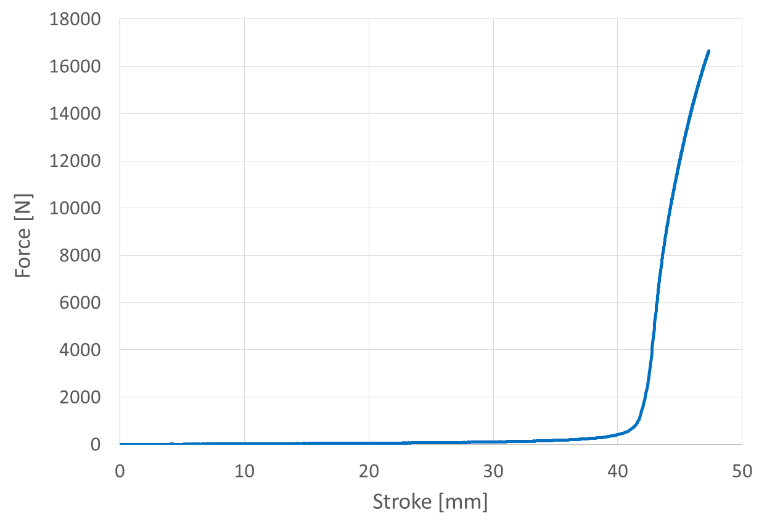
RF finger mechanical tests
Fatigue tests done for different grades and heat treatments (C17200). In preparation for selected grade (C17410).
Tensile test up to rupture
Failure of the weld
Fatigue tests
Test on a two convolutions module with 57 fingers
For the configuration of 3 convolutions with an operating angle of 15°, allowable transverse offset higher than 4 mm is expected.
Extrapolation to a three convolutions module with 94 fingers (ID 131)

Slide 18
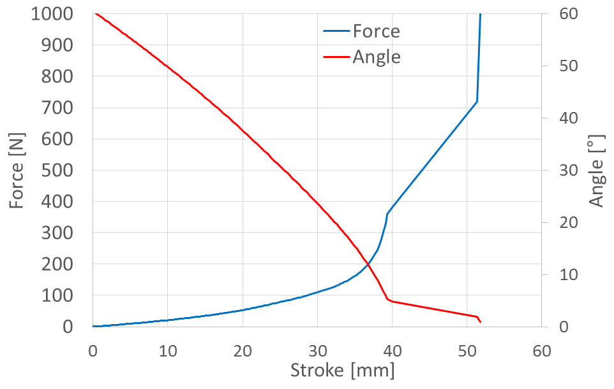
Plug-In module behaviour
The operation conditions are defined by an operation angle of 15°, corresponding to an extension (w.r.t. to installation position) of 27.7 mm and a stroke of the fingers of 35.2 mm.
Warm up
Operation
→ 11 mm margin for the cryostat/cold mass/beam vacuum component tolerances (and operation angle optimization)
Spring compression
Prototypes, under production, will be tested also with lower operation angle (~10 & 6 °).
Impact on RF performance and allowable transverse offset will be assessed.
Extreme configuration to be tested: RF fingers elongated by 39.4 mm with an angle of 6 °.

Slide 19
Conclusion
First cold bore prototypes have been manufactured. Good precision has been achieved. It allows a reduction of the tolerance on the thickness from 0/+0.5 to 0/+0.35 mm and compensates the coil aperture reduction.
The cold bore inner diameter remains unchanged: 136.7 H8
Study on the beam screen tolerances is ongoing. Significant improvement of the positioning tolerance is expected from the supports of cold bore in the cold mass.
The design of the plug-in module has been improved with the implementation of static contacts. This gives more margin for the longitudinal extension.
Nominal operation configuration has to be defined with respect to mechanical and RF performance (test on prototypes by end 2017) and longitudinal cryostat/cold mass/ beam vacuum component tolerances.

Slide 20
Longitudinal tolerances for the LHC interconnections
EDMS 548093
The position of the cryodipole on the jacks with respect to the theoretical position (± 0.5 mm)
The position of the cold mass in the vacuum vessel (± 1.4 mm)
The length of the cold mass (±2.2 mm) (reference plane C to L)
The position of the cold bore extremity ( ± 0.5 mm) (w.r.t. the reference plane)
The position of the fixed beam screen extremity ( ± 0.5 mm) (w.r.t. cold bore extremity)
The length of the beam screen (±1 mm)
The position of the cryogenic line extremity ( ± 0.25 mm) (w.r.t. the reference plane)
+/
-
1.1
+/
-
1.4
+/
-
1.1
+/
-
1.4
+/
-
0.25
+/
-
0.25
+/
-
0.25
+/
-
1.0
+/
-
1.0
+/
-
0.5
+/
-
0.5
+/
-
0.5
+/
-
0.5
Type of bellows | Upstream |  | Downstream
 | linear | quadratic | linear | quadratic
RF Contact bellows (positioning) | ± 4 | ± 1.98 | ± 5 | ± 2.22
Beam screen bellows (assembly) |  |  | ± 4.7 | ± 2.04
Tolerances of positioning and of assembly for the beam lines
If the linear stacking is used, it turns out that the longitudinal tolerance in the assembly of the RF-Contact is equal to ± 9 mm. For the quadratic sum, the tolerance of assembly is equal to ± 2.97 mm.

Slide 21
Shape tolerances – vertical
The aperture is decomposed into the position of the upper and lower part of the beam screen with respect to the cold bore axis.
=
A
+
B
Aperture

Slide 22
Shape tolerances – vertical
 |  |  | A max | A min
a1 | CB inner radius | 0/+0.05 | 0 | -0.05
a2 | Spring | +/- 0.2 | 0.2 | -0.2
a3 | Absorber | +/- 0.1 | 0.1 | -0.1
a4 | Beam screen | +/- 0.5 | 0.5 | -0.5
a5 | BS thickness | - | 0 | 0
A |  |  | +0.8 | -0.85
a5
A
a4
a1
a3
a2

Slide 23
Shape tolerances – vertical
 |  |  | B max | B min
b1 | BS thickness | - | 0 | 0
b2 | Absorber | +/- 0.1 | 0.1 | -0.1
b3 | Spring | +/- 0.2 | 0.2 | -0.2
b4 | CB inner radius | 0/+0.05 | 0.05 | 0
B |  |  | +0.35 | -0.3
B
b4
b1
b2
b3
→ Tolerance on vertical aperture due to shape tolerances of the components: +/-1.15

Slide 24
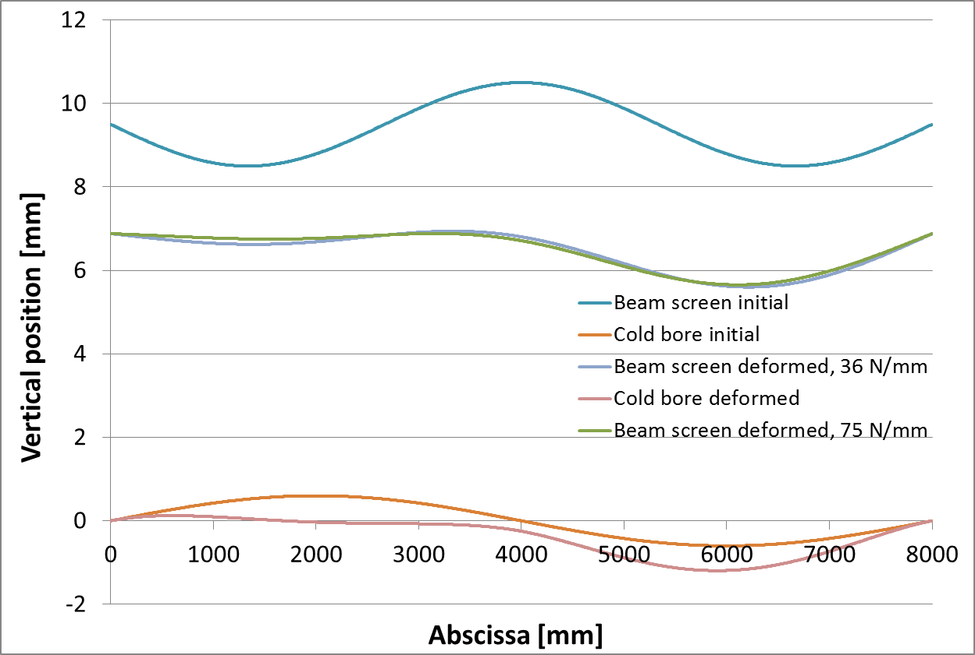
Vertical positioning tolerance
Q1
No significant impact of the spring stiffness on the beam screen deformation.

Slide 25
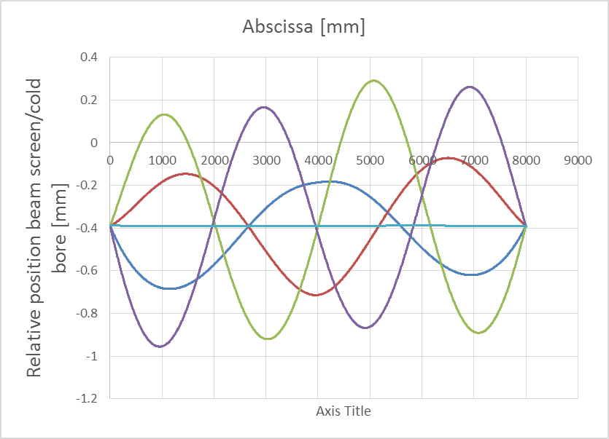
Deviation of the spring compression
Example for the Q2-D1
0.6
0.6
→ Deviation +/- 0.6 mm w.r.t. nominal
Minimum gap required on the bottom: 0.6+0.1+0.2 = 0.9 mm
Minimum gap required on the top:
0.6+0.2+0.1+0.5+0.1 = 1.5 mm

