Slide 1
Status of LIU MDs 2017 (protons)
H. Bartosik, G. Rumolo
with help from
H. Damerau, V. Forte, G. P. di Giovanni, A. Huschauer, V. Kain, E. Shaposhnikova
Many thanks to all MD users (acknowledgements on next slide)

Slide 2
Many thanks to MD users for their hard work!
S. Albright, F. Asvesta, M. E. Angoletta, W. Bartmann, H. Bartosik, P. Baudrenghien, M. Beck, N. Biancacci, T. Bohl, M. Carla, H. Damerau, G. Favia, M. Fraser, G. P. Di Giovanni, B. Goddard, G. Hagman, K. Hanke, A. Huschauer, M. Schenk, J. Sirvent Blasco, A. Findlay, V. Forte, G. Guidoboni, S. Hancock, W. Hofle, V. Kain, A. Lasheen, K. Li, B. Mikulec, G. Papotti, J. Repond, G. Rumolo, D. Quartullo, A. Saa Hernandez, A. Santamaria Garcia, E. Senes, G. Sterbini, T. Rijoff, M. Schwarz, E. Shaposhnikova, A. Garcia-Tabares Valdivieso, F. Velotti, P. Zisopoulos
… and all the ones not in the list ...

Slide 3
Outline
Introduction
Overview of ongoing LIU MDs
Critical points for reaching LIU performance
Summary & MD priorities

Slide 4
Outline
Introduction
Overview of ongoing LIU MDs
Critical points for reaching LIU performance
Summary & MD priorities

Slide 5
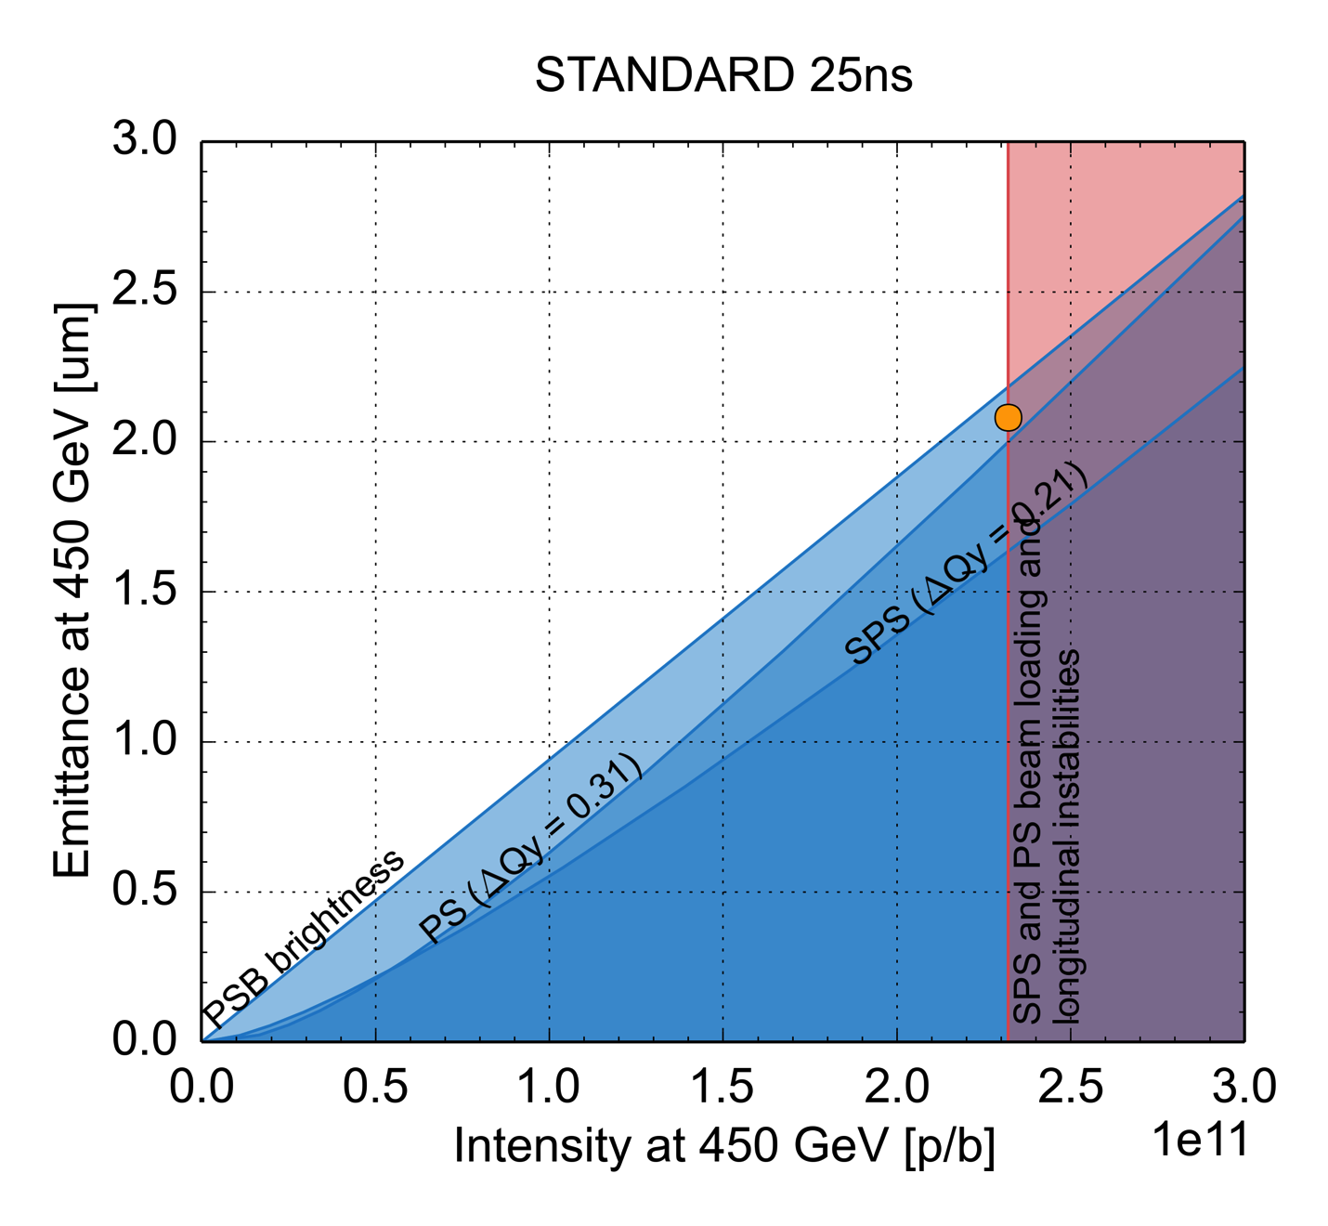
LIU performance reach
Present baseline
  Linac4 + 160 MeV PSB injection
  2 GeV PS injection energy
  200 MHz SPS RF upgrade
  Scrubbing + partial (staged) SPS aC coating
  Upgrade of protection devices & SPS beam dump
  SPS longitudinal impedance reduction to match LIU baseline with HL-LHC
white area accessible
HL-LHC
request
budget | PS | SPS
losses | 5% | 10%
blow-up | 5% | 10%
… based on 2012 experience with nominal intensity
Notes:
Need to increase intensity limit
No margin for brightness neither in PSB nor in PS

Slide 6
LIU performance reach
Present baseline
  Linac4 + 160 MeV PSB injection
  2 GeV PS injection energy
  200 MHz SPS RF upgrade
  Scrubbing + partial (staged) SPS aC coating
  Upgrade of protection devices & SPS beam dump
  SPS longitudinal impedance reduction to match LIU baseline with HL-LHC
white area accessible
HL-LHC
request
Critical points
Brightness preservation in PSB
Transfer of large longitudinal emittance bunches to PS
Brightness preservation in PS
PS intensity reach
Injection losses in SPS
Brightness preservation in SPS
Longitudinal instabilities and beam loading in SPS
budget | PS | SPS
losses | 5% | 10%
blow-up | 5% | 10%
… based on 2012 experience with nominal intensity
Notes:
Need to increase intensity limit
No margin for brightness neither in PSB nor in PS

Slide 7

Parameter table

Slide 8
Operational experience with BCMS from 2016

Slide 9
Outline
Introduction
Overview of ongoing LIU MDs
Critical points for reaching LIU performance
Summary & MD priorities

Slide 10
Types of MDs for LIU
Commissioning of LIU beam instrumentation
  Wire scanners, BGI, BSRT
  FBCT
  BLMs, diamond BLMs
  PSB Turn-by-turn BPM electronics
Hardware tests & commissioning
  PSB / PS Kickers waveform qualification, PS injection bumpers
  PSB & PS RF (Finemet® reliability, 1-turn delay feedbacks, …)
  White-Rabbit B-train tests and POPS regulation
Beam parameters & validation of assumptions
  PSB brightness
  Production of large longitudinal emittance in PSB
  PSB-PS transfer with large dp/p to mitigate space charge
  Emittance growth in PS
  PS intensity reach
  PS-SPS transfer
  SPS intensity reach and beam loading limitations
  Emittance growth in SPS

Slide 11
LIU PSB MD overview (for beam parameters)
to be started
ongoing/completed
PSB RF
  Finemet® reliability run
  Triple harmonic capture for bunch flattening at injection
  Phase Noise blow-up
  BCMS 1.5 eVs
PSB Transverse Dynamics
  Emittance preservation along the cycle
  Dispersion measurements for emittance measurement (WS) Emittance evaluation using de-convolution method (momentum contribution)
  Impedance measurements
  Resonance compensation based on turn-by-turn measurements
  Testing the SEM GRID performance in view of LIU beam (systematic bunch profile de-convolution)
PSB-to-PS
  Analysis and re-matching of R3 PSB-PS TL
  Emittance blow-up estimation due to recombination kickers

Slide 12
LIU PS MD overview (for beam parameters)
to be started
ongoing/completed
Emittance preservation and space charge
  Horizontal blow-up at injection & impact of injection bump and steering errors
  Optics measurements to improve emittance measurements
  Space charge mitigation with large momentum spread
  Identification and compensation of resonances
  RF voltage program to avoid bunch shortening at start of acceleration
  Deployment of transverse damper along the cycle and low chromaticity
  Double-harmonic operation at flat-bottom and constant bucket area at beginning of acceleration
Longitudinal instabilities
  Quadrupole coupled-bunch instability and impact of high-frequency cavity impedance
  Intensity limit with new coupled-bunch feedback
  20 MHz, 40 MHz or 80 MHz as Landau cavities at flat-top
Longitudinal impedance
  Impedance measurements of 10 MHz, 20 MHz, 40 MHz and 80 MHz RF cavities
  High-frequency structure of beam during, e.g., de-bunching
PS-to-SPS transfer
  Optimization of bunch rotation, test of adiabatic bunch shortening using 40 MHz and 80 MHz RF
  Uncaptured particles at PS-SPS transfer

Slide 13
LIU SPS MD overview (for beam parameters)
to be started
ongoing/completed
Losses
  Studies of loss mechanisms and scaling of losses with 25 ns beams
  Characterization and optimization of low level RF system
  SPS nonlinear optics model (for non-linear chromaticity)
  High intensity 25 ns “mini scrubbing run” in October (40 hours dedicated MD)
Longitudinal intensity limitations
  Intensity threshold along the cycle for different bunch trains and different optics
  Extraction of longer bunches to LHC (for LIU beam parameter reach)
  Bunch rotation at 450 GeV for high intensity 25 ns beams
Transverse impedance, instability and emittance preservation
  Transverse emittance growth on flat bottom
  Detuning with multi-bunch beams for automatic Q correction and possible impact on emittances
  Benchmarking of horizontal single bunch impedance model
Q22
  Losses and longitudinal instability threshold in comparison to Q20
  Losses at start of acceleration (more efficient use of available RF voltage / power?)
  Optics characterization (non-linear chromaticity, incoherent effects)
  Instabilities (TMCI threshold, longitudinal instabilities in comparison to Q20, …)
  High-bandwidth feedback studies (attempt to stabilize TMCI)

Slide 14
Outline
Introduction
Overview of ongoing LIU MDs
Critical points for reaching LIU performance
Summary & MD priorities

Slide 15
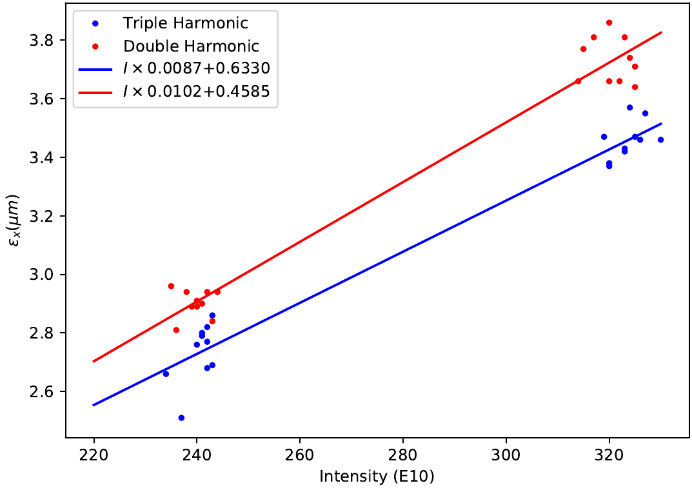
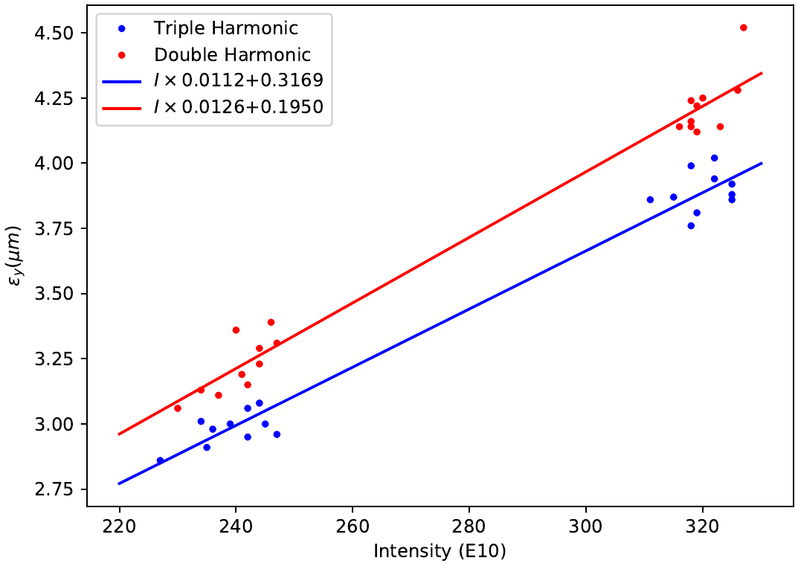
PSB brightness
Context
  PSB brightness essential for LHC beam parameters – expect factor 2 higher brightness with Linac4 and 160 MeV injection
Present status and ongoing studies
  PSB operated at expected brightness
  BCMS now setup with of capture of LHC25ns beam gave expected brightness improvement due to larger longitudinal emittance – confirms brightness limitation due to space charge
  Improved brightness demonstrated with triple harmonic capture

Slide 16
PSB brightness
Context
  PSB brightness essential for LHC beam parameters – expect factor 2 higher brightness with Linac4 and 160 MeV injection
Present status and ongoing studies
  PSB operated at expected brightness
  BCMS now setup with of capture of LHC25ns beam gave expected brightness improvement due to larger longitudinal emittance – confirms brightness limitation due to space charge
  Improved brightness demonstrated with triple harmonic capture
  Emittance preservation along the cycle verified
  Evaluation of horizontal emittance by “de-convolution” of momentum contribution and comparison with SEM grid measurements
Next steps
  Resonance compensation based on turn-by-turn data (with new BPM electronics) and impact on brightness reach
  Further benchmarking of brightness curve with space charge simulations

Slide 17
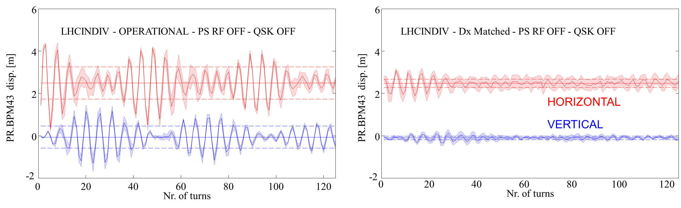
Large longitudinal emittance at PS injection
Context
  LIU parameters critically rely on space charge reduction from 2 GeV and from maximizing bunch length and momentum spread
Present status and observations
  Horizontal emittance measured right after injection into the PS is significantly larger than in PSB, even for operational beam conditions (up to 40%)
  Blow-up enhanced with large dp/p bunches (up to 100%)
  Optics mismatch between PSB & PS (mostly horizontal dispersion) – matching studies ongoing
    2017 Dx - rematched optics (preliminary)
Closed solution
@ PR.MARK42 | β_{x} [m] | α_{x} | β_{y} [m] | α_{y} | D_{x} [m] | D'_{x} | D_{y} [m] | D'_{y} | Betatron Mrms_{x} [%] * | Betatron Mrms_{y} [%] *
PS periodic solution | 12.17 | 0.13 | 22.17 | -0.02 | 2.22 | 0 | 0 | 0
Operational | 11.07 | -0.003 | 20.87 | 0.18 | 0.93 | 0.09 | 0.03 | 0.0018 | 1 | 2
Dx matched 2016 (trade – off) | 13.57 | -0.04 | 20.91 | 0.11 | 1.41 | 0.013 | 0 | 0 | 2 | 1
Preliminary Matched Dx 2017 | 30.37 | -0.5 | 28.322 | -0.08 | 2.022 | -0.008 | 0.03 | 0.0019 | 58 | 3

Slide 18
Large longitudinal emittance at PS injection
Context
  LIU parameters critically rely on space charge reduction from 2 GeV and from maximizing bunch length and momentum spread
Present status and observations
  Horizontal emittance measured right after injection into the PS is significantly larger than in PSB, even for operational beam conditions (up to 40%)
  Blow-up enhanced with large dp/p bunches (up to 100%)
  Optics mismatch between PSB & PS (mostly horizontal dispersion) – matching studies ongoing
  Also: considerable tune modulation during injection bump (towards horizontal integer resonance) … possible contribution from space charge (direct and indirect)?
position at BPM43
horizontal tune

Slide 19
Large longitudinal emittance at PS injection
Context
  LIU parameters critically rely on space charge reduction from 2 GeV and from maximizing bunch length and momentum spread
Present status and observations
  Horizontal emittance measured right after injection into the PS is significantly larger than in PSB, even for operational beam conditions (up to 40%)
  Blow-up enhanced with large dp/p bunches (up to 100%)
  Optics mismatch between PSB & PS (mostly horizontal dispersion) – matching studies ongoing
  Also: considerable tune modulation during injection bump (towards horizontal integer resonance) … possible contribution from space charge (direct and indirect)?
Next steps
  Evaluate emittances using de-convolution (also online)
  Disentangle from space charge effects by using very low brightness beam (i.e. pure optics study)
  Detailed studies of re-matching transfer line (may require dedicated MD)
  Modelling of PS optics distortion from injection bump using magnetic field measurement data of injection bumpers and space charge simulations
  Test beneficial effect of longer bunches with same dp/p (e.g. with standard 25 ns beam)
  Evaluate beam parameter reach with standard dp/p in case blow-up cannot be overcome

Slide 20
PS brightness and emittance preservation
Context
  LIU is based on a 5% budget on emittance blow-up in the PS
  Aim to achieve this while operating at PS space charge limit
Present status
  PS working point choice is constrained by 8th order structure resonance (losses for Qy>6.25)
  Vertical blow-up along cycle if working point too close to integer resonance and when RF voltage increased before / during acceleration – cured by constant bucket area now operational
BCMS, ε_{V}
BEFORE
AFTER

Slide 21
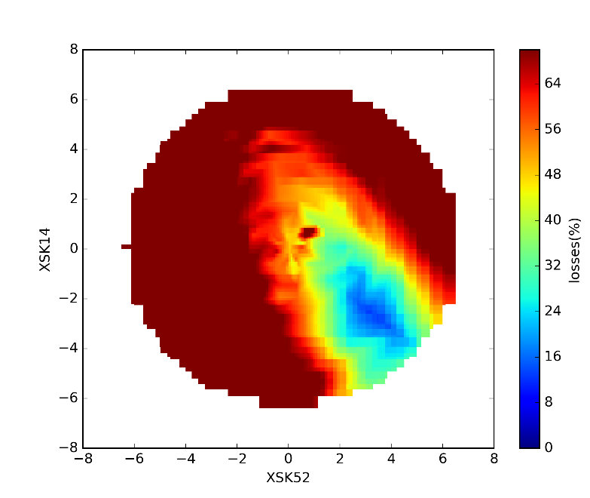
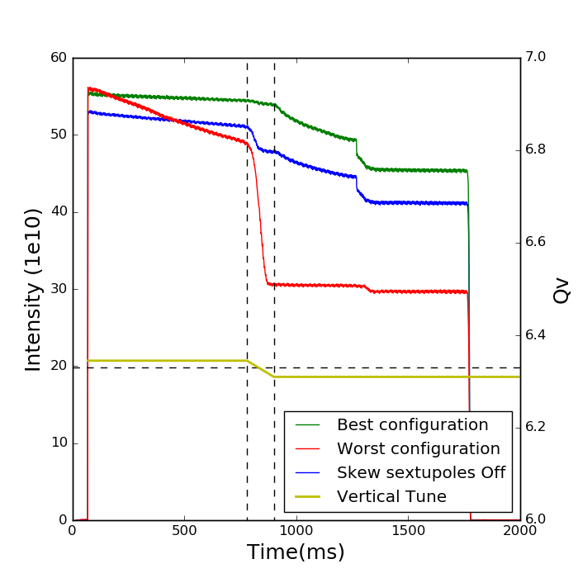
PS brightness and emittance preservation
Context
  LIU is based on a 5% budget on emittance blow-up in the PS
  Aim to achieve this while operating at PS space charge limit
Present status
  PS working point choice is constrained by 8th order structure resonance (losses for Qy>6.25)
  Vertical blow-up along cycle if working point too close to integer resonance and when RF voltage increased before / during acceleration – cured by constant bucket area now operational
  Detailed tune scans to characterize structure resonances and explore tune diagram for alternative working points including resonance compensation
Successful compensation of Qy=6.33 skew sextupole resonances

Slide 22
PS brightness and emittance preservation
Context
  LIU is based on a 5% budget on emittance blow-up in the PS
  Aim to achieve this while operating at PS space charge limit
Present status
  PS working point choice is constrained by 8th order structure resonance (losses for Qy>6.25)
  Vertical blow-up along cycle if working point too close to integer resonance and when RF voltage increased before / during acceleration – cured by constant bucket area now operational
  Detailed tune scans to characterize structure resonances and explore tune diagram for alternative working points including resonance compensation
Next steps
  Further studies of PS resonances (including resonance compensation) and working points
  Chromaticity correction
  Deployment of transverse damper and coupling correction

Slide 23
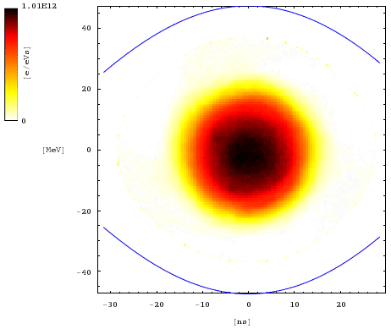
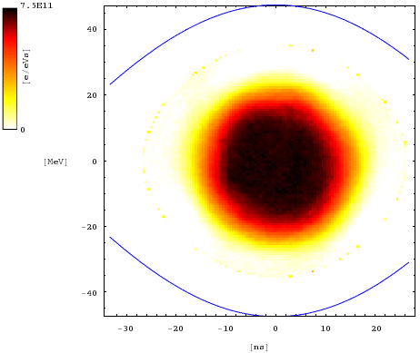
PS intensity reach
Context
  Intensity limited by dipolar and quadrupolar coupled-bunch oscillations after transition and flat-top
Present status and observations
  LIU intensity with nominal longitudinal emittace at PS extraction not yet reached despite most HW upgrades installed – so far “only” 2e11 p/b with nominal longitudinal emittance and 72 b
  LIU intensity of 2.6e11 p/b for the moment only within reach for large longitudinal emittance, but this is incompatible with transfer losses and acceleration in SPS
  Emittance blow-up due to impedance of 40/80 MHz cavities
Emittance at arrival on flat-top, ion cavity gap closed
Emittance at arrival on flat-top, ion cavity gap open
N_{b,ej} ≈ 1.9·10¹¹ ppb, ε_{l} ≈ 1.25 eVs
N_{b,ej} ≈ 1.9·10¹¹ ppb, ε_{l} ≈ 1.56 eVs

Slide 24
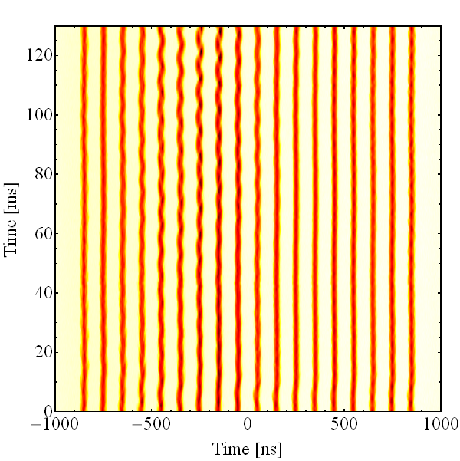
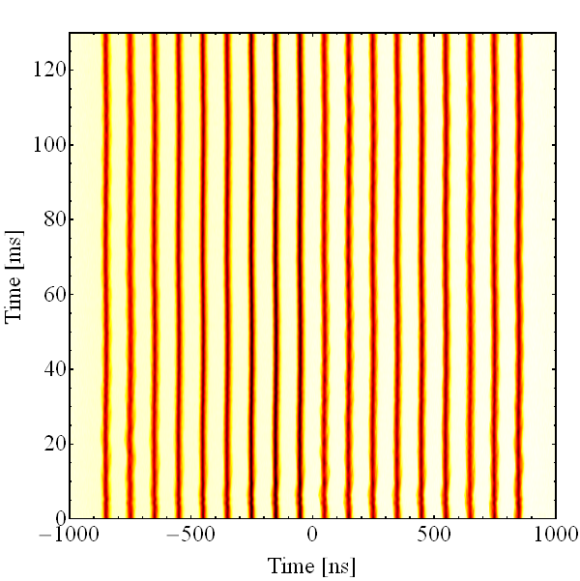
PS intensity reach
Context
  Intensity limited by dipolar and quadrupolar coupled-bunch oscillations after transition and flat-top
Present status and observations
  LIU intensity with nominal longitudinal emittace at PS extraction not yet reached despite most HW upgrades installed – so far “only” 2e11 p/b with nominal longitudinal emittance and 72 b
  LIU intensity of 2.6e11 p/b for the moment only within reach for large longitudinal emittance, but this is incompatible with transfer losses and acceleration in SPS
  Emittance blow-up due to impedance of 40/80 MHz cavities
What more can and needs to be done?
  Further probe intensity reach with coupled bunch feedback and clearly identify limitations
  Improve understanding of longitudinal impedance and instabilities → beam based impedance measurements
  Add higher-harmonic cavity for passive damping? First experimental studies at flat top very promising (tests with beam only at flat top due to limited frequency range of 40 MHz cavities)
  Initial 2016 measurements at flat-top 10/40 MHz confirmed
    Improved stability with 40 MHz cavity in bunch-shortening mode
    Promising, but would require additional RF system
Single harmonic, h = 21
Bunch shortening, h=21 + 84
Flat-top, N_{b,ej} ≈ 1.7·10¹¹ ppb

Slide 25
PS intensity reach
Context
  Intensity limited by dipolar and quadrupolar coupled-bunch oscillations after transition and flat-top
Present status and observations
  LIU intensity with nominal longitudinal emittace at PS extraction not yet reached despite most HW upgrades installed – so far “only” 2e11 p/b with nominal longitudinal emittance and 72 b
  LIU intensity of 2.6e11 p/b for the moment only within reach for large longitudinal emittance, but this is incompatible with transfer losses and acceleration in SPS
  Emittance blow-up due to impedance of 40/80 MHz cavities
What more can and needs to be done?
  Further probe intensity reach with coupled bunch feedback and clearly identify limitations
  Improve understanding of longitudinal impedance and instabilities → beam based impedance measurements
  Add higher-harmonic cavity for passive damping? First experimental studies at flat top very promising (tests with beam only at flat top due to limited frequency range of 40 MHz cavities)
  Develop impedance model including feedbacks that reproduces flat-top instabilities to be able to assess effectiveness of higher-harmonic cavity for beam stabilization
  Study intensity reach with BCMS beams

Slide 26
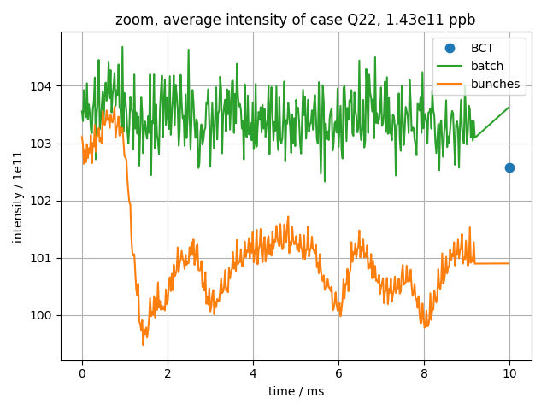
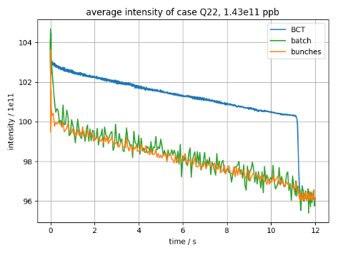
PS-to-SPS transfer & SPS low energy losses
Context
  During the 2015 high intensity scrubbing run in the SPS with up to 2e11 p/b injected significant losses were observed in the SPS by far exceeding the 10% loss budget when extrapolated to LIU intensity of 2.6e11 p/b
Present status of studies
  Main sources are losses due to uncaptured beam and continuous losses on SPS flat bottom

Slide 27
PS-to-SPS transfer & SPS low energy losses
Context
  During the 2015 high intensity scrubbing run in the SPS with up to 2e11 p/b injected significant losses were observed in the SPS by far exceeding the 10% loss budget when extrapolated to LIU intensity of 2.6e11 p/b
Present status of studies
  Main sources are losses due to uncaptured beam and continuous losses on SPS flat bottom
  Continuous losses from bunches on SPS flat bottom scale with intensity (or in reality with transverse emittance!?) while capture losses seem independent of intensity – also in Q22

Slide 28
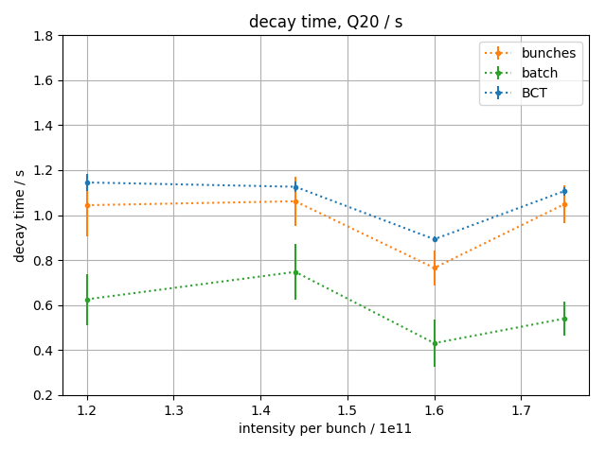
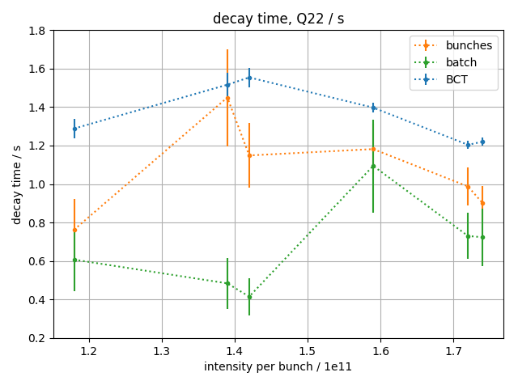
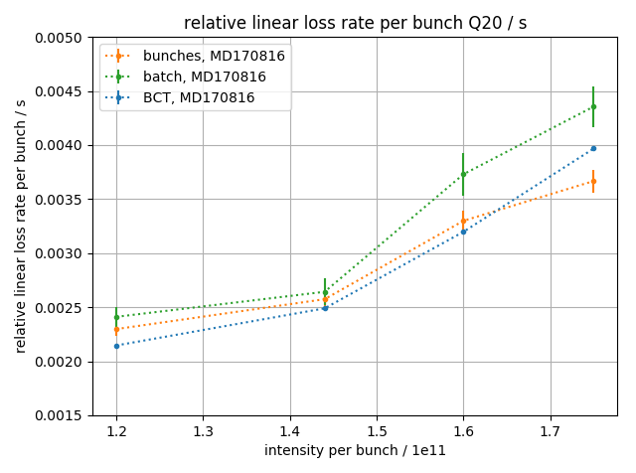
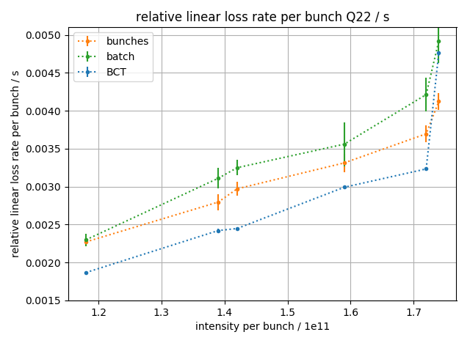
PS-to-SPS transfer & SPS low energy losses
Context
  During the 2015 high intensity scrubbing run in the SPS with up to 2e11 p/b injected significant losses were observed in the SPS by far exceeding the 10% loss budget when extrapolated to LIU intensity of 2.6e11 p/b
Present status of studies
  Main sources are losses due to uncaptured beam and continuous losses on SPS flat bottom
  Continuous losses from bunches on SPS flat bottom scale with intensity (or in reality with transverse emittance!?) while capture losses seem independent of intensity – also in Q22

Slide 29
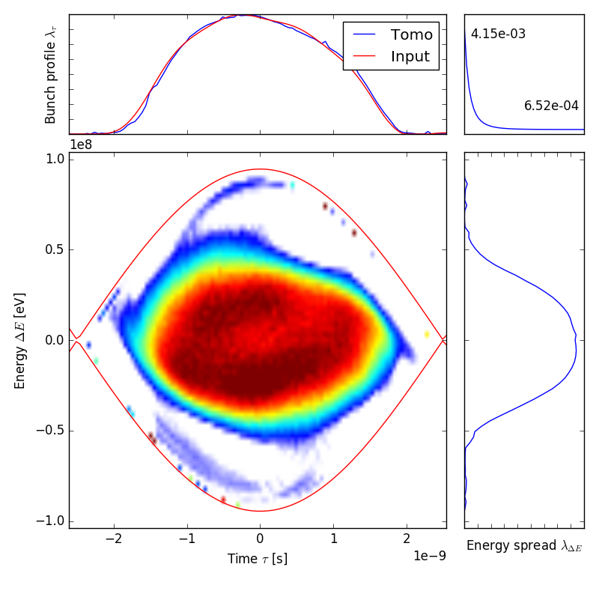
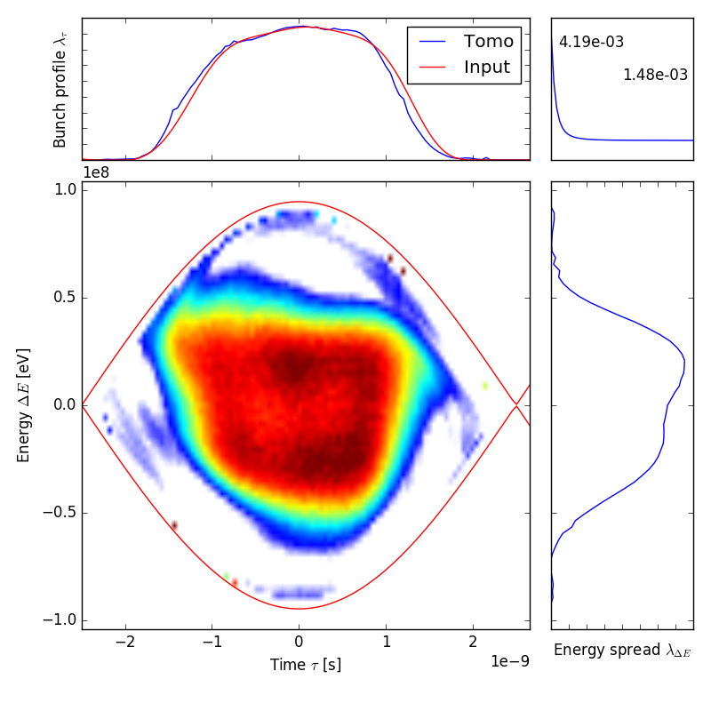
PS-to-SPS transfer & SPS low energy losses
Context
  During the 2015 high intensity scrubbing run in the SPS with up to 2e11 p/b injected significant losses were observed in the SPS by far exceeding the 10% loss budget when extrapolated to LIU intensity of 2.6e11 p/b
Present status of studies
  Main sources are losses due to uncaptured beam and continuous losses on SPS flat bottom
  Continuous losses from bunches on SPS flat bottom scale with intensity (or in reality with transverse emittance!?) while capture losses seem independent of intensity – also in Q22
  New bunch rotation schemes in PS to optimize longitudinal distribution and minimize tails
Without linearization
With linearization

Slide 30
PS-to-SPS transfer & SPS low energy losses
Context
  During the 2015 high intensity scrubbing run in the SPS with up to 2e11 p/b injected significant losses were observed in the SPS by far exceeding the 10% loss budget when extrapolated to LIU intensity of 2.6e11 p/b
Present status of studies
  Main sources are losses due to uncaptured beam and continuous losses on SPS flat bottom
  Continuous losses from bunches on SPS flat bottom scale with intensity (or in reality with transverse emittance!?) while capture losses seem independent of intensity – also in Q22
  New bunch rotation schemes in PS to optimize longitudinal distribution and minimize tails
  Flat bottom losses depend on transverse emittance (effective momentum acceptance reduction?)
Next steps
  Study amount of uncaptured beam from PS
  High intensity beam studies with BCMS type beams to profit from LIU like brightness
  Horizontal aperture scans in SPS & check losses as function of orbit at momentum scraper
  High intensity “scrubbing run” in October to study flat bottom beam degradation (+other aspects)
  Further study possible improvements from new bunch rotation schemes

Slide 31
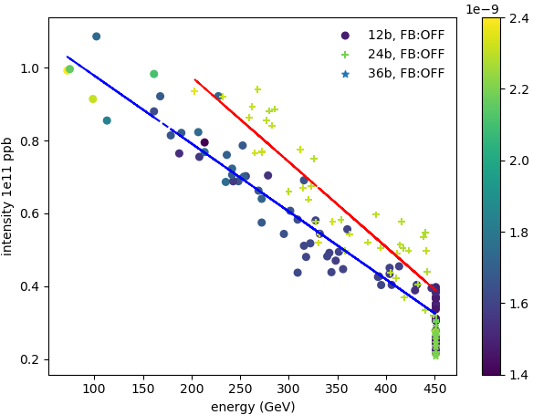
SPS longitudinal instabilities / beam loading
Context
  Apart from losses at low energy, longitudinal instabilities and beam loading are the main SPS intensity limitations
Present status and ongoing studies
  Series of dedicated MDs on longitudinal instability thresholds as function of intensity for different bunch trains, bunch lengths and different settings of LLRF – clear thresholds identified
Instability threshold minimal at flat top.
Average bunch length [s]
Bunch length for 12 bunches smaller due to effect of phase loop

Slide 32
SPS longitudinal instabilities / beam loading
Context
  Apart from losses at low energy, longitudinal instabilities and beam loading are the main SPS intensity limitations
Present status and ongoing studies
  Series of dedicated MDs on longitudinal instability thresholds as function of intensity for different bunch trains, bunch lengths and different settings of LLRF – clear thresholds identified
  Benchmarking with SPS longitudinal impedance model to extrapolate to LIU beam parameters and define impedance reduction requirements
  Measurements of the 200 MHz induced voltage and comparison with simulations
  Characterization of LLRF
  Presently operating without feed-forward (more difficult to reach beam stability with feed forward)
  Issue with new RF pre-amplifiers when accelerating high intensity 25 ns beams (solid state technology, several pre-amplifiers burnt during operation/MDs, limiters being implemented)
Next steps
  Measurements in Q22 to cross-check impedance model
  Study Potential gain of intensity with Q22 (more efficient use of available RF voltage / power?)
  Calibration of 800 MHz voltage

Slide 33
SPS emittance preservation
Context
  Emittance preservation along SPS was not a big issue during past operational periods
  Recent measurements indicate blow-up along batch with operational BCMS beam
Present status and ongoing studies
  Significant signal to noise ratio improvement of bunch-by-bunch emittance measurements after BI modified the signal chain on the existing SPS rotational wire scanners
  Emittance measurements still suffer from limited resolution of transverse beam profile, but bunch-by-bunch trends can be clearly observed showing bow-up along the train

Slide 34
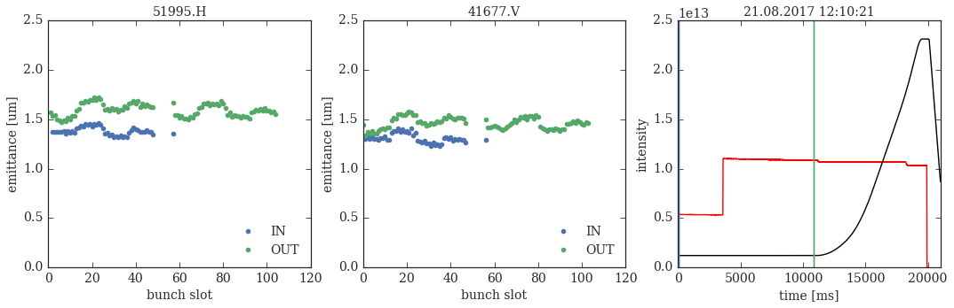
SPS emittance preservation
Context
  Emittance preservation along SPS was not a big issue during past operational periods
  Recent measurements indicate blow-up along batch with operational BCMS beam
Present status and ongoing studies
  Significant signal to noise ratio improvement of bunch-by-bunch emittance measurements after BI modified the signal chain on the existing SPS rotational wire scanners
  Emittance measurements still suffer from limited resolution of transverse beam profile, but bunch-by-bunch trends can be clearly observed showing bow-up along the train
  Measurements and characterization of tune shift with bunch trains to optimize tunes and damper settings along SPS flat bottom and start of the ramp

Slide 35
SPS emittance preservation
Context
  Emittance preservation along SPS was not a big issue during past operational periods
  Recent measurements indicate blow-up along batch with operational BCMS beam
Present status and ongoing studies
  Significant signal to noise ratio improvement of bunch-by-bunch emittance measurements after BI modified the signal chain on the existing SPS rotational wire scanners
  Emittance measurements still suffer from limited resolution of transverse beam profile, but bunch-by-bunch trends can be clearly observed showing bow-up along the train
  Measurements and characterization of tune shift with bunch trains to optimize tunes and damper settings along SPS flat bottom and start of the ramp
Next steps
  Further studies on machine settings to minimize blow-up (tunes, chromaticity, damper, …)
  Standardized emittance measurements for each LHC filling
  Commissioning of BSRT and BGI for transverse emittance monitoring
  Tests with Prototype wire scanner

Slide 36
Outline
Introduction
Overview of ongoing LIU MDs
Critical points for reaching LIU performance
Summary & MD priorities

Slide 37
Summary & MD priorities
LIU MD activities in the injectors in full swing
  Excellent results and good progress on all fronts
Need to focus efforts on remaining critical issues
  Horizontal emittance blow-up at PS injection in particular with large dp/p instead of expected gain due to space charge mitigation
  PS intensity reach with nominal longitudinal emittance
  PS-to-SPS transfer and losses in SPS
  SPS intensity reach (studies with present RF system to extrapolate to LIU)
  Transverse emittance preservation in the PS and SPS, which seems quite challenging already under the present operational conditions
  Full characterization of Q22 potential

Slide 38
Thank you for your attention!

Slide 39
LIU PSB MD overview (for beam parameters)
to be started
ongoing/completed
PSB RF
  Finemet® reliability run
  Triple harmonic capture for bunch flattening at injection
  Phase Noise blow-up
  BCMS 1.5 eVs
  Phase alignment of H1 with Finemet® and ferrite cavities
PSB Transverse Dynamics
  Emittance preservation along the cycle
  Dispersion measurements for emittance measurement (WS) Emittance evaluation using de-convolution method (momentum contribution)
  Impedance measurements
  Measurements on new Wire-scanner (R3V) prototype
  Commissioning of new TBT BPM electronics
  Resonance compensation based on turn-by-turn measurements
  Testing the SEM GRID performance in view of LIU beam (systematic bunch profile de-convolution)
PSB-to-PS
  Analysis and re-matching of R3 PSB-PS TL
  Emittance blow-up estimation due to recombination kickers

Slide 40
LIU PS MD overview (for beam parameters)
to be started
ongoing/completed
Emittance preservation and space charge
  Horizontal blow-up at injection & impact of injection bump and steering errors
  Beam based measurements of KFA45
  Optics measurements to improve emittance measurements
  Space charge mitigation with large momentum spread
  Identification and compensation of resonances
  RF voltage program to avoid bunch shortening at start of acceleration
  Deployment of transverse damper along the cycle and low chromaticity
  Double-harmonic operation at flat-bottom and constant bucket area at beginning of acceleration
  Commissioning of BGI (horizontal)
Longitudinal instabilities
  Quadrupole coupled-bunch instability and impact of high-frequency cavity impedance
  Intensity limit with new coupled-bunch feedback
  20 MHz, 40 MHz or 80 MHz as Landau cavities at flat-top
Longitudinal impedance
  Impedance measurements of 10 MHz, 20 MHz, 40 MHz and 80 MHz RF cavities
  Commissioning of feedbacks for cavities at 20 MHz, 40 MHz and 80 MHz
  High-frequency structure of beam during, e.g., de-bunching
PS-to-SPS transfer
  Optimization of bunch rotation, test of adiabatic bunch shortening using 40 MHz and 80 MHz RF
  Uncaptured particles at PS-SPS transfer

Slide 41
LIU SPS MD overview (for beam parameters)
to be started
ongoing/completed
Losses
  Studies of loss mechanisms and scaling of losses with 25 ns beams
  Characterization of longitudinal phase space at SPS injection with tomography
  Characterization and optimization of low level RF system
  SPS nonlinear optics model (for non-linear chromaticity)
  High intensity 25 ns “mini scrubbing run” in October (40 hours dedicated MD)
Longitudinal intensity limitations
  Intensity threshold along the cycle for different bunch trains and different optics
  Extraction of longer bunches to LHC (for LIU beam parameter reach)
  Bunch rotation at 450 GeV for high intensity 25 ns beams
Transverse impedance, instability and emittance preservation
  Optimization of existing SPS rotational WS to enable BbB and tests of new prototype
  Transverse emittance growth on flat bottom
  Detuning with multi-bunch beams for automatic Q correction and possible impact on emittances
  Benchmarking of horizontal single bunch impedance model
Q22
  Losses and longitudinal instability threshold in comparison to Q20
  Losses at start of acceleration (more efficient use of available RF voltage / power?)
  Optics characterization (non-linear chromaticity, incoherent effects)
  Instabilities (TMCI threshold, longitudinal instabilities in comparison to Q20, …)
  High-bandwidth feedback studies (attempt to stabilize TMCI)

Slide 42
Mid-year status and outlook of LIU MDs for PSB
G. P. Di Giovanni, V. Forte on behalf of:
S. Albright, M. E. Angoletta, J. Sirvent Blasco, A. Findlay, G. Guidoboni, D. Quartullo, A. Santamaria Garcia, T. Rijoff, A. Garcia-Tabares Valdivieso, P. Zisopoulos
Acknowledgements: the PSB OP team
LIU Beam Parameter WG meeting #22 1st September 2017

Slide 43
Outline
PSB RF:
  Finemet® reliability run (Alan/Maria-Elena)
  Triple harmonic capture for bunch flattening at injection (Simon)
  Phase Noise blow-up (Simon/Danilo/Maria-Elena)
  BCMS 1.5 eVs (Simon)
  Phase alignment of H1 with Finemet® and ferrite cavities (Simon)
PSB Transverse Dynamics:
  Emittance preservation along the cycle (Andrea)
  Dispersion measurements for emittance measurement (WS) and as tool to debug the BTMS (Greta/Andrea/Vincenzo)
  Status of the AC dipole MD (Ana/Panos)
  Impedance measurements (Tatiana)
  New Wire-scanner (R3V) prototype (Jose)
PSB-PS:
  Analysis and re-matching of R3 PSB-PS TL (Vincenzo)
  Emittance blow-up estimation due to recombination kickers (Vincenzo)
Conclusions and Outlook

Slide 44
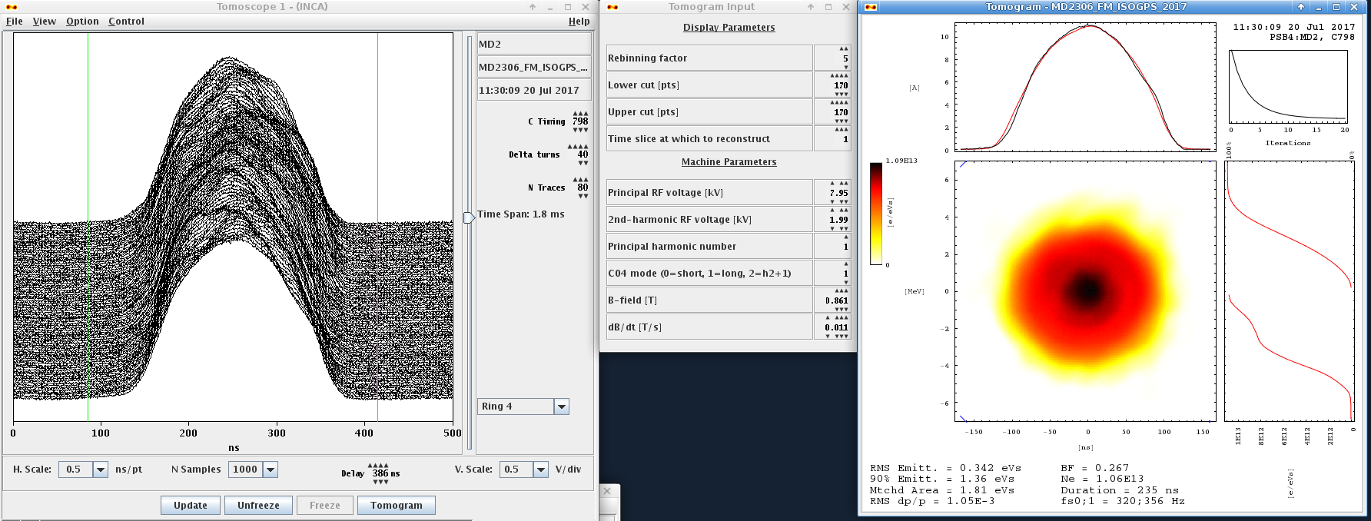
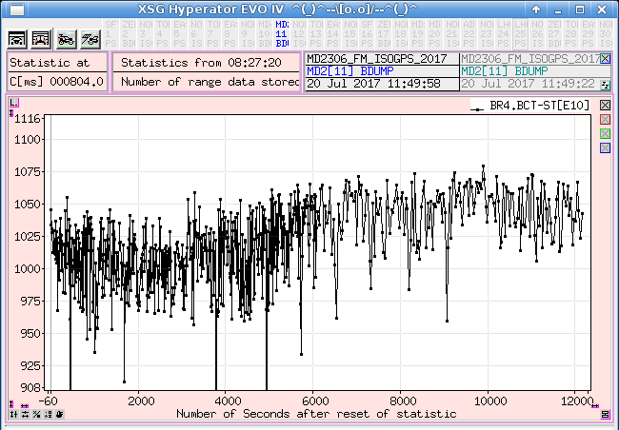
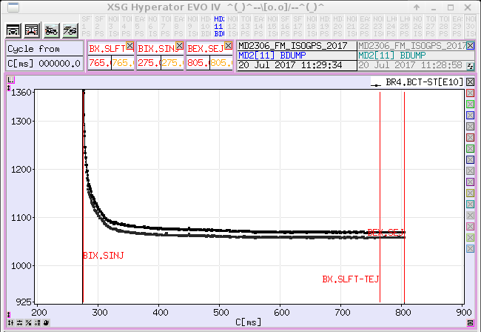
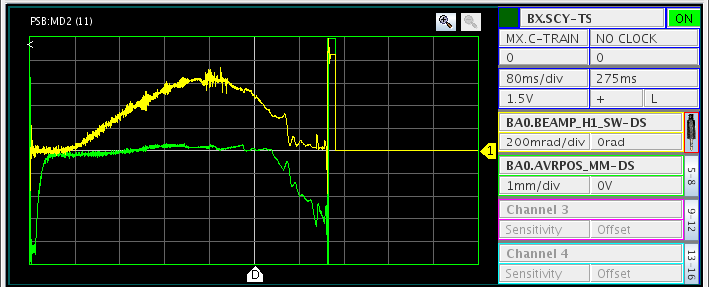
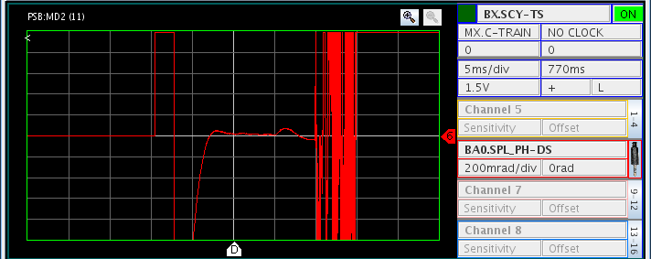
PSB RF: Finemet® Cavity 2017 Reliability Run
Finemet ® cavity was switched on in May for high level checks, tests with low level HW started 2nd June.
Beam tests started 6th June, initially with an LHC25 type beam(as low intensity), using Finemet ® as second harmonic.
Once teething problems ironed out, switched to setting up ISOLDE type beam using Finemet ® as second harmonic.
21st June setup GPS & HRS users to use Finemet ® second harmonic for operational beams, which will continue until the end of the year.
Set up an ISOLDE type beam with Finemet ® as first harmonic 21/6 to 20/7, good results with 1050E10 ppr accelerated with reasonable bunch shape.
Finemet® cavity available for MDs since mid-June.
Splitting beams with Finemet ® cavity as h=1 then as h=2 will be done soon.
R4 >1000e10 p accelerated !!!

Slide 45
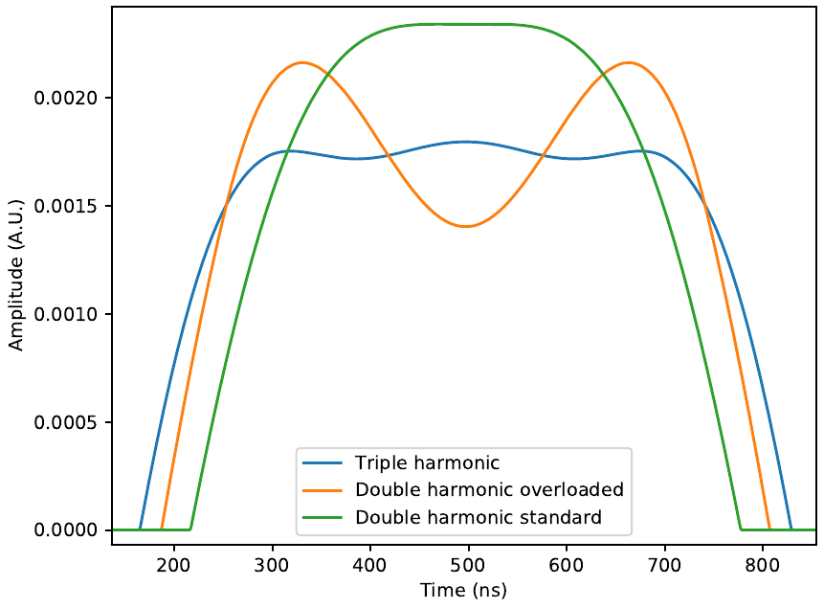
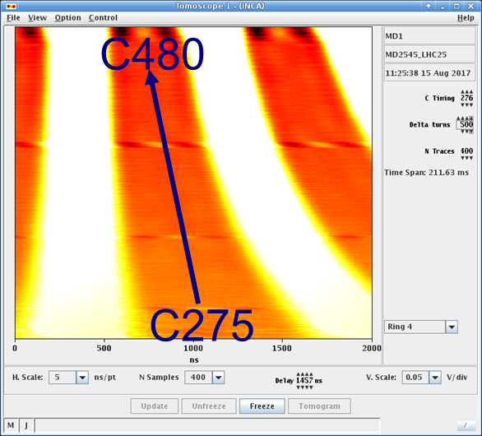
PSB RF: Triple Harmonic Capture
At constant emittance triple harmonic operation can be used to reduce peak line density → Reduce Transverse Space-Charge
Preliminary comparison with nominal LHC25 type at high intensity shows reduced transverse emittance blow-up → ~10% brightness increase
For Linac4 injection should allow larger longitudinal emittance for a given energy swing from PIMS
V₁ = 2V₂, Σ = 16 kV
V₁ ~ V₂ ~ 2V₃, Σ = 16 kV
V₁ = V₂, Σ = 16 kV
Horizontal
8+6 kV
Triple Harmonic
Vertical

Slide 46
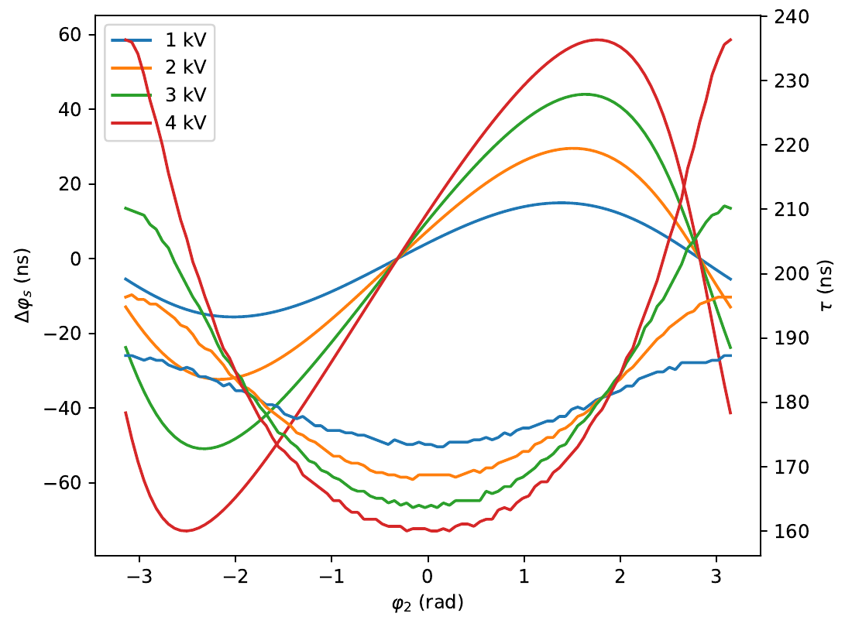
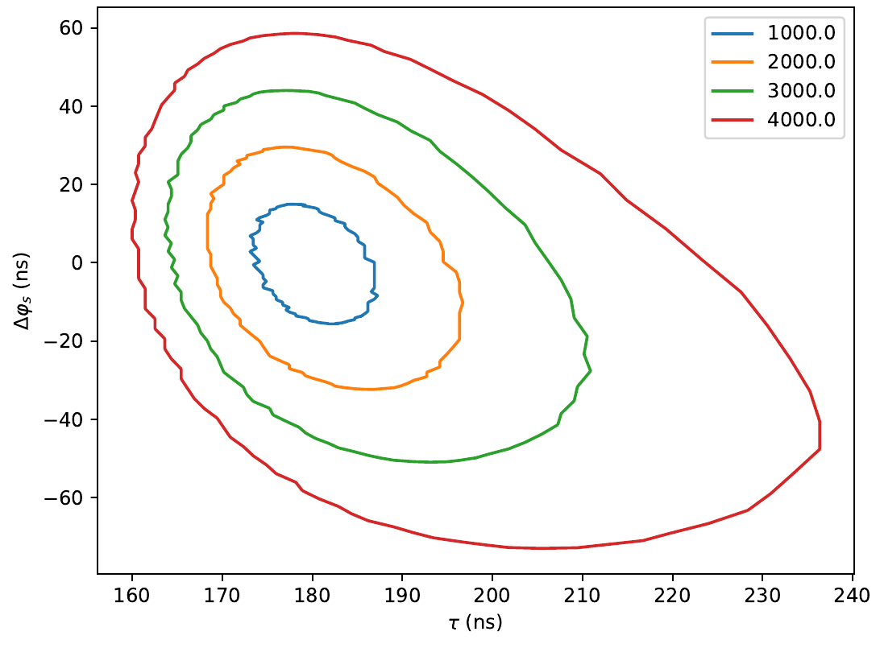
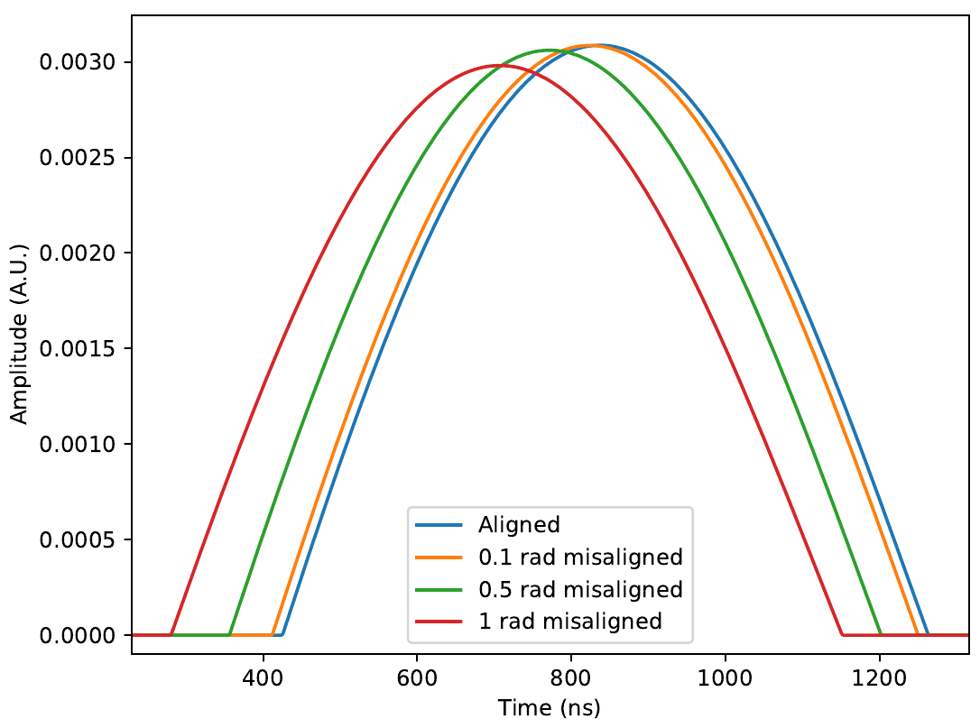
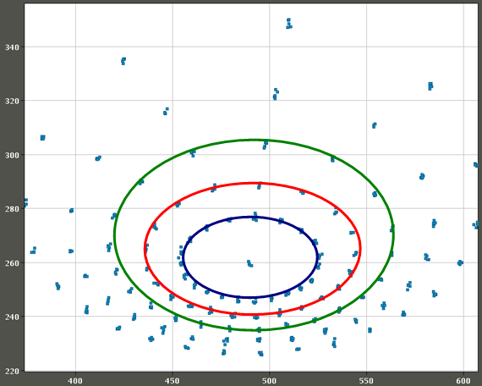
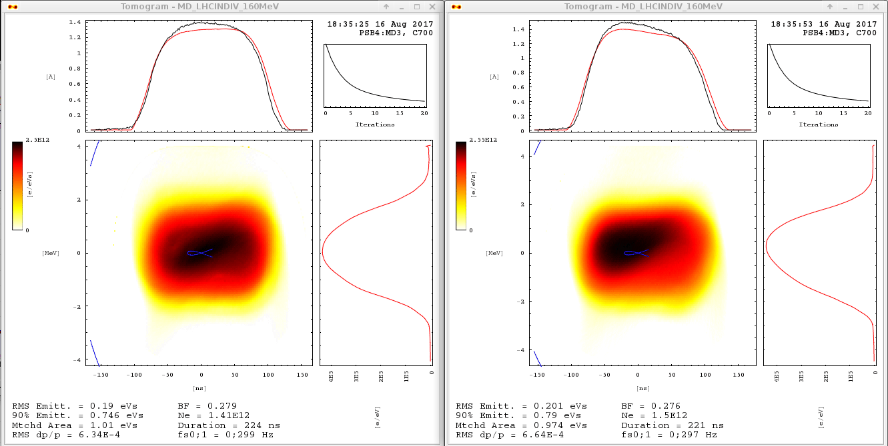
PSB RF: h=1 Finemet®-Ferrite Alignment
C1
LIU baseline assumes distributed RF voltage across 3 Finemet® cavities
Baseline magnetic cycle to 2 GeV designed assuming this possibility
Phase offset between cavities (as seen by beam) leads to change in bunch length and synchronous phase, allowing measurement of offset
C3
C2
Δφ_{s}
τ_{l}
Position on ellipse determined by voltage and phase offset
Allows conversion from programmed phase to phase offset seen by beam and calculation of required delay and phase compensation
τ_{l} and φ_{s} proportional to phase offset
Pure ferrite
Finemet + ferrite

Slide 47
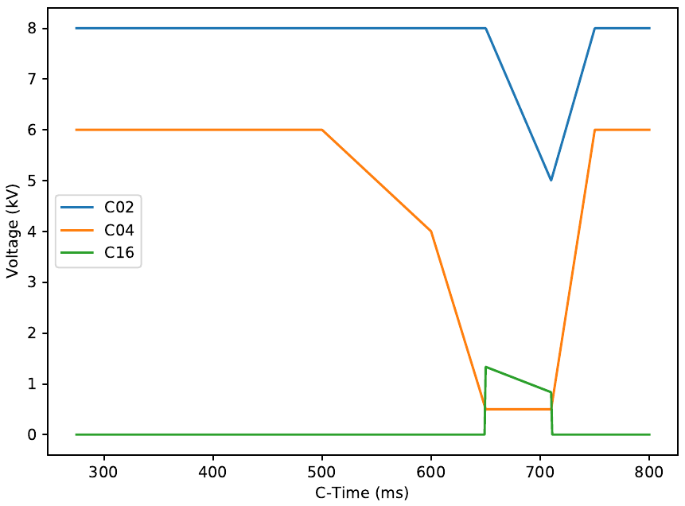
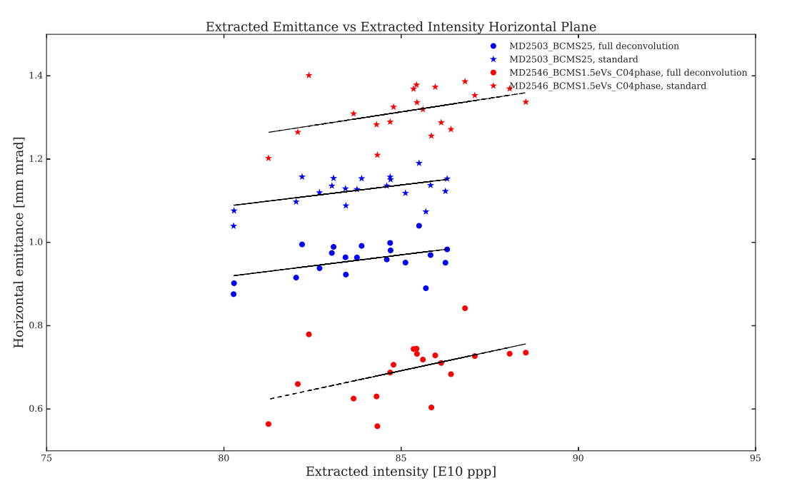
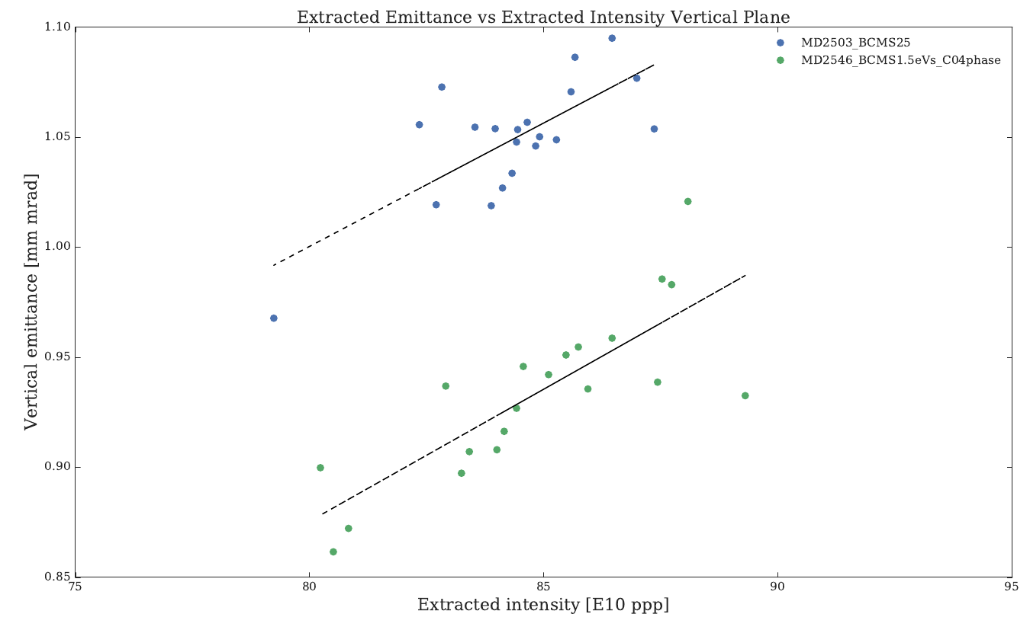
PSB RF: BCMS 1.5 eVs
Fixed bucket area
Set up with C04 at capture to be on LHC25 brightness curve
Fixed bucket area during blow-up has previously been found to be effective in both simulation and measurements
Longitudinal emittance blow-up also demonstrated using phase noise on C02
Slow collapse of inner-separatrix
Same capture as LHC25
Horizontal
Bunch shortening mode at extraction
Constant ratio C16/C02
Nominal BCMS
BCMS 1.5 eVs (@ PSB extr.)
ε_{l} (rms) | 0.34 eVs
Area | 1.51 eVs
dp/p (rms) | 1.49e-3
Bunching factor | 0.195
Bunch population | 8.83e11 ppr
Duration | 160 ns
1.5eVs BCMS (with C04)
Vertical

Slide 48
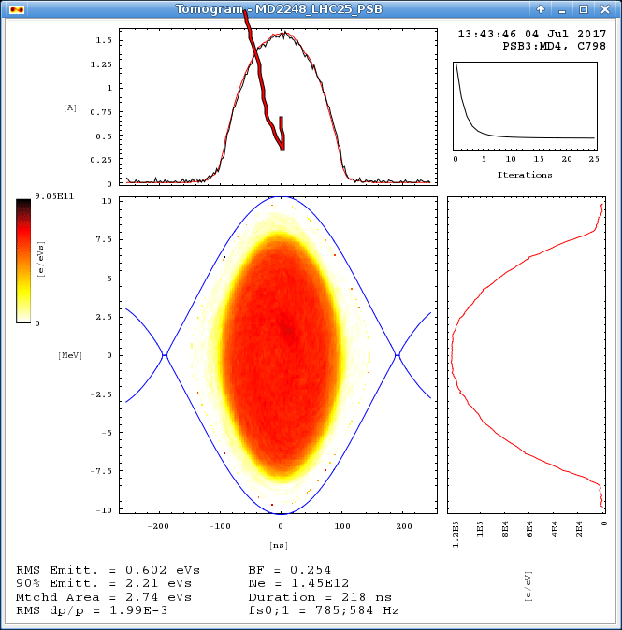
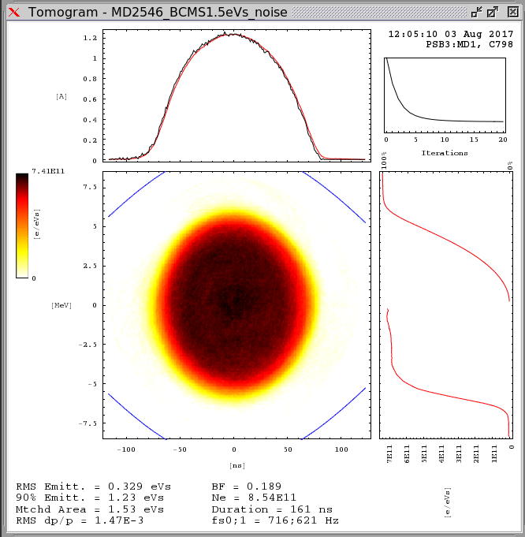
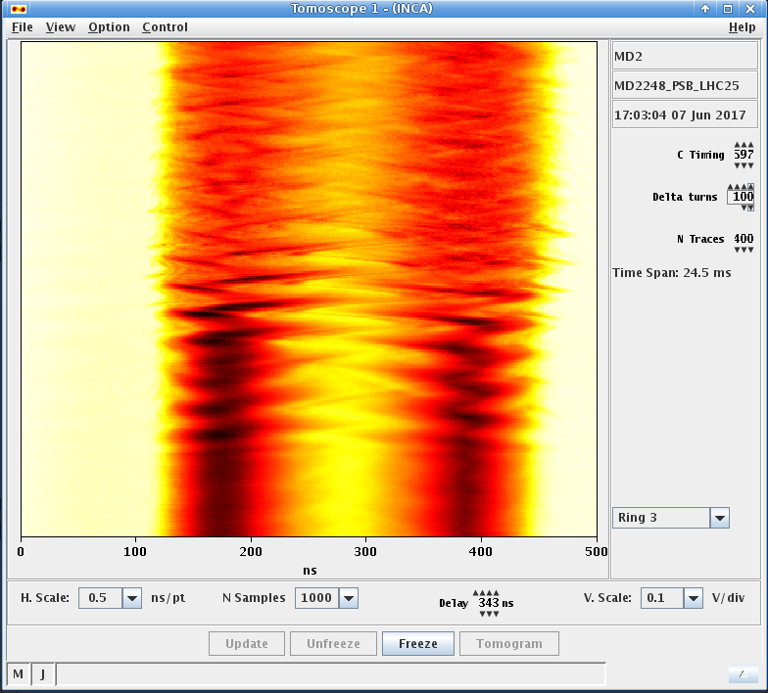
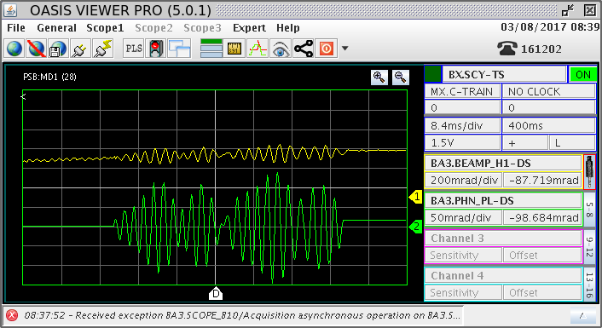
PSB RF: Phase Noise Blow-Up
LHC 25 ns ‘2.74 eVs’ at PSB extraction
Aim: verify if band-limited phase noise using C02 can substitute or complement current sinusoidal phase modulation using C16.
Advantages: no dedicated RF system (harmonic) and bypass current difficulties of calibration of phases between harmonics.
Noise injected in h=1 in bunch lengthening in 2 RF (8+6 kV) during C600-C700 for LHC and C600-C640 for BCMS beams.
2.8 eVs (220 ns) and 1.5 eVs (160 ns) were reached for LHC and BCMS respectively → Very stable beams and good reproducibility.
Method deployed for ferrite RF systems, being deployed for Finemet® RF.
Noise injection through phase loop or directly in the cavity drive studied.
Created a graphical interface with Inspector to easily input noise parameters (frequency band, time interval, amplitude etc.)
Promising results but further studies and simulations are needed.
BCMS 1.5 eVs beam at PSB extraction
start
LHC beam during noise blow-up
Phase noise injection confirmed by beam phase measurement

Slide 49
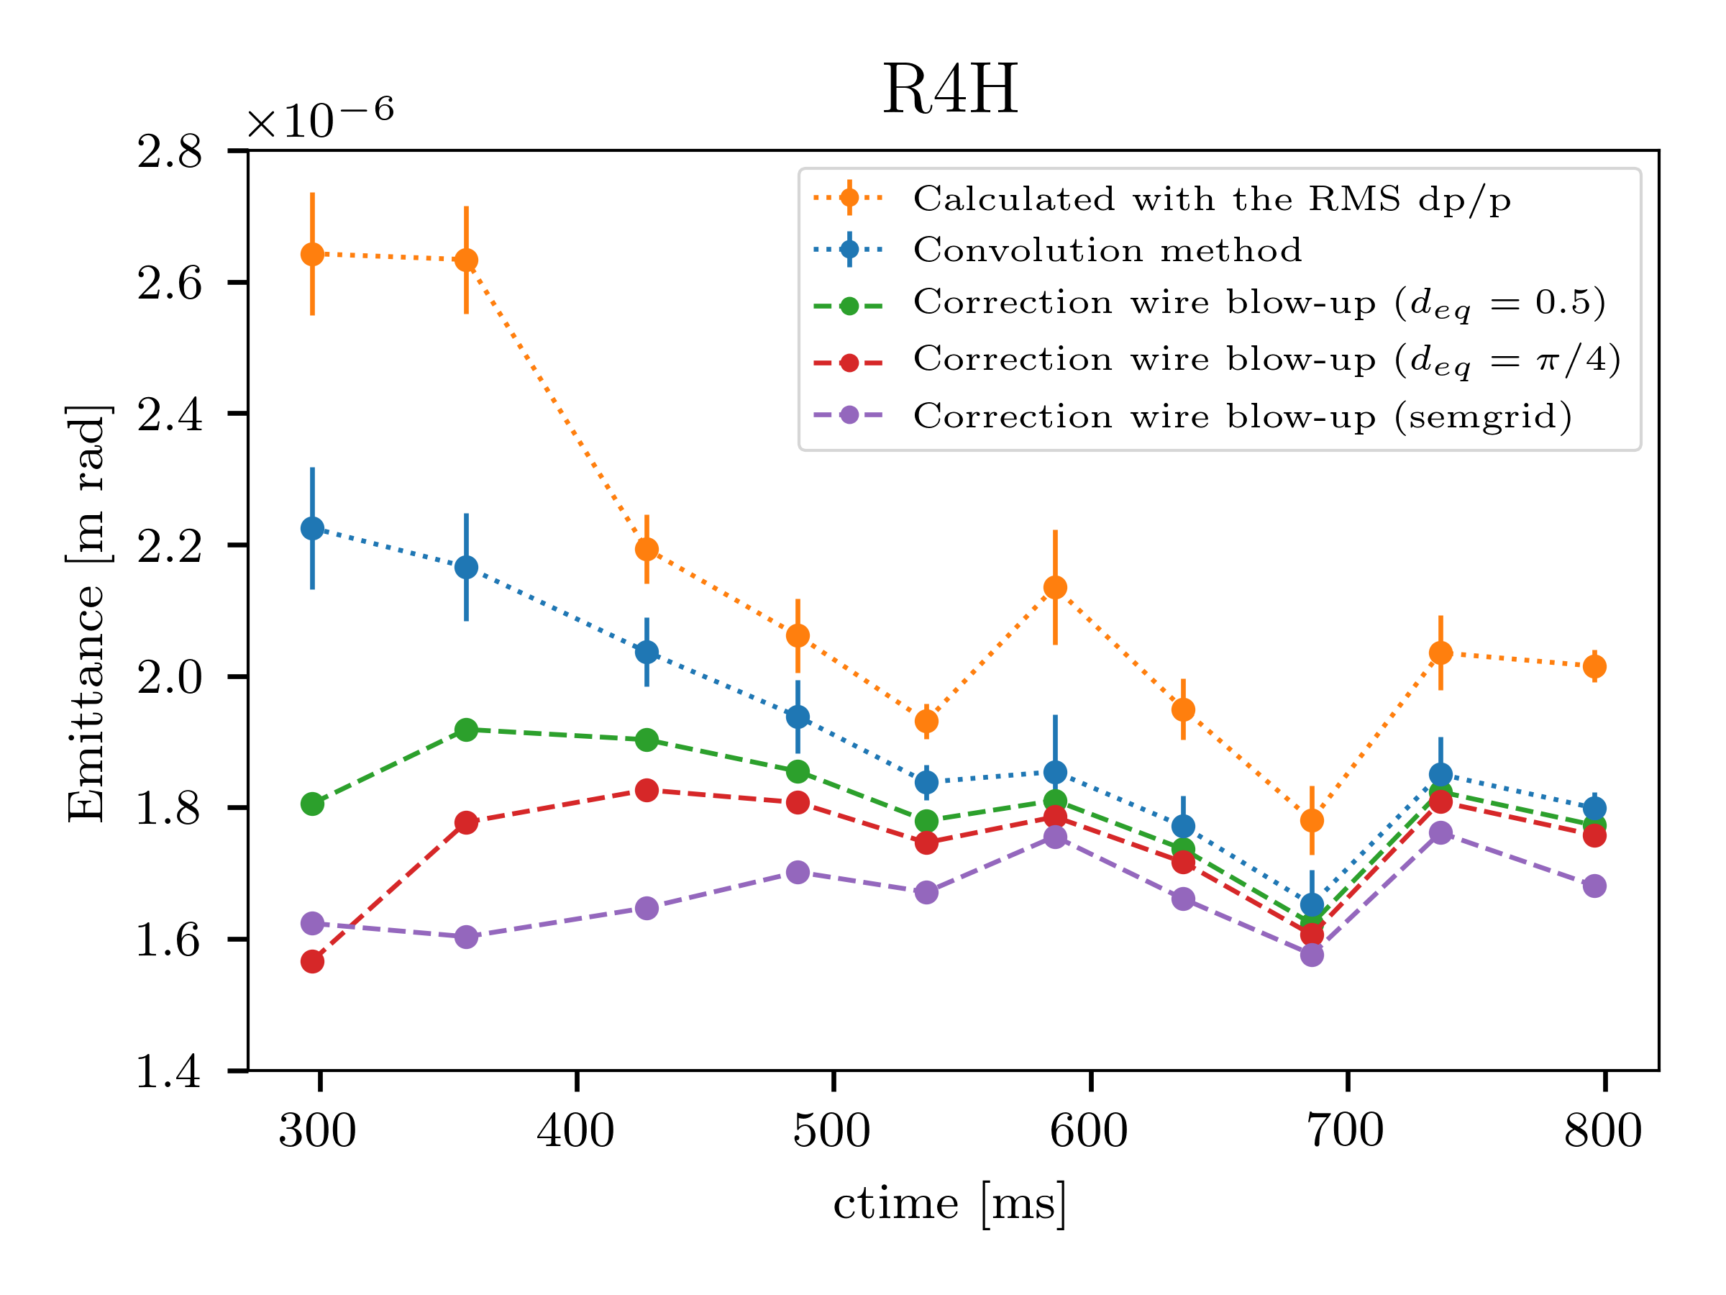
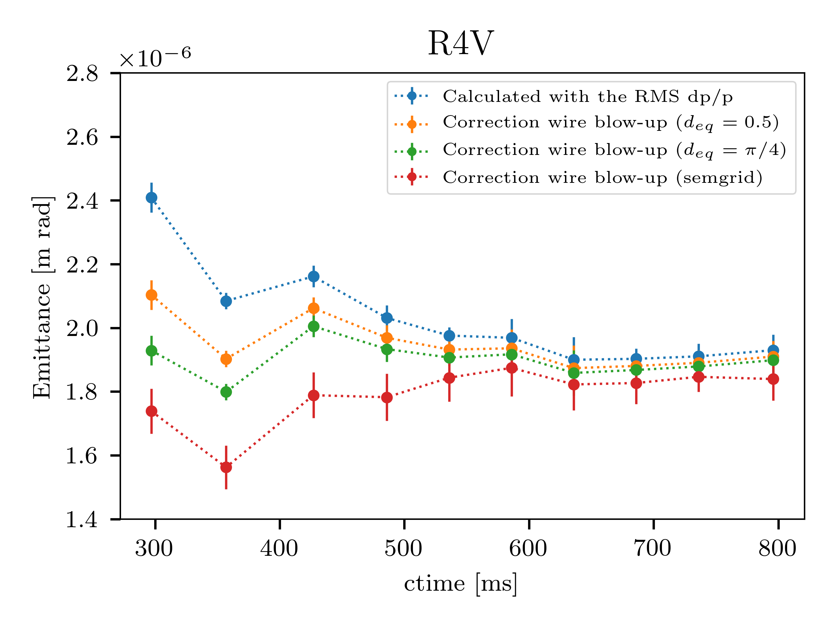
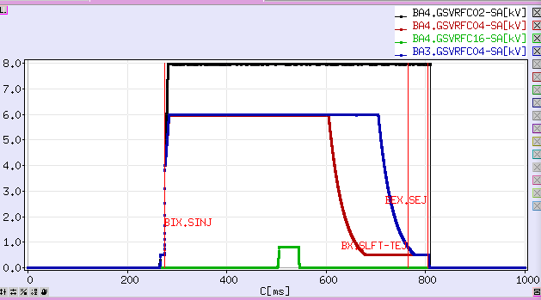
PSB: Emittance Measurements along the PSB Cycle
Emittance measurements were done in all the rings and planes.
Different techniques were used in the analysis of the results:
  Emittance calculation using the RMS momentum spread.
  Emittance calculation using the full momentum spread profile.
  Correction of the wirescanner particle scattering analytically and experimentally.
Next steps: understand emittance blow-up at the end of the cycle in the horizontal plane, probably due to uncertainty treating a double harmonic longitudinal profile.

Slide 50
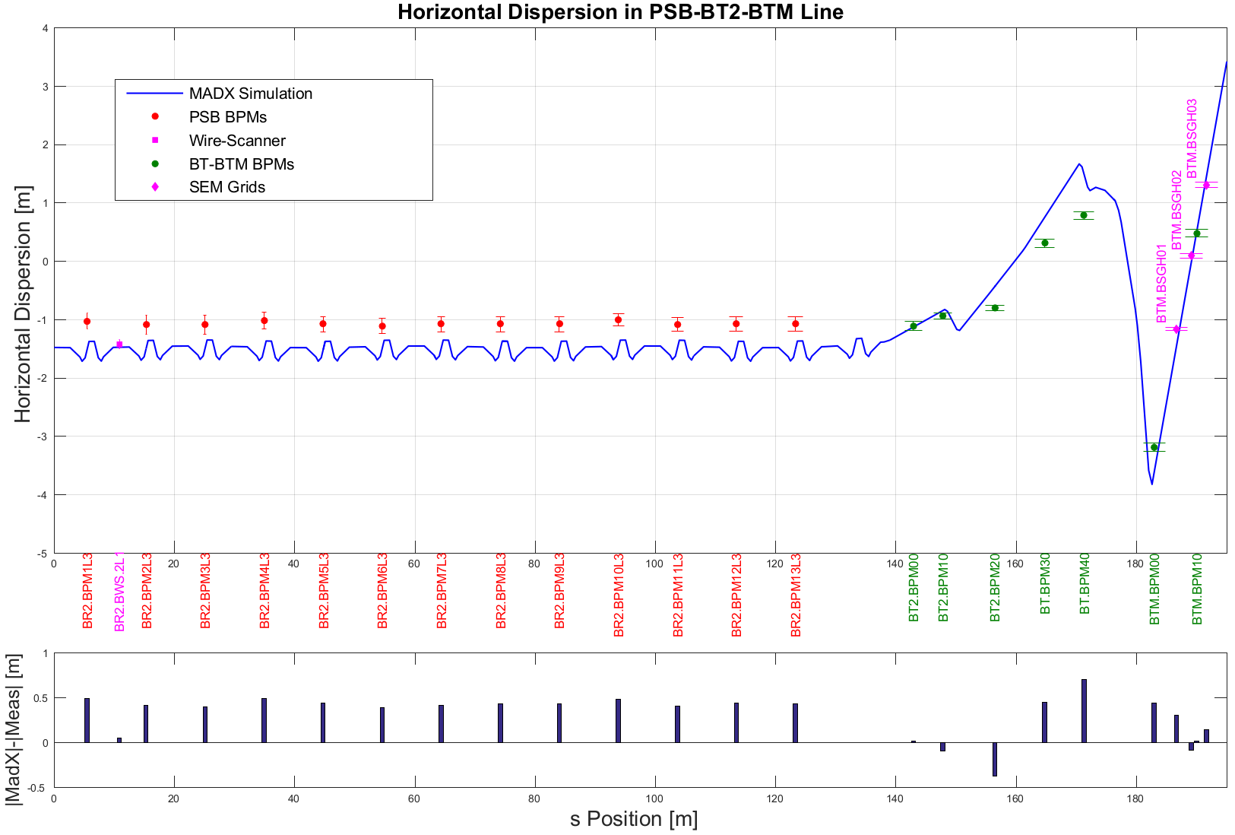
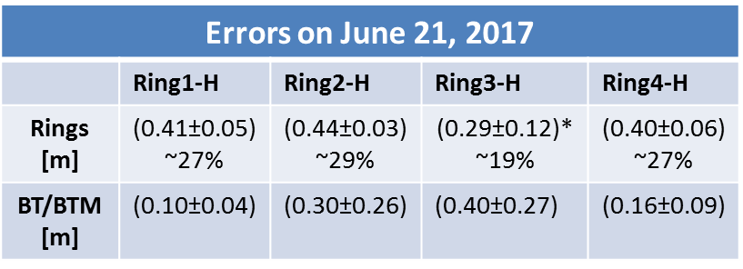
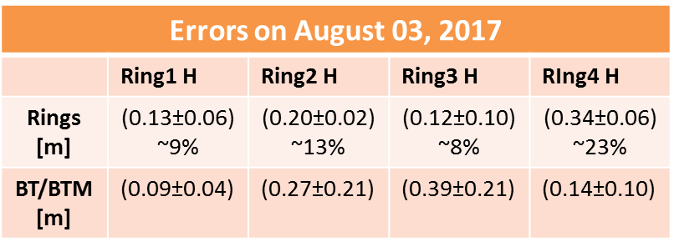
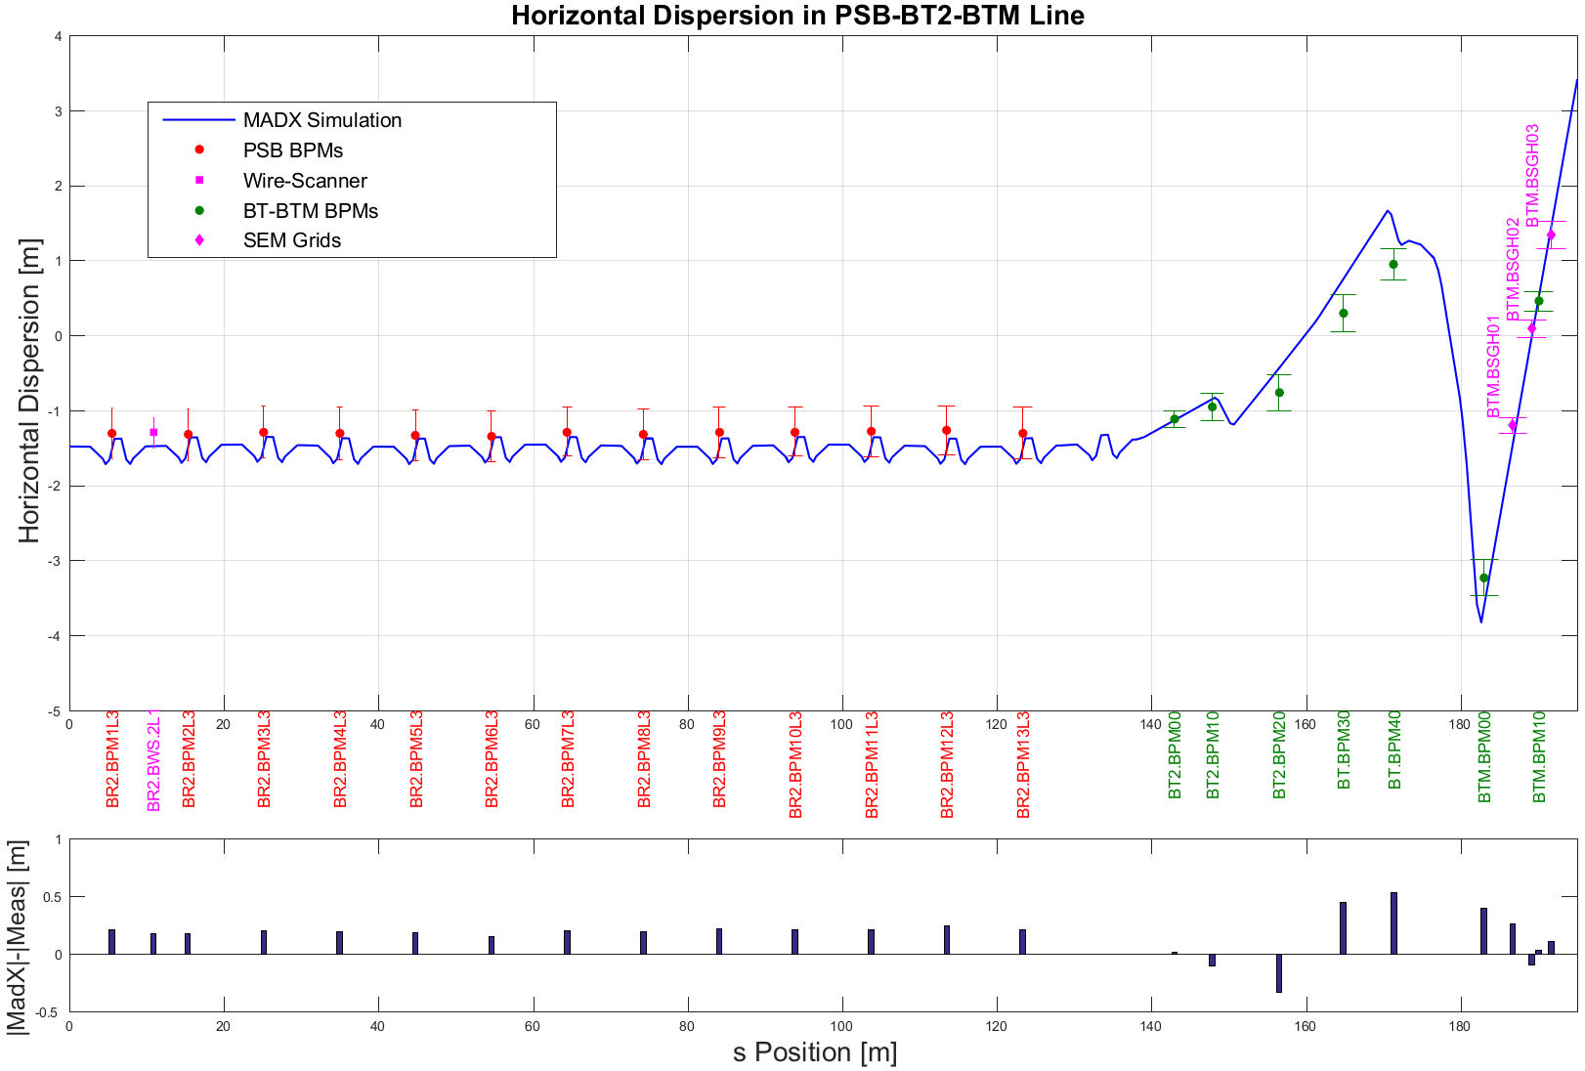
PSB-BT-BTM: Dispersion Measurements
*Excluding first point
Beam setup: LHC25; 165-170e10 ppr; Trim 1+4 active
Since July 11, 2017
Calibration factor of 6/5 included in the electronics
Contribute to debugging BTMS
Next steps:
Verify the effects of Trim1+4
Derive initial condition of the beam at the extraction

Slide 51
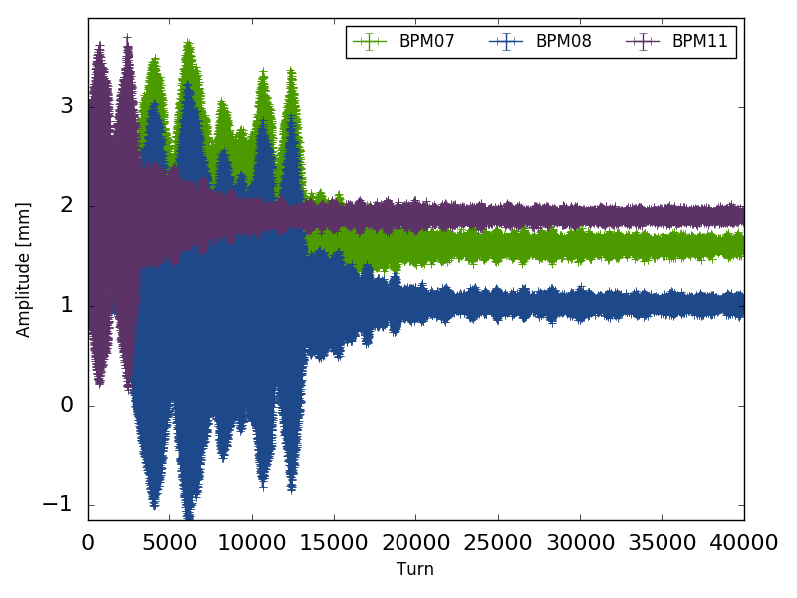
PSB: BMTS, AC Dipole MD
Motivation of the work:
  Optics measurements covering both linear/non-linear optics (original work by M. McAteer)
Plan for 2017 (continuation of 2016 MDs):
  Commission the new electronics pickups (only 3 BPMs in ring2 in 2016).
  Understand the instabilities observed during the excitation cycle.
  Monitor the AC (ADT) excitation to analyse the stability.
  Work restarted last week
Methodology:
  Implement the excitation method used in LHC to PSB.
  Try to maximize the peak to peak transverse excitation by
  moving the driven tune (ADT frequency) closer to the natural
  beam tune.
  Refined frequency analysis using SUSSIX of the driven
  motion turn-by-turn data.
  Ultimate goal is measure the driving terms for resonance compensation.
Delay in acquisition
signal
AC Dipole
excitation
Non-adiabatic
ramp down

Slide 52
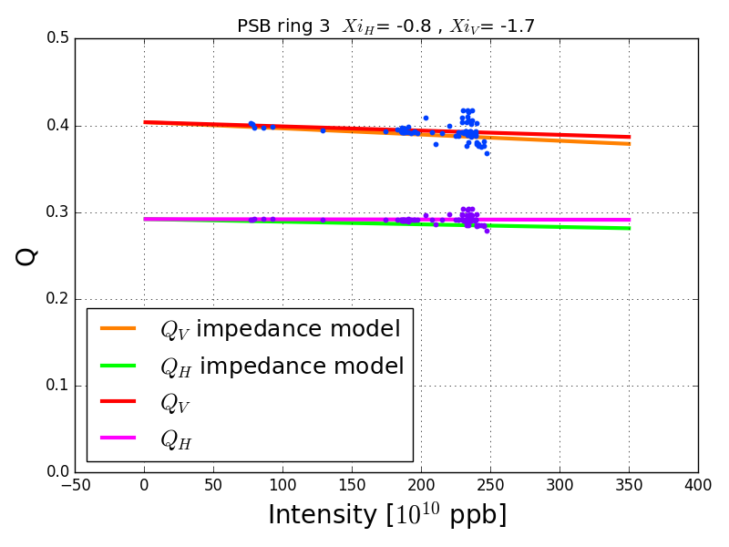
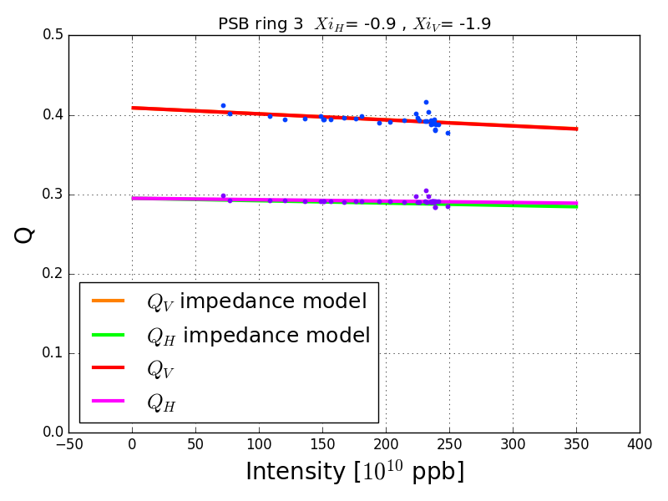
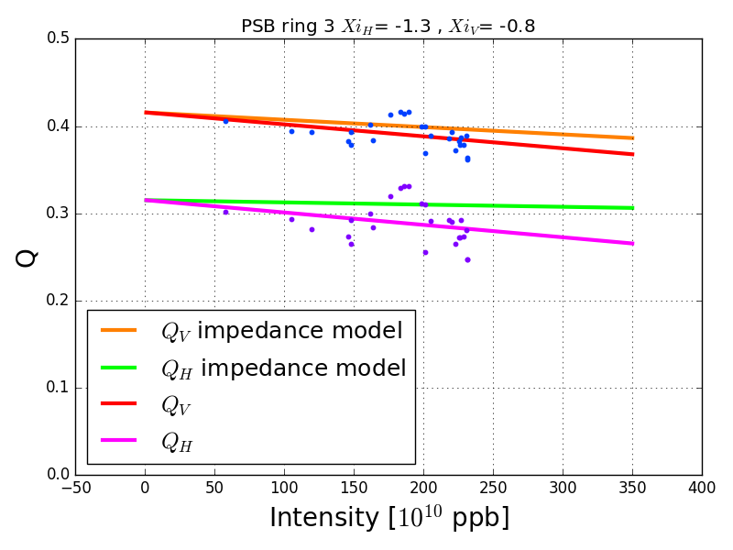
PSB: Impedance Measurements
Tune-shift dependency with chromaticity. Measurements at 160 MeV:
  Good agreement between theoretical model and measured values when XiH near to -0.8
  When horizontal chromaticity < -1 → Noisy data: Difficult interpretation.
  Generally better agreement in vertical plane.
Outlook:
  MD at higher energy (1.4 GeV) for all the rings
  MD at higher intensity

Slide 53



PSB: BWS Prototype Testing
High dynamic range (HDR) secondary shower acquisition system evaluation:
Aim: Ease BWS operation and avoid tuneable parameters (HV+Filter selection).
Prototype equipped with two secondary acquisition systems:
  A) Standard: Single channel acquired on surface.
  B) HDR Based on Q-PMT detector: 4 channels acquired on tunnel with ICECAL FE.
Prototype performance assessment and comparison with operational BWS:
Beam Sigma spread comparison for prototype and operational (Ring 3 Horizontal) with LHC25 and ISOLDE beams.
Issues with the prototype position sensors, to be solved on next TS. MD required after fixing the problem.
Successful Prototype operation with Beam sigma errors→ Prototype ± 0,7% , Operational ±1,3% (ISOLDE).
Scint. photon yield varied by 1e3:
STD → Required filter changes
HDR → Static configuration
  → PMT Saturation free
Prototype
Operational
Beam Type | Operational | Prototype
LHC25 1.4GeV | 2559 ± 31, 1.2% | 2569 ± 37, 1.4%
ISO 588 MeV/c | 8021 ± 125, 1.6% | 8245 ± 52, 0.6%
ISO 886 MeV/c | 6354 ± 88, 1.4% | 6571 ± 46, 0.7%
ISO 1.39 GeV/c | 5302 ± 44, 0.8% | 5538 ± 38, 0.7%
ISO 1.92 GeV/c | 4880 ± 53, 1.1% | 5025 ± 34, 0.7%
Beam sigma measurement (um) and spread during
MD in um and %.

Slide 54



PSB-PS: Analysis and re-matching of R3
PSB→PS transfer line
Stitching and benchmarking PSB R3 (last turn) – BT – BTP – PS (1st turn) optics model: LHCINDIV - dispersion model
    Operational optics
    2016 (partially) Dx - rematched optics
    2017 (~ perfectly) Dx - rematched optics
    (preliminary)

Slide 55
PSB-PS: Analysis and re-matching of R3
PSB→PS transfer line
Stitching and benchmarking PSB R3 (last turn) – BT – BTP – PS (1st turn) optics model
    Preliminary Re-matched Dx optics using only the 5 BT quads (PPM)
      Not possible to match β_{x,y} & α_{x,y} & D_{x,y} & D’_{x,y} at the same time
        →One loses betatron matching to reach perfect dispersion matching only with BT quads (2016 matching was a trade – off solution between betatron and dispersion matching)
        →Dedicated MD needed for PS injection sem-grids (3-screens method, already implemented for BT-BTP and BT-BTM) and free usage of BTP quads (end of September) to test different solutions and measure optics parameters
    2017 Dx - rematched optics (preliminary)
Closed solution
@ PR.MARK42 | β_{x} [m] | α_{x} | β_{y} [m] | α_{y} | D_{x} [m] | D'_{x} | D_{y} [m] | D'_{y} | Betatron Mrms_{x} [%] * | Betatron Mrms_{y} [%] *
PS periodic solution | 12.17 | 0.13 | 22.17 | -0.02 | 2.22 | 0 | 0 | 0
Operational | 11.07 | -0.003 | 20.87 | 0.18 | 0.93 | 0.09 | 0.03 | 0.0018 | 1 | 2
Dx matched 2016 (trade – off) | 13.57 | -0.04 | 20.91 | 0.11 | 1.41 | 0.013 | 0 | 0 | 2 | 1
Preliminary Matched Dx 2017 | 30.37 | -0.5 | 28.322 | -0.08 | 2.022 | -0.008 | 0.03 | 0.0019 | 58 | 3
* See formula in appendix from M. Giovannozzi “ Sources of emittance growth”

Slide 56


PSB-PS: Analysis and re-matching of R3
PSB→PS transfer line
Stitching and benchmarking PSB R3 (last turn) – BT – BTP – PS (1st turn) optics model
  Kick response (operational settings) of 18 elements (septa and steerers) from BE3.SMH15L1 to PI.SMH42
    Excellent agreement of response from all knobs apart:
    BT3.DHZ10 and BE.SMH15L1 (see Appendix) → suspected issue in some calibration (BT.QNO10?) → to be followed up
    Inversion of BT3.DVT20 (see Appendix) → confirmed by YASP
Measurement - BT3.DHZ10 - BT3.QNO20 nominal (MadX)
Measurement - BT3.DHZ10 - BT3.QNO10 strength x 1.05 (MadX)

Slide 57


PSB-PS: Analysis and re-matching of R3
PSB→PS transfer line
Stitching and benchmarking PSB R3 (last turn) – BT – BTP – PS (1st turn) optics model
  Kick response (operational and new settings) close to the PS
    Excellent agreement
From PI.SMH42
From BTP.DVT40

Slide 58


PSB-PS: Analysis and re-matching of R3
PSB→PS transfer line
Developed in Matlab 3-screens-method for BT-BTP and BT-BTM
    Useful to measure beam emittances and derive initial conditions
    In the future multi-turn grid will help evaluation of betatron mismatch
3-screens for BT-BTP (LHCINDIV 2016)
3-screens for BT-BTM (BCMS 2017)
BTM data courtesy G.P. Di Giovanni

Slide 59


PSB-PS: Preliminary emittance measurements (LHCINDIV ~27e10 p)
High brightness beams are not suited for single particle evaluation (blow-ups can be covered by coupling and integer resonances in combination with space charge).
Even LHCINDIV has too high brightness.
  In the future we will use “extremely” low brightness beams for optics evaluations
    (e.g. LHCINDIV VdM with ε_{x,y}~3um → |ΔQ_{x,y,s.c.}|<0.05)
Laslett direct space charge tune shifts
Operational
Dx-matched optics 2017
Bare tune
Tune shift
PS beam at C185
Tune shift PSB extracted
Beam in PS optics

Slide 60



PSB-PS: Emittance growth estimation from recombination kickers
2016 measurements allowed to benchmark PSpice simulations for the recombination kickers and obtain vertical emittance growth estimations at 2 GeV.
  Results are being released in an ATS note and foresee around 3% blow-up (leading to a 4%* residual from other possible sources, if one considers 5% limit)
Time margins are minimal → careful bunch length evaluation in specification
Estimated vertical emittance blow-up at 2 GeV
Extracted from LIU proton beam parameters table – rev. 25/08/17
* by adding in quadrature

Slide 61
Conclusions and outline
Intense MD activity in 2017 for LIU-PSB
Open topics to be followed up in the future MD time before end of the year:
  Testing the SEM GRID performance in view of LIU beam.
    Systematic de-convolution of energy distribution from wirescanner and sem-grid profiles, especially for large longitudinal emittance beams
  Extraction trajectory stability:
      Effect of the preceding cycle on the extracted trajectory.
      Automatic alignment of the 4 rings for LHC-type beam.
  Analytical resonance compensation using the BTMS.
  Evaluation of the mismatch between PSB and PS. Tools for ‘on-line’ evaluation have been developed.
    New optics solutions will be assessed:
      On extremely low brightness beams in terms of emittance growth
      Also by modifying the BTP quads (non-PPM) for optimal betatron and dispersive matching
      →dedicated MD
    Then:
    In terms of emittance growth for high brightness beams, i.e. BCMS 1.5 eVs and LHC25 2.8eVs
      To date, no improvement in brightness for different optics on achieved BCMS beams
  B-Train commissioning

Slide 62
Current status of LIU-PS MDs
H. Damerau, A. Huschauer, on behalf of the PS MD users

Slide 63
Horizontal emittance blow-up at injection
Tune and chromaticity measurements during the injection bump
  Observation of a dynamic variation of the tune during the bump (points at Eddy current effects)
  Magnetic measurements of variation of the sextupolar component during the bump started
  Impact of the tune change to be investigated in simulations
Beta-beating measurements during the injection bump
  Collaboration with OMC team started
  First results are currently being analyzed and an online tool is being prepared
position at BPM43
horizontal tune
P. Zisopoulos

Slide 64

Horizontal BGI monitor
First promising measurements with the prototype
  Observation of orbit distortion of the magnet due to proximity to adjacent main magnets
    Correction to the powering scheme implemented during TS2
  Commissioning of the device ongoing
J. Storey, H. Sandberg
chip 3 currently
not working

Slide 65
KFA45 hardware upgrades

Slide 66


Beam mis-steering studies at the PS injection
E. Senes, F. Tecker (BE-OP-PS) / V. Forte (TE-ABT-BTP)
BCMS single bunch beam (R3 PSB)
Horizontal injection kicker KFA45 varied in the range 90%-106% of nominal setting
Comparison between skew setting to compensate linear coupling and nominal settings (operational beam)
Compensated linear coupling with QSK (from minimum tune approach): (MD2586_missteering)
WS65H
WS85V
Same emittance blow-up pattern both in x and y plane,
other non-linear coupling sources under investigation

Slide 67


Beam mis-steering studies at the PS injection
E. Senes, F. Tecker (BE-OP-PS) / V. Forte (TE-ABT-BTP)
Laslett tune shift comparison using different skew quadrupole settings
PS Measured tune
PS Measured tune
Brightness colorbar
Brightness colorbar
PS @C180
PS @C185
Compensating linear coupling:
(MD2586_missteering)
Using linear coupling:
(MD2586_BCMS_nominal_clone)

Slide 68

Introduction and motivation
https://indico.cern.ch/event/603263/ H. Damerau, MSWG 03/02/17
3x80 MHz cavities available in the PS
2 used for proton operation (gaps always open) + 1 used for ion operation (gap opened only for ion operation)

Slide 69


Beam profile modulation at 80 MHz
Modulation starting around t = 25 ms, if at least two 80 MHz cavity gaps are open (C80-08 and C80-88 in this case)
Depends on the number of bunches
  Modulation seen only from 12 to 21 bunches in the machine

Slide 70


Simulation results
Measurements
Simulations
Simulations were done by scanning the R and Q of the 80 MHz impedance model (keeping R/Q constant), for variable number of bunches (multiples of 3, as in measurements)
In all cases, the present impedance model cannot reproduce the measured peak
Depending on the number of bunches, the necessary factor to R (keeping R/Q constant) to reproduce measurements depends on the number of bunches.
  Does the 80 MHz cavity + fast feedback beam coupling impedance depends on the number of bunches ?
A factor 2 (for 21 bunches) to 3 (for 12 bunches) is necessary to reproduce the peak measured at 80 MHz

Slide 71


Implementation of the linearized RF program
Power
Voltage
The low-level RF was adjusted to control the phase of the 80 MHz cavities (addition of a fast phase shifter module and a gate to apply the phase jump only on our cycle)
Tests were performed without the beam to evaluate the behaviour of the cavities for different configurations
  It is not possible to perform the phase jump at too large RF voltage (e.g. > 200 kV). The idea presented in previous meetings about using the unstable fixed point is not possible with the present hardware
  The phase jump can be done at low voltage (e.g. ~50 kV). The idea of linearizing the first step of the bunch rotation is possible
Tests were done with beam (single and multi bunch), the cavities follow the RF programs well

Slide 72
Space charge studies
Tune and emittance optimization along the cycle
  Operational deployment of constant bucket area during first acceleration on BCMS to reduce vertical emittance blow-up
  Further optimization along the cycle ongoing
BCMS, ε_{V}
BEFORE
AFTER
2
1
1
2
F. Asvesta, H. Bartosik

Slide 73


3rd order skew resonance compensation
Calculation of the resonance driving terms using PTC to understand how each sextupole affects the resonance and choose an orthogonal pair.
The sextupoles chosen were the ones at sections PS14 and PS52. The pair XSK10 and XSK14 could not be used as an issue with the XSK10 was discovered in the control room.
Various configurations of the sextupoles were tested while the resonance was dynamically crossed, Qv=6.35-6.31
Evaluating the beam losses in the time period of the tune change the best configuration for the resonance compensation was selected.
A vertical tune scan using an LHC25ns clone shows the reduction of losses in the region Qv=6.33 when the sextupoles for the resonance compensation are used.
F.Asvesta, H.Bartosik, A.Huschauer

Slide 74




Horizontal Tune Scan MD in the PS
Single bunch LHC25ns clone
Vertical tune fixed at $Q_{v}=6.2$4
Horizontal tune variation
$Q_{h}=6.20−6.29$
The scan was performed on a single session
Coupling Corrected
Transverse Feedback used to stabilize the beam
Natural Chromaticity
Losses up to $10\%$ are observed as the working point reaches the $Q_{h}=6.25$ resonance as well as the other 8th order resonances.
The crossing of those resonances seems to enlarge the core of the transverse beam profile without forming halo.
Injection
End of flat bottom
F.Asvesta, H.Bartosik, A.Huschauer

Slide 75




Vertical Tune Scan MD in the PS
Single bunch LHC25ns clone
Horizontal tune fixed at
$Q_{h}=6.20$
Vertical tune variation
$Q_{v}=6.24−6.35$
The scan was performed on a single session
Transverse Feedback used to stabilize the beam
Corrected Chromaticity
Losses up to $18\%$ are observed as the working point reaches the $Q_{v}=6.25$ resonance as well as the other 8th order resonances and the 3rd order skew resonance at $Q_{v}=6.33$
The crossing of those causes some tail formation in the beam profiles even at injection.
Injection
End of flat bottom
F.Asvesta, H.Bartosik, A.Huschauer

Slide 76





Vertical Tune Scan MD in the PS
Single bunch INDIV type beam in the PSB with large emittances thus minimizing the space charge effect
Horizontal tune fixed at
$Q_{h}=6.20$
Vertical tune variation
$Q_{v}=6.24−6.42$
The scan was performed on a single session
Transverse Feedback used to stabilize the beam
Natural Chromaticity
Coupling Corrected
$Q_{v}=6.33$ compensated
Losses up to 40% occur for
$Q_{v}=6.39$
Large halo formation in both planes
Could the resonance at
$Q_{v}=6.36, Q_{h}=6.20$ be
connected to the MTE octupoles?
Vertical
Horizontal
F.Asvesta, H.Bartosik, A.Huschauer

Slide 77
Intensity with coupled-bunch feedback
  Modifications during injector TS2
    All six gaps of Finemet cavity running reliably
  Reached again about 2 · 10¹¹ ppb with nominal parameters
    Initial difficulties with 10 MHz cavities fixed
  Significant emittance blow-up due to 80 MHz cavity for ions
    Possibly from beam harmonics sweeping through cavity resonance
Emittance at arrival on flat-top, ion cavity gap closed
Emittance at arrival on flat-top, ion cavity gap open
N_{b,ej} ≈ 1.9·10¹¹ ppb, ε_{l} ≈ 1.25 eVs
N_{b,ej} ≈ 1.9·10¹¹ ppb, ε_{l} ≈ 1.56 eVs

Slide 78
Higher-harmonic cavity studies
  Beyond LIU-PS baseline: possible Landau cavity in the PS?
  Initial 2016 measurements at flat-top 10/40 MHz confirmed
    Improved stability with 40 MHz cavity in bunch-shortening mode
    Promising, but would require additional RF system
  Benchmark simulations with flat-top measurements
  Simulation study: frequency and voltage during acceleration
Single harmonic, h = 21
Bunch shortening, h=21 + 84
Flat-top, N_{b,ej} ≈ 1.7·10¹¹ ppb

Slide 79

Landau cavity studies during acceleration?
  Existing 40 MHz cavities optimized for maximum RF voltage (~300 kV) at fixed frequency
  Measurements to explore frequency range at low RF voltage
  Range of existing cavities most likely too small for beam tests
40 MHz frequency during cycle
Usable frequency range:
V_{RF} | C40-77 | C40-78
10 kV | 110 kHz | 170 kHz
20 kV | 50 kHz | 90 kHz
  Measured frequency range of C40-78 at 20 kV
(preliminary, no beam)
  84 f_{rev} (protons) from transition to flat-top

Slide 80
Status of LIU-SPS MDs
H. Bartosik, E. Shaposhnikova, on behalf of the SPS MD users

Slide 81
Tomography in SPS
Without linearization
With linearization
The first tests with beam (single and multi-bunch) did not show an improvement in terms of losses
A better observable was necessary to make sure that the linearization of the RF voltage was effective

