Slide 1
“The neutrino mass experiment KATRIN”
- Florian Fränkle -

Slide 2
Outline
Neutrino masses and single β-decay
The KATRIN experiment
Commissioning measurements
Summary & outlook

Slide 3

Neutrino masses
ν_{e}
U_{e1}
U_{e2}
U_{e3}
m₁
ν_{μ}
=
U_{μ1}
U_{μ2}
U_{μ3}
m₂
Neutrino flavour eigenstates are related to neutrino mass eigenstates by the lepton mixing matrix (PMNS)
Neutrino oscillations are sensitive to the differences between the squares of neutrino masses
Two mass ordering scenarios possible
The value of the lightest neutrino mass is unknown
ν_{τ}
U_{τ1}
U_{τ2}
U_{τ3}
m₃
mass ordering
ν_{e}
²
m
ν_{μ}
ν_{τ}
²
²
m₃
m₂
²
Δm_{sol.}
²
Δm_{atm.}
²
²
m₁
m₂
²
Δm_{atm.}
²
²
Δm_{sol.}
m₃
²
m₁
?
?
0
normal
inverted

Slide 4



Neutrino masses
Neutrinos are massive particles, but so far there are only upper and lower limits
Absolute neutrino mass scale is one of the big open questions in particle physics, astrophysics and cosmology
Different approaches to determine neutrino mass:
direct measurements
neutrino
mass
cosmology
0νββ decay

Slide 5
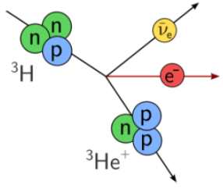
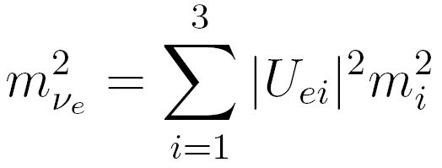
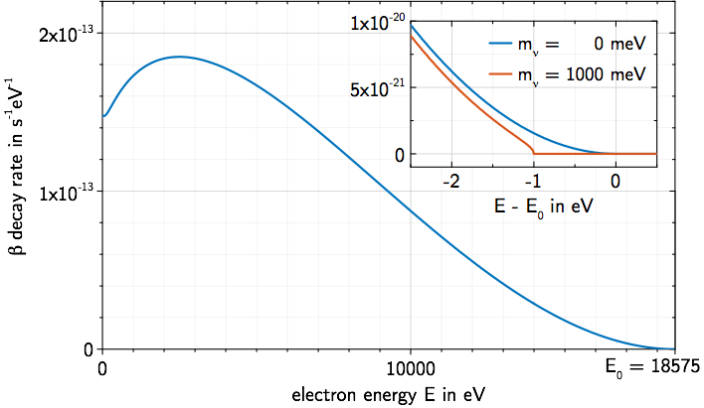
Neutrino mass and single β-decay
Fermi theory of β-decay:
β-decay: n → p + e⁻ + ν_{e}
Neutrino mass influences energy spectrum of
β-decay electrons
Neutrino mass determination via precise measurement of the spectral shape close to the endpoint
Model independent method
β-spectrum for tritium (E₀ = 18.6 keV, T_{1/2} = 12.3 y):

Slide 6
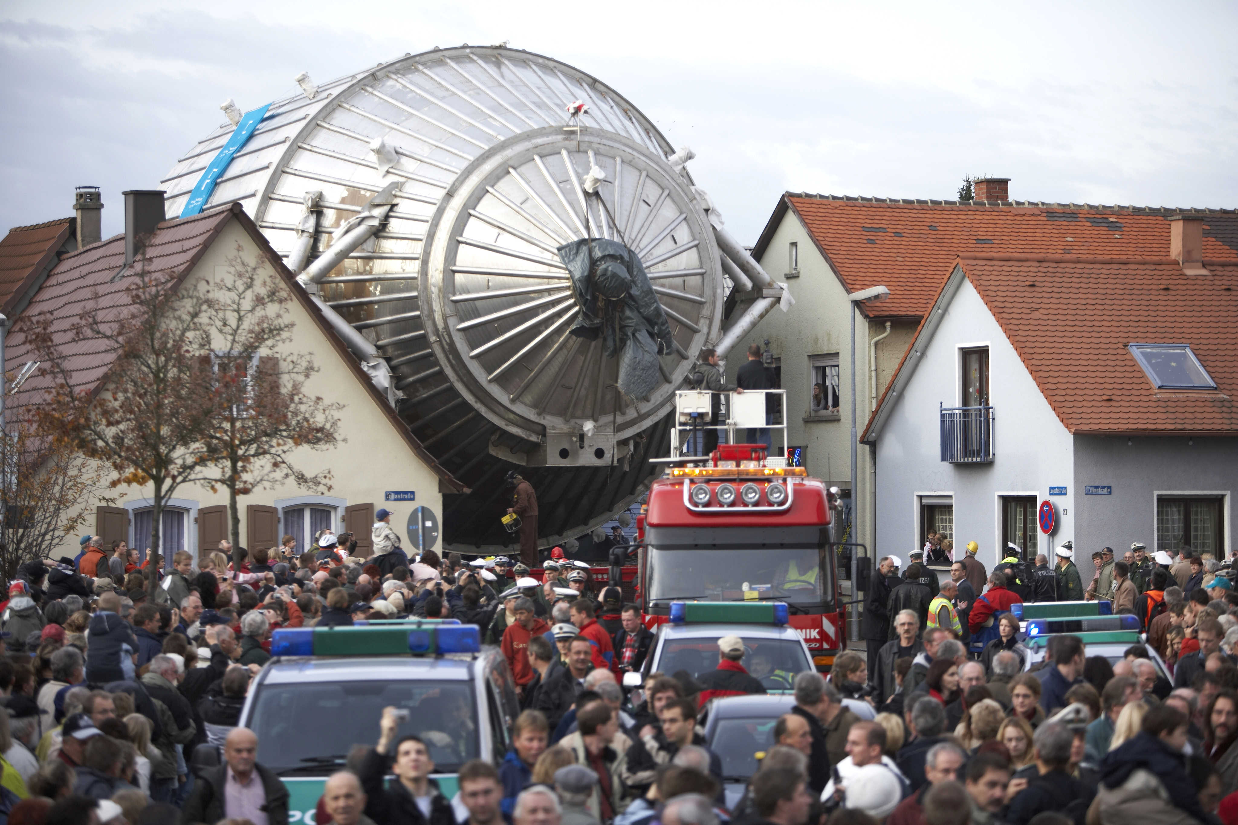


Slide 7

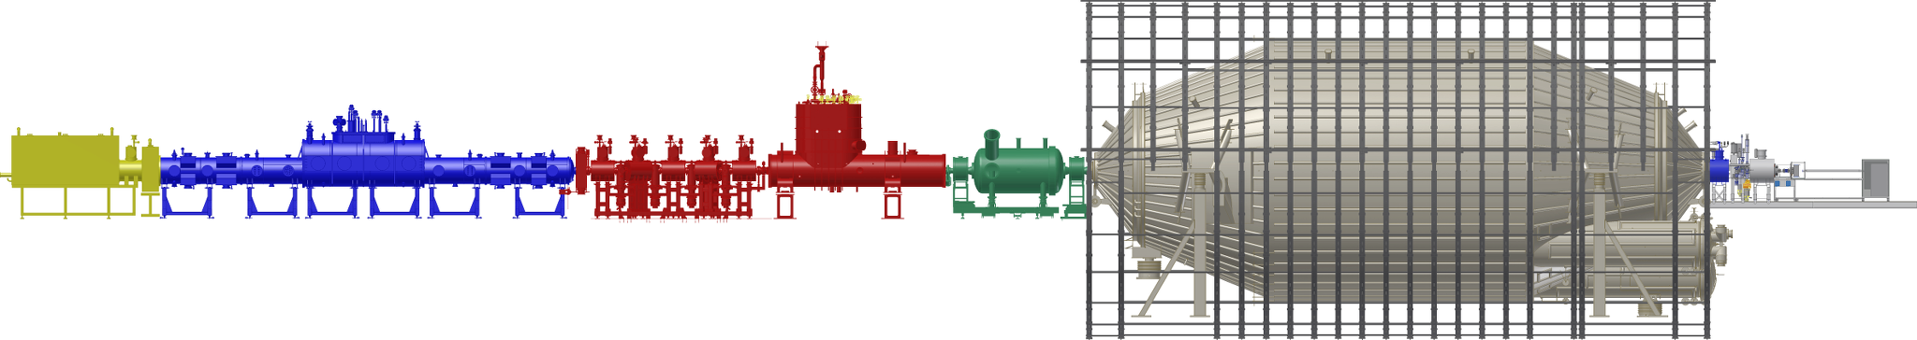
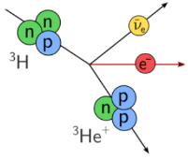
The KATRIN experiment
KArlsruhe TRItium Neutrino experiment
Goal: Measure neutrino mass with a sensitivity of 0.2 eV/c² (90% C.L.)
~ 70 m
Pre-Spectro-meter
Windowless Gaseous
Tritium Source
Differential and
Cryogenic Pumping
sections
Main Spectrometer
Detector
tritium β-decay
decay rate: 10¹¹ 1/s
T₂ pressure:
10⁻³ to 10⁻⁶ mbar
β-electron
transport
tritium retention
(factor > 10¹⁴)
energy analysis of β-electrons
resolution 0.93 eV @ 18.6 keV
pressure < 10⁻¹⁰ mbar
counting
of transmitted
β-electrons

Slide 8
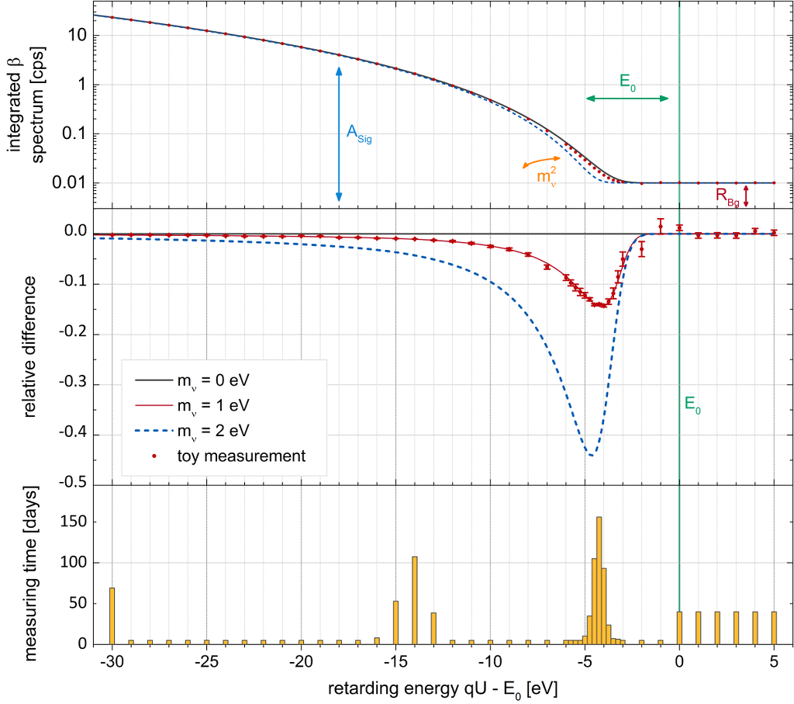
KATRIN measurement
KATRIN will measure the integrated
β-spectrum close to
the T₂ endpoint E₀
The influence of m_{ν} is most pronounced a few eV below E₀
Optimized measurement time distribution to increase sensitivity

Slide 9

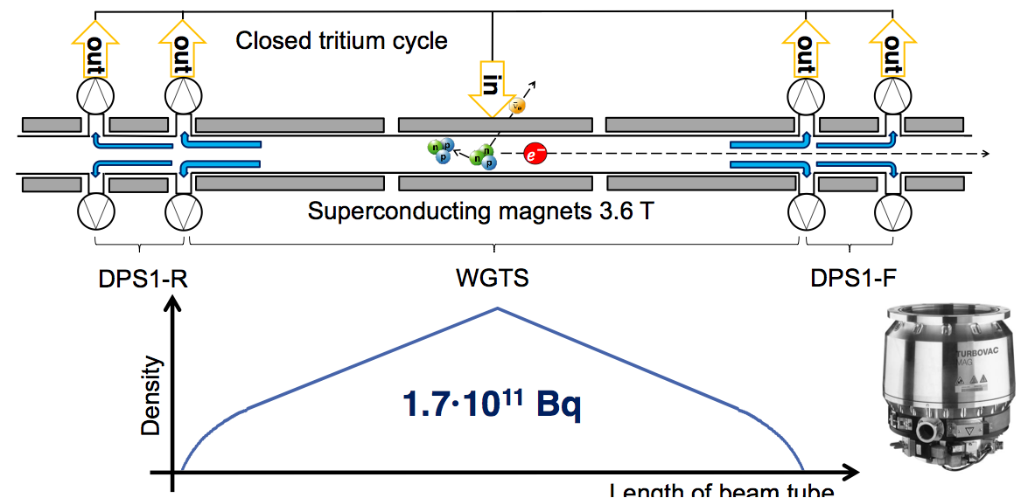
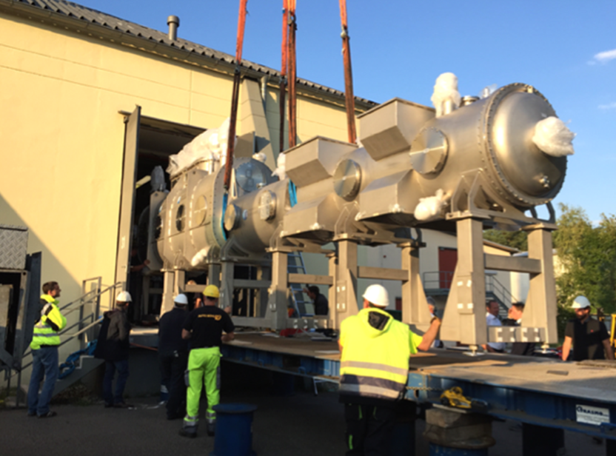
Gaseous Tritium Source
WGTS
Purpose: delivery of 10¹¹ β-decay electrons per second
September 10th, 2015
Stability of T₂ density profile of 10⁻³ (function of T₂ injection rate, purity, beamtube temperature stability and homogeneity, pump rate)
Complex cryostat, 16 m length, 27 t weight, > 800 sensors and valves
High isotopic purity (> 95%)
Tritium loop processes 40 g T₂ / day (same scale as ITER)

Slide 10
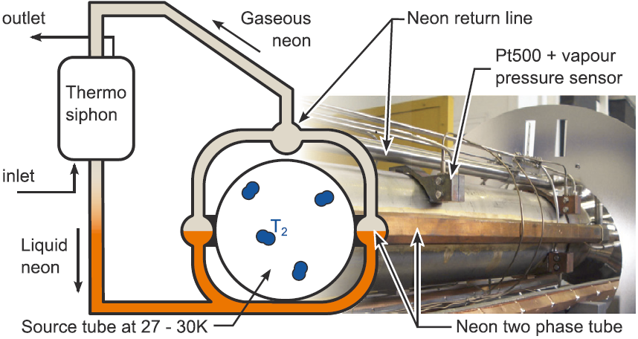
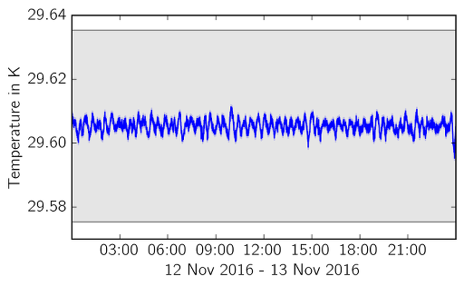
Gaseous Tritium Source
WGTS
Successful commissioning of magnet system at maximum field (3.6 T)
Test of two phase beam tube cooling system: temperature stability exceeds requirements by one order of magnitude!
preliminary
specification: ± 30 mK/h

Slide 11
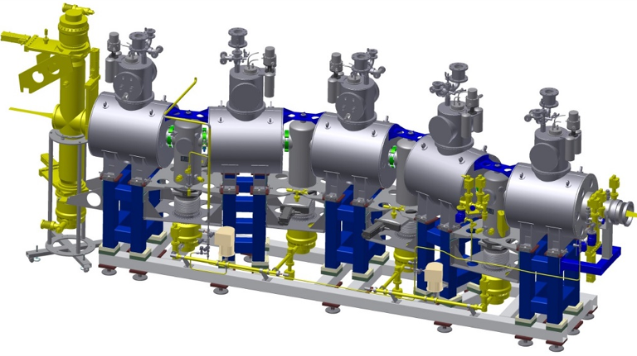
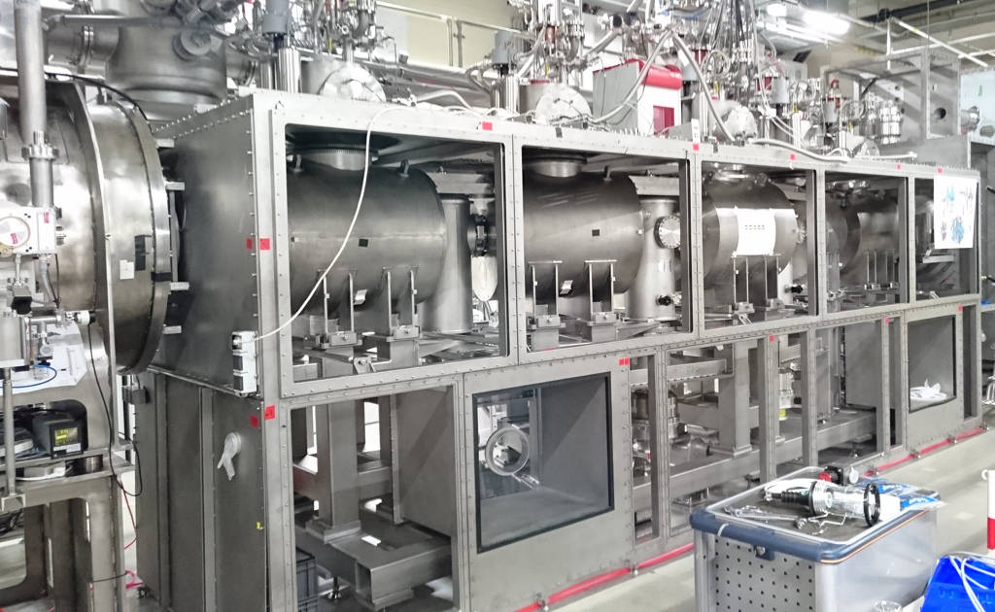
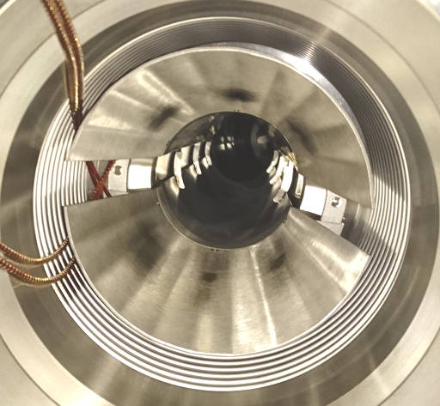
Differential pumping section
DPS
Purpose: reduce T₂ flux (10⁵) and magnetically guide β-decay electrons
Differential pumping of T₂ by turbomolecular pumps (TMPs)
Electric dipole electrodes for removal of positive ions
Magnet system and beamline successfully tested

Slide 12
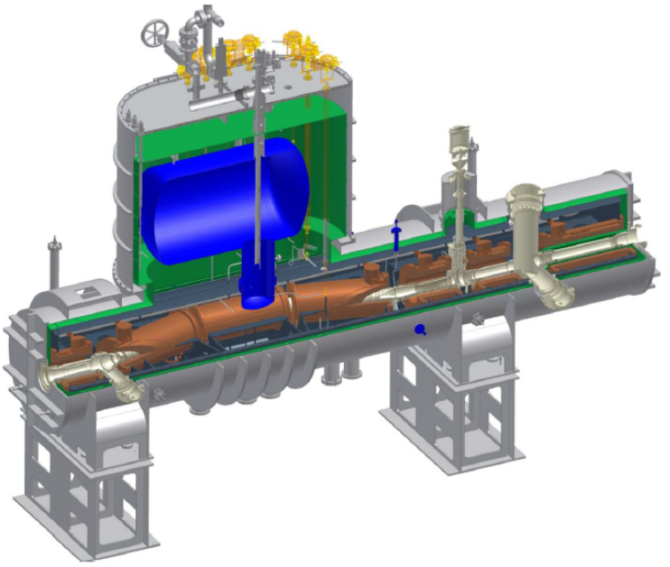
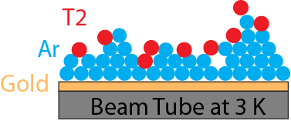
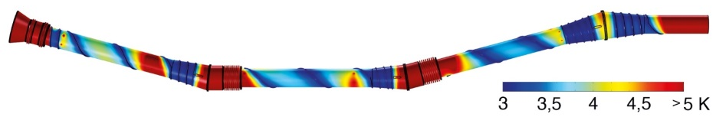
Cryogenic pumping section
CPS
Purpose: reduce T₂ flux (10⁷) and magnetically guide β-decay electrons
condensed crypton source
simulated temperature profile
forward
beam monitor
Cryosorption of T₂ on argon frost layer
Beam tube successfully cooled to 3K, simulations predict T₂ reduction of < 10⁹
CPS instrumented with ^{83m}Kr calibration source and β-activity monitor
Status: gas flow reduction measurements with deuterium and cold system ongoing, first preparation of argon frost layer end of November

Slide 13
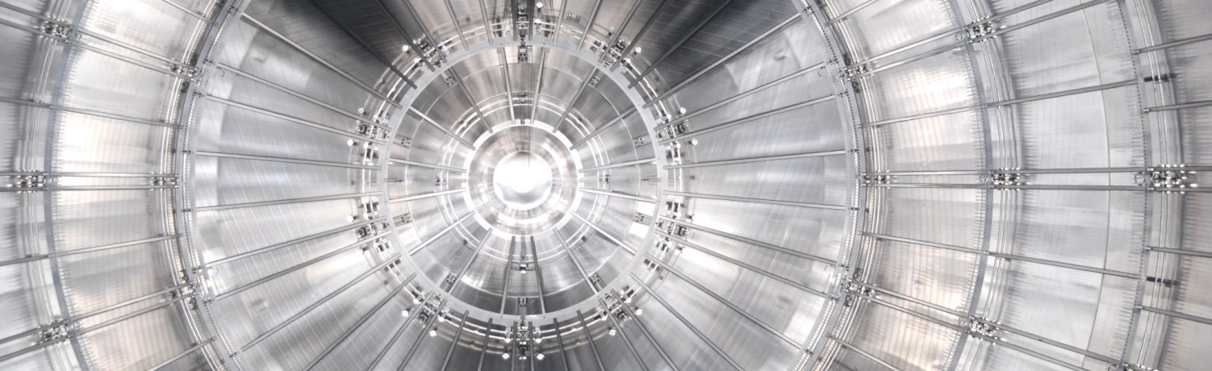
Main spectrometer
MS
Purpose: energy analysis of β-decay electrons (ΔE = 0.93 eV @ 18.6 keV)
Spectrometer mass 200 t, volume 1240 m³, inner surface 689.6 m²
Pressure ~ 10⁻¹¹ mbar
Inner wire electrode system for fine-tuning of retarding potential
Stable HV system (1 ppm @ -18.6 kV), variable voltage to scan E₀ region

Slide 14
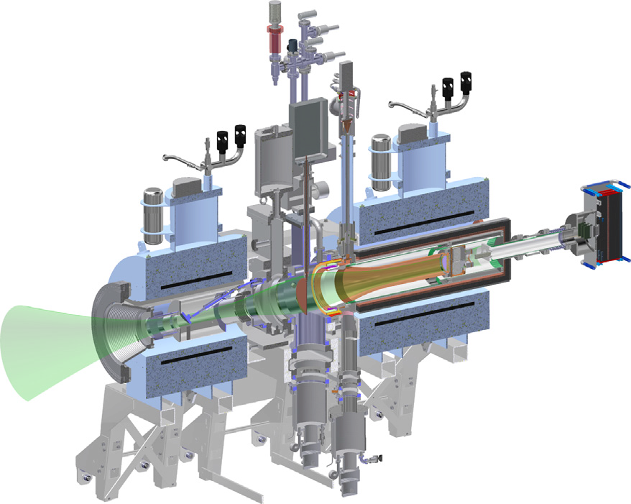
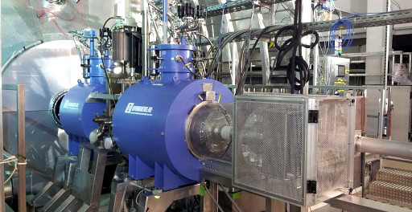
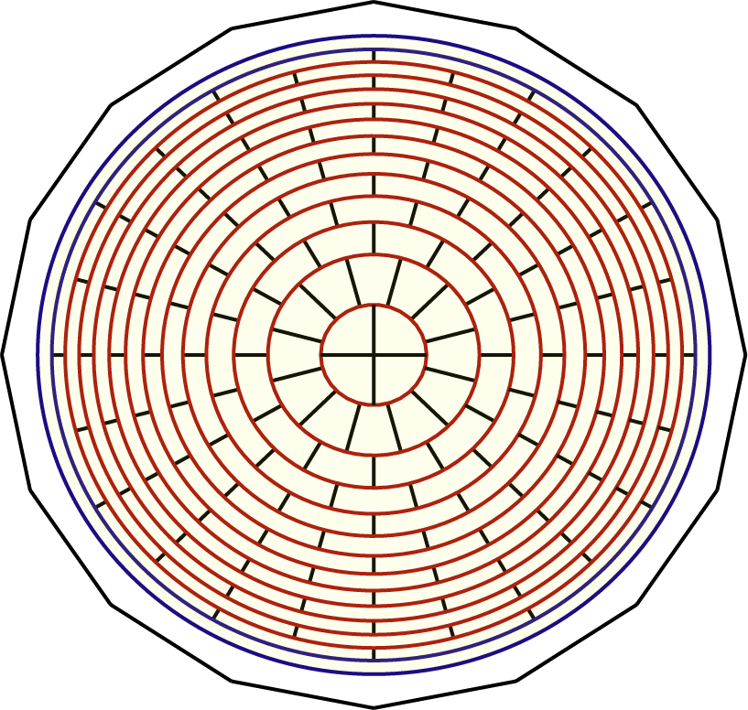
Focal plane detector
FPD
Purpose: counting transmitted β-decay electrons
detector magnet
3.6 – 6 T
pinch
magnet 6 T
90 mm
Segmented monolithic silicon PIN diode, 148 pixels (44 mm² each)
Energy resolution 1.4 keV (FWHM), dead layer ~ 100 nm
Post acceleration of electrons up to +10 kV
Muon veto and passive shield (Pb, Cu), background 1.2 mcps / keV

Slide 15
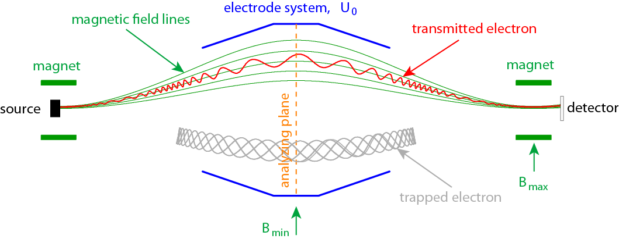
MAC-E filter
Magnetic Adiabatic Collimation combined with an Electrostatic Filter
Technique used by Mainz and Troitsk neutrino mass experiments
magnetic moment:
energy resolution:
Θ = 0°
Θ = 15°
Θ = 0 .. 90°
p_{e}
1
1
1
transmission
θ
B
0
0
0
qU₀
energy
qU₀
qU₀
qU₀+ΔE

Slide 16
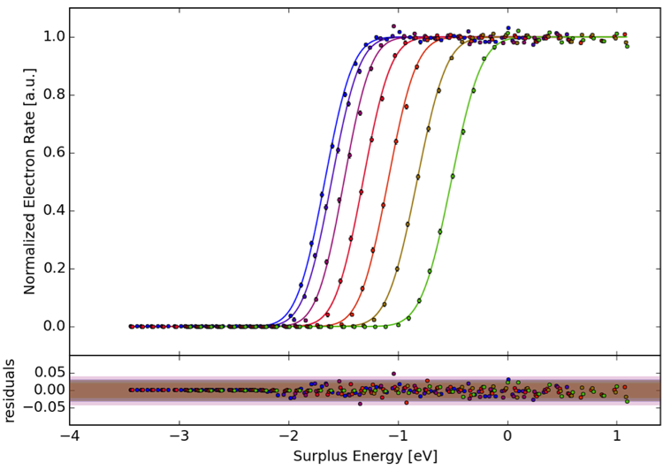
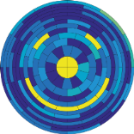
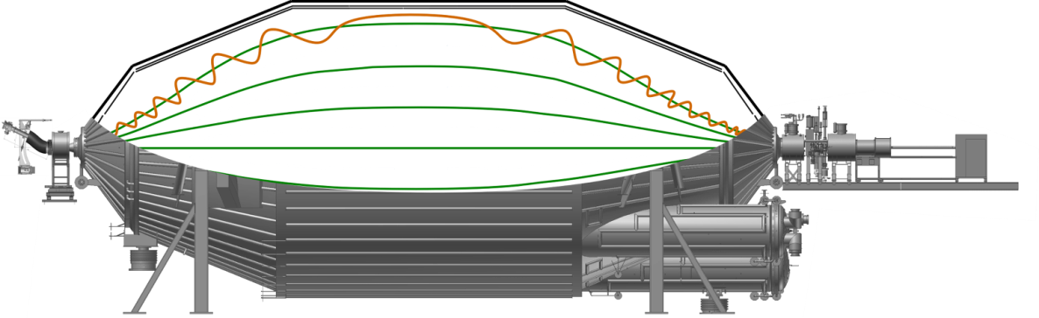
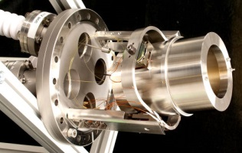
KATRIN – Spectrometer & Detector Section (SDS)
1
Angular selective
electron source
Main spectrometer
normalized rate
0
detector
-4
-3
-2
-1
0
1
surplus energy / eV
Several SDS commissioning measurement phases since autumn 2013
Main spectrometer successfully operated up to -33 kV
Successful operation of heating / cooling system (baking @ 200 °C)
Transmission characteristics of main spectrometer as expected
Detailed investigations of spectrometer backgrounds

Slide 17
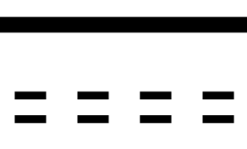
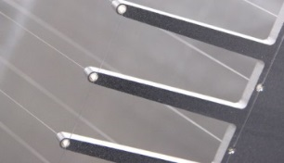
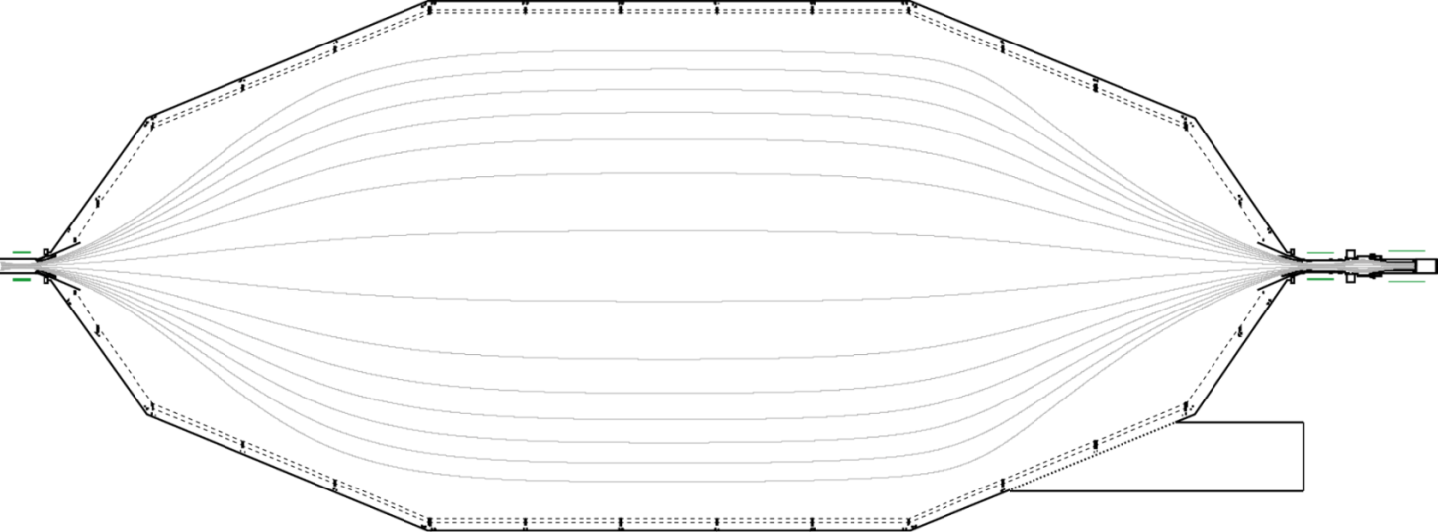
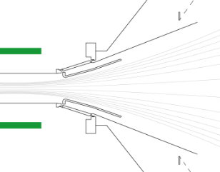

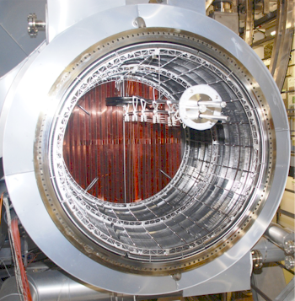
KATRIN backgrounds
²¹⁰Pb ~ 1 kBq
vessel
internal radioactivity
cosmic muons
µ
e
²¹⁰Pb, …
α
H
H*
H⁻
γ
NR
e
e
wire electrodes
BBR
field emission
e
H₂
FPD
Penning discharge
insulator processes
H⁺
e
e
UV
²¹⁹Rn
γ
baffle
⁴⁰K, … external radioactivity
Different processes can contribute to the spectrometer background
Several measurement phases were performed to investigate the background processes in detail

Slide 18
KATRIN backgrounds
²¹⁰Pb ~ 1 kBq
vessel
✓
cosmic muons
e
internal radioactivity
²¹⁰Pb, …
µ
H
H*
H⁻
α
γ
NR
e
e
wire electrodes
BBR
field emission
e
H₂
FPD
Penning discharge
insulator processes
H⁺
e
e
UV
²¹⁹Rn
γ
baffle
⁴⁰K, … external radioactivity
All previously known background processes are efficiently suppressed
Background rate about 50 times larger than design value (10 mcps), presumably due to ionization of Rydberg atoms by black body radiation
KATRIN sensitivity limited by backgrounds

Slide 19
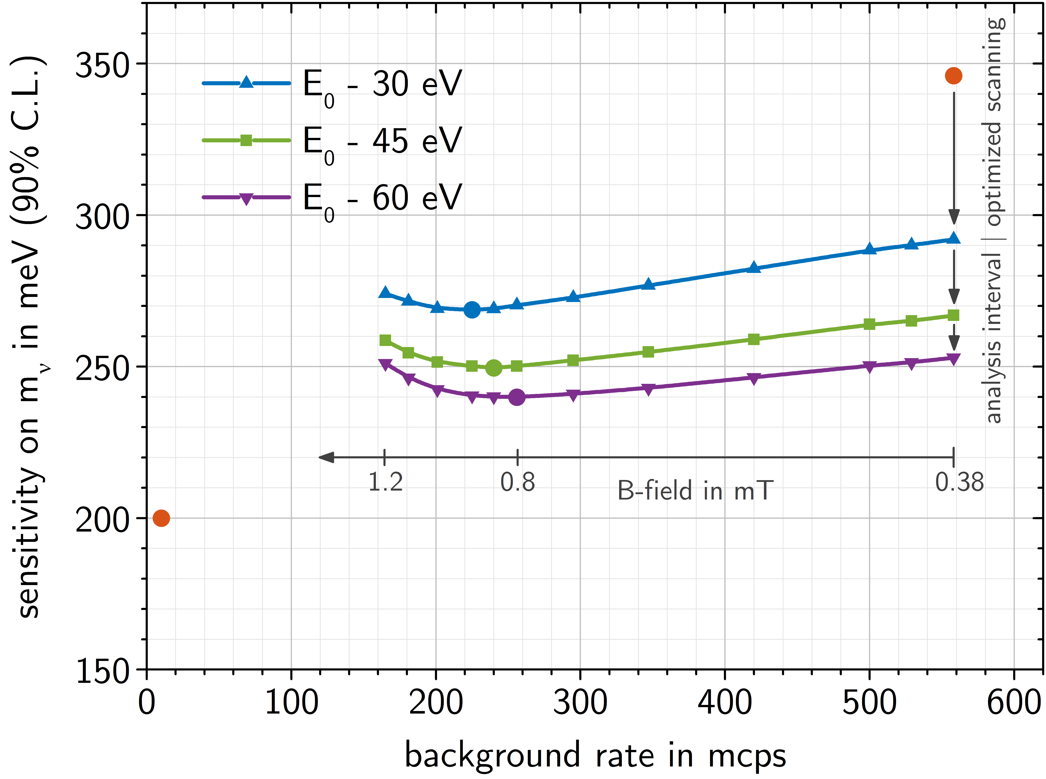
KATRIN background & sensitivity
558 mcps
non-optimized
~240 meV
ΔE ~ 2.5 eV
TDR 2004
optimized for
10 mcps
KATRIN sensitivity limited by backgrounds

Slide 20

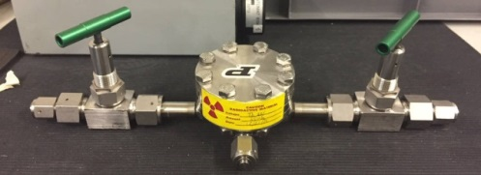

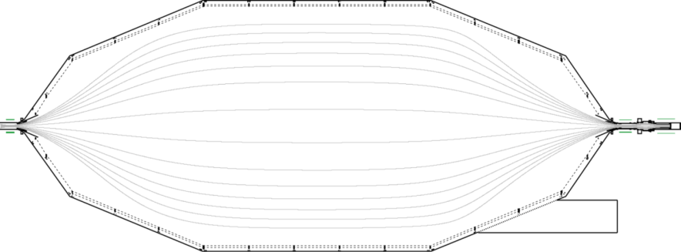
KATRIN backgrounds – Rydberg model test
Attach ²²⁸Th source to main spectrometer
“Contaminate” inner surface with ²¹²Pb
Close valve to ²²⁸Th source and check for exponentially decaying background rate
21.3 kBq
²²⁰Rn
²²⁸Th
²¹⁶Po
²¹²Pb
α, 9.0 MeV
β⁻, 2.3 MeV (64%)
²¹²Po
α, 5.5 MeV
α, 6.4 MeV
β⁻, 331 keV
α, 6.2 MeV (36%)
T_{1/2} = 0.3µs
²²⁸Th
²²⁰Rn
²¹²Pb
²¹²Bi
²⁰⁸Pb
T_{1/2} = 1.9yr
T_{1/2} = 56s
T_{1/2} = 10.6h
T_{1/2} = 1h
β, 5.0 MeV
stable
²⁰⁸Tl
T_{1/2} = 183s

Slide 21
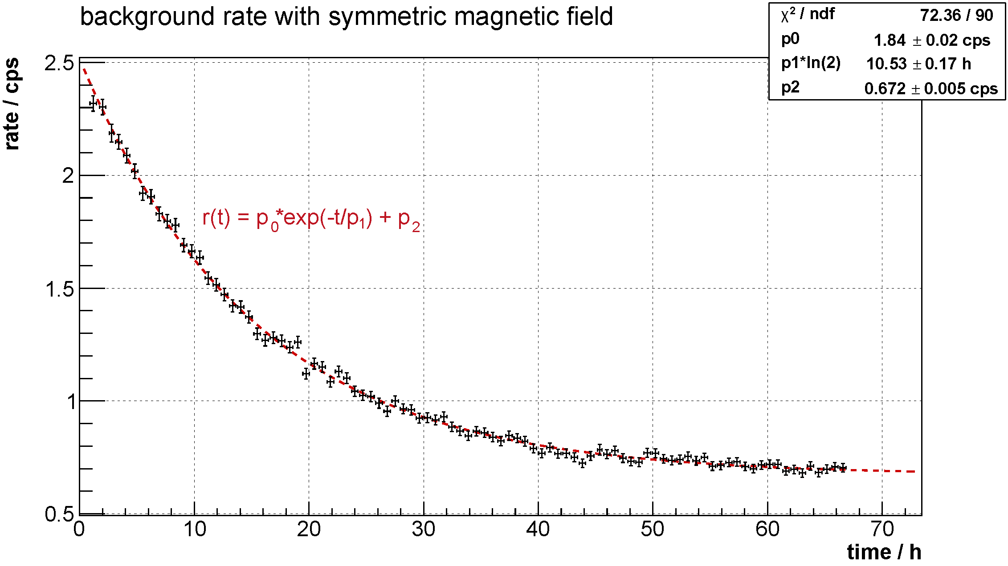
KATRIN backgrounds – Rydberg model test
background reference
0.6 cps
Observed half-life matches ²¹²Pb literature value of 10.64 ± 0.01 very well
Assuming similar processes, ²¹⁰Pb contamination < 5.1 kBq

Slide 22

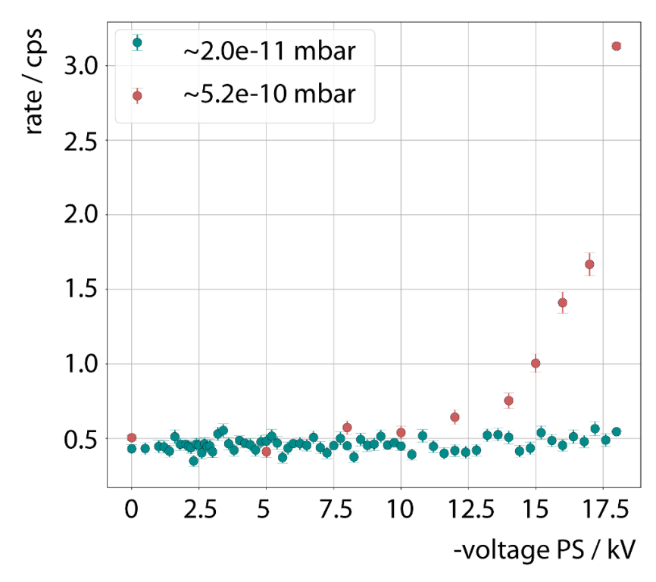
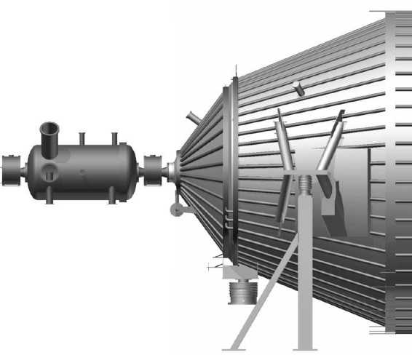
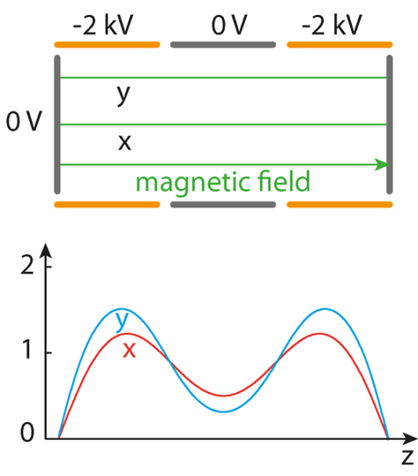

KATRIN backgrounds – Penning trap
preliminary
-18.3 kV
GND
-18.6 kV
PS2
Penning trap between spectrometers, strong Penning discharge observed before baking of spectrometers
At low pressure after baking no indication of Penning discharge

Slide 23
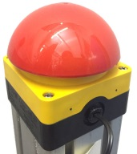
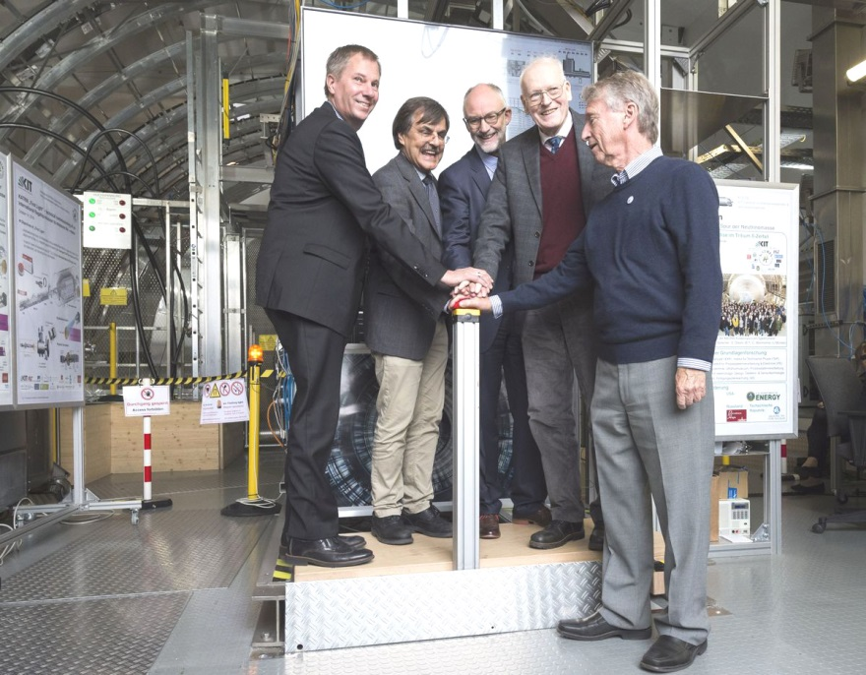








October 14th, 2016 – KATRIN first light
Experiment to Weigh 'Ghost Particles' Starts in Germany
KATRIN celebrates first beam
Experimente zum Wiegen von Neutrinos starten in Karlsruhe
Neutrinos kommen auf die Waage
Experiment starts to find weight of 'ghost particles'
The KATRIN Tritium Neutrino experiment: A giant scale for the tiniest of particles
Forscher geben Startschuss zum Wiegen von Geisterteilchen
Neutrino Mass: Germany’s KATRIN Experiment Aims To Weigh The Universe’s Lightest Particle
Neutrinos auf der Waage

Slide 24
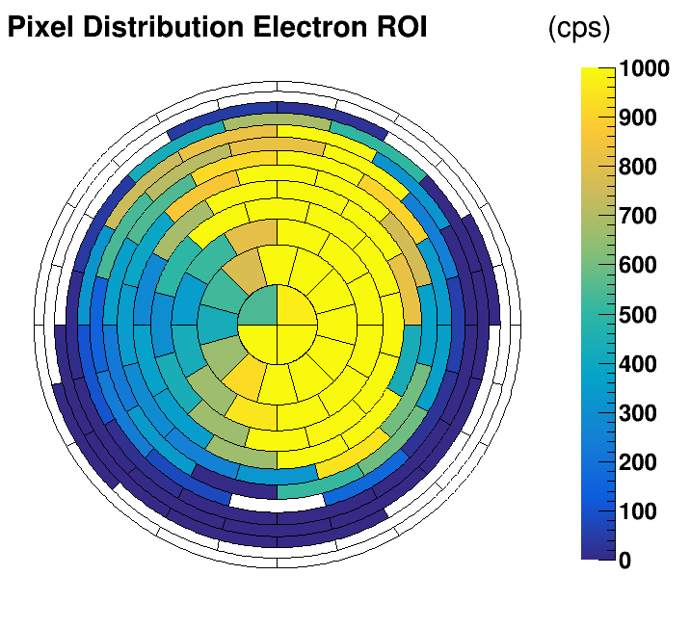
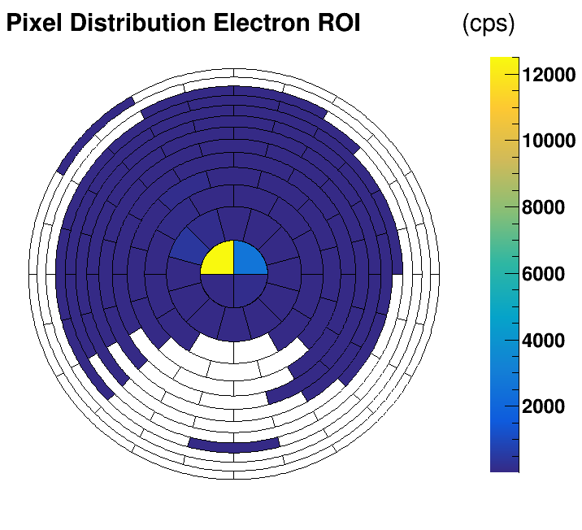
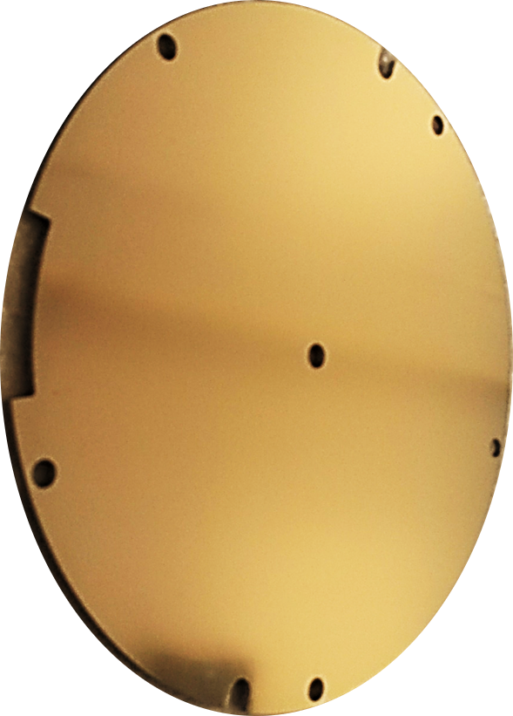
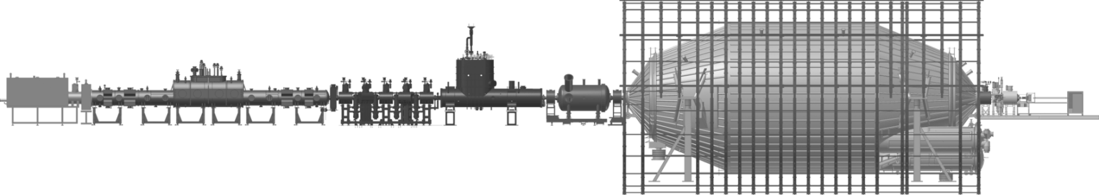
KATRIN first light – alignment
rear wall electron beam
pencil
electron beam
rear wall
electron beam
pencil electron beam from
ion source
90 mm
5 mm
electron sources
detector
61 087 mm
KATRIN beamline is aligned and in good agreement with simulations
Unobstructed transport of 191 Tcm² flux tube from source to detector

Slide 25
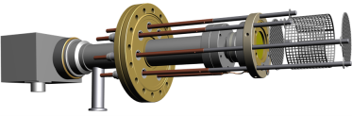


KATRIN first light – ion blocking
Tritium source produces an order of magnitude more positive ions than β-electrons
ELIOTT ion source produces positive
deuterium ions
MS used as ion detector
preliminary
BE PP5 | rate / cps
Off | 140 ± 2
On (375 V) | 0.9 ± 0.2
ELIOTT ion source
dipole electrodes
blocking electrodes
10⁷ ions/s
tritium: ~ 10¹² ions/s, ~ 10 kBq/s
Achieved ion suppression of > 10² with one blocking electrode (preliminary)

Slide 26
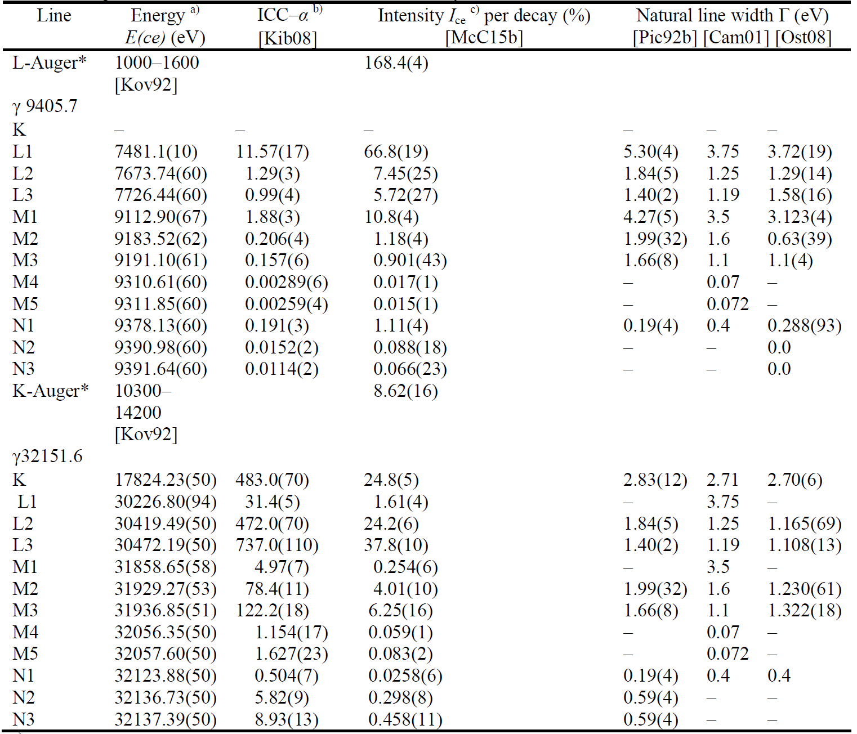
^{83m}Kr decay
^{83m}Kr
T_{1/2} 1.8 h
⁸³Rb
T_{1/2} 86.2 d
EC
41.6 keV
IC, γ
9.4 keV
IC, γ
stable
^{83m}Kr has well known lines from conversion electrons, for example K-32 (17.824 keV), L₃-32 (30.472 keV)

Slide 27
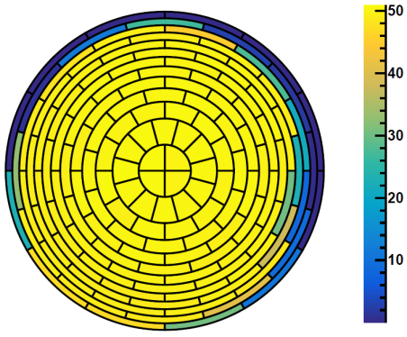
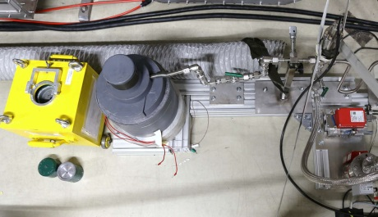
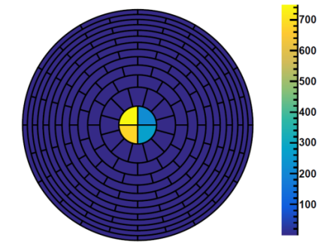

KATRIN krypton commissioning measurements
Production of ⁸³Rb at NPI cyclotron (51 MBq/h) using natural Kr gas target irradiated with protons, ⁸³Rb deposited in zeolite beads
Injection of ^{83m}Kr into the KATRIN source beamtube, no carrier gas
Measurement phase: July 3rd, 2017 – July 19th, 2017
gaseous ^{83m}Kr source
Kr decays inside
WGTS beamtube
⁸³Rb emanator ~ 1 GBq
⁸³Rb emanator
detector
condensed ^{83m}Kr source
“spot-like” source, can be scanned across flux tube
⁸³Rb emanator ~ 1 MBq
monitor spectrometer beamline
implanted ^{83m}Kr source
⁸³Rb activity ~ 2.5 MBq

Slide 28
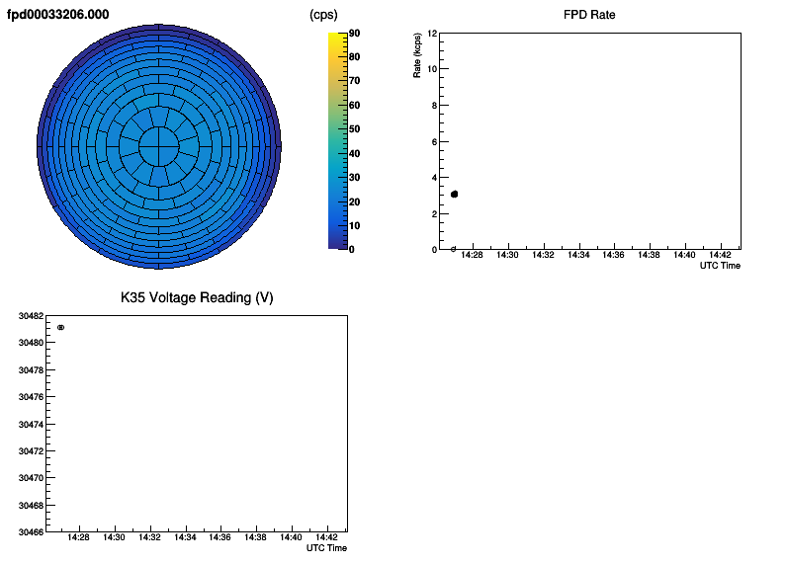
KATRIN krypton commissioning measurements
Measurement of the L₃-32 conversion electron line
The spectrometer retarding voltage is stepped in small increments (0.5V) to less negative values

Slide 29


KATRIN krypton commissioning measurements
L₃-32 line gaseous source
preliminary
stability gaseous source
preliminary
example run (one of many line scans)
only events on detector ring 0
(30x more statistics available)
repeated scans of L3-32 line
line position stability well within KATRIN goal of ± 60 meV

Slide 30



HV divider calibration
Measure retarding potential of -18.6 kV directly with precision voltmeter and precision HV divider.
Use difference of L₃-32 and K-32 lines with gaseous ^{83m}Kr source for absolute calibration, systematic effects due to ΔΦ and γ energies cancel out
2013 (PTB)
2017 (^{83m}Kr)
M = 1972.4531 (20)
M = 1972.453 (10)
preliminary
preliminary
L₃-32
K-32

Slide 31
KATRIN status & outlook
Elevated background limits KATRIN sensitivity to about 0.24 eV/c² but further background reduction measures being studied
Successful commissioning measurements with ^{83m}Kr , data analysis ongoing
Prepare KATRIN for tritium operation
Start of neutrino mass measurements in 2018
Official KATRIN inauguration on June 11th, 2018

Slide 32



















KATRIN collaboration
October 2017

Slide 33
xxx
Backup

Slide 34




HV divider calibration
  Calibration of HV dividers K35 & K65 with nuclear standard:
  → monoenergetic conversion electrons
  Monitor individual line position over measurement period of two months
  Use relative position of different lines to verify absolute calibration of HV dividers
  K-32 line
  E(ce) = 17824.23(50) eV
  E_{binding}(ce) = 14327.26(4) eV
  E_{recoil}(ce) = 0.120 eV
  L3-32 line
  E(ce) = 30472.19(50) eV
  E_{binding}(ce) = 1679.21(3) eV
  E_{recoil}(ce) = 0.207 eV
Energy of electrons:
Transmission condition:
$$E_{kin}=E_{γ}−E_{binding}+E_{γ}^{rec}−E_{ion}^{rec}$$
$$E_{kin}= − ∆Φ −q∆U + qU_{spec}$$
Energy of
$γ−$transition
Binding energy
Recoil energies
Work function difference source - spectrometer
Potential decrease in analyzing plane (≈2V)
$${q(U}_{spec}^{L3−32}−U_{spec}^{K−32})−q({∆U}_{L3−32}−{∆U}_{K−32}) =E_{binding}^{K−32}−E_{binding}^{L3−32}+E_{rec}^{K−32}−E_{rec}^{L3−32}$$
⇒ $M= \frac{{∆E}_{binding,rec,potential decrease}}{q∙{∆U}_{DVM}}=1972.453(10)$
Within uncertainties good agreement with PTB calibration in 2013!
$${M∙(U}_{DVM}^{L3−32}−U_{DVM}^{K−32})$$

Slide 35



Radon induced background
measurement
simulation
clustered events
“single” events
²¹⁹Rn emanates from NEG material in the pump ports
Electrons released in the Rn decay are magnetically trapped and create additional electrons via subsequent ionization of residual gas molecules
These electrons resemble the motion pattern of the trapped primary electron and create ring-shaped distributions at the detector

Slide 36



Radon background suppression
T6.6 J. Wolf
Radon analysis robust with respect to multiplicity cut
Radon is a major background source (about 50% of total background)
Radon activity suppression efficiency of three cold baffles is ${97{}_{−3}^{+2} }_{}^{ }$%

Slide 37




Cosmic muon induced background
Muon flux through main spectrometer surface about 10⁵ 1/s
Special magnetic field to guide electrons from vessel wall to detector
correlation plot
Only a fraction of 14.4 ± 0.7 % of secondary electrons are due to muons
(correlation coefficient 0.72 ± 0.06)

Slide 38



Rydberg atoms – selective field ionization
vessel
before baking
electric field
after baking
inner electrodes
Spectrometer baking improved background, but same behavior after baking
Rydberg atoms are ionized by the electric field between vessel and electrodes and hence can not reach the inner spectrometer volume

Slide 39


Rydberg atoms – BBR ionization
Spectrometer temperature was increased from 19°C to 43°C
Linear increase expected for large n
Most of background could be due to Rydberg atoms
G.W. Lehman, “Rate of ionisation of H and Na Rydberg atoms by black-body radiation”, J. Phys. B, 1983
slope (average): 0.79 ± 0.12
correlation factor: 0.6

Slide 40

²¹⁰Pb activity on inner spectrometer surface
α, 5.6 MeV
²²²Rn
T_{1/2} = 3.8d
²¹⁰Pb CE L
30.1 keV, 58 %
²¹⁰Pb CE M
42.5 keV, 14 %
β⁻, 17 keV (84%)
β⁻, 64 keV (16%)
²¹⁰Pb
T_{1/2} = 22.2yr
β⁻, 1.2 MeV
²¹⁰Bi
T_{1/2} = 5d
Characteristic ²¹⁰Pb peak(s) in energy spectrum
Measurements indicate a ²¹⁰Pb activity on order of kBq on inner spectrometer surface
α, 5.4 MeV
²¹⁰Po
T_{1/2} = 138d

Slide 41
xxx

