Slide 1
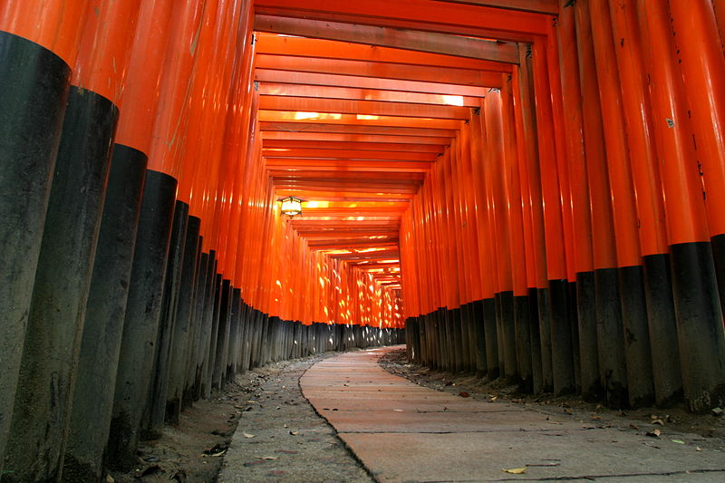
Towards CP Violation in ν Physics – Where Have We Been, Where Are We, and Where are We Going?
Praque Colloquium 2017
Nov. 3rd, 2017
Dave Wark
Oxford University/RAL

Slide 2
Where have we come during the Prague Colloquia?
This is the 4th Praque Colloquium in the “Towards CP Violation in ν Physics” series.
The first was in 2011, then 2013 and 2015.
Where were we in 2011?

Slide 3
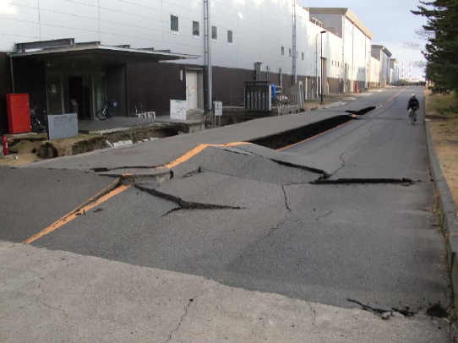
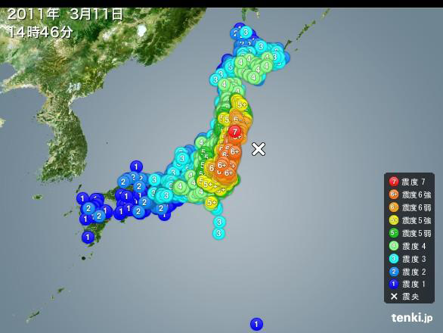
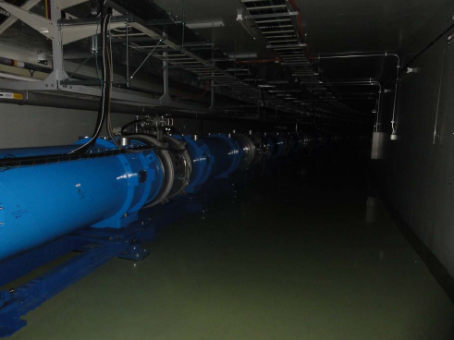
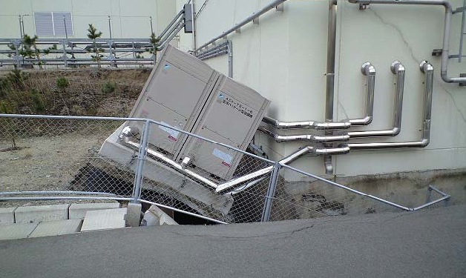
5/11, 14:46, all
Hell broke loose...
The outside world was giving us issues. . .

Slide 4
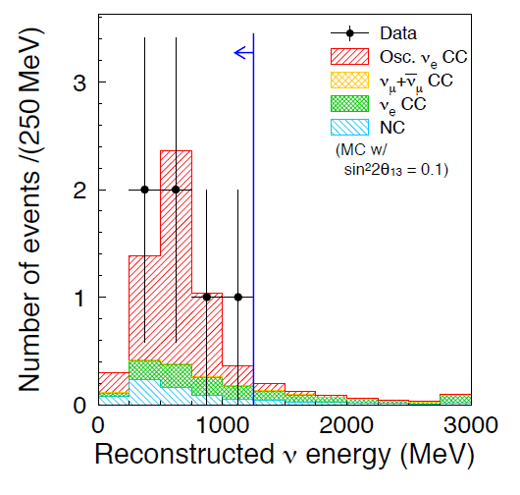
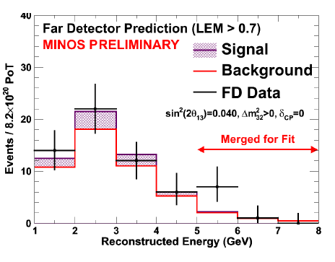

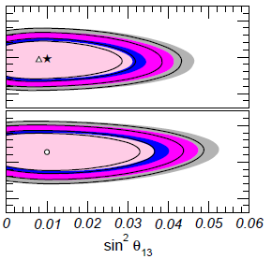

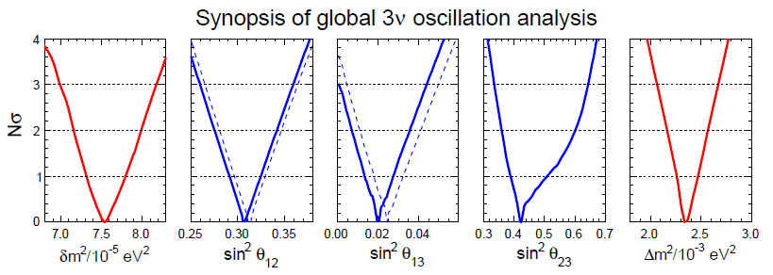
No CP info, just hints on θ₁₃
What about
θ₁₃?
T2K (2.5σ)
MINOS (1.7σ)
ν_{e} appearance, θ₁₃ > 0?
Interesting hints that
θ₁₃ > 0, but clearly
more data needed.

Slide 5

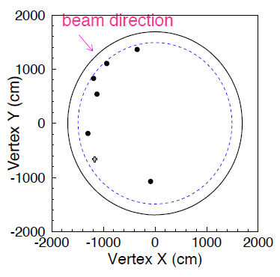
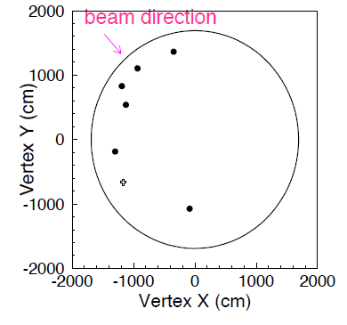
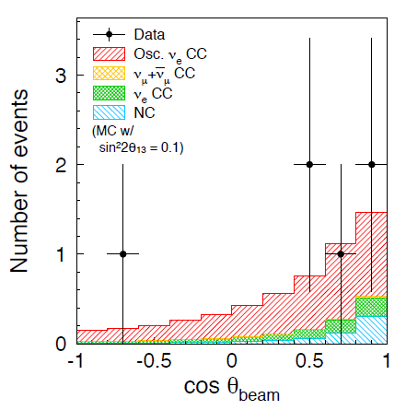
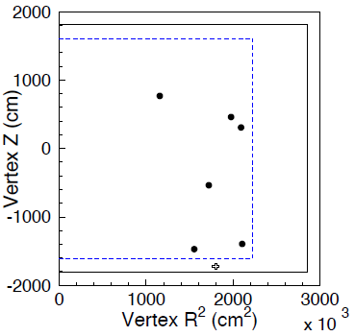
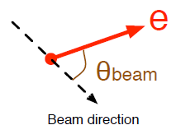
Check many distributions....
No excess outside FV or in OD,
but KS prob. for R² is ~3%
You win some...
We had our statistical oddities then as well. . .
You lose some.

Slide 6
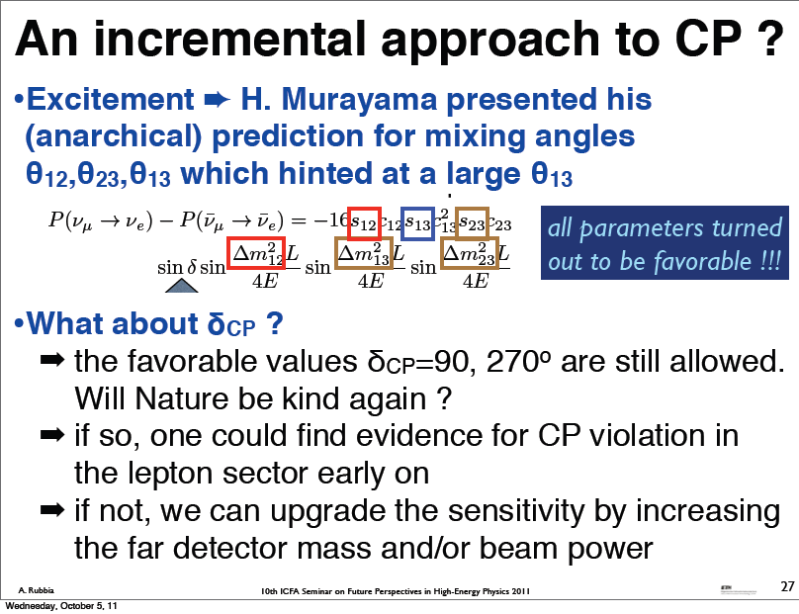
We had theorists leading us (astray?).

Slide 7
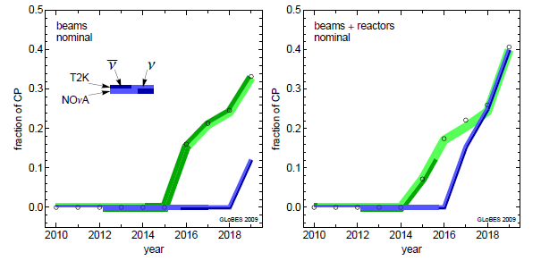
What will existing experiments yield?
Even some 90% CP violation sensitivity...
sin²2θ₁₃ = 0.1, NH
arXiv:0907.1896v1 [hep-ph] 10 Jul 2009

Slide 8
Where have we come during the Prague Colloquia?
This is the 4th Praque Colloquium in the “Towards CP Violation in ν Physics” series.
The first was in 2011, then 2013 and 2015.
Where were we in 2011?
Where were we in 2013?

Slide 9
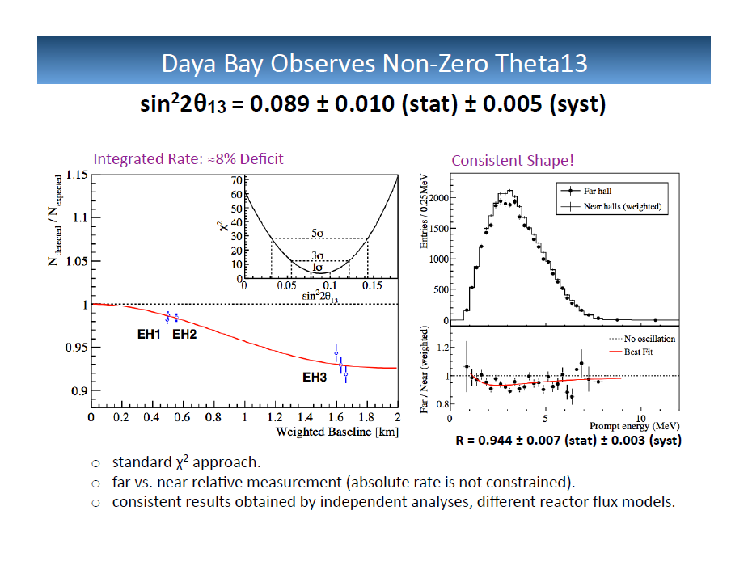
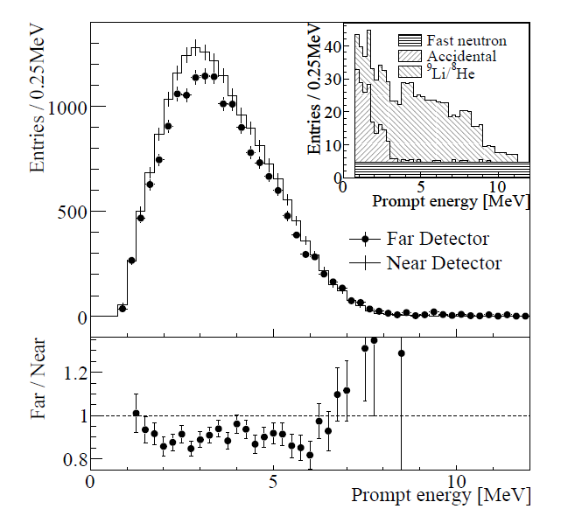
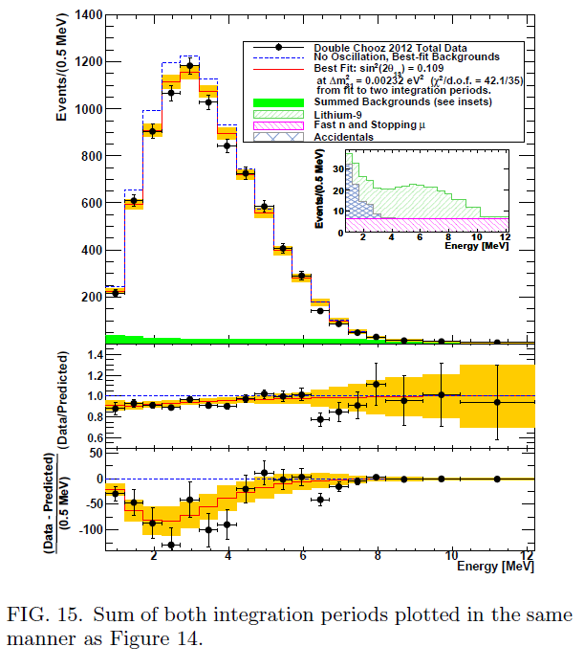
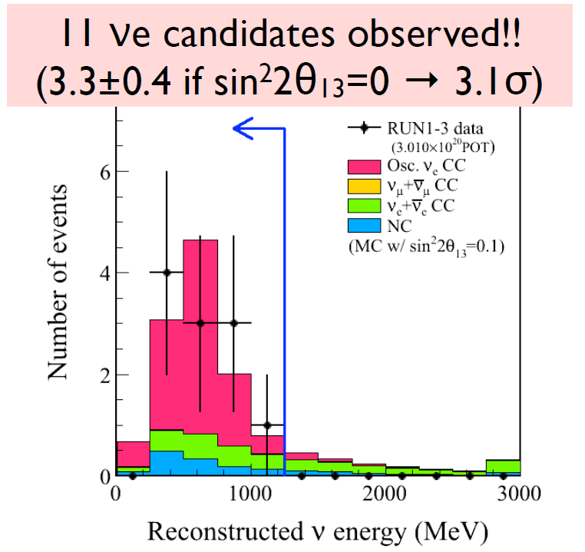
The Triumph of the Reactors!
Daya Bay
RENO
Semi-Double-Chooz
Hints of appearance had become evidence. . .
T2K

Slide 10
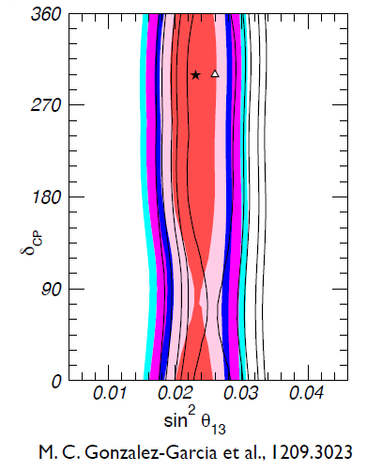
The Triumph of the Reactors!
Daya Bay
RENO
But no information on CP!
Semi-Double-Chooz
Hints of appearance had become evidence. . .
T2K

Slide 11
Where have we come during the Prague Colloquia?
This is the 4th Praque Colloquium in the “Towards CP Violation in ν Physics” series.
The first was in 2011, then 2013 and 2015.
Where were we in 2011?
Where were we in 2013?
Where were we in 2015?

Slide 12
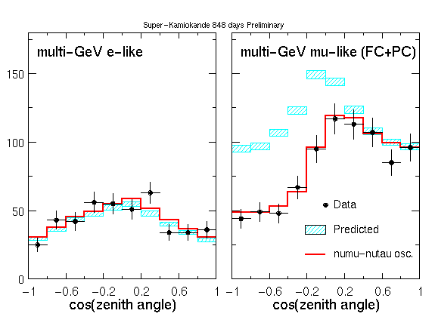
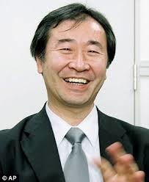
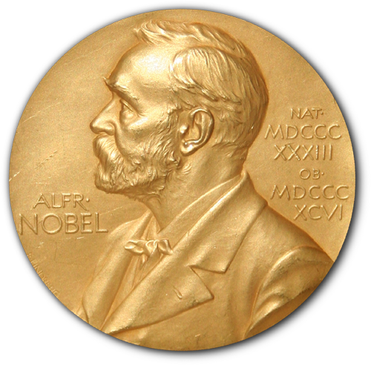
SK atmospheric ν data as a function of zenith angle

Slide 13
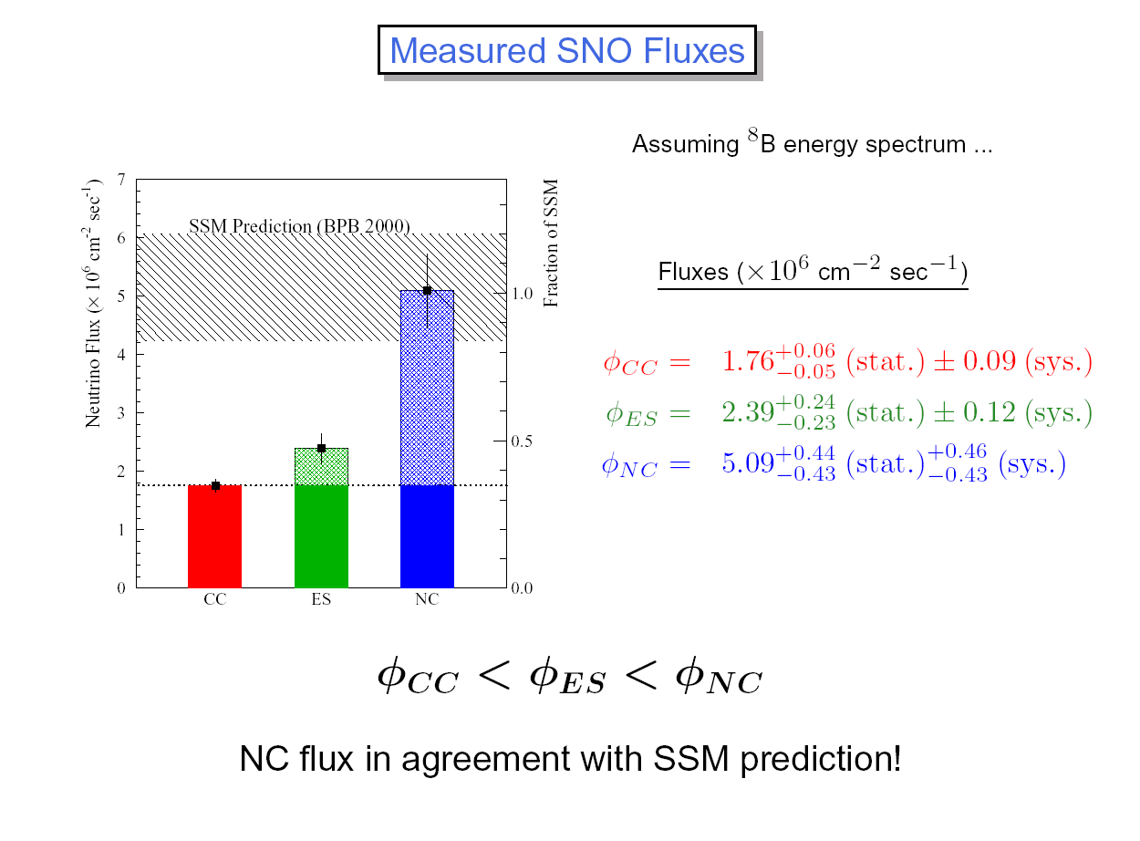


Slide 14
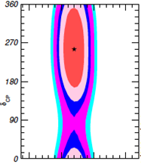
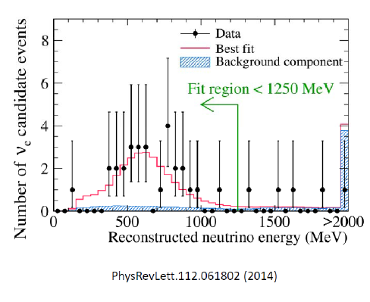
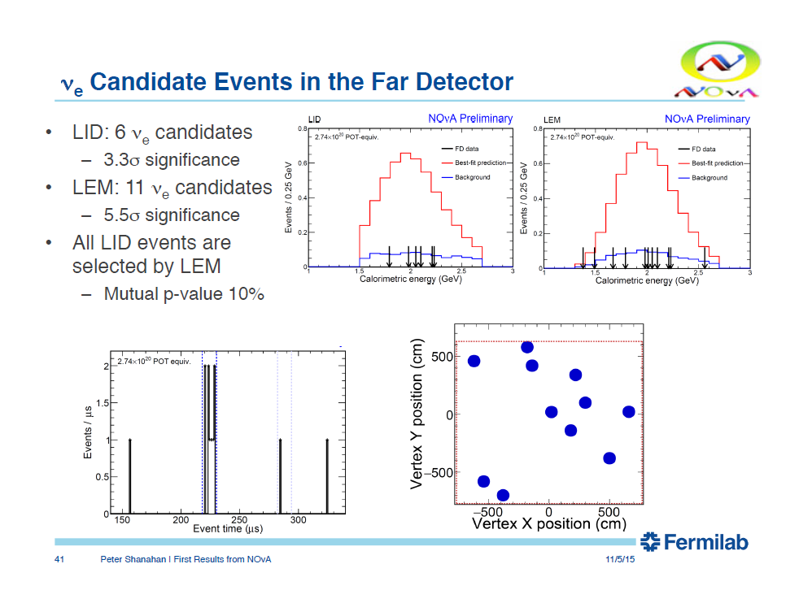
Evidence had become Proof !
T2K
Global fits give first
closed contours
for δ_{CP}. . .
NOvA
NOvA gives first results
with a consistent result on
appearance.

Slide 15
Where have we come during the Prague Colloquia?
This is the 4th Praque Colloquium in the “Towards CP Violation in ν Physics” series.
The first was in 2011, then 2013 and 2015.
Where were we in 2011?
Where were we in 2013?
Where were we in 2015?
Where are we in 2017?

Slide 16


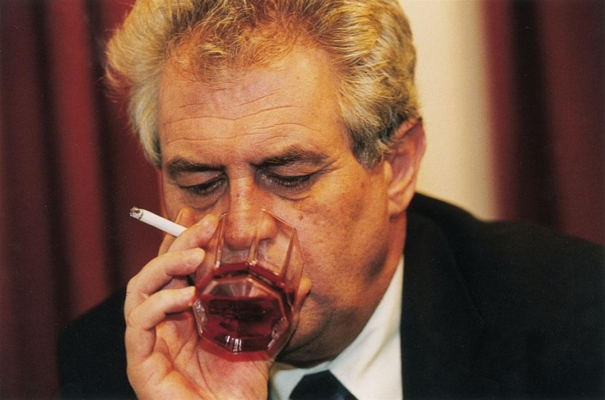
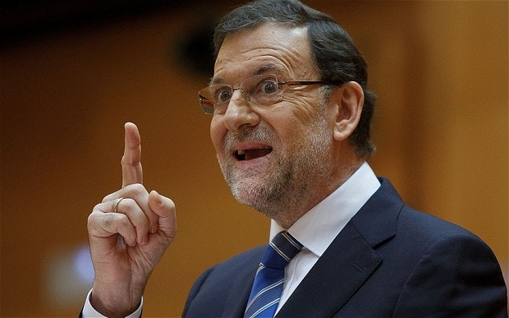
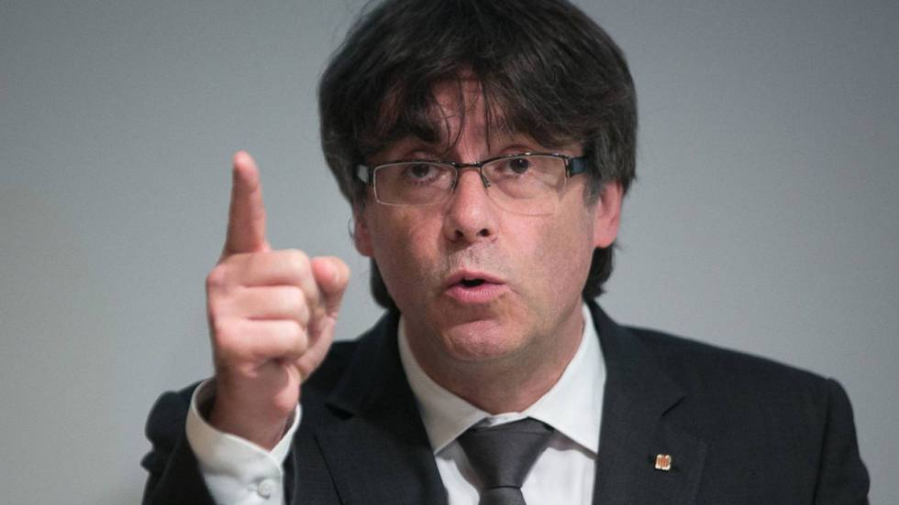
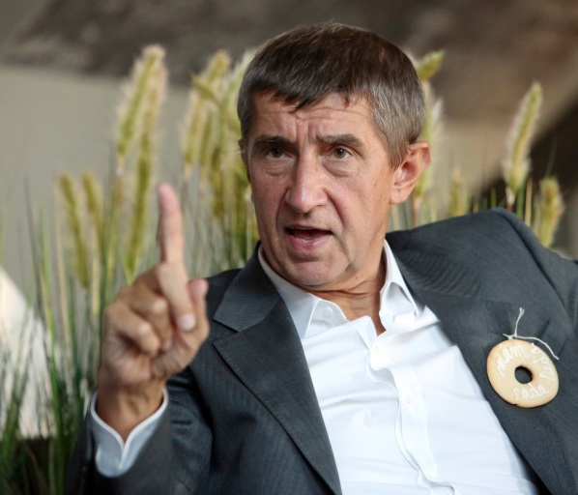
The outside world is still giving us issues. . .

Slide 17
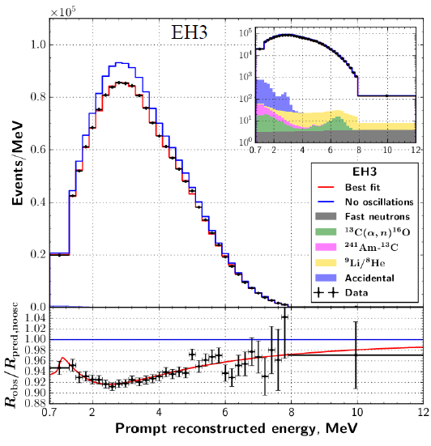
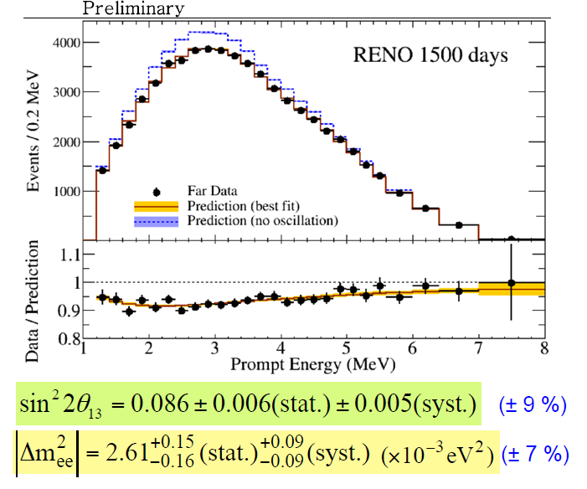
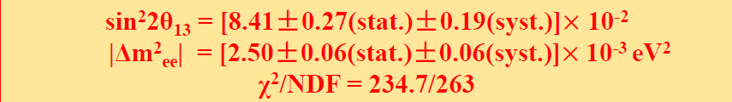
Beautiful new data from reactors. . .
Daya Bay
RENO

Slide 18
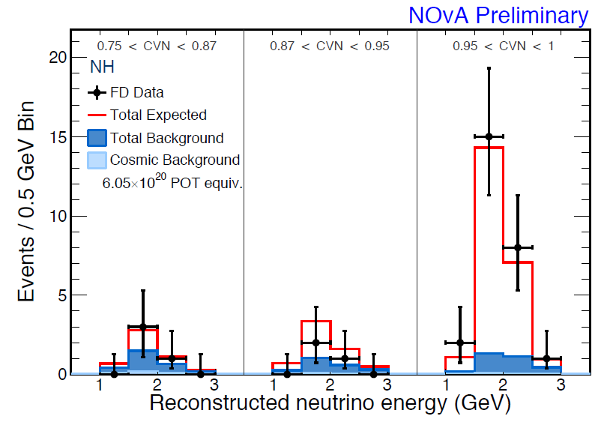
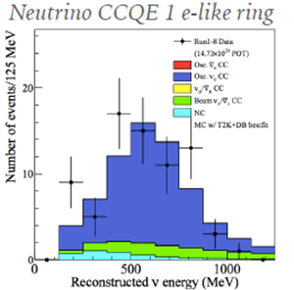
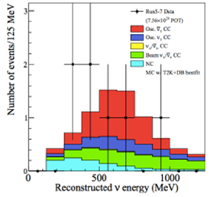
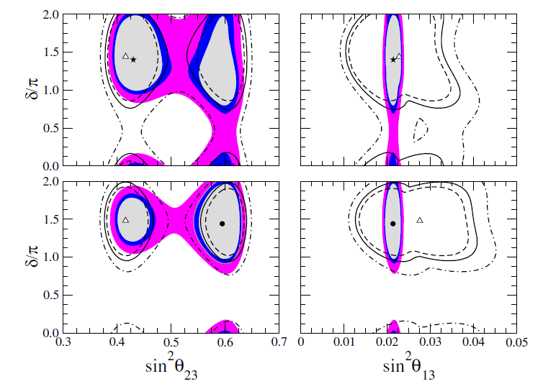
NOvA
And from accelerators. . .
T2K
CP Conservation is disfavoured!

Slide 19
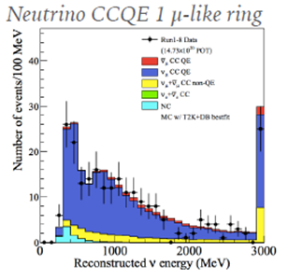
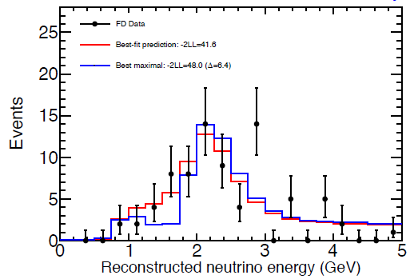
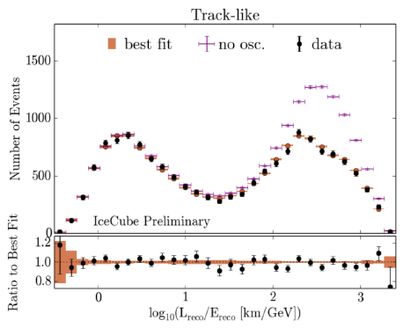
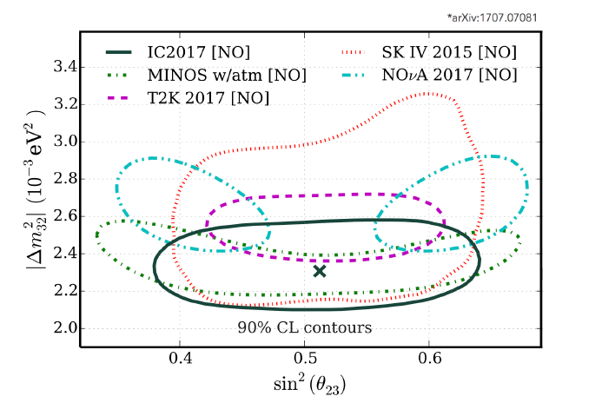
Disappearance in tension?
T2K
NOvA
IceCube
Statistics?
Neutrino Interactions?
Detector systematics?
New physics?

Slide 20
Where have we come during the Prague Colloquia?
This is the 4th Praque Colloquium in the “Towards CP Violation in ν Physics” series.
The first was in 2011, then 2013 and 2015.
Where were we in 2011?
Where were we in 2013?
Where were we in 2015?
Where are we in 2017?
Where are we going?

Slide 21
What will we have in future Prague Colloquia?
In 2019?
  KATRIN taking data!
  More information about steriles from reactors and sources – DANSS!
  More data from astrophysics.
  More 0νββ and 2νββ decay data from SuperNEMO, GERDA, COURE, XMASS, SNO+, and others.
  More data from T2K, NOvA, IceCube.
  Data from the proto-DUNEs.
  Hyper Kamiokande under construction?

Slide 22
What will we have in future Prague Colloquia?
In 2021(3)?
  JUNO taking data!
  Data from all the FNAL SNL detectors.
  Data from Phase 1 for IceCube.
  More data from all the others of the above.
In 2025(7)
  Determination of MH by JUNO.
  More data from all the others!
In 2027(9)?
  First data from DUNE.
  First data from Hyper Kamiokande.

Slide 23
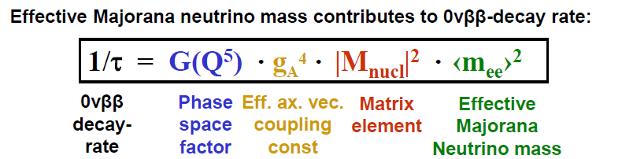
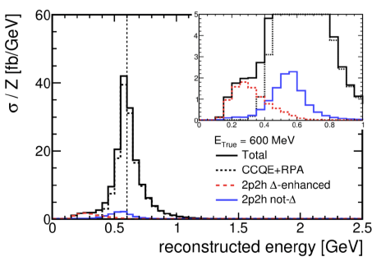
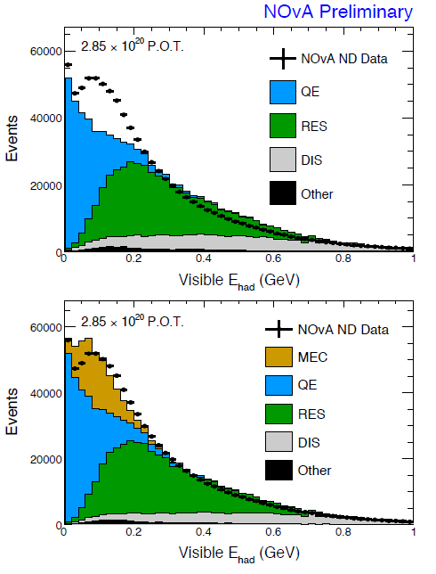
Three Issues I would like to raise (I).
We need help from nuclear theorists:
How do we get it?

Slide 24
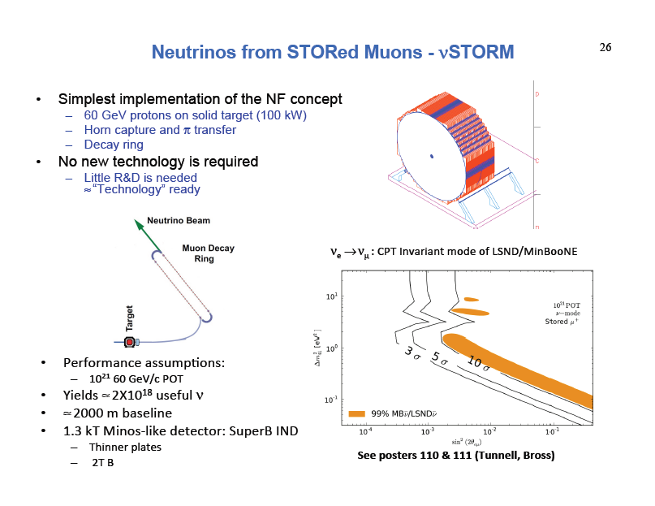
Three Issues I would like to raise (II).
The CERN Strategy Process is starting again.
We have raised the subject of NuSTORM at the colloquium before.
If we decide we need it in 2020, it will be too late!

Slide 25
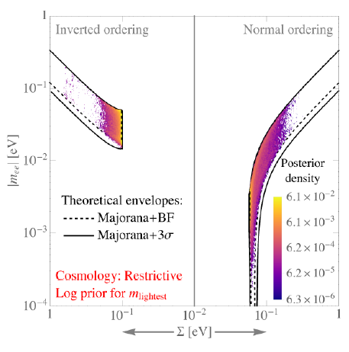
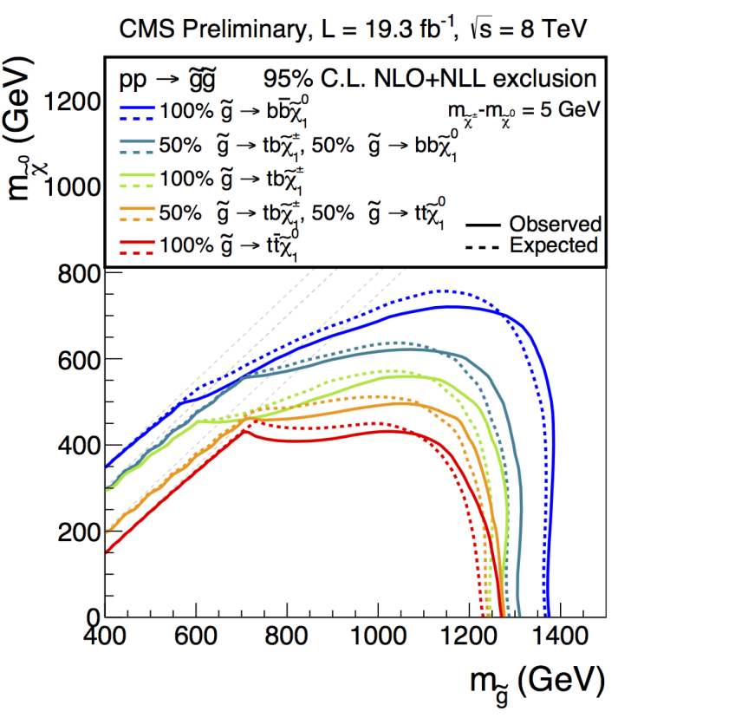
Three Issues I would like to raise (III).
Neutrino experiments suffer from a double-standard with respect to collider experiments!
We are told we should not spend
few X 10⁸$ for ton-scale ββ
experiments because of this.
But we can spend few X 10¹⁰$
To run/upgrade the LHC through
2040 despite this.

Slide 26
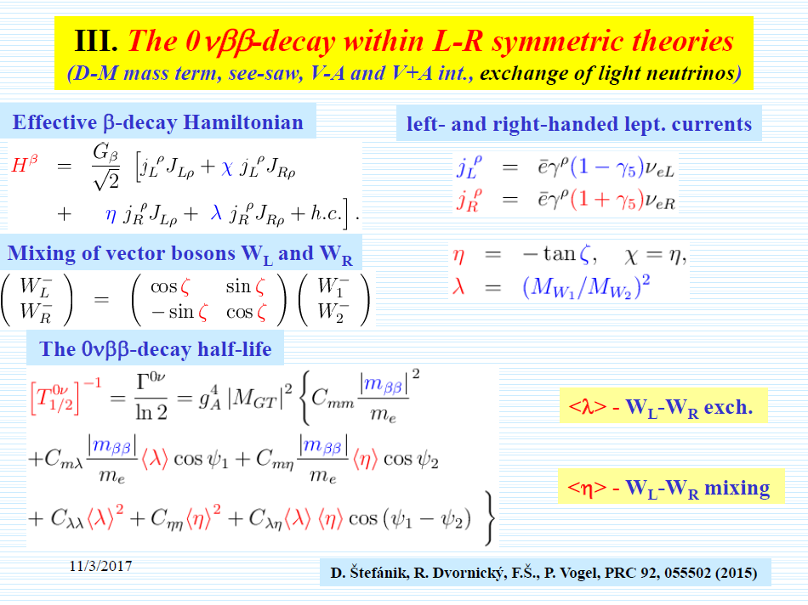
Three Issues I would like to raise (III).
We must keep pushing to find physics beyond the normal 3-ν paradigm.
Some theorists say that neutrinos are a poor place to search, but neutrinos give surprises!
What about the helicity problem?

Slide 27




Thanks to Rupert and Milos for
inviting us all and for the
wonderful organization…

