Slide 1
CRC Report
August 8, 2016
Jiri Chudoba
CRC shifter

Slide 2
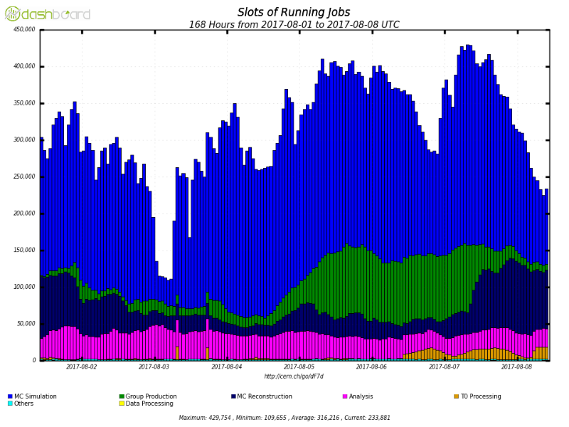
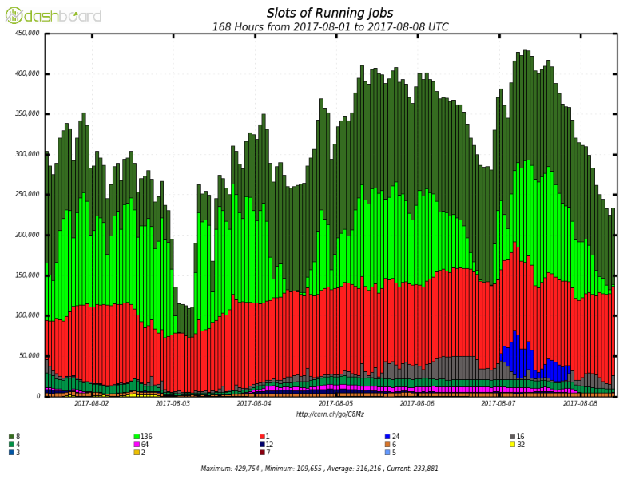
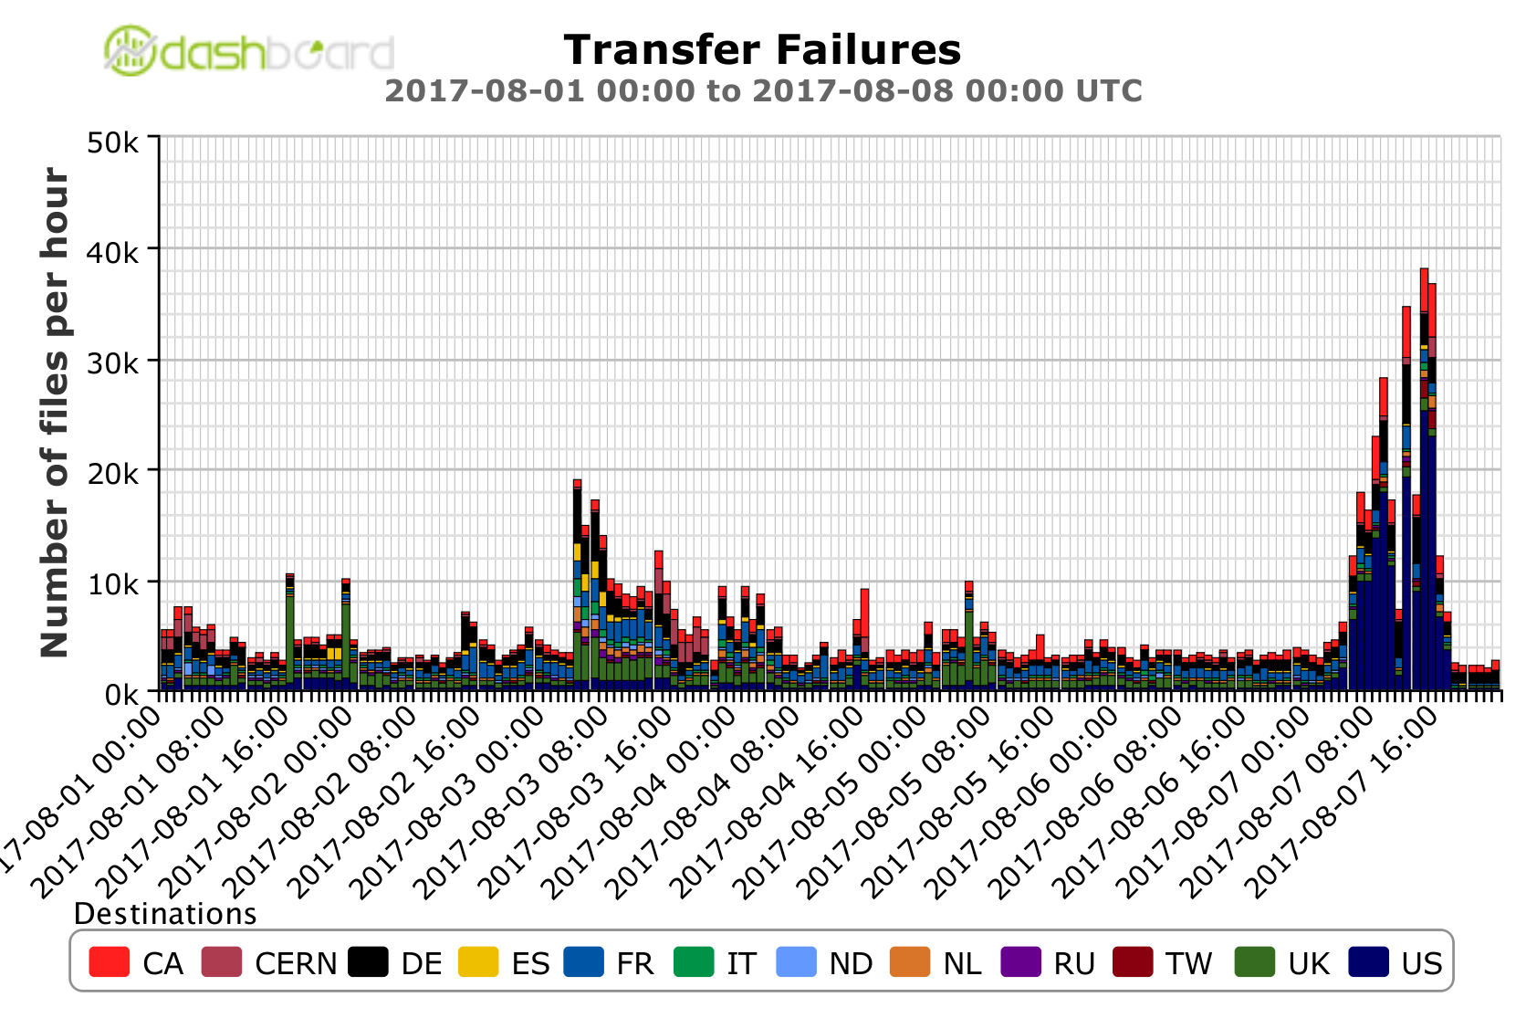
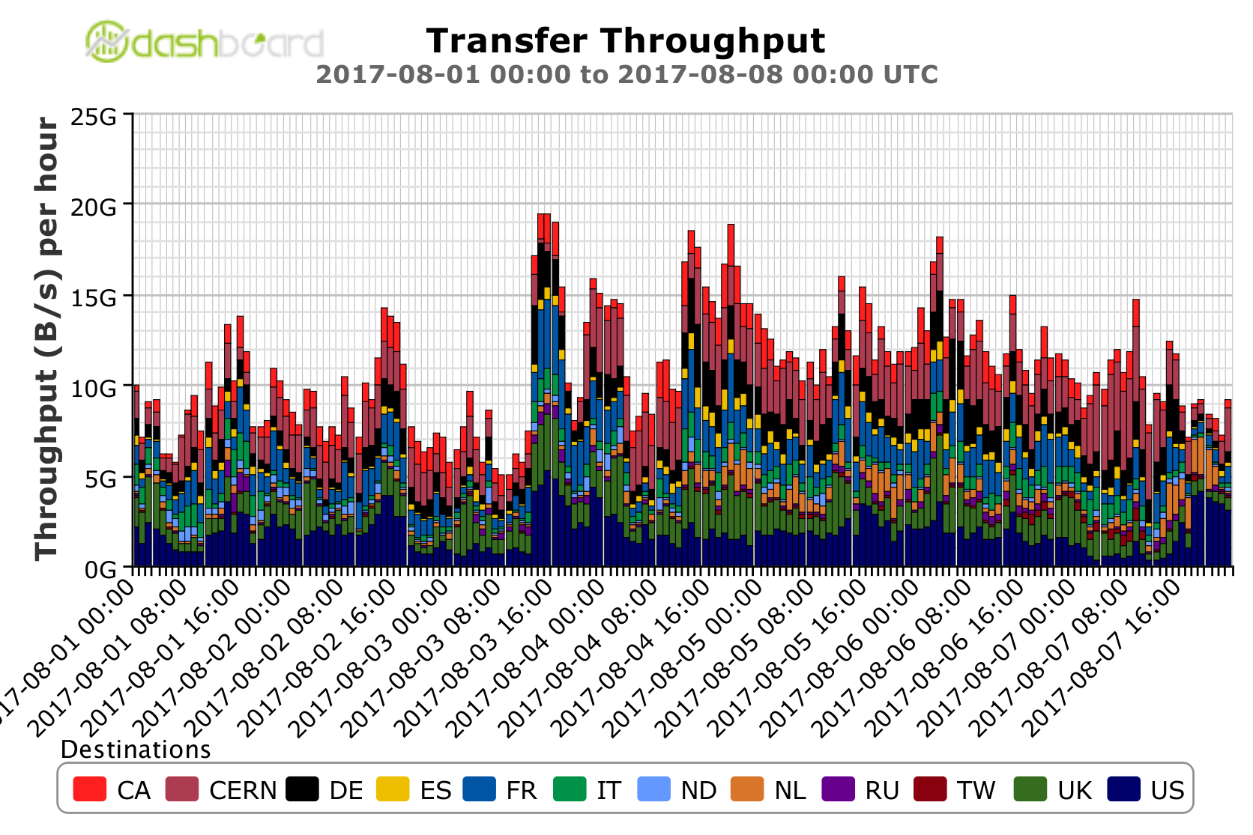
Graphical Overview
300k
Running job slots by activity
Running job slots by N cores
Transfer failures by cloud
Throughput by cloud
10 GB/s

Slide 3
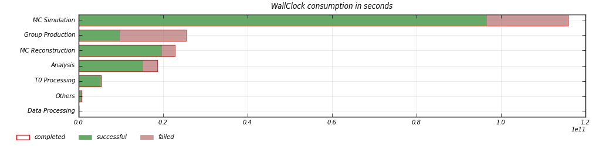
Issues
Frontier servers, overlay jobs:
  Problems at the end of July cured by setting a limit on number of overlay jobs to 1200
  It helped, but still there were 2 problematic frontier servers – at RAL and IN2P3. The first solved by restart, the latter was just a monitoring issue. The limit was in the meantime lowered to 800.
ATLASEOS
  Several issues lead to lost files. More servers added by EOS team to solve performance issue, also a change in configuration was done. A patch to a discovered bug is being applied since Monday.
  Some tasks were exhausted due to input files unavailability on EOS, number of retries increased
  The headnode crashed this morning
Group production
  Many tasks in group production with all jobs failing, paused

Slide 4
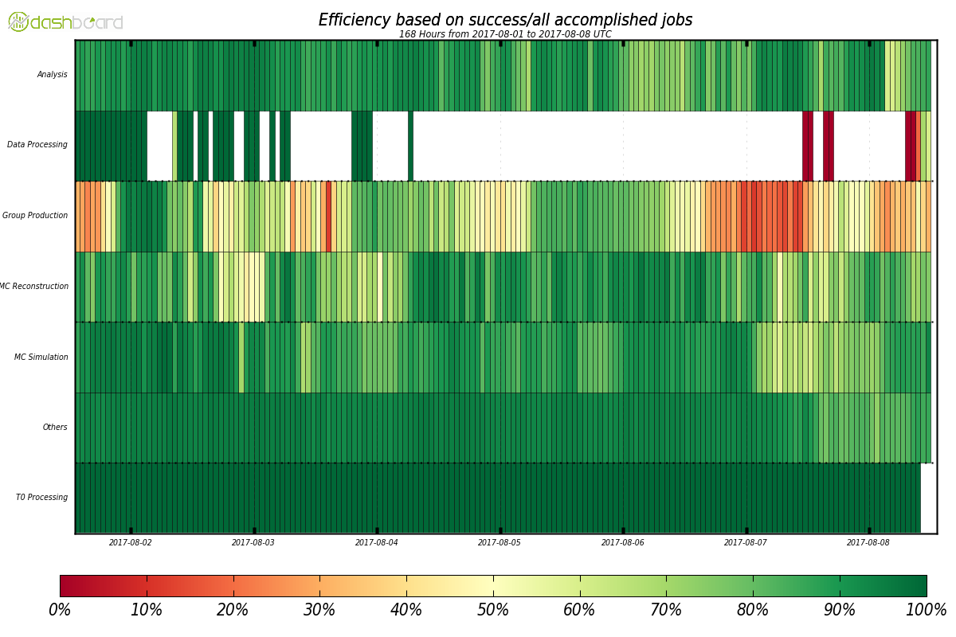
Low efficiency of jobs

Slide 5
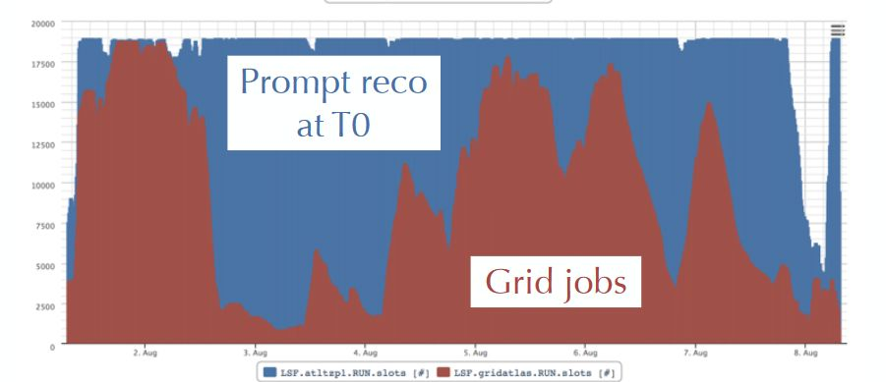
Issues
Lower number of running jobs on grid for half a day – not enough jobs
High number of failed jobs
Tier 1
  RAL lost network connectivity for 1 hour
DDM problems
  Deployment of a new code yesterday caused many failures in all types of transfers. Not all sites affected.

Slide 6
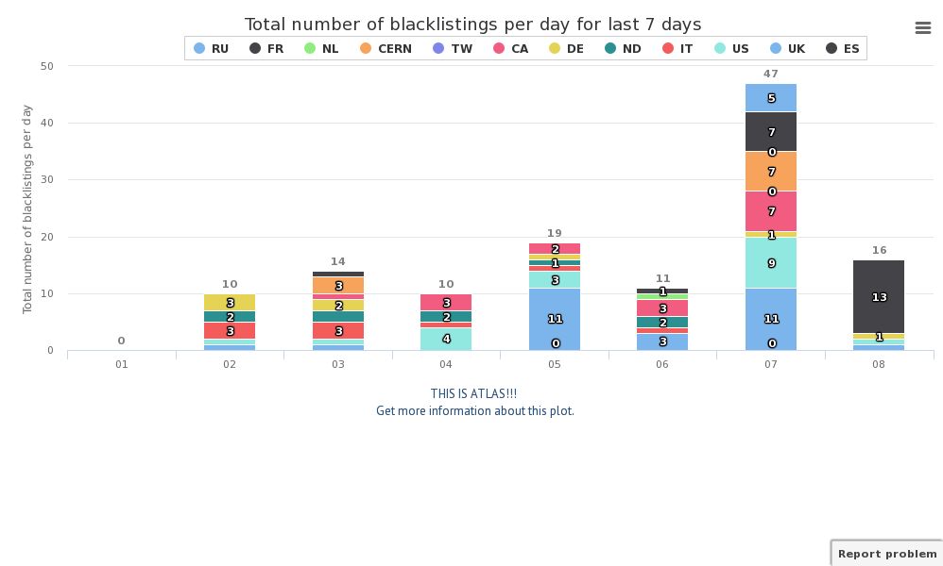
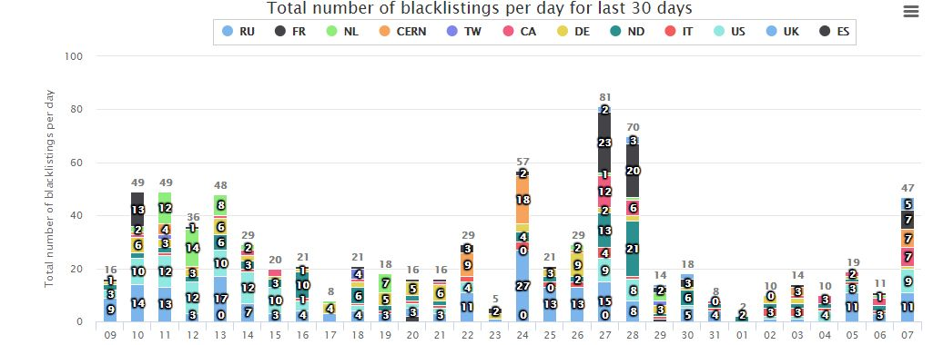
Number of exclusions by HC

Slide 7
Miscellaneous
As of Monday 7/August, Australia-ATLAS (Melbourne, Australia) should be connected to LHCONE
Squid service at RAL is dual stack since 3.8.
An agreement on a proposal to merge everything to 10k events per file, merge all future EVNT in mc16
Frontier monitoring - filebeat will be installed also in TRIUMF, instructions sent
3rd attempt of spillover test – worked well apart file input failures due to EOS

