Slide 1
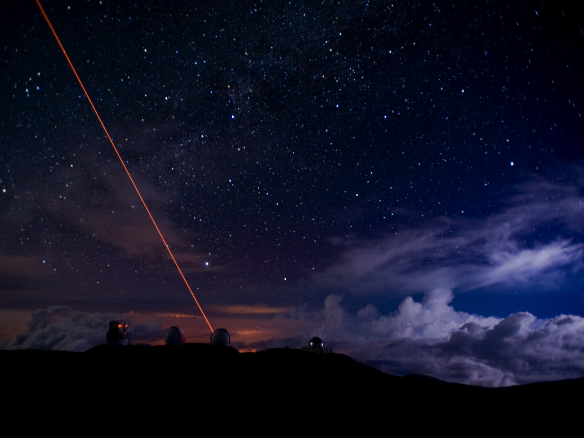
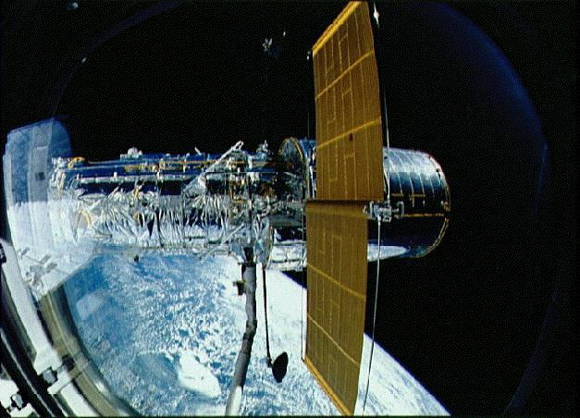
Probing dark matter with strong gravitational lensing
TOMMASO TREU
University of California Los Angeles

Slide 2
Outline
Introduction
  What is gravitational lensing and why do we need it?
Small-scale problems
  The inner regions of dark matter halos and the self-interaction cross section
    The core/cusp problem
    Colliding clusters
  Dark matter substructure and the dark matter free streaming length
Dark matter substructure: a roadmap for the future

Slide 3
What’s the dark matter?
Let’s use gravity to find out

Slide 4
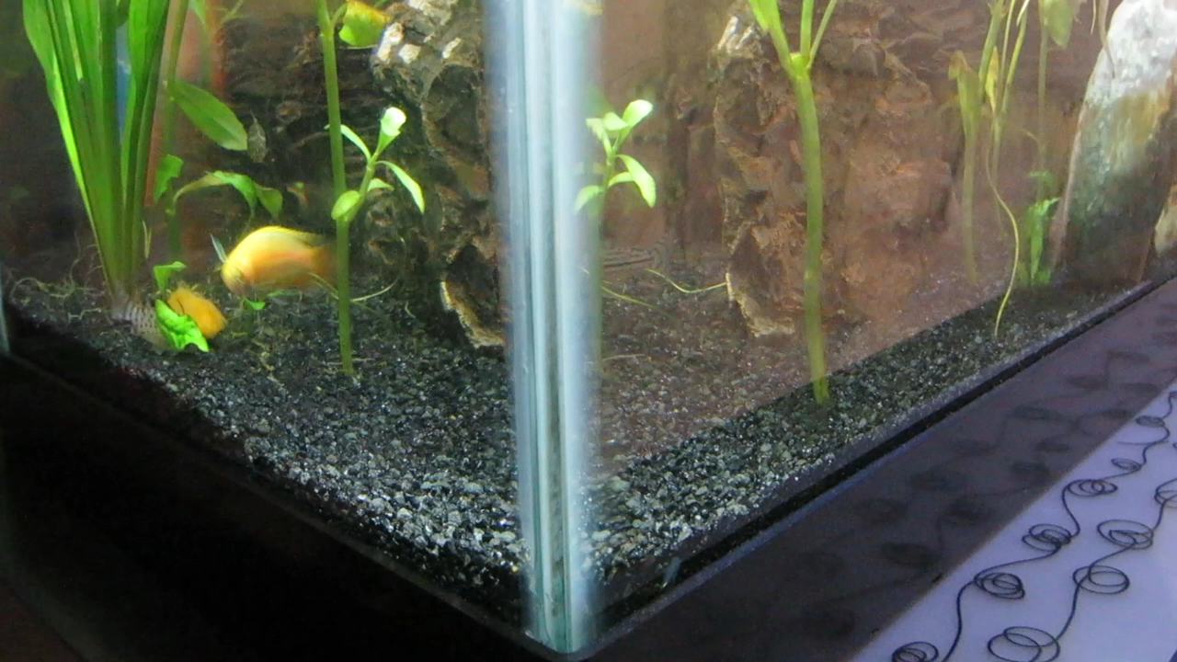
What is Gravitational Lensing?
Movie courtesy of Y. Hezaveh

Slide 5
Self-interaction cross section

Slide 6
The inner regions of dark matter halos

Slide 7
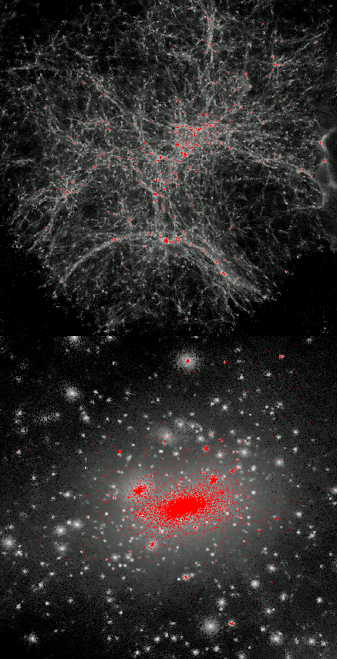
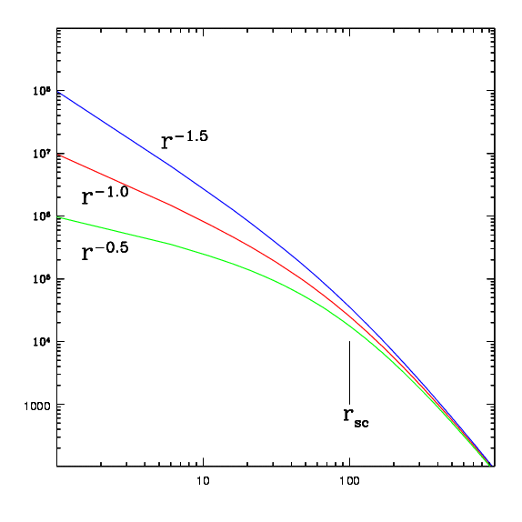
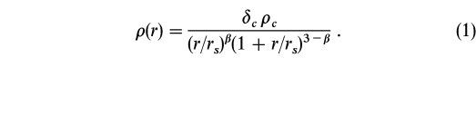
Cold dark matter predictions
How is matter distributed in clusters?
Do clusters (and galaxies) follow a universal dark matter profile?
Navarro, Frenk & White 1996,1997; Moore et al. 1998; Navarro et al. 2007

Slide 8
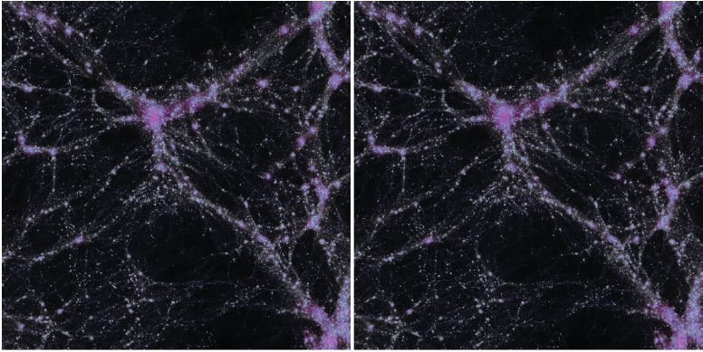
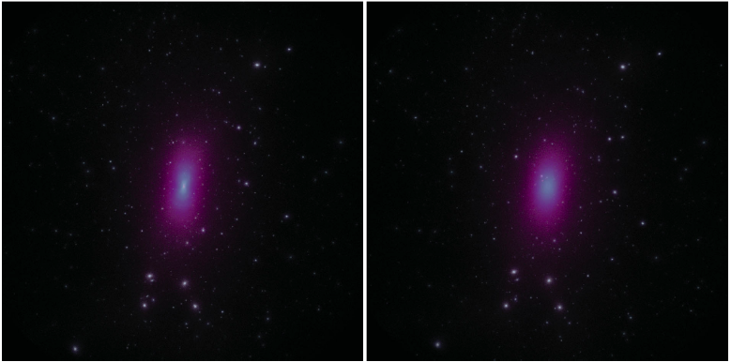
Self-Interacting dark matter
CDM
SIDM
LSS are same
Centers of clusters are flatter and rounder
Rocha et al. 2013

Slide 9
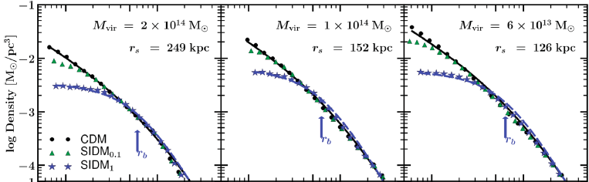
Self-Interacting dark matter
Only a limited range of (large) cross-sections has implications for clusters
Rocha et al. 2013

Slide 10
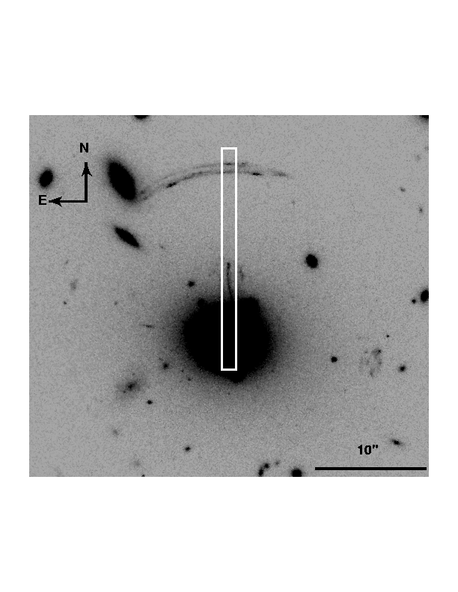

Methodology: critical lines and lensing constraints
MS2137
Tangential arc
Radial arc
Sand, Treu & Ellis 2002

Slide 11
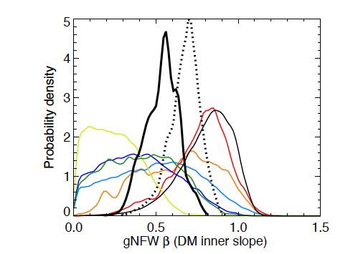
Results from lensing and dynamics work
Newman et al. 2013

Slide 12
Colliding clusters

Slide 13

The bullet cluster
σ/m<0.7cm²/g
Clowe et al. 2006; Bradac et al 2006; Randall et al. 2008 see also Bradac et al. 2008

Slide 14
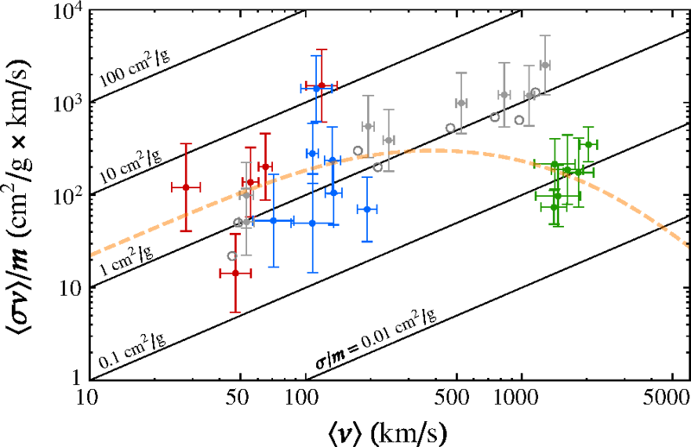
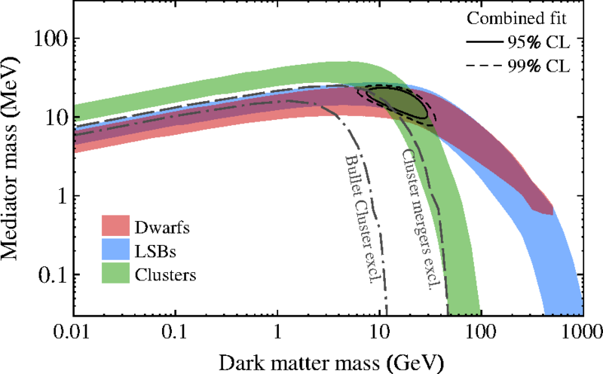
A possible explanation
Kaplinghat et al. 2016

Slide 15
Satellites as a probe of dark matter free streaming length

Slide 16
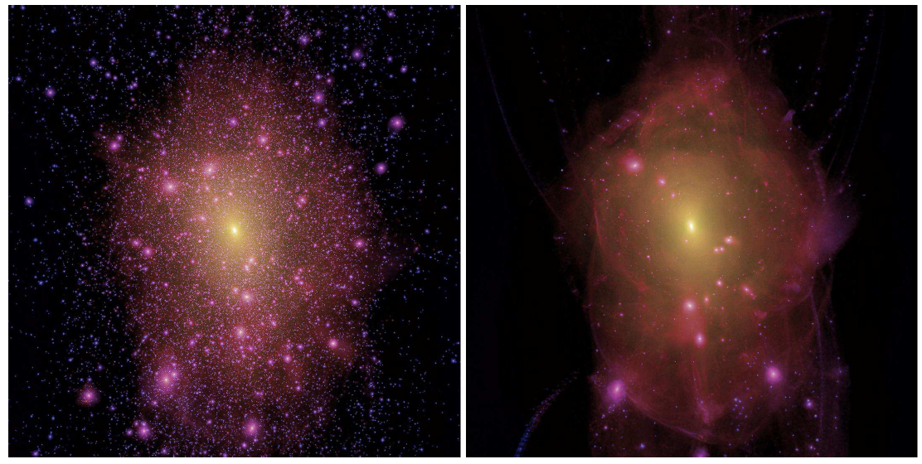
Warm Dark Matter
Free streaming ~kev scale thermal relic
Lovell et al. 2014

Slide 17
Dark satellites in CDM vs WDM
Li et al. 2016; Nierenberg et al. 2013

Slide 18
Luminous Satellites in CDM vs WDM
Nierenberg, Treu, Menci et al. 2016

Slide 19
“Missing satellites” and lensing
Strong lensing can detect satellites based solely on mass!
Satellites are detected as “anomalies” in the gravitational potential ψ and its derivatives
  ψ’’ = Flux anomalies
  ψ’ = Astrometric anomalies
  ψ = Time-delay anomalies
Natural scale is a few milliarcseconds. Astrometric perturbations of 10mas are expected
Notes:
TMT WIRC will go to vis, but not 1st light.
19

Slide 20
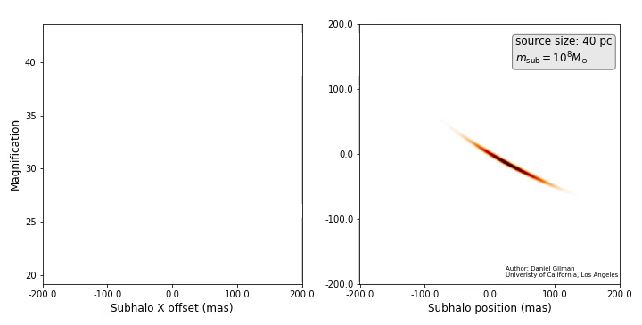
“Missing satellites” and lensing
Courtesy of D.Gilman
Notes:
TMT WIRC will go to vis, but not 1st light.
20

Slide 21
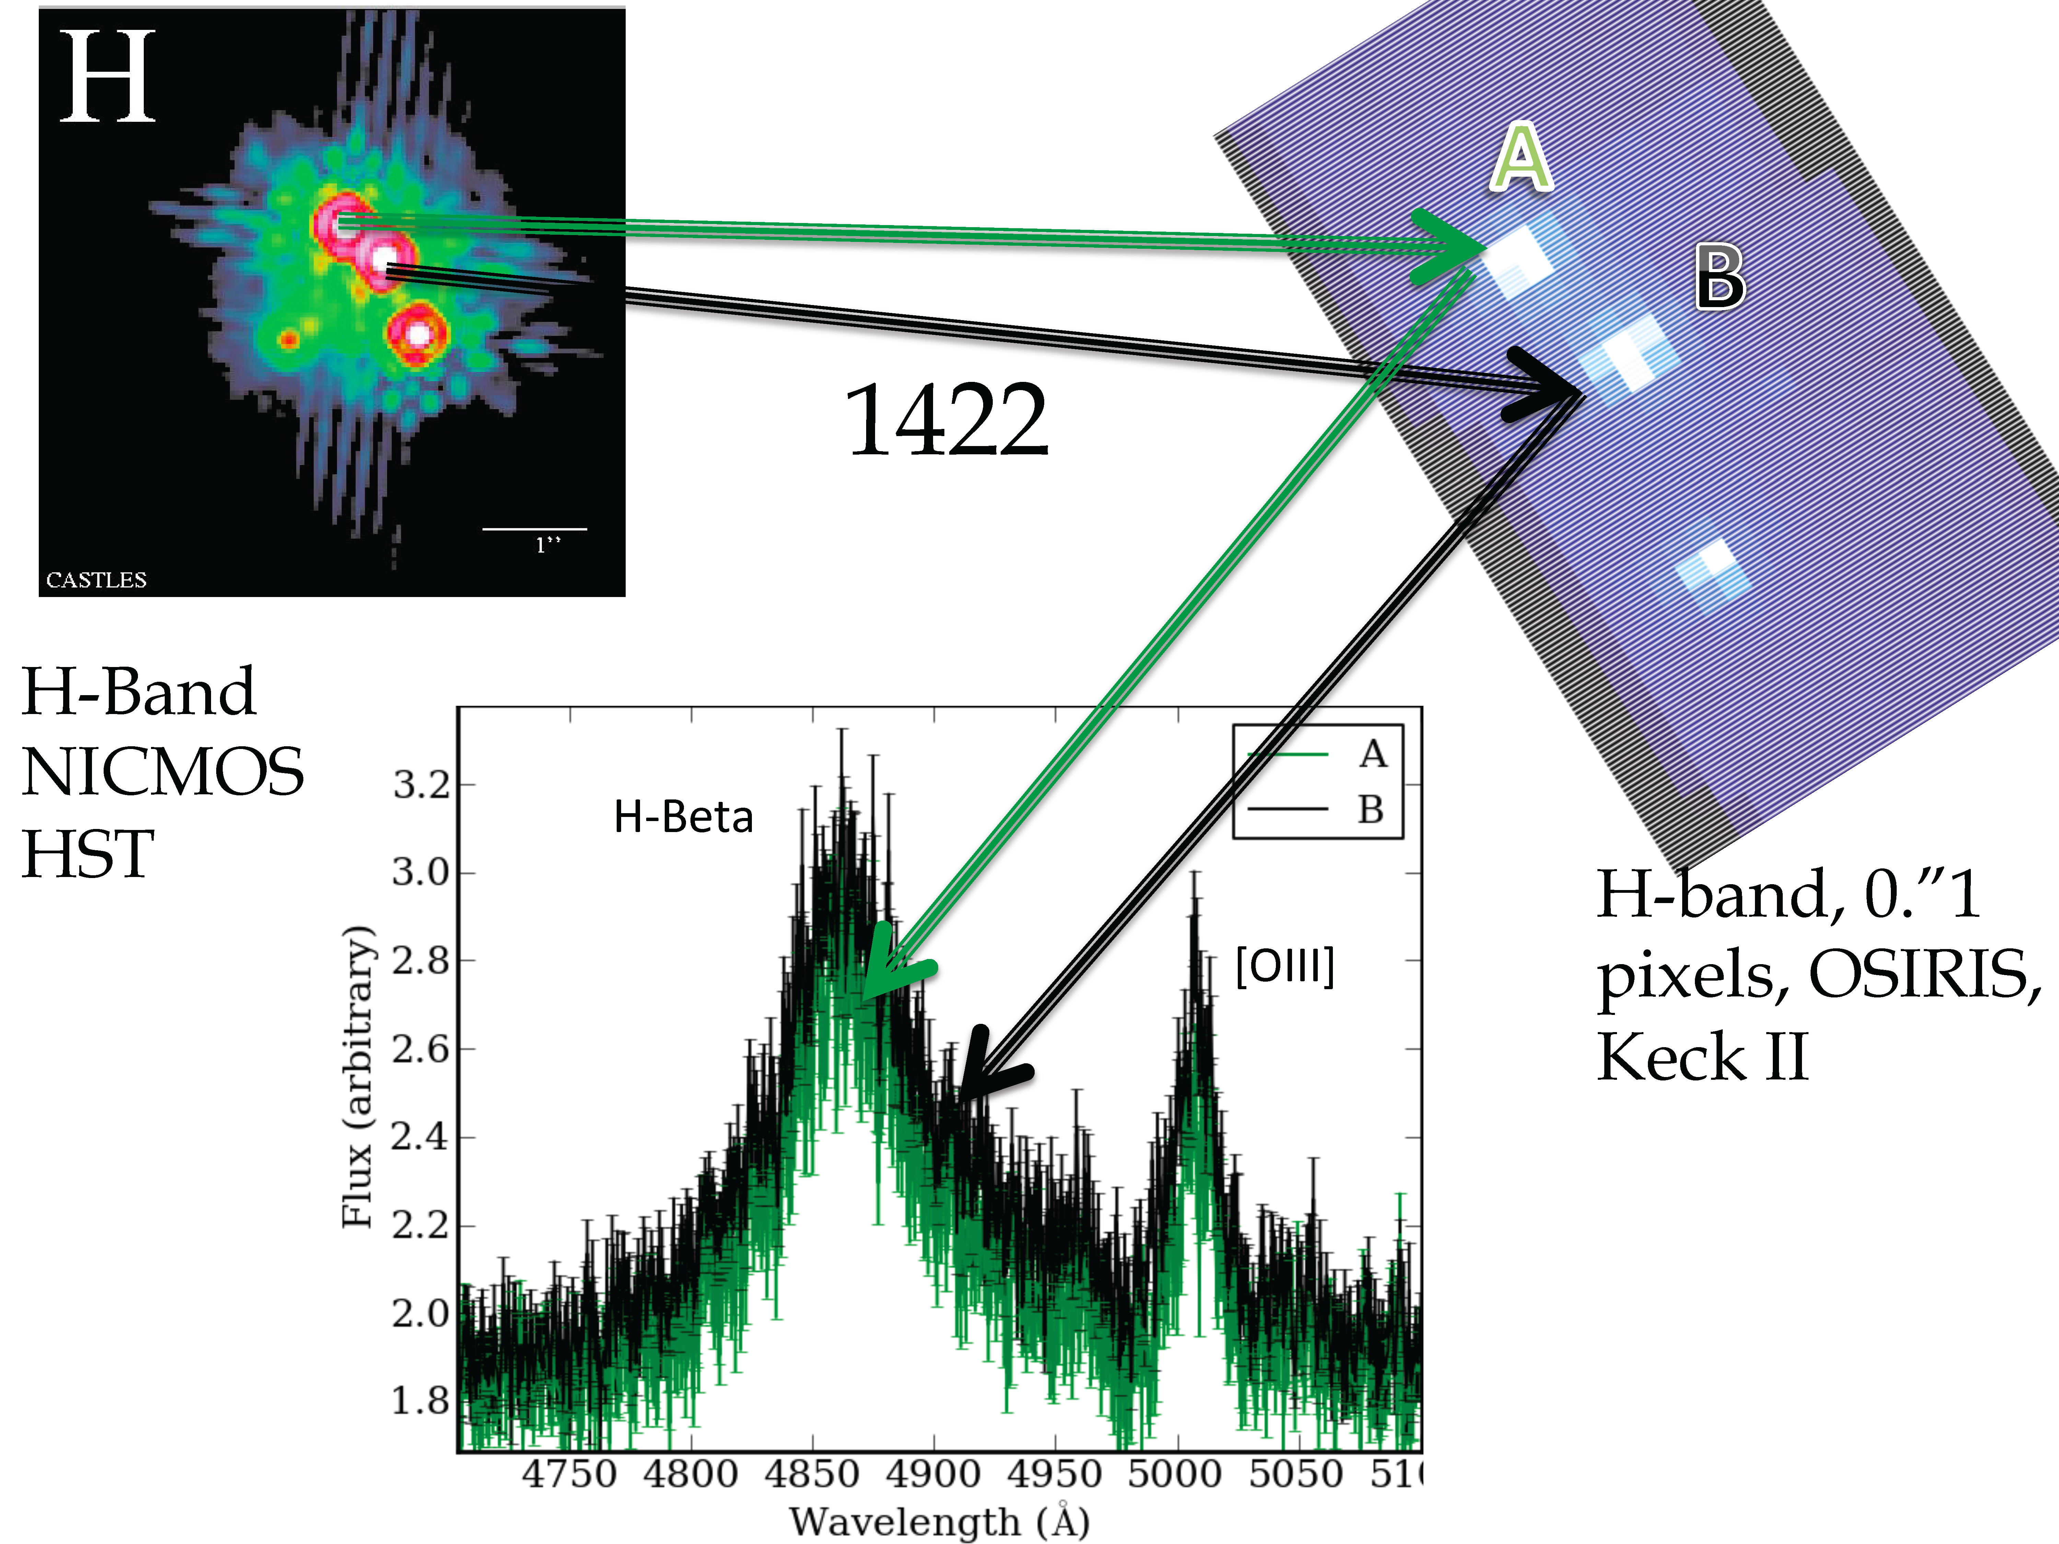
OSIRIS detection of substructure
Nierenberg Treu et al 2014
Notes:
Restframe infrared of the lens galaxy – reduces the effects of dust
Study Hb/OIII and Halpha/NII- Why is NII an interesting line? Why are we dividing by Halpha and Hbeta? To normalize?
Observed H at the lens redshift is 1140 nm, still redder than z
Observed lambda~ 1.66, 1.7, 2.3 micro meters

Slide 22
OSIRIS detection of substructure
Nierenberg Treu et al 2014
Notes:
Restframe infrared of the lens galaxy – reduces the effects of dust
Study Hb/OIII and Halpha/NII- Why is NII an interesting line? Why are we dividing by Halpha and Hbeta? To normalize?
Observed H at the lens redshift is 1140 nm, still redder than z
Observed lambda~ 1.66, 1.7, 2.3 micro meters

Slide 23
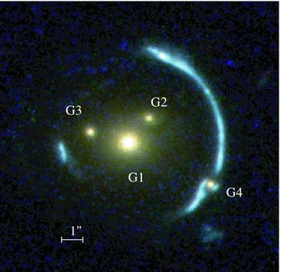
Astrometric perturbations:
gravitational imaging
Mass substructure distorts
extended lensed sources
Vegetti et al. 2010
Notes:
TMT WIRC will go to vis, but not 1st light.
23

Slide 24
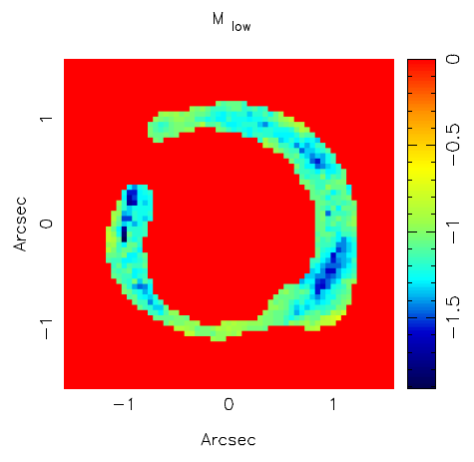
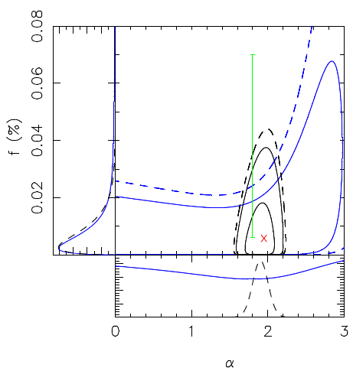
Statistics from gravitational imaging
HST/AO can detect down to 3e8 Msun
Vegetti et al 2010, 2012, 2014
Notes:
TMT WIRC will go to vis, but not 1st light.
24

Slide 25
Limits on sterile neutrinos from gravitational imaging
Vegetti et al 2018
Notes:
TMT WIRC will go to vis, but not 1st light.
25

Slide 26
Statistical gravitational imaging
Birrer et al. 2017
Notes:
TMT WIRC will go to vis, but not 1st light.
26

Slide 27
Gravitational imaging:
Future Prospects
Current limit is 10⁸ msun
(Vegetti et al. 2012, 2014)
With Next Generation Adaptive Optics and then TMT we should reach 10⁷ solar masses and below, where the discrepancy with theory is strongest
LARGE SAMPLES WITH SUFFICIENT SENSITIVITY WITHIN REACH
Range accessible with Adaptive Optics

Slide 28
Flux ratio anomalies:
Future Prospects
Gilman, Birrer, Treu et al. 2018

Slide 29
Flux ratio anomalies:
Future Prospects
Narrow line flux ratio anomalies can currently be studied for 20 systems
Future surveys will discover thousands of systems
NGAO/TMT will provide spectroscopic follow-up and emission line flux ratios

Slide 30
100 quasar lenses with Flux ratios. How do we do this in practice?

Slide 31
Roadmap. I. Find Lenses
Carry out large imaging survey.
  QSO forecasts by Oguri & Marshall (2010)
    DES (~1000 lensed QSOs, including 150 quads)
    LSST (~8000 lensed QSOs, including 1000 quads)
    Euclid/WFIRST many more!
Find lenses:
  Different strategies for lensed QSOs and galaxies (Marshall+, Gavazzi+,Kubo+,Belokurov+,Kochanek+,Faure+,Pawase+,Agnello+) and under development (Marshall, Treu, LSST collaboration)
  Successfully demonstrated

Slide 32
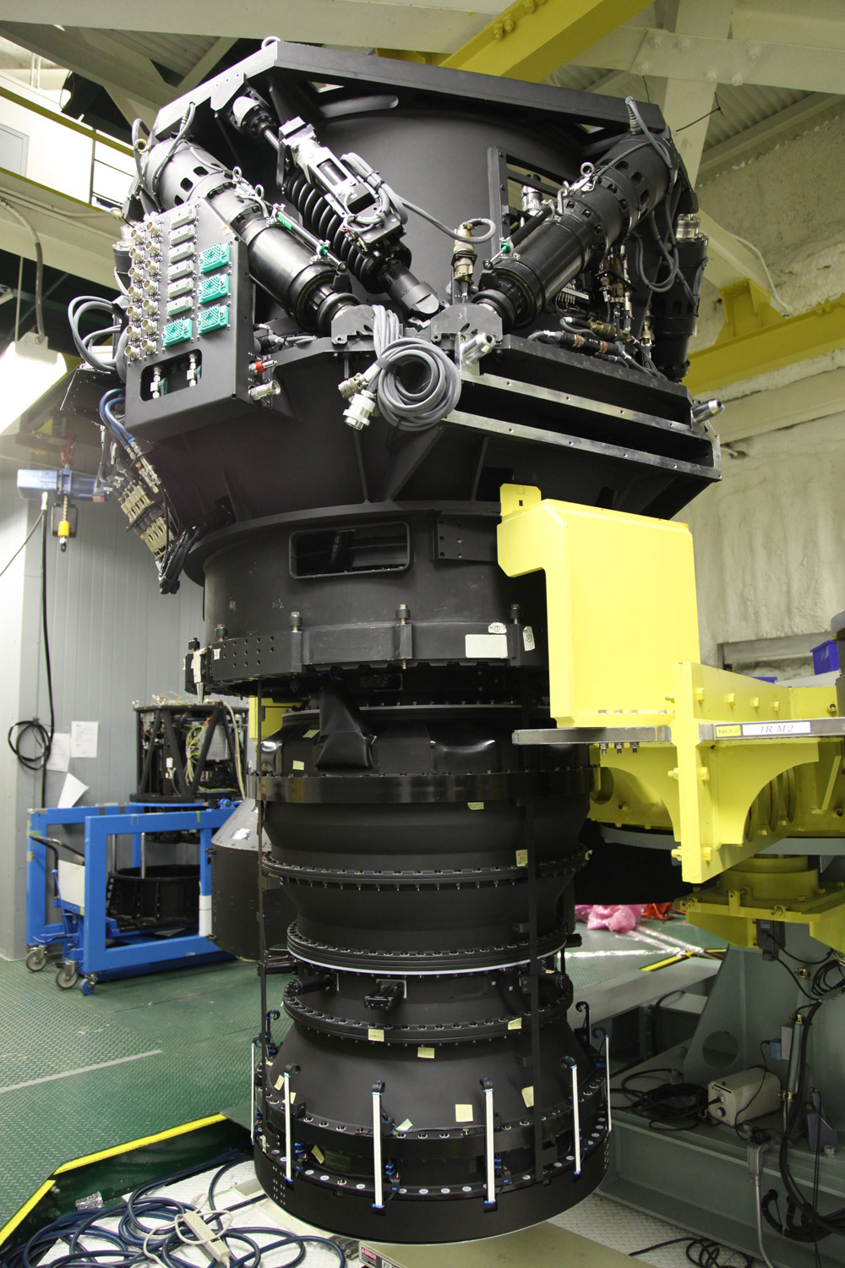
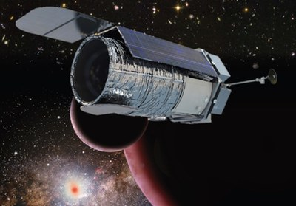
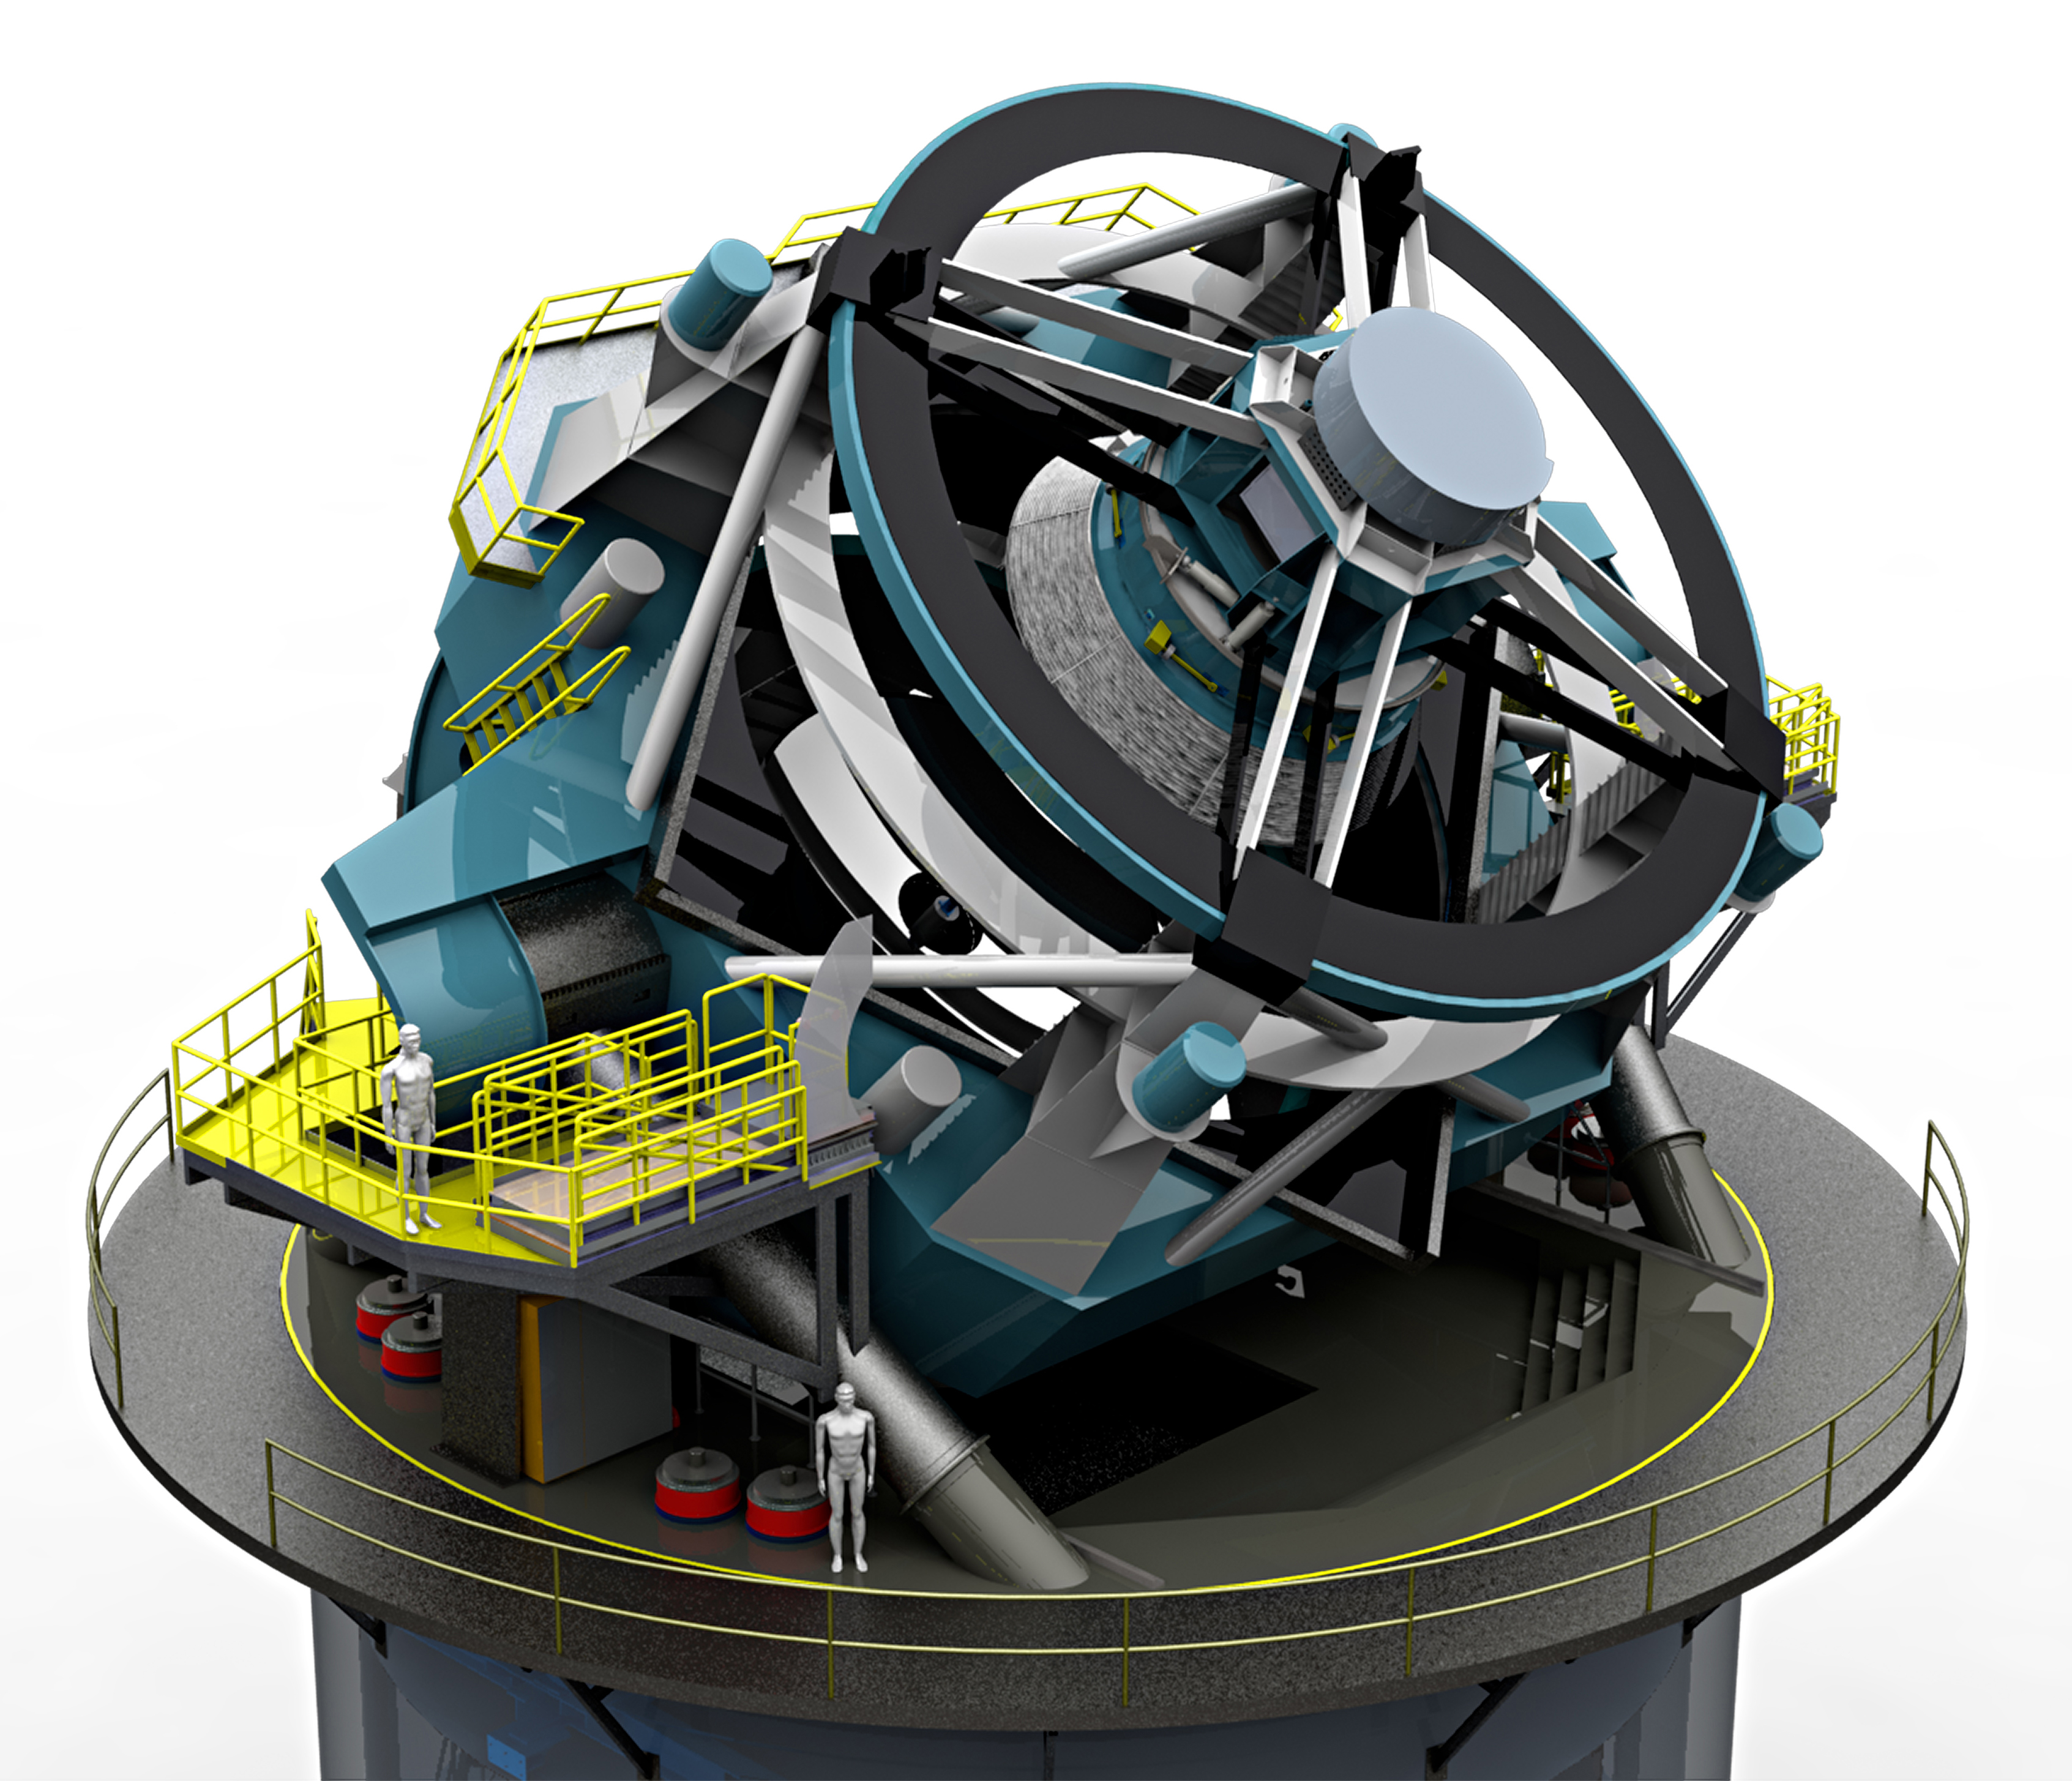
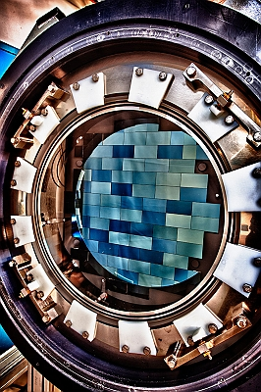
In large imaging surveys
WFIRST
HSC on Subaru
LSST
Dark Energy Camera

Slide 33
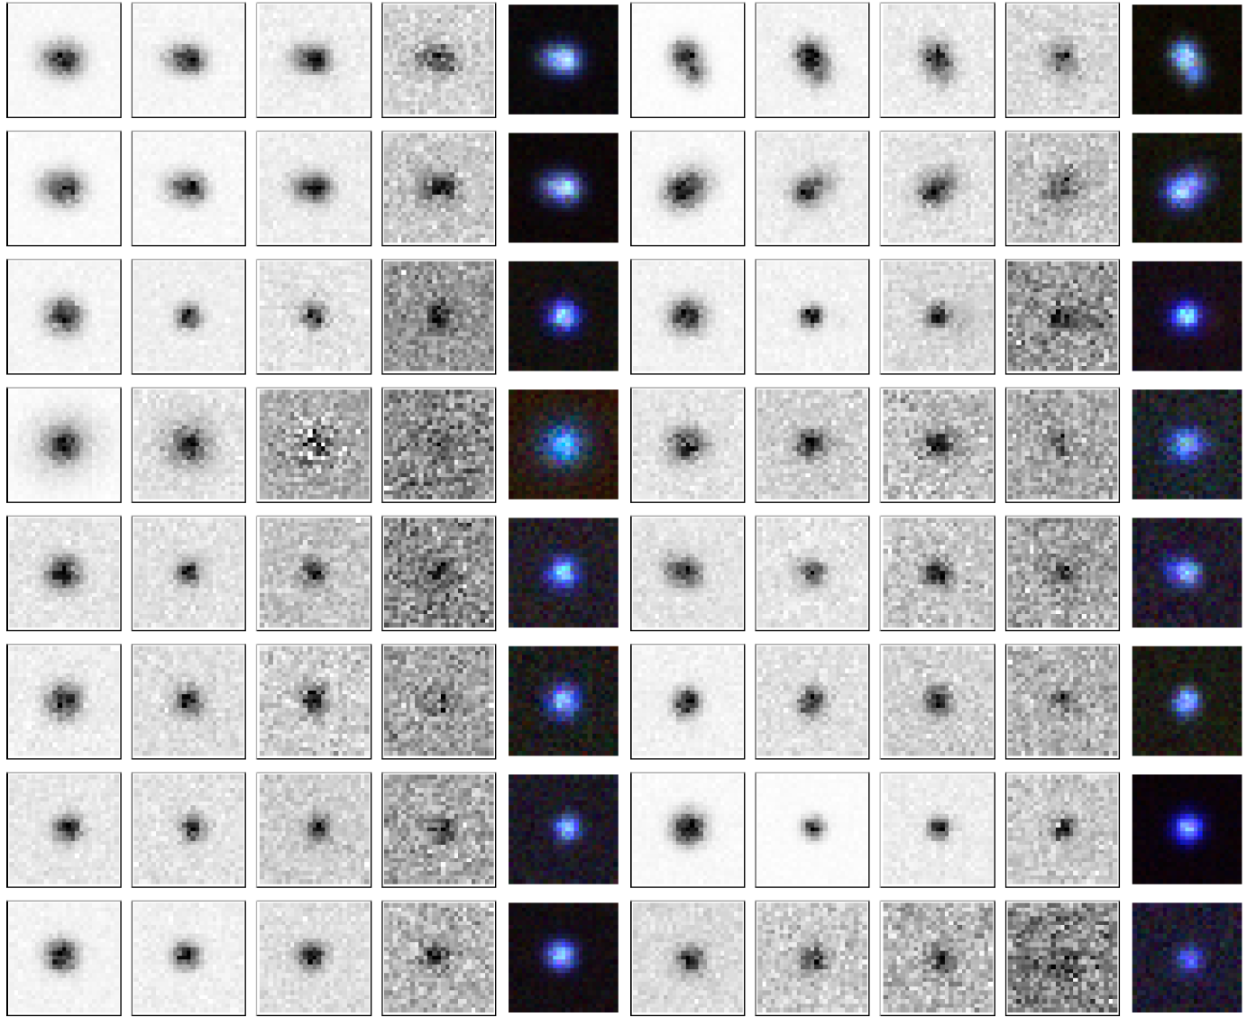
Needle in a haystack!
Which ones are lenses? Agnello, Kelly, Treu & Marshall 2015

Slide 34
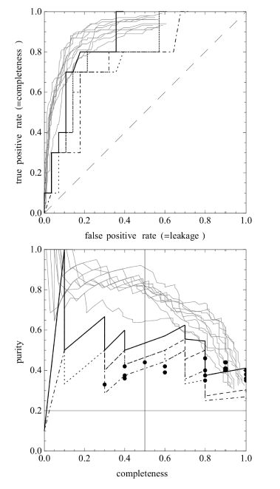
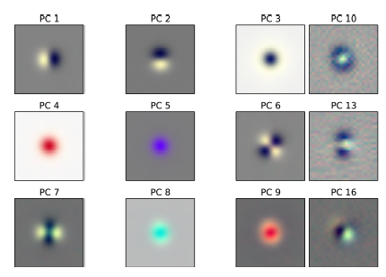
We can find them using machine learning techniques
Agnello et al. 2015a; Williams et al. 2016

Slide 35
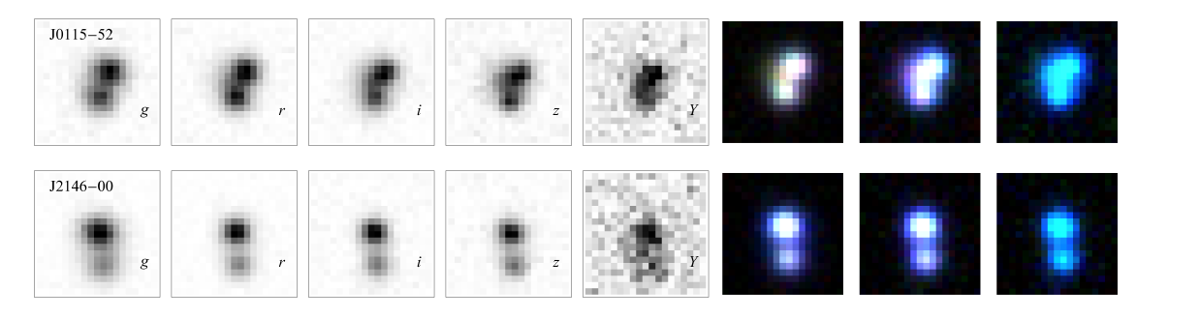

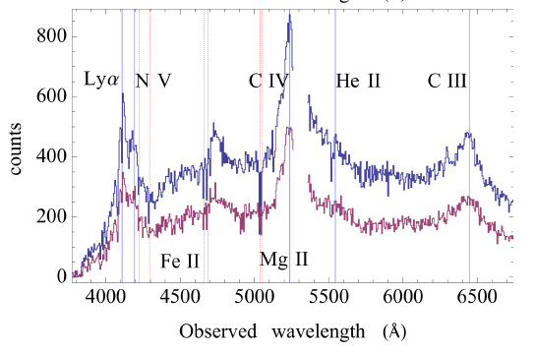
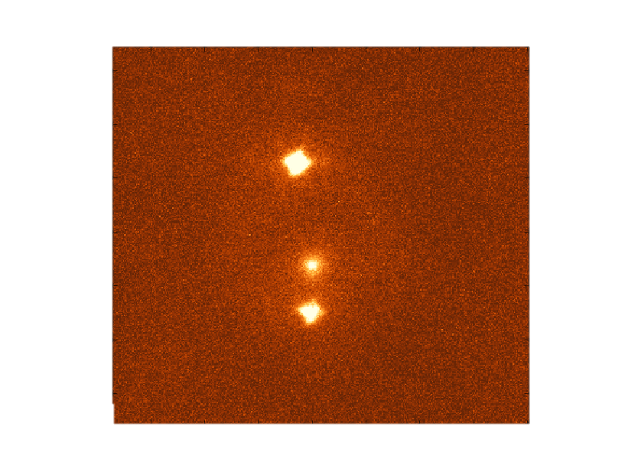
And here they are!
Agnello et al. 2015b
strides.astro.ucla.edu

Slide 36
Here are some more!

Slide 37
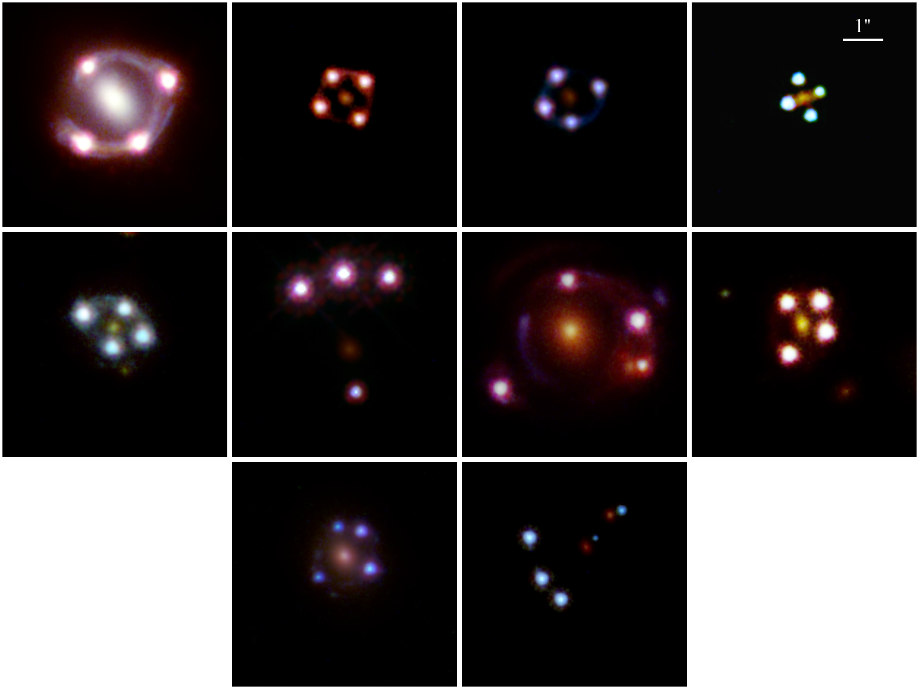
As viewed with the Hubble Space Telescope

Slide 38
Roadmap. II. Follow-up
  High resolution imaging: space or Adaptive Optics
  Deflector mass modeling: redshifts and stellar velocity dispersions (Keck/TMT)

Slide 39
High resolution information. Where will it come from?

Slide 40

Imaging landscape after HST

Slide 41
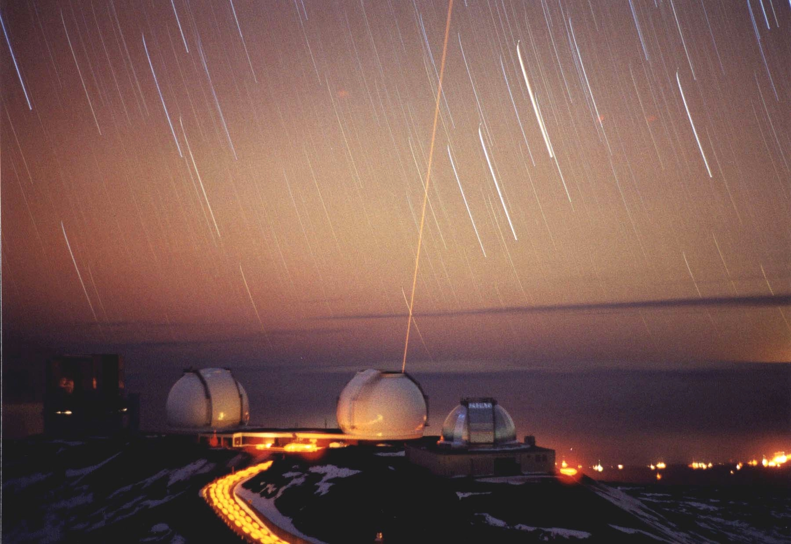
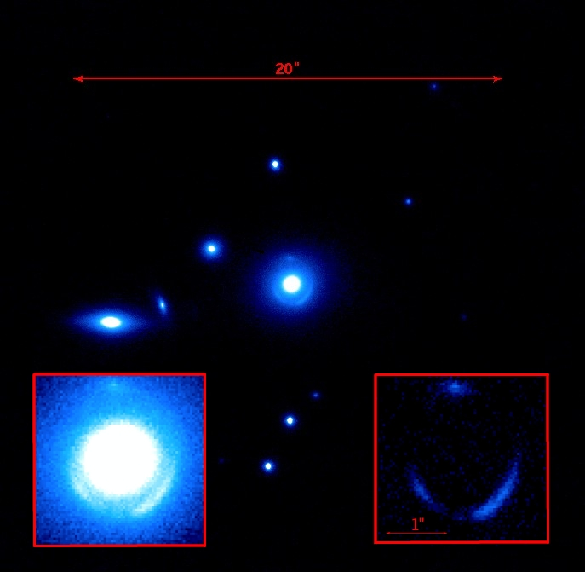
Imaging landscape after 2018:
Adaptive Optics
2012: 0.3-0.4 strehl at 2micron; improvements under way: PSF/TT
Marshall et al. 2007; Fassnacht

Slide 42
Imaging landscape after 2020:
Next Generation Adaptive Optics
For strong lensing at galaxy scales interested in high-strehl small fov:
  Keck-NGAO: 90% strehl at K, 60% at J (not funded yet)
  Gemini,VLT, Subaru etc are all developing AO+
Resources spread between large fov and high strehl

Slide 43
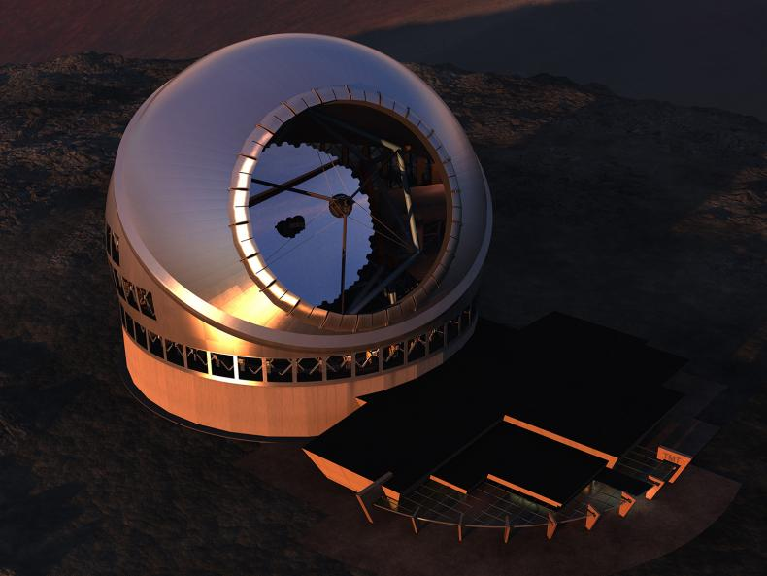
Imaging landscape after 2025:
Extremely Large Telescopes
With 30-40m apertures and advanced AO, in principle one can attain 10x resolution of HST
TMT should have strehl >70% at K and >30% at Y

Slide 44
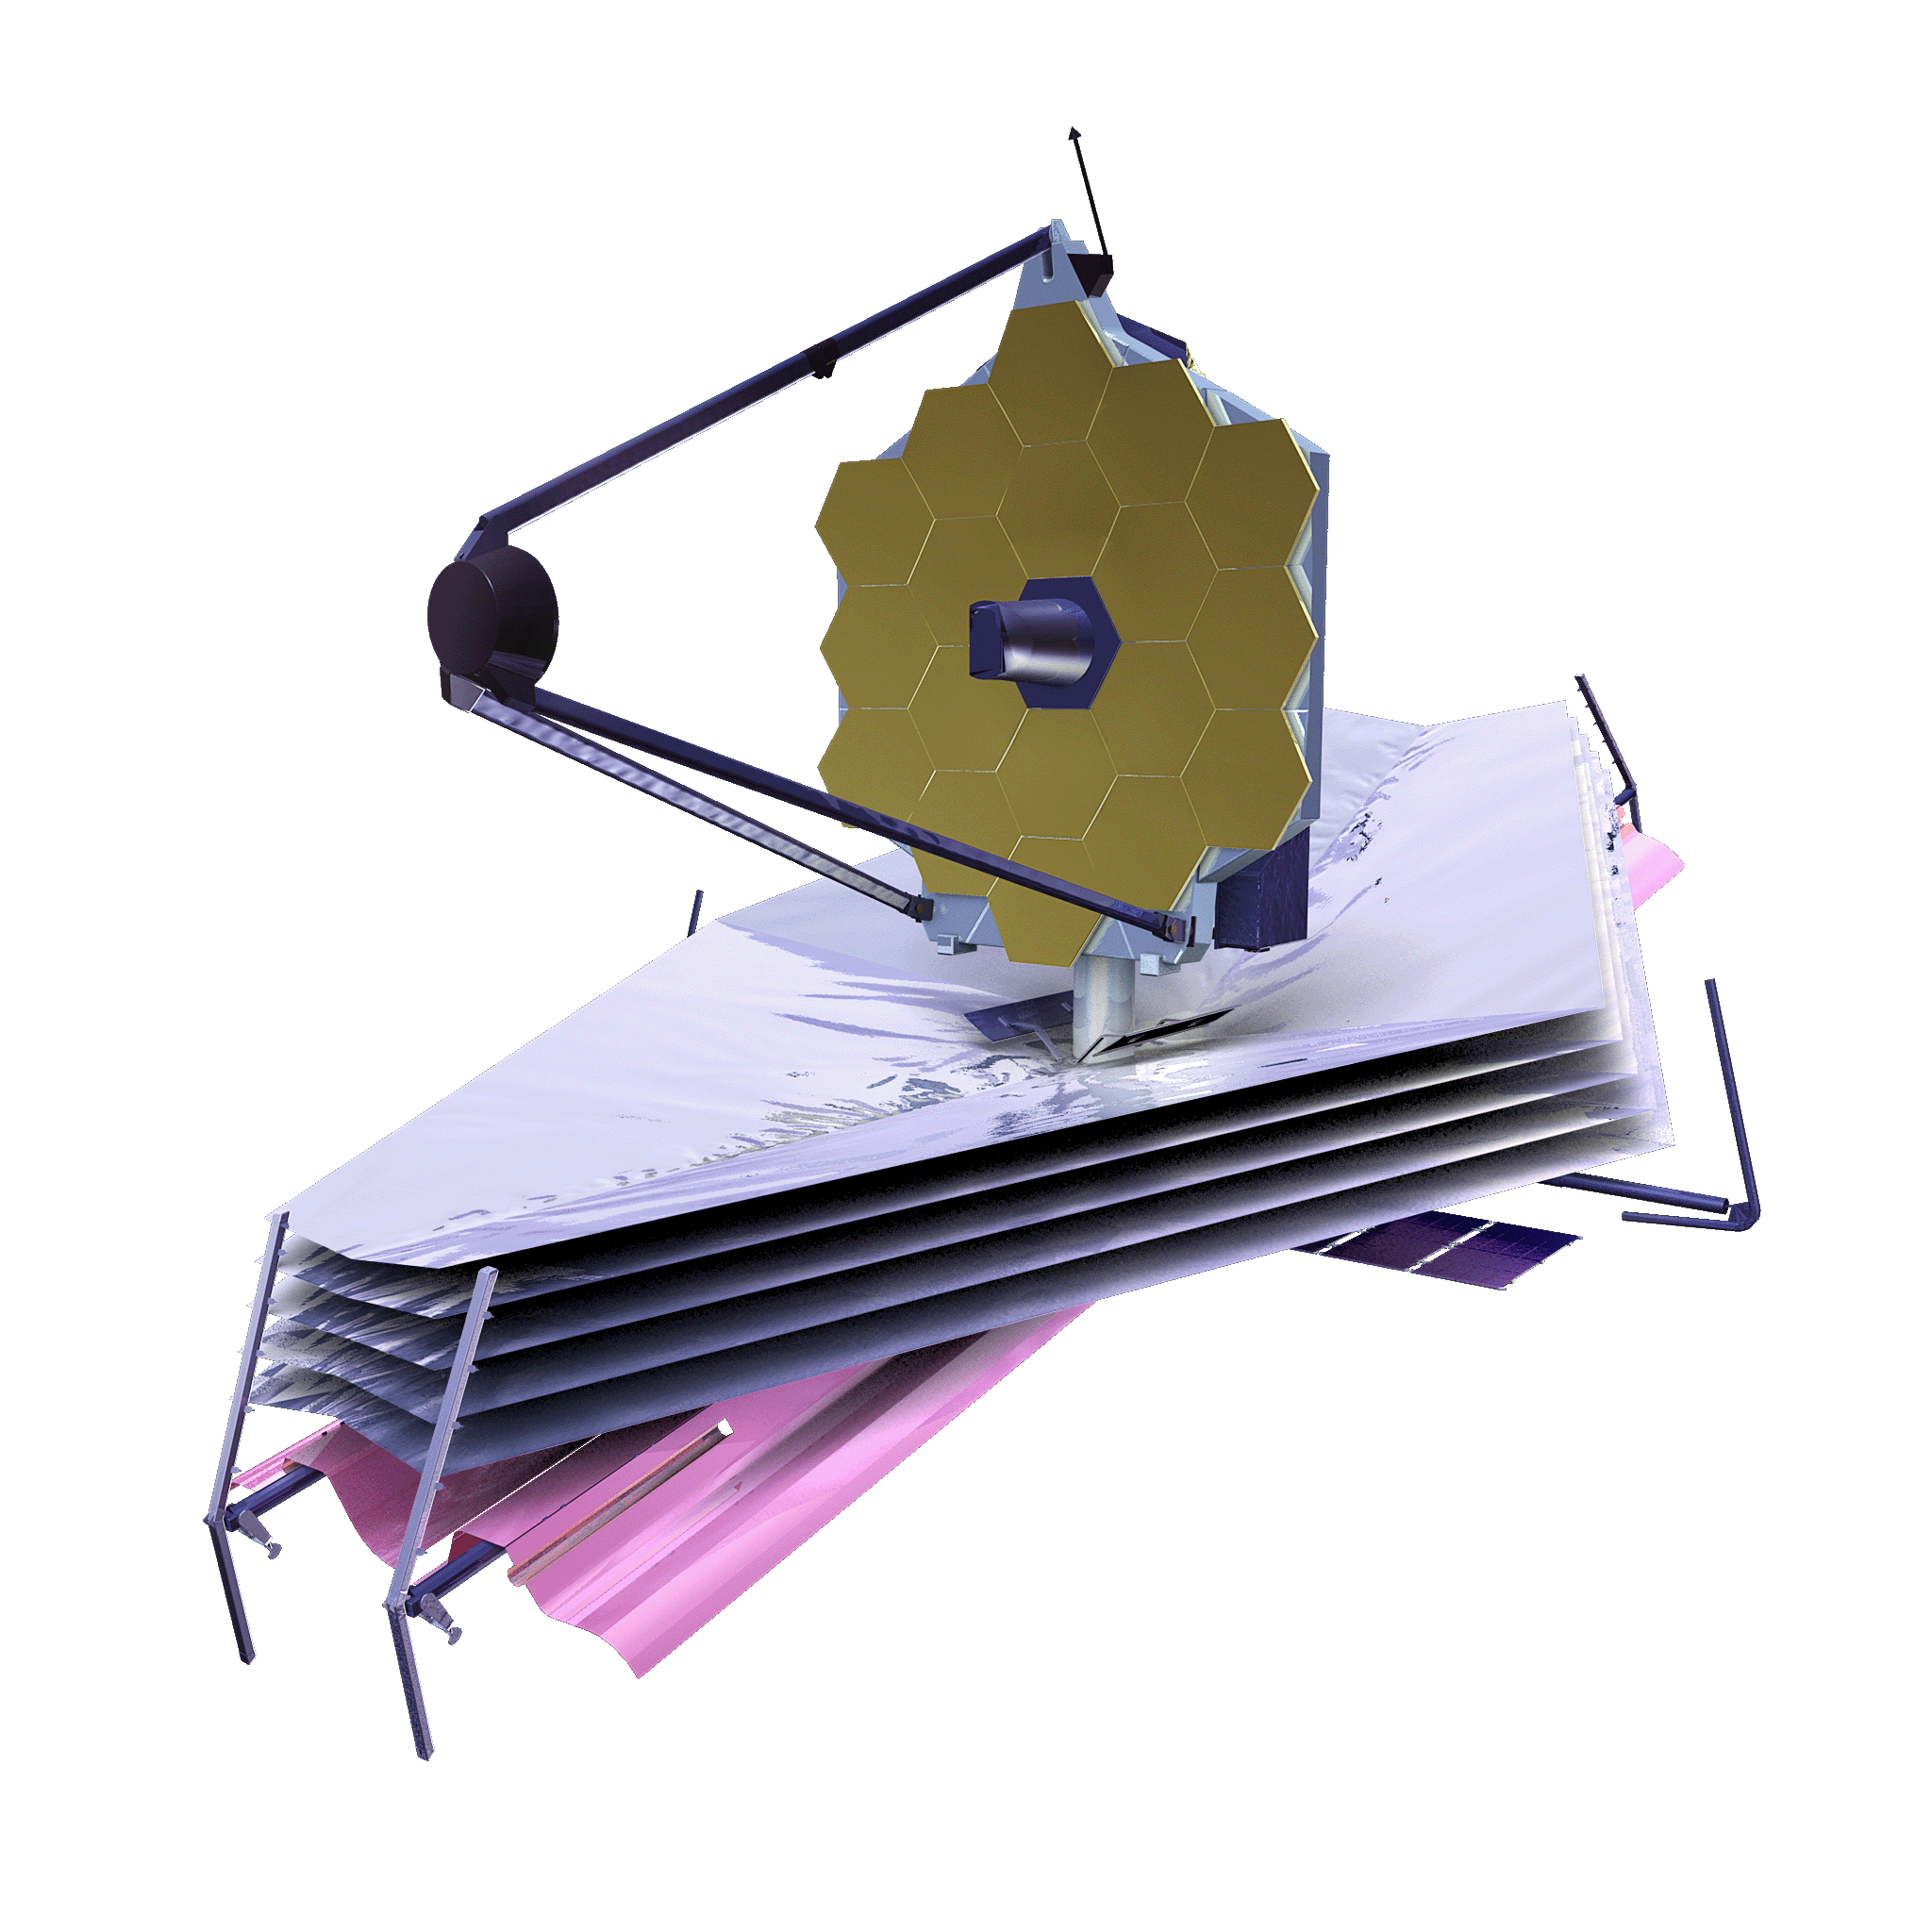
Imaging landscape after 2019: JWST
JWST is 6.5m, diffraction limited beyond 2micron
At best resolution equal to HST at ~0.7micron
0.032”/pix
Ok down to 1micron or so, 0.65 strehl.
Resolution ~HST

Slide 45
The bill
  100 gravitationally lensed AGN with deep images of host galaxies at 100mas resolution or better; ~200-300 orbits with HST; 4 nights with Keck NGAO; very fast with TMT/ELT
    ALMA?
  Redshifts of source and deflector: ~2 weeks of Keck; a few days of TMT / ELT. Easy with ALMA.

Slide 46
Conclusions
  Strong gravitational lensing is a cost-effective tool to study the composition of the universe:
  Lensing is probing the self-interaction cross sections that are relevant for astronomy. Hints of self-interaction are present, but are difficult to disentangle from baryonic effects
  Flux ratios and gravitational imaging can probe the subhalo mass function down to 1e7 solar masses and thus help rule out (or confirm) WDM
    This is feasible in the next five years with a concerted follow-up effort of quasar lenses discovered in DES and other imaging surveys

Slide 47
The end

