Slide 1


Welcome – Murakaza neza - to CERN
Global collaboration in Particle Physics
Interesting for Rwanda?
Research & Discovery
Technology
Training
Collaboration
Notes:
Copyright: generally creative commons
Except where otherwise noted, content of this ppt presentation is
licensed under a Creative Commons Attribution 3.0 License meaning:You are free:
to Share — to copy, distribute and transmit the work
to Remix — to adapt the work
Under the following conditions:
Attribution — You must attribute the work in the manner specified by the author or licensor (but not in any way that suggests that they endorse you or your use of the work). Attribute this work:
mentioning the author of the presentation, H F Hoffmann, CERN-honorary , and CERN for the origin of most transparencies and photos used
What does "Attribute this work" mean?
The page you came from contained embedded licensing metadata, including how the creator wishes to be attributed for re-use. You can use the HTML here to cite the work. Doing so will also include metadata on your page so that others can find the original work as well.
On some transparencies the web site of the author of the content is mentioned (URL of relevant page)and you need to give credit to those authors

Slide 2
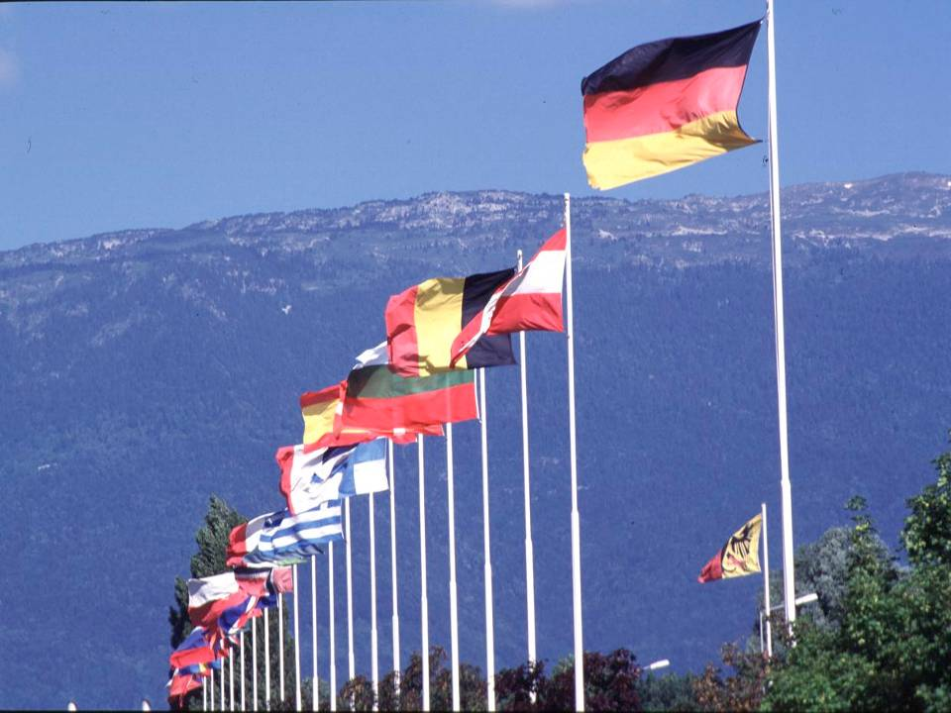

CERN in Numbers 2009
2256 staff
~700 other paid personnel
~9500 users
Budget (2009) 1100 MCHF
20 Member States: Austria, Belgium, Bulgaria, the Czech Republic, Denmark, Finland, France, Germany, Greece, Hungary, Italy, Netherlands, Norway, Poland, Portugal, Slovakia, Spain, Sweden, Switzerland and the United Kingdom.
1 Candidate for Accession to Membership of CERN: Romania
8 Observers to Council: India, Israel, Japan, the Russian Federation, the United States of America, Turkey, the European Commission and Unesco
2

Slide 3
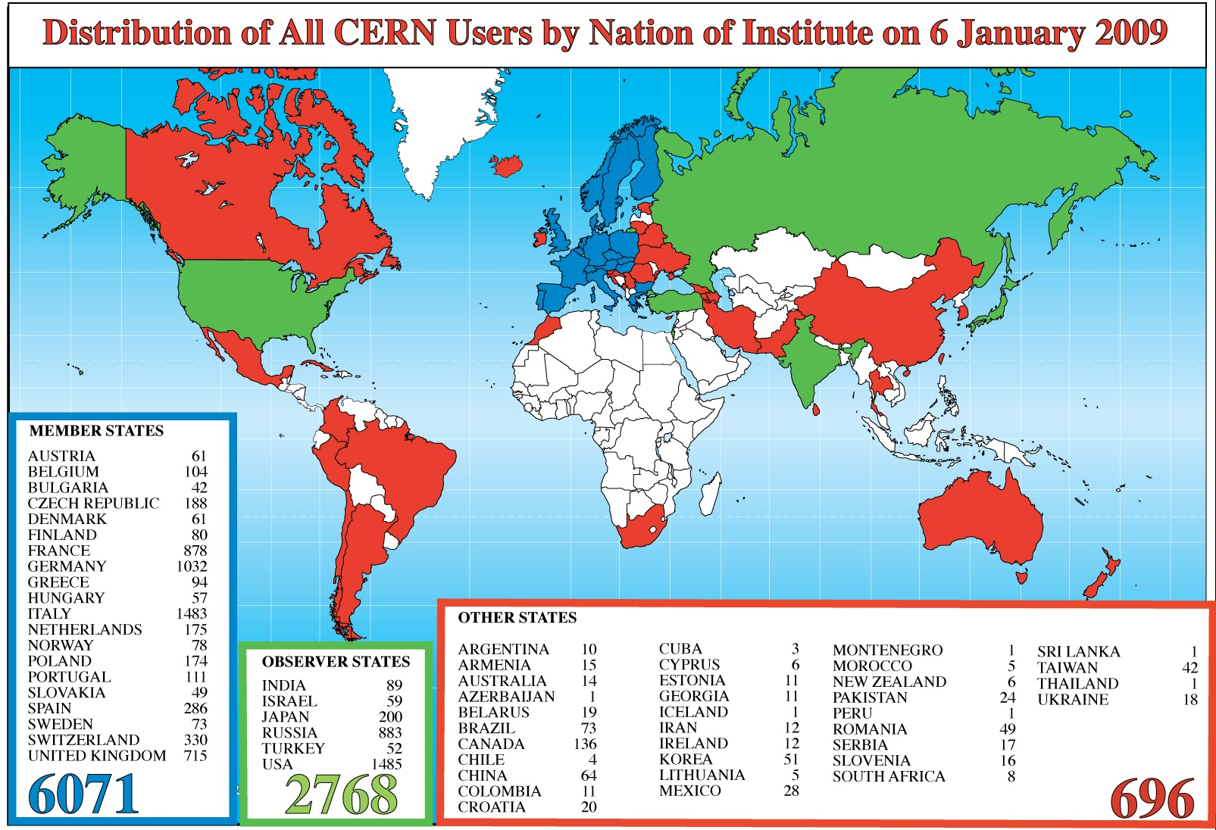
CERN in Numbers
~70% of world particle physics population; change over 1500/year
3

Slide 4

Curiosity and science: « out of the box »!!
Notes:
Lithographie anonyme de « L'atmosphère: météorologie populaire », par Camille Flammarion, 1888, page 163: Un missionnaire du moyen âge raconte qu’il avait trouvé le point ou le ciel et la terre se touchent.

Slide 5
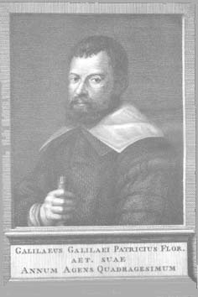
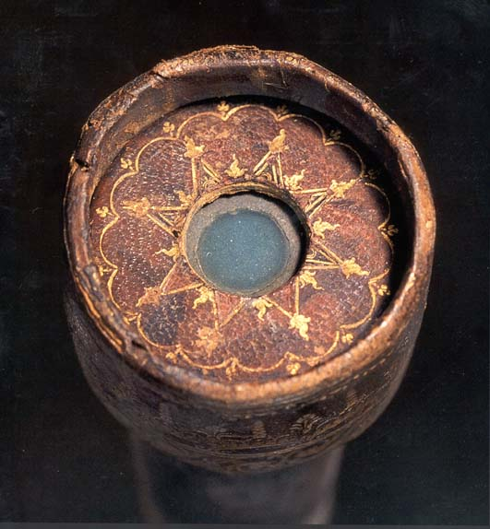
Padova, 1609

Slide 6
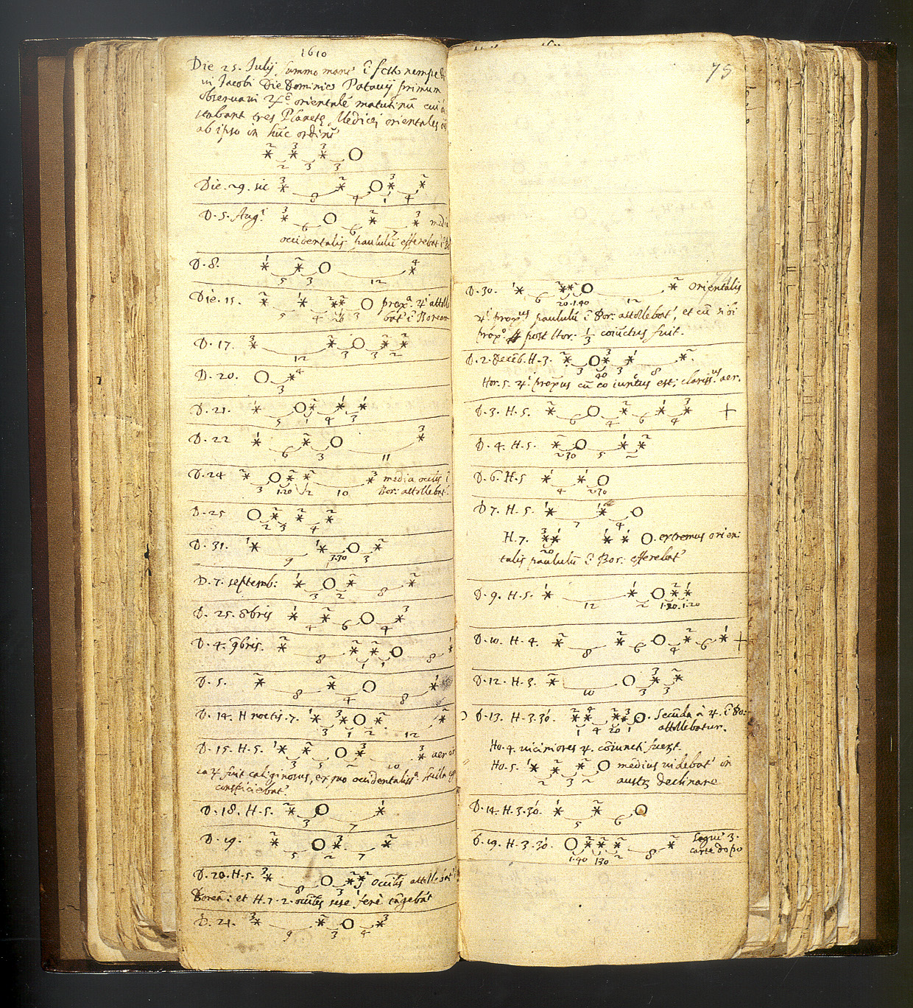

The revolutionary discovery
Notes:
Video: http://www.mogi-vice.com/Pagine/Scaricamento.html
Osservazioni di Galileo delle lune di Giove notte per notte, e deduzione dei loro moti orbitali

Slide 7
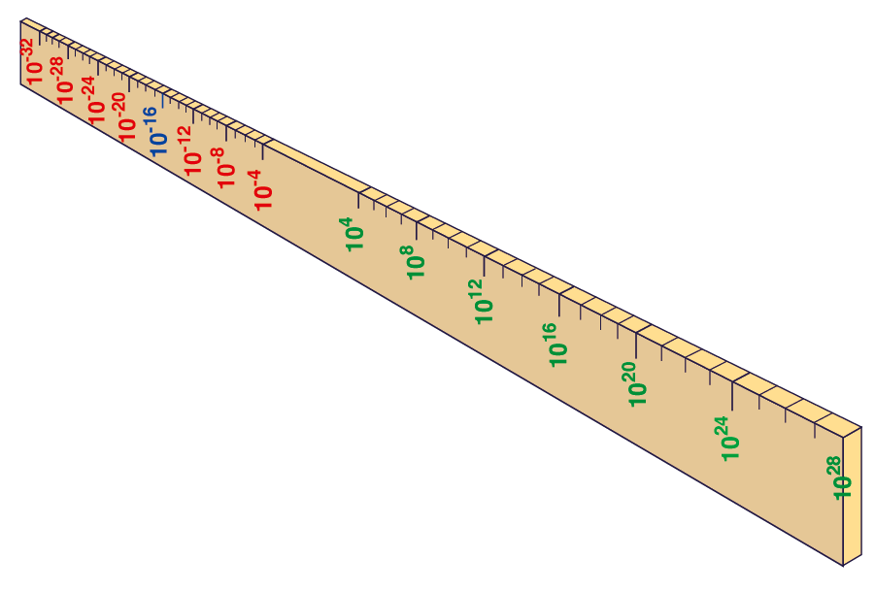
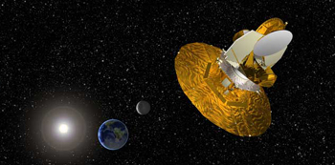
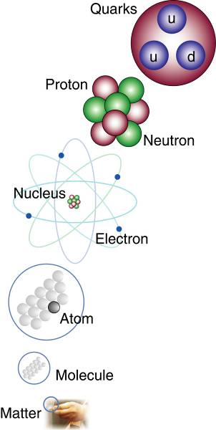
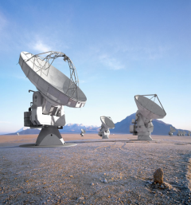
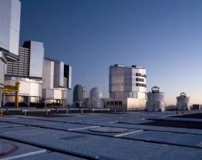
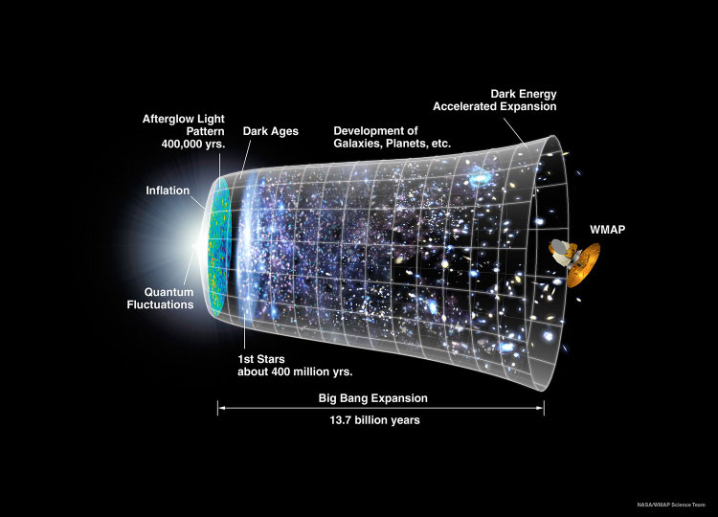
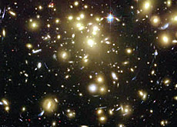
60 orders of magnitude: we know ~ 4% and about 96% we know nothing: dark matter, dark energy
Big Bang
Proton
Atom
Virus
Radius of Earth
WMAP
ALMA
Earth to Sun
VLT
Radius of Galaxies
Universe
cm
Notes:
60 Grössenordnungen

Slide 8
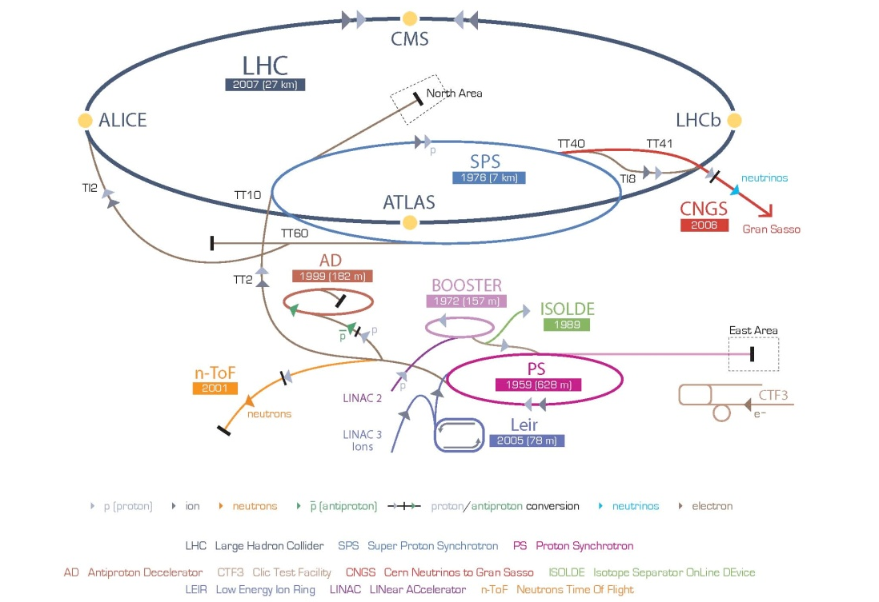
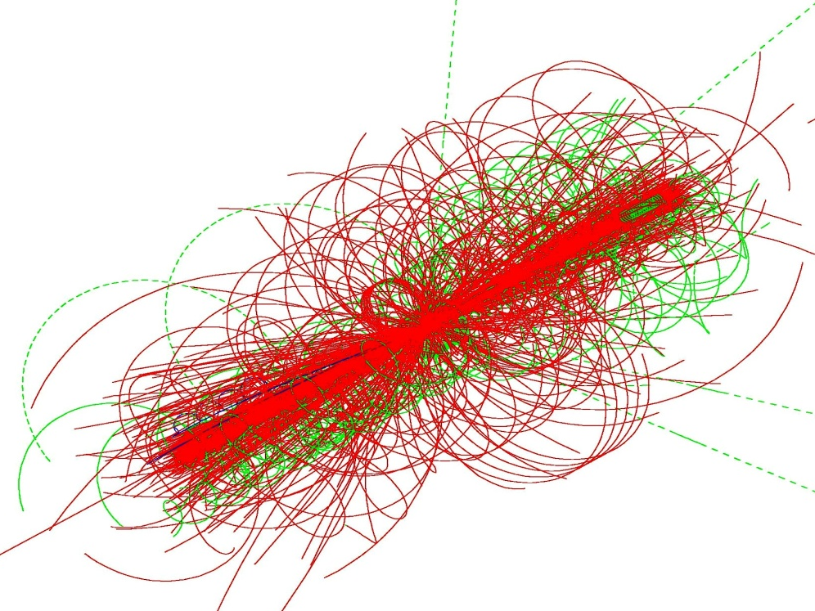
Particle Physics and CERN
Accelerators bring matter to extremely high temperatures and experiments observe the resulting decay products
Objectives: what are the elementary particles (amongst them the constituents of dark matter), what are their properties and the forces acting between them, what are the differences of matter and antimatter, what is the origin of mass, how many dimensions are there, . . . ?
E = mc²

Slide 9


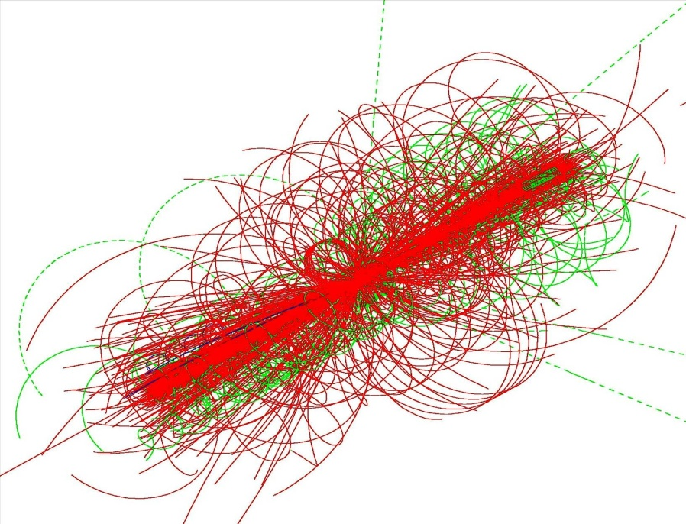

Next step in Particle Physics: LHC
LHC ring:
27 km circumference
ATLAS
Simulation of LHC collision
CMS
Equivalent temperature:1billion x temperature inside the sun

Slide 10
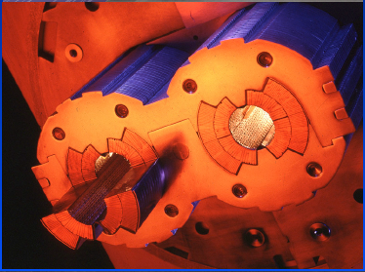
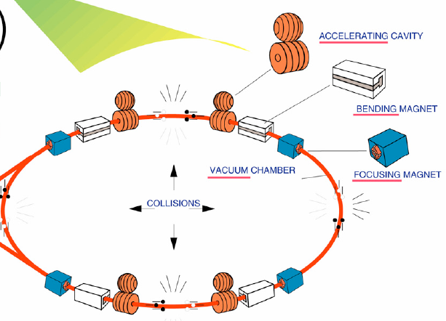
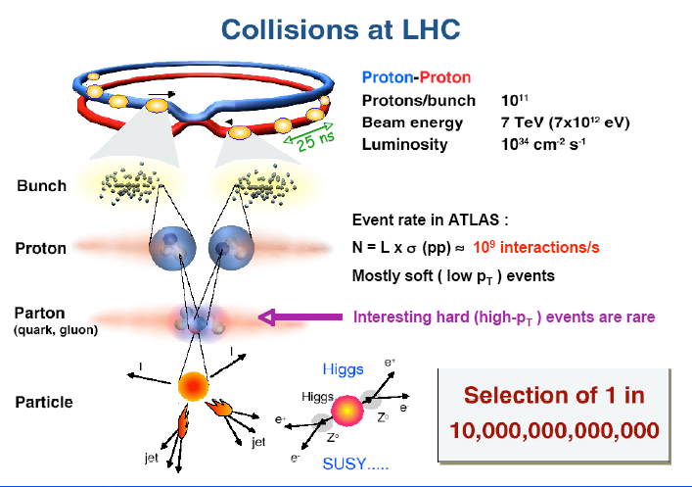
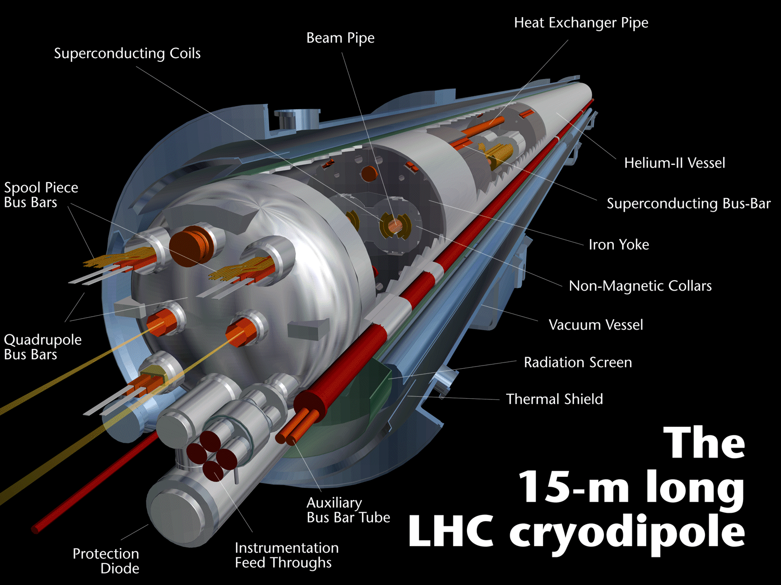
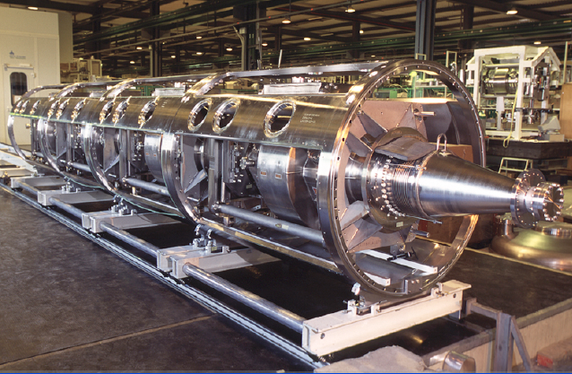
LHC: circular machine with energy gain per turn of some MeV

Slide 11
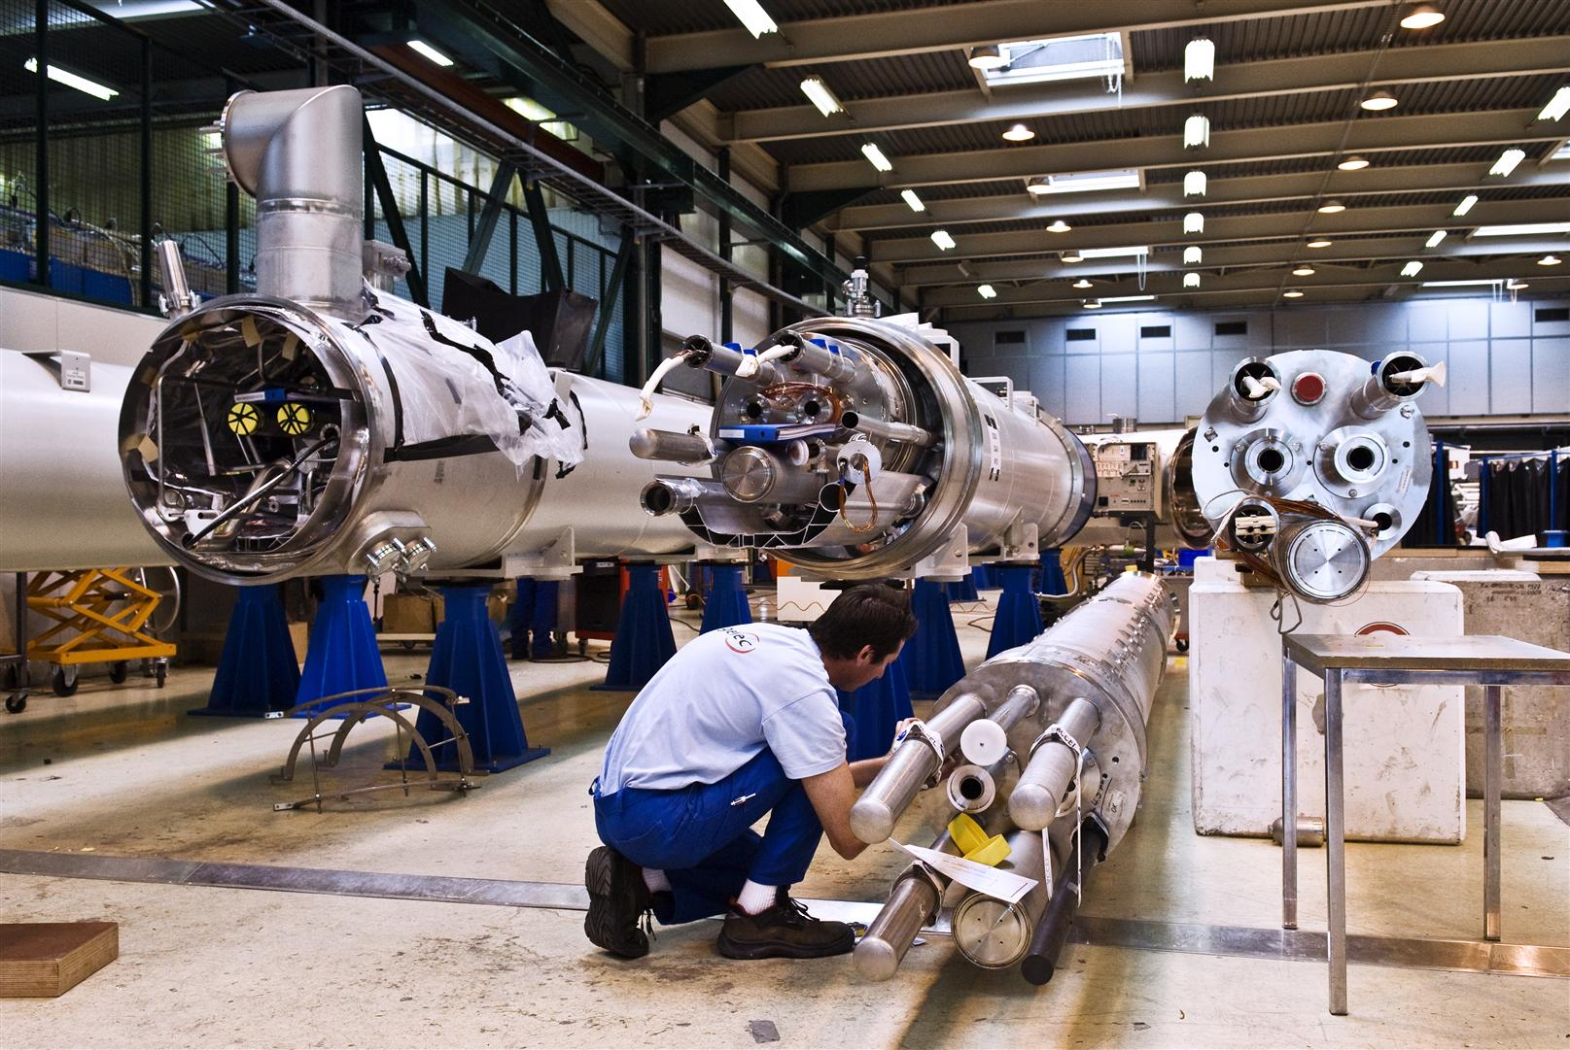
LHC magnet assembly at CERN

Slide 12
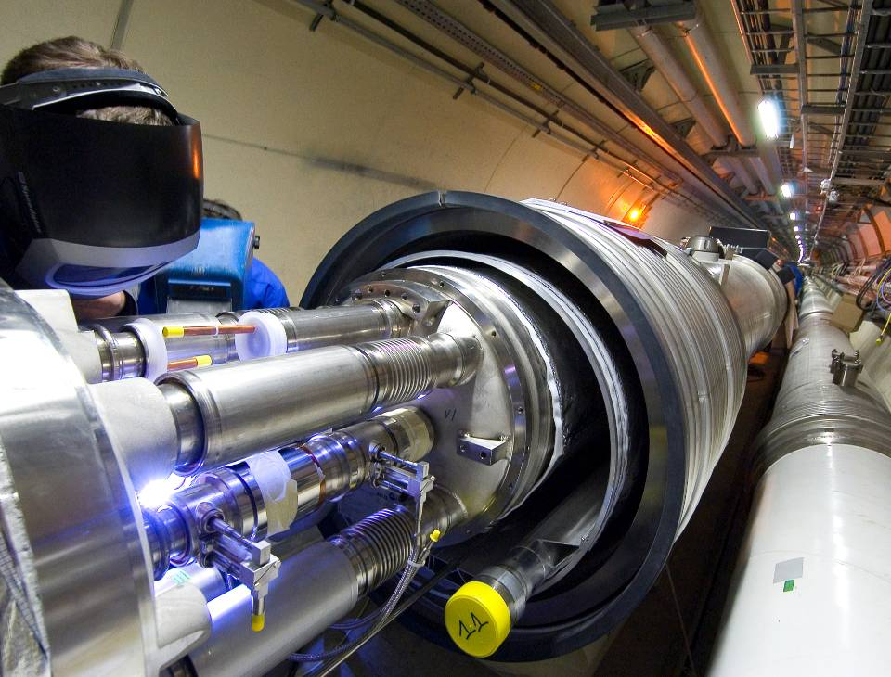
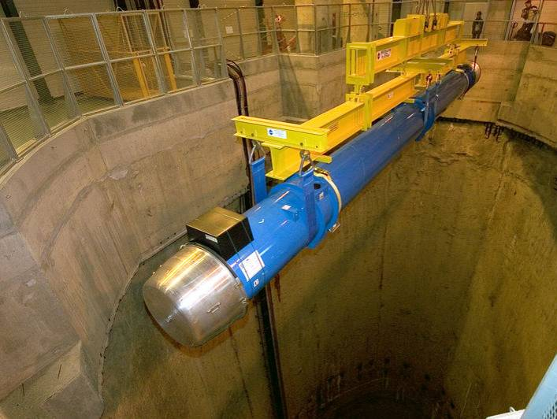
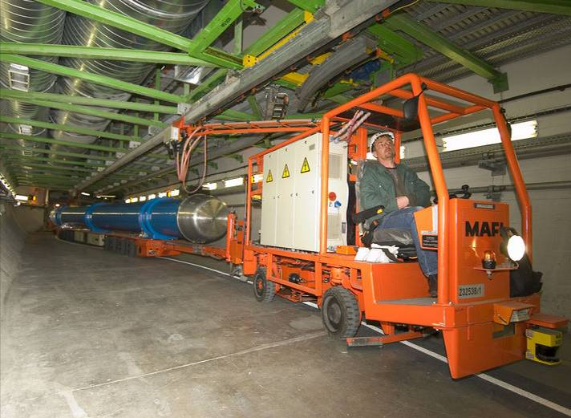
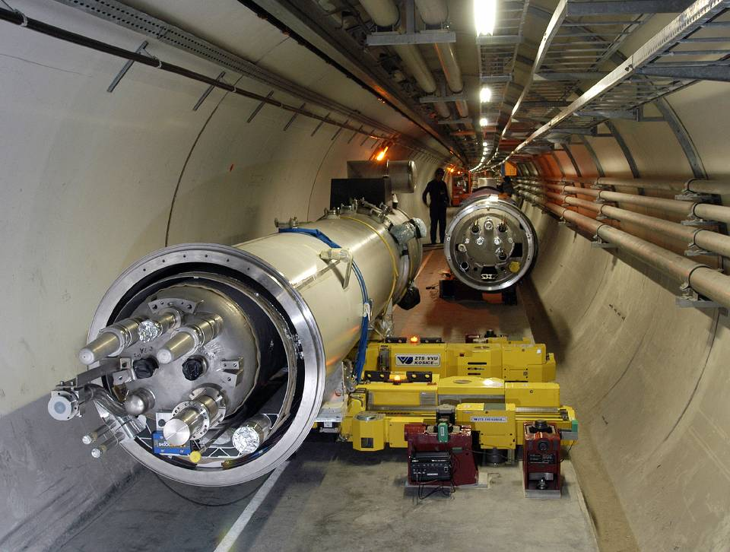
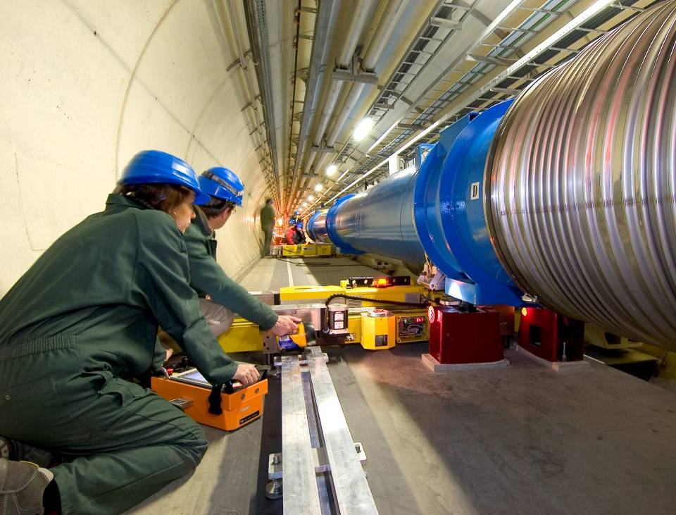
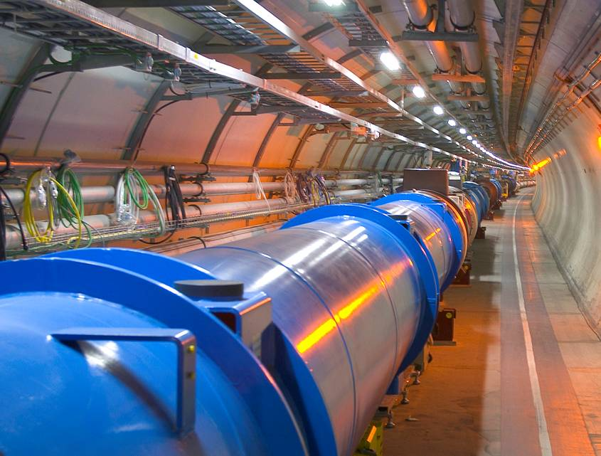
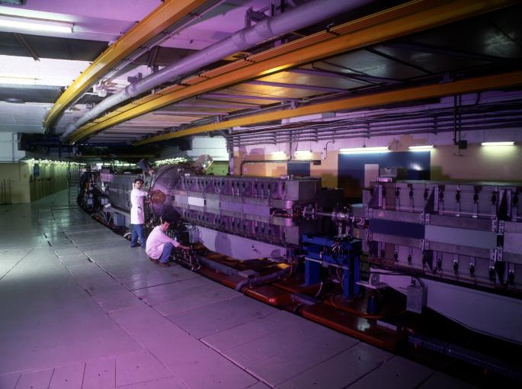

Slide 13
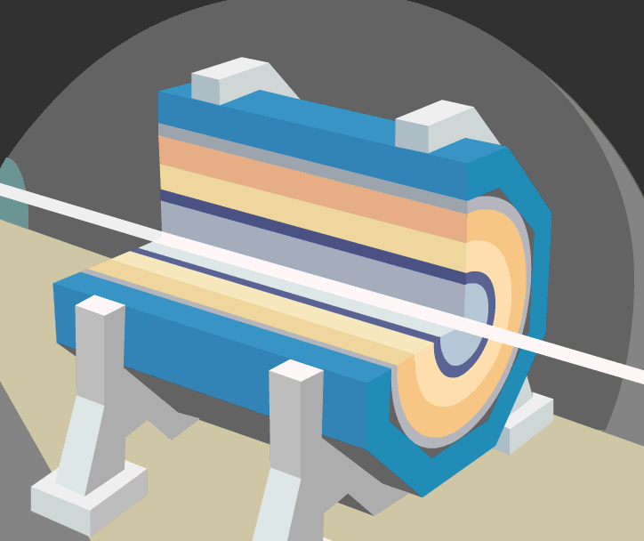
Observe the collisions

Slide 14
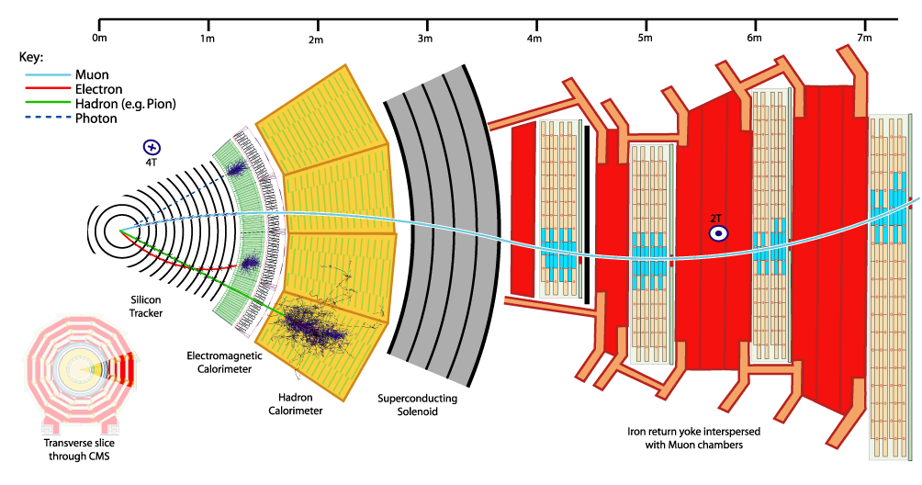
CMS

Slide 15
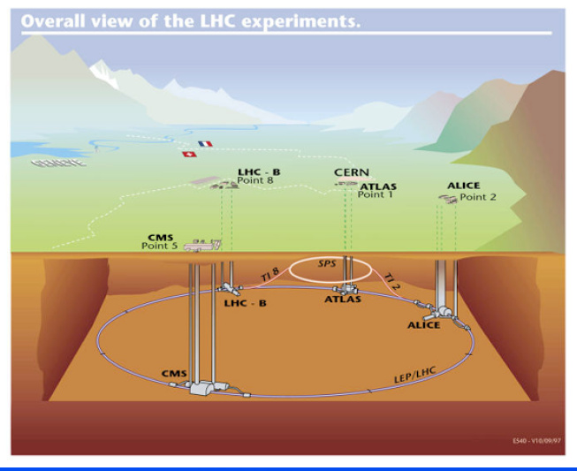
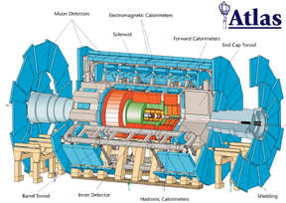
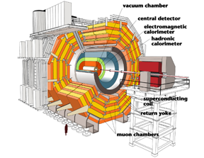
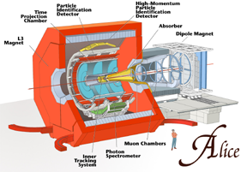
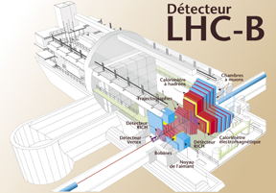
LHC Experiments
ATLAS, CMS:
- Higgs boson(s)
- SUSY particles
- more dimensions?
ALICE:
Quark Gluon Plasma
LHC-B:
- CP violation in B

Slide 16
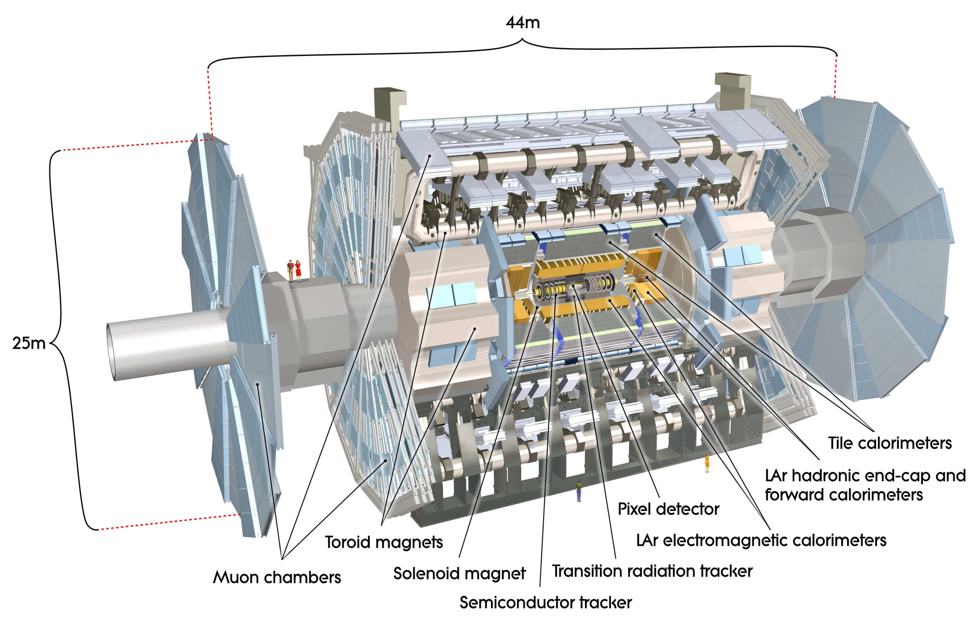
ATLAS (Spokesperson Fabiola Gianotti)
Number of scientists: 2100
Number of institutes: 167
Number of countries: 37

Slide 17
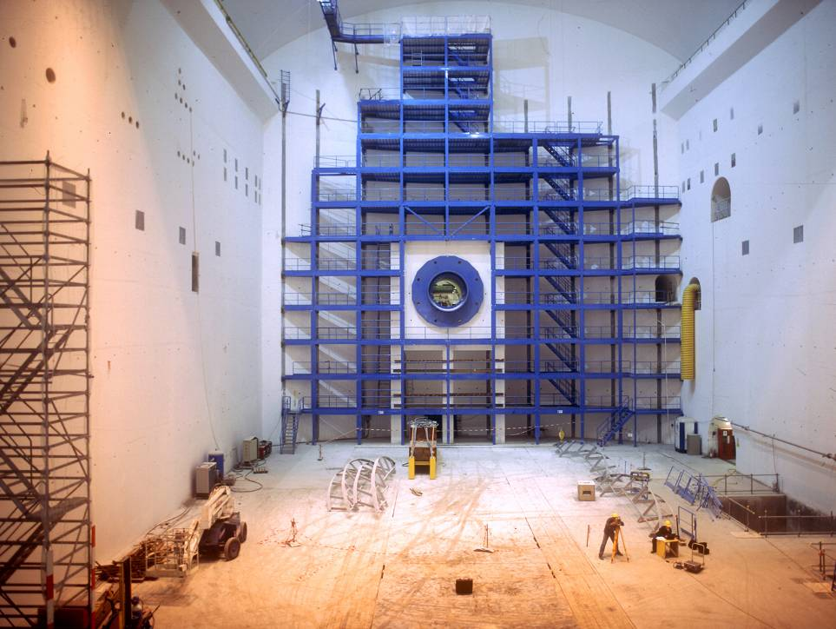
The ATLAS Cavern

Slide 18
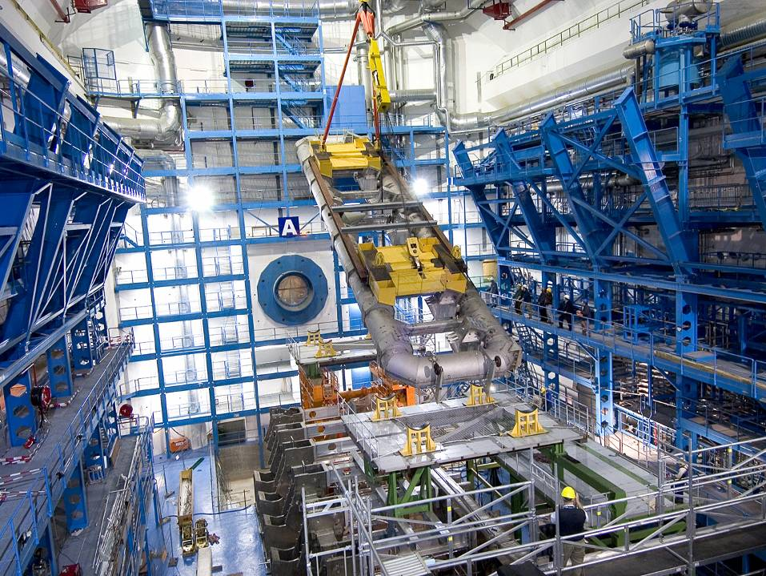

Slide 19
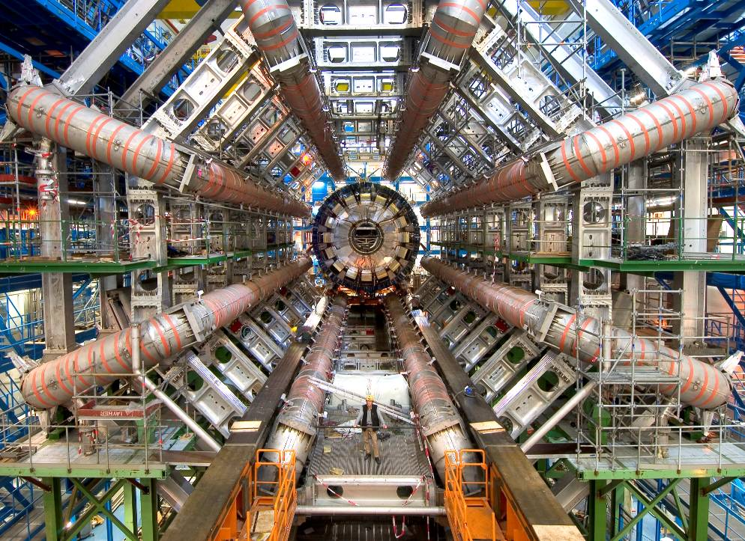
The ATLAS Cavern

Slide 20
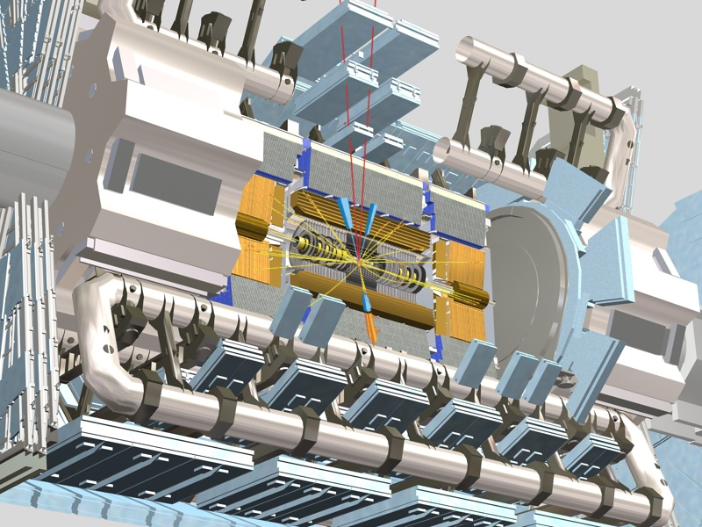
ATLAS
M.Nessi

Slide 21
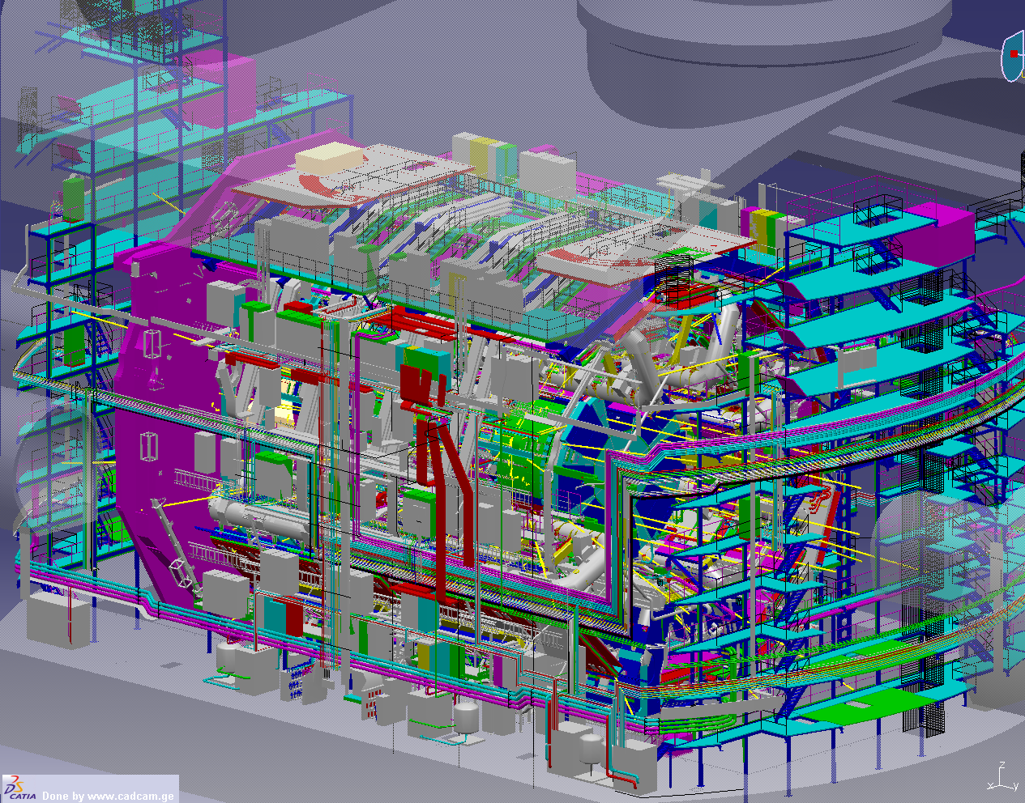

Slide 22
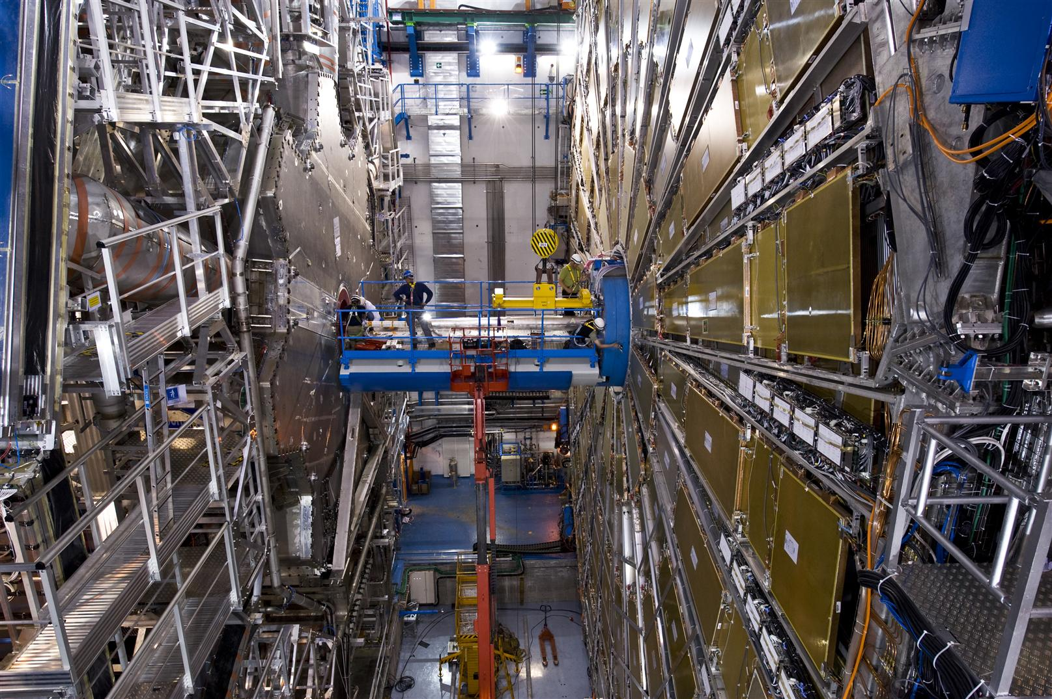
July 2008
“Digital camera”, 150 M pixels, observing: 10⁹ frames/s, recording selected frames: 200/s, ~1 GB/s recorded volume

Slide 23
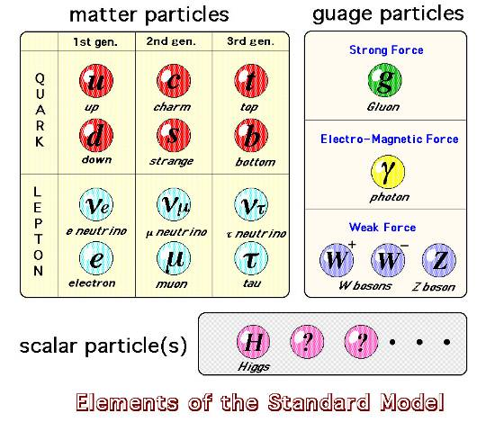
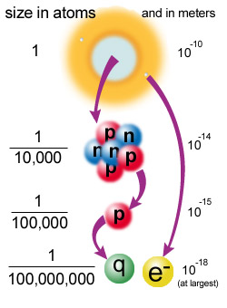
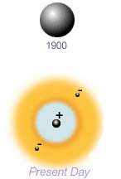


Matter and elementary particles
gauge
Atom
x8
Atomkern
Elektron
Quarks
Masse « top »: 171 GeV; Masse « neutrino » < fraction eV: m_{top} /m_{neutrino} >10¹³; explication par le champs de Higgs??
Notes:
A notre connaissance, le quark « top » a la même taille, le même comportement comme le quark « up » mais une masse plusieurs mille fois plus grande: pourquoi???

Slide 24
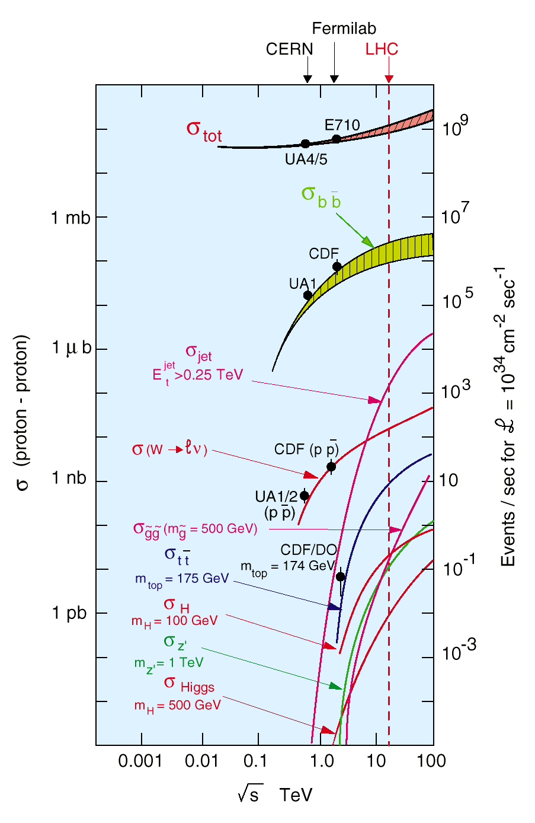
input information for experiments in 1988 and following years plus technical know how
interesting physics

Slide 25
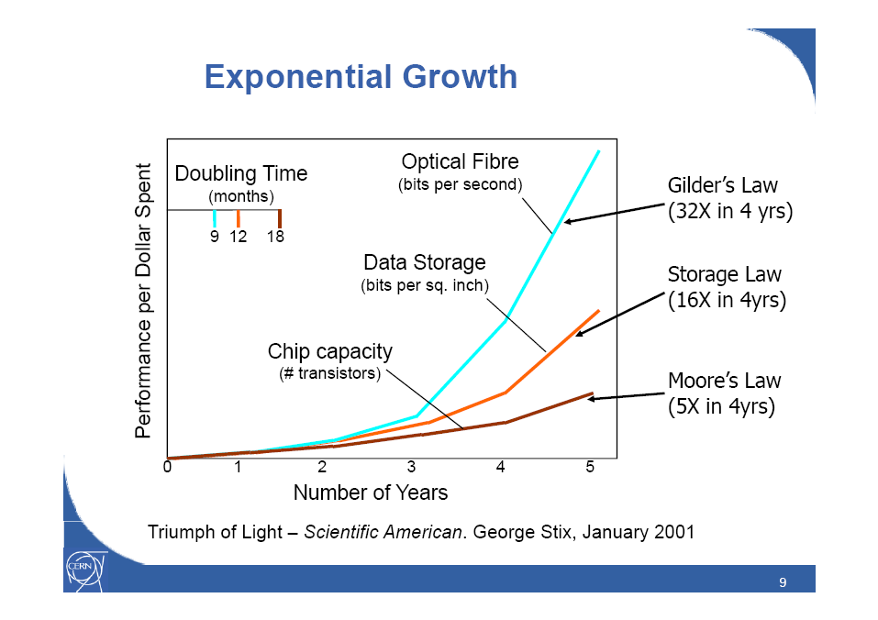
Example: Technologies’ watch
From CERN IT

Slide 26
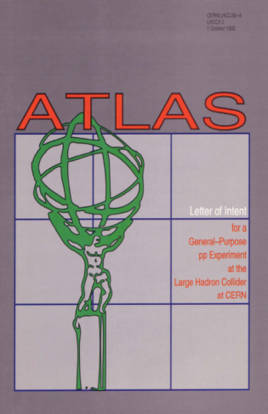

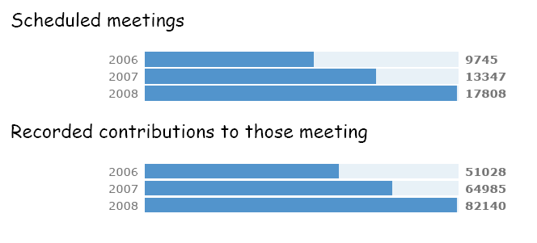
Maximum use of everybody’s knowledge
M&O MOU operation MOU
2003
MOU memorandum of understanding “construction”
LOI letter of intent 1992
RDxx
RD20
RD27
RD34
EAGLE
ASCOT
RDyy
RD13
RD6
RD3
TP technical proposal 1994
TDRs technical design reports from 1996
Beam 2009
Conception Phase
Design Phase
ATLAS only
Construction Phase
Exploitation Phase
Notes:
RD experiments and collaborations across all experiements
Phase 1 Conception of device by simulating interesting (hypothetical) physics in a variety of simulated detectors.
Phase 2: optimise and take engineering constraints into account
Construction phase: QA of all prototypes , then production of all pieces, their assembly and commissioning
Exploitation phase: operate device, analyse data under a variety of physics goals (>1000 planned analysis lines already)

Slide 27
Collaboration Board
(Chair: K. Jon-And
Deputy: G. Herten)
ATLAS
Plenary Meeting
Resources Review
Board
CB Chair Advisory
Group
Spokesperson
(F. Gianotti
2 Deputies)
ATLAS Organization
January 2009
Technical
Coordinator
(M. Nessi)
Resources
Coordinator
(M. Nordberg)
Executive Board
Inner Detector
(L. Rossi)
Tile Calorimeter
(B. Stanek)
Magnet System
(H. ten Kate)
Electronics
Coordination
(P. Farthouat)
Trigger
Coordination
(N. Ellis)
Data Prep.
Coordination
(C. Guyot)
Additional
Members
(T. Kobayashi,
M. Tuts, A. Zaitsev)
LAr Calorimeter
(I. Wingerter-Seez)
Muon
Instrumentation
(L. Pontecorvo)
Trigger/DAQ
( C. Bee,
L. Mapelli)
Commissioning/
Run Coordinator
(T. Wengler)
Computing
Coordination
(D. Barberis,
D. Quarrie)
Physics
Coordination
(D. Charlton)

Slide 28
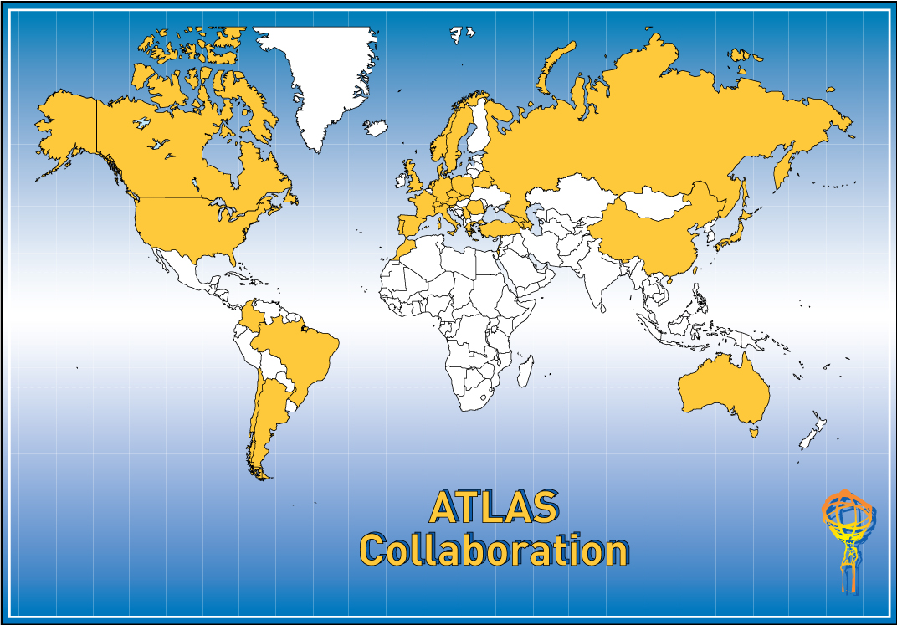
“Virtual” international big science laboratory
Funded, supervised by ~50 funding agencies
37 Countries
169 Institutions
2800 Scientific Authors
(1850 with a PhD)
Technical persons
Thousands of industrial relations
Notes:
Exists in some form since 1989, will continue 10-15 years: >30 years lifetime; then dissolve

Slide 29





International cooperation: Russian workers converting shells to CMS detector parts

Slide 30

CMS

Slide 31


Computing for LHC
a GRID the size of the planet!
Every year, the LHC experiments will produce about 15 peta-bytes of data. This is more than a thousand times the information contained in all books the World over and around,
~ 1% of all data ever produced by mankind – including photographs, digital imagery and everything else you can imagine! The only suitable way of accessing such a large quantity of information is using grid technology.

Slide 32
Information and Communication Technologies
ICTs are enabling, enhancing, encompassing, eliminating distances, pervasive, progressing rapidly
Cannot do without ICTs: science, innovation, development, education, health, . . . :
  overcome detail to address complexity
  need to get organised: collaborative culture, ICT education, application
We report some experiences and messages from a computer literate, globally collaborating (e-) science: particle physics
Grids: dynamically link together resources as a whole to support the execution of novel, large-scale, resource-intensive, and distributed applications

Slide 33
And have you heard of the… Web?

Slide 34




What is the Grid?
The World Wide Web provides seamless access to information that is stored in many millions of different geographical locations
In contrast, the Grid is an emerging infrastructure that provides seamless access to computing power, software and data; distributed over the globe.

Slide 35


Slide 36









Creating virtual organisations
Access to them needs to be provided in a secure, coordinated, seamless, dynamic and inexpensive way
Resources can be physical, virtual, single or multiple sited
Resources can be distributed world-wide
Resources can be of any information type
(storage, library, computing, networking, instrumentation, etc)
MárioCampolargo, DG INFSO

Slide 37
GÉANT - the global dimension
GÉANT and NORDUNET Networks
North America/Japan cooperation
SPONGE
SEEREN
Budget - 32 M€
In 2006
EUMEDCONNECT
ALICE
MárioCampolargo, DG INFSO
TEIN2
S. Africa
China
India

Slide 38
Measure Science Information Utility-Infrastructure
Earth Simulator
2003
LHC Exp.
Grav. Wave
Current accelerator Exp.
Nuclear Exp.
Astronomy
Atmospheric Chemistry Group

Slide 39

Provide equal access to the data, software, compute power. . to all participating scientists
“e-Science is about more than networks, Grids, High Performance Computing...; e-science is about global collaboration in key areas of science and the next generation of infrastructure that will enable it.” John Taylor, Director Research Councils, UK, 2000
Notes:
e-Science is about more than networks, Grids, High Performance Computing...; e-science is about global collaboration in key areas of science and the next generation of infrastructure that will enable it
John Taylor, Director Research Councils, UK, 2000

Slide 40


eScience infrastructure ingredients
people & VOs skills & training
computers (HPC; HTC); computer aided services
e-libraries
archive/curation centres
Multidisciplinary Collaborations:
Common objectives
Open sharing
Critical mass
Trust and respect
>Best efforts
Quality Assurance Service-oriented
interoperable open software
large data
repositories; data services
communication means
facilities, instruments, services
networks, services, dark λ

Slide 41
Start-up of LHC and experiments 2009 initial energy: 3500 GeV/beam later: 7000 GeV/beam

Slide 42

CERN as an Educator
Accelerator School
Apprentices
Doctoral Students
Academic Training
Fellows
Physics School
Exhibitions
Computing School
CERN-Latin America School
Visits
Technical Students
Summer Students
Microcosm
Outreach
Science on Stage
Technical Training
Language Training
Teachers programmes
Communications Training
Conferences
e-library school
Management Training

Slide 43

Bringing Nations Together
“…the promotion of contacts between, and
the interchange of, scientists…”

Slide 44
Knowledge preservation and availability (CERN)
Technical and scientific knowledge: publish and share “Open Access”; “green” ~100% , “gold” >85% publications
  Proprietary, industrial information: observe industrial agreements
Data: private to collaboration until no further interest, but publish any findings immediately (compete with other expts.)
    To work meaningfully with data one needs details of calibration, simulation, software, . . . and their time development
Finally produce and publish combined data analysis of all LHC experiments and their interesting physics channels

Slide 45
Green and golden roads to
Open Access publications
>20’000 journals, 2-3million articles/y; not affordable for anybody→ OA
Access, affordability and impact: OA on the web addresses all
Green Road to OA:
  Institutes mandate authors to self-archive all published articles in the institutional repository
    Golden road:
      mandate authors to publish in Open Access journals; authors pay for publications; publication fees part of research grant or in charge of mandating institution(s); authors keep copyright
    Use common-use licenses, with “some rights reserved” i.e. creative commons public licenses
    Promote Open Access to educational content and data
    Work on making use of the full potential of the digital medium and put an OA repository into each University or one for all
    Promote e-/cyber infrastructures for open, collaborative, networked science
Notes:
Access affordability and impact:
24,000 peer-reviewed journals publishing around 2.5 million articles per year; even at cost price not affordable for Universities
Loose research impact: articles not read are articles not quoted
Open Access quoted 2-3 times more than Pay to Access articles (Nature)
Green Road to OA: mandate institutions to self-archive all published articles in the institutional repository
80% of journals are green, allowing authors (theirs’ should be the IP!) to publish somehow in OA; example US-NIH 2007 (possibly 6-12 months embargo); EU ERC OA mandate 2008 and many more
INSPIRE, common retrieval platform for CERN, DESY, SLAC, FNAL based on Open Archive Initiative standards for metadata, also
Most effective for reaching the all relevant information
Golden road: journal publishes OA in the Web
5% of journals, >80% in particle physics publish OA (Springer, 2nd biggest overall, biggest OA . .)
Authors, funding agencies' consortia pay for QA and publishing cost
Living reviews, add digital objects to publications, reference details in publications down to source, add validated data such that paper can be understood fully
SPARC: Scholarly Publishing and Academic Resources Coalition
Not copyright free
Use common-use licenses, with “some rights reserved” for government and academic information online www.creativecommons.org
On OA read SPARC newsletter for figures, recent developments:
http://www.eartmam.edu/~peters/fos/ newsletter/01-02-09.htm
Data: One year after Canada converted it National Topographic Data Base to OA, there was a 54 times increase in downloads

Slide 46
IP, copyright, public interest
Broad implications of excessive restrictions on access to and reuse of government and government-funded research data
  Higher research costs
  Significant lost opportunity costs
  Barriers to innovation
  Less effective cooperation, education, and training
  Developing countries especially disadvantaged
Can avoid hyper-protection of data and information, especially in the public sector, by
  Balancing IP laws between the rights holder interests and the public interest, consistent with the country’s level of development
  Carve out broad public-interest exceptions for the public sector
  Use common-use licenses (example “creative commons”)
Notes:
Ref: Paul F. Uhlir, Director, Office of International Scientific and Technical Information Programs, and U.S CODATA; The National Academies; Washington, DC, USA); Pretoria, ZA, DCC: “Information Gulags, Intellectual Straightjackets & Memory Holes”

Slide 47










WSIS I, Geneva 2003
International Workshop on
African Research & Education Networking
September 25-27 2005
ITU, UNU and CERN for WSIS II in Tunis
WSIS II, Tunis 2005
Results:
Education, Training and Knowledge are Keys to Development
ICT are the means of storage of local content and access to the knowledge of the world; ICT make us virtual neighbours and enable close collaborations of distant partners using grids and e- infrastructures

Slide 48

Introduce e- repositories/libraries to African Universities to make African research output visible in the world
  Training in hard- and software for librarians from I-Themba/ZA, AAU Ghana, Rwanda (Kigali Inst. Education), Madagascar with the help of UNESCO IBSP in winter 2007
  e-Library tutoring and training for ~30 librarians from 15 institutions in Rwanda/Kigali in autumn 2009
  Training courses for high school teachers in physics, provision of teaching content

Slide 49
The global community of particle physicists and CERN…
Seeking answers to questions about the Universe
Advancing the frontiers of technology
Training the scientists, entrepreneurs, teachers of tomorrow
Bringing nations together through science

Slide 50


Knowledge is the capacity to act, the potential to start something*
The value of knowledge increases with its use
(Fundamental) scientific knowledge must be freely available (WSIS I: scientific community), “5th freedom” or “free movement of knowledge” for publicly funded research
When addressing great challenges, obtaining, sharing of all relevant knowledge is indispensible
  Balance IP laws between the rights holder’s interests and the public interest, consistent with the country’s level of development
Notes:
* Nico Stehr, Center for advanced cultural studies; Essen, Germany; published in: CERN-2004-004; 07 June 2004 “the role of science in the information society”

