Slide 1
Removal of distance margin for ATLAS-AFP
Sune Jakobsen (EP-UAT) on behalf of ATLAS-AFP
With input from:
Christina Yin Vallgren (TE-VSC)
Mario Deile (EP-CMT)
Benoit Salvant (BE-ABP)
Tatiana Medvedeva (BE-BI)
Barbara Holzer (BE-BI)
Markus Albert (BE-OP)
Giulia Papotti (BE-RF)
MPP/ CWG 24-07-2017

Slide 2
Introduction Operational experience Temperatures Primary vacuum Slow losses Fast losses UFOs Conclusion
Introduction
General agreed settings for horizontal Roman Pots in 2017:
General Roman Pot setting: TCT + 3 σ_{nominal} + 0.3 mm = 12 σ_{nominal} + 0.3 mm
Minimum 1.5 mm (not relevant for AFP).
Extra margin for new system for startup phase: TCT + 3 σ_{nominal} + 0.3 mm + 0.5 mm = 12 σ_{nominal} + 0.8 mm
Settings for AFP in startup phase:
Ultimate settings for AFP:
ATLAS-AFP requests to move to the ultimate settings after MD2/vdM.
Removal of distance margin for ATLAS-AFP MPP/ CWG 24-07-2017
Sune Jakobsen
2/9
Notes:
2

Slide 3
Introduction Operational experience Temperatures Primary vacuum Slow losses Fast losses UFOs Conclusion
Operational experience
ATLAS-AFP has been inserted in all allowed fills following the philosophy:
First fill at intensity step: Not inserted.
Second fill at intensity step: Inserted after 2 hours of Stable Beam.
Third fill at intensity step and onwards: Inserted directly after Stable Beam.
ATLAS-AFP has not experience any problems with insertions:
No unexpected extractions of Roman Pots.
No beam dumps coursed by AFP interlocks.
No problems with the sequences used to move in/out AFP (after the “Update absolute position” was made none-parallel).
Removal of distance margin for ATLAS-AFP MPP/ CWG 24-07-2017
Sune Jakobsen
3/9
Notes:
3

Slide 4
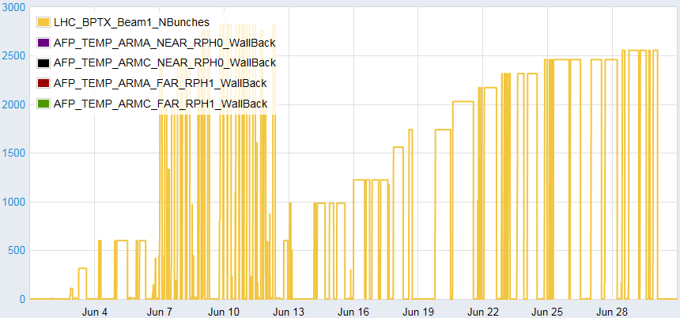
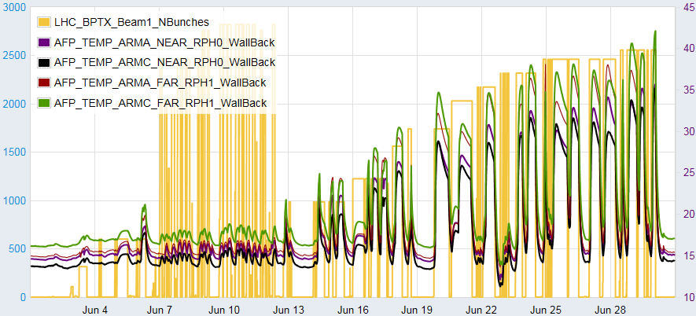
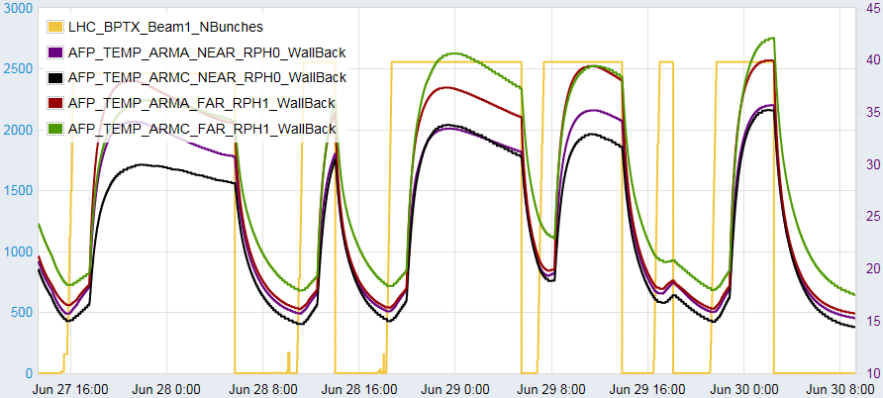
Introduction Operational experience Temperatures Primary vacuum Slow losses Fast losses UFOs Conclusion
Operational experience – Temperature of the Roman Pots
B-stations
Number of bunches
Temperature [°C]
A-stations
Clear correlation between number of bunches and temperature increase of the AFP Roman Pots.
The heating is significantly more pronounced for the B-stations, which has Roman Pots closer to the beam.
Maximum temperature observed on a Roman Pot is 42 °C (Roman Pots are baked-out at ~200 °C).
Even for the most pessimistic estimate of thermal expansion (~2 µm/°C) the distance from beam changes less than 1 σ_{nominal} for any realistic temperature increase.
By moving the Roman Pot closer to the beam additional heating is expected (+ ~30 %), but the temperatures of the Roman Pots are not worrying (however the detector cooling might need to be revisited => not a LHC safety concern).
Removal of distance margin for ATLAS-AFP MPP/ CWG 24-07-2017
Sune Jakobsen
4/9
Notes:
4

Slide 5
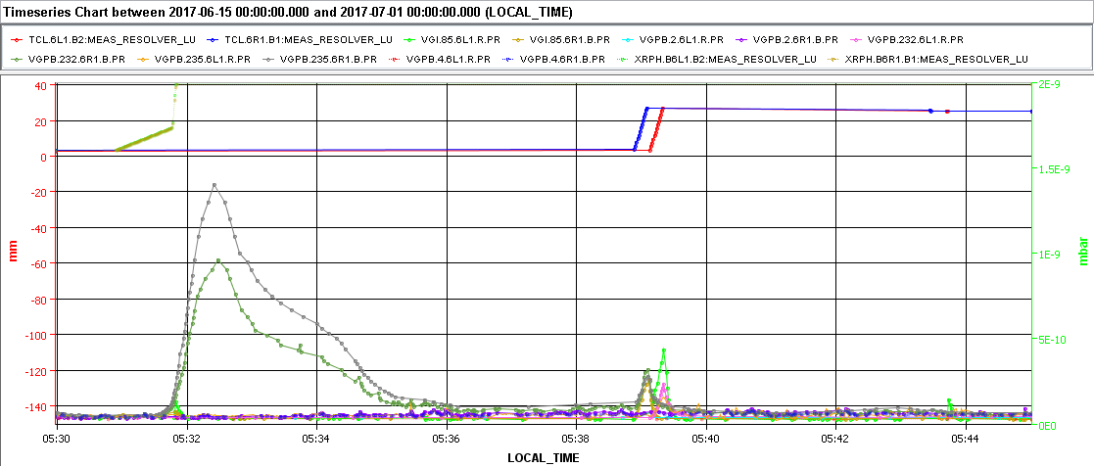
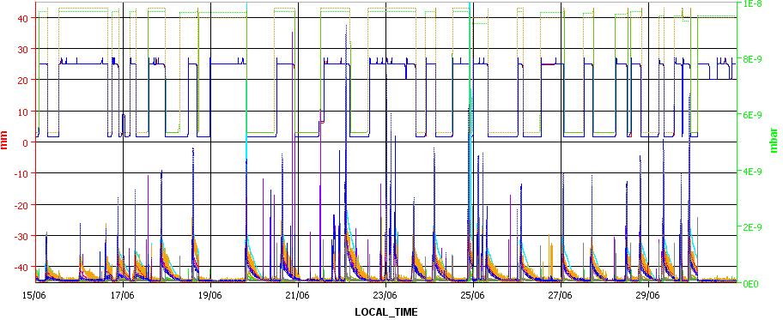
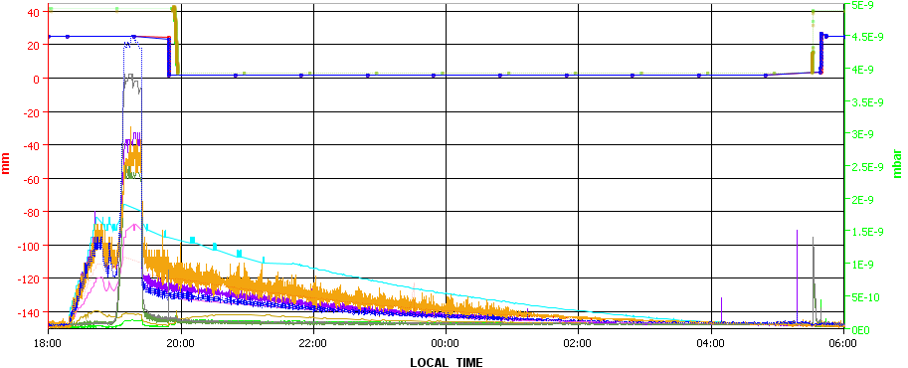
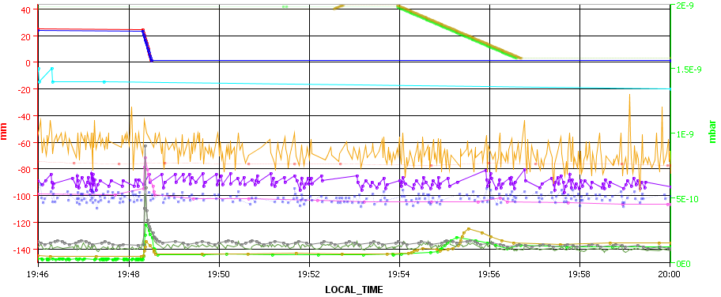
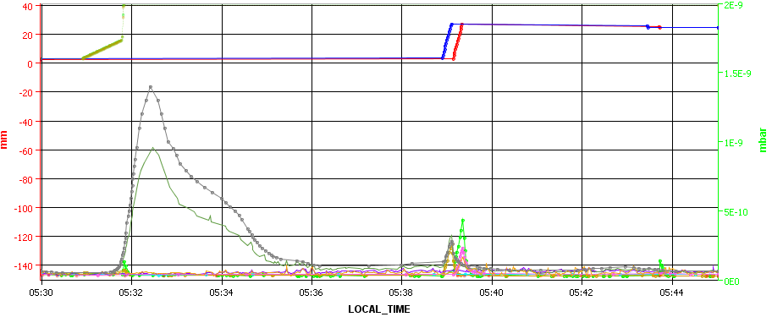
Introduction Operational experience Temperatures Primary vacuum Slow losses Fast losses UFOs Conclusion
Operational experience – Primary vacuum
Vacuum layout in backup slides
Overview of intensity ramp up
One fill
Indication of heating
Insertion of AFP Roman Pots and TCL6
Extraction of AFP Roman Pots and TCL6
TCL6s
Roman Pots
Roman Pots
TCL6s
Minor spikes
Only on RIGHT side
Minor spikes
Vacuum behavior very reproducible from fill to fill.
Some indication of heating on the vacuum pressures.
Minor (~1E-9 mbar) spikes systematically observed when moving the TCLs or AFP Roman Pots.
When moving OUT the AFP Roman Pots on the RIGHT side, larger/longer vacuum spikes are observed.
The spikes are observed both with and without beam, which could indicate it comes from friction.
Removal of distance margin for ATLAS-AFP MPP/ CWG 24-07-2017
Sune Jakobsen
5/9
Notes:
5

Slide 6
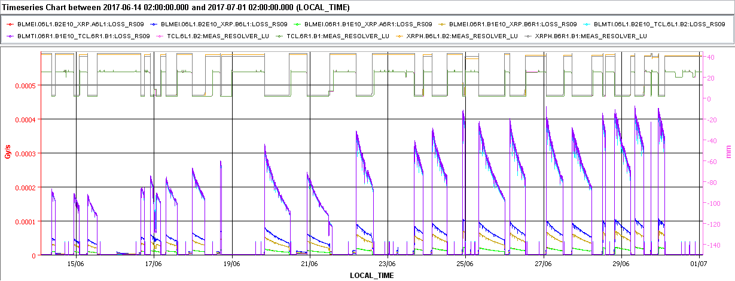
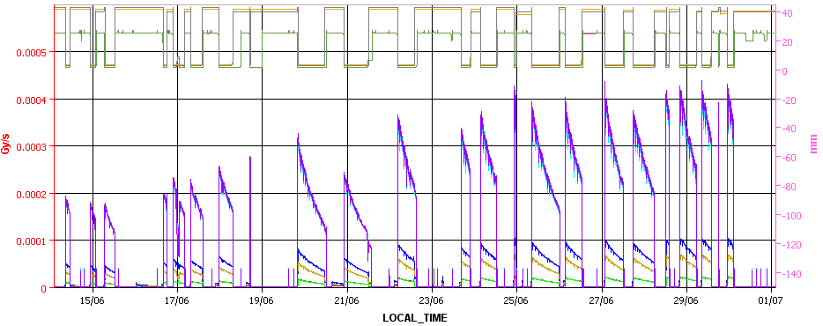
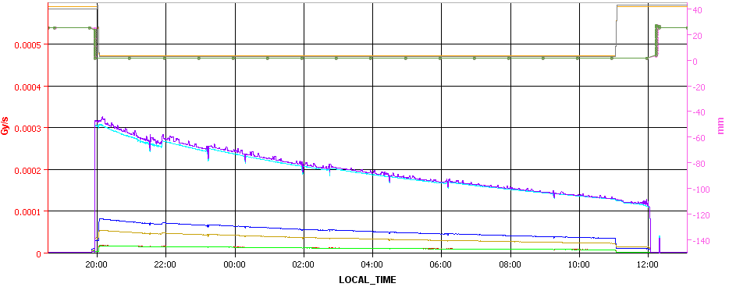
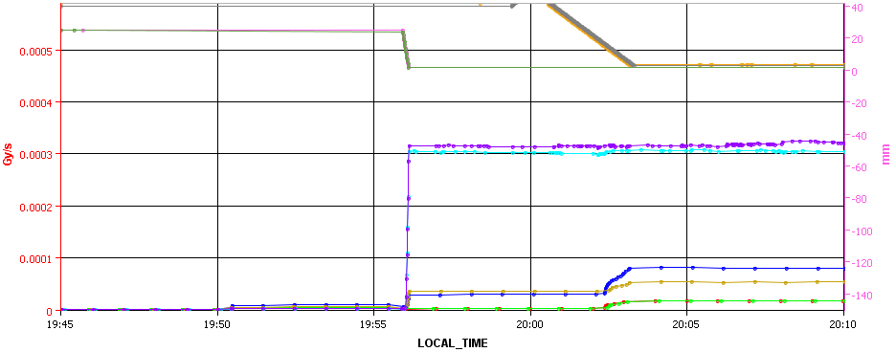
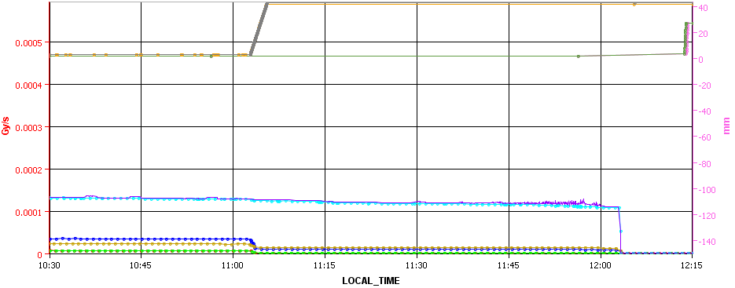
Introduction Operational experience Temperatures Primary vacuum Slow losses Fast losses UFOs Conclusion
Operational experience – slow losses (RS9)
Overview of intensity ramp up
One fill
Insertion of AFP Roman Pots and TCL6
Extraction of AFP Roman Pots and TCL6
Roman Pots
Roman Pots
TCL6s
TCL6s
Slope of losses when moving Roman Pot
Movement of TCL6 and AFP Roman Pots clearly visible.
Slope losses vs Roman Pot position not alarming.
BLM threshold (RS09) XRP ~0.007 Gy/s, TCL6 ~0.004 Gy/s, so all losses below 10 % of threshold.
Analysis repeated for BLM threshold RS12 the results confirmed.
Removal of distance margin for ATLAS-AFP MPP/ CWG 24-07-2017
Sune Jakobsen
6/9
Notes:
6

Slide 7
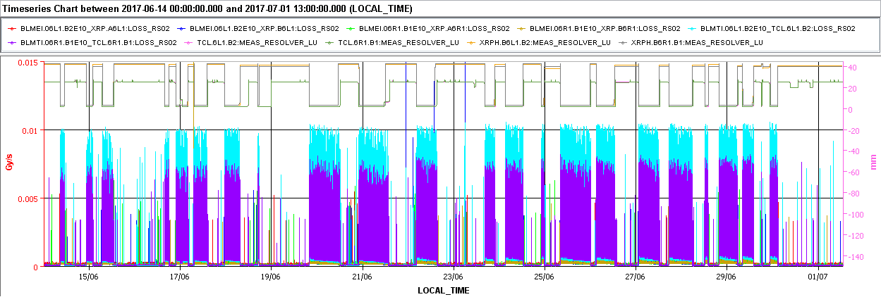
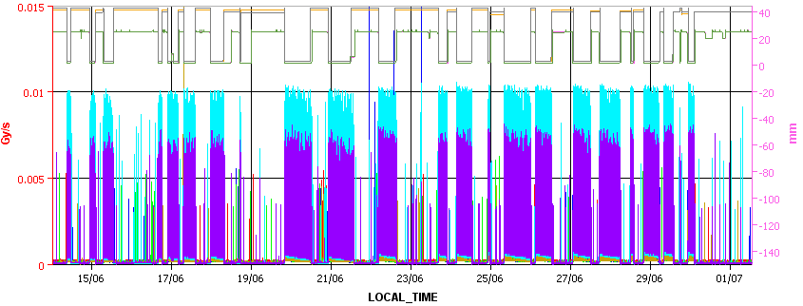
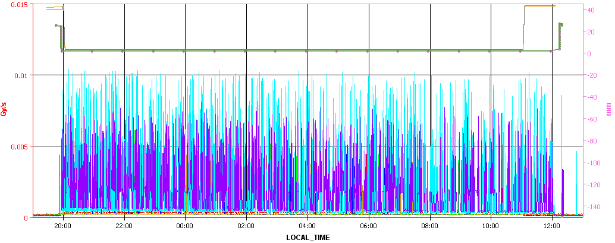
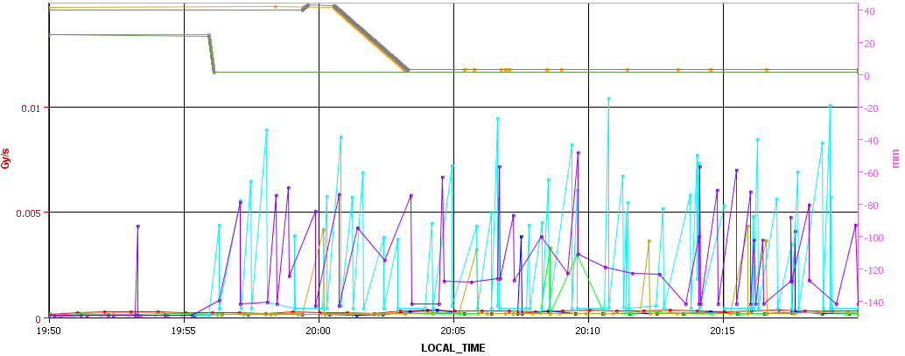
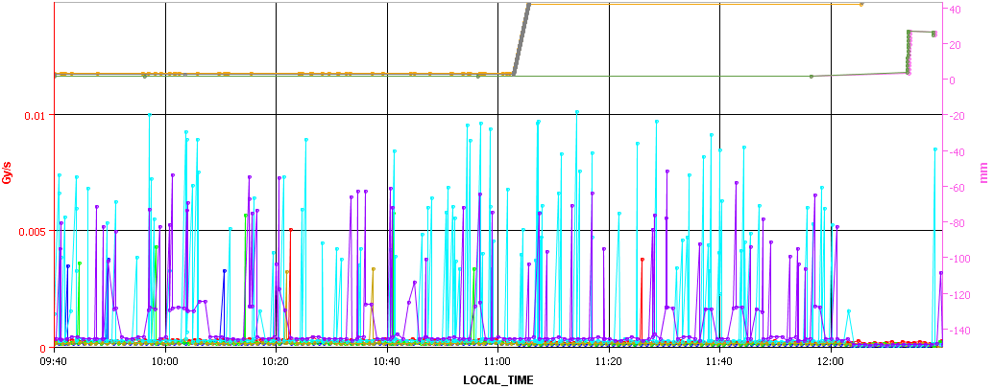
Introduction Operational experience Temperatures Primary vacuum Slow losses Fast losses UFOs Conclusion
Operational experience – fast losses (RS2)
Overview of intensity ramp up
One fill
Insertion of AFP Roman Pots and TCL6
Extraction of AFP Roman Pots and TCL6
Roman Pots
Roman Pots
TCL6s
TCL6s
No particular spikes when moving the Roman Pots or TCL6.
BLM threshold (RS02) XRP ~7.7 Gy/s, TCL6 ~23.2 Gy/s, so all losses below 1 % of threshold.
Removal of distance margin for ATLAS-AFP MPP/ CWG 24-07-2017
Sune Jakobsen
7/9
Notes:
7

Slide 8
Introduction Operational experience Temperatures Primary vacuum Slow losses Fast losses UFOs Conclusion
Operational experience – UFOs
Analysis curtesy of Giulia Papotti and Markus Albert.
Conclusions:
UFOs observed at AFP (until 15/7):
B1: 7 UFOs
B2: 37 UFOs
The number of UFOs are not outstanding nor alarming.
Most UFOs are 2-3 % of BLM dump threshold.
No UFO at AFP reached 25 % of BLM dump threshold.
Removal of distance margin for ATLAS-AFP MPP/ CWG 24-07-2017
Sune Jakobsen
8/9
Notes:
8

Slide 9
Introduction Operational experience Temperatures Primary vacuum Slow losses Fast losses UFOs Conclusion
Conclusion
Various check made:
Temperature of Roman Pots
Primary vacuum (friction observed when moving OUT)
Slow losses
Fast losses
UFOs
No alarming point discovered.
All loss maps performed with ultimate setting (no instabilities or problematic losses).
ATLAS-AFP therefore requests to move to the ultimate settings after MD2/vdM.
Settings for AFP in startup phase:
Ultimate settings for AFP:
Removal of distance margin for ATLAS-AFP MPP/ CWG 24-07-2017
Sune Jakobsen
9/9
Notes:
9

Slide 10
Introduction Operational experience Temperatures Primary vacuum Slow losses Fast losses UFOs Conclusion
Backup
Removal of distance margin for ATLAS-AFP MPP/ CWG 24-07-2017
Sune Jakobsen
10/9
Notes:
10

Slide 11
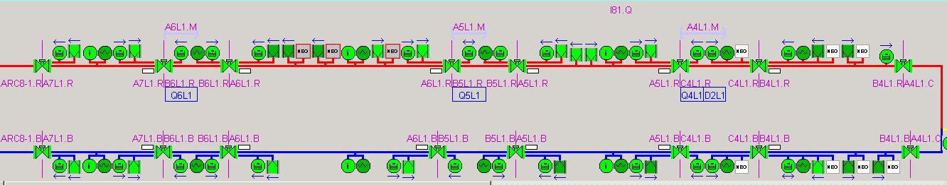
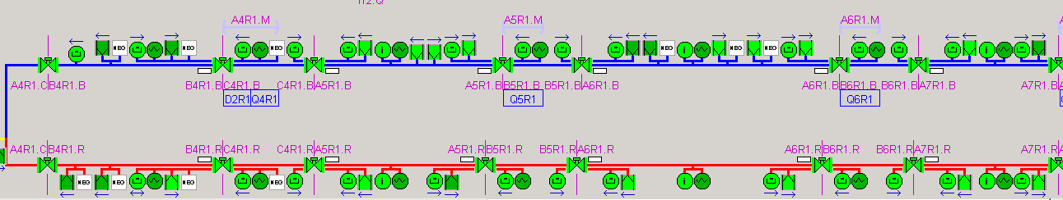
Introduction Operational experience Temperatures Primary vacuum Slow losses Fast losses UFOs Conclusion
Vacuum layout – cutesy of Christina Yin Vallgren
VGPB.232.6L1R
VGI.85.6L1.R
VGPB.4.6L1.R
VGPB.4.6R1.B
VGI.85.6R1.B
VGPB.232.6R1.B
Removal of distance margin for ATLAS-AFP MPP/ CWG 24-07-2017
Sune Jakobsen
11/9
Notes:
11

