Slide 1


Analysis of SIS interlock triggering in 2017 run and outcome of dedicated beam tests
Arek Gorzawski
A. Mereghetti, J. Wenninger, L. Ponce, S. Redaelli, R. Bruce
LHC Collimation Working Group #221 - Joint MPP

Slide 2

Outline
Interlocking concept and motivation
Validation status
  Log file
  Log file NEW
  Dedicated Tests with a beam
Summary

Slide 3
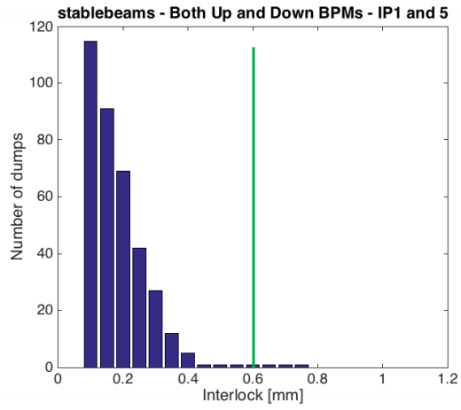
Motivation
SIS follows the collimator beam center measured from the embedded BPMs.
Following the TCT BPM performance analysis (A.Mereghetti et.al, Evian2016)
600 μm interlock limit was set (from 2016)
In addition to the analysis of orbit quality/stability, this new analysis of sis logs will also provide an assessment of the overall chain, addressing the complete implementation (status of acquisitions, etc) and the reliability.
Notes:
From summary on the evian (validation of the orbit reproducibility & performace analysis) -> trigger/interlock window
-> overall test (SIS system to log…)
In addition to the analysis of orbit quality/stability, this new analysis of sis logs will also provide an assessment of the overall chain, addressing the complete implementation (status of acquisitions, etc) and the reliability. in addition to the analysis of orbit quality/stability, this new analysis of sis logs will also provide an assessment of the overall chain, addressing the complete implementation (status of acquisitions, etc) and the reliability.

Slide 4
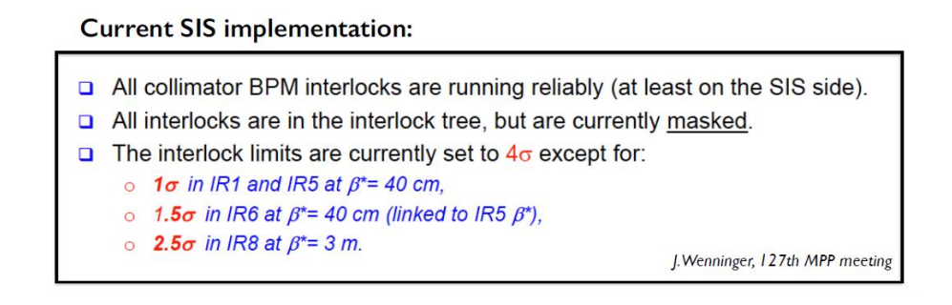
Motivation
The SIS produces the log file for EVERY interlocking case.
  How many (false?) dumps we would have, if in 2017 we use 2016 analysis result?

Slide 5
Outline
Interlocking concept and motivation
Validation status
  Log file
  Log file NEW
  Dedicated Tests with a beam
Summary

Slide 6
The SIS Log File
2017-05-25 22:49:43,004 [EventUpdaterThread-null-5] ERROR BpmCollimatorCenterValueConditionExtImpl adc97491-418b-11e7-843f-0f3eb12d931c =>
*** Collimator beam center [SISREF_TCTPV_4R2B2 / BPTUV_A4R2B2_ACQ - BPTDV_A4R2B2_ACQ] :
Beta @ collimator = 101.7 [m] for beta* = 10.00 [m] @ IR2
Beam sigma @ collimator = 0.232 [mm] with tolerance = 4.00 [sigma] @ E = 6499 [GeV] - emit = 3.5 [um]
Up BPM position = -1.123 [mm] - -121 [tol %] status = true
Down BPM position = -1.193 [mm] - -129 [tol %] status = true
Dump count =
2017-05-25 22:49:45,003 [EventUpdaterThread-null-5] ERROR BpmCollimatorCenterValueConditionExtImpl aefaa191-418b-11e7-843f-0f3eb12d931c =>
*** Collimator beam center [SISREF_TCTPH_4R8B2 / BPTUH_A4R8B2_ACQ - BPTDH_A4R8B2_ACQ] :
Beta @ collimator = 234.5 [m] for beta* = 3.00 [m] @ IR8
Beam sigma @ collimator = 0.352 [mm] with tolerance = 2.50 [sigma] @ E = 6499 [GeV] - emit = 3.5 [um]
Up BPM position = 2.899 [mm] - 329 [tol %] status = true
Down BPM position = 3.101 [mm] - 352 [tol %] status = true
Dump count =
2017-05-25 22:49:45,003 [EventUpdaterThread-null-5] ERROR BpmCollimatorCenterValueConditionExtImpl aefaa191-418b-11e7-843f-0f3eb12d931c =>
*** Collimator beam center [SISREF_TCTPV_4R2B2 / BPTUV_A4R2B2_ACQ - BPTDV_A4R2B2_ACQ] :
Beta @ collimator = 101.7 [m] for beta* = 10.00 [m] @ IR2
Beam sigma @ collimator = 0.232 [mm] with tolerance = 4.00 [sigma] @ E = 6499 [GeV] - emit = 3.5 [um]
Up BPM position = -1.123 [mm] - -121 [tol %] status = true
Down BPM position = -1.194 [mm] - -129 [tol %] status = true
Dump count =

Slide 7
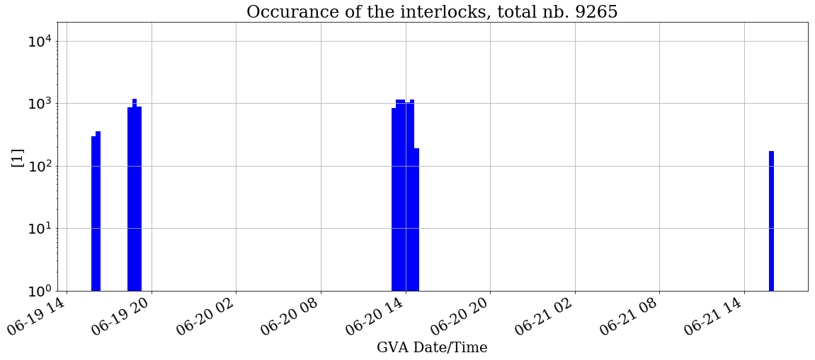
June (as from 4th)
Operation related interlocks - potential dump cause?
TCTPH, R2 B2
(orbit excursion, 5850 Dumped by IR6 BPM)
Tests @ Injection:
Xing levelling test
Tests @ Injection:
new OFB deployed
Tests @ Injection:
(NO ENTRY IN THE LOGBOOK!)

Slide 8
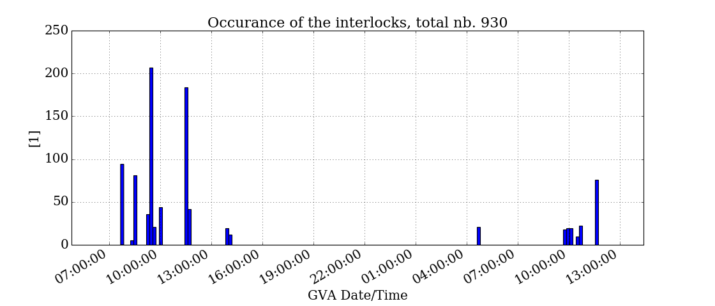
July 9-10
Operation related interlocks - potential dump cause!
Detailed TEST results in next slides…
SIS Tests @ Injection (9 July)
SIS Tests @ FT (10 July)
14:02 (9 July) SISREF_TCTPH_4L8B1
4:02 (10 July)
SISREF_TCSP_A4L6B2
LogBook 14:06: RCBH16.R8B1 tripped with feedback off. Lost beam 1 therefore.
We will refill directly and re-attempt.
No Logbook entry about orbit drifts etc. no beam dump by something else
Both cases a gentle rise of the tolerance exceed is recorded… orbit drift.

Slide 9
July, after SIS test, before the 24th
SIS server left with logging option ON
  That means ALL logged checks also the ones with not tolerance exceed were saved…
  … therefore log file was flooded with ‘normal checks’ and over rotate the buffer…
  No representative data can be found!

Slide 10
Procedure for the beam tests
We moved collimators by 3.5s (or ~90% of the interlock) to not trigger the interlock.
  Noted down the meassured vs expected tolerance budget used,
We moved another 15% (remaining 10 plus some to trigger)
  When interlock was triggerd we moved back to original position and moved to another channel
If needed repeated with small steps of ~5% to hit the triggering levels.

Slide 11
Results from the beam tests
Injection (Sun 9 July) tests:
  All channels passed the test, with one remark.
  IP2 tolerance difference: 4σ expected ~6.5σ found.
    Discrepancy comes from the ATS optics in IP2:
      Beta* does not change while beta at TCT goes from 40m to 80m.
      SIS mechanics follows the beta* change, and was only with one value (80m)
    To decide: change the limits?

Slide 12
Results from the beam tests
Flat top/ squeezed (Mon 10 Jul):
  All channels passed the test!
  One channel (IP1 B2 V) had wrong tolerance: 1σ was expected 4σ found
    Fixed!
  IP8 tolerance (logged by SIS) found at 2.95σ...
    The optics correction was applied and it modified the β*: 3.03m instead of 3.0m,
    thus the interpolation from SIS modified the initial 2.5σ to 2.95σ
    Understood, to be changed!

Slide 13
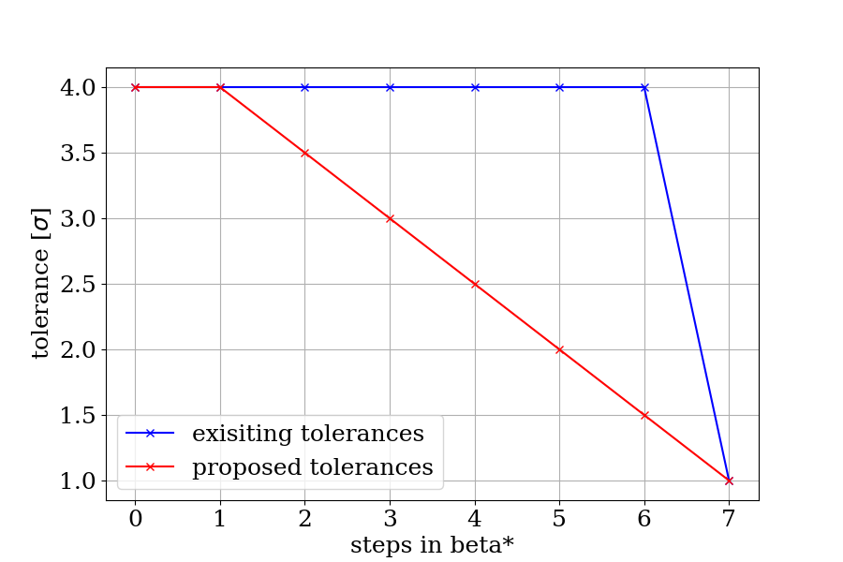
Miscellanea (1)
As another outcome of the test we propose to consider to include more smooth change of the limits:
EXAMPLE

Slide 14
Miscellanea (2)
No signature of IP1 TCTPH (B1/B2) being logged (in the data from month of June)
  Check if imported to SIS!
UPDATE (after the SIS test):
IP1 TCTPH (L1/R1) did appear in the logs from the tests!

Slide 15
Summary
No spurious triggers, however:
  One dump trigger (back in June) case where beam was dumped by another interlock (IR6).
  Another two in July (SIS WE tests), one dumped by another means one unknown…
Dedicated beam tests ultimately qualified the supervised channels.
  Revealing some inconsistencies that are fixed by now!

