Slide 1

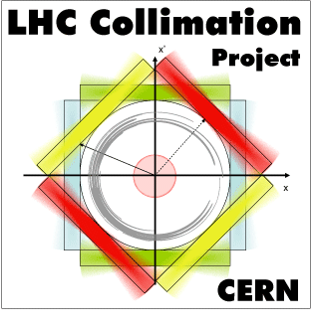
Beam 2 loss maps at injection after TS1
D. Mirarchi, C. Bracco, R. Bruce, A. Mereghetti

Slide 2
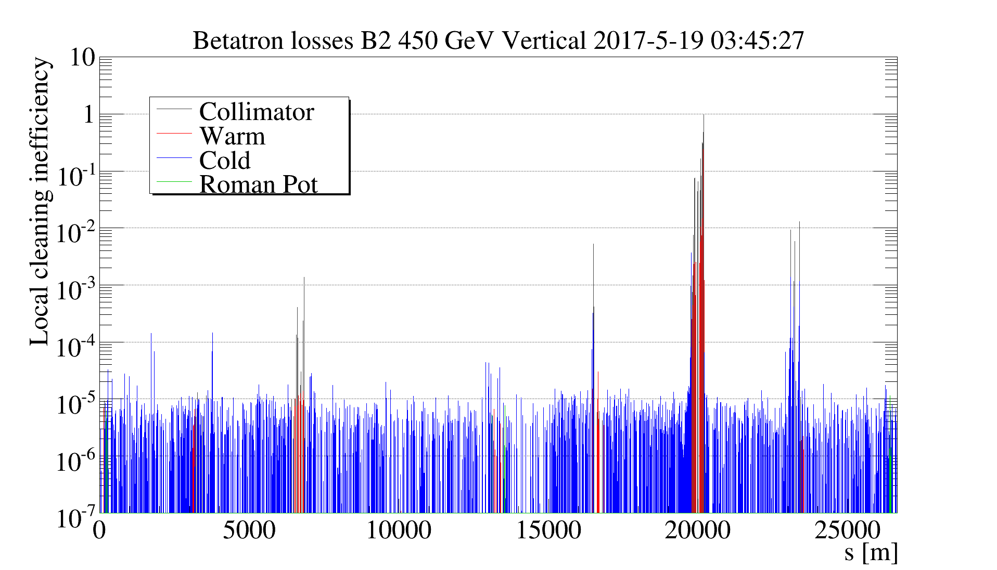
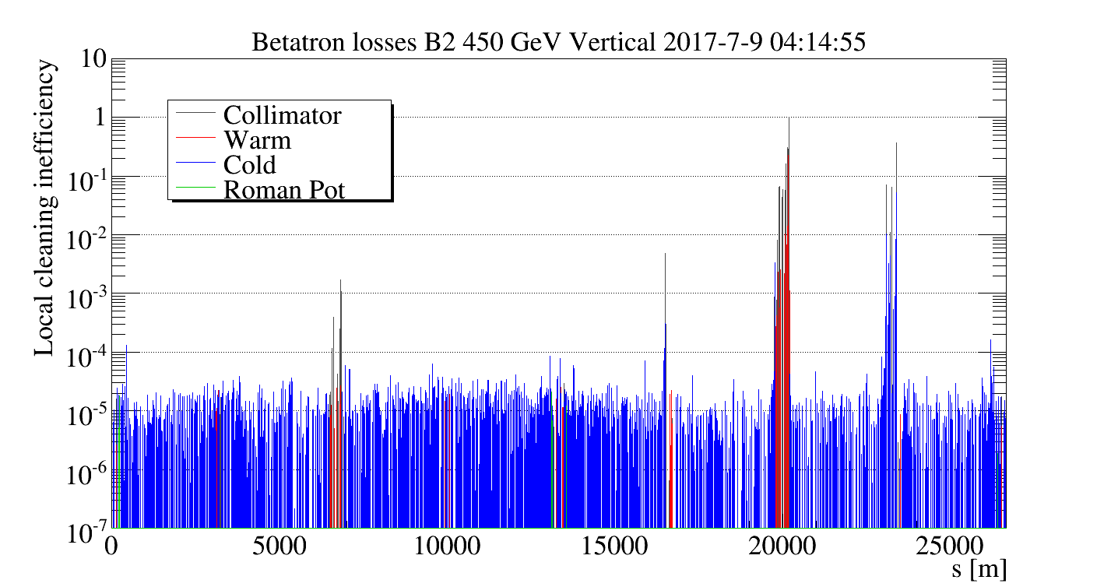
Introduction
Validation loss maps after TS1 shown much higher losses on TDI.4R8 w.r.t. commissioning (factor ∼40)
Commissioning 2017
TS1 2017
Investigations performed to understand the source of such increased losses:
  Checked TDI alignment
  Loss maps B2V with nominal settings and single jaw
Within 100 μm, i.e. 1/6 σ

Slide 3
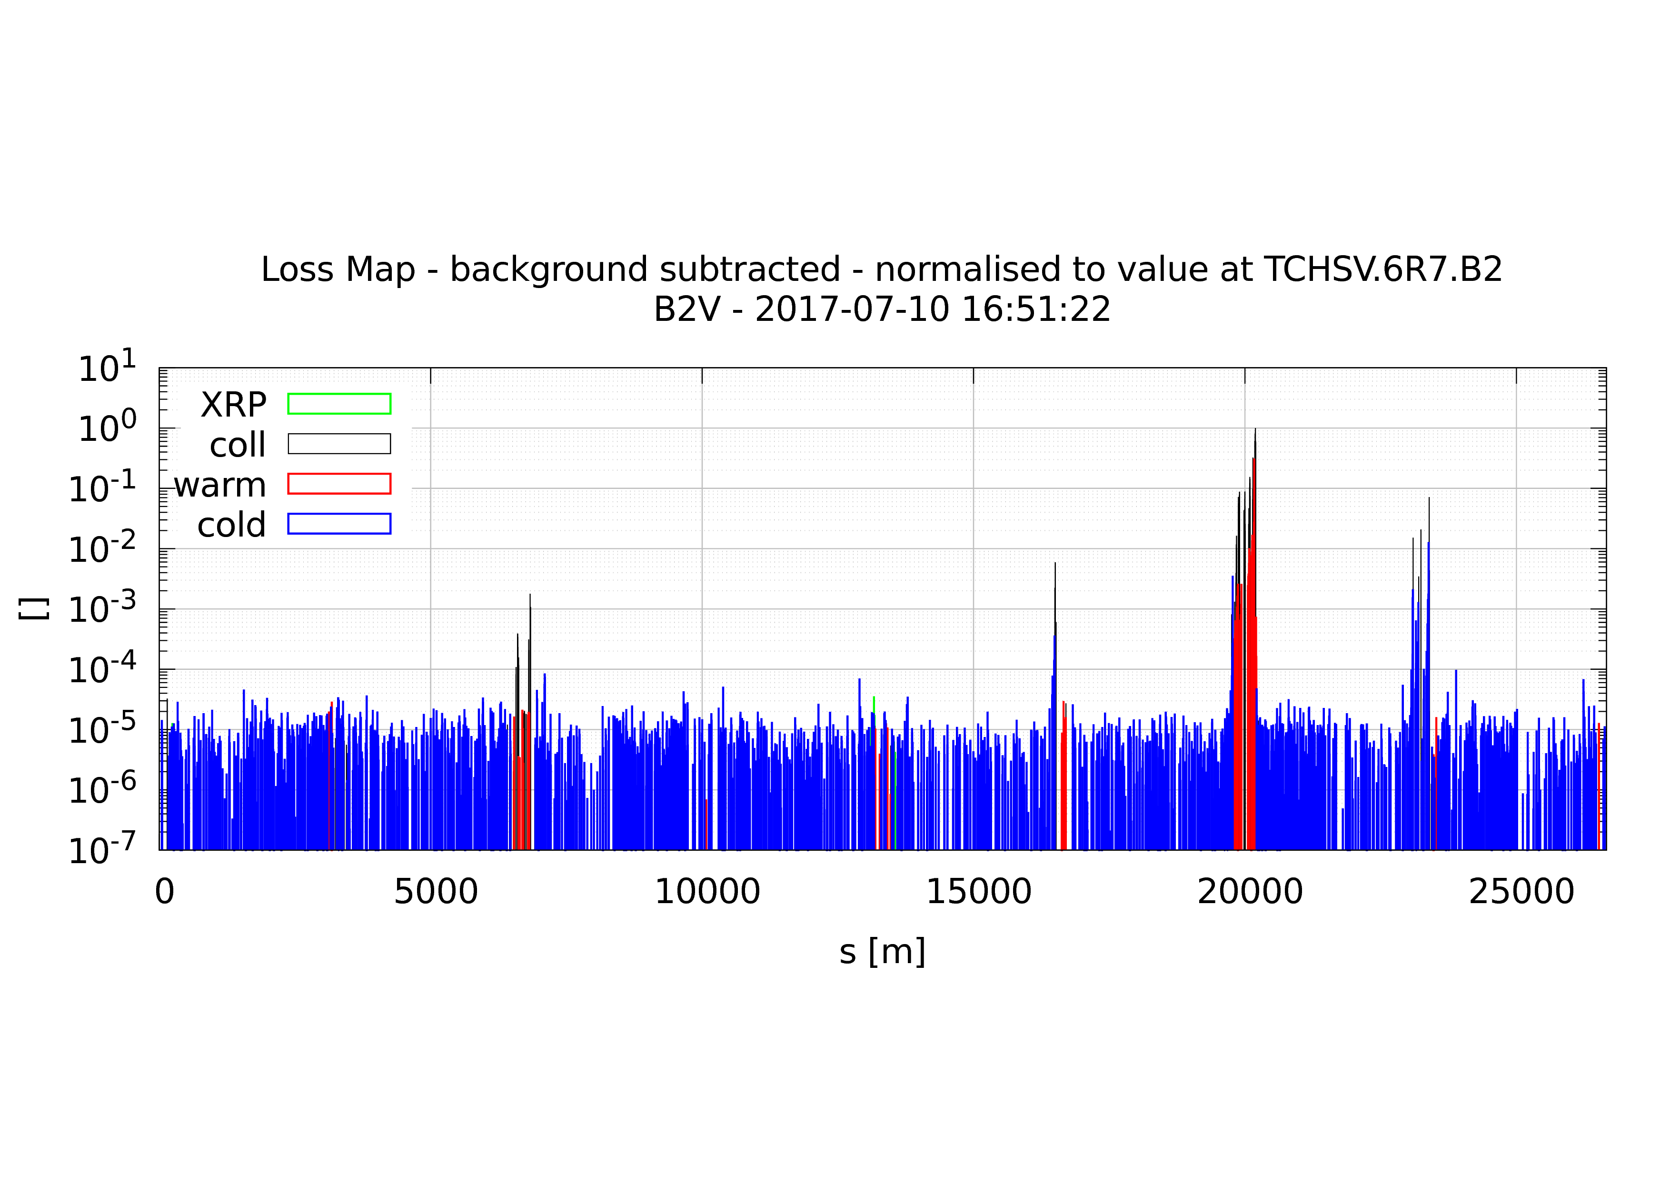
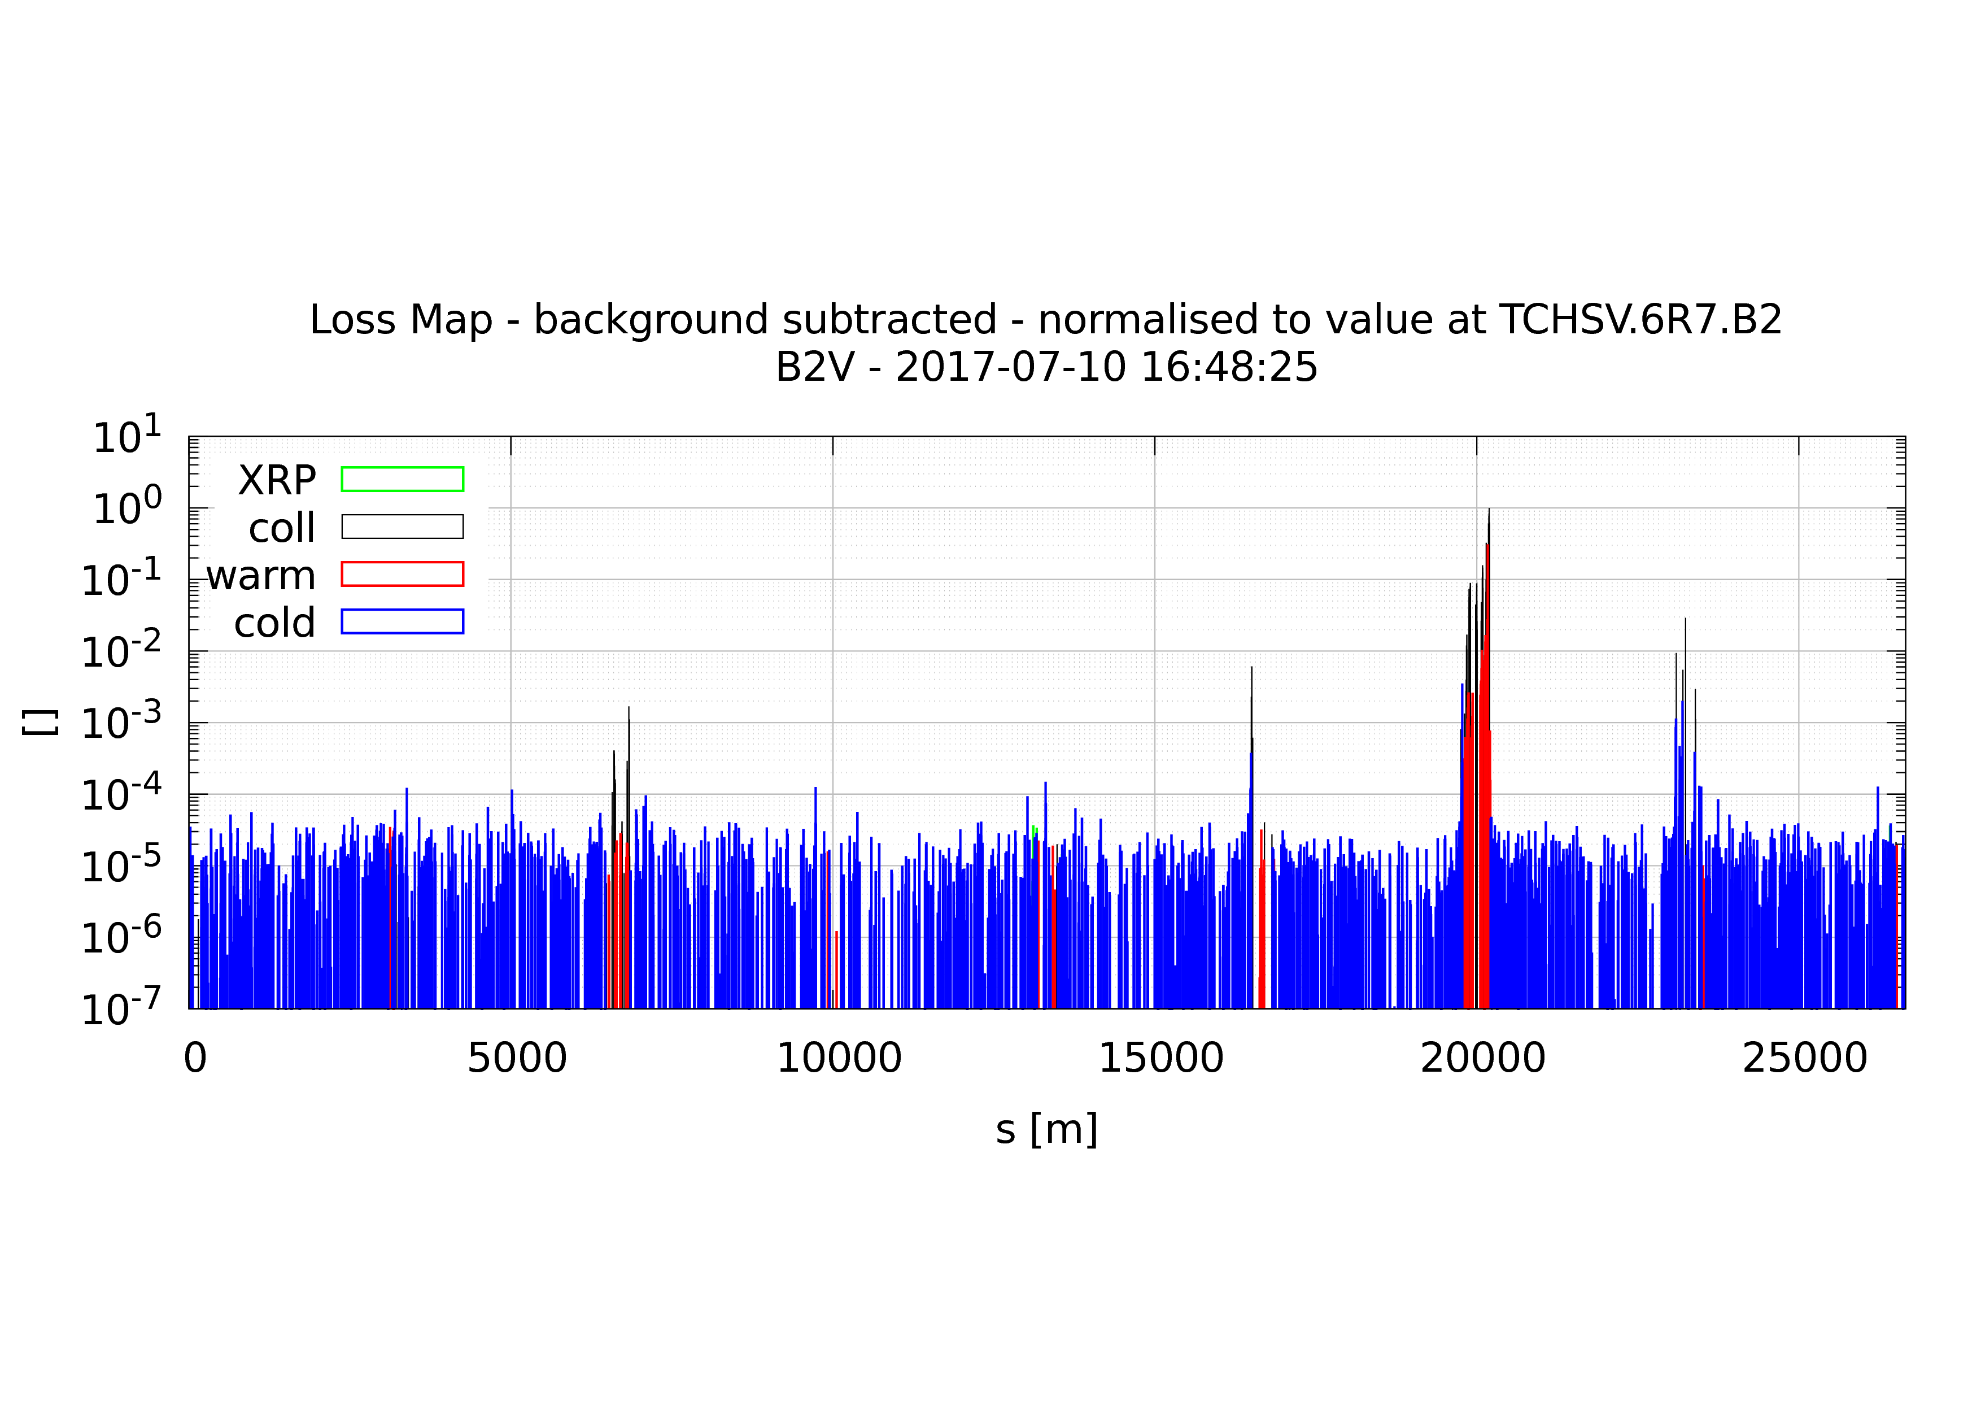
Loss maps
Nominal settings
Right jaw only
Left jaw only

Slide 4
Conclusion
Alignment of TDI.4R8 good also after TS1
Main losses are on left jaw
Might be due to the phase advance between the TCP jaw cutting the beam at first and the TDI left jaw
Loss maps repeated with same nominal settings: beam loss pattern in agreement w.r.t. commissioning
Main hypothesis to explain larger losses during first TS1 re-validation loss maps:
  Not optimal steering of the transfer line (YASP closed by accident and not realized by the OP crew)

