Slide 1




R Dark Energy in the Laboratory
2
Philippe Brax
IPhT Saclay
Collaboration with P. Valageas and P. Vanhove
arXiv:1711.03356

Slide 2
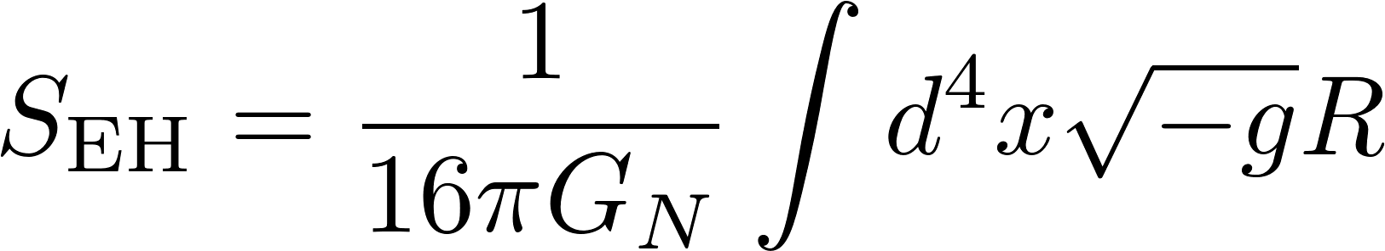
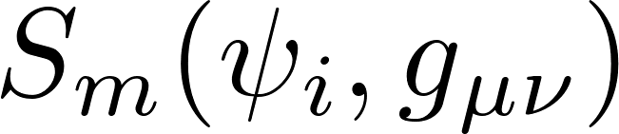
Gravity is described by General Relativity (GR):
Uniqueness theorem (Weinberg 1965):
GR is the unique Lorentz invariant theory of massless helicity 2 fields
Lorentz invariance implies the weak equivalence principle (Weinberg 1965) for elementary particles.
Particles couple to a unique metric.

Slide 3
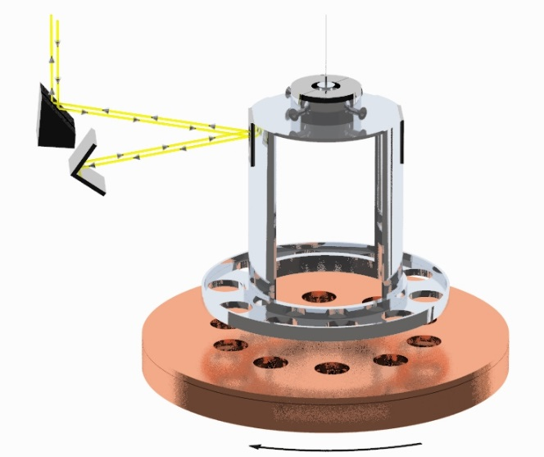
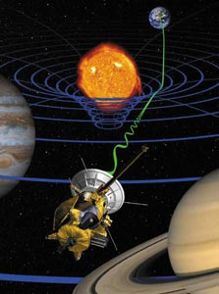
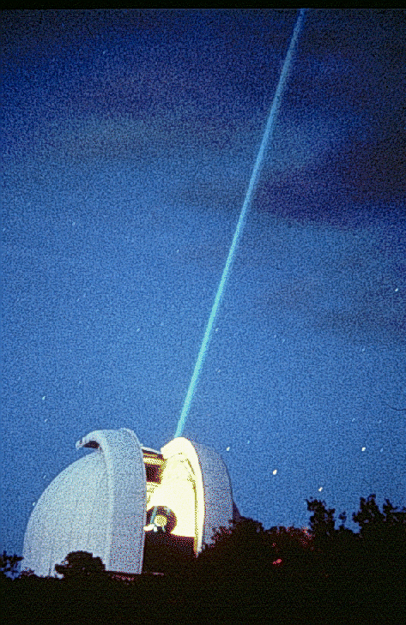
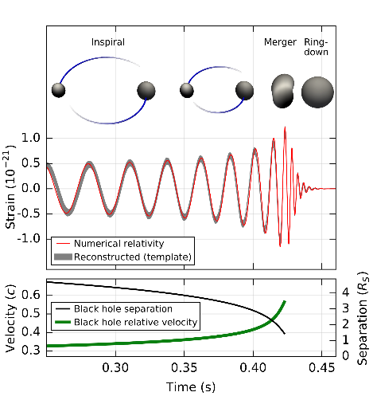
GR has been wonderfully tested on many length scales:
Laboratory experiments (Eotwash) tests of fifth forces and equivalence principle
0.1 mm
Cassini probe test of fifth forces
1 a.u., 150 million km.
Lunar ranging tests of strong equivalence principle and time variation of Newton’s constant, 400 000 km
Gravitational wave emissions from black hole and neutron star mergers
50 Mpc

Slide 4
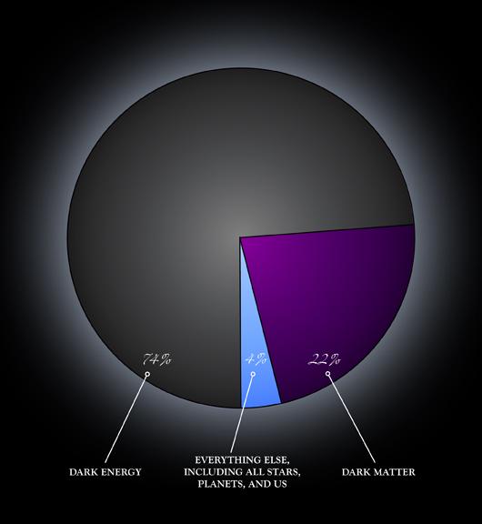
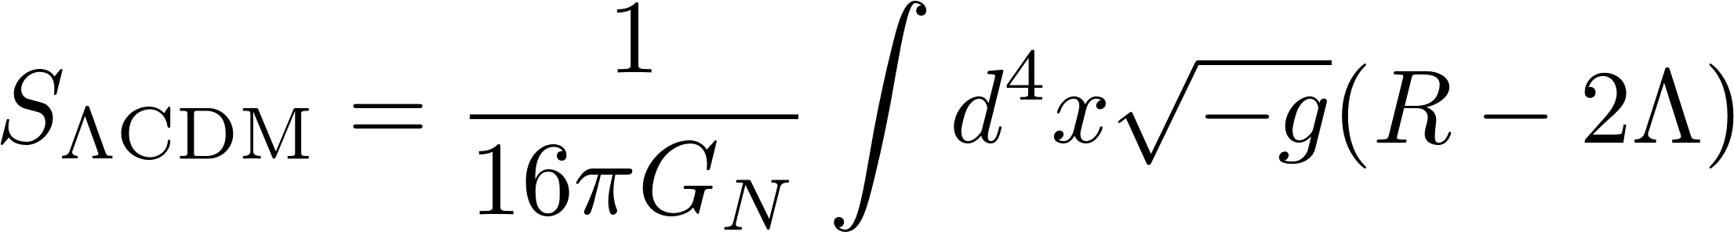
But GR fails miserably on cosmological scales where both dark matter and dark energy are necessary to explain Baryon Acoustic Oscillations (BAO) or the Cosmic Microwave Background (CMB).
Cosmological constant
The cosmological constant behaves like a constant and uniform vacuum energy.

Slide 5
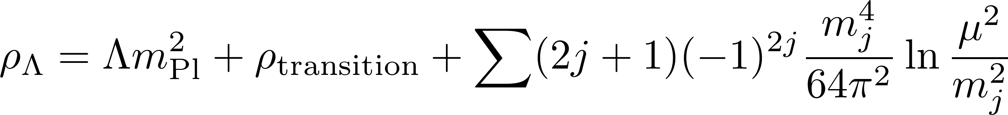
The problem of the vacuum energy was brought to the fore of cosmological research thanks to the discovery of the acceleration of the expansion of the Universe:
See J. Martin’s review « all you wanted to know… » (2012)
Phase transitions
Quantum fluctuations
Cosmological constant
The result takes into account all particles of any spin.
The sole contribution from the top quark is larger than the energy at the formation of the elements (Big Bang Nucleosynthesis) preventing one from understanding the Universe’s dynamics since then.
It is thus a sheer catastrophe.

Slide 6
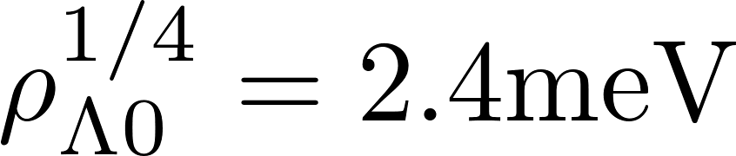
There are three contribution to the vacuum energy: the “latent heat” from phase transitions, e.g. electroweak, the vacuum fluctuations and the cosmological constant. The latter plays the role of a counter term and the measured value of the vacuum energy is:
This scale is far lower than any of the scales in particle physics and the early Universe ( apart from neutrinos ….) !
Hence the cosmological constant (counter term) must almost cancel all the disparate contributions from all the particles and the phase transitions of the Universe:
WHO ORDERED THAT ?
I.I. Rabi about the muon in 1936

Slide 7
AN EFFECTIVE FIELD THEORY APPROACH
The late time acceleration is a large distance phenomenon. It should be describable by a low energy field theory approach. Analogous to the Landau-Ginzburg theory of second order phase transitions (irrelevance of short distance details)
Two logical possibilities:
Fine-tuning:
all the contributions to the vacuum energy are tuned to the measured value cosmologically. GR + cosmological constant is the low energy effective field theory.
Dynamics:
The acceleration should be described by a theory where all particles have decoupled.
EXTENSIONS of GR at LOW ENERGY

Slide 8
This requires to classify the violations of Weinberg’s uniqueness theorem:
Massive graviton
Lorentz violating theories
vector
Massive spin 2 fields
5=2+2+1
scalar
Fields of spin 0, 1 … : scalars or vectors
Self-acceleration
Dynamical (violation of Weinberg’s no-go theorem: no Poincare invariant self-accelerating vacuum) evolution of the scalar leading to an effective vacuum energy.
GR + scalar= Scalar-tensor theories
Quantum effects

Slide 9


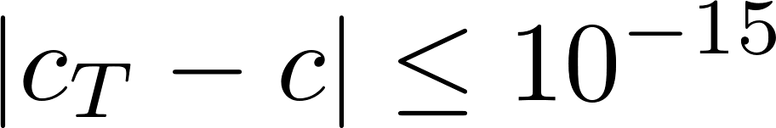
In this approach, the vacuum energy is set at high enough energy to zero using renormalisation by the cosmological constant counter-term. Below this scale:
GR +scalars
Many requirements to construct such theories: absence of instabilities (ghosts, gradient instabilities, tachyons...) and
LIGO-VIRGO neutron star merger
Speed of gravitons
Speed of light
This last requirement has ruled out most of the candidate for self-acceleration! In particular, all Galileons and higher order Horndeski are out.

Slide 10
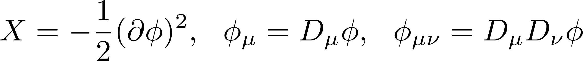
The remaining theories have a complex Lagrangian:
Contains cubic Galileons and KGB theories. KGB self-accelerates.
Contains the usual case of quintessence models with kinetic terms and potential. Long term tracking solutions exist.
Contains the case of a conformal coupling of matter to the metric, leading to chameleons, symmetrons…
These theories are obtained from a quartic Horndeski theory by a disformal change of metric. For the theories where the higher order terms dominate, no general result on self-acceleration is known. Very particular tuning between coefficients: quantum stability?

Slide 11
The remaining theories have a complex Lagrangian:
Contains cubic Galileons and KGB theories. KGB self-accelerates.
Contains the usual case of quintessence models with kinetic terms and potential. Long term tracking solutions exist.
Contains the case of a conformal coupling of matter to the metric, leading to chameleons, symmetrons…
See 1711.07403 for instance and P. Ferreira’s talk
These theories are obtained from a quartic Horndeski theory by a disformal change of metric. For the theories where the higher order terms dominate, no general result on self-acceleration is known. Very particular tuning between coefficients: quantum stability?

Slide 12
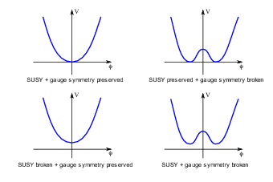
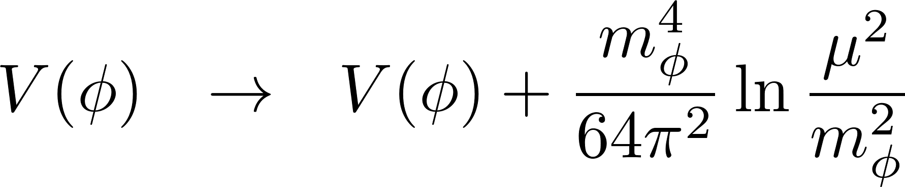
Another approach can be followed where quantum corrections play a crucial role:
The vacuum energy is chosen to vanish here. It cannot be negative otherwise the universe has a big crunch singularity.
Low energy effective potential
One-particle irreducible effective potential
The quantum corrections due to the massive scalar field, only field present at low energy together with gravity, lift the vacuum energy.

Slide 13
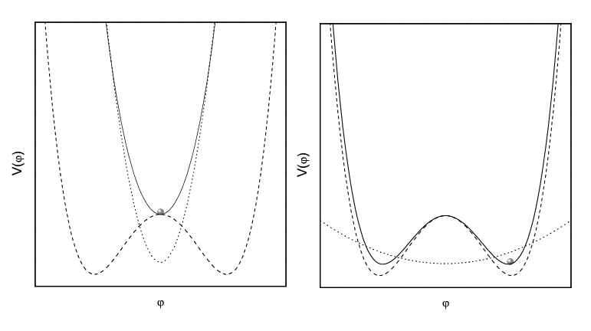
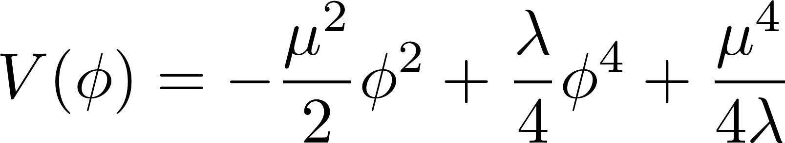
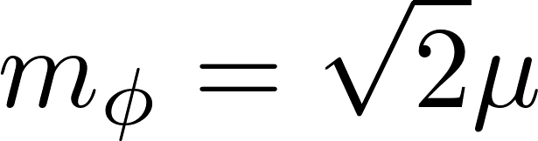
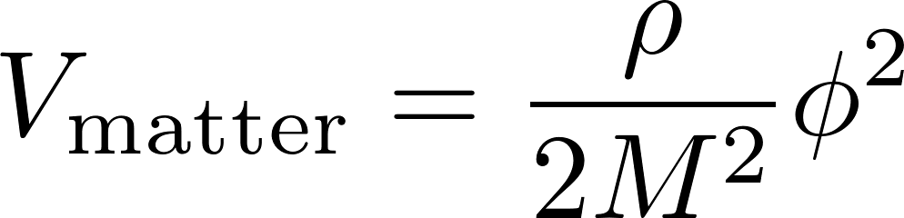
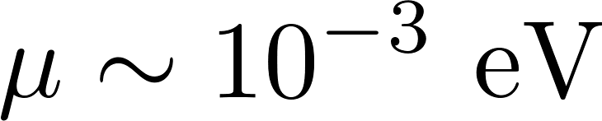
This can be applied to interesting models like the symmetron where matter couples to a field with a Higgs-like potential:
Hinterbinchler-Khoury (2010)
Dark energy range, tested by atomic interferometry, Q-bounces and Casimir effect.

Slide 14
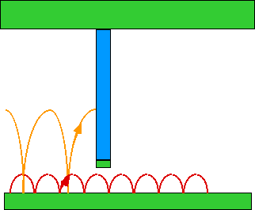
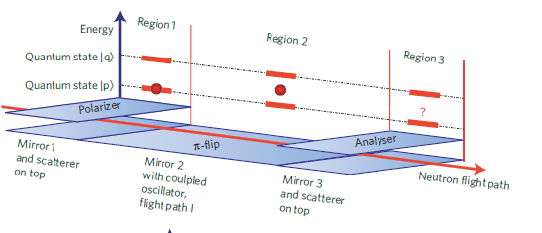
Bouncing Neutrons
Ultra cold neutrons from a nuclear reactor fly over a mirror in the terrestrial gravitational fields. Their energy levels are quantised with wave functions of extension a few microns. Sensitive to new interactions.

Slide 15
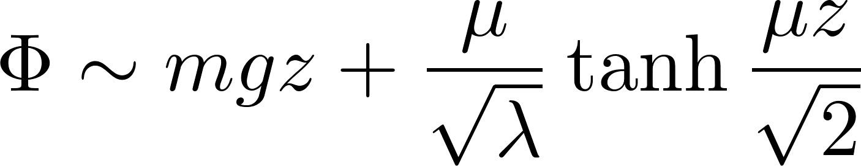
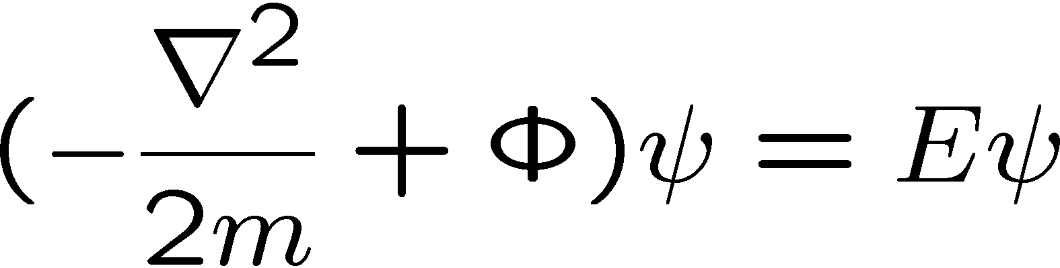
neutron
mirror
The symmetron potential above the mirror perturbs the neutron energy levels:
.
Symmetron profile
Perturbed eigenvalues due to the presence of the symmetron
Symmetrons shift the energy levels of the neutrons. Experimentally sensitive to 1-3 and 1-4 transitions.

Slide 16
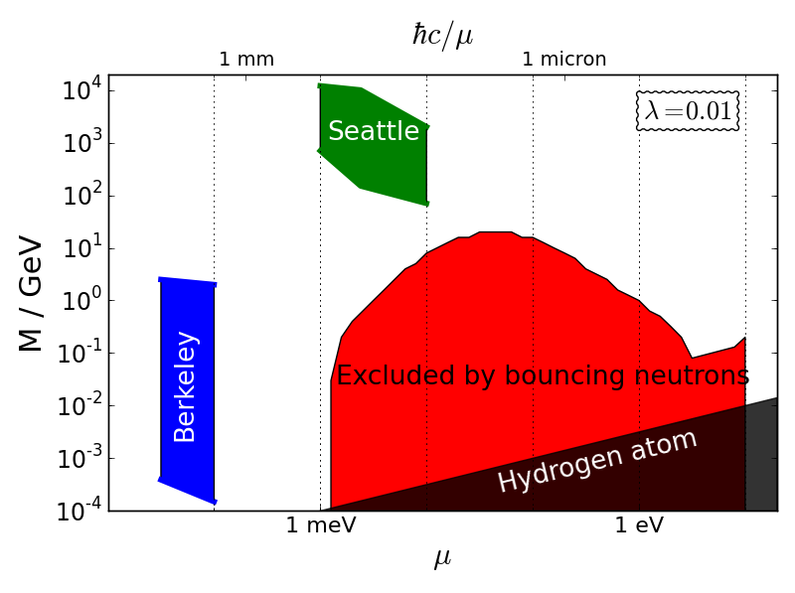
Torsion pendulum Eotwash
To appear soon…
(G. Cronenberg, PB, H. Filter, P. Geltenbort, T. Jenke, G. Pignol, M. Pitschmann, M. Thalhammer, H. Abele).
Atomic interferometry
See P. Haslinger’s talk

Slide 17
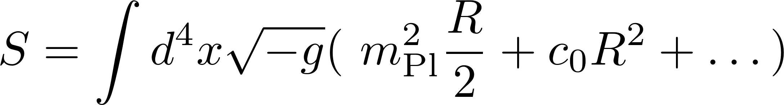
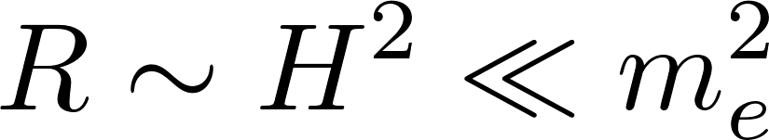
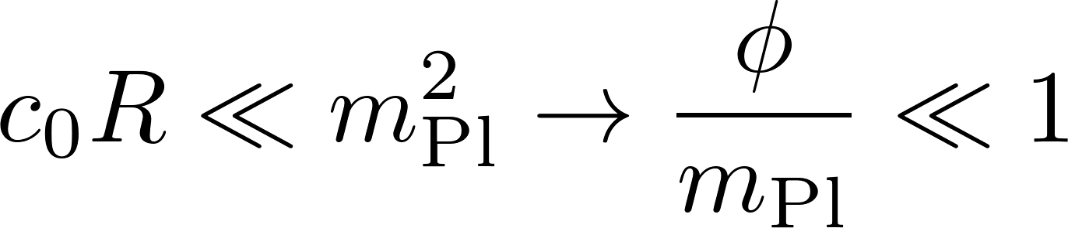
We would like to use something even simpler: the gravitational effective action
The devil is the dots… more later
dimensionless
Similar approach Stelle(1978) and Starobinsky (1979)
We consider the physics at late times where the curvature is low, i.e. describing the physics from BBN till now:
This theory is the simplest example of f(R) model, i.e. completely equivalent to a scalar-tensor theory with a constant coupling to matter. Moreover we assume that the correction to the Einstein-Hilbert term is small:
This scalar is the ingredient which violates Weinberg’s theorem

Slide 18
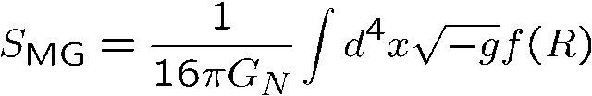
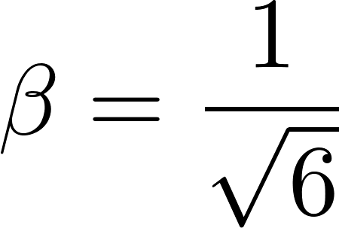
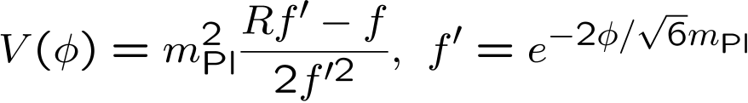
What is f(R) gravity?
See Sotiriou-Faraoni (2010)
f(R) is totally equivalent to a field theory with gravity and a scalar
The potential V is directly related to f(R)
Crucial coupling between matter and the scalar field
Generically would be ruled out if no chameleon effect

Slide 19
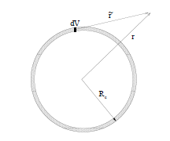

The effect of the environment
When conformally coupled to matter, scalar fields have a matter dependent effective potential:
Khoury-Weltman (2003)
Environment dependent minimum
The field generated from deep inside is Yukawa suppressed. Only a thin shell radiates outside the body. Hence suppressed scalar contribution to the fifth force.
Chameleon

Slide 20
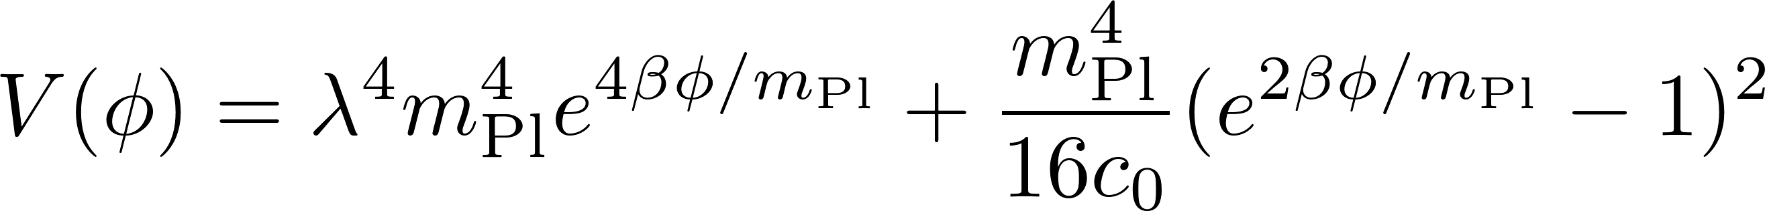
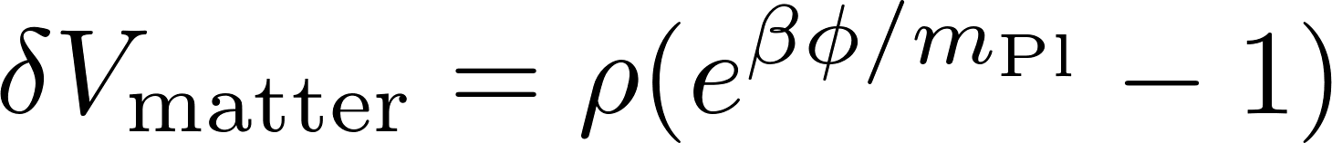
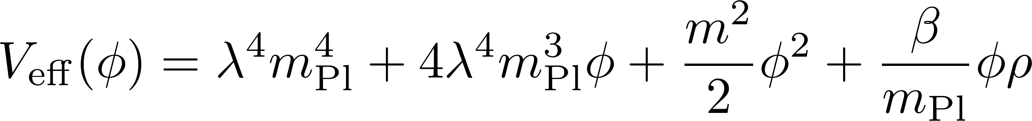
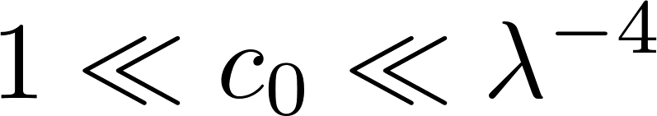
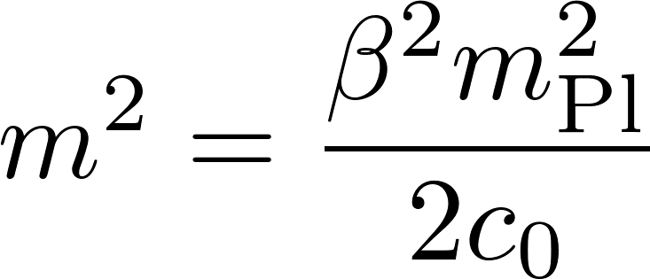
In our case the scalar field theory is extremely simple in the domain of validity of the effective field theory:
The coupling to matter complements this:
For vev’s less than the Planck scale, this is nothing but a massive scalar field with a linear coupling to matter:
Mass almost independent of the density
Large coupling=small mass

Slide 21
This theory is best tested in the laboratory

Slide 22

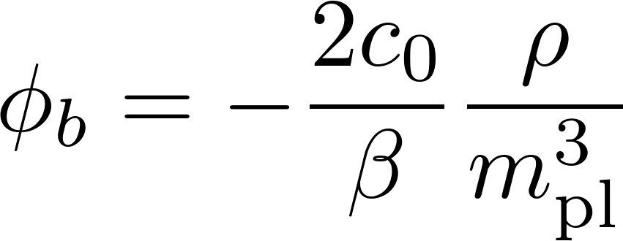


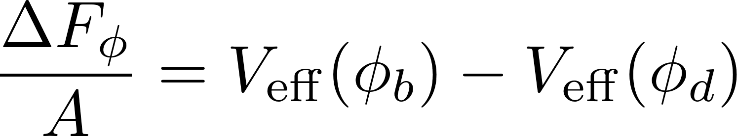
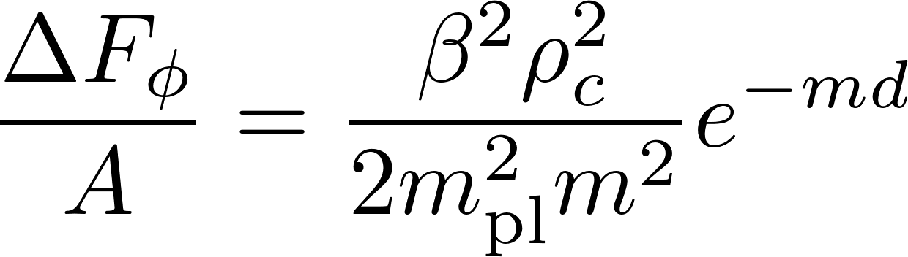
A bubble profile !
The scalar interaction between the plates depends on the difference of potential between the situation with and without boundary plates:
Brax-Davis (2014)
When the mass of the scalar field is larger than the inverse distance between the plates the scalar pressure is Yukawa-suppressed.

Slide 23
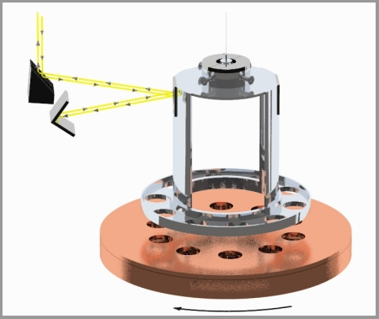
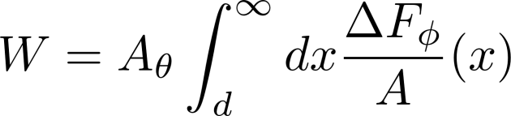
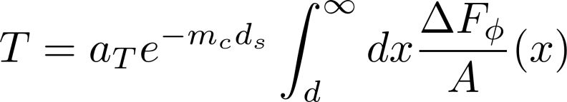
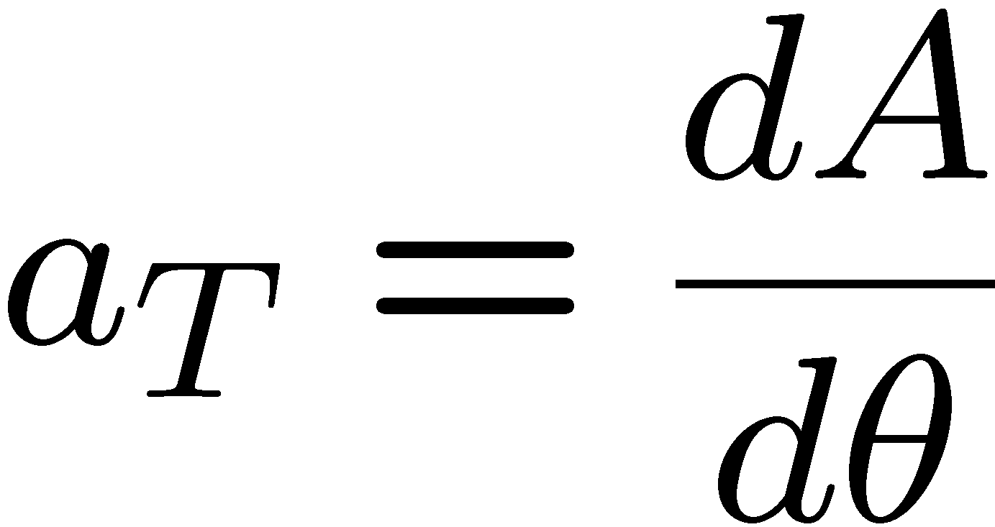
Eotwash experiment:
Measurement of the torque between two plaques with holes. The potential energy of the system due to a chameleon force between the plates is simply the work:
The torque between the plates can be approximated:
Electrostatic shielding
Brax et al. (2008)

Slide 24
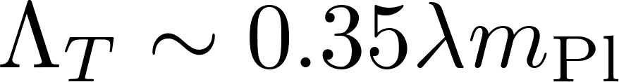
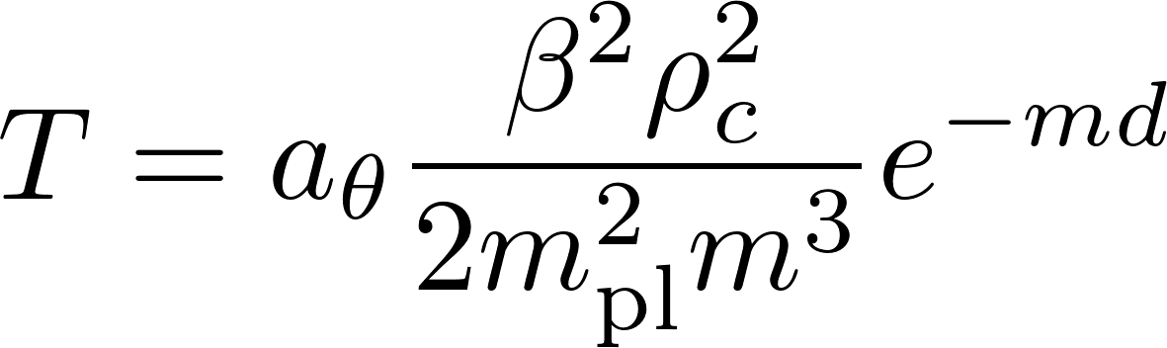
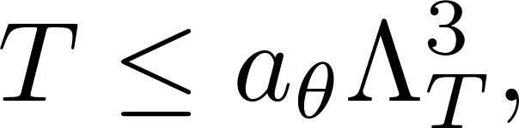
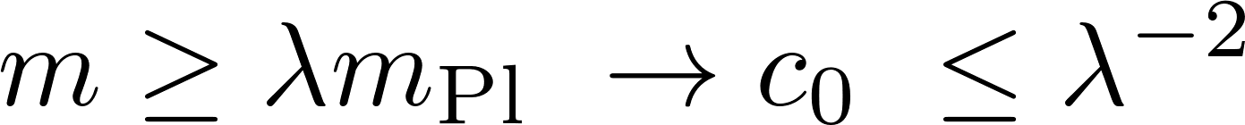
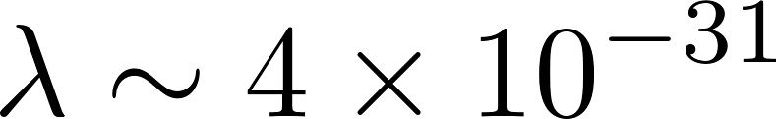
The Eotwash experiments gives the strongest experimental constraint on the model:
Dark energy scale
As the dark energy scale is of order 82 microns, this bound gives that the range of the scalar interaction must be larger than 0.1 mm:
The coupling is also bounded from below by quantum stability
Large upper bound on the coupling

Slide 25
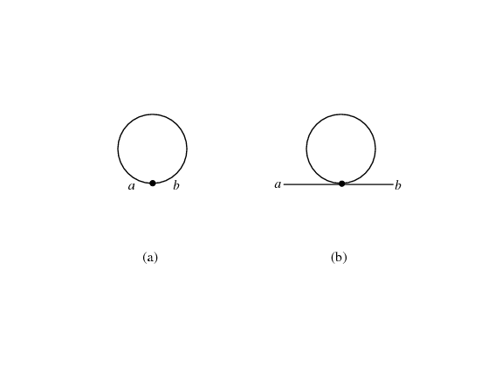
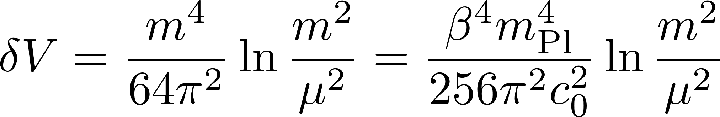


The vacuum energy at low energy is fixed by observation. At low energy the only massive particle present in the model is the scalar field. The quantum corrections to the 1pI effective potential, the one which matters for the equations of motion, are solely due to the one loop vacuum diagram:
If the bare vacuum energy is positive, otherwise the universe is cosmologically unstable, this contributes only to a part of the vacuum energy
This quantum correction provides the measured value of the vacuum energy!
Depends on the infrared sliding scale and can only be inferred experimentally

Slide 26


The coupling is extremely constrained:
implying that a signal could be around the corner! Measurable effects at around 10 microns.
For cosmology, the cosmological background evolves like in the concordance model. The main difference with the concordance model, coming from the modification of gravity, arises at the perturbative level where the Cold Dark Matter density contrast evolves like:
As the range is tiny (less than 0.1 mm) these models are ultra-local with no effects on cosmological perturbations. Very small effects on astrophysical scales in galactic halos too.
Brax et al. (2004)
Modified gravity… very small
Brax-Valageas (2015)

Slide 27



So far we have only considered the leading terms in a curvature expansion. Can we neglect the higher order terms? Not always!
This leads to higher order equations of motion and a propagator:
This term adds a massive degree of freedom to the spectrum:
Massive ghost cured when including higher derivative interactions.
Stelle (1978)
Such a very massive (meV) spin 2 state would have escaped the LIGO window. On the other hand, as it is ghost-like this term only makes sense at very low energy making the decay rate low enough, typically a few MeV’s.
If the mass of the ghost is of order of meV, not clear how to make the model consistent at energies larger than a few MeV’s up to the very large scale where the higher derivatives cure the instability.
Emission of two ghosts and two photons.
Cline et al. (2003)

Slide 28

This is a general phenomenon corresponding to Ostrogradski’s theorem (1850):
Higher order derivatives in the action lead to
New degrees of freedom
Ghosts…
A consistent way of dealing with these unwanted degrees of freedom is to make them appear only at the scale where the derivative expansion breaks down.
For the massive graviton which is ghost-like this requires that c2<< c0 and the mass of the massive graviton is at least as large as the cut-off scale of the derivative expansion.

Slide 29
If the effective field theory had the expansion
where there were only one scale in the problem… this would not make sense as m is the mass of the low energy scalar and in this approach the cut-off scale of the theory where another particle has been integrated out… The effective theory should behave like:
with a hierarchy M>>m to guarantee that the higher order terms can be dropped at low energy and the leading terms is the lowest one, i.e. there is one field of mass m much lower than the fields at the mass scale M which have been integrated out.

Slide 30

String theory is a natural setting to decouple higher order effects from the leading term:
Smooth 6d compactification
At low energy we can expect that the theory will be described by one scalar, the volume modulus, representing the « breathing » mode of the compactification manifold, coupled to gravity. We expect the dictionary:
Breathing mode
term
String scale
Cut-off scale M of the derivative expansion

Slide 31





Symbolically, all sorts of indices!
We consider the compactification of the 10d string action:
Compactification volume
Tree level in string theory, p loops
String scale
The 4d action after dimensional reduction is of the form :

Slide 32






The four dimensional quantities are derived:
In a non-warped compactification:
Hence the scalar and massive graviton have a mass larger than the string scale, and the string scale is the scale where the derivative expansion breaks down: GR at low energy.
NEED EXTRA INGREDIENTS

Slide 33
This can be remedied by introducing susy breaking by brane-antibrane. The Goldstino field of broken supersymmetry is captured by a nilpotent superfield S.
Working at low energy this can be captured in N=1 supergravity in 4d which works at the two derivative level with the dictionary. This does not change the coefficients of the higher derivative terms in the curvature expansion but will modify only the lowest order due to the dictionary:
Breathing mode
Matter brane
Low energy due to warping
A cartoon KKLT compactification
Anti-brane
Compactification manifold

Slide 34





The model is described by a T volume modulus and a nilpotent field S corresponding to the anti-brane:
where S satifies the constraint:
and the superpotential is:
When is much smaller than the Planck scale:
The exact form of the potential is not relevant. What matters is that T is stabilised (moduli stabilisation) with a low enough mass.
Nothing but the scalar model!

Slide 35





The identification is even true for the matter coupling:
Normalised field
This is the crucial point as the identification with the quadratic correction to Einstein-Hilbert only requires a massive scalar coupled with this particular coupling:
This is the field dependence of f(R)
This completes the equivalence with the f(R) theory at low energy

Slide 36




We can now identify the low energy parameter of the quadratic term:
The low energy vacuum energy is then due to the quantum fluctuations of the volume modulus:
The massive spin 2 state has a mass larger the string scale implying that it becomes relevant at the scale where all the higher order corrections are relevant too, not at low energy.
Vacuum energy
This may hint in favour of a fundamental origin for a scalar field whose mass and coupling to matter could be testable by laboratory experiments. A better understanding of the underlying microscopic theory is certainly needed.

Slide 37
SUMMARY
We have argued that the effective field theory of gravity at the lowest order in curvature could have phenomenologically appealing properties such as a of scalar degree of freedom which could be just around the corner for laboratory experiments... if certain conditions ascalar degree re satisfied…
In particular, such a low energy effective field theory is only valid when there is a hierarchy of scales. If this is not the case then the effective field theory of gravity reduces to a pure cosmological constant at low energy: no dynamics (or the dynamics is not from the gravitational sector at all)…
We have suggested that this, i.e. the non-trivial dynamical case…, may occur in string theory where the lowest order in the curvature expansion may dominate when SUSY is broken by low energy by brane-antibrane effects. All this requires is moduli stabilisation for the compactification breathing mode.
Building a string model which reproduces the indications of the supergravity model would be extremely interesting.

