Slide 1
Search for new interactions
in the Casimir regime
Ricardo S. Decca
Department of Physics, IUPUI
Work motivated by a Colloquium given by E. Fischbach: Search for the “Fifth Force”

Slide 2




Collaborators
Daniel López Argonne National Labs, USA
Ephraim Fischbasch Purdue University, USA
Dennis E. Krause Wabash College and Purdue University, USA
Valdimir M. Mostepanenko Noncommercial Partnership “Scientific Instruments”, Russia
Galina L. Klimchitskaya North-West Technical University, Russia
Eduardo Osquiguil Instituto Balseiro, Argentina
Vladimir Aksyuk CNST/Univ. of Maryland, USA
Diego Dalvit Los Alamos National Lab., USA
Francesco Intravaia Los Alamos National Lab., USA and Max Born Institut, Germany
Ryan Behunin Los Alamos National Lab., Yale University, USA
Paul Davids Sandia National Lab., USA
Giuseppe Bimonte Universita di Napoli Federico II, Italy.
Farbod Shafiei, Sannah Ziama,
Eric Curtis, Jing Ding, Brad Chen IUPUI
Edwin Tham, Hua Xing, Guillaume
Voisin
Integrated Nanosystems
Development Institute

Slide 3
Yukawa-like potential
Arises from very different pictures:
Compact extra-dimensions
Exchange of single light (but massive,
    μ =1/λ) boson
    Moduli; Graviphotons; Dilatons;
    Hyperphotons; Axions
PRL 98, 021101 (2007)

Slide 4
Yukawa-like potential
Arises from very different pictures:
Compact extra-dimensions
Exchange of light (but massive, μ =1/λ) boson
    -Moduli
    -Graviphotons
    -Dilatons
    -Hyperphotons
    -Axions
How do we establish limits?
μ
Measure background and subtract it
f₁
f₂
Get rid of the background altogether
1
2

Slide 5
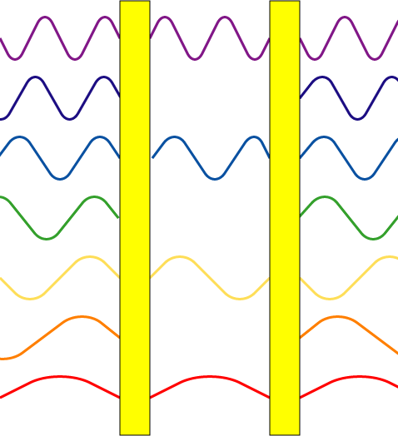
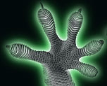
Attractive force
Dominant electromagnetic force at small (~ 1 nm) separations
Non-retarded: van der Waals
Retarded: Casimir
a
No mode restriction on the outside

Slide 6
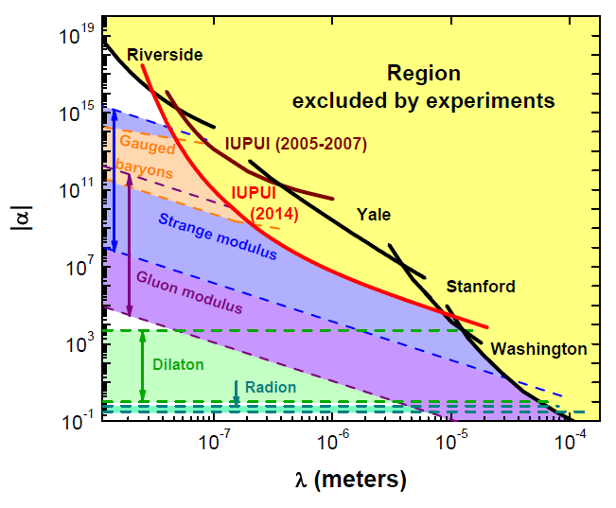
1410.7267

Slide 7
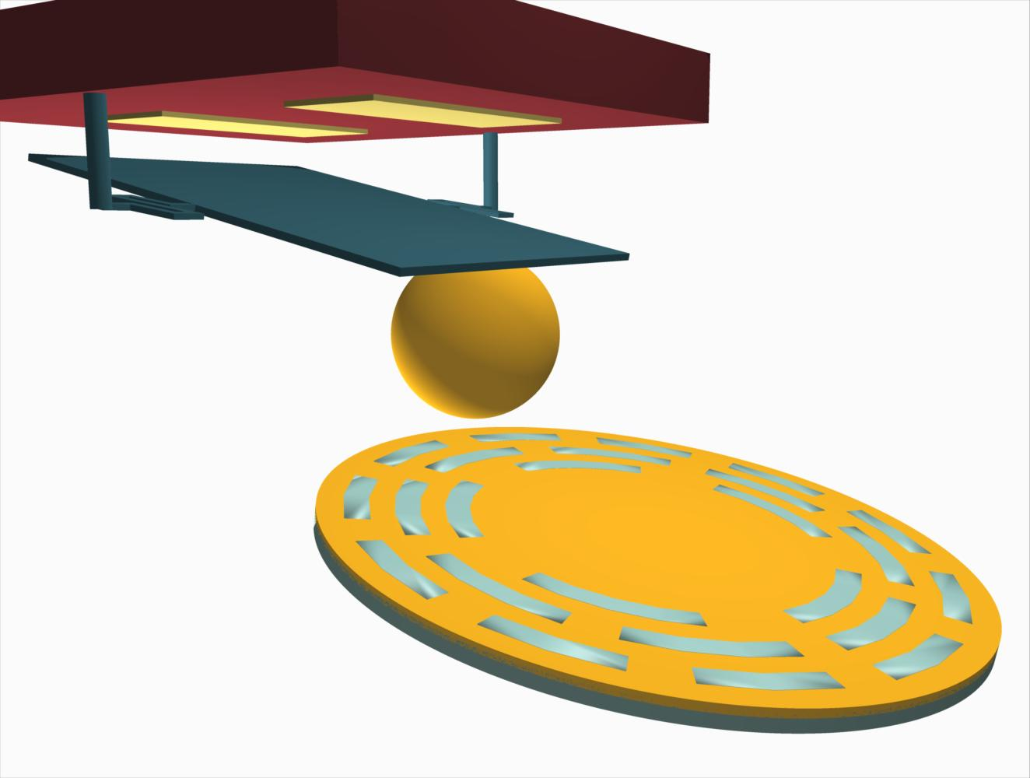
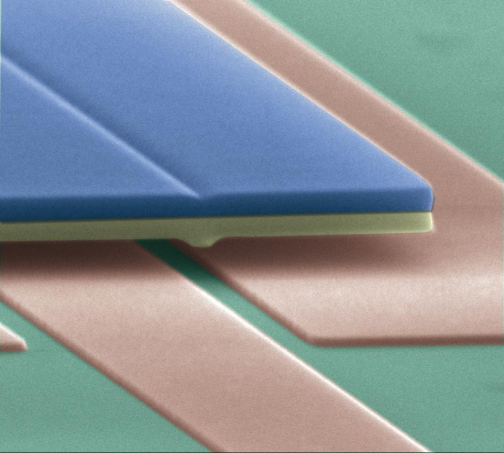
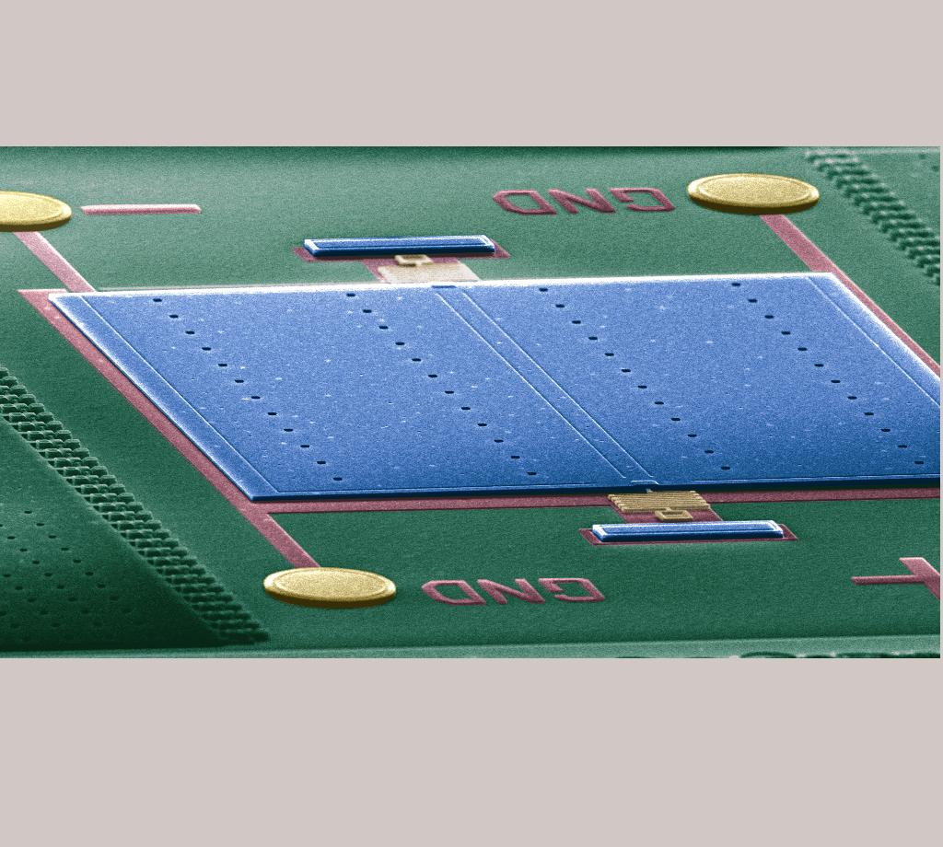
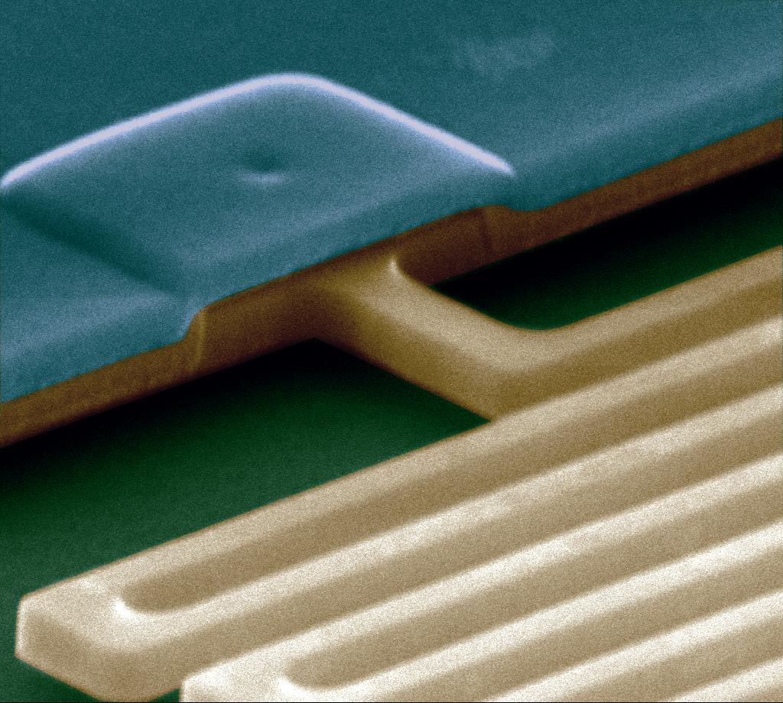
Experimental setup

Slide 8
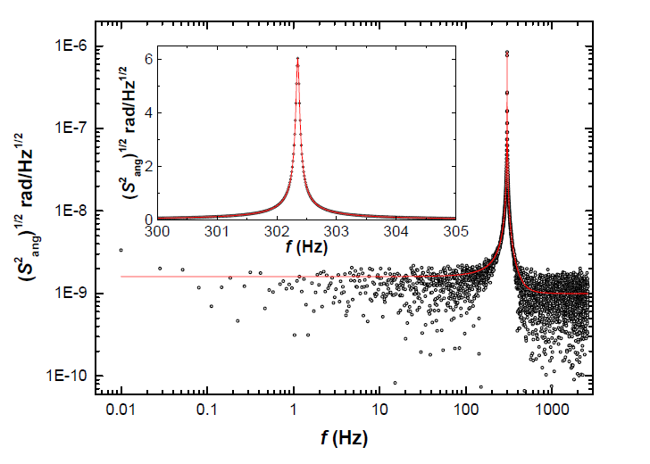

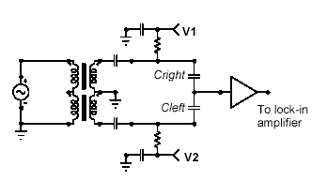
Experimental setup

Slide 9
Experimental setup
Design an experiment where only the desired signal is measured
-If F < δF => no signal
-Determine z and a signature of the
interaction
-In general, higher sensitivity if ΔF is
measured

Slide 10
F
-T/2
T/2
t

Slide 11
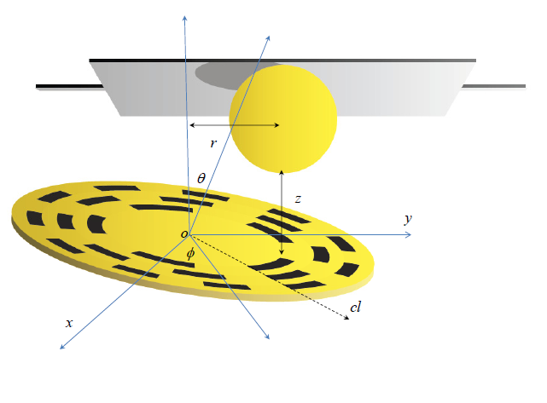
Measurement of the separation
z_{g} = (2172.8 ± 0.1) nm, interferometer
z_{i} = ~(10000.0s ± 0.2) absolute interferometer
z_{o} = (8162.3 ± 0.5) nm, electrostatic calibration
b = (207 ± 2) μm, optical microscope
Θ = ~(10.000 ± 0.001) μrad
z_{o} is determined using a known interaction
z_{i}, Θ are measured for each position
z_{i}
z_{o}
z_{g}

Slide 12
Measurement of the separation
Electrostatic force calibration

Slide 13
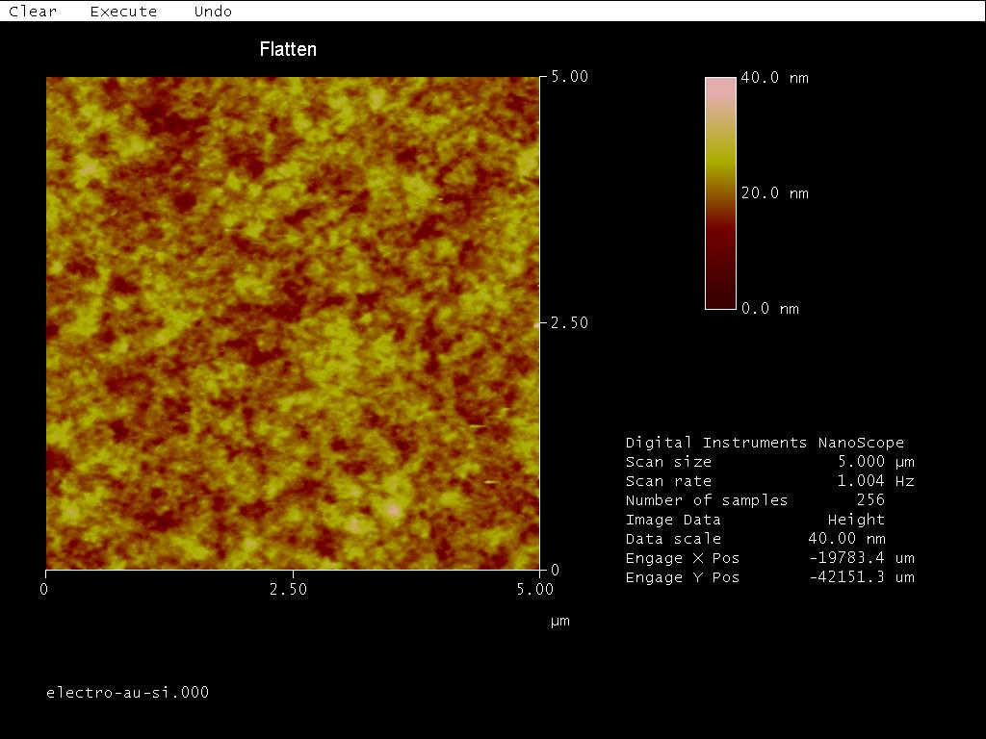
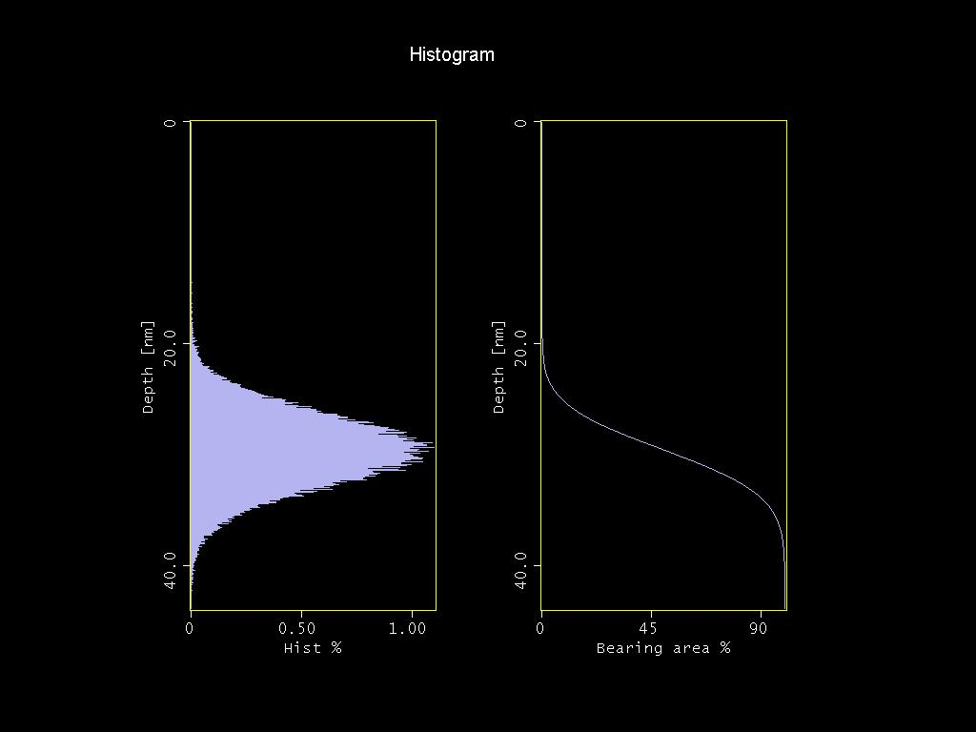
Sample preparation and characterization
-Au on the sapphire sphere is deposited by thermal evaporation.
-Samples are characterized by measuring resistance as a function of temperature, AFM, and ellipsometry.

Slide 14
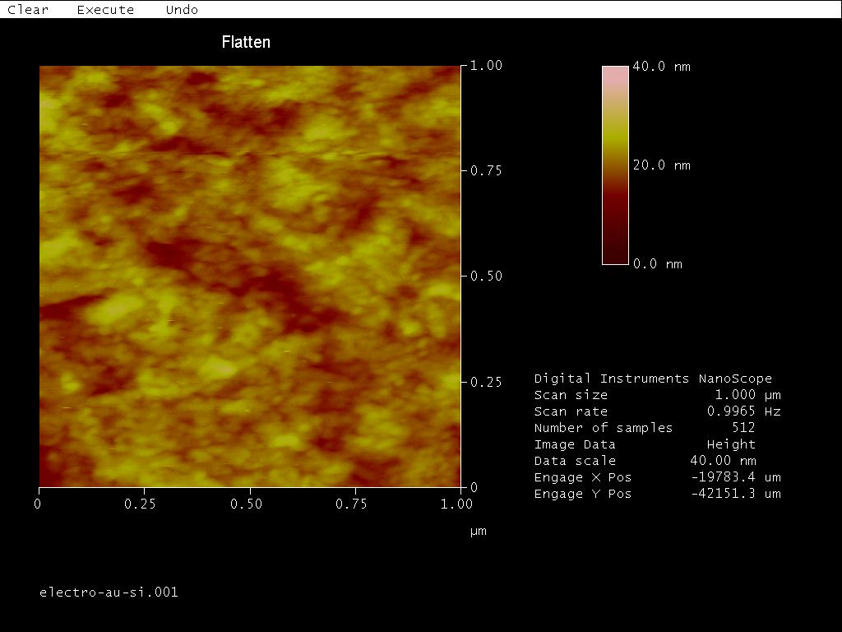
Sample characterization
Kelvin probe force microscopy => mV range fluctuations
ΔF_{e} < 1 aN @ 1 μm
1407.3741 (Phys. Rev. A 90, 062115
1304.4074 (Phys. Rev. D 89, 051301

Slide 15
Interaction

Slide 16
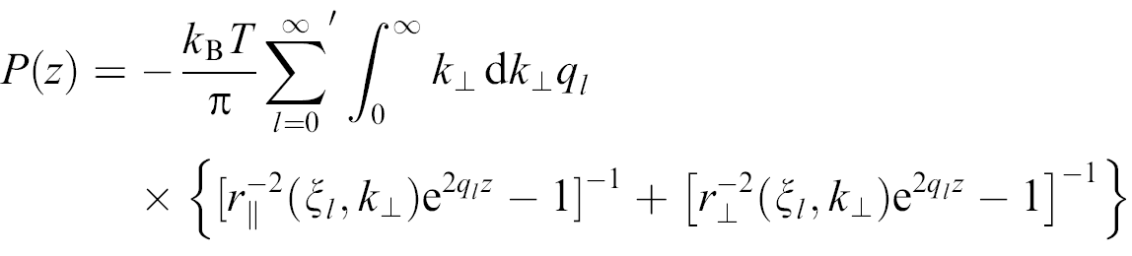
Comparison with theory
Finite conductivity and finite temperature

Slide 17
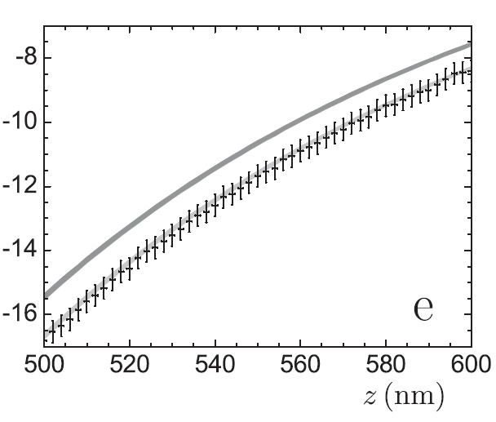
Comparison with theory
PRD 75, 077101
Used to extract
limits on
Chameleons
Dark grey, model with dissipation
-Light grey, model without dissipation

Slide 18
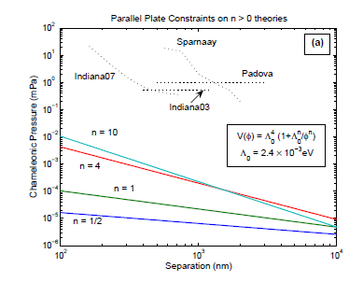
Limits

Slide 19
Interaction

Slide 20
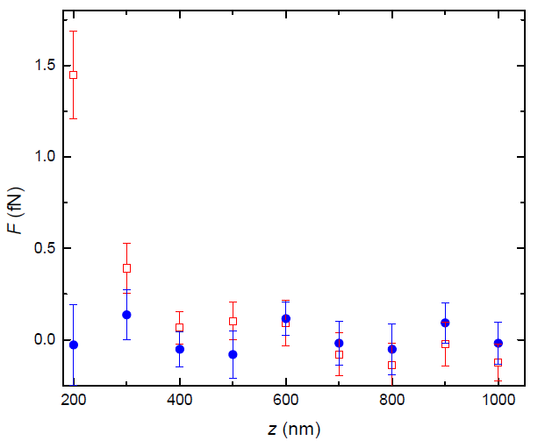
Interaction
The signal is “aligned” with the Au/Si interface

Slide 21
Residuals
@ z = 200 nm, τ = 1s
F_{e} < 0.01 fN
F_{C} < 0.05 fN
F_{spindle} < 4 fN (0.02 fN)
Total error (τ = 1000 s) ΔF = 0.2 fN

Slide 22
New Limits

Slide 23
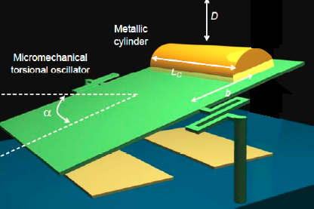
Summary
Improvement in the constraints for Yukawa-like corrections. Still far away from
α = 1
Measurement of the interaction might give alternative technique for constraining
scalar field contributions. Dedicated experiments need to be designed
Need to explore parameter space and optimize shape
Defined by 256 exposure levels

Slide 24
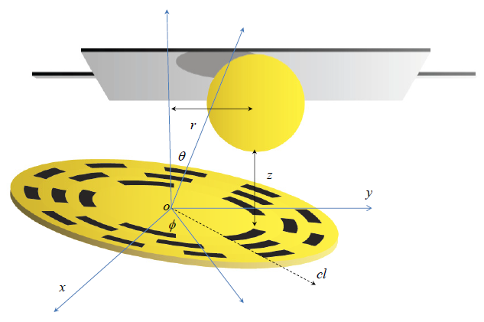

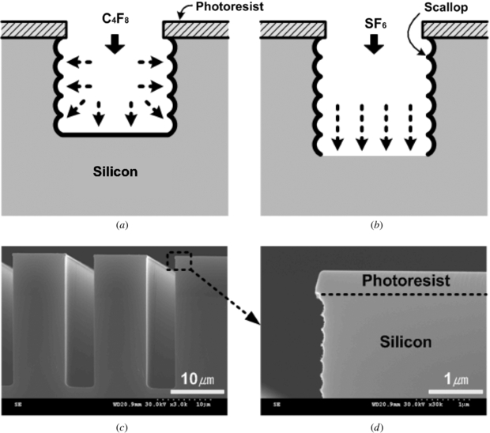
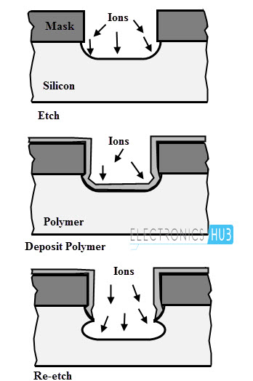
Interaction
Developed a sensitive differential technique
Trenches in our samples
are 50 to 150 μm deep.
Everything is sputtered with
Au.
J. Micromech. Microeng. 18 075007, (2008)

Slide 25



Interaction: Case B2
n > 2
0709.2075, Brax et al.

Slide 26
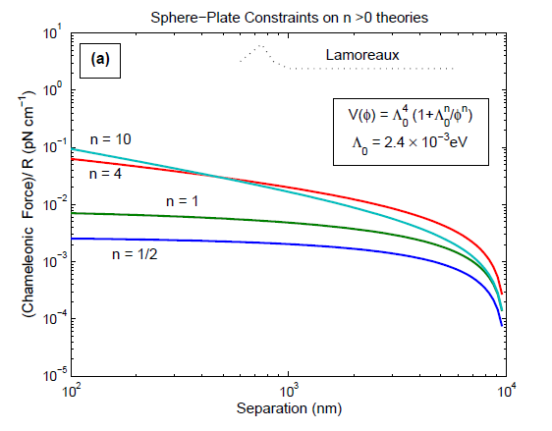
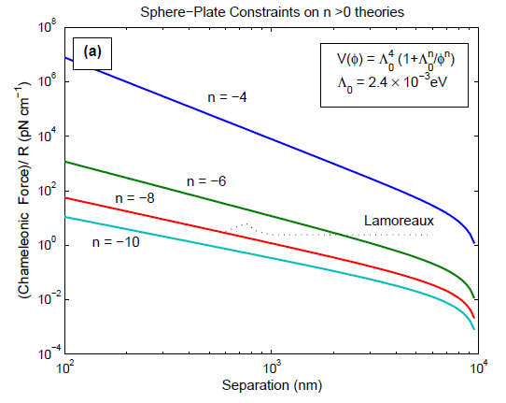
Limits?

