Slide 1
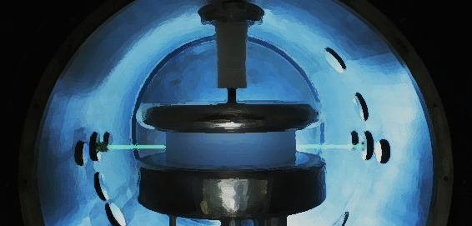


Search for axion-like
Dark Matter with
Ultracold neutrons
Guillaume Pignol, 1/12/2017
VCES13, Vienna

Slide 2
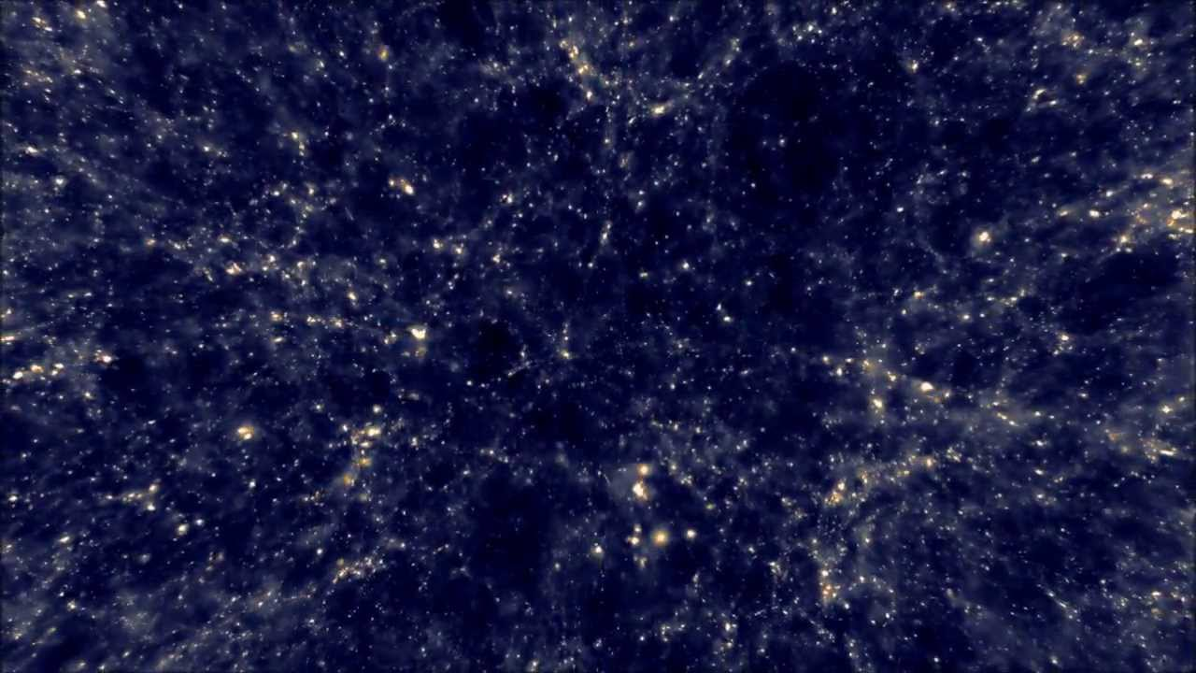

Energy budget of the Universe in ΛCDM
5 % normal baryonic matter
Unknown origin
Dark matter is
a pressure-less fluid
Cosmological density $10^{−6} GeV/{cm}^{3}$
Local density
$0.4 GeV/{cm}^{3}$
69 %
Dark Energy
Unknown nature
26%
Dark Matter
Unknown nature

Slide 3
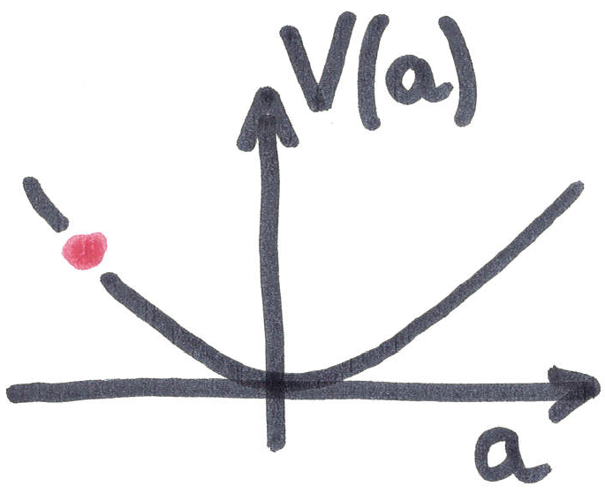
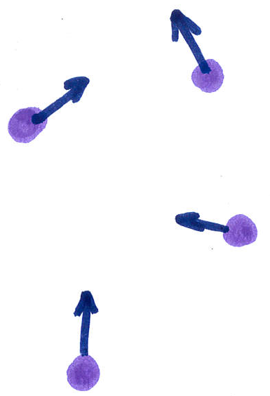
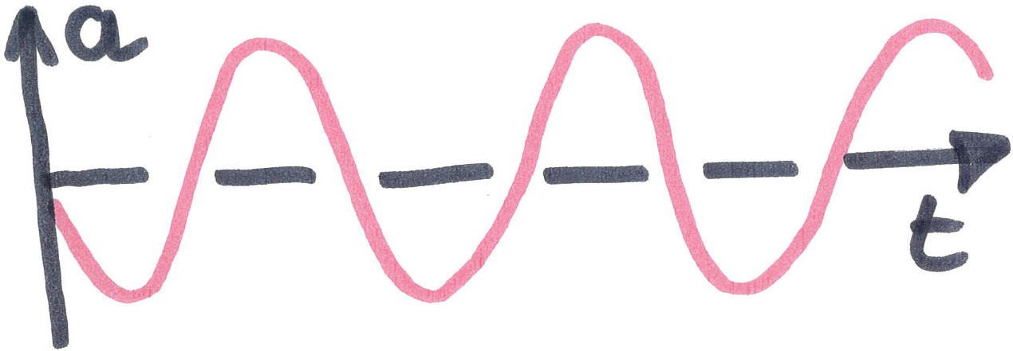






Nature of pressure-less Dark matter?
Weakly Interacting Massive Particles
Coherent oscillation of a light scalar field
$$m_{a}<0.1 eV$$
$$M>2 GeV$$
$$V\left(a\right)={\frac{1}{2}m}_{a}a^{2}$$
$$a\left(t\right)=a_{0}\cos{m_{a}t}$$
$$ρ_{a}={\frac{1}{2}m}_{a}^{2}a_{0}^{2}$$
$$v≈200 km/s$$

Slide 4
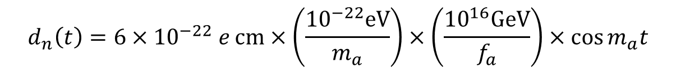
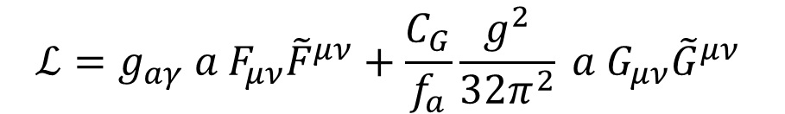
How to detect the oscillation?
$$ℒ=g_{aγ} a F_{μν}{\tilde{F}}^{μν}+\frac{C_{G}}{f_{a}}\frac{g^{2}}{32π^{2}} a G_{μν}{\tilde{G}}^{μν}$$
Coupling to photons
Induce axion-photon conversion
Coupling to gluons
Induce a neutron electric dipole moment
$$d_{n}\left(t\right)=6×{10}^{−22} e cm×\left(\frac{{10}^{−22}eV}{m_{a}}\right)×\left(\frac{{10}^{16}GeV}{f_{a}}\right)×\cos{m_{a}t}$$

Slide 5
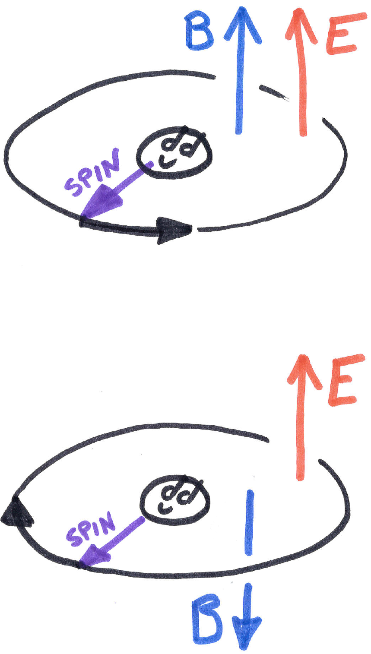

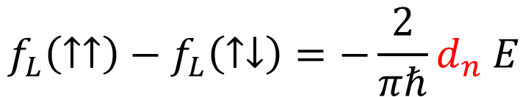
Electric Dipole Moments and T symmetry
> PLAY >
$$\hat{H}=−μ_{n} B {\hat{σ}}_{z}−d_{n} E{ \hat{σ}}_{z}$$
$$f_{L}\left(↑↑\right)−f_{L}\left(↑↓\right)=−\frac{2}{πℏ}d_{n} E$$
< REWIND <
The existence of an electric dipole violates the T symmetry and therefore the CP symmetry

Slide 6
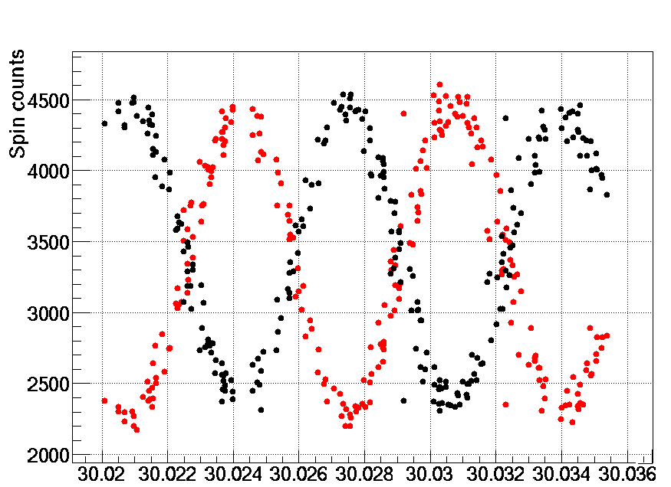
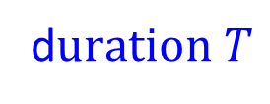
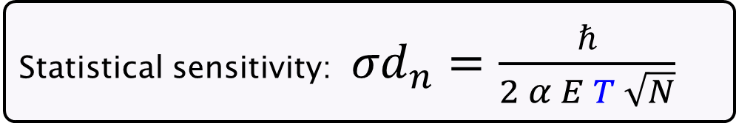
The Ramsey method
“Spin up” neutron...
Apply π/2 spin-flip pulse...
Applied pulse frequency [Hz]
Free precession...
d$uration T$
Statistical sensitivity: ${σd}_{n}=\frac{ℏ}{2 α E T \sqrt{N}}$
Second π/2 spin-flip pulse

Slide 7
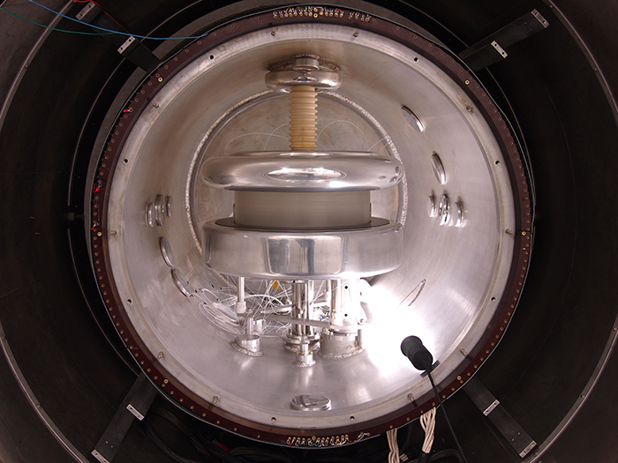
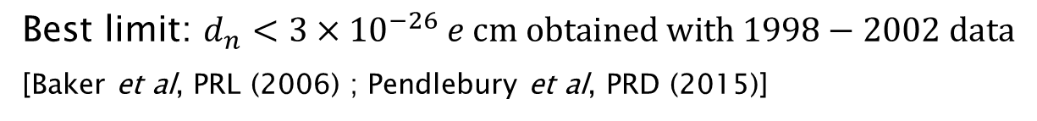
Sussex/RAL apparatus installed at PF2, ILL, Grenoble (1986-2009)
Best limit: $d_{n}<3×{10}^{−26} e cm obtained with 1998−2002 data$
[Baker et al, PRL (2006) ; Pendlebury et al, PRD (2015)]

Slide 8
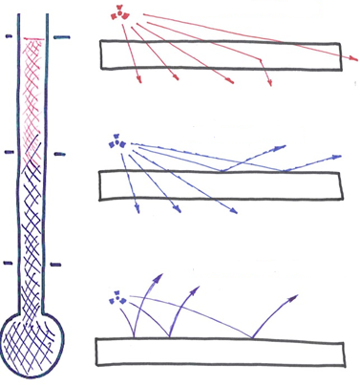
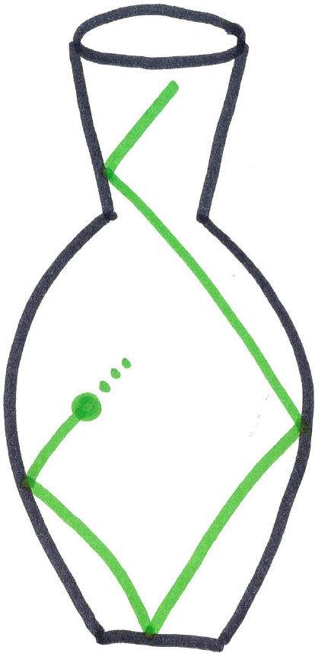
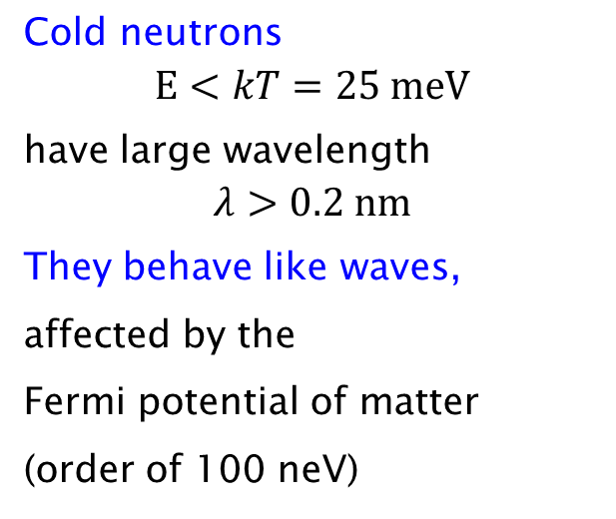
Neutron optics, cold and ultracold neutrons
Thermal neutrons
Cold neutrons
$$E<kT=25 meV$$
have large wavelength
$$λ>0.2 nm$$
They behave like waves,
affected by the
Fermi potential of matter
(order of 100 neV)
Cold neutrons
Ultracold neutrons
Neutrons with energy < 100 neV,
are reflected by material walls
they can be stored in material bottles.

Slide 9
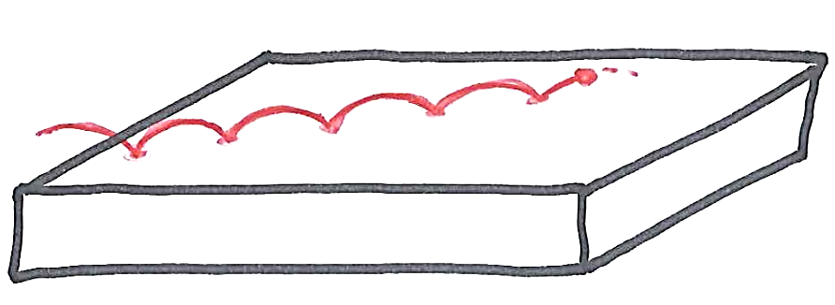
Interlude: bouncing neutrons

Slide 10
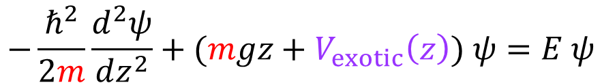
Bouncing neutrons: quantum states
m g z
Vertical energy (peV)
The vertical motion is a simple quantum well problem
$$−\frac{ℏ^{2}}{2m}\frac{d^{2}ψ}{dz^{2}}+(mgz+V_{exotic}\left(z\right)) ψ=E ψ$$
Height (µm)

Slide 11





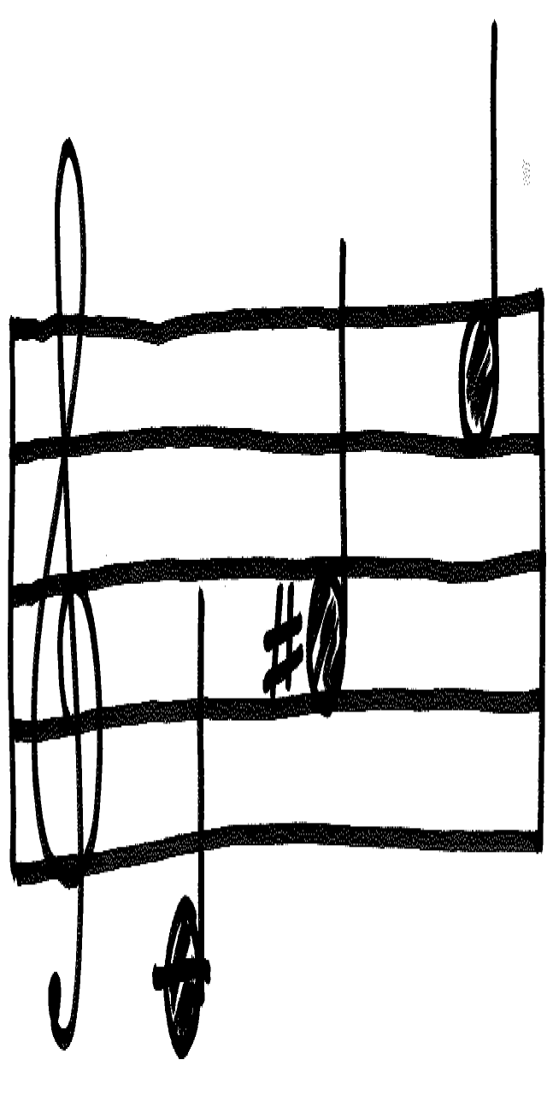
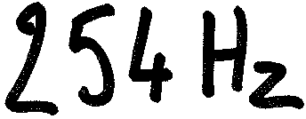
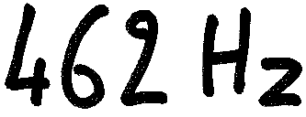
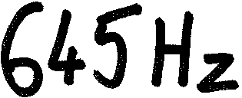
Probing exotic interaction
Chameleons
Symmetrons
By measuring the transition frequencies using Gravitational Resonance Spectroscopy

Slide 12
Back to neutron EDM

Slide 13
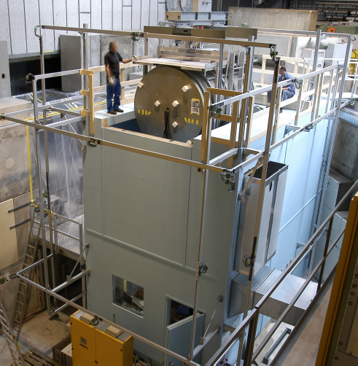
History of the 1-chamber UCN nEDM apparatus
1997
1998
1999
2000
2001
2002
2003
2004
2005
2006
2007
2008
2009
2010
2011
2012
2013
2014
2015
2016
2017
ILL data production
UCN source startup
& nEDM upgrade
PSI data
Dismantling nEDM
n2EDM construction starts
Move of the apparatus at Paul Scherrer Institute (PSI)

Slide 14
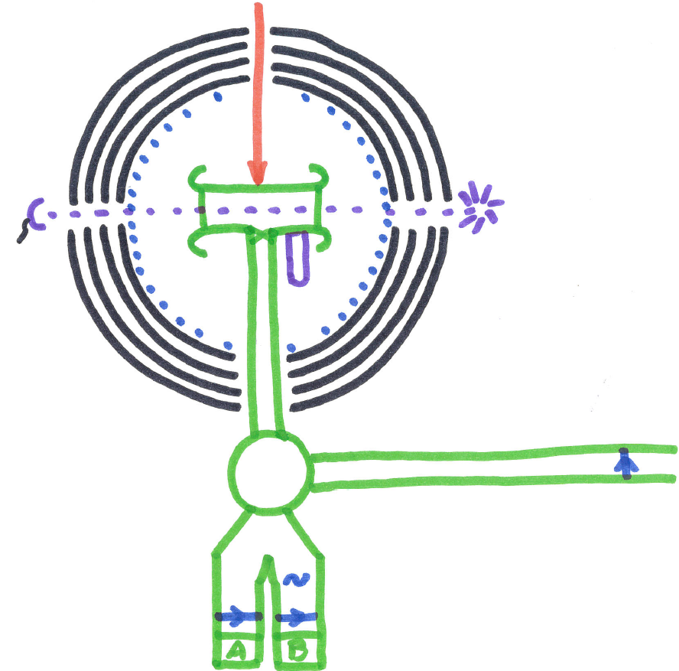
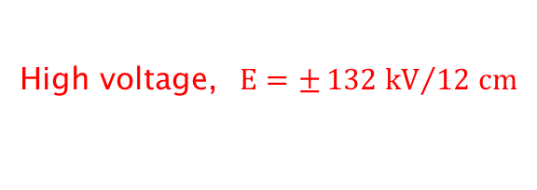
High voltage, $E=±{132 kV}/{12 cm}$
4 layers mu-metal shield
photomultiplier
Mercury lamp
Scheme of the apparatus at PSI
UCN source
SWITCH
5T polarizer
(SC magnet)
Spin flipper
Iron analyser

Slide 15
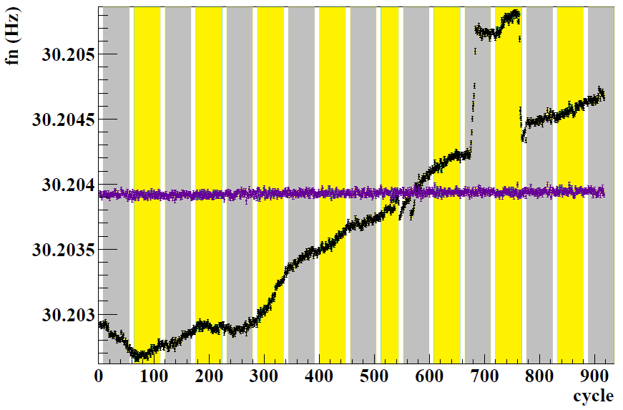
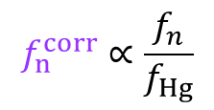


Typical measurement sequence at PSI, 1 cycle every 5 minutes
-
+
-
+
-
+
-
+
-
+
-
+
Uncorrected neutron frequency
$$f_{n}=\frac{γ_{n}}{2π}B$$
Mercury-corrected neutron frequency
$$f_{Hg}=\frac{γ_{Hg}}{2π}B$$
$$f_{n}^{corr}∝\frac{f_{n}}{f_{Hg}}$$
The mercury co-magnetometer compensates for the residual magnetic field fluctuations

Slide 16
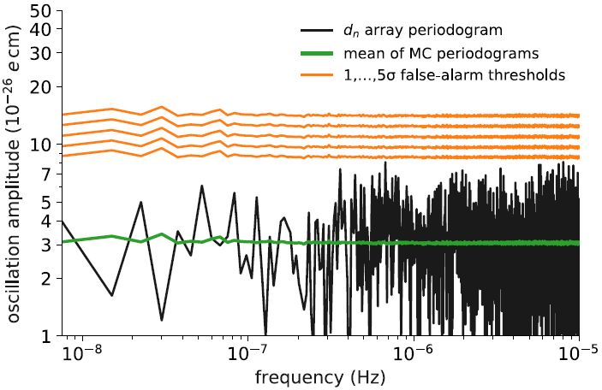
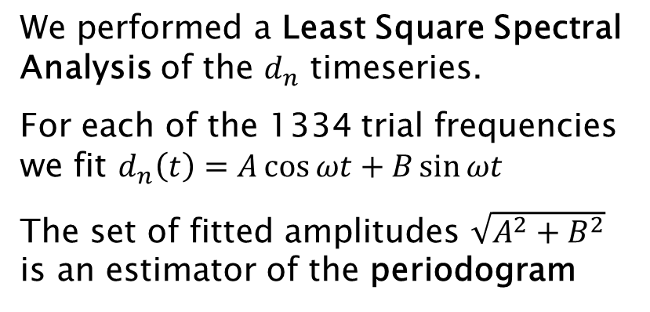
Long-time-base analysis of the ILL data
We performed a Least Square Spectral Analysis of the $d_{n}$ timeseries.
For each of the 1334 trial frequencies we fit $d_{n}\left(t\right)=A\cos{ωt}+B\sin{ωt}$
The set of fitted amplitudes $\sqrt{A^{2}+B^{2}}$ is an estimator of the periodogram
False alarm thresholds are estimated by Monte-Carlo.
(look elsewhere effect is taken into account)

Slide 17
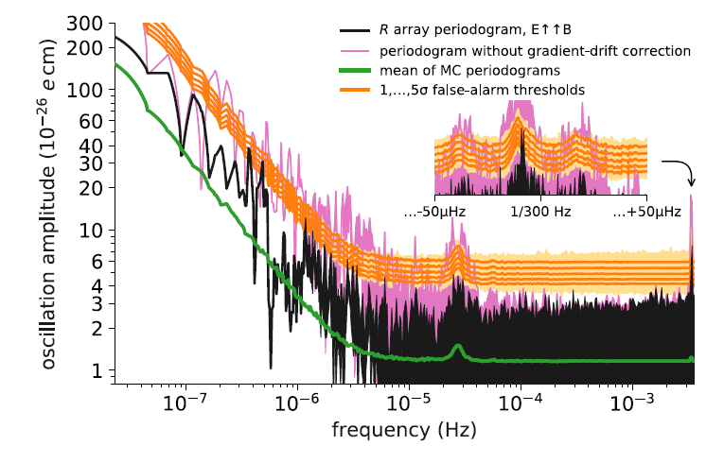
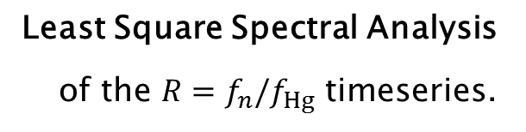
Short-time-base analysis of the PSI data
Least Square Spectral Analysis
of the $R=f_{n}/f_{Hg}$ timeseries.

Slide 18
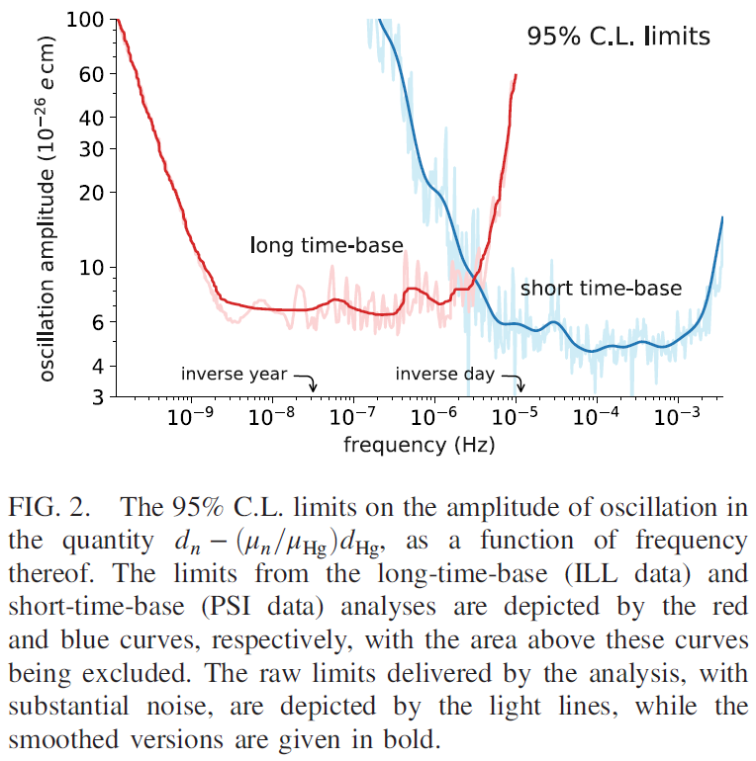
No oscillation in both datasets

Slide 19
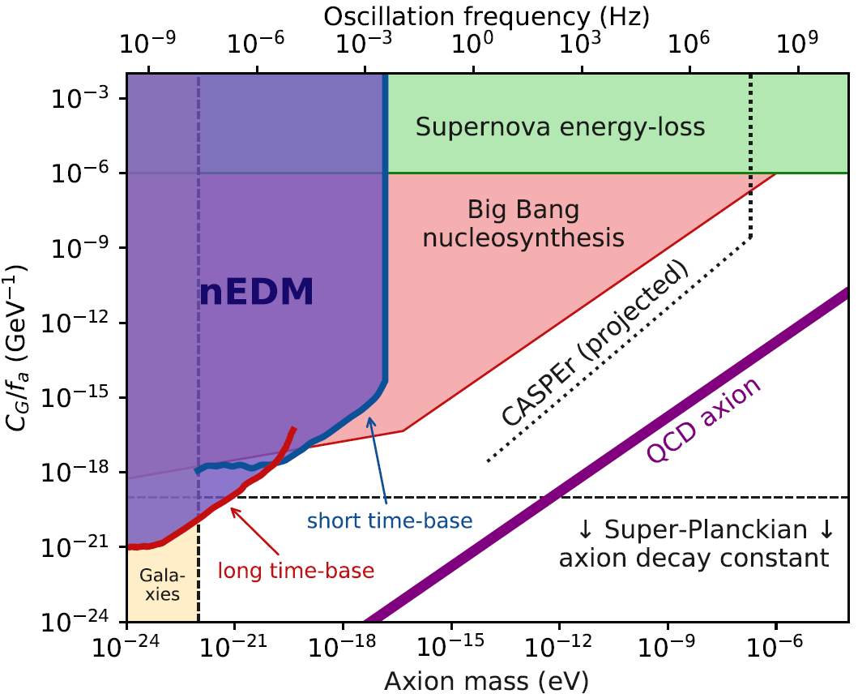
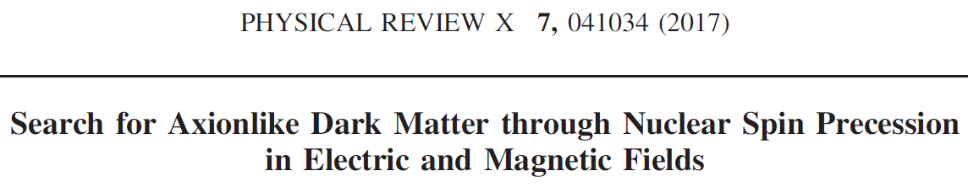

Slide 20
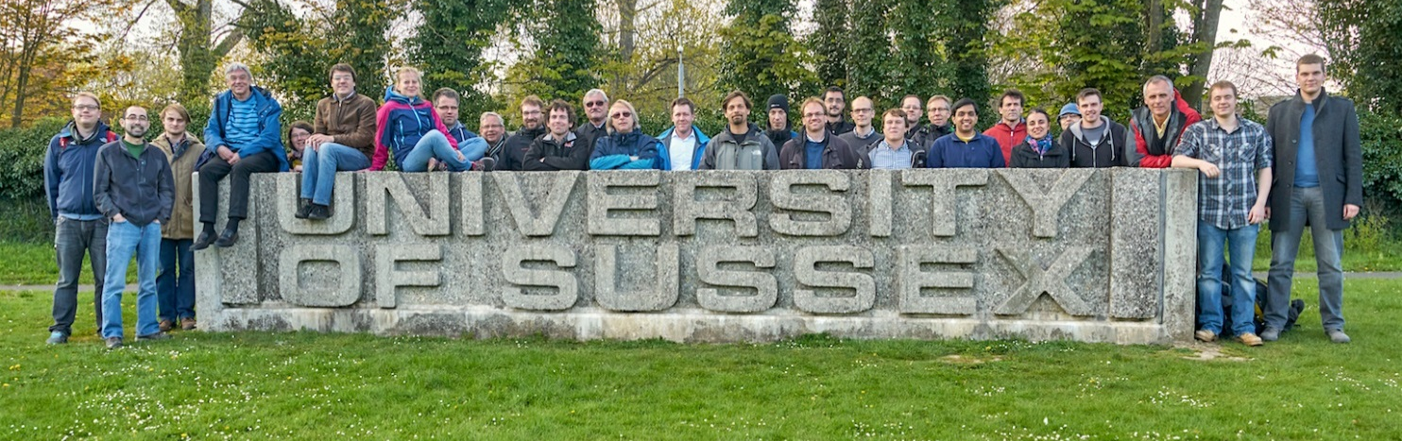

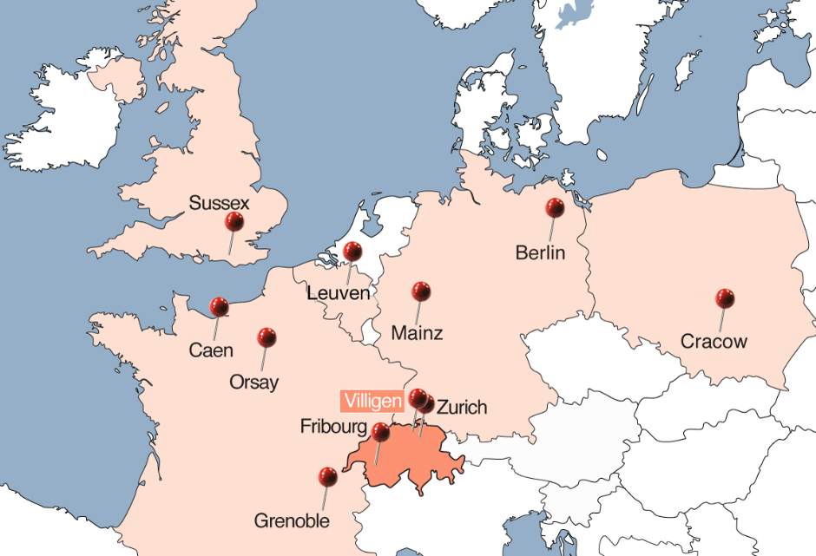
This is it, thank you!
The nEDM collaboration
Credits
The nEDM collaboration, particularly
N. Ayres (analysis ILL data)
M. Rawlik (analysis PSI data)
The theory team
M. Fairbairn, D.J.E. Marsh, Kings College London
V.V. Flambaum, University of New South Wales
Y.V. Stadnik, Johannes Gutenberg Universität Mainz

Slide 21
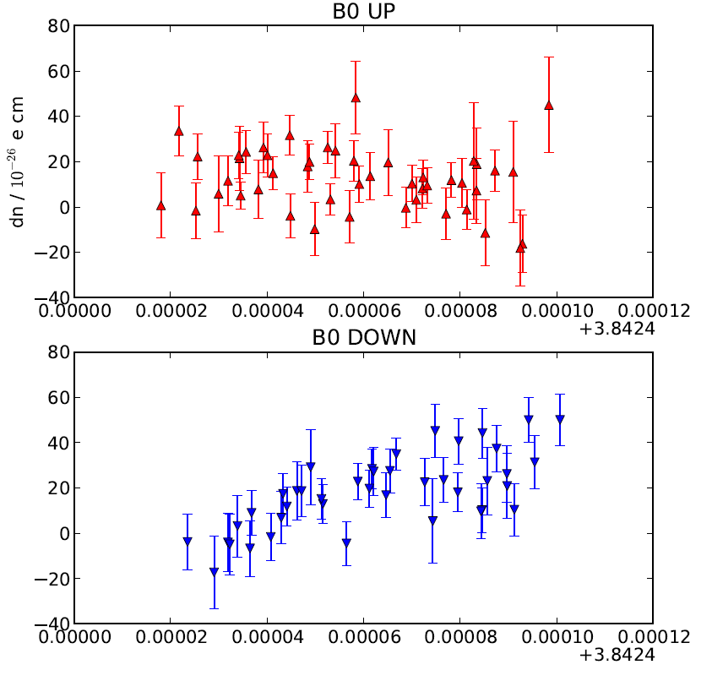

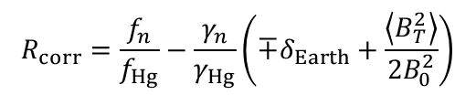


Analysis of the 2015/2016 PSI data is still congoing
Relativistic Hg false EDM
$$d_{False}∝\left\langle xB_{x}+yB_{y}\right\rangle$$
Gravitational shift
$δR∝\frac{{dB}_{z}}{dz}$
Preliminary blind result
$$d_{×}=\left(14.6±1.1\right)×{10}^{−26}e cm$$
$$R_{corr}=\frac{f_{n}}{f_{Hg}}−\frac{γ_{n}}{γ_{Hg}}\left({∓δ}_{Earth}+\frac{\left\langle B_{T}^{2}\right\rangle }{2B_{0}^{2}}\right)$$

Slide 22
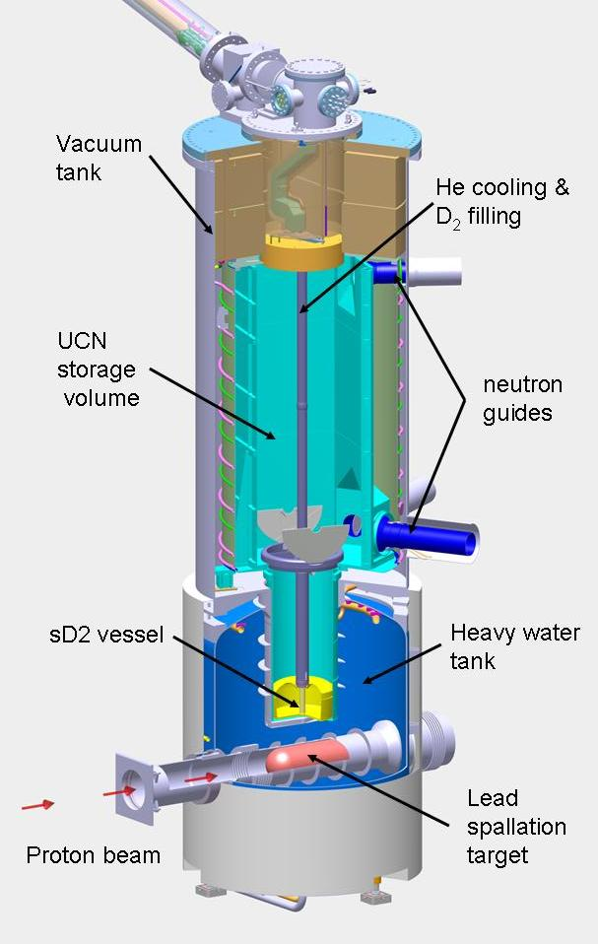
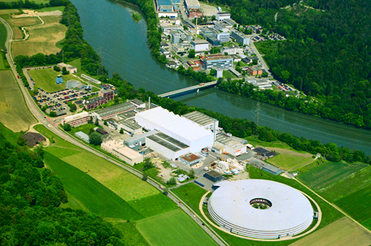
UCN source at the
Paul Scherrer Institute
pulsed UCN source
One kick per 5 min
online since 2011
600 MeV, 2.2 mA

Slide 23
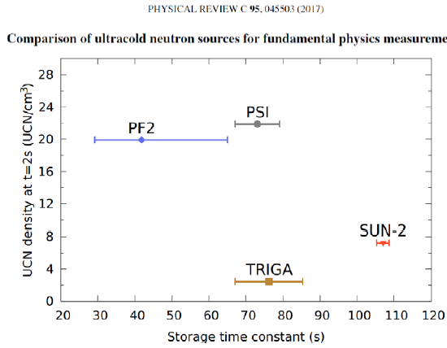
Finally a worldwide comparison of UCN sources
Diter Ries standard stainless steel bottle

Slide 24
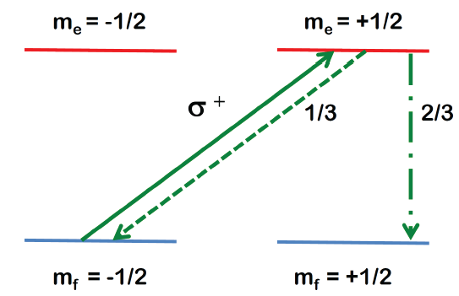
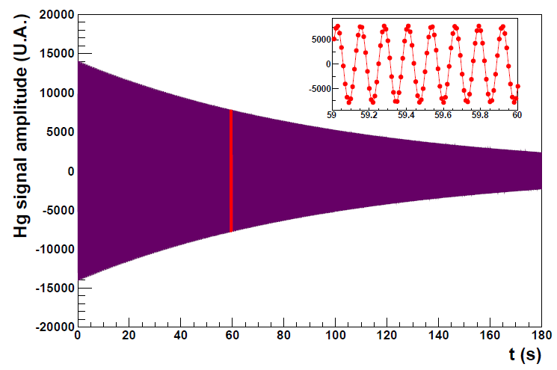
199Hg Magnetometer
Continuous optical pumping in a polarization chamber,
polarized gas injected in the precession chamber
Modulated absorption of polarized light in the precession chamber.
Precision per cycle about 50 fT.

Slide 25


Summary of the 2015/2016 dataset
8,070 cycles with HV = 0 kV
100 sequences recorded
First 12 seq (2015) not blind
25 seq blind in 2015
63 seq blind in 2016
980 cycles
Cut during analysis
45,283 cycles with HV = ±132 kV
Total number of neutrons
counted at 132 kV
$$∑N=515,231,581$$
Effective number of polarized neutrons
$∑α^{2}N=301,717,$744
Irreducible statistical error
$$σ_{irr}d_{n}=\frac{ℏ}{2E \tilde{T}\sqrt{∑α^{2}N}}$$
$$=0.944×{10}^{−26} e cm$$

Slide 26
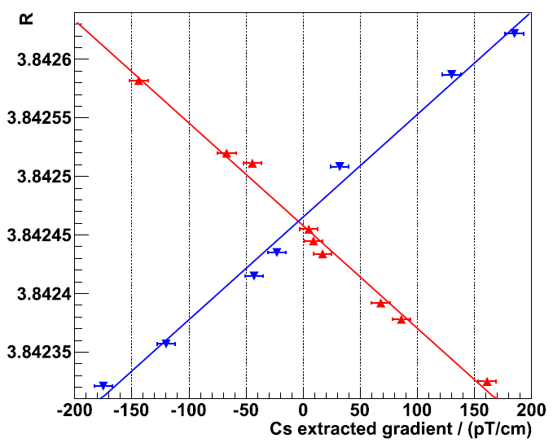
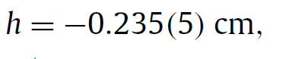

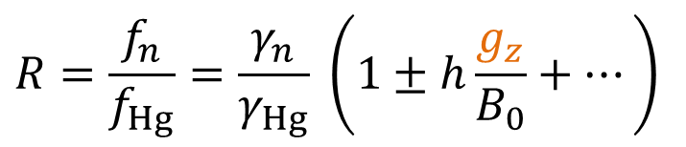
The gravitational shift...
UCN gas
Mercury gas
$$R=\frac{f_{n}}{f_{Hg}}=\frac{γ_{n}}{γ_{Hg}} \left(1±h\frac{g_{z}}{B_{0}}+⋯\right)$$
$$\vec{g}$$
Same precession chamber
Direct measurement Using an array of
Cesium magnetometers
S. Afach et al.,
Phys. Lett. B 739, 128 (2014)

Slide 27

Next phase: n2EDM.
2 chambers in a colossal magnetic shield

Slide 28


