Slide 1
Planning and Installation
LIU Project Team meeting

Slide 2
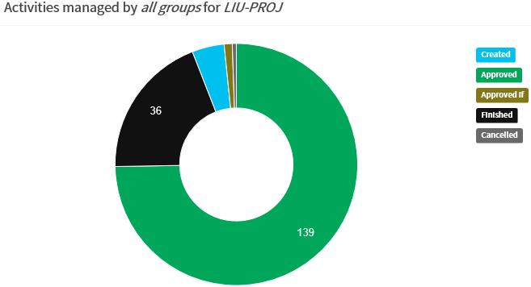
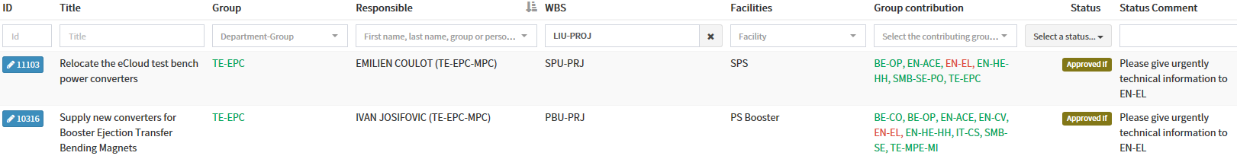
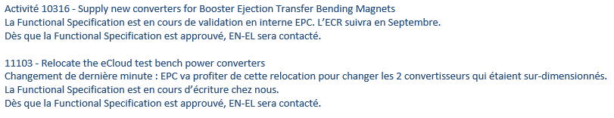
PLAN version 2
2 activities Approved if
Information from Valerie Montabonnet:
9 activities Created (announce too late for the version 2 → will be approved in the version 3)

Slide 3
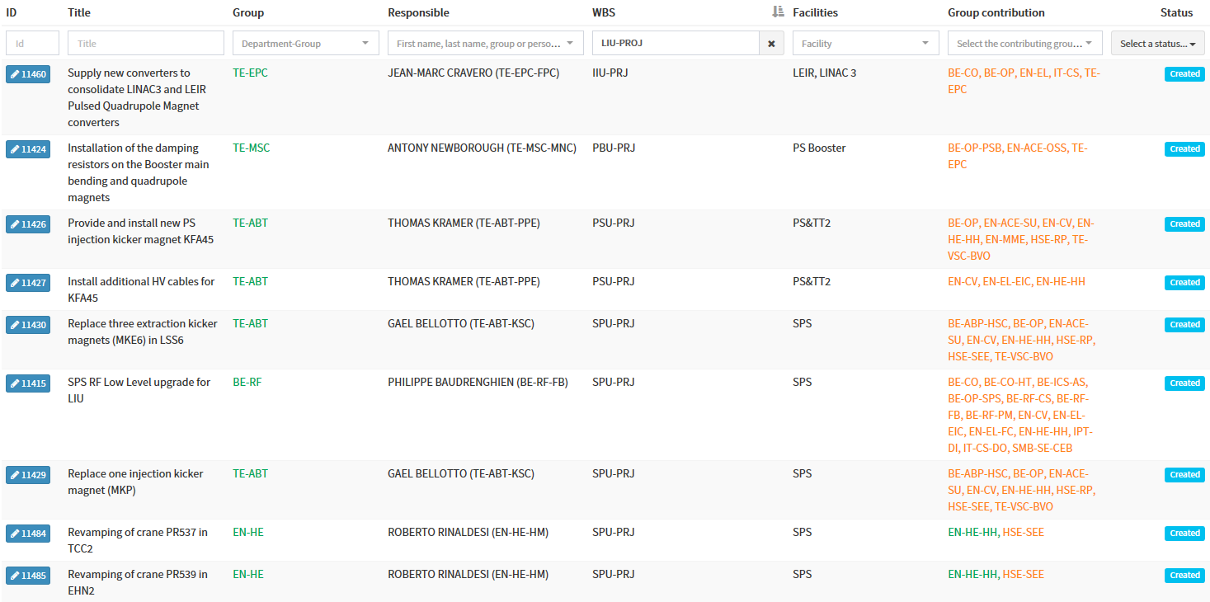
PLAN version 2

Slide 4
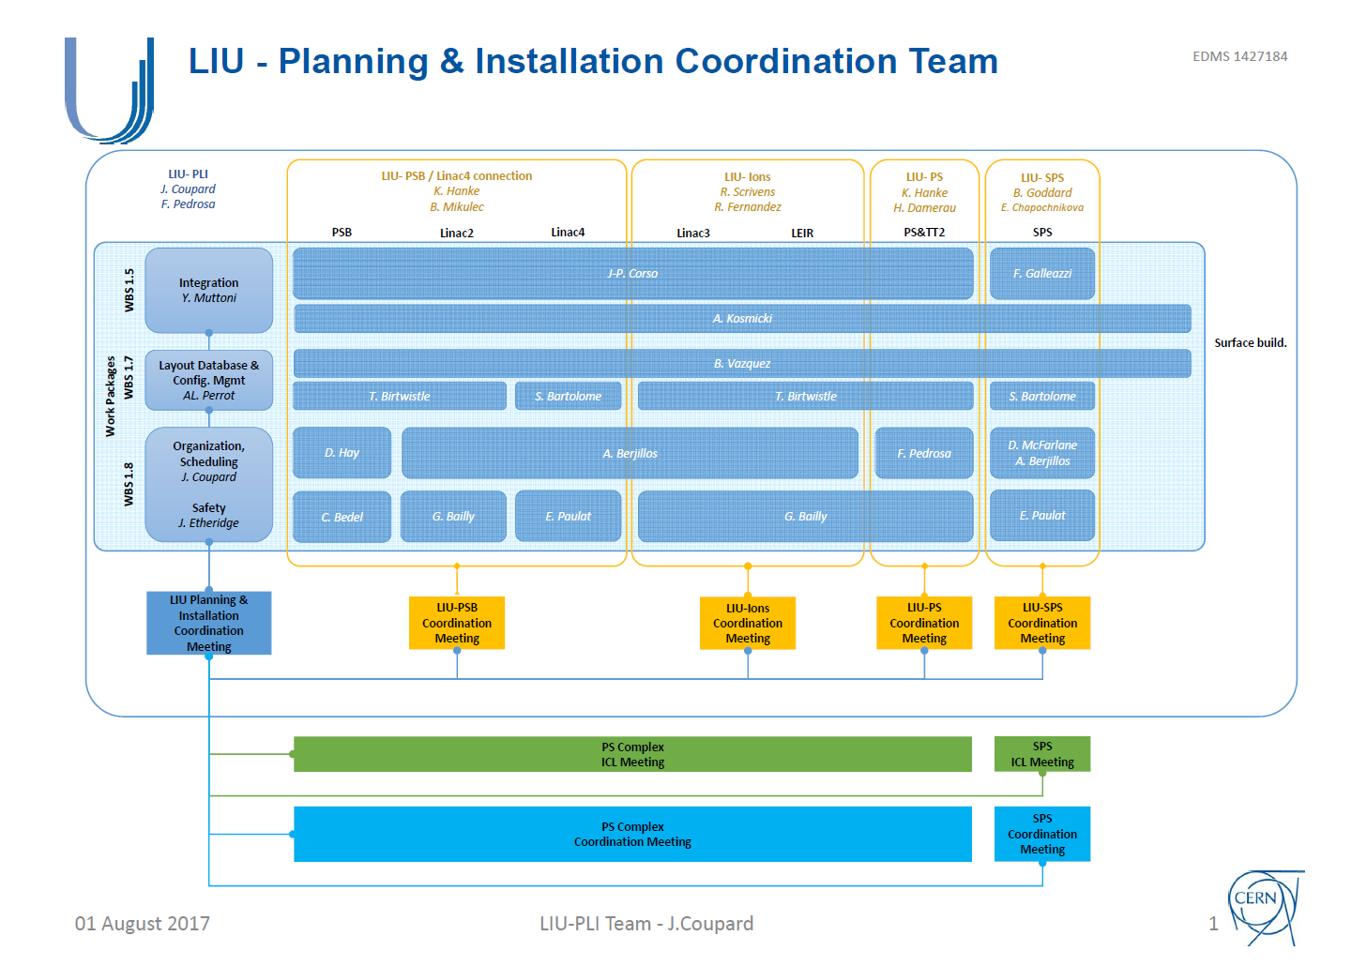
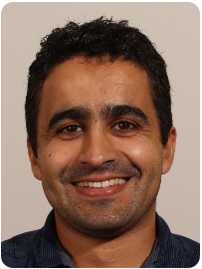
LIU-PLI deputy and PS Facility Coordinator Simon Mataguez is replaced by Fernando Pedrosa

Slide 5
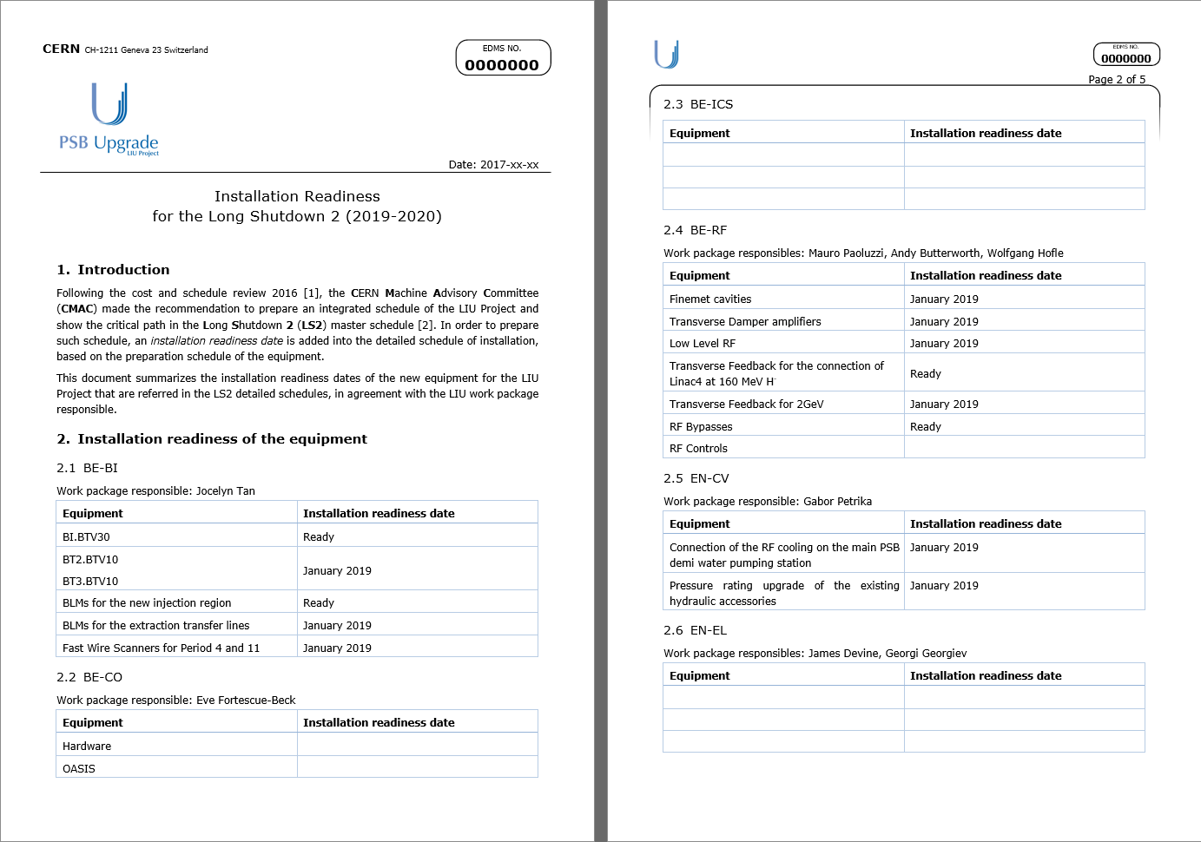
Cost & Schedule Review 2016 recommendation Prepare an integrated schedule and show the critical path
Proposal

Slide 6
LS2
Based on the LS1 experience with the R2E Project and LHC Collimation Project, it is necessary to have dedicated persons in charge of the day-to-day in-situ management and supervision for
The 200 MHz RF Upgrade in SPS Point 3
The New Beam Dump in SPS Point 5 and reconfiguration of the SPS Point 1
→ 2 FTE (Staff CERN-wide ? BE-RF ? TE-ABT ? BE-OP ?)
Based on Linac4 experience with installation of the transfer line, it is necessary to have a dedicated person in charge of the mechanical removal and installation of the Complex PS transfer lines (connection to LT-BHZ20, LBE, BI and BTP lines)
→ 1 FTE (Staff CERN-wide ? )
LS2 Space Management:
Did all the LIU requests have been sent (from Groups to Dep. Space Managers) ?
LS2 Team dedicated : Germana Riddone (TE-VSC), Katy Foraz (EN-ACE), Jonathan Meignan (EN-ACE) with support from David Hay (EN-ACE)
Surface space management will be linked to the facility coordinators schedule

Slide 7
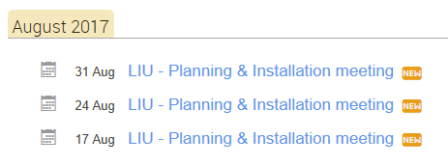
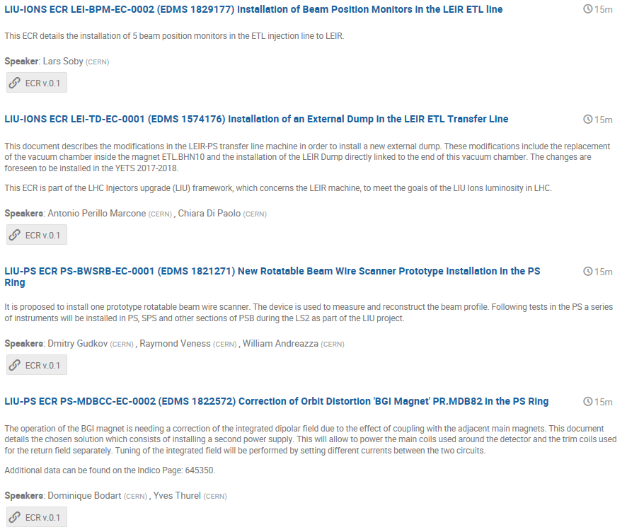
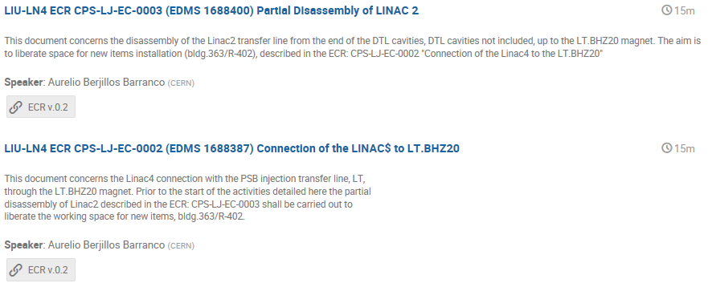
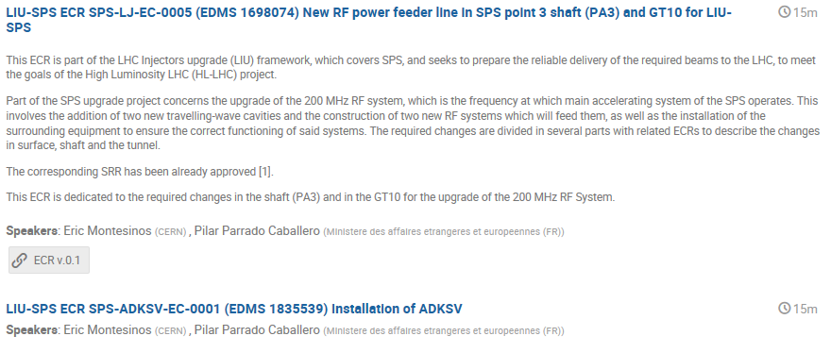
LIU-PLI meetings

Slide 8
LS2 schedule
Linac4 connection
Done
Presentation during the review in August 2016
Review of the schedule with the PSB and PS schedules
PS Booster
In work → strategy under discussion with
EN-EL for the de-cabling and cabling campaigns
TE-VSC and TE-MSC on the sequence for the upgrade of the transfer lines
PS & TT2
In work → strategy based on the consolidation of the main magnets
Priority on the PS Switch Yard area for LIU Project (injection upgrade, new LBE)
Integration of the CV works
SPS
In work
Main activity in Points1, 3 and 5 for LIU Project (critical path on SPS 3 and 5)
Coordination between aC coating/impedance reduction, Cabling campaigns and SPS Fire Safety Project
LHC
In work → New TCDIs in TI2 and TI8 scheduled in LHC 1 and 8 (critical path on LHC 8)
Complex PS
SPS
LHC

