Slide 1

The ARC Information System
Quick overview
Available information
Maiken Pedersen, University of Oslo
Florido Paganelli, Lund University
On behalf of Nordugrid ARC

Slide 2
Outline
ARC key concepts and technologies
Integration challenges past, present and future
What information is available from ARC information system

Slide 3
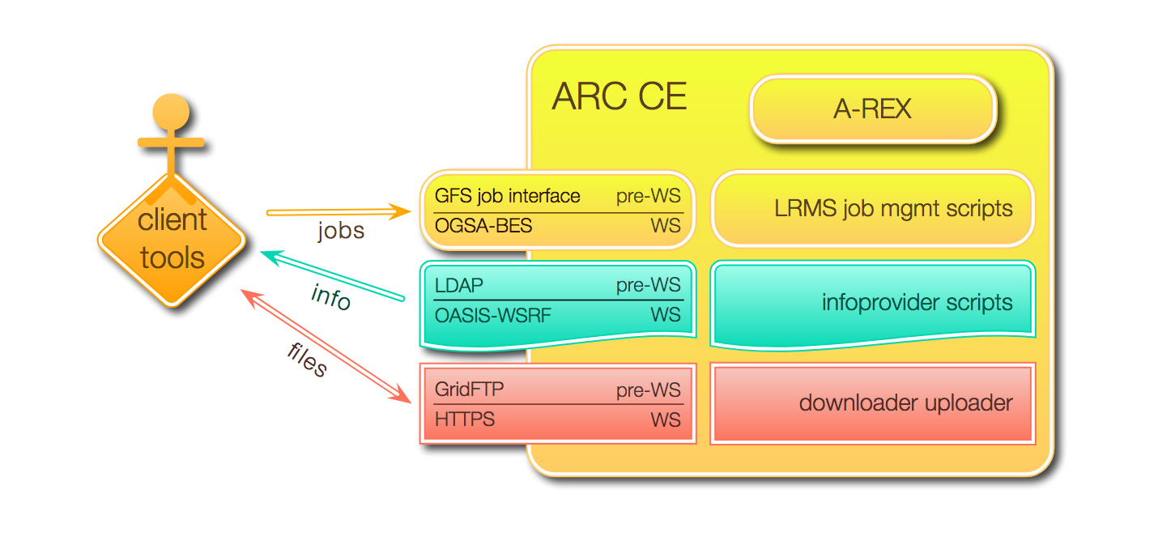
ARC CE with and without (pre-) WS
Information system

Slide 4
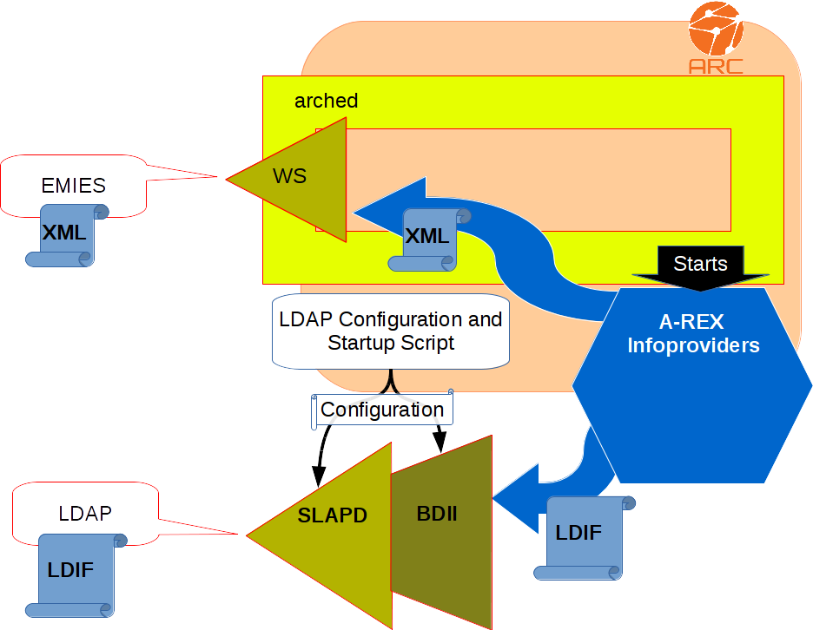
Overview of ARC Information system
ARIS: ARC Resource Information Service
  Installed on the CE or storage resource
  Publishes via
    LDAP
    OASIS-WSRF (OASIS)
  Info on: OS, architecture, memory, running and finished jobs, what users are allowed to run, trusted certificate authorities, …
  GLUE2.0 schema (GLUE 1.2, Nordugrid schema)
    GLUE2: An attempt to unify information and make it independent from the specific LRMS
Infoproviders collect dynamic state info
  Grid layer (A-REX or GridFTP server)
  Local operating system (/proc area)
Interfaces to
  UNIX fork
  PBS-family
  Condor
  Sun Grid Engine
  IBM LoadLeveler
  SLURM
Output:
  LDIF format populates local LDAP tree
  XML format for OASIS-WSRF
Notes:
Arched: arc hosting environment daemon
Things out of the orange thing are not in the control of ARC
We're reducing the number of supported protocols in order to phase out legacy code
The hope is to drop LDAP as well
BDII Berkley Database Information Index
Slapd standalone ldap daemon

Slide 5
Briefly how info is collected and served
Infoproviders are Perl/python LRMS modules that continuously run and collect information from the batch system
Information is temporarily stored in an internal datastructure
The content of this datastructure is reshaped according to the two official ARC information schema, NorduGRID and GLUE2
The information is rendered as LDIF for LDAP and as XML for webservices
Notes:
LDIF: LDAP Data Interchange Format
Rendered: gjengitt
Record: fortegnelse

Slide 6
Supported interfaces and schemas
Submission interface
Information Schema
GRIDftp
NorduGRID
LDAP/LDIF only
Works only with
Depends on
EMI-ES
Web Services
HTTPS
Glue1
Generated from NorduGRID
LDAP/LDIF only
Incomplete
Local
interface
Filesystem
Works only with
GLUE2 XML
LDAP/LDIF with reduced functionality
Notes:
Each interface is bound to a schema to work at its optimum
Efforts to make the schema and interface interchangeable were unsuccesful
We would like to get rid of all legacy code and stick with only one interface and for sure only one schema, GLUE2

Slide 7
Supported interfaces and schemas
Submission interface
Information Schema
GLUE2
Most Complete!
Includes all info the other
schema have and more!
GRIDftp
NorduGRID
LDAP/LDIF only
Works only with
Depends on
EMI-ES
Web Services
HTTPS
Glue1
Generated from NorduGRID
LDAP/LDIF only
Incomplete
Local
interface
Filesystem
Works only with
GLUE2 XML
LDAP/LDIF with reduced functionality
Notes:
Each interface is bound to a schema to work at its optimum
Efforts to make the schema and interface interchangeable were unsuccesful
We would like to get rid of all legacy code and stick with only one interface and for sure only one schema, GLUE2

Slide 8
Resource
Information Consumers
LDAP:
  Can simply be queried using ldapsearches
  ldapsearch -x -h piff.hep.lu.se -p 2135 -b 'GLUE2GroupID=resource,o=glue’
Web Services:
  Communication encrypted (certificates)
  EMI-ES: Any client capable of speaking this protocol
    E.g. arcinfo –c arctest1.hpc.uio.no
Notes:
maikenp@purplerain ~$ arcinfo -c arctest1.hpc.uio.no
Computing service: Abel (Test Minimal Computing Element) (production)
Information endpoint: ldap://arctest1.hpc.uio.no:2135/Mds-Vo-Name=local,o=grid
Information endpoint: ldap://arctest1.hpc.uio.no:2135/o=glue
Information endpoint: https://arctest1.hpc.uio.no:443/arex
Information endpoint: https://arctest1.hpc.uio.no:443/arex
Submission endpoint: https://arctest1.hpc.uio.no:443/arex (status: ok, interface: org.nordugrid.local)
Submission endpoint: https://arctest1.hpc.uio.no:443/arex (status: ok, interface: org.ogf.bes)
Submission endpoint: https://arctest1.hpc.uio.no:443/arex (status: ok, interface: org.ogf.glue.emies.activitycreation)
Submission endpoint: gsiftp://arctest1.hpc.uio.no:2811/jobs (status: ok, interface: org.nordugrid.gridftpjob)
Extract from ldapsearch:
# urn:ogf:ExecutionEnvironment:arctest1.hpc.uio.no:execenv0, ExecutionEnvironme
nts, urn:ogf:ComputingManager:arctest1.hpc.uio.no:fork, urn:ogf:ComputingServi
ce:arctest1.hpc.uio.no:arex, services, glue
dn: GLUE2ResourceID=urn:ogf:ExecutionEnvironment:arctest1.hpc.uio.no:execenv0,
GLUE2GroupID=ExecutionEnvironments,GLUE2ManagerID=urn:ogf:ComputingManager:ar
ctest1.hpc.uio.no:fork,GLUE2ServiceID=urn:ogf:ComputingService:arctest1.hpc.u
io.no:arex,GLUE2GroupID=services,o=glue
GLUE2EntityValidity: 1200
GLUE2ExecutionEnvironmentMainMemorySize: 1831
GLUE2ExecutionEnvironmentOSFamily: linux
GLUE2ExecutionEnvironmentCPUModel: Intel(R) Xeon(R) CPU E5-2690 0
GLUE2EntityName: execenv0
GLUE2ExecutionEnvironmentTotalInstances: 1
GLUE2ExecutionEnvironmentLogicalCPUs: 2
GLUE2ExecutionEnvironmentUnavailableInstances: 0
GLUE2ExecutionEnvironmentVirtualMemorySize: 5926
GLUE2ExecutionEnvironmentConnectivityIn: FALSE
GLUE2ExecutionEnvironmentPhysicalCPUs: 2
GLUE2ExecutionEnvironmentCPUClockSpeed: 2900
GLUE2ExecutionEnvironmentCPUVendor: GenuineIntel
GLUE2ResourceID: urn:ogf:ExecutionEnvironment:arctest1.hpc.uio.no:execenv0
GLUE2ExecutionEnvironmentComputingManagerForeignKey: urn:ogf:ComputingManager:
arctest1.hpc.uio.no:fork
GLUE2ExecutionEnvironmentPlatform: amd64
GLUE2ExecutionEnvironmentUsedInstances: 0
GLUE2ResourceManagerForeignKey: urn:ogf:ComputingManager:arctest1.hpc.uio.no:f
ork
objectClass: GLUE2Resource
objectClass: GLUE2ExecutionEnvironment
GLUE2ExecutionEnvironmentCPUMultiplicity: multicpu-singlecore
GLUE2ExecutionEnvironmentConnectivityOut: TRUE
GLUE2EntityCreationTime: 2017-09-19T19:22:15Z

Slide 9
GLUE2 mapping of relevant cluster information
Concept
GLUE2 information tree
A-REX status
A-REX ComputingService
Batch system
technology information
ComputingManager
objects
Cluster nodes technology
information: hardware and OS
Cluster nodes technology
information: hardware and OS
ExecutionEnvironment
objects
Cluster nodes technology
information: hardware and OS
Application software
information
ApplicationEnvironment
objects
Batch system
resources information
ComputingShare
objects
Authorization information
such as VO
MappingPolicy
objects
Notes:
ComputingManager object: example attribute: name: slurm
ExecutionEnvironment object: example attribute: architecture : x86_64
The
ExecutionEnvironment
class describes the hardware and operating system environment
in which a job will run
ApplicationEnvironment object: example attribute: name: athena
The ApplicationEnvironment
class describes the software environment in which a job will
run, i.e. what pre-installed software will be available to it.
The ComputingShare class is the specialization of the main Share class for computational
services. A Computing Share is a high-level concept introduced to model a utilization target for a
set of Execution Environments defined by a set of configuration parameters and characterized by
status information. A ComputingSharecarries information about "policies" (limits) defined over
all or a subset of resources and describes their dynamic status (load).
Most interesting for this presentation:
Batch system
Batch system resources info

Slide 10
GLUE2 mapping of relevant info: Queues, Limits. Static
Cluster information | Sample value | GLUE2 object | GLUE2 attribute | Sample GLUE2 value
Authorized VO names | atlas | MappingPolicy | PolicyRule | vo:atlas
Batch system name | slurm | ComputingManager | ComputingManagerProductName | slurm
Batch system queue name | batch | ComputingShare | ComputingShareMappingQueue | batch
Name of allocation of batch queue for atlas | (created by A-REX) | ComputingShare | ComputingShareName | batch_atlas
Maximum allowed CPU time | 7 days | ComputingShare | ComputingShareMaxCPUTime | 604800 (seconds)
Maximum Wall time | 7 days | ComputingShare | ComputingShareMaxWallTime | 604800 (seconds)
Maximum usable memory for a job | 16GB | ComputingShare | ComputingShareMaxVirtualMemory | 16384 (MB)
The maximum allowed jobs for this share | 5000 | ComputingShare | ComputingShareMaxTotalJobs | 5000
The maximum allowed number of jobs per grid user in this share | 10000 | ComputingShare | ComputingShareMaxUserRunningJobs | 10000
Notes:
A Share is a set of resources.
A ComputingShare is typically an allocation on a batch system queue, but can be anything that reserves resources.
Every Share has a related MappingPolicy, that represents some kind of authorization associated to that share. So far there are no special authorization rules but the simple “Belonging to a VO” information
In ARC there is a special ComputingShare for each batch system's queue with NO MappingPolicy, that represents the status of every queue as a whole, regardless of policy restrictions and resource allocations

Slide 11
GLUE2 mapping of relevant info: jobs statistics, dynamic
Cluster information | Sample value | GLUE2 object | GLUE2 attribute | Sample GLUE2 value
Jobs scheduled by A-REX not yet in the batch system | 1 | ComputingShare | ComputingSharePreLRMSWaitingJobs | 1
Jobs scheduled by A-REX for which A-REX is performing data staging (downloading or uploading data) | 1 | ComputingShare | ComputingShareStagingJobs | 1
Number of jobs waiting to start execution, in queue in the batch system, both non-grid and grid | 262 | ComputingShare | ComputingShareWaitingJobs | 262
Queued non-grid jobs | 67 | ComputingShare | ComputingShareLocalWaitingJobs | 67
Total number of jobs currently running in the system, non-grid and grid | 1458 | ComputingShare | ComputingShareRunningJobs | 1458
Running non-grid jobs | 1025 | ComputingShare | ComputingShareLocalRunningJobs | 1025
Total number of jobs in any state (running, waiting, suspended, staging, PreLRMSWaiting) from any interface both non-grid and grid | 1721 | ComputingShare | ComputingShareTotalJobs | 1721
1721 = 1+262+1458

Slide 12
GLUE2 mapping of relevant
info: job statistics, dynamic
Cluster information | Sample value | GLUE2 object | GLUE2 attribute | Sample GLUE2 value
Number of free slots available for jobs | 1140 | ComputingShare | ComputingShareFreeSlots | 1140
Number of free slots available with their time limits | 1140 | ComputingShare | ComputingShareFreeSlotsWithDuration | 1140:604800 #slots:duration [#slots:duration], a list
Number of slots required to execute all currently waiting and staging jobs | 686 | ComputingShare | ComputingShareRequestedSlots | 686
Batch system overview of grid jobs | 1774 | ComputingManager | ComputingManagerSlotsUsedByGridJobs | 1774
Batch system overview of non-grid jobs | 8233 | ComputingManager | ComputingManagerSlotsUsedByLocalJobs | 8233

Slide 13
Formats and adding information
The existing formats can be converted to e.g. json by Harvester ARC plugin
Or: format of information can easily be provided as a json file on ARC side.
Information needed by ATLAS which is not already provided:
  Can be put on top of the glue2.0 schema, but:
    will “pollute” the glue2.0 schema and must be used sparingly and after careful discussion and agreement
Notes:
Add comments from various, David, Florido etc here.

Slide 14
Summary
ARIS is a powerful local information service:
  speaks multiple dialects (NorduGrid, Glue1, GLUE2)
  Creates LDIF and XML renderings
    ARC is the only middleware that renders both
  Offers information via both LDAP and Web Services
Information consumers:
  are easy to write as they would be based on well known standard technologies
  Can get very accurate information directly from ARIS Resource level.
Aiming at a full GLUE2 support
  Hoping to phase-out of old technologies like LDAP or Gridftpd

Slide 15
Backup – general and additional info

Slide 16






The ARC Information system key concepts
Information must be as fresh as possible.
The main source is therefore the
local or resource level
Index must be as lightweight as possible:
EGIIS contains just URLs.
No caching of information:
it only makes sense when fresh
Being able to speak all the possible
information system dialects
As a consequence, clients accessing the resources need to
discovery and query resources on their own.
Notes:
Nothing much more to say

Slide 17

Technologies
A collection of Perl scripts, the infoproviders, collecting information
LDAP:
  Backend consisting of a
  schema and the
  EGIIS index
  A dynamically populated OpenLDAP server and a collection of ldap Berkeley Database update scripts
Web Services:
  Web Services Container: HED
  ARCHED, serves info via WSRF based on XML
performance only depends on slapd
and optimization of perl scripts
Notes:
The non-orange part is software out of ARC control
Web Services Resource Framework (WSRF)

Slide 18
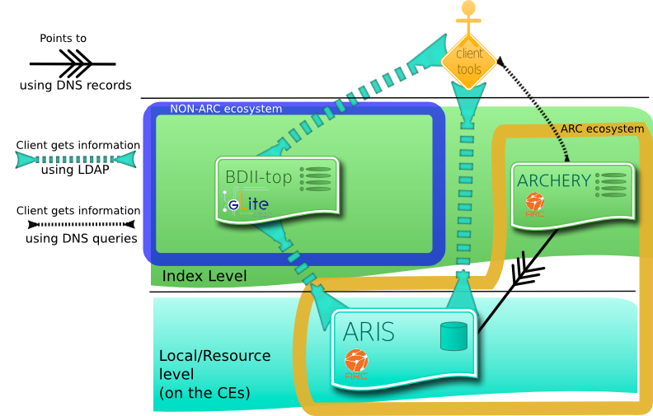
ARC IS: extended to “speak” other dialects
Notes:
The orange band is around our software
The blue band is non-ARC software
Clients here are any general client, not just the arc one. Arc clients can use all channels
Able to register to different indexes/registries/cache
ARCHERY substitutes EGIIS
ARIS and BDII already share Glue1 and GLUE2 information

Slide 19
What GLUE2 VO info looks like
One Share for the actual queue, without any VO information
A Share for each VO, reporting specific VO numbers. Share names are of the form
queuename_voname
A MappingPolicy for each Share, should be used by clients for discovery
Notes:
Not important

Slide 20
The ComputingShare and MappingPolicy concepts
For each queue that is serving a VO, there is a ComputingShare and a MappingPolicy for such VO to represent the status of resources of that queue allocated to that VO.
  Example: the queue called batch serving the VO atlas will be represented by a ComputingShare “called” batch_atlas
NOTE: the name of a Share should not be used for discovery. It is written that way just for humans to be able to read at first glance.
GLUE2 is a distributed database and using the attributes and unique IDs of its objects are the proper way to do it:
    Search for ID of the MappingPolicy associated with a VO
    Find the ComputingShare that serves that Policy ID.
  Note that the use of unique IDs allows for large scale scheduling across clusters.
Notes:
Too much info, could skip most, check.

Slide 21
The ComputingShare and MappingPolicy concepts
A Share is a set of resources. A ComputingShare is typically an allocation on a batch system queue, but can be anything that reserves resources.
Every Share has a related MappingPolicy, that represents some kind of authorization associated to that share. So far there are no special authorization rules but the simple “Belonging to a VO” information
  In Glue1 this information was somewhere in VoView
In ARC there is a special ComputingShare for each batch system's queue with NO MappingPolicy, that represents the status of every queue as a whole, regardless of policy restrictions and resource allocations

Slide 22
Ongoing developments related to available information
VO support: based on GLUE2 ComputingShares
  Generic solution: gets VO info from user certificate. Sysadmin should just specify what are the expected VO names per queue/cluster
Notes:
Work ongoing to publish information per vo.
Maybe not really intersting for ATLAS, as ATLAS knows about its jobs, could be relevant for Harvester if submitting jobs from many different vos

Slide 23
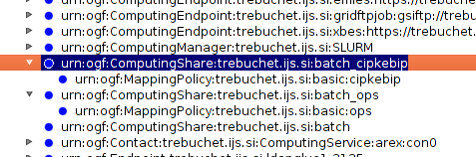
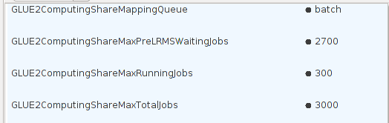
What VO info looks like
VO name
queue name

Slide 24
Future developments
VO:
  MAY get VO info from LRMS that support it, but still not planned. Condor solution (ClassAds) far from being generic

