Slide 1
Status of Nudy
Harphool Kumawat
Nuclear Physics Division, BARC
25/07/16
H. Kumawat, Group meeting, EP-SFT
1
Notes:
H. Kumawat

Slide 2
Introduction: Evaluated Nuclear Data File
ENDF File
Different sections
1 → General description, Fission neutron multiplicity, partial photon data
2 → Resonance parameters for cross-section
3 → Cross-sections for all reactions
4 → Independent angular distributions
5 → Independent energy distributions
6 → Correlated angle-energy distributions
7 → Thermal neutron scattering data
8 → Decay data and fission products
9 → Multiplicities for radio-active nuclide production
10 → Production cross-section for radio-active nuclide
11 → General comments for Photon production
12 → Photon production multiplicities
13 → Photon production cross-section
14 → Photon angular distributions
15 → Continuous photon energy distribution
Complete
To be checked
To be Completed
19/07/17
H. Kumawat, Neutron meeting
2
Notes:
H. Kumawat

Slide 3
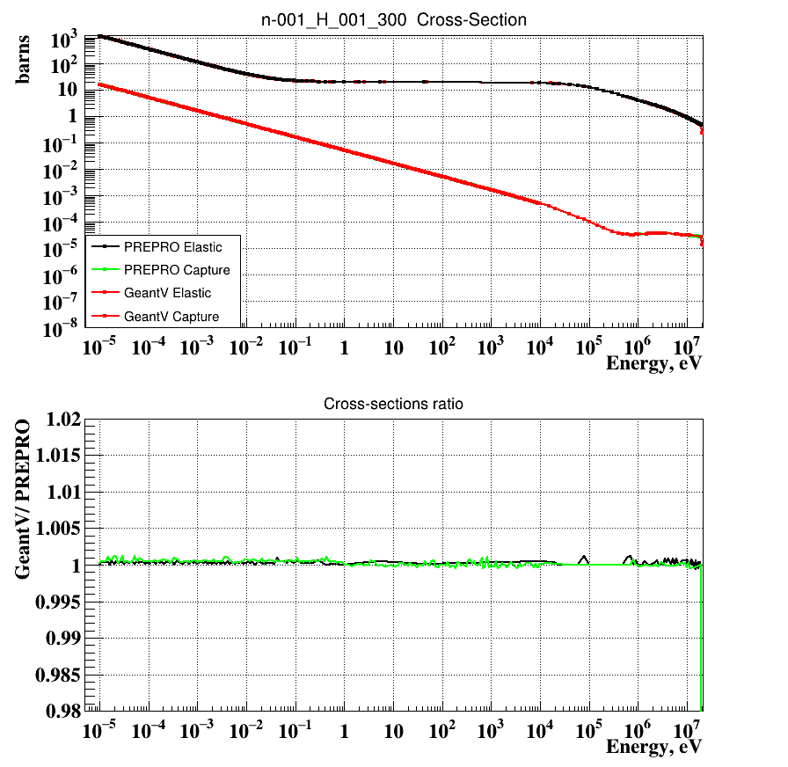
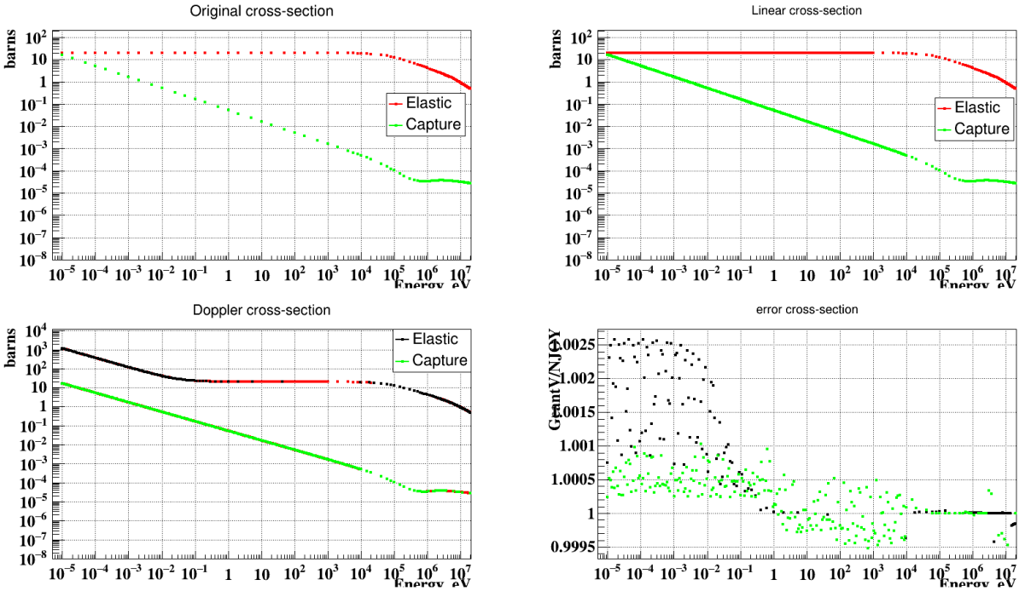
Reconstruction: Hydrogen cross-section
Present
July 2016
25/07/16
H. Kumawat, Neutron meeting
3
Notes:
H. Kumawat

Slide 4
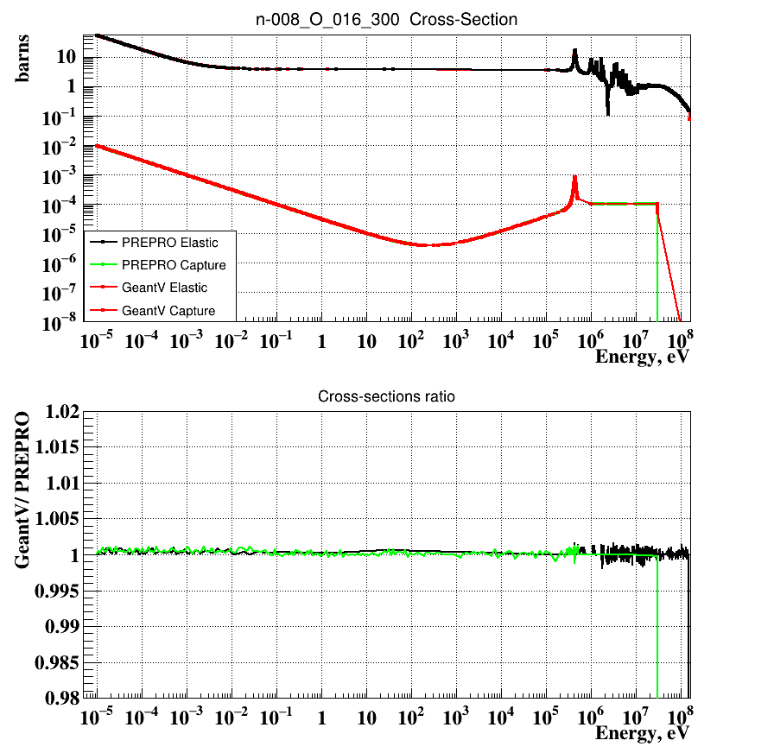
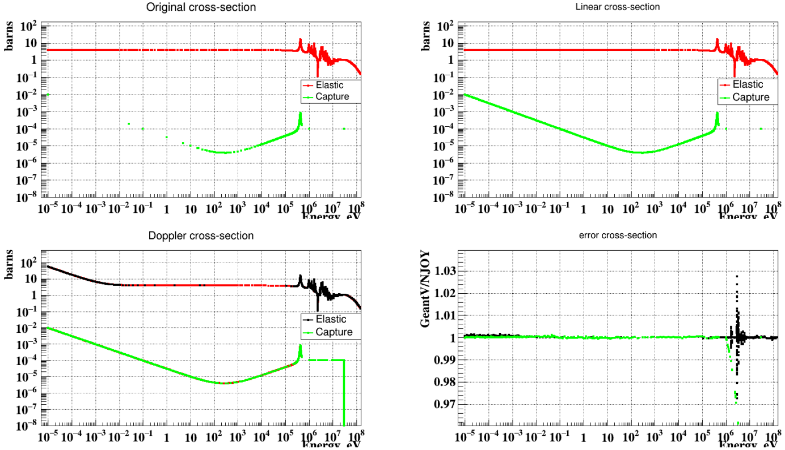
Reconstruction: O16 cross-section
Present
July 2016
25/07/16
H. Kumawat, Neutron meeting
4
Notes:
H. Kumawat

Slide 5
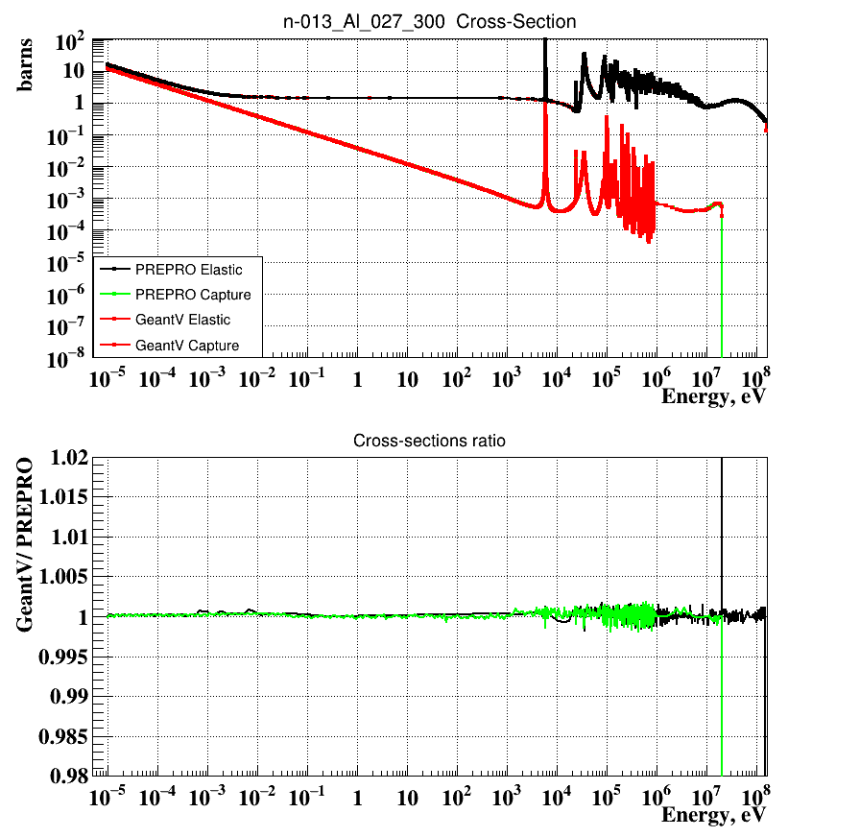
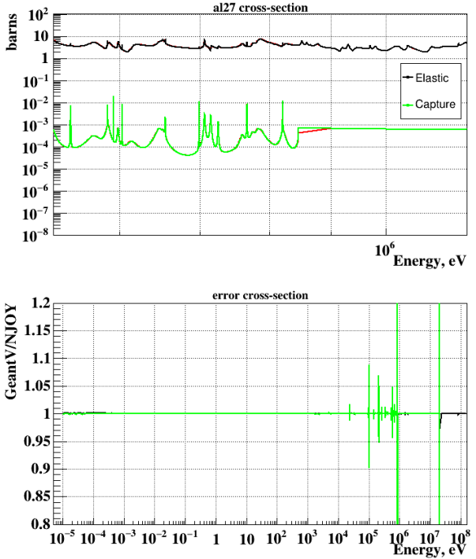
Reconstruction: Al27 cross-section
Present
July 2016
25/07/16
H. Kumawat, Neutron meeting
5
Notes:
H. Kumawat

Slide 6
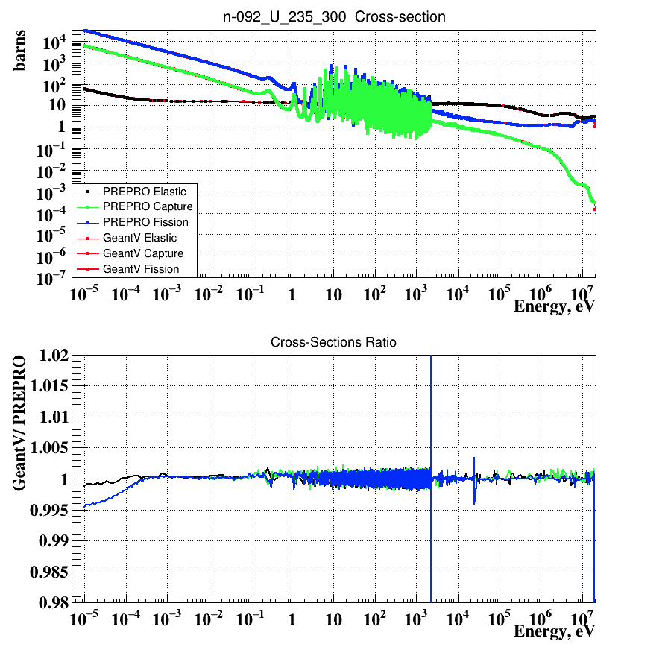
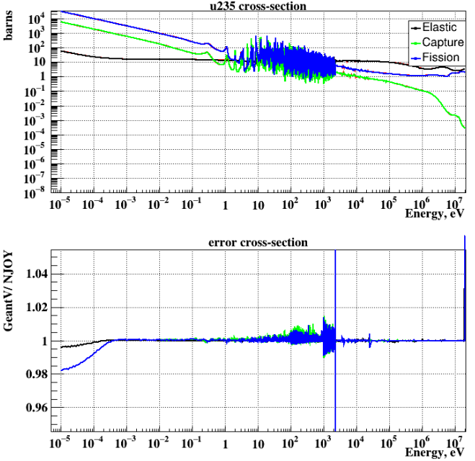
Reconstruction: U235 cross-sections
Present
July 2016
25/07/16
H. Kumawat, Neutron meeting
6
Notes:
H. Kumawat

Slide 7
New Additions in Cross-sections
Neutron induced charge particle cross-section MT 103-107 (p, d, H3, He3, He4)
Are created if cross-sections are given in 600-850
Angular and energy distributions of these particles were read along with the
Neutron but to be separated
Doppler broadening is improved by introducing new points around peak as the peak broadens
Strategy to be followed
My strategy is to put first neutron, second charge particles and Third photons
cross-sections 2) angle 3) energy
19/07/17
H. Kumawat, Neutron meeting
7
Notes:
H. Kumawat

Slide 8
Status of photon production data
I have read photon cross-sections. Angle and energy is also done to some extent but it should be usable in the normalized format for continuous and discrete photons
I have run the program in my branch and created a merge request and people can start from here
That’s all, folks!
19/07/17
H. Kumawat, Neutron meeting
8
Notes:
H. Kumawat

