Slide 1








WP4

Slide 2
Progress with the cryogenic vacuum system of FCC-hh
Francis Perez (ALBA) and Paolo Chiggiato (CERN)
on behalf of EuroCirCol WP4

Slide 3
Progress with the FCC-hh beam screen design
In the last two year, the beam screen design has been modified several times to attain:
  Improved heat transfer (for example, cold spray copper ring in the outer surface)
  Reduced transverse impedance (symmetric cross section)
  Higher pumping efficiency (larger pumping holes)
  Easier manufacturing (polygonal shape)

Slide 4

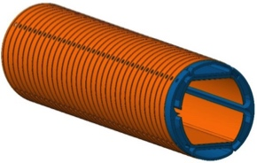

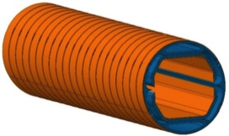

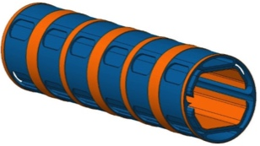
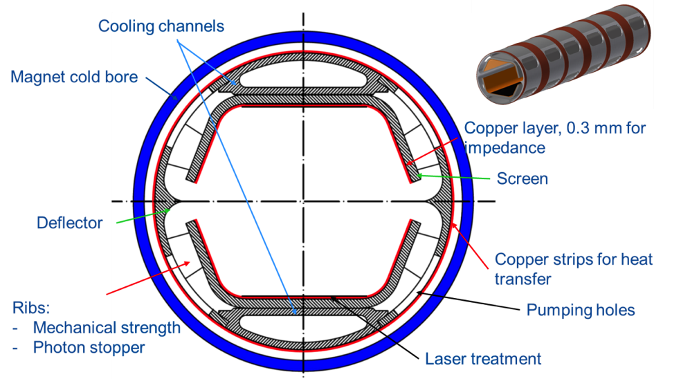
Progress with the FCC-hh beam screen design
Orsay 09/2015
3th WP4 meeting
Geneva 06/2016
4th WP4 meeting
Barcelona 11/2016
5th WP4 meeting
Karlsruhe 04/2017
6th WP4 meeting

Slide 6
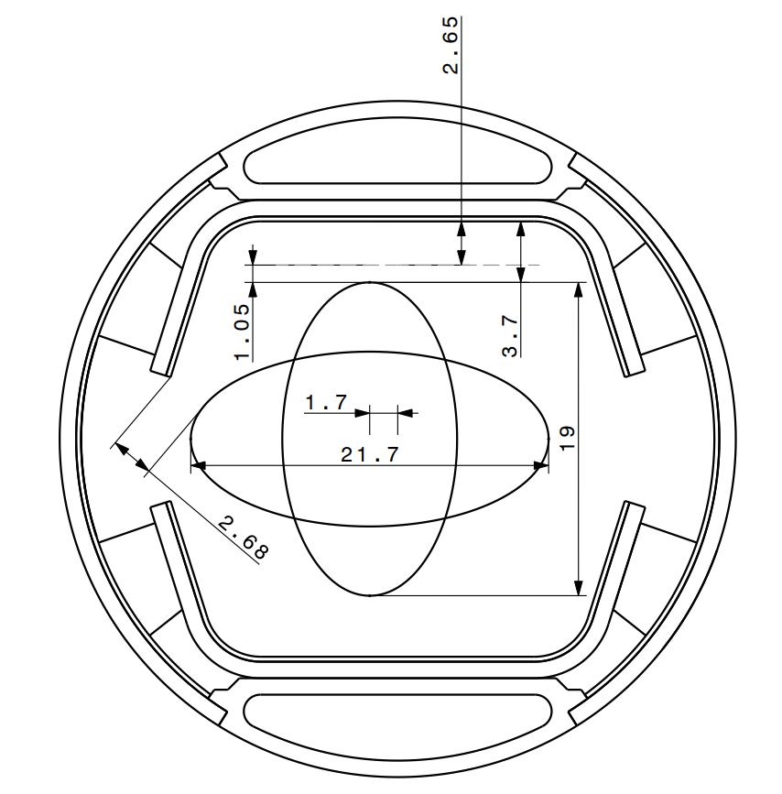
BEAM DYNAMICS REQUIRED LARGE APERTURES
Large acceptance to accommodate vertical orbit error
Larger horizontal aperture to accommodate injection (15.5 sigma)

Slide 17
KARA (Karlsruhe Research Accelerator - Ex-ANKA)
BESTEX (BEam Screen Testbench EXperiment)

Slide 22
Next prototypes:
Considering several options:
Work in parallel with LASE, deflector &/or sawtooth
Final decision before welding (April 18 – July 18)
4th prototype: Sawtooth (& electrode) ??

Slide 30
Gas adsorption/desorption dynamics and SEY

Slide 35
Conclusion
Impresive work by the team
Thanks

