Slide 1
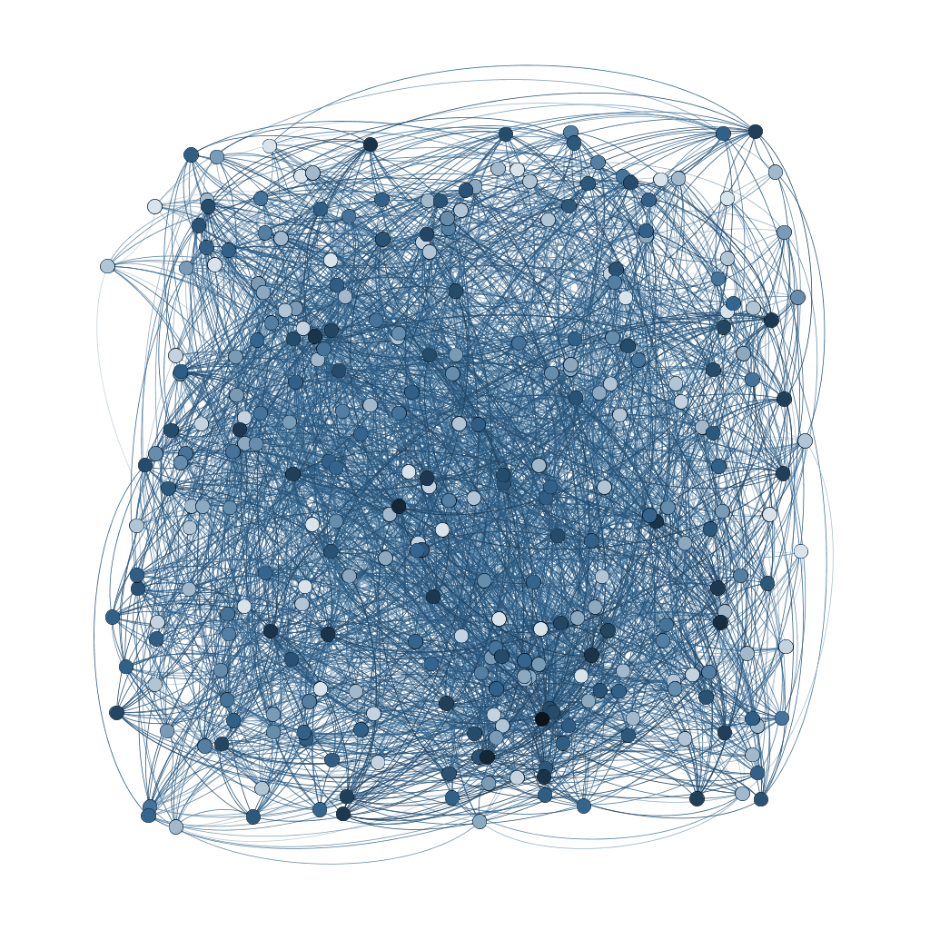
Gaudi Scheduler Updates
Since GAUDI workshop 2016
Illya Shapoval
Lawrence Berkeley National Laboratory

Slide 2
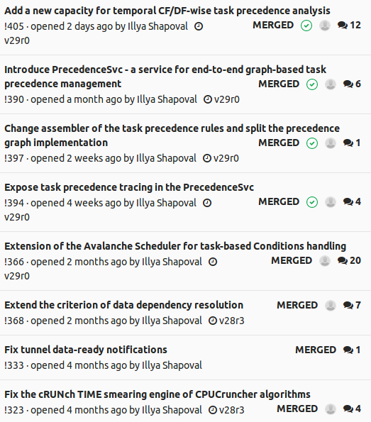
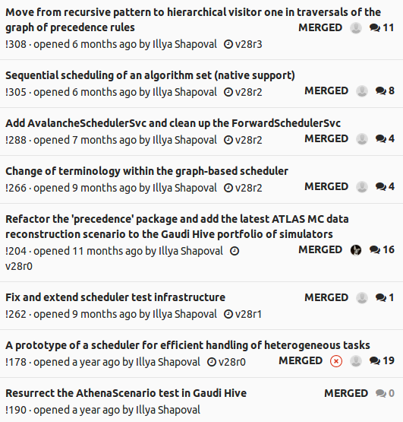

Slide 3
Refactoring
Extensions
New features

Slide 4
1.
Refactoring

Slide 5
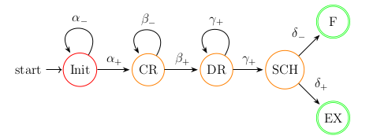
New Pattern for Precedence Rules Resolution
What:
Traversals of the precedence
rules graph
Was:
Based on recursive pattern
Now is:
Based on hierarchical visitor pattern

Slide 6
New Pattern for Precedence Rules Resolution
What:
Traversals of the precedence
rules graph
Was:
Based on recursive pattern
Now is:
Based on hierarchical visitor pattern
Benefits:
Abstract an operation from an object structure it operates on
  Helps following the Open/Closed Principle
Simulate double dispatch (flexibility)
Do conditional navigation (more traversal optimization tweaks)
Drawback:
If an object structure is extended, all visitors need to be modified
  BUT, our pool of operations evolves more dynamically than object structure

Slide 7
Introduction of Avalanche* Scheduler Service
Motivation:
Maintainability. Interference of two distinct approaches that co-existed within the ForwardSchedulerSvc started to hinder each other's evolution (mainly, evolution of the approach suggested by me).
The Avalanche Scheduler thus took over the following features:
Unified (CF+DF) graph-based decision making approach
  Bottom-up graph traversal policy (faster decision making)
  Hierarchical visitor pattern
Proactive task scheduling modes (higher intra-event throughput)
Latency-oblivious task scheduling mode (higher throughput)
Support for task-based conditions handling (added later by !366, see next slides)
* Etymology: from its capacity to sustain chain-reaction-like intra-event task emission process

Slide 8
Introduction of Precedence Service
Motivation:
Standardization. Replace standalone C++ class Execution Flow Manager, used by the Avalanche Scheduler to manage/query the Precedence Rules Graph (PRG), with dedicated Service.

Slide 9
Introduction of Precedence Service
Motivation:
Standardization. Replace standalone C++ class Execution Flow Manager, used by the Avalanche Scheduler to manage/query the Precedence Rules Graph (PRG), with dedicated Service.
Avalanche Scheduler Svc
Forward Scheduler Svc
Unchanged
Precedence Svc
Execution Flow Manager
Data Flow Manager
PRG
Control Flow Graph
AlgResourcePoolSvc

Slide 10
2.
Extensions

Slide 11
Task-based concurrent conditions handling
Task precedence rules augmented with Conditions realm
  Added ConditionNode graph node type to represent a condition data object
    Inherits from DataNode, plus a SmartIF<ICondSvc> tunnel for IOV-awareness
  Added graph initialization gears to assemble the conditions realm
  DF-realm visitors made ConditionNode-aware
Graph of precedence rules remains invariant across all events
Mechanism is optional
  AvalancheSchedulerSvc(EnableConditions = True)
Augmented DF Realm
Algorithm Node
Data Node
Condition Node

Slide 12
Extension of criterion of data dependency resolution
What:
Promotion of an algorithm
to DATAREADY.
Change:
Promote an algorithm to DATAREADY if all its data supplying algorithms are either in EVTACCEPTED or EVTREJECTED state.
Enables the following cross-branch data flow pattern:
Sequential, OR,
Late Exit
Control flow
Data flow
Z
Sequential,
AND,
Early Exit
Y
Executed Algorithm
Skipped Algorithm
CF hub
C
A
B

Slide 13
3.
New features

Slide 14
Native support for sequential scheduling of algorithms
Purposes: cleaner implementation of Early Exit, debugging, etc.
Enabled with: AthSequencer(Sequential = True) / GaudiSequencer(Sequential = True)
Replacement for: AtomicSequencer
In-sequence and out-sequence algorithms can be scheduled sooner
no “cumulative inputs/outputs” bottleneck

Slide 15
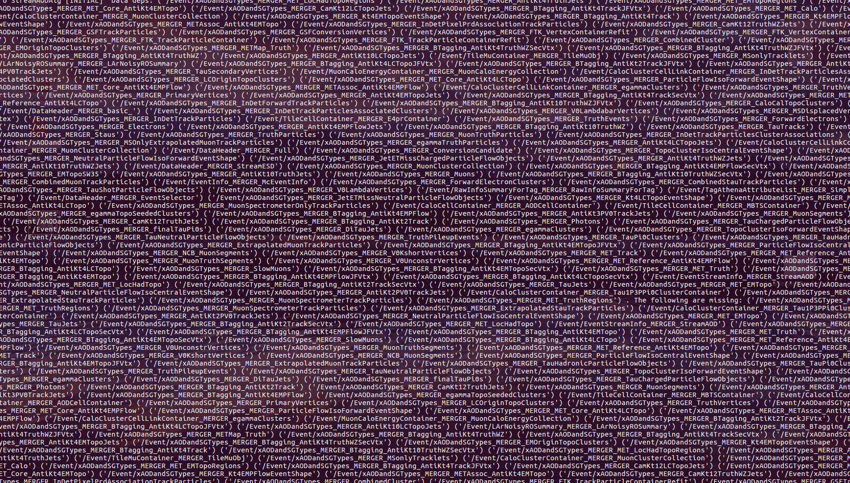
Good luck..
STALL!

Slide 16
Temporal and Topological Tracing (TTT) in Gaudi
Mode: Precedence Rules Analysis (PRA)
Step 1: Enable Tracing
PrecedenceSvc(DumpPrecedenceRules = True) [as of Gaudi v29]
TimelineSvc(RecordTimeline = True)
set job output level to DEBUG, or lower
Step 2: Run with 1 event in flight, any number of threads
generates ./precedence.analysis.*/rules.evt-X.run-Y.graphml
Step 3: Visualize the GRAPHML file
wide range of graph visualization software out there
I recommend Gephi ( https://gephi.org/ )

Slide 17
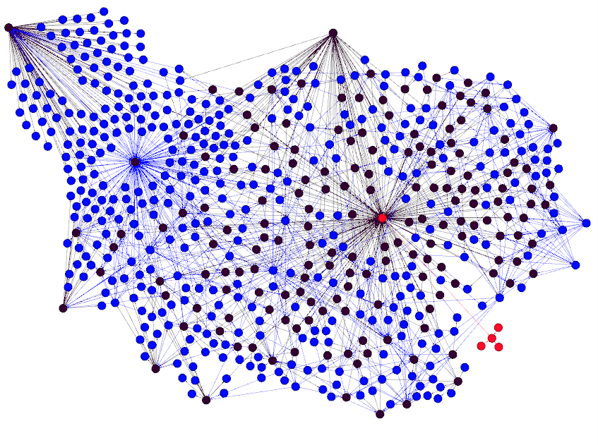
PRA: Precedence Rules Topology
[ATLAS MC data reconstruction]
Algorithms
CF decision hubs
Data

Slide 18
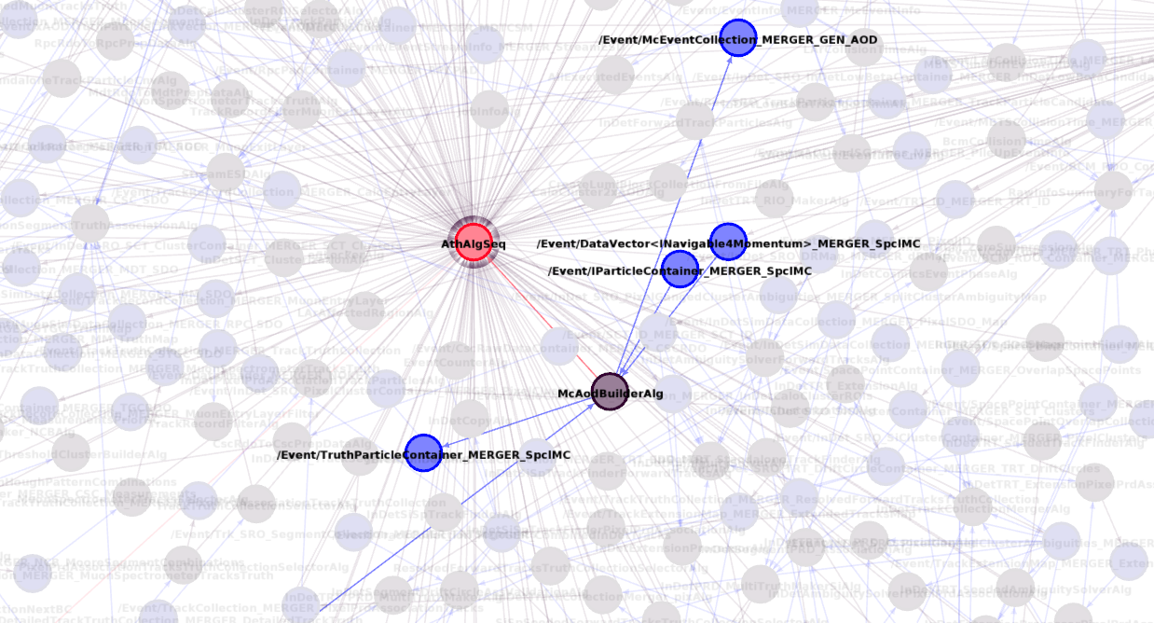
PRA: Precedence Rules Topology: Zoom
[ATLAS MC data reconstruction]
Algorithms
CF decision hubs
Data

Slide 19
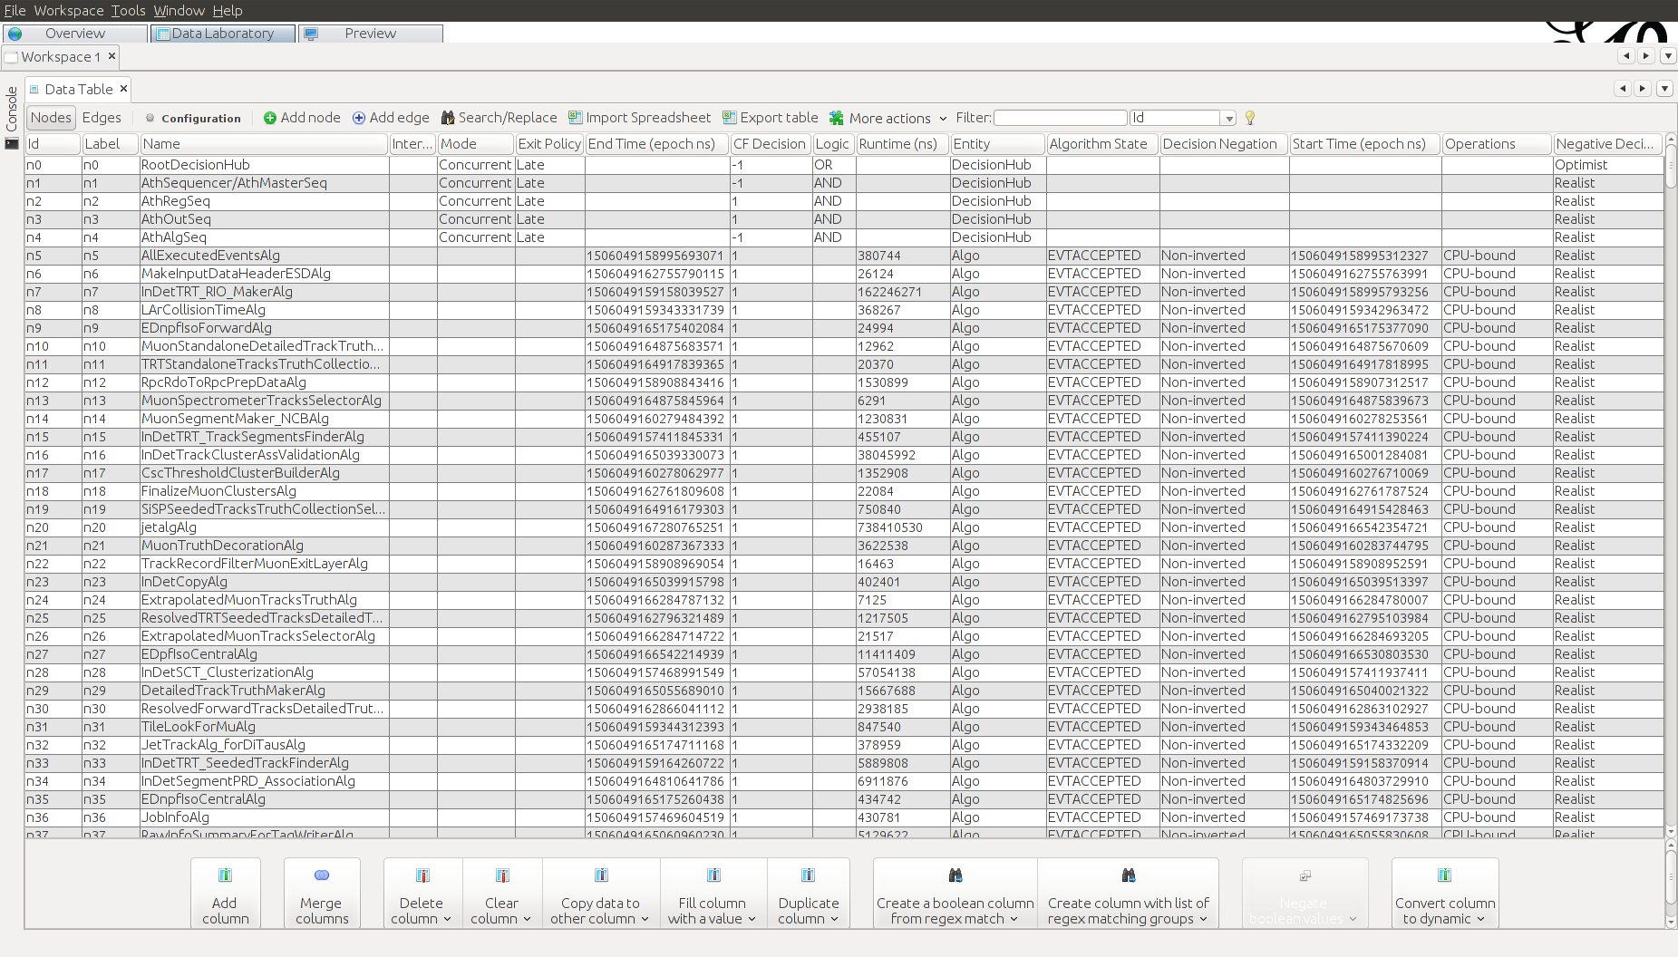
Full content of the rules.* dump file

Slide 20
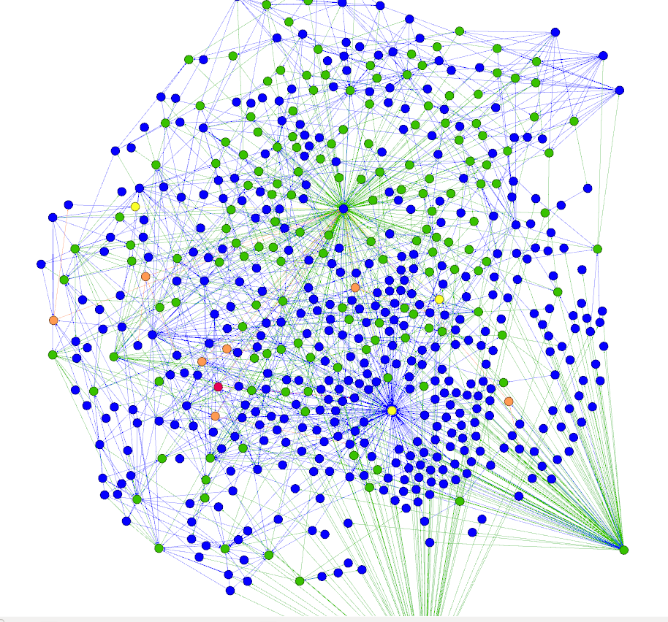
PRA: Event Processing Failure (FSM)
[ATLAS MC data reconstruction]
Algorithm states:
Control Ready
Data Ready
Scheduled
Event Accepted
Data

Slide 21
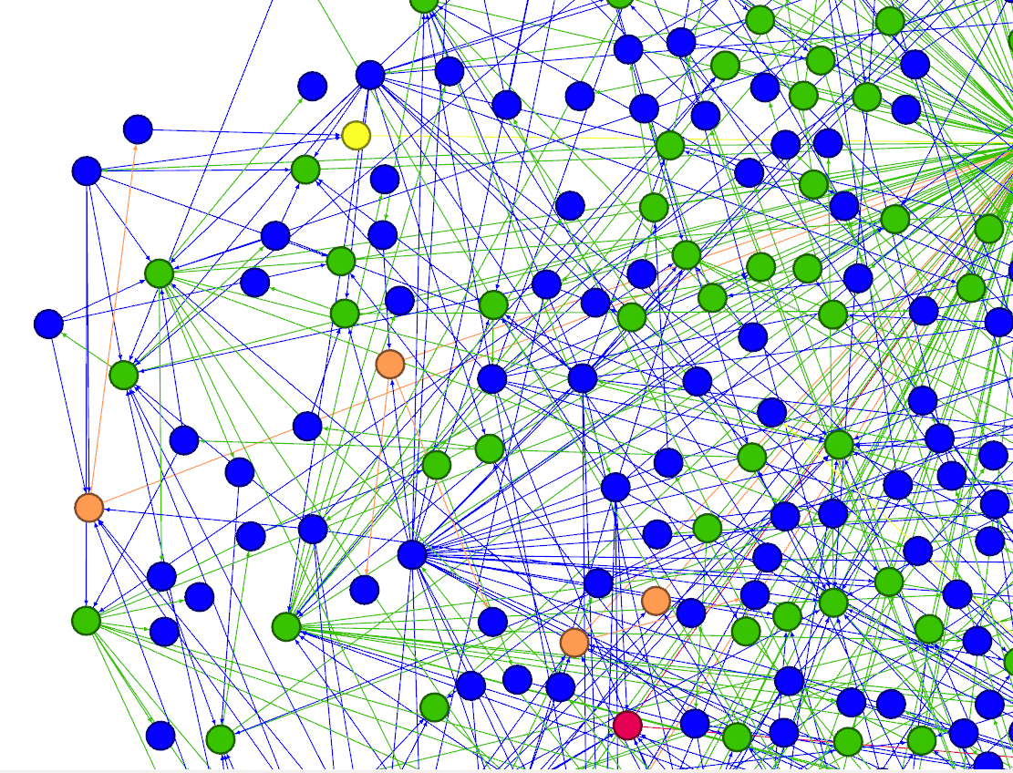
PRA: Event Processing Failure: Zoom
[ATLAS MC data reconstruction]
Algorithm states:
Control Ready
Data Ready
Scheduled
Event Accepted
Data

Slide 22
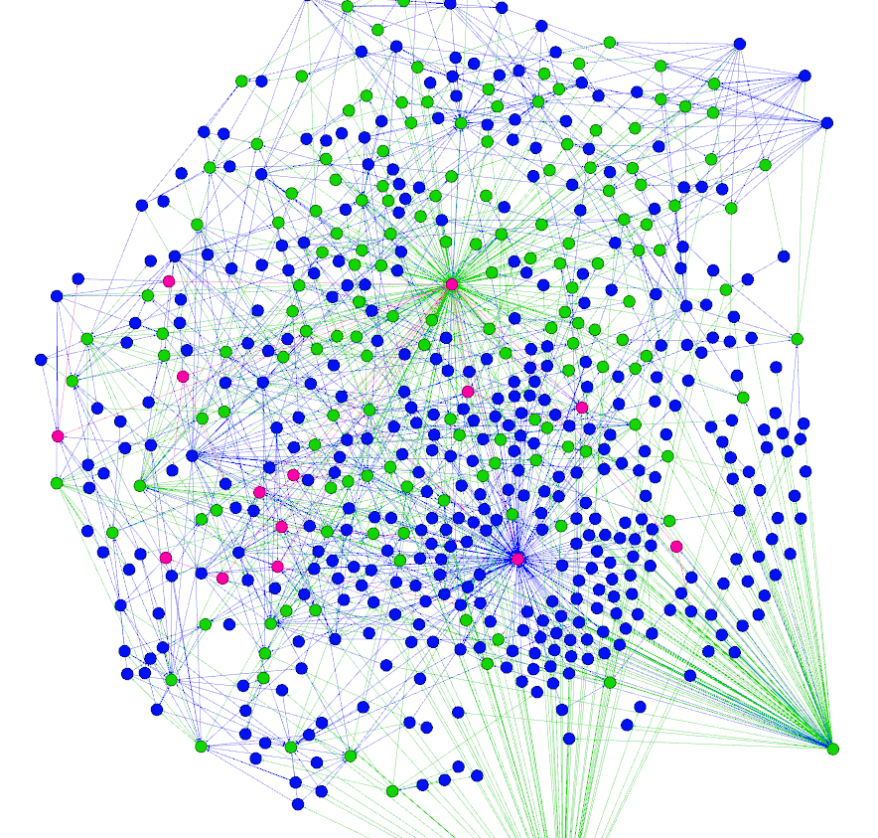
PRA: Event Processing Failure: Control Flow
[ATLAS MC data reconstruction]
Control Flow:
Positive
Negative
Data

Slide 23
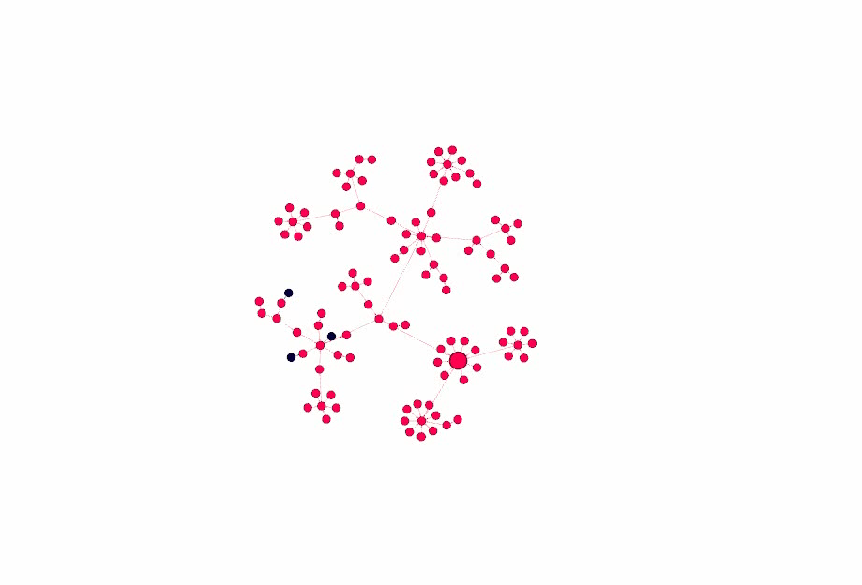
PRA: Temporal Precedence Analysis (Control Flow Realm)
[Video]
Algorithms
CF decision hubs

Slide 24
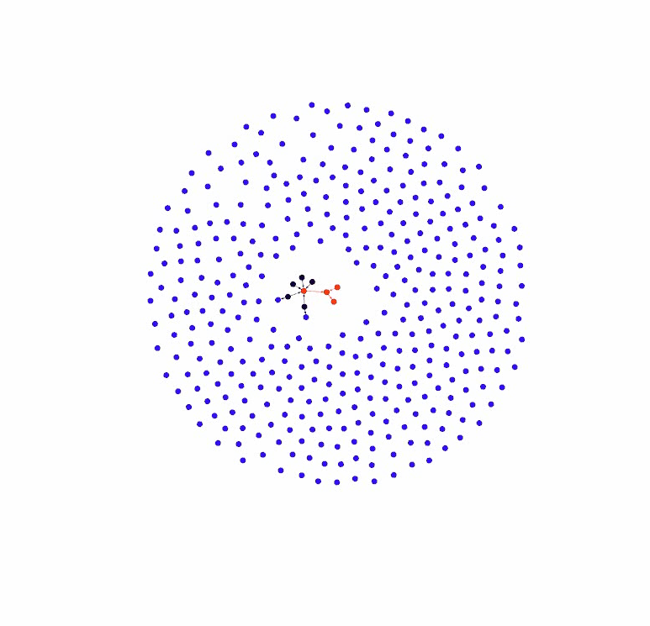
PRA: Temporal Precedence Analysis (Data Flow Realm)
[Video] [ATLAS MC data reconstruction]
Algorithms
Data

Slide 25
Temporal and Topological Tracing (TTT) in Gaudi
Mode: Precedence Trace Analysis (PTA)
Step 1: Enable Tracing
PrecedenceSvc(DumpPrecedenceTrace = True) [as of Gaudi v29]
TimelineSvc(RecordTimeline = True)
set job output level to DEBUG, or lower
Step 2: Run with 1 event in flight, any number of threads
generates ./precedence.analysis.*/trace.evt-X.run-Y.graphml
Step 3: Visualize the GRAPHML file
wide range of graph visualization software out there
I recommend Gephi ( https://gephi.org/ )

Slide 26
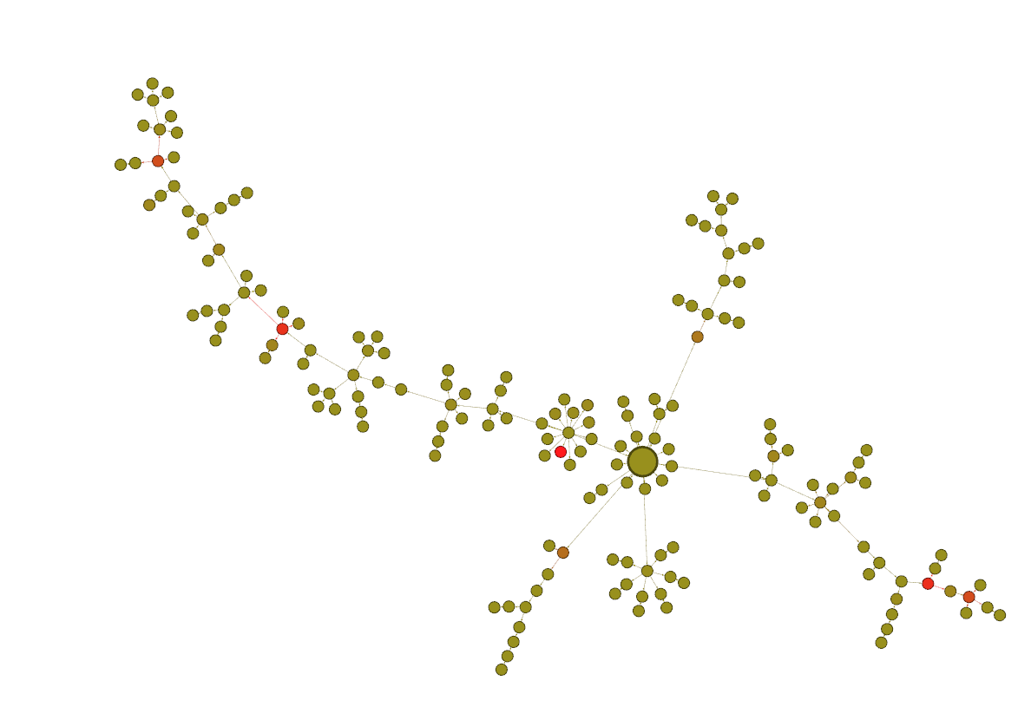
PTA: Precedence Trace Analysis (Critical Path)
[ATLAS MC data reconstruction]
DataLoader

Slide 27
Q/A

