Slide 1
Detector and Component Stress & Deformation Analysis
Ronan McGovern & Diego Perini

Slide 2
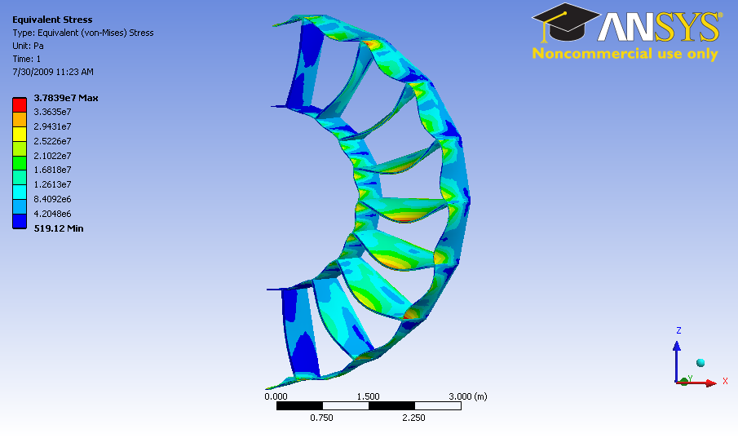
Summary
Layer & Bolting Analysis
Detector Section 2D analysis
3D detector analysis

Slide 3
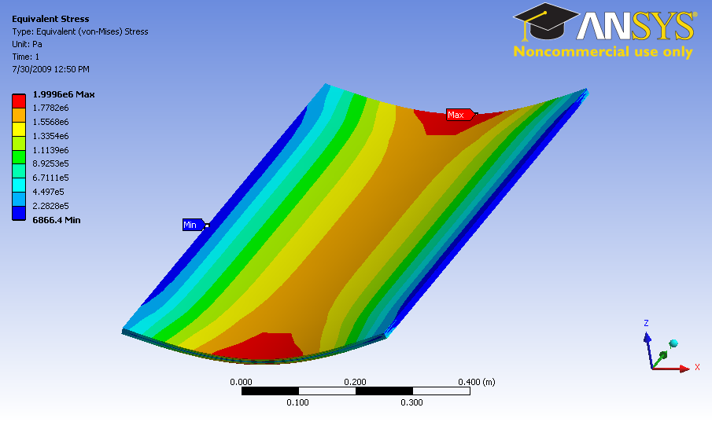
Layer Analysis – Layer Options

Slide 4
Layer Analysis – Layer Options

Slide 5
Layer Analysis – Layer Options
Layer subjected to it’s own weight

Slide 6
Layer Analysis – Layer Options
Advantages of SS-W layer over W layer
  Reduced costs
  Allow a reduction of concentrated forces applied to W.
Sandwich versus Dual layer
  Sandwich protects Tungsten from washer forces
  Thickness of SS in sandwich is thin - difficult to bolt

Slide 7
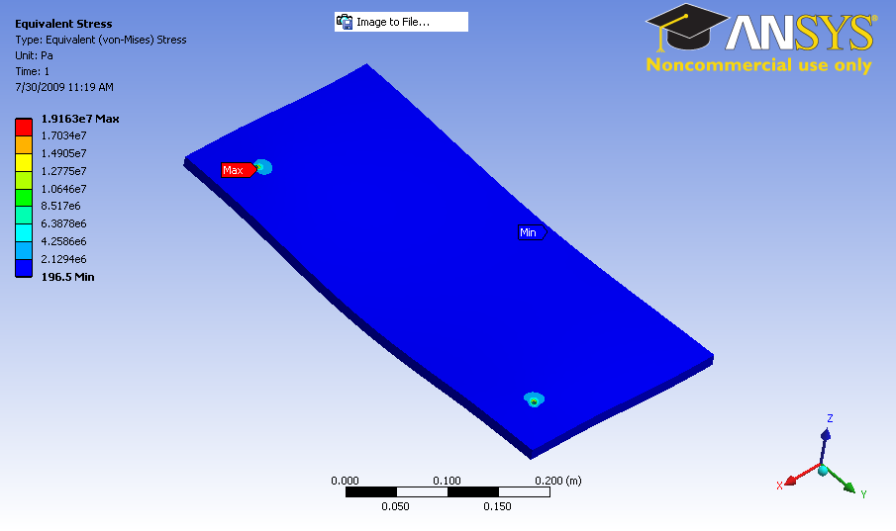
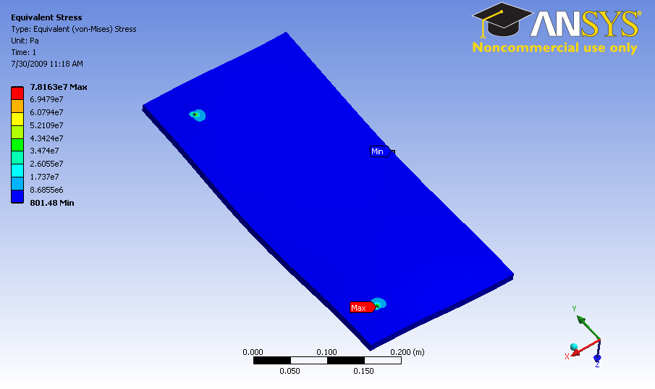
Layer Analysis – Bolting Analysis
Normal Weight – 1 Plate
Force - 1275.652 N/m
Max Mises – 19 MPa
Normal Weight – 4 plates
Force - 5102.606 N/m
Max Mises – 78 MPa

Slide 8
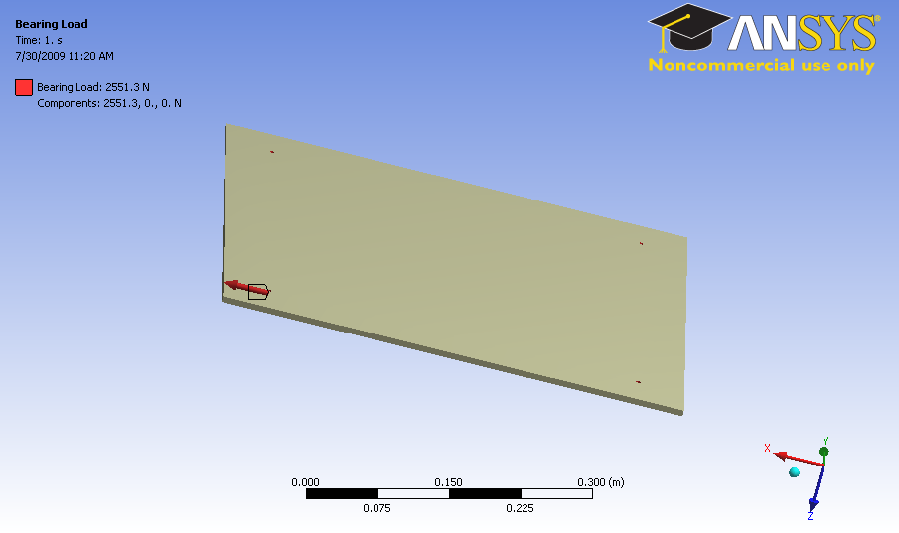
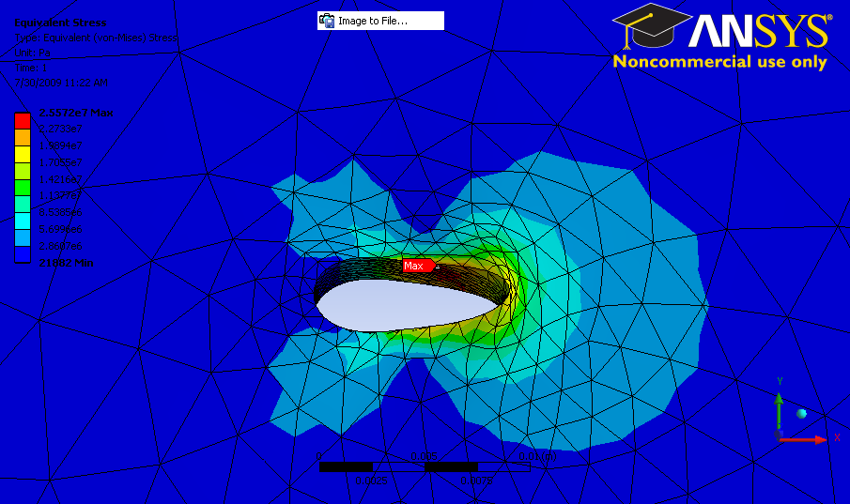
Layer Analysis – Bolting Analysis
Shear Weight – 4 plates
Force - 5102.606 N/m – distributed over 4 bolts
Max Mises – 256 MPa

Slide 9
Layer Analysis – Bolting Analysis
Conclusions
  From initial calculations bolting remains feasible
However, difficulties lie within calculation of
  Bolt thread stress
    Note: Threads were previously used in INERMET in other detectors
  Forces exerted upon plates by SS lattice and washers

Slide 10
Detector Section 2D analysis

Slide 11
Detector Section 2D analysis
Simulation does not take into account the rigidity of the layers.

Slide 12
Section 2D analysis – Layer Density

Slide 13
Detector Section 2D analysis

Slide 14
Detector Section 2D analysis

Slide 15
Detector Section 2D analysis

Slide 16
Detector Section 2D analysis
Conclusions
  Initial wall thickness approximation = 20 mm
  Stresses in horizontal sections need to be estimated allowing for the rigidity of internal layers

Slide 17
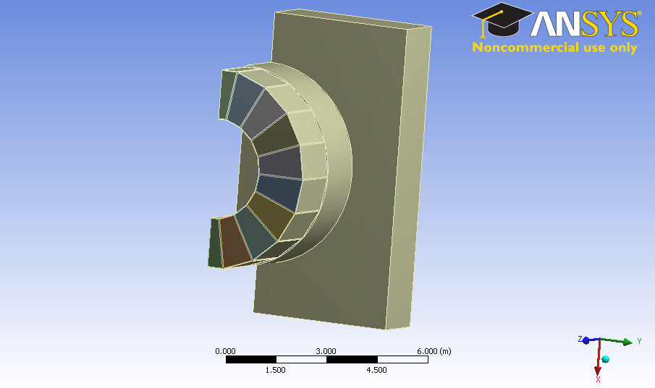
3D detector analysis

Slide 18
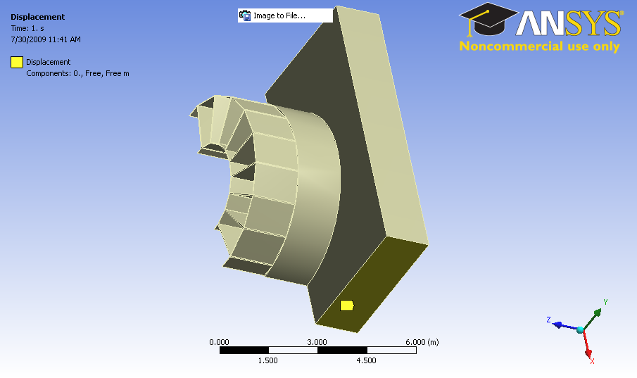
3D detector analysis – Overall Model
We seek to calculate the maximum deflection
Simulation does not take into account the rigidity of the layers.
Layers (Dual Layer Composition)
Iron
Imposed zero displacement condition

Slide 19
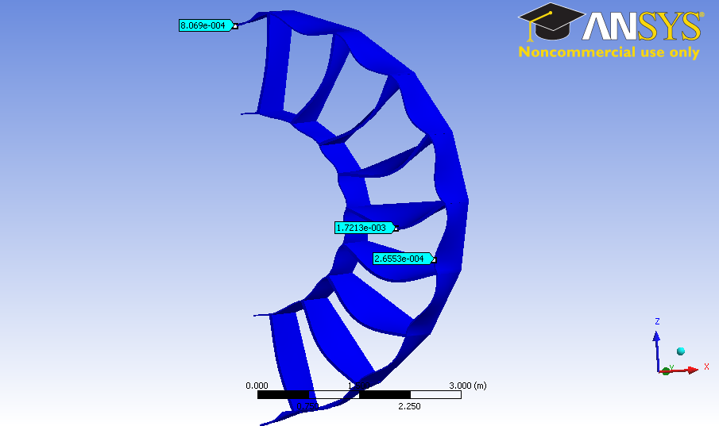
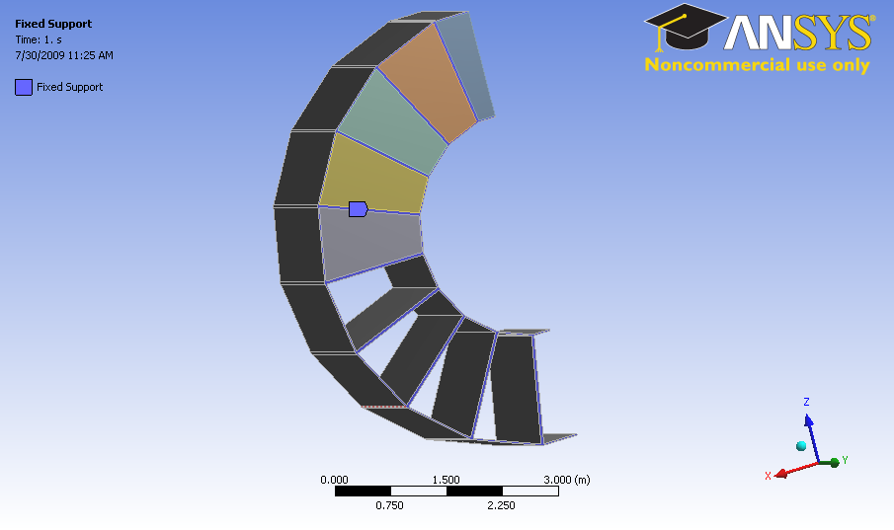
3D detector analysis – Detector Lattice
We seek to calculate the maximum deflection and stress
Simulation does not take into account the rigidity of the layers.
Zero displacement imposed on SS lattice face.

Slide 20
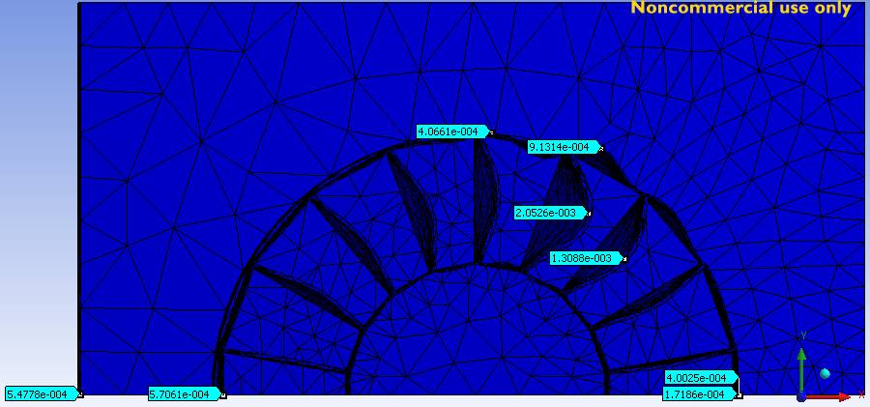
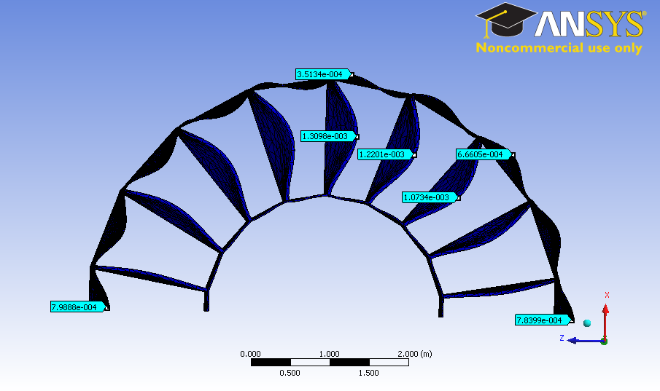
Overall model
Max Total Deformation
= 2.05 mm
Detector Lattice
Max Total Deformation
= 1.31 mm

Slide 21
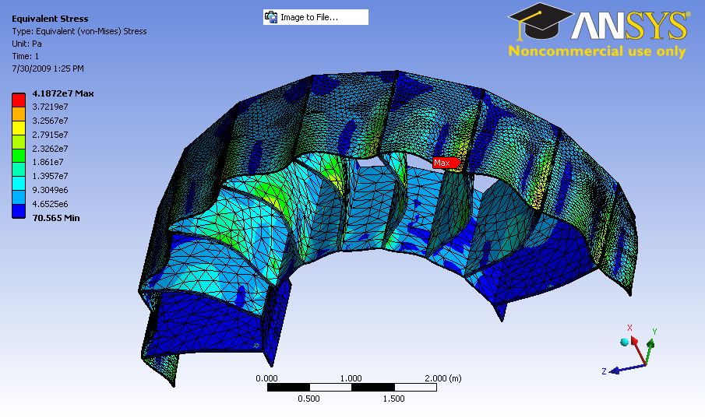
Max Stress = 42 MPa

Slide 22
3D detector analysis – Detector Lattice
Conclusions
  Welding or bolting the detector lattice to such a mass is very advantageous in reducing deformation and stress compared to supporting the detector at radial points.
    “Closed section” greatly reduces stress and deformation.
    Weight of each section is mainly supported by the iron mass rather than other sections.
    The feasibility of having an iron mass at either end of the detector should be carefully considered.
  Stresses fall within a reasonable range
    Especially considering that the rigidity of the layers has been neglected
  Deflection goes beyond 1 mm but in reality the rigidity of the layers should reduce this.
  Boundary condition issues regarding distribution of the weight of layers on SS lattice

Slide 23
Further work
Transfer of 3D detector model from Philippe Lenoir to Ansys Workbench. (Week of 3rd Aug. 09)
Analysis of stress and deformation distributions for various support configurations of the detector lattice, including radial. (Completed by Tuesday 4th Aug. 09)

