Slide 1



Slide 2

Continuous
INTEGRATION
Continuous
DEPLOYMENT
COMMIT

Slide 3


Slide 4
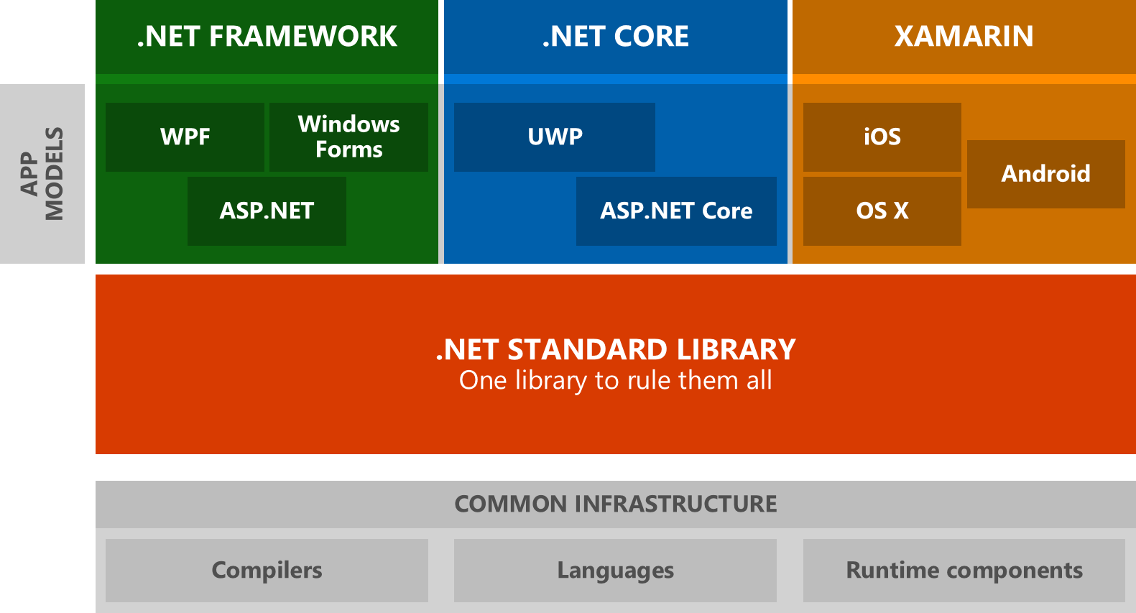
source: https://blogs.msdn.microsoft.com/dotnet/2016/09/26/introducing-net-standard/

Slide 5

NO CONFIGURATION!!!

Slide 6
gitlab.cern.ch/wkulma/fibonacci

Slide 7
Many Thanks :)

