Slide 1

Change Deployment in ServiceN w
4th Developers@CERN Forum
David Martin Clavo
23 October 2017

Slide 2






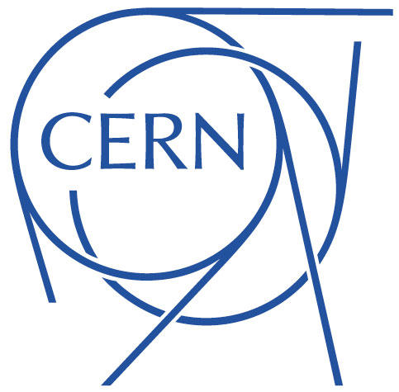
About ServiceNow…
ServiceNow company founded in 2004 in California
From 4 employees to 5000+ today
Forbes top 2000 companies : 800 clients
In Switzerland, 100+ clients, including government, banks, education & research institutions, private companies.
Used at CERN since 2011 for Service Management

Slide 3
SaaS or PaaS?
Platform as a Service, or Software as a Service… Why not both?
Provide the platform and applications for the platform
Kind of like providing Android and the Gmail app
Example apps:
  IT Service Management
  Customer Service Management
  HR Service Delivery
Example platform features:
  Data centres
  Form / list engine
  Website engine
  Machine learning engine

Slide 4
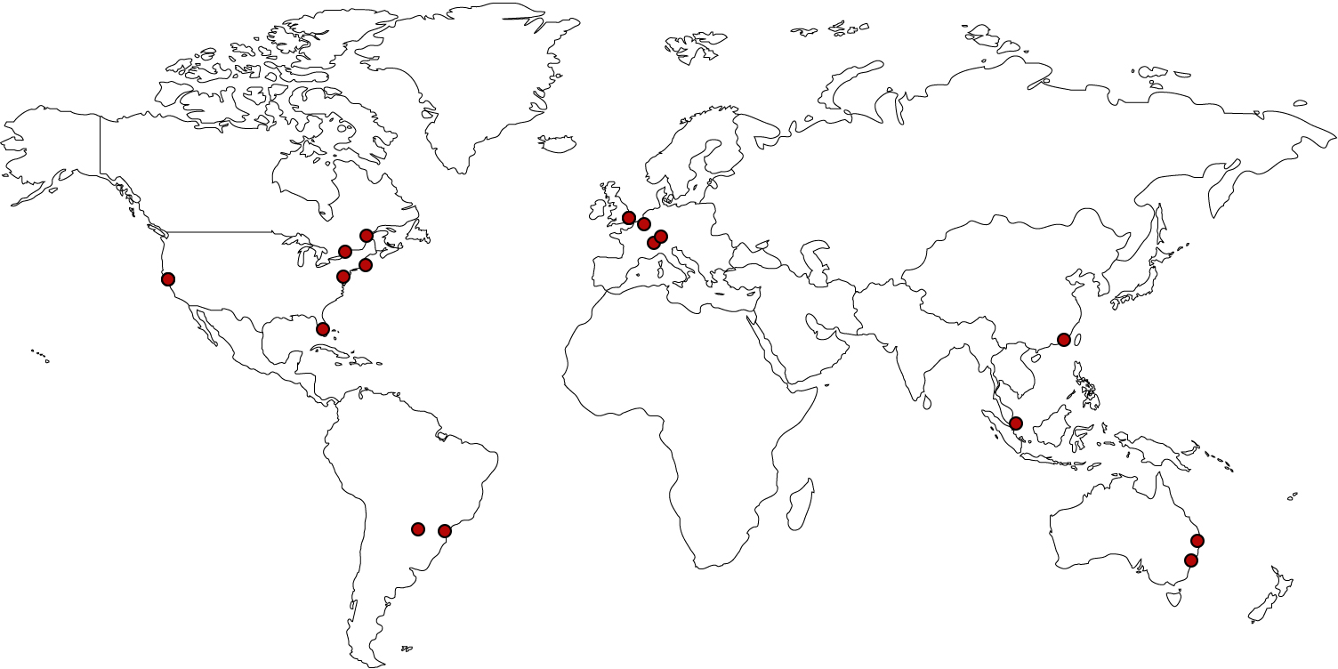
PaaS architecture
8x2 data centres

Slide 5
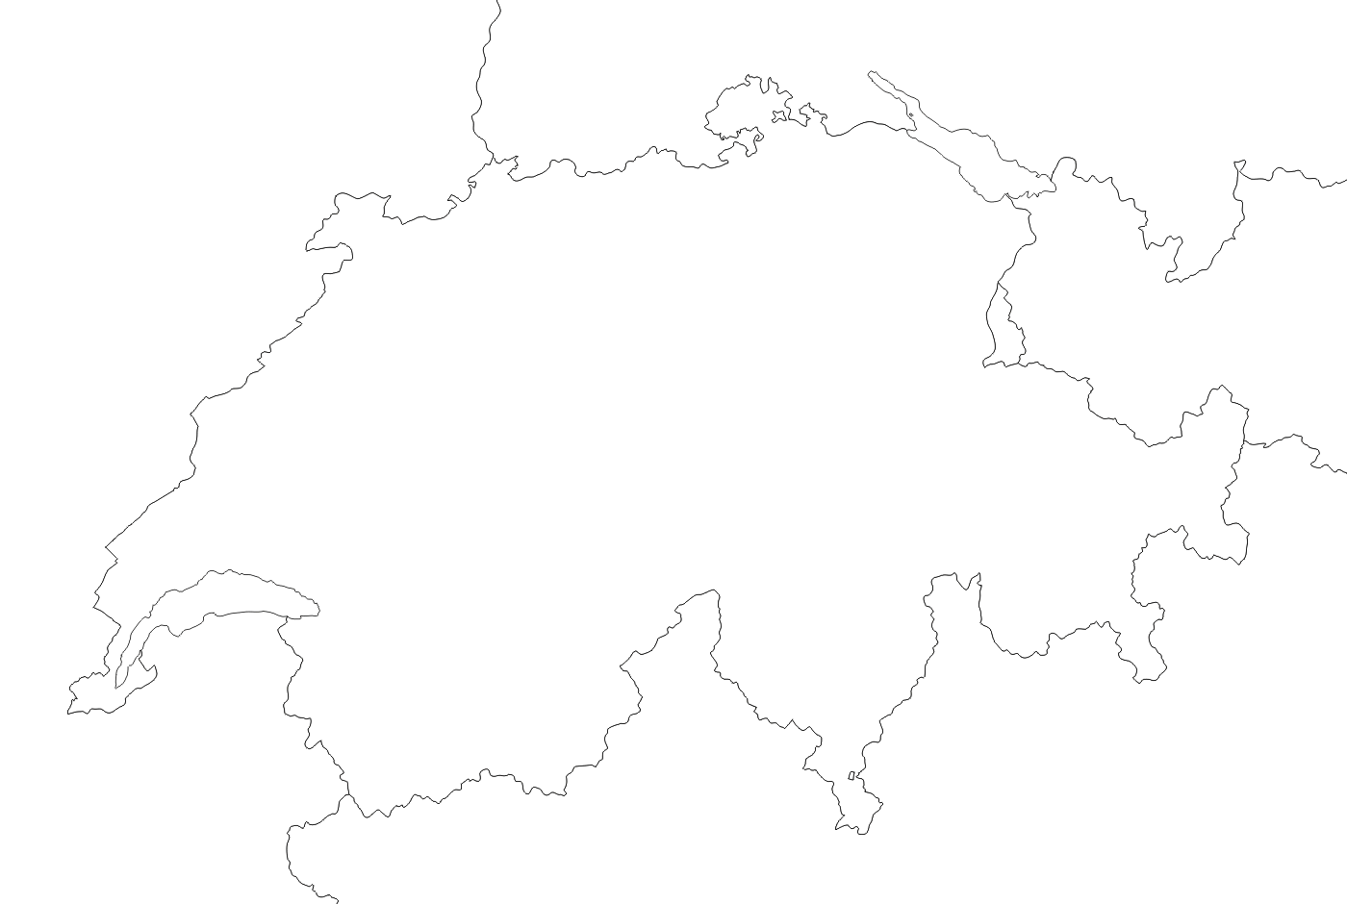





PaaS architecture
Zurich
Prod
Geneva
Prod (backup)
Dev
Test
Training
Sandbox
CERN instances

Slide 6

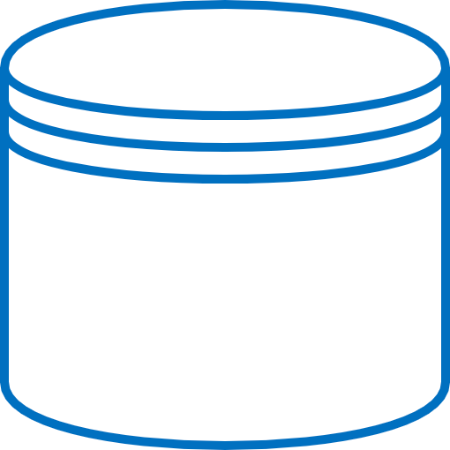
PaaS architecture
Backup Data centre
Load Balancer
(inactive)
DNS Switch
App nodes
(Tomcat)
Active Data centre
Load Balancer
(distributes user sessions)
DB
(MySQL)
Passive DB
Backup DB
App nodes
(Tomcat)
DB
(MySQL)
Master-Master replication
Active DB
Backup DB

Slide 7
PaaS architecture
Browser
AngularJS, jQuery, Bootstrap,
PrototypeJS, ServiceNow libs
Javascript
(Mozilla Rhino VM)
Apache Jelly
(templating)
ServiceNow libs
App node (Server)
Java
Custom ORM
DB
MySQL

Slide 8
PaaS architecture
Multi-instance architecture:
Customers have their own database, app nodes.
Full control of behaviour, upgrades.
Browser
AngularJS, jQuery, Bootstrap,
PrototypeJS, ServiceNow libs
Customer can see / edit (part of) source code
Javascript
(Mozilla Rhino VM)
Apache Jelly
(templating)
ServiceNow libs
The database holds everything
that a customer can see/edit:
- Server-side and client-side code and configuration
- Table structure: tables & columns about tables & columns
- Even files such as images, logs
→ Plenty of caching in the app layer
App node (Server)
Java
Custom ORM
DB
MySQL

Slide 9
Version Control and Deployment
“Update Set” concept.
Records modifications to configuration tables… in the database.
Propagated between instances
cern (prod)
cerndev
cerntest
cerntraining (qa)

Slide 10
Version Control and Deployment
DEMO TIME

Slide 11
Update sets vs normal Version Control
Update Sets
Usual VCS
Serializes full file
Auto-commit
Developers share instance
Conflicts usually detected early
Possible to merge into one Update Set
Stores diff (except git)
Controlled commit
Each developer has own branch
Conflicts may only appear at branch merge time
Possible to squash

Slide 12
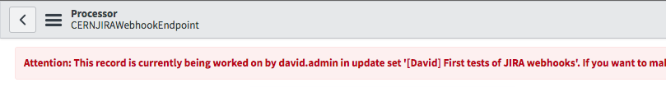
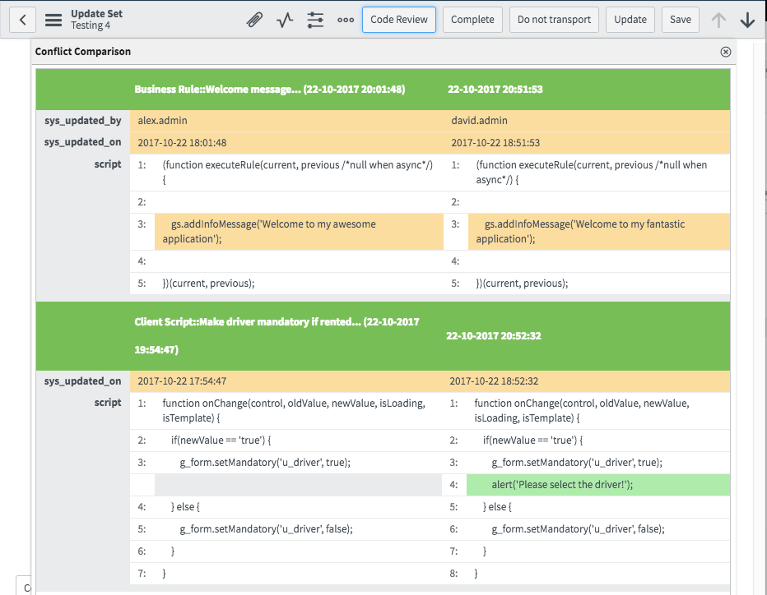
CERN Improvements
Warning when two devs edit the same file
Easy preview before commit
Easy code review before pushing
to next instance

Slide 13
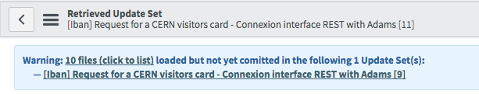
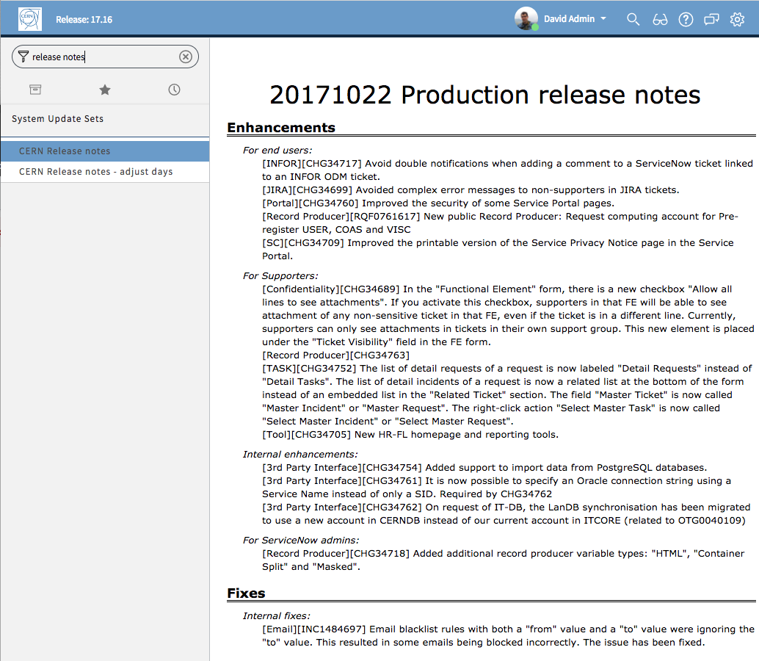
CERN Improvements
Warning when committing update set in wrong order
Additional fields in Update Sets:
Owner, Related Task, Category, Target Population,
Release Notes, Manual instructions, Internal Notes
Automated release notes

Slide 14
Thank you

