Slide 1
International Review of the
Conceptual Design of the Cold Powering System for the
HL-LHC Superconducting Magnets
-- held at CERN, 3-4 July, 2017 --
Summary of the Review
The Review Panel
Maciej Chorowski (WUT), Chen-yu Gung (ITER), Joe Minervini (MIT)
Davide Tommasini (CERN), Pierre Vedrine (CEA)
Akira Yamamoto (KEK-CERN, Chair)
To be reported to HL-LHC TCC, 27 July, 2017

Slide 2
Introduction
Superconducting links (SL) are to be implemented for powering IR magnets in the HL-LHC Project and they are to be completed by 2026 (during LS3).
MgB₂ SC links have been demonstrated with a capacity of 20 kA – 20 m long, in 2015, and links of 20 kA - 60 m long are in preparation and will be demonstrated at SM18.
A review has been performed of the “Preliminary design” for the HL-LHC project covering technical aspects and general integration as well as global planning.
The general review information is given in the following URL:
https://indico.cern.ch/event/643197/

Slide 3
Agenda: 3 July
AM
Welcome and Review Charge (L. Rossi)
System overview and baseline design (A. Ballarino)
Circuits description and requirements (F. R. Mateos)
Bus-bars deflinition and requirements ... (E. Todescco)
MgB₂ wire (B. Bordini)
MgB₂ cables (K. Konstantopoulou)
SC link cryostat (P. W. Retz)
PM
Interconnection boxes (DFX) (Y. Leclercq)
Cooling scheme for the cold powering system (S. Claudet)
Integration in the HL-LHC tunnel (V. Parma)
Test plan overview (A. Ballarino)
String test and series test plan (M. Bajko)
Eletromagnetic compatibility and losses … (Y. Yang)
Requirements for the protection … (A. Ballarino)
Protection system for the SC links ... (R. Denz)
Question and answers

Slide 4
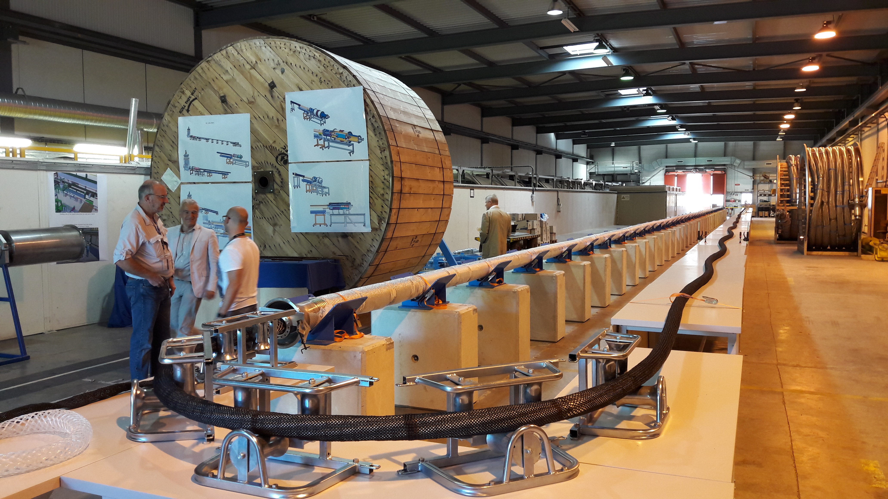
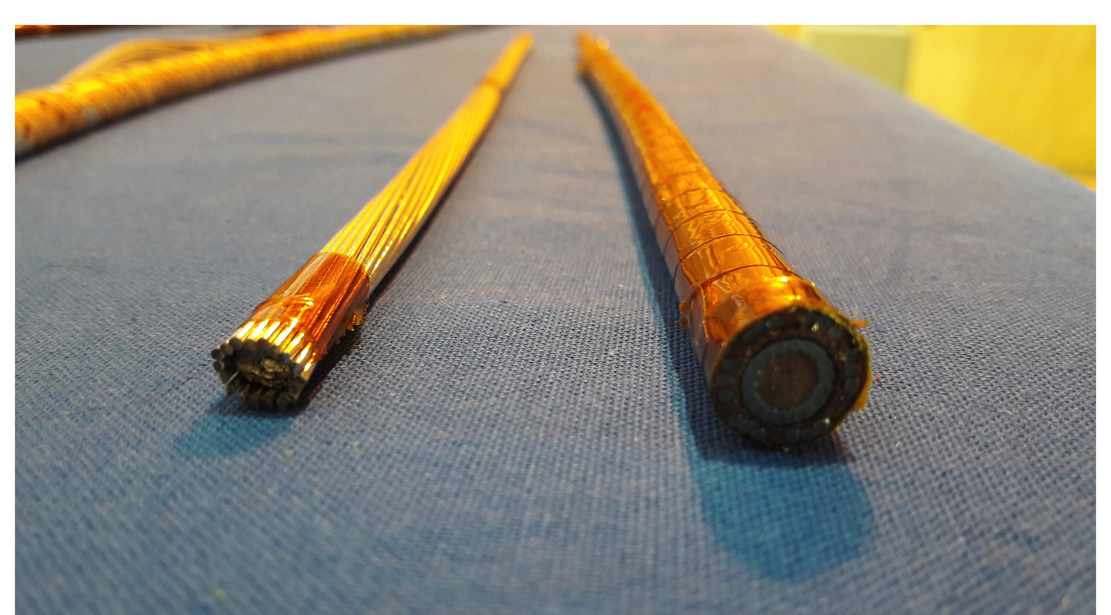
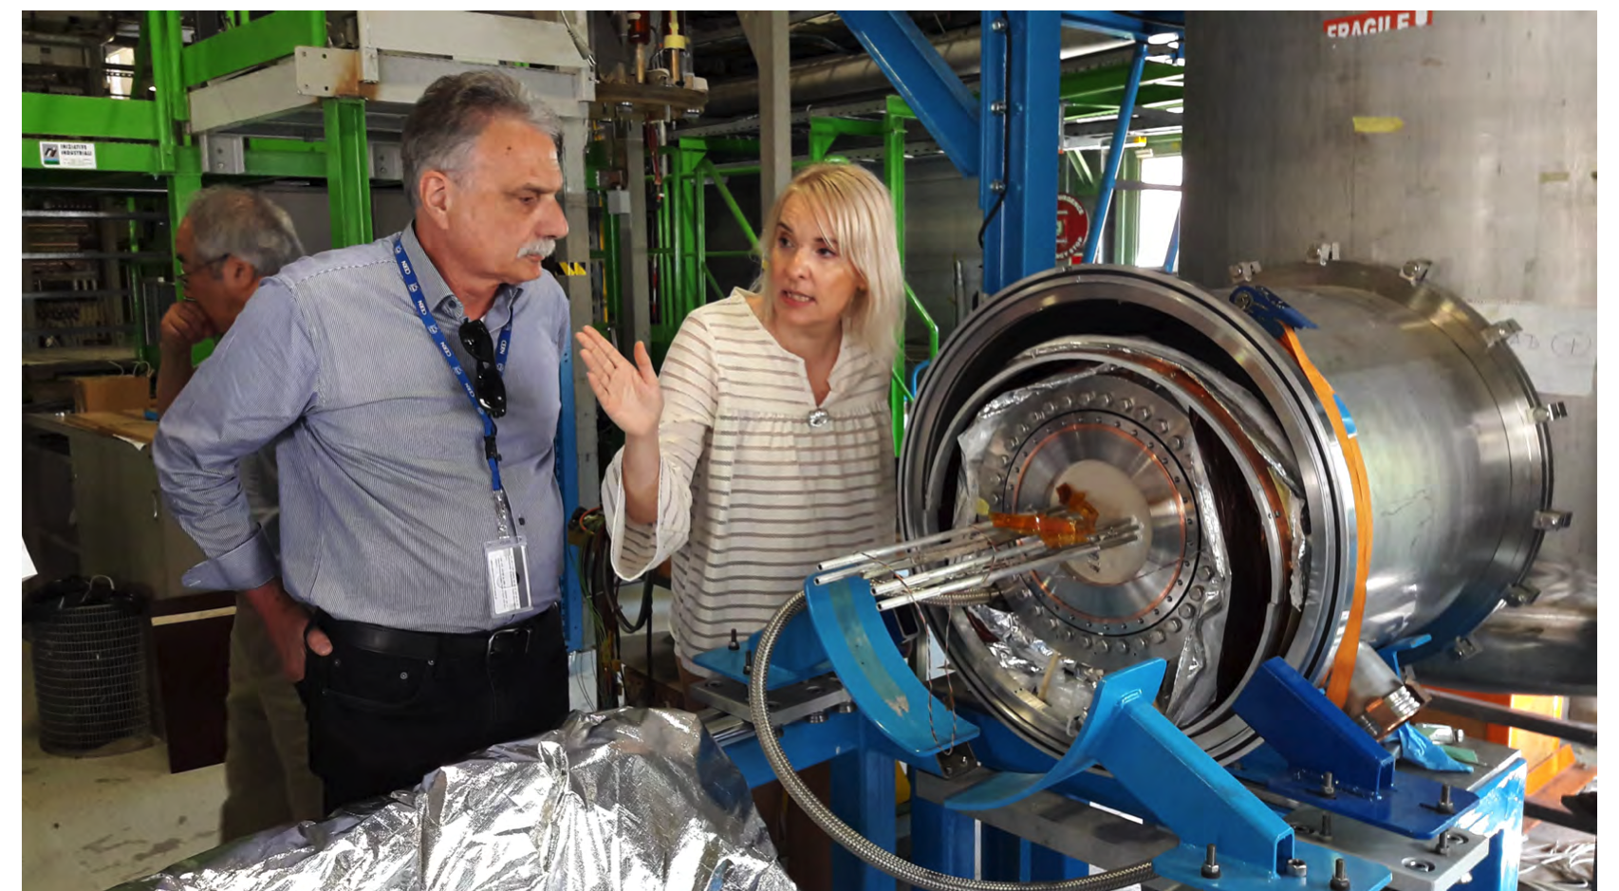
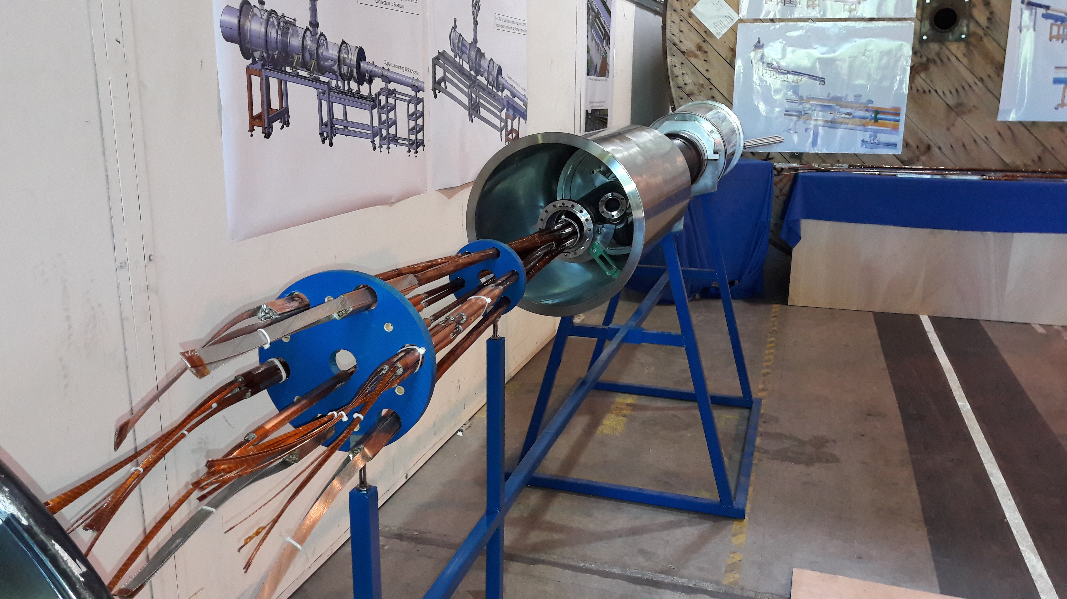
Agenda: 4 July
AM:
Visit B927 (SC link R&D area)
Answers to questions from reviewers
PM:
Close session
Close out (17:00)

Slide 5
Executive Summary (1/3)
General:
The review panel would like to thank the participants to this review. The presentations have been well prepared with 15 very comprehensive reports that have been very clearly presented as well as discussed during the technical tour.
We have been very much impressed with the technical progress in design/preparation and development for the HL-LHC superconducting link (SL) based on the MgB₂ technology.
We congratulate the team on the extraordinary progress they have made in improving the performance of MgB₂ and bringing commercial scale development to a high level.
The SL preliminary design with MgB₂ is sound for this early stage of design and development, and further detailed design study and technology demonstration should be extended.

Slide 6
Executive Summary (2/3)
General (continued) :
The use of MgB₂ and the SL will be a crucial and fundamental technology for realizing the stable, long-term operation of the HL-LHC IR magnet system.
We strongly support the 60-m long prototype demonstration, now in preparation, including various extreme operational and failure modes, to confirm the design reliability and robustness of the MgB₂ SL.
Comments:
It is an essential concept that the SL must be a transparent and crucial technology (“as similar as air”). It must be extremely robust in order to support SC magnet operation in any kind of emergencies or failure modes.
We encourage very thoughtful planning for the SL prototype demonstration as well as for the SM18 string tests.
A very thorough risk analysis of failure modes of the SL should be performed and an experimental program carried out.

Slide 7
Executive Summary (3/3)
Recommendations:
Further detailed plans for future development and testing should be established.
Adequate resources should be foreseen to perform the test program and validate the SL system.
Advantages of the MgB₂ should be further quantified in comparisons with other technical approaches.

Slide 8
Question 1:
Is the technical scope of the Cold Powering System (CPS) well defined and interfaces with adjacent equipment well clarified, also regarding installation? And in particular, is the design and validation of the components closely linked to the cold powering (for example: bus bars, quench detection and protection, warm powering, etc.) sufficiently defined to allow finalization of the design of the CPS?
Response:
Generally yes.
The technical scope of the SC link is well defined and the interfaces with the other systems are clear enough.
Quench scenarios have been studied in detail and the analysis gives conservatives values for the overcurrent in the SC trim circuit.
We encourage further study to optimize cable installation in the tunnel taking into account the stiffness and minimum bend radius of the cryostat (4-wall versus 2-wall). It should include consideration of maintenance, repair, or replacement.
The present design margin in length required for the link seems excessive, possibly forcing a snake-like installation over the whole length of the link (worst case of 8 meters too long). The length tolerance can be adjusted also by the warm cable length.
Some interface issues shall be further identified and resolved. The baseline for the electrical circuit (e.g. routing of the low current links) should be frozen soon. We note that a very reliable SL may allow location of diodes at the warm end.
Cryogenic design parameters (temperature, pressure drop, mass flow, etc.) shall be further established to quantify the enthalpy margin of the SL.
A cooling scheme should be designed allowing demonstration of the technology advantages, including thermodynamic and manufacturing aspects of the selected scheme. The design decision can be made once the results of the cold tests are completed for the 60 m cryostat prototypes.
We recognize the advantage of a design that avoids the SL flow partially bypassing the current leads, if possible.

Slide 9
Question 2:
Is the general design correct and adequate to meet the scope? Is the design safe also with respect to the boundary conditions given by the magnets and circuit protection system?
Response:
Generally yes.
We encourage the team’s plan to perform a very thorough risk analysis of failure modes of the SL and corresponding experimental program.
Conductor design and development are mature and this allows the procurement of 1200 km of wires. Nevertheless there is only one manufacturer on the market and its QA/QC is still a potential issue as significant non-conformities for the first delivered batch have been detected during testing at CERN.
Specific work on identified technical challenges are underway (plug, splices, LHe barriers, etc.) and must be strongly pursued. Final details could have an impact on the overall schedule.
Filler materials in the cable are still in the process of being defined
Theoretical contraction of the cable is taken into account but the real values must be measured.
Cryostat design of the terminations are at a preliminary design stage.
The two cryostat options should be optimized regarding power consumption to show the clear advantage of the MgB₂ solution compared to a classical LTS solution.

Slide 10
Question 3:
Is the basic design of each components or subsystem adequate to the scope with reasonable margins? For the items still under definition, is the plan to finalize the design sound?
Response:
Generally, yes.
We recognize that the design and performance of the MgB₂ wire has been established with adequate margins and manufacturing tolerances, and we endorse the approach that has been taken.
Cable manufacture processes to date appear feasible and have been initially demonstrated on the 20 m cable.
Fabrication of and testing of the 60 m cable prototype will be an important next step.
At this early stage of the project we find that the margins appear reasonable and there are no show stoppers. More detailed evaluation of the design margins should be determined as the design is refined.
The MgB₂ to NbTi/Cu splices need further development, and the MgB₂ to HTS splice development is at an early stage and needs to be continued.

Slide 11
Question 4:
Is the plan to complete the design, to develop demonstrators for each critical item (e.g., splices among different materials, cabling of many large conductors, handling of the heavy and long SC links, electromagnetic coupling inter-circuit at acceptable level, etc.) properly done and sound? Are any critical design and technological developments that are still missing or in severe delay?
Response:
Generally yes, but:
A plan to complete the design and develop the demonstrators have been described in general, but no detailed results have been presented.
The schedule seems challenging with consideration of the development steps still to be made (plugs, splices, etc.). The team should seek additional technical staff to expedite the progress on the under-developed items.
For further comments, the response to question 3 may be referred.

Slide 12
Question 5:
Is the test plan including the IT String test adequate (without too many details at this early stage)?
Response:
Generally yes, but:
As explained by the team, many morę details need to be developed before a specific schedule and milestones can be confirmed to be adequate.
We encourage very thoughtful planning for the SL prototype demonstration as well as for the SM18 string tests.

Slide 13
Question 6:
Are there issues that have been neglected or underestimated?
Response:
Comparing to the state of progress of the projects, most issues have been appropriately addressed.
More detailed analyses of the failure modes and mitigation measures need to be done.
Additional comments are included in the answer to question 1.

Slide 14
Final Word
The panel would like to stress the importance of the project, not only for the HL-LHC project but also for future CERN projects and for the large-scale superconductor community.
MgB₂ is an extremely interesting material for power transmission and low field magnet applications.
With the low cost of the raw material and the relatively high operating temperature, it has great potential.
This project will serve as an important demonstration of its application.

Slide 15
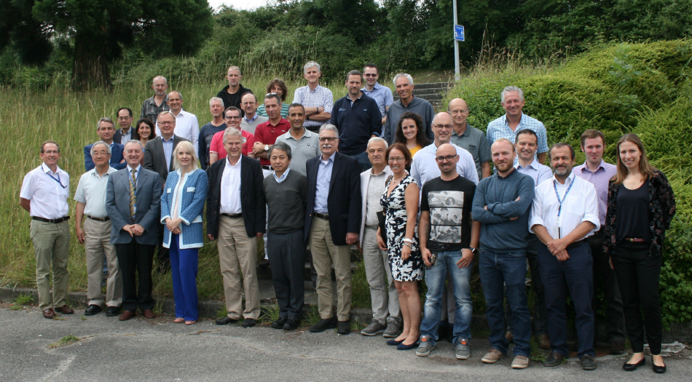
Acknowledgements
We would like to thank the SL team, led by Amalia (Ballarino) and Vittorio (Parma), for their hard work to prepare for this review. We appreciate the hospitality of the HL-LHC project. Finally we wish to thank Jean-Philippe (Tock) and Celine (Le Bon) for their assistances with the logistics.

Slide 16
Appendix

Slide 17
Review Panel Members
Maciej Chorowski (WUT)
Chen-yu Gung (ITER)
Joe Minervini (MIT)
Davide Tommasini (CERN)
Pierre Vedrine (CEA)
Akira Yamamoto (KEK-CERN, Chair)

Slide 18
Mandate and charges - 1
L. Rossi
The High Luminosity LHC (HL-LHC) project has been approved by the CERN Council in the June 2016 session, with a financing profile covering till end of installation in 2026. For the first time the powering system is based on high current long (>100 m) superconducting lines (called Superconducting Links) employing superconductor operating in He gas, well above the usual LHe or HEII temperatures.
The HL-LHC cold powering (WP6A in the Project Breakdown) is a complex system that has to enable transferring about 100 kA into the superconducting magnets of the upgraded LHC insertion magnets. The system is now in an advanced phase of design; MgB2 SC links basic concept have been demonstrated about two years ago in a 20 kA - 20 m long demonstrators, while a long prototype (>60 m) of final size and current is under constructions. Other features of the system, like joint box, cold distribution box, etc. are being designed or under validation or in conceptual phase.

Slide 19
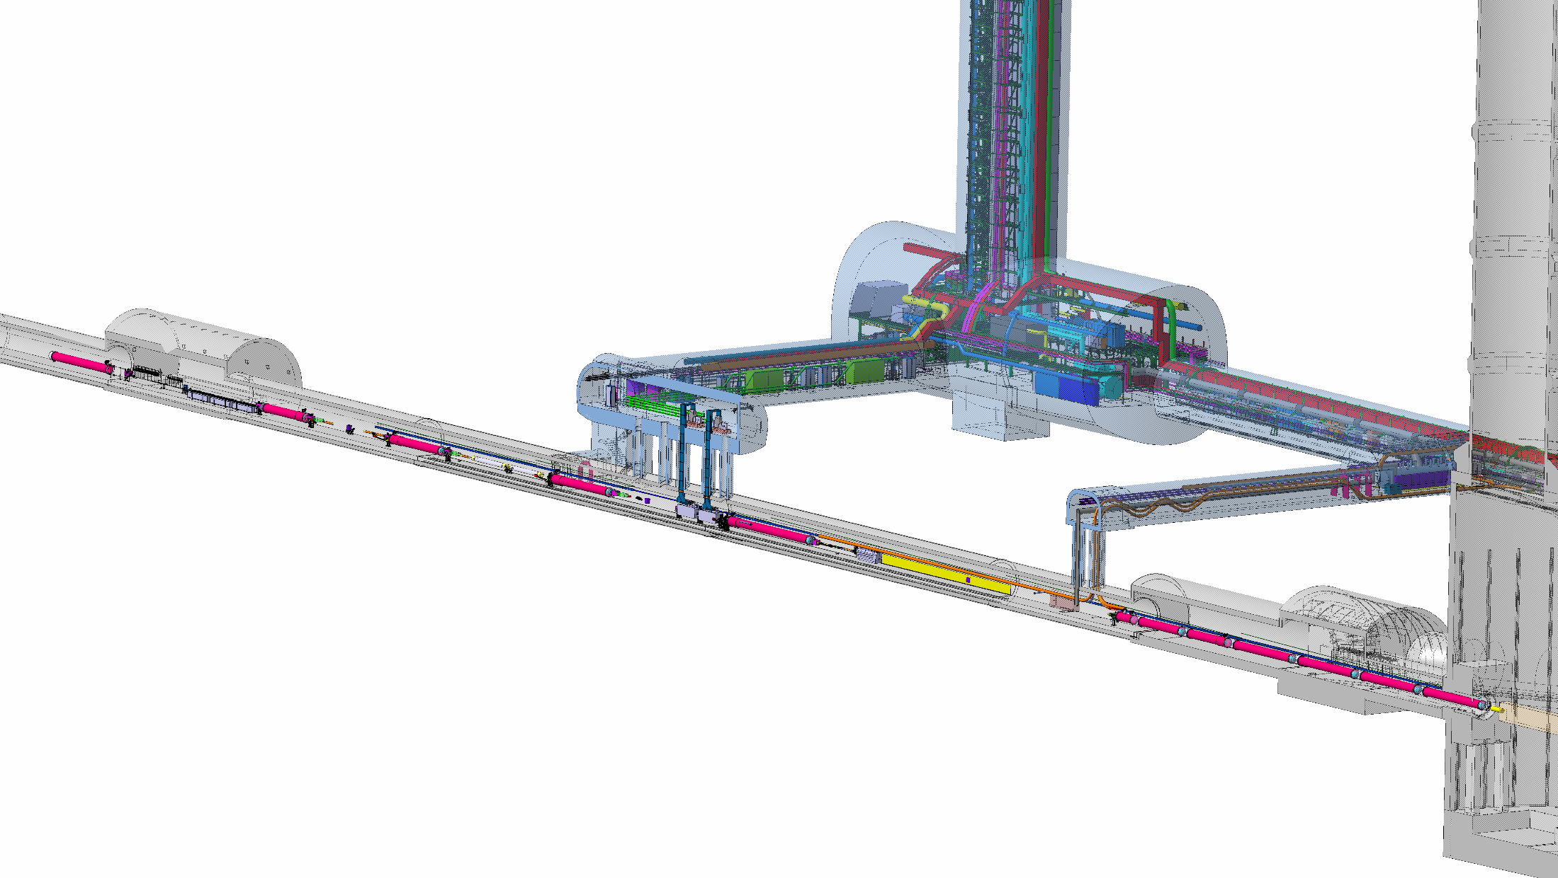
Mandate and charges - 2
L. Rossi
Since the early design phase, end 2010, we decided to explore the MgB2 (with an eye on HTS!) potential for the links, that at beginning were 300 m long, 100 m high, and 150 kA capability, to benefit of the large temperature margin and to make a completely different (from LHC) Cold Powering system, with no liquid in the CL box and removing CL box (DFBs) from LHC tunnel.
(there was also a 60 m long horizontal link, rated for 25 kA, for P7, for which was foreseen in 2013-14 one prototype: the cancellation of that link in 2015 has required that the prototype was redirected toward the big IT link)
With the double decker solution adapted in 2015, the link became shorter (100 m) and taller (about 15 m). Then, following various circuit reduction the current is reduced to 100 kA.
SC links

Slide 20
Mandate and charges - 3
L. Rossi
In addition, also due to various changes in the general powering scheme, some of them rather recent, the design and optimization of the full system still requires some time. The system must be fully designed and validated within 2018 to allow launching production of components for the final production in 2019 and 2020. The design must also live with the constraints given by the already defined technical infrastructure and integration, which at this stage cannot be changed. A test of a full, prototype system in the Inner Triplet String is foreseen in 2021-23, and installation in LHC P1 and P5 is foreseen in 2024 and early 2025.
The present review has been called to examine the preliminary design, the main choices, to assess the presence of possible show-stoppers and to see if interfaces between WP3 (Magnets) and WP6B (warm powering), as well as Cryogenics and Circuit protection, are well defined. The review will cover both technical aspects and general integration, as well as the global planning.

Slide 21
Questions to be answered (1/2)
L. Rossi
Is the technical scope of the Cold Powering System well defined and interfaces with adjacent equipment well clarified, also regarding installation? And in particular is the design and validation of the components closely linked to the cold powering (for example: bus bars, quench detection and protection, warm powering, etc.) sufficiently defined to allow finalization of the design of the Cold Powering System?
Is the general design correct and adequate to meet the scope? Is the design safe also with respect to the boundary conditions given by the magnets and circuit protection system?
Is the basic design of each components or subsystem adequate to the scope with reasonable margins? For the items still under definition, is the plan to finalize the design sound?

Slide 22
Questions to be answered (2/2)
L. Rossi
Is the plan to complete the design, to develop demonstrators for each critical item (for example splices among different materials, cabling of many large conductors, handling of the heavy and long SC links, e.m. coupling inter-circuit at acceptable level, etc.) properly done and sound? Are any critical design and technological developments that are still missing or in severe delay ?
Is the test plan including the IT String test adequate (without too many details at this early stage)?
Are there issues that have been neglected or underestimated?

Slide 23
Various
L. Rossi
While the cost and resources are not in the scope of the review (they have been reviewed by an international panel in HL-LHC C&S reviews on March 2015 and October 2016), the reviewers may comment on the level of resources allocated to design , prototyping and validations, as well as on the schedule.
(for your info next C&SR3 is on March 2018)
The review panel reports to the HL-LHC Project Leader and the panel chair is required to deliver a written report within one month after the review.

Slide 24



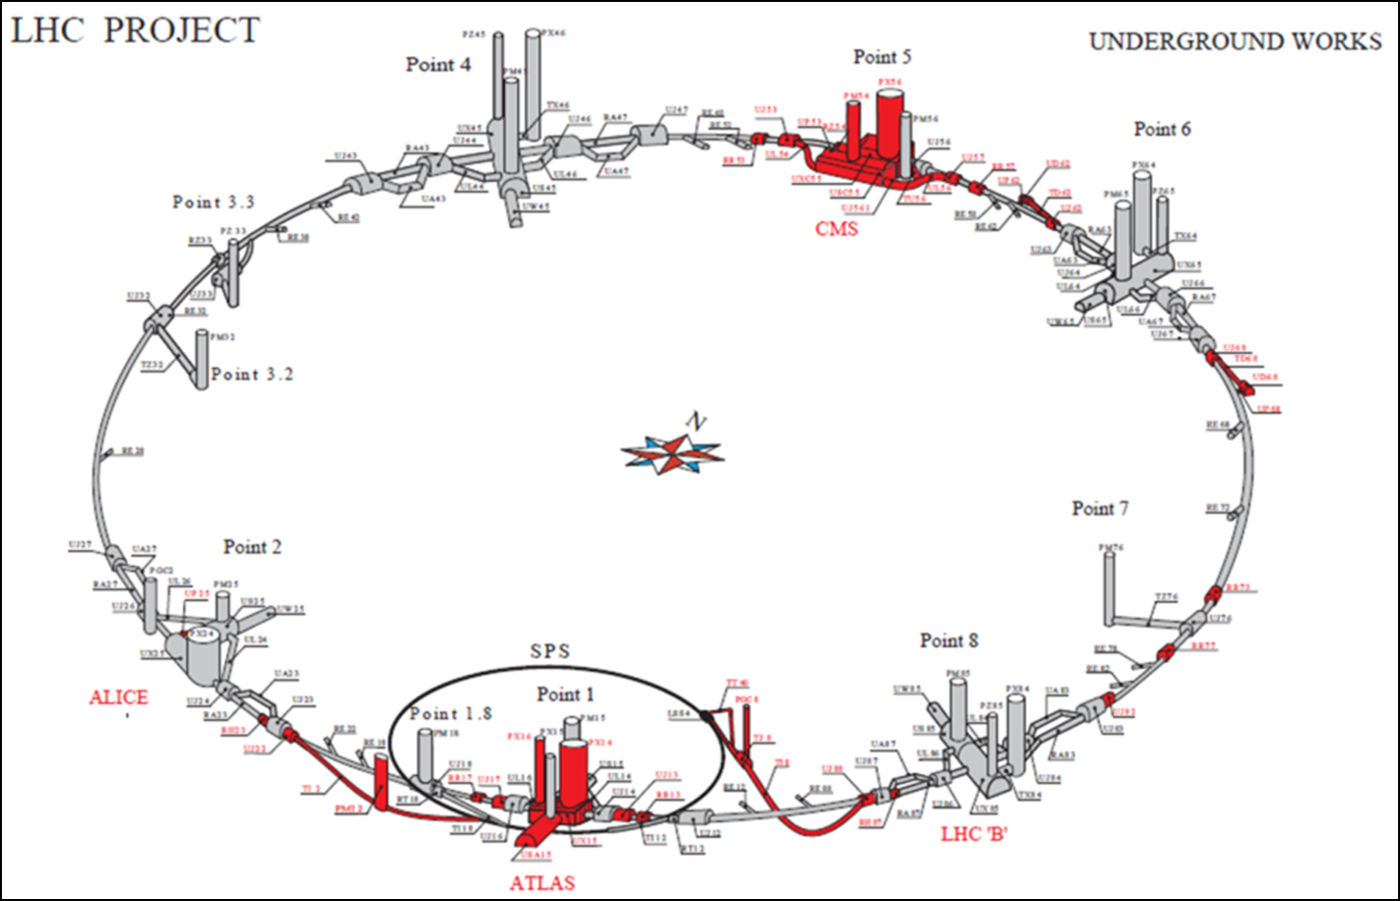
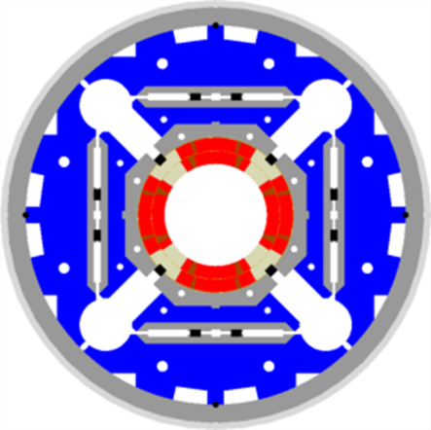






Nb₃Sn Superconducting Magnets and MgB₂ SC Links for HL-LHC
Courtesy, L. Rossi
IR-FF Quadrupole
(MQXF)
Service gallery (UR)
SC Links
Q2a
Q1
CP
Q3
Q2b
DFX
D1
DFM
Notes:
New slide from Davide.
Showing that conductor development is launched at international level, Russia, Japan, (Korea and Europe in preparation)
Underline importance of that development as main cost driver for the hadron collider machine.

Slide 25
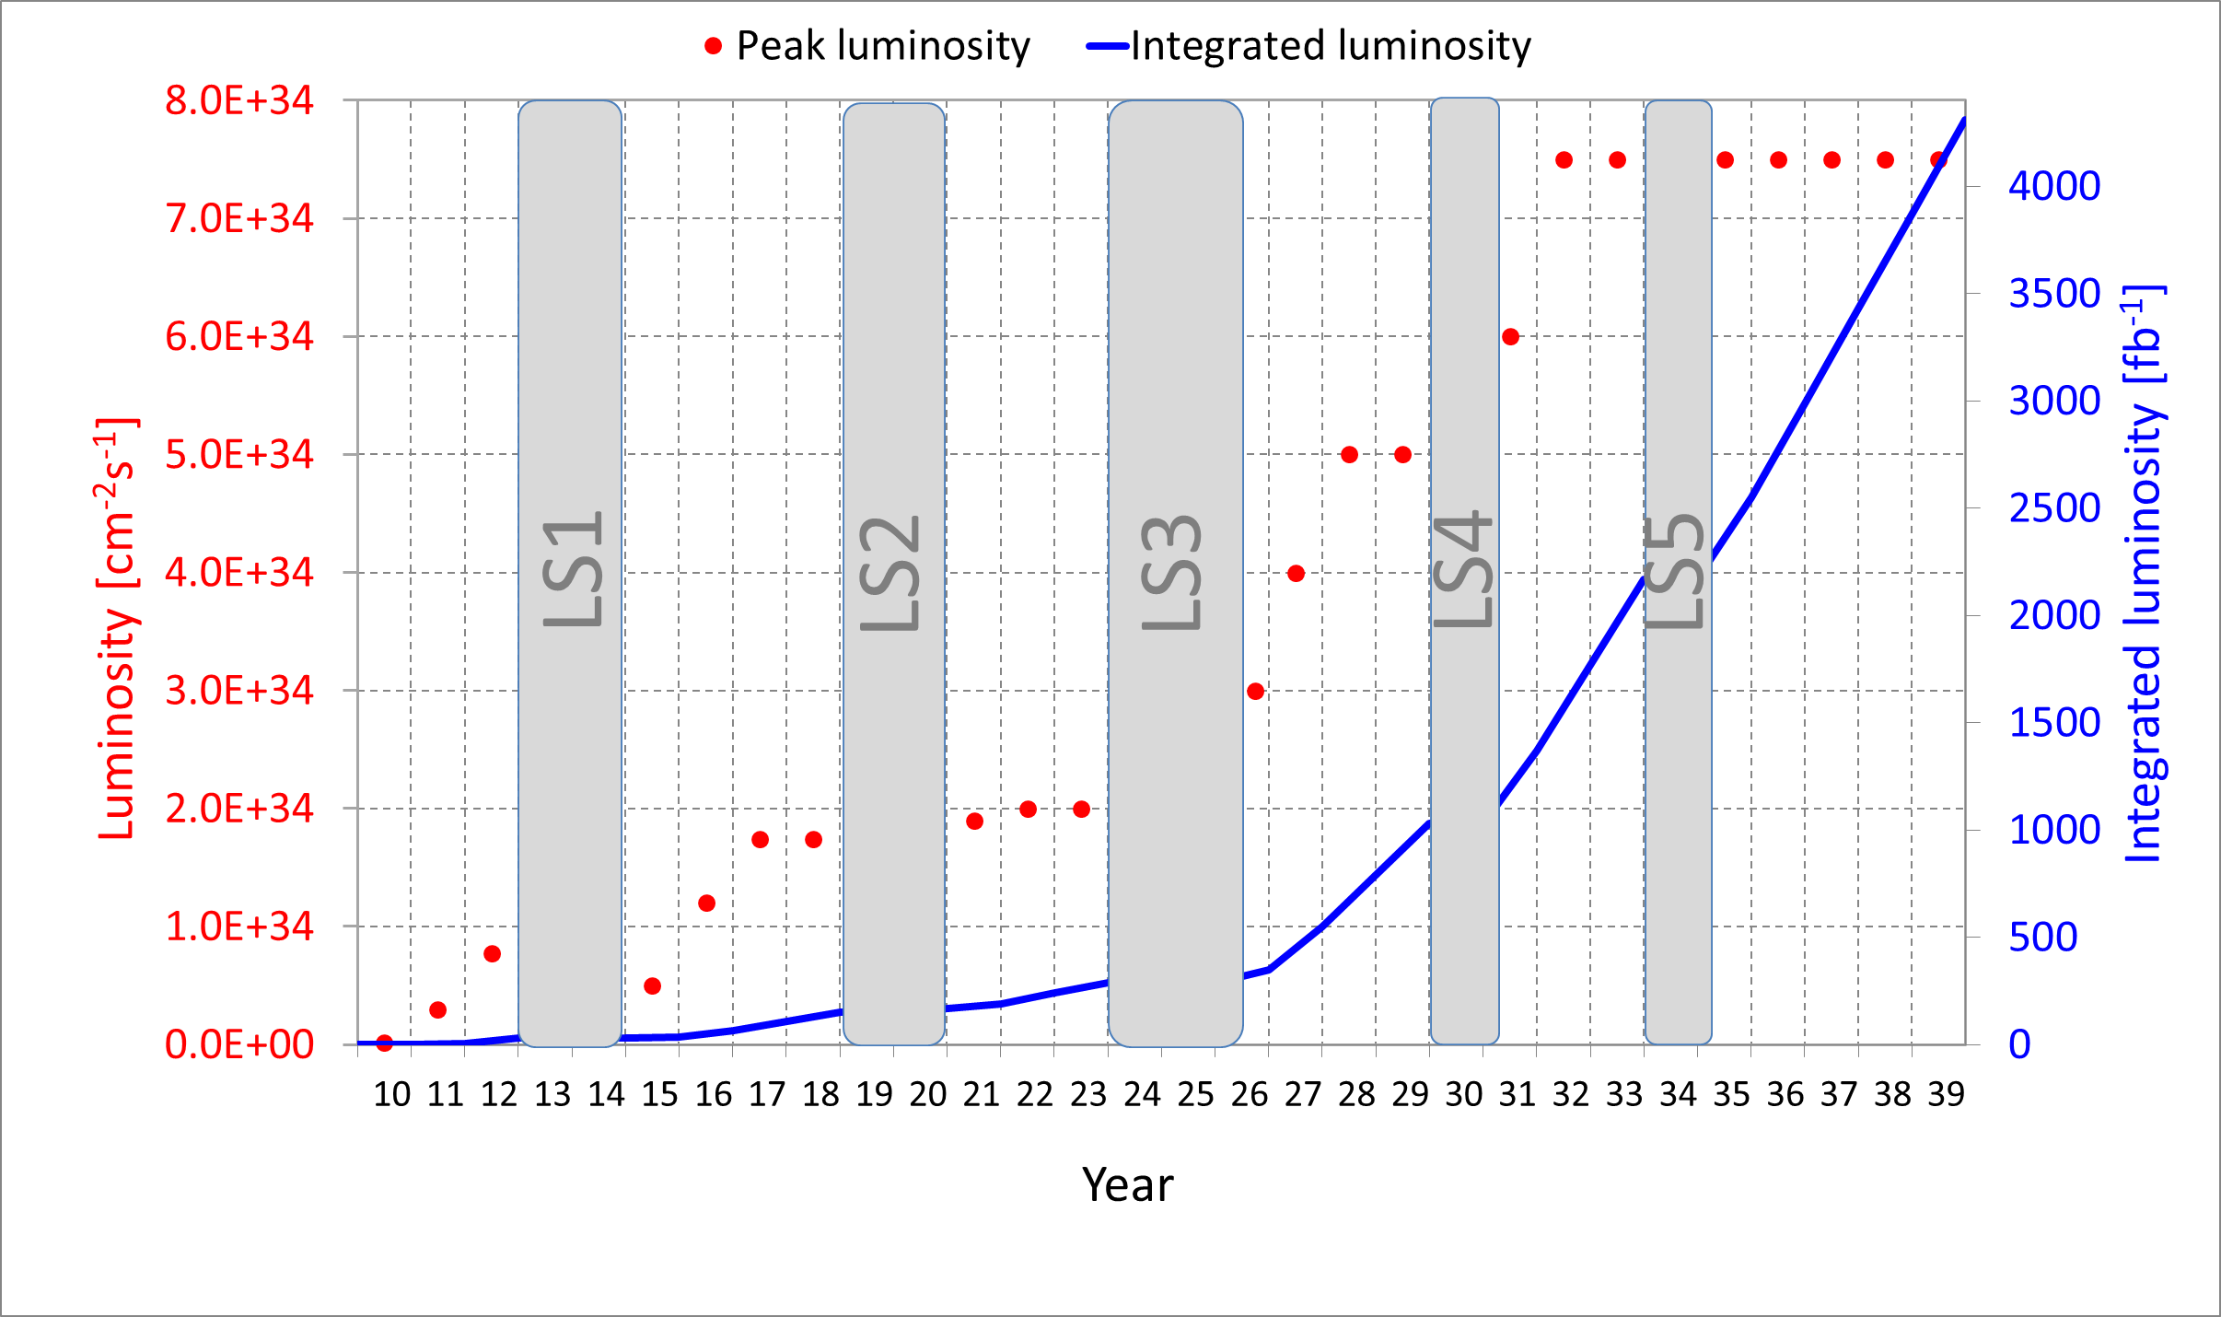
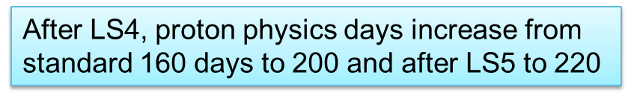
Luminosity profile: ULTIMATE goal
SC Link Construction

