Slide 1
7th HL-LHC Collaboration Meeting
Madrid, 13-16 November 2017
Preliminary programme and practicalities
C. Noels, ATS-DO
TCC Meeting – 23 June 2016

Slide 2

Preliminary programme
Annual meeting website: https://espace.cern.ch/HiLumi/2017/SitePages/Home.aspx
Detailed agenda in Indico: https://indico.cern.ch/event/647714/timetable/#20171113.detailed

Slide 3
Overview

Slide 4
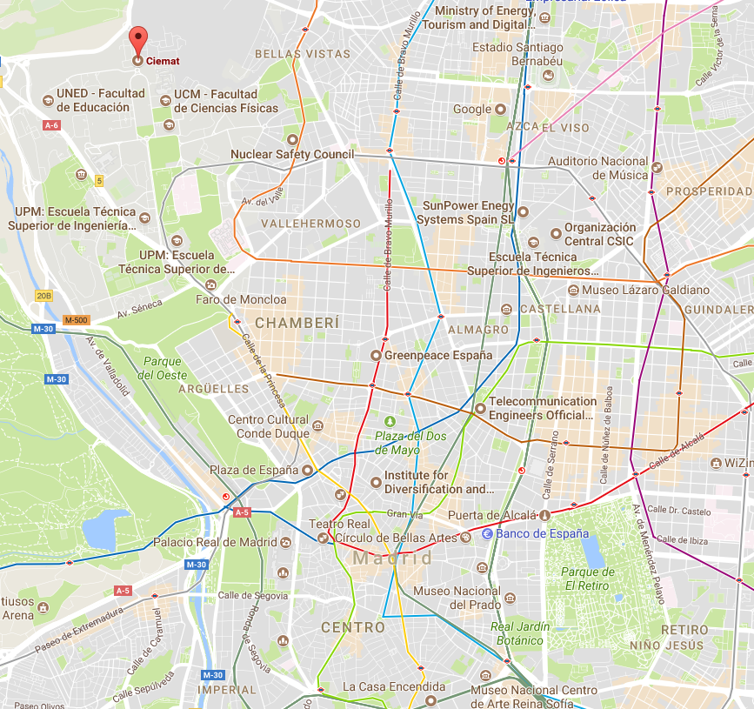
How to get to CIEMAT
Bus line 82 to Paraninfo CIEMAT stop from hotels
From airport, metro lines 8 & 6 to Ciudad Universitaria
From hotels: metro line 6 to Ciudad Universitaria
20 minute walk from Ciudad Universitaria station to CIEMAT
Area of hotels

Slide 5
CIEMAT: Venue and Social Events
One auditorium for plenary sessions: up to 190 participants
Plus 6 meetings rooms for joint and parallel sessions (capacity from 15 to 45 participants)
Dedicated spaces for coffee breaks and Welcome Drink ( on Monday evening)
CIEMAT will organize a bus transfer to the Cultural Event and Collaboration Banquet location ( on Wednesday evening)

Slide 6
Next steps
In the coming weeks, the Project Office will:
  Finalize the CERN participants’ list and submit it to Freddy for approval.
  Send the invitation to HiLumi collaborators (CERN and externals) before end of August.
  Send rules of reimbursement of travels to group secretariats, beginning of September.
Before 21st August: send missing topics for parallel sessions to Cecile.
Registration will open on 1st September. Deadline for registration: 20th October.

