Slide 1
Preliminary comparison of 5 hollow beam electron guns performance

Slide 2
5 guns generating hollow electron beams has been analysed:
Adiabatic gun with minimum transverse electric field
Non-adiabatic gun with controlled transverse electric field
BNL gun, which is a modification of the existing BNL Gaussian gun with modified cathode
Fermilab gun, designed at Budker Institute by Gennadiy Kuznetsov (original dimentions)
Fermilab gun scaled down

Slide 3
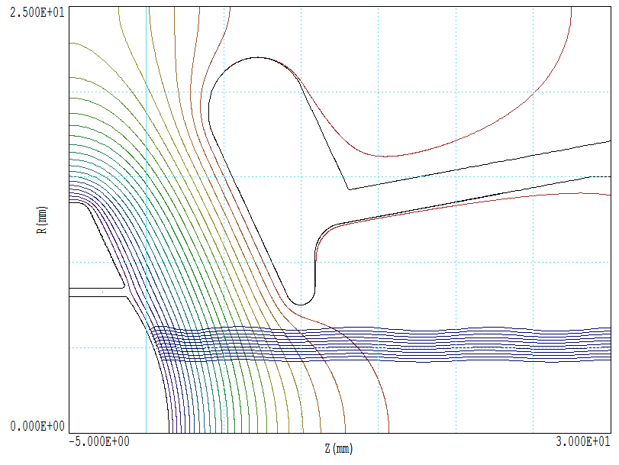
Adiabatic gun (P= 5.97E-6 A/V^{1.5})

Slide 4
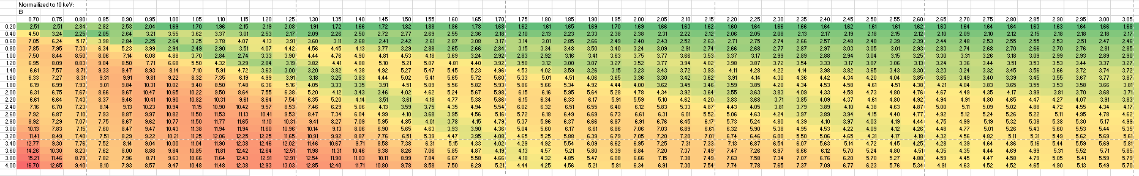
Maximum angles of electron trajectories with z-axis for adiabatic gun

Slide 5
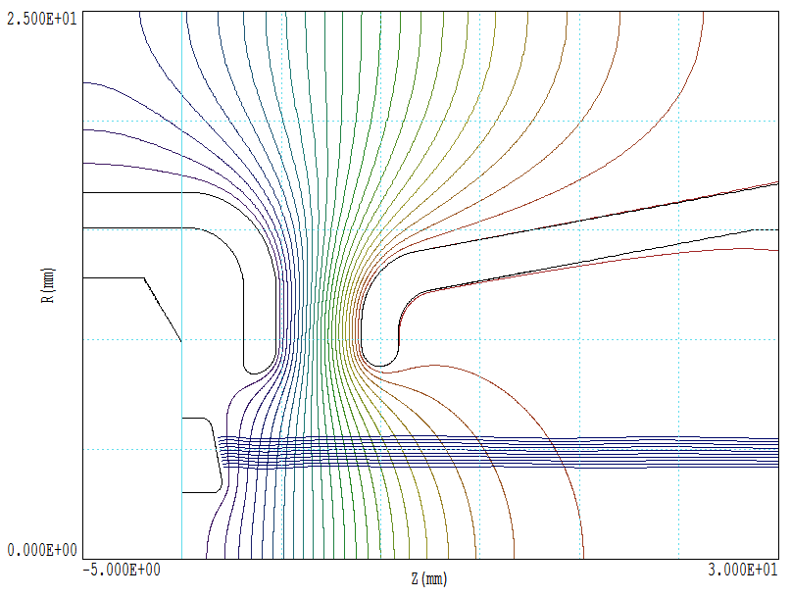
BNL gun (P=1.59E-6 A/V^1.5)

Slide 7
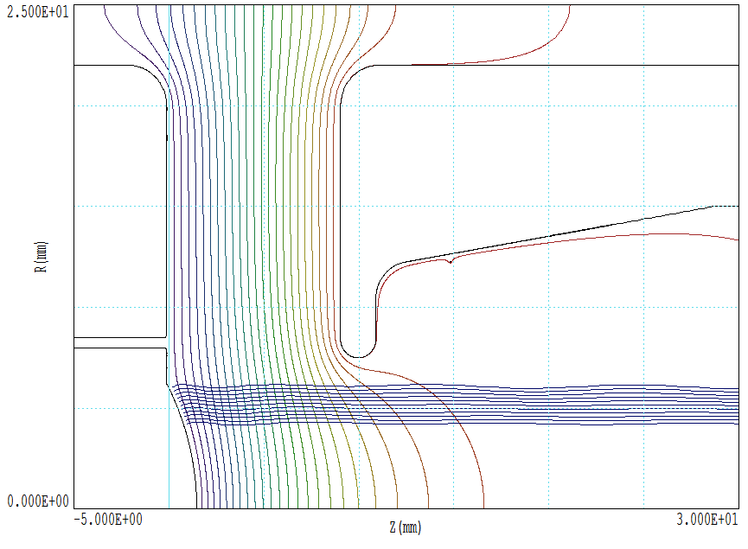
Non-adiabatic gun, P=3.39E-6 A/V61.5

Slide 8
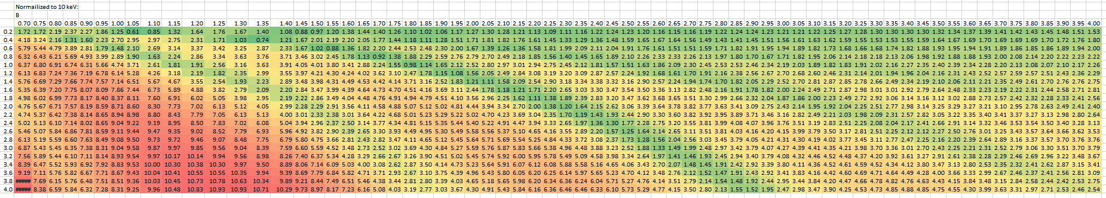
Maximum trajectory angles for non-adiabatic gun

Slide 9
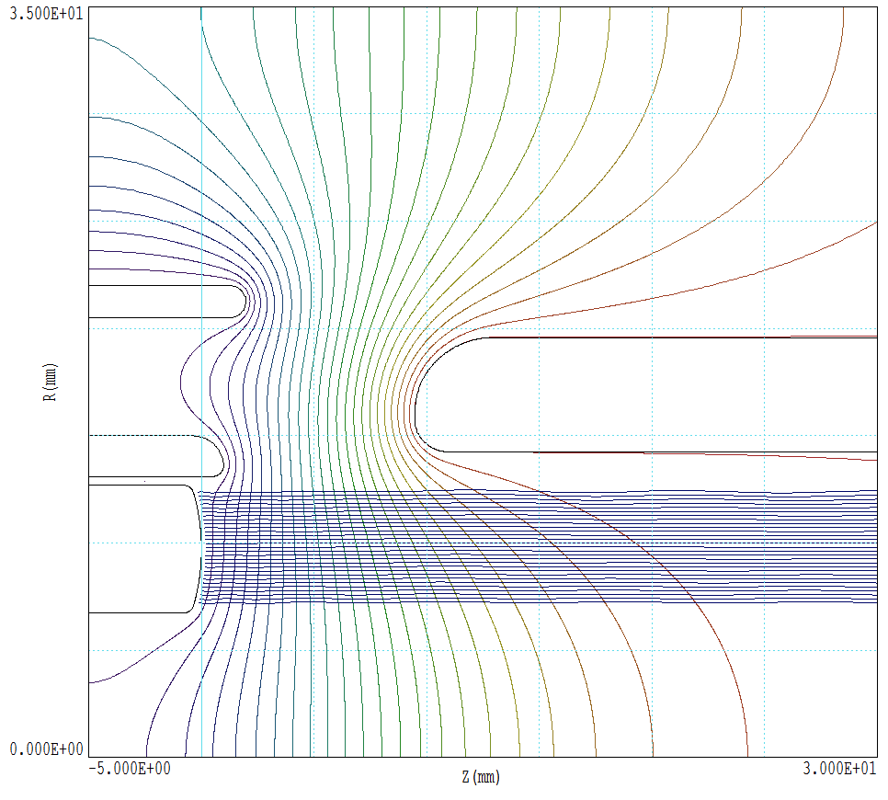
Fermilab gun (P=6.4E-6 A/V^1.5)

Slide 11
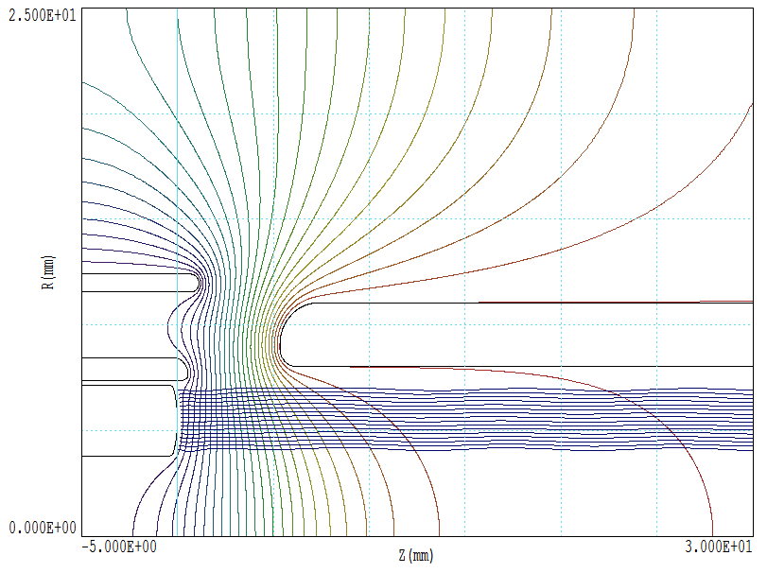
Fermilab gun scaled town to r_{in}=4.0 mm, P=6.4E-6 A/V^1.5

Slide 13
Cumulative angles:

