Slide 1
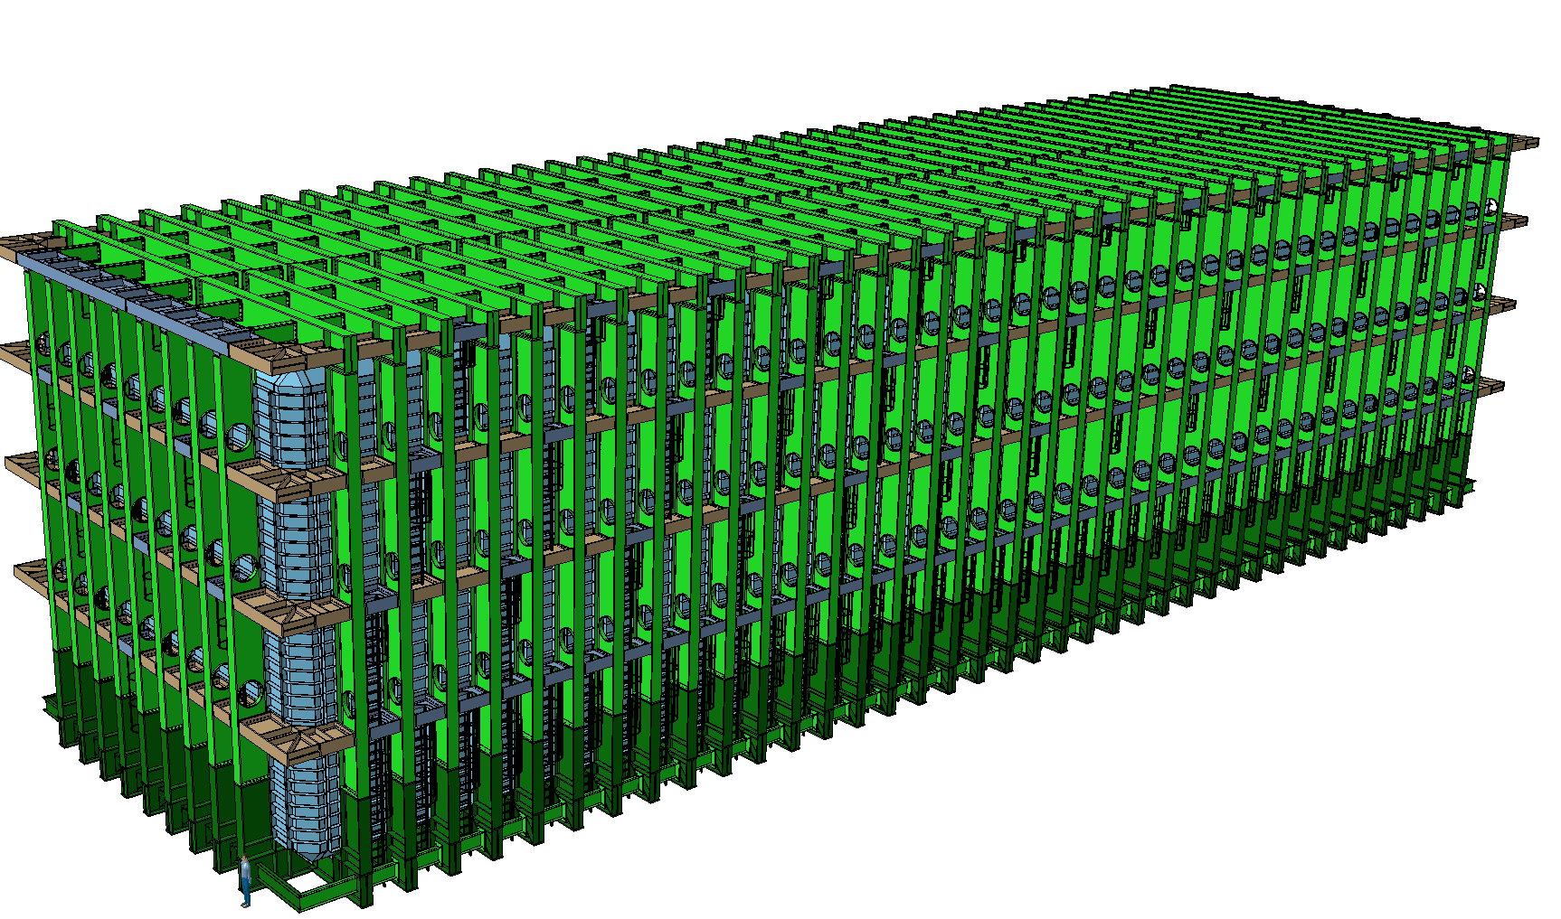


Agreed design rules
Testing requirements
O. Beltramello, CERN
LBNF Cryostat, final design review
SURF, 21-22 August 2017

Slide 2
Table of Content
Who Am I and Where Have I Been?
Reminder .. the basis
Tests performed to qualify of the warm structure of the cryostats
Preliminary analysis of the risks related to the tests methods
CERN position versus the testing campaign
Documents and references
Summary

Slide 3
Who Am I and Where Have I Been?
Mechanical engineer within the Neutrino Platform project
Member of the LBNF/DUNE Collaboration.
CERN Physics Department Safety Officer
Head of safety of the ATLAS LHC project at CERN during construction and run1 operation.
Responsible of the ATLAS detector integration
ATLAS configuration control manager
Engineer in charge of system structural analysis for aeronautics and aerospace – ESA and Aerospatiale.
Aerospace and Aeronautical mechanical engineer.
Notes:
I have been recently appointed as FSF L2 Manager for N2 Cryo Systems and Cryo Fluids, positioned occupied by Barry Norris who deserves all the credit for what I am about to present.
I have started as lead cryostat engineer for the 35 ton prototype and I have then been his deputy for the past 3 years in the Cryogenics Systems, starting from LBNE and then LBNF.
I am currently stationed at CERN acting as liaison between CERN and Fermilab.
My experience is a little shorter than that of some of the people that preceded me, it includes … READ.
I am also a certified PMP.

Slide 4
Reminder .. the basis:
October 2015 - MoU signed between CERN and Fermilab, Design, Fabrication, Installation and Testing of the LBNF/DUNE and SBN Membrane Cryostats - EDMS 1554082
Reference for the design, manufacturing and testing of all membrane cryostats of LBNF/DUNE and SBN programs.
The main points are:
- US ANSI/AISC 360 (latest edition) “Specification for Structural Steel Buildings” applies to the design and construction of the support structure.
- the warm steel supporting structure design is performed per the European standard for steel structure design and construction EN1993 - EUROCODE 3 (equivalent to ANSI/AISC 360).
- the design approach is to generate a detailed FEA model of the vessel and to perform a detail stress analysis of each component.
- the level of safety per ASME Boiler and Pressure Vessel Code, Section VIII, Div. 2. is demonstrated to comply with the U.S. DOE 10 CFR 851.

Slide 5
Tests performed to qualify of the warm structure of the cryostats
Prior to each testing campaign:
a risk assessment is performed to verify personnel and equipment safety during the tests.
the respective authorities of the host laboratory performs an internal review.
Their approval is mandatory prior to each test.
1. Destructive tests for the weakest structural part of the steel frame in order to validate the FEA model and the structure mechanical behavior.
2. Prior to the Liquid Argon filling process, a pneumatic test is performed
at a testing pressure PT:
PT = 1.15 x Maximum Allowable Working Pressure = 1.15 x 350 mbars.
3. Fill of the cryostat with liquid argon in incremental steps until the service level.

Slide 6
Preliminary analysis of the risks related to the tests methods
Destructive tests for the weakest structural part of the steel frame
- performed remotely from the cavern and under control.
- anticipated from the installation (expected 2017) to correct if required the design
This test will enable to validate the FEA model (local worst behavior) and the worst connections case. (see Joao and Dimitar talks)
No risk for personnel, no risk for the cryostat, no risk for the detector
3. Filling of the cryostat with liquid argon in incremental steps until the service level.
This test is complementary of test 1.
It verifies the global model of the cryostat and the general behavior of the structure under the worst load case.
In particular, it qualifies the bottom part of the structure.
The structural behavior (deformations and strains) of the warm structure is checked during the whole filling process:
- Height of the liquid = service height (96% of LAr)
- Overpressure of LAr gas in the remaining volume at 350 mbars.

Slide 7
Preliminary analysis of the risks related to the tests methods
Compensatory safety measures:
1. The cryostat is instrumented with deformation and strain gages at strategic locations.
2. In case of any abnormal behavior of the structure:
- filling is stopped
- the cryogen is transferred to an available adjacent cryostat or drained
3. Oxygen deficiency monitors are installed all around the vessel linked to evacuation of the SURF undergrounds.
4. Exceptional access to the bottom part of the cavern during filling process with specific safety measures (ODH portable, 2 persons rules, oxygen masks)
A FEA calculation of the tests conditions (at 350 mbars + 10% safety margin for the safety valves) and a check of the structural behavior local and global behavior is required to check the maximum design stresses are not exceeded.
Risk mitigated for the personnel, limited risk for the cryostat, limited risk for the detector.
The probability of an event is very low.

Slide 8
Preliminary analysis of the risks related to the tests methods
2. Pneumatic test of the cryostat.
This test will NOT qualify the entire vessel structure and connections as the most loaded structural elements of the vessel are loaded by the Lar static head (not represented by this test).
It will NOT remove the risk of an issue during the filling with LAr as the static head will load highly the bottom connections.
The vessel will be filled with 1.15 x 350 mbars = 402.5 mbars Ar or N2 gas.
The pneumatic test will generate energy in the vessel.
E= 420 Mjoules equivallent to 100 Kg of TNT
With missiles estimated at > 300 meters
These energies and effects are still optimistic as the area around the vessel is not open.

Slide 9
Preliminary analysis of the risks related to the tests methods
2. Pneumatic test of the cryostat.
If a structural break happen during the test, it will probably happen:
- damage of the detectors
- damage of the foam and the internal primary and secondary membranes
- the static overpressure in the cavern is estimated to be around 1.3 bars
this is around 3 tones/m2 (if we estimate the cavern isolated from the rest of the undergrounds).
No damage expected on the cavern rock.
But will the cavern doors and the cryogenics platform stand this loading ?
- Depending of the local failure mode (opening large or small), the shock waves propagation (blast wind) and the drag force (dynamic effect) might vary quite a lot. This depends on the velocity of the gas (and indirectly of the severity of the structure break). We might observe global deformations.
A detailed analysis is required to determine the effect of such a failure (dynamic) on the external structures of the cavern and on the insulation/membranes and on the detector components inside the vessel.

Slide 10
Preliminary analysis of the risks related to the tests methods
2. Pneumatic test of the cryostat.
The cryostat is NOT related to PED or ASME BPVC.
But, if we would apply these standards for the pressure test, it would be required that “critical areas must be observed during the tests with adequate measurements” (PED).
- What will be the criteria for test acceptance as the test will not load at maximum the most critical areas ?
- What will be the adequate measurements ?
- How to protect people during the visual inspection ?

Slide 11
Preliminary analysis of the risks related to the tests methods
Possible compensatory safety measures for pressure test 2.:
1. No access to the undergrounds during the test
but there are no mitigation measures for the detector, the cryostat structure and the internal insulation.
Risk mitigated for the personnel
High risk for the cryostat (definitive structural damage for the external structure and for insulation)
High risk for the detector
High risk for the cryogenics platform
High risk for the project (one detector missing)

Slide 12
CERN position versus the testing campaign
CERN propose to qualify the warm structure via :
- Destructive tests for the weakest structural part (1.)
- Fill of the cryostat with liquid argon in incremental steps until the service level (3.)
together with :
- welds and construction QA (see Dimitar talk)
- Local leakage tests of each weld of the 3 containments (primary, secondary and external structure)
- test of the concrete floor
We disagree to perform a pressure test prior filling process:
- it is too risky for the personnel, for the equipments and for the project.
- the critical locations are at the bottom of the cryostat (LAr static head) where the pressure test is not representative at all.
Pressure test 2. do not test anything.
- we did not find any code related to membrane cryostat requiring to perform this test
Our cryostat is NOT related to Directive 97/23/CE- Pressure equipment (PED) or to ASME BPVC.

Slide 13
Documents and references
EDMS 1554082: Design, Fabrication, Installation and Testing of the LBNF DUNE and SBN Membrane Cryostats.
ASME BVPC, section VIII division 2
Directive 97/23/CE- Pressure equipment (PED)
ANSI/AISC 360 – Specification for Structural Steel Buildings
EUROCODE 3 – EN 1993 –Design of Steel structures
U.S. DOE 10 CFR 851
FESHM 5031.7 : “Membrane Cryostats” September 2015
FESHM 5031.7 Technical Note – Guidelines for design, fabrication, Installation and Testing of Metallic Membrane cryostats.”

Slide 14
Summary
The design, fabrication, installation and testing of the LBNF cryostat follows
the MoU (EDMS 1554082) signed between CERN and FERMILAB.
Following a preliminary risk assessment, CERN do not agree to perform the
pneumatic test 2. as :
- it will not qualify the cryostat and will not remove the risks while filling with LAr
- it is not required for a membrane cryostat
- a preliminary risk assessment shows that the risks are too high for the detector and for the project
We propose to qualify the vessel via test 1. and 3. together with leak tests
and a strict quality insurance policy.

Slide 15
Summary
If such test request is nevertheless maintained:
CERN remove his responsibility for all project consequences of a failure
during the test (financial, schedule).
CERN will ask for a technical justification of the need of such a test
CERN will ask to FERMILAB to present a detailed risk assessment for the
detector, the cryostat and the external structures.
This should include the analysis of the vessel structure possible modes of
failure and the associated detector and environmental damages due to the
pneumatic dispersion.

