Slide 1
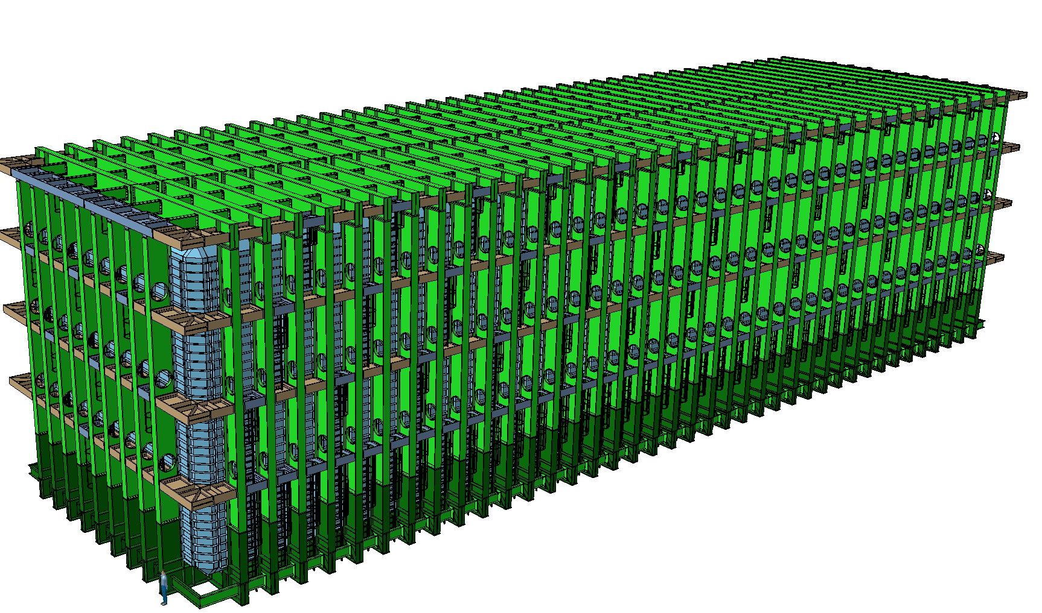


Components logistics, manipulations, lowering
Dimitar MLADENOV - CERN EP/NU
LBNF Cryostat, final design review
SURF, 21-22 August 2017

Slide 2
Table of Content
Who Am I and Where Have I Been?
List of components to be lowered
Long beam transportation
Corner beam transportation
Warm skin transportation
Documents and References
Summary

Slide 3
Who Am I and Where Have I Been?
Chief Project Engineer of the CERN Neutrino Platform.
Member of the LBNF/DUNE Collaboration.
Mechanical Engineer at the ATLAS LHC project at CERN during construction and operation.
Experience includes 17 years as a project engineer for support structures for large scale physics detectors, from its conceptual stage to the final commissioning.
Large experience on design, manufacturing, underground installation, assembly and logistics.
Education as Mechanical Engineer (PhD).
Notes:
I have been recently appointed as FSF L2 Manager for N2 Cryo Systems and Cryo Fluids, positioned occupied by Barry Norris who deserves all the credit for what I am about to present.
I have started as lead cryostat engineer for the 35 ton prototype and I have then been his deputy for the past 3 years in the Cryogenics Systems, starting from LBNE and then LBNF.
I am currently stationed at CERN acting as liaison between CERN and Fermilab.
My experience is a little shorter than that of some of the people that preceded me, it includes … READ.
I am also a certified PMP.

Slide 4
List of components
Cage Load 240 x 60min
240 hours
10 days
Skip Load 300 x 60 min
300 hours
13 days
In addition to this:
125t of Bolts 1 day
4’000 boxes of insulation
We need to transport 1’800 components
600 pcs with weight 0.1t ÷ 0.5t
900 pcs with weight 0.5t ÷ 1.0t
120 pcs with weight 1.0t ÷ 5.0t
120 pcs with weight 5.0t ÷ 7.0t
60 pcs with weight 7.0t ÷ 7.5t

Slide 5
List of components

Slide 6
List of components

Slide 7
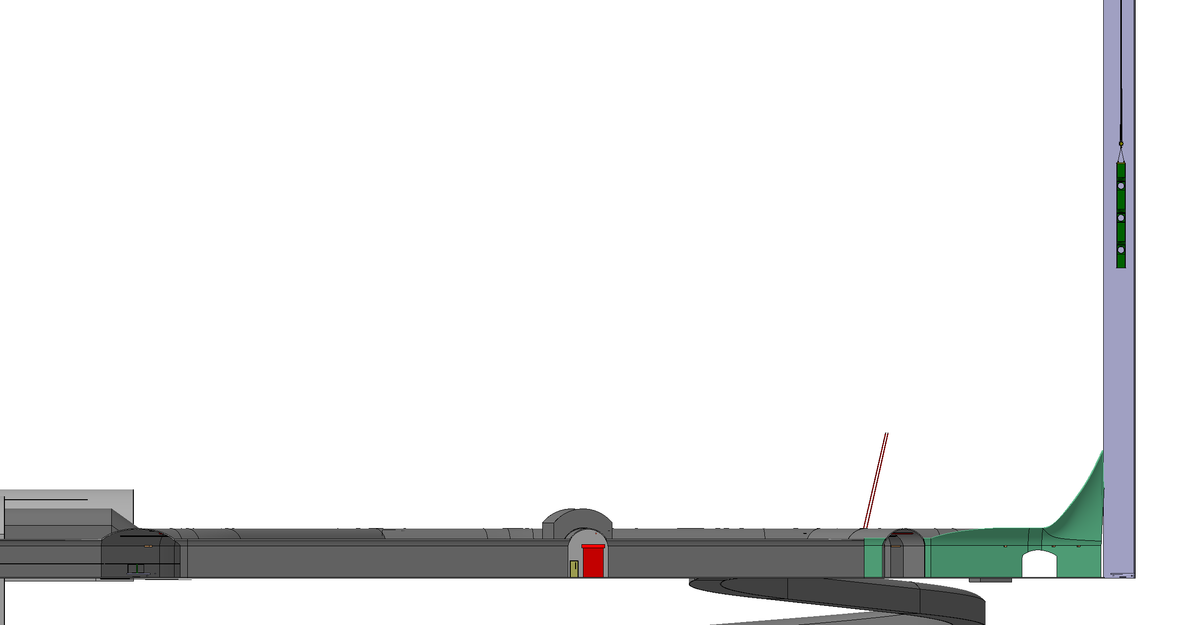
Vertical beam lowering
Weight: 7.5t
Length: 13.6m

Slide 8
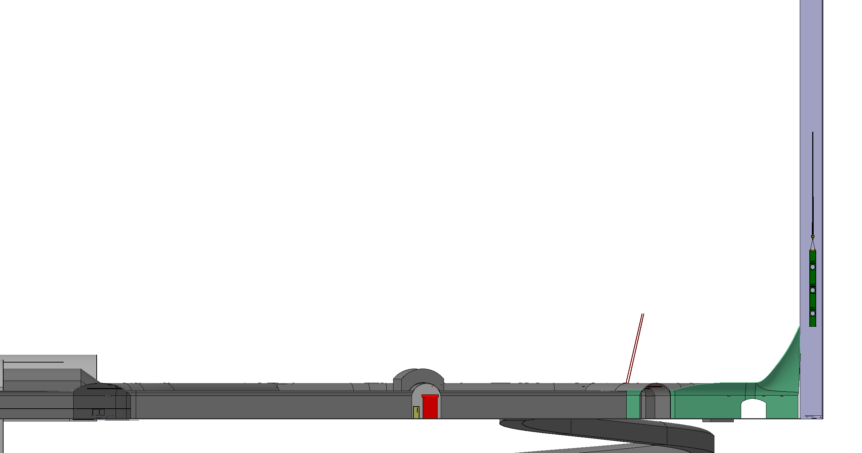
Vertical beam lowering

Slide 9

Vertical beam lowering

Slide 10

Vertical beam lowering

Slide 11

Vertical beam lowering

Slide 12

Vertical beam lowering

Slide 13
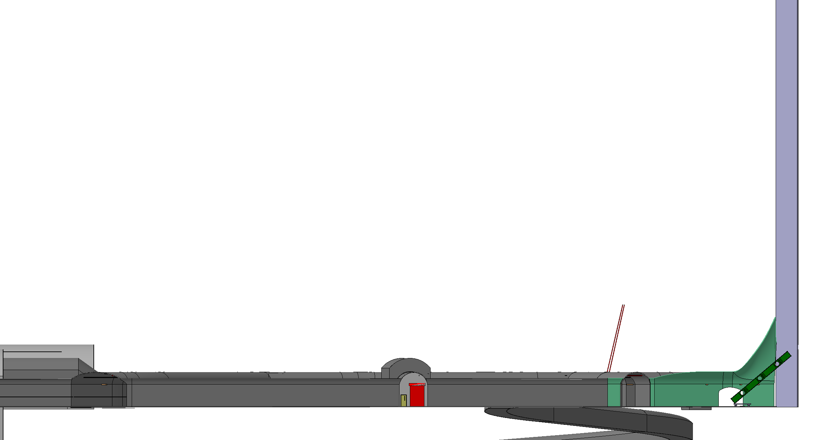
Vertical beam lowering

Slide 14

Vertical beam lowering

Slide 15

Vertical beam lowering

Slide 16

Vertical beam lowering

Slide 17

Vertical beam lowering

Slide 18

Vertical beam lowering

Slide 19
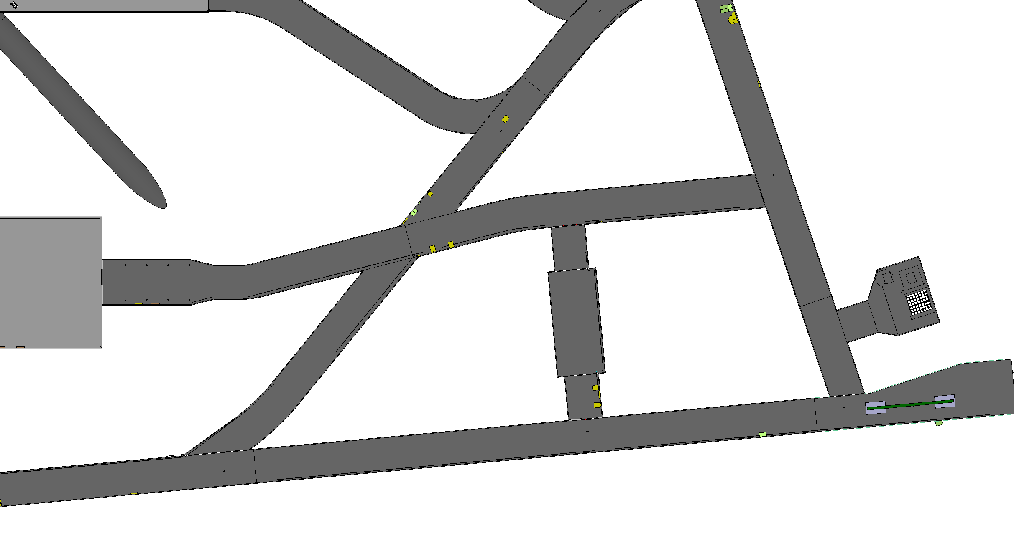
Vertical beam lowering

Slide 20
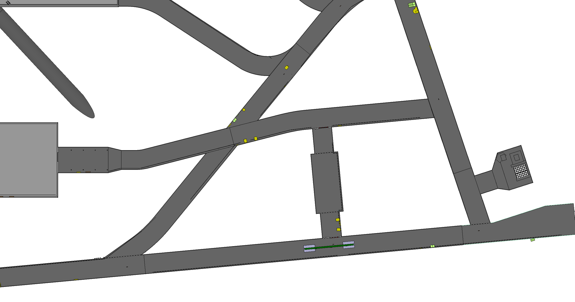
Vertical beam lowering

Slide 21
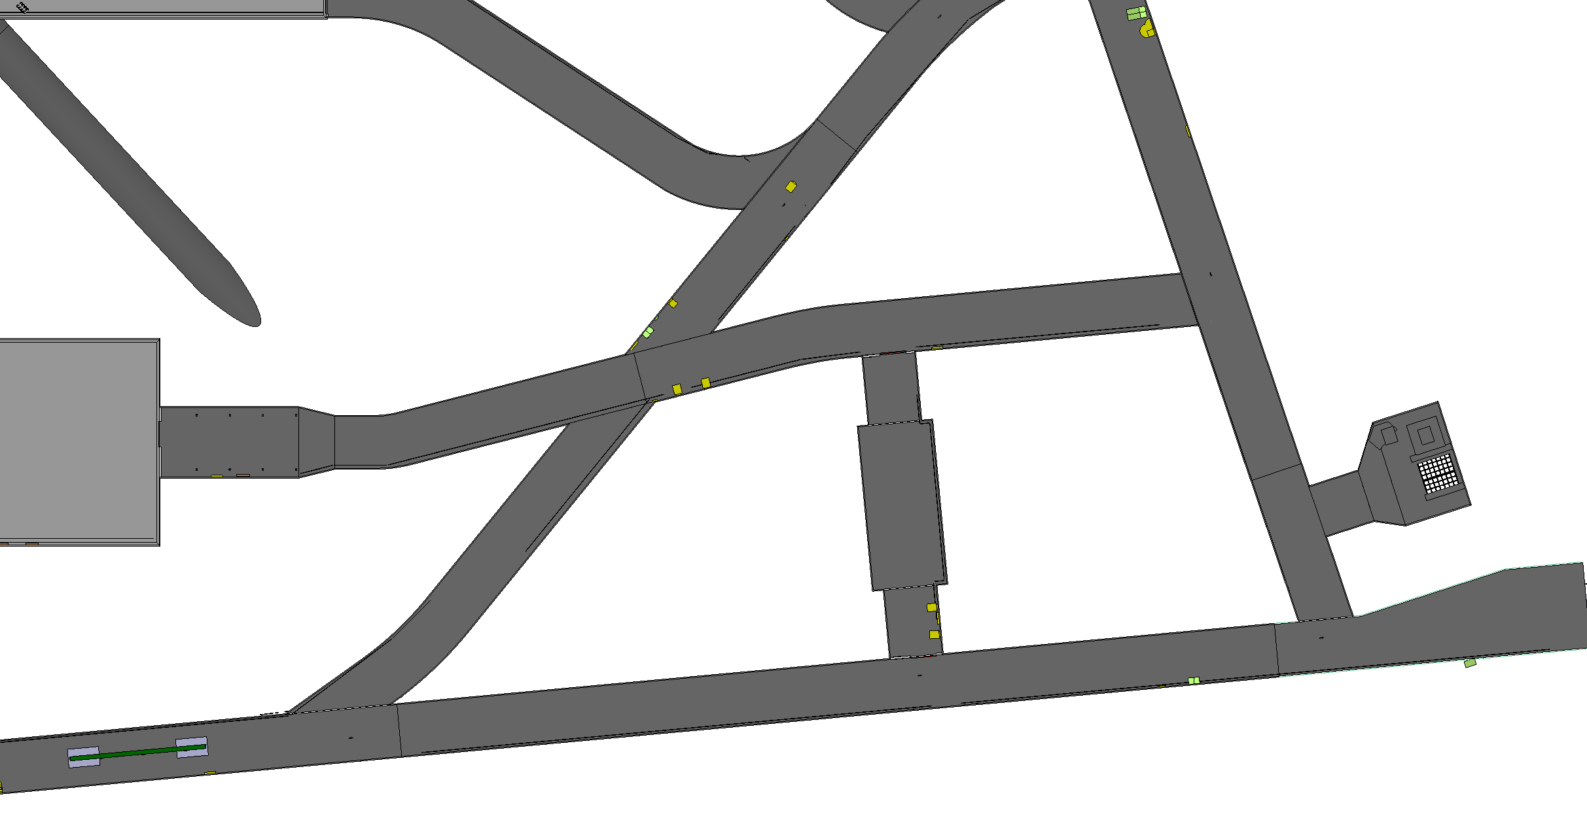
Vertical beam lowering

Slide 22
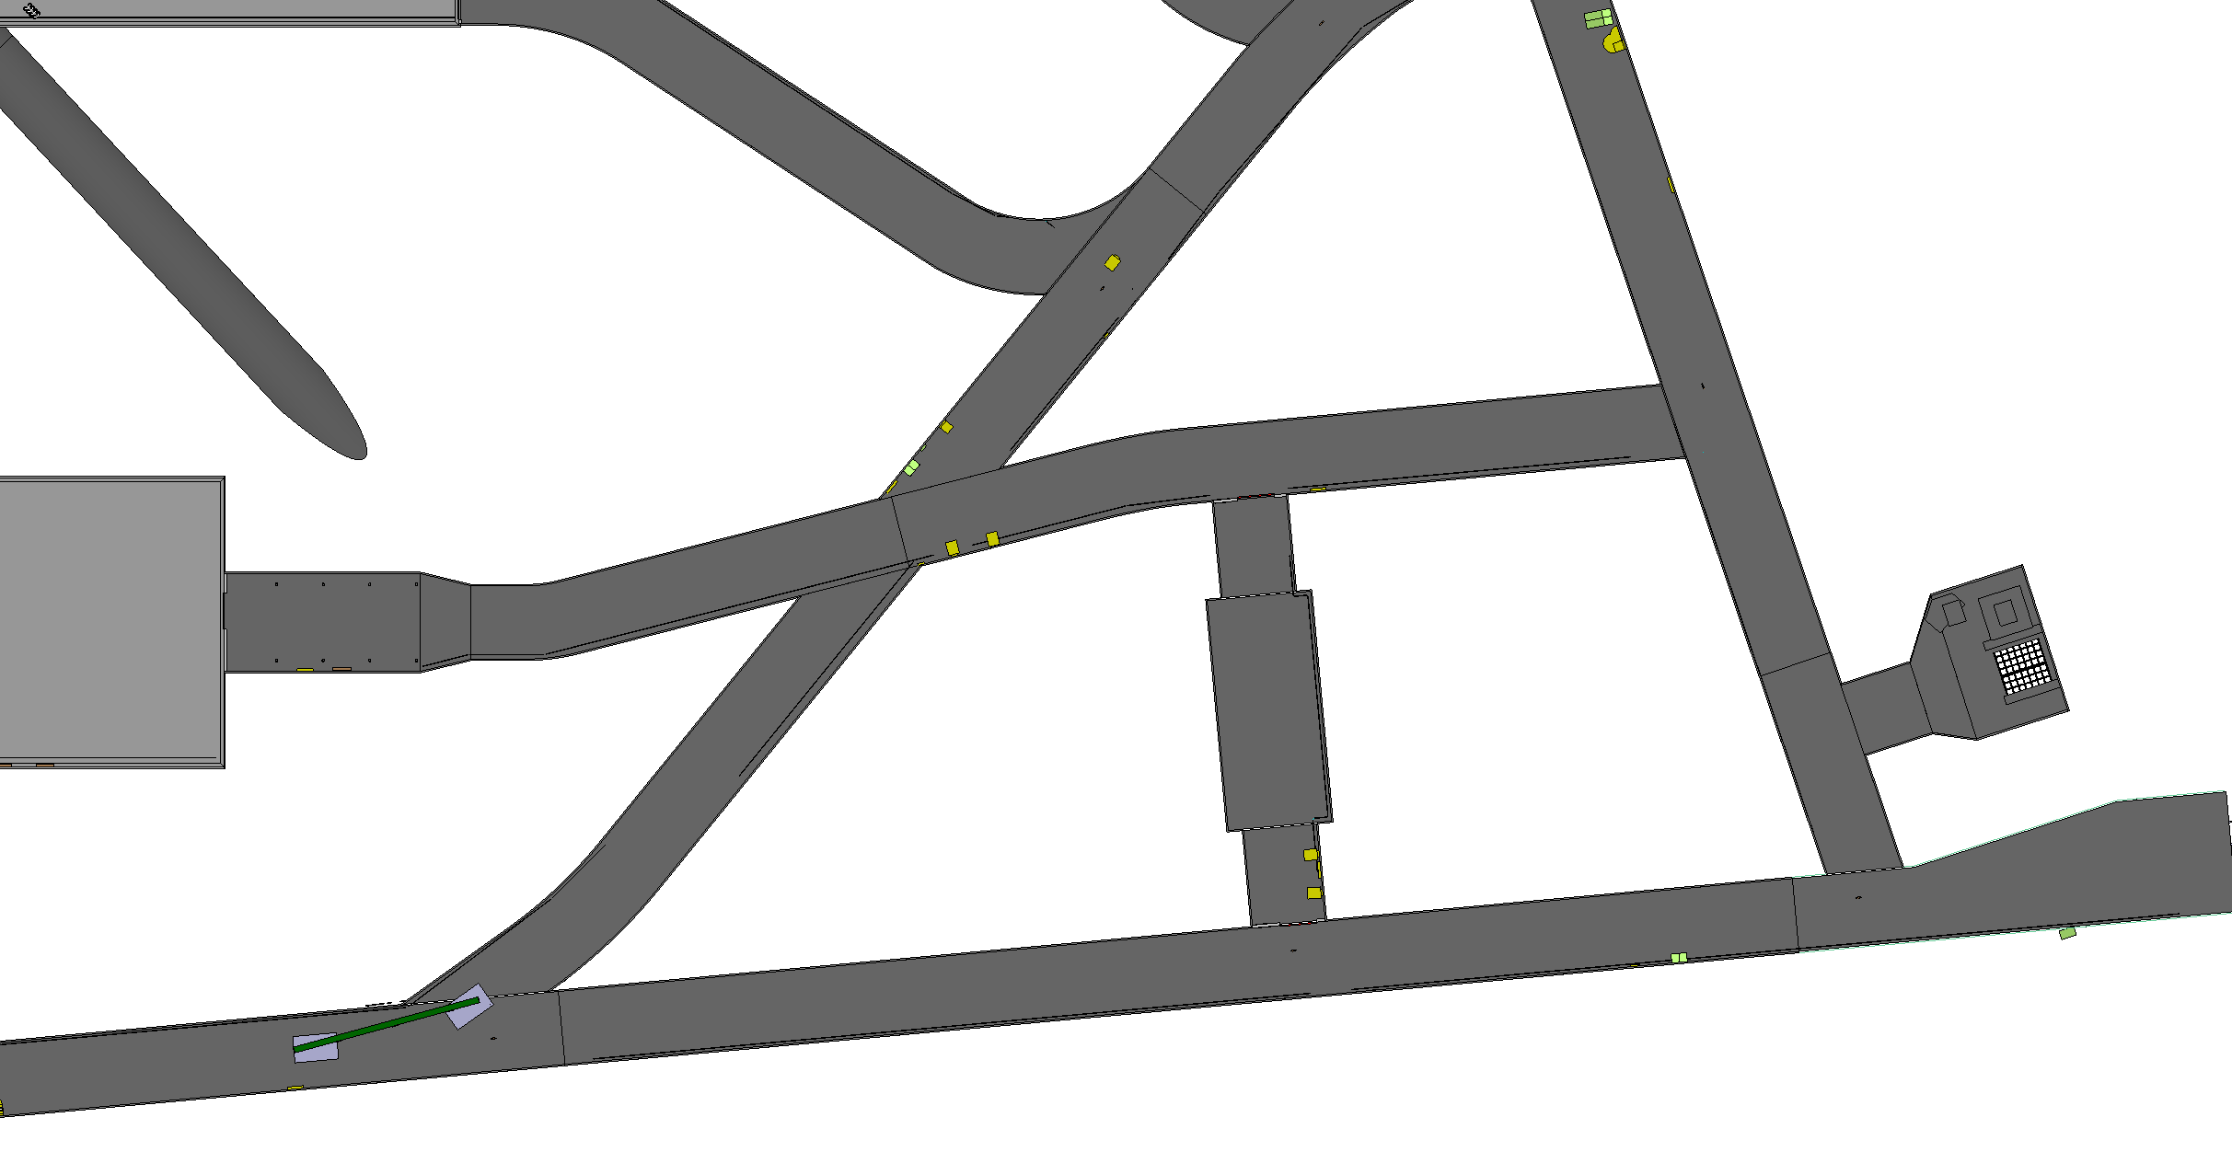
Vertical beam lowering

Slide 23

Vertical beam lowering

Slide 24
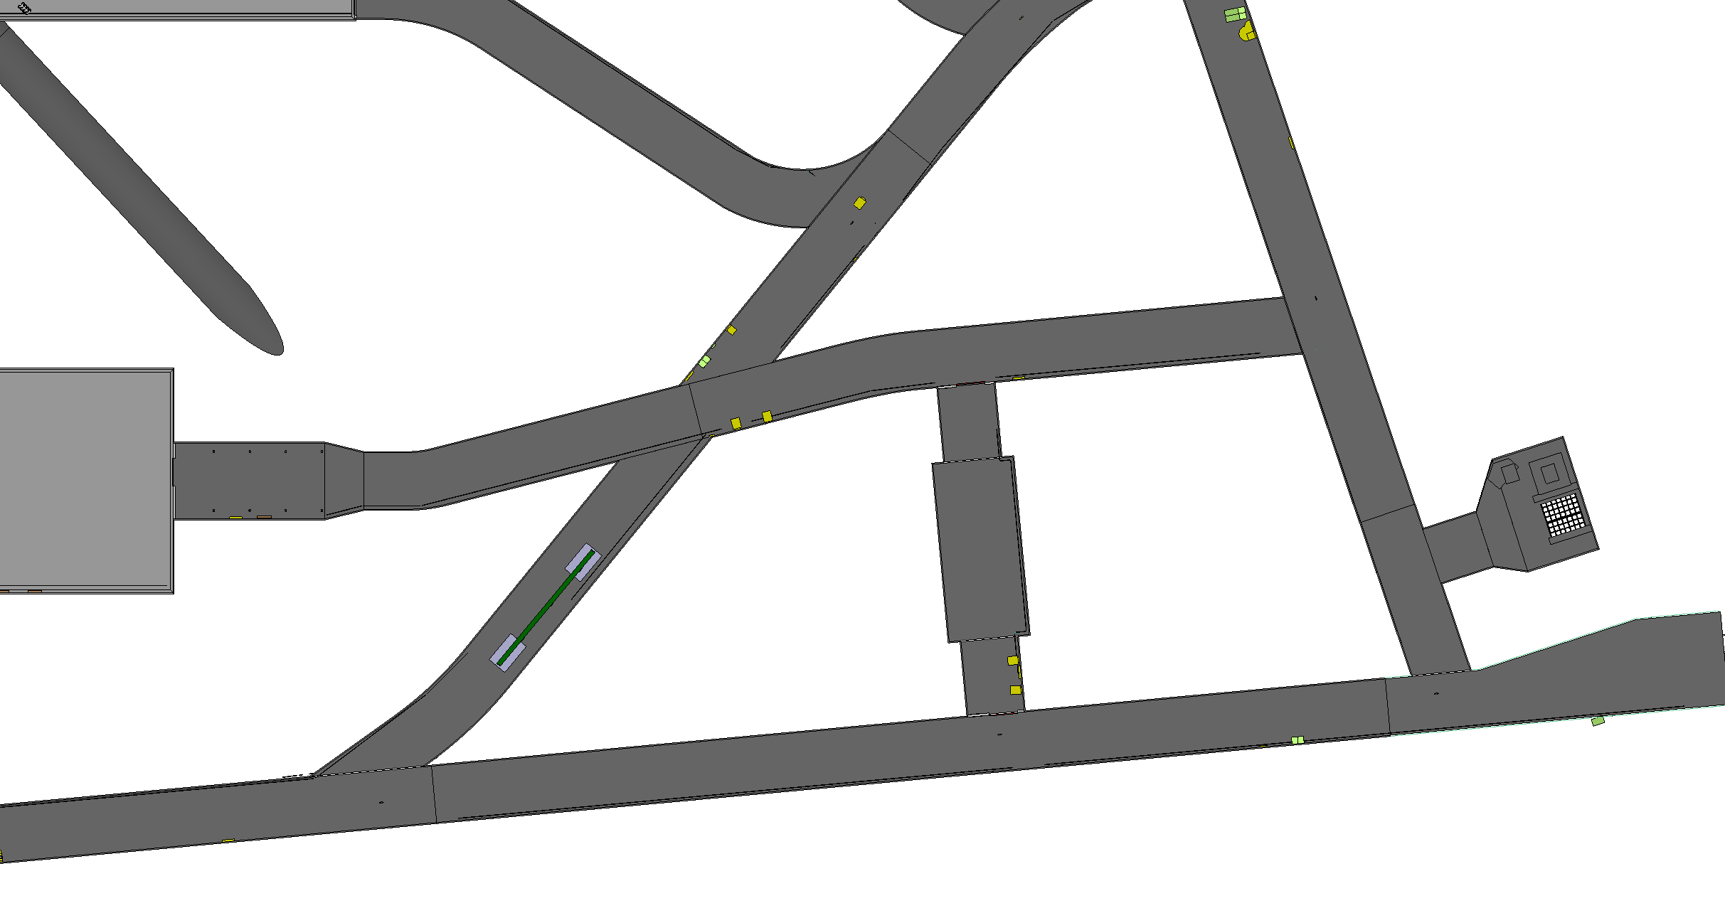
Vertical beam lowering

Slide 25
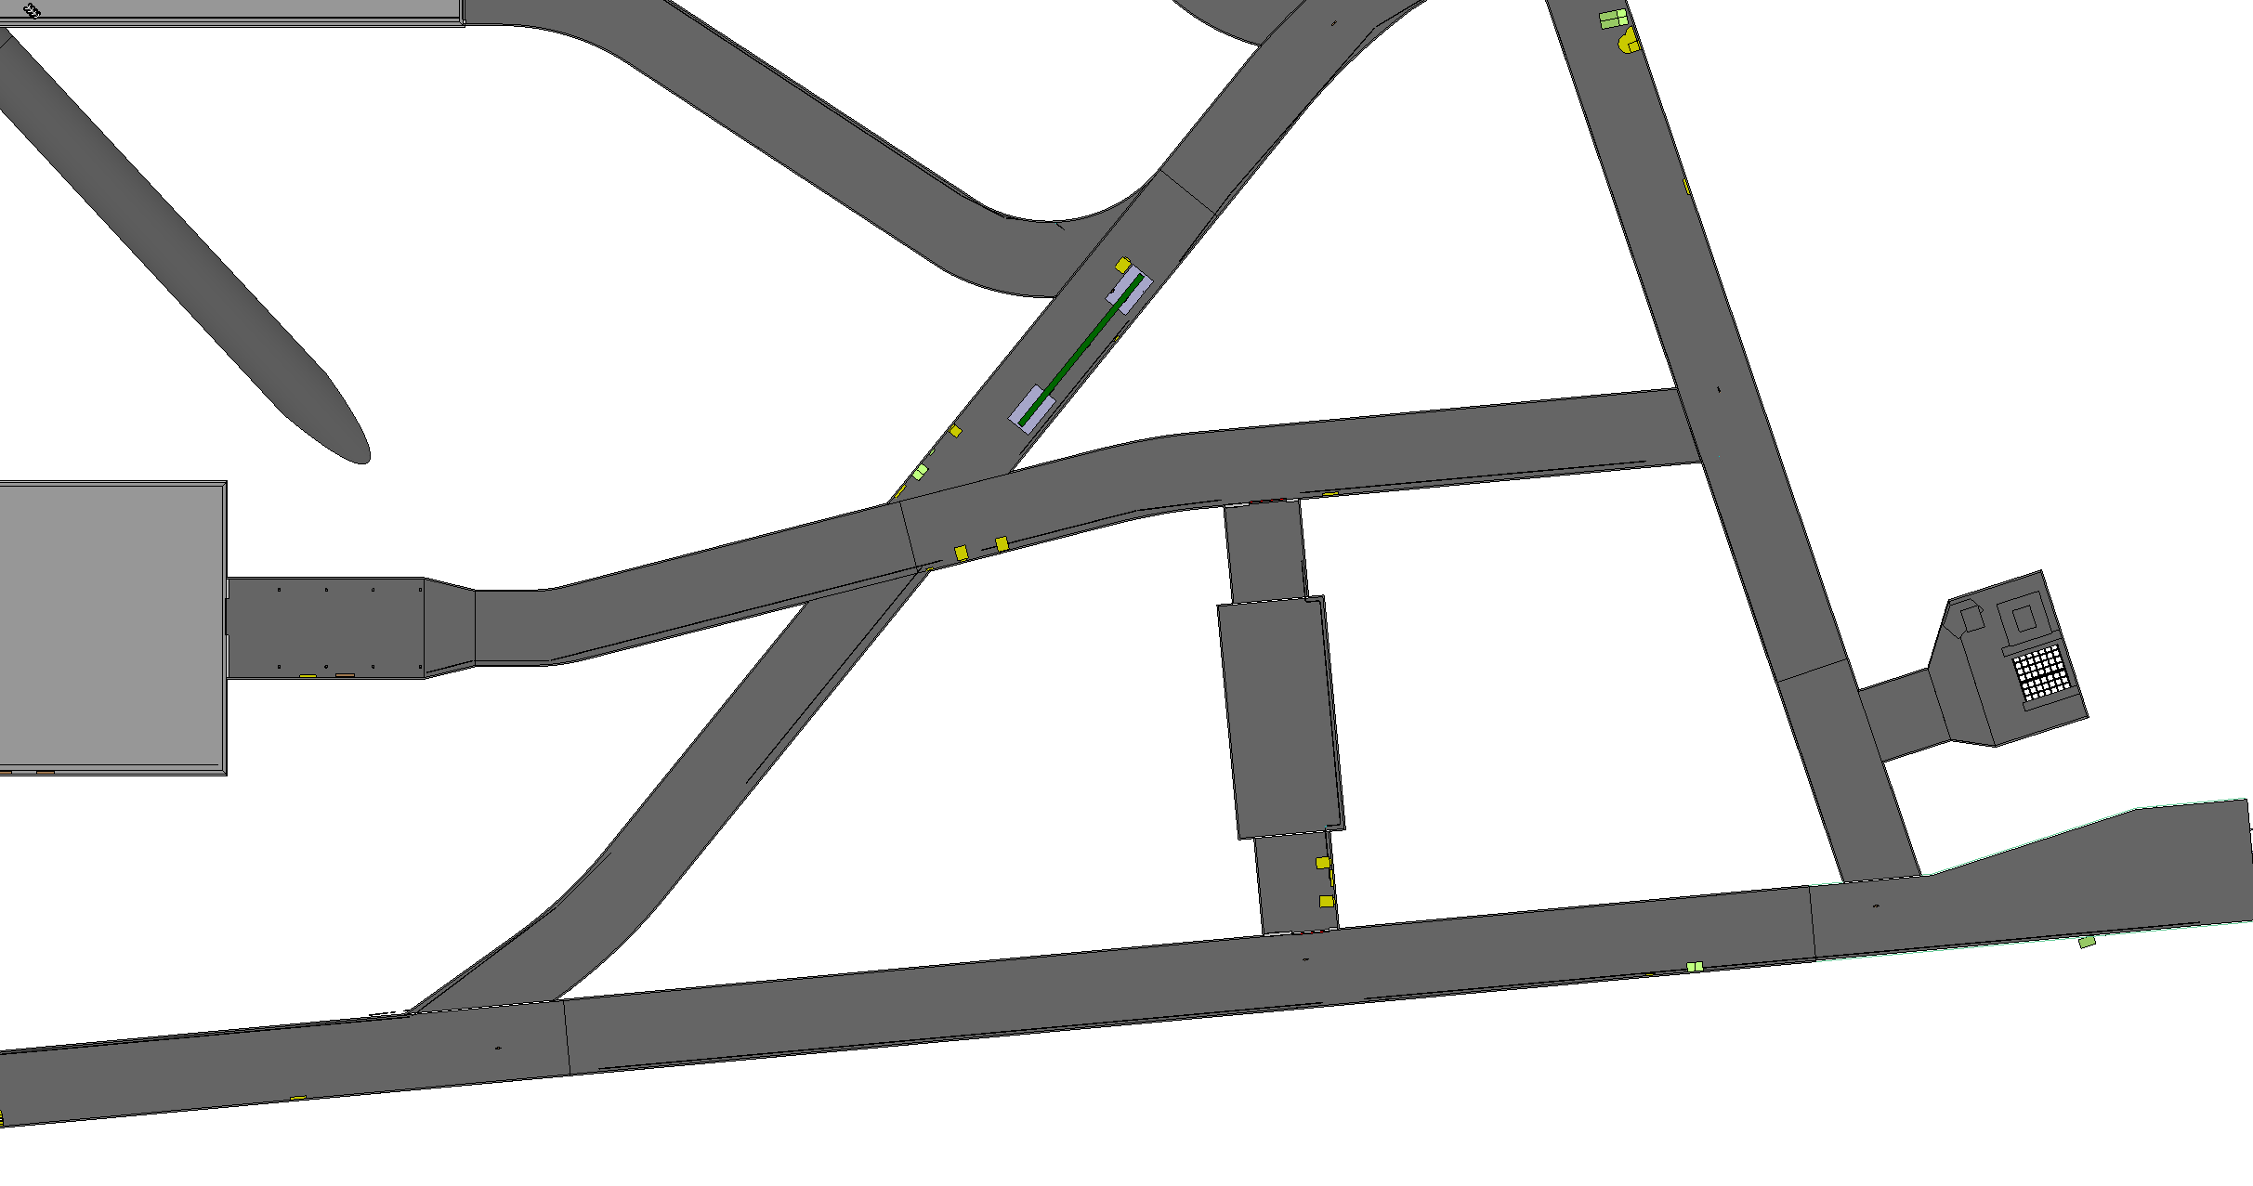
Vertical beam lowering

Slide 26
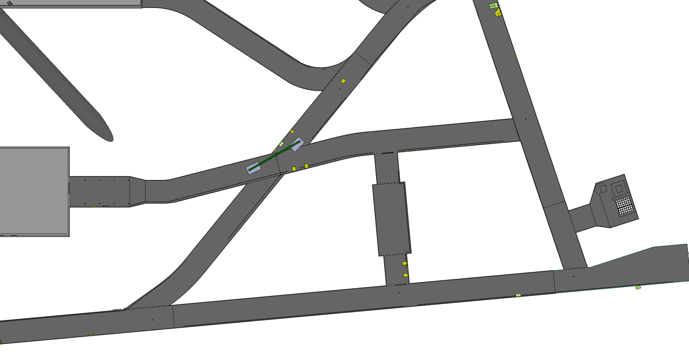
Vertical beam lowering

Slide 27
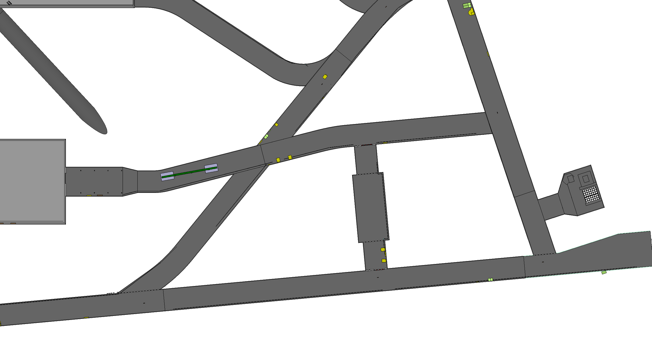
Vertical beam lowering

Slide 28
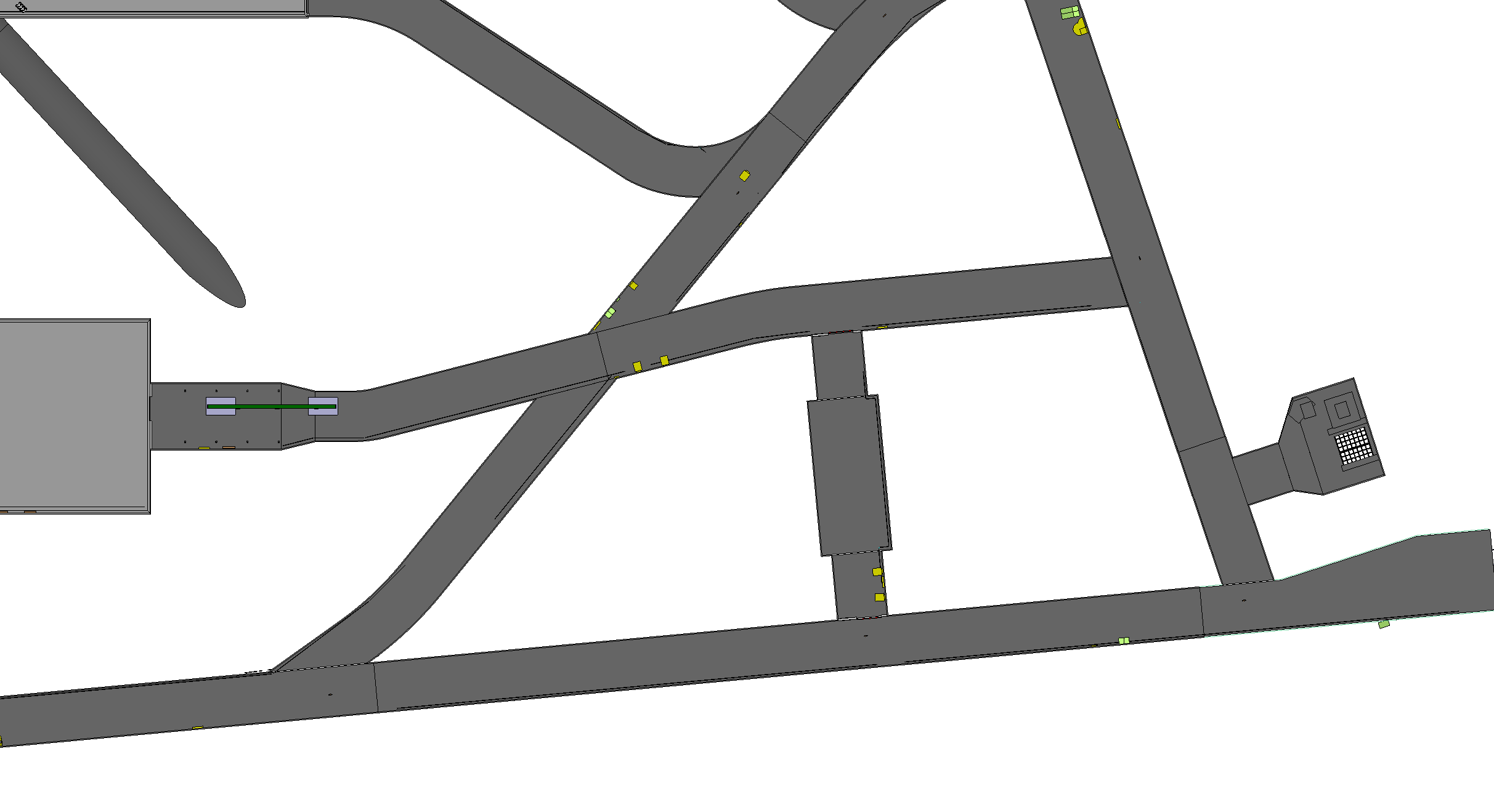
Vertical beam lowering

Slide 30
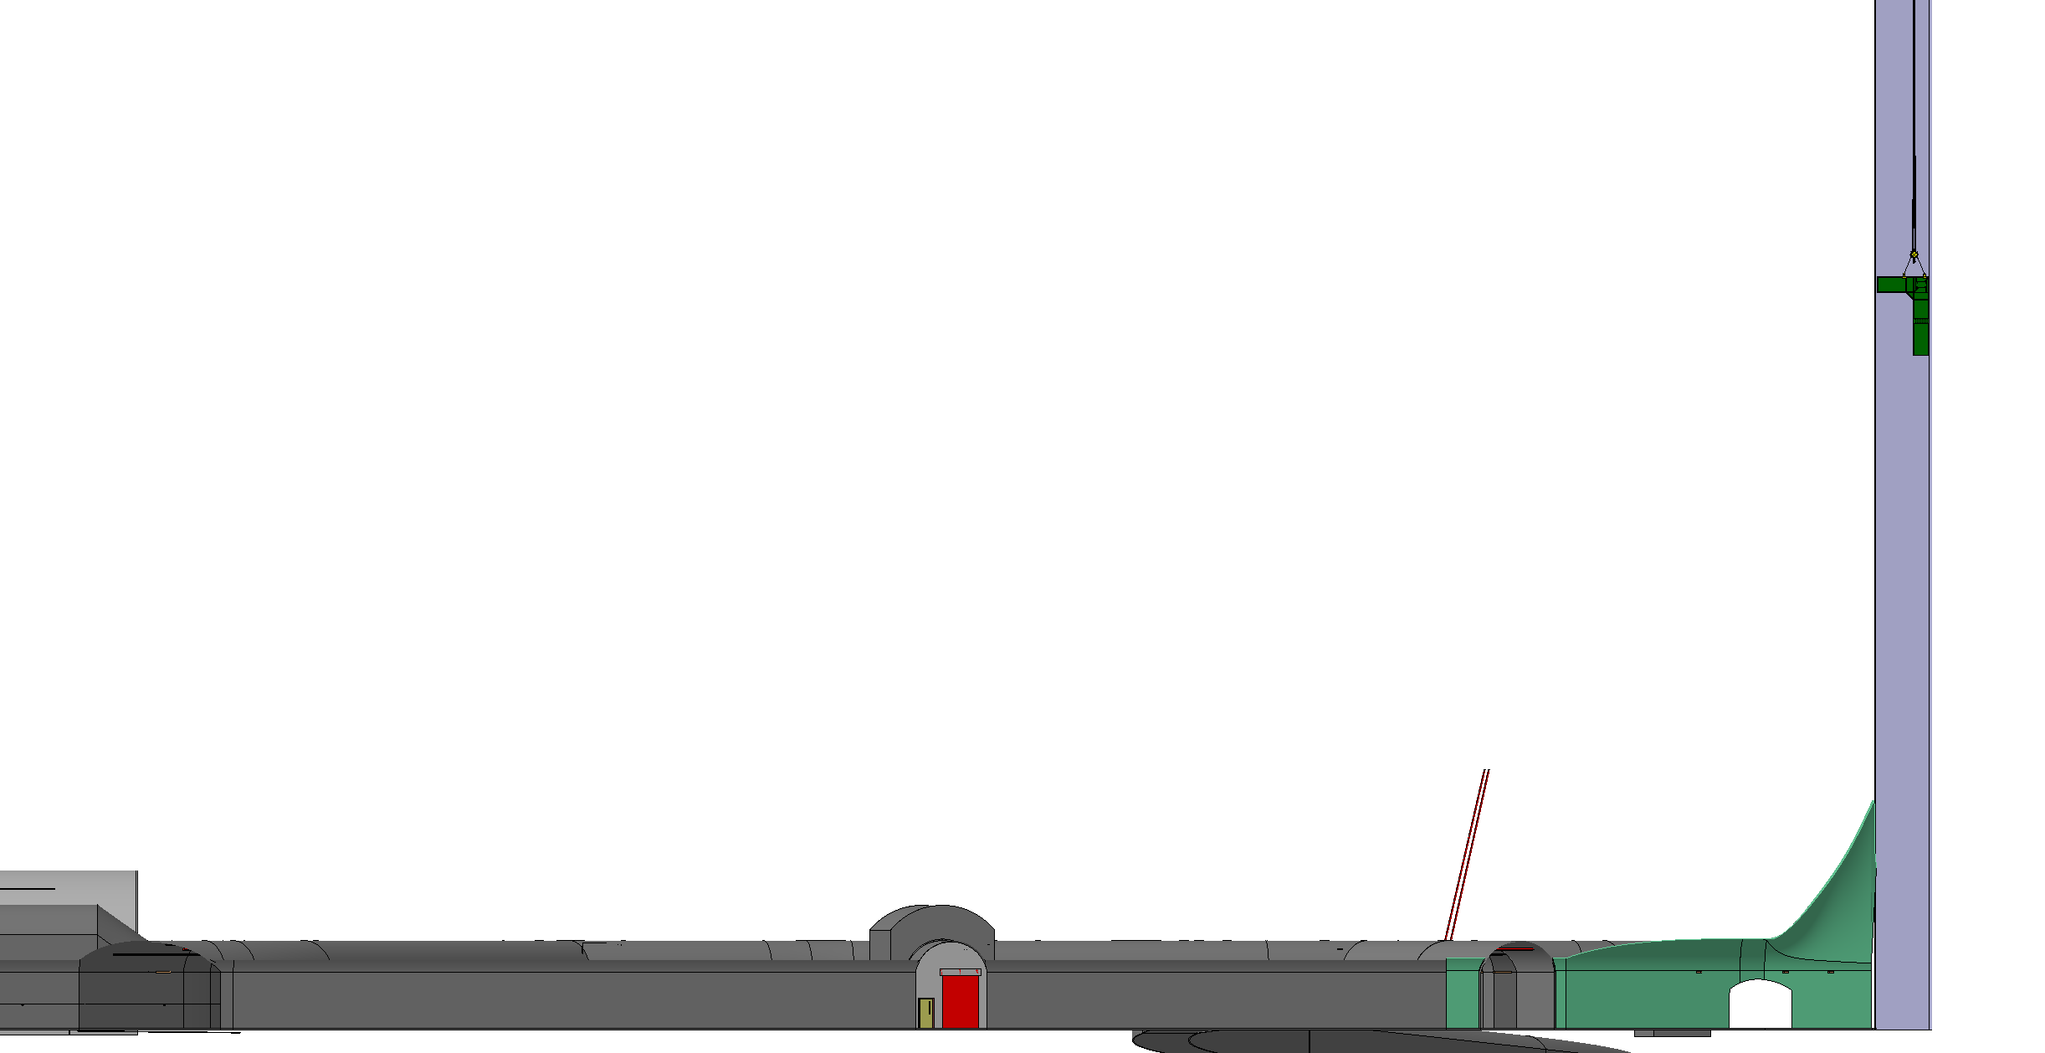
Corner beam lowering
5.5t and 5.6m x 3.6m
Weight: 5.5t
Length: 5.6m
Width: 3.6m

Slide 31
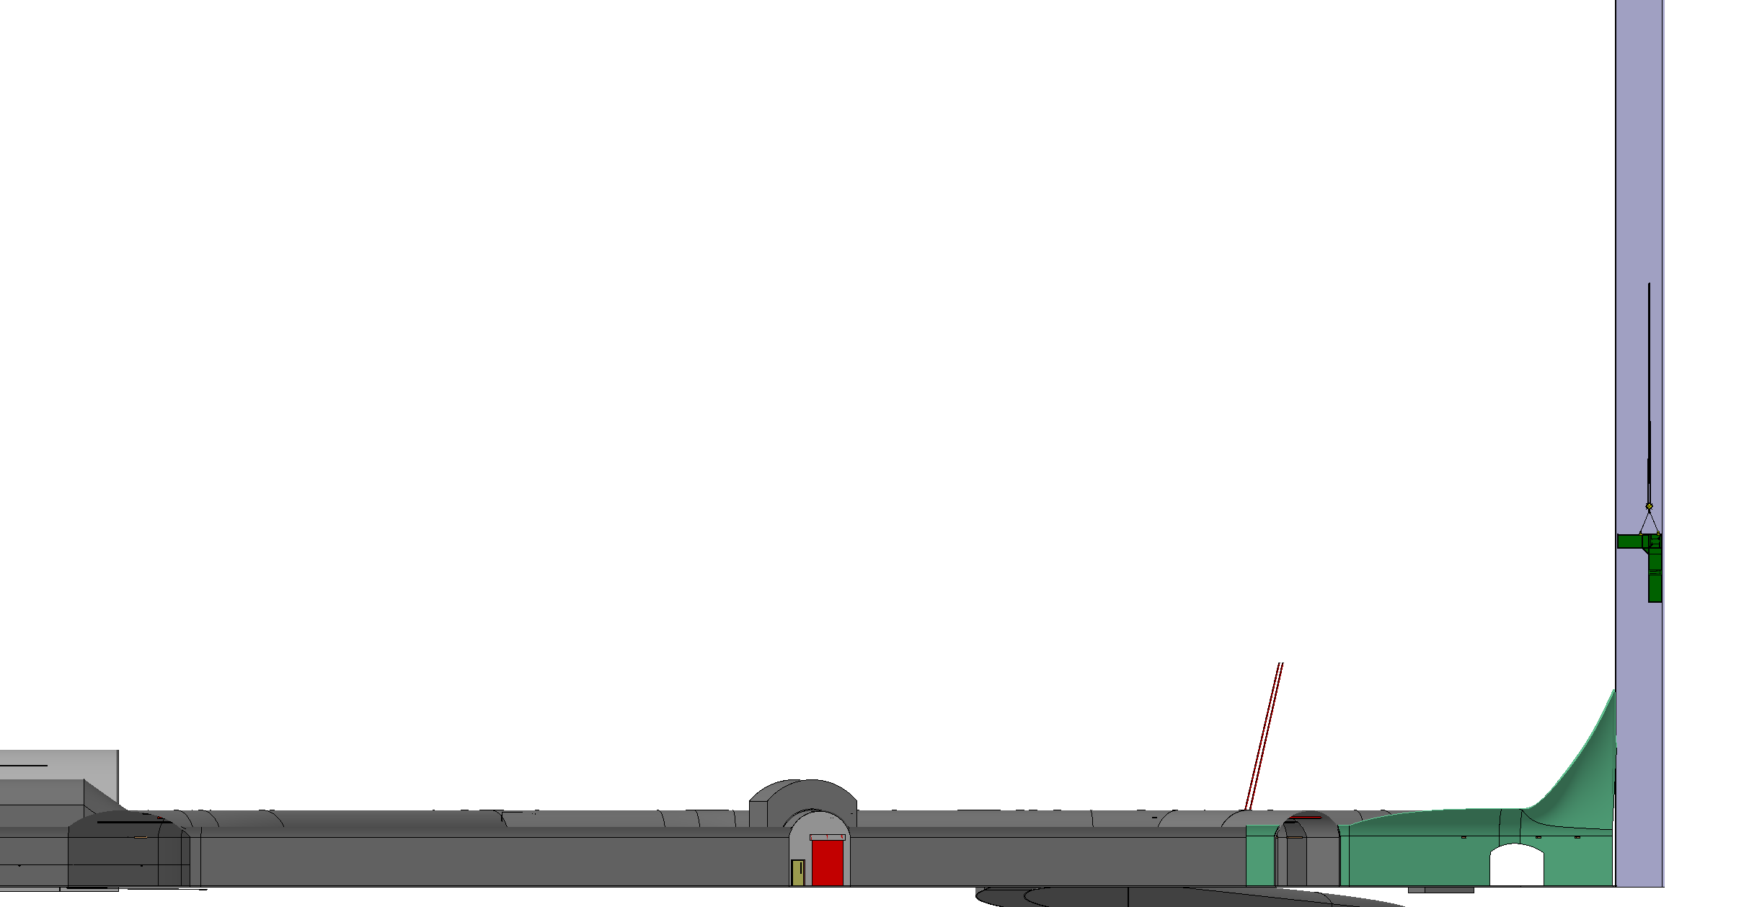
Corner beam lowering

Slide 32
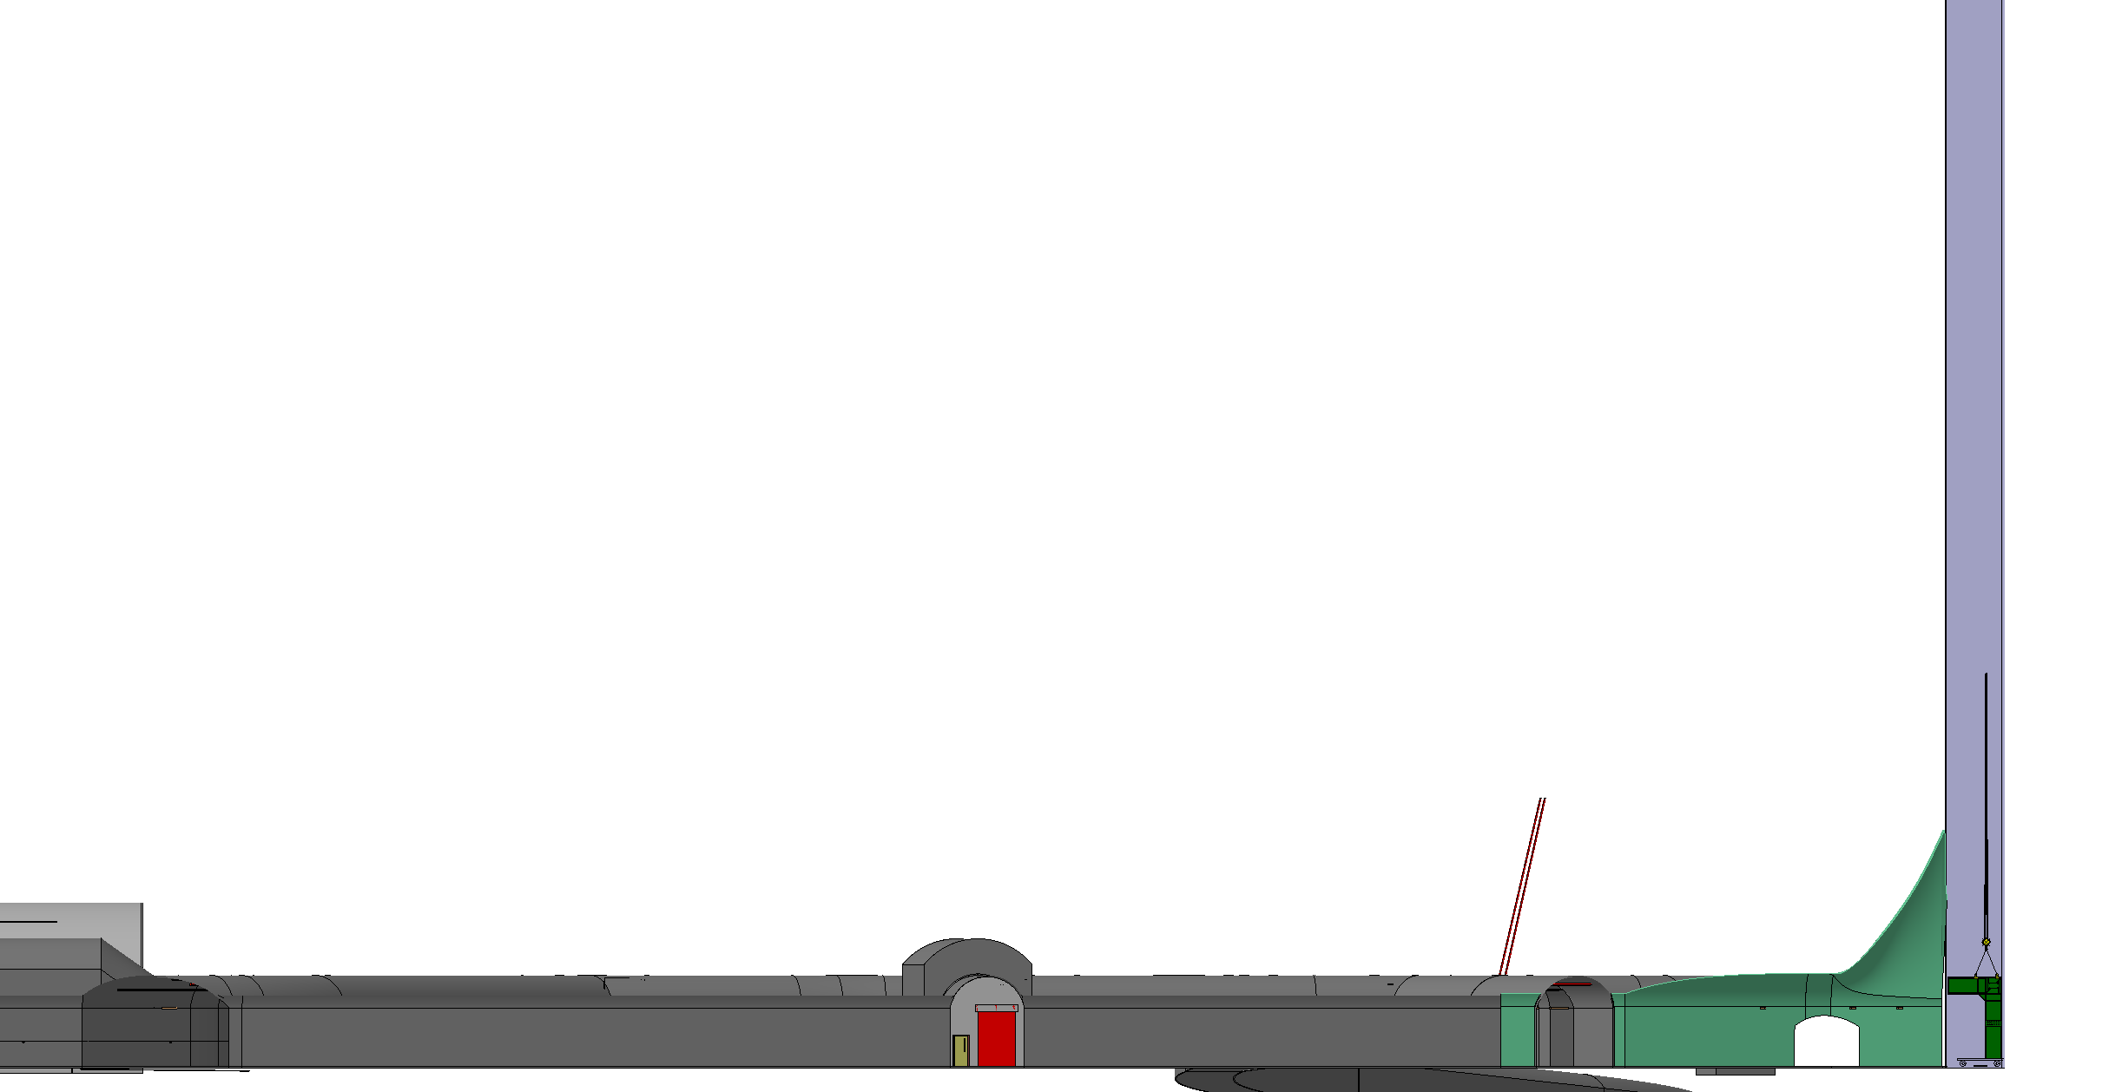
Corner beam lowering

Slide 33
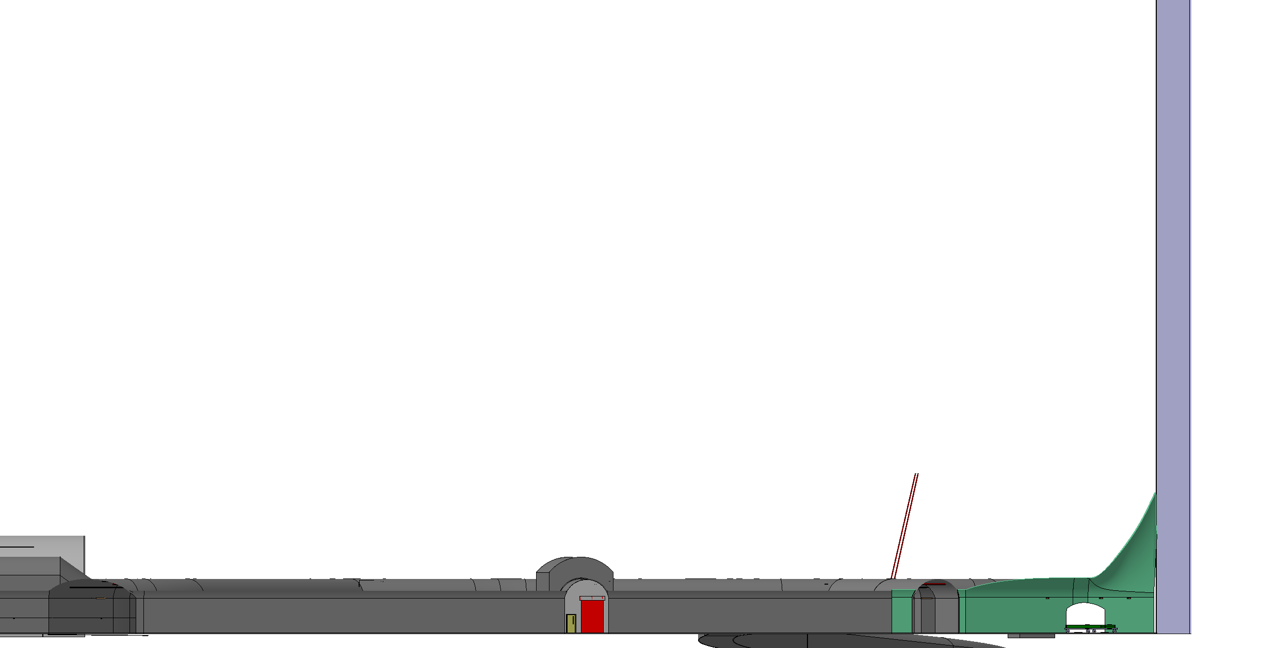
Corner beam lowering

Slide 34
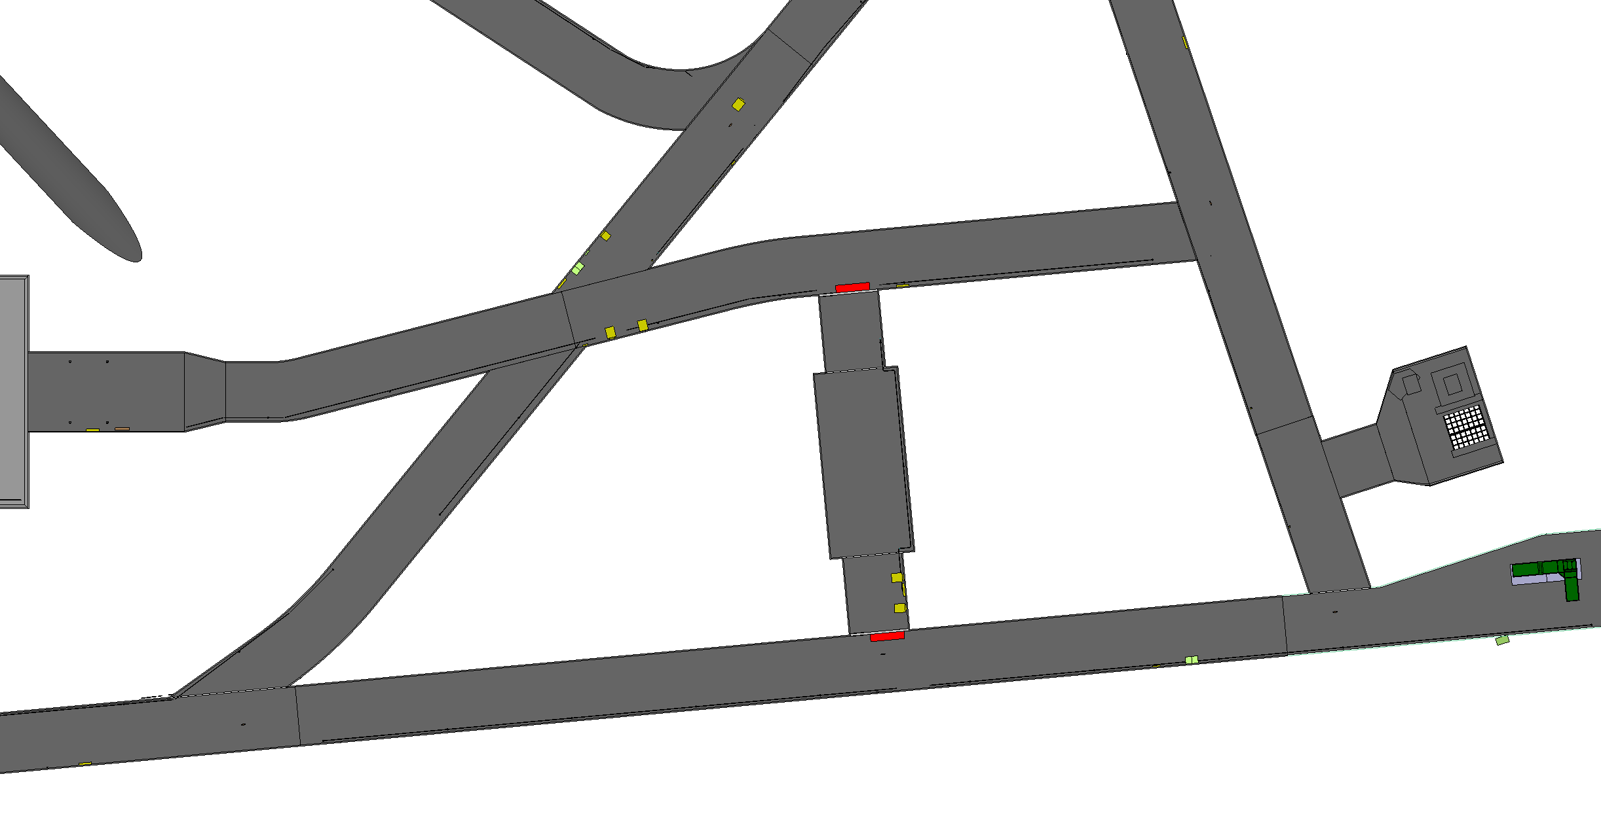
Corner beam lowering

Slide 35
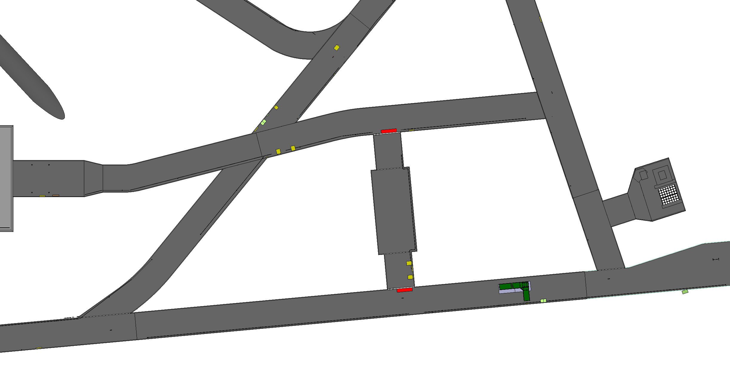
Corner beam lowering

Slide 36
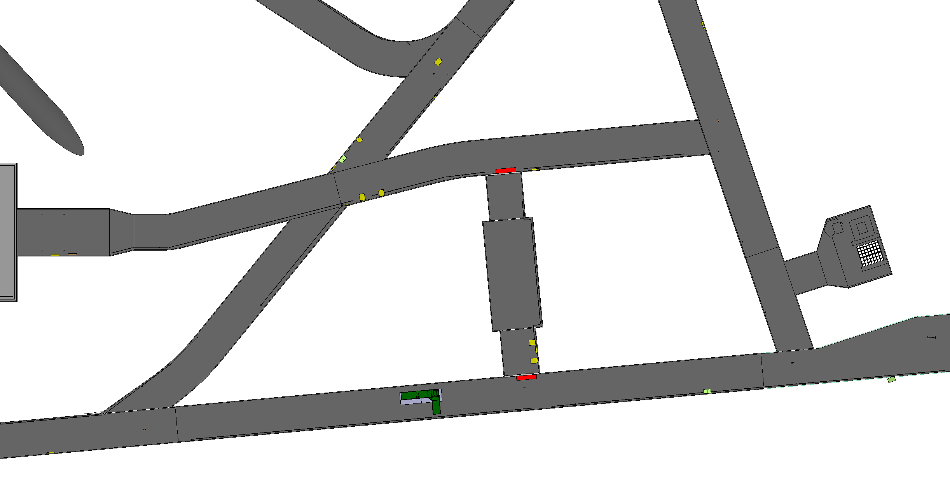
Corner beam lowering

Slide 37
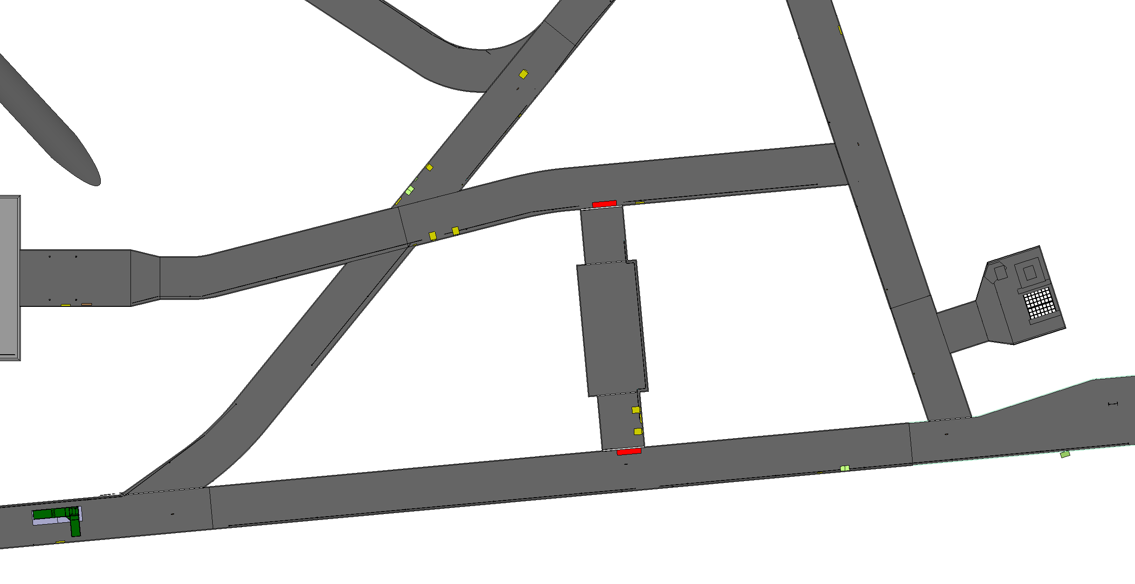
Corner beam lowering

Slide 38
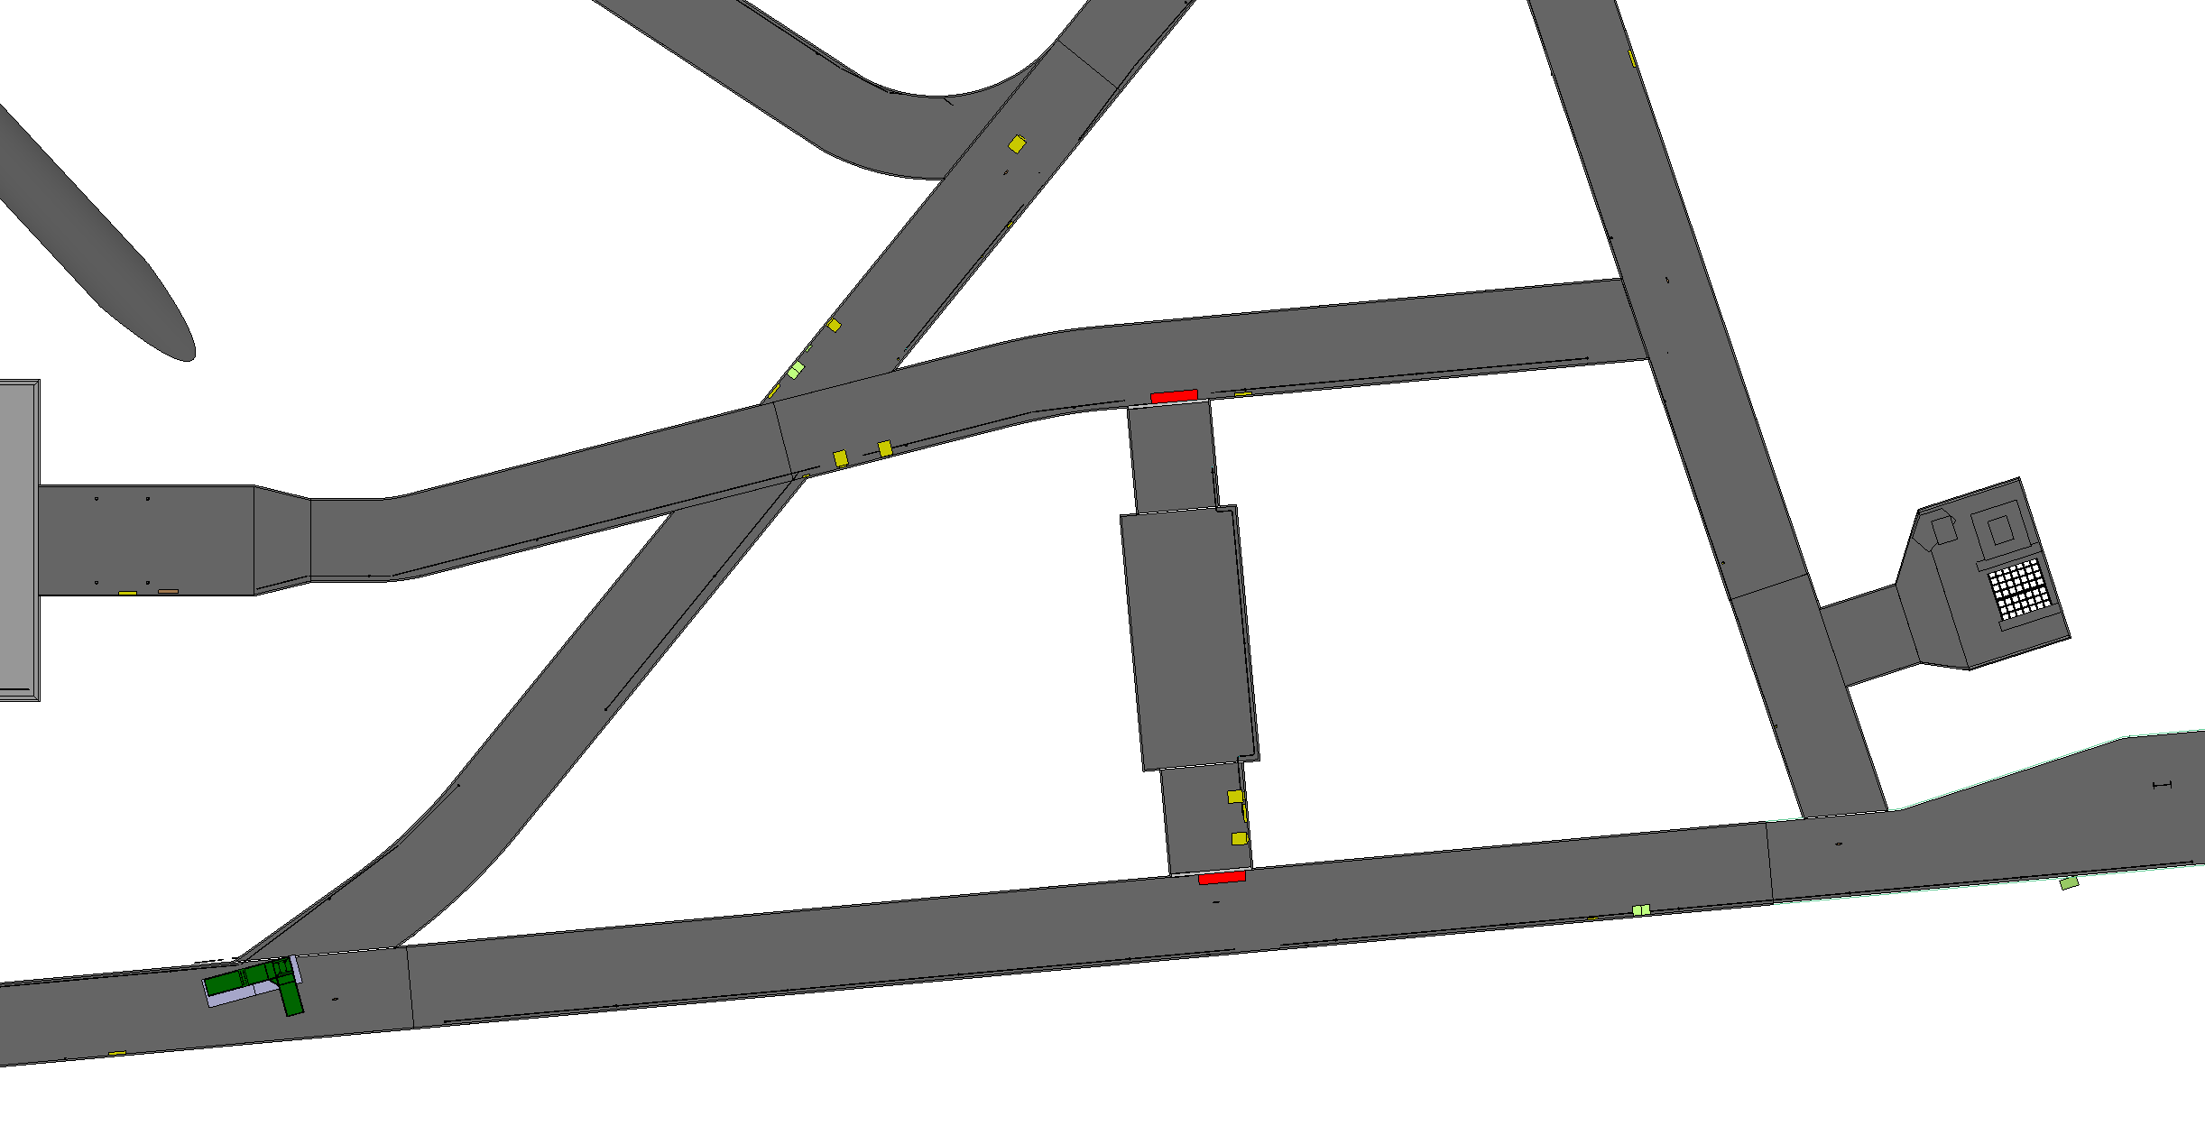
Corner beam lowering

Slide 39
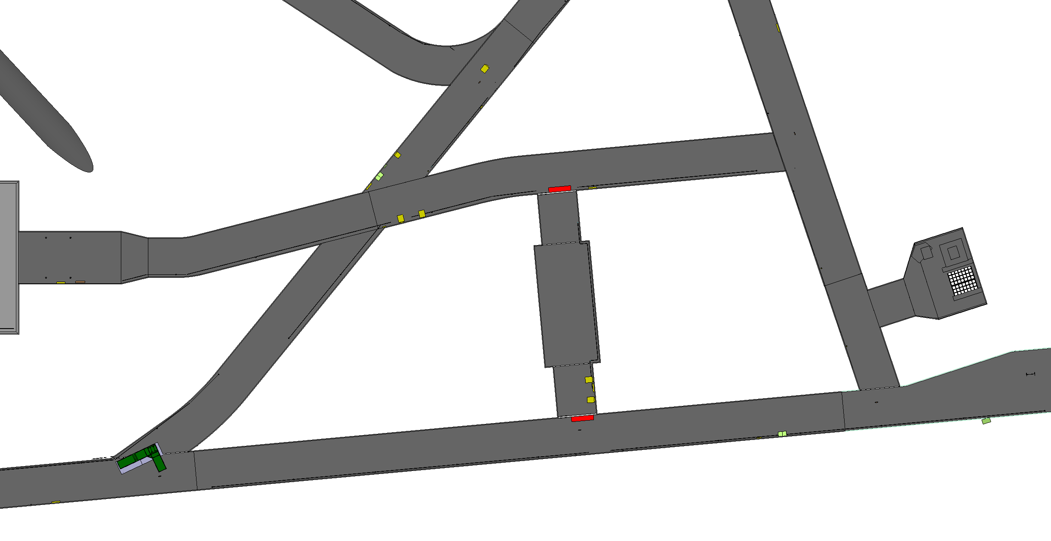
Corner beam lowering

Slide 40
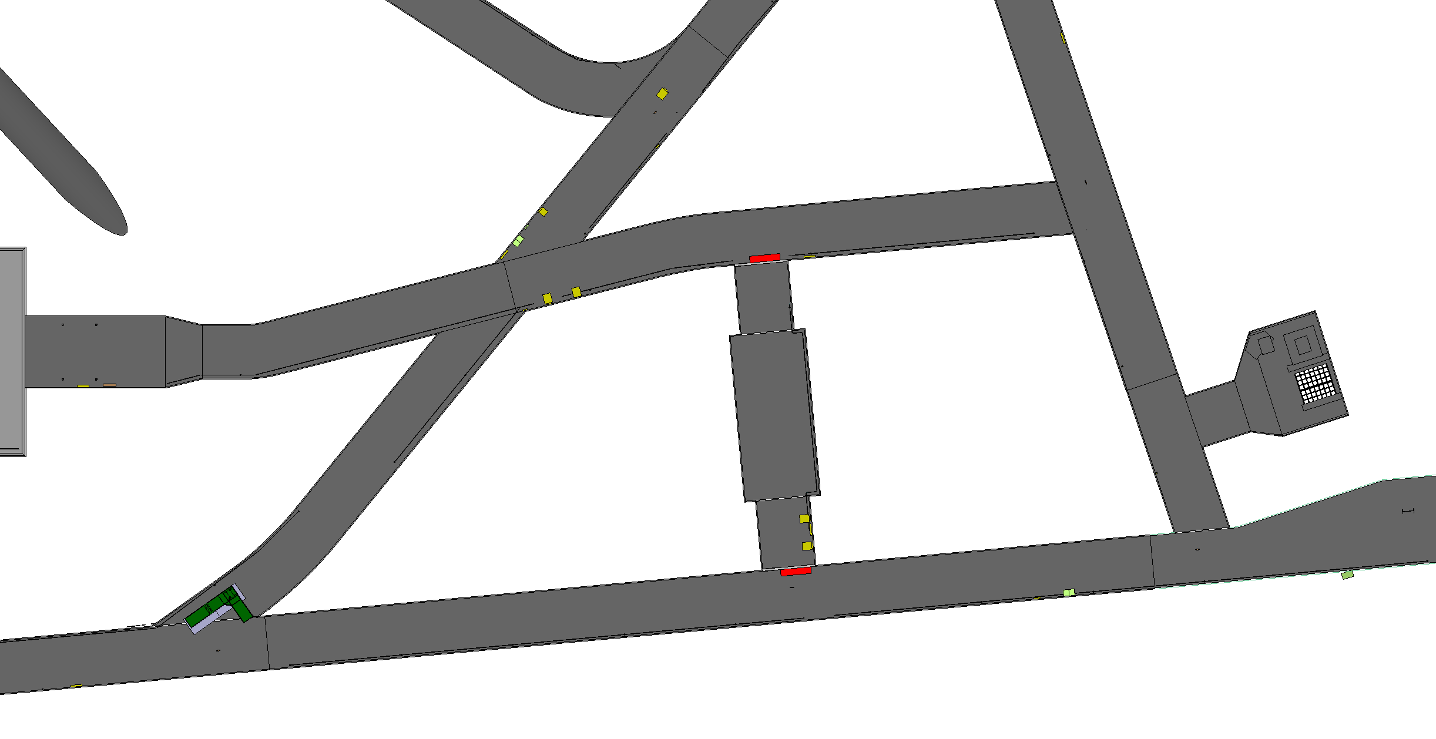
Corner beam lowering

Slide 41
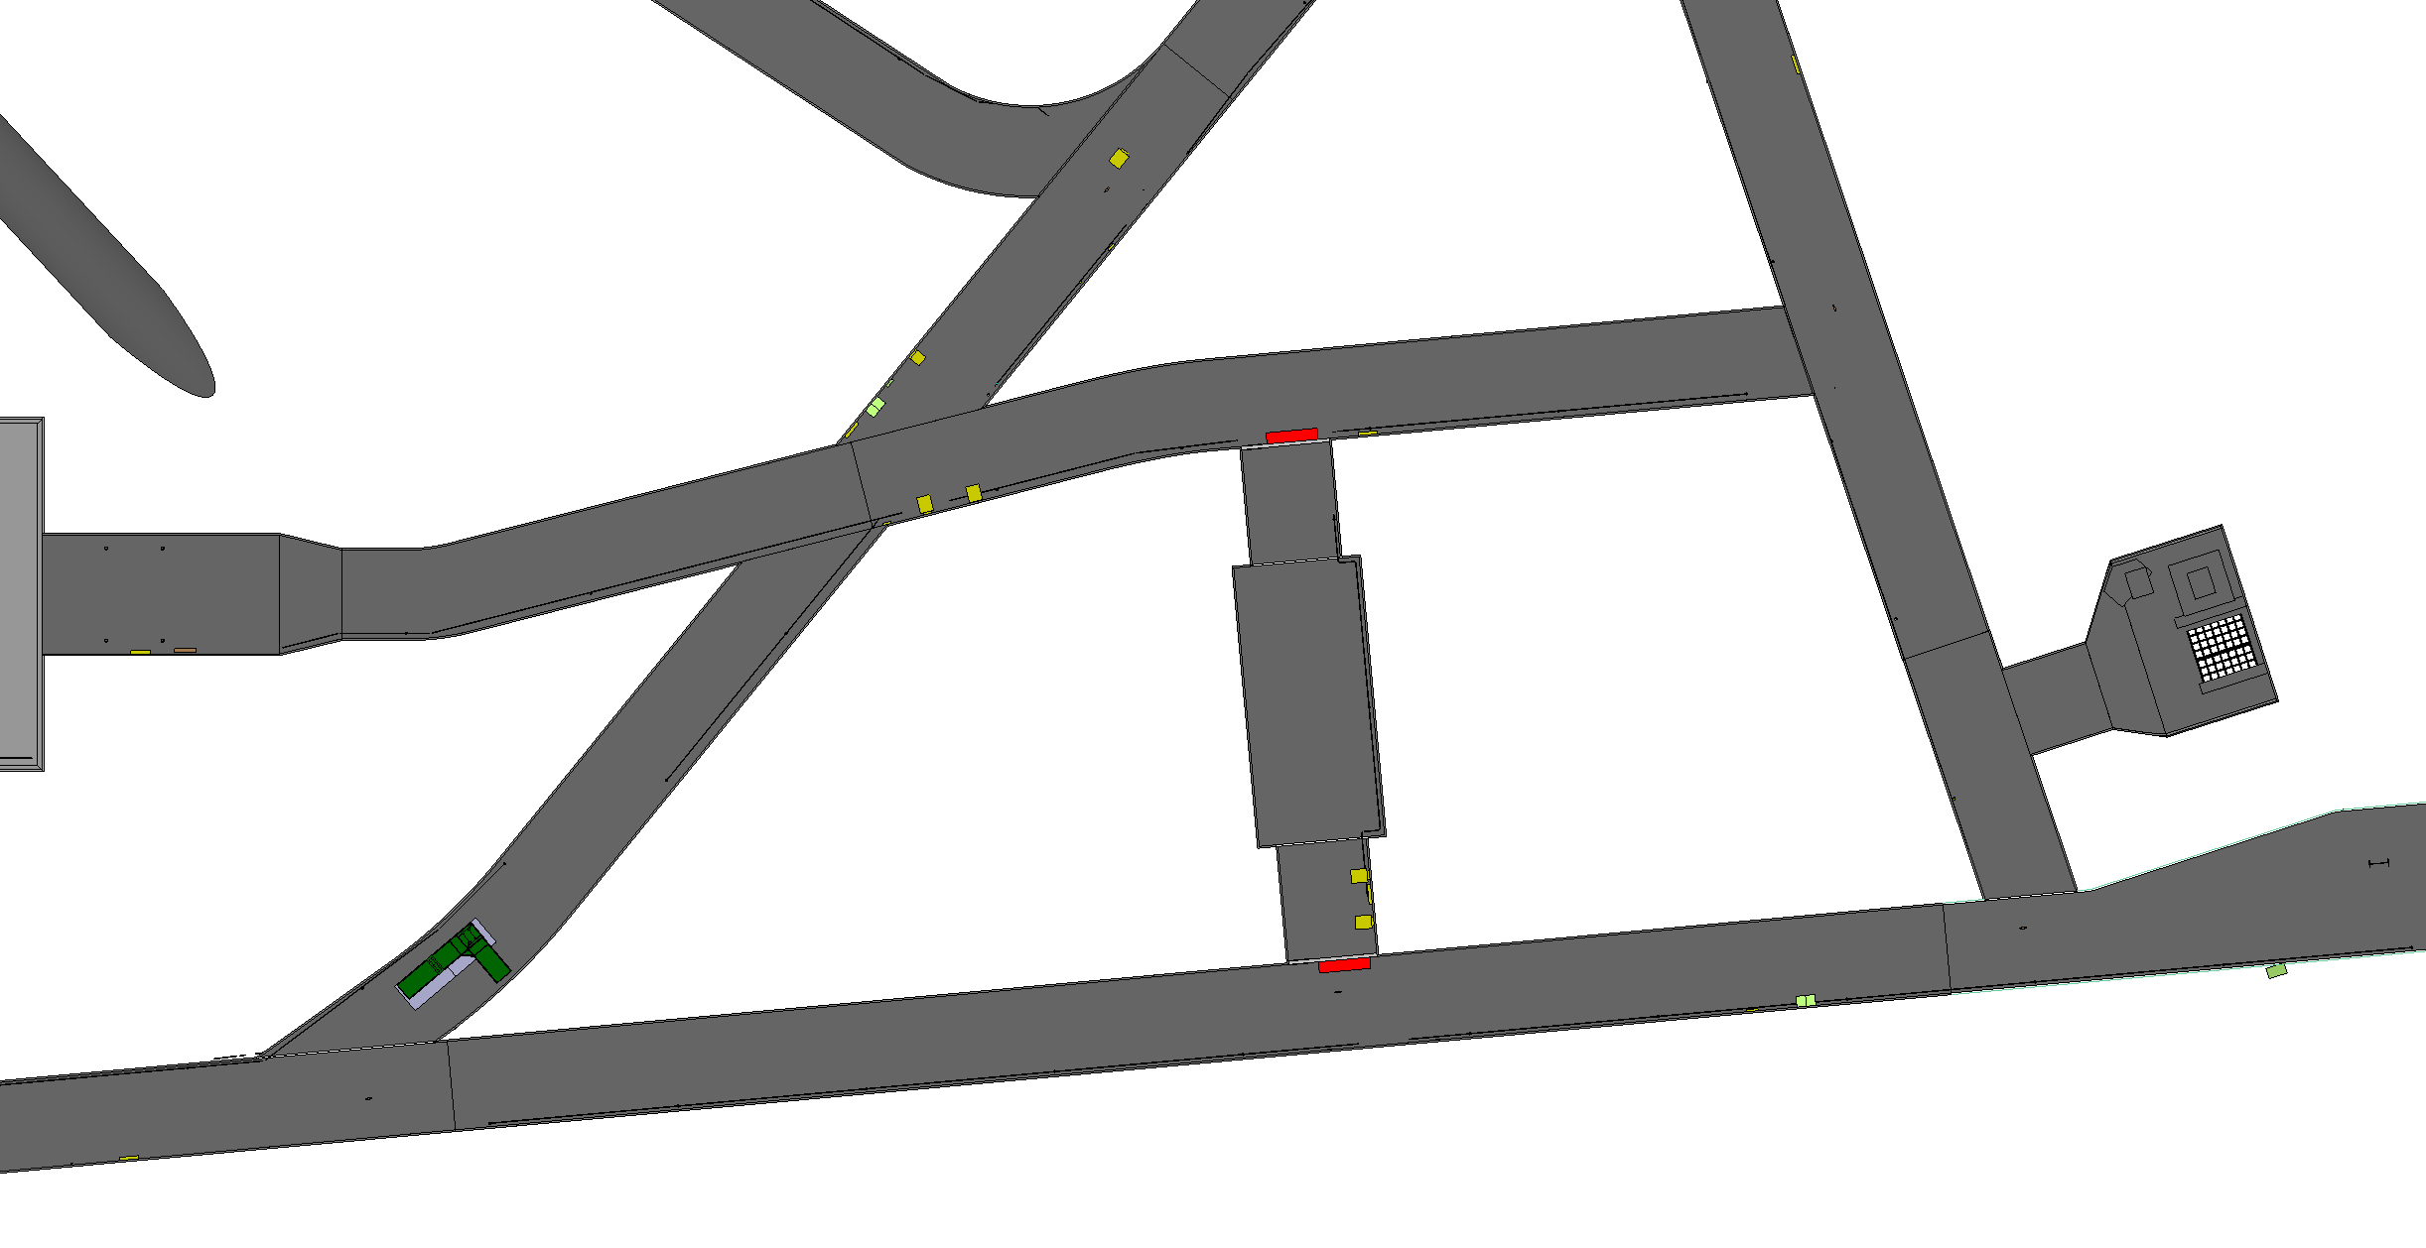
Corner beam lowering

Slide 42
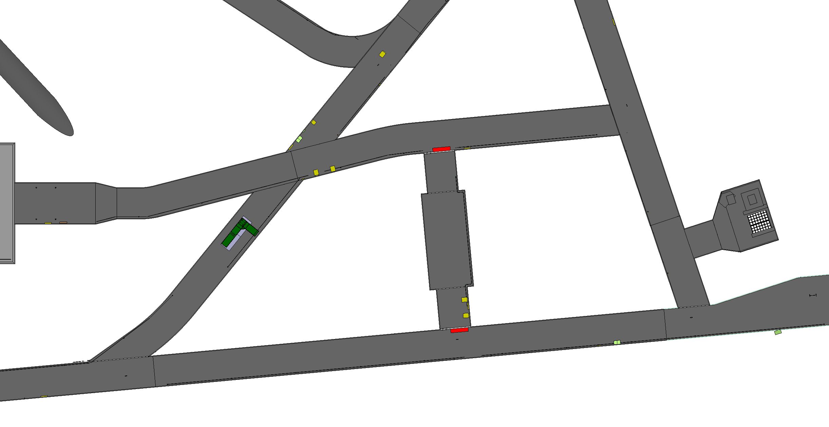
Corner beam lowering

Slide 43
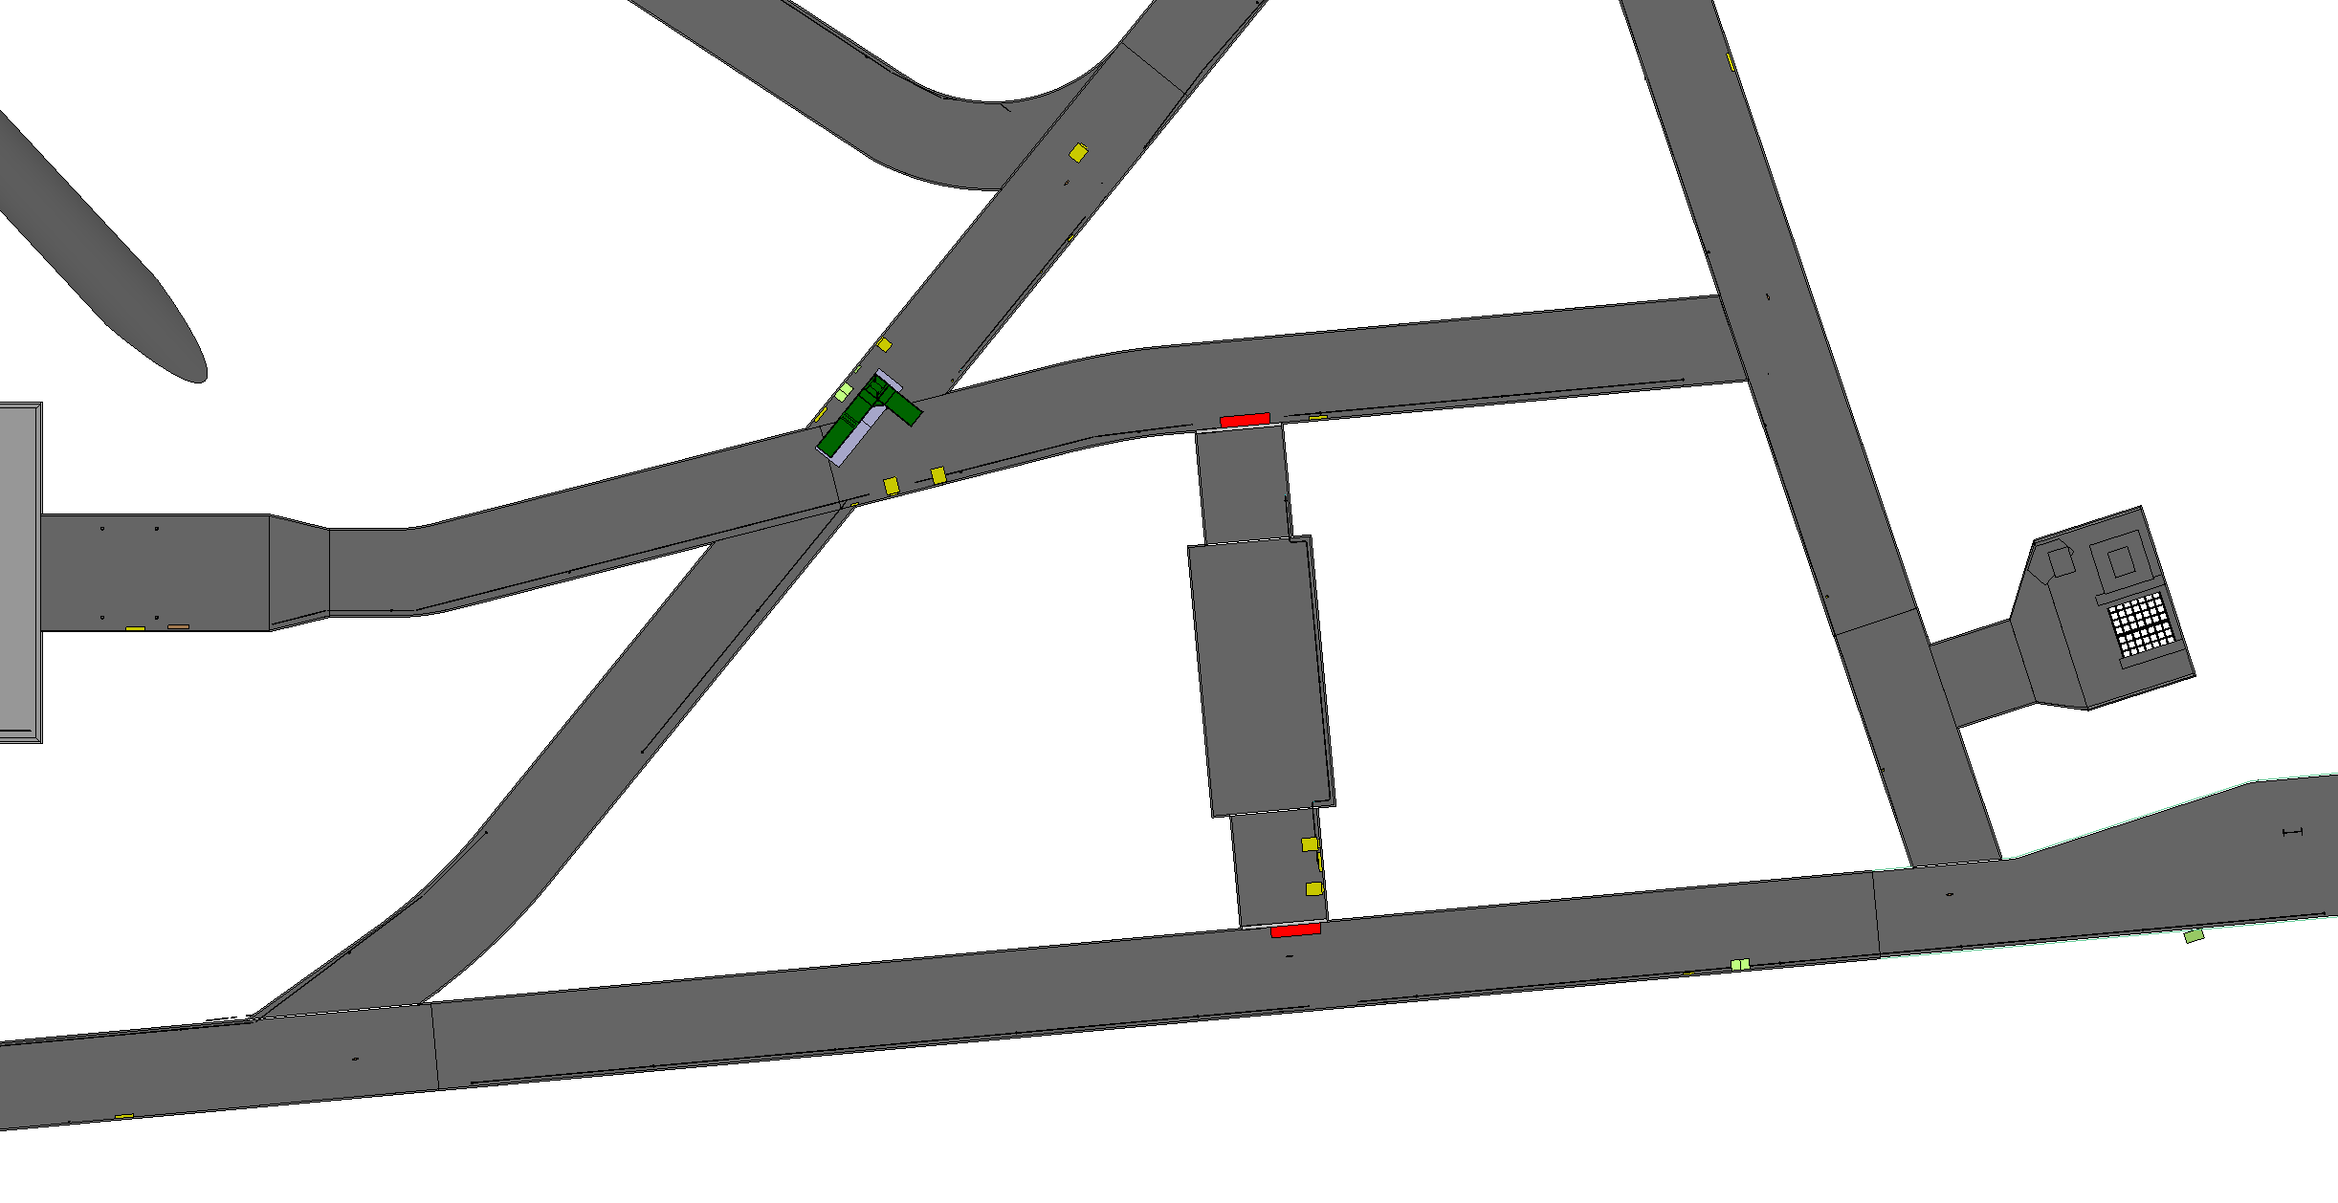
Corner beam lowering

Slide 44

Corner beam lowering

Slide 45

Corner beam lowering

Slide 46
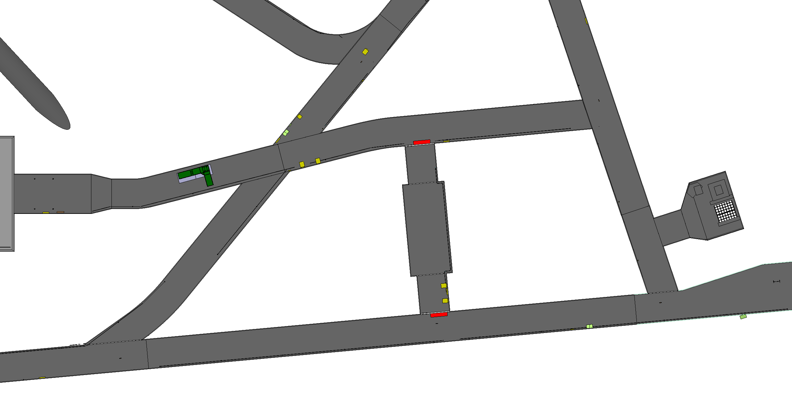
Corner beam lowering

Slide 47
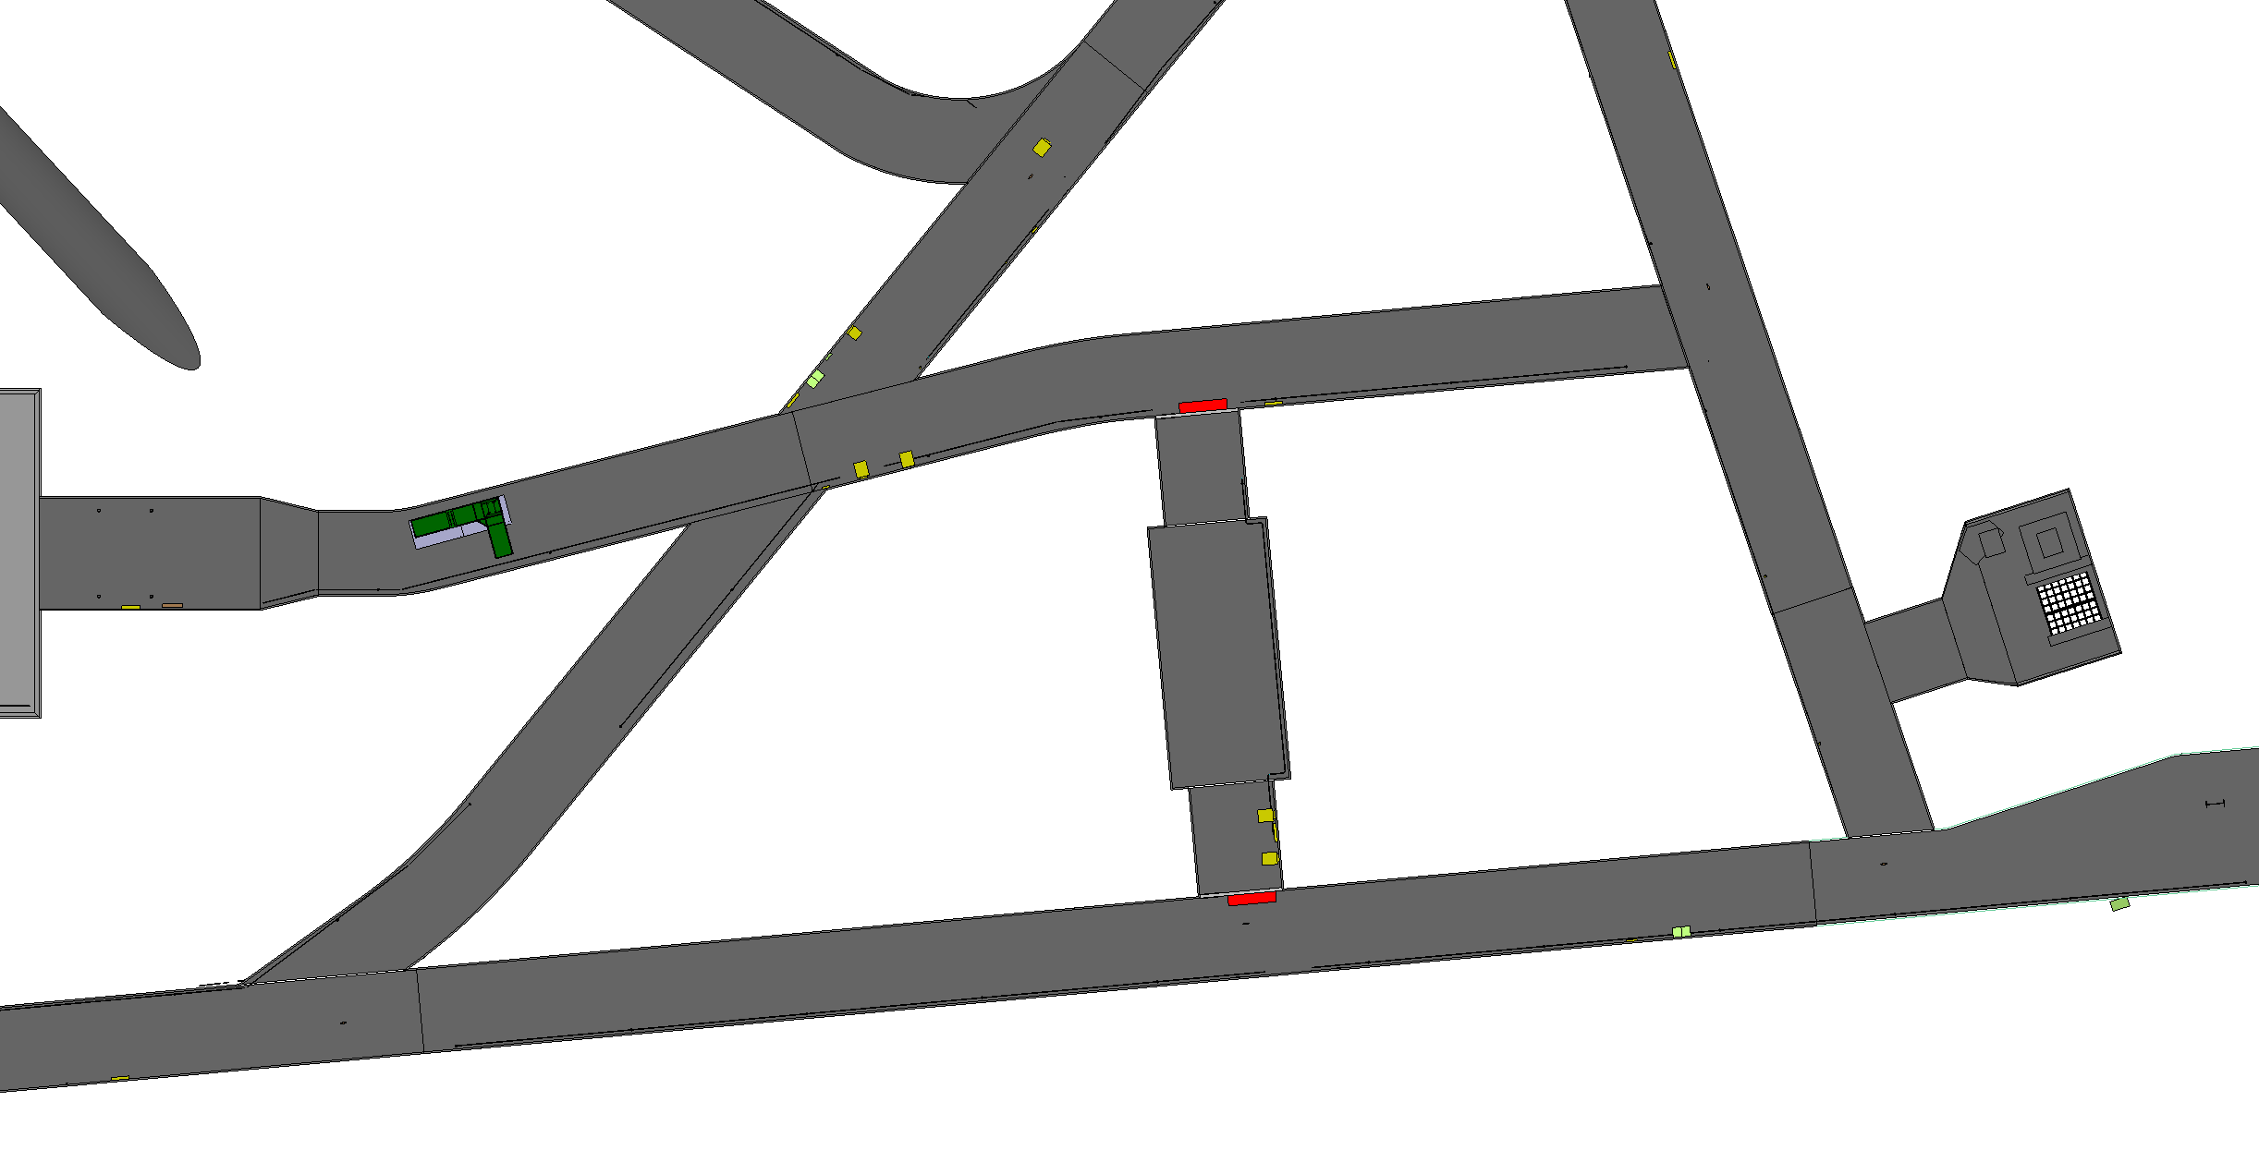
Corner beam lowering

Slide 48

Corner beam lowering

Slide 49
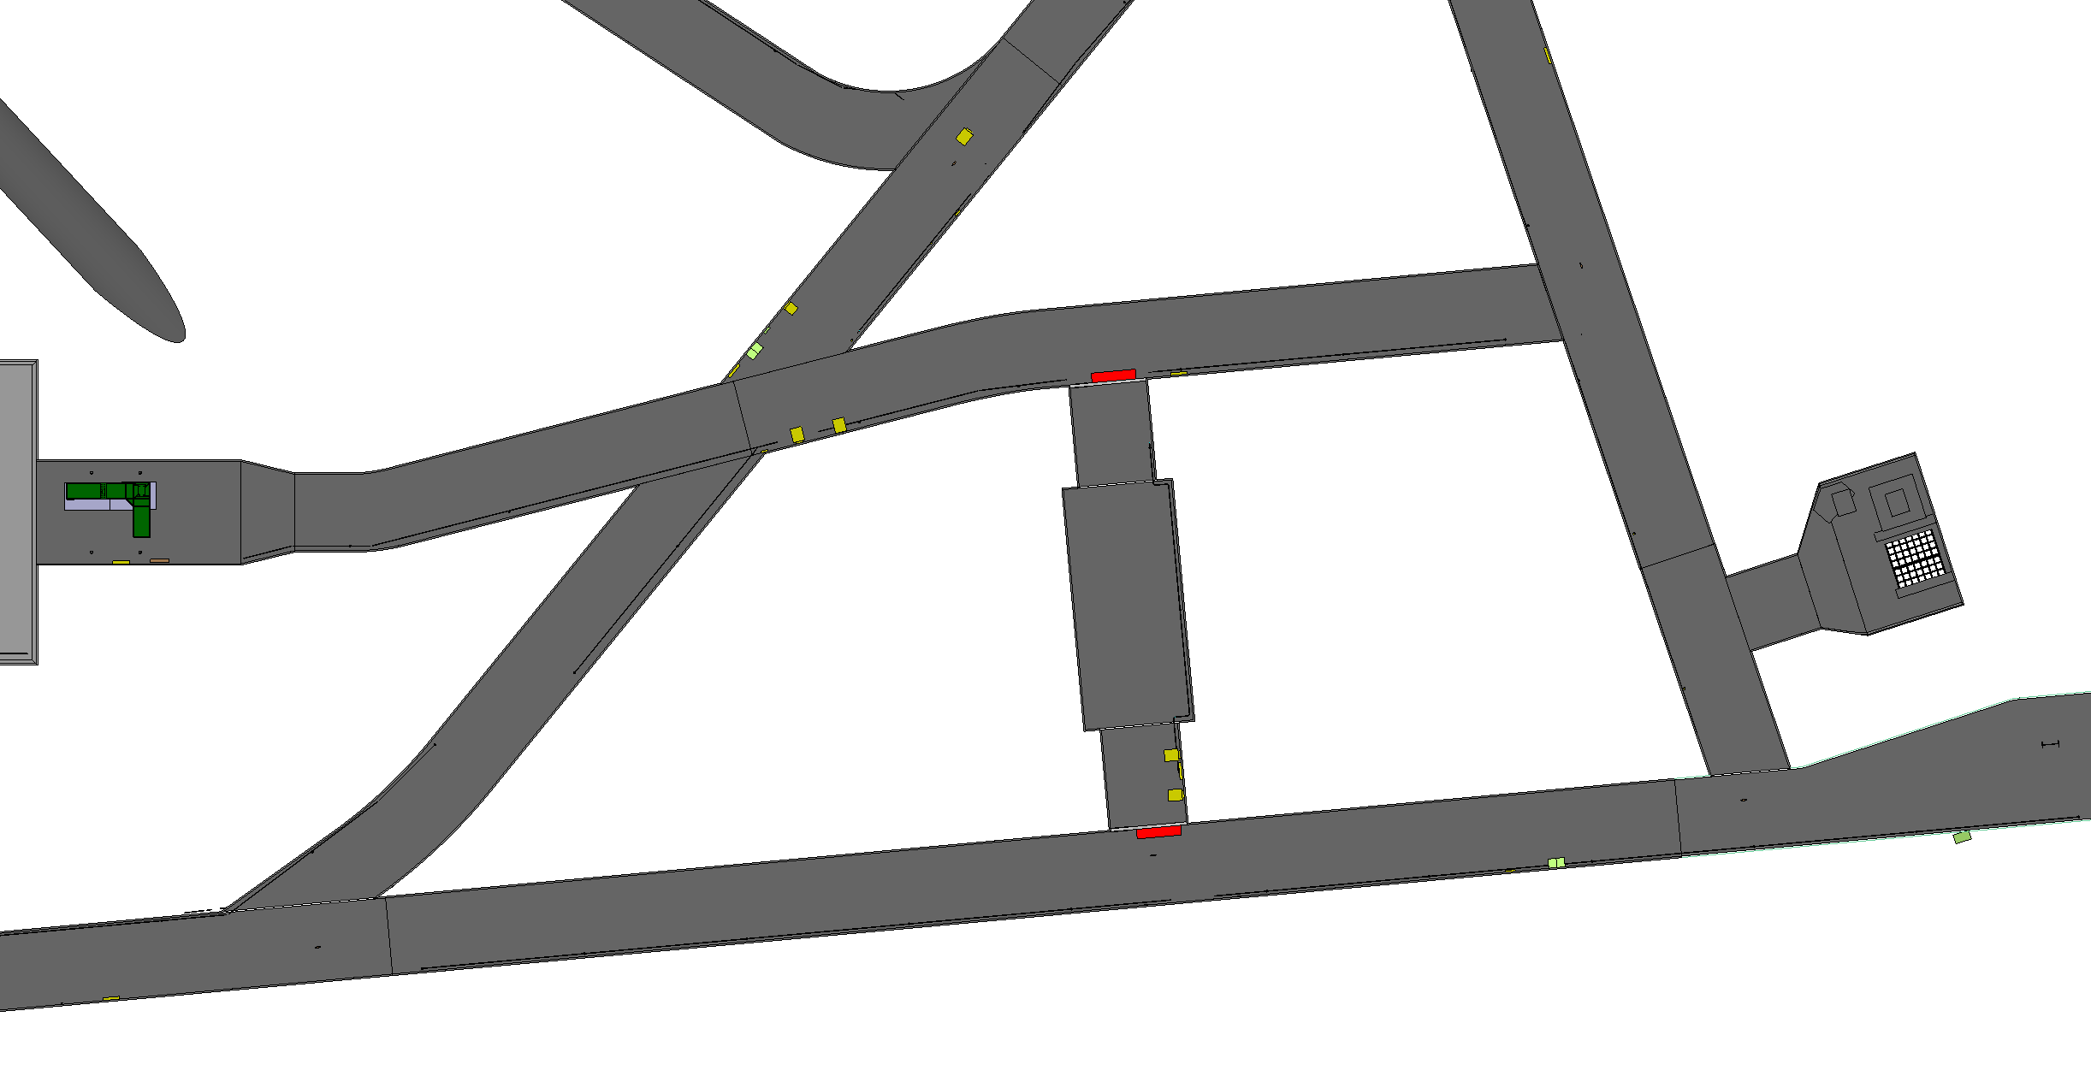
Corner beam lowering

Slide 51
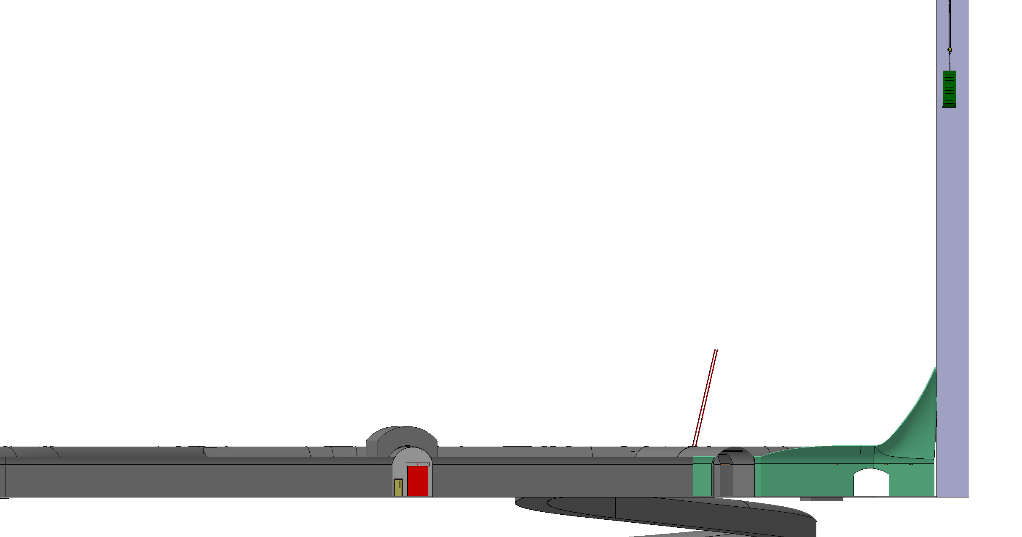
Warm skin lowering

Slide 52
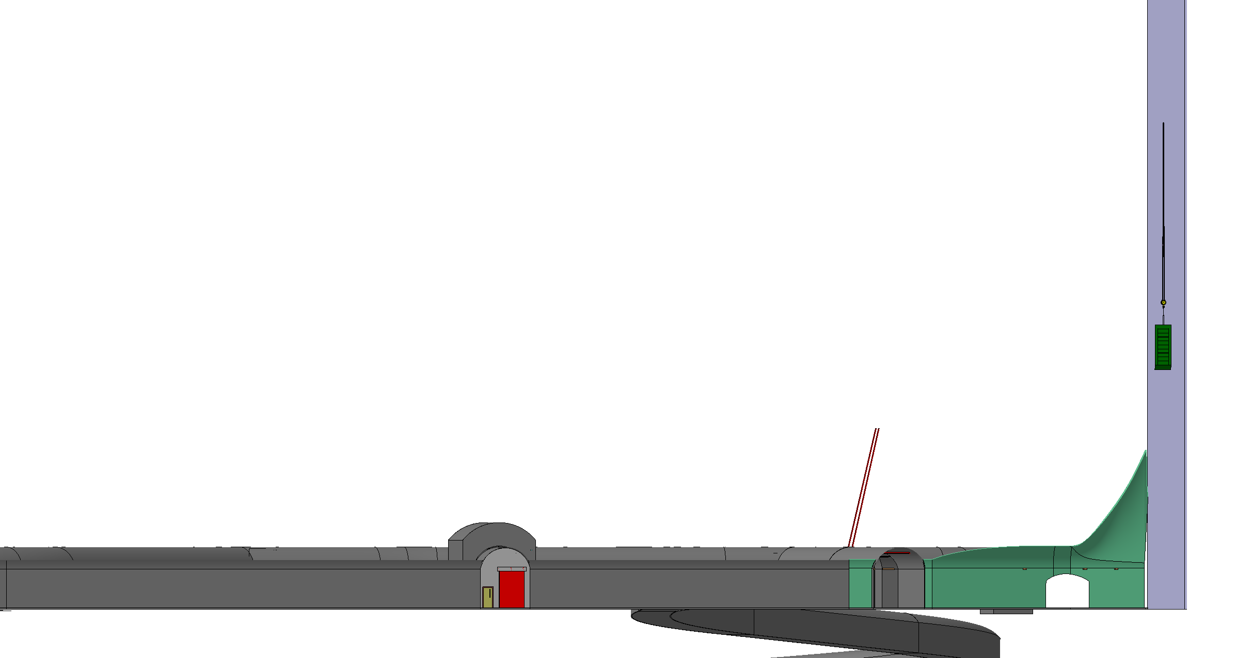
Warm skin lowering

Slide 53
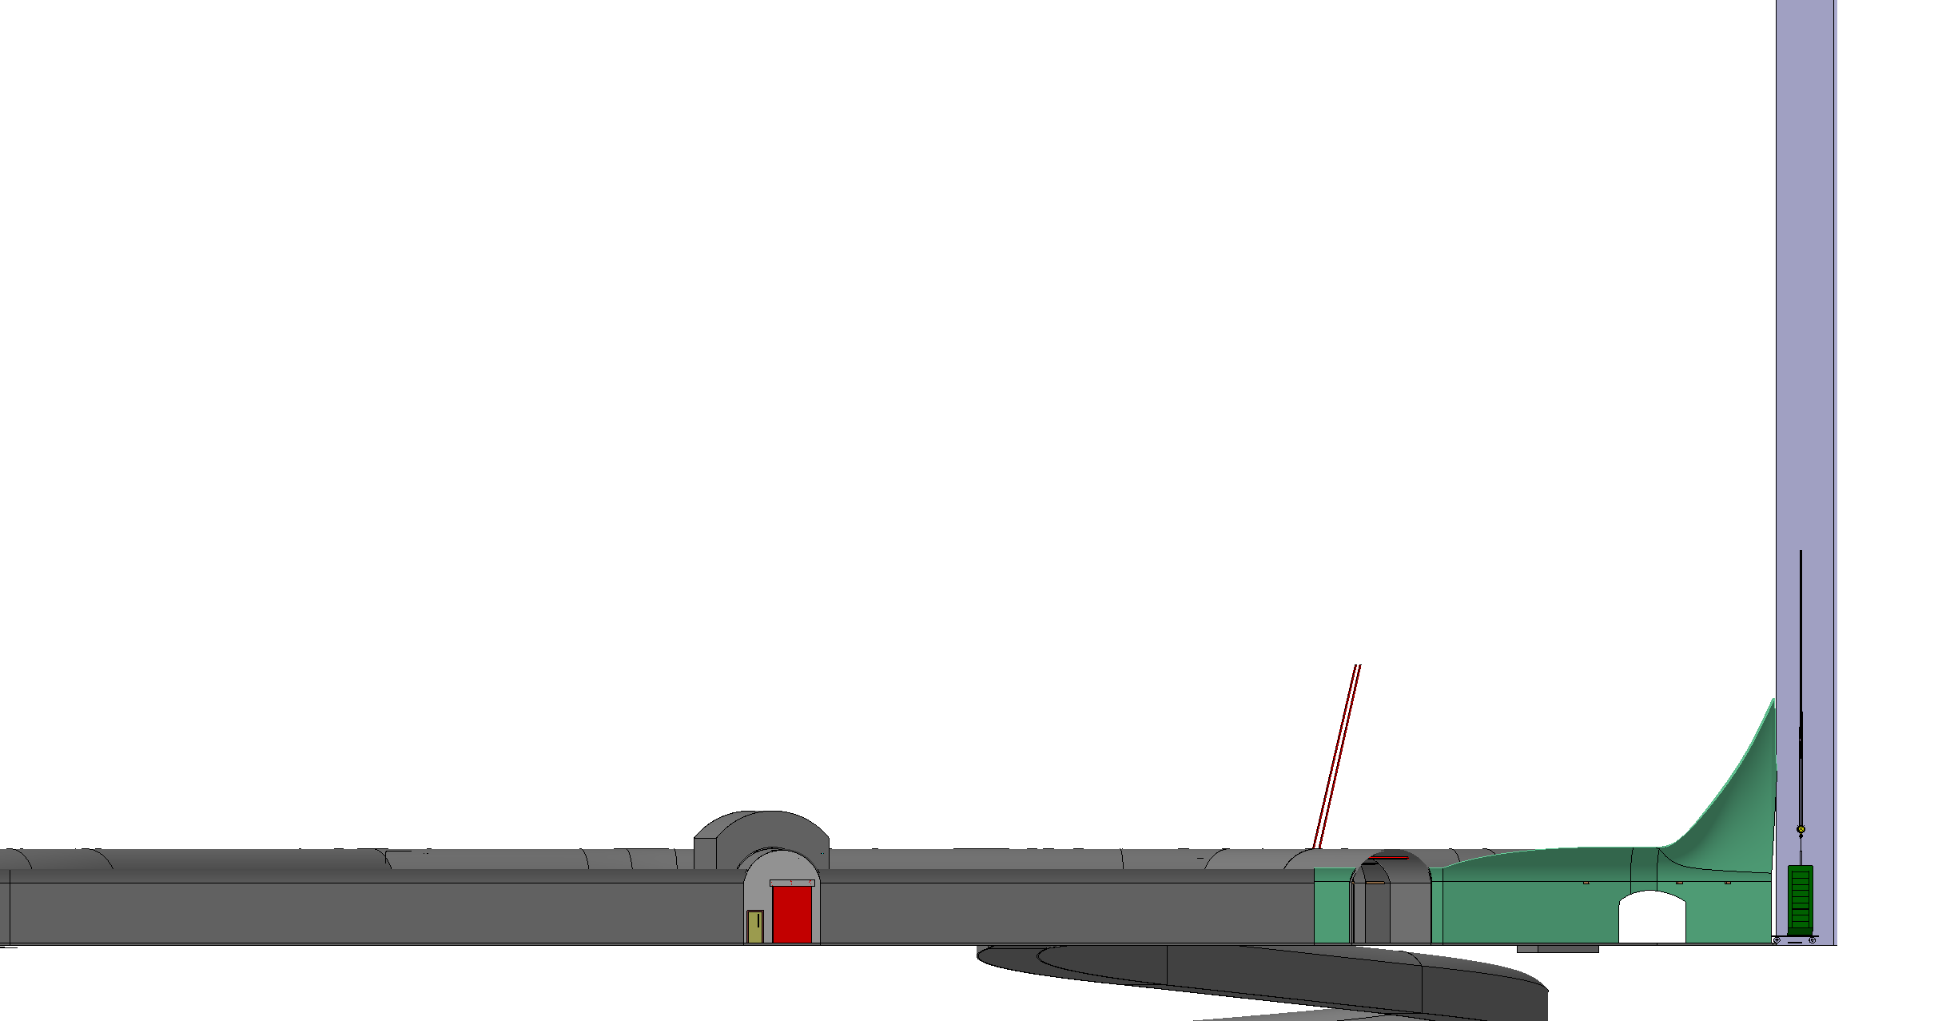
Warm skin lowering

Slide 54

Warm skin lowering

Slide 55
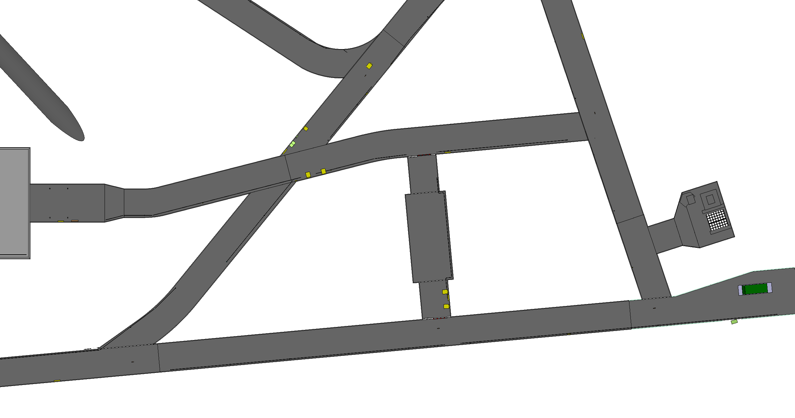
Warm skin lowering

Slide 56
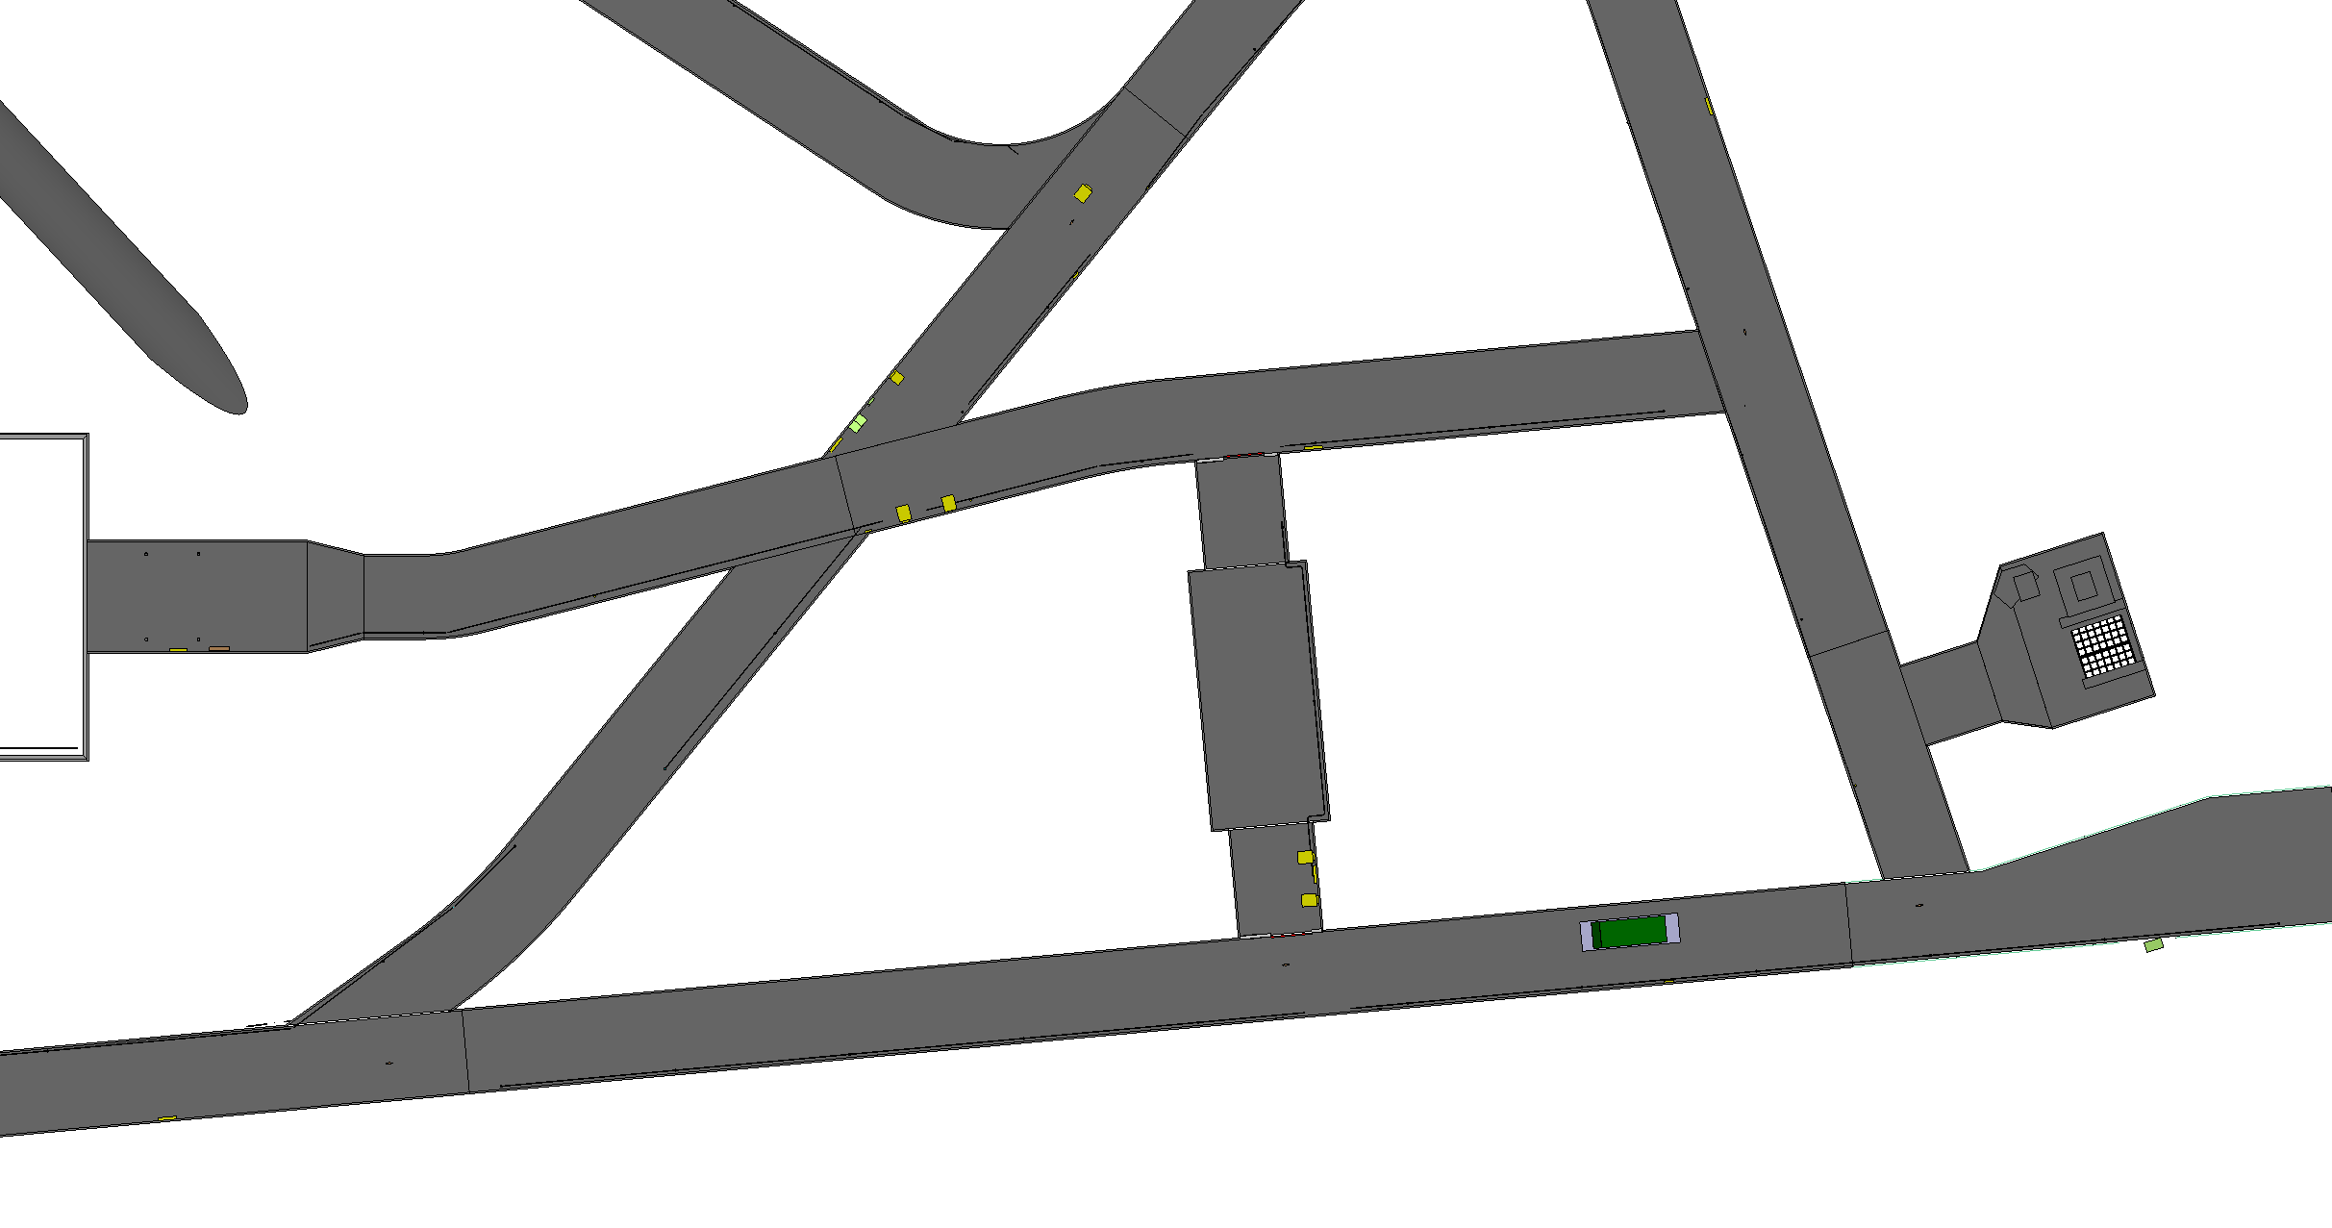
Warm skin lowering

Slide 57
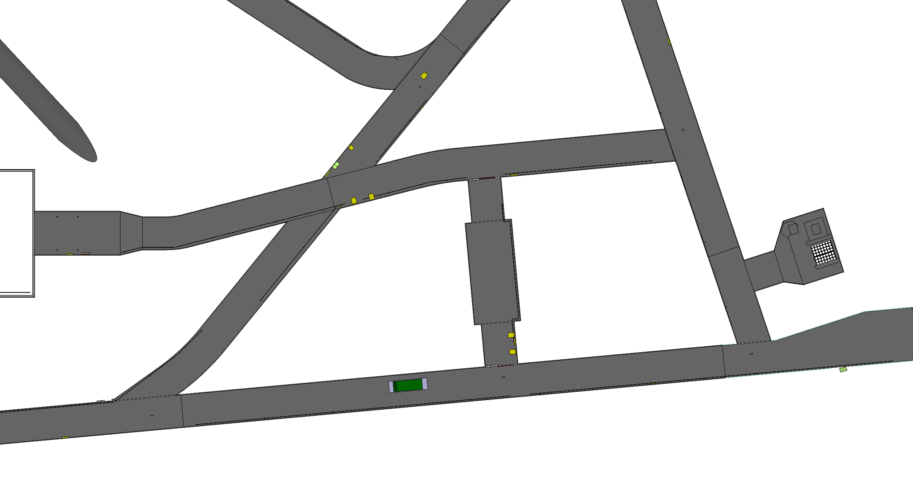
Warm skin lowering

Slide 58
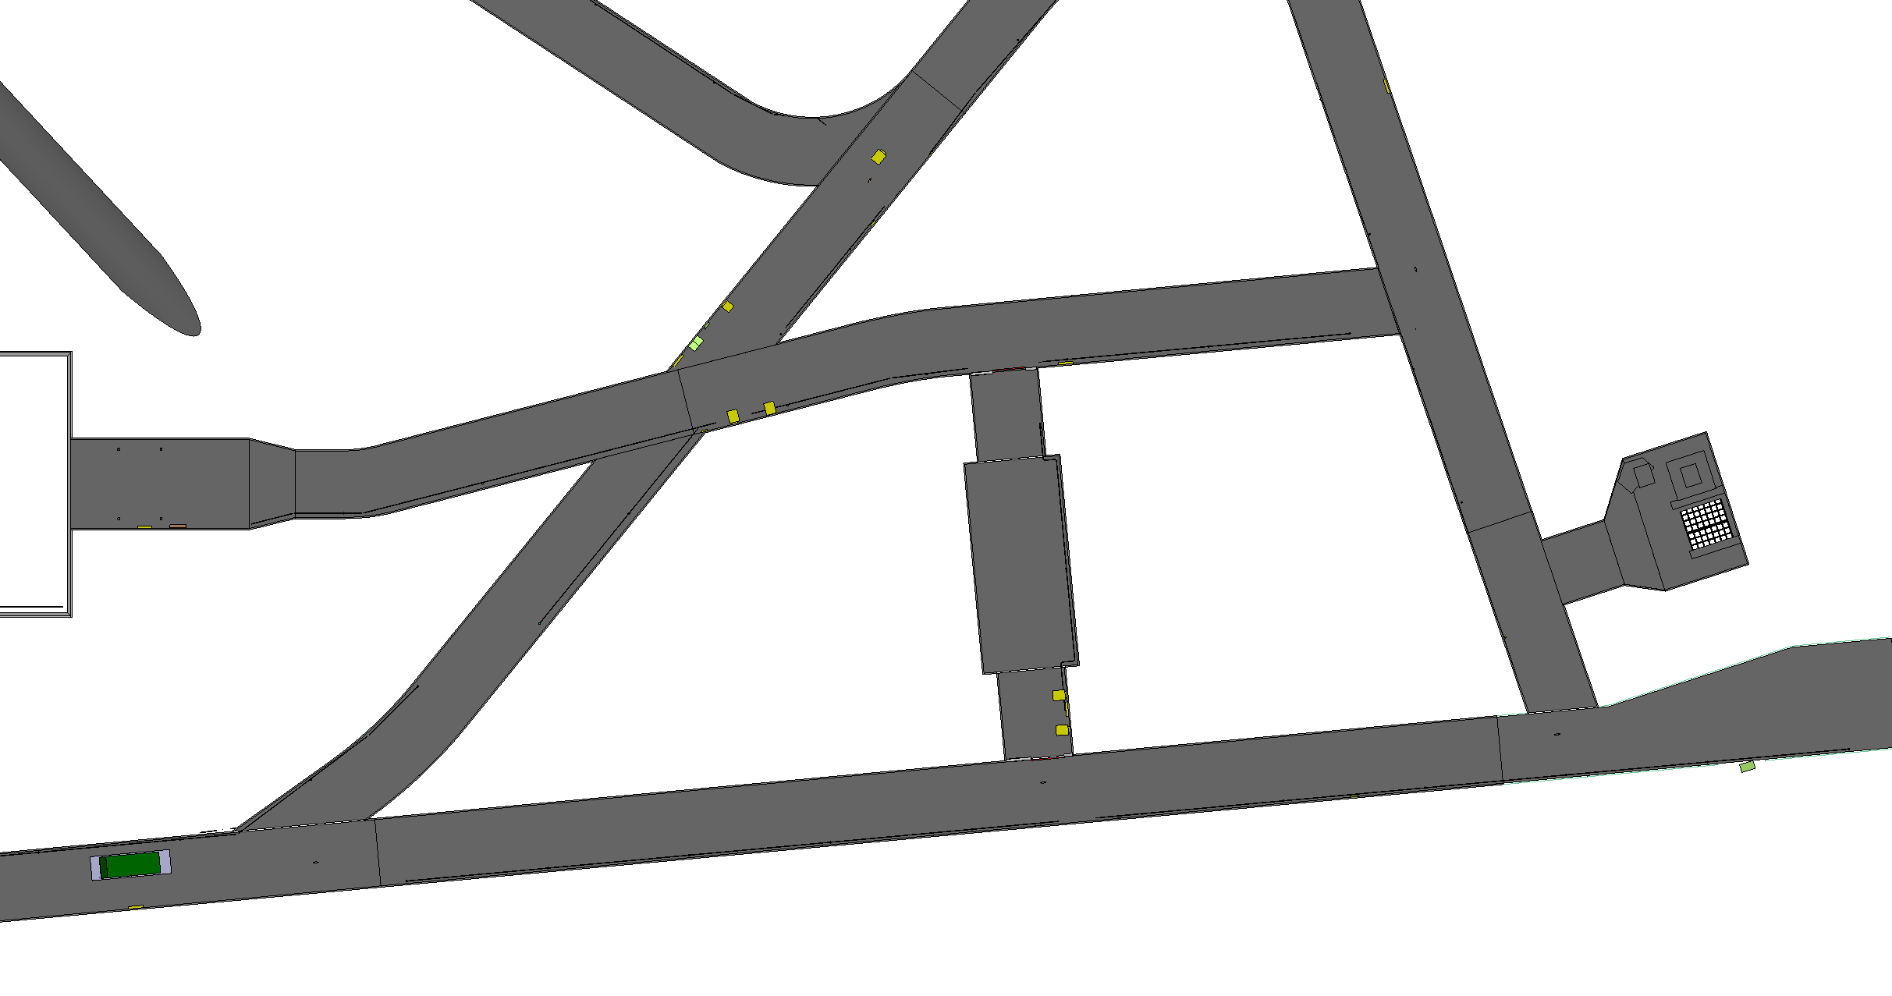
Warm skin lowering

Slide 59
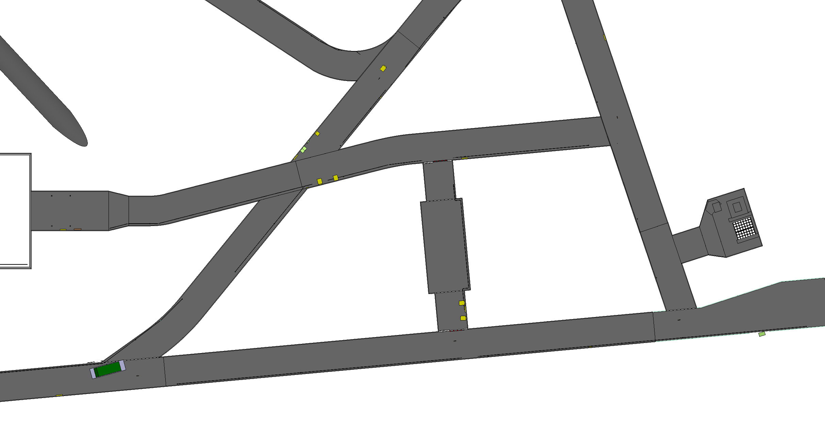
Warm skin lowering

Slide 60
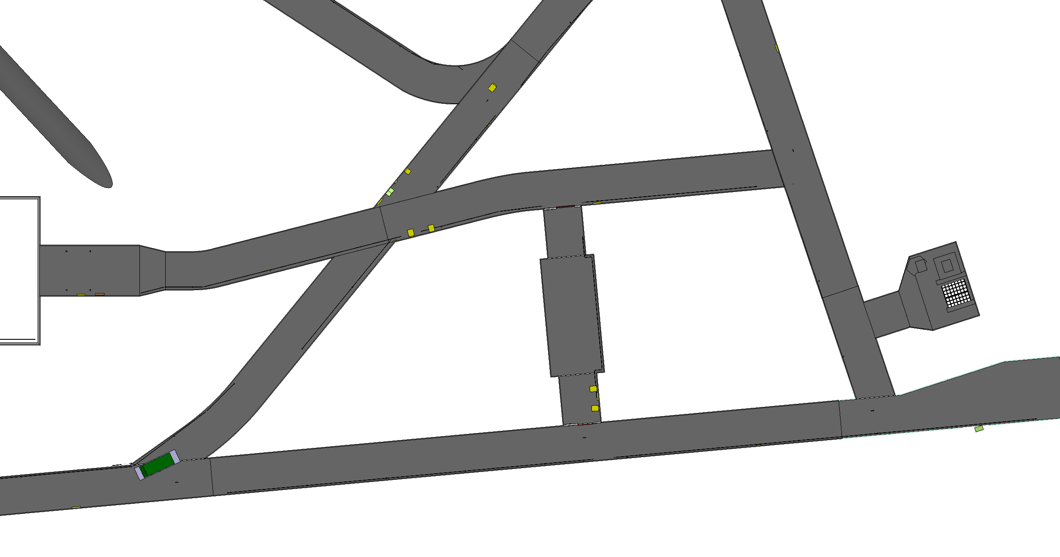
Warm skin lowering

Slide 61
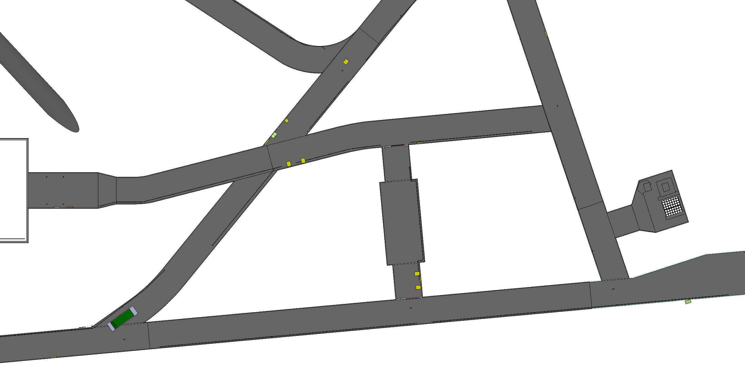
Warm skin lowering

Slide 62
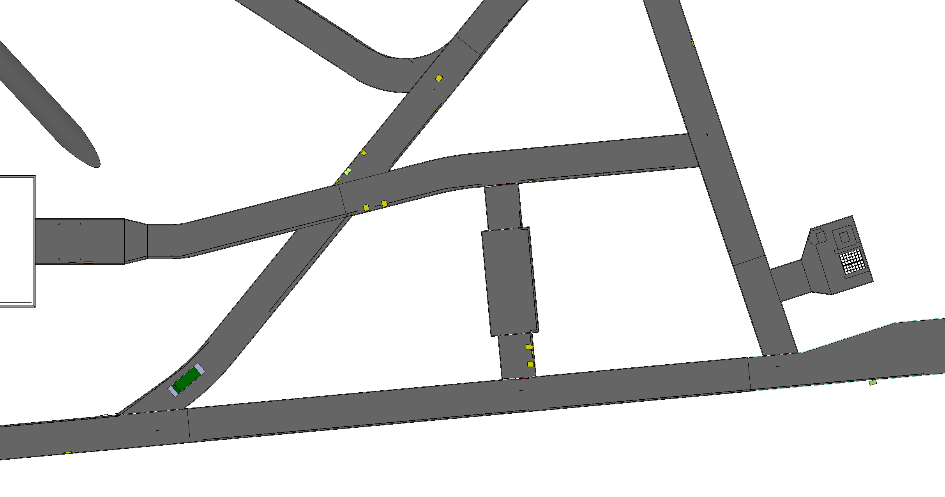
Warm skin lowering

Slide 63
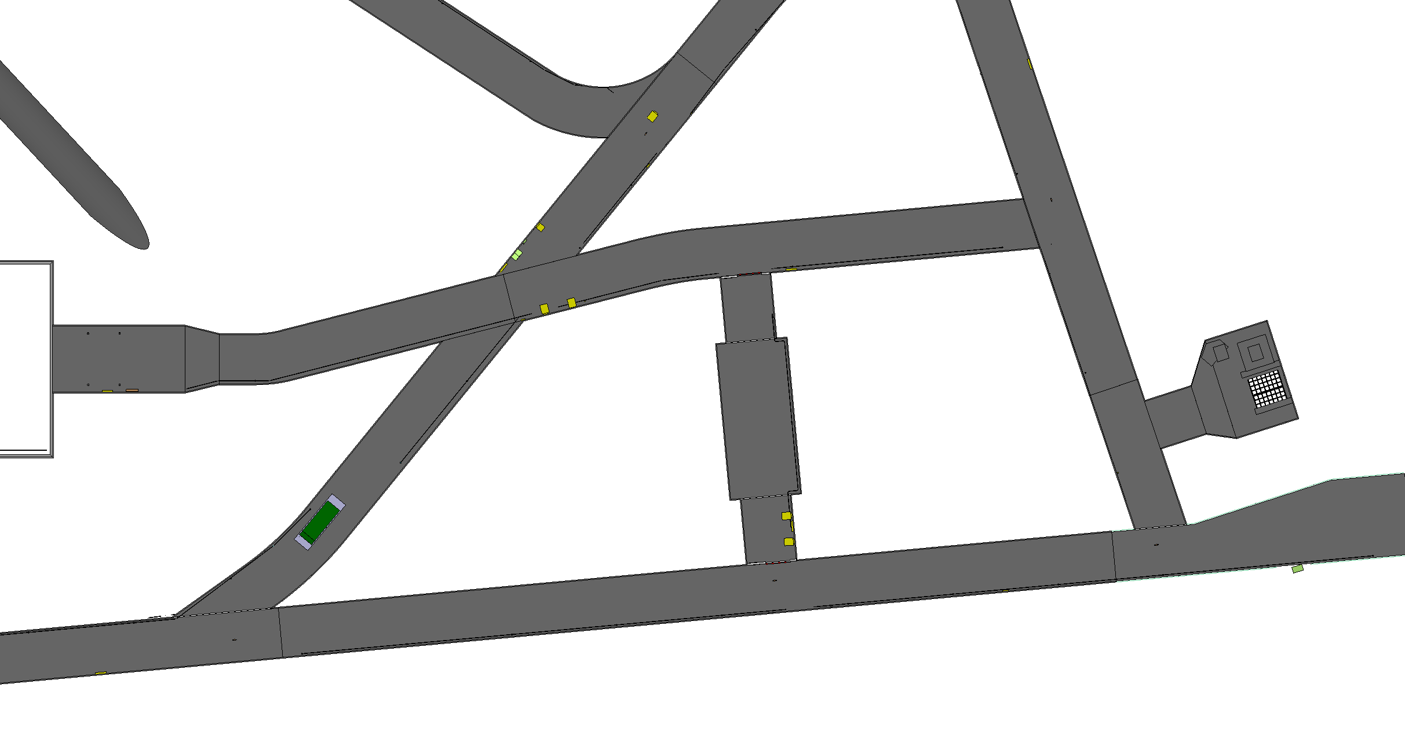
Warm skin lowering

Slide 64
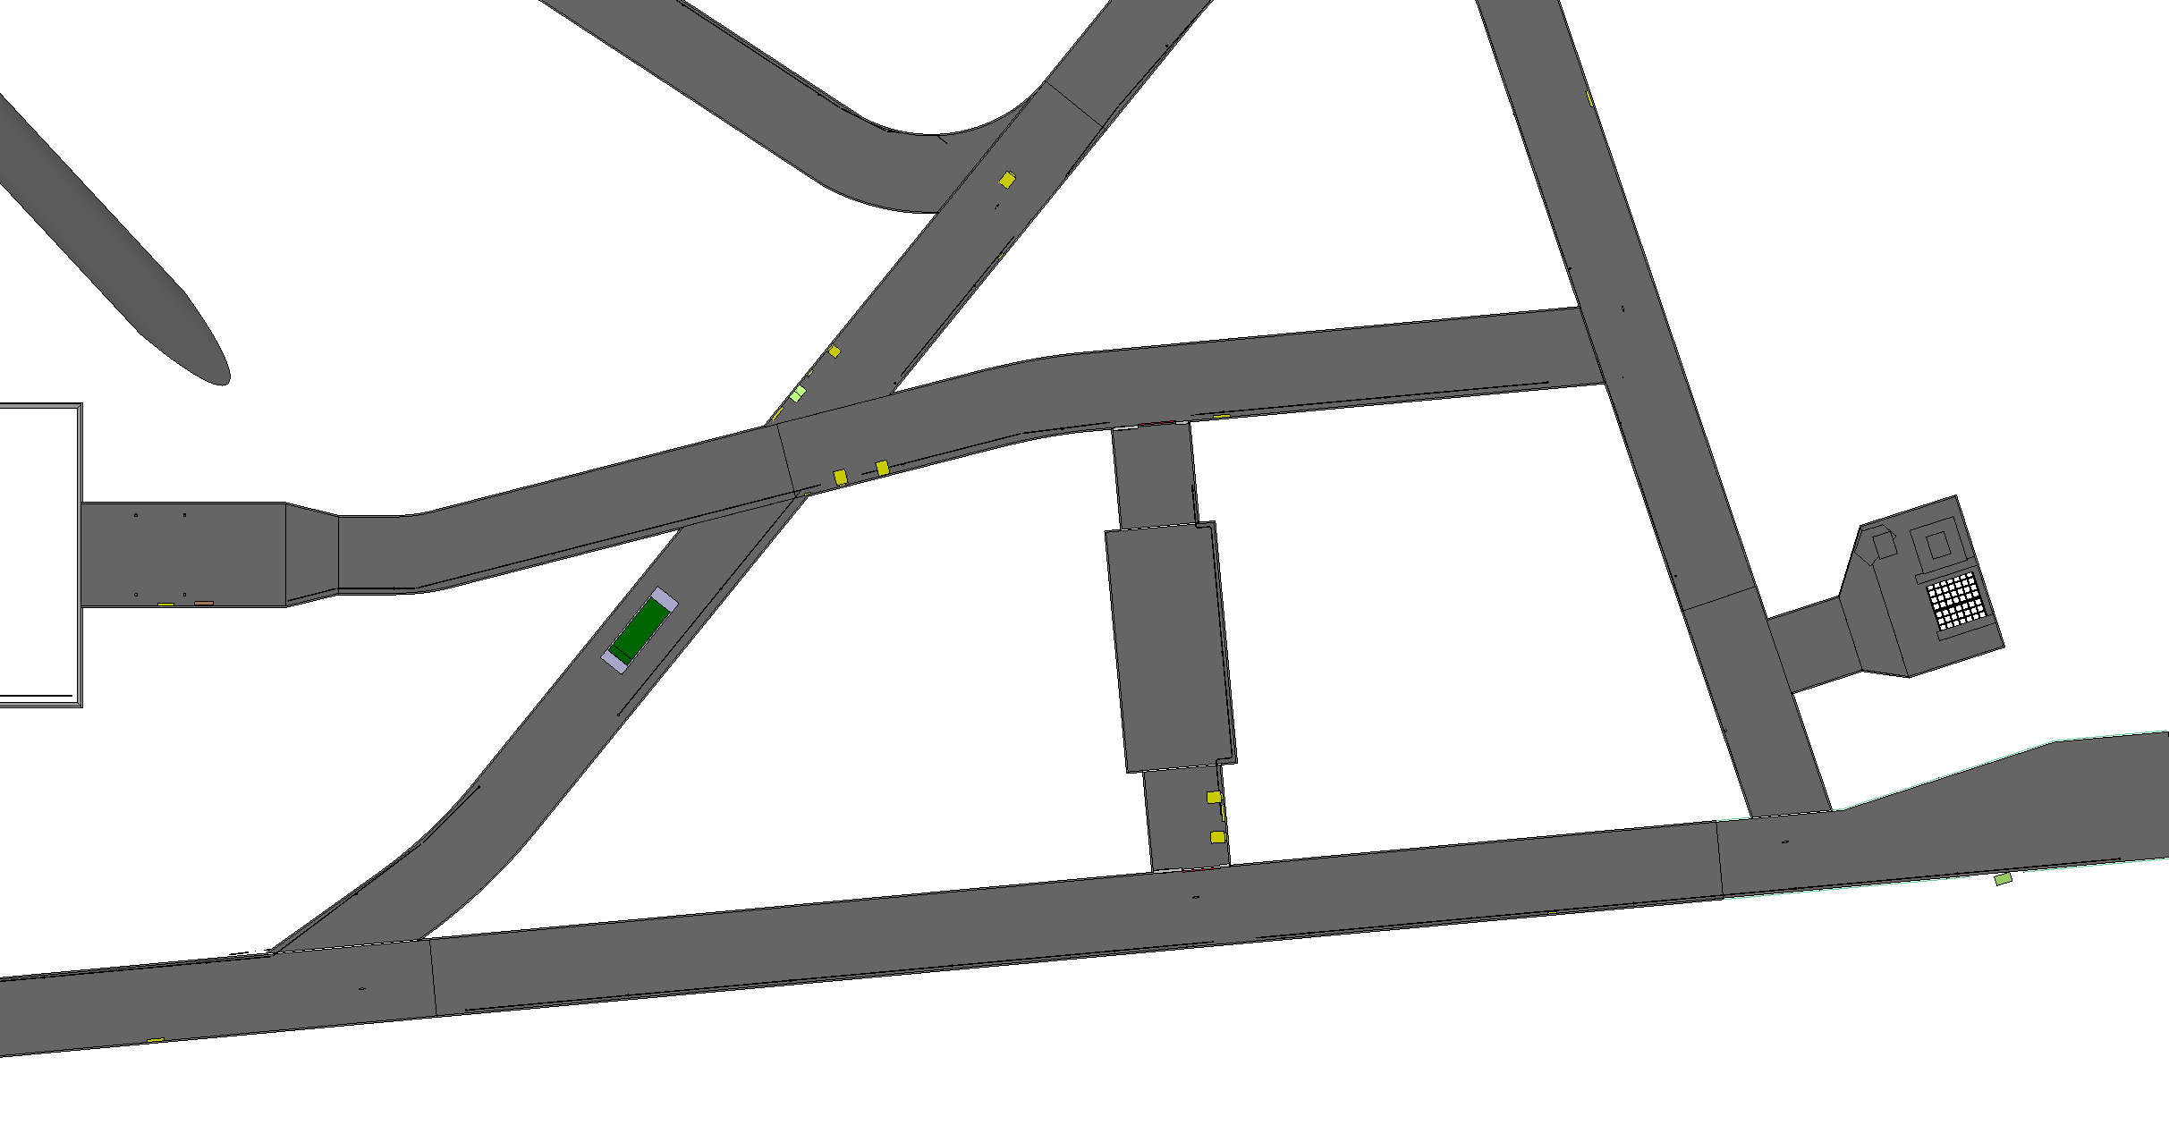
Warm skin lowering

Slide 65
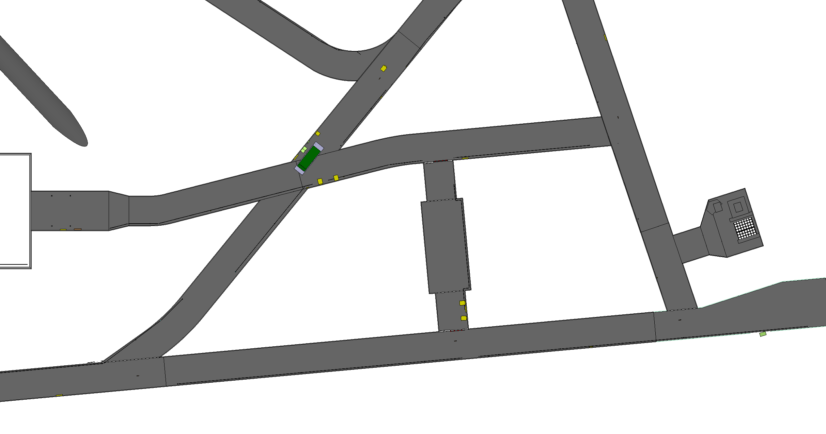
Warm skin lowering

Slide 66
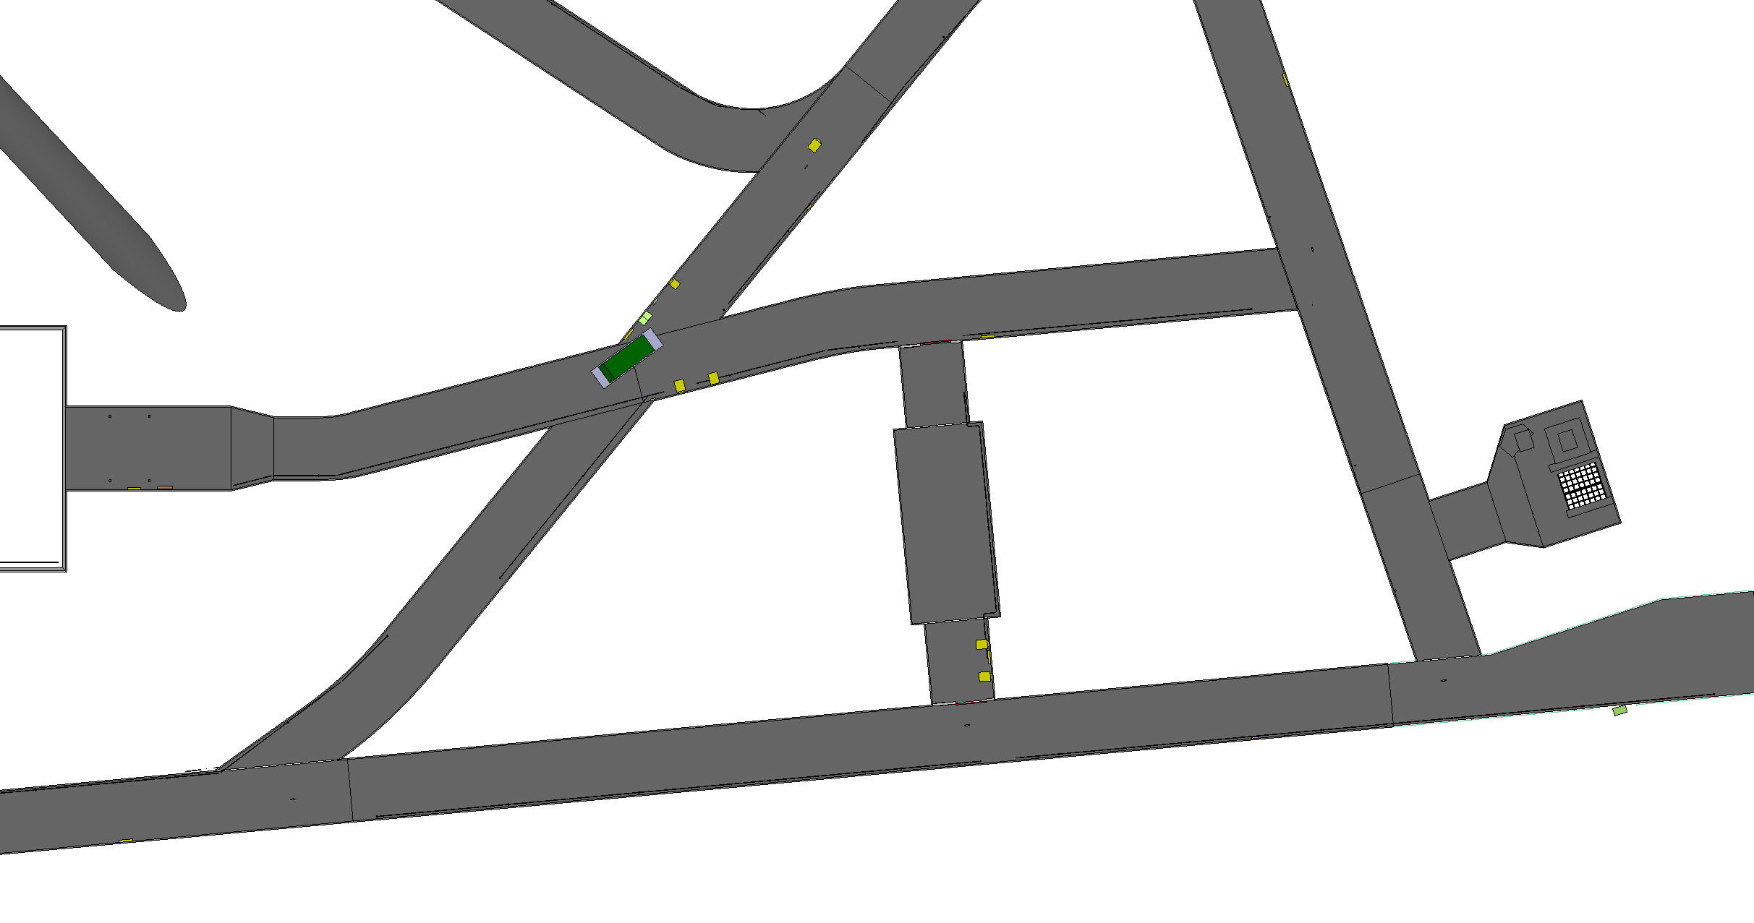
Warm skin lowering

Slide 67
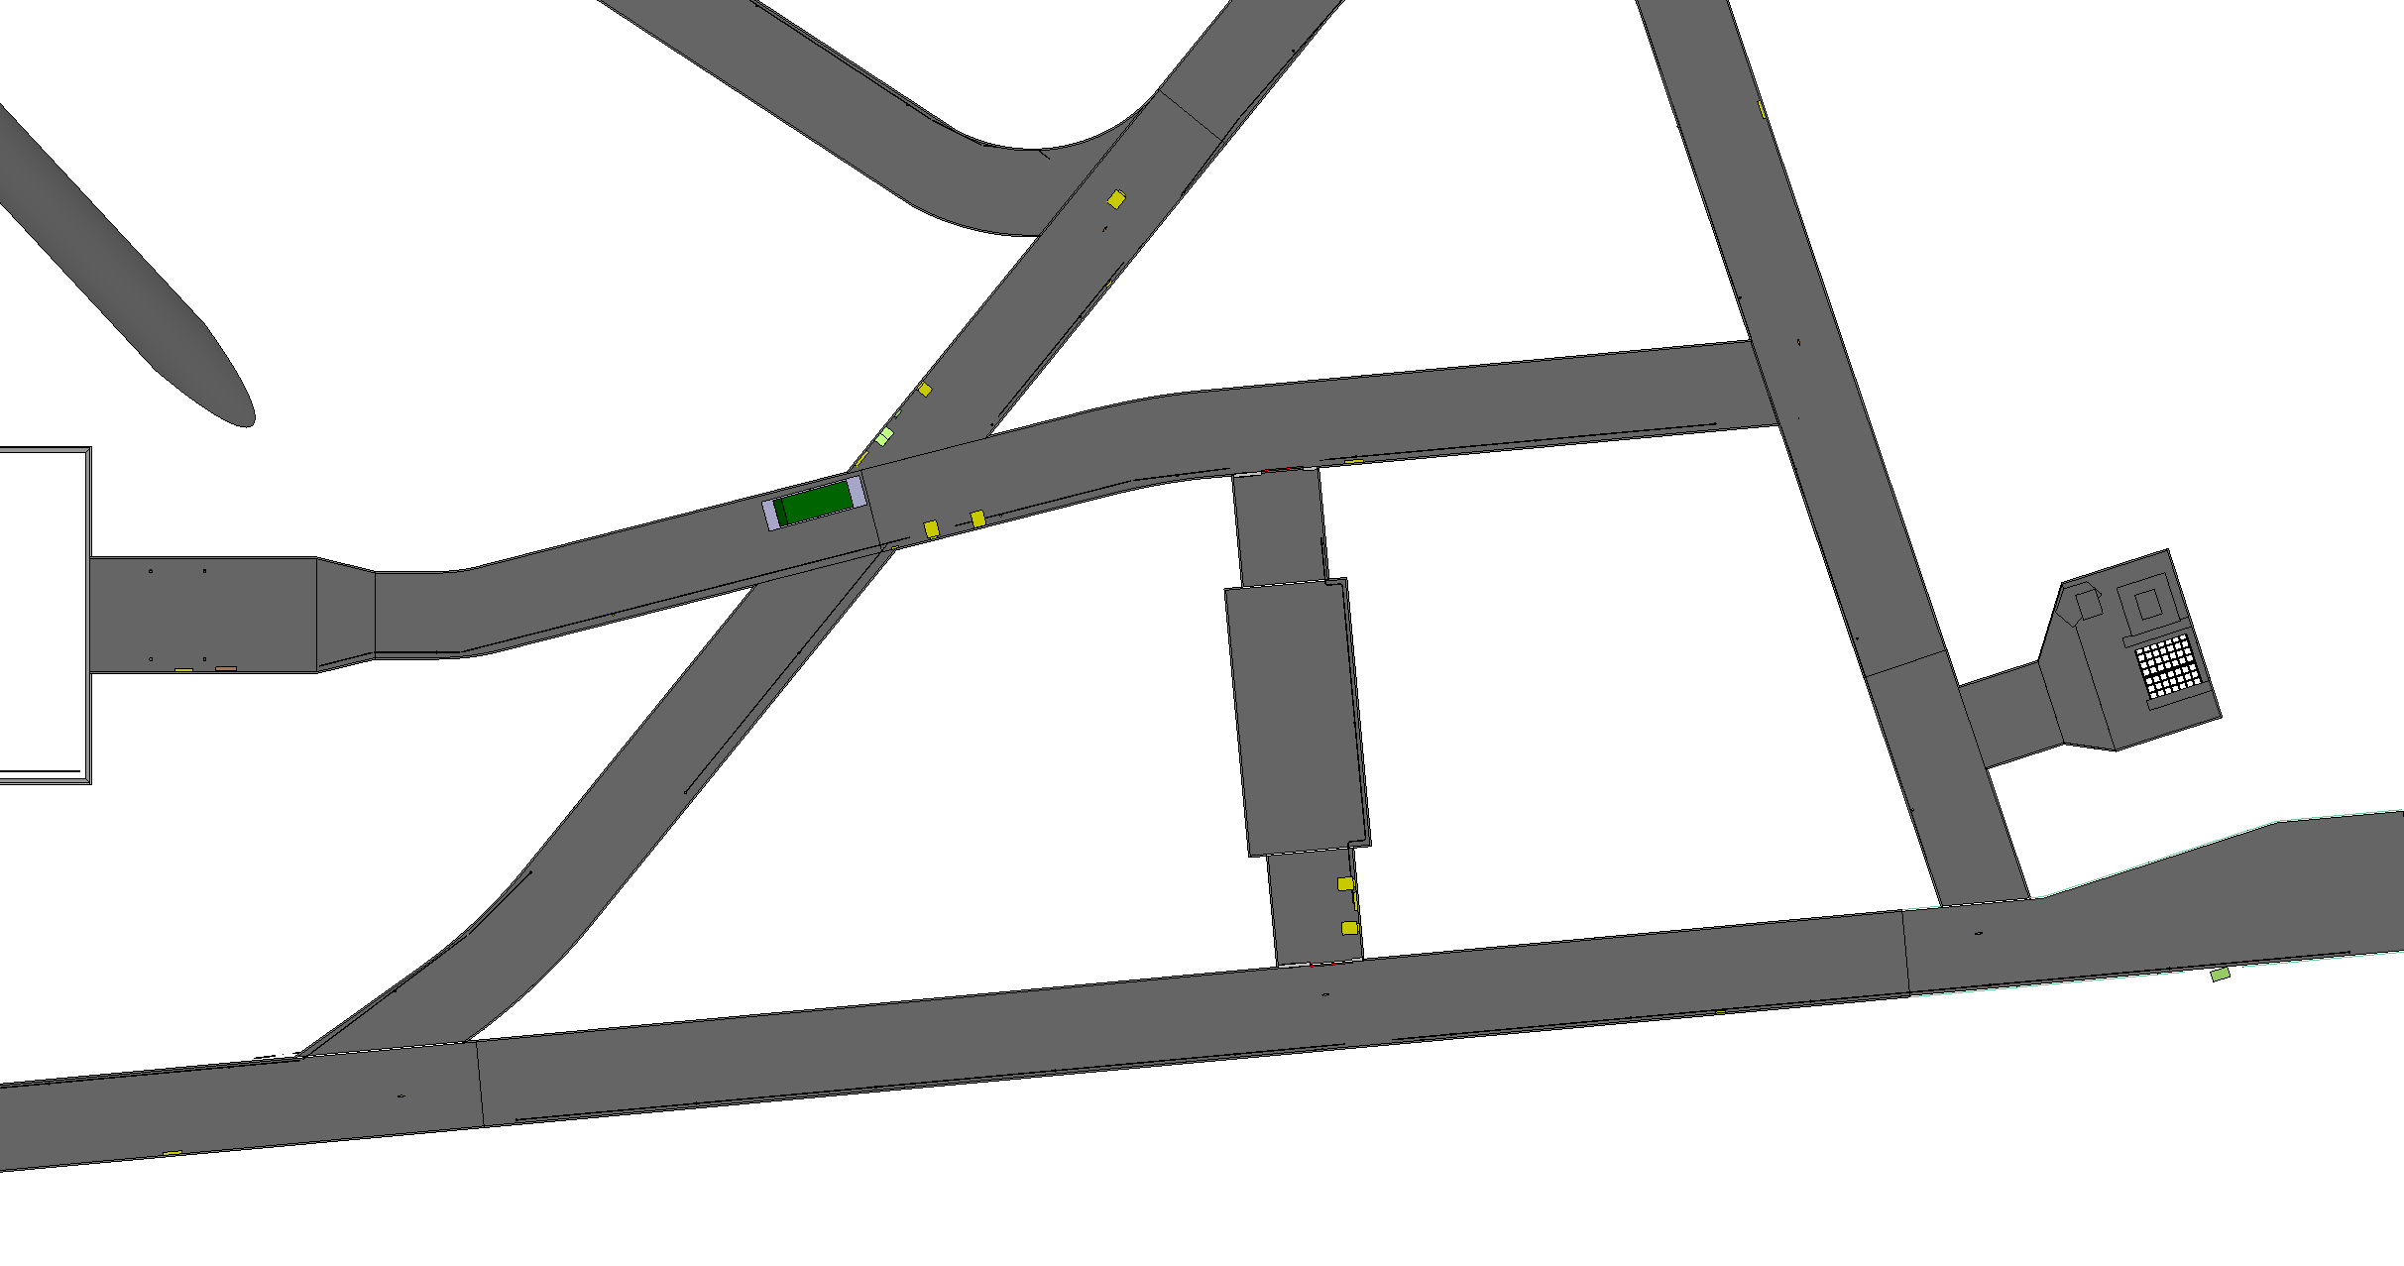
Warm skin lowering

Slide 68
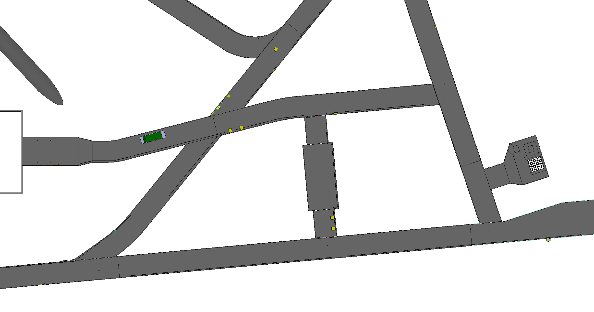
Warm skin lowering

Slide 69

Warm skin lowering

Slide 70
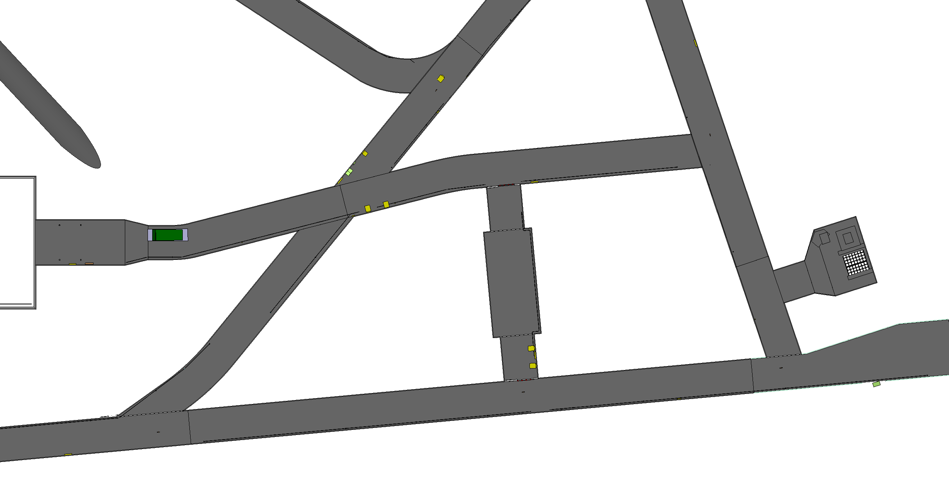
Warm skin lowering

Slide 71
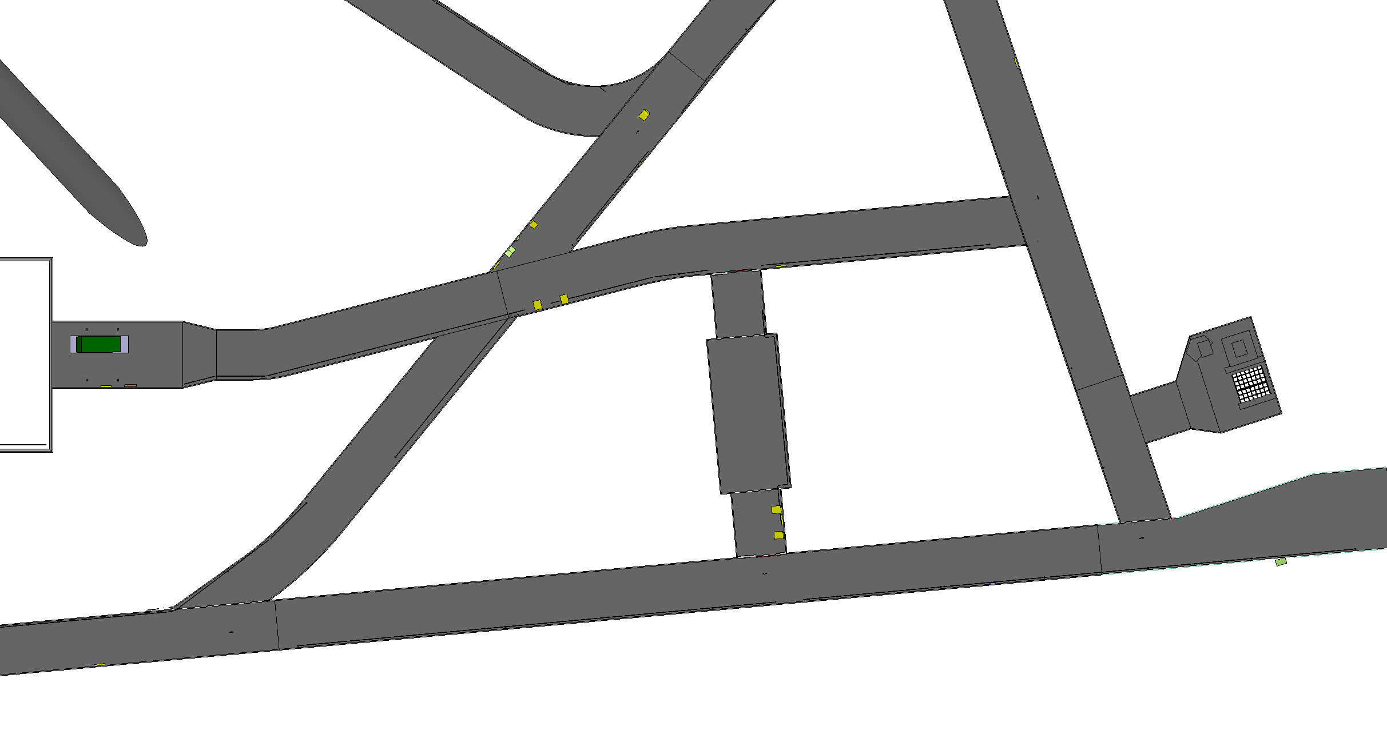
Warm skin lowering

Slide 72
Documents and references
EDMS

Slide 73
Summary
The number, the sizes and the weights of the components to be lowered in the cavern is well defined and understood
All infrastructure limitations are taken into account
The time needed to lower 1’500m down, all the 1’800 cryostat’s elements, and to transport them to the cavern, is realistic.

