Slide 1
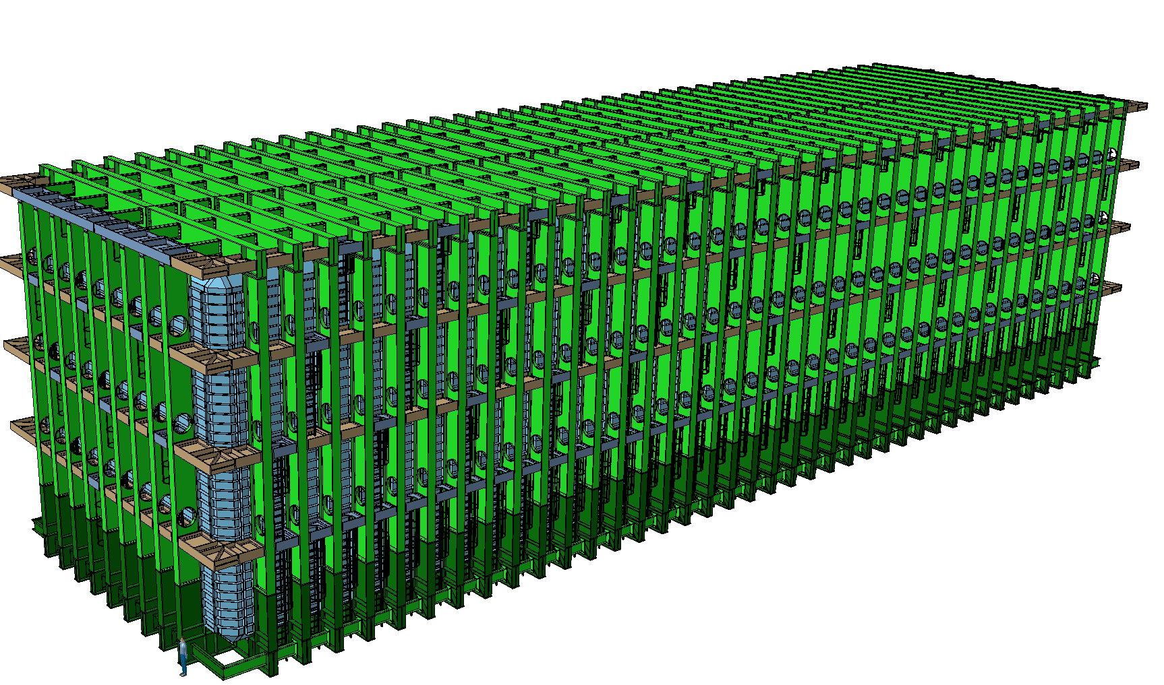


Structural Analysis of Reinforced Warm Membrane
Luca D’Angelo
LBNF Cryostat, final design review
SURF, 21-22 August 2017

Slide 2

Table of Content
Who Am I and Where Have I Been?
Introduction
Reinforced membrane concepts
Baseline concept
Door concept
Membrane welds
Membrane brackets
Documents and References

Slide 3
Who Am I and Where Have I Been?
Fellow at CERN working on LBNF from August 1, 2016.
Doctoral assistant and research associate at Swiss Federal School of Technology, in Lausanne, from February 2012 to July 2016. Aeronautical Engineer in GECI SkyAircraft (France) from March 2010 to January 2012. Research Assistant at DTU MEK (Denmark) from September 2008 to February 2010.
Expert in structural analysis, fatigue, risk and reliability assessment, probabilistic modelling and simulations. Reviewer for International Journal of Fatigue.
BSc and MSc in Aerospace Engineering. PhD in Civil and Environmental Engineering. Experience in teaching.
Notes:
I have been recently appointed as FSF L2 Manager for N2 Cryo Systems and Cryo Fluids, positioned occupied by Barry Norris who deserves all the credit for what I am about to present.
I have started as lead cryostat engineer for the 35 ton prototype and I have then been his deputy for the past 3 years in the Cryogenics Systems, starting from LBNE and then LBNF.
I am currently stationed at CERN acting as liaison between CERN and Fermilab.
My experience is a little shorter than that of some of the people that preceded me, it includes … READ.
I am also a certified PMP.

Slide 4
Introduction

Slide 5
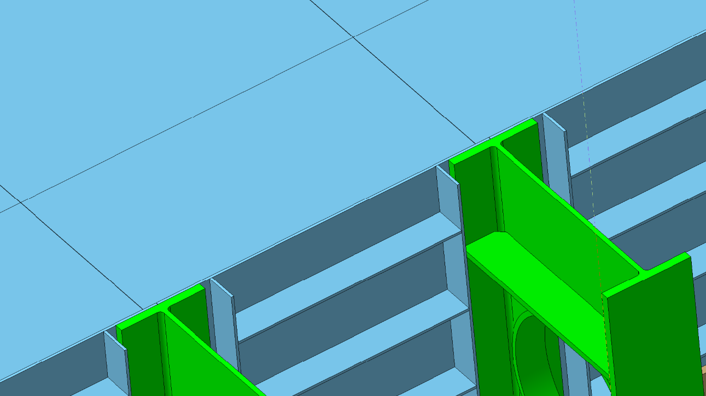
Introduction
Warm membrane
Roles:
1) Ensure leak tightness
2) Hold the liquid pressure
3) Transfer loads to primary structure

Slide 6
Introduction
Warm membrane
Roles:
1) Ensure leak tightness
2) Hold the liquid pressure
3) Transfer loads to primary structure
Warm membrane has to be reinforced to take pressure-induced bending

Slide 7
Reinforced membrane

Slide 8
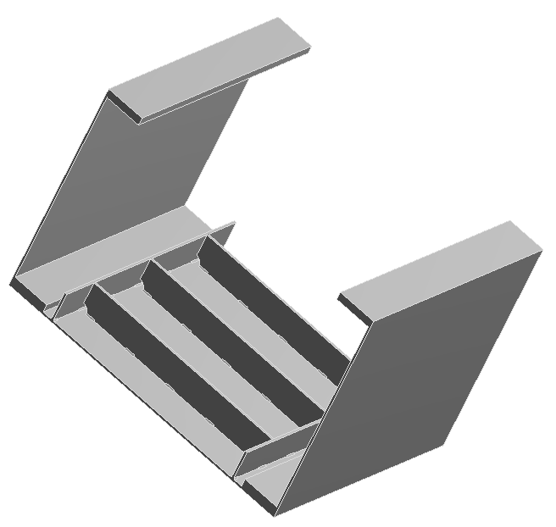
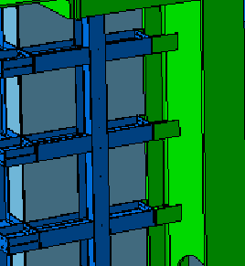
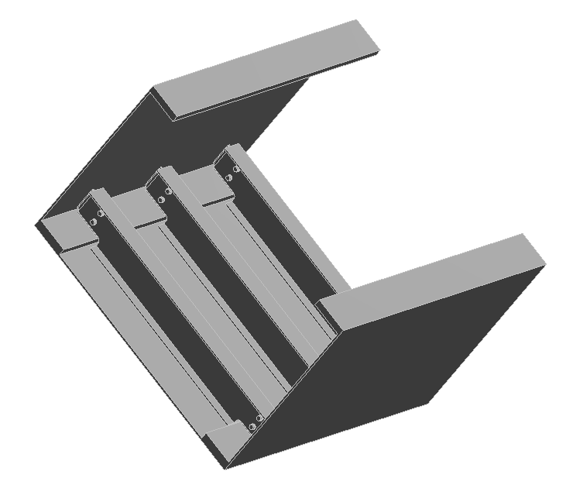
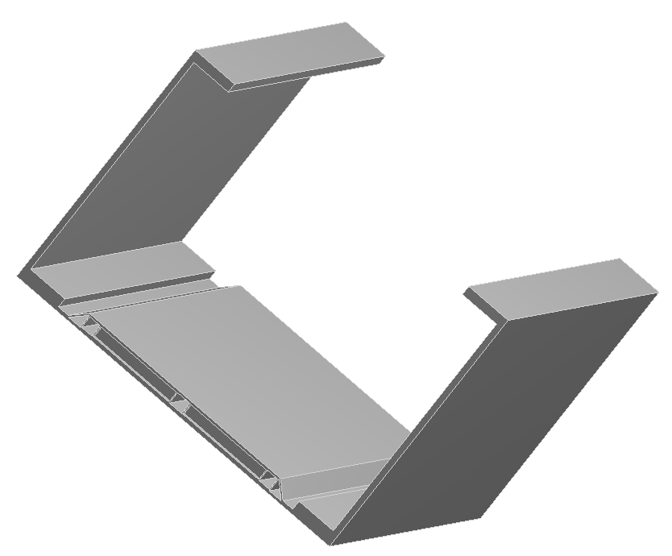
Solutions studied to increase bending stiffness
GRID
RIBS
1)
2)
BOLTED BEAMS
SANDWICH
3)
4)

Slide 9
Solutions studied to increase bending stiffness
RIBS
2)
BOLTED BEAMS
3)

Slide 10
Baseline concept

Slide 11
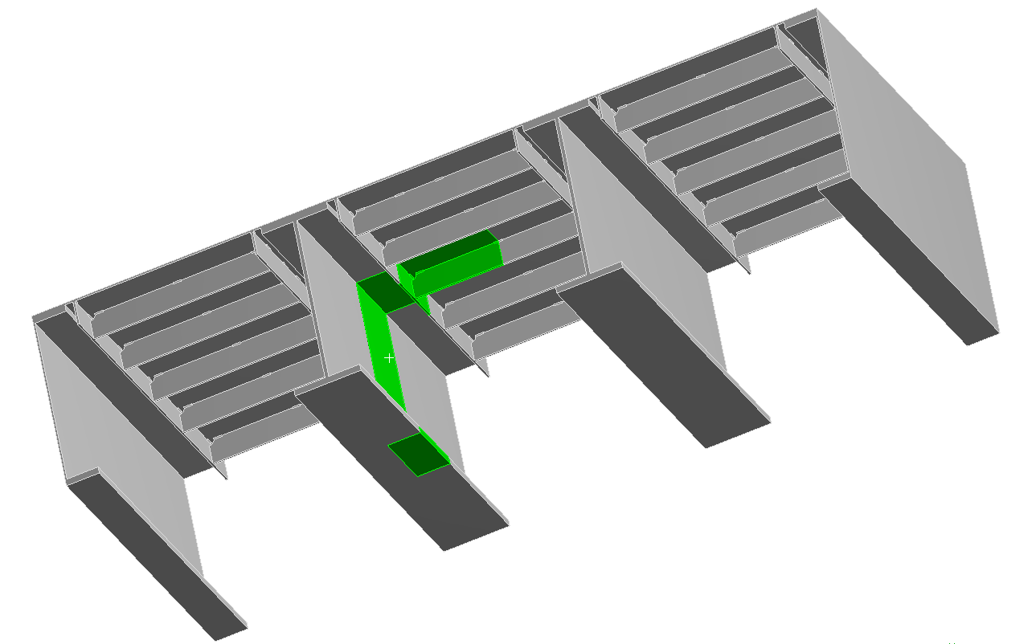
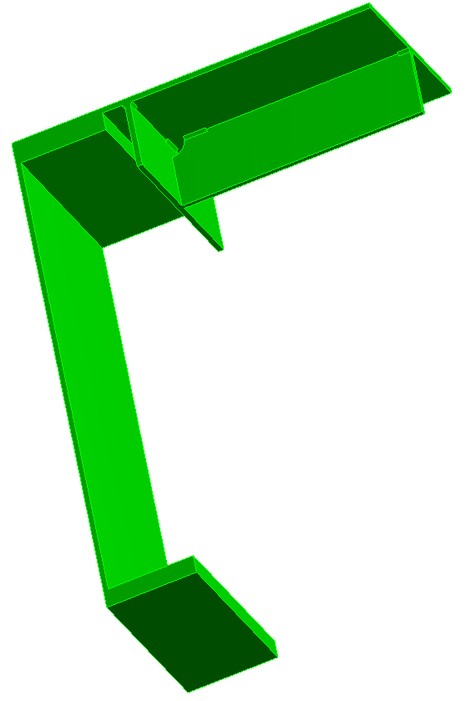
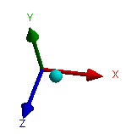
Concept
longitudinal ribs
transversal ribs
Outer vessel floor
pitch = 400 mm
S460 ML
Unit Cell : 800 x 400mm
12mm warm membrane
4mm fillet welds
FLA 150×12mm ribs
HL1100M main column

Slide 12
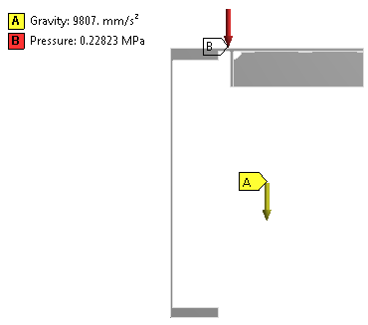
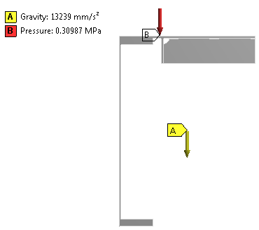
Displacement Analysis Stress Analysis
(SLS)
(ULS)
p₀+ρgh_{max}
p₀+ρgh_{max}
Nominal loads: γ_{F}=1.0
Design loads: γ_{F}=1.35 - 1.40

Slide 13
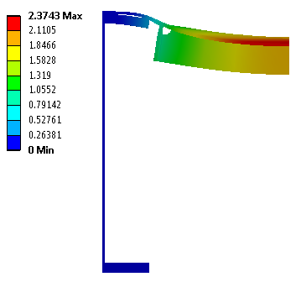
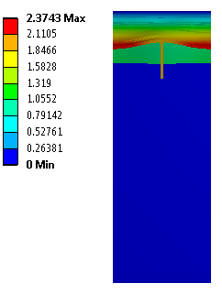
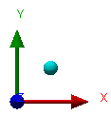
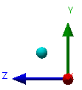
Displacement Analysis
Membrane displacement in mm (amplification = 60 x)

Slide 14
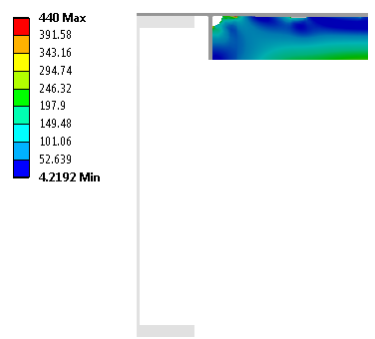
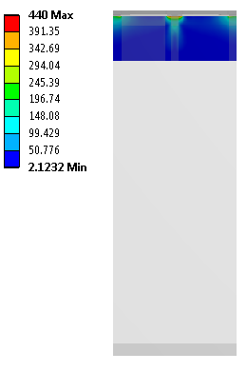
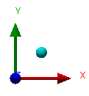
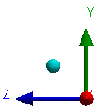
Stress analysis – reinforcing ribs
σ_{VM} [MPa] – longitudinal rib
σ_{VM} [MPa] – transversal rib

Slide 15
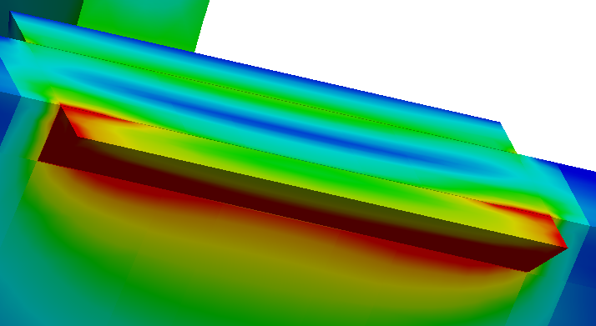
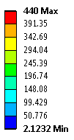
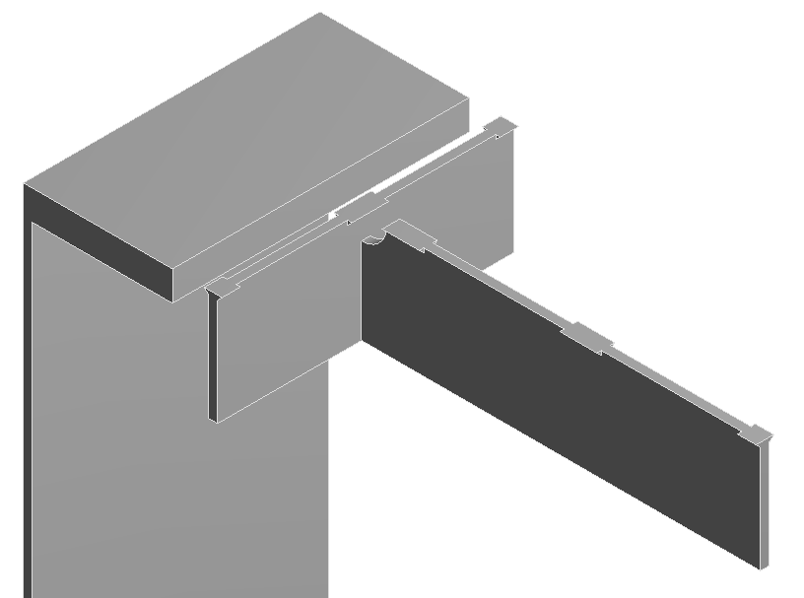
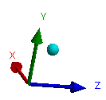
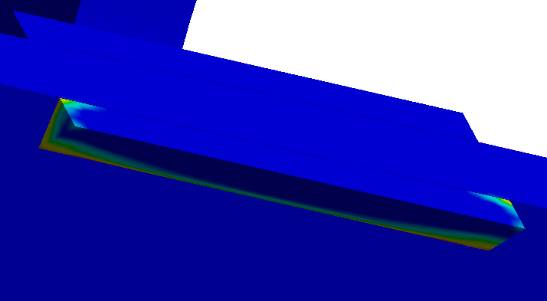
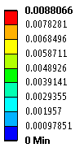
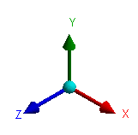
Local stress analysis of welds – central transversal rib
σ_{VM} plot [MPa] – EP analysis
Equivalent plastic strain (<0.8%)
In the other ribs, the equivalent plastic strain is negligible

Slide 16
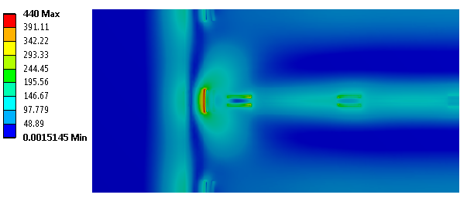
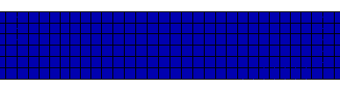
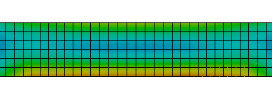
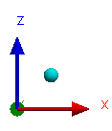
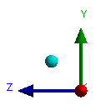
Local stress analysis of welds – warm membrane
σ_{VM} plot [MPa] – EP analysis
A
Equivalent plastic strain
σ_{VM} plot [MPa]
A
Section A-A

Slide 17
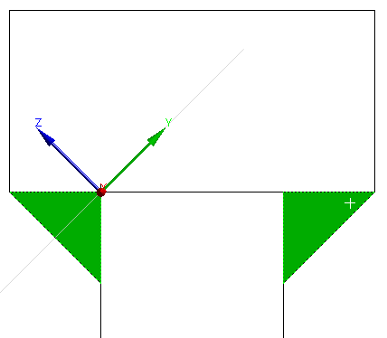

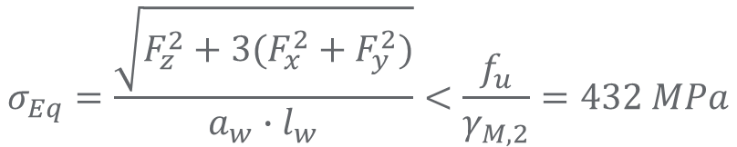
Verification of welds according to Eurocode 3
$$σ_{Eq}=\frac{\sqrt{F_{z}^{2}+3(F_{x}^{2}+F_{y}^{2})}}{a_{w}∙l_{w}}<\frac{f_{u}}{γ_{M,2}}=432 MPa$$
$$UF=\frac{σ_{Eq}}{f_{u}}∙γ_{M,2}$$
a
S460 ML
a=4mm
ID | F_{X} [kN] | F_{Y} [kN] | F_{Z} [kN] | S_{Eq} [MPa] | UF
LW1 | 32.2 | 0.4 | 6.2 | 281 | 65%
LW2 | 23.7 | 2.0 | 7.8 | 210 | 46%
LW3 | 1.1 | 0.2 | 3.2 | 37 | 9%
TW1 | 8.6 | 1.8 | 15.0 | 214 | 49%
TW2 | 16.1 | 24.3 | 66.8 | 419 | 97%
TW2
LW1
TW1
LW2
LW3

Slide 18
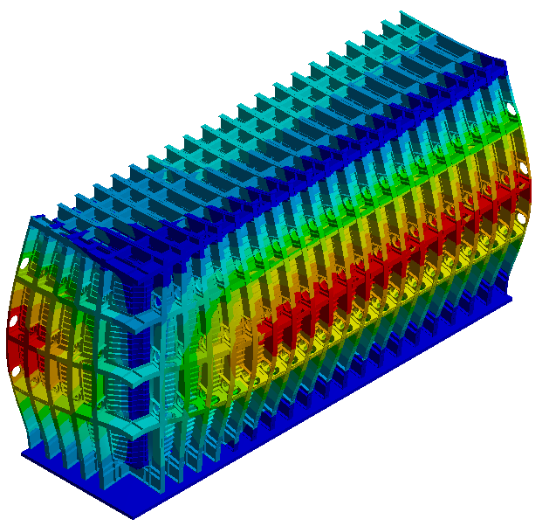


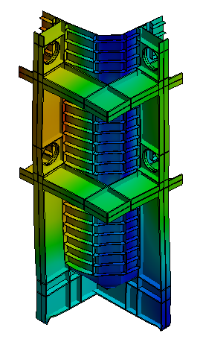
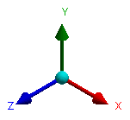
Corners
Global model (shell)
Sub-model (solid membrane)
Total def. [mm] (ULS)
Total def. [mm] (ULS)
(amplification = 50 x)

Slide 19
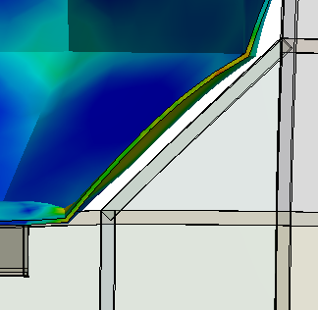
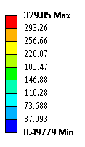
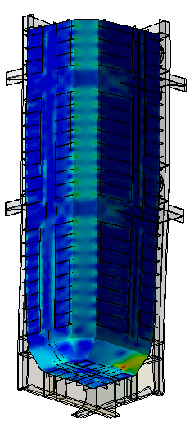
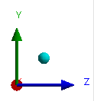
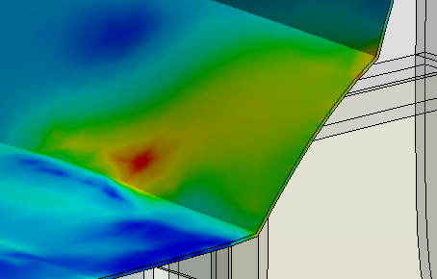
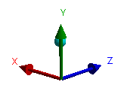
Corners
deformed shape (amplification = 20x)
σ_{VM} plot [MPa]
Stiffening effect of insulation is neglected (no pressure)

Slide 20
Conclusions
Maximum displacement of warm membrane < 3 mm;
Ribs take bending moment by remaining in the elastic domain;
EP stress analysis of ribs shows that yield strength is reached very locally on some areas of welds (not through the thickness);
Max EP strain in central transversal weld < 0.8%
EP stress analysis of warm membrane shows that yield strength is reached in external layer at central transversal rib. Eq. pl strain = 0;
50 mm length welds with 4 mm throat allow to take design loads;
Stress level in membrane corner stay below yield strength.
(*) Detailed calculations are given in EDMS doc. N. 1831536

Slide 21
Door concept

Slide 22
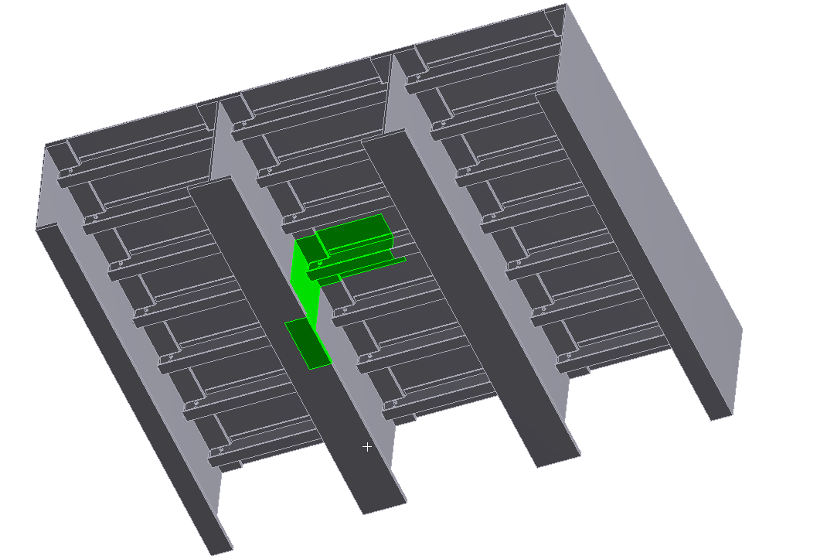
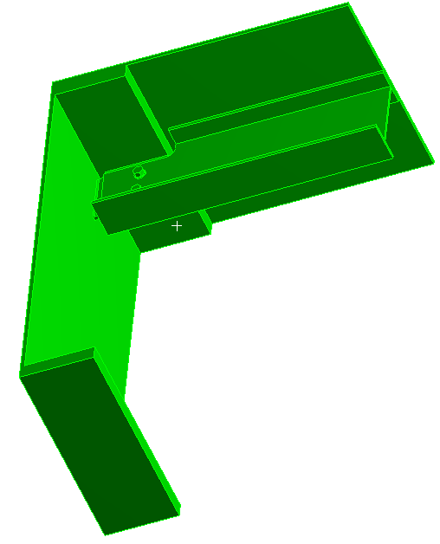
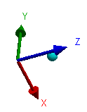
Concept
Unit cell in the center of the floor: worst case loading scenario
Unit Cell : 800 x 550 mm
12mm warm membrane
2 M16 bolts, grade 8.8
(slotted holes)
IPE 220, l=1540 mm
Outer vessel floor
pitch = 550 mm
S460 ML
10 mm fin plate
HL1100M main column

Slide 23
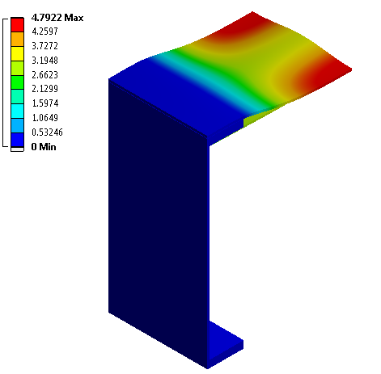
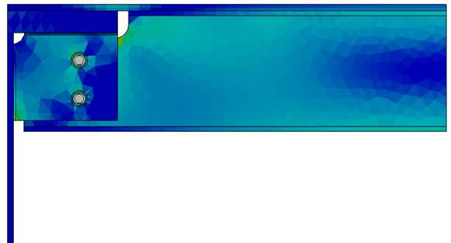

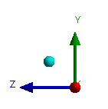
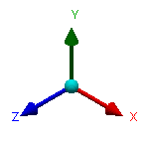
Displacement Analysis Stress Analysis
(SLS)
(ULS)
Nominal loads: γ_{F}=1.0
Design loads: γ_{F}=1.35 - 1.40
σ_{VM} plot [MPa]
Displacement in mm
(amplification = 15 x)

Slide 24
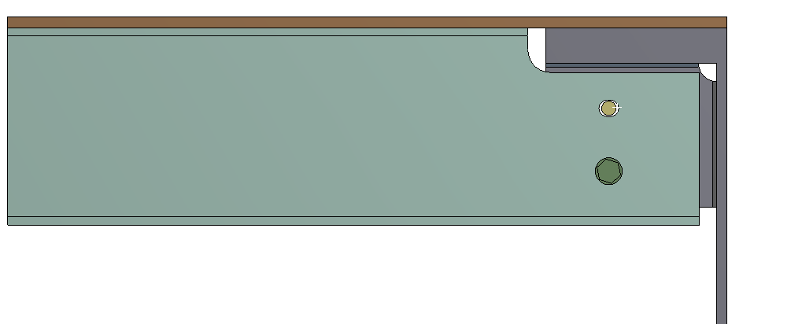


Verification of bolted connection (FEA and Analytical)
FE model of connection is used
Bolts are verified according to Eurocode 3
Stress analysis of bolts and welds is also
performed

Slide 25






Verification of bolted connection
Envelope for drilling holes
design case

Slide 26




FE analysis of bolts and welds
Bolts (steel grade 8.8)
$$σ_{Eq}=\frac{\sqrt{F_{z}^{2}+3(F_{x}^{2}+F_{y}^{2})}}{a_{w}∙l_{w}}$$
Vertical weld (a_{w}=5mm)
$$σ_{Eq}=59 MPa <\frac{f_{u}}{γ_{M,2}}=432 MPa$$
Horizontal weld (a_{w}=5mm)
$$σ_{Eq}=59 MPa <\frac{f_{u}}{γ_{M,2}}=432 MPa$$
σ_{VM} plot [MPa]

Slide 27
Conclusions
Maximum displacement of warm membrane < 5 mm;
IPE beams take bending moment by remaining in the elastic domain;
Bolted connections passes the Eurocode 3 checks, with all Utilization Factors staying below 85%;
FE analysis of the bolts shows that maximum σ_{VM} stays below the yield strength;
5mm throat welds allow to transfer loads from the fin plate to the columns with a considerable safety margin.
(*) Detailed calculations are given in EDMS doc. N. 18315363

Slide 28
Membrane welds

Slide 29




Method
- Worst case scenario: all longitudinal forces are taken by the membrane
- Shell model of warm membrane
- Equivalent thickness is used
(max deform. = max deform. of the warm vessel)
- Internal forces at section -S are used for weld design
S
F_{Ed}=6.7 MN
F_{Ed}=9.2 MN
F_{Ed}=3.6 MN

Slide 30




Welding options:
a
t_{m}
Full penetration:
Partial penetration:
$$F_{w,Rd}=\frac{f_{y}∙t_{m}∙l_{m}}{γ_{M,0}}$$
$$a_{w,min}=\frac{{F_{Ed}∙γ}_{M,2}}{l_{w}}∙\frac{\sqrt{3}}{f_{u}}$$
 | F_{ed} [kN] | F_{w,Rd} [kN] | F_{ed} F_{w,Rd}
Top | 3570 | 44151 | 8%
Wall | 9221 | 82368 | 11%
Bottom | 6745 | 44151 | 15%
 | F_{ed} [kN] | l_{w} [mm] | a_{w,min} [mm]
Top | 3570 | 8362 | 1.7 (42%*)
Wall | 9221 | 15600 | 2.4 (60%*)
Bottom | 6745 | 8362 | 3.2 (80%*)
(*) for a throat section equal to 4mm

Slide 31

Results
Effect of misalignment:
Probabilistic study EDM N. 1828091
 | F_{ed} [kN] | l_{w} [mm] | a_{w,min} [mm]
Top | 3570 | 8362 | 1.7
Wall | 9221 | 15600 | 2.4
Bottom | 6745 | 8362 | 3.2
Compatible
(Scenario 1)
(Scenario 2)
Effect of bending stress in the warm membrane
 | F_{ed} [kN] | l_{w} [mm] | a_{w,min} [mm]
Top | 8587 | 8362 | 4.1
Wall | 18581 | 15600 | 4.8
Bottom | 11762 | 8362 | 5.6

Slide 32
Conclusions
Full penetration butt welds allow to take pressure-induced stresses in the warm membrane with very high safety margin;
Full penetration weld can be replaced by 4 mm throat partial penetration weld.

Slide 33
Membrane clamps

Slide 34



Concept
Clamping system is used during assembly phase to hold the warm membrane
Z
Used to put in contact the membrane with the beam
X
Y
tolerance bolt -z
M8 clamping bolts
tolerance bolt –xy
M8 clamping bolt hold the weight of the warm membrane (and insulation)
Same concept of insulation studs: bolted welded on the warm membrane

Slide 35









Verification of clamping system on longitudinal wall
$$F_{V,Rd}=\frac{0.5∙f_{u,b}∙A_{s}}{γ_{M,2}}∙n_{b}=175.7 kN$$
$$F_{Ed}=78.4 kN$$
$$\frac{F_{Ed}}{F_{V,Rd}}=45\%$$
3 belts
4 M8 bolts x belt (n_{b}=12)
10.9 steel grade
3 mm throat weld, S460 ML
$$F_{w,Rd}=\frac{f_{u}}{\sqrt{3}}∙\frac{a∙l_{w}}{γ_{M,2}}∙n_{b}=225.7 kN$$
$$\frac{F_{Ed}}{F_{V,Rd}}=35\%$$
w_{panel}=5.5 tons

Slide 36









Verification of clamping system on the roof
12 M8 bolts
10.9 steel grade
$$F_{b,Rd}=\frac{0.9∙f_{u,b}∙A_{s}}{γ_{M,2}}∙n_{b}=170.7 kN$$
$$F_{Ed}=75.8 kN$$
$$\frac{F_{Ed}}{F_{V,Rd}}=44\%$$
Warm membrane is clamped to main beams
3 mm throat weld, S460 ML
$$F_{w,Rd}=225.7 kN$$
$$\frac{F_{Ed}}{F_{V,Rd}}=34\%$$

Slide 37
Conclusions
Clamping system with M8 bolts allows to hold longitudinal wall with high safety margin. The same applies to transversal wall;
Clamping system with M8 bolts allows to hold roof membrane with high safety margin;

Slide 38
Documents and references
EDMS N. 1831536
EDMS N. 1815363
EDMS N. 1828091
EDMS N. 1832537
Eurocode 3, Part 1-1: General rules for buildings
Eurocode 3, Part 1-8: Design of joints

