Slide 1
Gas jet experiment update and Pump quotation

Slide 2
New E-gun installation
Things changed
  Introduce a 4 way cross to host the E-gun.
  Change back to the phosphor screen to better locate the E-beam
  Gate valve installed before the screen to prevent damage over long time exposure of the screen.
Things unchanged
  Old optical system (better known and familiar with the data process)
  Larger 3rd skimmer

Slide 3
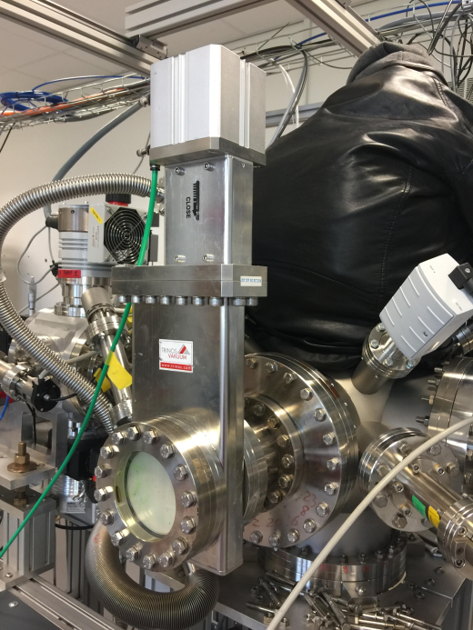
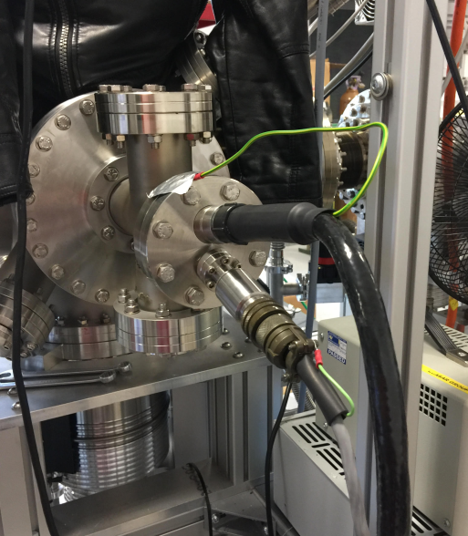
Conditions
E-gun
  Beam current is related to the beam energy.
    Current is read by the default anode reading
    3 keV : 40-45
    10keV: 85-100

Slide 4
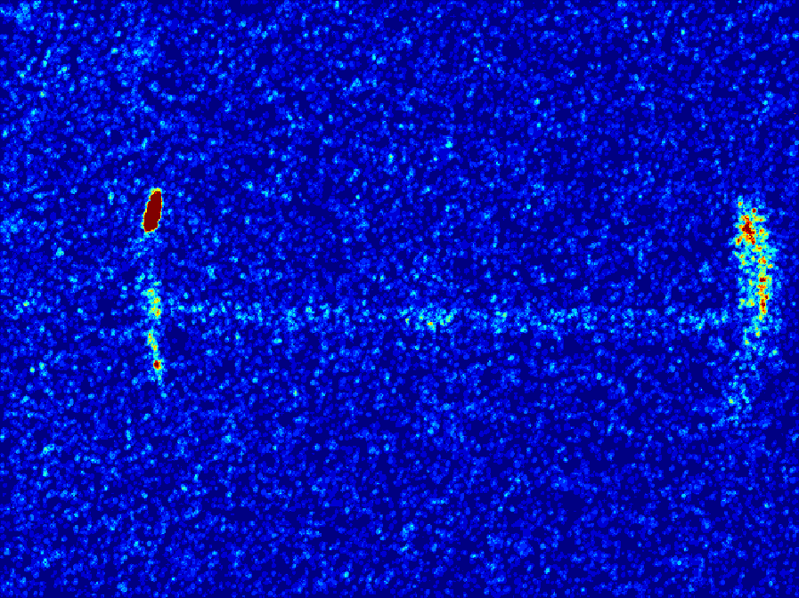
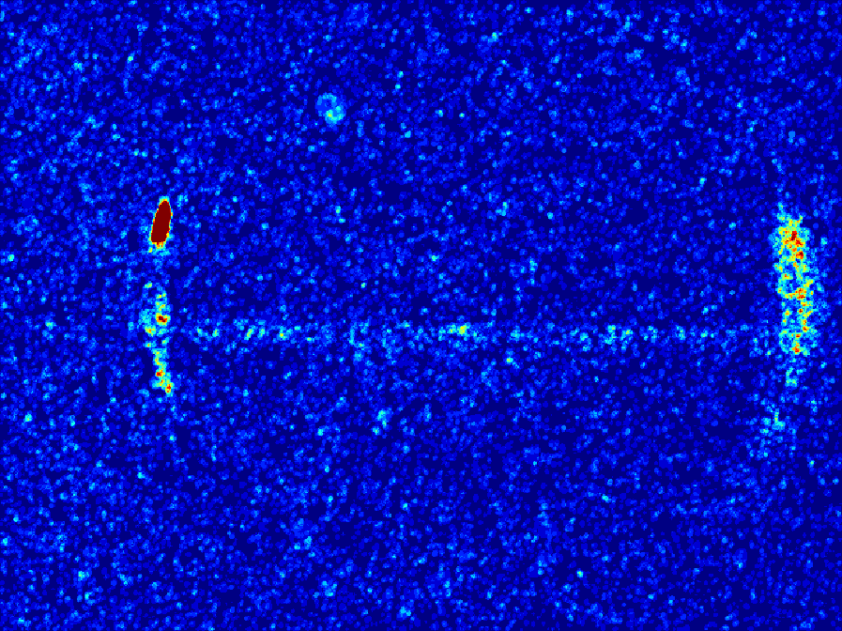
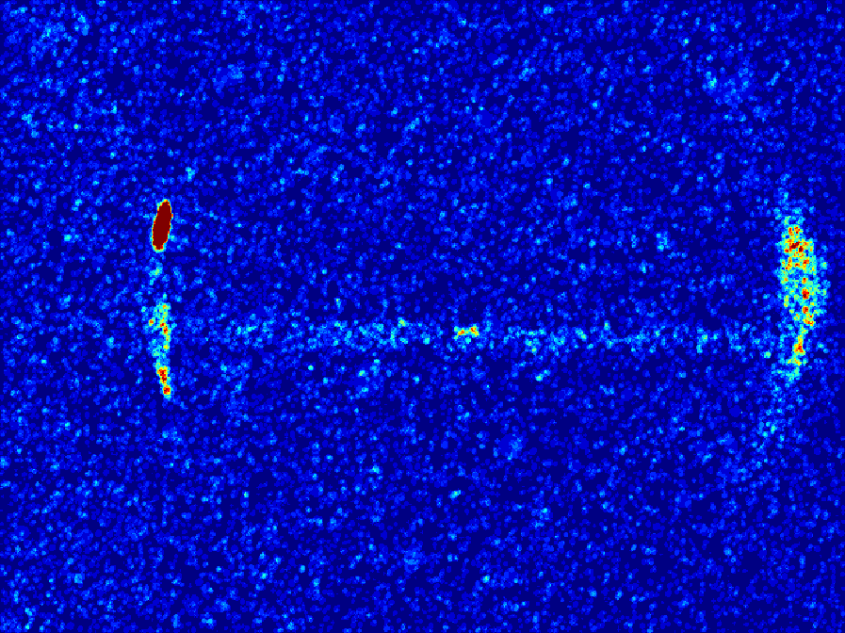
Preliminary results
3 keV

Slide 5
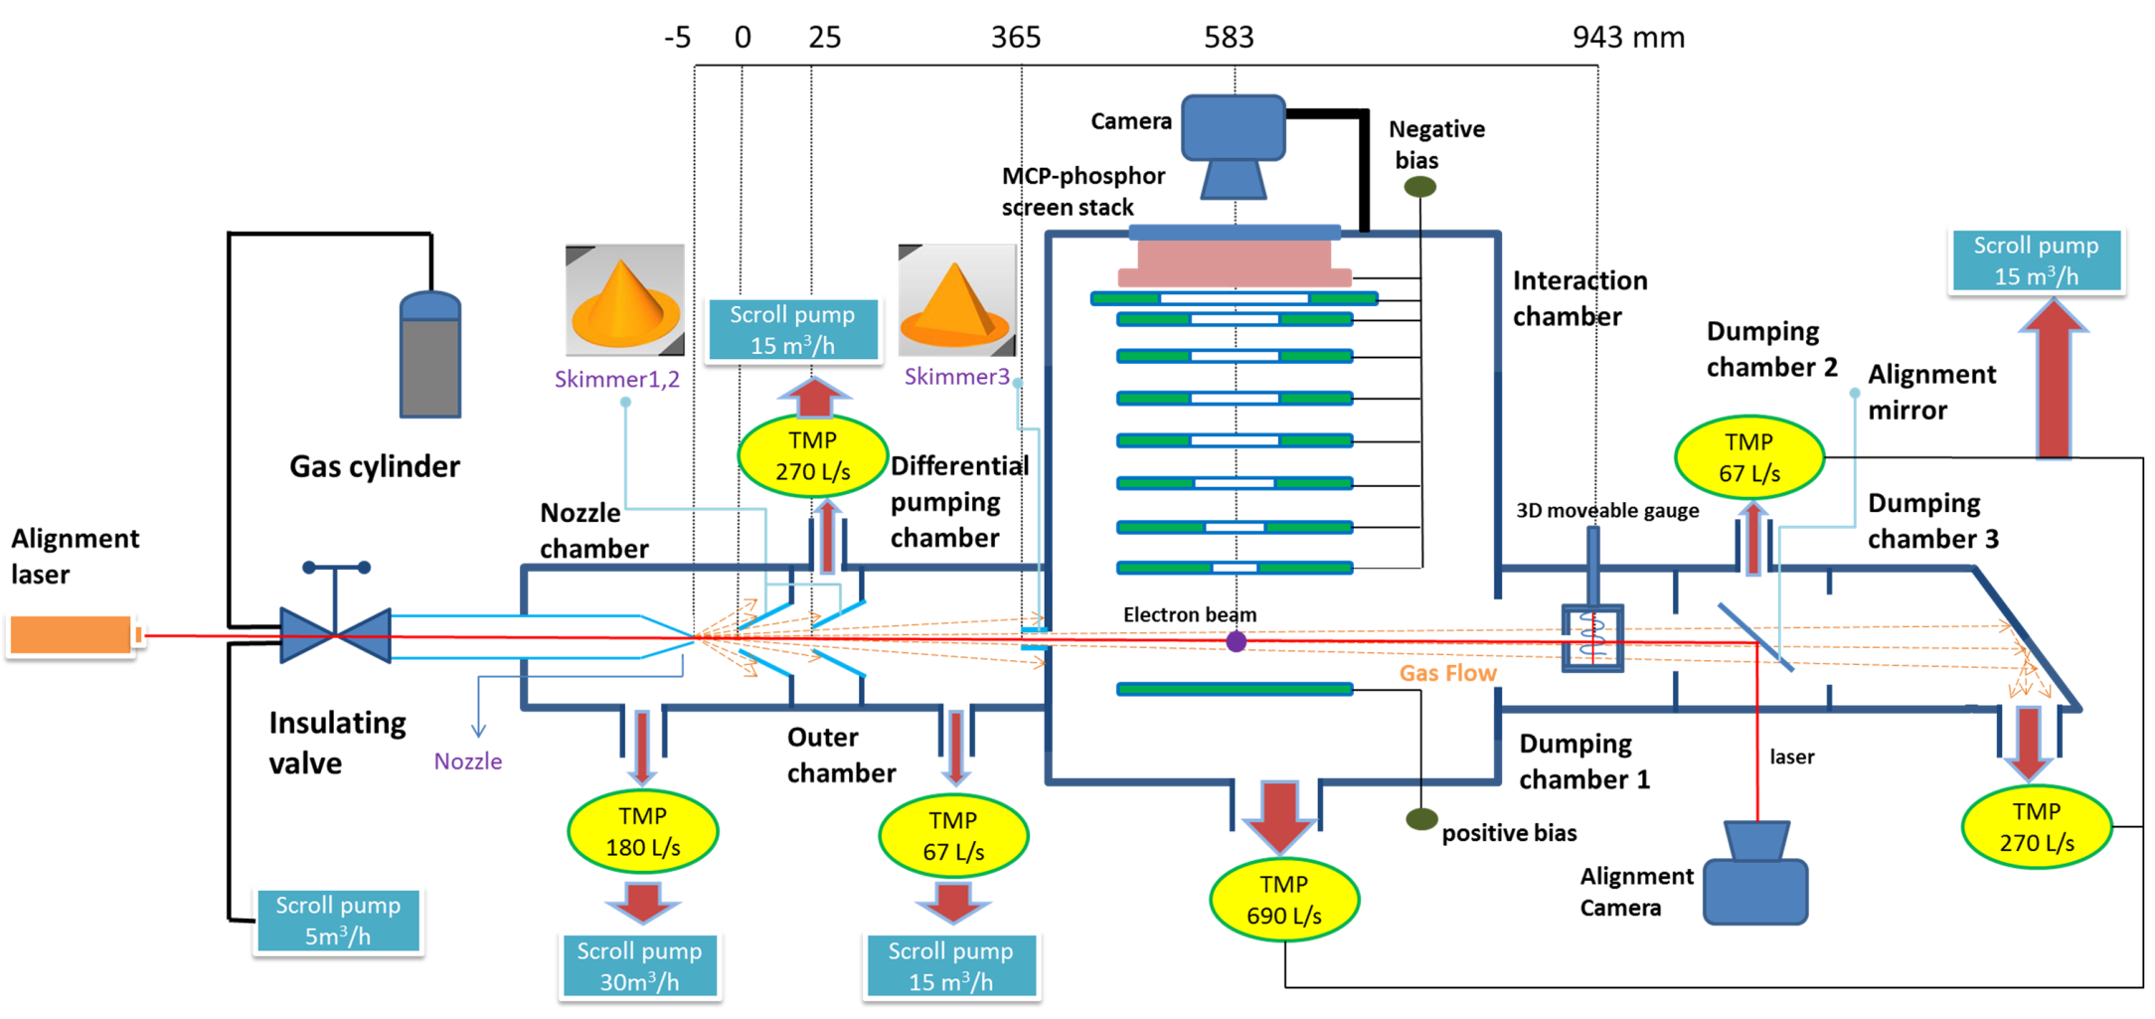
Proposed modification
New E-gun

Slide 6
Turbo pump
Leybold |  | price (exl. VAT) |  | Feature
TURBOVAC 350 i | Hybrit bearing | £3,460.00 |  | 300L/s
MAG W 300 P | Magnetic bearing | £10,563.00 |  | 300L/s
MAG W 700 P | Magnetic bearing | £13,035.94 |  | 700L/s
MAG W 830 | Magnetic bearing | £22,941.42 |  | 800L/s
Pfeiffer |  |  |  |  | CERN Price (2014)
Turbo HiPace 300 Package | Hybrit bearing | £4,241.50 |  | 300L/s | € 3,905.00 | £3,486.61
Turbo HiPace 700 Package | Hybrit bearing | £7,216.50 |  | 700L/s | € 5,241.00 | £4,679.46
Turbo HiPace 800 Package | Hybrit bearing | £8,965.65 |  | 800L/s

Slide 7
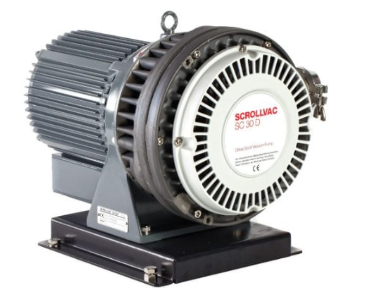
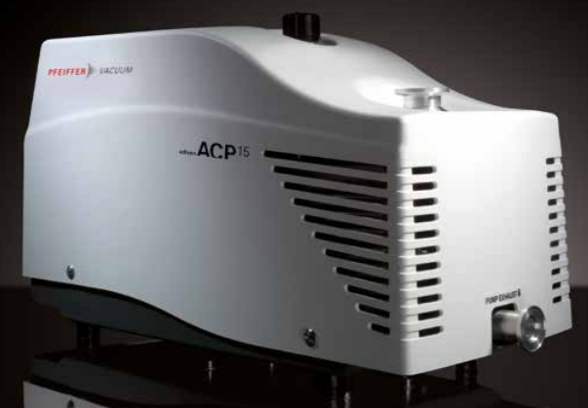
Backing Pump
Leybold |  | price (exl. VAT) |  | Feature | ultimate pressure
SCROLLVAC SC15D | (scroll pump) | £3,967.35 |  | 15m3/h | 1e-2mbar
SCROLLVAC SC30D | (scroll pump) | £6,867.83 |  | 30m3/h | 1e-2mbar
ECODRY 40 plus | (multi-stage roots) | £5,927.70 |  | 40m3/h | 3e-2mbar
Pfeiffer
ACP15 | (multi-stage roots) | £2,465.00 |  | 14 m3/h | 3e-2mbar
ACP28 |  | £2,975.00 |  | 28 m3/h | 3e-2mbar
ACP40 |  | £3,400.00 |  | 40 m3/h | 3e-2mbar

