Slide 1
Effect of mirror on illumination

Slide 2
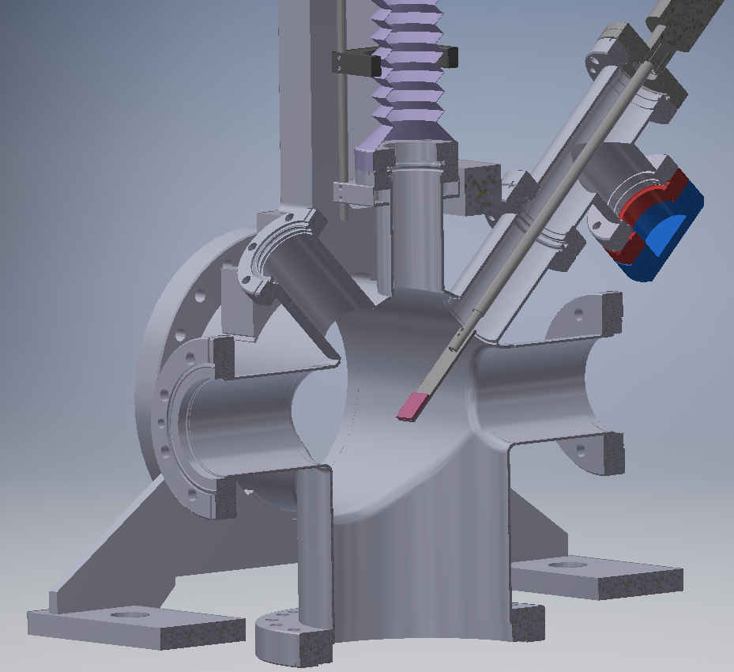
Setup received from Serban
The idea is to illuminate a target with a LED light after several reflections
Window
LED
Target
Original setup

Slide 3
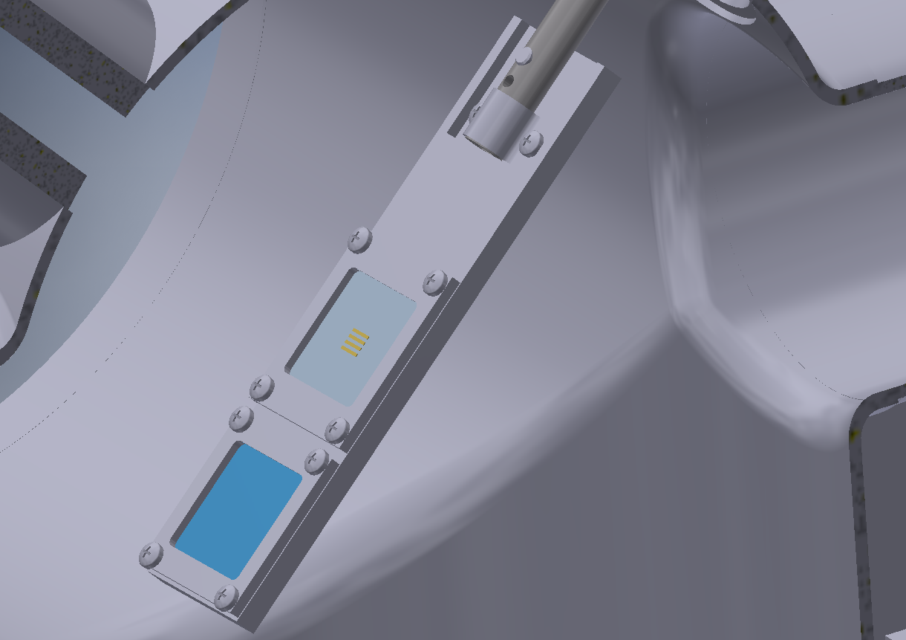
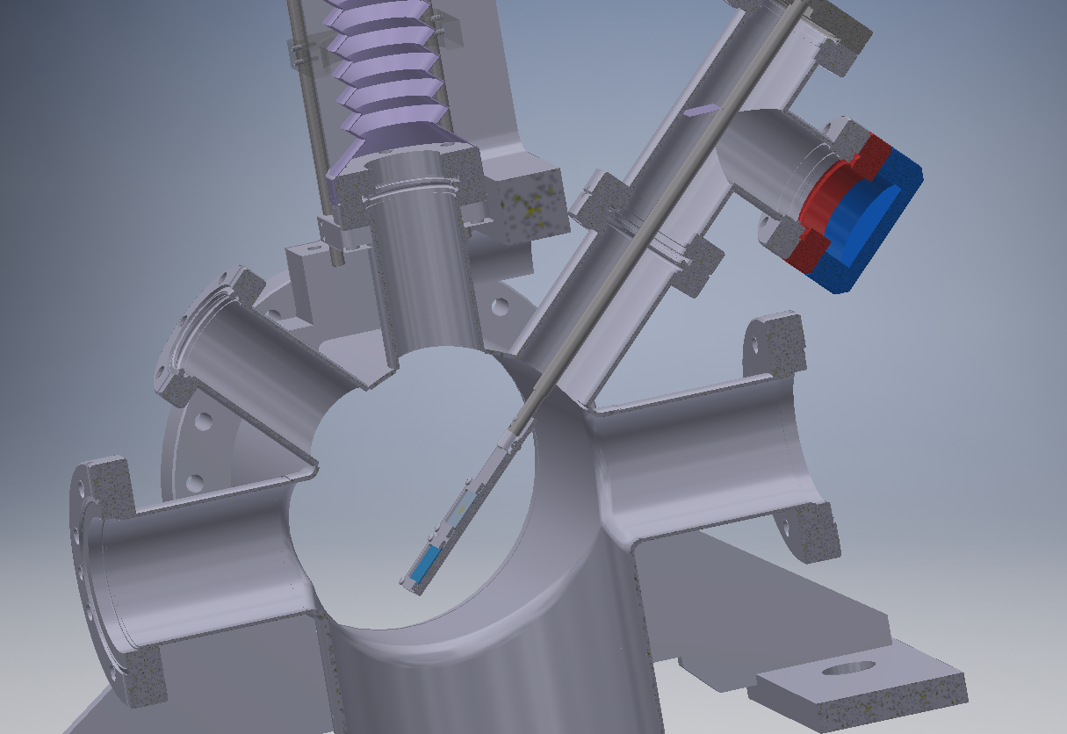
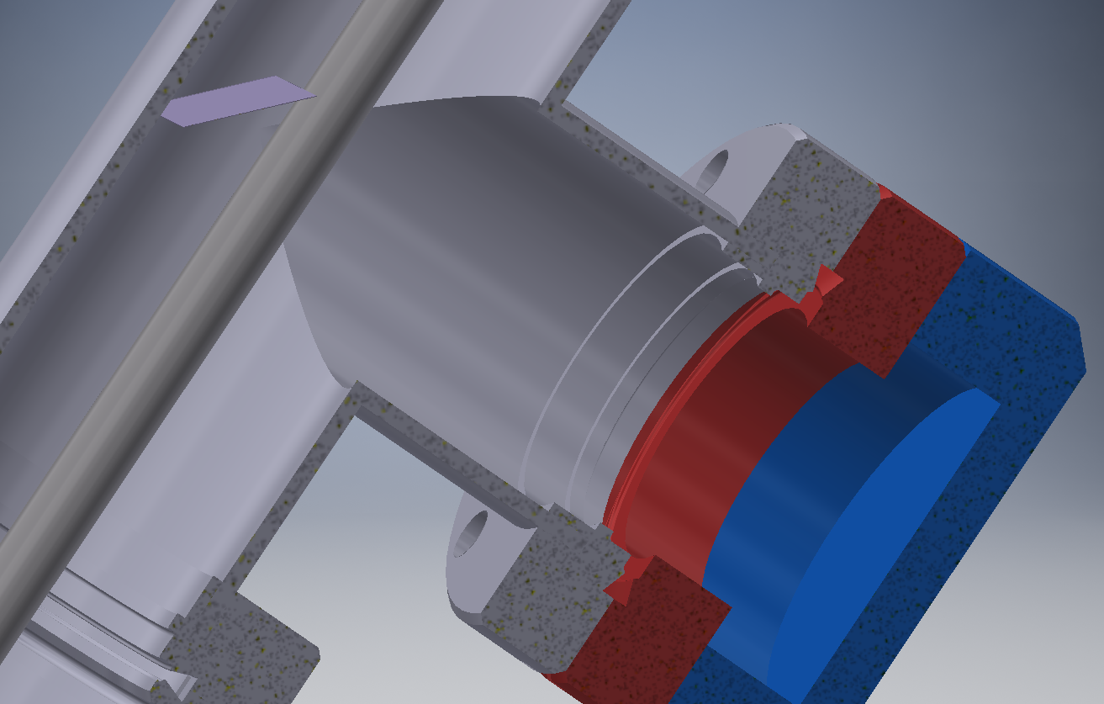
Mirror and new holder

Slide 4
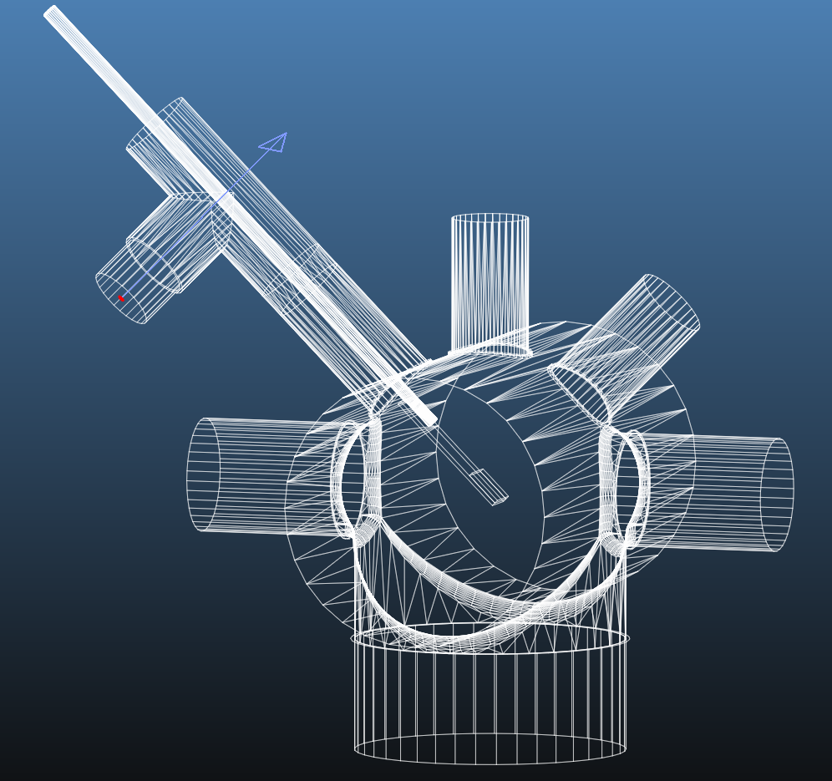
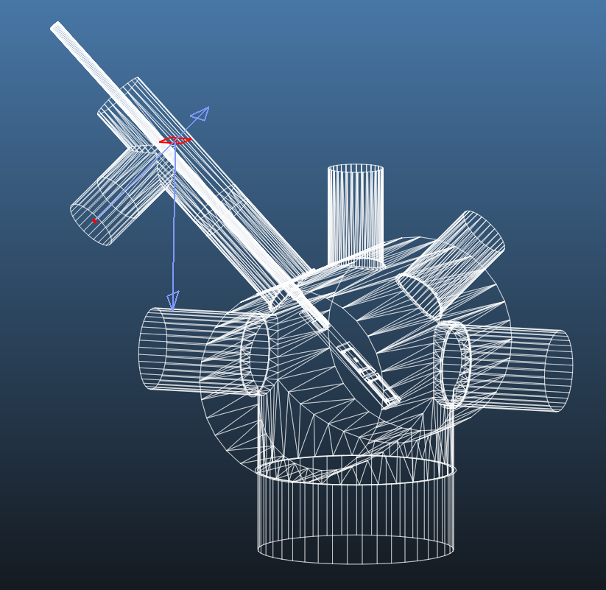
Original setup
Mirror and new holder

Slide 5
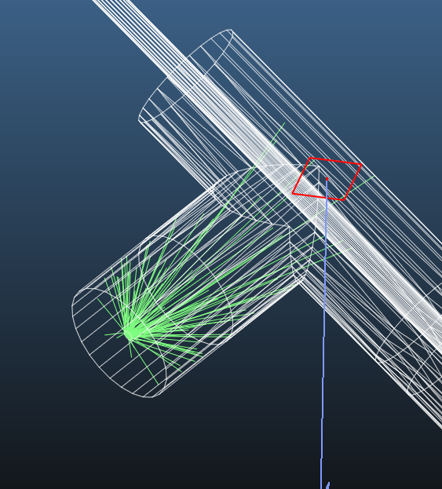
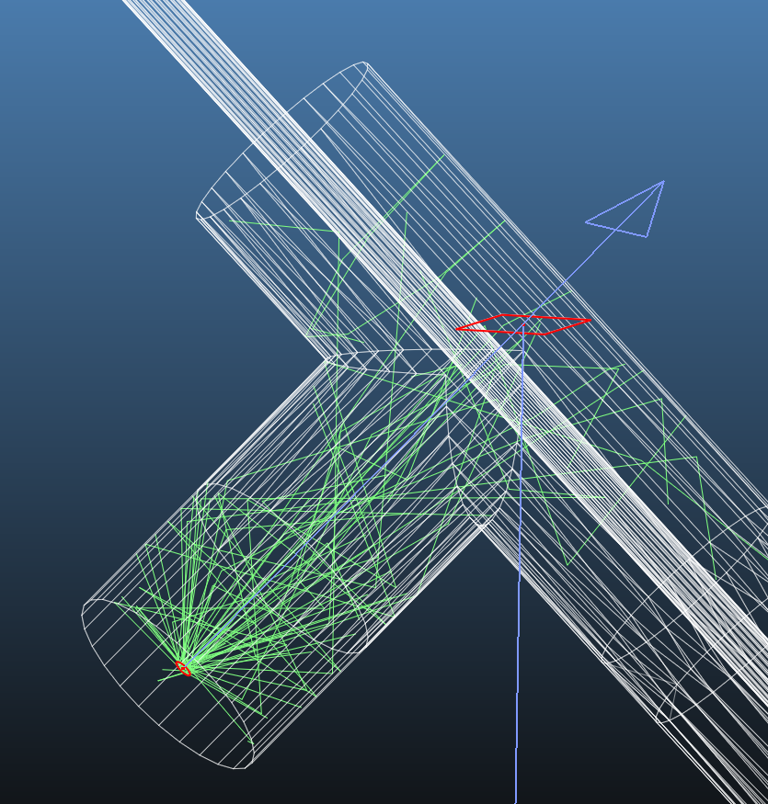
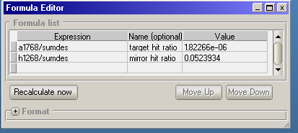
0.7% to mirror
5.2% to mirror

Slide 6
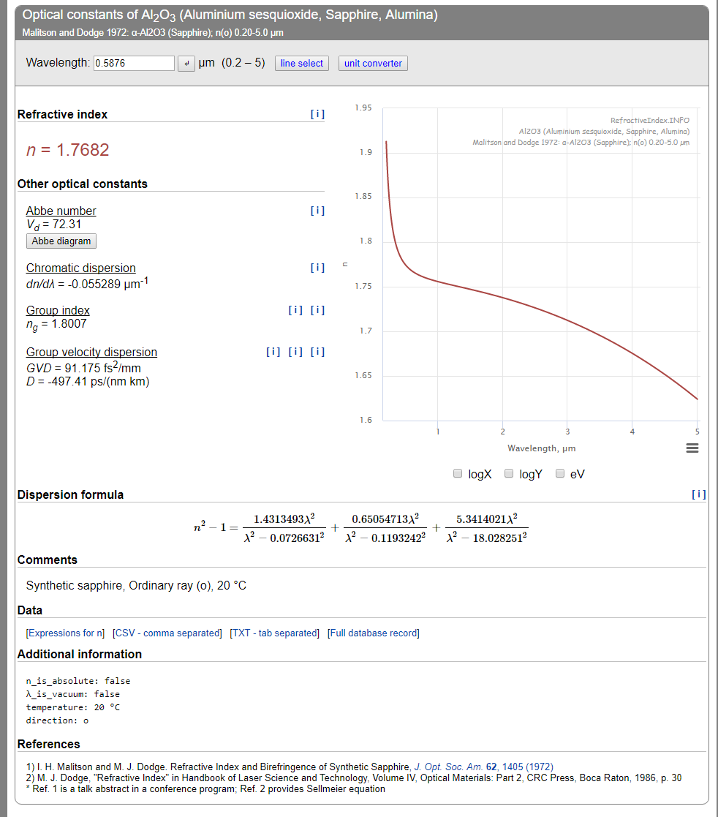
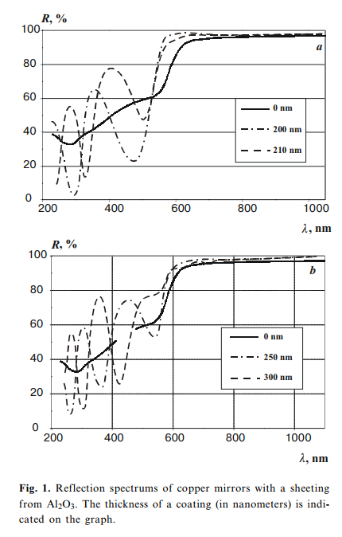
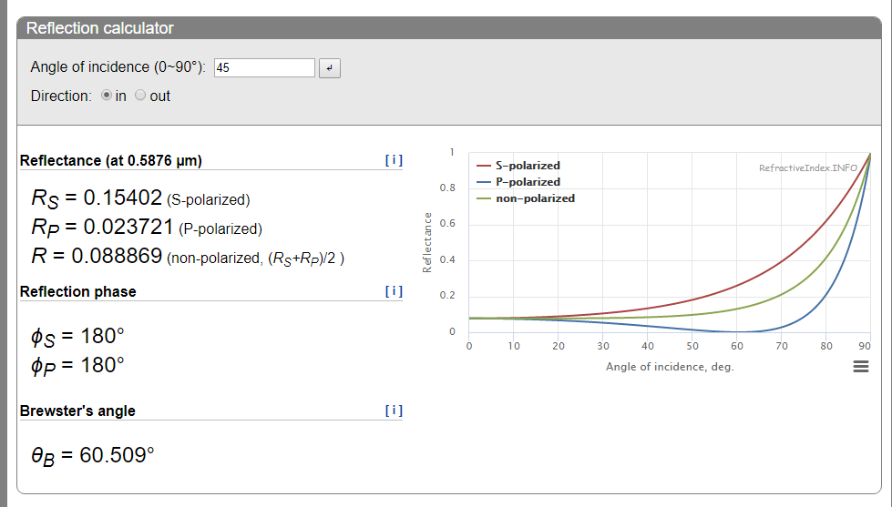

Slide 7
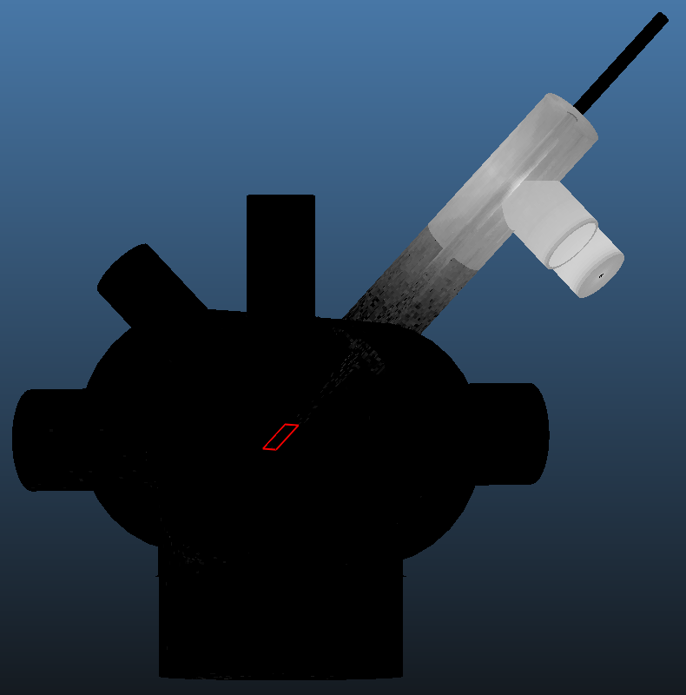
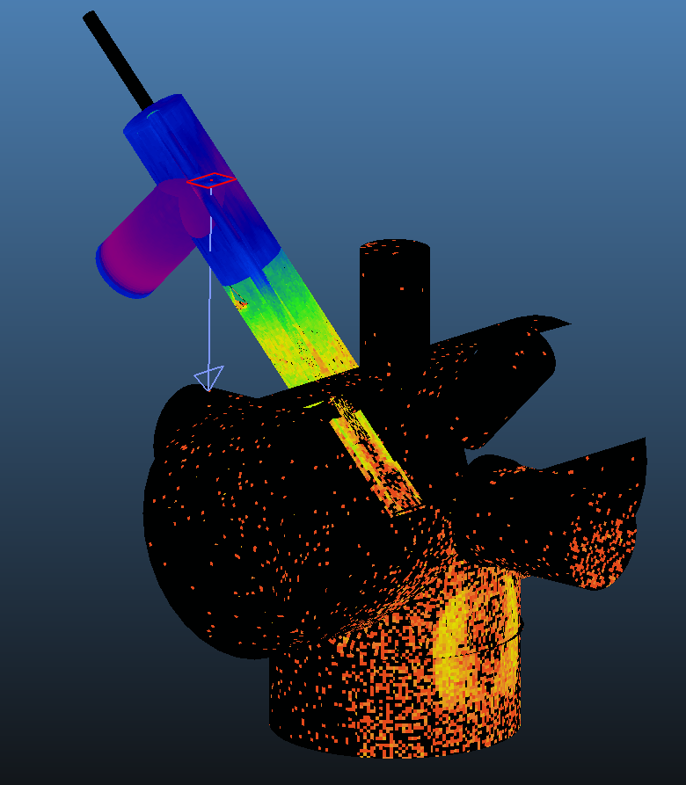
Original setup
Mirror and new holder

Slide 8
Reflectivity | Reflection diffuse part | Photons reaching target | Target illumination
60% | 10% | 1.7E-5 | 46 lux
60% | 30% | 1.8E-5 | 48 lux
60% | 50% | 1.9E-5 | 51 lux
70% | 10% | 6.2E-5 | 150 lux
10% | 50% | 1.0E-6 | 4 lux
10% | 50% | 1.8E-6 | 7 lux
60% | 10% | 2.9E-2 | 75.000 lux
10% | 50% | 8.3E-3 | 23.000 lux
Stainless steel
Blackened
Blackened + mirror
Direct (Stainless steel)
Direct (Blackened)

Slide 9
Skimmer analysis

Slide 10
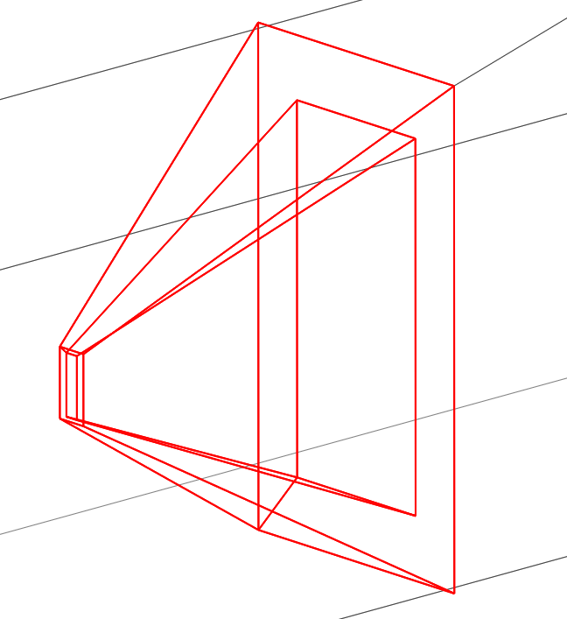
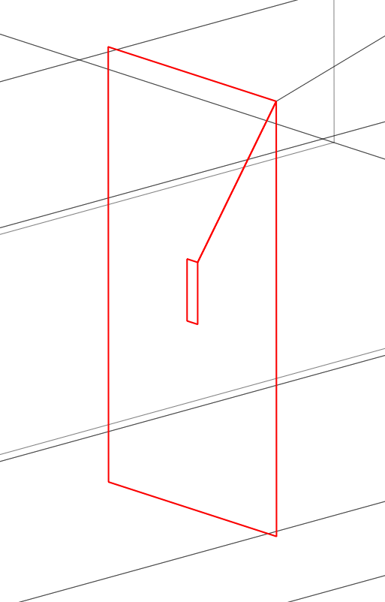
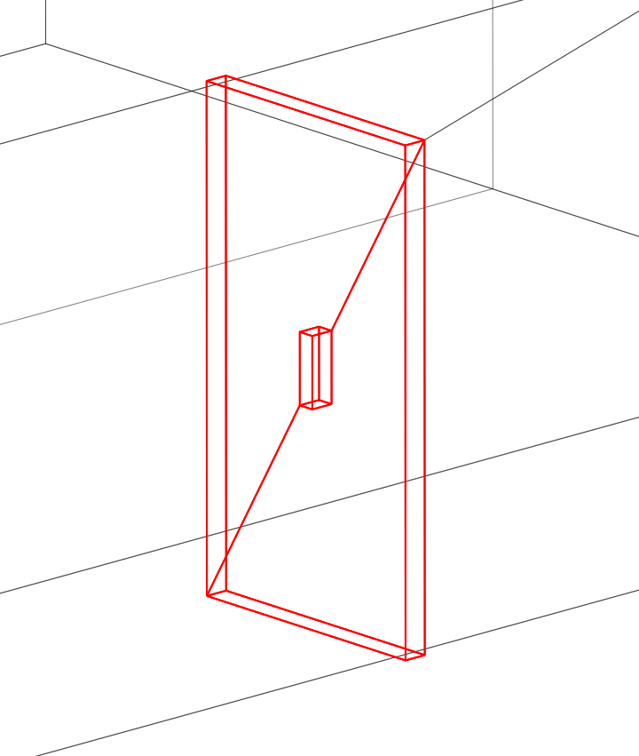
Original ‘pyramid’ skimmer
78x18mm
Thin plate with hole
(theoretical)
Thick plate with hole
(3mm thickness)

Slide 11
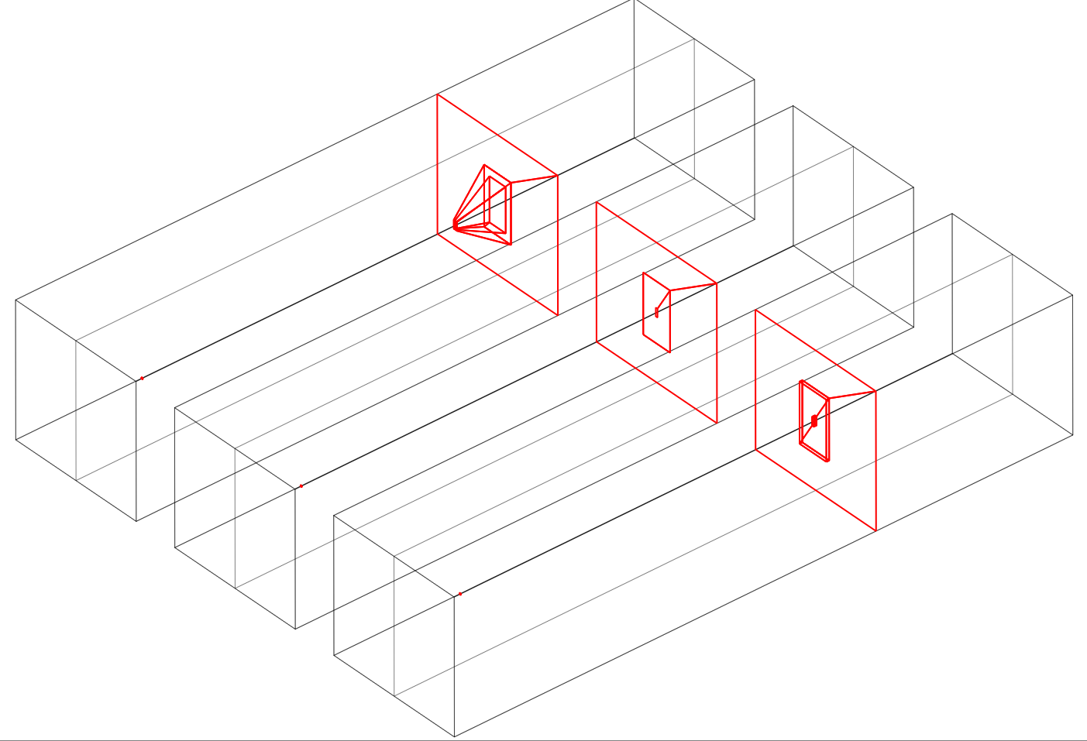
90% sticking targets
Diffuse + directed desorption
Representing skimmer2
10% sticking walls

Slide 12
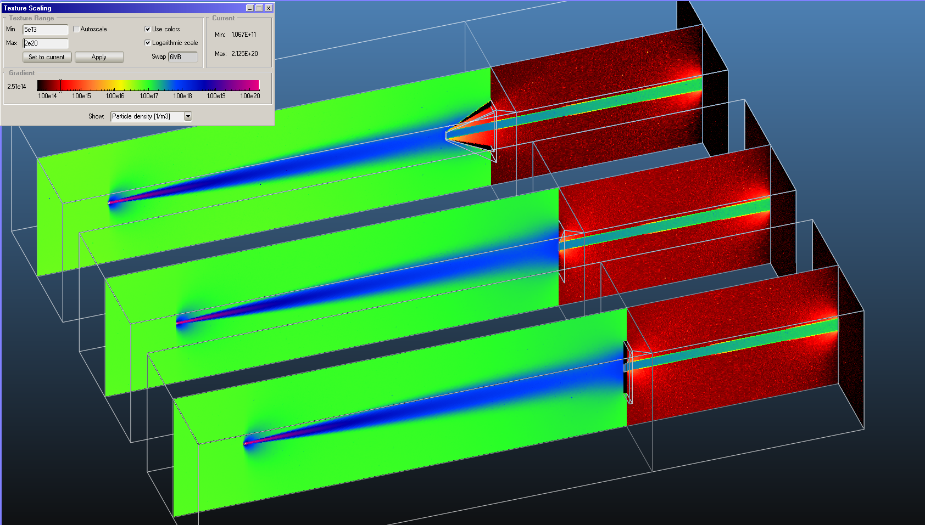
Density

Slide 13
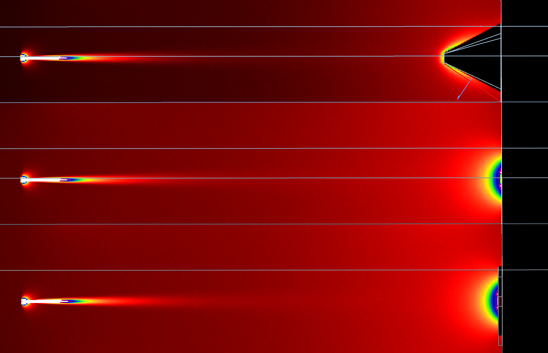
Impingement rate

Slide 14
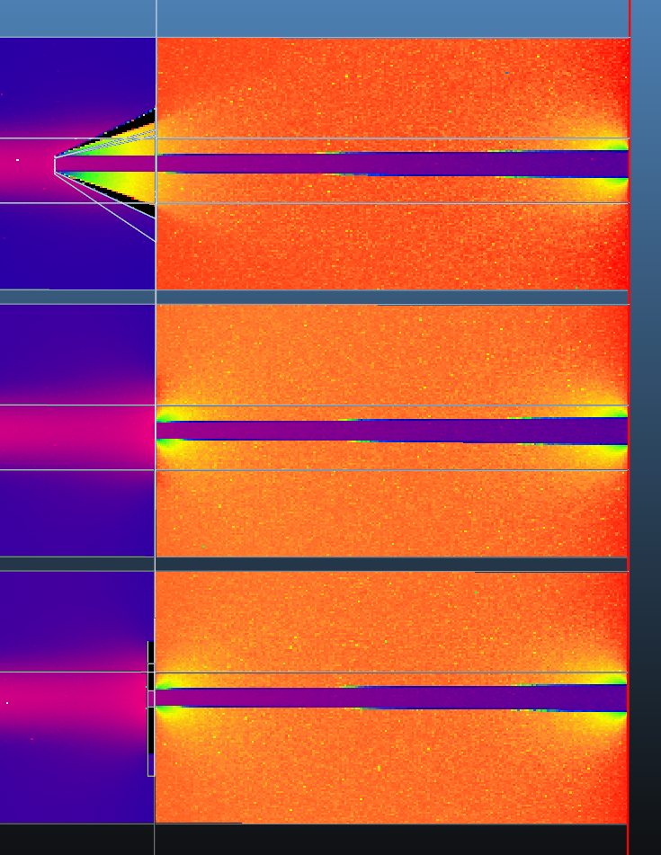
Density

Slide 15
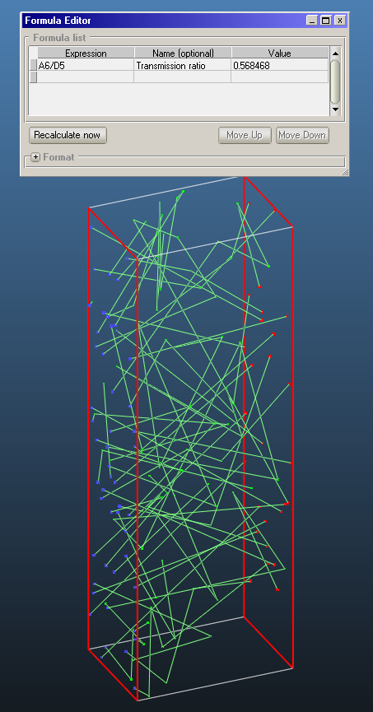
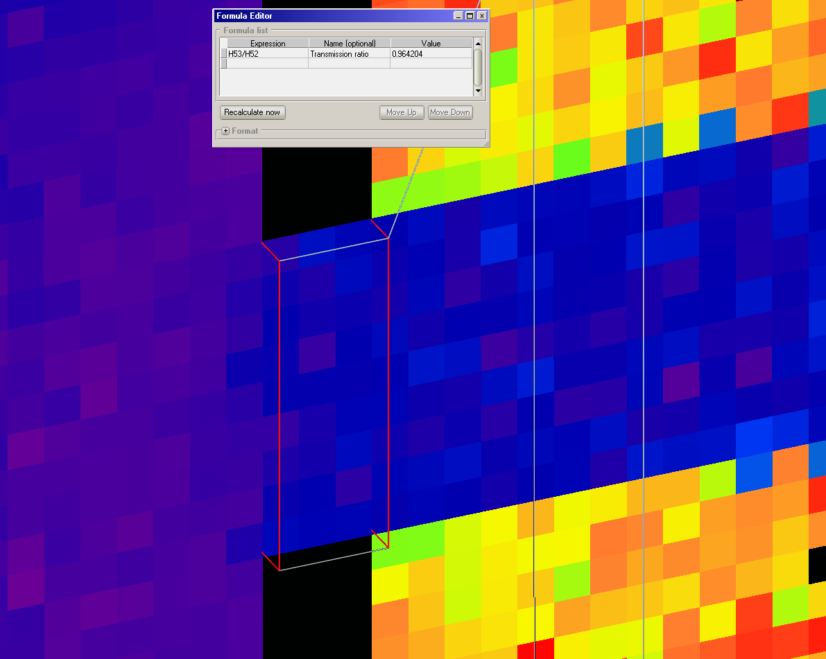
Oriented gas jet
96% transmission
Cosine desorption
57% transmission

Slide 16
Gas jet densities

Slide 17
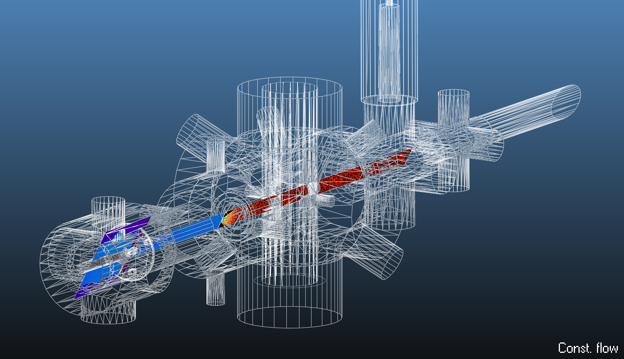
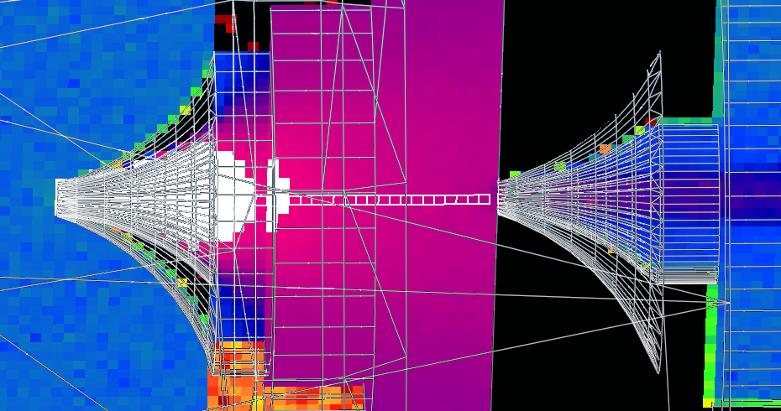

Slide 18
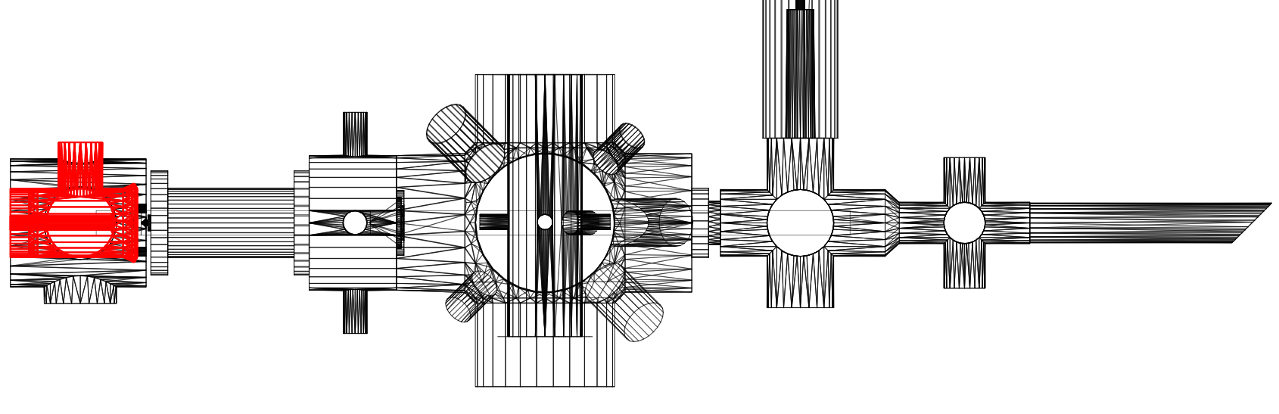
1
2
5
3
4
Mark | Name | Pressure (molflow) | BG Density (molflow) | Density_bg /pressure | Real diff | corr factor | Normalized pressure | Normalized density
1 | Between skimmers 1 - 2 | 3.20E-03 | 8.10E+19 | 2.53E+22 | 5.00E-06 | 1.56E-03 | 5.00E-06 | 1.27E+17
2 | Between skimmers 2 - 3 | 2.30E-04 | 5.70E+18 | 2.48E+22 | 1.70E-07 | 7.39E-04 | 3.59E-07 | 8.91E+15
3 | Interaction chamber | 5.13E-07 | 1.27E+16 | 2.48E+22 | 6.00E-09 | 1.17E-02 | 8.02E-10 | 1.98E+13
4 | Ionization chamber | 4.30E-07 | 1.00E+16 | 2.33E+22 |  |  | 6.72E-10 | 1.56E+13
5 | Last pump | 3.00E-07 | 7.00E+15 | 2.33E+22 | 3.60E-10 | 1.20E-03 | 4.69E-10 | 1.09E+13

Slide 19
1
2
5
3
4

