Slide 1
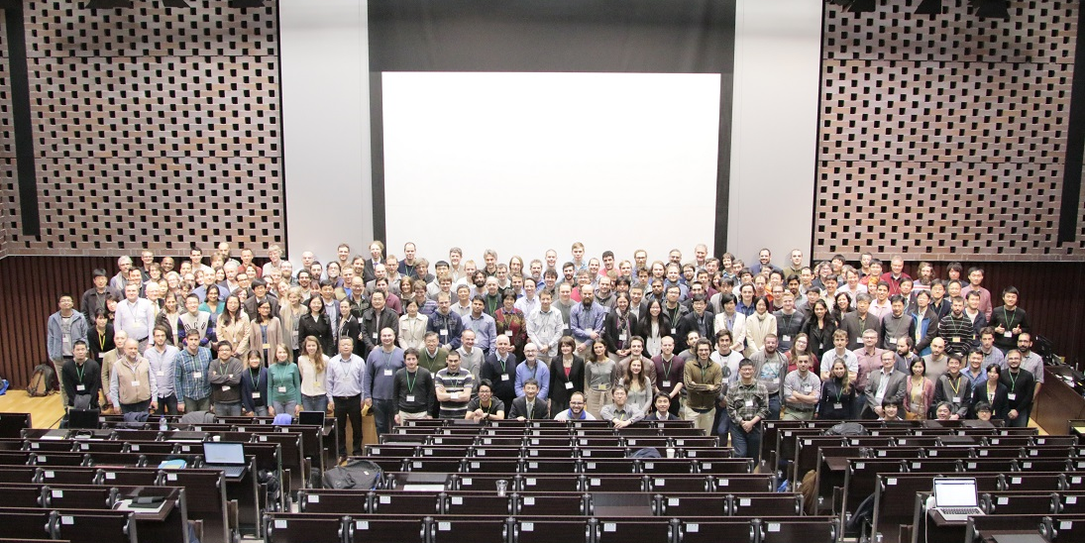
It is hard to say farewell …
253 participants
from 32 nations

Slide 2
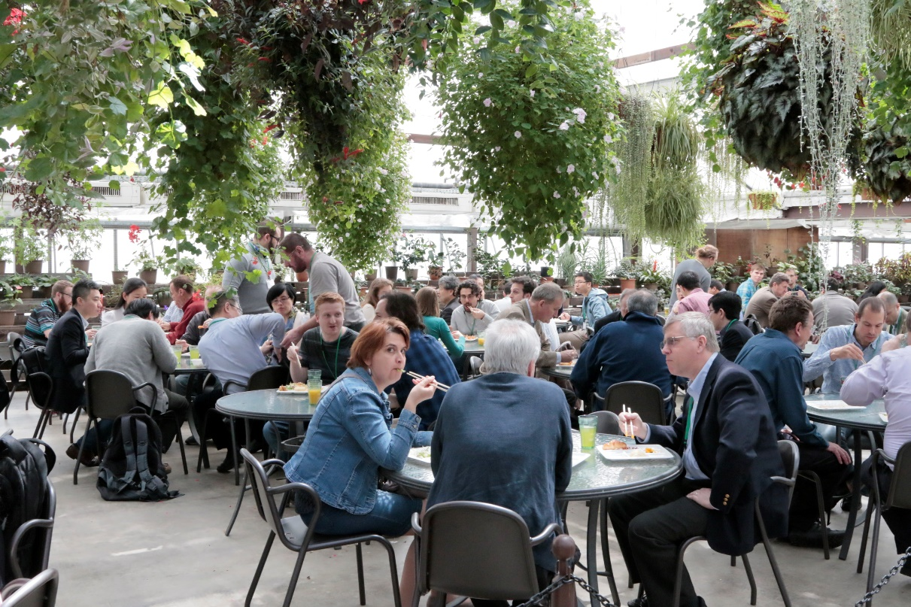
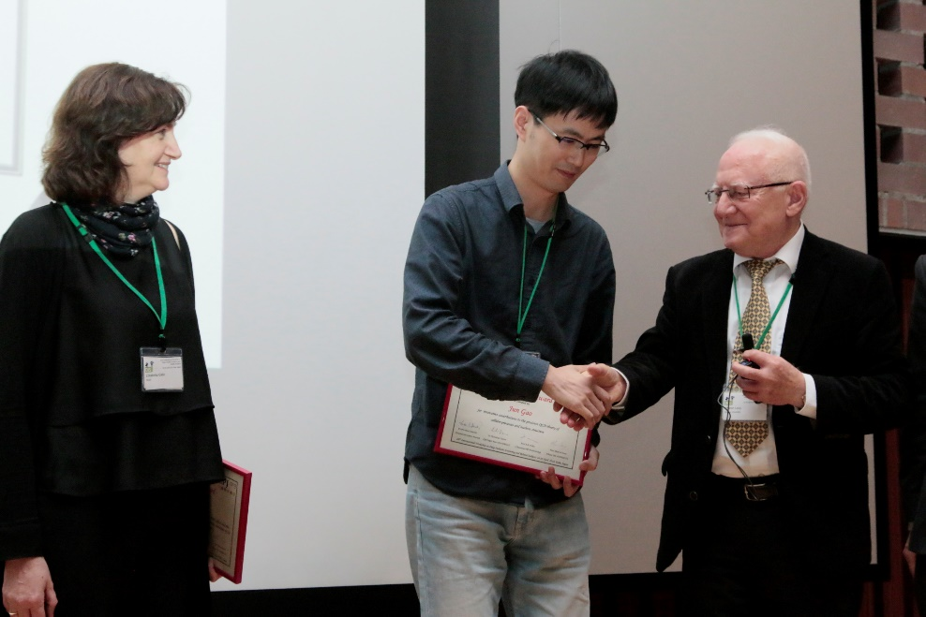
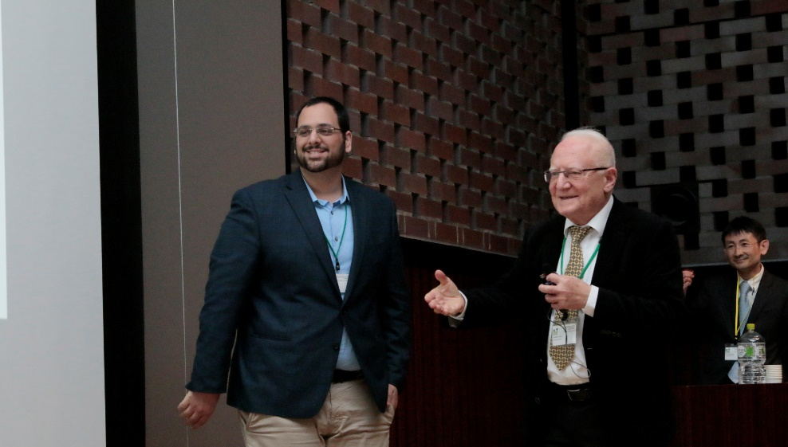
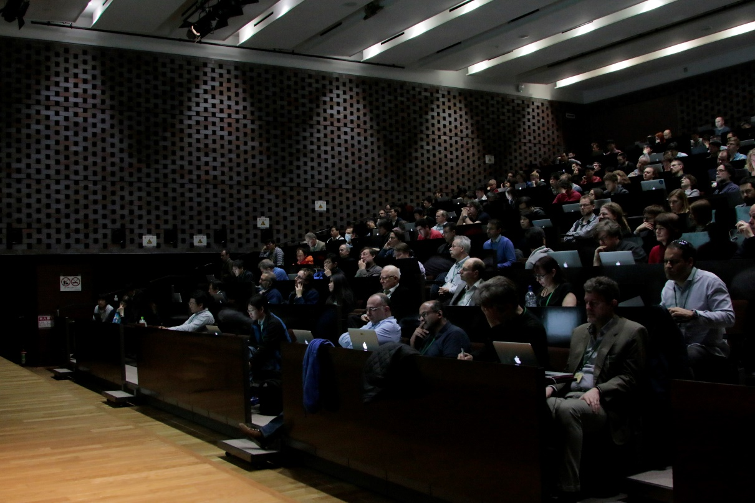
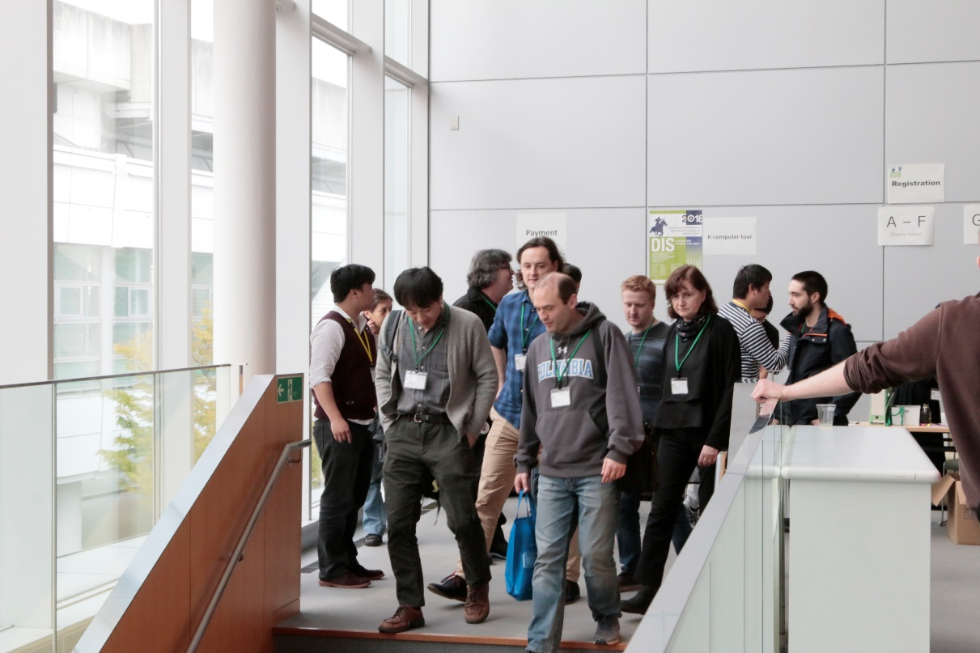

Slide 3
Proceedings
Chief editor: Koji Terashi (Tokyo ICEPP / ATLAS)
  Will be published online by PoS / SISSA
  Speakers will receive E-mail instruction for template and how to upload to the PoS site
  You find the contributions eventually at:
  https://pos.sissa.it/316/
Deadline: 30 June 2018

Slide 4
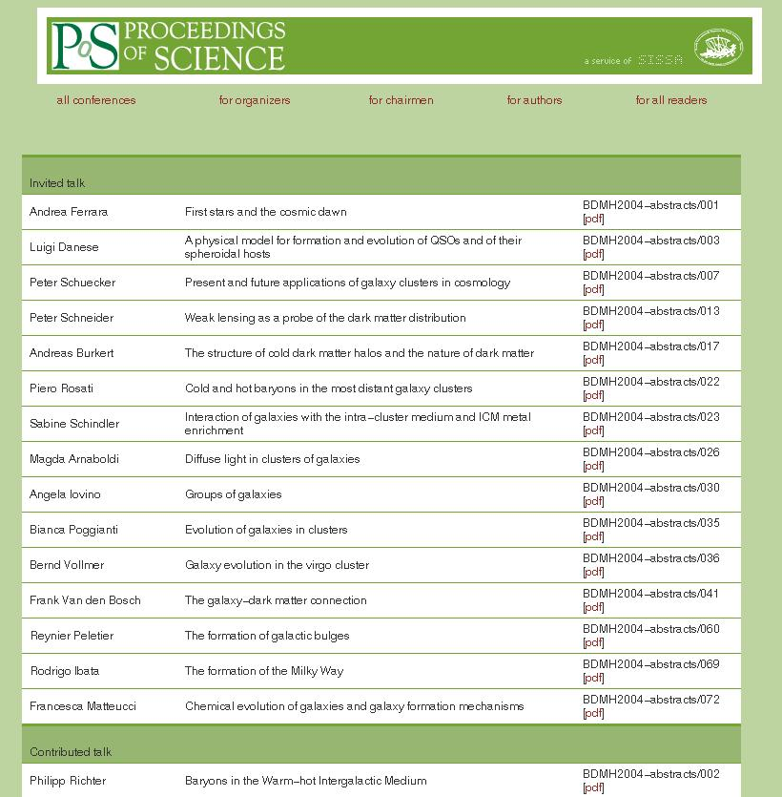
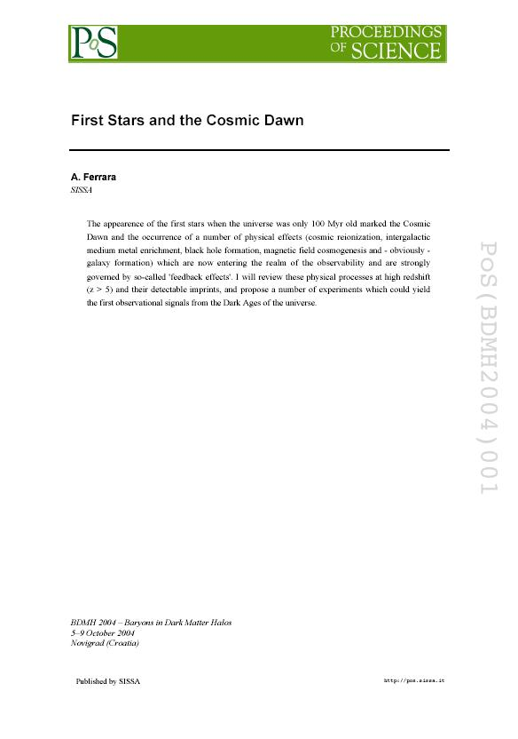
The proceedings for DIS2018 will be published on PoS
authors will be contacted by the organisers and provided with login data to access their personal pages on PoS (where the style files are available)
from their PoS pages authors can upload a PDF file (plus any attachments), with a simple two-step procedure.
For more information please contact:
pos-eo@sissa.it (PoS Editorial office)

Slide 5
Dear _AUTHOR_FIRSTNAME_ _AUTHOR_MIDDLENAME_ _AUTHOR_LASTNAME_,
Following the "XXVI International Workshop on Deep-Inelastic Scattering and Related Subjects" event, you are invited to submit your contribution for the conference proceedings.
Please login to your author pages at
https://pos.sissa.it/cgi-bin/reader/login.cgi
For first access or to recover your password, please go to
https://pos.sissa.it/cgi-bin/reader/recovery_pwd.cgi
(please note that your e-mail on our systems is "_AUTHOR_EMAIL_")
Your contribution must be set in the PoS style and uploaded in the form of a pdf file as specified in the instructions available at https://pos.sissa.it/cgi-bin/reader/info.cgi?p=authors
As PoS authors, you are requested to submit a PDF file, and are free to produce this in your favourite way. Please note though that the paper format must be A4 and not US letter, so that the green PoS logo on the title page does not appear partly cut off.
When you login to your Author pages on PoS you will find a link "Workarea". By clicking there and then on the link "template files and instructions" you will download a ZIP file which contains the following:
1. Instructions (pdf),
2. The word processing template (PoStemplate.odt; software available at, for instance, http://www.openoffice.org/)
3. The LaTeX class file (PoS.cls) with the PoS logo (PoSlogo.ps or PoSlogo.png)
For LaTeX users: unzip the file, save the class and the logo in your working directory, then use the skeleton file to create your contribution.
Speakers will receive an E-mail
with instruction

Slide 6





Thanks to our sponsors for support
CERN
DESY
Kobe Convention Bureau
Tsutomu Nakauchi Foundation for Promoting Conventions
RIKEN
KEK
Grant-in-Aid for LHC (MEXT)
… and others …

Slide 7
Thanks to …
LOC members:
Yuji Goto (RIKEN)
Kazunori Hanagaki (KEK)
Masaki Ishitsuka (Tokyo University of Science)
Kentaro Kawade (Kobe University)
Hisaya Kurashige (Kobe University)
Masahiro Kuze (Tokyo Institute of Technology)
Junpei Maeda (Kobe University)
Yoshiyuki Miyachi (Yamagata University)
Itaru Nakagawa (RIKEN)
Masayuki Niiyama (Kyoto University)
Toshi Sumida (Kyoto University)
Junichi Tanaka (ICEPP, The University of Tokyo)
Kiyoshi Tanida (JAEA)
Koji Terashi (ICEPP, The University of Tokyo)
Makoto Tomoto (Nagoya University)

Slide 8
Thanks to …
Our scientific secretaries
Chief: Shima Shimizu
Keisuke Amimoto Sakiko Ashikaga
Hikaru Hirata Hirohisa Ishiura
Shogo Kido Koichiro Kuniyoshi
Keita Mizukoshi Tomohiro Ikeda
Genta Muroyama Takuma Nakamura
Yuta Okazaki Hikaru Setsuda
Tomohiro Shiozawa Kosuke Takeda
Chen Ye

Slide 9

… and special thanks to …
our conference secretaries from KEK and RIKEN
Rie Sakamoto
Ritsuko Ota
Sachiko Arimoto (visa)
Keiko Suzuki
Midori Yamamoto

Slide 10
Thank you again to all of you
Thank you for your joining us,
taking and discussing ….
Hope you have time to relax
and still enjoy a different part of the globe

Slide 11
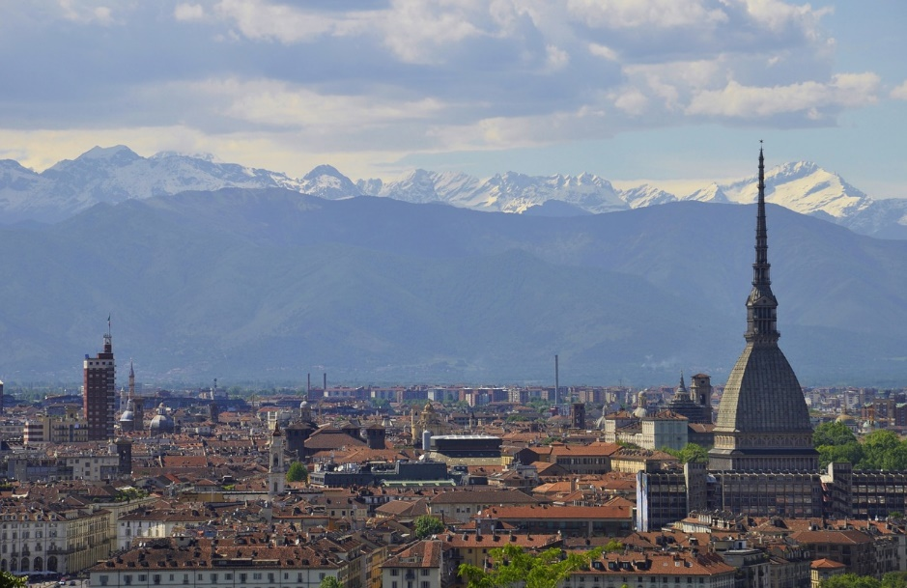
See you again in Turin!

