Slide 1
Measurement of CLICpix2
Power Supply Bounces
Edinei Santin
CERN, July 27th 2017

Slide 2
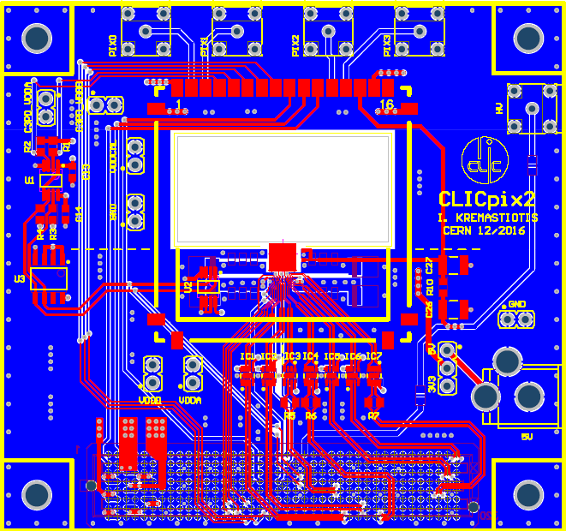
Measurement conditions
The V_{DD} measurements were performed as follows:
  After normal power on and configuration sequence (all pixels unmasked), the command “acquire 1 1 filename 0” was called manually and the scope triggered to the rising edge of PWR_ACQ
  PWR_ACQ pulse duration is 100 µs and SHUTTER is 60 µs, starting 40 µs later and finishing simultaneously with PWR_ACQ
  After PWR_ACQ/SHUTTER sequence, the readout is performed
  The V_{DD}’s were measured at PCB level (ac coupled)
Boards used:
  CaR board #3
  Chip board #2
  measurement points →

Slide 3
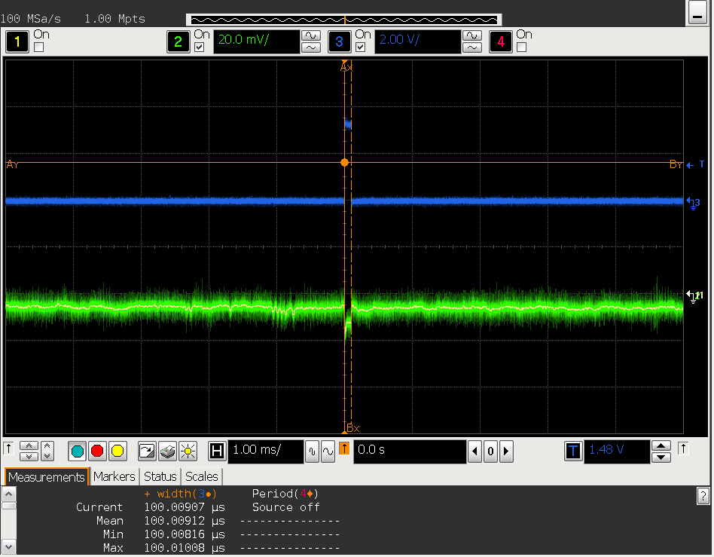
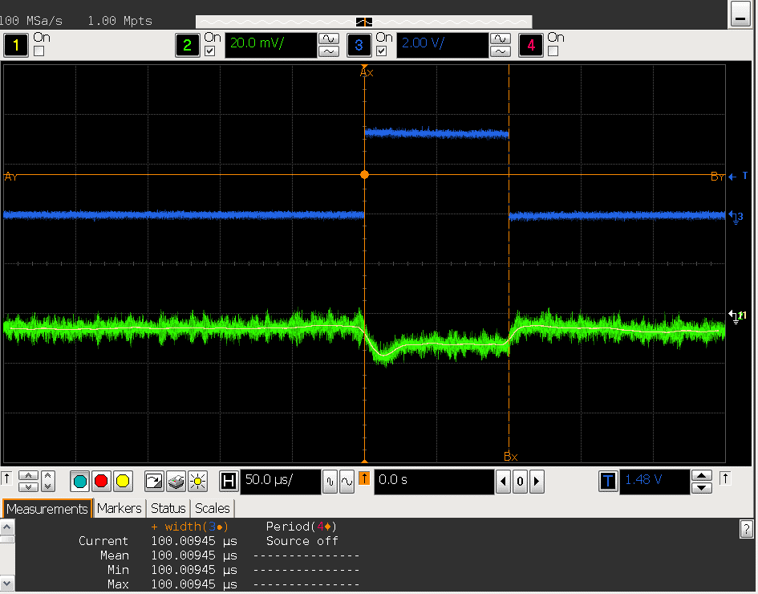
V_{DD,DIG} with pp_en_n = 0
zoom in
PWR_ACQ
←
V_{DD} (ac component)
10 ms
500 µs
There is a bounce of ~ 10 mV when PWQ_ACQ rises, which settles in ~ 25 µs

Slide 4
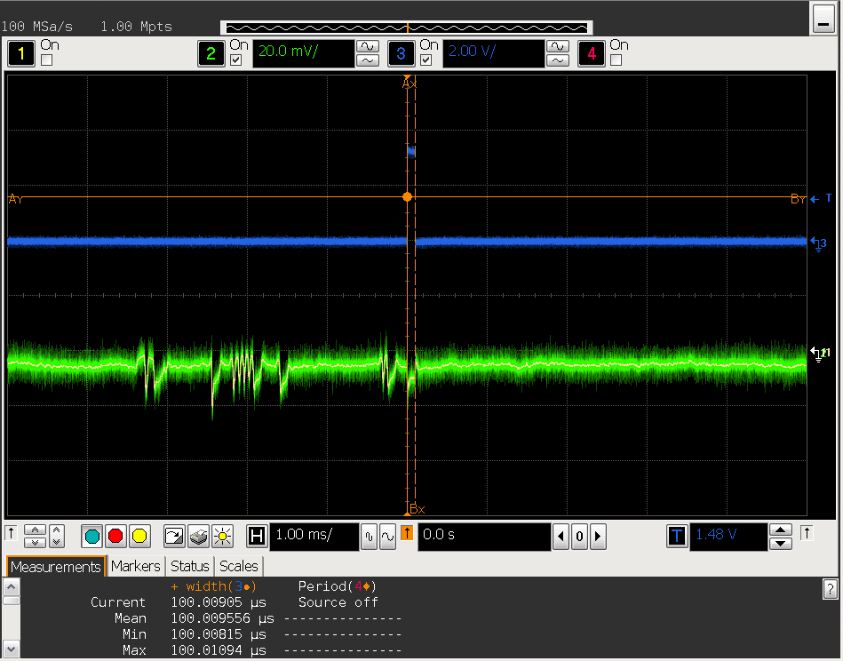
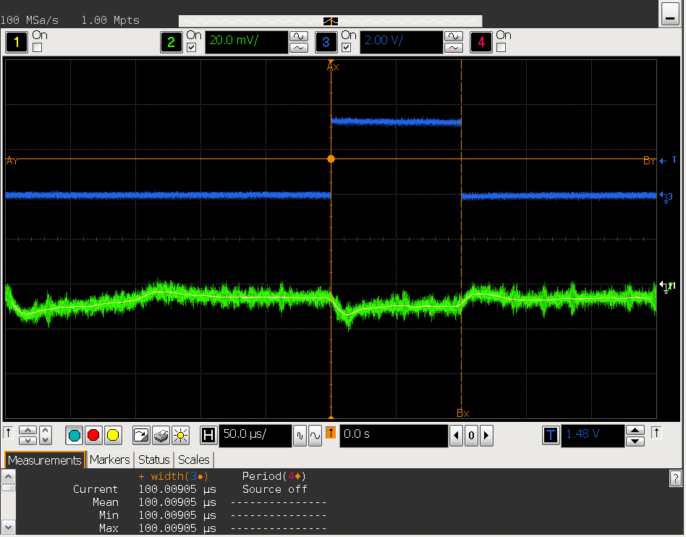
V_{DD,ANA} with pp_en_n = 0 (1/..)
zoom in
10 ms
500 µs
There is a bounce of ~ 5 mV when PWQ_ACQ rises, which settles in ~ 25 µs

Slide 5
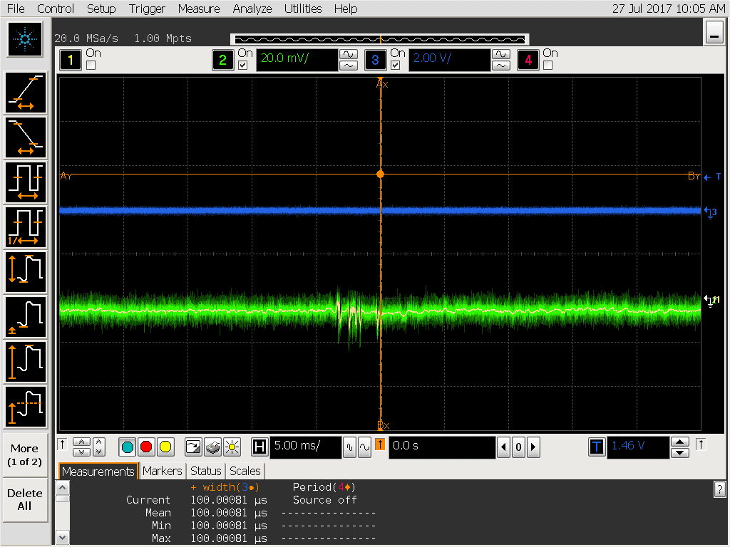
V_{DD,ANA} with pp_en_n = 0 (2/2)
zoom out
10 ms
50 ms
There is also a strange bounce pattern preceding PWR_ACQ. The pattern is roughly the same between acquisitions and it happens roughly at the same time wrt PWR_ACQ
It is not clear what causes these bounces, since chip should be quiet during that time

Slide 6

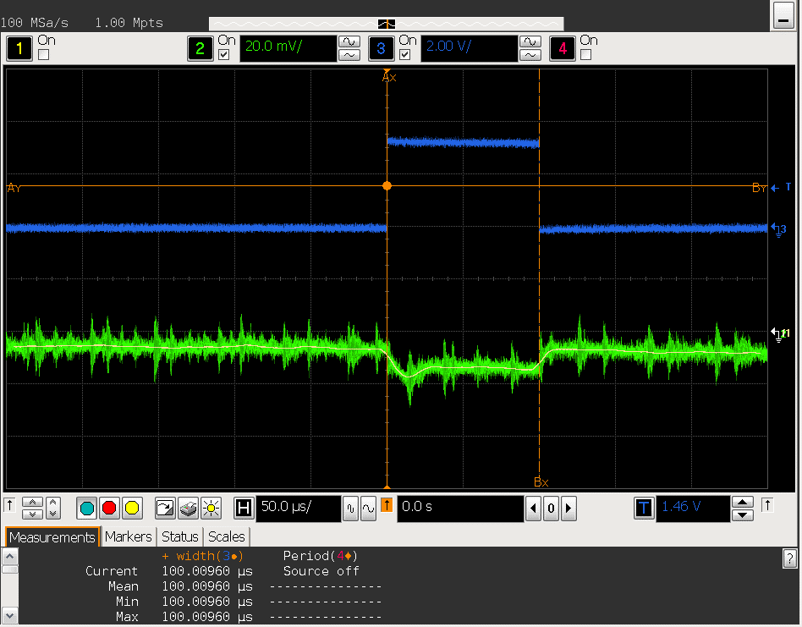
V_{DD,DIG} with pp_en_n = 1
zoom in
10 ms
500 µs
There is a bounce of ~ 10 mV when PWQ_ACQ rises, which settles in ~ 25 µs. Very similar to the case when pp_en_n = 0.

Slide 7
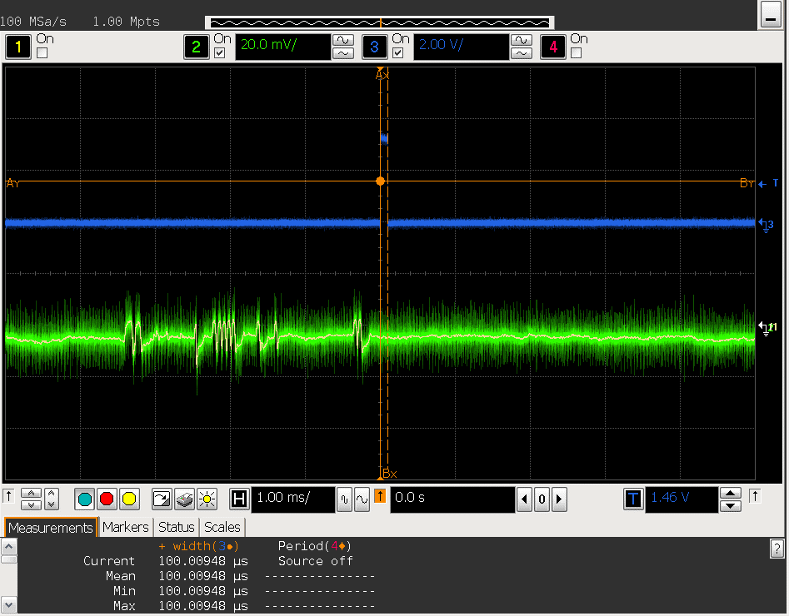
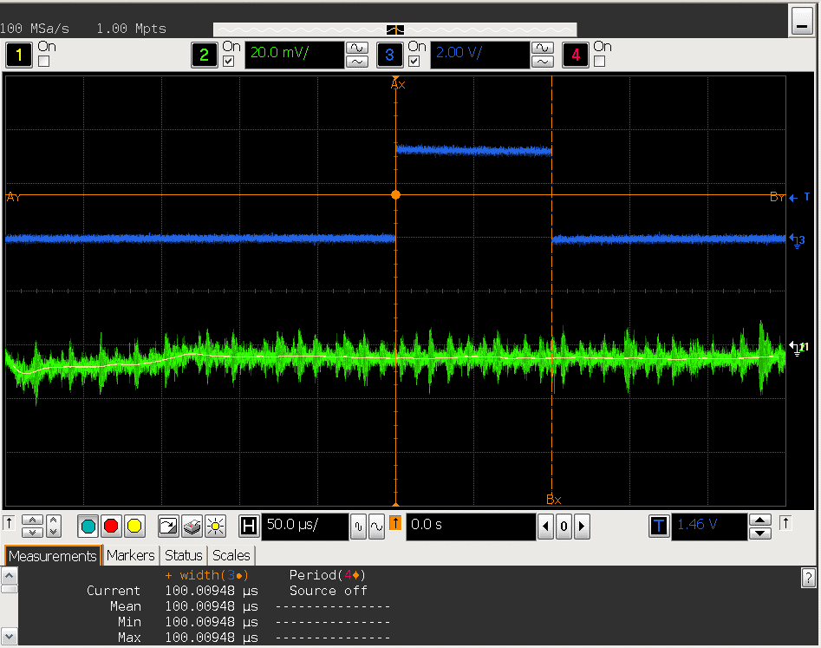
V_{DD,ANA} with pp_en_n = 1
zoom in
10 ms
500 µs
There is no bounce when PWQ_ACQ rises, since analog biasing is not switched off (i.e. pp_en_n = 1)
Strange pattern preceding PWR_ACQ is still present

Slide 8
Conclusion
Despite the strange bounce pattern on V_{DD,ANA} that happens before acquisitions, it doesn’t seem to exist a large V_{DD} bounce that would deteriorate the chip performance

