Slide 1

The FLUKA Code: a short introduction
An Introduction to FLUKA:
a Multipurpose Particle Interaction and Transport MC code
OMA School on Monte Carlo simulations
Ludwig Maximilian University of Munich
6-10 November 2017

Slide 2
FLUKA
Main authors: A. Fassò, A. Ferrari, J. Ranft, P.R. Sala
Contributing authors: G. Battistoni, F. Cerutti, M. Chin, T. Empl, M.V. Garzelli, M. Lantz, A. Mairani,
V. Patera, S. Roesler, G. Smirnov, F. Sommerer, V. Vlachoudis
Developed and maintained under an INFN-CERN agreement Copyright 1989-2017 CERN and INFN
>10000 registered users
http://www.fluka.org

Slide 3














The FLUKA International Collaboration
R. Augusto, G. Aricò, C. Bahamonde Castro, M.I. Besana, M. Brugger, F. Cerutti, A. Cimmino, L. Esposito, Alfredo Ferrari, R. Garcia Alia, J. Idarraga Munoz, W. Kozlowska, A. Lechner, M. Magistris, A. Mereghetti, E. Nowak, S. Roesler, F. Salvat-Pujol, P. Schoofs, E. Skordis, G. Smirnov, C. Theis, A. Tsinganis, Heinz Vincke, Helmut Vincke, V. Vlachoudis, J.Vollaire CERN
G. Battistoni, F. Broggi, M. Campanella, I. Mattei, S. Muraro, P.R. Sala, S.M. Valle INFN. Milano, Italy N. Mazziotta INFN Bari, Italy A. Margiotta INFN & Univ. Bologna, Italy M.C. Morone Univ. Roma II, Italy F. Ballarini, E. Bellinzona, M. Carante, A. Embriaco, A. Fontana INFN & Univ. Pavia, Italy
L. Sarchiapone INFN Legnaro, Italy V. Patera, S. Pioli INFN Frascati & Univ. Roma I , Italy P. Colleoni, Ospedali Riuniti di Bergamo, Italy G. Magro, M. Pelliccioni CNAO Pavia, Italy A. Mairani, CNAO Pavia, Italy & HIT, Germany
P. Degtiarenko, G. Kharashvili, JLab, USA M. Santana, SLAC, USA L. Lari ,FNAL USA A. Empl, S. Hoang, M. Kroupa, L. Pinsky Univ. of Houston, USA K.T. Lee, E. Semones, N. Stoffle, N. Zapp NASA, Houston, USA A.Bahadori Kansas Univ. USA M. Trinczec, A. Trudel TRIUMF, Canada
G. Dedes, S. Mayer, K. Parodi, LMU Munich, Germany Anna Ferrari, S. Mueller HZDR Rossendorf, Germany
S. Brechet, L. Morejon, N. Shetty, S. Stransky, S. Trovati, R. Versaci, ELI-Beamlines, Prague, Czechia
T.J. Dahle, L. Fjera, A. Rorvik, K. Ytre-Hauge , Bergen Univ., Norway
F. Belloni INSTN-CEA, France
A. Fedynitch DESY Zeuthen, Germany T. T. Boehlen, Medaustron, Austria, D.Georg, MedUni, Vienna, Austria
C. Cuccagna, TERA Switzerland T.V. Miranda Lima Kantonhospital Aarau, Switzerland
M. Lantz, Uppsala Univ., Sweden F. Fiorini, Oxford Inst. Rad. Oncol., UK
P. Garcia Ortega IUFFYM, Spain I. Rinaldi, INP Lyon, France
M. Chin, Malaysia
A. Fassò, M.V. Garzelli, E. Gadioli, J. Ranft

Slide 4
FLUKA short description:
FLUKA is a general purpose tool for calculations of particle transport and interactions with matter
All Hadrons (p, n, π, K,pbar, nbar, (anti)hyperons…) [0-10000 TeV]
Electromagnetic (γ, e^{+/-}) and μ and ν [1 keV – 10000 TeV]
Nucleus-nucleus [0-10000 TeV/n]
Low energy neutrons (0-20 MeV, multigroup, ENDF… )
Transport in magnetic field
Combinatorial (boolean) and Voxel geometries
Double capability to run either fully analogue and/or biased calculations
On-line evolution of induced radioactivity and dose
Radiation damage predictions (NIEL, DPA)
User-friendly GUI interface thanks to the Flair interface
http://www.fluka.org

Slide 5
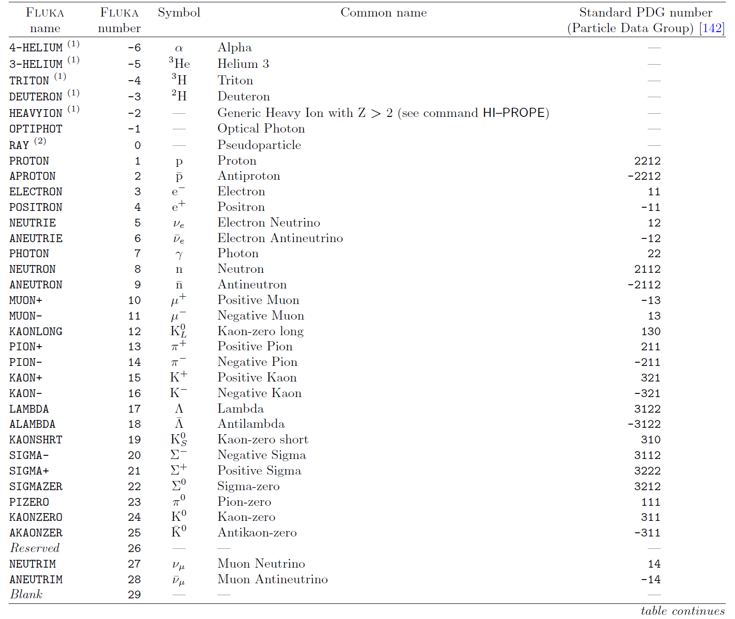
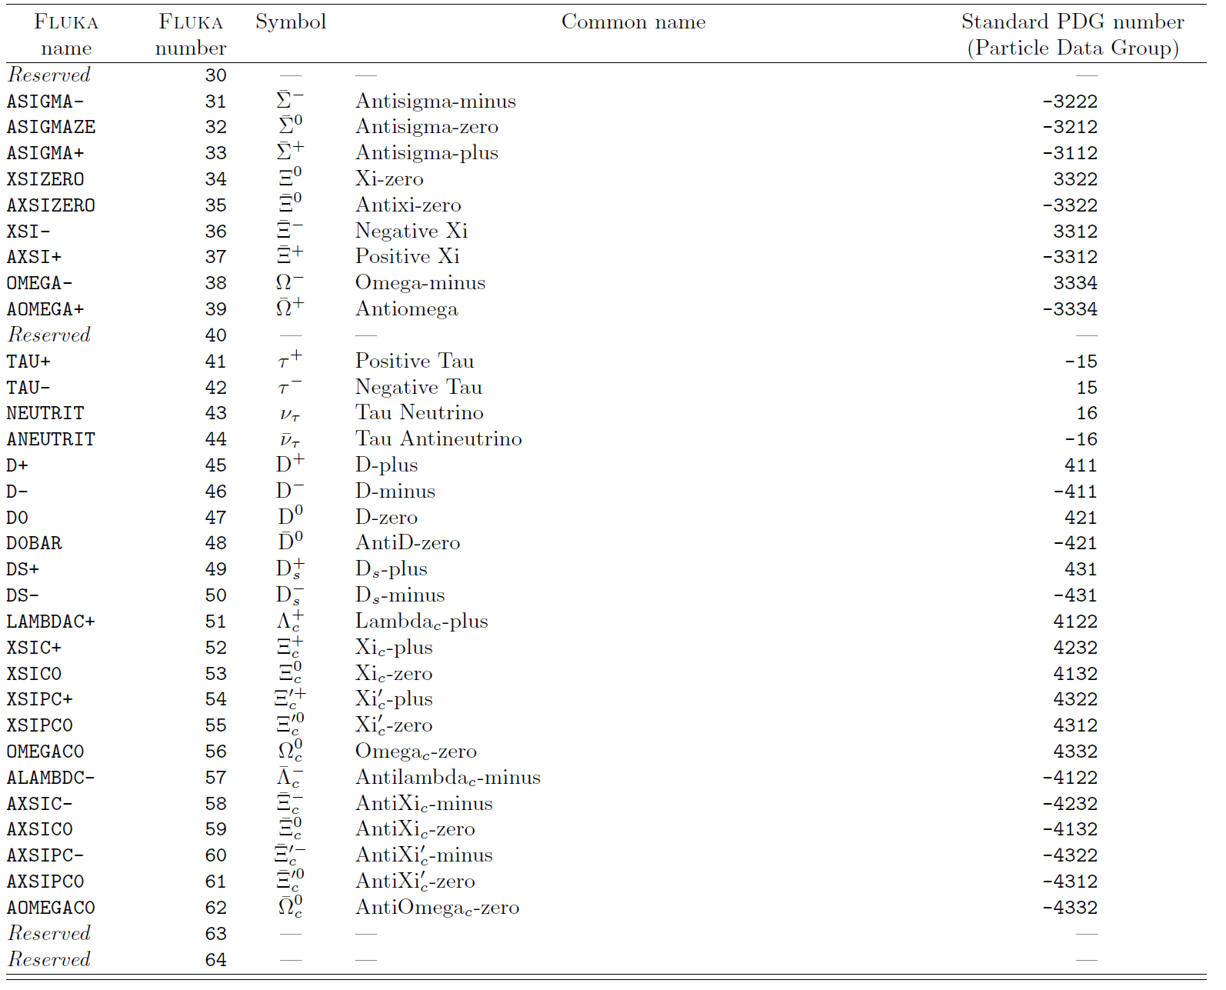
Particles transported by FLUKA:

Slide 6
The FLUKA Code design
Based, as far as possible, on original and well-tested microscopic models
Full cross-talk between all components: hadronic, electromagnetic, neutrons, muons, heavy ions
It is a “condensed history” MC code, however with the possibility to use single instead of multiple scattering
FLUKA is NOT a toolkit! Its physical models are fully integrated
  The user does not need to choose a “physics list”
  The user has, however, the possibility to optimize CPU vs accuracy when needed
Fluka provides powerful built-in scoring, well tested and suited for most applications
  The user does not need to write external code to get results and statistics

Slide 7
Online evolution and buildup of induced activity
In all accelerator-related applications... and in many more, the evaluations of induced activation and prompt/residual dose rates are essential. In Fluka:
Reliable interaction models, with particular care of the latest stages (evaporation, fragmentation, break-up)
Decay β+/-’s, γ’s, EC electrons, α’s, produced according to a database (based on ENSDF, www.nndc.bnl.gov )
  Screening and Coulomb corrections for β^{+/-} spectra
Analytical calculation of activity build-up and decay
In the same run, prompt and delayed results according to user-defined irradiation and cooling profiles
Activities: 2D and 3D distributions, and full inventories at each buildup/cooling time
Energy deposition (dose, decay heat), particle fluences (including dose equivalent with folding online) at each buildup/cooling time

Slide 8
What can be done with FLUKA?
Some examples

Slide 9
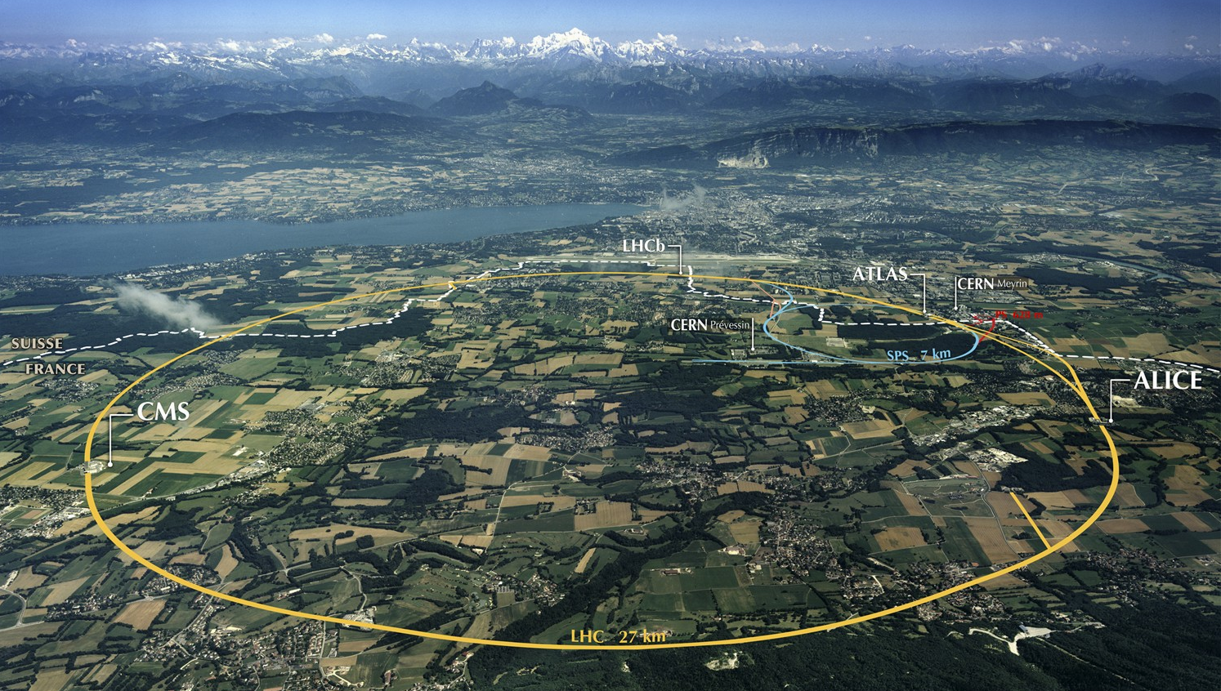
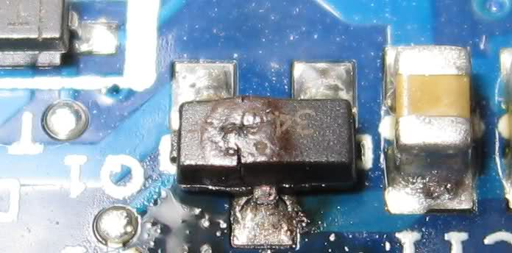


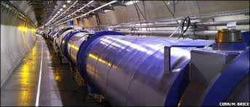
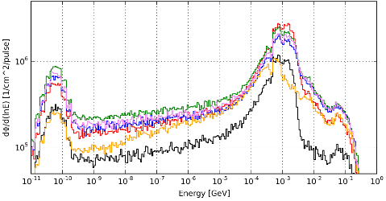
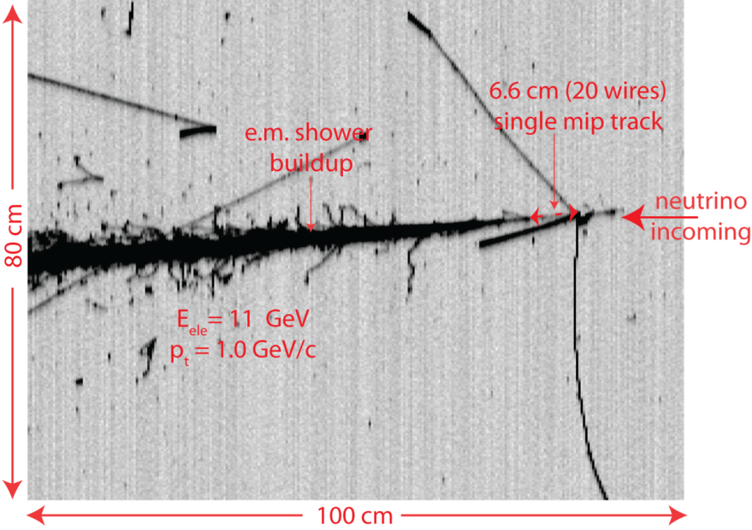
Cern & Fluka (~9000 registered users worldwide, http://www.fluka.org)
Radiation damage
(electronics, insulations)
Activation, Waste disposal
Shielding, residual dose rates
LHC: pp 6.5+6.5 TeV, PbPb 2.5+2.5 TeV/n
PS: 24 GeV p
Spallation sources (n_ToF),
secondary beams (ν!!)
SPS: 450 GeV p
(ν) Experiments
Energy deposition (quenching, damage)
Notes:
9

Slide 10
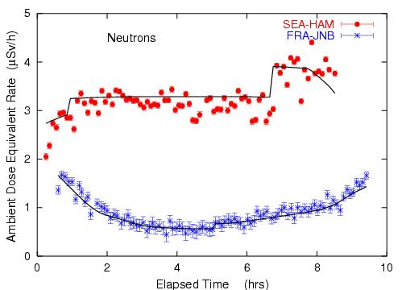
Dosimetry + cosmic rays
Complete simulation of cosmic rays interactions in the atmosphere
  Dedicated “cosmic” package available to users
Model of airplane geometry
Response of dosimeters
Dose to aircrew on commercial flights , depending on route
Ambient dose equivalent from neutrons at solar maximum on commercial flights from Seattle to Hamburg and from Frankfurt to Johannesburg.
Solid lines: FLUKA simulation
Roesler et al.,
Rad. Prot. Dosim.
98, 367 (2002)

Slide 11
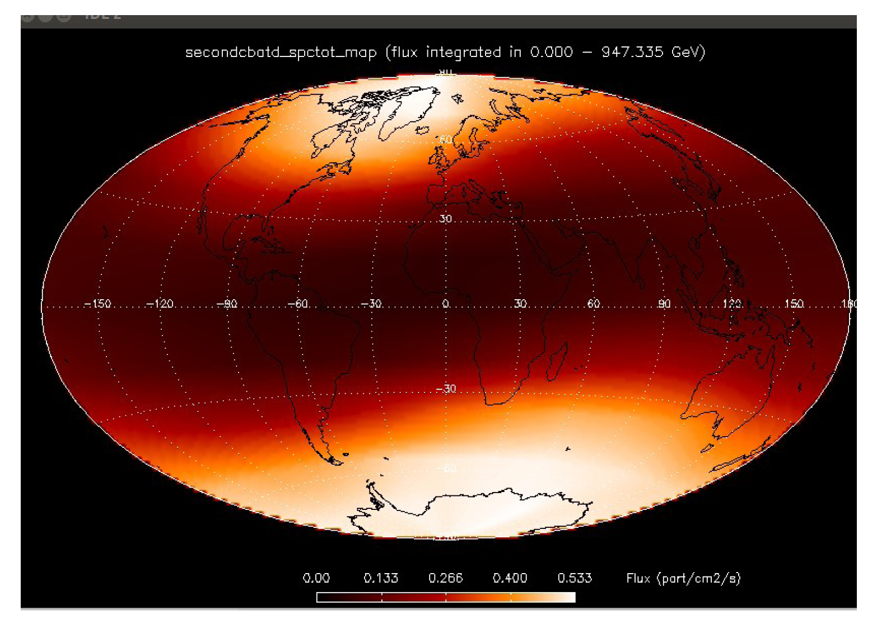
The neutron albedo from GCR’s at 400 km altitude*
*In collaboration with CEA-Saclay

Slide 12
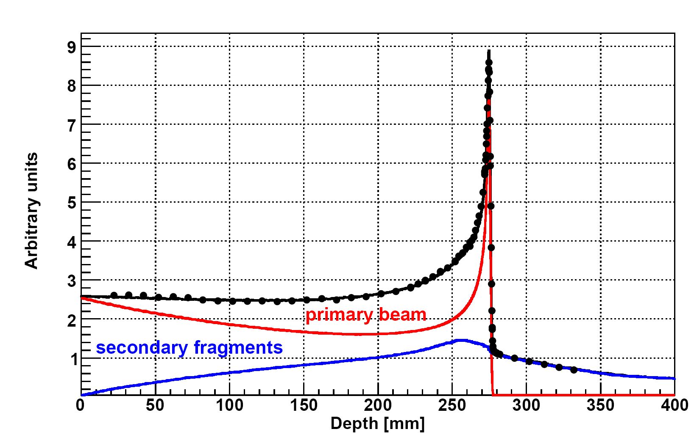
Medical physics : Radiotherapy
Bragg peak in a water phantom
400 MeV/A C beam:
The importance of fragmentation
Exp. Data (points) from Haettner et al, Rad. Prot. Dos. 2006
Simulation: A. Mairani PhD Thesis, 2007, Nuovo Cimento C, 31, 2008

Slide 13
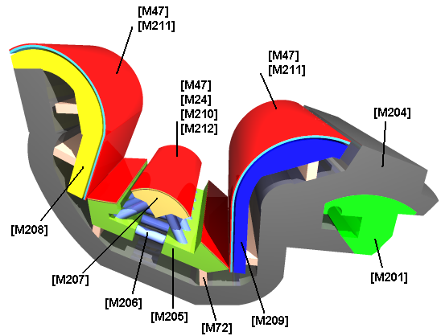
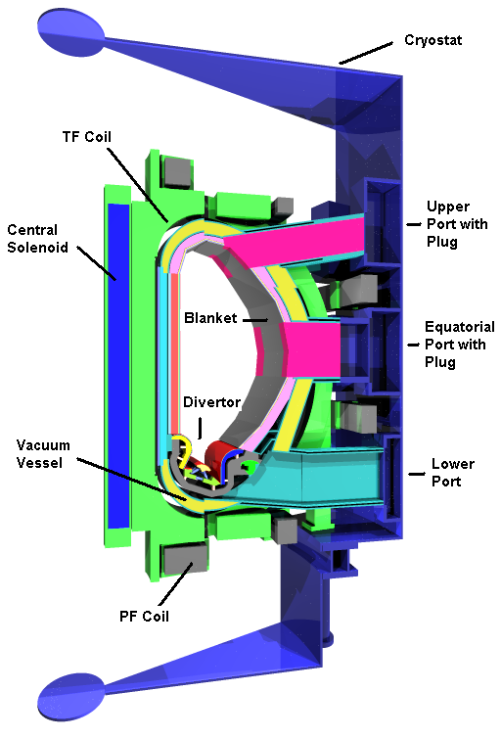
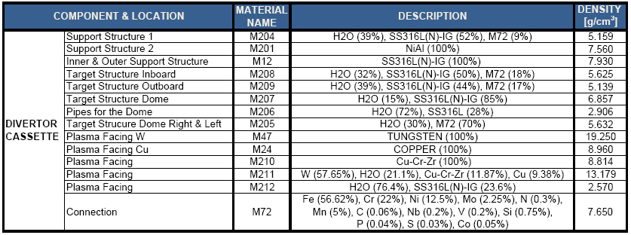
ITER geometry: divertor cassette
[FLUKA ray tracer by D. Pastor]

Slide 14
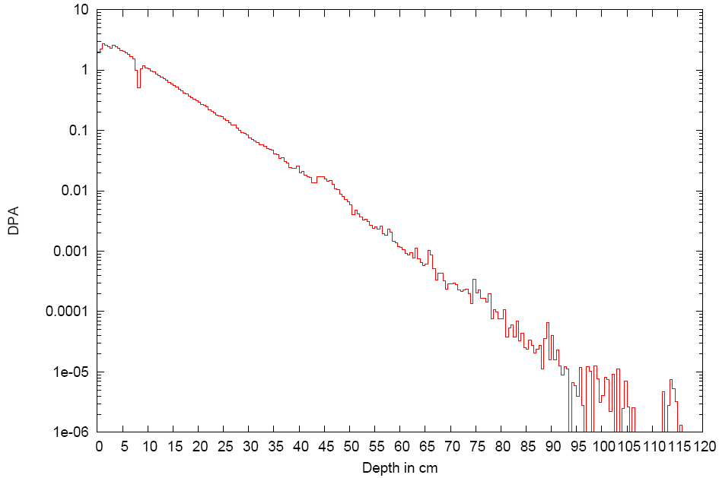
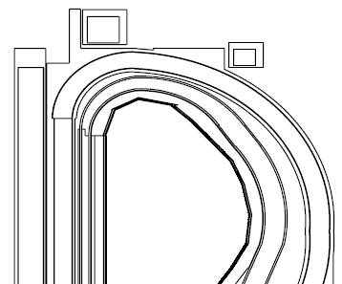
DPA: ITER, blanket module
Max. 3 DPA
For a safety evaluation of the ITER machine, IRSN* asked CERN to perform neutronic and activation calculations with the FLUKA Monte Carlo code.
blanket
Vacuum
vessel
10%<err.<20%
The report presents FLUKA results on radionuclide inventory, ambient residual dose rate, dose evaluation,
residual power for the cooling circuit, and displacement per atom (DPA)
Stat. error > 20%
Stat. error < 10%
*Institute de Radioprotection et Surete Nucleaire

Slide 15
The MC course: an Introduction
How:
This course is not a full FLUKA course. It is intended to provide a basic and general overview on:
  The most relevant FLUKA instructions and options
  The basic principle of combinatorial geometry in FLUKA
  The physics models adopted in FLUKA
  Running, scoring and plotting in FLUKA
  For further information, refer to the existing documentation.
  In this course the basic FLUKA input and the graphical interface Flair will be presented.
  Practical exercises:
  particle accelerators, dose scoring (depending on the time)
Notes:
modified

Slide 16
Agenda
 | 6 Nov | 7 Nov | 8 Nov | 9 Nov | 10 Nov
8:30 - 9:00 | General introduction (A. Ferrari) | Penelope models (low-energy elctromagnetic) (J.M. Fernández-Varea) | Geometry in FLUKA (E. Skordis) | Heavy ion beams and radioactivity in FLUKA (A. Mairani) | Geant4 for space and medicine (G. Dedes)
9:00 - 9:30 | Principles of Monte Carlo calculations and codes (F.Salvat)
9:30 - 10:00 |  | Electron accelerator modeling with Penelope + Tutor (L. Brualla) | FLUKA models (A. Ferrari) | Monte Carlo treatment planning in FLUKA (A. Mairani)
10:00 - 10:30
10:30 - 11:00 | coffee break |  | coffee break | coffee break | coffee break
11:00 - 11:30 | Introduction to Geant4 (G. Dedes) | Transfer to Munich + lunch | Ionization and transport in FLUKA (F. Salvat-Pujol) | Scoring in FLUKA (A. Mairani) | Outlook in Penelope (F. Salvat-Pujol)
11:30 - 12:00
12:00 - 12:30 |  |  |  | Transfer to Munich + lunch
12:30 - 13:00 | lunch |  | lunch |  | lunch
13:00 - 13:30 |  | Exercises with Penelope
13:30 - 14:00
14:00 - 14:30 | Structure and operation of PENELOPE (F. Salvat) |  | Accelerators in FLUKA (E. Skordis) | Exercises with FLUKA | Outlook in GeantV (A. Gheata)
14:30 - 15:00
15:00 - 15:30 | Introduction to FLUKA (A. Ferrari) | coffee break | Social activity |  | GeantV: machine learning techniques (S. Vallecorsa)
15:30 - 16:00 |  | Exercises with Geant4
16:00 - 16:30 | coffee break |  |  | coffee break | coffee break
16:30 - 17:00 | Introduction to Flair (E. Skordis) | Poster session |  | Exercises: medical applications with FLUKA | Outlook in FLUKA (A. Ferrari)
17:00 - 17:30
17:30 - 18:00 | Geometry in Penelope (F. Salvat) |  |  |  | Closing remarks
18:00 - 18:30
Notes:
New slide

Slide 17
A glimpse of FLUKA

Slide 18
The FLUKA version
  FLUKA20xx.n(y)(.m)
Major version
Respin
Minor version
Patch level
In this course we are using FLUKA2011.2c.6
Notes:
I updated the version

Slide 19
The FLUKA license (it is not GPL):
Standard download: binary library + user routines.
  FLUKA can be used freely for scientific and academic purposes,
  ad-hoc agreement for commercial purposes
  It cannot be used for weapon related applications
It is possible, by explicit signing of license, to download the source for researchers of scientific/academic Institutions.
  FLUKA can neither be copied into other codes (not even partially), nor translated into another language without permission
For commercial use, trial version (limited in time and random seeds) available. Commercial license to be negotiated with CERN & INFN.
Please register on www.fluka.org …..and read the license!

Slide 20
The FLUKA mailing lists
fluka-users@fluka.org
Users are automatically subscribed here when registering on the web site.
It is used to communicate the availability of new versions, patches, etc.
fluka-discuss@fluka.org
Users are encouraged to subscribe at registration time, but can uncheck the relevant box. It is used to have user-user and user-expert communication about problems, bugs, general inquiries about the code and its physics content
Users are strongly encouraged to keep this subscription
Notes:
20

Slide 21
Using FLUKA
Platform: Linux with g77 (on 32 and 64 bit machines)
and gfortran (on 64 bit machines)
Work in progress: Mac OSX with gfortran
The code may be compiled/run only using operating systems, compilers (and associated) options tested and approved by the development team
Standard Input:
Command/options driven by “data cards” (ascii file)
Graphical interface is available
Standard Geometry (“Combinatorial geometry”): input by “data cards”
Standard Output and Scoring:
Apparently limited but highly flexible and powerful
Output processing and plotting interface available

Slide 22
A brief overview: your first input

Slide 23
FLUKA Manual
in continuous development (as the program)!
More a User Guide than a Reference Manual (only a short summary about physics)
Many formats: pdf: FM.pdf, ASCII : fluka2011.manual, Tk interface accessible through FLAIR, html on FLUKA website
REMEMBER!
The first place to look at when puzzled!
...and the very best friend of a beginner user!

Slide 24
FLUKA and FLAIR
FLUKA users can….
  prepare their own input with a text editor (remember: the input is a simple text file )
  use their own tools for plotting results
  submit jobs by command line
FLAIR (Fluka Advanced InteRface) can be used as well
It helps the users with the aforementioned tasks
(see FLAIR lecture)
You can choose your favorite way…
…but a good user should be able to go both ways!

Slide 25
Structure of the input file
General definitions
Beam definition
Materials: definition and assignment
Random number initialization
Start/Stop of simulation
Physics settings
Defaults
Physical processes
Transport thresholds
Low energy neutrons
Induced radioactivity
Biasing
Geometry related biasing
Interaction/decay biasing
Geometry
Setup description
Voxel phantoms
Output settings
Estimators / scoring cards

Slide 26
FLUKA input file commands
Commands aka cards, aka options, aka directives, aka definitions
One keyword (command), 6 floating point numbers (WHATs), one string (SDUM)
Example of a FLUKA command
*...+....1....+....2....+....3....+....4....+....5....+....6....+....7....+...
BEAM 1.E+04 0.0 0.0 0.0 0.0 0.0PROTON
*keyword momentum mom.spread diverg. X-width Y-width ignored particle
* WHAT(1) WHAT(2) WHAT(3) WHAT(4) WHAT(5) WHAT(6) SDUM
Command keywords MUST be uppercase, numbers MUST have the decimal point
Some commands require more than one “card“
With few exceptions, the order of commands is irrelevant
Repeated commands can add themselves or override previous commands
A line with a * character in column 1 is a comment
Text after an exclamation mark (!) is ignored (does not work within the geometry)
Almost all the WHAT() have a default value
Commands can be issued in fixed or free format
Special commands, called #directives, allow for input parametrization

Slide 27
Fixed format
Fixed format:
*...+....1....+....2....+....3....+....4....+....5....+....6....+....7....+...
BEAM 1.E+04 0.0D+00 0.0 0.0 0.0 0.0PROTON
*keyword momentum mom.spread diverg. X-width Y-width ignored particle
* WHAT(1) WHAT(2) WHAT(3) WHAT(4) WHAT(5) WHAT(6) SDUM
The “traditional“ FLUKA format is (A8, 2X, 6E10.0, A8)
Numbers: 9 digits at most can be used!
All WHAT fields are in floating point format, even integers
They must always be written with the decimal point
Exponential notation numbers (e.g. 1.234E+5), must be right aligned
Double precision format (e.g. 1.234D+5) is allowed
Blank numerical fields are read as 0.0
In most cases (not all!) such values are ignored and
the corresponding default values are used
Blank lines NOT ALLOWED in geometry declaration (tolerated elsewhere)
FLAIR takes care of all the alignment problems for you

Slide 28
Names instead of numbers
FLUKA also allows to use keywords (names) - 8 characters maximum length - instead of numbers inside FLUKA commands
Examples later (for instance materials, or geometrical region, can be inserted using their names instead of numbers)
This helps the user, improving the readability of the input FLUKA file
Internally, FLUKA works always by NUMBERS, and keeps name-to-number bidirectional tables / functions

Slide 29
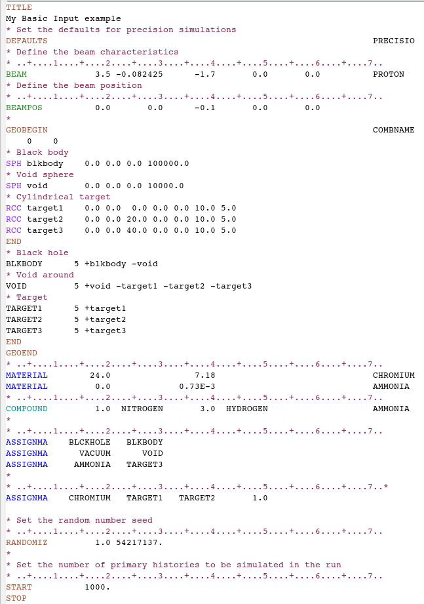
A basic input: step 1: Physics settings

Slide 30
A basic input: step 1: Physics settings
Defaults set reasonable FLUKA defaults for a specified kind of problem:
SDUM = CALORIMEtry : calorimetry simulations
EET/TRANsmut : energy transformer or transmutation
calculations
EM-CASCAde : pure EM cascades
ICARUS : studies related to the ICARUS experiment
HADROTHErapy : hadrotherapy calculations
NEUTRONS : pure low-energy neutron runs
NEW-DEFAults : reasonable minimal set of new
defaults (very coarse!) – set by default
PRECISIOn : precision simulations
SHIELDINg : hadron shielding calculations without gammas

Slide 31
A basic input: step 2: Beam

Slide 32
A basic input: step 2: Beam
The card BEAM defines the particle type and energy (or momentum).
The card BEAMPOS controls particle starting position and direction.
For complex particle sources (complex distributions in energy, space and direction) a special user routine, SOURCE, can be used*. The card SOURCE has to be added in the input file.
* Some pre-defined cases (volume sources, cosmic ray source, uniform isotropic source etc are already built-in and available via data cards, see the manual

Slide 33
A basic input: step 3: Geometry

Slide 34
A basic input: step 3: Geometry
The Combinatorial Geometry in FLUKA must be preceded by a GEOBEGIN card and followed by a GEOEND card.
The whole geometry must be surrounded by a region of “blackhole” limited by a closed body.
For details on the Combinatorial Geometry (bodies, regions and optional region volumes) please wait for the Geometry lecture on Wednesday.

Slide 35
A basic input: step 4: Materials

Slide 36
Materials
FLUKA handles:
elemental materials (by default natural composition, the user can set a specific isotope, being aware of low energy neutron cross sections availability)
compounds (chemical molecules, alloys, mixtures…)
Each material is uniquely identified by an index/name
FLUKA has a set of predefined materials.
Users can both use/modify these and define their own ones.
Basic cards:
MATERIAL material declaration
COMPOUND compound definition (a MATERIAL card is mandatory for a compound declaration)
ASSIGNMA material assignment to regions of geometry

Slide 37
Predefined materials
In FLUKA 2 special materials +23 natural elements of most common use, e.g. Oxygen, Carbon, Iron… (check them out in the manual, Chap. 5), are predefined.
The first two are very important:
BLCKHOLE (mat #1): material with infinite absorbance;
VACUUM (mat #2)
12 compound materials with the composition suggested by ICRU are predefined as well (again, check the manual!).
All predefined materials can be used WITHOUT explicit MATERIAL / COMPOUND cards.
WARNING: user defined MATERIAL cards OVERRIDE PREDEFINED materials having the same name.

Slide 38
Material definition: MATERIAL
  Defines a new material or override a previous one.
  [SDUM] material name
  [WHAT(1)] atomic number Z
  [WHAT(2)] atomic weight (leave it empty)
  [WHAT(3)] density [g/cm³]
  [WHAT(4)] material number (leave it empty)
  [WHAT(5)] alternate material to be used for dE/dx (normally empty)
  [WHAT(6)] mass number A (leave it empty unless you want a
  specific isotope)

Slide 39
Material definition: COMPOUND
  Defines a new compound.
  Each COMPOUND card must be associated to a MATERIAL card.
  More COMPOUND card can be used to define a compound.
  [SDUM] compound name
  [WHAT(1)] amount of the first component
  [WHAT(2)] first component material
  [WHAT(3)] amount of the second component
  [WHAT(4)] second component material
  [WHAT(5)] amount of the third component
  [WHAT(6)] third component material
  How to define the “amount”?
  By atom relative content, mass fraction or volume fraction.

Slide 40
Material definition: ASSIGNMA
  A material must be associated to each of the geometry regions, except to those defined as blackhole.
  The command ASSIGNMAt assigns a material to one (or more) region in the geometry
  (for the region definition see the geometry lecture or the manual).
  The assigned material could be either a single element material or a compound.

Slide 41
A basic input: step 5:Random Seed, START, and STOP

Slide 42
A basic input: step 5: Random Seed, START, and STOP
  The random number generator is initialized to read a vector of 97 seeds from an external file. Different numbers input will initialize different and independent random number sequences.
  A START card at the end of the input file is mandatory.
  It defines the number of particle histories required.
  The START card is optionally followed by a STOP card, which stops the execution of the program.

Slide 43
Running the code
Download and Install according to instruction in the manual or in the web page
ALWAYS define an environmental variable FLUPRO, that points to the installation directory (export FLUPRO=my_path_to_fluka)
Create your input and run your jobs in an area different from FLUPRO
RUN:
No. of previous
cycle (default is 0)
No. of Last cycle
(default is 5)
A script is provided to run fluka:
$FLUPRO/flutil/rfluka -e $FLUPRO/flukahp -N0 -M1 ex1
Specifies the executable
name: if it is flukahp in $FLUPRO (default) then it can be omitted
Name of the input file. It must be a file named ****.inp

Slide 44
What rfluka does, and what a cycle is:
Remember:
Many primaries are needed to obtain convergence of the results towards the “true”values
Statistical errors need to be evaluated
Running for more than a few hours is “dangerous” (ops… it crashed after one week…)
Monte Carlo uses pseudo-random number sequences
Standard way for FLUKA:
Divide a “run” in “batches” or “cycles”
Run many of them, keeping track of the random number sequence
At the end of the run, sum the results from the cycles and calculate statistical errors
Cycles can be added later, continuing in the random sequences
Cycles can be run in parallel (multi-core), starting from different initial random seeds

Slide 45
What rfluka does, and what a cycle is:
rfluka creates a temporary subdirectory: $PWD/fluka_nnnn ($PWD means the current directory) where nnnn is the system process-id assigned to FLUKA. There all necessary assignments are defined and output files are written.
At the end of the cycle, it copies the output/log/results to the working directory, ADDING A NUMBER to the input file name
It also copies the random number seed for the next run
Running ex1.inp , after the n-th cycle one gets
ex100n.log, ex100n.out, ex100n.err (n=cycle)
and ranex100m (seed for cycle m = n+1)
One also gets results from scoring, if defined (see lecture). Utilities to sum results are provided.

Slide 46
A brief overview:
Standard Output and Plotting

Slide 47
The FLUKA Standard Output
FLUKA provides a standard output file that contains plenty of useful information:
(fortran unit 11, inp###.out from rfluka)
The output file contains the echo and interpretation of your input cards → helps in understanding if what you wrote is what you wanted
The output file contains the physics settings and threshold settings
The output file contains basic summary quantities → helps to check that the input is meaningful (..ops, all my particles escaped from the geometry..why?)
It must be checked at least once when setting up a simulation and always in case of doubts/crashes
(together with inp###.err and inp###.log files)

Slide 48
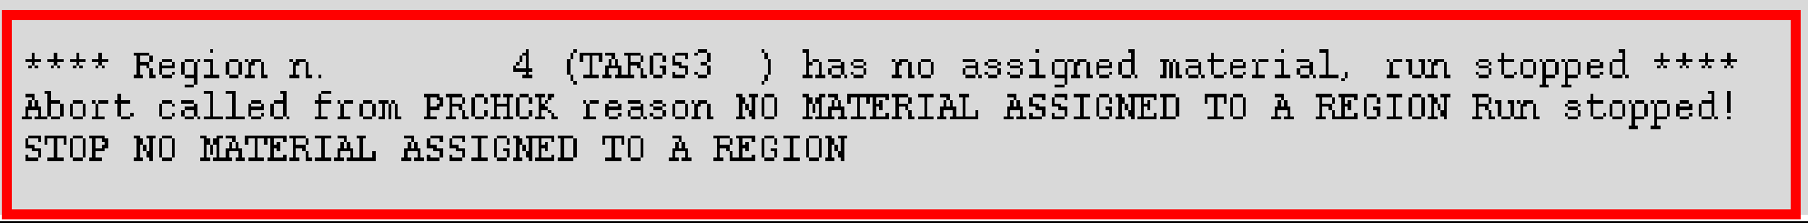
The FLUKA Standard Output
  Fatal error messages are also printed in the output file.
  For example:
  Error messages should be of concern to the user.
  For more details on possible error messages, see the FLUKA manual.

Slide 49
FLUKA plot
Simulation results can be plotted externally, or via Flair.
Flair makes use of Gnuplot. See Gnuplot manual for all available commands.
Flair also allows Geometry plotting and debugging.
See Flair lecture for more details.

Slide 50
Thanks for your attention!

