Slide 1

Flair Geometry Editor
OMA MC School

Slide 2
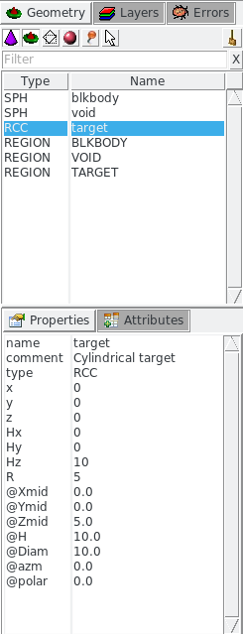
Listbox - Objects
With Geometry tab activated
Lists the type/name of bodies, regions, objects
Text coloring:
  RED Error in the card description
  Magenta Visible body/object
  Cyan Selection frozen
Filtering text box can narrow the list with items containing the typed-in text
Buttons – on/off the display
Hold [Ctrl] to select only one button
  Bodies
  Regions
  Transformations
  Materials
  Objects
  Selected or Visible items (Useful to narrow the list)

Slide 3
Listbox – Properties / Attributes
Properties:
Displays the common WHATs of the selected cards
REGION:
  If one REGION and Bodies are selected the REGION will stay visible
  Additionally one can select the MATERIAL and automatically an ASSIGNMAt will be created/modified
  WARNING: Only if this region is not part of a range or inside an #if..#endif
Tips:
  [Enter] moves to the next field
  Typing multiple values splits them into many fields:
  e.g. x: 1 2 3 [Enter]
  will split it to x: 1, y: 2, z: 3
Attributes:
Displays other information related to the card
Bodies: Visibility, Selection Locking, Wireframe
Regions: NAZ, Alpha(Transparency), ROT-DEFI…

Slide 4
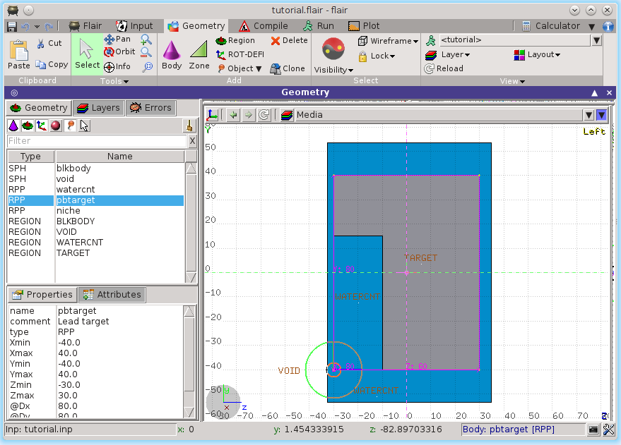
Selection
Objects/Bodies/Regions/Zones can be selected using:
  Object and/or Properties list boxes
  graphically with the action [s] using the left mouse button on the viewport;
[Ctrl] + left mouse button: allows to toggle the selection (select/unselect);
Area selection: Click on the background and drag the mouse to draw a rectangle area. Everything inside the area will be selected.
The selected bodies are:
    outlined in magenta
    yellow dots appear on their vertices;
    highlighted also into the object list in the left bar;
    Their common properties & attributes will be displayed on the list boxes.
The selected regions are shaded;
The select zones are shaded with a hash pattern; To select a zone first you have to select the REGION
[ESCape] cancels the selection

Slide 5
Objects
There are a few auxiliary objects in flair for helping the drawing
Point [p]
  to be used as snapping points
  provide help text to the user
  automatically generated after image calibration
Arrow or line
  to be used as snapping points
  provide basic drawing/pointing means to the user
Ruler simple or angle
  to measure distances and angles
  to project snapping points to a different location
  to be used as snapping points
Light for the 3D
The objects are stored in the input file with the special flair tags: !point, !arrow, !ruler, !light
All tags starting with ! are treated as comments and ignore by FLUKA

Slide 6
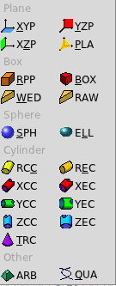
New Body
Add a body: Right-Click, or [b] or [Space] or [Ins]
Menus is organized in sub-categories
[B] (capital) to repeat last add body
  left-click on the wished location of the new body
  keeping the left-button pressed drag to the location of the first extend of the body
  release and continue with the next one…
Renaming a body will automatically rename any reference to it without asking the user
All new bodies will use the same name prefix from the last body renaming
[n]ame allows to fast edit the name of the object

Slide 7
New Body Mouse Steps
The default dimension/radius of all new bodies is one grid unit
XYP, ZXP, YZP: Viewport should not be parallel to body
Location
PLA: ⊥ viewport
Location → Second point belonging on the plane
RPP: symmetric around the w-axis
Location → Outer corner on the viewing plane
BOX: XY plane // viewport, Z vector = -w
Location → X-vector end → Move outer plane
WED: as in BOX
Location → X-vector → Y-vector (forced ⊥ X)

Slide 8
New Body Mouse Steps
RCC: Height will be lying on viewport
Location → Height → Radius
REC: Height will be lying on viewport
Location → Height → Radius-X [→ Radius-Y if viewport permits it]
XCC, YCC, ZCC
Location → Radius
XEC, YEC, ZEC: be careful on the chosen viewport
Location → Radius-X [→ Radius-Y if viewport permits it
TRC: Height will be lying on viewport
Location → Height → Apex radius → Base Radius
ARB: not possible for the moment
QUA: will generate a sphere at desired location
Location

Slide 9
Body Visibility
Default: Body SEGMENTS ARE ONLY VISIBLE when they represent borders of REGIONs
In order to make them visible (to be able to visually select them):
  Select the body (from the list box, or from its visible segment) and
  Either
  Go to the Attributes and click on Visible [X] check box
  Right-click → Visibility → Set
  Shortcut [v]
  Icon on Toolbar
Wireframe (experimental) display an approximate 3D wireframe of the bodies. Useful to select or visualize bodies that do not intersect the viewport
  Go to the Attributes and click on Wireframe [X] check box
  Right-click → Wireframe → Set
  Shortcut [#]
  Icon on Toolbar

Slide 10
Body Editing
Text:
Bodies can be edited by typing the correct coordinates in the Properties or in flair
Graphically:
Select the body and the action handler(s) will be displayed
Click with the mouse for a second time:
  on the small circle to freely move [g]rab
  on the large circle to rotate [r]otate around w axis
  on the red/green/blue line to move but locked on X, Y or Z axis
  Hitting [x], [y], [z] while moving a body toggles the locking on the axis
  Typing the coordinates moves or resizes the objects
  e.g. 100 50 10
Shift-Click the mouse to clone the body/object
  Using /nnn or *nnn multiple clones can be generated divided or multiple of the distance specified
  e.g. /5 creates 5 clones in 1/5th of the distance
Move locked on Y
Move locked on X
Move handle
Rotate handle

Slide 11
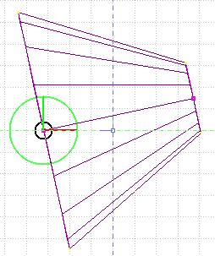
Body Editing
When a body is selected and the action handlers are shown you can either click ‘n drag the handlers for moving, rotating, resizing the object:
TRC example, click `n drag:
On the base plane, to move it perpendicular ⊥ to height vector
On the small square handler on the apex plane, to freely move the height, axis or normal of body
This handler appears only if it lies on the viewing plane
On the apex plane, to move it perpendicular to the height vector
On the conic surface close to the apex to resize the appex radius
On the conic surface close to the base to resize the base radius
4
3
2
1
5

Slide 12
Region Editing
Add a REGION: Right-Click or [R] or [Space] or [Ins]
Immediately the properties listbox will be activated to edit the name
Renaming a region will automatically rename any reference to it without asking the user
When changing the material or transformation of a region flair will automatically add the appropriate ASSIGNMAT and/or LATTICE cards
However deleting a region will not delete the associated ASSIGNMAT and/or LATTICE cards

Slide 13
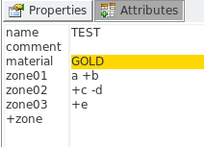
Zone editing
With the keyboard:
Add: Enter an expression in the “+zone” field
Modify: Select the zone to modify and alter with the keyboard the zone expression
Delete: Select the zone and then Right-Click→Delete or hit the [Del] key INSIDE the Property Listbox!
Zone: is a subregion expressed in terms of + and – only
e.g. REGION TEST +a +b | +c –d | +e
contains three zones
zone01: +a +b
zone02: +c –d
zone03: +e

Slide 14

Zone editing
Graphically:
First select the desired REGION to add/modify the zone
Add a new zone:
  Verify that there is no zone selected in the property listbox.
  If there is any hit Escape to unselect them
  Add on the selection ONLY the bodies representing the borders of the zone
  Click on Right-click or [Space]->Zone or with [d]efine
  Move the mouse and click in one of the viewports a point that should belong to the wished zone
  Automatically the zone expression will be created
Modify/Edit an existing zone:
  Select the zone either on the property listbox or graphically in any viewport clicking a point that belongs to it
  Automatically all bodies involved in the zone expression will be selected
  With the zone selected, select or unselect additional bodies if needed
  Then like in the “Add a new zone” click on “Zone” or with [d]efine and click on point that belongs to it
Do not select bodies that you don’t need

Slide 15
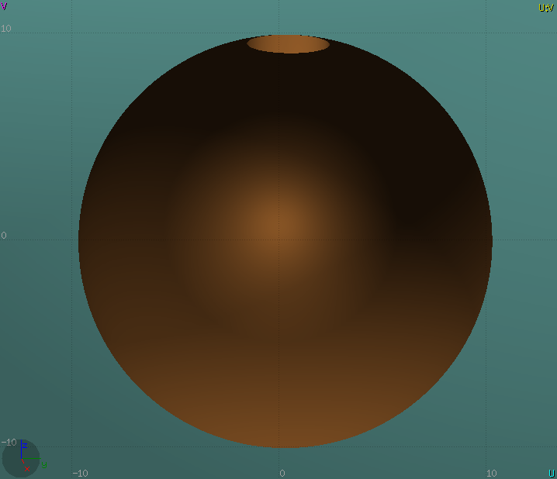
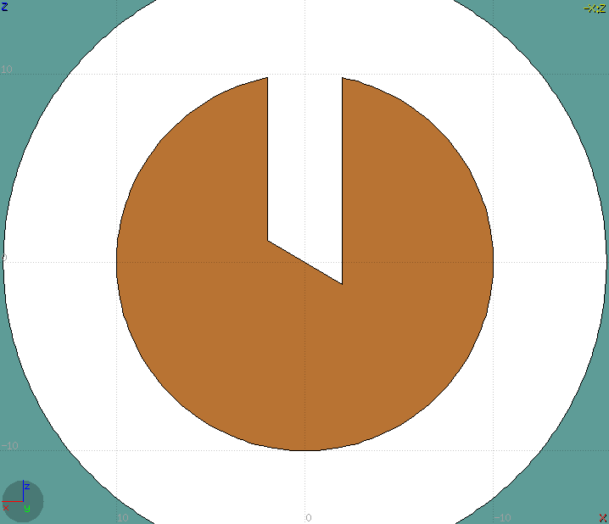
Zone Editing: Example ^{[1/8]}
In this example we will create a sphere with a cylindrical hole cut with a tilted plane (@ 30º)
First we have to create all necessary bodies
  sphere
  infinite cylinder
  tilted plane

Slide 16
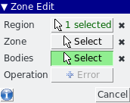
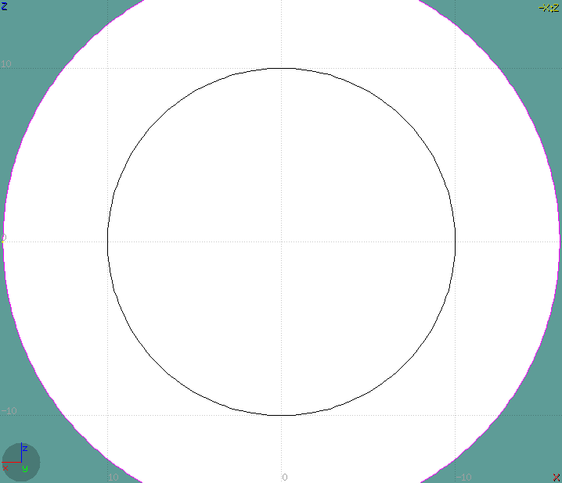
Zone Editing: Example ^{[2/8]}
Add a new REGION
[Spacebar] → Region
The region expression is empty
Type-in the [n]ame and select the appropriate [m]aterial
Press [ESCape]
The region should remain selected
Alternatively press [d]efine to start the editing with no region selected
➔ it will create one for you automatically
Reference image

Slide 17
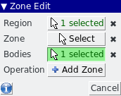
Zone Editing: Example ^{[3/8]}
Press [d]efine to start the editing
Each body e.g. sphere divides the space into 2 zones
Add to the selection the sphere (holding [Ctrl] pressed) and the sphere outline will be highlighted
The sphere divides the space into two zones:
+sphere inside the sphere
-sphere outside the sphere
1
+ inside sphere
-
2
outside
Reference image

Slide 18


Zone Editing: Example ^{[4/8]}
Add to the selection the infinite cylinder with [Ctrl] + Left mouse click
The 2 selected bodies divides the space into 4 zones
+sphere +cylinder
+sphere - cylinder
- sphere +cylinder
- sphere - cylinder
3
-
+
1
4
4
2
2
cylinder
+
-
sphere
3
Reference image

Slide 19

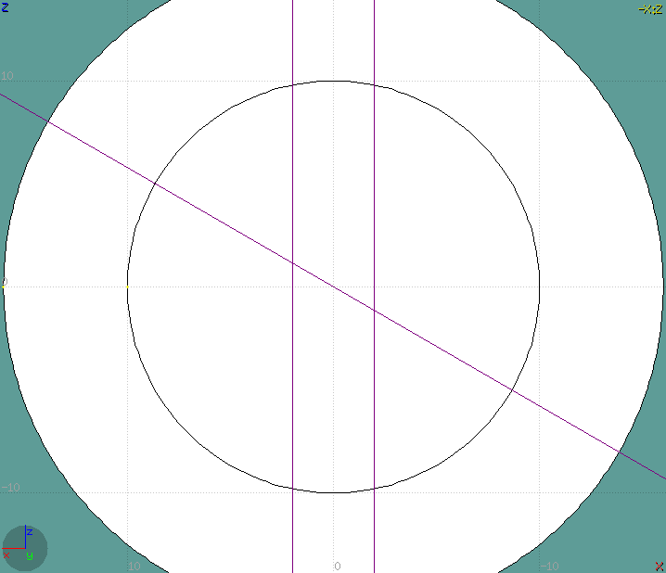
Zone Editing: Example ^{[5/8]}
Add to the selection [Ctrl]+left click the tilted plane.
Now the space is divided into 8 zones
+sphere +cylinder +plane
+sphere +cylinder - plane
+sphere - cylinder +plane
+sphere - cylinder - plane
- sphere +cylinder +plane
- sphere +cylinder - plane
- sphere - cylinder +plane
- sphere - cylinder - plane
Number of valid zones ≤ 2^{bodies}
6
8
-
+
4
-
+
2
4
8
3
7
plane
1
cylinder
+
3
-
sphere
7
5
Reference image

Slide 20
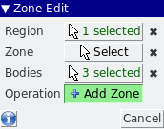
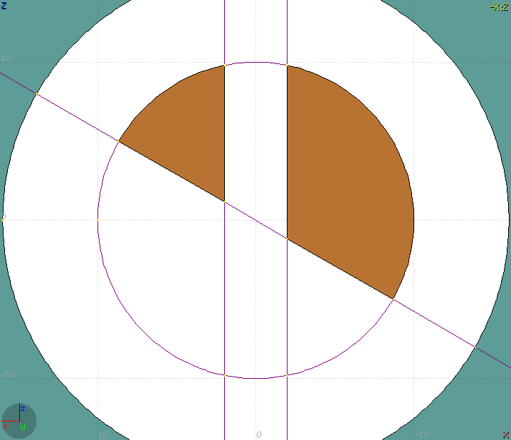
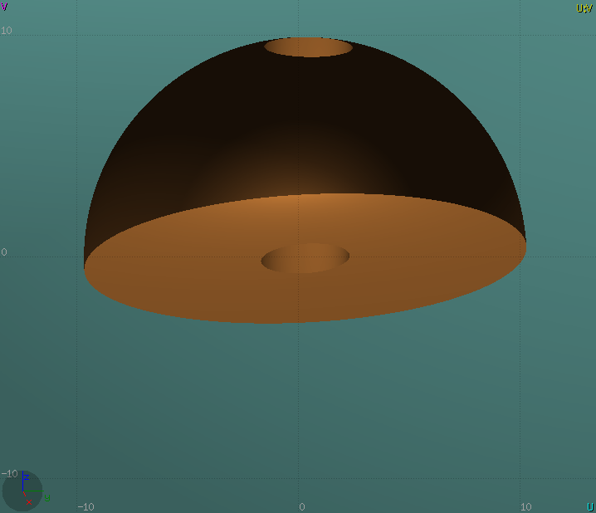
Zone Editing: Example ^{[6/8]}
Press [Spacebar] and select the action Zone
or with the shortcut [d]efine
Moving the mouse, shows the various subdivisions of space and their corresponding expression.
Point and click with the mouse somewhere inside zone 4
Automatically the zone expression
+sphere -cylinder -plane
will be added to the REGION
4
4
Reference image

Slide 21
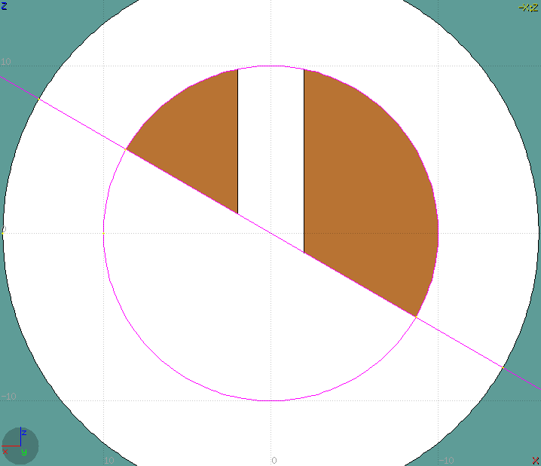
Zone Editing: Example ^{[7/8]}
Finally we have to add as second zone the lower half of the sphere.
Press once [ESCape] to unselect the bodies, but to leave the region selected
Select the sphere and plane (or by deselecting the cylinder)
Again the space is divided into 4 regions
+sphere +plane
+sphere - plane
- sphere +plane
- sphere - plane
4
-
+
2
1
plane
+
-
sphere
3
Reference image

Slide 22
Zone Editing: Example ^{[8/8]}
Press [Spacebar] and select the action Zone
or with the shortcut [d]
Point and click with the mouse somewhere inside zone 1
Automatically the zone expression
+sphere +plane
will be appended to the REGION
1
Reference image

Slide 23
Summary: Region and Zone Editing
Remember the sequence:
Create or Select the region to edit
Select the REGION if not selected
Select a zone to modify or none to add a new one
Add on the selection the bodies that involve in the zone expression
Click on the [Spacebar] “Zone ” action [d] or [D]
Move the mouse and click to a point that belongs to the wished zone
Repeat steps 2-6 as many times as required
You have to create a selection containing:
the REGION to edit;
the bodies representing the boundaries of the new zone;
optionally an existing zone if you want to modify it
Verify the selected items and do NOT select bodies that you don’t need

Slide 24
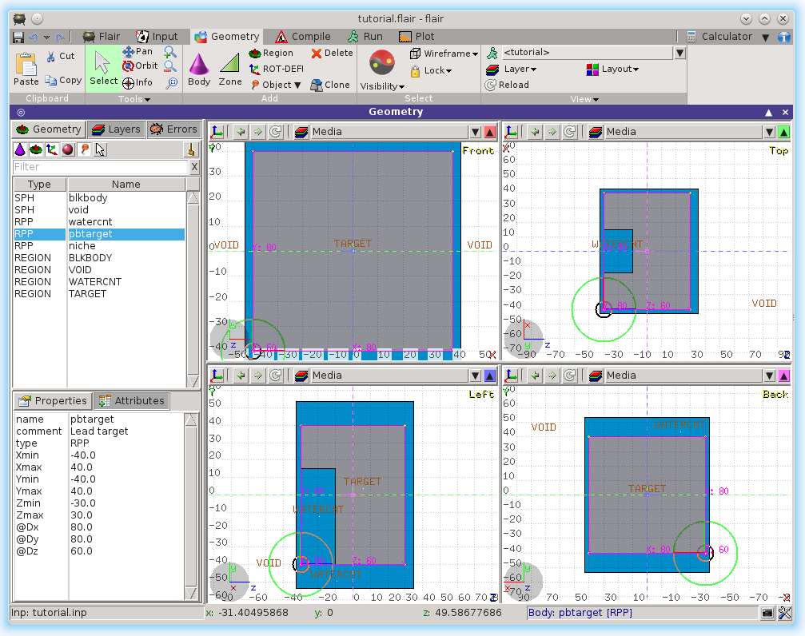
Geometry Layers ^{[1/6]}
Custom Layers can be specified in the “Configure Layer menu” ( )

Slide 25
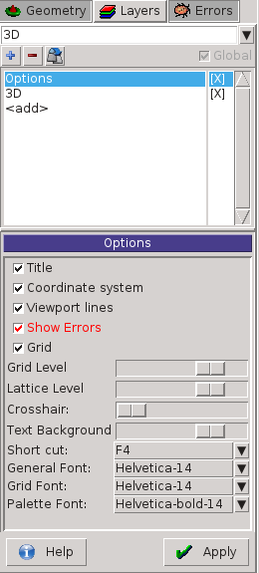
Geometry Layers ^{[2/6]}
Toolbar:
Add/delete/rename/clone layers.
Options:
Enable/Disable: Title, Coordinate system, Viewport lines, Vertexes and Grid;
Adjust:
  Grid level (set gridline intensity);
  Lattice level (set lattice hash line intensity);
  Crosshair (dimension of the crosshair in the center of the project)
All layers can be combined together e.g:
  USRBIN and 3D
  Custom color values (EMFCUT) with 3D
  Image and USRBIN
  …

Slide 26
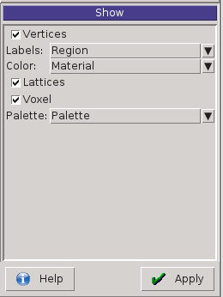
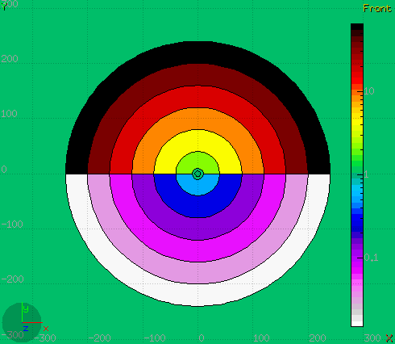
Geometry Layers ^{[3/6]}
Show: (2D drawing, and color filling options)
Bodies: display the boundaries of bodies;
Vertices: display the intersection of bodies;
Enable/Disable: Lattice and Voxel;
Associate Region Colors to:
  Regions
  Materials
  Density
  Importance Biasing
  Splitting
  Corrfactor
  Deltaray
  Thresholds
  …

Slide 27
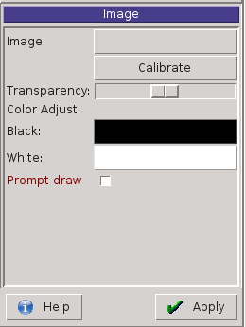
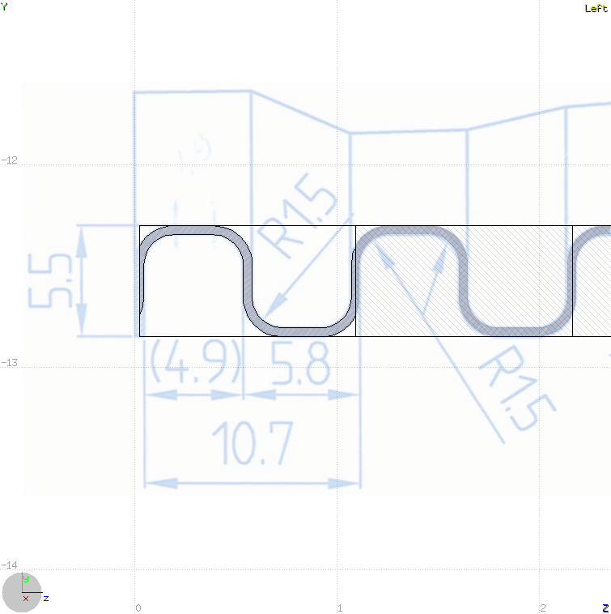
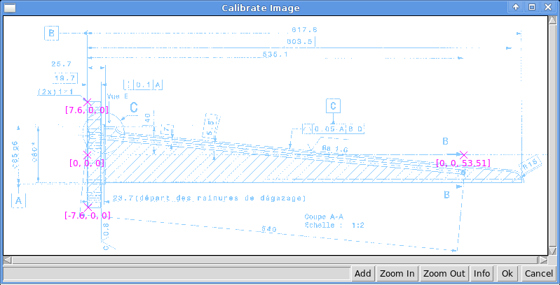
Geometry Layers ^{[4/6]}
Image: set a background image to the geometry (i.e. a CAD-drawing);
Image: load an image file (.png, .gif or .jpg);
Calibrate: calibrate the image. Define a set of points (min. 3) on the image and specify their coordinate;
Alpha: blending of the image
Color Adjust: readjust the black and white colors of the loaded image.
Prompt draw: immediate drawing of image (slower) or when display is idle. For editing is good to activate it.

Slide 28
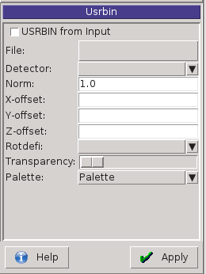
Geometry Layers ^{[5/6]}
USRBIN:
USRBIN from input: To select a USRBIN card from input and displayed with a checker pattern
Load USRBIN file (see SCORING lecture);
Select a detector (or URSBIN) among the ones present in the file;
Normalization constant;
Associate a ROT-DEFI transformation;
Alpha blending between USRBIN colors and materials colors
USRBIN should be combined with the Colorband to define the color limits

Slide 29
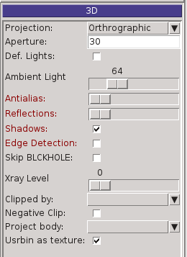
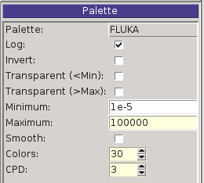
Geometry Layers ^{[6/6]}
3D: enable 3D rendering
Enable/Disable Perspective;
Set camera aperture angle;
Intensity of ambient light;
Antialias for supersampling (slow rendering);
Xray – automatic transparencies;
Clipped by: setting a clipping body;
Negative Clip: Use the –clipping body
Colorband: enable/set color band properties
Change the default color Palette;
Enable/Disable Log scale;
Set: Maximum, Minimum and color steps.

Slide 30
ESCape
[ESCape] will stop/unselect in the following order on item at a time:
Stop the current action e.g. during rotation or panning
If a zone is selected unselected the zone
Unselect any selected bodies
Unselect any selected region

