Slide 1

Main Linac Optimisation at 380 GeV and 350 GeV
N. Blaskovic
Acknowledgements: D. Schulte

Slide 2
Contents
CLIC staging: 380 GeV up to 3 TeV
Energy spread minimisation at 350 GeV
N. Blaskovic

Slide 3
CLIC staging
N. Blaskovic

Slide 4
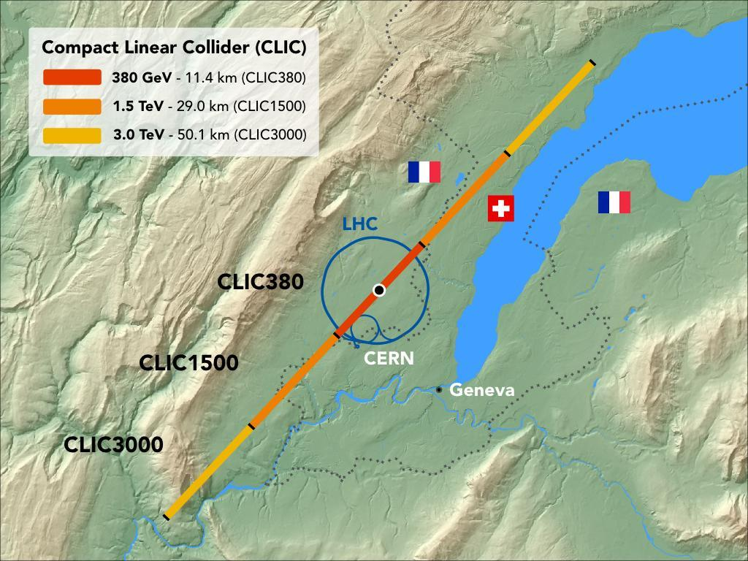
CLIC staging
N. Blaskovic

Slide 5
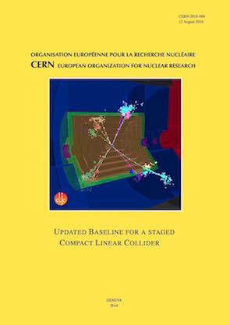
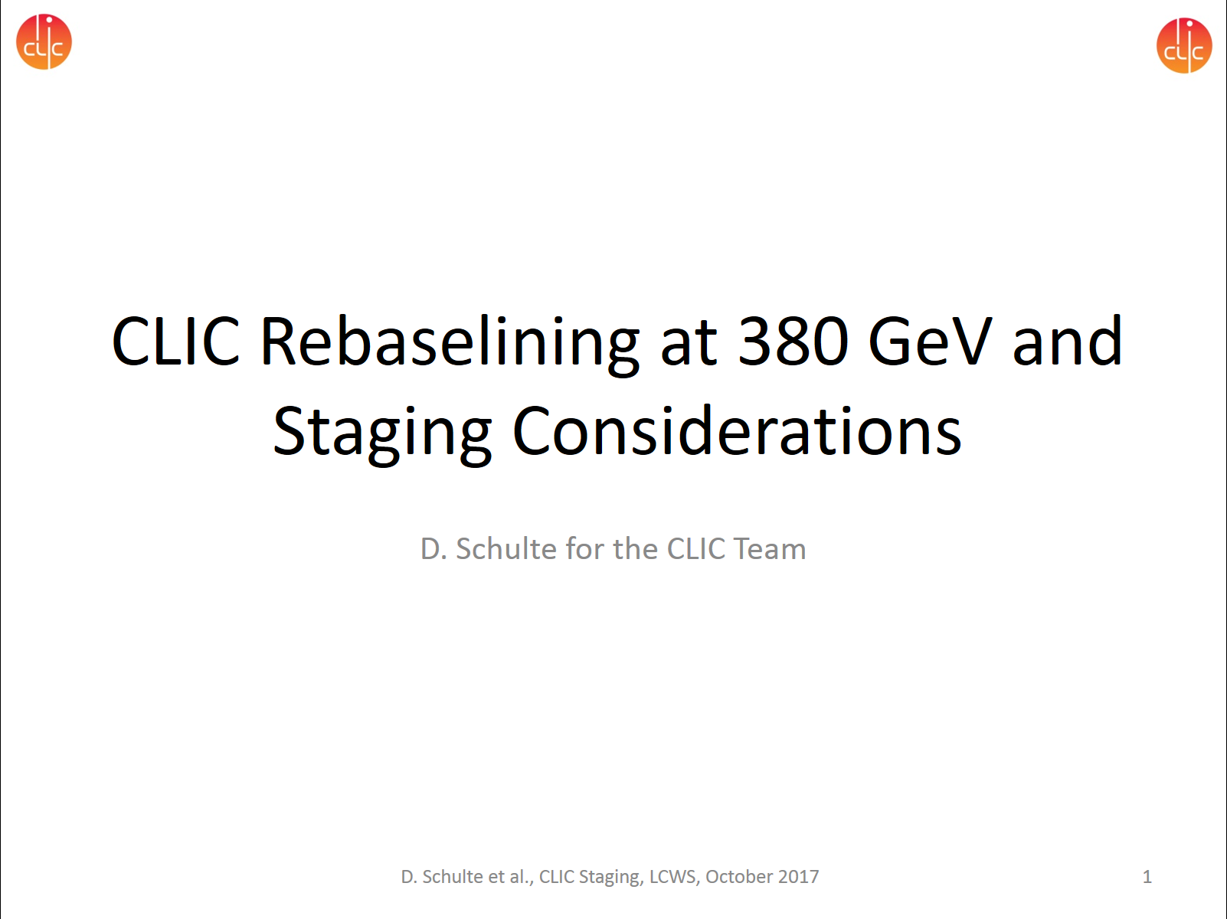
CLIC staging
Literature:
  ‘Updated baseline for a staged Compact Linear Collider’ (CERN-2016-004)
  ‘CLIC Rebaselining at 380 GeV and Staging Considerations’, D. Schulte, LCWS 2017
N. Blaskovic

Slide 6
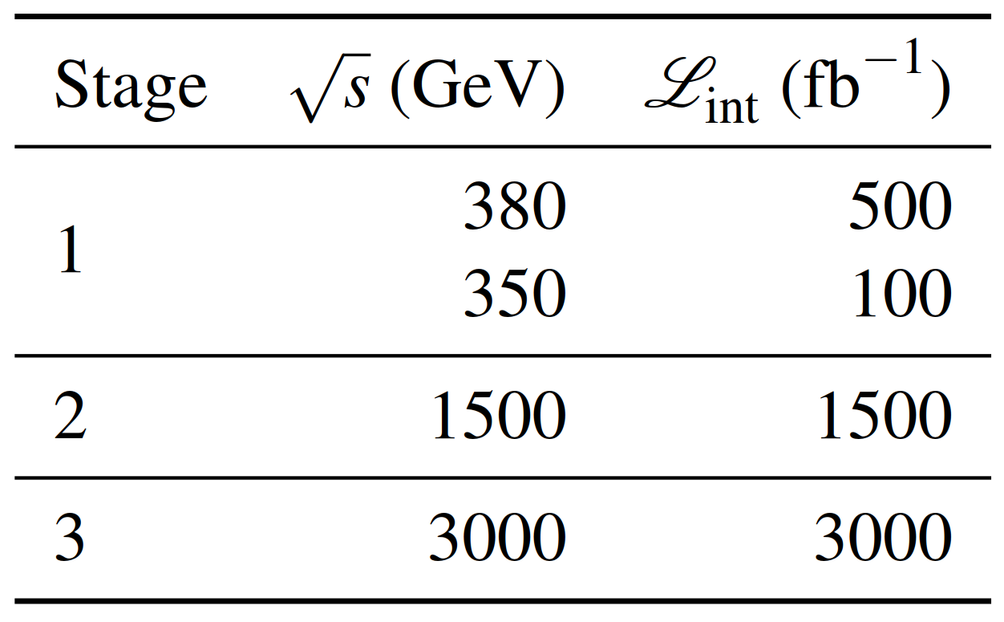
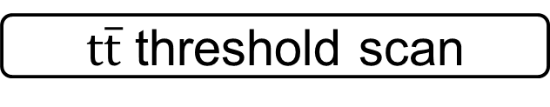

Energy stages
HZ, WW, top
$\text{t}\overline{\text{t}}$ threshold scan
$$\text{t}\overline{\text{t}}H$$
H self-coupling, BSM?
N. Blaskovic

Slide 7
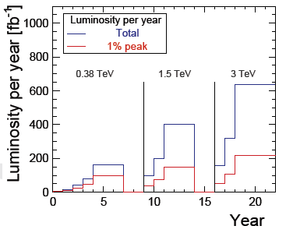
Luminosity ramp-up
7 years
5 years
6 years
N. Blaskovic

Slide 8
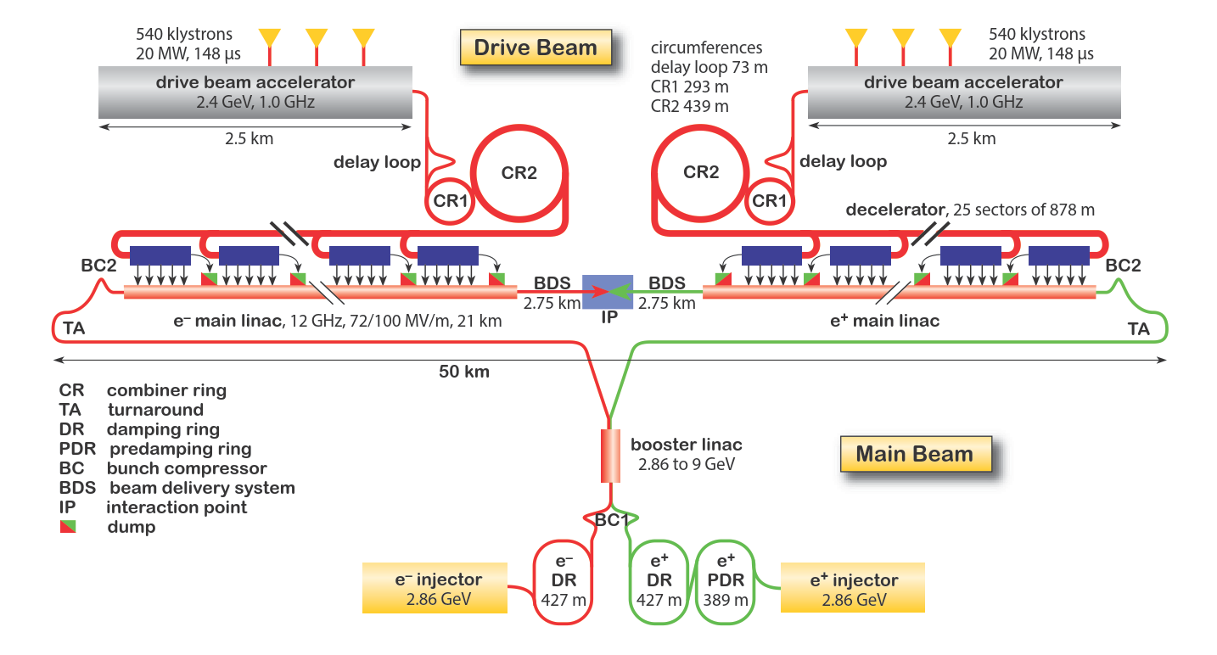
3 TeV design
2 drive beams
25 decelerator sectors/linac
N. Blaskovic

Slide 9
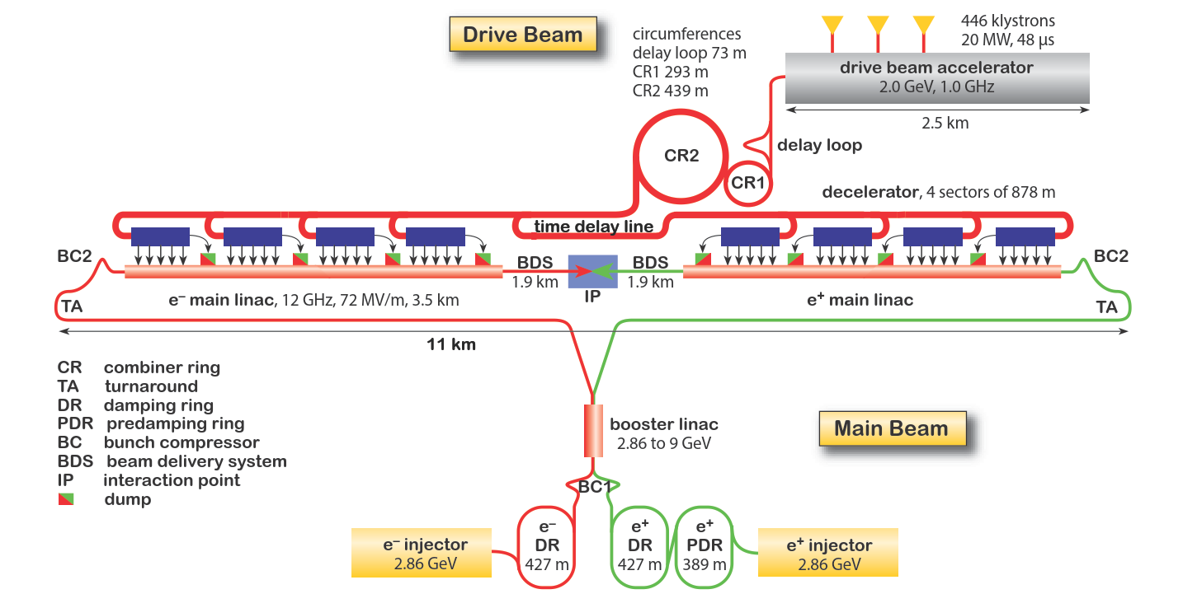
380 GeV design
same decelerator length = same RF pulse length
1 drive beam
4 decelerator sectors/linac
main linac injection unchanged
N. Blaskovic

Slide 10
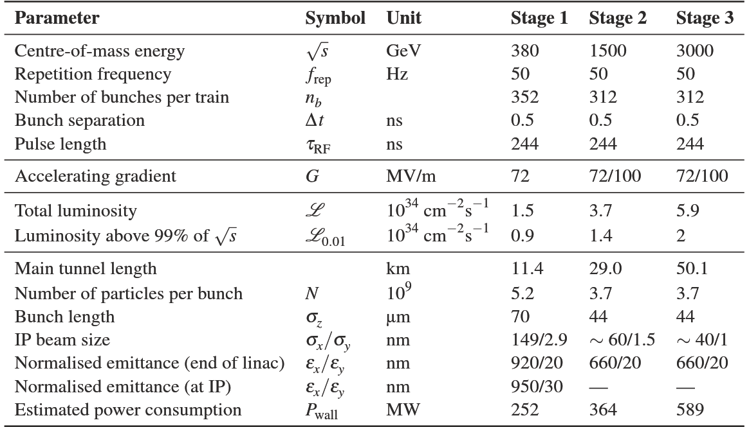
Accelerator parameters
First: 72 MV/m
Later: 100 MV/m
‘baseline’ values
1 nm at 3 TeV
N. Blaskovic

Slide 11
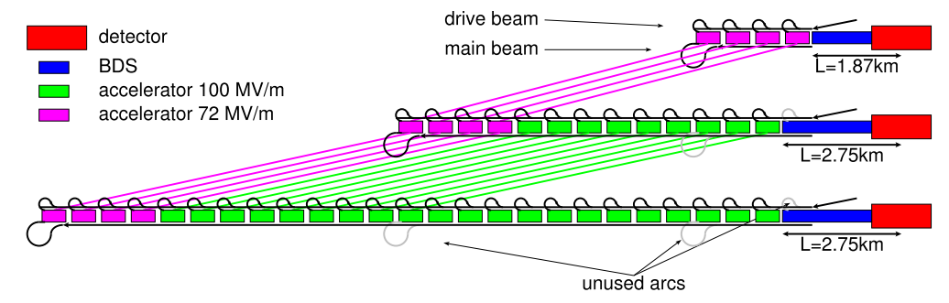
Upgrade strategy
For upgrade, move 72 MV/m accelerating structures to start of linac to preserve structure & quad lengths at low energies
N. Blaskovic

Slide 12
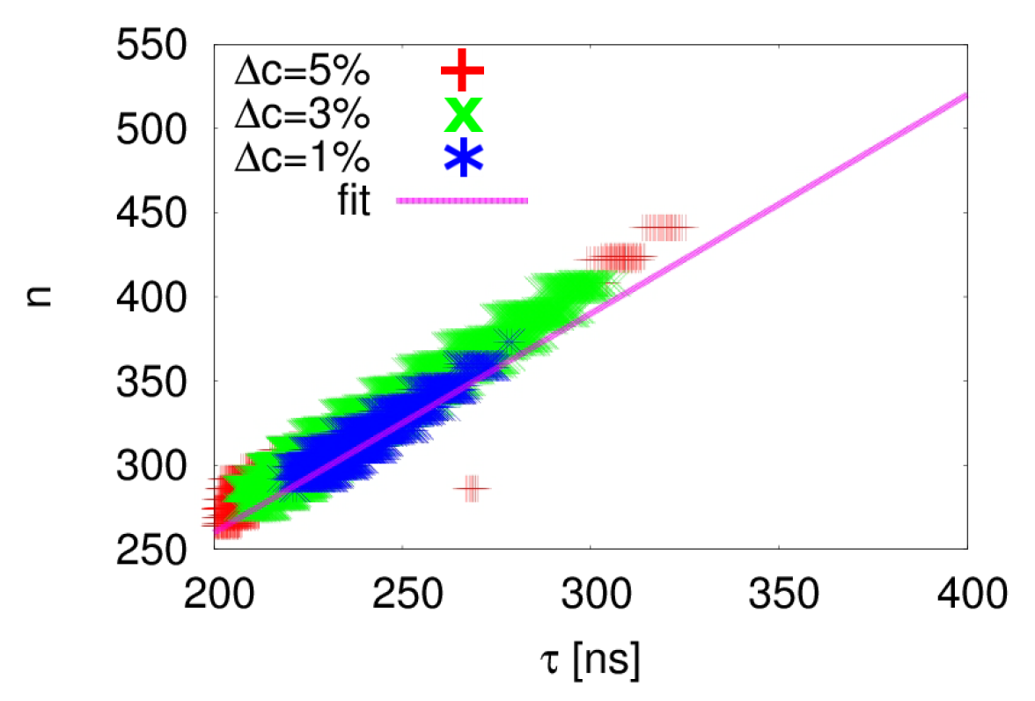
Cost optimisation
Cost increase relative to minimum cost for 3 TeV design with 100 MV/m gradient
number of bunches
RF pulse length [ns]
To minimise cost, require RF pulse length of 244 ns.
This sets drive beam pulse length to decelerator and, thus, also sets decelerator length (common for all stages)
N. Blaskovic

Slide 13
Klystron-based alternative
Replace drive beam for 380 GeV stage
Faster implementation: drive beam not needed for accelerator structure testing
Upgrade to 3 TeV with drive beam
380 GeV
Drive beam
Klystrons
BDS
Detector
3 TeV
Klystrons remain in wide-tunnel section;
quadrupole and structure lengths adjusted for higher beam energy
N. Blaskovic

Slide 14
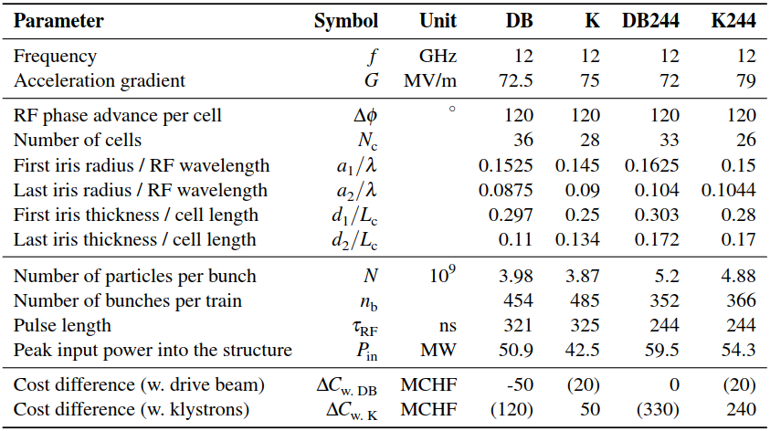
Baseline structure choice
DB
Drive beam
Optimised at 380 GeV
K
Klystrons
Optimised at 380 GeV
DB244
Drive beam
Upgradable to 3 TeV
K244
Klystrons
Upgradable with DB to 3 TeV
‘baseline’ design
upgradable
to 3 TeV
N. Blaskovic

Slide 15
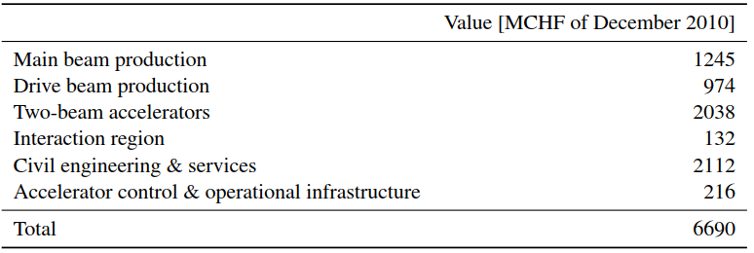
Value estimate
Drive-beam baseline design at 380 GeV
N. Blaskovic

Slide 16
Energy spread minimisation at 350 GeV
N. Blaskovic

Slide 17
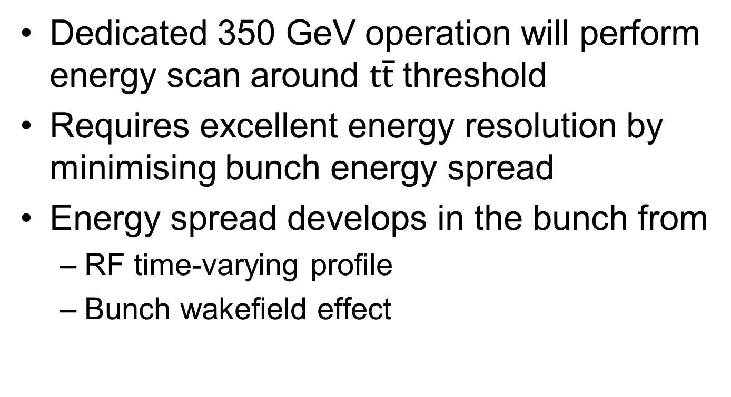
Energy spread minimisation
Dedicated 350 GeV operation will perform energy scan around $\text{t}\overline{\text{t}}$ threshold
Requires excellent energy resolution by minimising bunch energy spread
Energy spread develops in the bunch from
  RF time-varying profile
  Bunch wakefield effect
N. Blaskovic

Slide 18
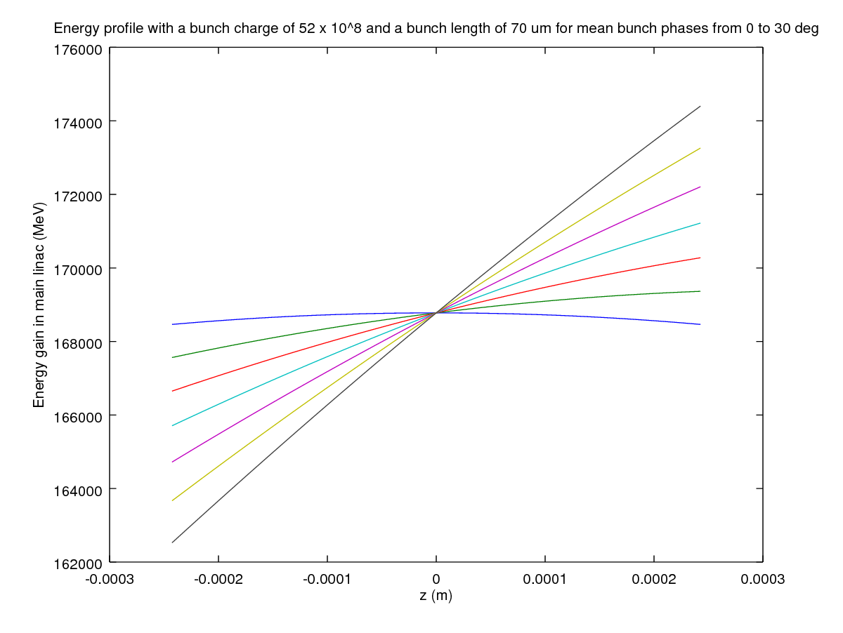
RF contribution
30°
off-crest
RF phase
15°
0°
on-crest
head of bunch
tail of bunch
N. Blaskovic

Slide 19
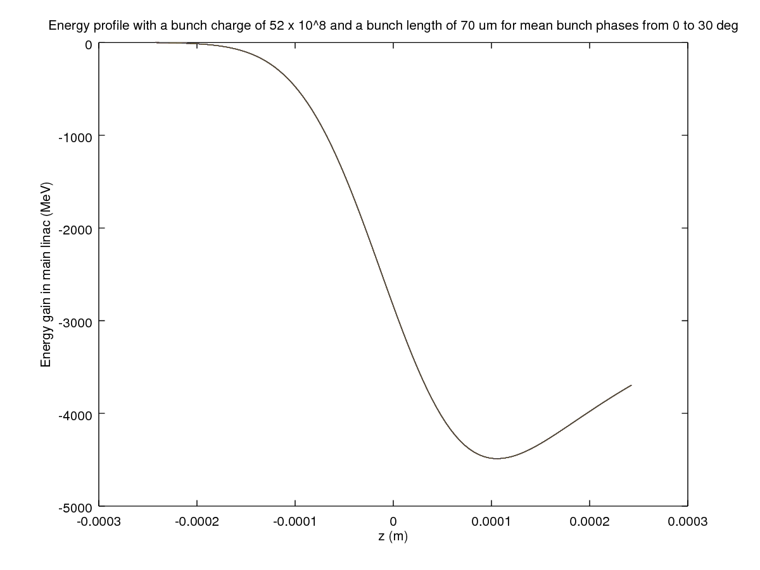
Wakefield contribution
head of bunch
tail of bunch
N. Blaskovic

Slide 20
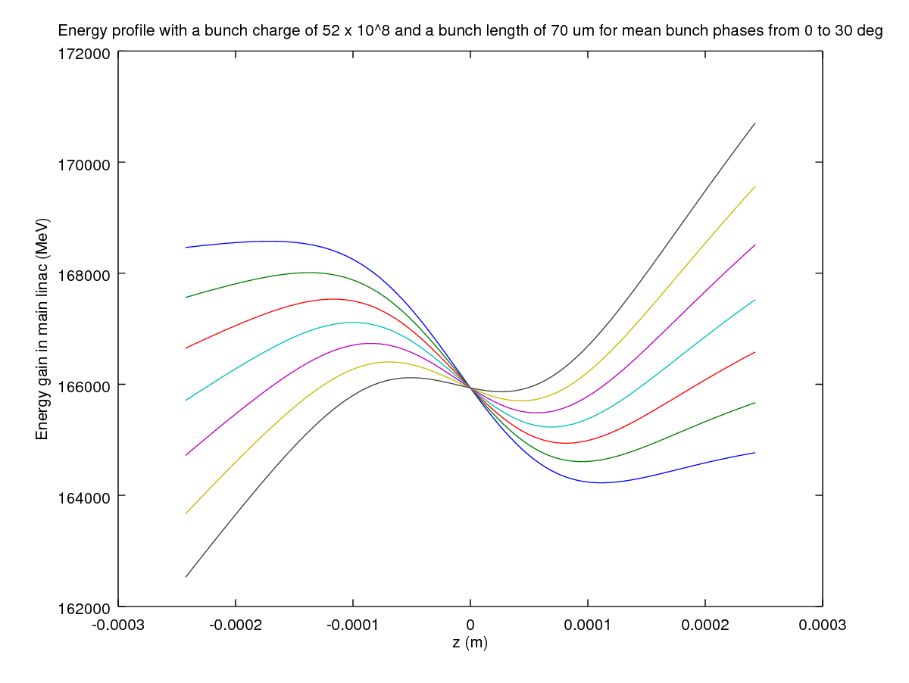
Combined contribution
30°
smallest energy spread for RF phase ~ 15°
RF phase
15°
0°
head of bunch
tail of bunch
N. Blaskovic

Slide 21
Energy spread
Energy spread optimised at 0.35% (std) at the end of the linac by D. Schulte et al. for baseline 380 GeV design:
  5.2 x 10⁹ particles/bunch
  70 um bunch length
Optimum RF phase:
  12° in first 3 linac sectors
  18.1° in last linac sector
N. Blaskovic

Slide 22
Energy spread minimisation
The energy spread has been studied further by varying:
  Number of particles/bunch
  Bunch length
RF gradient of 380 GeV stage re-adjusted for operation at 350 GeV
N. Blaskovic

Slide 23
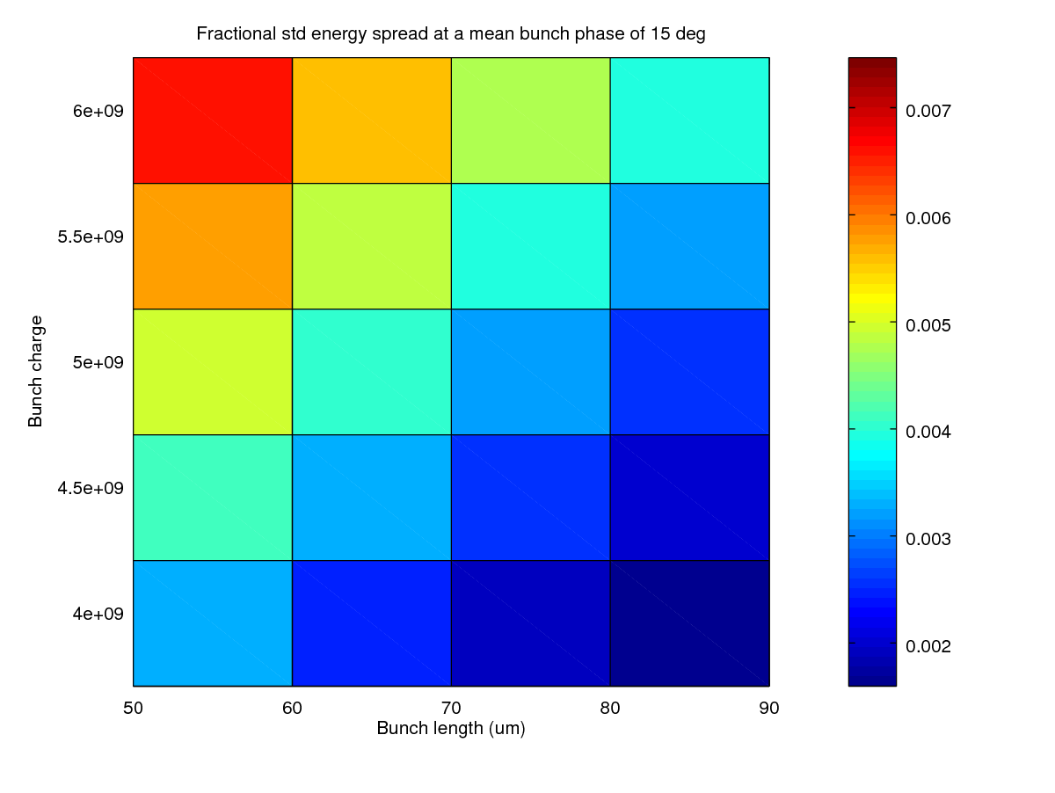
Energy spread
optimised
high
high
baseline
Fractional std energy spread
low
low
new optimum?

Slide 24
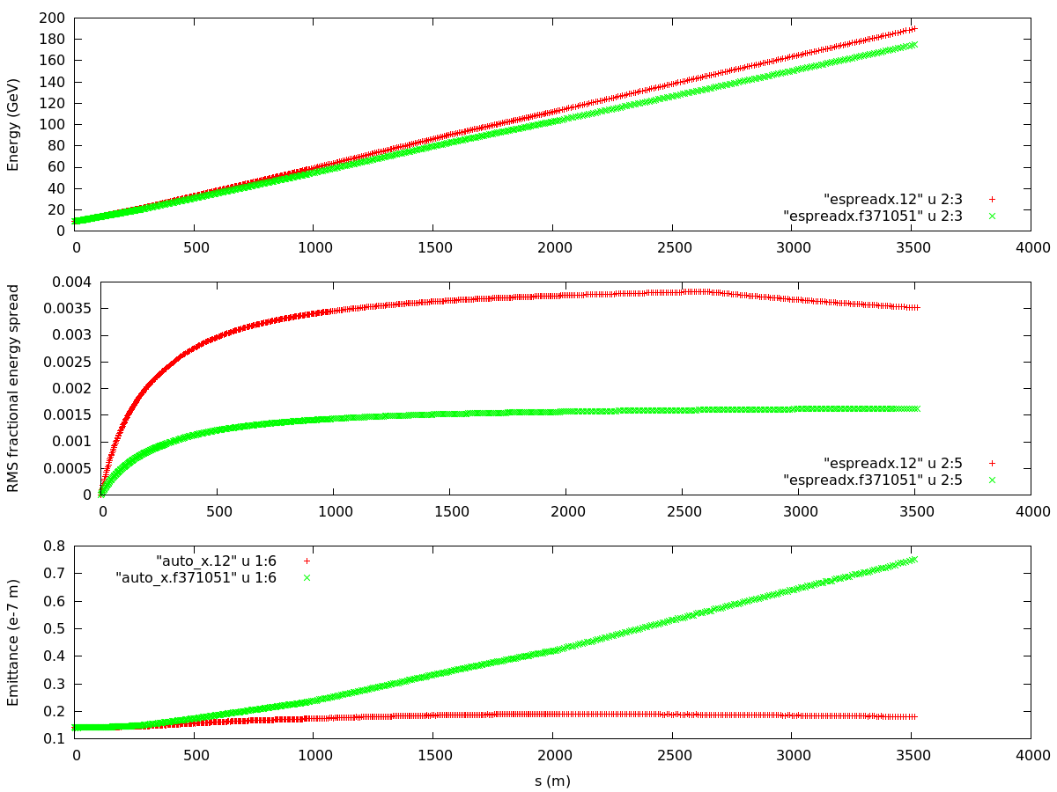
Comparison
380 GeV
350 GeV
linac injection at 9 GeV

Slide 25
Comparison
380 GeV
350 GeV
linac injection at 9 GeV
380 GeV
incoming energy spread to be added
350 GeV
reduced energy spread

Slide 26
Comparison
380 GeV
350 GeV
linac injection at 9 GeV
380 GeV
incoming energy spread to be added
350 GeV
14 nm incoming emittance (w.r.t. axis)
350 GeV
huge emittance
380 GeV

Slide 27
Emittance growth
Small energy spread along the linac leads to poorer beam stability and a larger beam emittance
Zero incoming energy spread gives worst case scenario
Mitigate emittance growth by introducing energy spread in early stages of linac (with offset RF phase) and after taking it out
N. Blaskovic

Slide 28
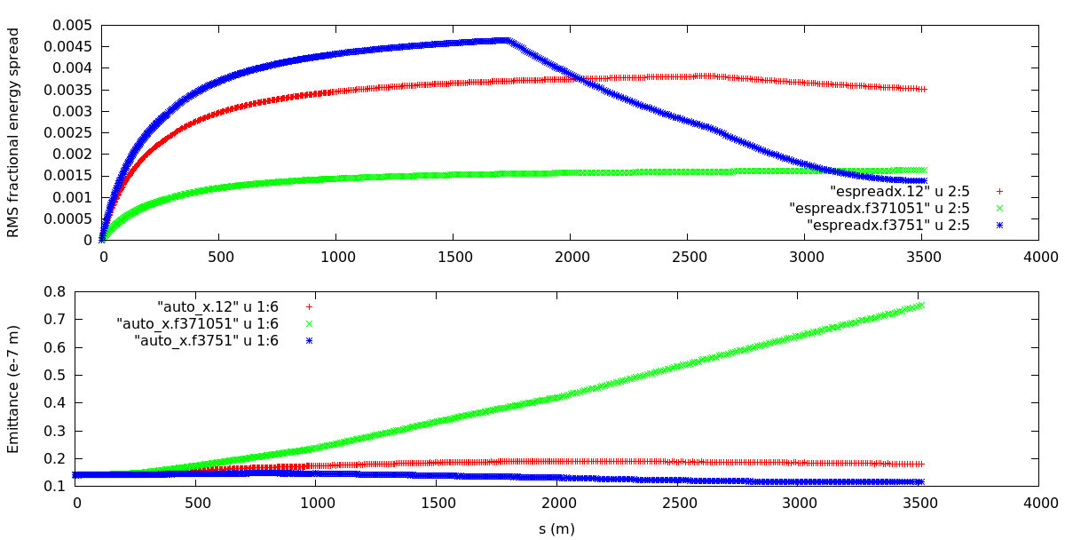
Mitigating emittance growth
380 GeV
350 GeV
adjusted
350 GeV
380 GeV
adjusted
RF: 0°
RF: 0°
RF: 20°
RF: 30°

Slide 29
RF phase scanning
RF phase combinations scanned to find lowest energy spread and emittance at end of linac
RF phases of all 4 linac sectors scanned together from 0° to 30°
For each phase, sequentially increase:
  Last sector’s phase up to 30°
  Preceding sectors’ phases up to 30°
N. Blaskovic

Slide 30
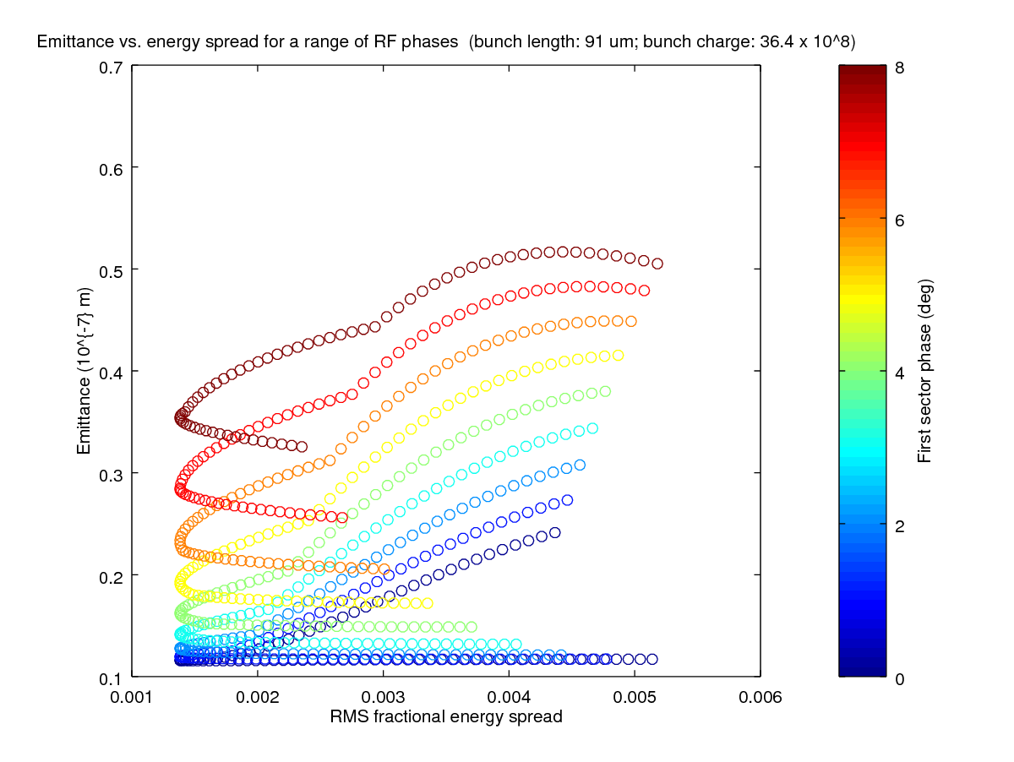
RF phase scanning
optimum phase:
sector 1: 0°
sector 2: 0°
sector 3: 20°
sector 4: 30°
all sectors
at 0°
last sector scanned 0° to 30°

Slide 31
Optimum bunch length & charge
Scan RF phase combinations over a range of bunch lengths and charges to find
whilst preserving an acceptable bunch charge for good luminosity
 | 380 GeV | Target
Emittance | 18 nm | < 14 nm
Energy spread | 0.35% | < 0.20%
N. Blaskovic

Slide 32
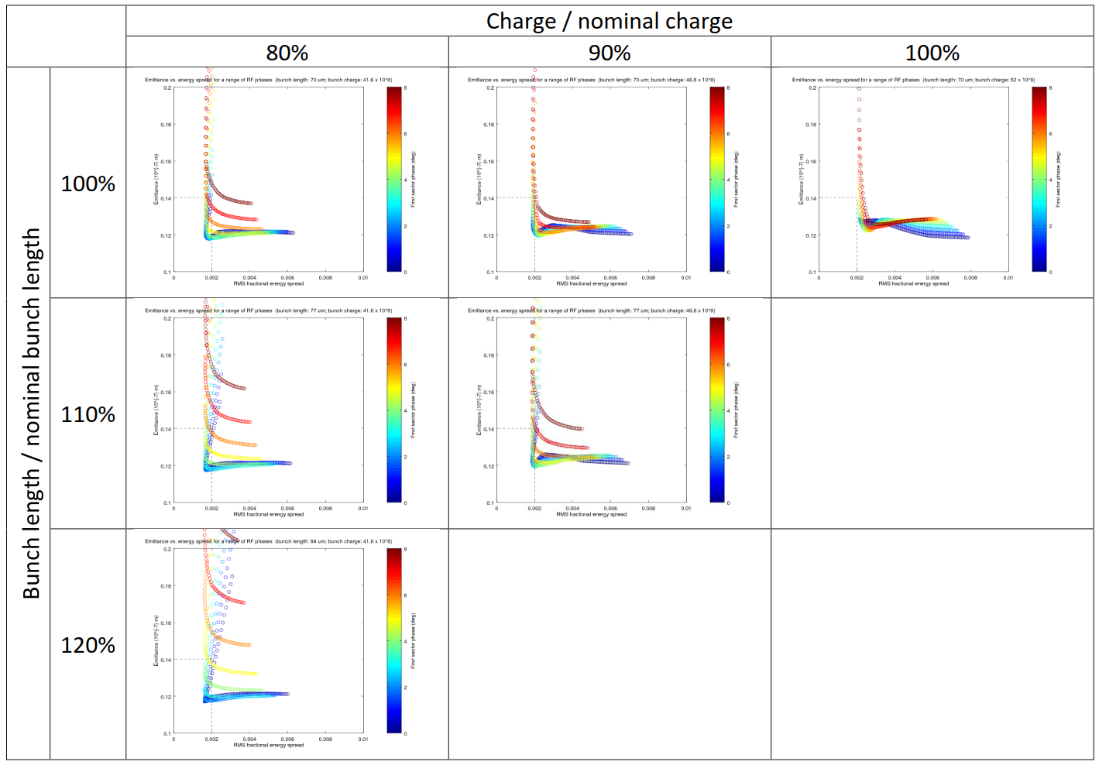
target
N. Blaskovic

Slide 33
target reached
with RF phases
sectors 1 & 2: 6°
sectors 3 & 4: 30°
N. Blaskovic

Slide 34
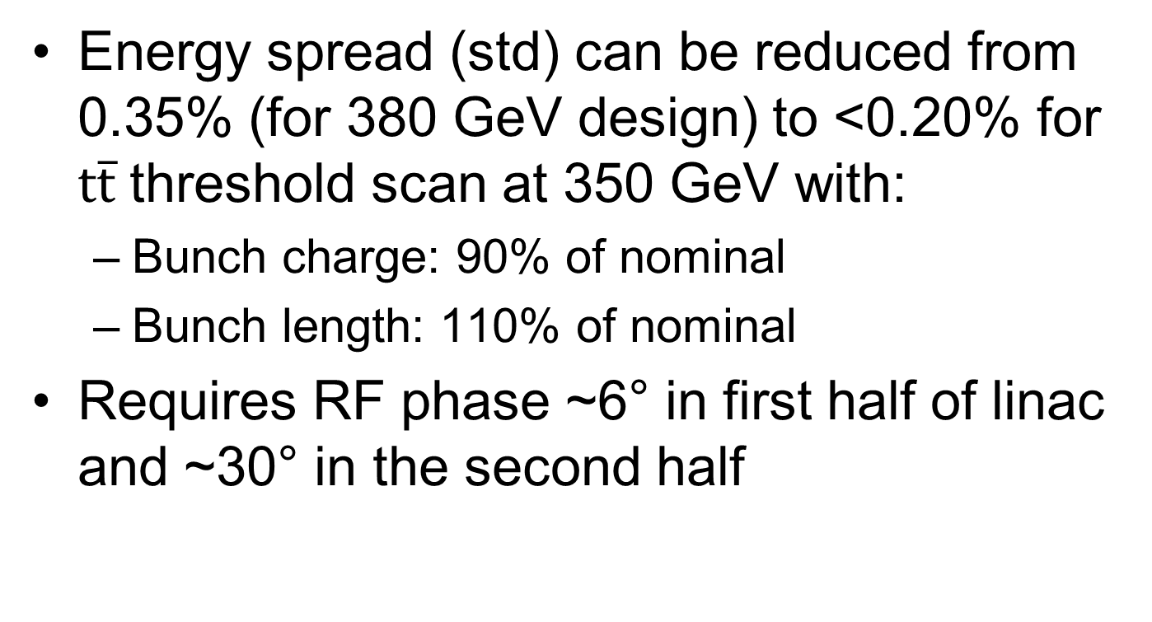
Conclusions
Energy spread (std) can be reduced from 0.35% (for 380 GeV design) to <0.20% for $\text{t}\overline{\text{t}}$ threshold scan at 350 GeV with:
  Bunch charge: 90% of nominal
  Bunch length: 110% of nominal
Requires RF phase ~6° in first half of linac and ~30° in the second half
N. Blaskovic

Slide 35
Thank you for your attention!
N. Blaskovic

Slide 36
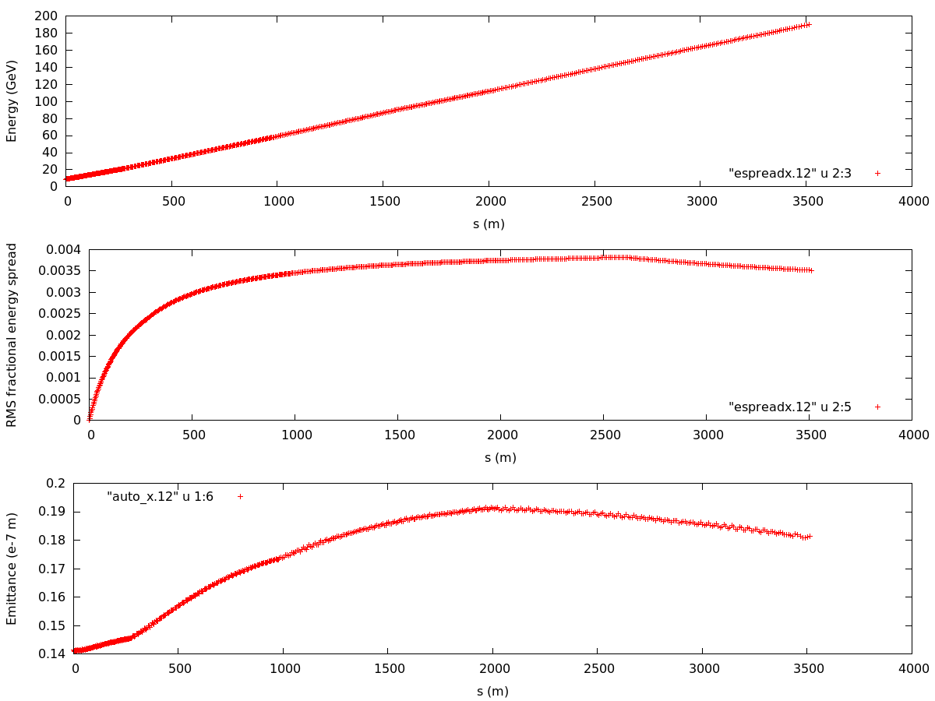
380 GeV baseline design
linac injection at 9 GeV
incoming energy spread to be added
14 nm incoming emittance (w.r.t. axis)

