Slide 1
stray field sources
And Mitigation Techniques
C. Gohil, E. Marin, D. Schulte, P. Burrows
(22/01/18)

Slide 2
Contents
Stray Field Sensitivity
  CLIC 3 TeV
Sources of Stray Fields
  Natural
  Environmental
  Technical
Mitigation Techniques
  RTML
  BDS
  Passive Shielding
  Active Compensation
Summary

Slide 3
Stray field sensitivity

Slide 4
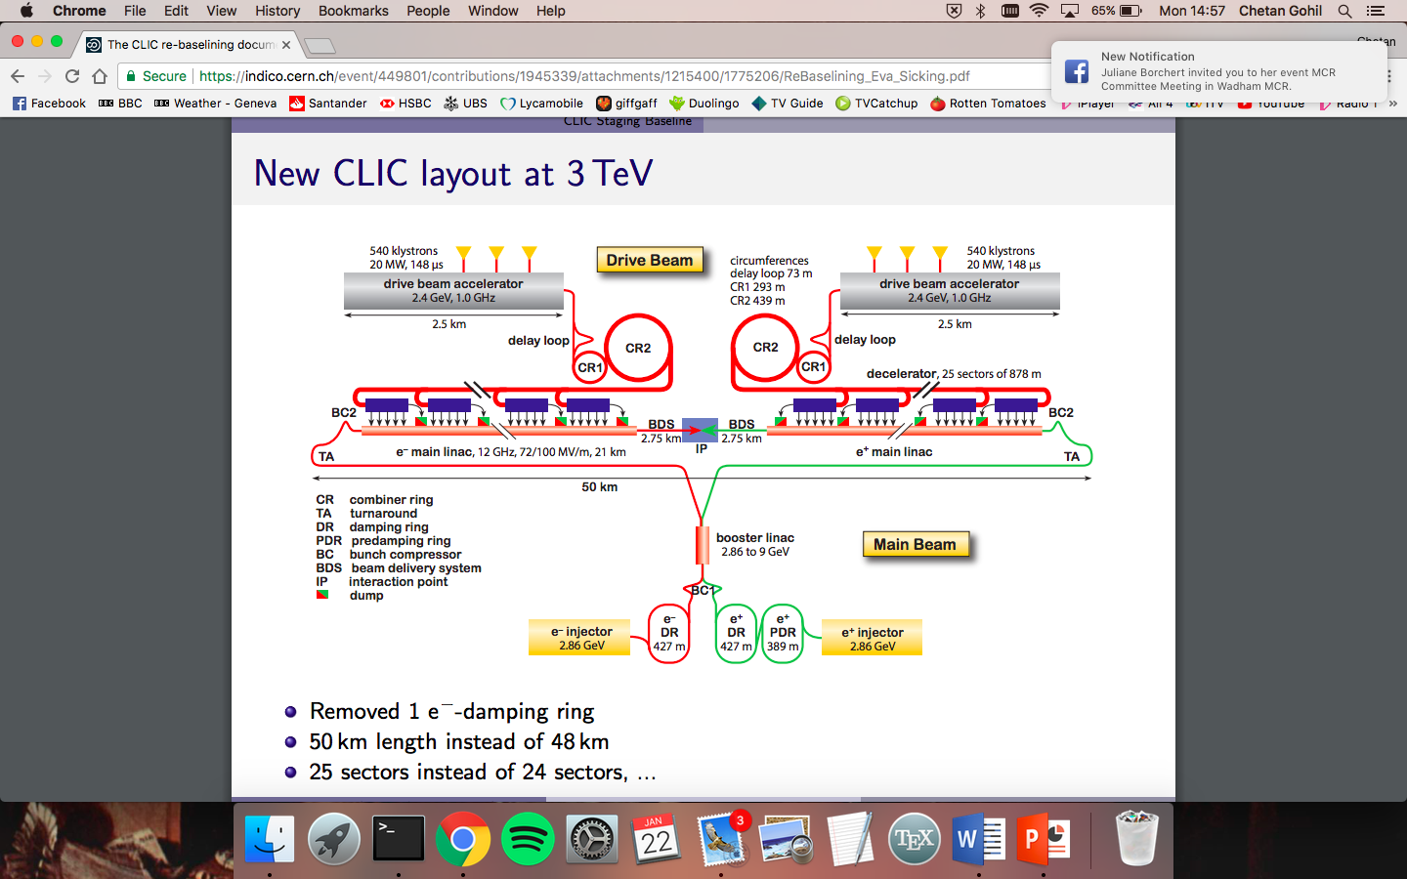
CLIC 3 teV

Slide 5
CLIC 3 teV

Slide 6
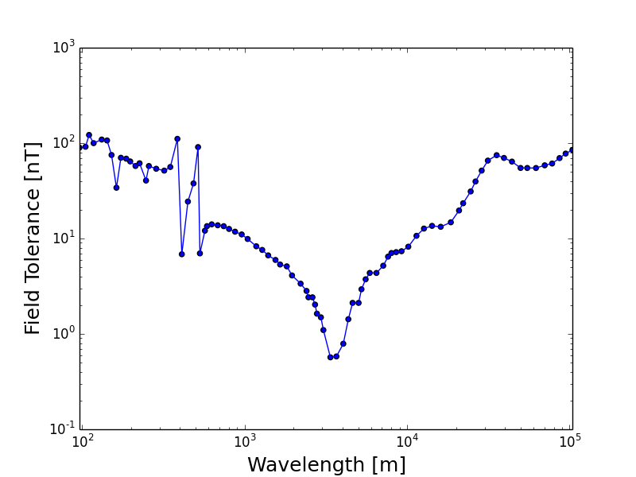
rtml
Stray field tolerance for a 0.4 nm emittance growth. Equivalent to 2% luminosity loss.
Offset and angle is assumed to corrected in the turn-around.
J. Snuverink et al.
(IPAC10, WEPE023)

Slide 7
rtml
Stray field tolerance for a 0.4 nm emittance growth. Equivalent to 2% luminosity loss.
Offset and angle is assumed to corrected in the turn-around.
J. Snuverink et al.
(IPAC10, WEPE023)
Betatron wavelength

Slide 8
CLIC 3 teV

Slide 9
CLIC 3 teV

Slide 10
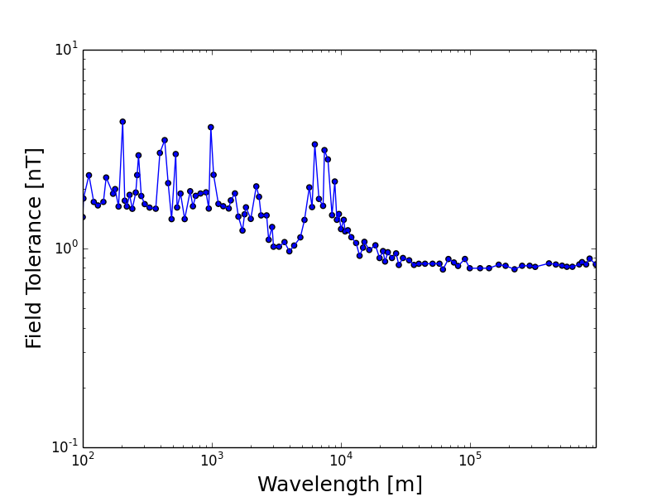
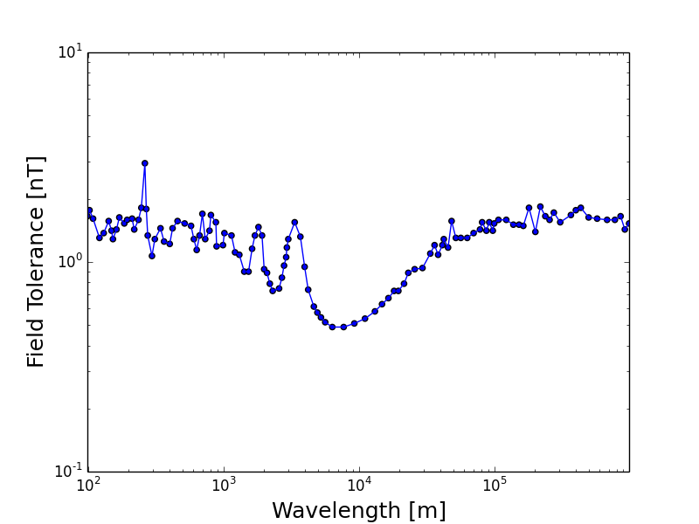
Ml + bds
Symmetric field w.r.t the IP
Anti-symmetric field w.r.t the IP
J. Snuverink
et al. (IPAC10, WEPE023)
Luminosity loss dominated by emittance growth.
Luminosity loss dominated beam-beam offset.
Show a ~$1$ nT sensitivity.

Slide 11
Sources of stray fields

Slide 12
Sources of stray fields
There are three classifications for stray fields sources:

Slide 13
Sources of stray fields
There are three classifications for stray fields sources:
  Natural sources.
    Stray fields from non-man-made objects.

Slide 14
Sources of stray fields
There are three classifications for stray fields sources:
  Natural sources.
    Stray fields from non-man-made objects.
  Environmental sources.
    Stray fields from man-made objects in the vicinity of the accelerator.

Slide 15
Sources of stray fields
There are three classifications for stray fields sources:
  Natural sources.
    Stray fields from non-man-made objects.
  Environmental sources.
    Stray fields from man-made objects in the vicinity of the accelerator.
  Technical sources.
    Stray fields from man-made objects that constitute the accelerator.

Slide 16
Natural Sources

Slide 17
Natural Sources
Natural magnetic variation spectrum:
Natural magnetic field variations exist at all frequencies.
Amplitude diminishes with increasing frequency.
C. Constable

Slide 18
Natural Sources
Natural magnetic variation spectrum:
Natural magnetic field variations exist at all frequencies.
Amplitude diminishes with increasing frequency.
C. Constable

Slide 19
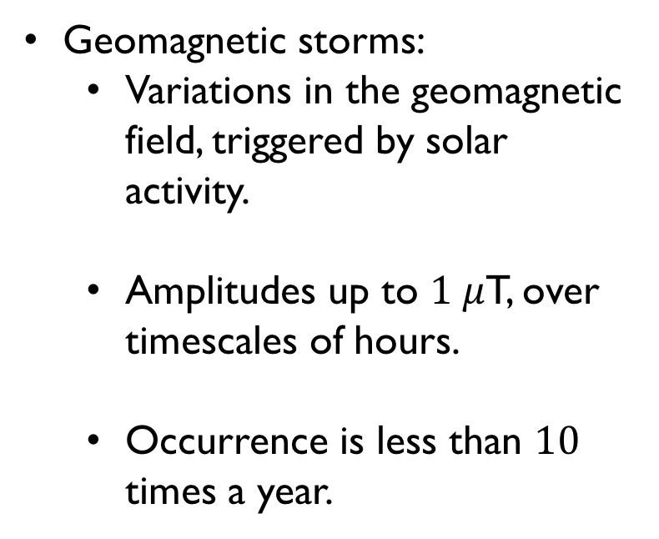
Natural Sources
Geomagnetic storms:
  Variations in the geomagnetic field, triggered by solar activity.
  Amplitudes up to $1 μ$T, over timescales of hours.
  Occurrence is less than $10$ times a year.
C. Constable

Slide 20
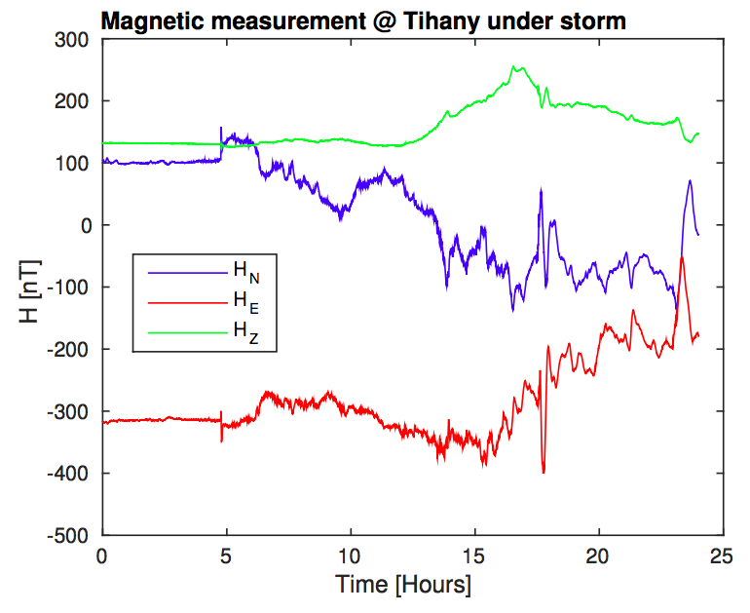
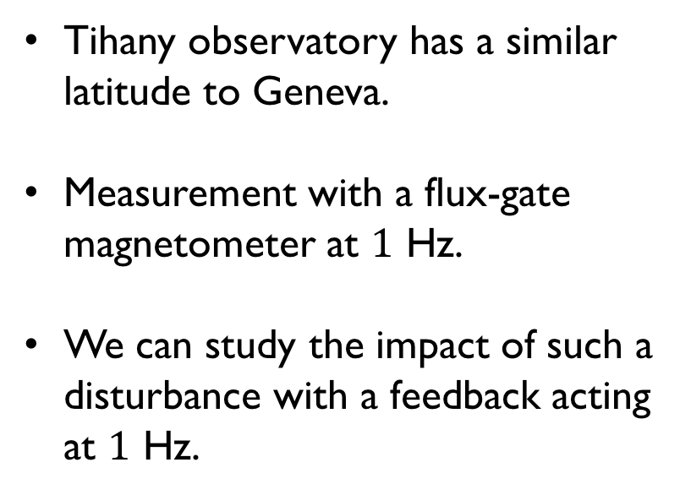
Natural Sources
Typical geomagnetic storm:
Tihany observatory has a similar latitude to Geneva.
Measurement with a flux-gate magnetometer at $1$ Hz.
We can study the impact of such a disturbance with a feedback acting at $1$ Hz.

Slide 21
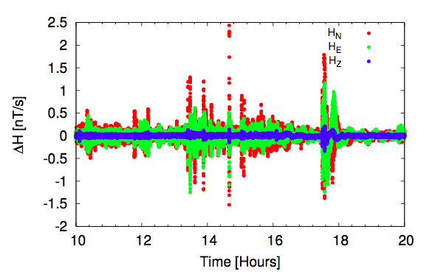
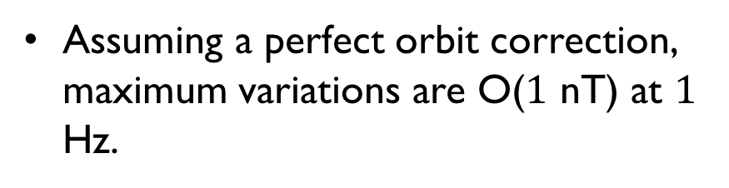
Natural Sources
Typical geomagnetic storm:
Assuming a perfect orbit correction, maximum variations are O($1$ nT) at $1$ Hz.

Slide 22
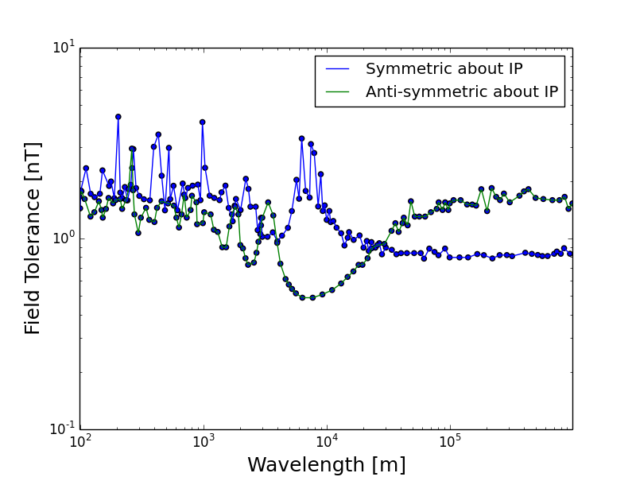
Natural Sources
Typical geomagnetic storm:
Assuming a perfect orbit correction, maximum variations are O($1$ nT) at $1$ Hz.
J. Snuverink
(IPAC10, WEPE023)

Slide 23
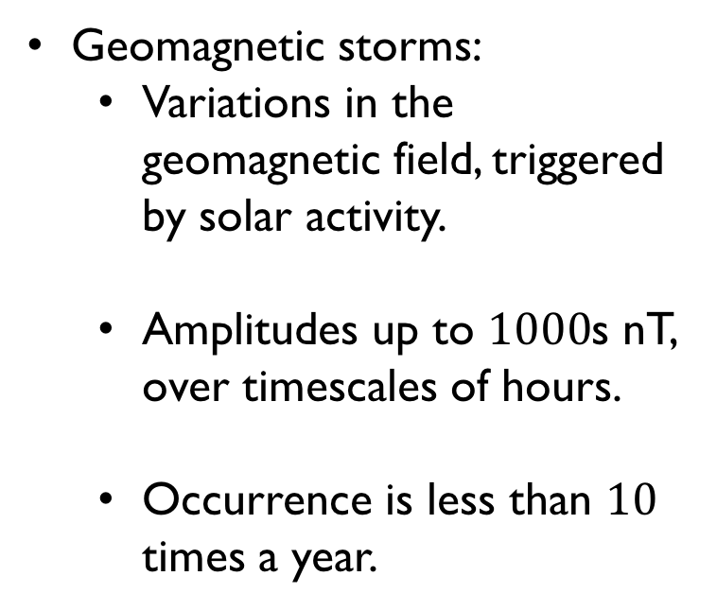
Natural Sources
Geomagnetic storms:
  Variations in the geomagnetic field, triggered by solar activity.
  Amplitudes up to $1000$s nT, over timescales of hours.
  Occurrence is less than $10$ times a year.
Can be handled with feedback
C. Constable

Slide 24
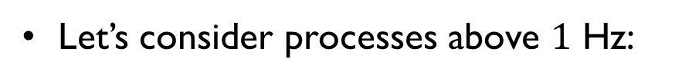
Natural Sources
Let’s consider processes above $1$ Hz:
C. Constable

Slide 25
Natural Sources
Let’s consider processes above $1$ Hz:
C. Constable

Slide 26
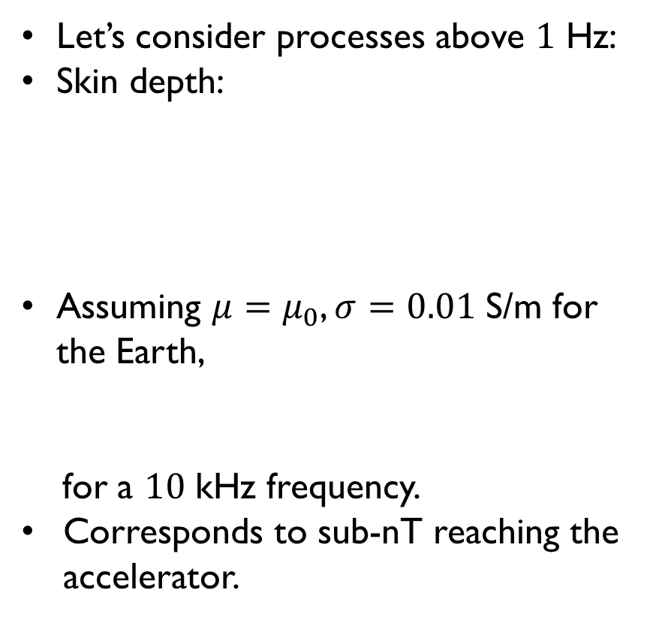

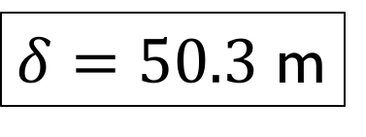
Natural Sources
Let’s consider processes above $1$ Hz:
Skin depth:
Assuming $μ=μ_{0}$, $σ=0.01$ S/m for the Earth,
for a $10$ kHz frequency.
Corresponds to sub-nT reaching the accelerator.
$$δ=\sqrt{\frac{2}{μσ(2πf)}}$$
$δ=50.3$ m
C. Constable

Slide 27
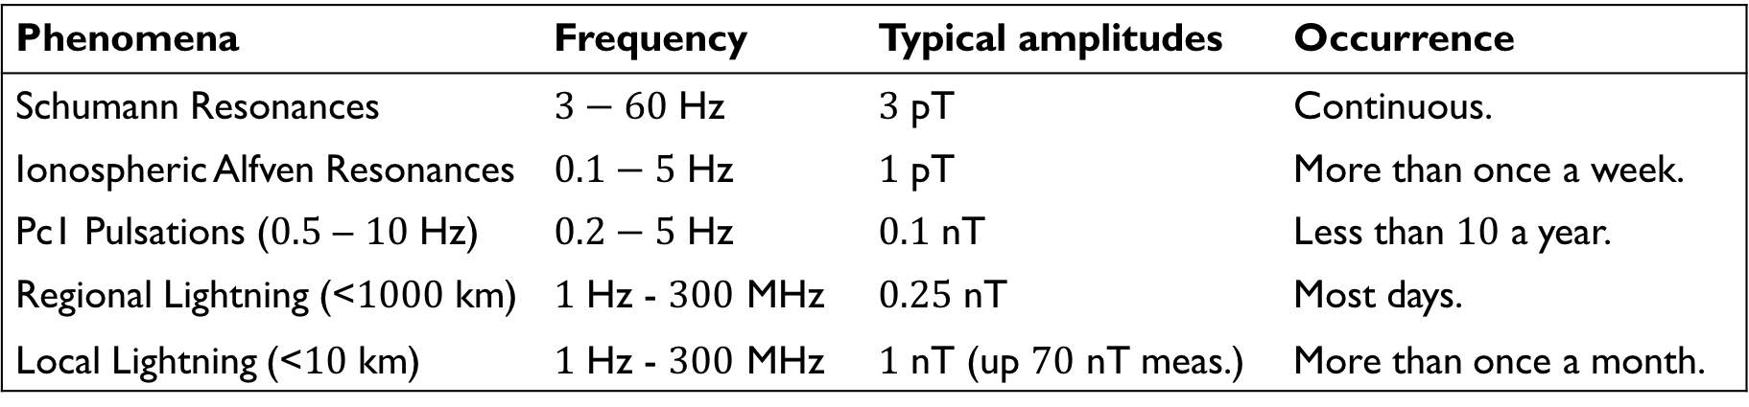
Natural Sources
Amplitudes and occurrences of natural magnetic field variations above $1$ Hz:
Phenomena | Frequency | Typical amplitudes | Occurrence
Schumann Resonances | $3−60$ Hz | $3$ pT | Continuous.
Ionospheric Alfven Resonances | $0.1−5$ Hz | $1$ pT | More than once a week.
Pc1 Pulsations ($0.5$ – $10$ Hz) | $0.2−5$ Hz | $0.1$ nT | Less than $10$ a year.
Regional Lightning (<$1000$ km) | $1$ Hz - $300$ MHz | $0.25$ nT | Most days.
Local Lightning (<$10$ km) | $1$ Hz - $300$ MHz | $1$ nT (up $70$ nT meas.) | More than once a month.
Most processes are within the field tolerance.

Slide 28
Environmental sources

Slide 29
Environmental sources
Examples:
  Electrical grid, power lines.
  Local infrastructure – Trains, trams, etc.
  Other accelerators – PS.

Slide 30
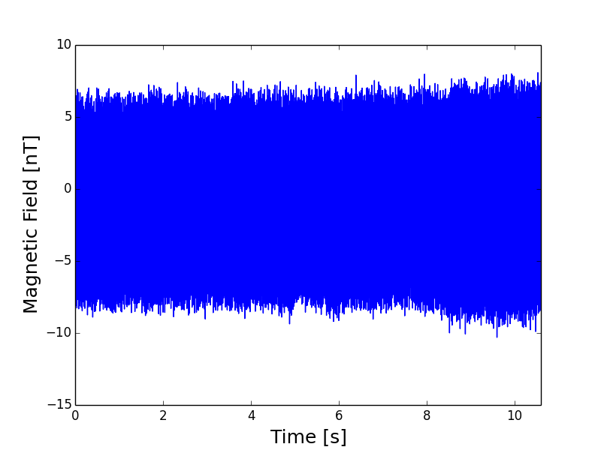
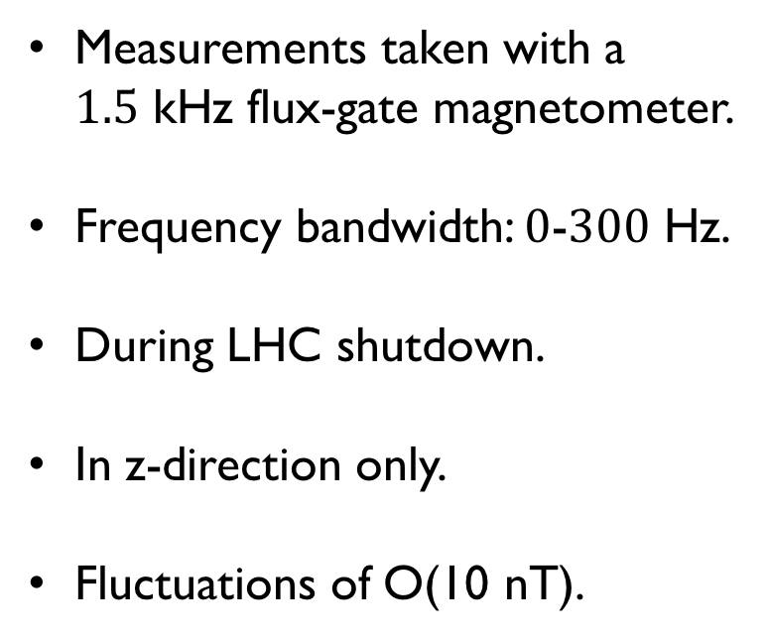
Environmental sources
Background magnetic field variations in building 10 (15/01/18):
Measurements taken with a $1.5$ kHz flux-gate magnetometer.
Frequency bandwidth: $0$-$300$ Hz.
During LHC shutdown.
In z-direction only.
Fluctuations of O(10 nT).

Slide 31
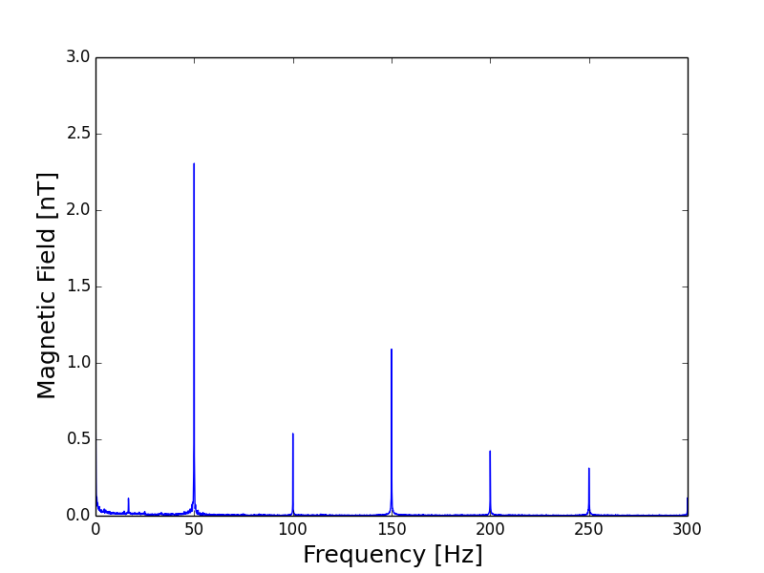
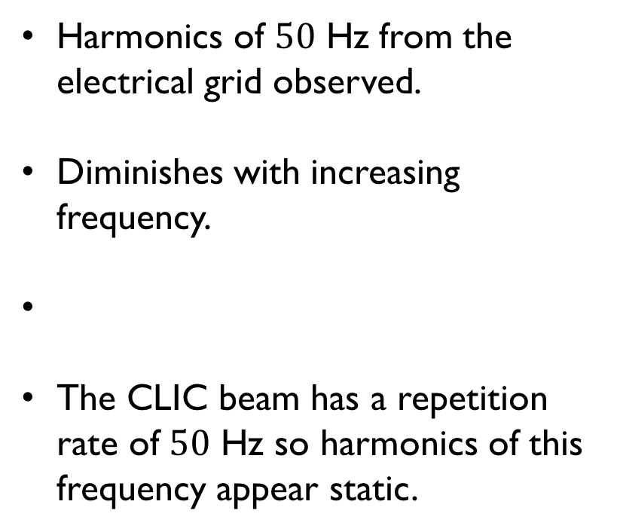
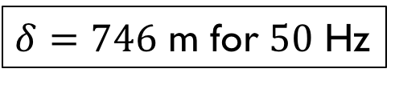
Environmental sources
Background magnetic field variations in building 10 (15/01/18):
Harmonics of $50$ Hz from the electrical grid observed.
Diminishes with increasing frequency.
The CLIC beam has a repetition rate of $50$ Hz so harmonics of this frequency appear static.
$δ=746$ m for $50$ Hz

Slide 32
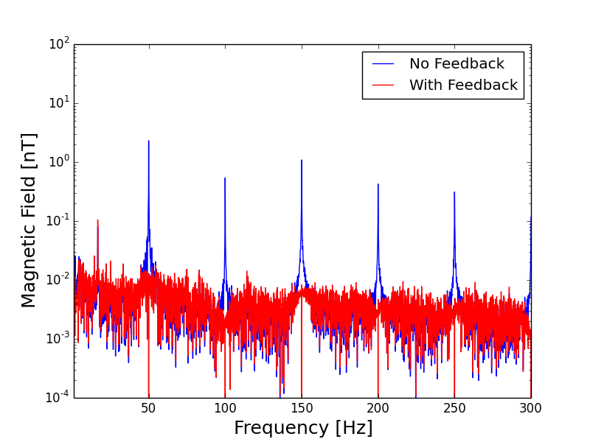
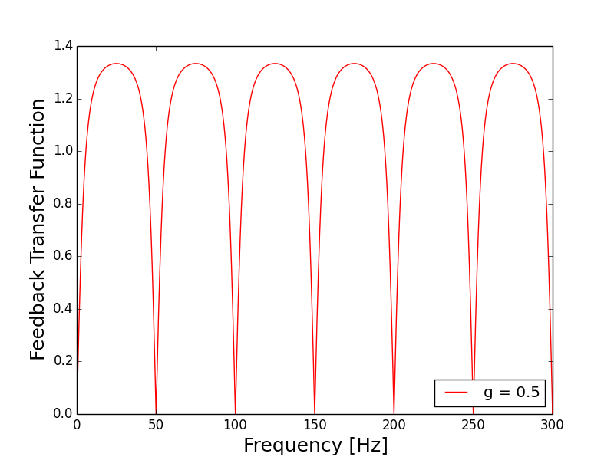
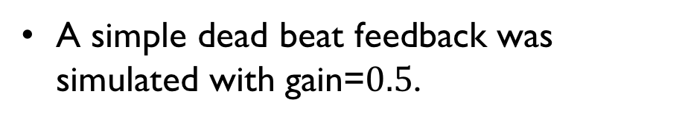
Environmental sources
Background magnetic field variations in building 10 (15/01/18):
A simple dead beat feedback was simulated with gain=$0.5$.

Slide 33
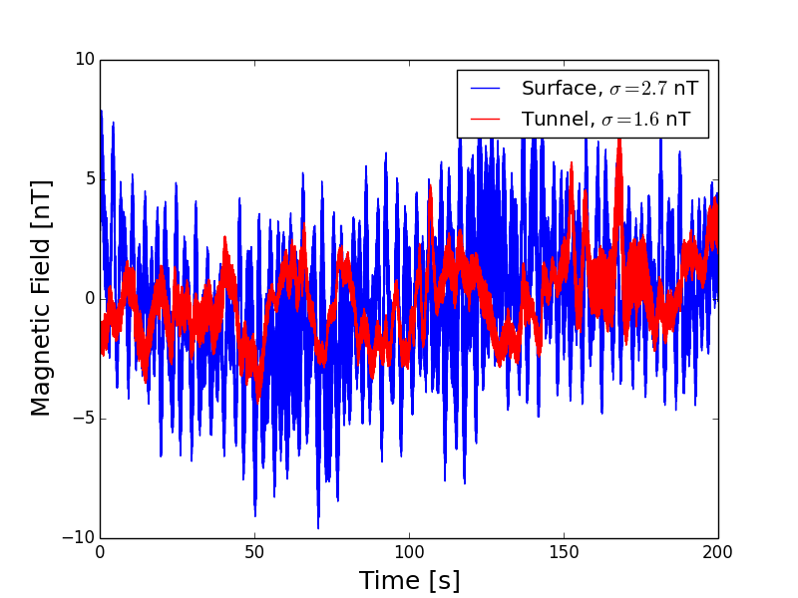
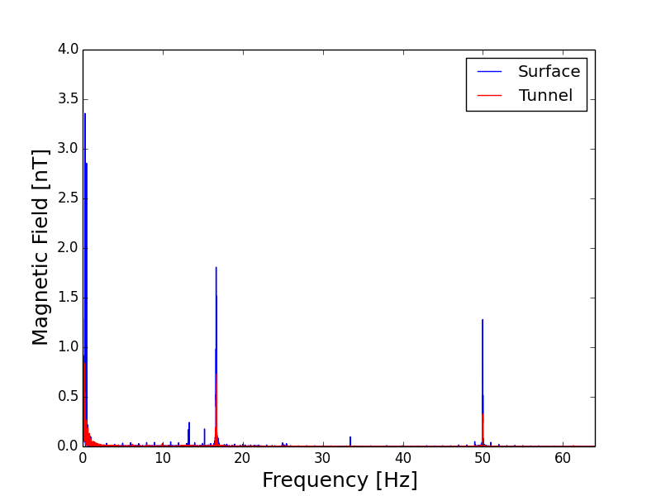
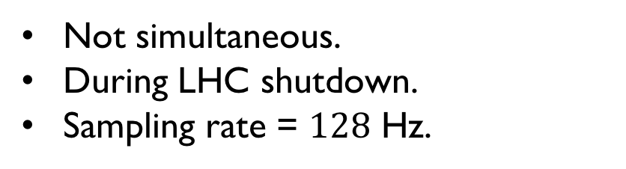
Environmental sources
Background measurements in the LHC tunnel (03/07/17):
Not simultaneous.
During LHC shutdown.
Sampling rate = $128$ Hz.

Slide 34
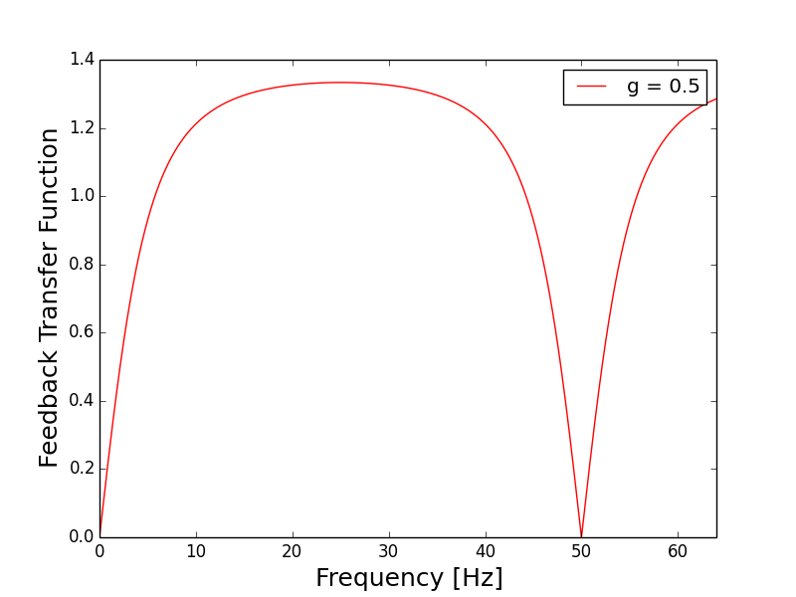
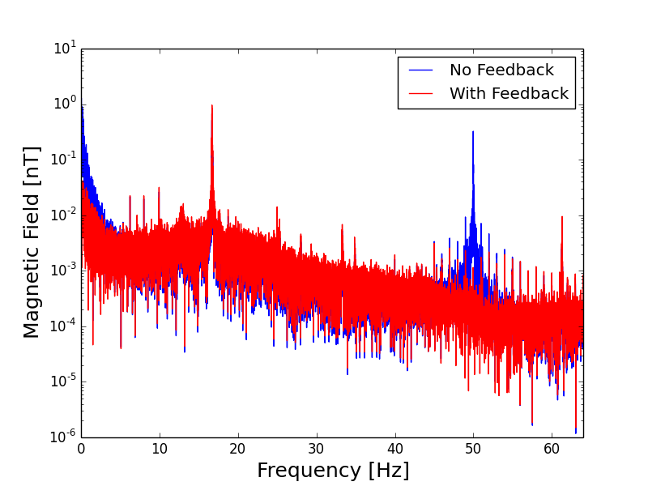
Environmental sources
Background measurements in the LHC tunnel (03/07/17):

Slide 35
Technical sources

Slide 36
Technical sources
Examples:
  Magnets.
  RF systems.
  Power supplies.
  Cables.
  Etc.
Measurements have been taken at CTF3, AD hall and XBOX.
  Used a sensor with sampling frequency 128 Hz.
  Frequency cut-off at 20 Hz.

Slide 37
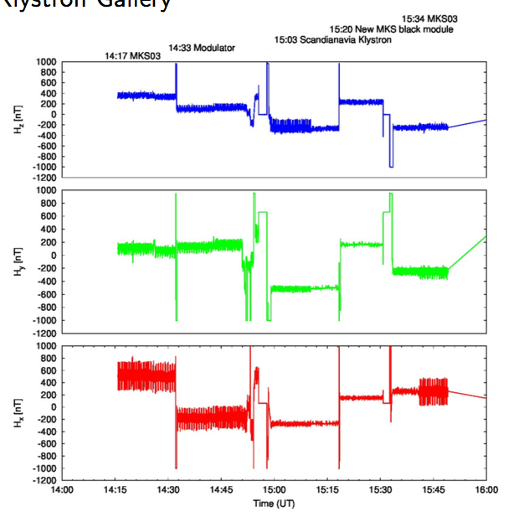
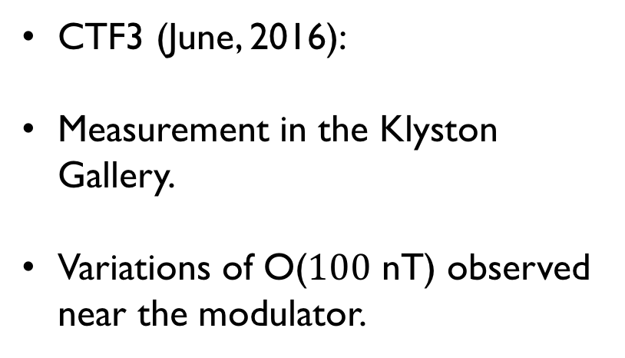
Technical sources
CTF3 (June, 2016):
Measurement in the Klyston Gallery.
Variations of O($100$ nT) observed near the modulator.
E. Marin

Slide 38
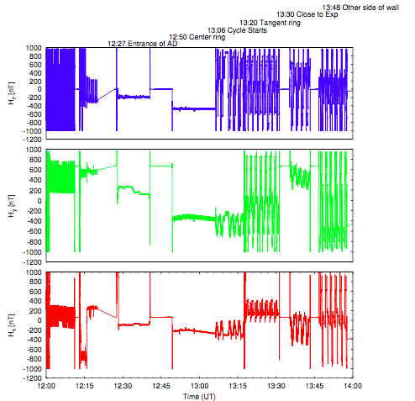
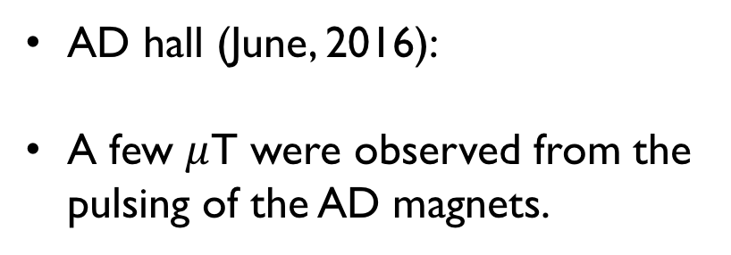
Technical sources
AD hall (June, 2016):
A few $μ$T were observed from the pulsing of the AD magnets.
E. Marin

Slide 39
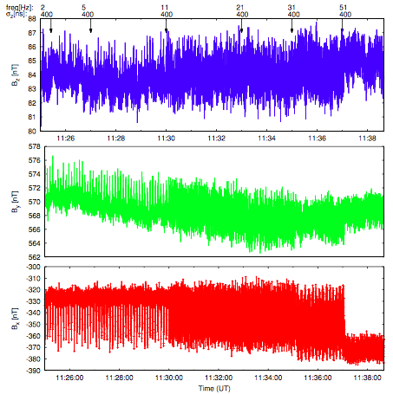
Technical sources
XBOX (17/01/2017):
Variations of a few 10s nT observed.
E. Marin

Slide 40
Mitigation techniques

Slide 41
rtml
This tight tolerance is due to a resonance.
Reducing the periodicity of the RTML transfer line could help avoid the resonance.
Using stronger focusing would also reduce the sensitivity.
J. Snuverink et al.
(IPAC10, WEPE023)
Betatron wavelength

Slide 42
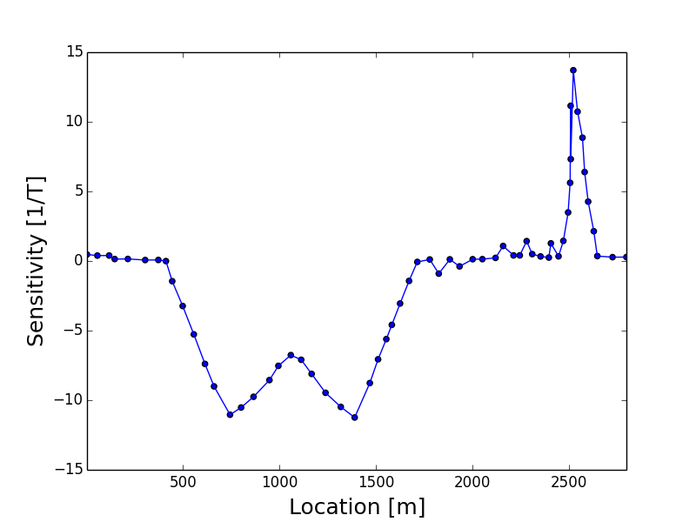
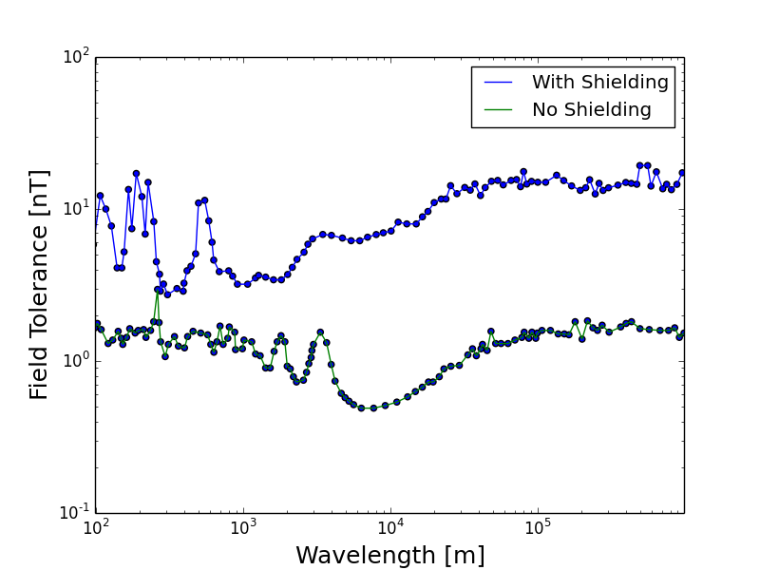
BDS
Point sensitivity:
J. Snuverink et al. (IPAC10, WEPE023)
Most of the sensitivity arises from the collimation section and final focus.
Assuming perfect shielding.
(Antisymmetric about IP)

Slide 43
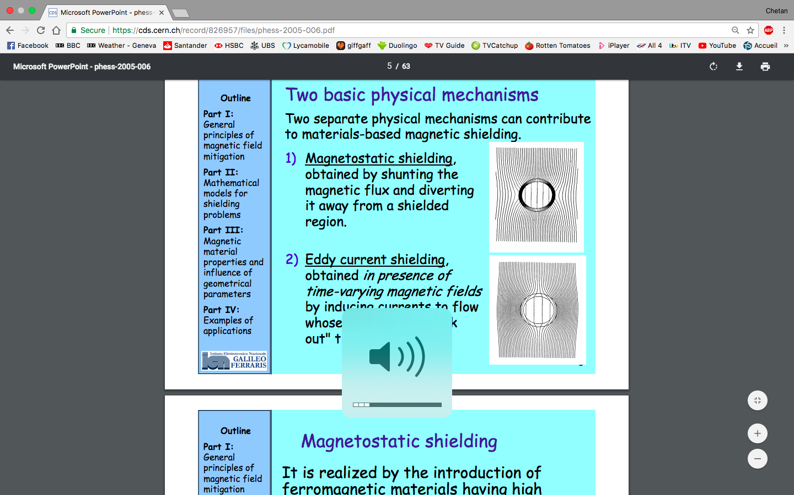
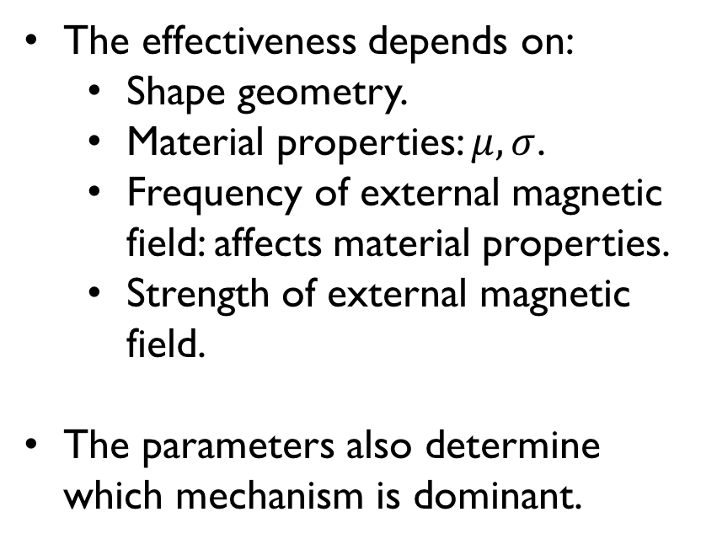
Passive shielding
There are two mechanisms of shielding magnetic fields:
The effectiveness depends on:
  Shape geometry.
  Material properties: $μ, σ$.
  Frequency of external magnetic field: affects material properties.
  Strength of external magnetic field.
The parameters also determine which mechanism is dominant.
Magnetostatic
Eddy current

Slide 44
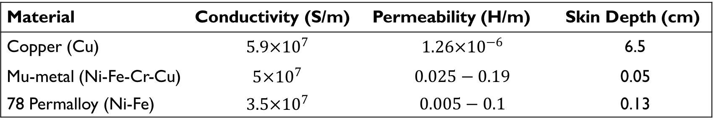
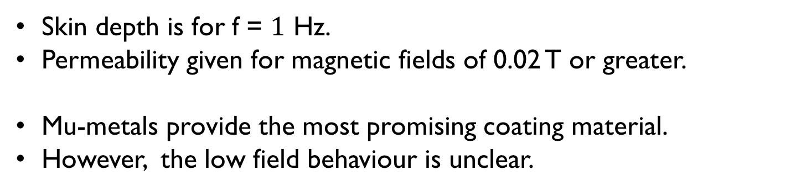
Passive shielding
Comparison of potential materials:
Material | Conductivity (S/m) | Permeability (H/m) | Skin Depth (cm)
Copper (Cu) | $$5.9×{10}^{7}$$ | $$1.26×{10}^{−6}$$ | 6.5
Mu-metal (Ni-Fe-Cr-Cu) | $$5×{10}^{7}$$ | $$0.025−0.19$$ | 0.05
78 Permalloy (Ni-Fe) | $$3.5×{10}^{7}$$ | $$0.005−0.1$$ | 0.13
Skin depth is for f = $1$ Hz.
Permeability given for magnetic fields of 0.02 T or greater.
Mu-metals provide the most promising coating material.
However, the low field behaviour is unclear.

Slide 45
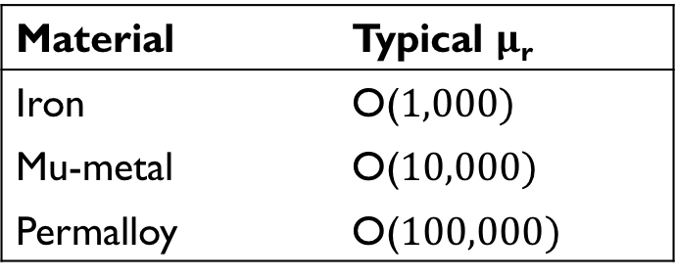
Passive shielding
10⁶
Magnetic shields for superconducting cavities are being studied at KEK.
10⁵
Material | Typical $μ$_{r}
Iron | O($1,000)$
Mu-metal | O($10,000)$
Permalloy | O($100,000)$
Relative Permeability
10⁴
10³
Behaviour at nT level fields still to be determined.
10²
10²
10³
10⁴
10⁵
10⁶
K. Tsuchiya et al. (EPA06)
B (nT)

Slide 46
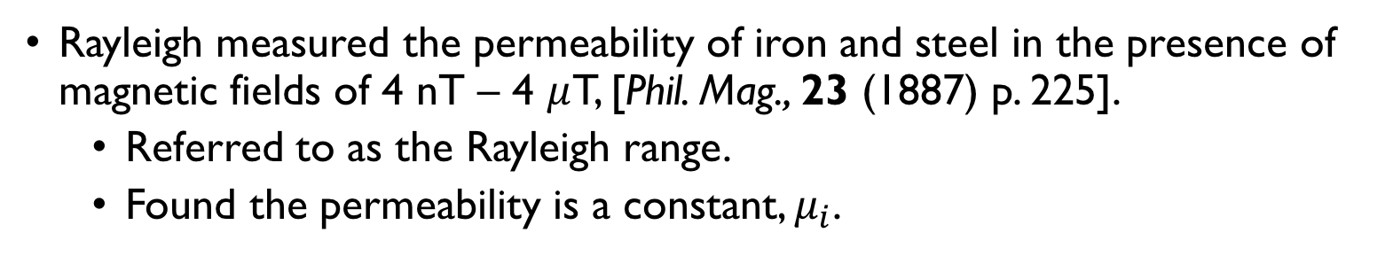

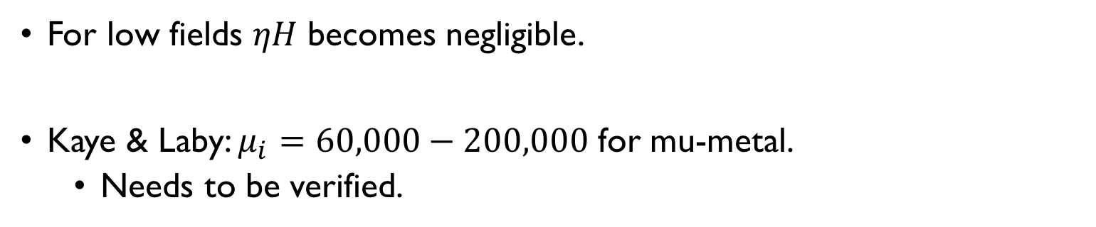
Passive shielding
Rayleigh measured the permeability of iron and steel in the presence of magnetic fields of 4 nT – 4 $μ$T, [Phil. Mag., 23 (1887) p. 225].
  Referred to as the Rayleigh range.
  Found the permeability is a constant, $μ_{i}$.
$$μ=μ(H)=μ_{i}+ηH$$
Rayleigh Law
For low fields $ηH$ becomes negligible.
Kaye & Laby: $μ_{i}=60,000−200,000$ for mu-metal.
  Needs to be verified.

Slide 47
Passive shielding
Material | Advantages | Disadvantages
Conductive materials: E.g. Copper/Silver | - Effective for high frequencies | - Expensive. - Not effective for low frequencies
Ferromagnetic materials: E.g. Mu-metals/Permalloys | - High permeability - Good frequency range | - Not effective for weak fields? - Availability
High temperature superconductors: | - Would attenuate all frequencies | - Expensive - Availability - Temperature requirements
Comments:
  There is always a residual field.
  Mechanical imperfections can lead to inhomogeneous fields inside the shield.

Slide 48



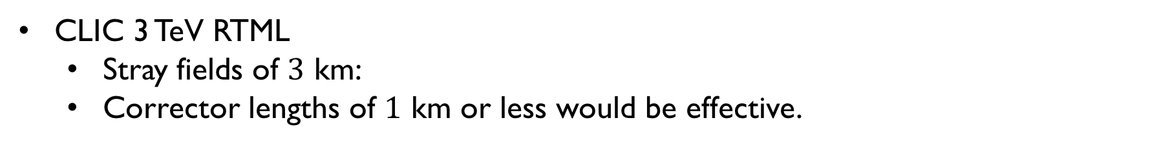
Active compensation
A corrector has a finite length:
$$B=0$$
$$B=0$$
Corrector
Corrector
Corrector
Corrector
Corrector
Corrector
$$L_{corr}$$
$$L_{corr}$$
Before correction
After correction
CLIC 3 TeV RTML
  Stray fields of $3$ km:
  Corrector lengths of $1$ km or less would be effective.

Slide 49


Active compensation
Technical sources are suspected of producing localised stray fields.
Long correctors would not be effective for local sources.
Strategies for placing sensors and correctors depends on the technical sources.
The design of the lattice can be used to mitigate stray field effects.
$$B(s)$$
$$s$$
876 m

Slide 50
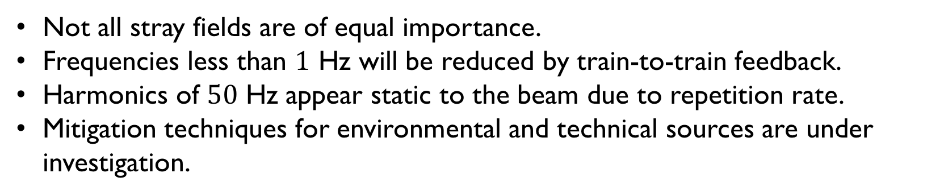
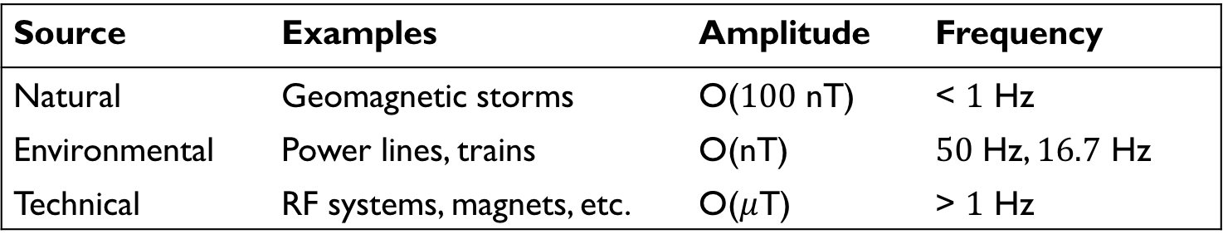
Summary
CLIC shows a stray field tolerance down to the nT level.
Source | Examples | Amplitude | Frequency
Natural | Geomagnetic storms | O($100$ nT) | < $1$ Hz
Environmental | Power lines, trains | O(nT) | $50$ Hz, $16.7$ Hz
Technical | RF systems, magnets, etc. | O($μ$T) | > $1$ Hz
Not all stray fields are of equal importance.
Frequencies less than $1$ Hz will be reduced by train-to-train feedback.
Harmonics of $50$ Hz appear static to the beam due to repetition rate.
Mitigation techniques for environmental and technical sources are under investigation.

Slide 51
Thank you. Questions?

Slide 52
Back up slides

Slide 53

Active compensation
$$B(s)$$
Corrector length
Alternative to passive shielding.
Generate a compensating field to cancel the stray field.
Requires an accurate measurement of the stray field.
Noise in the measurement results in a residual kick.
$$s$$
After correction
$$B(s)$$
$$s$$

Slide 54
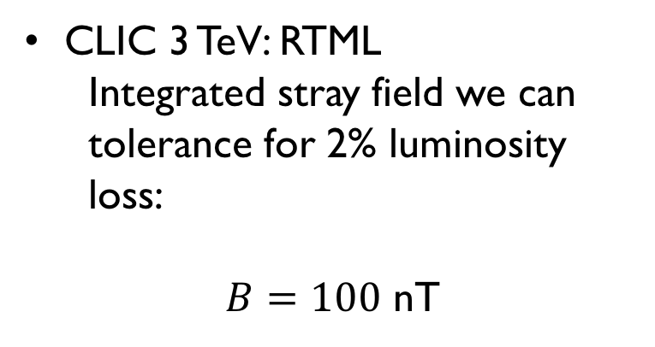
Active compensation
$$B(s)$$
Corrector length
CLIC 3 TeV: RTML
  Integrated stray field we can tolerance for 2% luminosity loss:
$B=100$ nT
$$s$$
After correction
$$B(s)$$
$$s$$

Slide 55
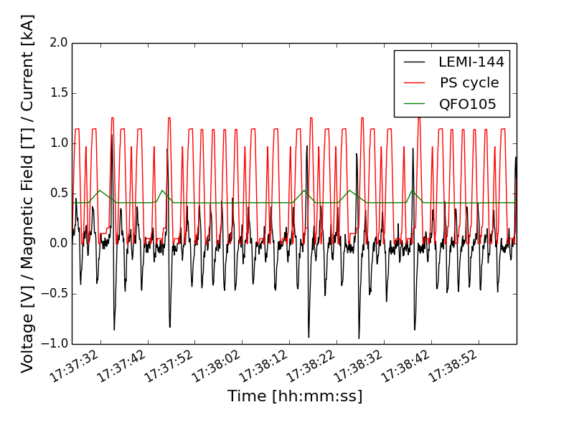
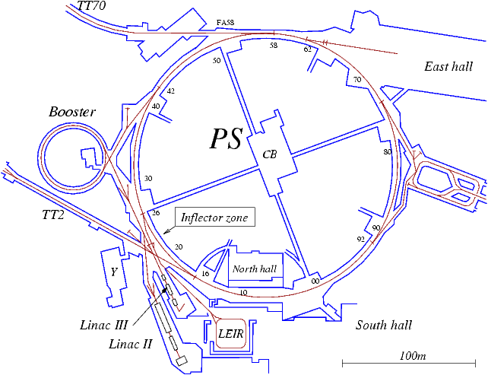
Environmental sources – Ps cycle
PS measured from building 10 (30/11/17):

Slide 56
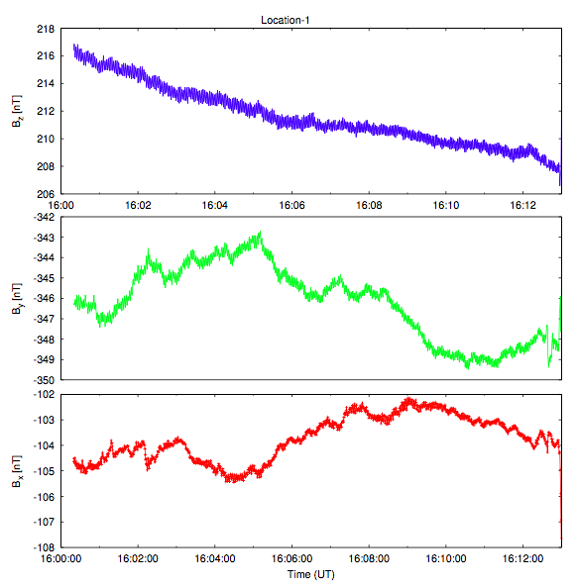


Environmental sources - trains
Measurements taken in Thoiry:
Away from the CERN site.
Largest fluctuations observed were ~$5$ nT.
B. Heilig
E. Marin

Slide 57


Environmental sources - trains
Measurements taken in Thoiry:
Observed harmonics:
  $60$ Hz
  $50$ Hz
  $33.6$ Hz
  $16.7$ Hz
The signals are O(nT).
Likely produced by
$16.7$ Hz AC trains
B. Heilig

