Slide 1



Report from the CLIC main linac hardware baselining wg
CLIC workshop 2018
C. Rossi on behalf of the MLHW baselining WG
CLIC WS 2018 – 25th January 2018

Slide 2
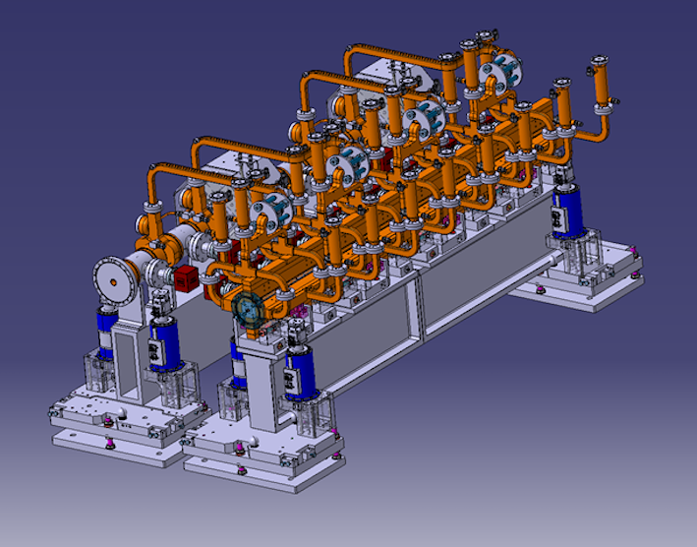
OUTLINE
The CLIC Implementation Studies
Main Linac Hardware WG
Key Aspects of Rebaselining
Plans for the Near Future

Slide 3
The CLIC Implementation Studies
The CLIC Implementation WGs started to meet in September 2016 .
CLIC Design - lead by D. Schulte;
CLIC Main Linac Hardware Baselining - lead by H. Schmickler (C. Rossi as from January 2017);
CLIC Civil Engineering & Infrastructure and Siting - lead by J. Osborne;
CLIC Cost and Power - lead by S. Stapnes.
GOALS:
Focus the attention on the 380 GeV stage and consider all options;
Increase the exchange of information and synergies among the different study areas of CLIC;
Prepare the next update of the European Strategy document.

Slide 4
CLIC Main Linac Hardware Baselining
Review the specification for the CLIC Module and its integration, by looking also at its environment and lifecycle.
CLIC Main Beam Module as described in the CLIC CDR (CERN-2012-007)

Slide 5
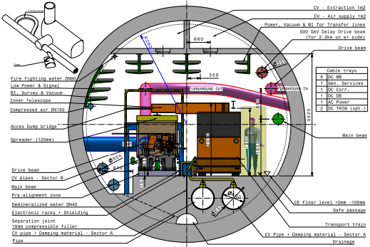
CLIC Main Linac Hardware Baselining
Provide the required information to refine the study of its integration into the linac tunnel, for the definition of the infrastructure and evaluation of cost.
CLIC Accelerator tunnel as described in the CLIC CDR (CERN-2012-007)

Slide 6
CLIC Main Linac Hardware Baselining
With the increase of the klystron and modulator efficiencies, the interest for a low energy stage driven by klystrons is growing.
See presentations at CLIC WS 2018 from B. Weatherford and J. Neilson on 24/01
Indicative cost balance based on a semi-analytical model. Model update in progress. (Courtesy D. Schulte)
Beam dynamics optimized at 380 GeV for the two possible options: klystron and drive beam-based. See presentation at LCWS2017 by D. Schulte
Mechanical tolerances and pre-alignment requirements reconsidered, also to the light of PACMAN’s achievements. See presentation at CLIC WS 2018 by H. Mainaud-Durand
Include considerations on the module life cycle in the design process, study the impact of the heat load to the infrastructure and operating conditions.
See presentation at CLIC WS 2018 by M. Aicheler

Slide 7
CLIC Main Linac Hardware Baselining
New reference parameters for the RF Design based on optimization for beam dynamics and cost, provided for the two design options. CLIC Design - D. Schulte, November 2016.
With constant Luminosity = 1.5 10³⁴ cm⁻² s⁻¹

Slide 8
CLIC two beam accelerator at 380 GeV
DB option optimized for the 380 GeV stage (in Updated baseline for a staged Compact Linear Collider, CERN – 2016 – 004).
2 GHz RF system in PDR and DR

Slide 9
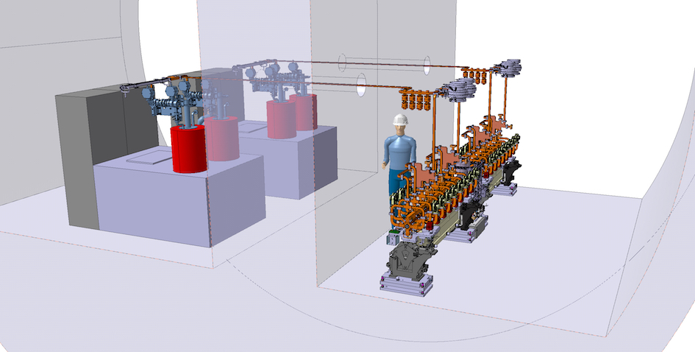
380 GeV K-based module layout and tunnel integration
Preliminary klystron-based scheme for the 380 GeV stage. The tunnel integration is progressing. see presentation at CLIC WS 2018 by M. Stuart on 25/01.
Courtesy Y. Cuvet

Slide 10
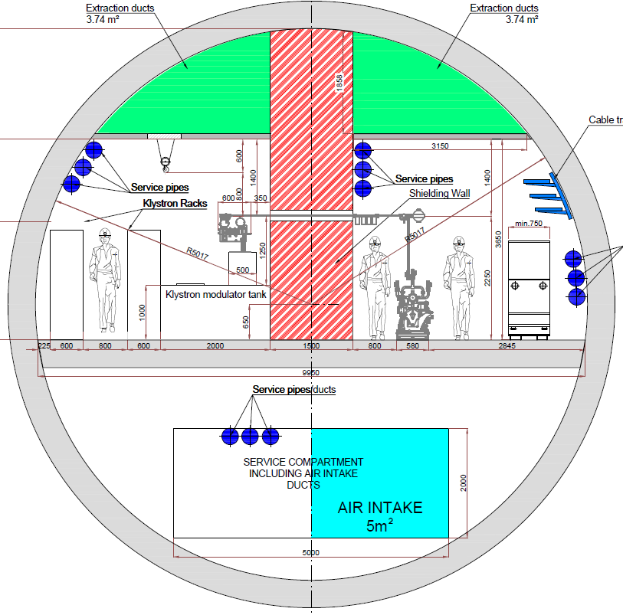
Module integration at 380 GeV
Tunnel integration for the DB (still CDR version) and K options, still preliminary.
see presentation at LCWS 2017 by M. Stuart
Courtesy M. Stuart

Slide 11
Upgrade to 3 TeV
With the DB option the 380 GeV modules are moved to the low-energy end.
With the K option the 380 GeV modules will remain in the region before BDS, increasing the flexibility of operation.
Increased tunnel width in the klystron region.

Slide 12
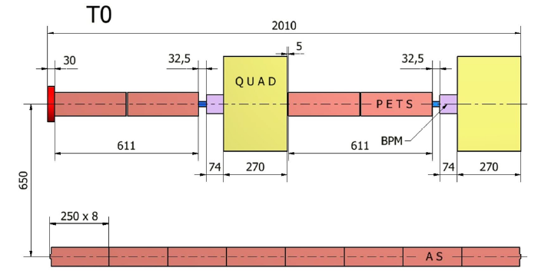
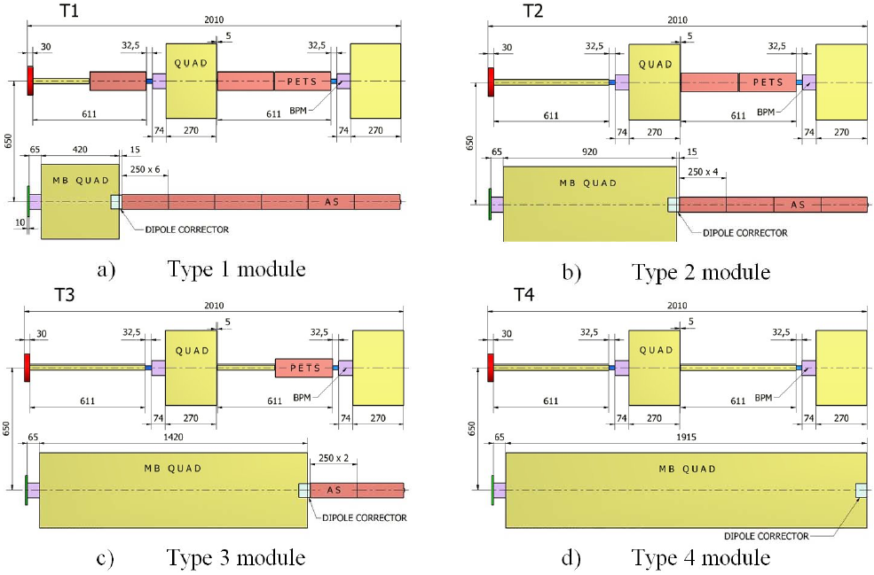
CLIC Main Linac Hardware Baselining
The CLIC CDR proposal at 3 TeV considers a mix of different Module layouts to adapt to the requirements of the Main Beam and Drive Beam lattices.
The CLIC Module length is about 2 m long.
T0, T1 and T2 type are needed by the 380 GeV DB layout.
Only T0 type is needed by the 380 GeV K layout.
Independent supports are required by the Main Beam quadrupoles to assure the required stabilization requested by the challenging beam dynamics.

Slide 13
380 GeV Module Sequence - Klystron Option
Areas of possible improvement
Sectors of the Main Beam FODO lattice for one Linac
FODO Sector | T0 | Q1 | Q2 | Totals |  | AS with 28 cells
1 | 148 | 148 |  |  |  | sequence: 148 x T0Q1
2 | 276 | 138 |  |  |  | sequence: 138 x T0T0Q1
3 | 228 | 76 |  |  |  | sequence: 76 x T0T0T0Q1
4 | 300 |  | 100 |  |  | sequence: 100 x T0T0T0Q2
5 | 504 |  | 126 |  |  | sequence: 126 x T0T0T0T0Q2
Totals | 1456 | 362 | 226
Quads | 0 | 362 | 226 | 588 |  | 362 x 0.4 + 226 x 0.65
AS | 11648 |  |  | 11648 |  | Module length 2.010 m
T0 Module is made of 8 x AS
Q1 is 0.4 m and Q2 is 0.65 m long

Slide 14
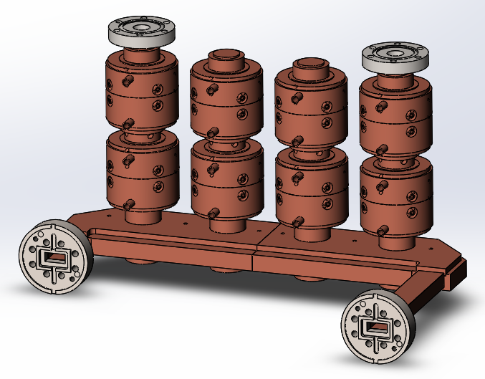
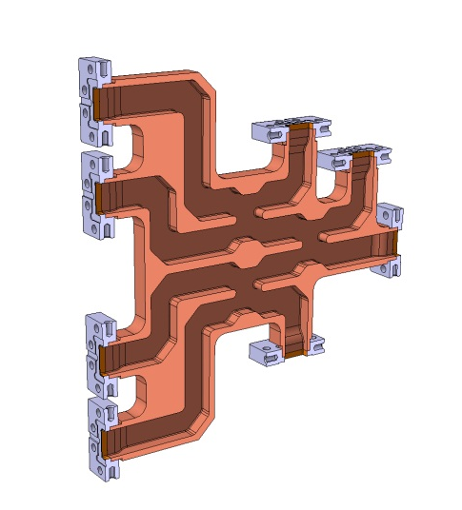
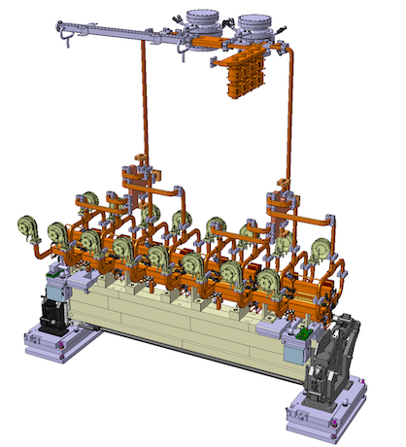
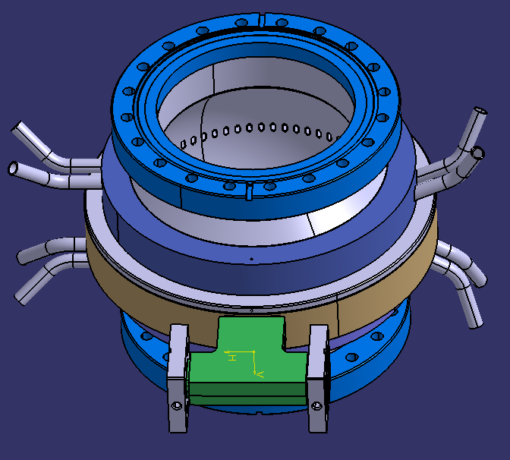
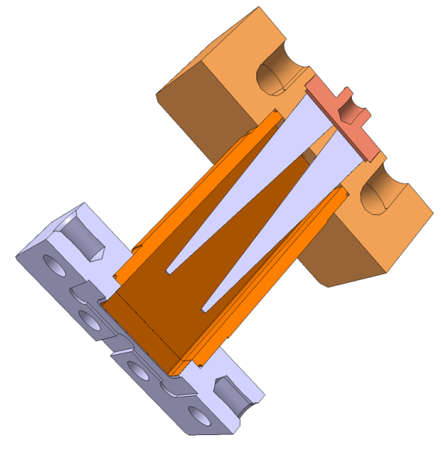
380 GeV K-based module layout
Key RF components are in the design or in the prototyping phase and we plan to test them soon.
Courtesy Y. Cuvet (CERN), R. Zennaro (PSI) and J. Shi (Tsinghua)

Slide 15
380 GeV Module Sequence – Drive Beam Option
Sectors of the Main Beam FODO lattice for one Linac
FODO Sector | T0 | T1 | T2 | Totals | AS | AS with 33 cells
1 |  | 120 |  | 120 | 720 | sequence: 120 x T1
2 | 150 | 150 |  | 300 | 2100 | sequence: 150 x T0T1
3 | 172 | 86 |  | 258 | 1892 | sequence: 86 x T0T0T1
4 | 124 |  | 62 | 186 | 1240 | sequence: 62 x T0T0T2
5 | 468 |  | 156 | 624 | 4368 | sequence: 156 x T0T0T0T2
Totals | 914 | 356 | 218 | 1488
Quads | 0 | 356 | 218 | 574 |  | 356 x 0.43 + 218 x 1.1
AS | 7312 | 2136 | 872 | 10320 |  | Module length 2.343 m
T1 Module is made of 6 x AS, T2 is made of 4 x AS
Q1 is 0.43 m and Q2 is 1.1 m long

Slide 16
380 GeV DB-based module layout
Considerable simplification work with respect to CDR
Courtesy J. Vainola

Slide 17
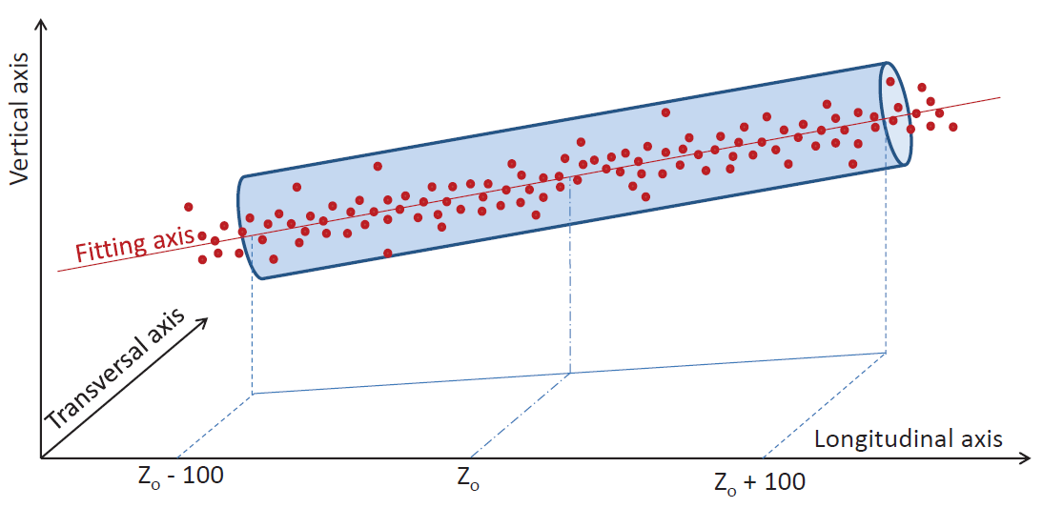
CLIC alignment strategy
Adopt PACMAN approach to alignment, with adjustable supports.
See details in H. Mainaud Durand’s presentation at CLIC WS 2018 on 23/01.
Beam off
Mechanical pre-alignment
~0.2 - 0.3 mm over 200 m
Active pre-alignment
14 - 17 µm over 200 m
Beam on
Beam based Alignment & Beam based feedbacks
One to one
steering
Dispersion Free
Steering
Minimization of
AS offsets
Make the beam
pass through
Optimize the position of
BPM & quads by varying
the beam energy
Using wakefield
monitors &
girders actuators
Minimization of the emittance growth
Courtesy H. Mainaud Durand

Slide 18
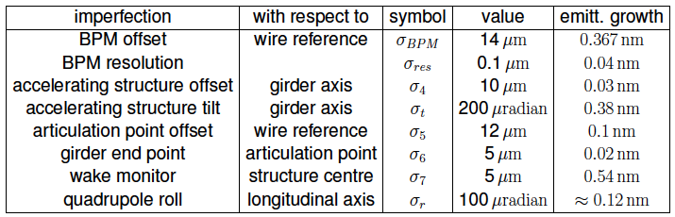
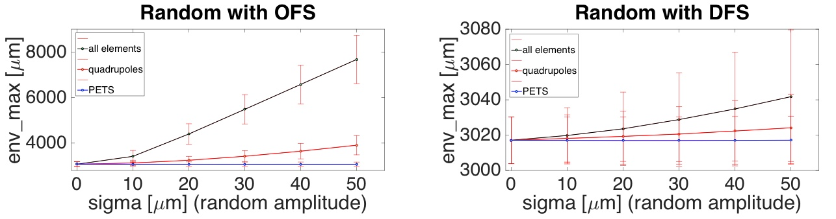
CLIC alignment strategy
Main Beam alignment
Assembly
Pre-alignment
Transport
Courtesy D. Schulte
Drive Beam alignment
Courtesy X. Meng

Slide 19
CLIC alignment strategy
The 380 GeV beam energy has implications on the required tolerances with respect to 3 TeV. See details in D. Schulte’s presentation at LCWS2017
Most imperfection affect the beam less at 380GeV than at 3TeV
– Structure misalignment leads to 0.3 nm vs. 0.54 nm emittance growth
  • Could relax tolerance by 40%
– BPM misalignment leads to 4.4 times less emittance growth
– Quadrupole jitter leads to 6 times less emittance growth
We decide to maintain specifications
– Ready for energy upgrade
– Less risk or better performance in the first stage
– But review impact of specifications on technology choice/cost reduction
Also preparing ultimate parameter set
– Will take advantage of smaller emittance growth
– And more aggressive tuning
Courtesy D. Schulte from LCW2017

Slide 20
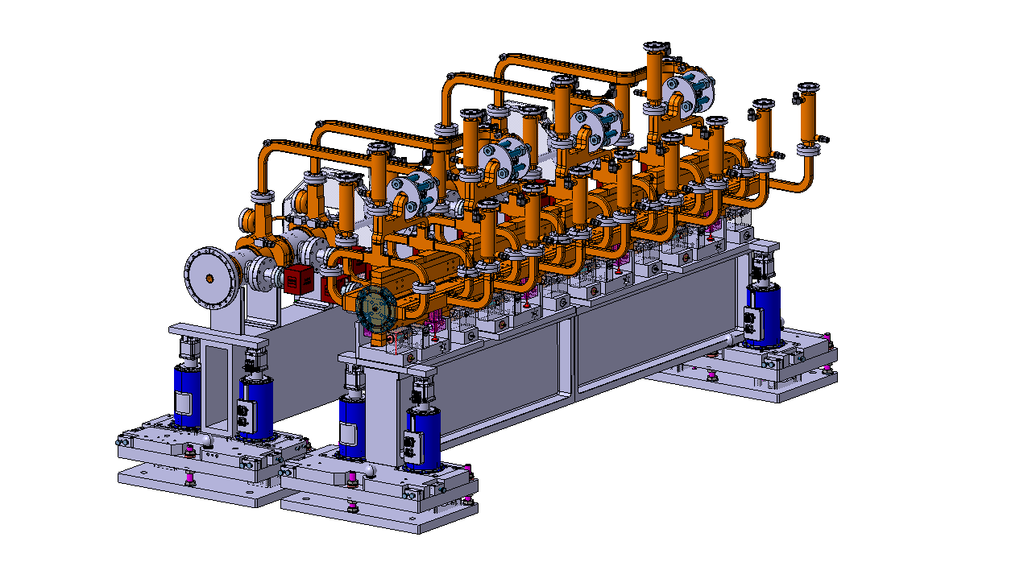
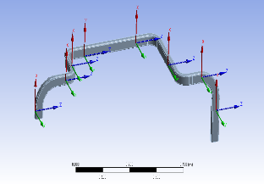
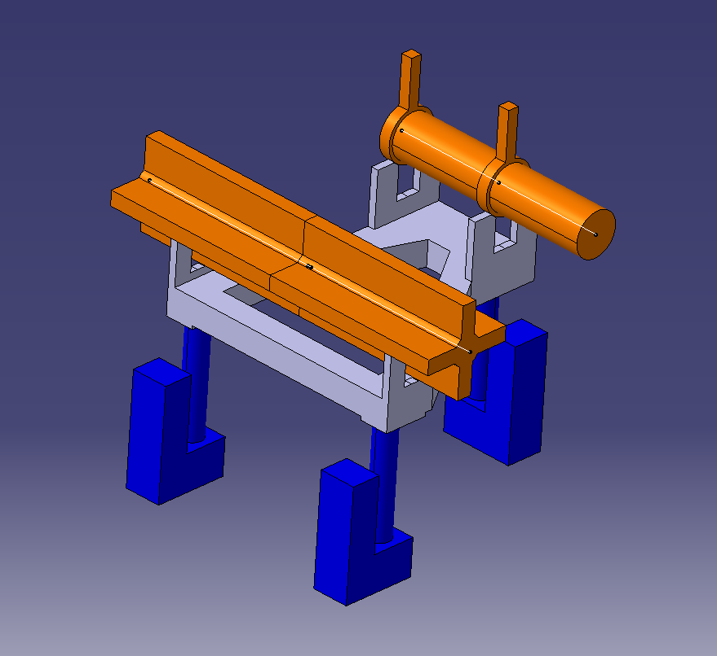
CLIC Module alignment
A solution has been studied to keep the coupling between the two RF structures under control
The development of the RF-unit concept provides an interesting alternative
Courtesy A. Vamvakas
Operation
Temperature sensitivity
Transients
Failure rate + maintenance
Ground movement
Human interaction
Epument
Mass <50kg
Deformation <1μm
Modal: >400Hz
only two points of support
Lot of space for access

Slide 21
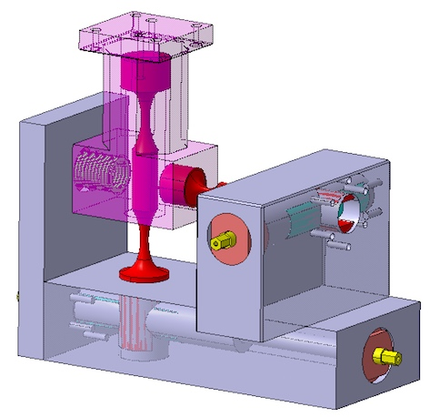
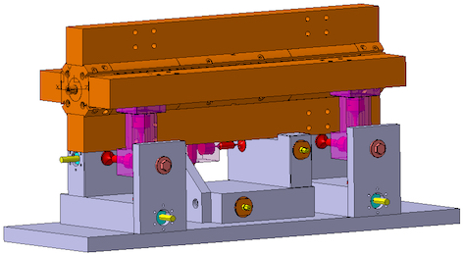
Developments for the CLIC Module alignment
Assure adjustability of components after installation
Courtesy J. Vainola
Developing adjustable supports that can allow semi-automatic alignment techniques for rapid and very precise adjustment of the component position in the tunnel.

Slide 22
RF Efficient Design
Structure | CLIC-G* | CLIC380 | Klystron (K)
f_{rep} [Hz] | 50 | 50 | 50
Efficiency: η [%] | 28.5 | 39.8 | 38.7
Rise time: tr [ns] | 22 | 13.1 | 20.3
Filling time: tf [ns] | 65.5 | 55.4 | 62.7
Efficient beam loading time: tb [ns] | 155.5 | 175.5 | 242
Pulse length: tp [ns] | 243 | 244 | 325
P_{in} [MW] | 62.3 | 59.7 | 41.7
P_{out}^{unloaded} [MW] | 26.5 | 27.6 | 17.9
P_{out}^{loaded} [MW] | 9.76 | 6.2 | 4.5
P_{beam} [MW] | 27.747 | 33.035 | 21.673
Thermal dissipation [W]: <P_{dissipated}^{unloaded}>, <P_{dissipated}^{loaded}> | 434.970, 349.394 | 391.620, 289.526 | 386.750, 286.649
Mean power in the load [W]: <P_{load}^{unloaded}>, <P_{load}^{loaded}> | 321.975, 191.822 | 336.720, 148.935 | 290.875, 128.735
Mean power to the beam: <P_{beam}> [W] | 215.729 | 289.879 | 262.241
A. Grudiev and X. X. Huang 5/04/17

Slide 23
380 GeV K-based powering scheme
Example of RF Distribution as presented by I. Syratchev on 21/01/2017
42.5 x 4 = 170MW in 325ns out of BOC
60% RF transfer efficiency of BOC + waveguides
Multiplication factor BOC = 5
Power needed from klystron = 57MW in 1.625μs
Insertion losses have not been considered
Losses in WG = 0.1dB/m, ~ 60 to 100W/m
2 x 57
my numbers in red
Plug power ranging 20 – 25kW/modulator (without solenoids) for klystron efficiencies 70 – 60%.
170MW
8
8
I. Syratchev 21/01/17

Slide 24
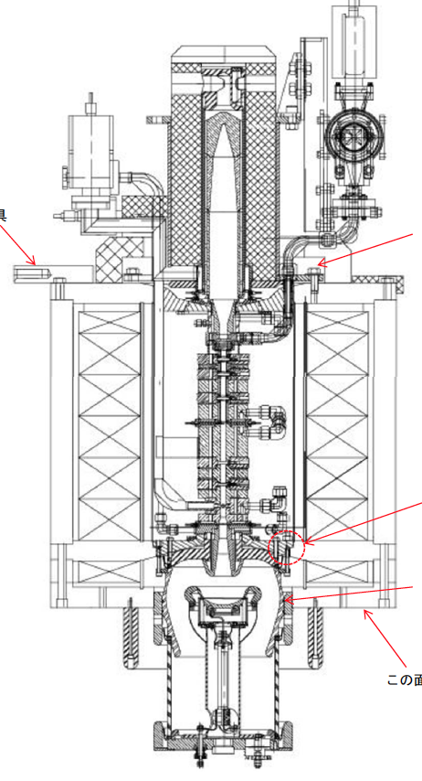
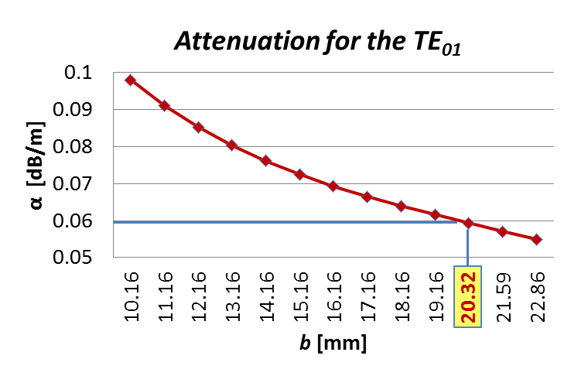
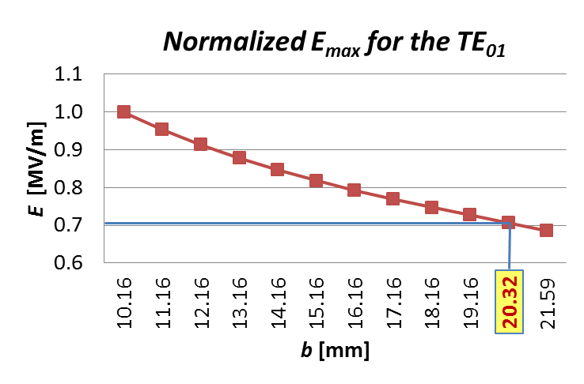
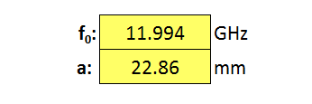
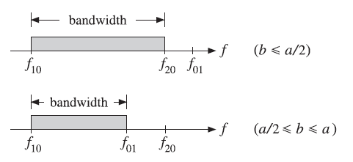
Efficiency is a key parameter
Search for maximum efficiency includes klystron solenoids and waveguides.
Design Parameters
Superconductor (T-operation) | MgB₂ (@ 20 K)
Current | 50 A
Central field | 0.7 T
Stored energy | ~ 10 kJ
Cryo-cooler applied | 6.7 W @ 20 K, 13.5 W @ 80 K
AC Plug Power | ≤ 3 kW
See presentation at CLIC WS 2018 by A. Yamamoto on 24/01
With present Cu-based solenoid magnets, the ac-plug power is 20kW/klystron
(40kW/modulator)
RECTANGULAR WAVEGUIDE
With a double-height waveguide, the attenuation is reduced by 40% and electric and magnetic fields are reduced by 30%. See presentation at CLIC WS 2018 by C. Serpico on 23/01

Slide 25
CLIC Module Power Dissipation
Power dissipation and temperature stabilization are critical. Limiting the heat transfer to air in the tunnel is a requirement. Development work is in progress to clarify the picture.
Component | unit | 380 GeV DB | 380 GeV K
MBQ | MW | 1.9 | 1.4
DBQ | MW | 1.1 | 0
MB Beam instrumentation | MW | 0.015 | 0.015
DB Beam instrumentation | MW | 0.077 | 0
MBQ stabilization | MW | 0.1 | 0.1
MB AS loaded | MW | 9 | 9.7
MB AS unloaded | MW | 15 | 15.8
DB RF structures | MW | 0.91 | 0
MB klystrons (klys. η = 70%) | MW | 0 | 18
MB klystron modulators | MW | 0 | 8
Dissipated in the klystron gallery

Slide 26
CLIC Module Power Dissipation
Developed a strategy for the definition of the parameter space.
Approach
Obtained Results
Experiment
Temperatures at pre-selected points
CFD
Different variable fields for every fluid/ solid domain
external models for assumptions (e.g. tunnel wall)
tuning of coefficient for convection
validation
FEA Steady-State Thermal
Temperature field for solid & heat dissipation values
Analytical M.
Temperature at specific points & heat dissipation values
E. Lam, CLIC Project meeting 08.12.2017
Courtesy E. Lam

Slide 27
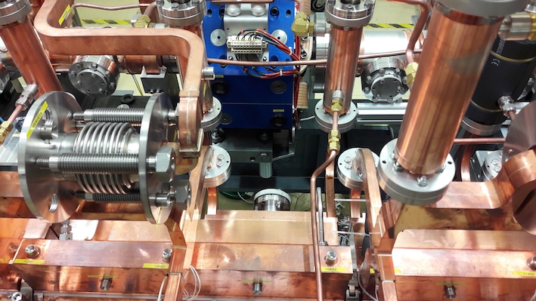
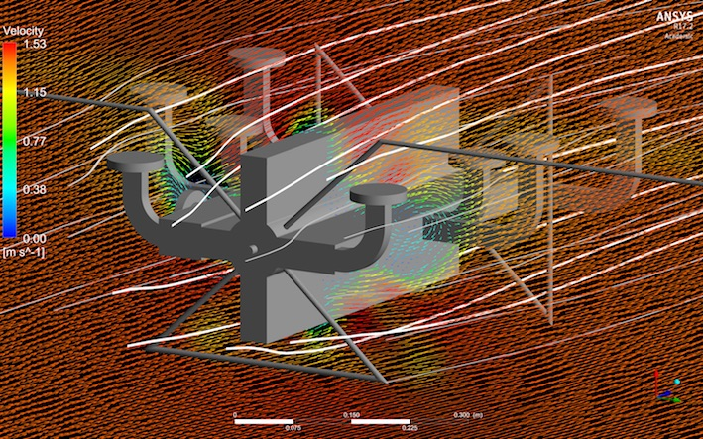
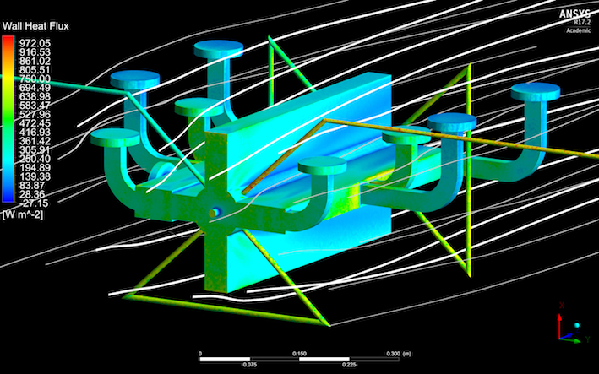
CLIC Module Power Dissipation
Experimental data and heat flux modelizations have been used to evaluate the cooling needs and the heat load to air in the accelerator tunnel.
Planned tests on AS in the Xbox Test Stand will contribute to the model benchmarking.
Courtesy E. Lam

Slide 28
CLIC Module Power Dissipation
Parameter range based on the model developed by the Module team, by considering 7.4kW dissipated / T0 DB Module. See presentation at CLIC WS 2018 by M. Aicheler
Higher flow lowers component T (but not below 27°C)
Higher flow lowers heat to air
Higher ambient T lowers heat to air
Zero emission point
Courtesy M. Aicheler
Higher flow lowers ΔT of water!
Higher ambient T increases ΔT of water!
Cooling&Ventilation feedback needed

Slide 29
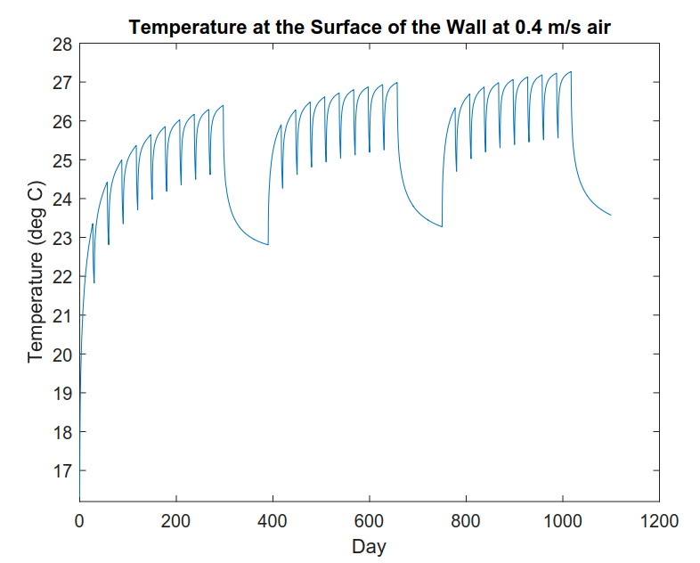
CLIC Module Temperature stability requirements
Temperature stability within modules is essential to achieve the luminosity target.
Synchronous phase: ϕ₀ =30º
dV/V < 1%
Loaded case: dT < 0.55 K
Unloaded case: dT < 0.5 K
Synchronous phase: ϕ₀ =12º
dV/V < 1%
Loaded case: dT < 1.3 K
Unloaded case: dT < 1.2 K
Courtesy A. Grudiev
Acceptable voltage error AS-to-AS < ± 1%.
Transition states should be limited in amplitude and duration.

Slide 30
Plans for the near future
Areas of possible improvement
Before the end of 2018:
A complete description of the 380 GeV stage will be provided, with emphasis on the klystron option.
A cost estimate will be provided for the 380 GeV stage, in the K and DB configurations, with update of the 3 TeV CDR cost.
After 2018 :
Prepare the TDR phase by:
Developing and building a K Module with its X-band test station capable of producing nominal field gradient and validate efficiency figures;
Completing the design of a two-beam RF unit (1m Super Accelerating Structure + 2 PETS) with details of its realization and installation, including acceptance test and initial commissioning scheme;
Launching industrialization studies and refining the cost and power estimates to the light of results achieved with device efficiencies.

