Slide 1
CLIC Master Schedule & Options
Marzia Bernardini, Lucia Maricalva, EN-ACE-OSS thanks to the inputs from many groups.
CLIC Workshop,
25th January 2018

Slide 2
Content
Schedule Overview
Methodology
Option analysis
Construction, Installation sequences and Critical path for:
    Drive Beam Option
        380 GeV
        1.5 TeV
        3 TeV
    380 GeV Klystron Option
Conclusions

Slide 3
Methodology
The proposed CLIC Master Schedules consists on two main different options:
  Drive Beam: 380 GeV, 1.5 TeV and 3 TeV
  Klystron: 380 GeV
DRIVE BEAM
The proposed schedules are based on the Master Schedule described in CLIC CDR (500 GeV-CDR 12th Oct. 2012): same machine configuration, general services and infrastructures, but at different energy stages
  For ex.: 18 km (baseline for 500 GeV-CDR 12th Oct. 2012) turned into 13.5 km for 380 GeV
KLYSTRON
New option considered

Slide 4
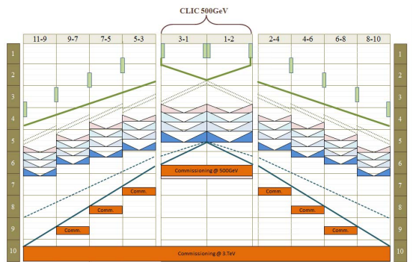
Option analysis
Drive Beam Option
  Four years for Excavation and tunnel lining + Tunnel infrastructures installation + Machine equipment transport and installation
  6 months of Commissioning is foreseen after each installation period followed by 2 months of smoothing of the line.
  6 years of Physics where the two first years will be dedicated to the Decision making (Deadline for decision taking after second year of Physics) to whether continue or not with the construction of the 1,5 TeV line or the 3 TeV machine afterwards
  When positive → 2 years for connection of the lines following Physics period
CLIC CDR 12thOct 2012
Klystron Option:
  380 GeV has double construction and equipment installation time rates than DB Option
  Same upgrade possibilities than DB Option in terms of length and time → same planning
  Connection of the lines would probably take more than 2 years (to be studied)
  Same Physics periods than for DB option

Slide 5
Drive beam schedule overview
2026
2031
2033
2037
2039
2041
2045
2047
2051
380 GeV (5 years):
- Construction
- Installation
- HWC
Decision taking
1.5 TeV (4 years):
- Construction
- Installation
- HWC
Connection & Reconfiguration
380 GeV – 1.5 TeV
(2 years)
Decision taking
3 TeV (4 years):
- Construction
- Installation
- HWC
Connection & Reconfiguration
1.5 TeV – 3 TeV
(2 years)
1y
1y
380 GeV Physics (6y)
1.5 TeV Physics (6y)
3 TeV Physics (6y)
27 years

Slide 6
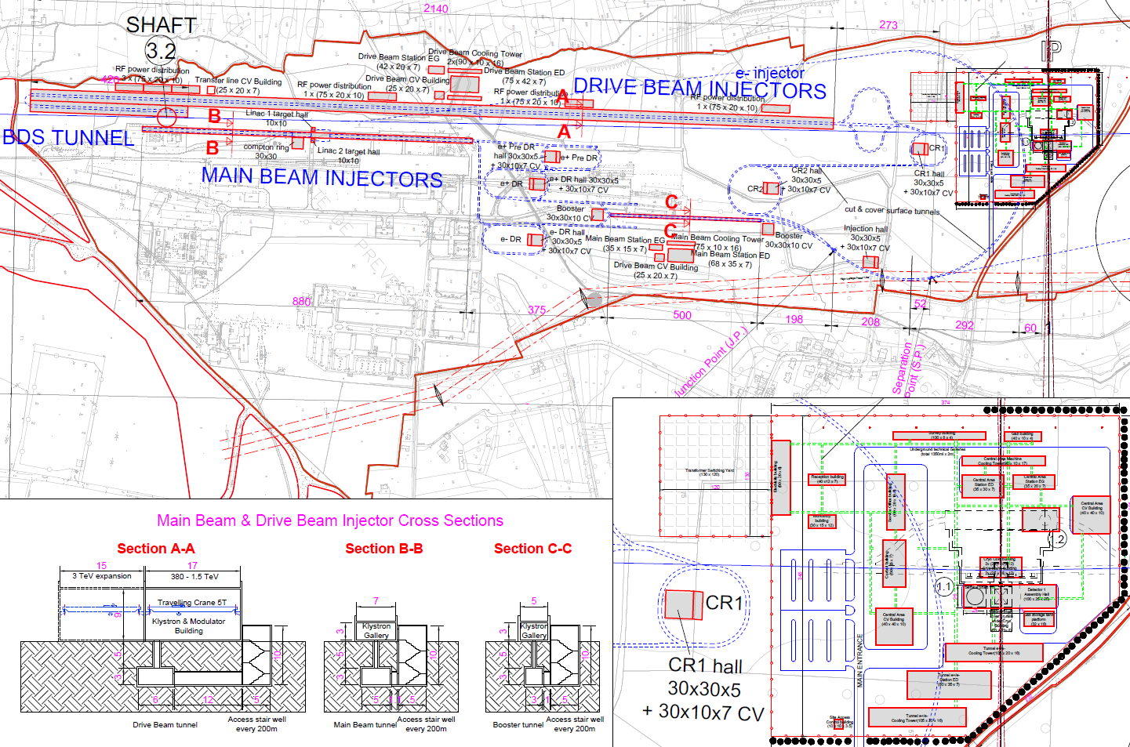
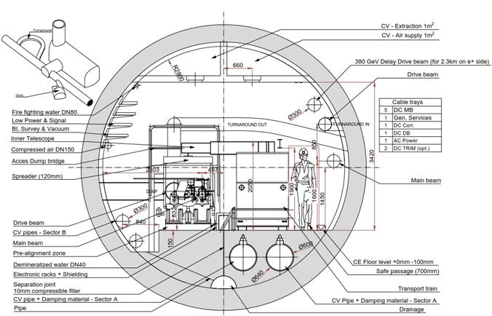
Drive beam option overview
CLIC Drive Beam Design Cross-section

Slide 7
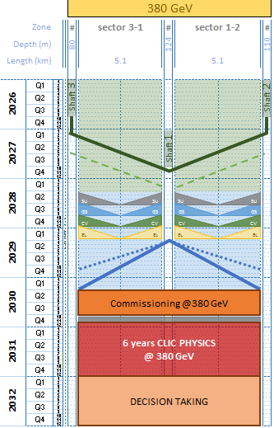
Drive beam planning
Civil Eng.
Tunnel excavation TBM Good rock
380 GeV
Inner lining
Infrastr. + Machine Inst.
Survey works
General services installation
CV Installation works
Electrical installation and cabling
Machine transport
Machine Installation
Commissioning period
Physics

Slide 8
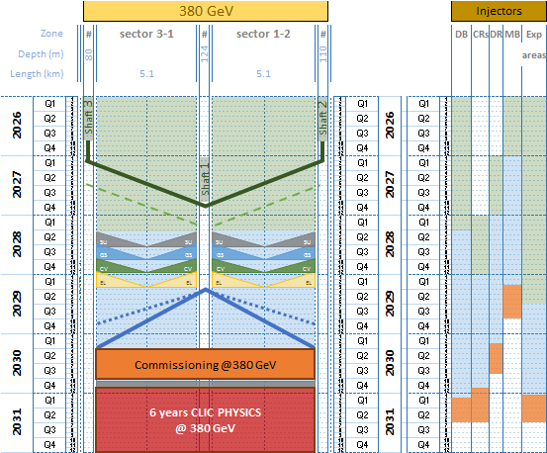
Drive beam planning
Tunnel
Injectors
CRITICAL PATH
380 GeV
Drive beam surface building, Combiner Rings, Damping rings, Main Beam building and Experimental areas construction end date could compromise the start of the Physics period
Potential corrective measures:
Optimization of time for surface buildings construction
Reduce the resources for tunnel infrastructure installation works
and extend the duration
3 shafts at the same time and start exp. areas 1 year earlier
CRITICAL
Note: Planning for works out of the tunnel are the same wrt CDR in terms of scope and time

Slide 9
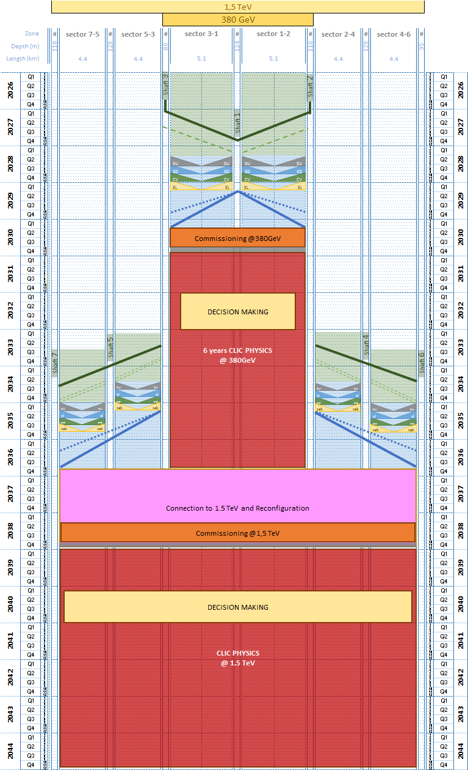
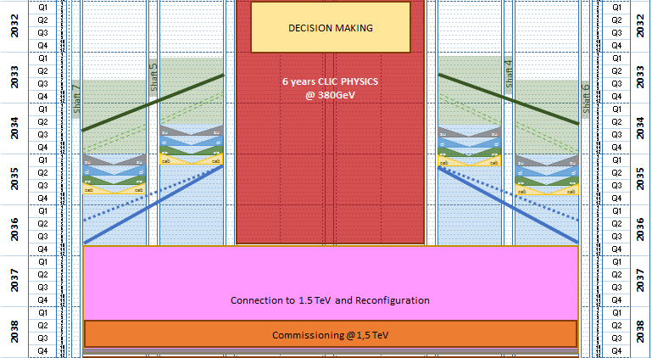



Drive beam planning
1.5 TeV

Slide 10
Drive beam planning
1.5 TeV
Retro-planning starting from the date of the end of Physics period
2 years for connection and reconfiguration of the lines
(6 months for commissioning)

Slide 11
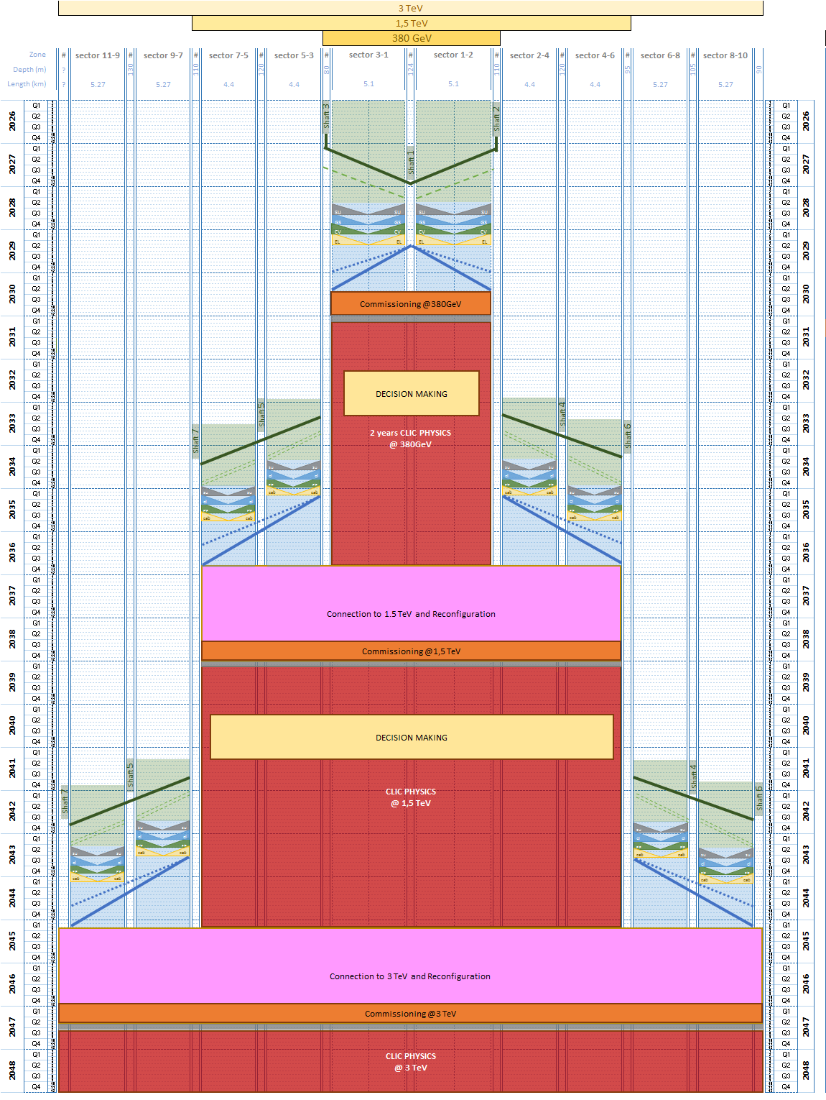
Drive beam planning
Same exercise as with 1,5 TeV
The installation can start according the Physics results and decisions
Ready for 3 TeV physics 6 years after the decision
3 TeV
Drive Beam building extension needed for the 3 TeV option

Slide 12
3 TeV
Comparison between CDR
and proposed schedule

Slide 13
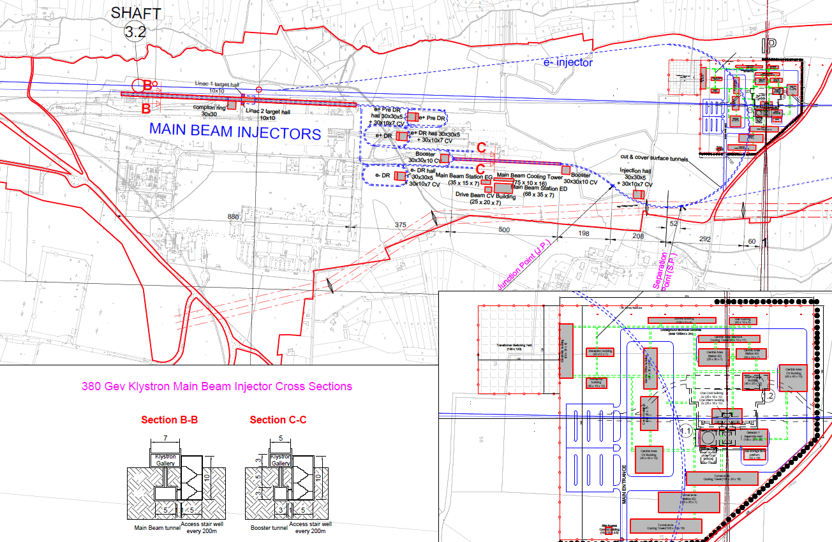
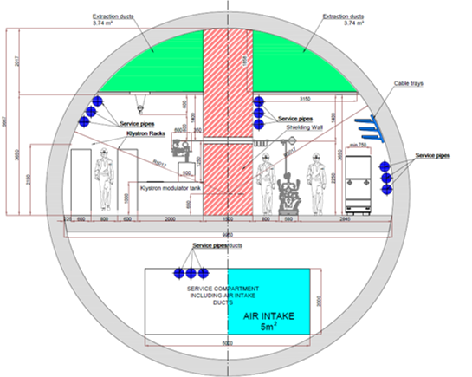
Klystron option overview
For a Klystron 380 GeV Design, the Drive Beam Complex is no longer required
CLIC Klystron Design Cross-section

Slide 14
Klystron option schedule overview
2026
2034
2040
…?
380 GeV Physics (6y)
Further decisions to be taken
380 GeV (8 years):
- Construction
- Installation
- HWC
Decision Making
Evolutions to be defined
1y
14 years

Slide 15
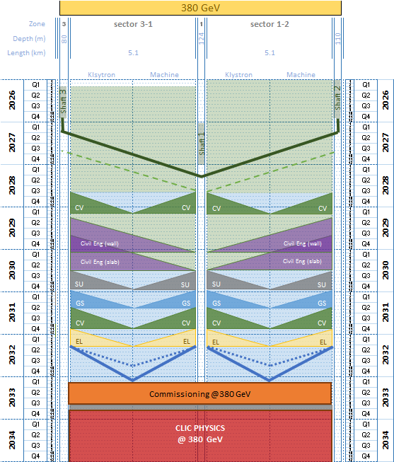
Klystron option planning
380 GeV
Surface buildings reduced to
Experimental Areas (only one cavern)
Main Beam building
Double installation time
wrt Drive beam option
Different construction sequence
wrt Drive Beam option
→ changes in the tunnel configuration

Slide 16
Conclusions
The new strategy of the CLIC project has an heavy impact on the construction schedule:
the drive beam machine upgrades from 380 GeV to 3 TeV, depends on the Physics’ results and subsequent decisions taken
The new schedule for the drive beam machine takes into account the physics programme and upgrade decisions, which was not included in the CDR
The time scale of the new Drive beam options for the CLIC project, from 380 GeV to 3 TeV, is more than 20 years (compared to the 10y in the CDR)
The rates of installation of infrastructures and equipment can evolve, in function of parallel CERN activities and resources availability (long shutdown, construction of other machines, …).
This will be refined in due time, when the final layout and timescale are consolidated.
At the present stage of the study, the drive beam option seems more flexible, compared to the klystron option

