Slide 1
Depressed collector option for HE 50 MW X-band klystron
Jeff Neilson, Mark Kemp, Brandon Weatherford – SLAC
CLIC Workshop
January 23, 2018

Slide 2
Overview
Pulsed depressed collector technology
Current programs
Application to HEX
Conclusions

Slide 3
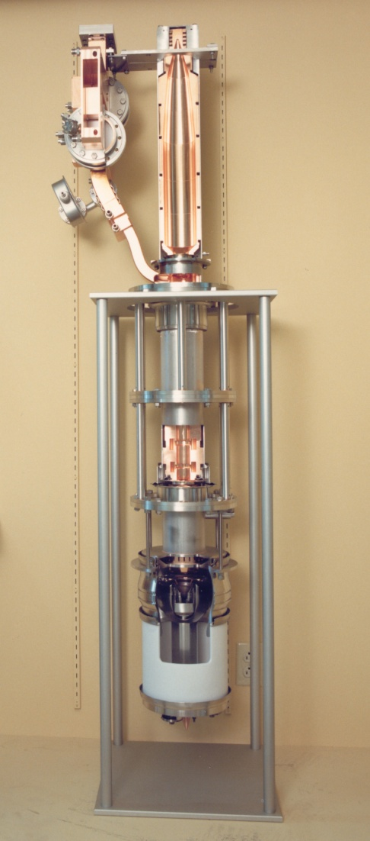
High Efficiency Retrofit Program for S-Band Source at SLAC
Two programs to upgrade efficiency and power of 65MW S-Band 5045 tubes used in SLAC LCLS
  Redesign of 5045 interaction circuit to increase rf output power via increase in efficiency using high efficiency bunching technique Bunch-Align-Collect (BAC)
  Increase system efficiency by recovery of energy in spent beam of klystron (depressed collector)
  Both approaches constrained to be “plug-compatible”

Slide 4
Conventional Depressed Collector Power Supply
In the conventional approach to depressed collectors, the power supply must be replaced with one appropriate for multiple collector stages
Power Supply
Upgrading existing systems
is very expensive
Power Supply

Slide 5
Feed-forward energy recovery scheme
Energy Recovery
Power Supply
Ideal Characteristics for “drop-in” retrofit for use of depressed collectors for increased efficiency :
Existing infrastructure is re-used so power supply remains the same
Energy is recovered by a separate component, and returned to the DC supply
Energy recovery is completely passive

Slide 6
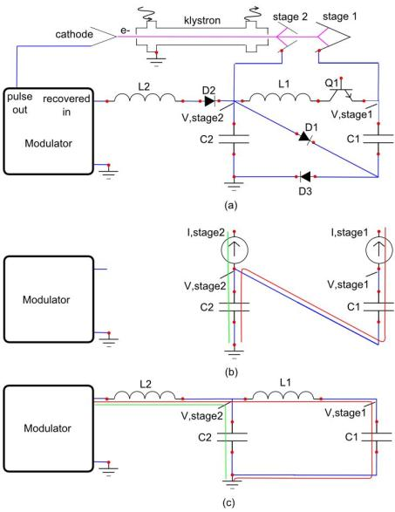
An “Inverse” Marx Energy Recovery Modulator
Capacitors charge in series, and discharge in parallel
Each cell pre-charged to a voltage
  The initial voltage at a tap is the number of cells below that tap times the pre-charge voltage
During pulse
Voltage rises in response to current to stage, and capacitance
In-between pulses
CLC resonant structure transfers energy in capacitors to modulator
Voltages re-settle to pre-charge value

Slide 7
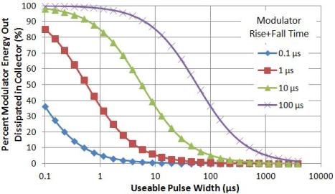
Ability to Recover Rise and Fall of Pulse
RF is applied when the cathode current is flat
A key advantages of a depressed collector for pulsed klystrons is the ability to recover energy during the rise and fall time
Even for well designed modulators with short rise and fall, large fractions of the energy supplied to the beam are wasted
With proper energy recovery, could relax modulator rise and fall constraints, potential cost savings
Cathode current
Amplitude
RF
Time
Energy wasted in collector during rise and fall times

Slide 8
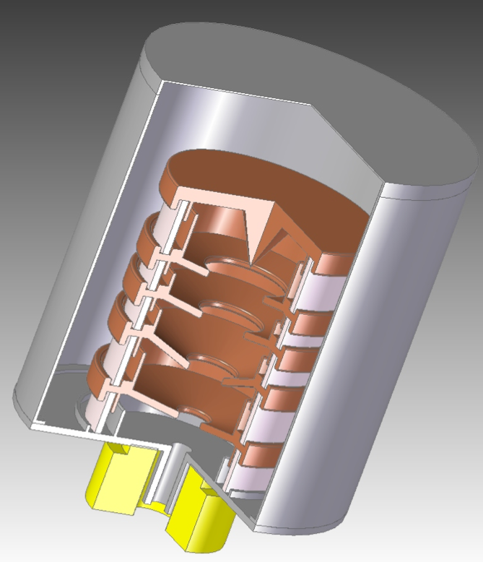
Test Results and Current Programs

Slide 9
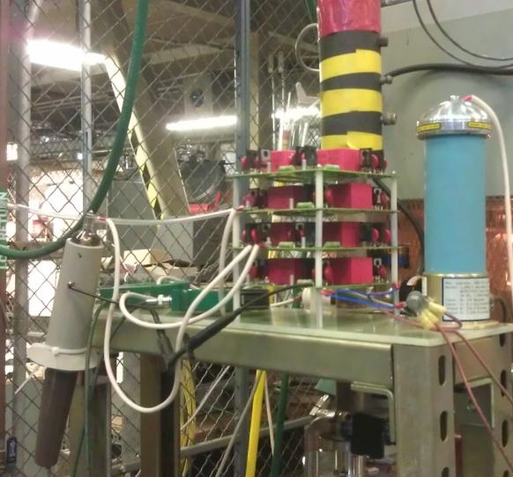
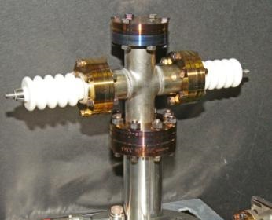
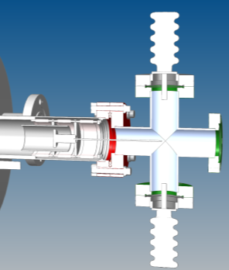
Sub-booster Demonstration (S band, 65 kW, 25 kV tube)

Slide 10
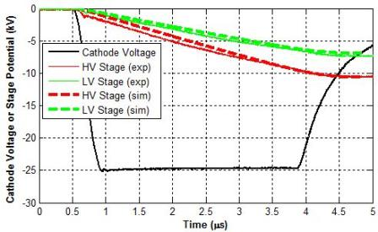
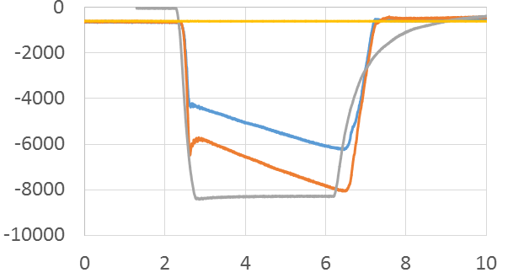
Sub-booster Demonstration
Comparison of Simulation to Experiment
Without pre-bias applied:
During Pulse
Capacitors pre-charged:
Voltage (V)
During Pulse
Collector
Stages
Cathode
Potential (/3)
Time (µs)

Slide 11
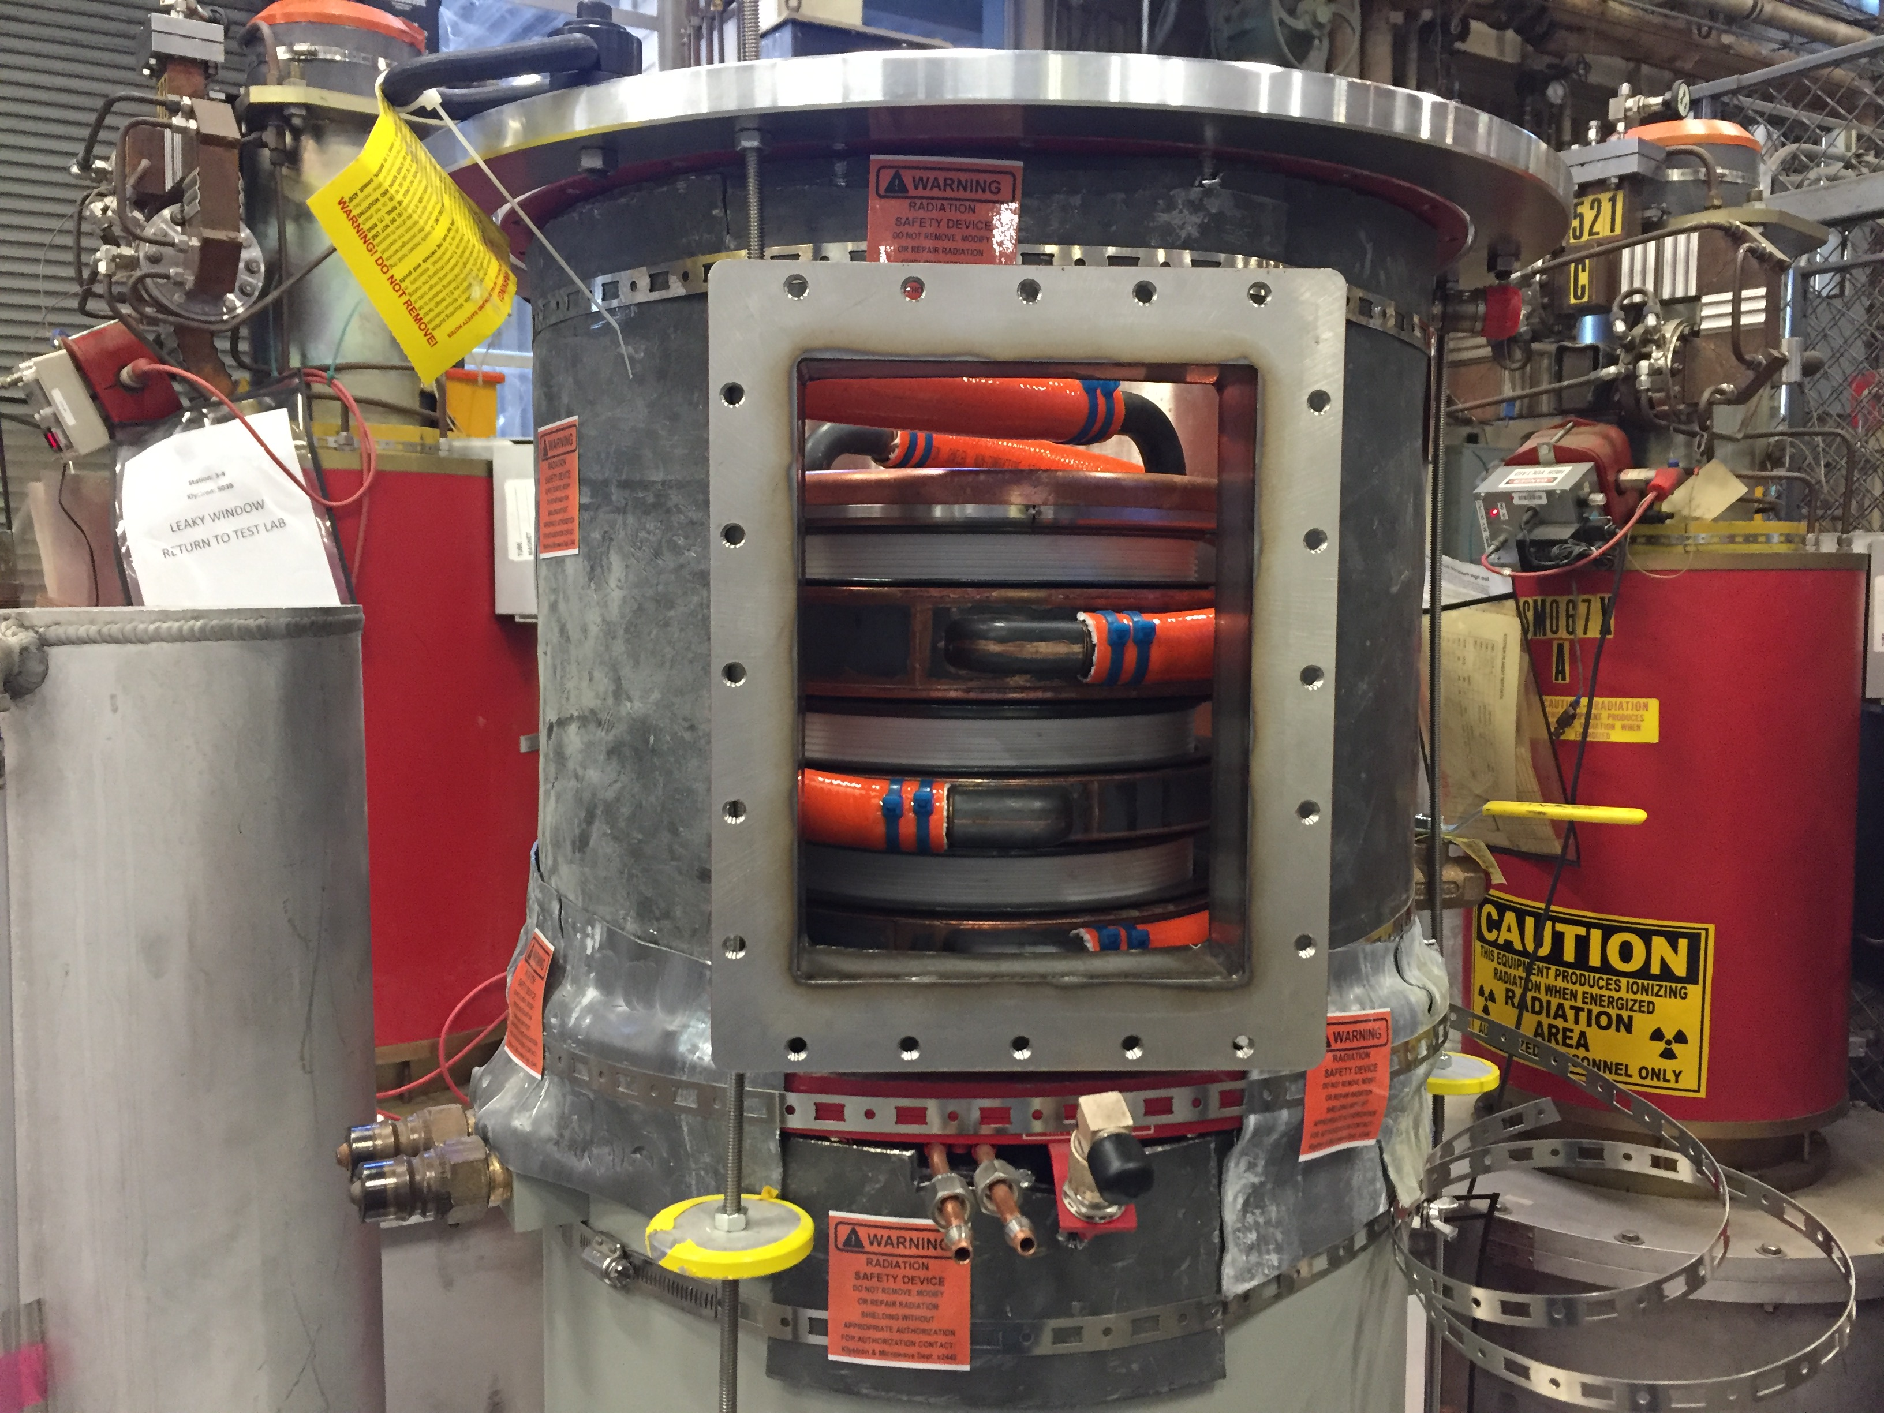
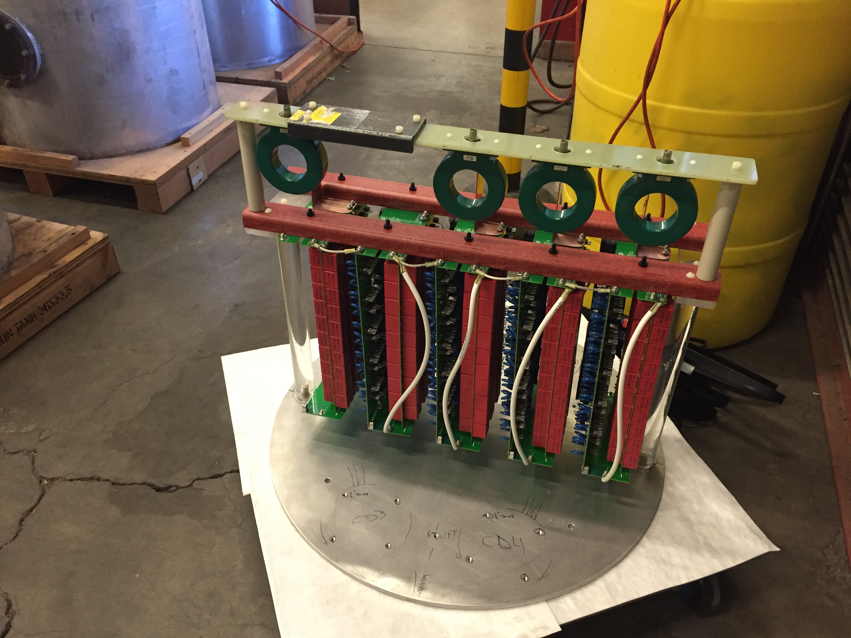
Current Testing at SLAC
    First test of multi-stage depressed collector with energy recovery between pulses has just been started
Collaboration between SLAC and CPI
Four stage collector on modified VKS-8262 tube (2.856 GHz, 5.5 MW peak, 6 us, 180 Hz, 45% efficiency)
Collector predicted to improve total efficiency to 65%
Depressed Collector on VKS-8262
“Inverse” Marx power recovery module

Slide 12
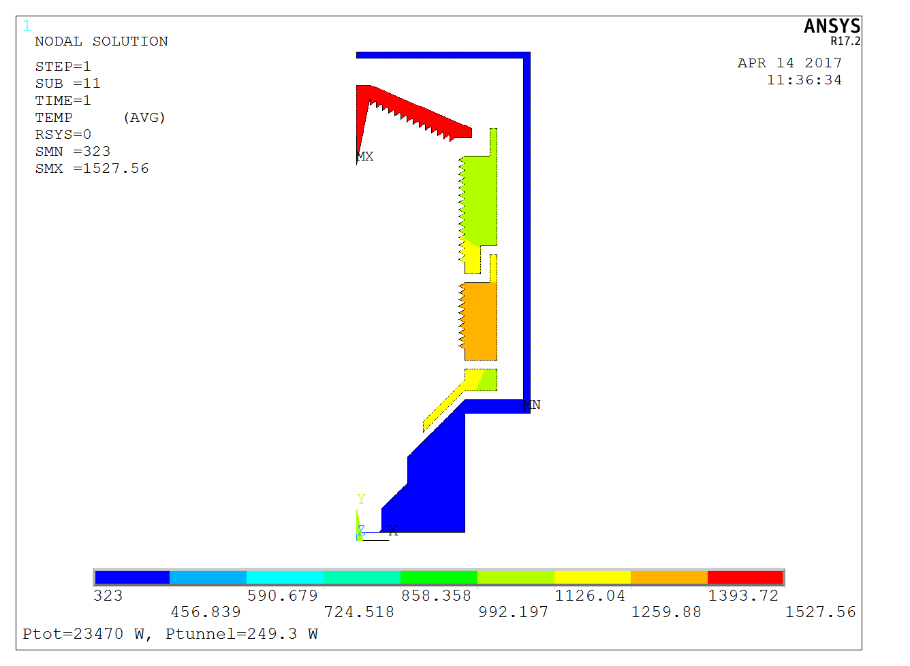
Program for 5045 Test
Will use radiation cooling with isotropic graphite surfaces
  Collector efficiency 53 %
  Total efficiency = 68%
  Include three generations of secondaries
Test in late 2017
Temperature on this outer can fixed, assumed to be held by liquid cooling
Average power from each ray applied to appropriate surface

Slide 13
Application to HEX Klystron

Slide 14
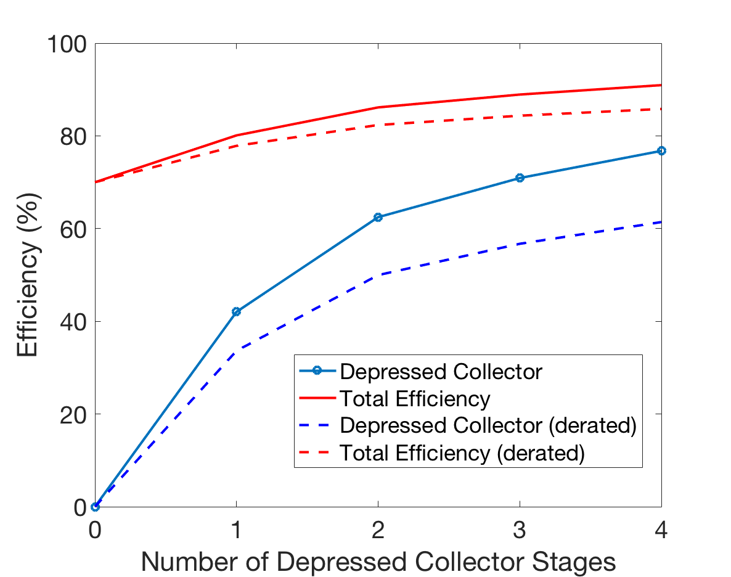
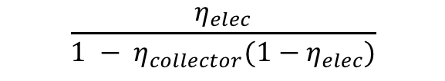
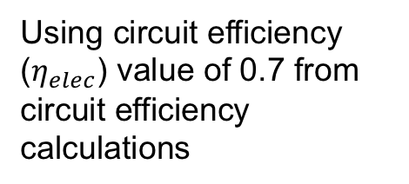
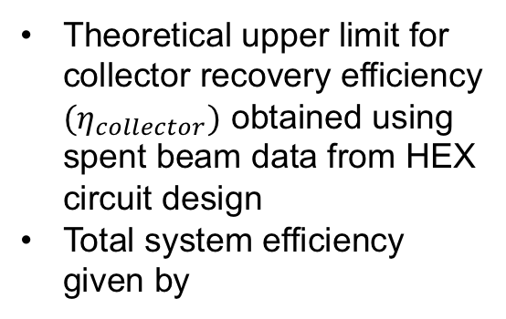

Efficiency Gain Estimate for HEX
Theoretical upper limit for collector recovery efficiency ${(η}_{collector})$ obtained using spent beam data from HEX circuit design
Total system efficiency given by
$η_{elec}$= 0.7
$$\frac{η_{elec}}{1 − η_{collector}(1−η_{elec})}$$
Using circuit efficiency ($η_{elec}$) value of 0.7 from circuit efficiency calculations

Slide 15
Rough Power Savings Estimate
Assume 50MW peak rf power, duty cycle 0.01%
Average power savings per tube is 1kW for increase in efficiency from 70->80%
Capturing the 30% energy loss in rise/fall time at 60% efficiency saves 2kW per tube
For recent CLIC concept, 5000 tubes with operation time of 5000 hours/year:
5000 tubes X 5000 hours X 3 kW X 50 Euro/MW hour
=> 3.8M Euro/year
Calculation doesn’t include savings from reduction in cooling costs, power plan acquisition cost, modulator cost reduction
System efficiency
  0.7 modulator X 0.7 tube efficiency => 0.5
  (0.7 / (1 – 0.6(1 - 0.7)) X 0.8 tube efficiency => 0.68

Slide 16
Conclusions
Pulsed depressed collector technology particularly useful for retrofitting low efficiency (<50%) existing systems
Use of depressed collector for HEX klystron likely to provide 80% tube efficiency
Because of HEX high tube efficiency, largest gains result from recovery of pulse rise/fall time power loss

Slide 17
Backup Slides

Slide 18
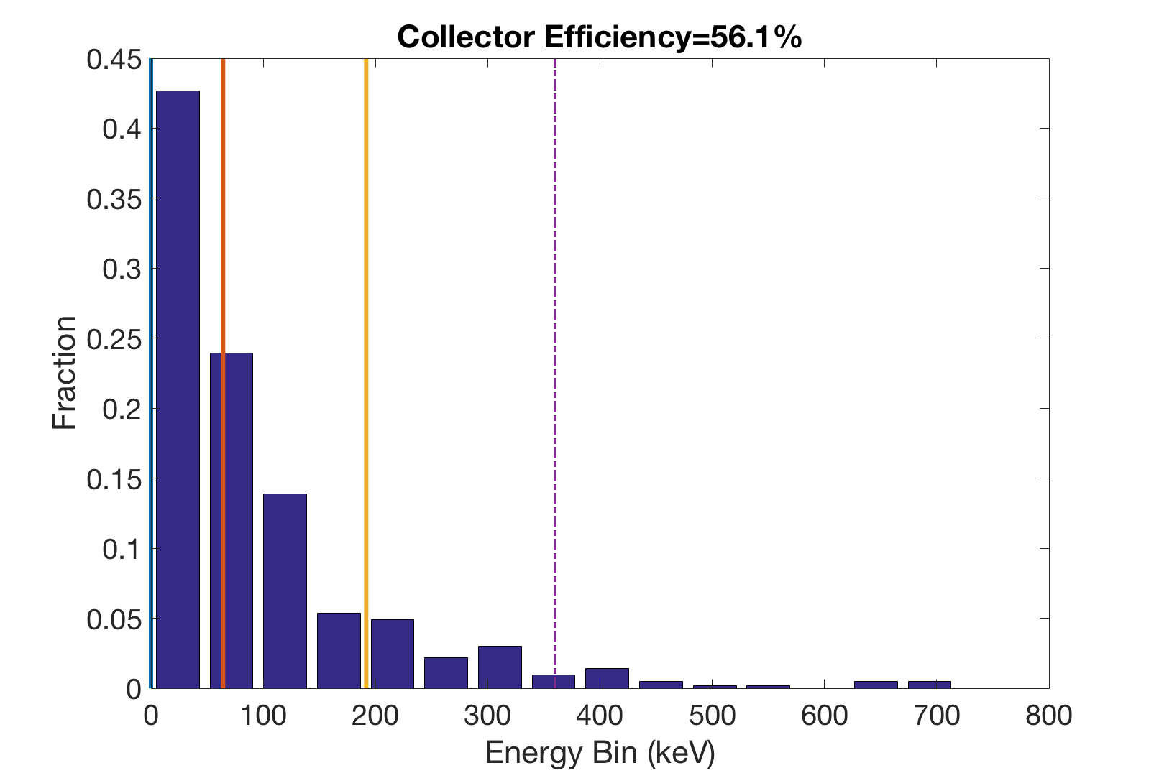
Depressed Collector

Slide 19
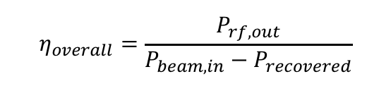
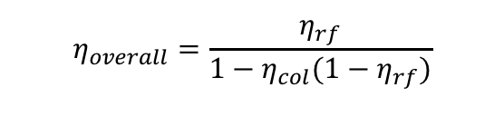
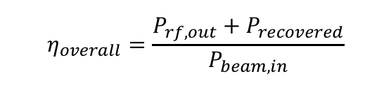
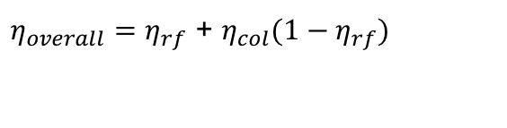
The Effect of Collector Efficiency on Overall Efficiency
$$η_{overall}=\frac{P_{rf,out}}{P_{beam,in}−P_{recovered}}$$
$$η_{overall}=\frac{η_{rf}}{1−η_{col}(1−η_{rf})}$$
Claimed correct relation:
Claimed incorrect relation:
“If I have a 50% klystron, and a 50% efficient collector, half of the wasted energy is recovered, so I have a 75% efficient system”
$$η_{overall}=\frac{P_{rf,out}+P_{recovered}}{P_{beam,in}}$$
$η_{overall}=η_{rf}$ + $η_{col}(1−η_{rf})$
Say, with a 50% RF efficiency, and a 50% collector efficiency, the expected system efficiency would be 75%
With 10W beam power in and 5W RF out, 5W*0.5=2.5W would be recovered and 2.5W would be wasted.
  To produce 5W of RF out, how much net power is input to the system?
  5 W (for RF out) plus 2.5 W (wasted in collector) is 7.5W total input to the system
  System efficiency = RF Pout/Pin = 5W/7.5W = 66%

