Slide 1


STATUS OF THE CLEAR
W. Farabolini
E. Adli, R. Corsini, S. Curt, S. Doebert, D. Gamba, C. A. Lindstrøm,
G. McMonagle, K. N. Sjobaek, P. Skowronski, F. Tecker

Slide 2
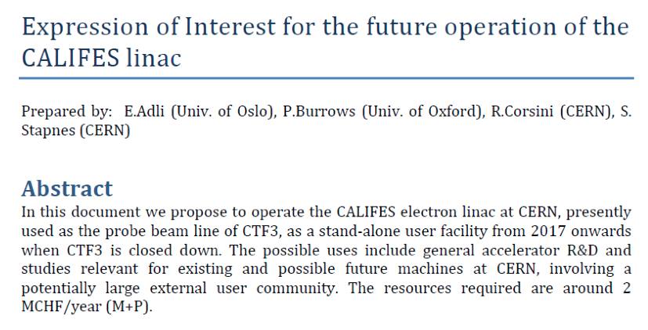
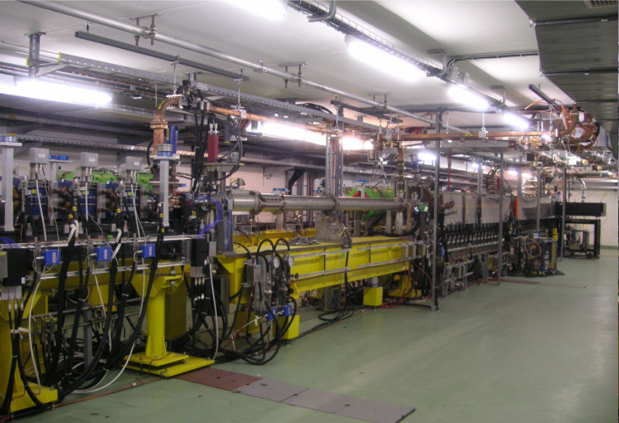
Proposal of a CALIFES-based Accelerator Test Stand
CTF3 scientific program completed
as planned in December 2016
What to do with CTF3
hardware & building?
➔
Interest in CALIFES
Longer document send in February 2016 CALIFES_document.pdf
Positive statement by the CLIC Review Panel in March 2016
CALIFES Workshop, October 2016
Final proposal (CLEAR)
and
approval in December 2016

Slide 3
From CTF3 to CLEAR: December 2016 – August 2017
DL & CR
Drive beam
CTF2
Connected
2 MKS
CLEX
Improved sensitivity
renewed
Created
Created
Moved down-stream
Just insta-lled
Re-located
WFM phase shifter added
Installed from DB

Slide 4
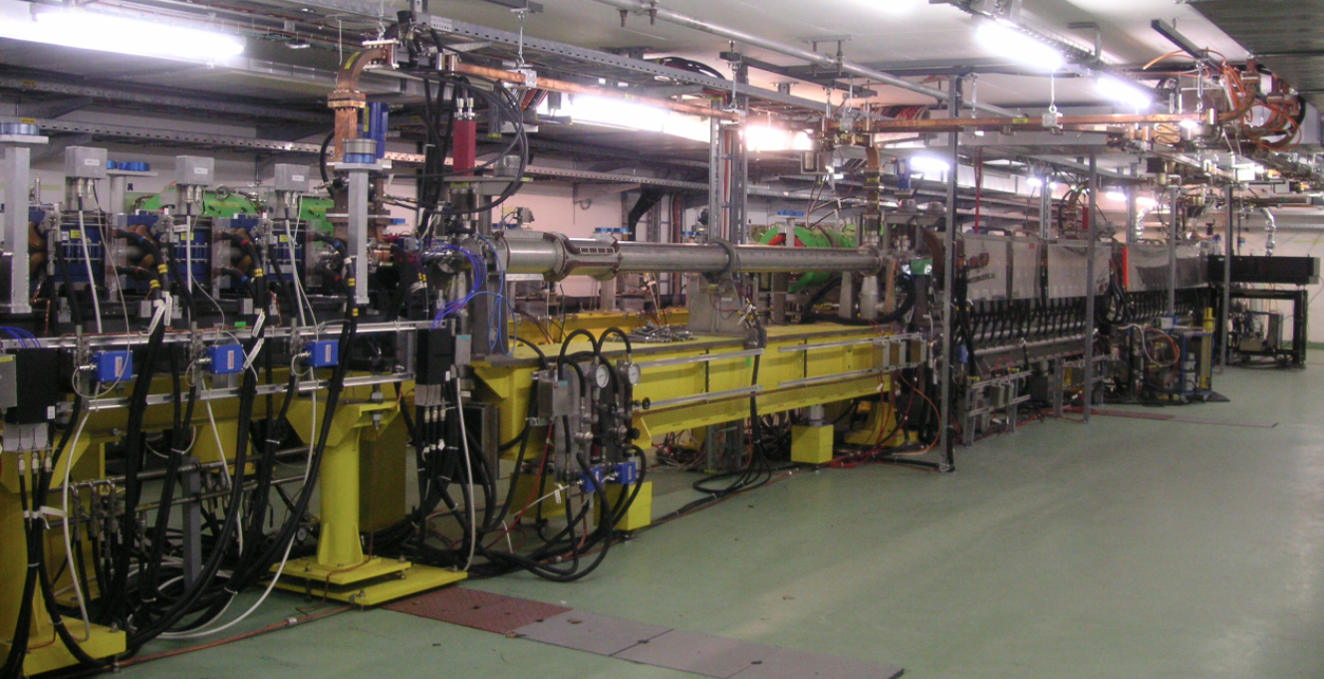
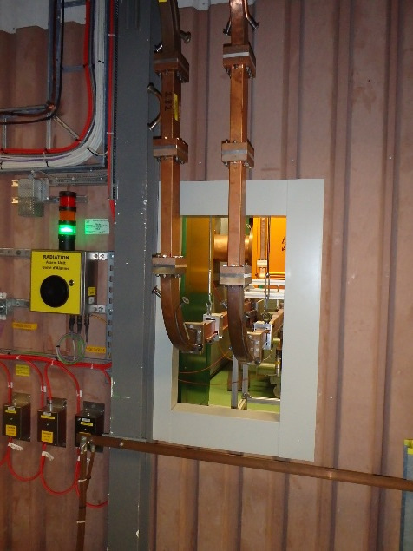

New CALIFES performances
Waveguides from building 2001 to 2010
Beam parameters | Range | Comments
Energy | 60 – 180 MeV | More flexible with 2 klystrons. > 220 MeV expected with pulse compression.
Energy Spread | < 1 MeV (FWHM)
Bunch Charge | 1 pC – 200 pC | Photocathode changed but limited laser power. Goal: 0.6 nC.
Bunch Length | 2.4 ps – 8 ps | 0.1 ps according to simulation. Velocity bunching studies to be resumed
Normalized emittances | 3 μm to 30 μm | Bunch charge dependent
Repetition rate | 0.8 to 5 Hz | 25 Hz with klystrons and laser upgrade
Number of micro-bunches in train | 1 to >150 | Single bunch capability assessed
Micro-bunch spacing | 1.5 GHz (Laser) | 3.0 GHz: Dark current

Slide 5
CLEAR operation in 2017 (from August)
Week
33 First beam! August 18 | 34 Cont’d commissioning | 35 Cont’d commissioning | 36 First beam to users VESPER
37 Installation of plasma lens | 38 Beam through plasma lens | 39 VESPER | 40 Beam tuning, plasma lens
41 BCM improvement WFM | 42 WFM First spark plasma lens | 43 Inductive BPMs LAL: injector optimization | 44 Cavity BPMs
45 Laser spot study VESPER | 46 TRAD/ESA at VESPER THz studies | 47 Combined WFM and Cavity BPMs | 48 AWAKE screen Plasma lens
49 VHEE phantom irradiations | 50 Plasma lens, instrumentation, THz | 51 Plasma lens, instrumentation, THz VESPER | 52 Instrumentation, THz VESPER

Slide 6
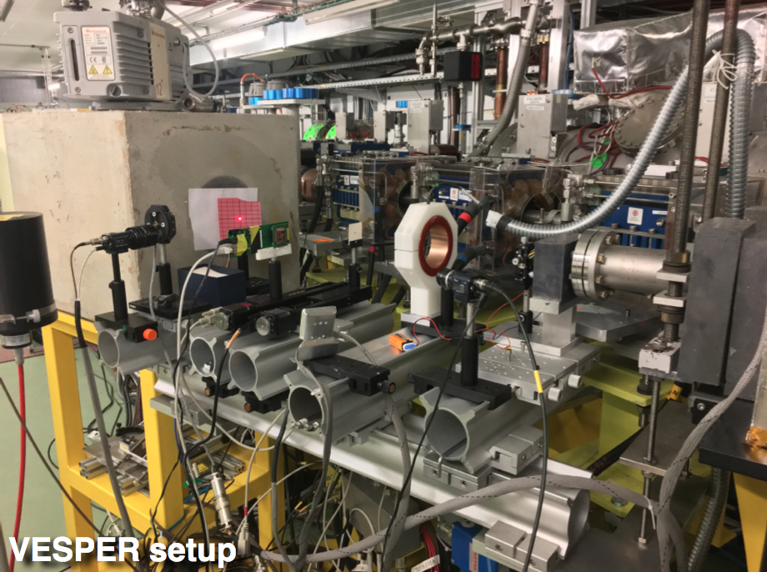
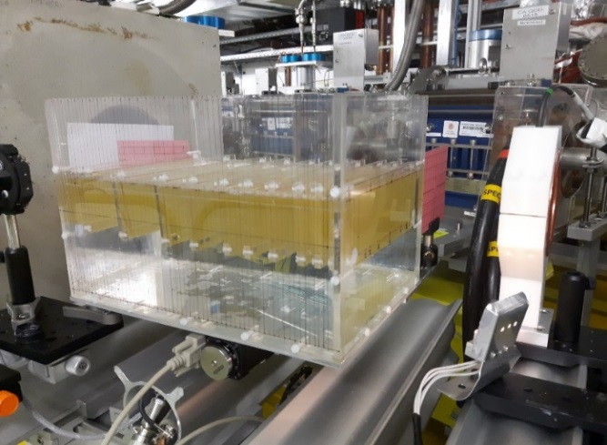
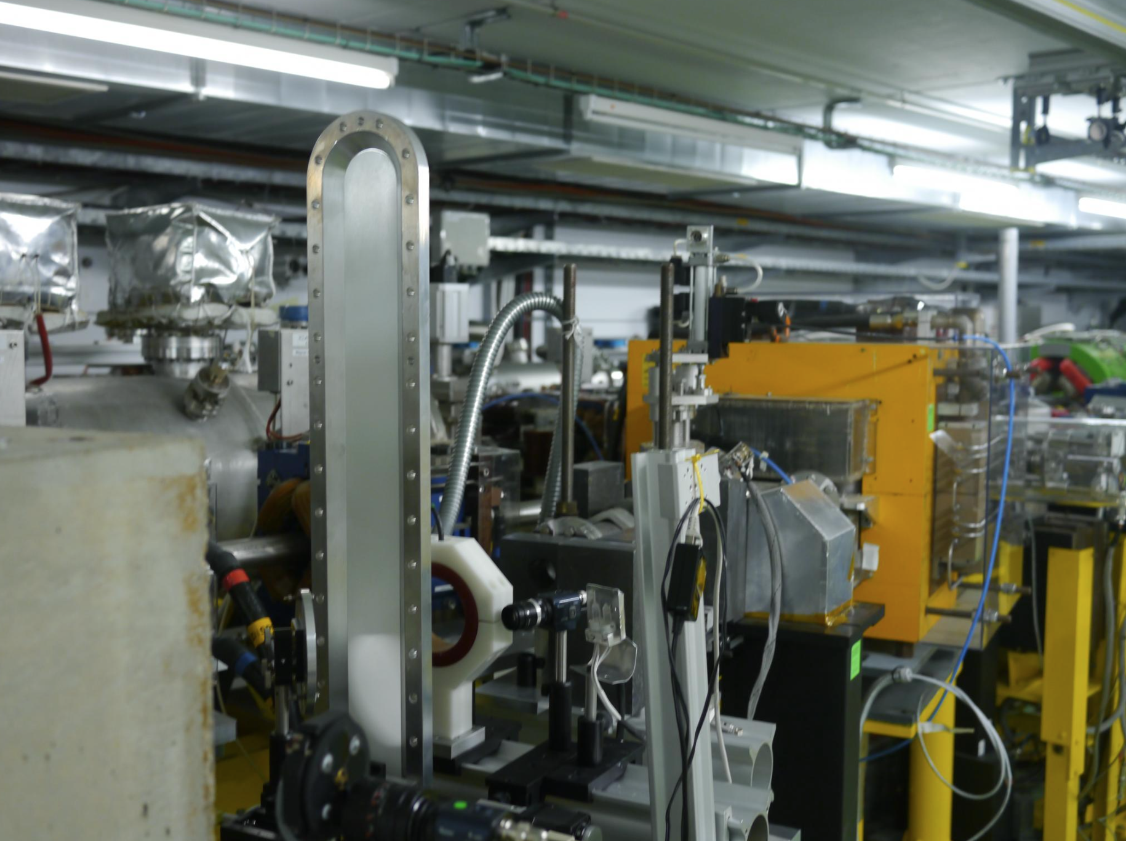
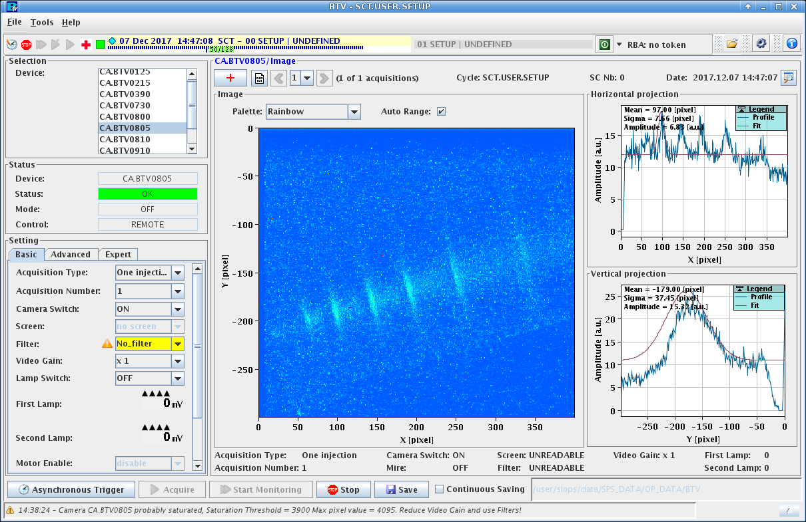
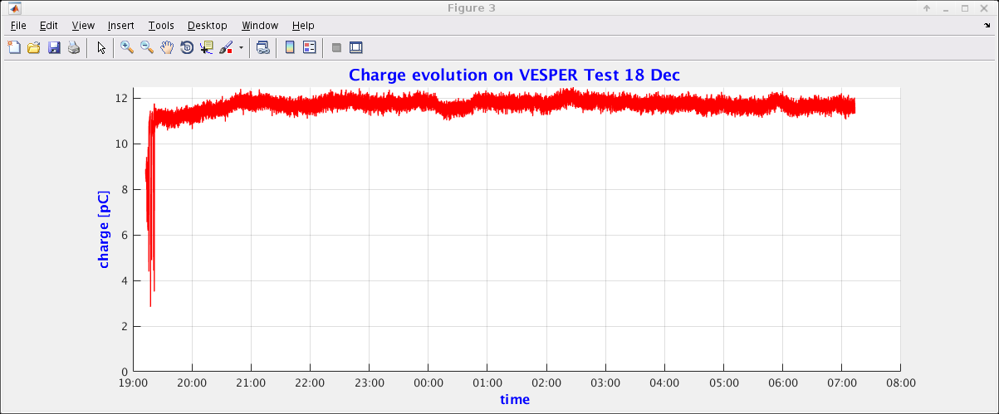
Some experiments
Electronics irradiations
VHEE
Scintillation screen test
Cherenkov in water
Electronics Irradiation Tests in VESPER.
Maris Tali, Ruben Garcia Alia, this cession
Results of the VHEE studies in VESPER/CLEAR.
Agnese Lagzda, Roger Jones, this cession
Test and calibration of scintillator for AWAKE electron spectrometer.
Fearghus Keeble

Slide 7
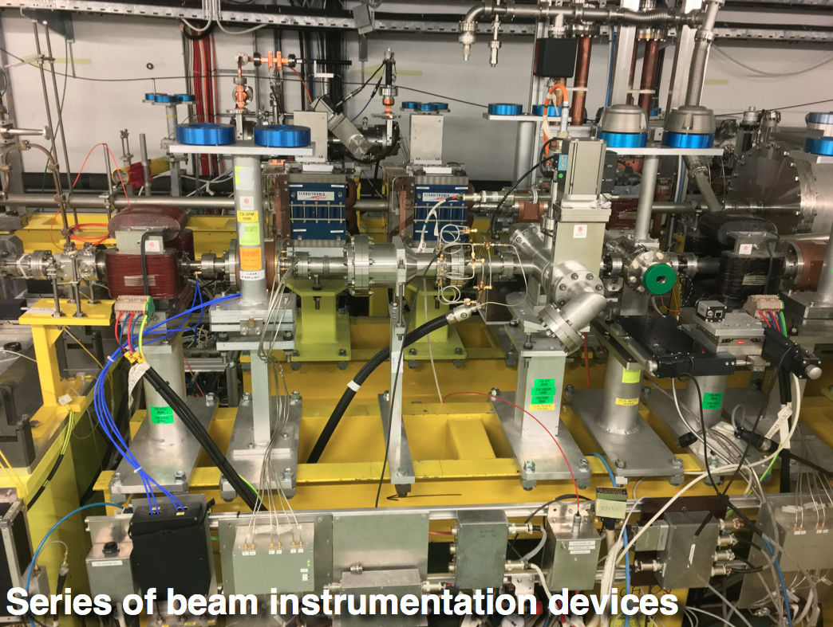
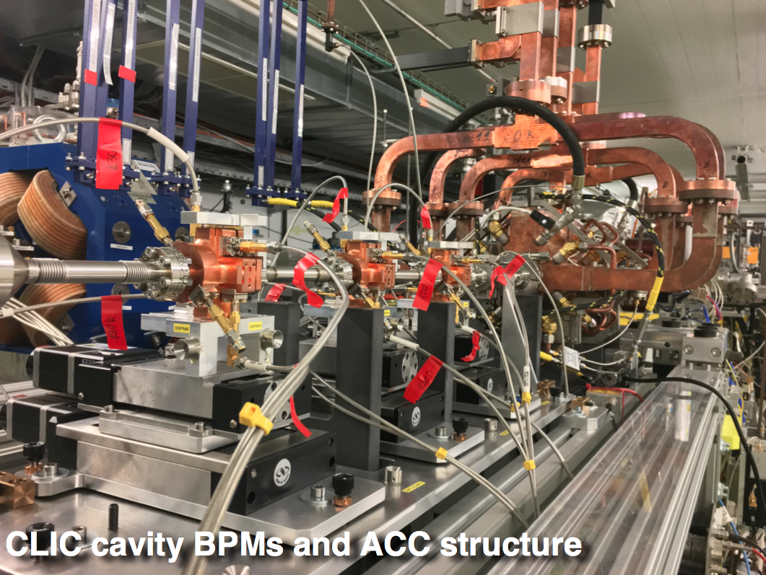
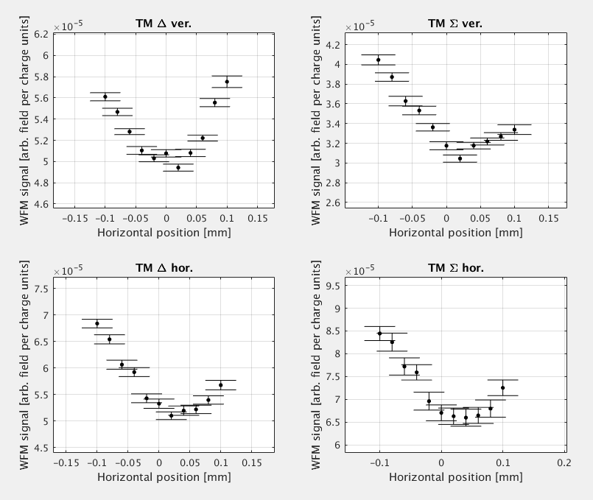
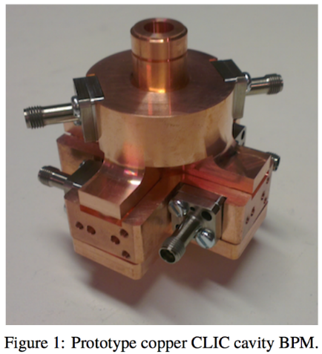
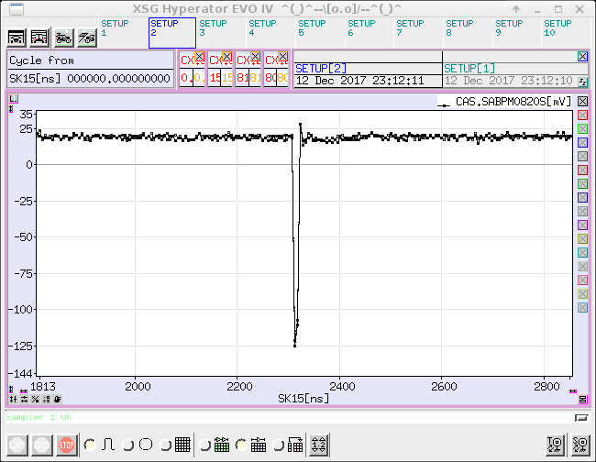
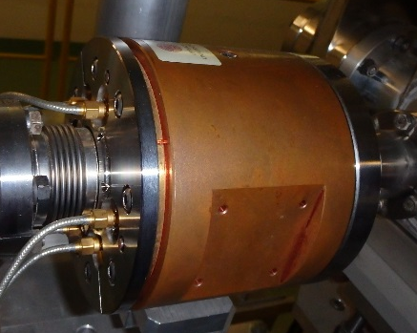
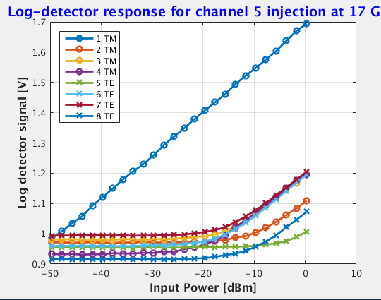
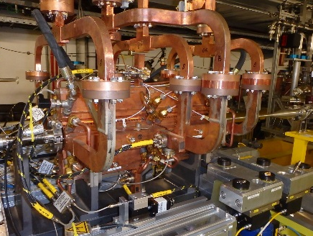
Some experiments (cont’d)
Inductive BPM upgrade
Cavity BPM performances
WFM performances
OTR, ChR, ChDR setup
Inductive
BPM
Beam Phase monitor,
WG monitor (bunch length)
WCM
Beam Instrumentation upgrade and development
Michal Grupa, this cession
Status and plans for the Cavity BPMs
Johanes Nadenau, this cession
Update on Wake-Field Monitor Studies in CLEAR
Kyrre Sjøbæk, this cession

Slide 8
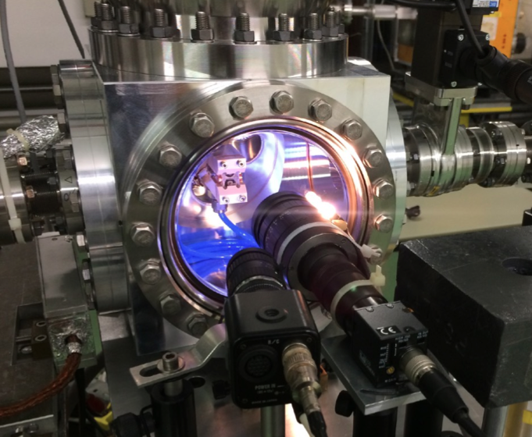
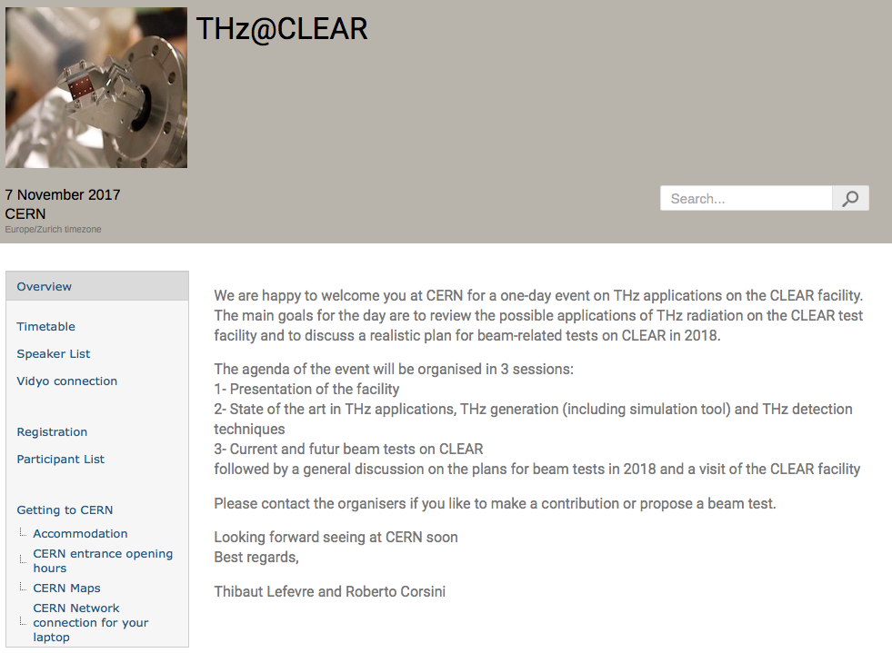
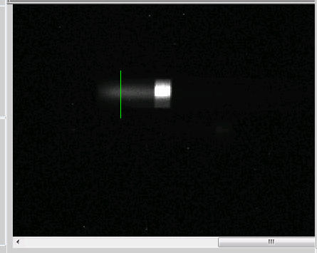
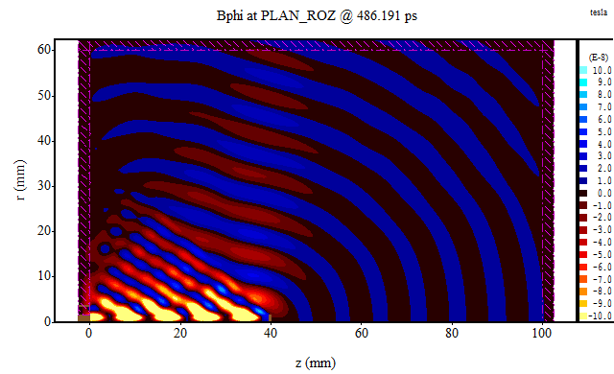
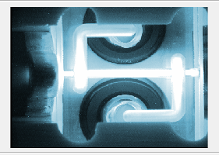
Some experiments (end, so far…)
Plasma Lens
THz studies
Cherenkov diffraction
https://indico.cern.ch/event/672235/
1/ The Plasma Lens Experiment at CLEAR: Experimental Set-Up and Results
2/ Progress on active plasma lens technology in CLEAR
Carl Lindstrøm, this cession and 23 Jan 2018, 16:40
THz@CLEAR: source and diagnostics for the electron acceleration
Alessandro Curcio, this cession
Non-invasive beam diagnostic for advanced accelerators: Cherenkov Diffraction radiation, Robert Kieffer, Thibault Lefevre, Tues 23 Jan, 17:05

Slide 9
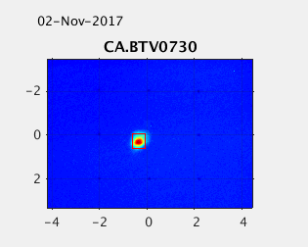
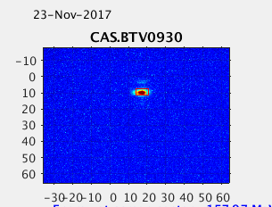
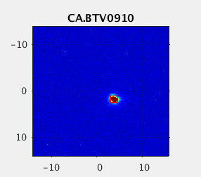
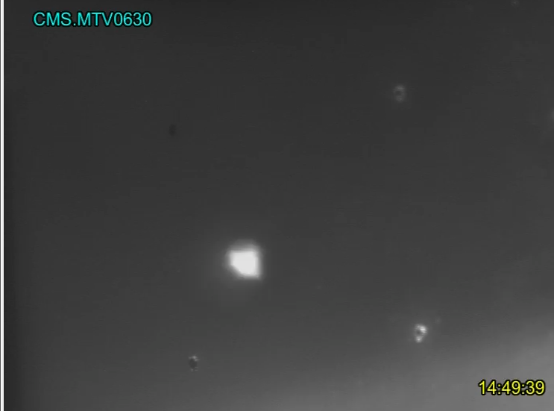
Improvements and consolidation
Good beam aspect is not all.
Problems with high charges (>100 pC)
Position jitter
Charge jitter and drift
Time structure
Bunch length

Slide 10
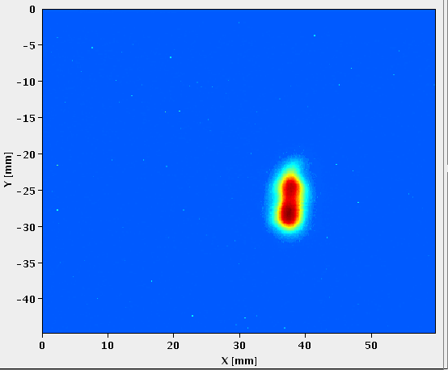
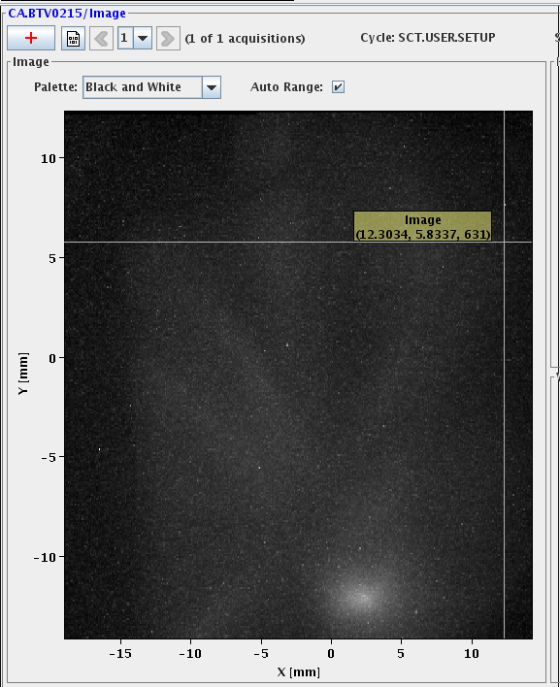
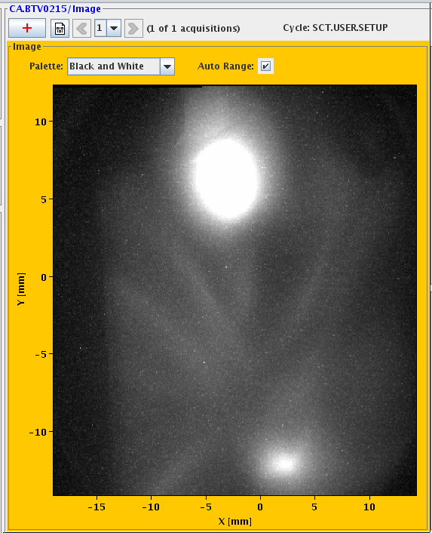
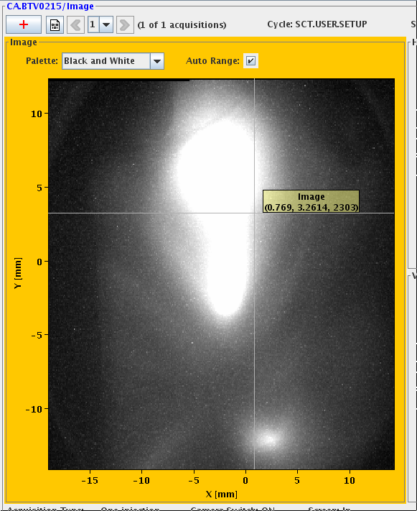
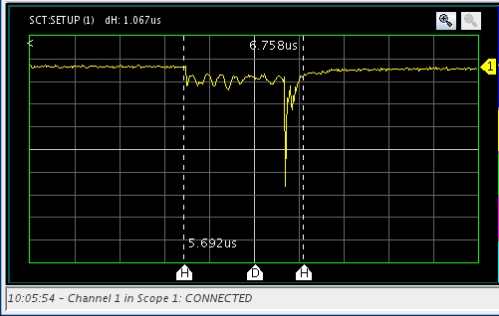
Laser works foreseen
Improve beam shape, stability (position and energy)
Improve the diagnostics and the controls
Minimize pulse picker leakage
Consolidate the installation (new stack od diodes, new oscillator, more power)
Improve the transport: move the laser closer to the gun
Variable pulse distance capability
A new fellow expert in laser to arrive in February
Laser shape on virtual cathode
Dark current
Dark current + laser leakage
Dark current + laser leakage
+ 1 bunch
laser leakage and a bunch detected by PM (beam loss)

Slide 11
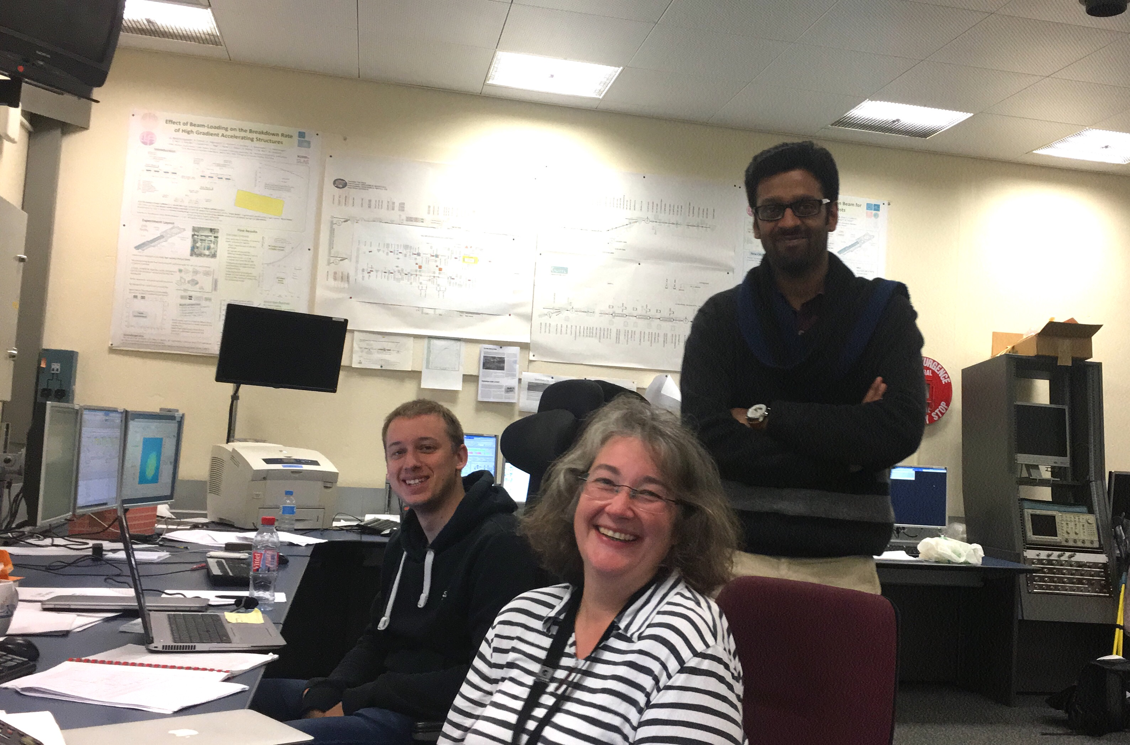
Injector optimisation for shorter bunch length
26 Oct 2017
Collaboration with LAL colleagues.
Aim to:
  Verify the theoretical best performance achievable (0.1 ps bunch length, 5 mm-mrad possible?)
  Crosscheck of ASTRA simulations.
  Guide the optimisation of our injector.
C. Bruni and al.

Slide 12
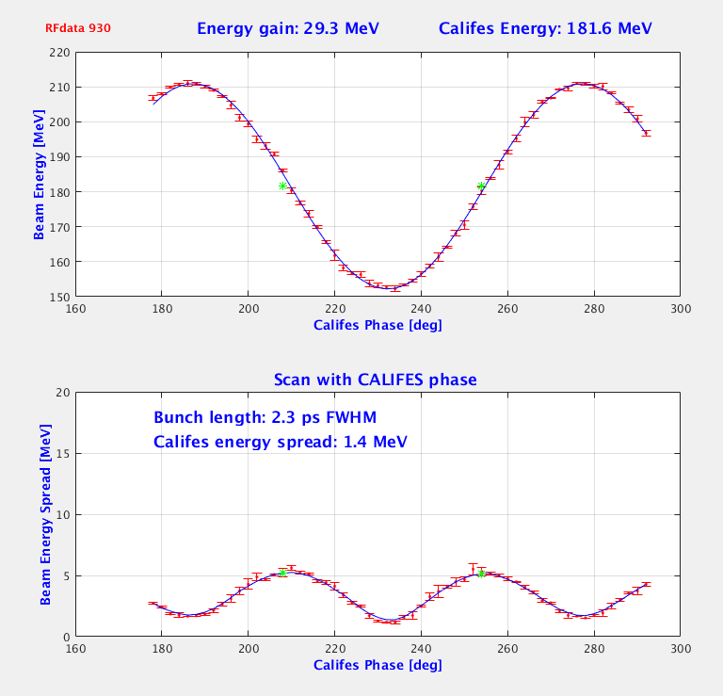
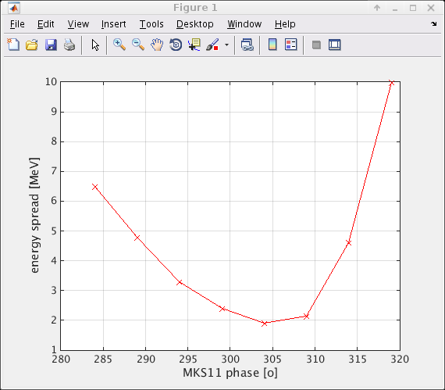
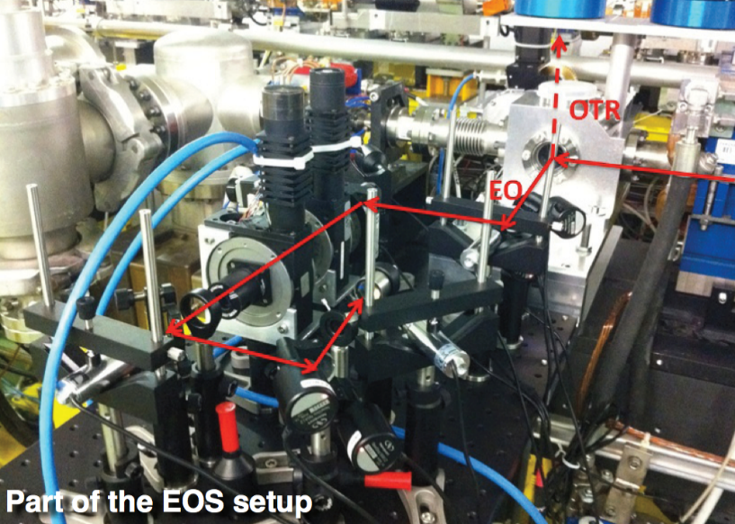
Full set of diagnostics for bunch length measurement
Streak camera (on laser and on beam)
S-band deflecting cavity (MKS31 permanently connected)
Energy spread at zero crossing on LIL structures
Energy spread at zero crossing on X-band structures (once connected)
BPR and THz radiation (non interceptive)
Electro-optical sampling (BI plan for EOS revival, Ishkhan Gorgisyan)
Phase scan with X-band structures (19 oct 2016)
Phase scan with LIL structures (A. Curcio)

Slide 13
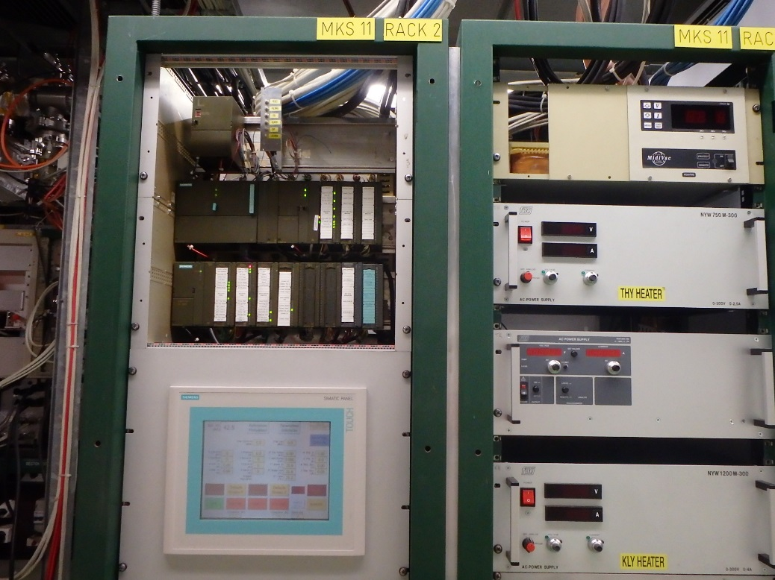
RF consolidation
Calibration of all the S-band RF measurements chains
Check of the RF chains (phase shifter, preamplifier, Klystron stability…)
Re-establish RF pulse compression for higher energy
MKS11, 15 and 31 new command control for compatibility after LS2
Connect X-band klystron to CLIC module

Slide 14
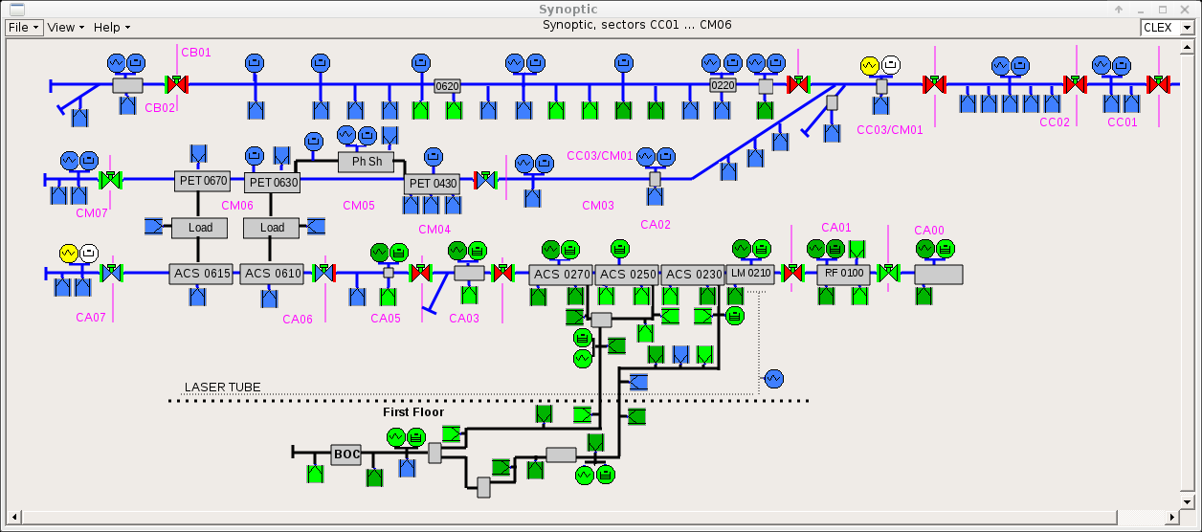
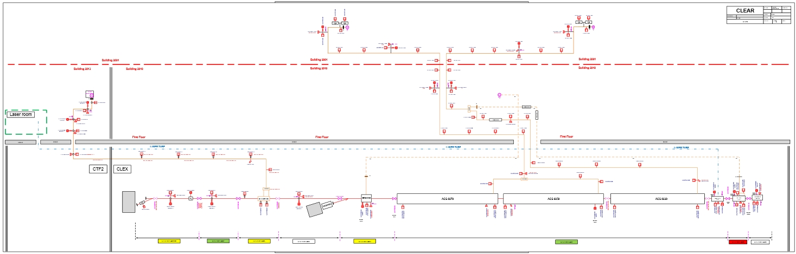
Vacuum consolidation
Regroup all equipment still in building 2008 to 2010 (re-cabling)
Additional sector valves between LIL structures
Assess the interlocks
Renew the PVSS synoptic
Integrate the future X-band connection to the CLIC module
Present PVSS synoptic
Actual CLEAR layout

Slide 15
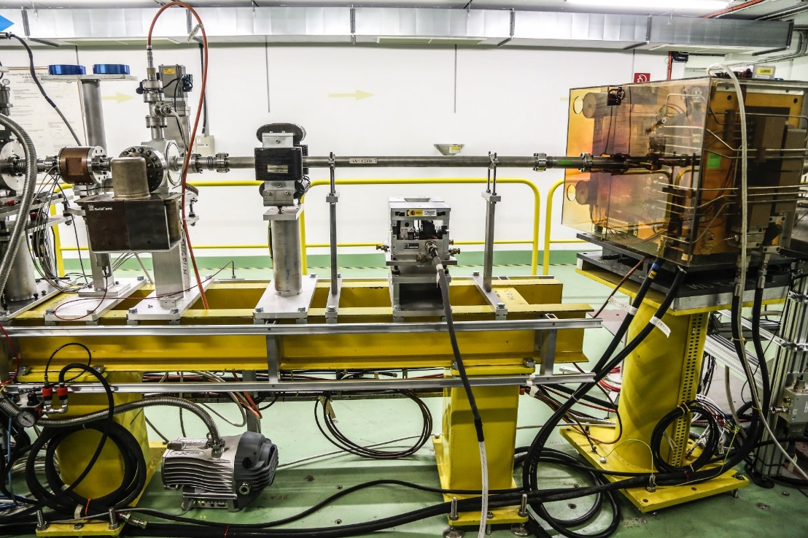
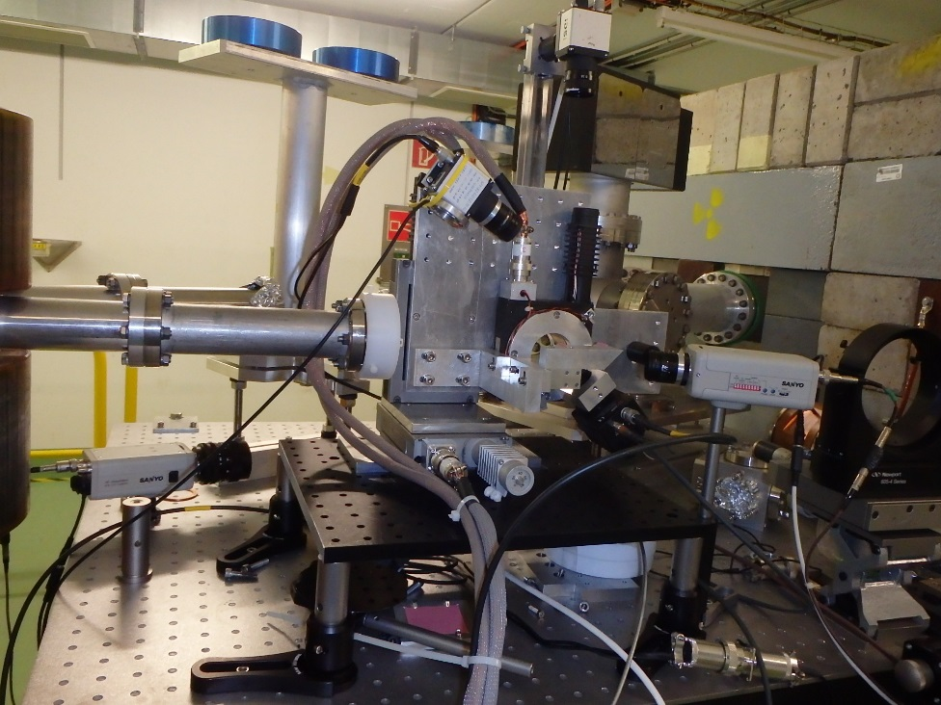
Other improvements
Additional quads (emittance measurement after PL and in-air beam size)
Additional OTR screen for emittance measurement
Camera multiplex
Laser for user’s installation alignment
Additional Beam Current Monitor
Breadboard table for VESPER
In-vacuum test stand
In-air test stand

Slide 16
Conclusion
CLEAR has successfully been prepared in 2017 and then delivered beam to many experiments.
Requests from users have (surprisingly ?) been quite numerous.
The CLEAR International Scientific Committee is now established (kick-off meeting – 11 Dec. 2017)
We have an ambitious program of consolidation and facility development.

Slide 17
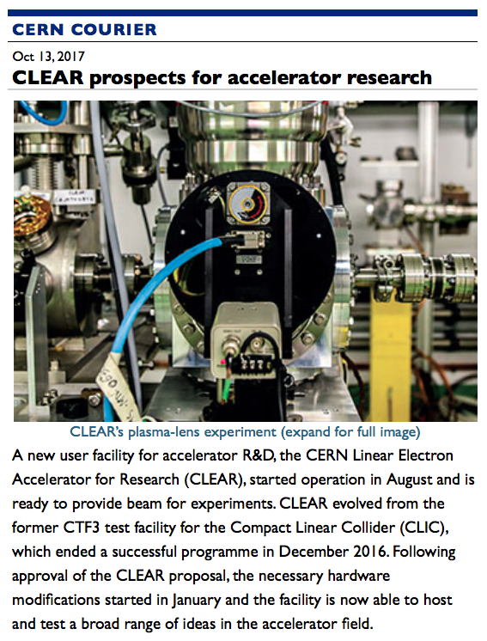
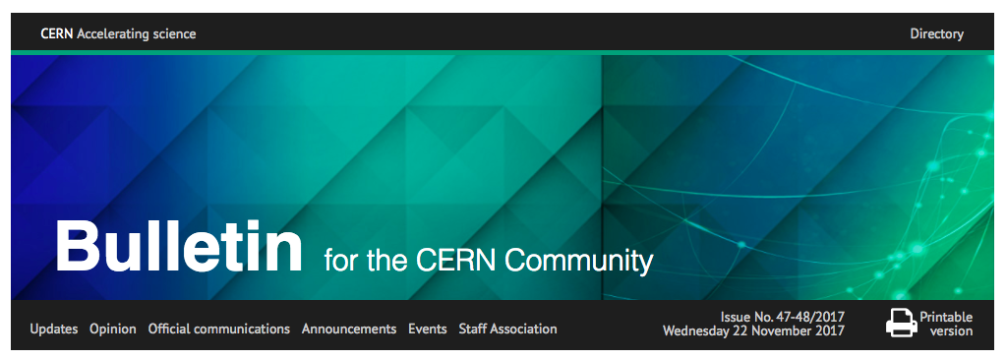
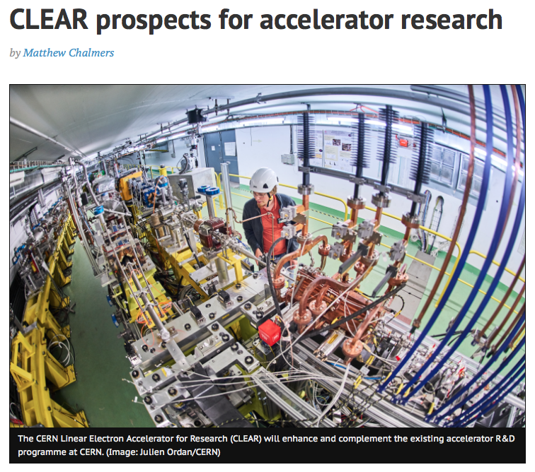
Already making the headlines
Thank you for your attention

