Slide 1
Beam instrumentation upgrades and developments on CLEAR
CLIC Workshop 2018
Geneva 24/01/2018
CLEAR BI team:
M. Bergamaschi, F. Guillot-Vignot, I. Gorgisyan, R. Kieffer, M. Krupa, T. Lefevre, S. Mazzoni,
J. Nadenau, M. Wendt

Slide 2
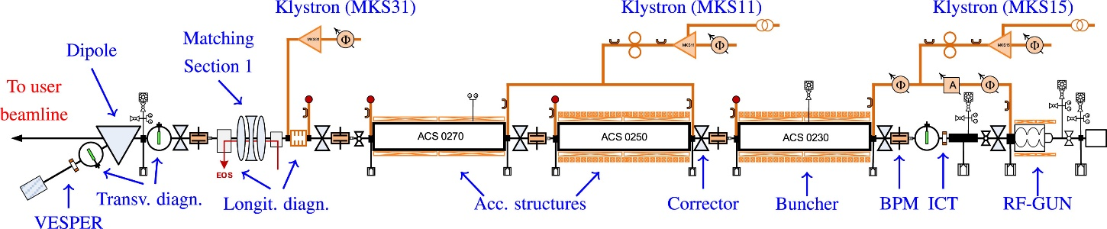
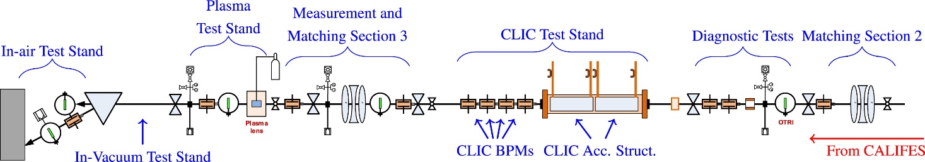
BI at CLEAR
Operational and R&D devices:
Inductive BPMs
Electro Optical Sampling
BPR
Wall Current Monitor
Cherenkov Diffraction Radiation
CLIC BPMs
ICTs
Screens
not covered here
24/01/2018
M. Krupa

Slide 3
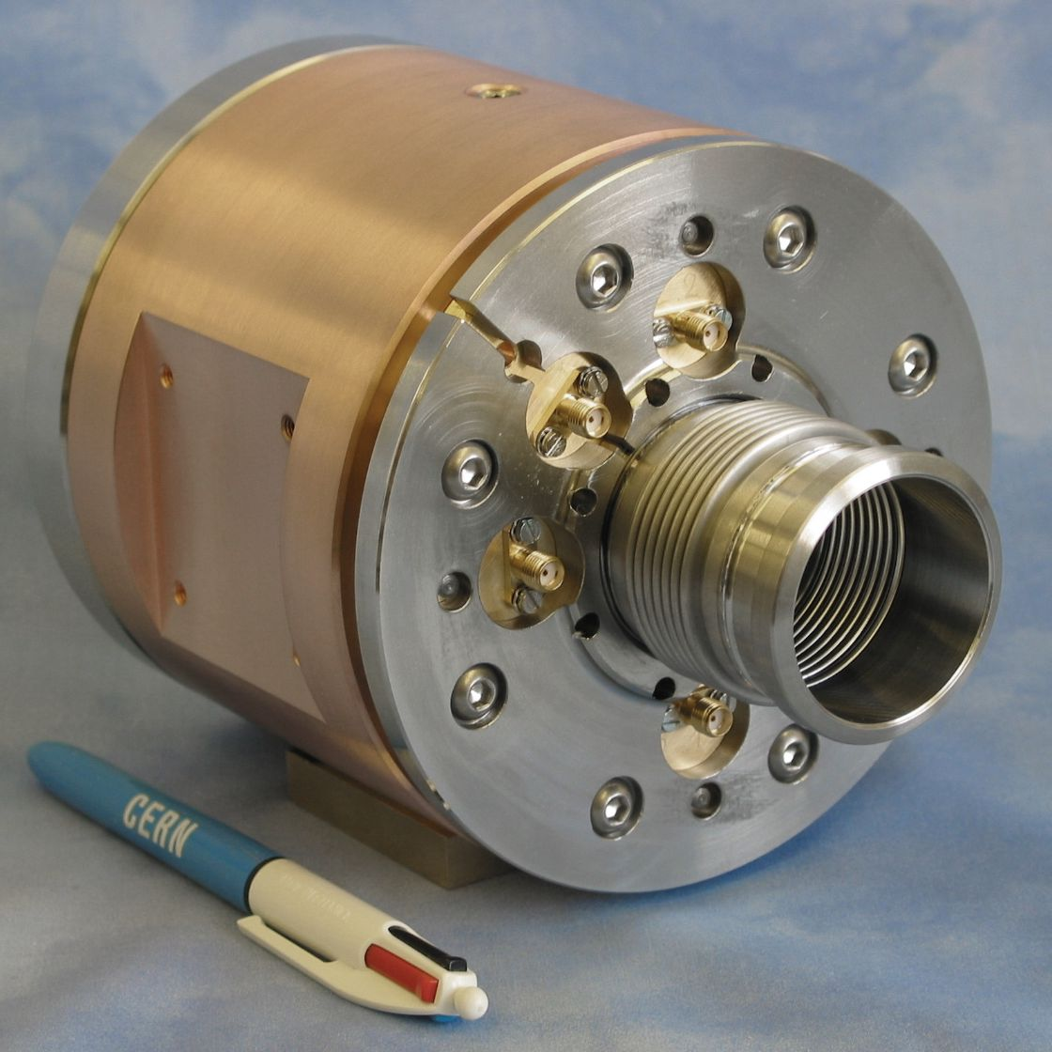
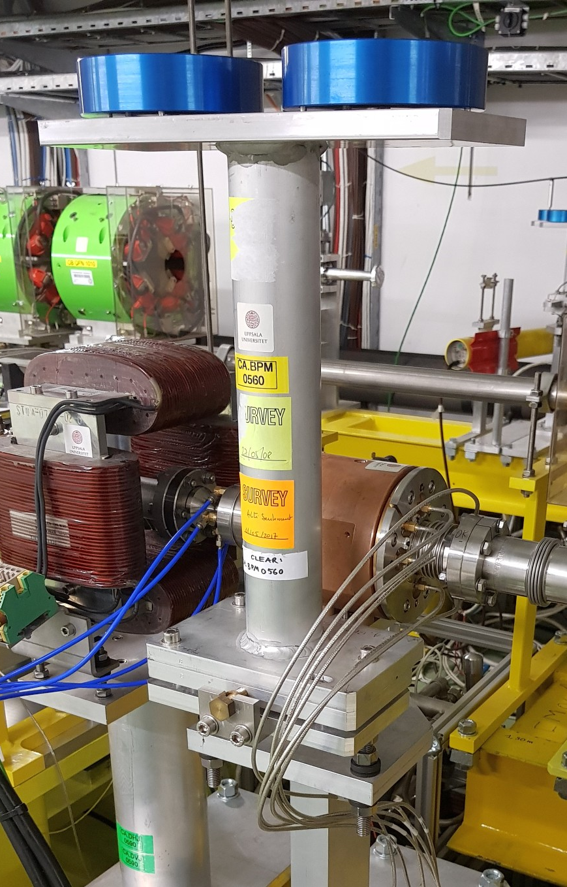
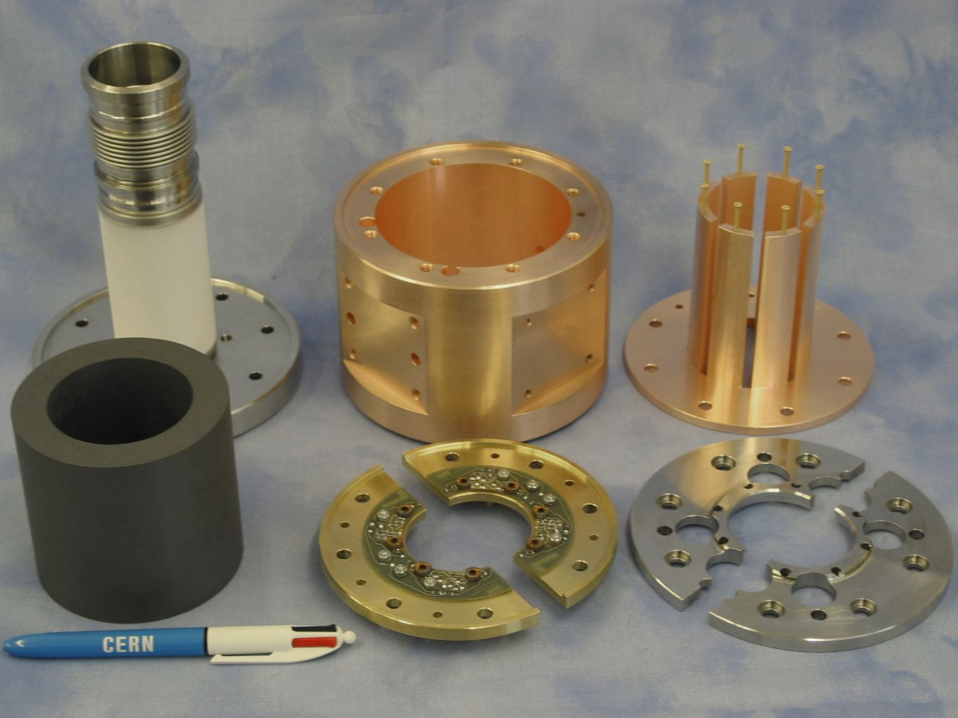
Inductive BPMs
Developed by M. Gasior for CTF3
Absolute and calibrated position and beam current measurements
Measurement done outside of the vacuum chamber: modifications possible in-situ (without vacuum opening and realignment)
24/01/2018
M. Krupa

Slide 4
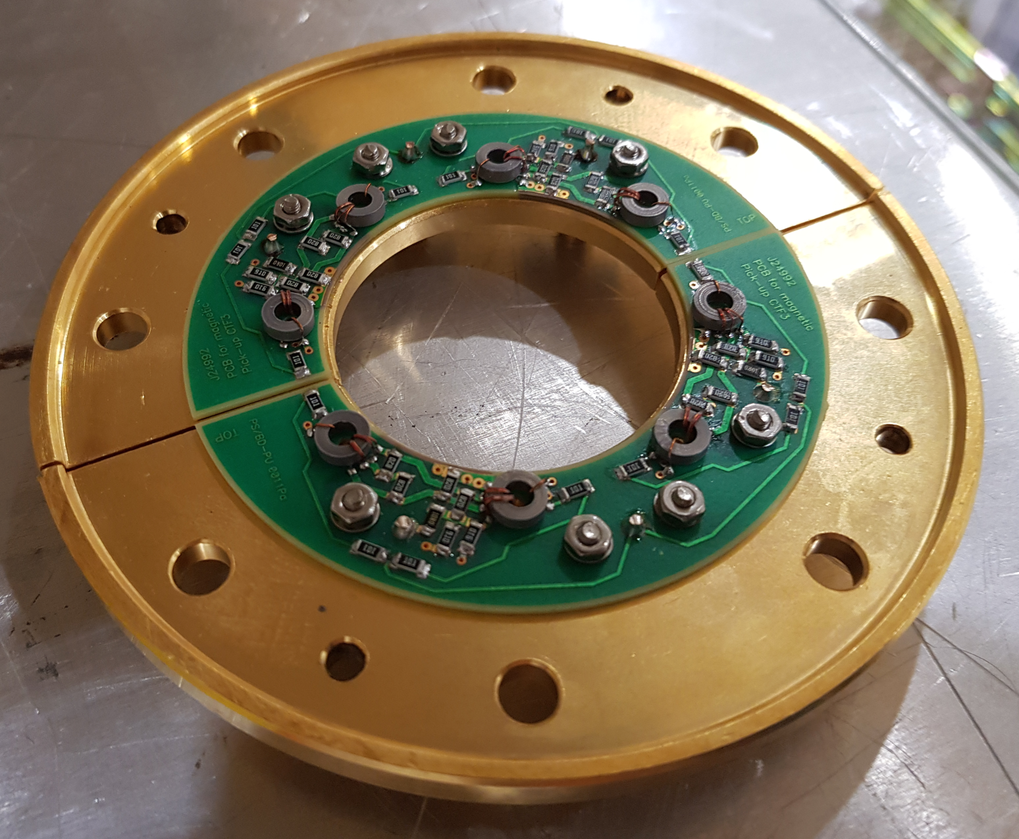
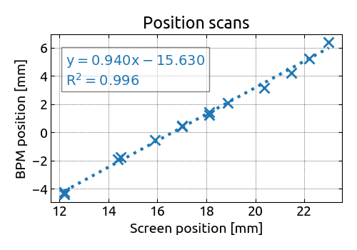
Inductive BPMs – upgrades
Low beam current at CLEAR: two BPMs modified in 2017 to increase sensitivity by a factor of 8
Early commissioning: beam position scans compared with a downstream screen
Plans for 2018: modification of additional BPM, commissioning
24/01/2018
M. Krupa

Slide 5
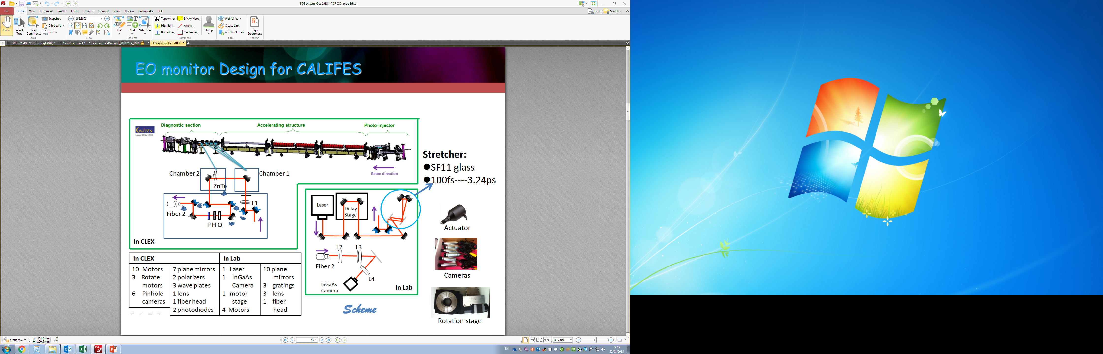
Electro Optical Sampling (EOS)
Awake Run 2 (2021): diagnostics for sub-ps bunch length
Concept: simplify and upgrade EOS at CLEAR
Single vacuum chamber design: easier to align and operate
Plans for 2018: bunch length measurements at CLEAR with EOS and streak camera in late 2018
Chamber
ZnTe
e- beam
BS
Fibre
24/01/2018
M. Krupa

Slide 6
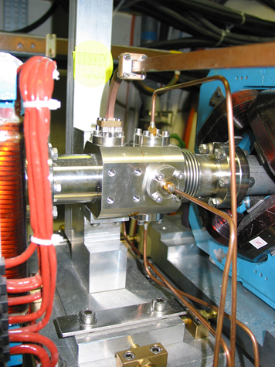
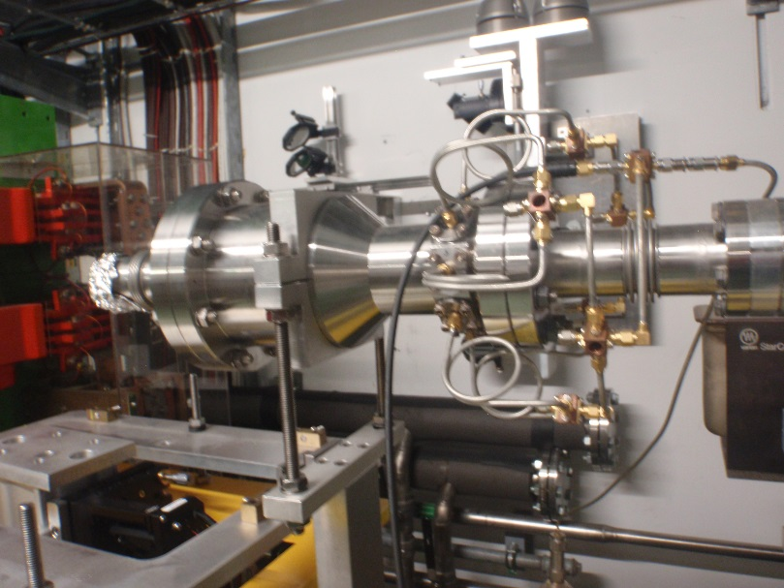
BPR and WCM
Longitudinal diagnostics: very high frequency pick-ups
Plans for 2018: revival and commissioning
24/01/2018
M. Krupa

Slide 7
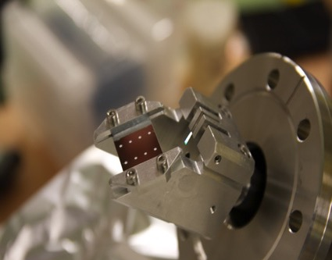

Diamond Cherenkov Diffraction Radiation
Noninvasive beam size measurements: see Thibaut’s talk from yesterday
CVD diamond radiator under vacuum
Goal for 2017: Comparison between OTR, Cherenkov, and ChDR light emission
Setups (cameras) tested in 2017:
  Ueye (visible range): not appropriate for
  200 MeV
  Onca-MWIR-InSb (2-5 um): bad SNR
  Gobi-LWIR (8-15 um): gating issues
  Bobcat-SWIR (0.8-1.6 um): seems to be the most adapted
Dielectric
Cherenkov DR
photons
E Field
h
Vacuum
$$θ_{Ch}$$
TR screen
ChDR radiator
24/01/2018
M. Krupa

Slide 8
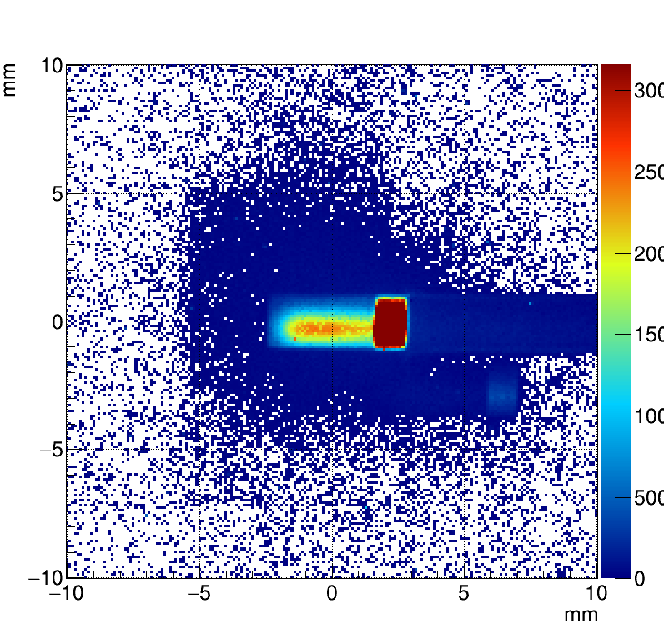
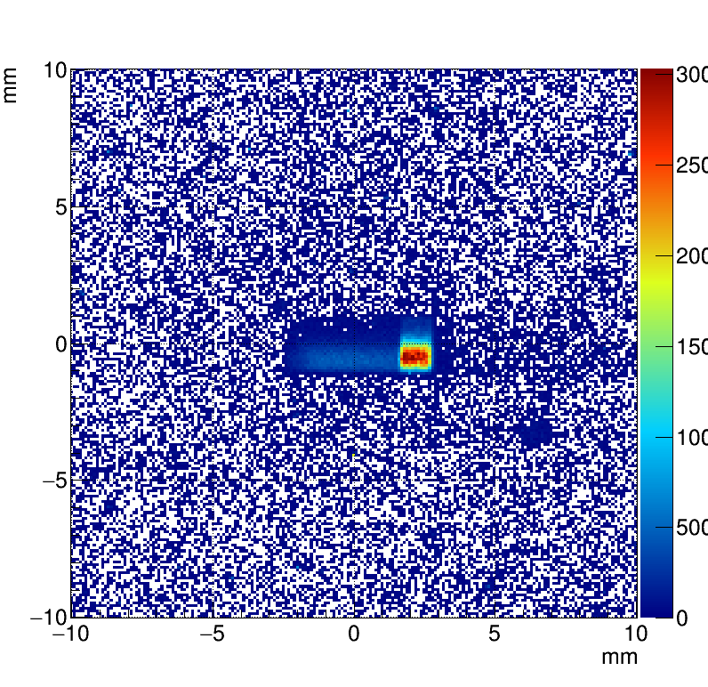
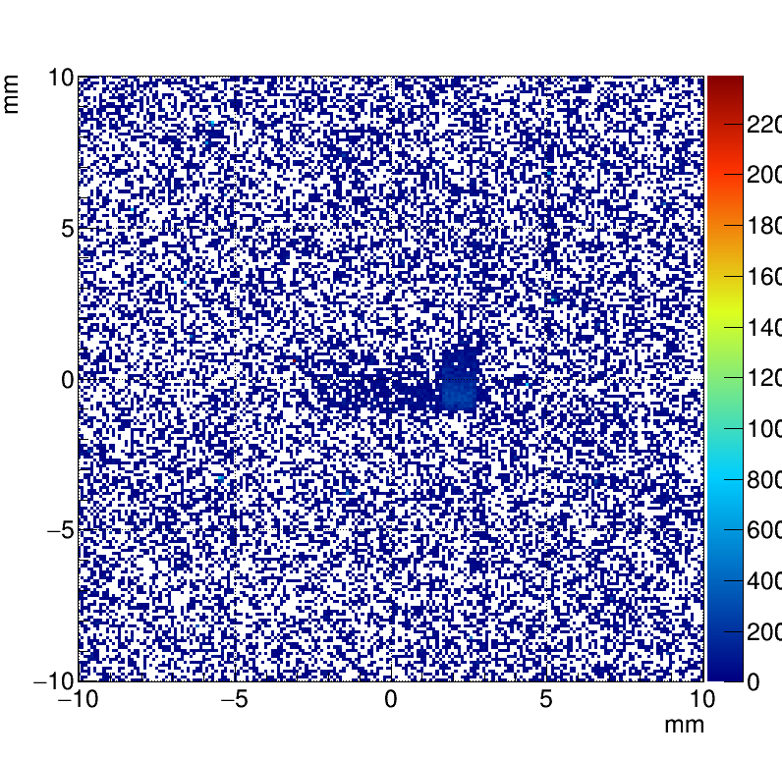
Diamond Cherenkov Diffraction Radiation
Measurements setup in 2017: 15x2x1.2mm diamond crystal with one face cut and Al Coated to reflect the ChDR photons
Al coating
h
e- Beam
ChDR
direct
ChDR
Internal reflection
24/01/2018
M. Krupa

Slide 9
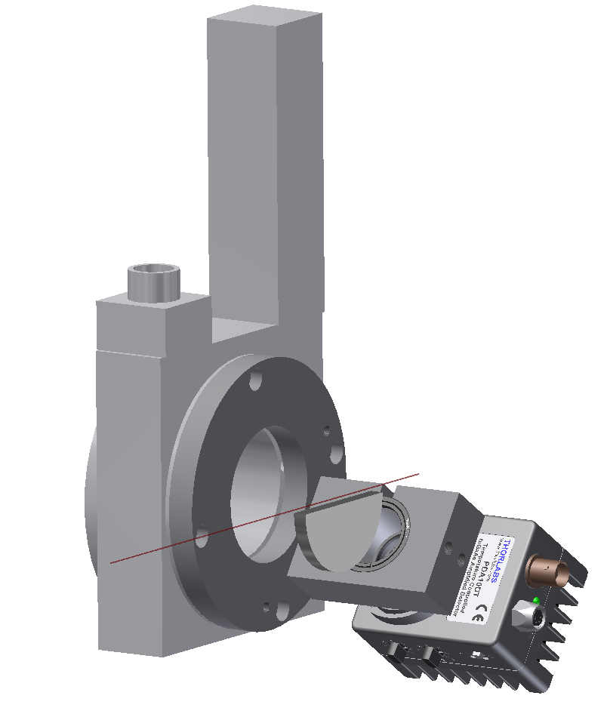
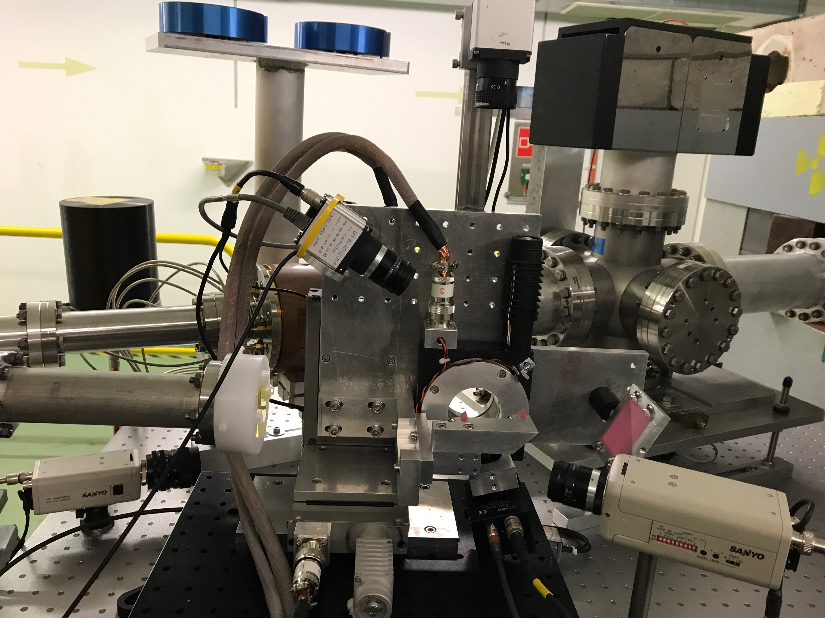
In-air tests in 2018 – Silicon ChDR
In-air spectral-angular measurement of ChDR in an half silicon wafer radiator
Detector: PDA10 InGaAs (0.9-2.6um) single pixel photodiode on a motorized Goniometer
Bandpass filters to select wavelength
(BW 30 nm)
Installed and ready to take data
e- Beam
ChDR
Si Radiator
24/01/2018
M. Krupa

Slide 10
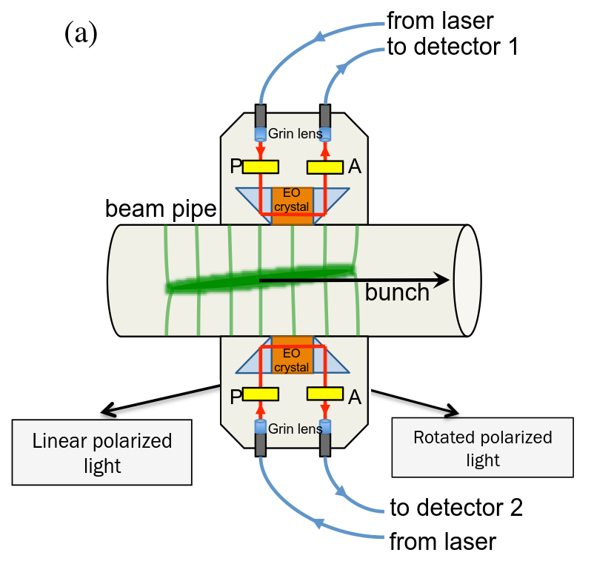
In-air tests in 2018 – EO BPM
Electro optical BPM being developed for intrabunch transverse diagnostics in HL-LHC
Collaboration with RHUL (UK)
24/01/2018
M. Krupa

Slide 11
Summary
CLEAR is an extremely interesting facility for BI – challenging diagnostics and R&D possibilities
A lot of work done in 2017 to revive and improve old CTF3 instruments
Most of the instruments provide data but there is still some work ahead of us
New developments done for future facilities: Awake Run 2, HL-LHC
BI would like to use the in-air test line more extensively in 2018
24/01/2018
M. Krupa

Slide 12
Thanks for your attention

