Slide 1


Global Λ polarization in intermediate & high energy heavy ion collisions
Yilong Xie
Sci. Doctor of UiB

Slide 2
Introduction
Polarization 3Vector
Results
Outlook
Summary

Slide 3
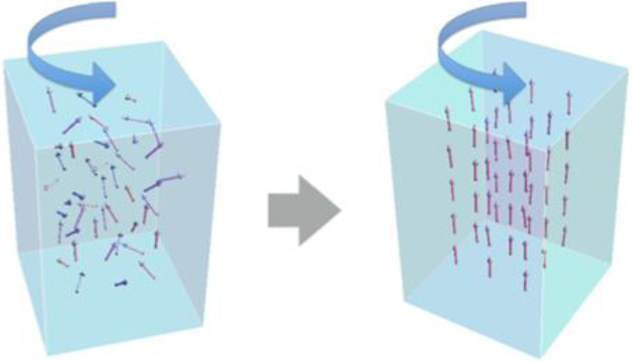
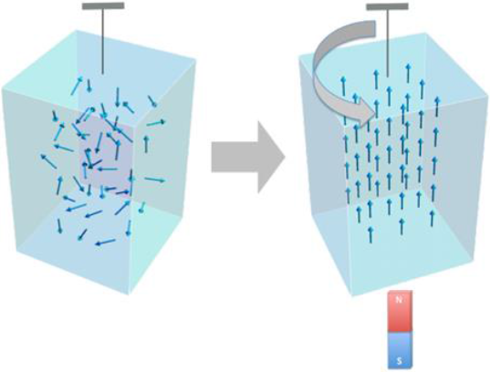
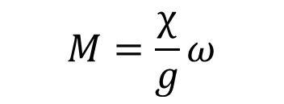
Introduction: Spin-orbit Coupling
Barnett Effect (1915)
Einstein-de Hass Effect(1915)
$$M=\frac{χ}{g}ω$$
Uncharged body will be spontaneously magnetized when rotated with fixed axis
[ S. J. Barnett, Magnetization by Rotation, Phys. Rev.. 6, 239–270 (1915).]
Ferromagnet at rest, when put into an external H field, will start to rotate
[ A. Einstein, W. J. de Haas, Koninklijke Akademie van Wetenschappen te Amsterdam, Proceedings, 18 I, 696711 (1915) ]
Coupling between macroscopic orbital angular momentum and microscopic spin angular momentum
Another interpretation of this coupling: Equipartition of angular momentum degrees of freedom

Slide 4
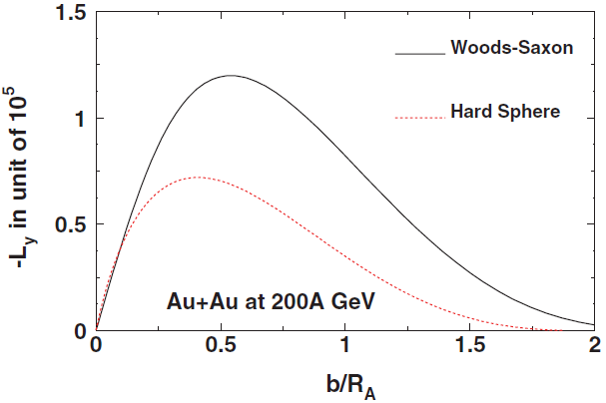
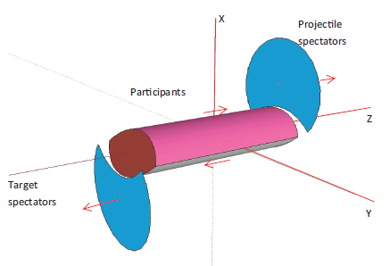
Introduction: Angular momentum
X.N. Wang, et al., PRC77, 044902 (2008)
Fig.1 3D view after collisions. Tilted Initial State
Fig.2 (a)Transverse view. (b) Shear velocity profile.
[ L. P. Csernai, et al. Phys. Rev. C 87, 034906 (2013)]
Tilted initial state (Fig. 1) carries the angular momentum from impact.
The velocity shear (Fig. 2b) will further rotate this initial state, and even leads to Kelvin Helmholtz Instability(KHI).

Slide 5
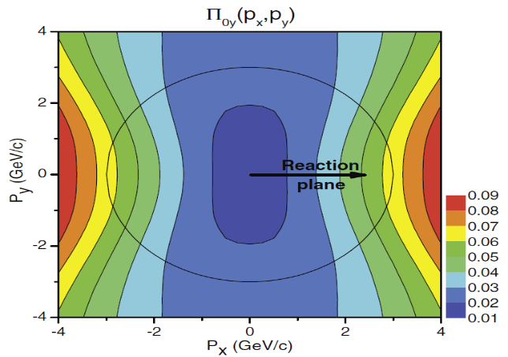
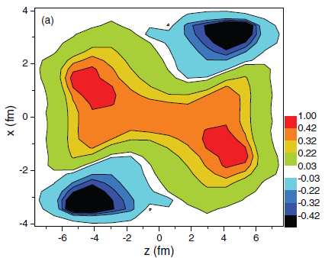
Introduction: Vorticity and Polarization
Fig. 3 The vorticity calculated in the reaction (xz) plane at t = 0.17 fm/c after the start of fluid dynamical evolution.
Fig. 4. The dominant y component of the observable polarization, Π₀(p) in the Λ’s rest frame.
[ L. P. Csernai, et al, PRC 87, 034906 (2013)]
[ F. Becattini, et al. PRC 88, 034905 (2013) ]
The rotation can lead to observable vorticity (Fig. 3), and polarization (Fig. 4).
The initial angular momentum can be transfer to the polarization at final state, via spin-orbital coupling or equipartition of the freedom of angular momentum.

Slide 6
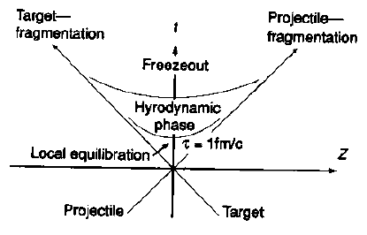
Introduction: Hydrodynamic Simulation
Fig. 5 Space-time evolution in Bjorken model
An initial state based Yang-Mills fields (flux tube) is formed after Lorentz contracted nuclei penetrate each other, then system evolves with a (3+1)D fluid dynamics: the high resolution Particle-In-Cell Relativistic (PICR) hydrodynamic model.
The major part of freeze out hypersurface is assumed to be time like here. And we use the ideal-gas post-FO distribution. The precise FO prescription in Hydro fluid dynamics was discussed in Ref. [Yu Cheng, 2011].
[ Yun Cheng, et al., Phys. Rev. C 81, 064910 (2010) ]

Slide 7


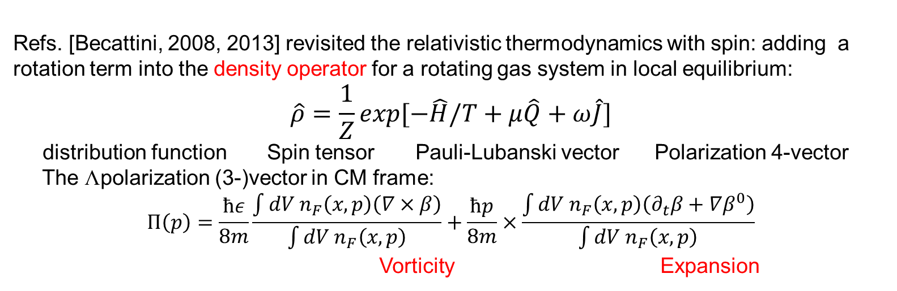
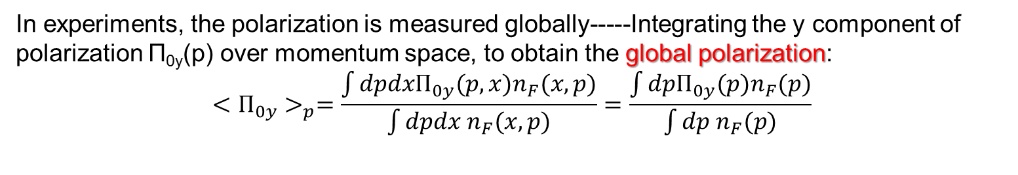
Polarization vector
Refs. [Becattini, 2008, 2013] revisited the relativistic thermodynamics with spin: adding a rotation term into the density operator for a rotating gas system in local equilibrium:
$$\hat{ρ}=\frac{1}{Z}exp[−\hat{H}/T+μ\hat{Q}+ω\hat{J}]$$
distribution function Spin tensor Pauli-Lubanski vector Polarization 4-vector
The Λpolarization (3-)vector in CM frame:
$$П\left(p\right)=\frac{ħε}{8m}\frac{\int{dV n_{F}\left(x,p\right)\left(∇×β\right)}}{\int{dV n_{F}\left(x,p\right)}}+\frac{ħp}{8m}×\frac{\int{dV n_{F}\left(x,p\right)\left(∂_{t}β+∇β^{0}\right)}}{\int{dV n_{F}\left(x,p\right)}}$$
Vorticity Expansion
where is the inverse temperature four-vector field. Then thermal vorticity is ω= $∇×β$.
In experiments, the polarization is measured in particle’s rest frame---- Lorentz-boosting:
In experiments, the polarization is measured globally-----Integrating the y component of polarization Π_{0y}(p) over momentum space, to obtain the global polarization:
$$<П_{0y}>_{p}=\frac{\int{dpdxП_{0y}(p,x)n_{F}(x,p)}}{\int{dpdx n_{F}(x,p)}}=\frac{\int{dpП_{0y}(p)n_{F}(p)}}{\int{dp n_{F}(p)}}$$
F. Becattini, L.P. Csernai, and D.J. Wang, Phys. Rev. C 88, 034905 (2013).

Slide 8
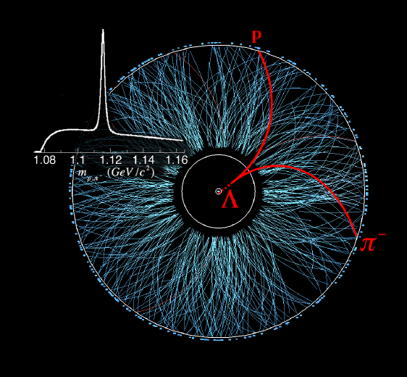
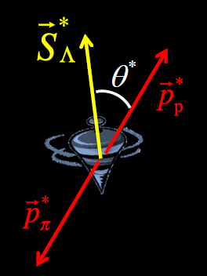
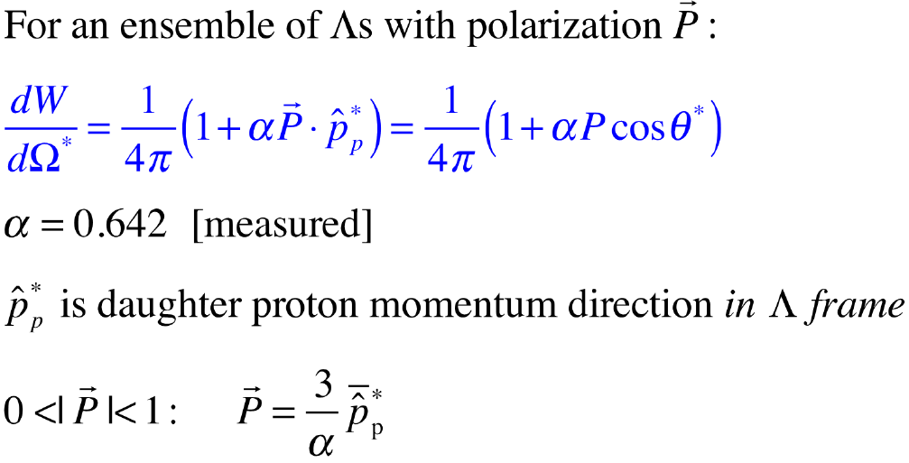
Polarization vector
Lambdas are “self-analyzing”:
Reveal polarization by preferentially emitting daughter proton in the spin direction.
In experiments, we measure the emitted protons’ angular distribution in Λ’s frame to obtain the Lambda’s polarization

Slide 9
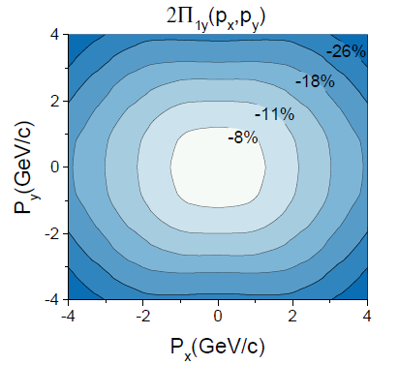
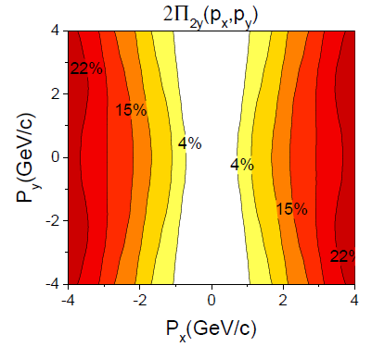
Results: Y Component
Fig. 6 The first (left) and second (right) term of the dominant y component of the Λ polarization for momentum vectors in the transverse plane at pz = 0,for the FAIR U+U reaction at 8.0 GeV at time t = 2.5+4.75 fm/c.
The y component is dominant, up to ~20%, as we can compare it with x and z components later.
Opposite directions. Result into a relatively small value of global polarization.

Slide 10
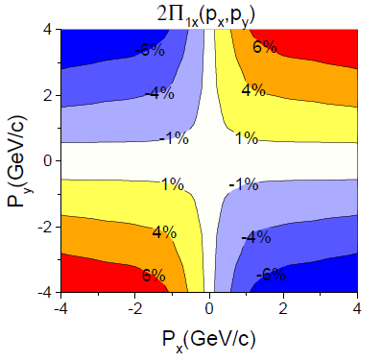
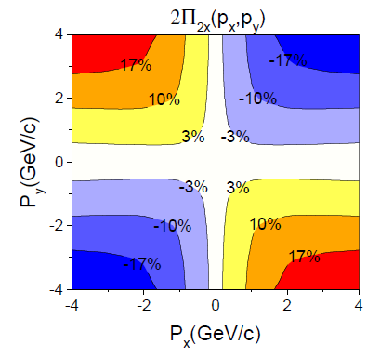
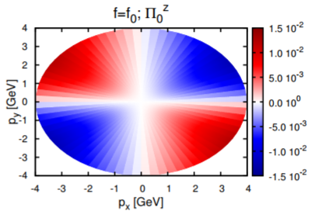
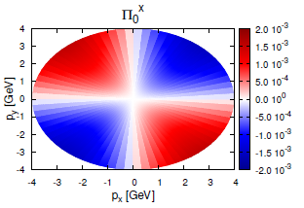
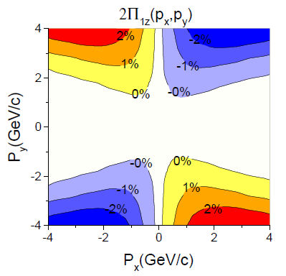
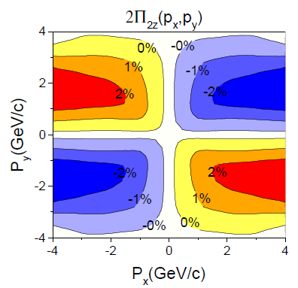
Results: X and Z components
1. Small magnitude.
2. Anti-symmetric
ECHO-QGP numerical code, implementing relativistic dissipative hydrodynamics
in the causal Israel-Stewart framework in 3+1 dimensions with an initial Bjorken flow profile
Fig. 7 The first (left) and second (right) terms of the x(up) and y(down) components of the Λ polarization for momentum vectors in the transverse plane at pz = 0,for the FAIR U+U reaction at 8.0 GeV
[Becattini, et al., Eur. Phys. J. C 75, 406 (2015).]

Slide 11
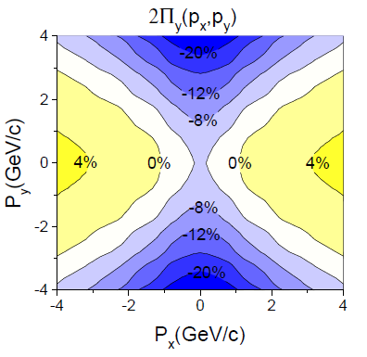
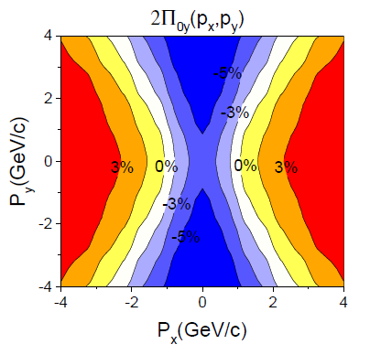
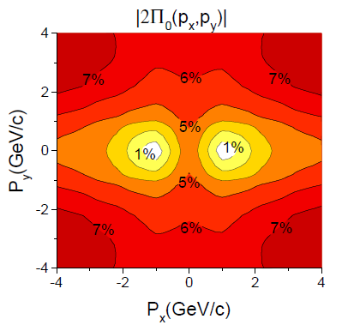
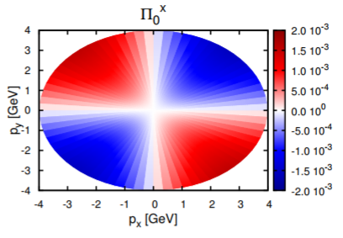
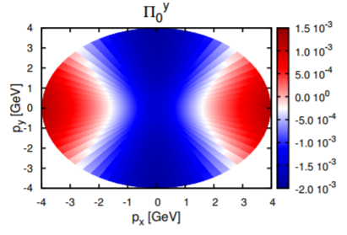
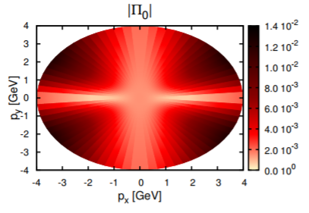
Results: Polarization at FAIR
Fig. 8 The y component (left) of polarization vector in center of mass frame and Λ’s rest frame. The right sub-figure are the modulus of the polarization in Λ’s rest frame. At FAIR 8.0 GeV at time 2.5+4.75 fm/c.
The modulus of polarization is very similar with the y component of polarization, both in magnitude and the structure. I. e. the other x and z components do not contribute to the polarization, which is in line with previous observations in this work and other papers.
[Becattini, et al., Eur. Phys. J. C 75, 406 (2015).]

Slide 12
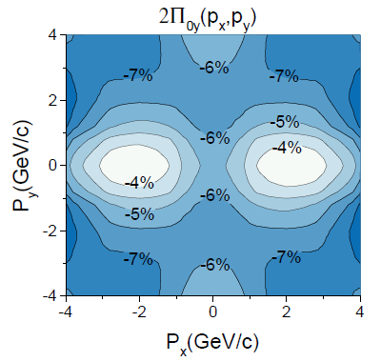
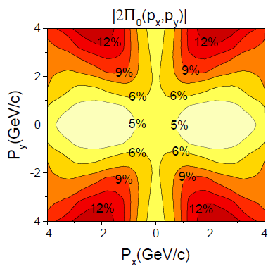
Results at Earlier time
Fig. 9 The y component (left) and the modulus (right) of the polarization for momentum vectors in the transverse plane at pz = 0, for the FAIR U+U reaction at 8.0 GeV, but at an earlier time t= 2.5+1.7 fm/c. The figure is in the Λ’s rest frame.
The similarity of the magnitude and structure between Π_{0y} and Π₀ here is even more obvious than that in previous figures.
I.e. The contribution from x and z components is even smaller in earlier time.

Slide 13
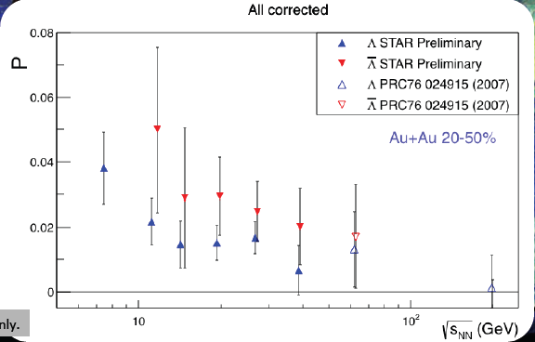
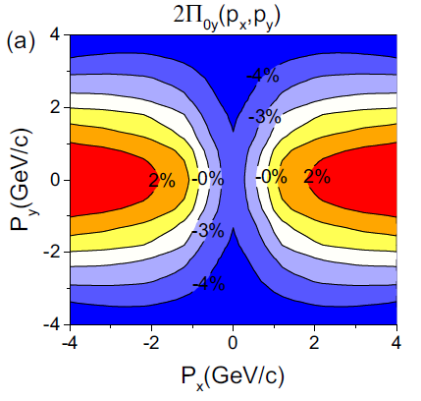
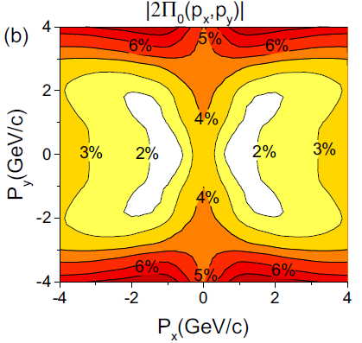
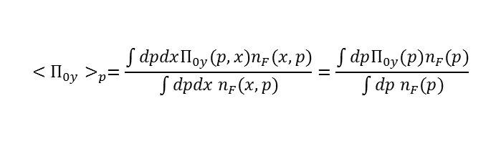
Results: RHIC Au+Au Collisions
Recently, RHIC BES program has measured the global polarization at energies √s = 7.7, 11.5, 14.5, 19.6, 27.0, 39.0, 62.4, and 200 GeV.
M.A. Lisa, et al., (STAR Collaboration) invited talk at
QCD Chirality Workshop 2016.
Thus we perform the simulation and calculation for these energies.
Transverse Momentum Analysis: Similar behavior as before: The Structure and magnitude between Π_{0y} and |Π₀| are similar. y directed component dominates the polarization.
$$<П_{0y}>_{p}=\frac{\int{dpdxП_{0y}(p,x)n_{F}(x,p)}}{\int{dpdx n_{F}(x,p)}}=\frac{\int{dpП_{0y}(p)n_{F}(p)}}{\int{dp n_{F}(p)}}$$
Fig. 10 The y component (left) and the modulus (right) of the polarization for momentum vectors in the transverse plane at pz = 0, for the RHIC Au+Au collisions at 11.5 GeV, at time t= 2.5+4.75 fm/c. The figure is in the Λ’s rest frame.

Slide 14
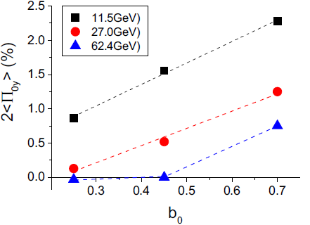
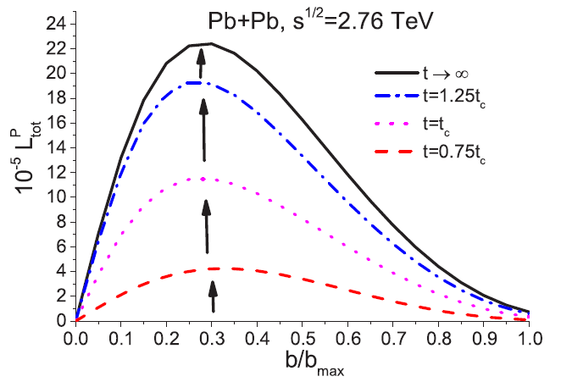
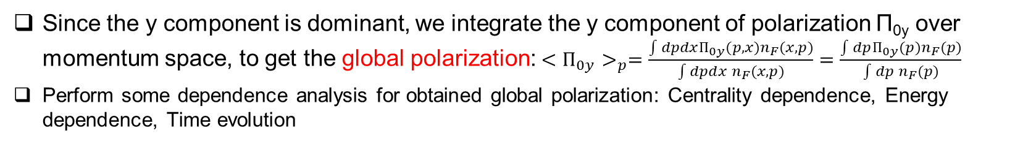
Results: Centrality dependence
Since the y component is dominant, we integrate the y component of polarization Π_{0y} over momentum space, to get the global polarization:$<П_{0y}>_{p}=\frac{\int{dpdxП_{0y}(p,x)n_{F}(x,p)}}{\int{dpdx n_{F}(x,p)}}=\frac{\int{dpП_{0y}(p)n_{F}(p)}}{\int{dp n_{F}(p)}}$
Perform some dependence analysis forobtained global polarization: Centrality dependence, Energy dependence, Time evolution
Glauber-like model calculation.
[ V. Vovchenko, L.P.Csernai, Phys.Rev. C 90, (2014) 044907. ]
Fig. 11 The global polarization, 2<Π_{oy}>_{p}, as a function of impact parameter ratio b₀ = b/b_{max} at 11.5, 27.0, and 62.4 GeV.
This linear dependence of global polarization on impact parameter clearly shows that the polarization arises from initial angular momentum.
At the higher energy, the central and semi-central collision have vanishing polarization. This is why in 200GeV, the polarization magnitude is closed to zero.

Slide 15
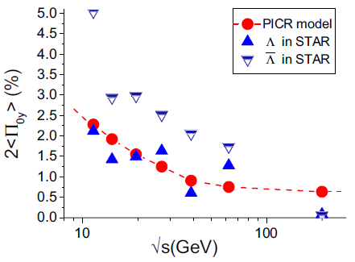
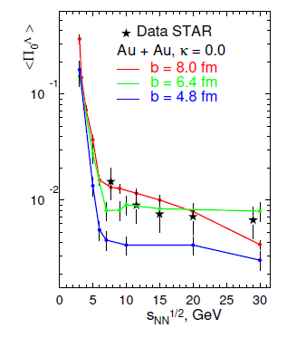
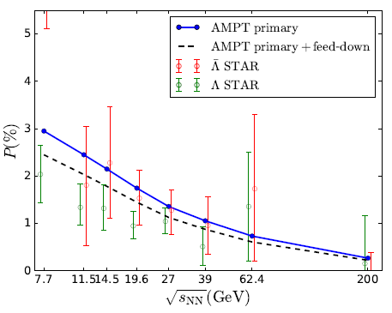
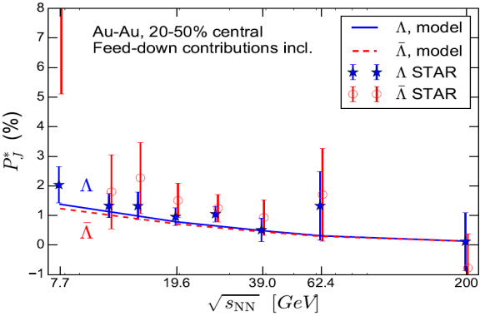
Results: Energy dependence
QGSM+Axial Vortrical Effect
AMPT+Spin-Vorticity Coupling
M. Baznat, et al., arXiv:1701.00923.
H. Li, X.N. Wang et al., PRC 96,054908 (2017).
Fig. 12 The global polarization, 2<Πoy>p , in our PICR model (red circle) and STAR BES experiments (green triangle), at energies √s of 11.5, 14.5, 19.6, 27.0, 39.0, 62.4, and 200 GeV.
The polarization magnitude and the tendency of our results are very similar with the results from RHIC’s Beam Energy Scan program.
UrQMD-vHLLE hybrid Model
The polarization decreases with increasing collision energy. What is the reason?
I. Karpenko, F. Becattini, et al., Eur. Phys. J. C 77, 213 (2017).

Slide 16
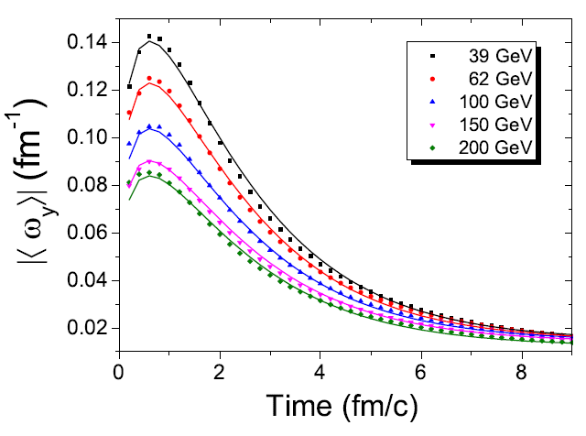
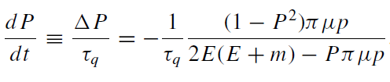
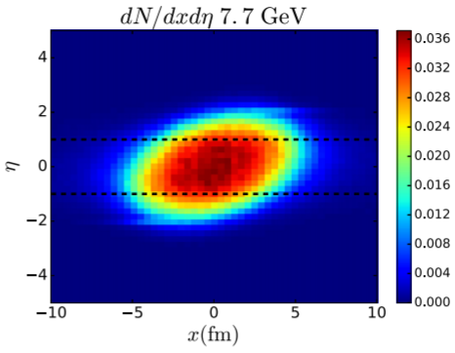
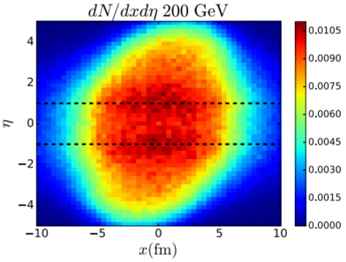
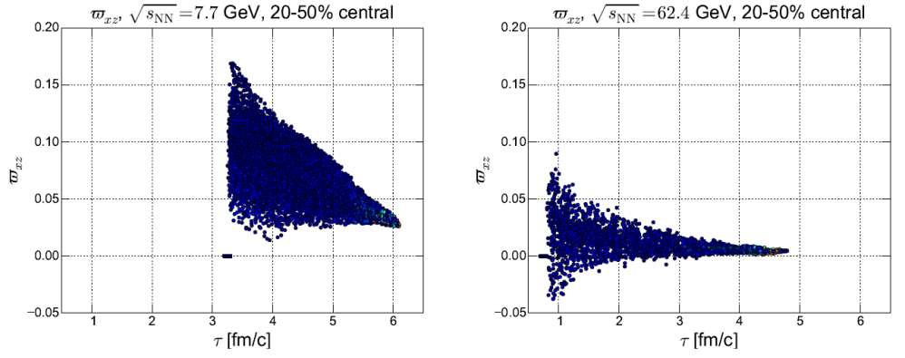



Results: Energy dependence
Interpretations of the energy dependence behavior:
Drastic thermal motion of particles in
higher temperature/energy.
3. Initial State: tilted more for low energy, Larger ${\overline{ω}}_{xz}$
2. The vorticity decreases with the increased energy
4. Freeze out: Longer hydro evolution time for larger $√s$
Mean Free Path $∝$ Temperature
[ P. Huovinen, X.N. Wang et al., PRC 84,054910 (2011). ]
AMPT simulation for 39-200 GeV (b=7fm)
[Y. Jiang, et al., Phys. Rev. C 94, 044901 (2016).]
[ H. Li, L.G. Pang, et al., Phys. Rev. C 96, 054908 ]
[ I. Karpenko, F. Becattini, et al., Eur. Phys. J. C 77, 213 (2017). ]

Slide 17
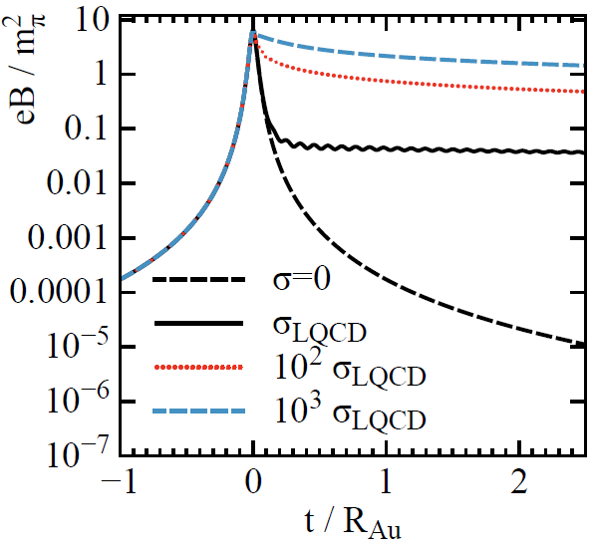
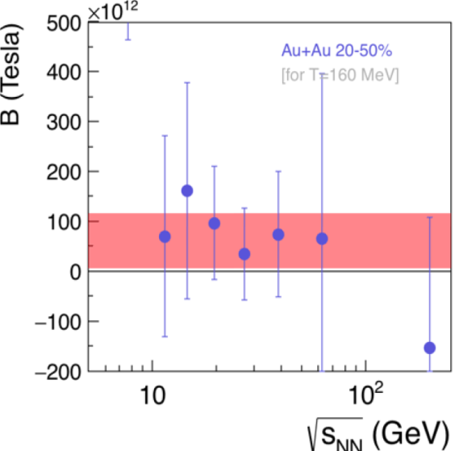
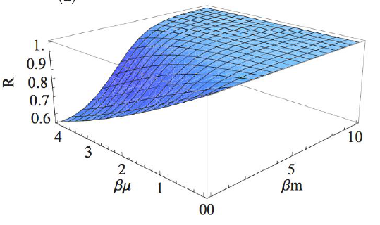



Outlook
Why is the Λ polarization larger than anti-Λ’s polarization, in RHIC BES program?
1. Polarization induced by magnetic field might split the vorticity induced polarization?
2. Effect of baryon chemical potential : accounts for only 1%
3. Axial Anomaly Charge: The same for Λs and anti-Λs. But $N_{Λ}>N_{\overline{Λ}}$
m_{π}²/e ≈10¹⁴T
[ L. McLerran, V. Skokov, Nucl.Phys. A929 (2014) 184-190 ]
[ M.A. Lisa, invited talk in Zimany School, Amesterdam 2017 ]
$$n_{F}\left(x,p\right)=\frac{1}{e^{β(p^{μ}u_{μ}∓μ)}+1}$$
R.H. Fang, et al., PRC 94 (2016) 024904;
M.A. Lisa, invited talk in WPCF, Budapest 2017
A. Sorin, O. Teryaev, PRC 94 011902(R) (2017)

Slide 18


Outlook
What is the relation between the final hyperon polarization and the quark’s Chiral Vortical Effect (CVE)? Can we predicate the other one when we know one of them?
What is the full relativistic fluid dynamics for particle system with spin?
In Becattini’s deduction of polarization 4-vector, he used mainly the spin
thermodynamics, but also a little fluid dynamics. Then what is the full spin
hydrodynamics. Nice attempt:
A. Sorin, O. Teryaev, PRC 94 011902(R) (2017)
[ X.N. Wang, et al., PRL 109, 232301 (2012) ]
[ W. Florkowski, et al., arxive:1705.00587. ]

Slide 19

4 Summary
The y component of polarization dominates the global polarization.
The polarization in our model linearly depends on impact parameter, which clearly shows the polarization arises from initial angular momentum.
The polarization decreases very fast with increased energies, and this can be attributed to drastic thermal motion of particles in higher temperature/energy. Or other effects.
We hope the future RHIC BES II program can provide a higher centrality resolution, to determine precisely the centrality dependence of polarization

Slide 20


Slide 21

Results: Time evolution
Fig. 13 The time evolution of global polarization for energy √s = 11.5, 27, and 62.4 GeV.
At earlier time(0-5 fm/c), the polarization is increasing. However, it is not possible to have Λ at this time.
From time 5 fm/c, the polarization is decreasing with the time. After 10 fm/c, the polarization even goes to negative value, which shows the limitation of hydro model in the later stage of collisions, due to the large surface to volume ratio
AMPT simulation for 39-200 GeV (b=7fm)
[Y. Jiang, et al., Phys. Rev. C 94, 044901 (2016).]

Slide 22




New Initial State
Nowadays, particle physicists are more and more concerning the initial state, because the final state is very sensitive to the initial state configuration.
Aim: Compact Initial State with Shear
Main Features: Steak by Steak collisions, Bjorken expansion, Matching, Propagation(mapping)
[ VK Magas, LP Csernai, et al., NPA 712 (2002) 167–204 ]
[L.G. Pang, X.N. Wang, et al., Nucl. Phys. A 956, 272 (2016).]

Slide 23



New Initial State

Slide 24


Configuration
Fig. 1. Sketch of peripheral heavy ion collisions at high energy. The Λ polarization points essentially into the direction of the total angular momentum (-y) of the interaction region, it is orthogonal to the reaction plane.
Fig.2 Due to the azimuthal symmetry the rotation is in the reaction plane. The radial component of momentum is chosen to be p_{x} only.
Fig.3 The Shear in transvers plane, and the collective flow viewed in different directions.

Slide 25
Equation of State
Both in the initial state and subsequent CFD simulation, the frequently used bag model equation of state (EoS) was applied: P = c₀² e² − (4/3)B, with constant c₀² = 1/3 and a fixed bag constant B.
The energy density takes the form e = αT 4 + βT 2 + γ + B, where α, β, γ are constants arising from the degeneracy factors for (anti)quarks and gluons.

Slide 26


3 Results: Polarization at NICA
Department of Physics and Technology, University of Bergen
Fig. 9 The y component (left) and the modulus (right) of the polarization for momentum vectors in the transverse plane at pz = 0, for the NICA Au+Au reaction at 9.3 GeV. The figure is in the Λ’s rest frame.
Similarity between y component and modulus of Polarization, in magnitude and structure.
Similarity between NICA and FAIR’s polarization results.
The net polarization is still negative, which means the first term is larger than the second term, at this time.

