Slide 1
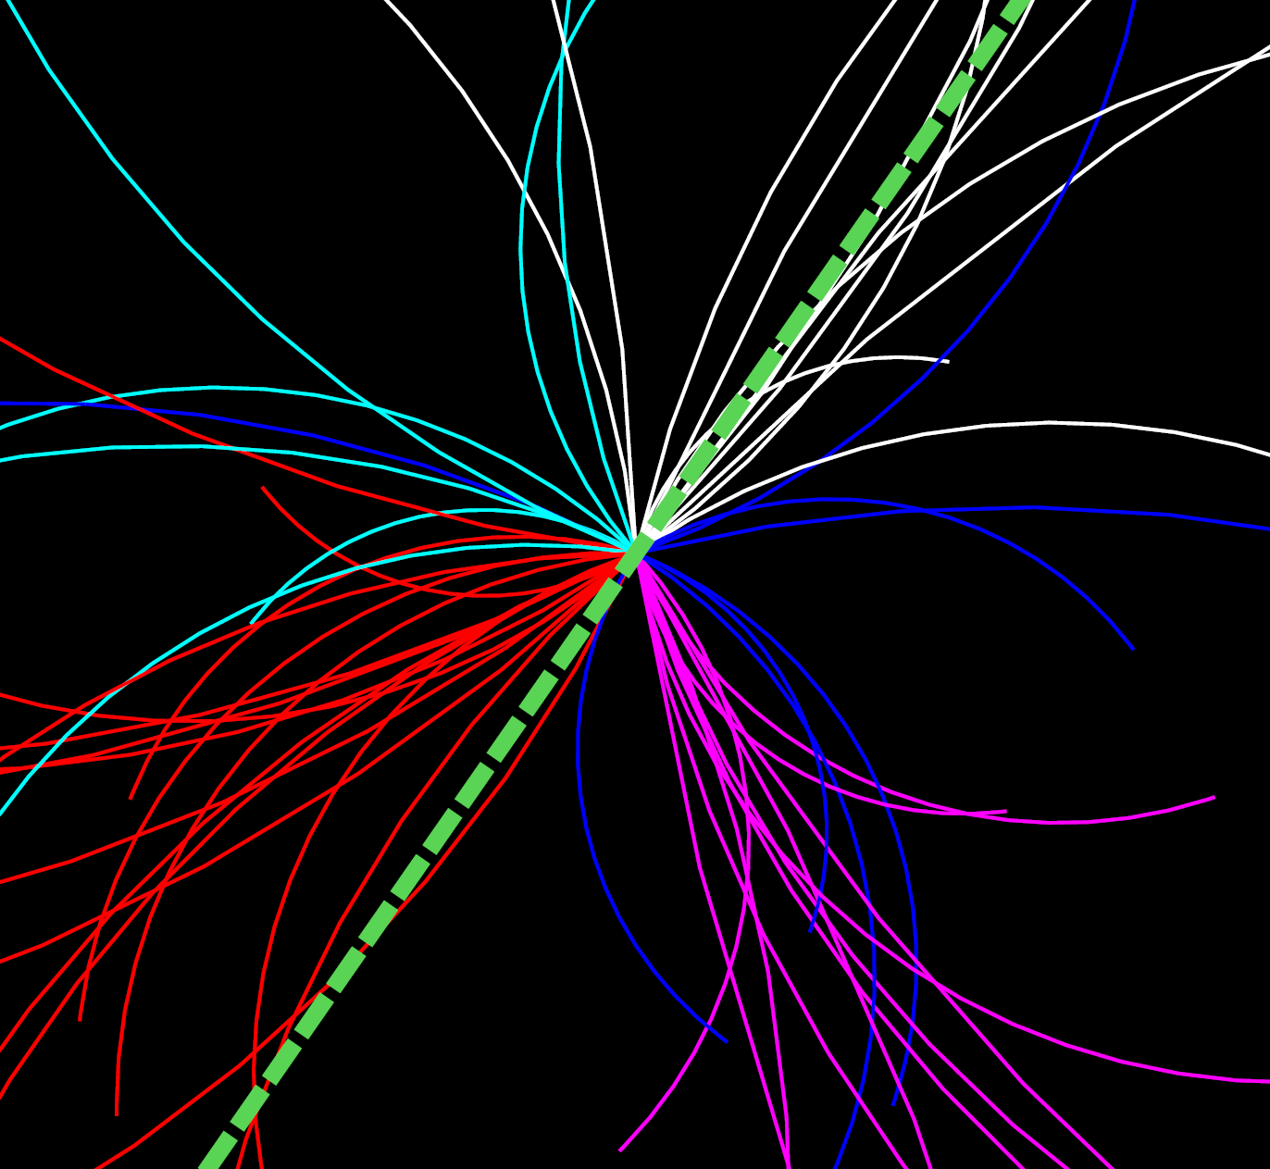



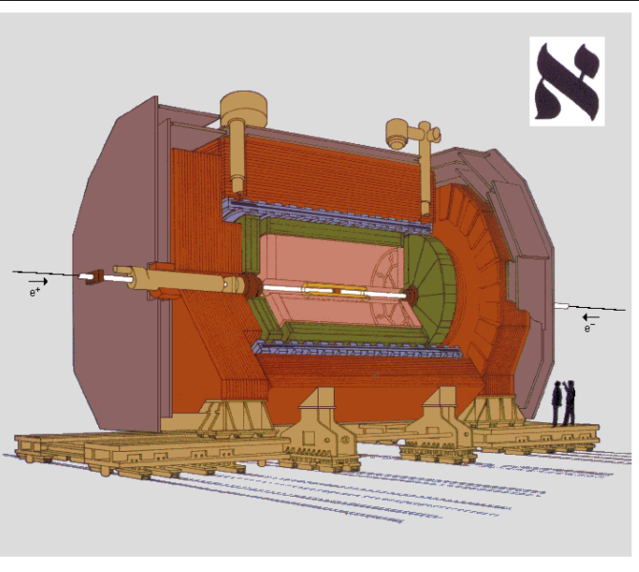
Two-Particle Correlation in e⁺e⁻ Collisions
at 91.2 GeV with ALEPH Archived Data
Anthony Badea, Austin Baty, Gian Michele Innocenti, Yen-Jie Lee,
Christopher McGinn, Michael Peters, Jesse Thaler
Massachusetts Institute of Technology
Paoti Chang, Tzu-An Sheng
National Taiwan University
Marcello Maggi
Universita degli Studi di Bari
Quark Matter 2018, Venezia, Italy
13-19 May, 2018

Slide 2
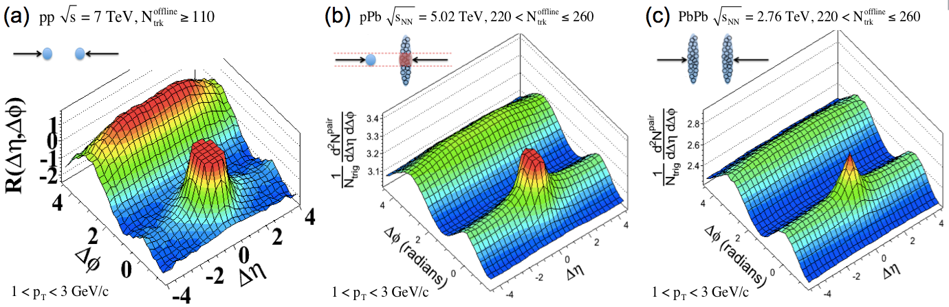
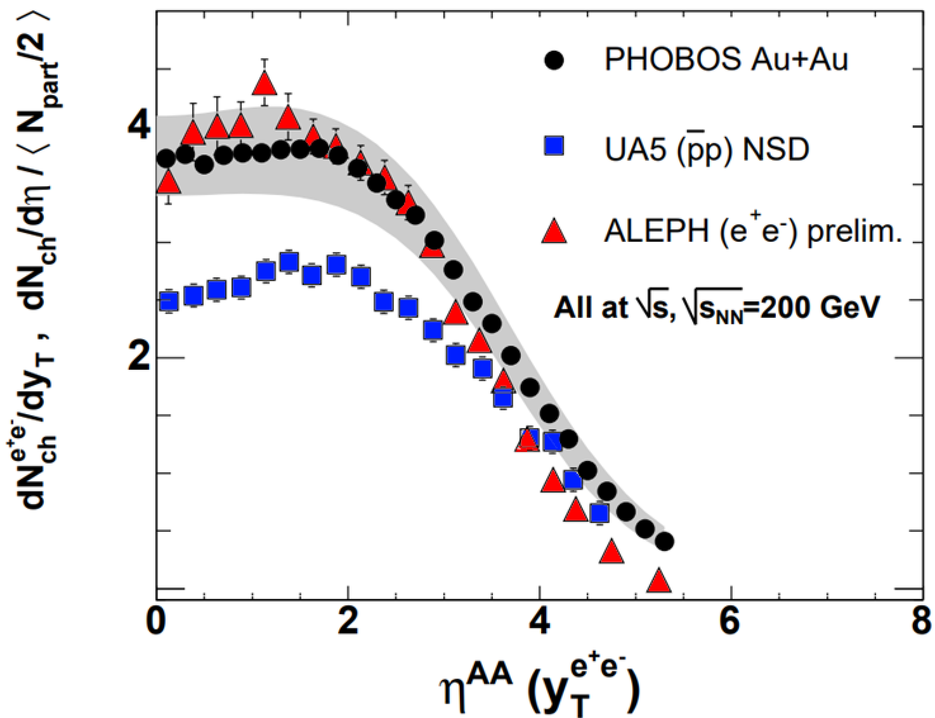
Motivation
e⁺e⁻
pp
pPb
PbPb
?
Charged Hadron dN/dη
e⁺e⁻
Ridge observed in small systems, possible explanations:
  Initial state effect (CGC)
  Final state effect due to mini-QGP
  …
Similarity between e⁺e⁻, pp and AA
  Event multiplicity per participant
  dN/dη(y)
Study of high multiplicity event with well-defined initial condition:
  No complication from hadron structure
  No multi-parton interaction
pp
AuAu
Notes:
Total multiplicity
Many similarity between ee and pp and AA
Fundamental rifference is the initial
PHOBOS and energy dependence

Slide 3
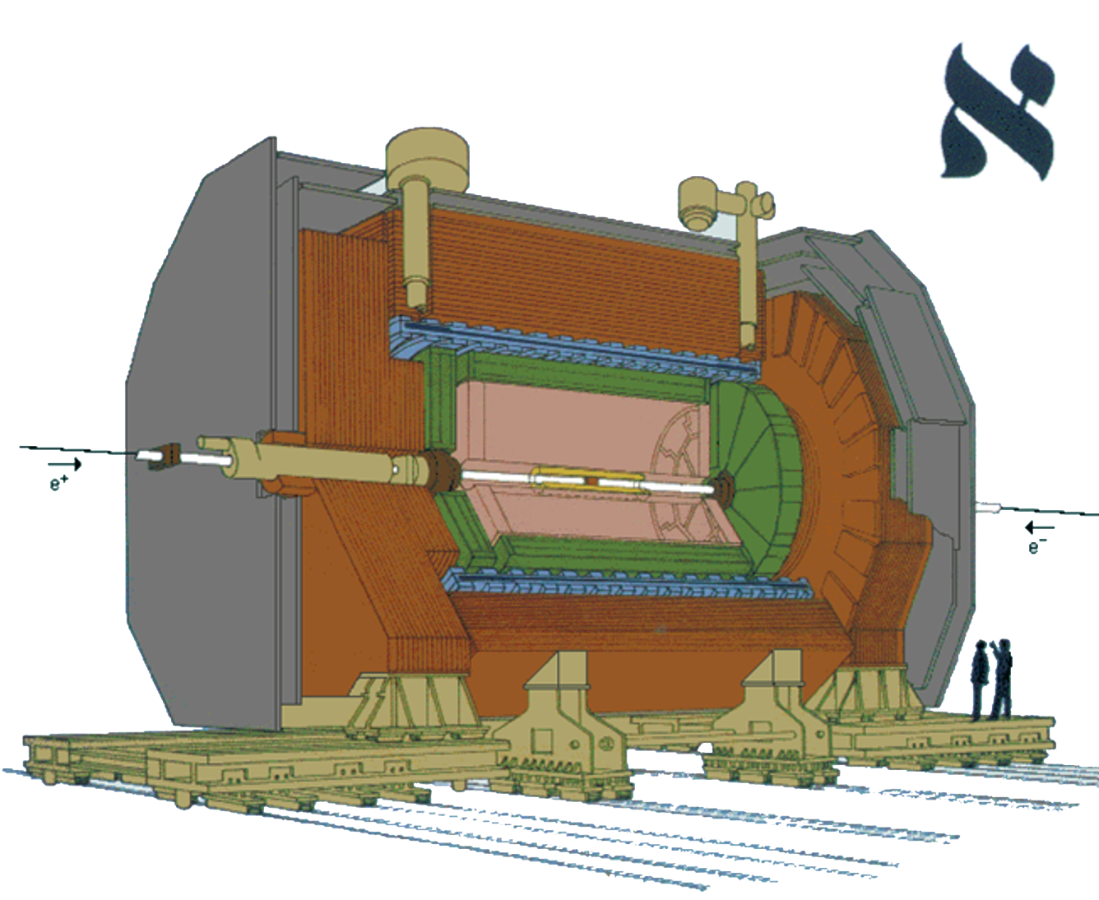
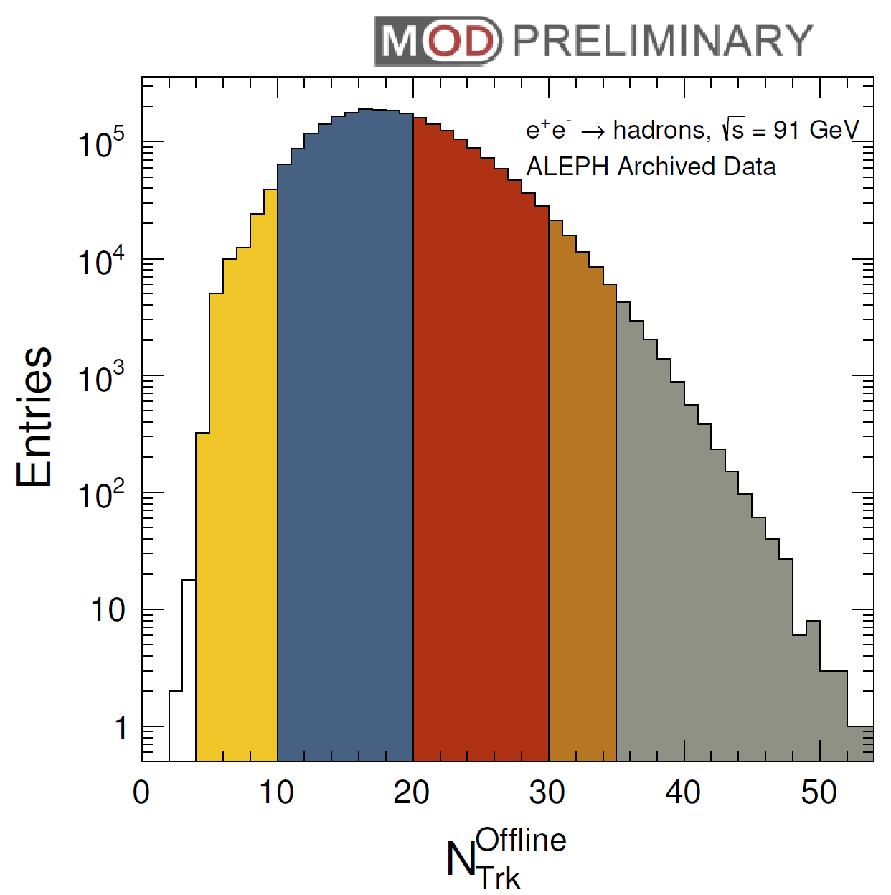
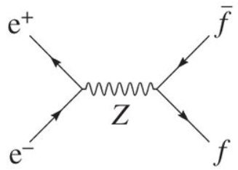
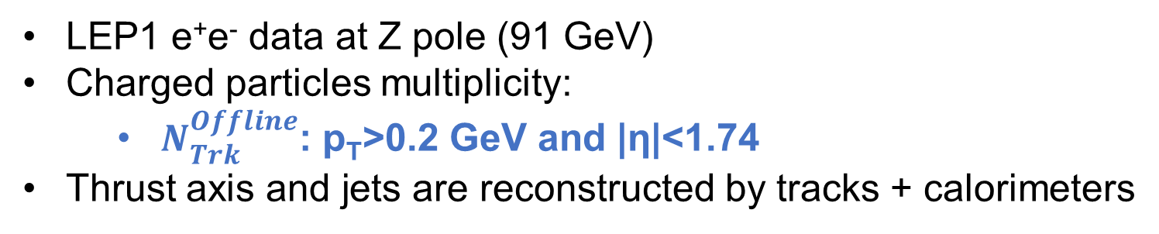
The ALEPH Detector
Hadron Calorimeter
Charged Particle Multiplicity
Superconducting
Magnet (1.5T)
Electromagnetic
Calorimeter
Muon Chamber
>30
10-20
Time Projection
Chamber
<10
20-30
>35
Inner Tracking Chamber
LEP1 e⁺e⁻ data at Z pole (91 GeV)
Charged particles multiplicity:
  $N_{Trk}^{Offline}$: p_{T}>0.2 GeV and |η|<1.74
Thrust axis and jets are reconstructed by tracks + calorimeters

Slide 4
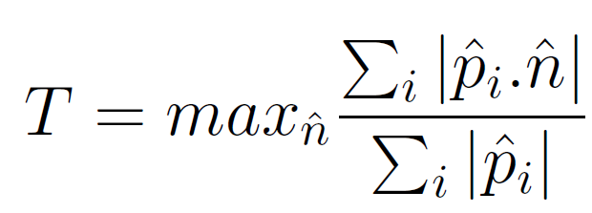
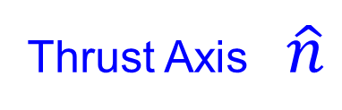
Event Shape: Thrust
Thrust Axis $\hat{n}$
e⁺
e⁻

Slide 5
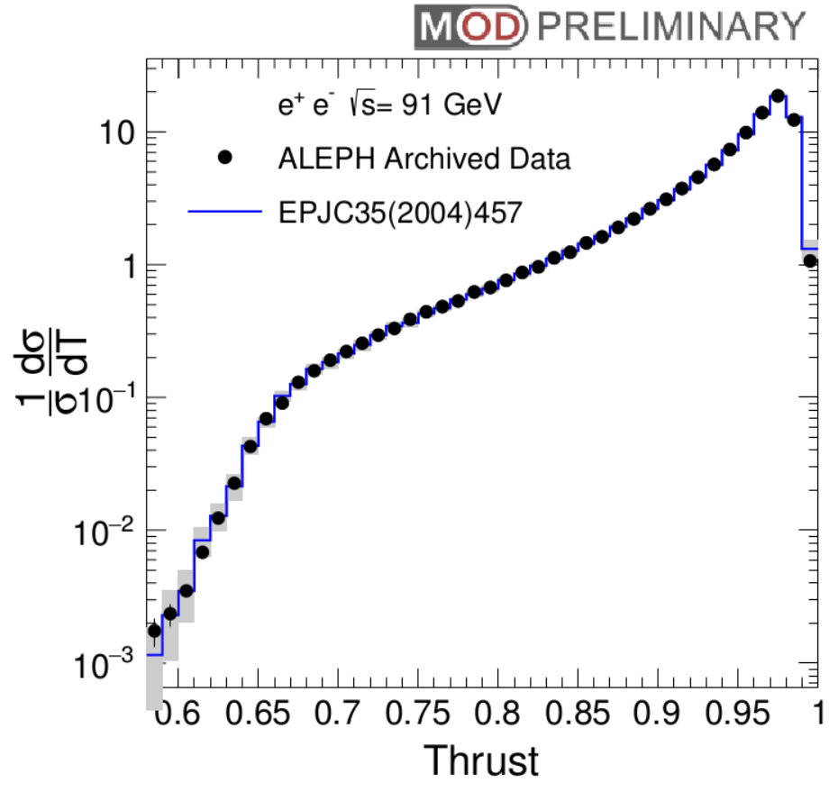
Unfolded Thrust Distribution
Pencil-like: T~1
Thrust (T)
Spherical: T~0.5
Typical e⁺e⁻ annihilation events are more pencil-like

Slide 6
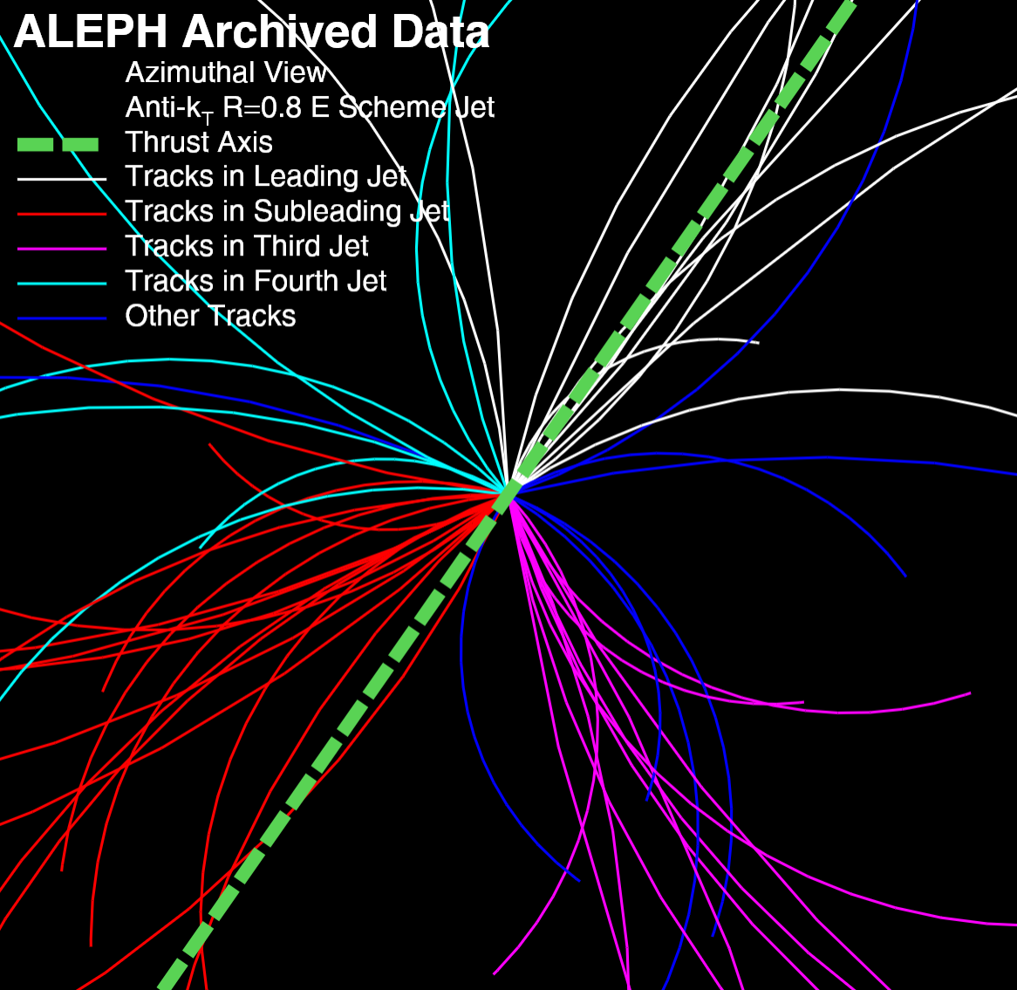
High Multiplicity Event in e⁺e⁻ Collisions (1)
Highest multiplicity event in
ALEPH LEP1 data
55 Tracks
T=0.71

Slide 7
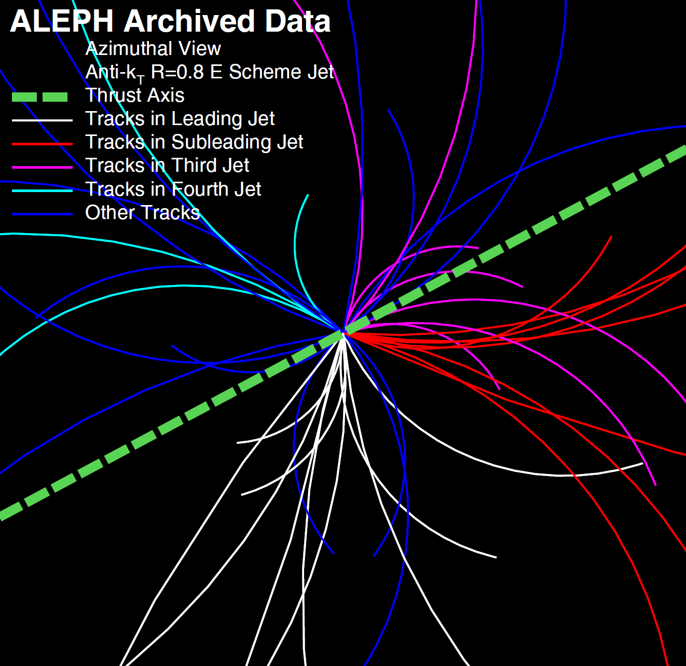
High Multiplicity Event in e⁺e⁻ Collisions (2)
44 Tracks
T=0.57

Slide 8
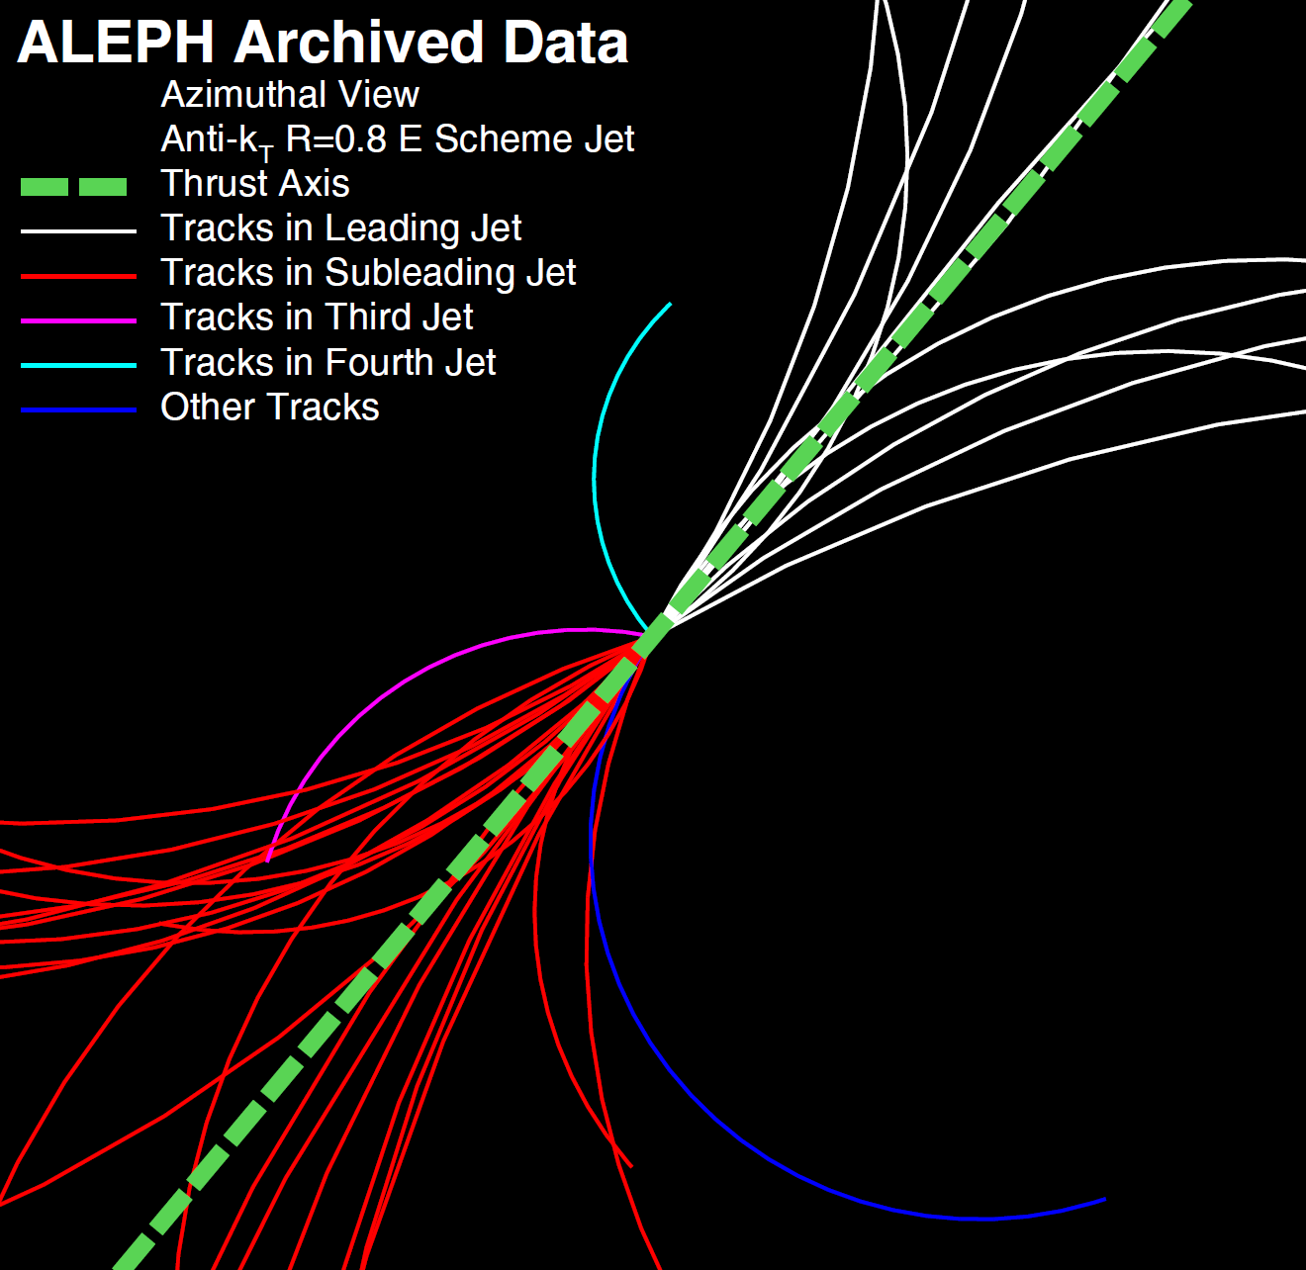
High Multiplicity Event in e⁺e⁻ Collisions (3)
39 Tracks
T=0.98

Slide 9
Beam Axis Analysis
Soft radiation
e⁺
e⁻
Identical measurement as performed in pp, pA and AA collisions in various experiments

Slide 10
Beam Axis Analysis
η
Φ
e⁺
e⁻
Pseuodorapidity (η) and azimuthal angle (Φ) are calculated with respect to the beam pipe

Slide 11
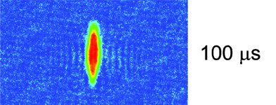
Beam Axis Analysis
Φ₂
Δη=η₁-η₂
Φ₁
e⁺
e⁻
Search for ridge signal with beam axis: enhance number of charged particle pairs with large Δη gap and similar Φ (small ΔΦ=Φ₁-Φ₂)
Ex: Sensitive to “pressure driven expansion” of the medium in the direction perpendicular to the beam axis

Slide 12
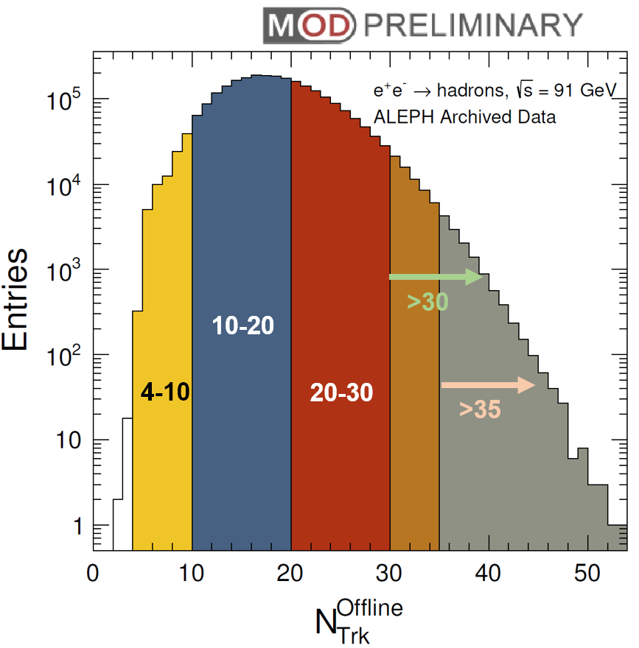
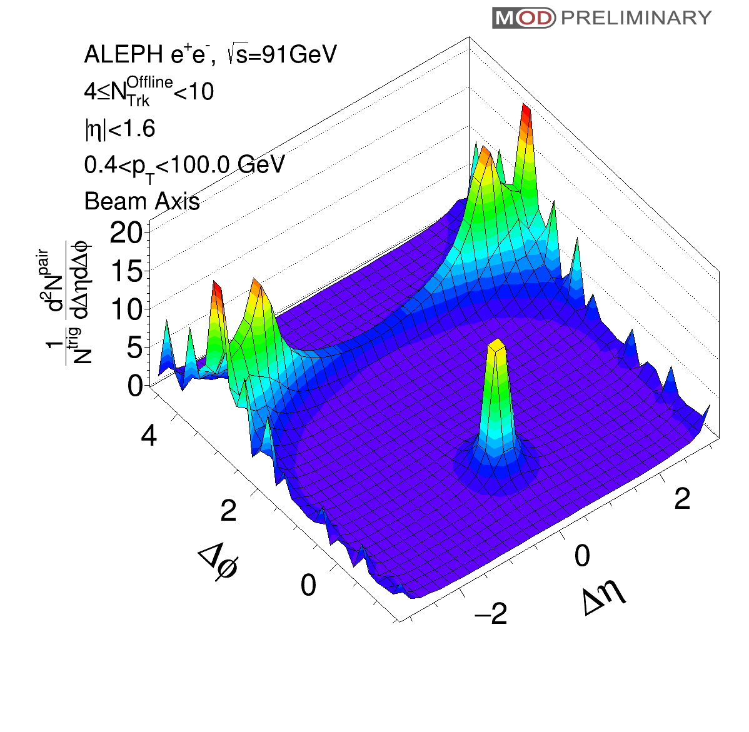
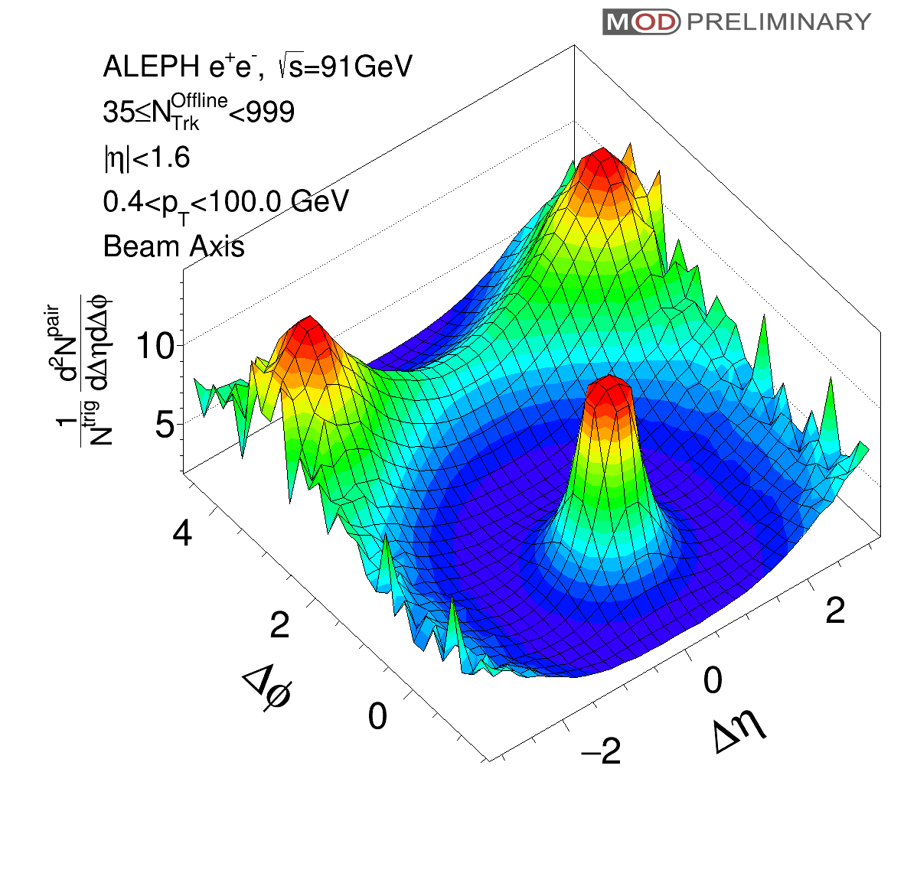
Beam Axis Analysis Result
Low multiplicity
4≤N<10
High Multiplicity
N≥35

Slide 13
Beam Axis Analysis Result
Low multiplicity
4≤N<10
High Multiplicity
N≥35
Beautiful jet-like structure at (Δη,ΔΦ) ~ (0,0)

Slide 14
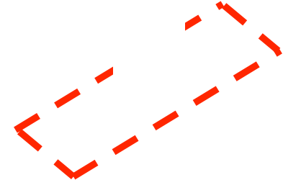
Beam Axis Analysis Result
Low multiplicity
4≤N<10
High Multiplicity
N≥35
Beautiful jet-like structure at (Δη,ΔΦ) ~ (0,0)
No ridge structure observed at small ΔΦ and large Δη

Slide 15
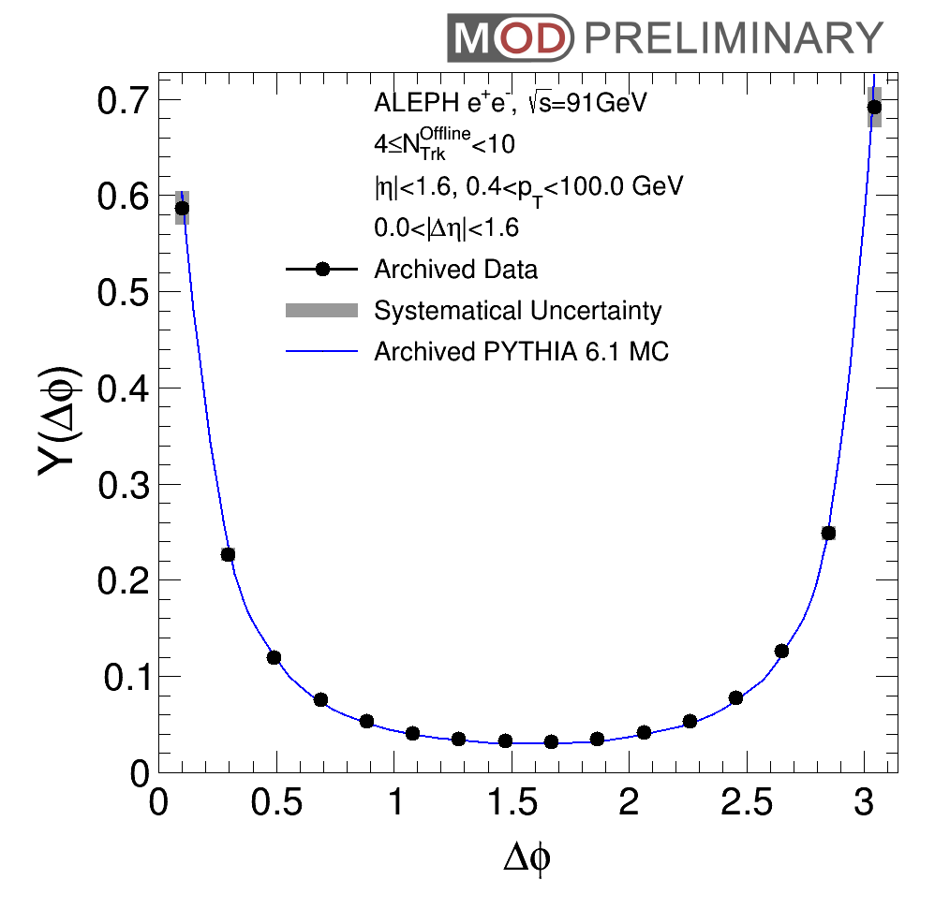
Beam Axis Analysis Result
Low multiplicity
4≤N<10
PYTHIA6 vs. Data
|Δη|<1.6 (Jet Region)
Projection
Excellent agreement between PYTHIA6 and Data

Slide 16
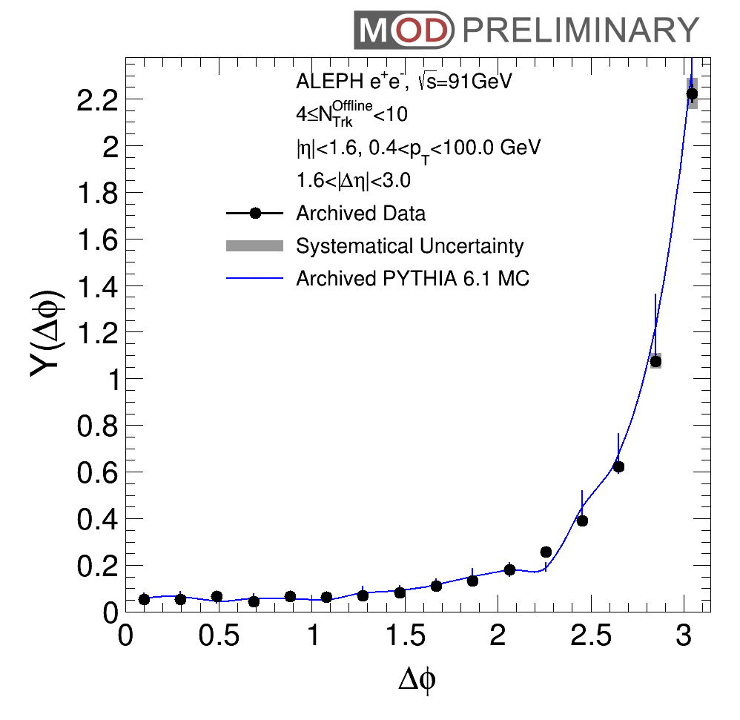
Beam Axis Analysis Result
Low multiplicity
4≤N<10
PYTHIA6 (curve)
Data (dots)
|Δη|<1.6
(Jet Region)
Projection
Projection
1.6<|Δη|<3.0
(Long range)
Excellent agreement between PYTHIA6 and Data

Slide 17
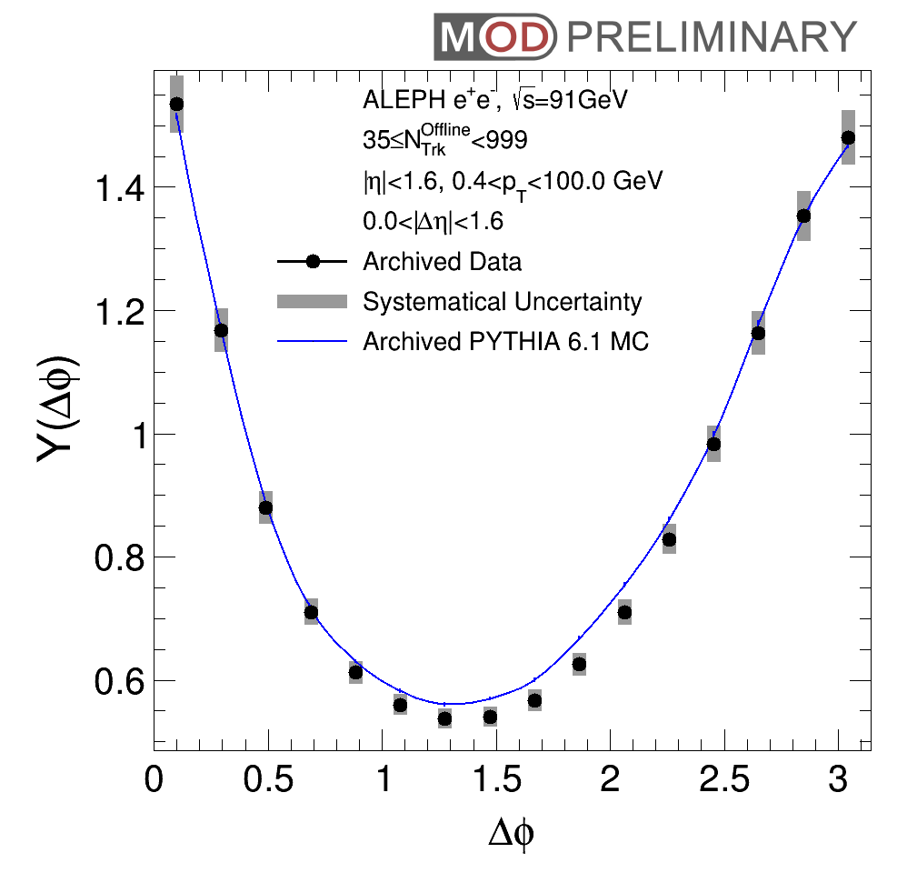
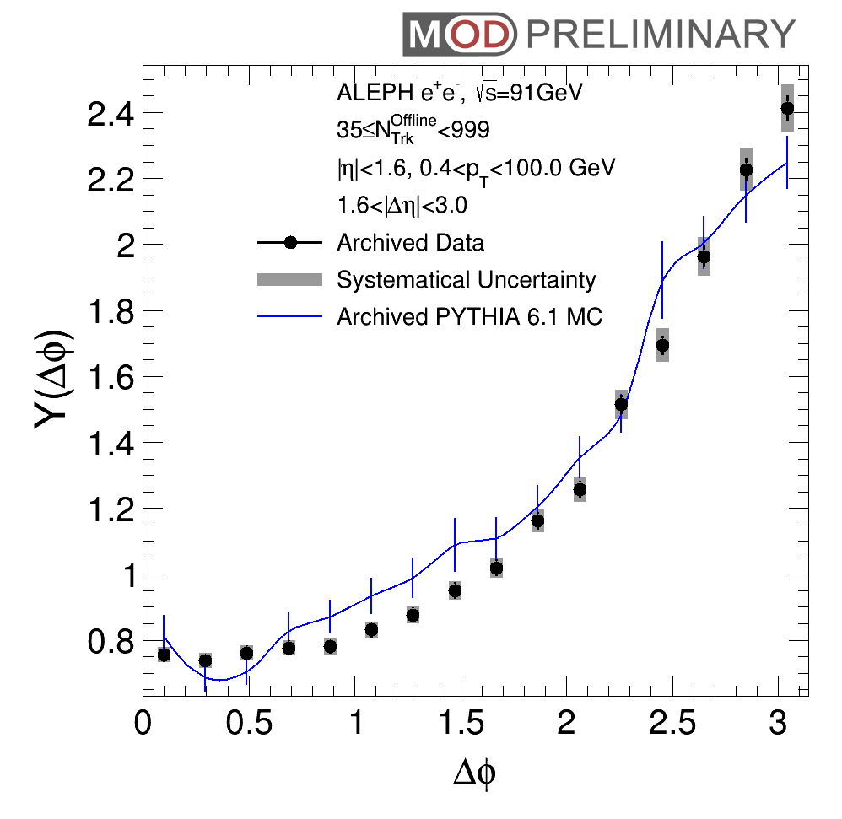
Beam Axis Analysis Result
High multiplicity
N>35
PYTHIA6 (curve)
Data (dots)
|Δη|<1.6
(Jet Region)
Projection
Projection
1.6<|Δη|<3.0
(Long range)
Good agreement between PYTHIA6 and Data
No near-side ridge observed

Slide 18
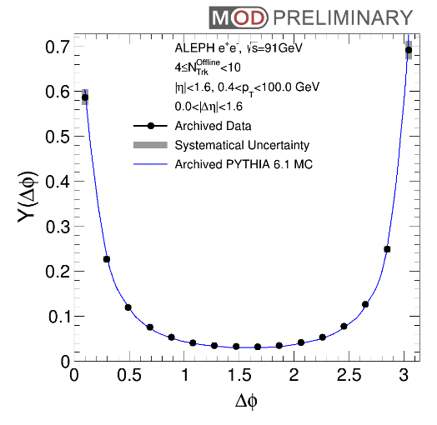
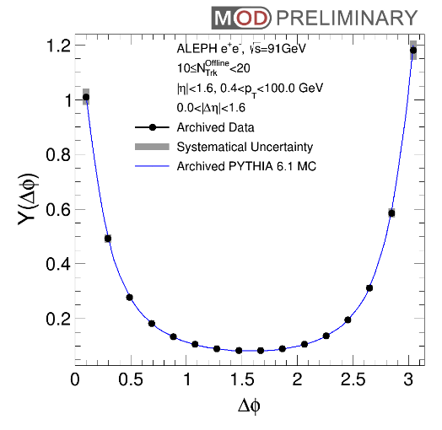
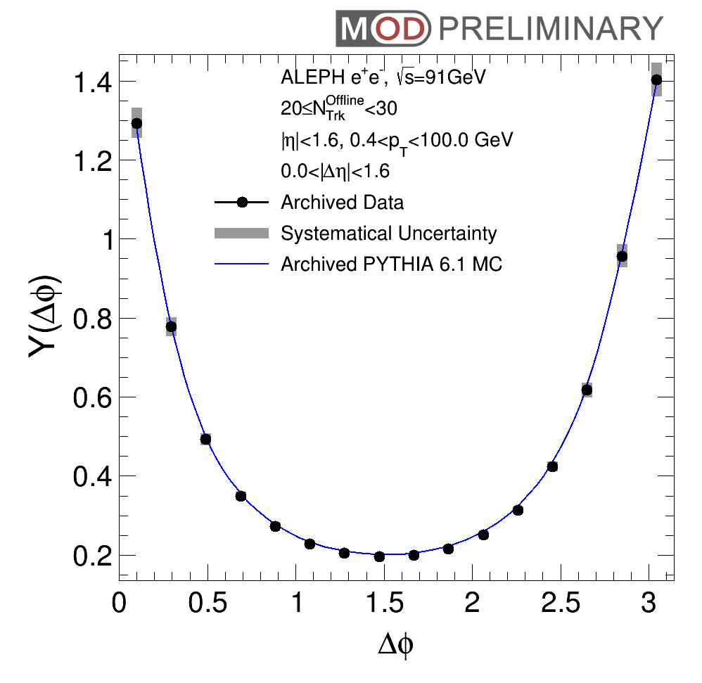
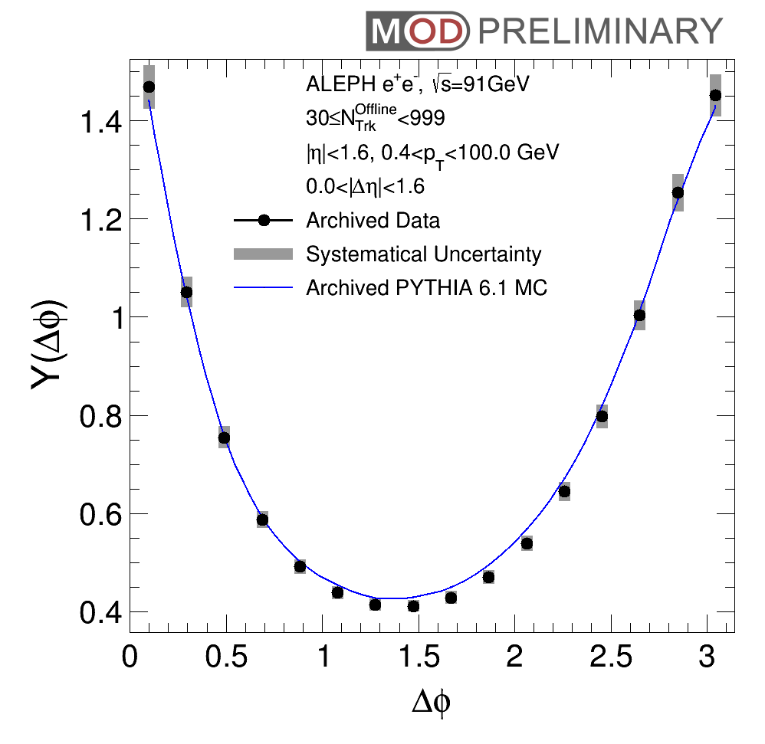
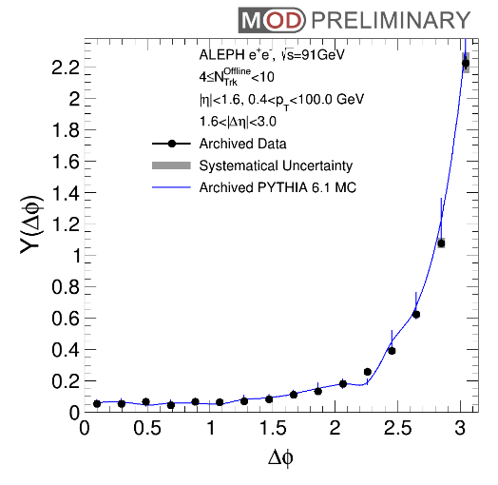
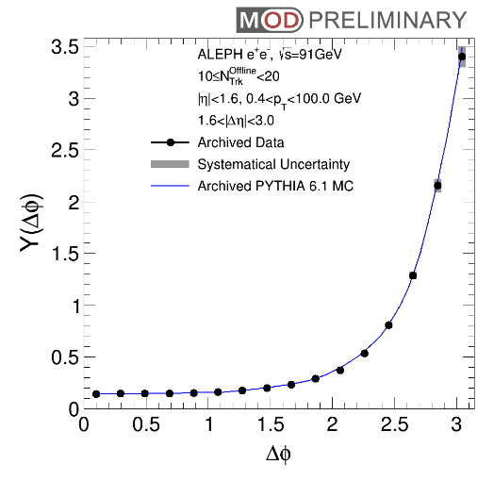
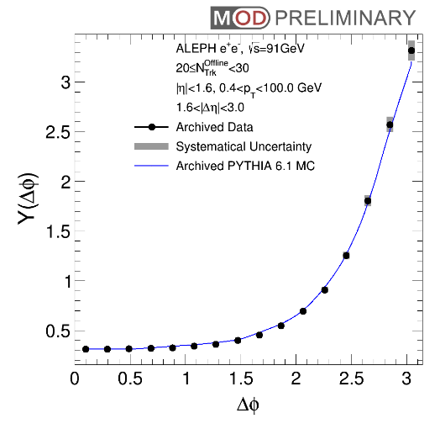
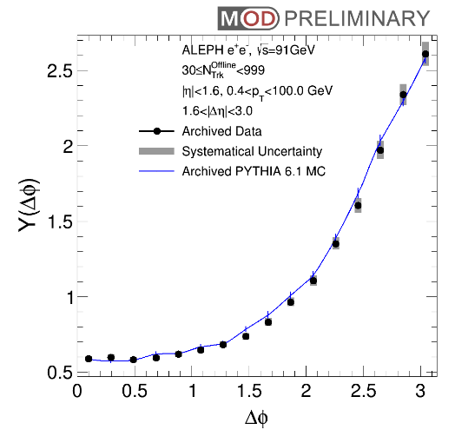
ΔΦ Projection vs. Event Multiplicity
4≤N<10
10≤N<20
20≤N<30
N≥30
N≥35
|Δη|<1.6
(Jet Region)
1.6<|Δη|<3.0
(Long range)
PYTHIA6 (curve) vs. Data (dot) [Beam axis analysis]
Good agreement between PYTHIA6 and ALEPH Data for N<30
  No near-side peak (ridge) is found at small ΔΦ in long range correlation
Some difference observed at high multiplicity N ≥35

Slide 19
Beam Axis Analysis
e⁺
e⁻
No ridge signal is found in beam axis analysis, which is sensitive to perturbative physics
(+ parton shower)

Slide 20
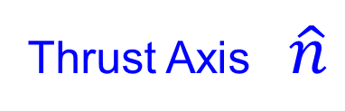
Thrust Axis Analysis
Thrust Axis $\hat{n}$
e⁺
e⁻
Thrust axis analysis to follow the “direction of color string”

Slide 21
Thrust Axis Analysis
Thrust Axis $\hat{n}$
Φ
η
e⁺
e⁻
Thrust axis analysis to follow the “direction of color string”
Pseuodorapidity (η) and azimuthal angle (Φ) are calculated with respect to the Thrust Axis

Slide 22
Thrust Axis Analysis
Φ₁
Thrust Axis $\hat{n}$
Δη=η₁-η₂
e⁺
e⁻
Φ₂
Search for ridge signal with thrust axis: enhance number of charged particle pairs with large Δη gap and similar Φ (small ΔΦ=Φ₁-Φ₂)
Thrust axis analysis to follow the “direction of color string”
Pseuodorapidity (η) and azimuthal angle (Φ) are calculated with respect to the Thrust Axis

Slide 23
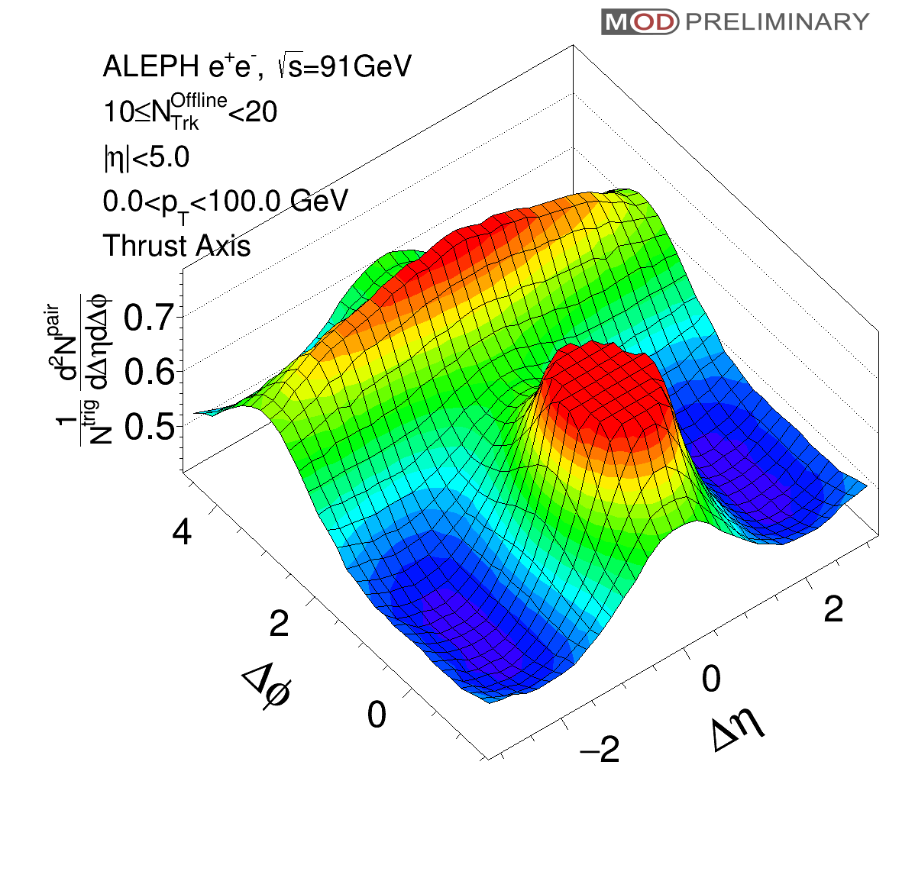
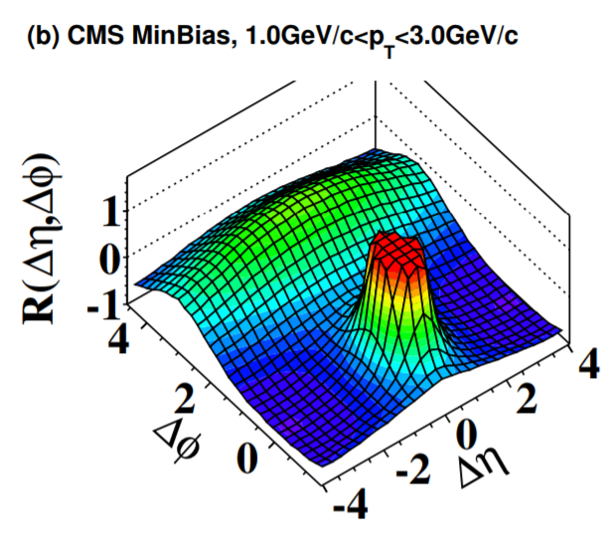
Correlation Function with Thrust Axis
ALEPH e⁺e⁻
10≤N<20 Thrust axis
CMS pp
Inclusive Beam axis
Correlation function with Thrust Axis as reference become much more similar to the beam axis result in pp collisions (with many caveats / differences)

Slide 24
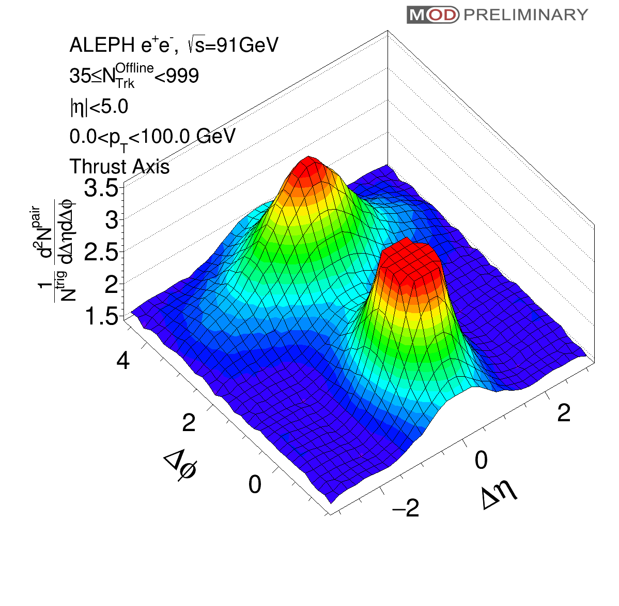
Correlation Function with Thrust Axis
ALEPH e⁺e⁻
10≤N<20 Thrust axis
ALEPH e⁺e⁻
N≥35 Thrust axis
Narrower away side peak in high multiplicity events

Slide 25

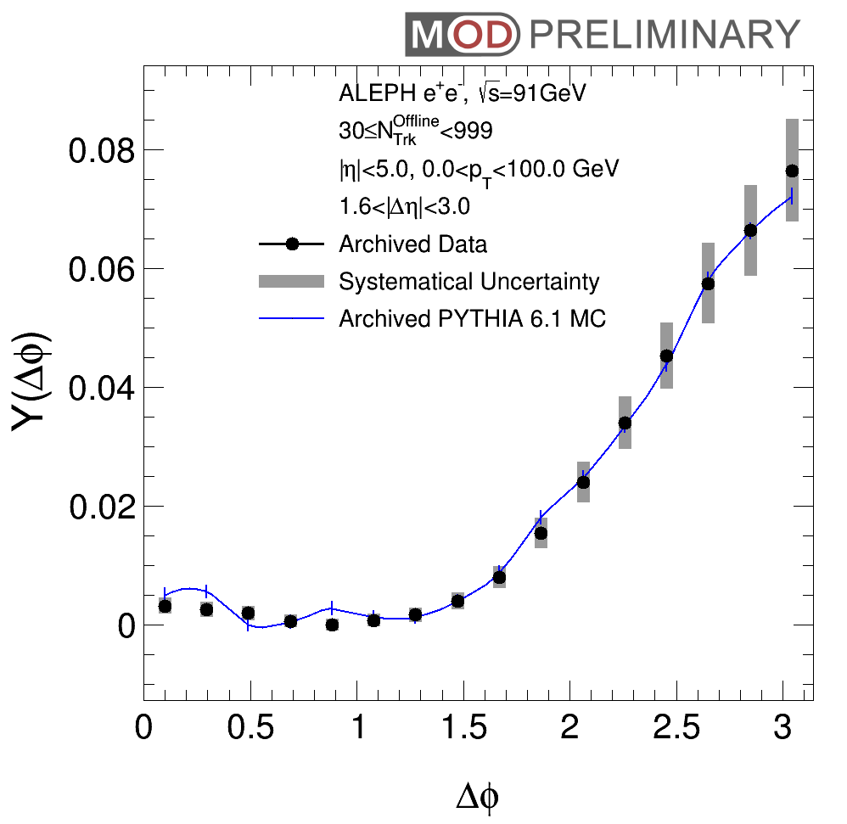
LEP1 Data vs PYTHIA6 N≥30
Projection
1.6<|Δη|<3.0
(Long range)
(ZYAM subtracted)
Hint of near-side peak in data
  Consistent with PYTHIA6 without final state effects
  Contribution from multi-jet correlation
PYTHIA6 reference limited by archive MC statistics

Slide 26
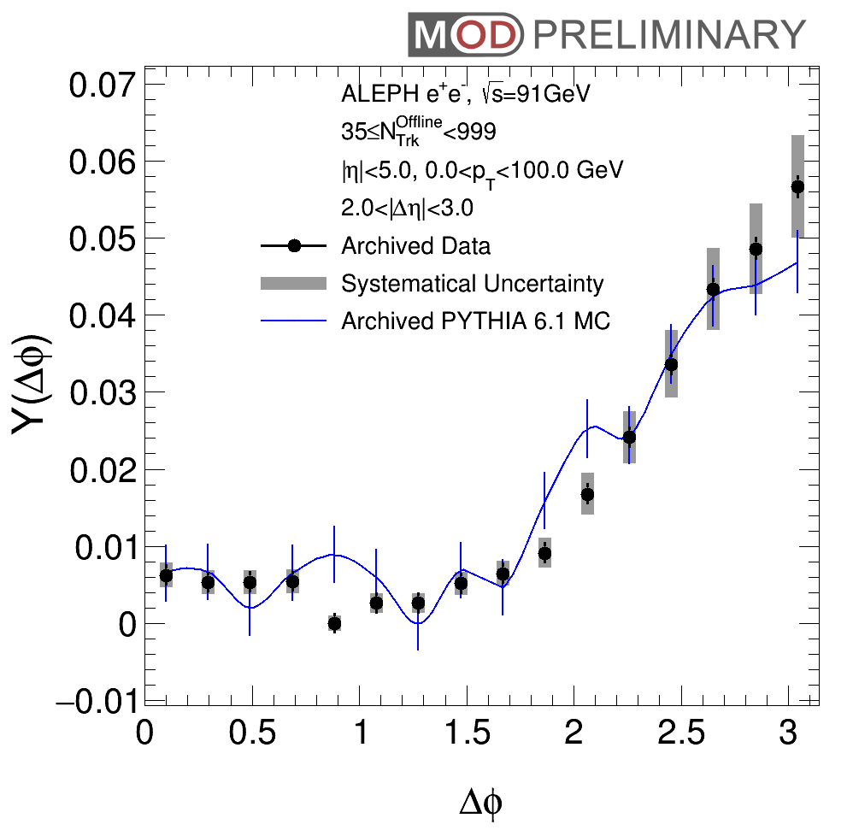
LEP1 Data vs PYTHIA6 N≥35
Projection
1.6<|Δη|<3.0
(Long range)
(ZYAM subtracted)
Hint of near-side peak in data
  Consistent with PYTHIA6 without final state effects
  Contribution from multi-jet correlation
PYTHIA6 reference limited by archive MC statistics

Slide 27
Thrust Axis Analysis
Thrust Axis $\hat{n}$
e⁺
e⁻
“Perturbative QCD physics” still comes in the Thrust axis analysis (Jets)
One possibility to suppress jet component is to apply a |η| selection

Slide 28
Thrust Axis Analysis with “Barrel Particles”
Thrust Axis $\hat{n}$
soft radiation
Jet Veto
e⁺
e⁻
Remove particles at large η
(in the leading and subleading jet) by requiring |η| < 1.6
Enhance the contribution of
soft radiation
“Perturbative QCD physics” still comes in the Thrust axis analysis (Jets)
One possibility to suppress jet component is to apply a |η| selection

Slide 29
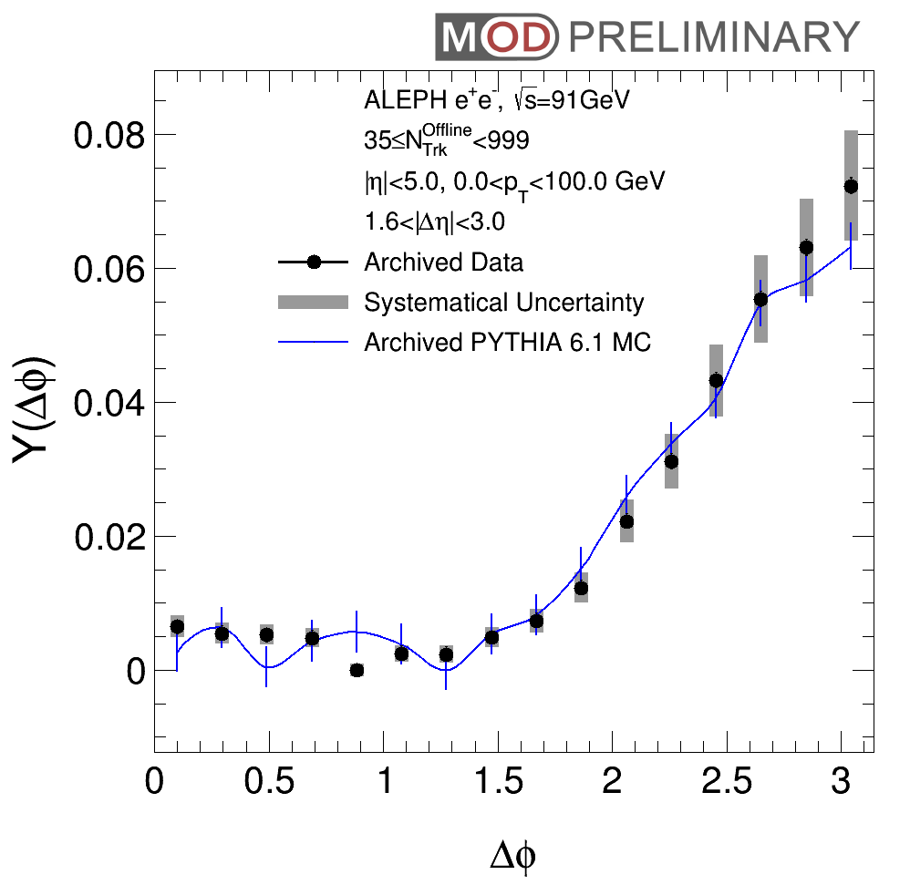
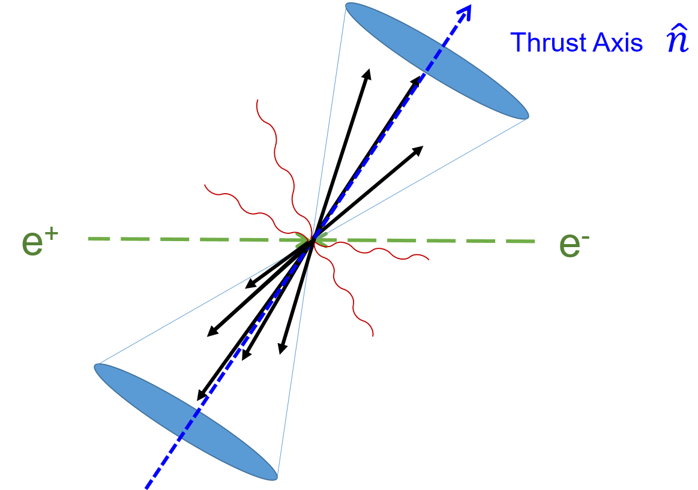
LEP1 Data vs LEP1 MC N≥35
Projection
Hint of near-side peak in data
  Consistent with PYTHIA6 w/o final state effects
  Contribution from multi-jet correlation
PYTHIA6 reference limited by archive MC statistics

Slide 30
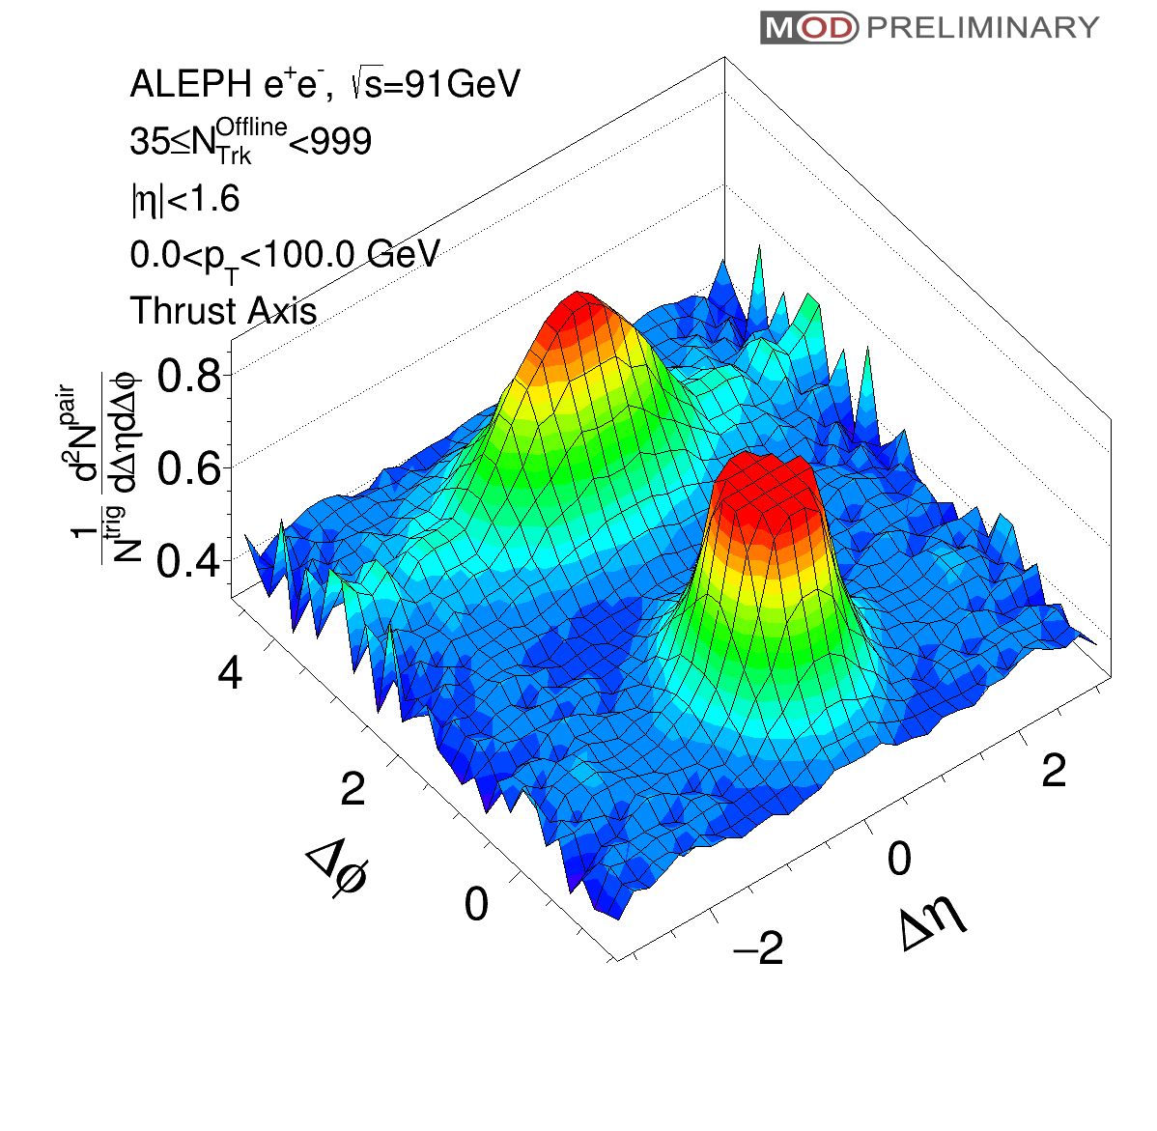
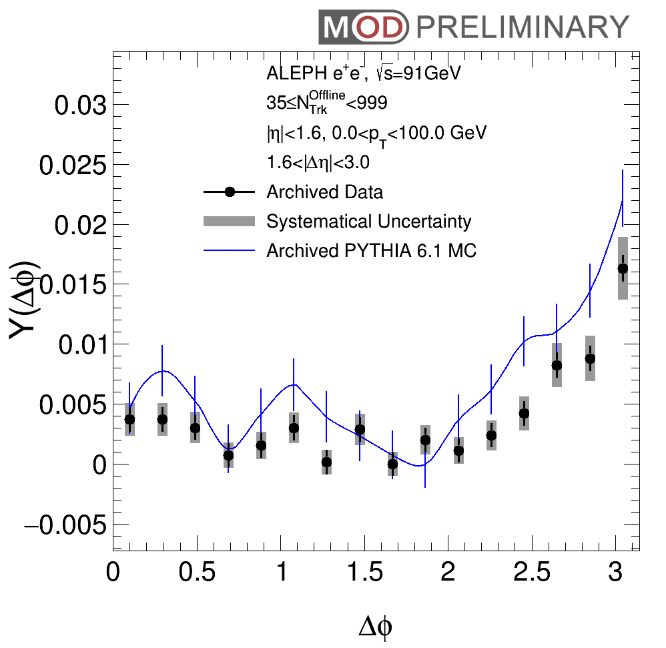
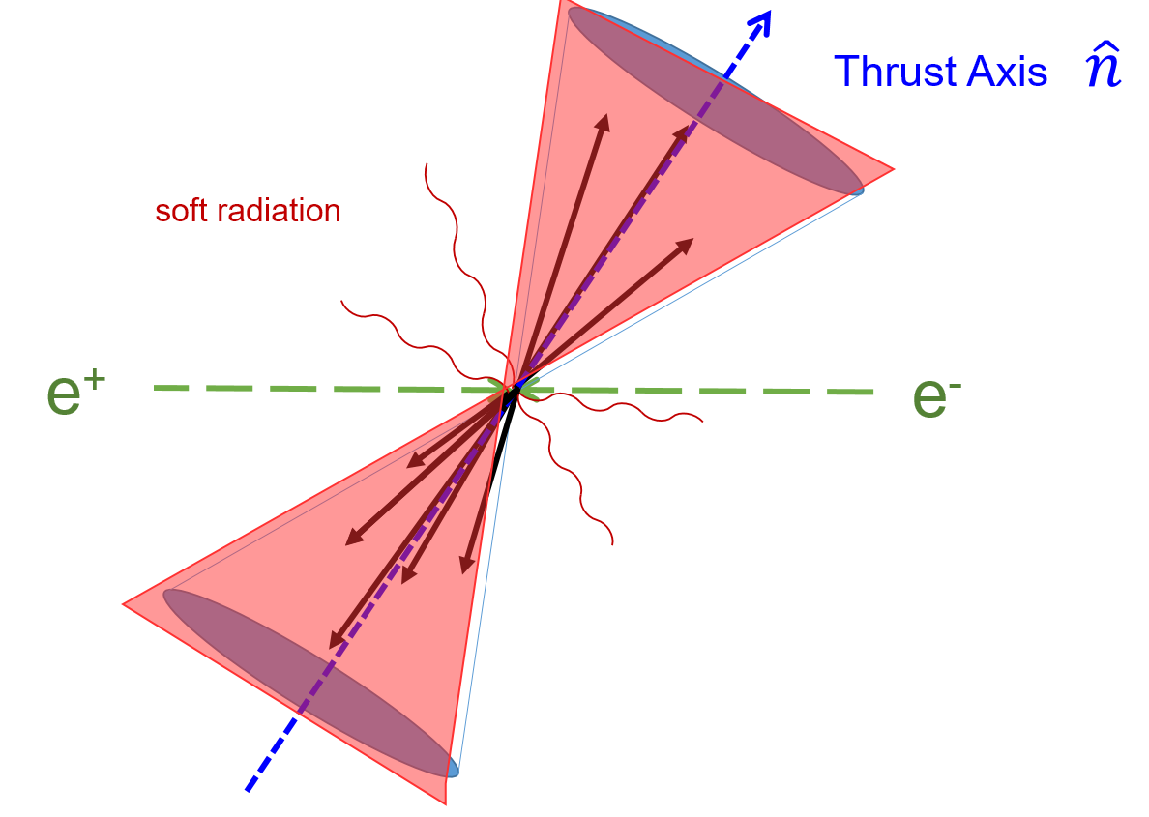
LEP1 Data vs LEP1 MC N≥35
Projection
|η| < 1.6
Hint of near-side peak in data
  Consistent with PYTHIA6 w/o final state effects
  Contribution from multi-jet correlation
PYTHIA6 reference limited by archive MC statistics

Slide 31
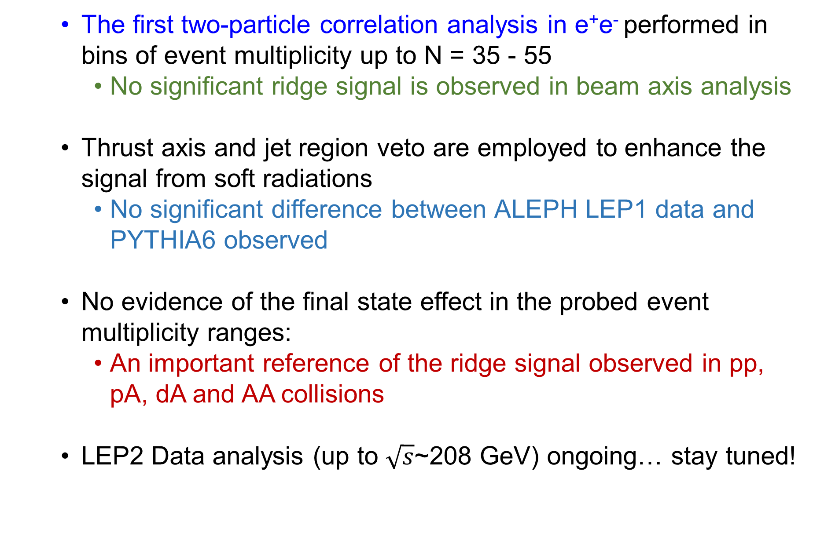
Summary
  The first two-particle correlation analysis in e⁺e⁻ performed in bins of event multiplicity up to N = 35 - 55
    No significant ridge signal is observed in beam axis analysis
  Thrust axis and jet region veto are employed to enhance the signal from soft radiations
    No significant difference between ALEPH LEP1 data and PYTHIA6 observed
  No evidence of the final state effect in the probed event multiplicity ranges:
    An important reference of the ridge signal observed in pp, pA, dA and AA collisions
  LEP2 Data analysis (up to $\sqrt{s}$~208 GeV) ongoing… stay tuned!
Notes:
With the different mentioned in the introduction

Slide 32
Acknowledgement
We would like to thank Roberto Tenchini and Guenther Dissertori from the ALEPH collaboration for the useful comments and suggestions on the use of ALEPH archived data.
We would like to thank Wei Li, Maxime Guilbaud, Wit Busza and Yang-Ting Chen for the useful discussions on the analysis.
The MIT group's work was supported by US DOE-NP

Slide 33
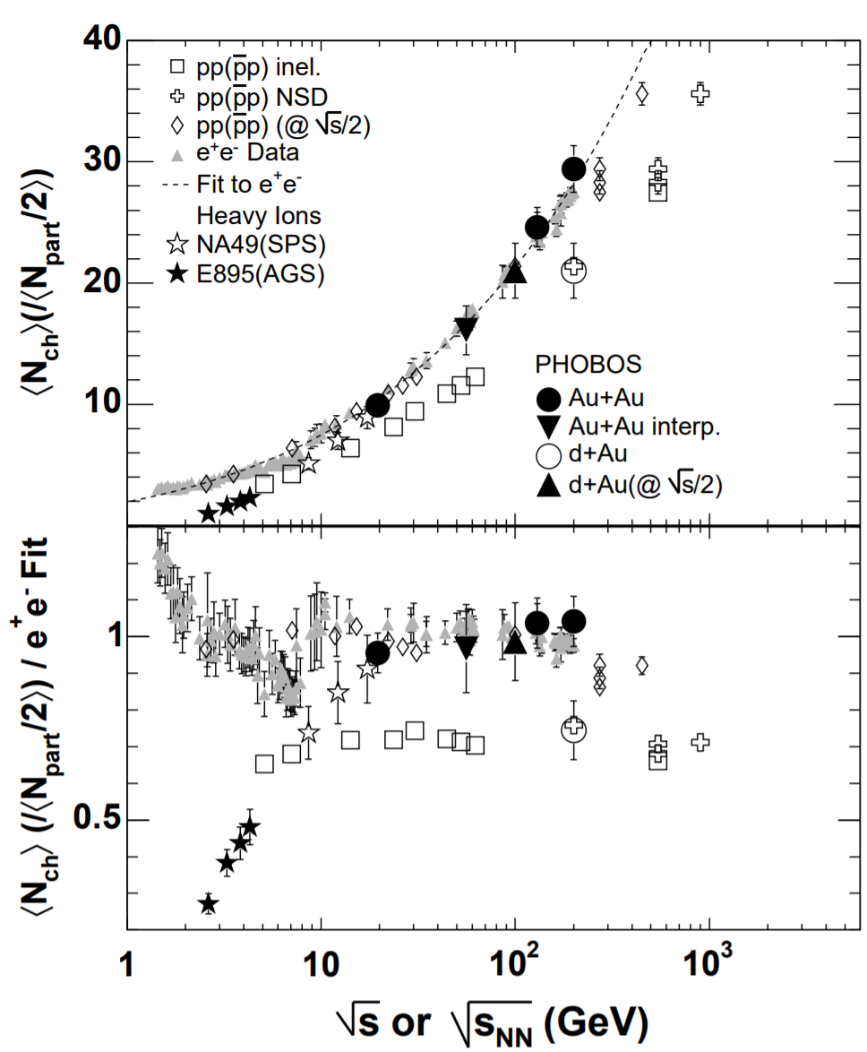
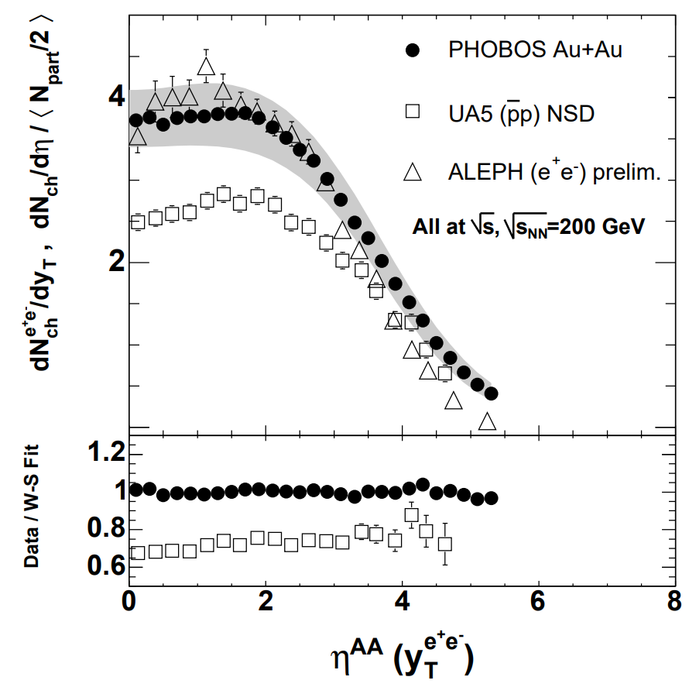
Particle Production
Notes:
Total multiplicity
Many similarity between ee and pp and AA
Fundamental rifference is the initial
PHOBOS and energy dependence

Slide 34
Event Selection
Track Selection:
  Particle Flow Candidate 0, 1, 2
  Number of TPC hits for a charged tracks >= 4
  |d0| < 2 cm
  |z0|< 10 cm
  |cosθ|<0.94
  p_{T}> 0.2 GeV (transverse momentum with respect to beam axis)
  N_{TPC} >=4
  x²/ndf < 1000.
Neutral Hadron Selection:
  Particle Flow Candidate 4, 5 (ECAL / HCAL object)
  E> 0.4 GeV
  |cosθ|<0.98
Event Selection:
  Number of good charged particles >= 5 (including charged hadrons and leptons)
  Number of good ch+neu. Particles >= 13
  E_{charged} > 15 GeV
  |cos(θ_{sphericity})|<0.82

Slide 35
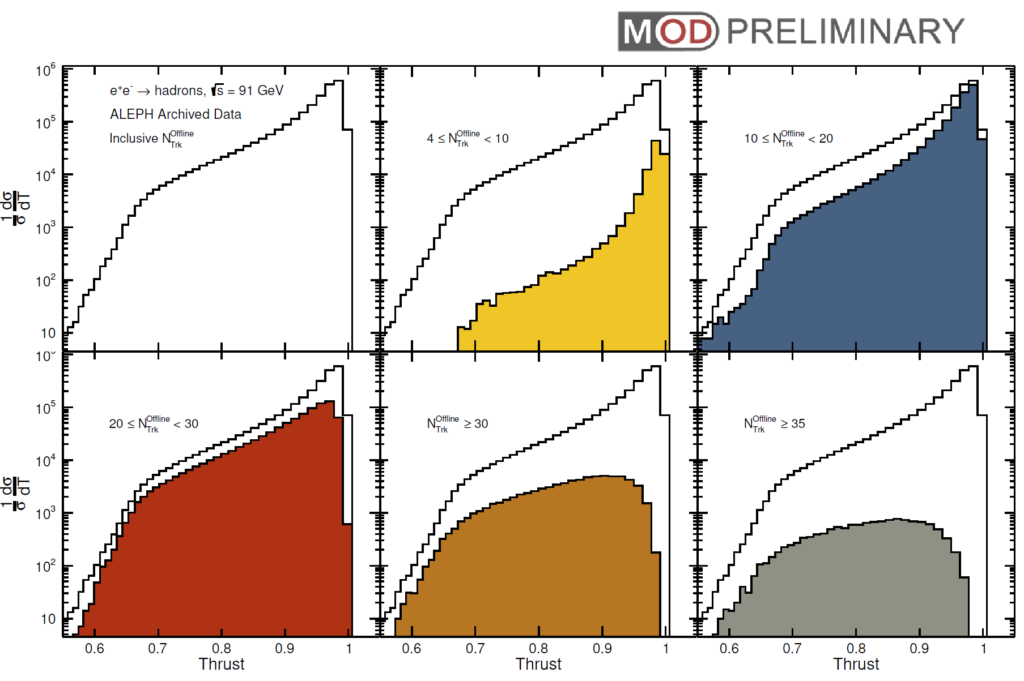
Uncorrected Thrust Distributions
Inclusive
N
N<10
10≤N<20
20≤N<30
N≥30
N≥35
N: # of charged particles with p_{T}>0.2 GeV and |η|<1.74
High multiplicity events are more spherical

Slide 36
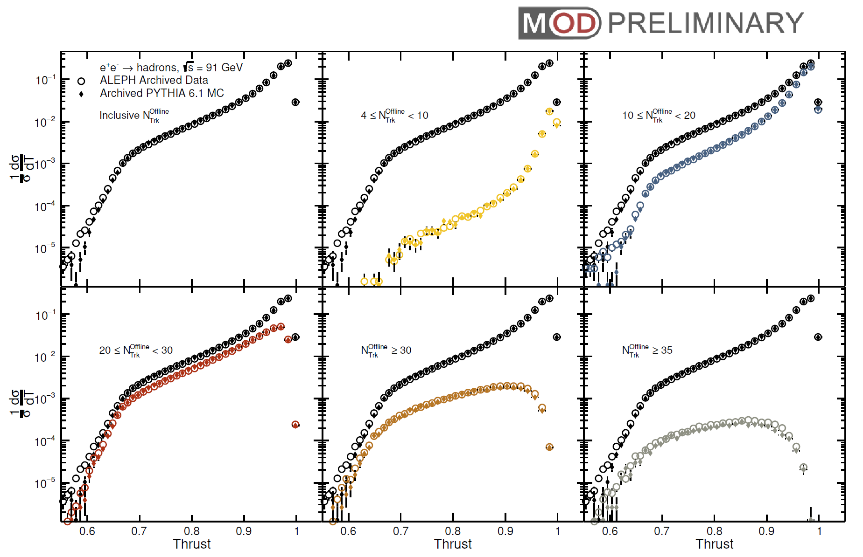
Uncorrected Thrust distributions in different N intervals

Slide 37
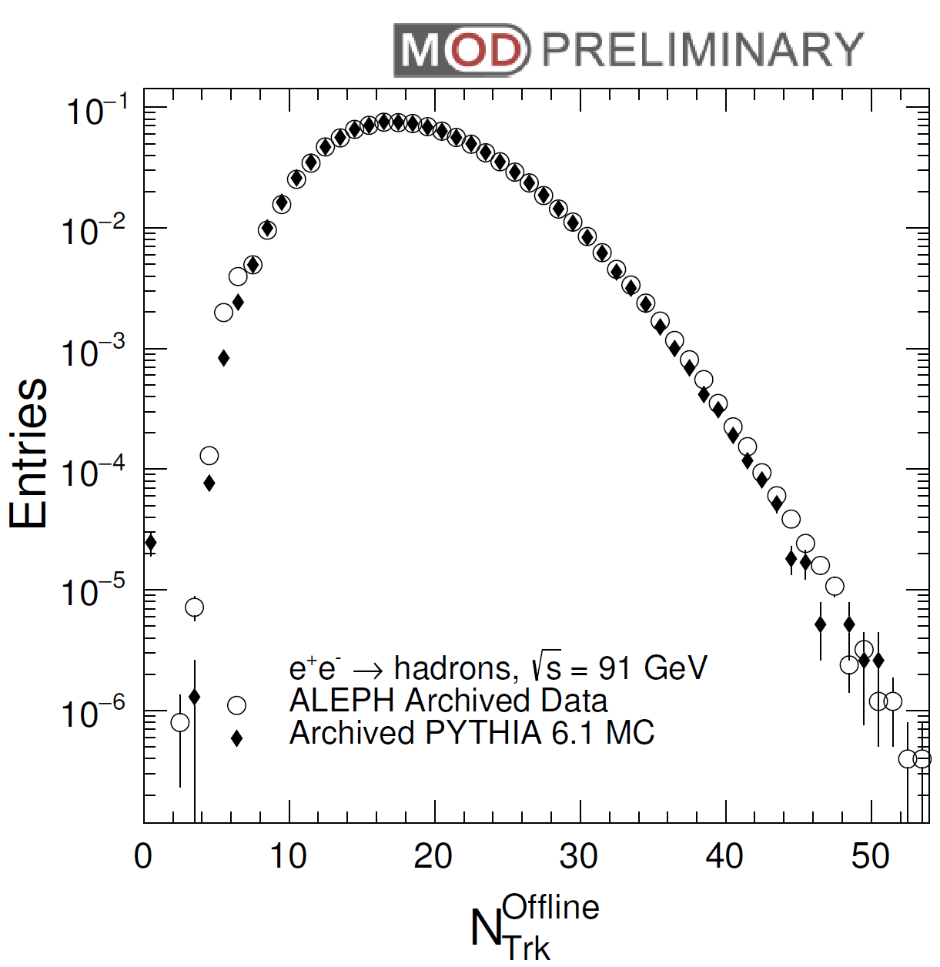
Charged Particle Multiplicity

Slide 38
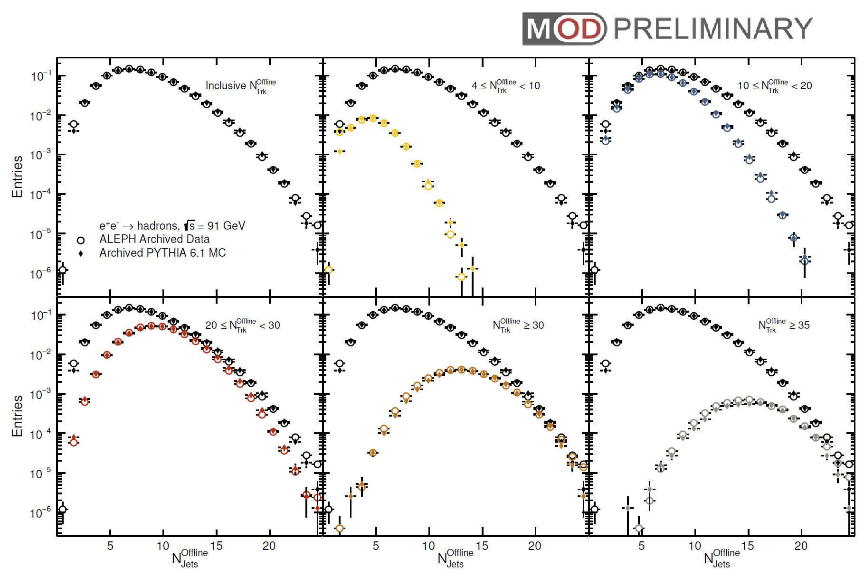
Jet multiplicity

