Slide 1
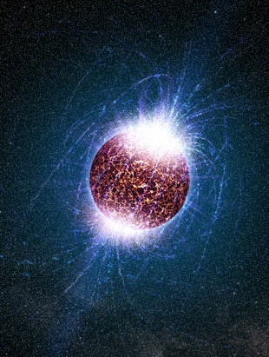
Neutron stars and stellar mergers as a laboratory of dense QCD matter
Aleksi Vuorinen
University of Helsinki & Helsinki Institute of Physics
High energy physics: looking into the smallest and largest in Nature
High energy theory in Helsinki: presentation by research area
A few research highlights
Some facts and figures
Final thoughts
Quark Matter, Lido Island
14 May 2018
Main reference: Annala, Gorda, Kurkela, Vuorinen, PRL 120 (2018), 1711.02644

Slide 2
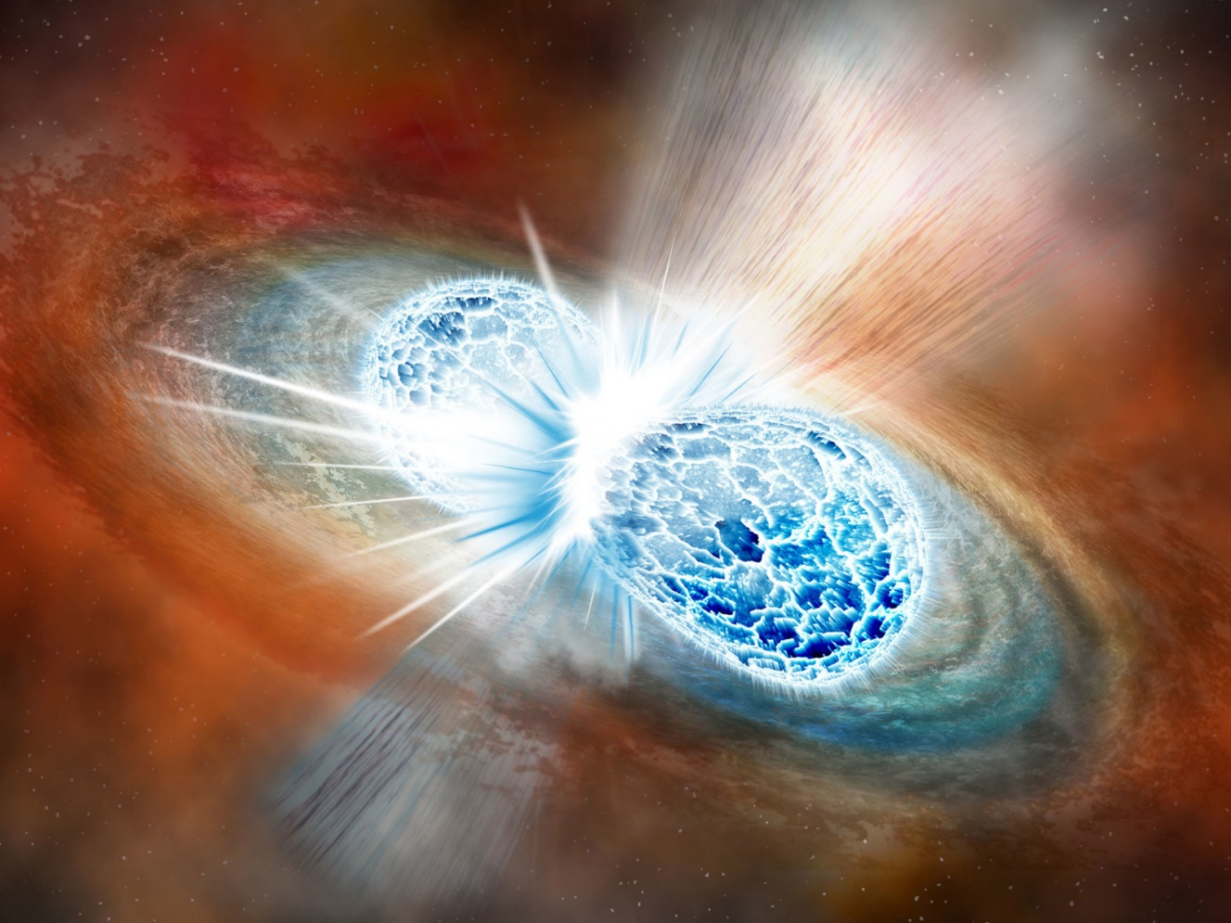
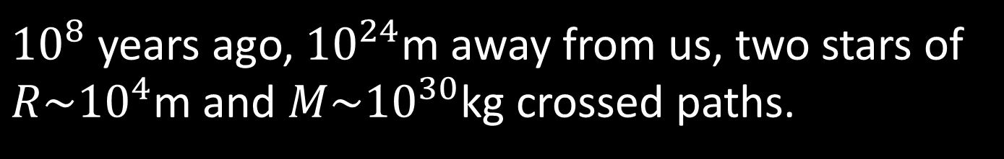
${10}^{8}$ years ago, ${10}^{24}$m away from us, two stars of ${R\sim 10}^{4}$m and ${M\sim 10}^{30}$kg crossed paths.

Slide 3
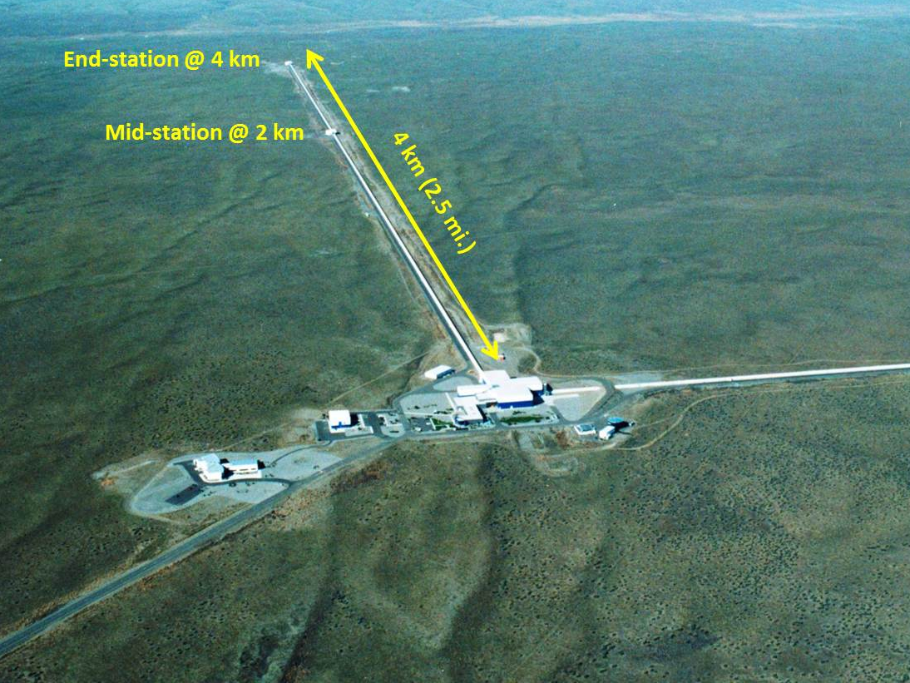
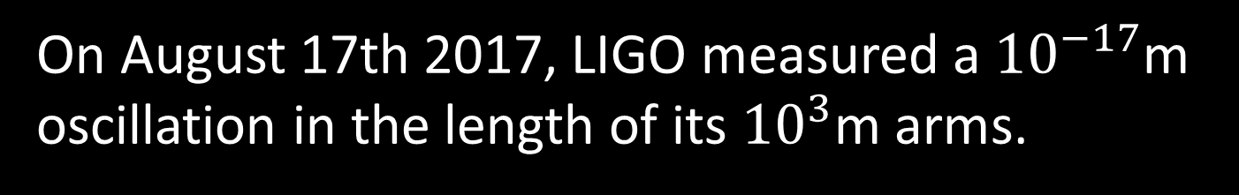
On August 17th 2017, LIGO measured a ${10}^{−17}$m oscillation in the length of its ${10}^{3}$m arms.

Slide 4
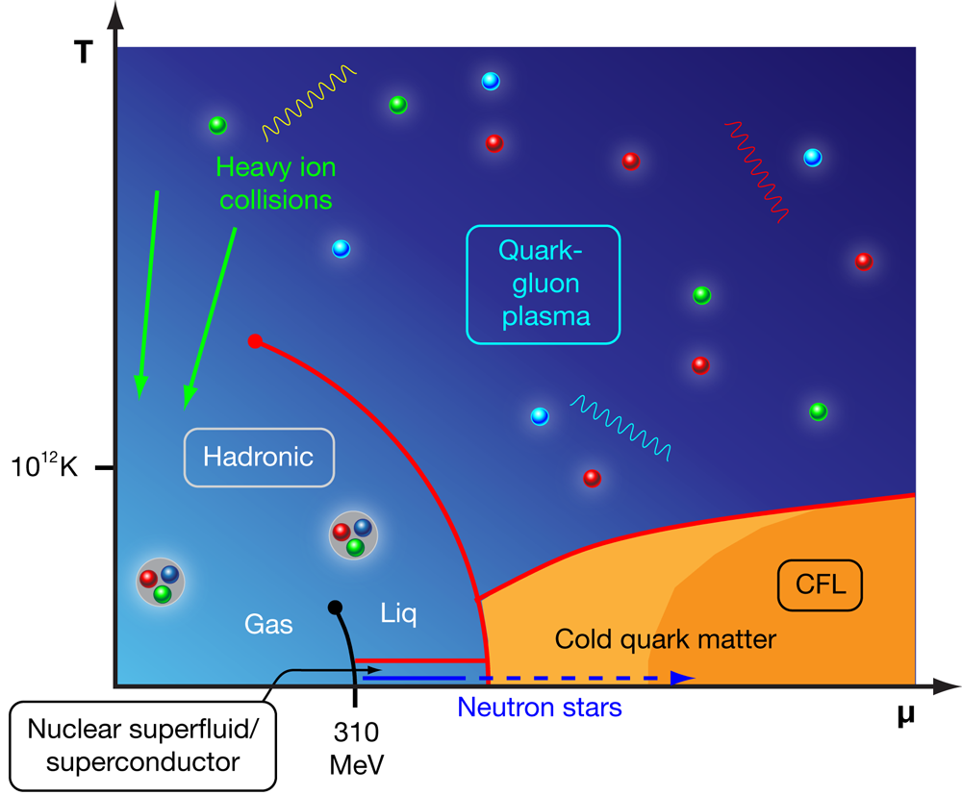
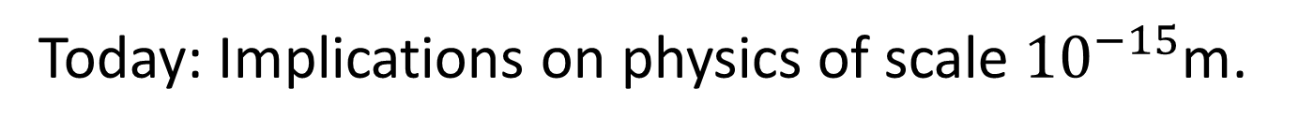
Today: Implications on physics of scale ${10}^{−15}$m.

Slide 5
Neutron star basics

Slide 6
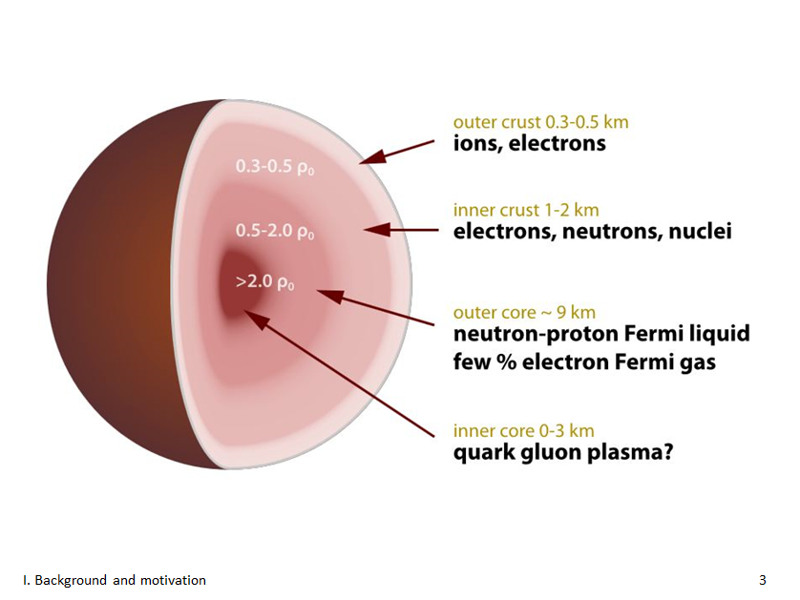
?

Slide 7
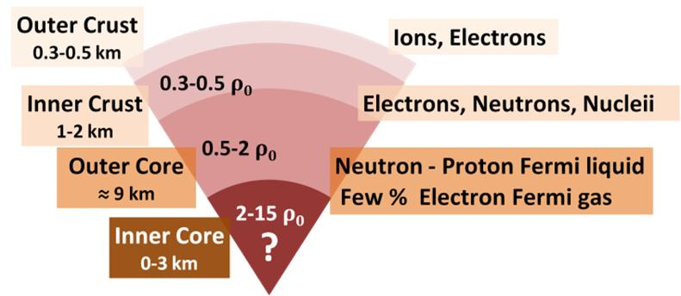
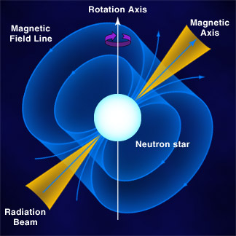
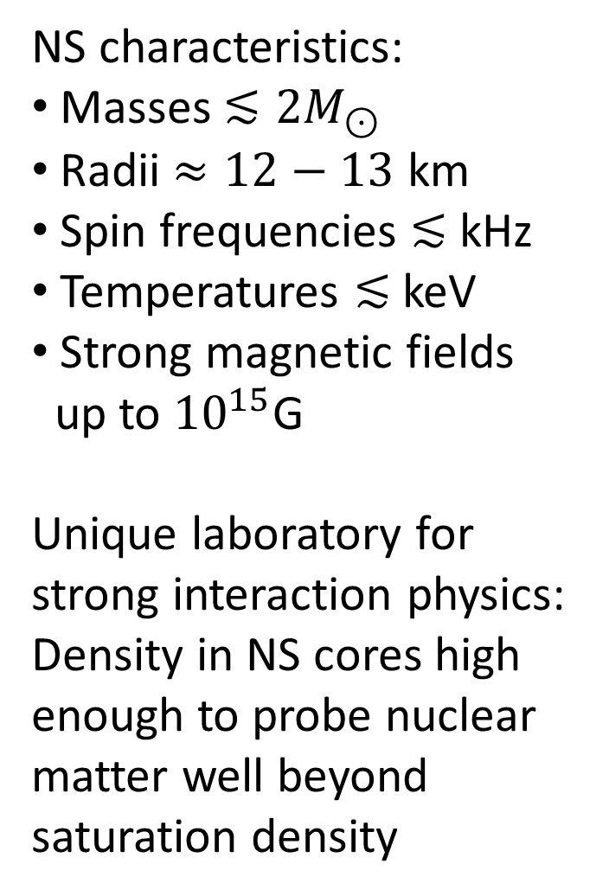
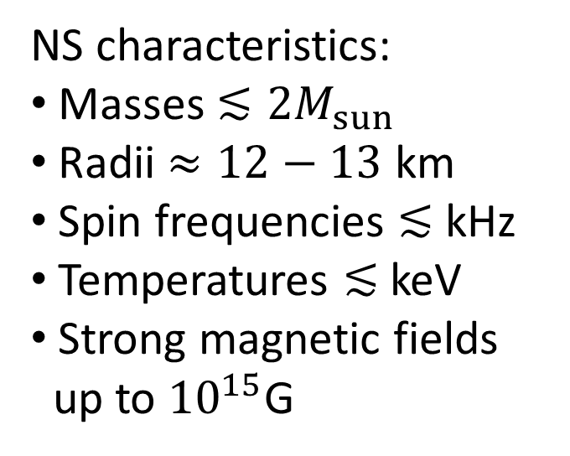
NS characteristics:
Masses $≲2M_{sun}$
Radii $≈12−13$ km
Spin frequencies $≲$ kHz
Temperatures $≲$ keV
Strong magnetic fields
up to ${10}^{15}$G
NS characteristics:
Masses $≲2M_{⊙}$
Radii $≈12−13$ km
Spin frequencies $≲$ kHz
Temperatures $≲$ keV
Strong magnetic fields
up to ${10}^{15}$G
Unique laboratory for strong interaction physics: Density in NS cores high enough to probe nuclear matter well beyond saturation density

Slide 8
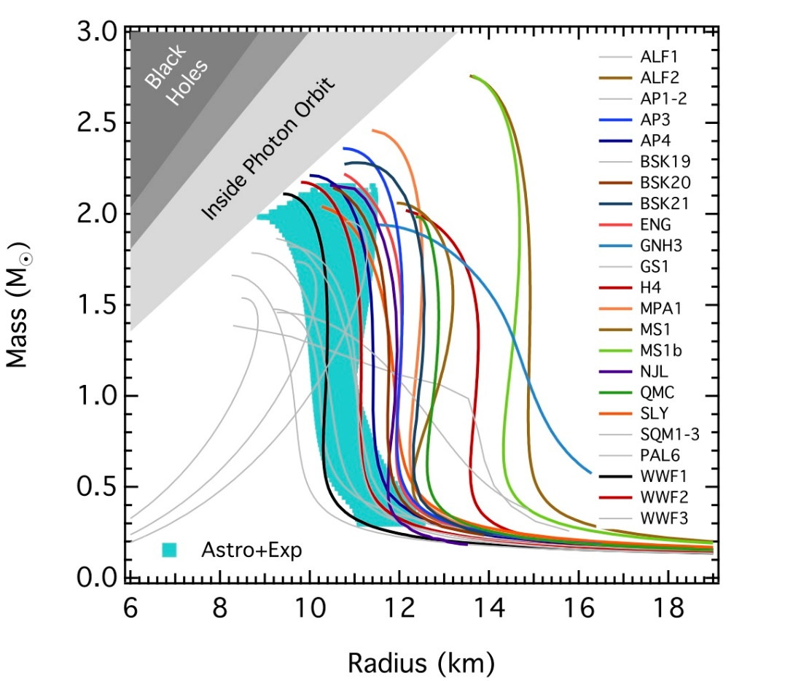
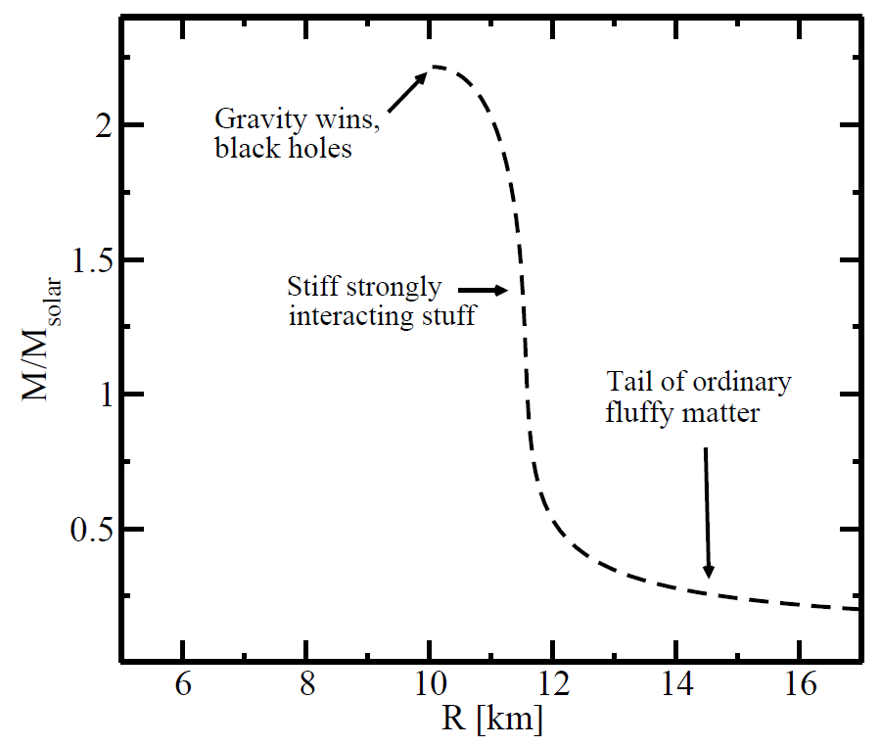
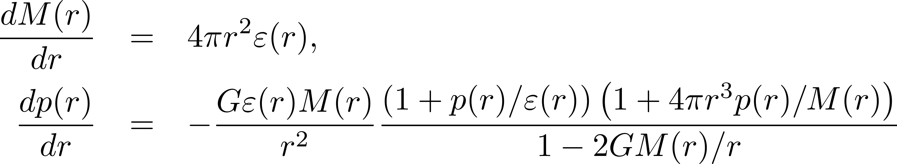
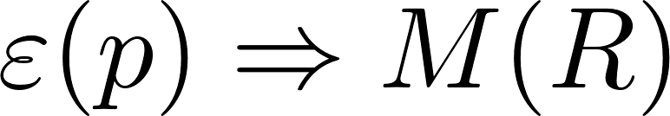
Physics picture: Hydrostatic equilibrium resulting from fierce competition between gravity and the pressure of QCD matter
GR description via Tolman-Oppenheimer-Volkov eqs:
Ozel et al., ApJ 820 (2016)

Slide 9
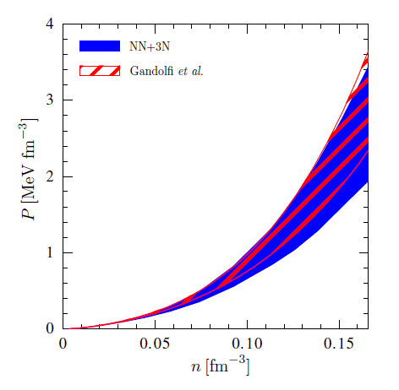
Particle/nuclear theory challenge: Find Equation of State of strongly interacting matter that is
Cold and dense
Electrically neutral:
In beta equilibrium:
Hebeler et al., ApJ 773 (2013)
Big open questions:
Can QCD theorists predict neutron star measurements?
Can we infer the QCD matter EoS from observations?
Can deconfined matter be found inside the stars?

Slide 10
What do we know from observations?

Slide 11
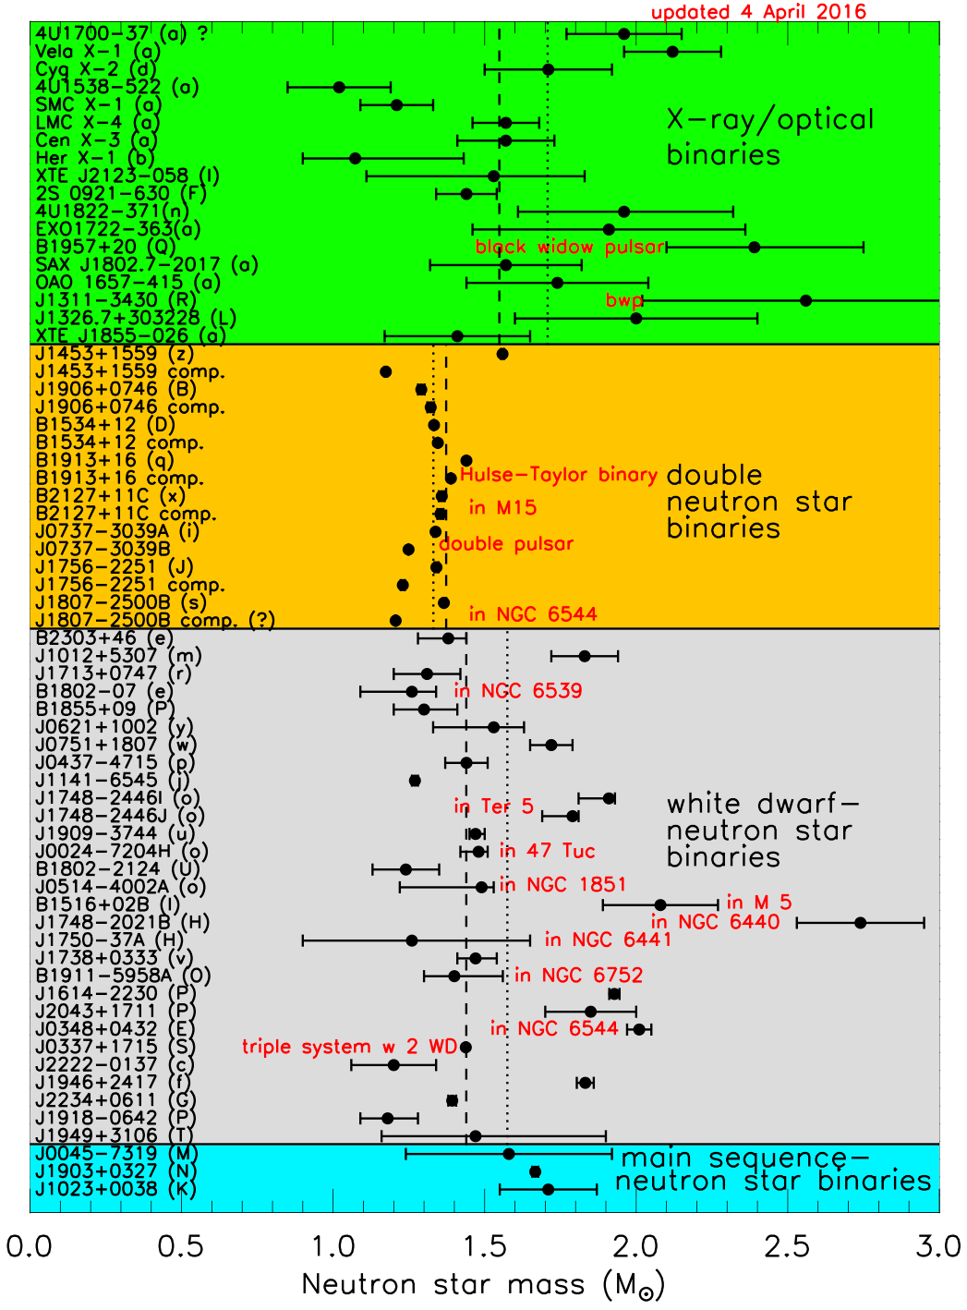

By now, two accurate Shapiro delay measurements of two- solar-mass stars:
Demorest et al., Nature 467 (2010)
Antoniadis et al., Science 340 (2013)
$$∴ M_{max}>2M_{⊙}$$
Fig: J. Lattimer

Slide 12
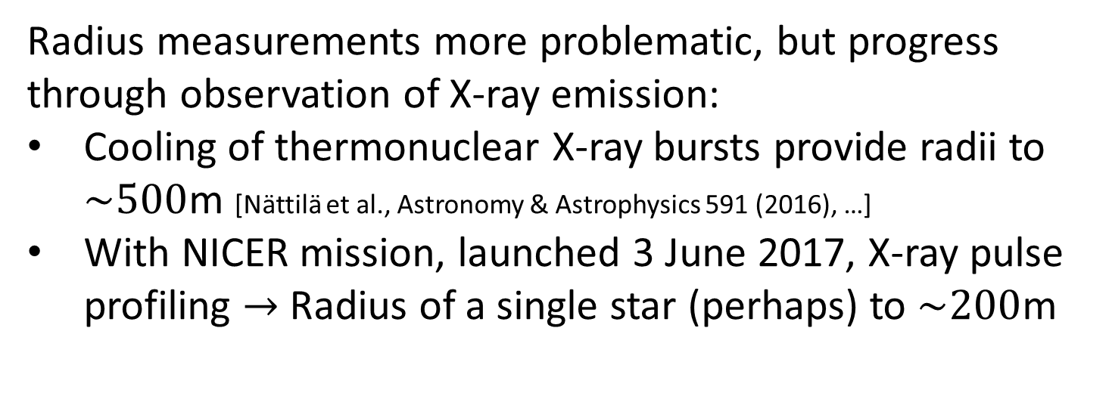
Radius measurements more problematic, but progress through observation of X-ray emission:
Cooling of thermonuclear X-ray bursts provide radii to $\sim 500$m [Nättilä et al., Astronomy & Astrophysics 591 (2016), …]
With NICER mission, launched 3 June 2017, X-ray pulse profiling $→$ Radius of a single star (perhaps) to $\sim 200$m

Slide 13
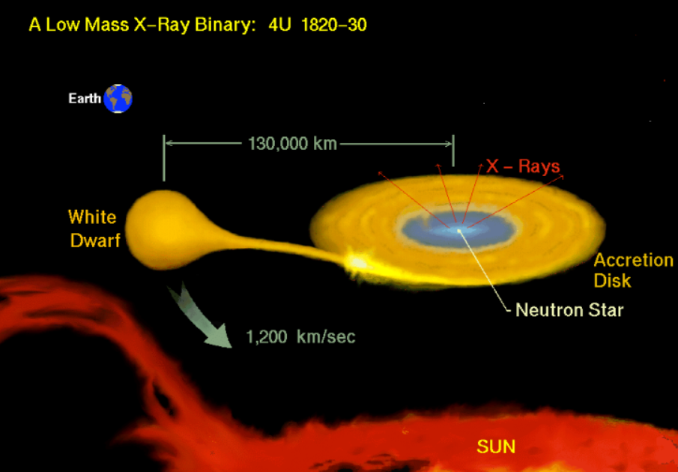
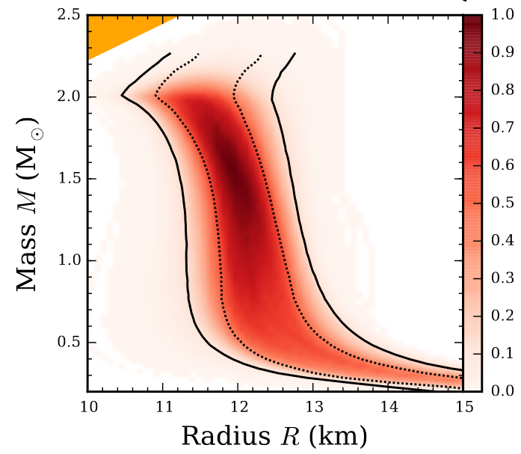
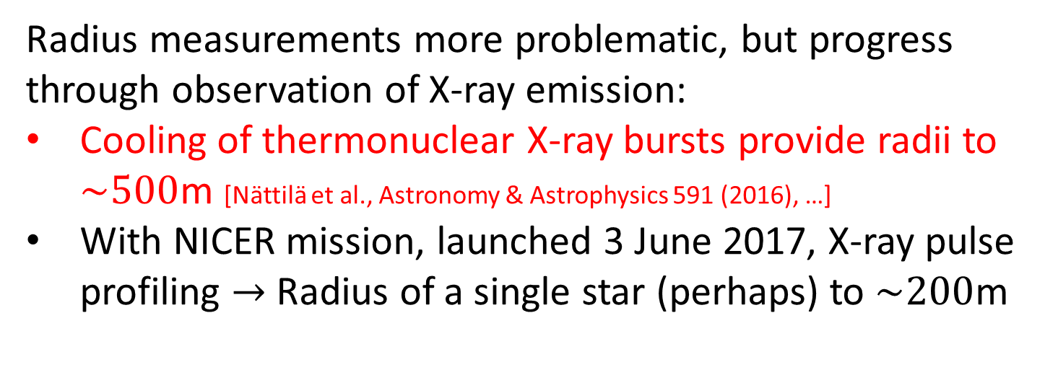
Radius measurements more problematic, but progress through observation of X-ray emission:
Cooling of thermonuclear X-ray bursts provide radii to $\sim 500$m [Nättilä et al., Astronomy & Astrophysics 591 (2016), …]
With NICER mission, launched 3 June 2017, X-ray pulse profiling $→$ Radius of a single star (perhaps) to $\sim 200$m

Slide 14
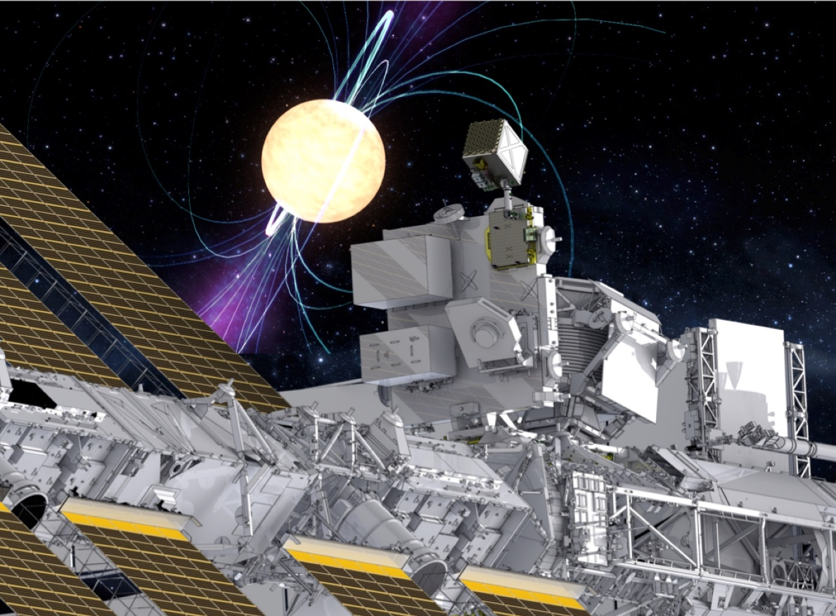
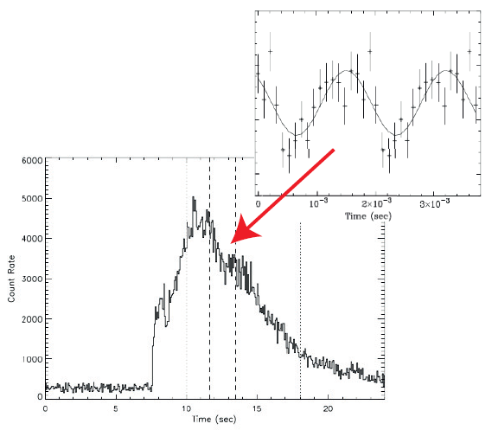
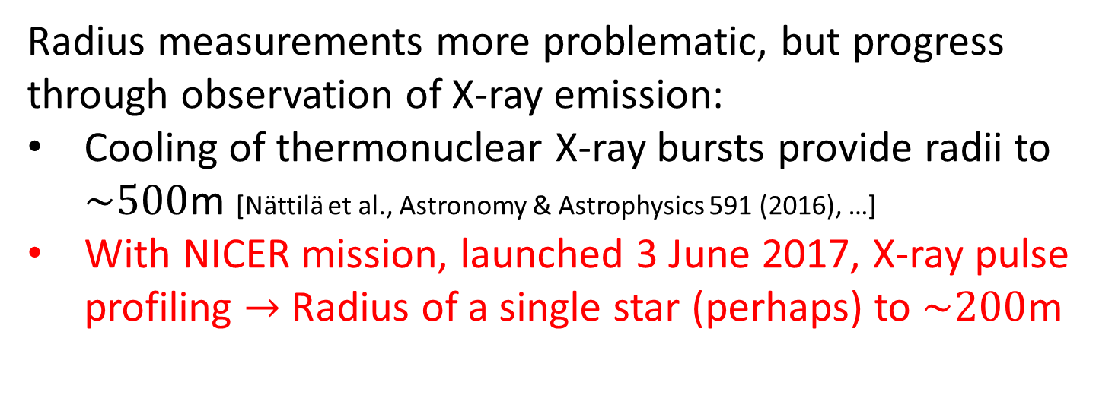
Radius measurements more problematic, but progress through observation of X-ray emission:
Cooling of thermonuclear X-ray bursts provide radii to $\sim 500$m [Nättilä et al., Astronomy & Astrophysics 591 (2016), …]
With NICER mission, launched 3 June 2017, X-ray pulse profiling $→$ Radius of a single star (perhaps) to $\sim 200$m

Slide 15
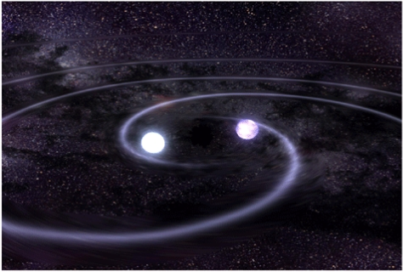
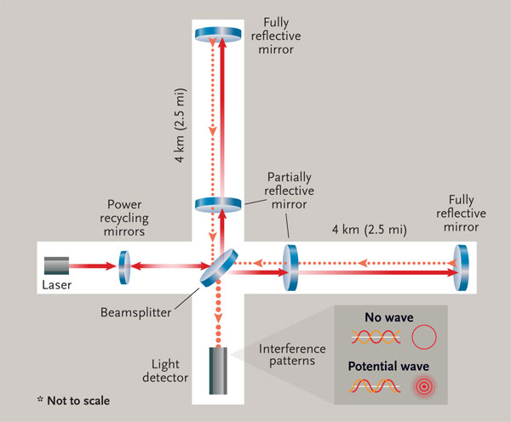
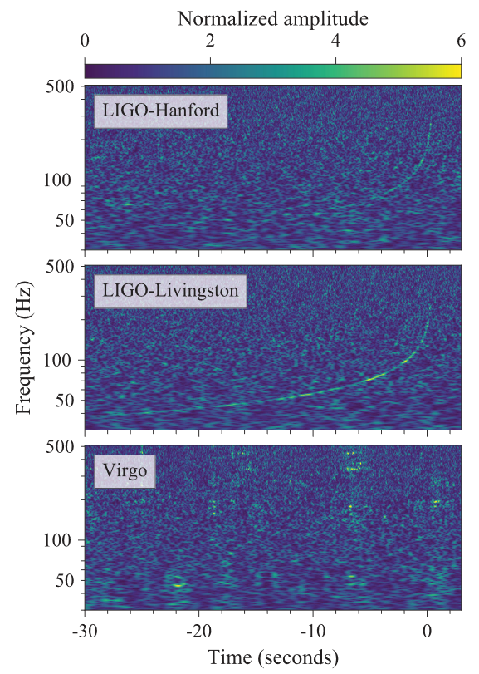


Gravitational wave breakthrough: LIGO and Virgo observation of NS merger 130 million ly away!
Three types of potential inputs:
Tidal deformabilities of the NSs during inspiral – good measure of stellar compactness
EM signatures – present if no immediate collapse to a BH
Ringdown pattern – sensitive to EoS (also at $T≠0$), but freq. too high for LIGO
Gravitational wave breakthrough: LIGO and Virgo observation of NS merger 130 million ly away!
Three types of potential inputs:
Tidal deformabilities of the NSs during inspiral – good measure of stellar compactness
EM signatures – present if no immediate collapse to a BH
Ringdown pattern – sensitive to EoS (also at $T≠0$), but freq. too high for LIGO
LIGO and Virgo collaborations, PRL 119 (2017)

Slide 16
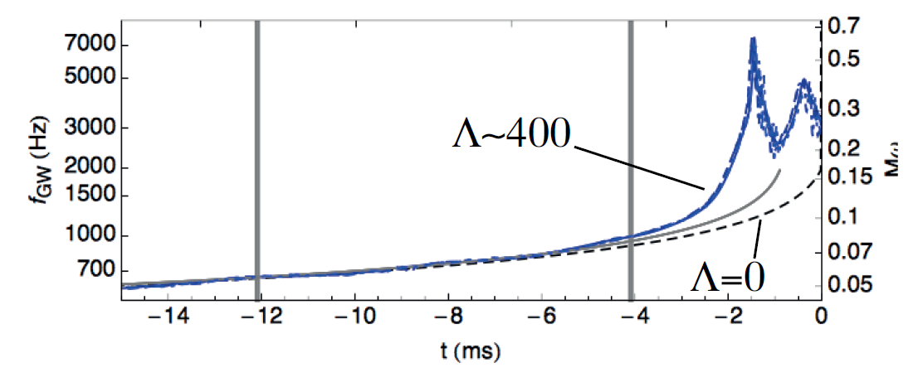
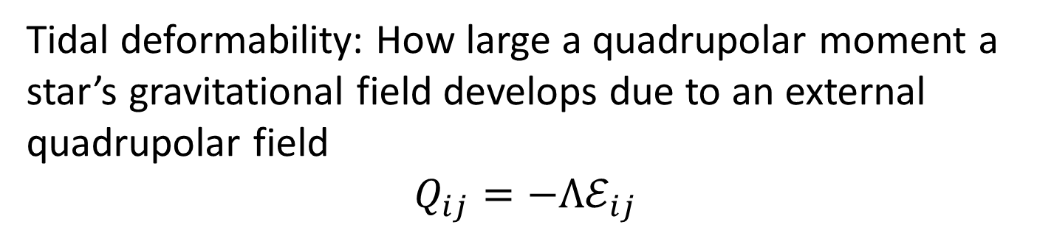
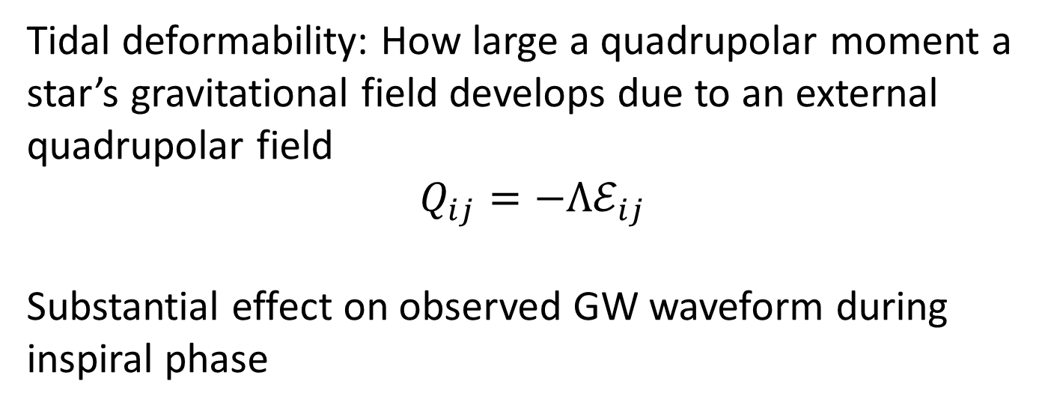
Tidal deformability: How large a quadrupolar moment a star’s gravitational field develops due to an external quadrupolar field
$$Q_{ij}=−Λℰ_{ij}$$
Tidal deformability: How large a quadrupolar moment a star’s gravitational field develops due to an external quadrupolar field
$$Q_{ij}=−Λℰ_{ij}$$
Substantial effect on observed GW waveform during inspiral phase
Read et al., PRD 88 (2013)

Slide 17
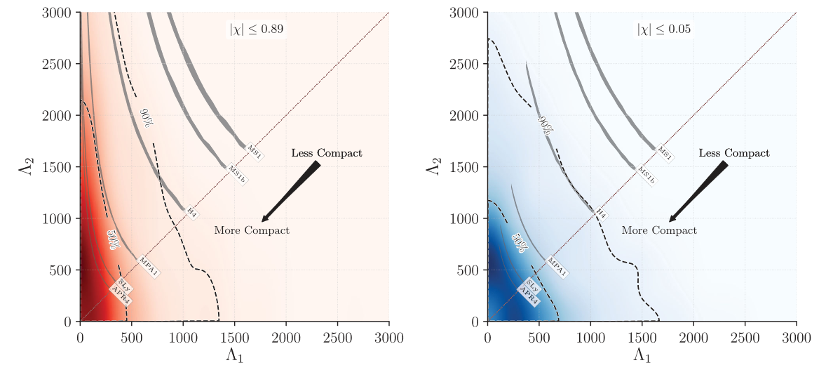
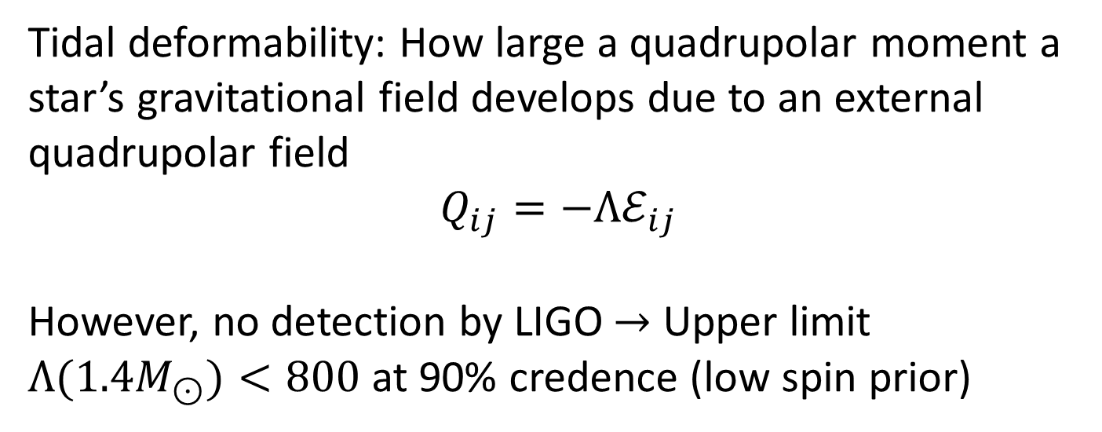
Tidal deformability: How large a quadrupolar moment a star’s gravitational field develops due to an external quadrupolar field
$$Q_{ij}=−Λℰ_{ij}$$
However, no detection by LIGO $→$ Upper limit $Λ(1.4M_{⊙})<800$ at 90% credence (low spin prior)

Slide 18
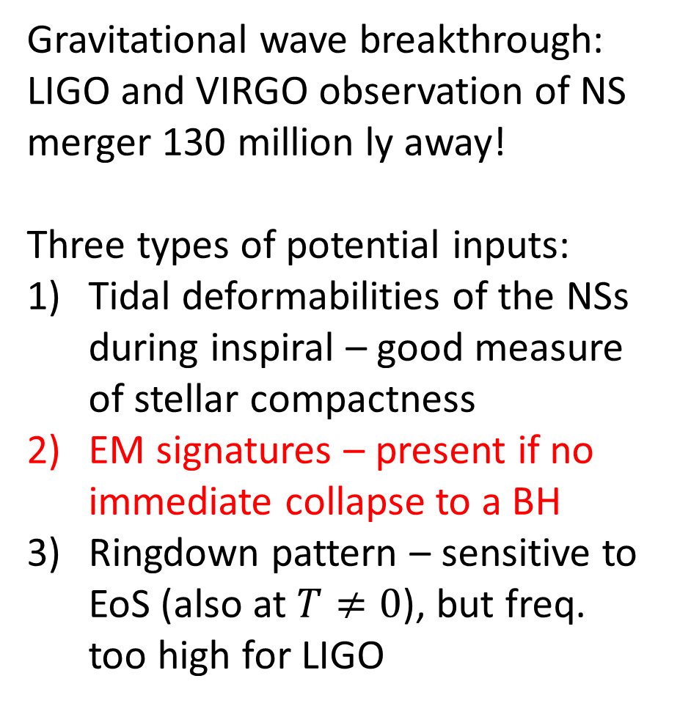
Gravitational wave breakthrough: LIGO and VIRGO observation of NS merger 130 million ly away!
Three types of potential inputs:
Tidal deformabilities of the NSs during inspiral – good measure of stellar compactness
EM signatures – present if no immediate collapse to a BH
Ringdown pattern – sensitive to EoS (also at $T≠0$), but freq. too high for LIGO

Slide 19
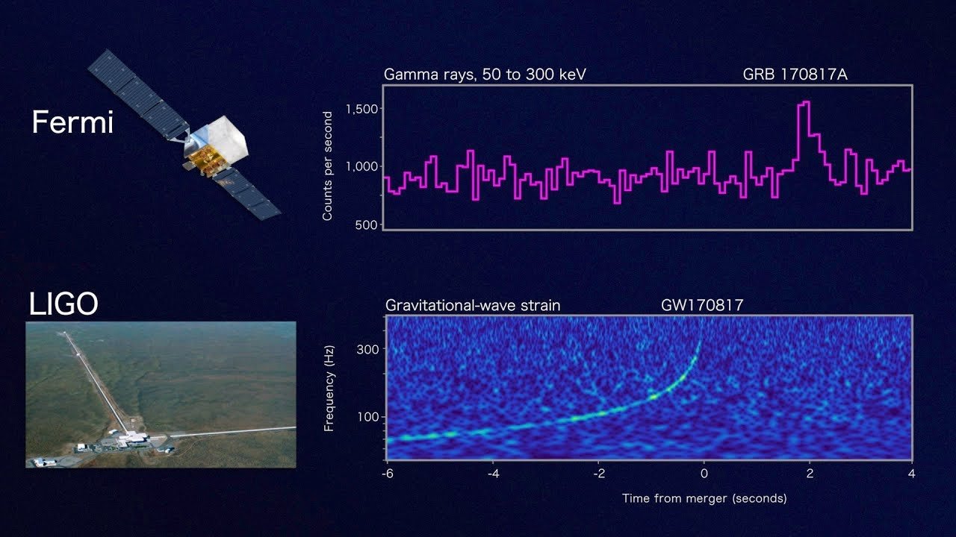
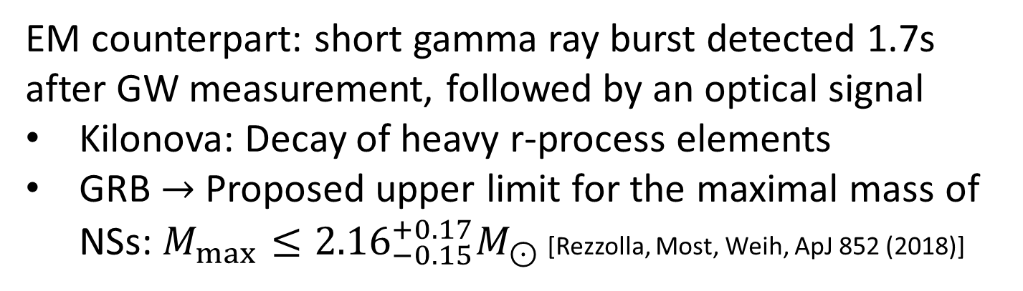
EM counterpart: short gamma ray burst detected 1.7s after GW measurement, followed by an optical signal
Kilonova: Decay of heavy r-process elements
GRB $→$ Proposed upper limit for the maximal mass of NSs: $M_{max}≤{2.16}_{−0.15}^{+0.17}M_{⊙}$ [Rezzolla, Most, Weih, ApJ 852 (2018)]

Slide 20
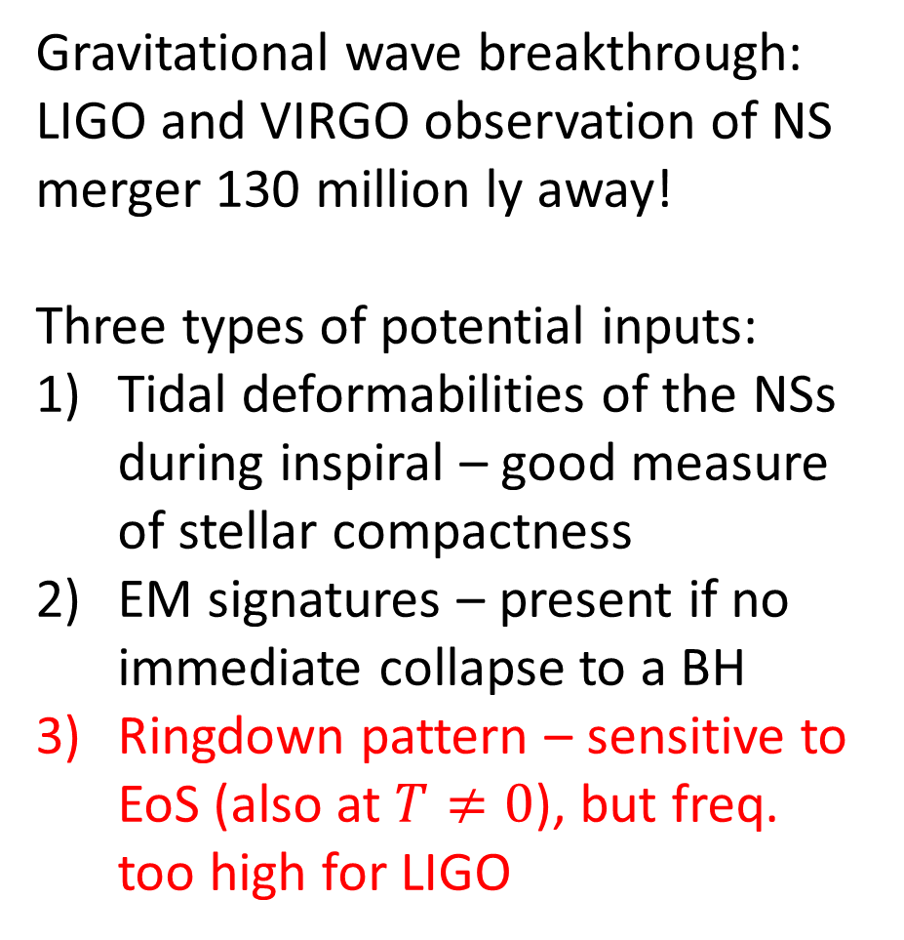
Gravitational wave breakthrough: LIGO and VIRGO observation of NS merger 130 million ly away!
Three types of potential inputs:
Tidal deformabilities of the NSs during inspiral – good measure of stellar compactness
EM signatures – present if no immediate collapse to a BH
Ringdown pattern – sensitive to EoS (also at $T≠0$), but freq. too high for LIGO
20

Slide 21
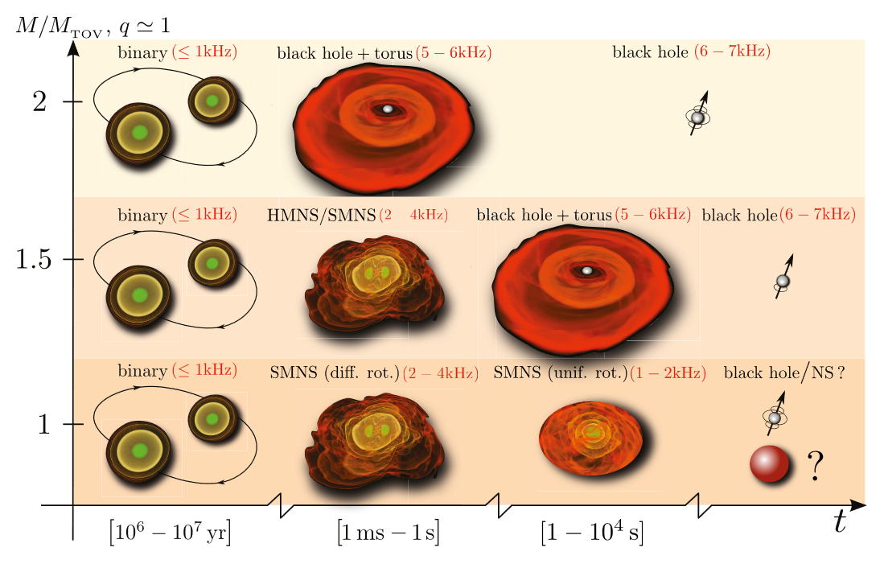
Ringdown pattern: Unlike in BH mergers, expect a complex period of relaxation characterized by GW spectrum sensitive to both initial NS masses and the EoS
Baiotti, Rezzolla, Rept.Prog.Phys. 80 (2017)

Slide 22
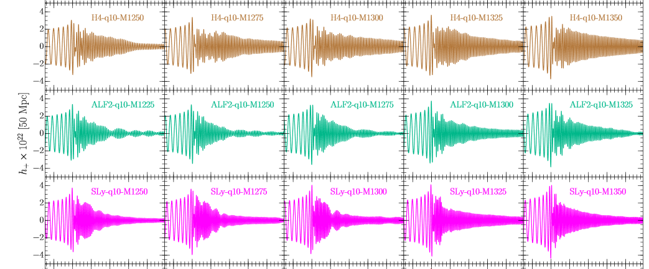
Post-merger dynamics can be studied with relativistic hydrodynamics, showing marked sensitivity to EoS, but frequency range (currently) too high for LIGO and Virgo
Takami, Rezzolla, Baiotti, PRD 91 (2015)

Slide 23
EoS – theoretical limits

Slide 24
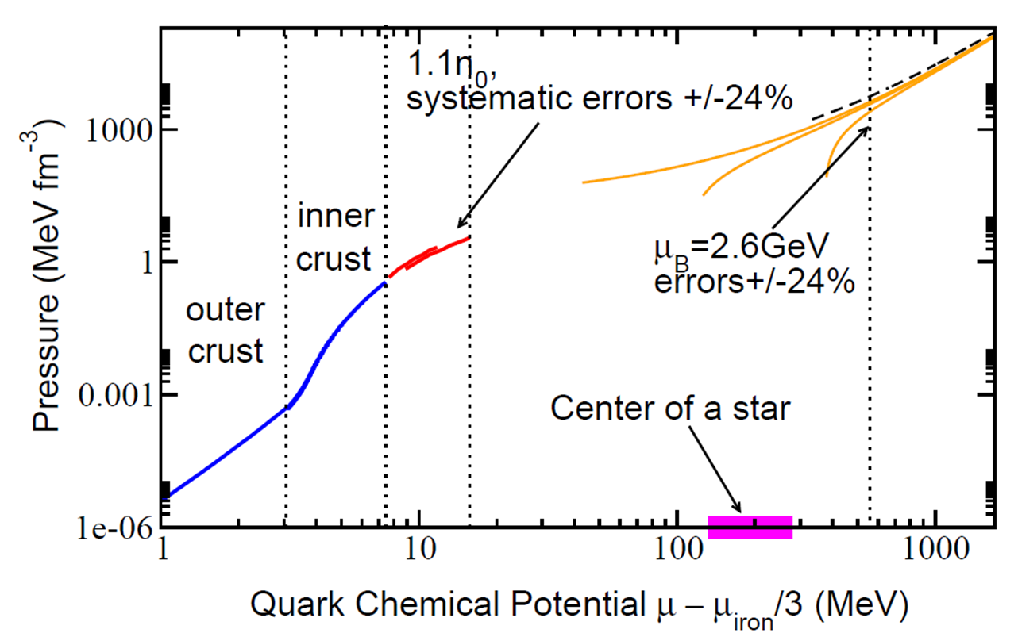
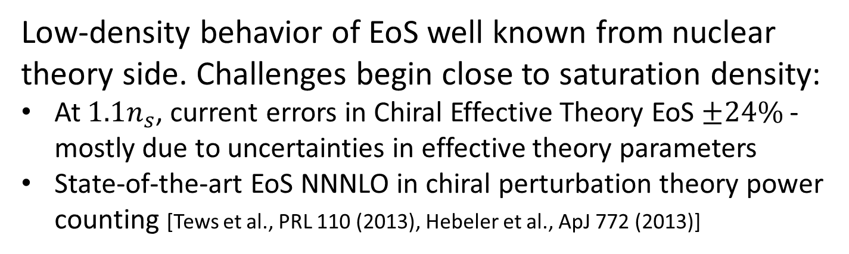
Low-density behavior of EoS well known from nuclear theory side. Challenges begin close to saturation density:
At $1.1n_{s}$, current errors in Chiral Effective Theory EoS $±24\%$ - mostly due to uncertainties in effective theory parameters
State-of-the-art EoS NNNLO in chiral perturbation theory power counting [Tews et al., PRL 110 (2013), Hebeler et al., ApJ 772 (2013)]

Slide 25
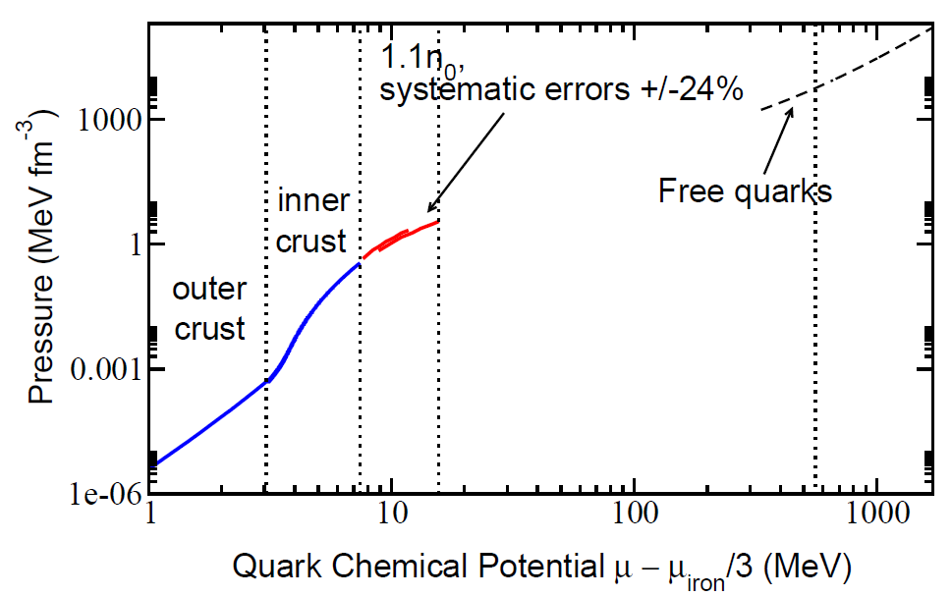
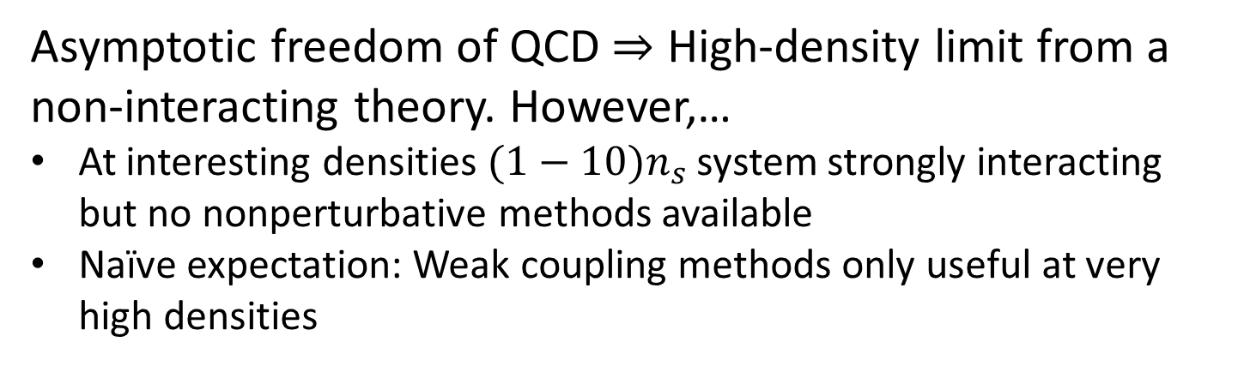
Asymptotic freedom of QCD $⇒$ High-density limit from a non-interacting theory. However,…
At interesting densities $(1−10)n_{s}$ system strongly interacting but no nonperturbative methods available
Naïve expectation: Weak coupling methods only useful at very high densities

Slide 26
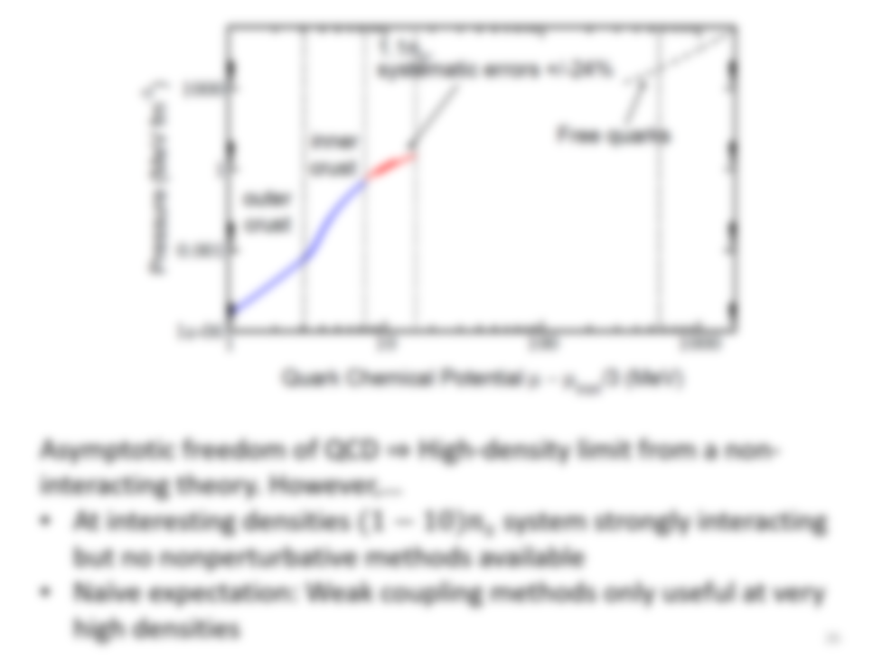
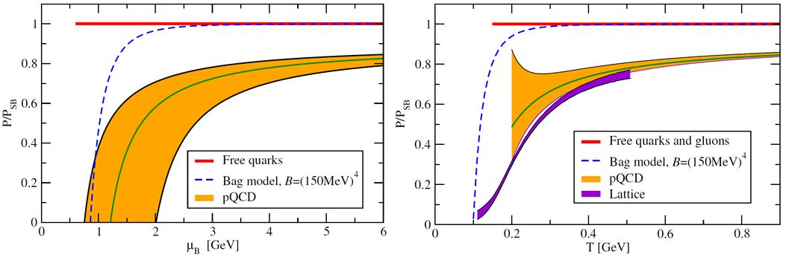
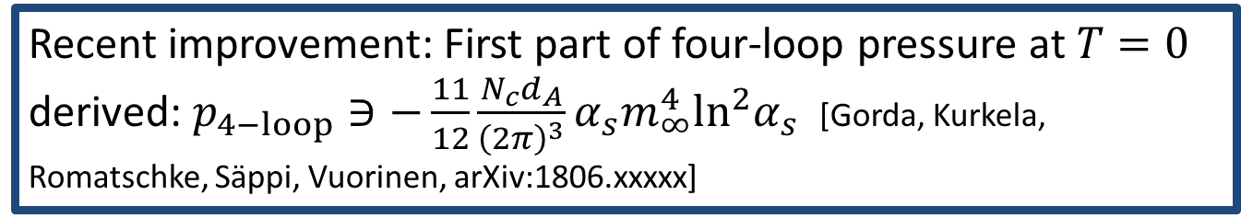
Recent improvement: First part of four-loop pressure at $T=0$ derived: $p_{4−loop}∋−\frac{11}{12}\frac{N_{c}d_{A}}{{\left(2π\right)}^{3}}α_{s}m_{∞}^{4}\ln^{2}α_{s}$ [Gorda, Kurkela, Romatschke, Säppi, Vuorinen, arXiv:1806.xxxxx]

Slide 27
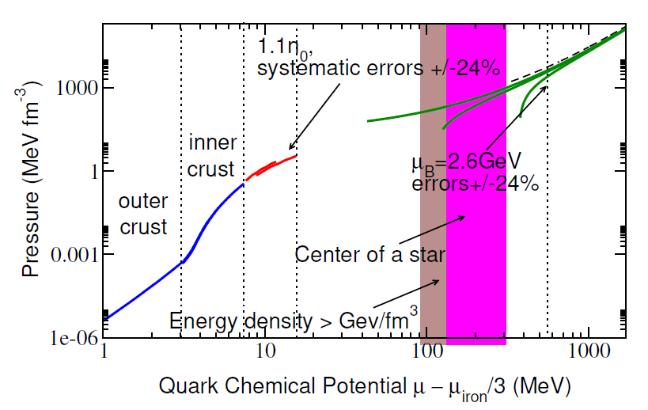


Three-loop result with nonzero quark masses [Kurkela, Romatschke, Vuorinen, PRD 81 (2009)]
Uncertainty of result at $±24\%$ level around $40n_{s}$
Main uncertainty from renormalization scale dependence
Pairing contributions to EoS subdominant at relevant densities

Slide 28

Conclusion: Sizable no man’s land extending from outer core to densities not realized inside physical neutron stars
Options: Use models, deform theory, or interpolate EoS between known limits and use astrophysical constraints
Conclusion: Sizable no man’s land extending from outer core to densities not realized inside physical neutron stars
Options: Use models, deform theory, or interpolate EoS between known limits and use astrophysical constraints

Slide 29
Interpolation – with and without observational constraints

Slide 30



Interpolate EoS using piecewise polytropic form, $p_{i}\left(n\right)=κ_{i}n^{γ_{i}}$, varying all parameters ($γ_{i}$, $μ_{i}^{match}$)
Require:
Smooth matching to nuclear and quark matter EoSs
Continuity of $p$ and $n$ – with at most one exception (1st order transition)
Subluminality
Optional: astrophysical constraints
[Kurkela et al., ApJ 789 (2014)]

Slide 31





Implement then two-solar-mass constraint: Accept only EoSs that fulfill $M_{max}>2M_{⊙}$
Assumption here and in the following: All stars considered main seq. NSs
Excluded: twin stars [e.g. Alvarez-Castillo, Blaschke, PRC96 (2017)], strange quark stars [Weber et al., IAU 291 (2013)]
Quadrutropic interpolation, using close to 200.000 randomly generated EoSs
Figures from [Annala, Gorda, Kurkela, Vuorinen, PRL 120 (2018)]

Slide 33



Next, determine tidal deformabilities from each EoS and compare to LIGO results for $1.4M_{⊙}$stars:
$Λ(1.4M_{⊙})<800$ at 90%
$Λ(1.4M_{⊙})<400$ at 50%

Slide 35




How would this look with future improved radius measurements, e.g. NICER $R\left(1.4M_{⊙}\right)=12.25±0.25$ km?
Or with proposed limit $M_{max}≤2.16M_{⊙}$[Rezzolla, Most, Weih, ApJ 852 (2018)]?

Slide 37

Lesson 1: $2M_{⊙}$and pQCD constraints force EoS to be hard at low density and soft at high density $→$ Efficient bracketing of $p\left(ε\right),$ $R\left(1.4M_{⊙}\right)≥10$km

Slide 38


Lesson 2: Stringent limits from only one tidal deformab. measurement: EoS cannot be overly stiff at low density$,$ $R\left(1.4M_{⊙}\right)≤13.6$km

Slide 39
One stellar merger later – where are we?

Slide 40
Big open questions:
Can QCD theorists predict neutron star measurements?
  Not there yet – need fundamentally new machinery
Can we infer the QCD matter EoS from observations?
  Looks very promising, fast progress with GWs
Can deconfined matter be found inside the stars?
  Tough question, but we’re on the right path!
Big open questions:
Can QCD theorists predict neutron star measurements?
Can we infer the QCD matter EoS from observations?
Can deconfined matter be found inside the stars?

Slide 41



