Slide 1

DETERMINATION OF THE INTRINSIC PARAMETERS OF THE THERMOLUMINESCENCE OF KUNZITE USING NUMERICAL MODELS
BY
FAJEMISIN JESUTOFUNMI AYO
B.Sc Physics
University of Ibadan, Nigeria.

Slide 2
Overview
Introduction
Methodology
Results
Conclusion

Slide 3
INTRODUCTION
Thermoluminescence (TL) is the phenomenon of light emission from an insulator or semiconductor when it is heated after a previous absorption of energy from ionizing radiation (Piters, 1993).

Slide 4
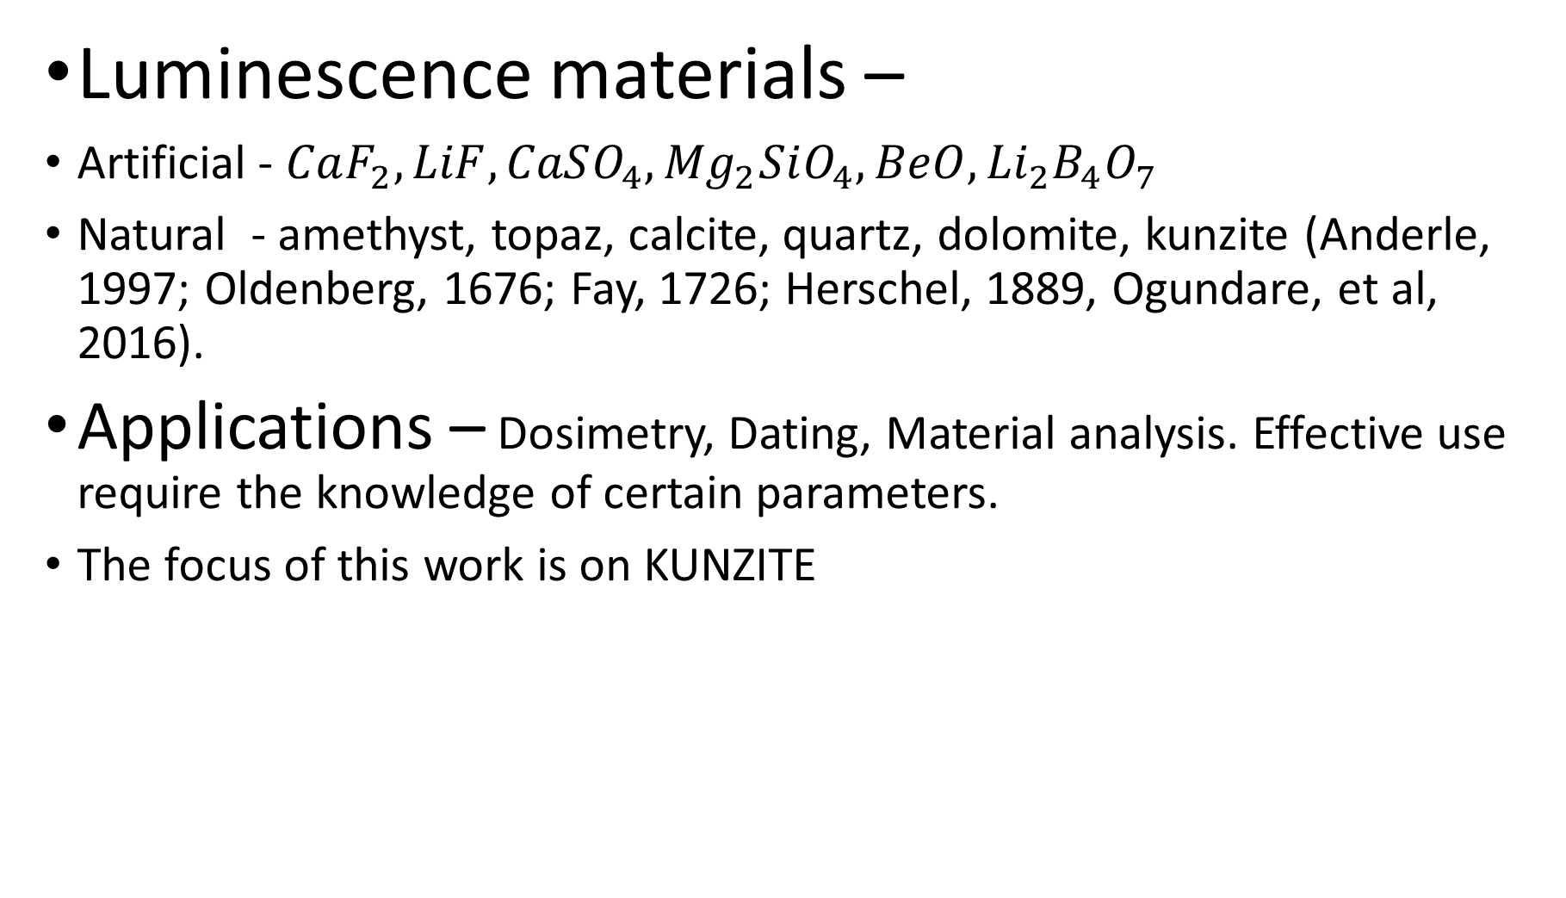
Luminescence materials –
Artificial - $CaF_{2}, LiF, CaSO_{4}, {Mg}_{2}SiO_{4}, BeO, {Li}_{2}B_{4}O_{7}$
Natural - amethyst, topaz, calcite, quartz, dolomite, kunzite (Anderle, 1997; Oldenberg, 1676; Fay, 1726; Herschel, 1889, Ogundare, et al, 2016).
Applications – Dosimetry, Dating, Material analysis. Effective use require the knowledge of certain parameters.
The focus of this work is on KUNZITE

Slide 5
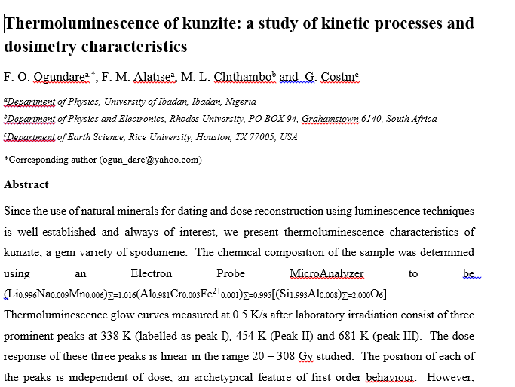

Slide 6
Objectives
To develop an energy band model for the thermoluminescence observed in Kunzite.
To fit the experimental glow curve (Ogundare et al, 2016) with the model.
To obtain the parameters that gives the best fit.

Slide 7
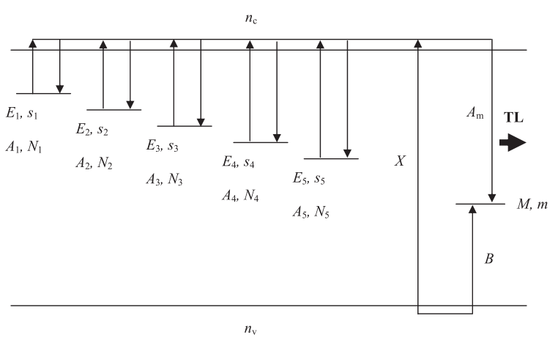
METHODOLOGY
Experimental Glow Curve
Proposed band model (5 traps and one recombination centre based on Ogundare et al)
Irradiation, Relaxation and Heating

Slide 8
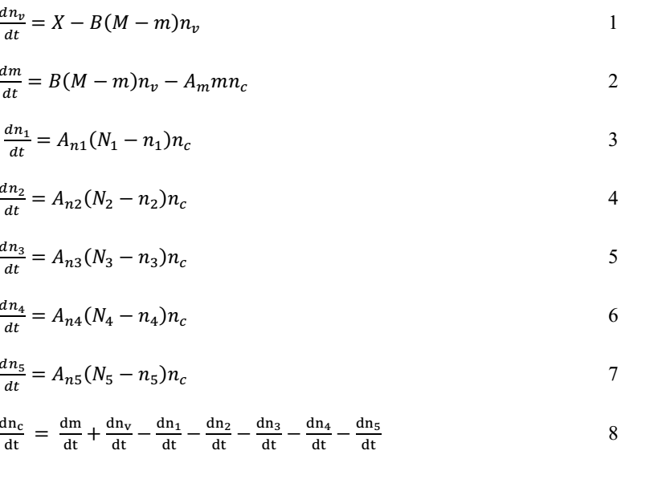
TL Equations
Irradiation
Relaxation
Same equations as in irradiation stage except X = 0

Slide 9
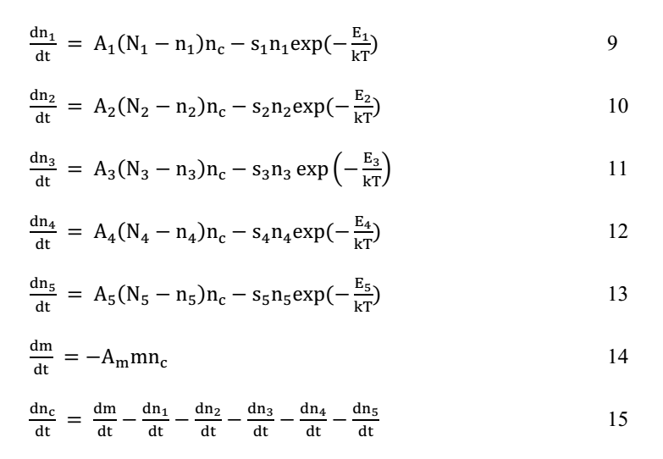
Heating Stage
These equations were solved using MATLAB ode45 solver

Slide 10
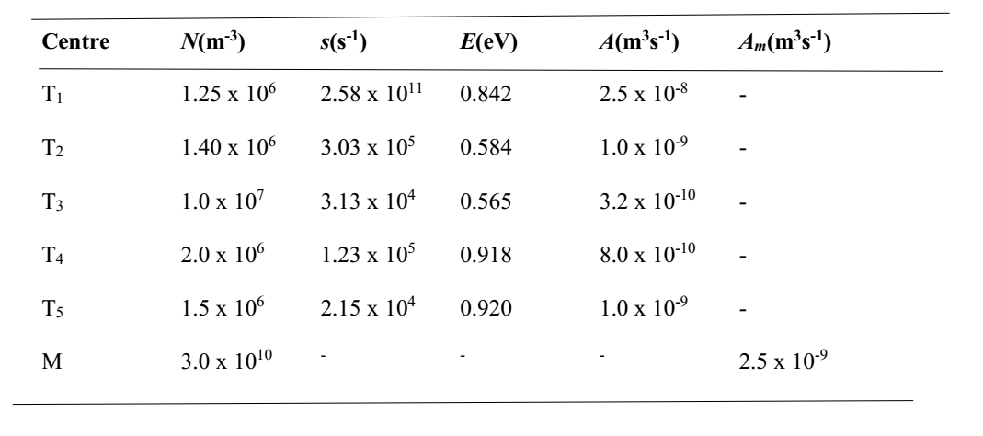
Results
Table showing the intrinsic parameters
N= electron population; s = frequency factor; E = activation energy; A= retrapping probability; A_{m} = recombination probability

Slide 11
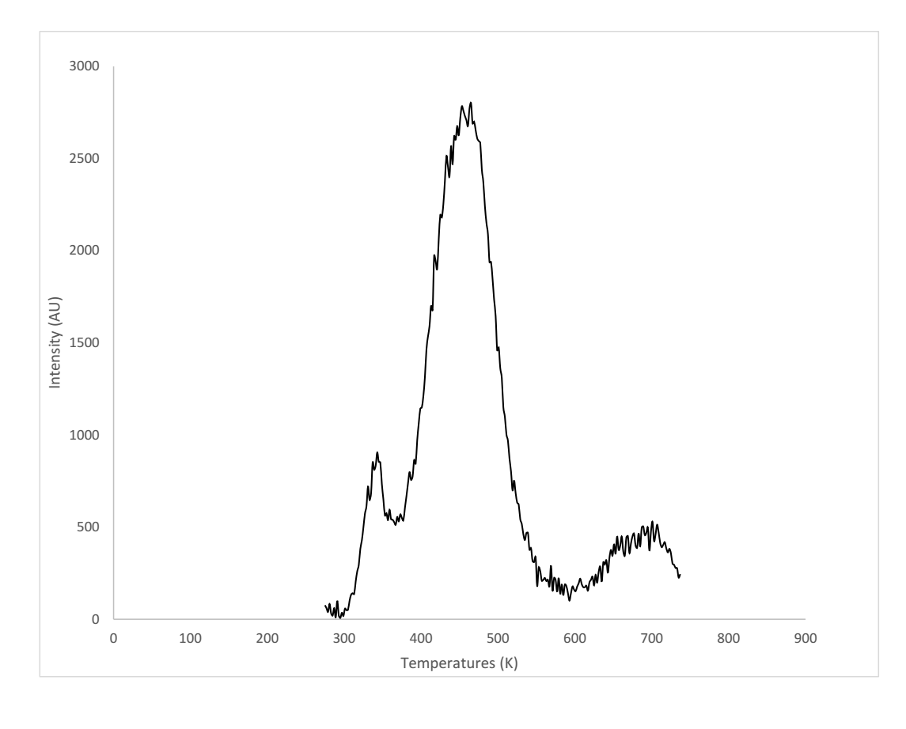
Simulated Glow Curve

Slide 12
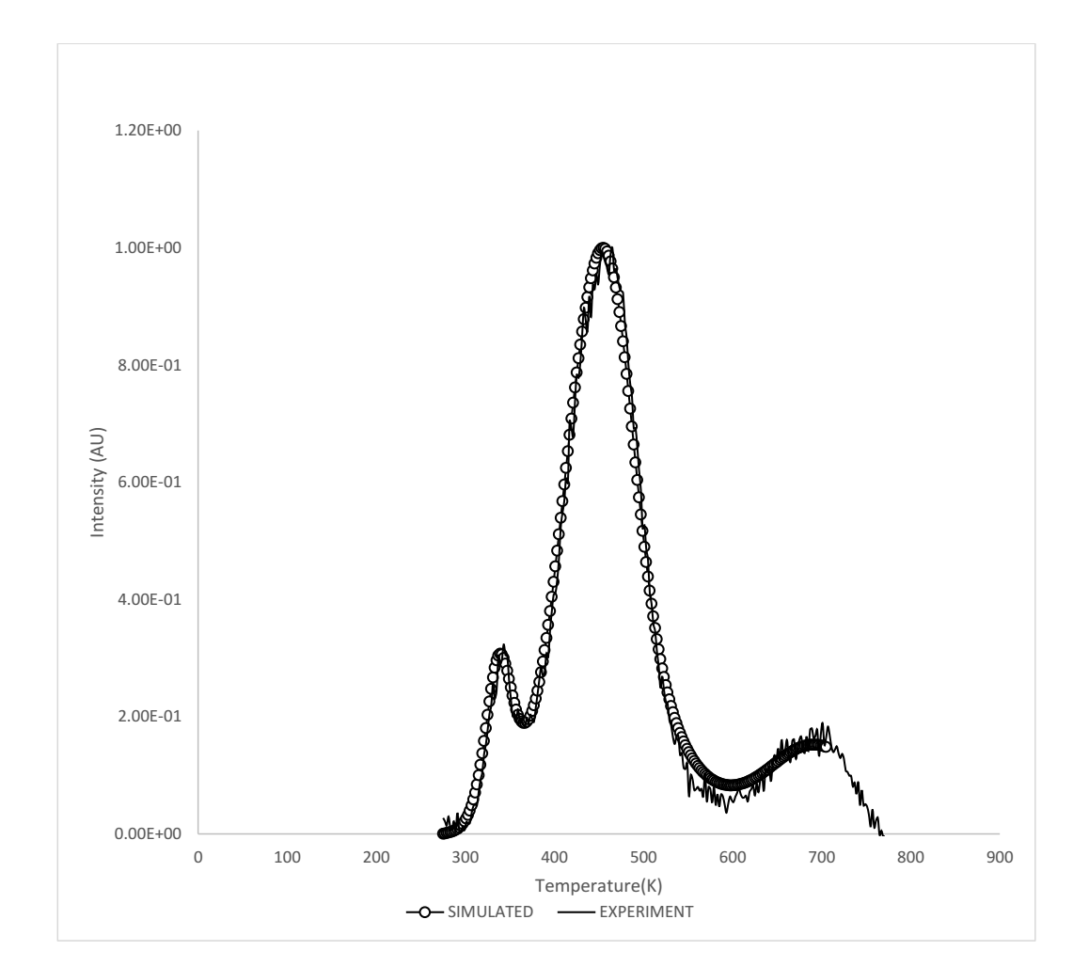
Simulated and Experimental Glow curves

Slide 13
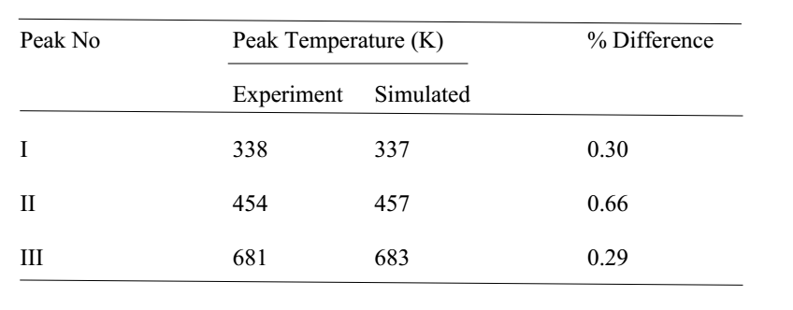

Slide 14
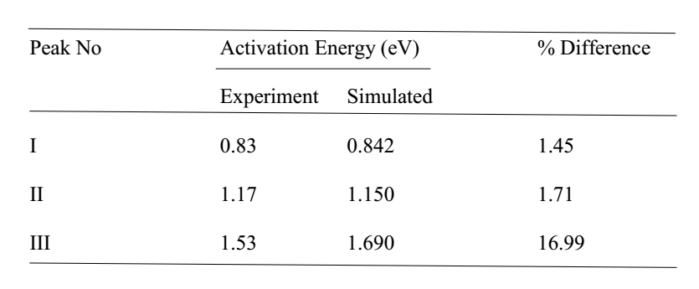

Slide 15
Conclusion
The band model proposed by Ogundare et al, 2016 describe perfectly the thermoluminescence in kunzite.
The simulated thermoluminescence glow curve showed three distinct peaks similar to what Ogundare et al (2016) reported from their experimental study of kunzite thermoluminescence.
The percentage differences of the simulated and experimental values for peak temperature and activation energy validates the numerical model

Slide 16
Thank you for listening

