Slide 1

16 T Magnet R&D Overview
Susana Izquierdo Bermudez
On behalf of EuroCirCol WP5 and the FCC-hh Magnet Development Program
D. Arbelaez¹¹, B. Auchmann¹², M. Bajko¹, A. Ballarino¹, E. Barzi¹⁰, G. Bellomo², M. Benedikt ¹, S. Izquierdo Bermudez¹, B. Bordini¹, L. Bottura¹, L. Brower¹¹, M.Buzio¹, B. Caiffi⁵, S. Caspi¹¹, A. Chakrabort, E. Coatanea ⁸, M. Dhalle³, M. Durante⁴, G. de Rijk¹, P. Fabbricatore⁵, S. Farinon⁵, H. Felice⁴, A. Fernandez ⁶, P. Gao³, S. Gourlay¹¹, M. Juchno¹¹, V. Kashikhin ¹⁰, K. Koskinen, F. Lackner¹, C. Lorin⁴, A.M. Louzguiti¹, K. Lyytikainen⁸, M. Marchevsky¹¹, S. Mariotto², J. Munilla⁶, I. Novitski¹⁰, T. Ogitsu⁷, A. Pampaloni⁵, C. Pes ⁴, J. Perez¹, C. Petrone¹, S. Prestemon¹¹, M. Prioli¹, A.M. Ricci⁵, J.M. Rifflet ⁴, E. Rochepault ⁴, S. Russenschuck¹, T. Salmi⁸, F. Savary¹, M. Segreti ⁴, C. Senatore⁹, D. Schoerling¹, M. Sorbi², M. Statera, A. Stenvall ⁸, D. Tommasini ¹, F. Toral ⁶, A.P. Verweij¹, S. Wessel³, F. Wolf ¹, A.V. Zlobin¹⁰
1.CERN, 1211 Geneva, Switzerland; 2.INFN, 20133 Milano, Italy; 3.Twente University, 7500 Twente, Netherlands; 4.CEA, 91400 Saclay, France; 5.INFN, 16146 Genova, Italy; 6.CIEMAT, 28040 Madrid, Spain; 7.KEK, 305-0801 Tsukuba, Japan; 8.Tampere University, 33100 Tampere, Finland; 9.University of Geneva, 1211 Geneva, Switzerland; 10.FNAL, Batavia IL 60510, USA; 11.LBNL, Berkeley, CA 94720, USA; 12.PSI, 5232 Villigen, Switzerland

Slide 2
16 T dipoles, a key technology
3
Future Circular Collider (FCC), or an energy upgrade of the LHC (HE-LHC), would require bending magnets operating at up to 16 T.
This is about twice the magnetic field amplitude produced by the Nb-Ti magnets of the LHC, and about 5 T higher than the field produced by the Nb₃Sn magnets for the High Luminosity LHC.
Can, these magnets, be feasible in «accelerator quality»?
If yes, at which cost?

Slide 3
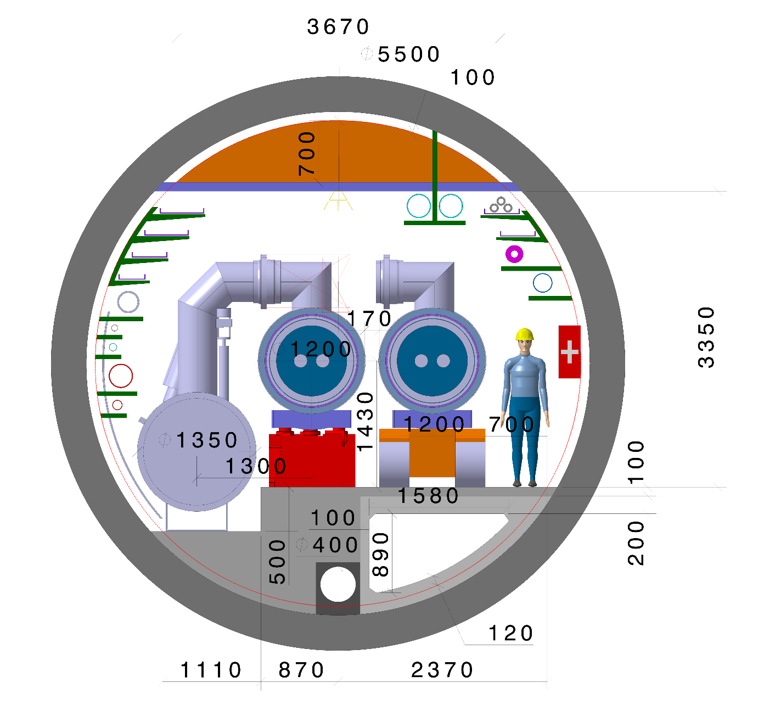
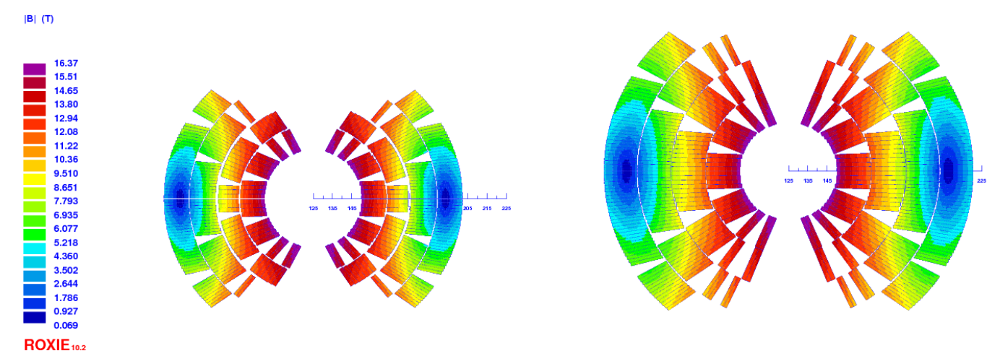
Accelerator quality
Driving design criteria:
Compact magnet with sufficient margin
  Same magnet design for FCC-hh and HE-LHC
Construction including alignment
Field quality
Protection in a circuit
FCC-hh
FCC target strand
(J_{c} = 1500 A/mm² at 4.2 K, 16 T)
HL-LHC strand
(J_{c} = 1000 A/mm² at 4.2 K, 16 T)
5.5 m diameter

Slide 4



Present 16 T Development Programs
EuroCirCol WP5 (CEA, CERN, CIEMAT, Geneva UNIV, KEK, INFN, Tampere UNIV, Twente UNIV)
Feed the FCC CDR with design and cost model of 16 T magnets
WP 5
FCC 16 T Magnet Development, supporting:
conductor development & procurement
R&D magnets and associated development
model magnets
US Magnet Development Program (ASC/NHMFL, FNAL, LBNL)
initially focused to a 14-15 T cosine-theta magnet (2017-2018)
also exploring a canted cosine-theta option, in a first step possibly as an insert to the outer layers of the 14-15 T magnet above

Slide 5
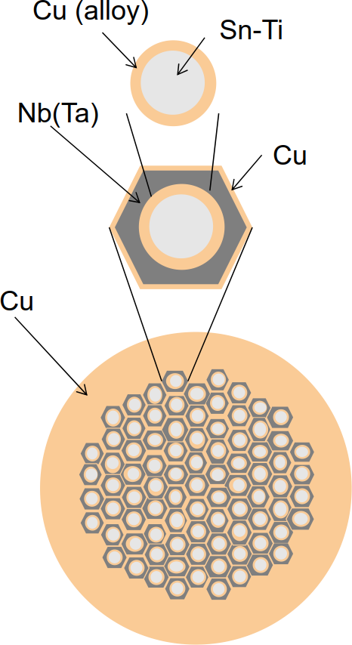
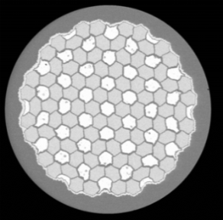

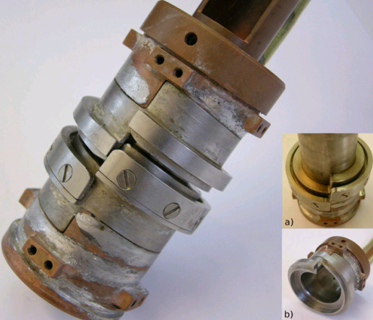
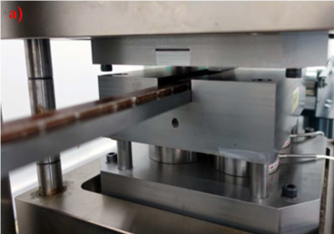
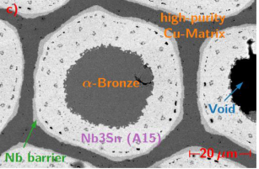
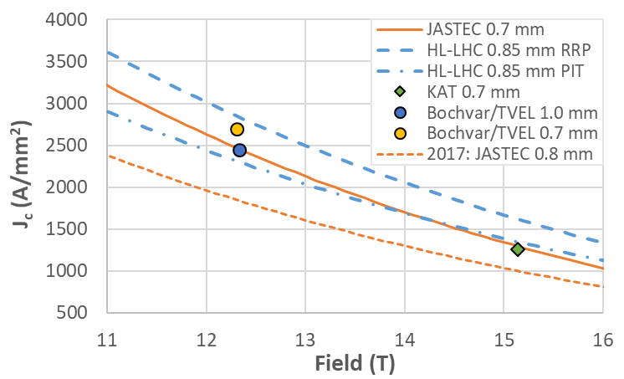

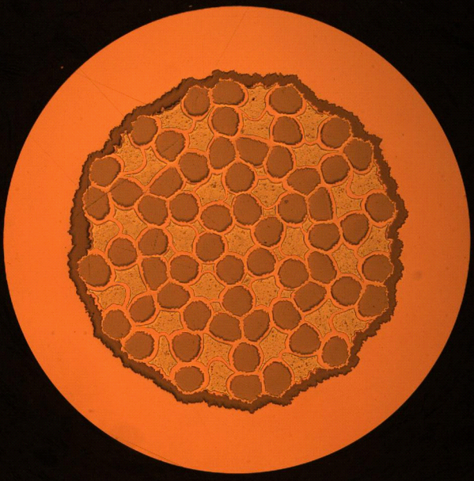
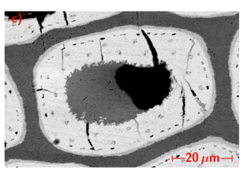



Conductor
Initial effort is to achieve J_{c} = 1500 A/mm² at 4.2 K, 16 T
Until 2023, the 16 T development program requires up to 1.5 tons/year
Interesting results from collaborations
  Korea, Japan, Russia
Non-Cu J_{c} approaching HL-LHC specification at 12 and 16 T
Intensive studies on-going for the electro-mechanical characterization of the conductor.
Irreversible degradation starts at around 170 MPa.
UNIGE Sample
CERN Sample
Twente Sample
Sample without (top) and after (bottom) loading with 200 MPa (CERN).
See sessions on Tuesday Morning

Slide 6
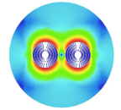
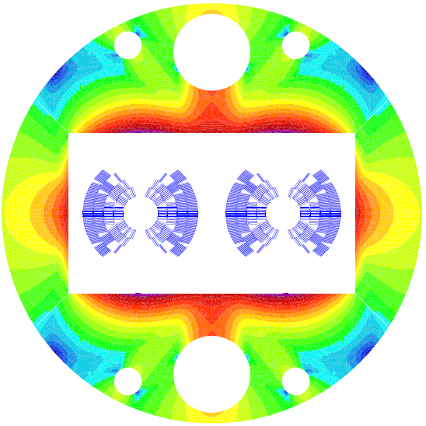
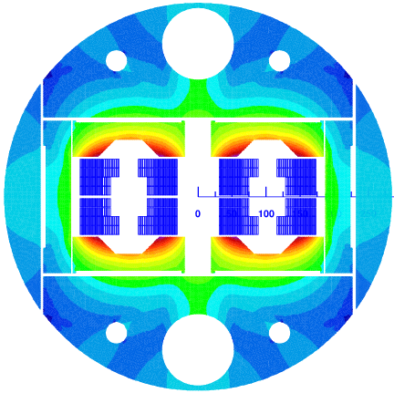




EuroCirCol – WP5: Design options
EuroCirCol shows that more than one design option may work
Each of the options has stronger and weaker points than the others.
For the FCC CDR, the cos-theta variant has been selected as the baseline option.
We have now an opportunity to build up a varied experience on Nb₃Sn magnets beyond the HiLumi specifications thanks to new initiatives:
Agreement to build a model magnet at INFN under finalization
Agreement to build a model magnet at CEA signed
Agreement to build a model magnet at CIEMAT under finalization
Magnet model under construction at PSI
See sessions on Tuesday Afternoon & Wednesday Morning

Slide 7
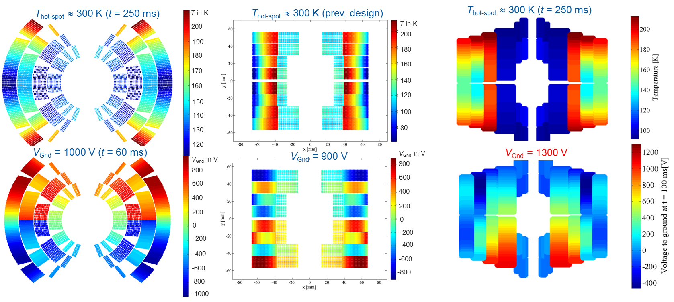
EuroCirCol – WP5: Circuit & protection
Quench protection was integrated into the magnet design since an early state, using the same software tools under the same assumptions.
All designs fulfill the required targets:
  T_{hot} < 350 K at 105 % I_{nom}
  V_{max}< 1.2 kV at 105 % I_{nom}
CLIQ has been selected as the baseline protection design.
See sessions on Wednesday Morning & Thursday Afternoon

Slide 8
EuroCirCol – WP5: Cost model
Phase 1
Scope: Establishment of a full and cost-effective parameter set for FCC-hh dipoles to drive the design selection.
Status: Completed and implemented into the designs
Phase 2
Scope: Establishment of a target cost for the 16 T magnet
Status: Concluded and ready for the CDR
Assembly cost scale up LHC magnet cost:
Double of coils (x 2)
Higher coil complexity (+ 20%)
Higher assembly complexity (+20 %)
Parts cost: + 30 % above LHC
    Conductor cost: 670 kEUR/magnet
    Assembly cost: 600 kEUR/magnet
    Parts cost: 420 kEUR/magnet
    Total cost: 1690 kEUR/magnet
Phase 3
Scope: Identify cost drivers of the assembly and magnets parts, and work with industry in the reduction of the cost.
Status: Started
See session on Wednesday Morning

Slide 9
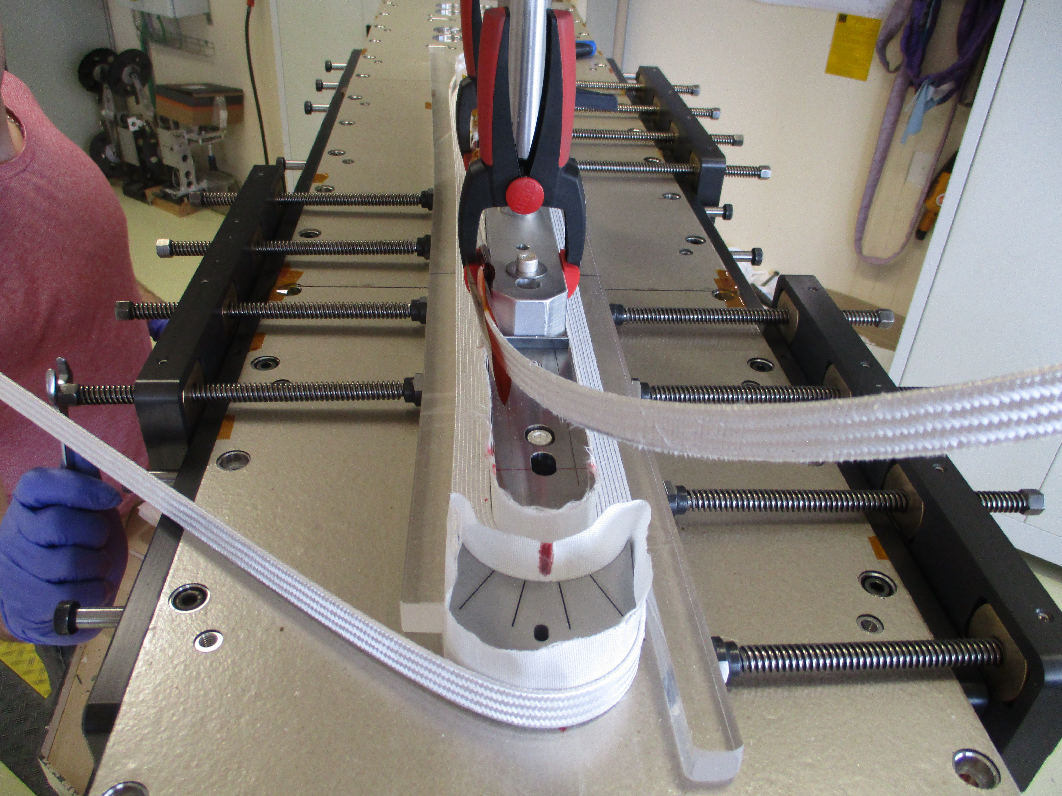
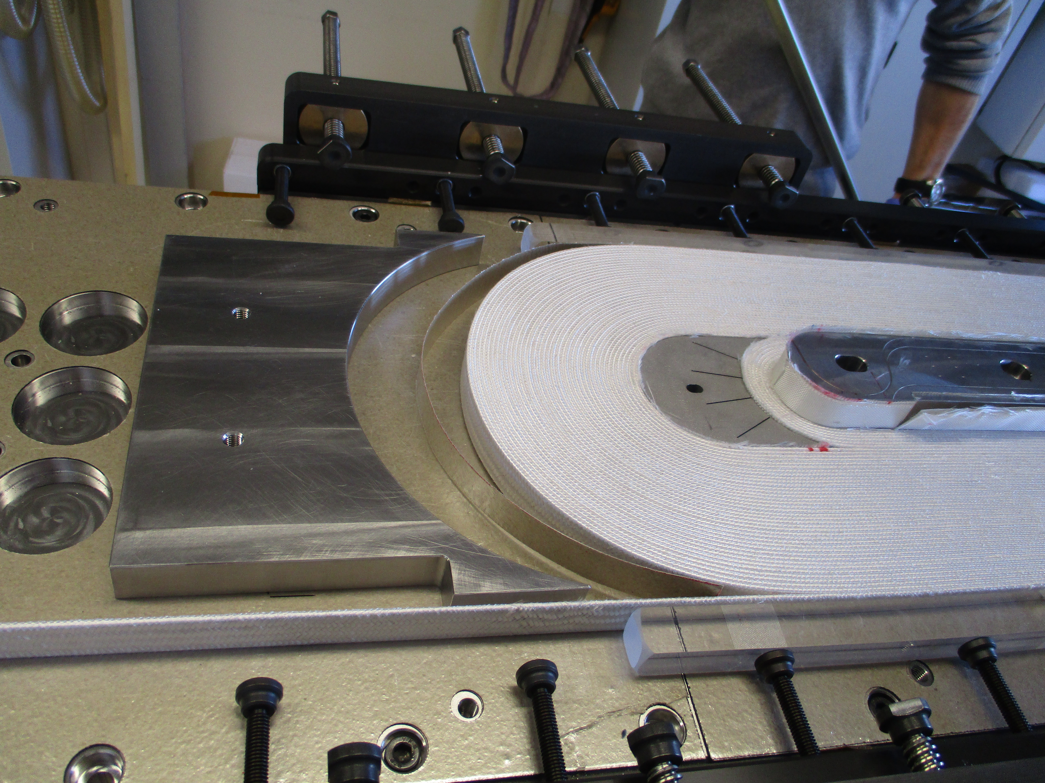
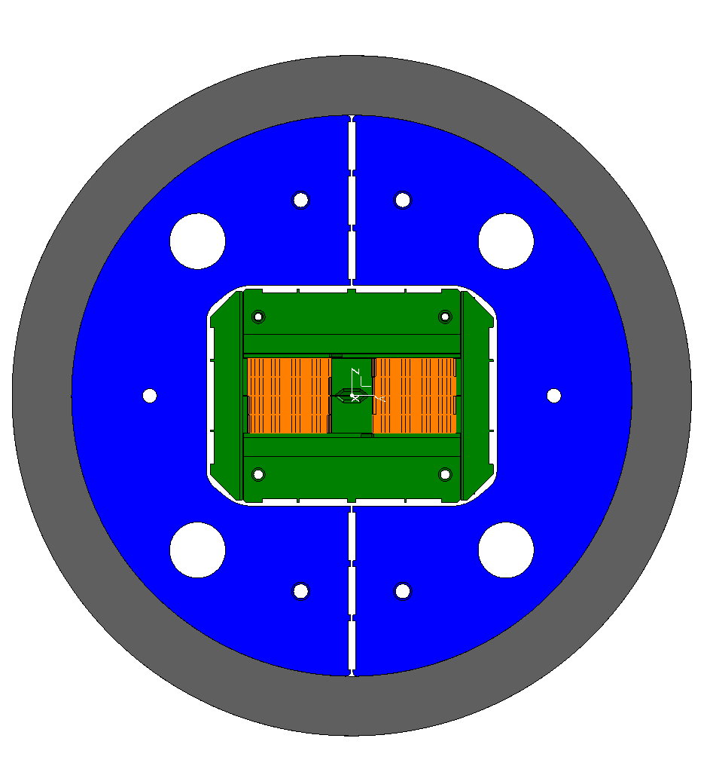
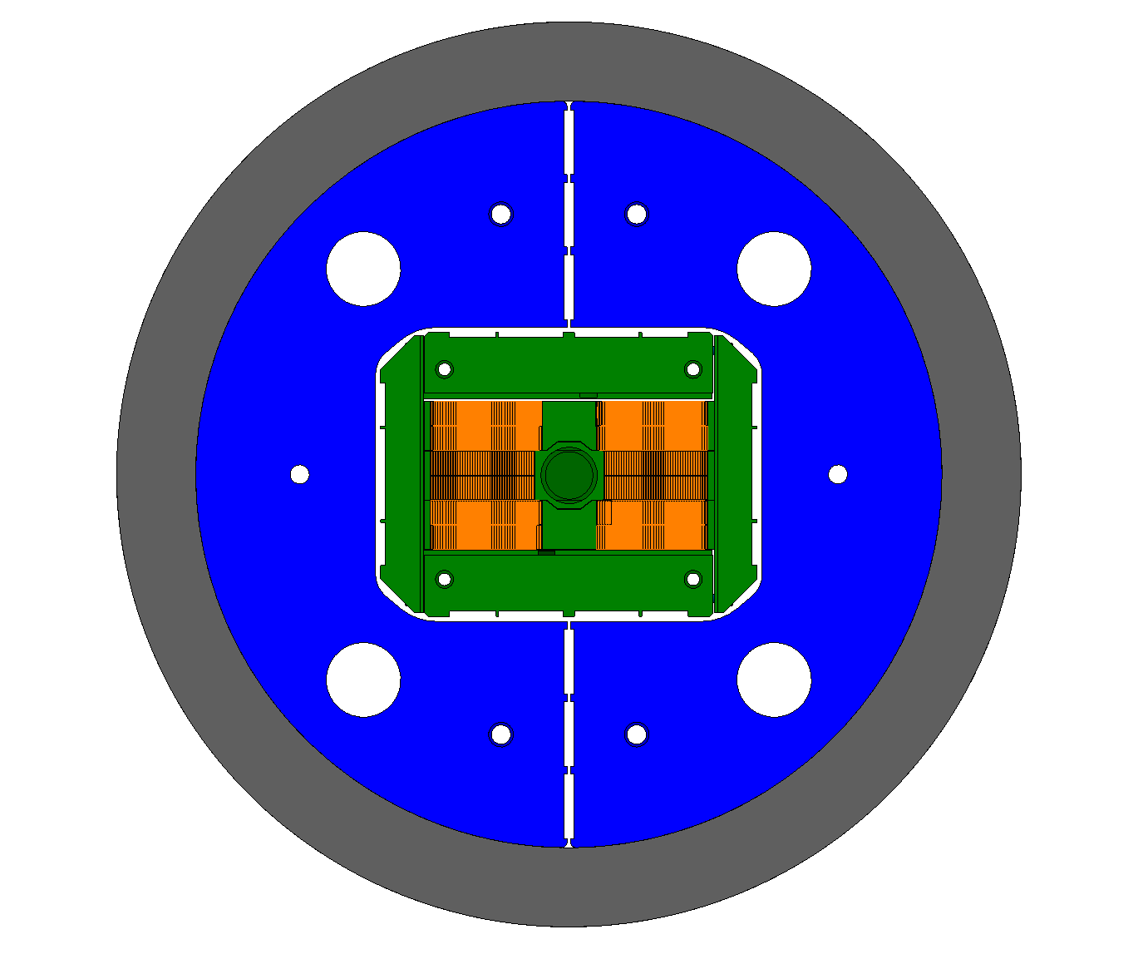
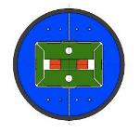
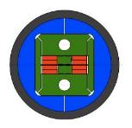
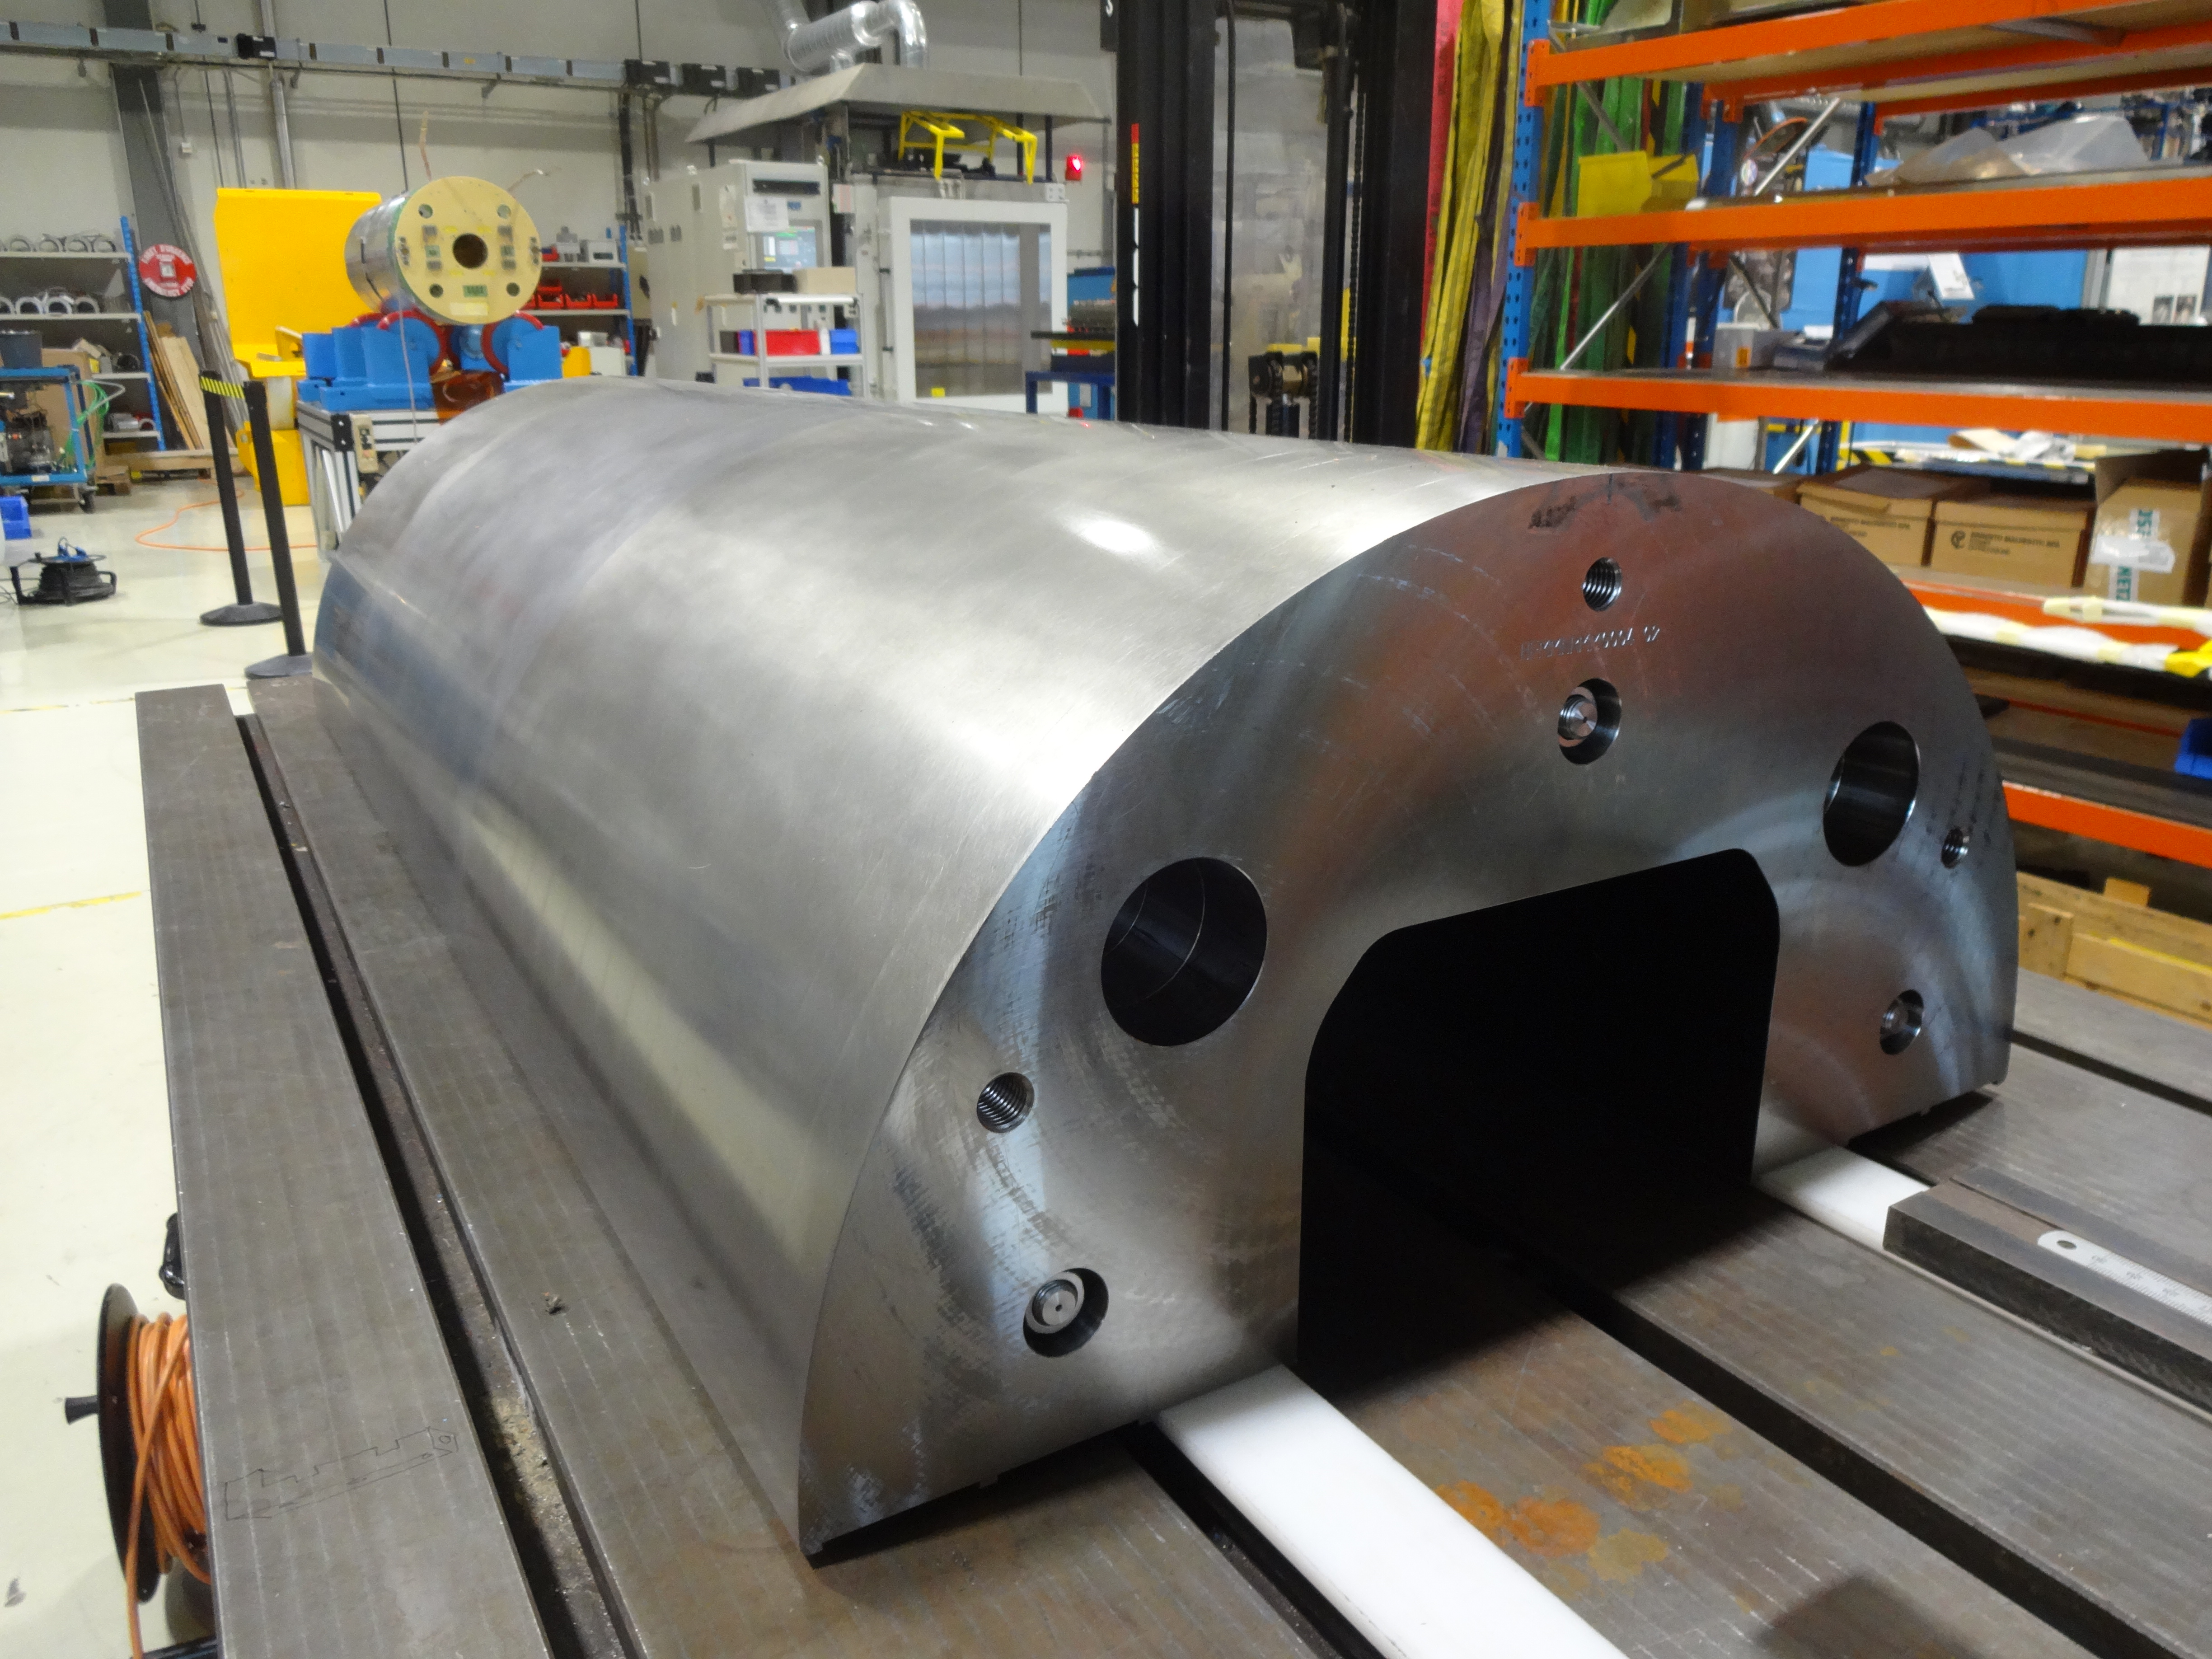
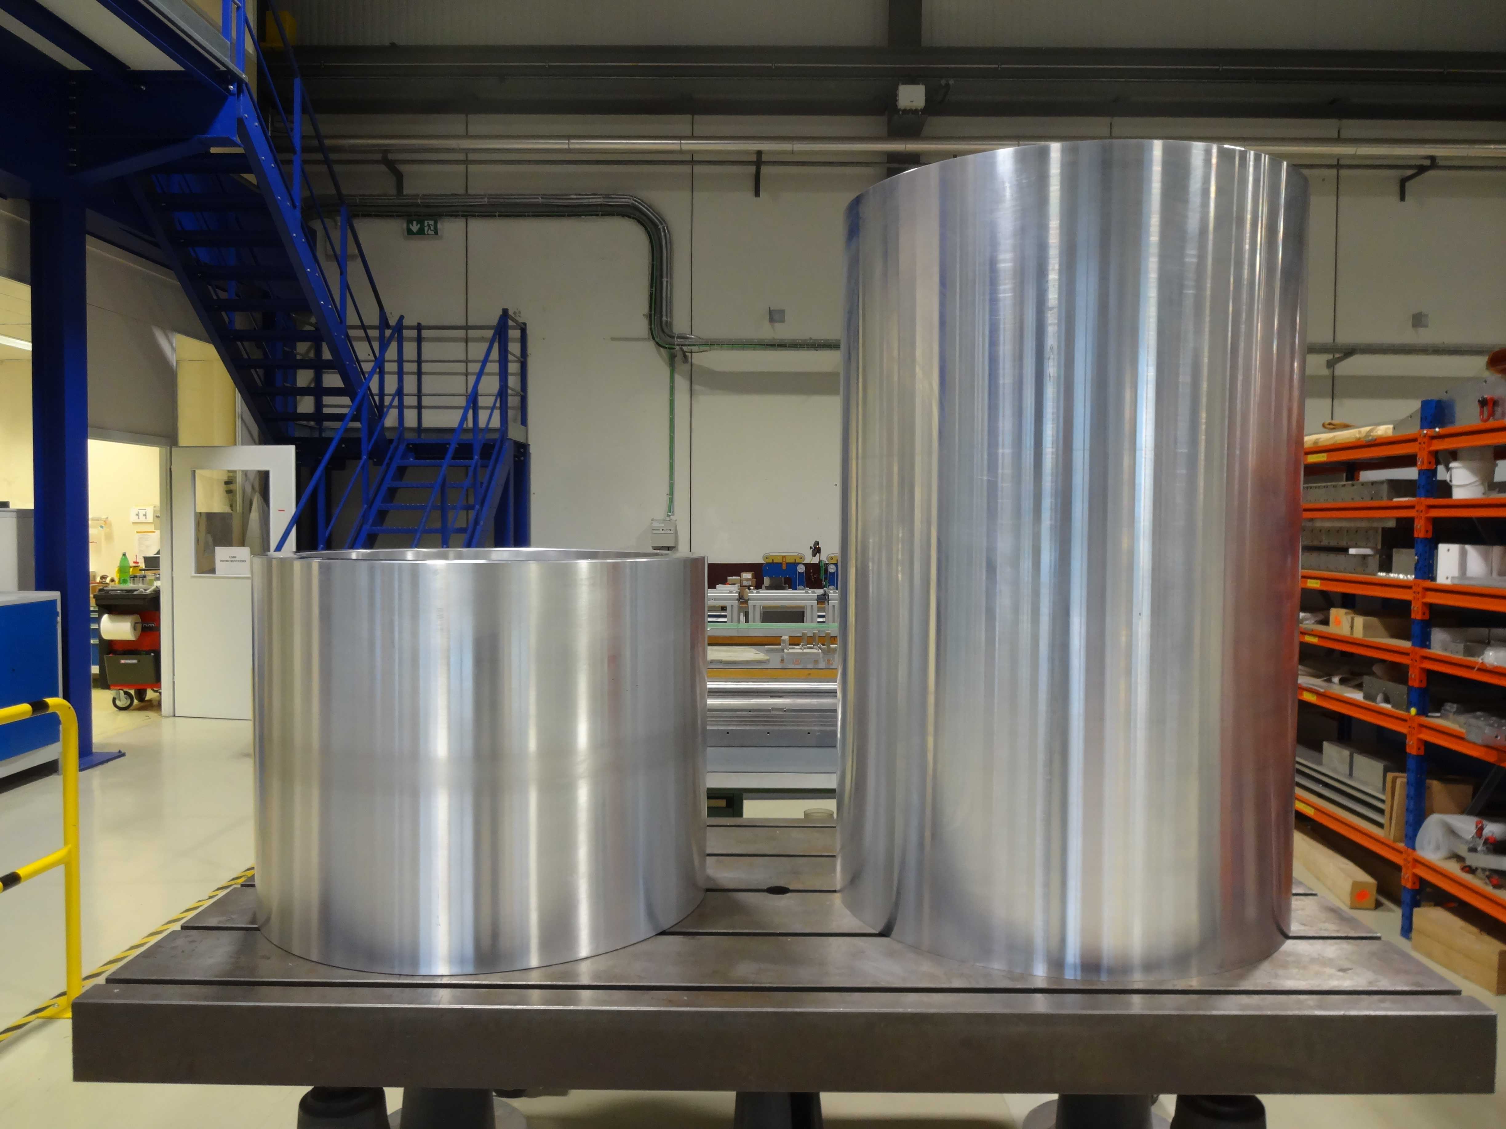
CERN R&D Model Magnets
First coil has been wound
SMC
RMC
ERMC
RMM
OD = 530 mm
L = 500 mm
No Ap.
B_{op}= n.a.
B_{ult} = 14 T
OD = 570 mm
L = 820 mm
No Ap.
B_{op}= n.a.
B_{ult} = 16 T
OD = 800 mm
L = 1.2-1.4 m
No Ap.
B_{op}= 16 T
B_{ult} = 18 T
OD = 800 mm
L = 1.2-1.4 m
50 mm closed Ap.
B_{op}= 16 T
B_{ult} = 18 T
Hi-Lumi R&D
FCC R&D
Assembly test with dummy coils on-going
See session on Wednesday Morning

Slide 10
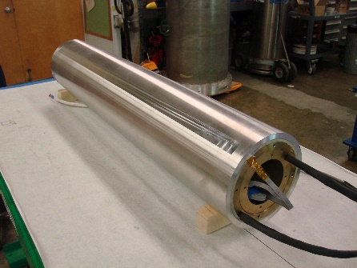
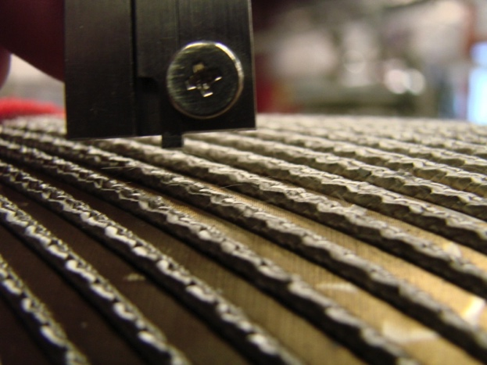
US Magnet Development Program
Fabrication of a 15 T cos-theta demonstrator on progress.
  Design and procurement completed.
  Coil fabrication on-going.
  Mechanical structure have been tested.
Design studies for an “utility” structure on-going
CCT technology and understanding has advanced through the development of two layer models
Issues with conductor damage have been resolved (CCT 4 reached 9.1 T (86% of SS limit)).
Next main focus is on training reduction
See sessions on Wednesday Morning

Slide 11
Other initiatives
Specific initiatives to tackle key aspects
CERN-Univ. Tampere (Fl) for industrialization of large production signed
CERN-EPFL (CH) for Nb₃Sn splice R&D signed, under way.
Compact coils → Cost
Cost
See session on Wednesday Afternoon
CERN-ETHZ-PSI (CH) for R&D on impregnation resins under signature
CERN-Univ. Patras (Gr) for compact mechanical structures under signature
Training
Cost & Performance

Slide 12
Conclusions
Accelerator magnets in Nb₃Sn technology are becoming reality in HiLumi. Still, the distance between 11 T and 16 T is large.
We are ready to the FCC CDR:
  The contribution for the <concise, short> CDR volume (8 pages for magnets) is ready, and will be shared for final check by the end of April.
  The first drafts for the contribution for <comprehensive, long> CDR volume will be ready by end of September, and the final documents will be provided by the end of November.
HE-LHC has triggered a development towards compact magnets, which is both beneficial for FCC-hh and HE-LHC.
The effort of EuroCirCol will be continued and we plan 3 short model 16 T magnets built by the respective institutes with CERN contributions.
16 T Dipole development is an international collaboration, including our European, US, Korean and Japanese partners, and now Russia is about to join our effort ☺

Slide 13



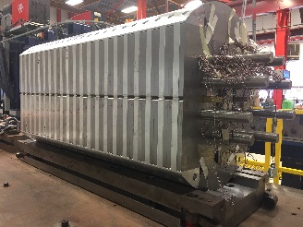





















Thank you!
Programs:
Institutes and companies:
Bruker, Germany/USA
Technical University Freiberg, Germany
Consiglio Nazionale delle Ricerche - SuPerconducting and other INnovative materials and devices institute, Italy
Lawrence Berkeley National Laboratory, USA
University of Twente, Netherlands
INFN Milano, Milano, Italy
INFN Genova, Genova, Italy
Tampere University of Technology, Finland
IRFU, CEA, Université Paris-Saclay, France
CIEMAT, Spain
PSI, Switzerland
Columbus Superconductor, Italy
Technical University Vienna, Austria
University of Geneva, Switzerland
Fermi National Accelerator Laboratory, USA
Bochvar Institute, Russia
TVEL, Russia
Kiswire (KAT), Corea
KEK, Japan
Jastec, Japan
Fukurawa Electric, Japan
MDP 15 T technological model
CERN’s first ERMC coil is wound

Slide 15
Field quality table for 3.3 TeV (LHC injection, 1.1 T)
Better field quality would ease machine operation
Smaller random b₃ is required to control the chromaticity, which cannot be measured in real time during beam acceleration
Within EuroCirCol WP5 studies to mitigate in particular b₃ have been started
b₂ can be reduced by increasing the inter-beam distance, for example to 20 units at 250 mm
Systematic:
Injection = Geometric + Persistent
High Field/Collision = Geometric + Saturation
Beam acceleration
Beam acceleration

