Slide 1



Civil Engineering Developments
FCC week 2018 Amsterdam
J. Osborne, J. Stanyard

Slide 2
Agenda
Civil Engineering study progress since Berlin 2017
Scope of Civil Engineering for:
  FCC-hh
  FCC-ee
  FCC-eh
  HE-LHC
Alignment and Geology Update
Update on the principal structures and position
Typical tunnel cross-section
Experimental cavern layout options
Cost and Schedule Study
Spoil Management Study
Ground Investigation planning and Future Steps

Slide 3
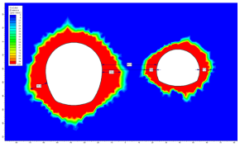
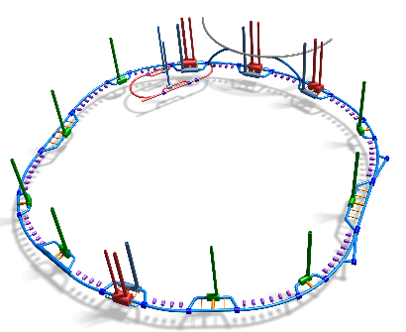
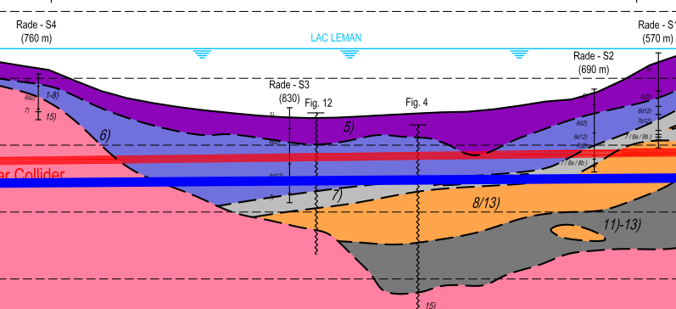


Study progress 2017/18
Alignment update following geological review of key areas:
Lake crossing
Arve and Rhone Valleys
Led to the lowering of the alignment by 30 m.
Phase 3 of cost and schedule study launched.
Refinement of results from previous phases
Produce a cost and schedule estimate that is compatible with the CDR baseline.
Design development with integration, including study to investigate feasibility of interaction region layout.
Cost and schedule round up for all 3 machines:
FCC-hh, FCC-ee and FCC-eh
CDR writing
Ongoing work:
Surface site investigation
Spoil management study
Site investigation planning
HE-LHC feasibility and cost
Transfer line design
August 2017
September 2017
February 2017
March 2018
Ongoing

Slide 4
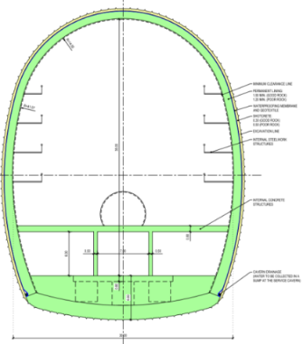

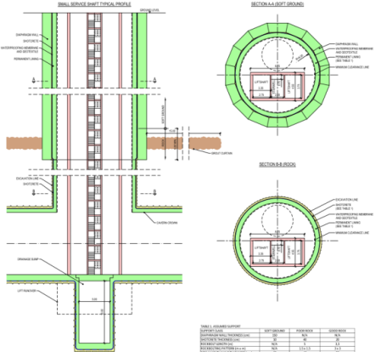
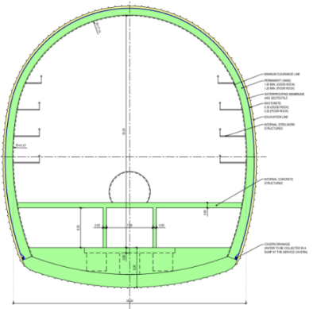
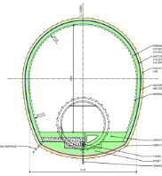
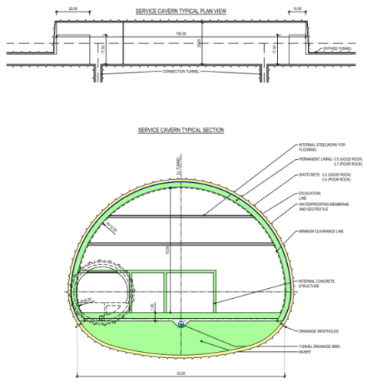
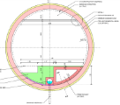
Scope of FCC-hh
Shafts:
Experimental Shafts:
15 m dia. + 10 m dia.
Service shafts:
12 m dia.
Magnet delivery shaft:
18 m
Small Experimental Caverns
30 m x 35 m x 66m
Dump Caverns
10 m x 10 m x 50 m
Large Experimental Caverns
35 m x 35 m x 66 m
Service Caverns
25 m x 15 m x 100 m
Tunnels:
97.75 km of 5.5 dia. machine tunnel
Approx. 8 km 5.5 dia by-pass tunnels

Slide 5
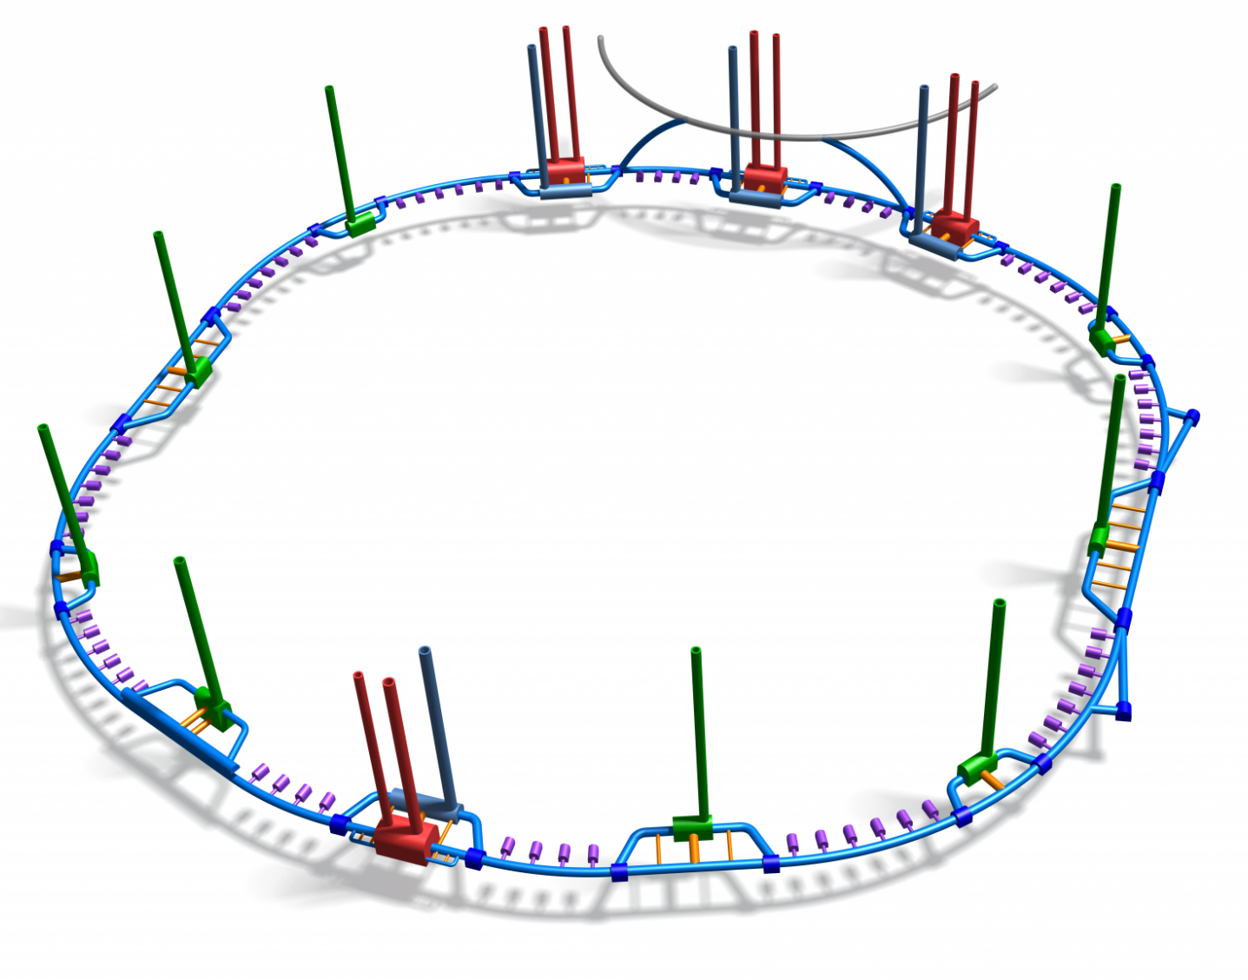
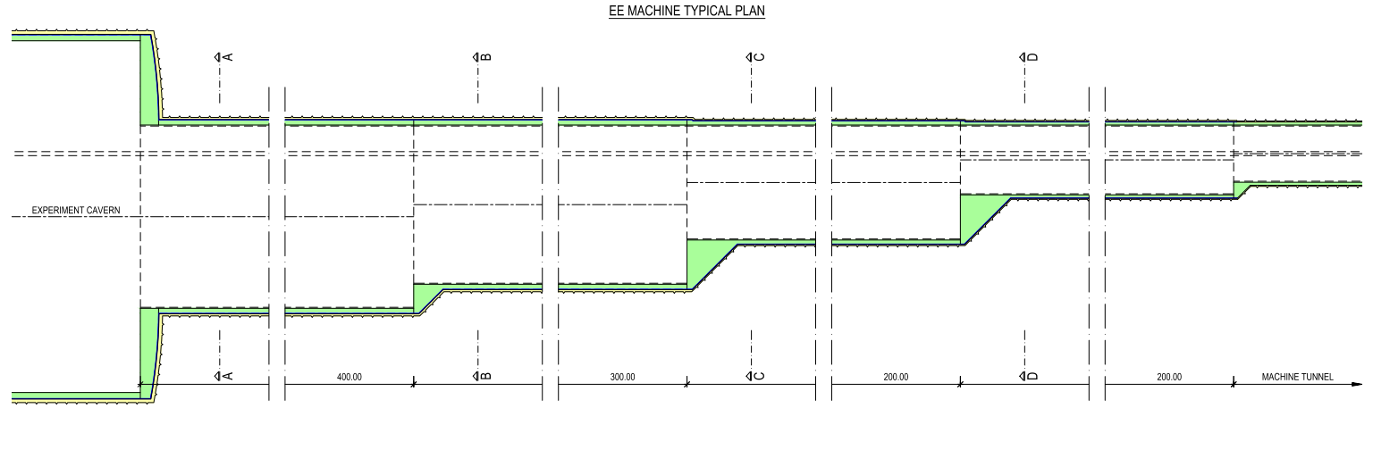
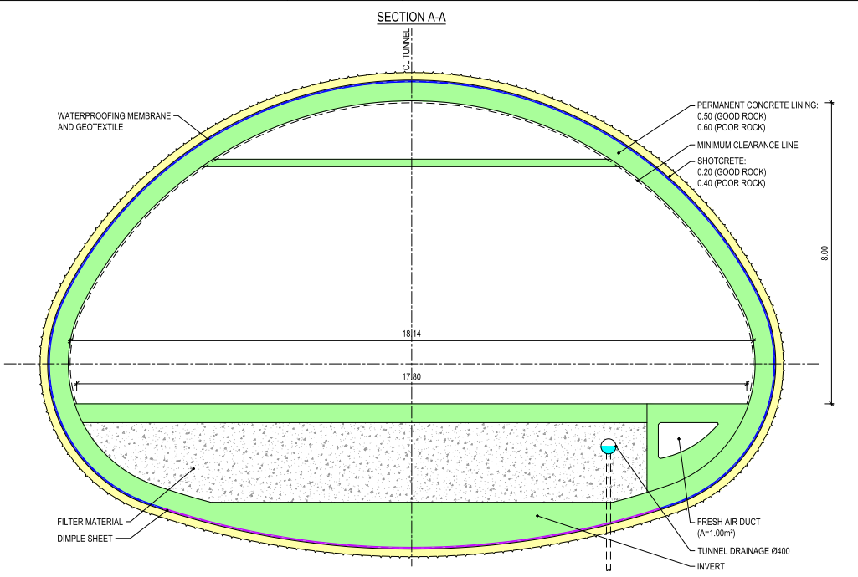
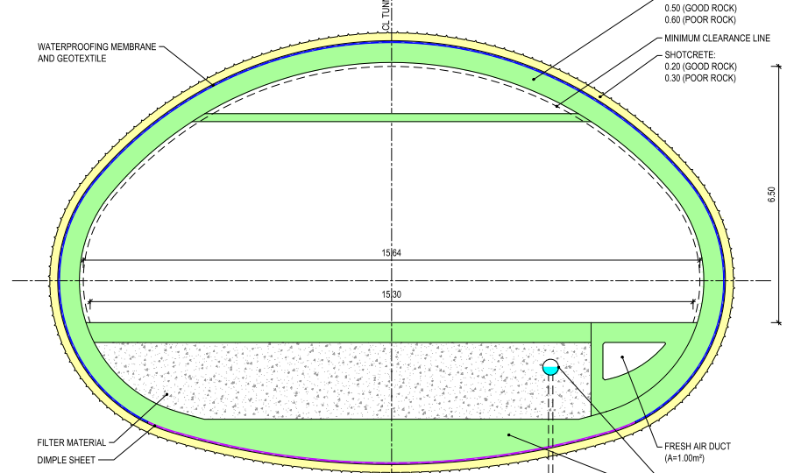
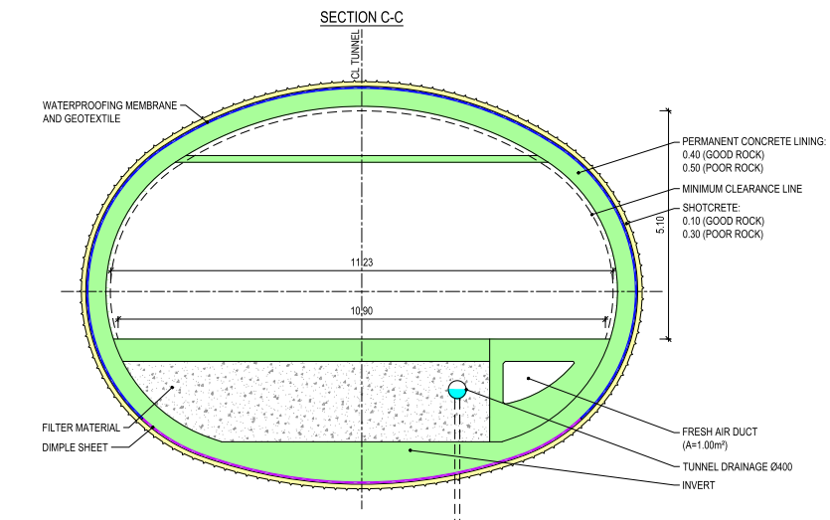
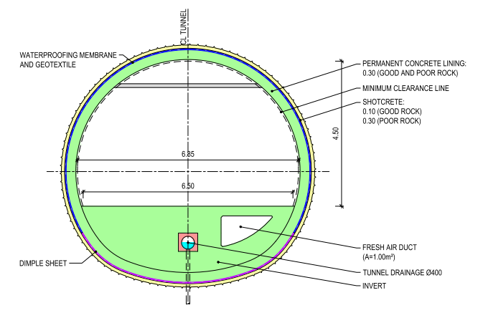
FCC-ee
Would be constructed at the same time as FCC-hh
Infrastructure must be able to accommodate both machines.
Enlargements required at experiment points A and G.

Slide 6

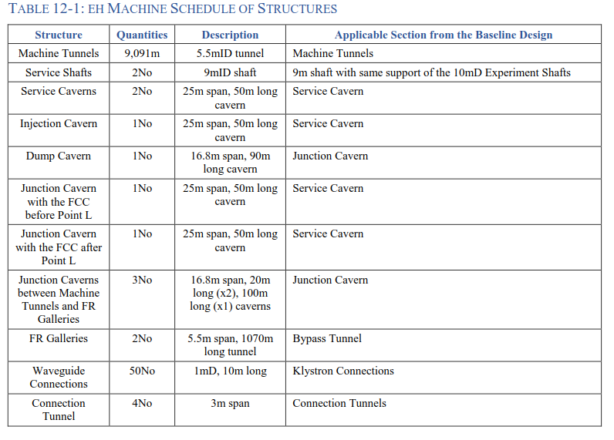
FCC-eh
Civil Engineering of FCC-eh – J.Osborne
Thursday 12th April 9:00, Berlage Zaal 1.9

Slide 7
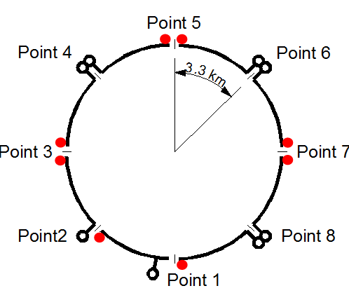
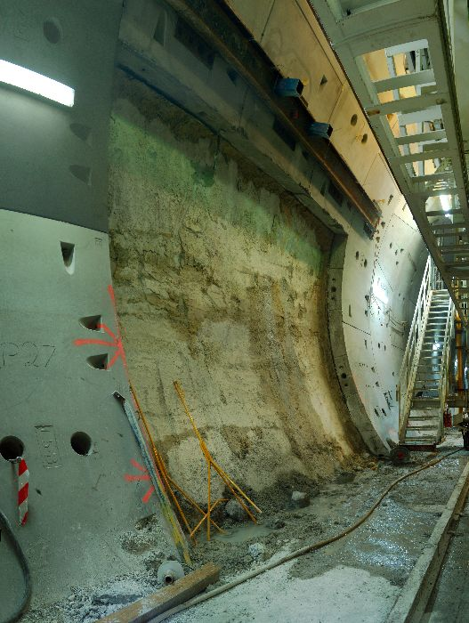
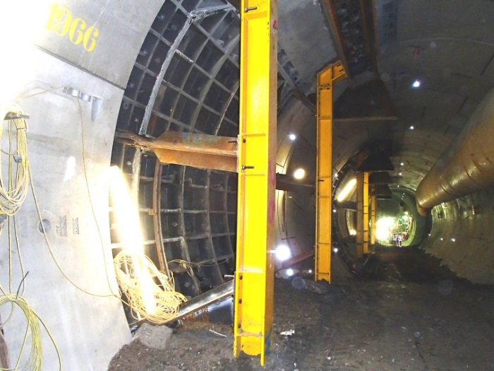
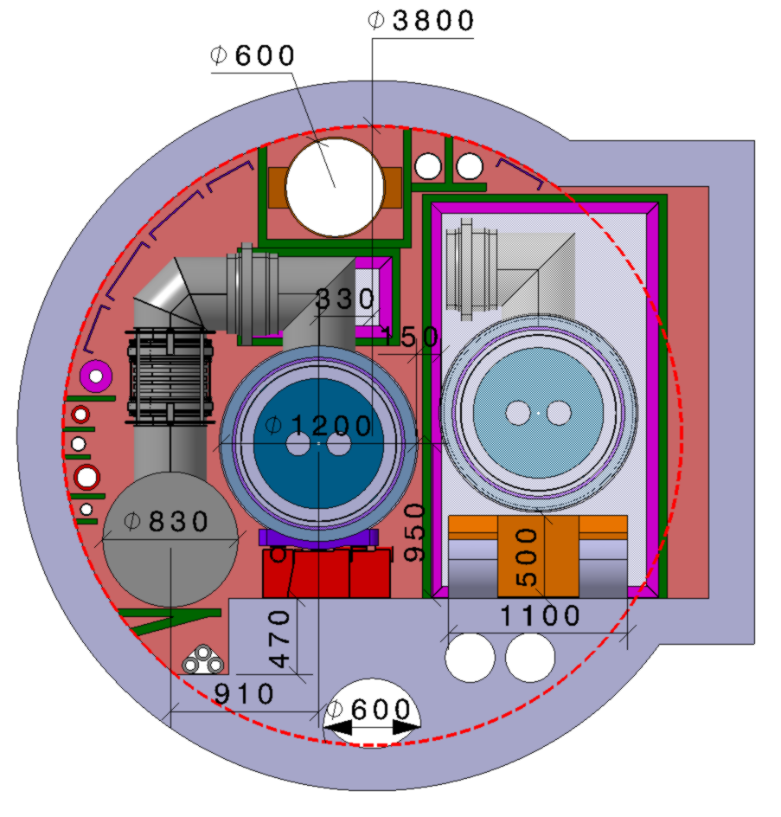
HE-LHC
For HE-LHC modifications are required to house a new accelerator, including:
  Cryogenic caverns and buildings
  Installation of fire separation walls including extension of the tunnel envelope each 400 m
  Maintenance of the existing structure.
Crossrail – Cross Passage Temporary Frames
Brisbane – Airport Link
(Similar ground to CERN)

Slide 8
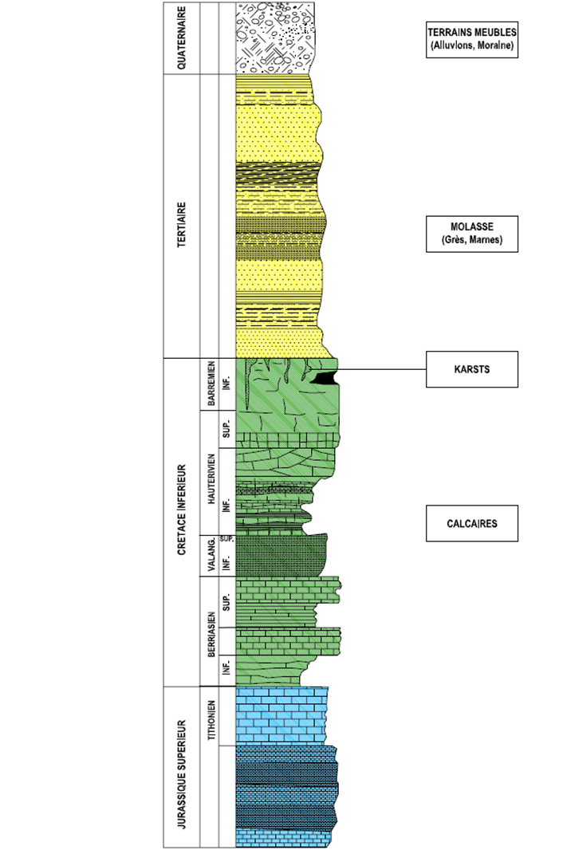
Introduction to the geology of the Geneva Basin
Moraines
Glacial deposits comprising gravel, sands, silt and clay
Water bearing unit
Low strength
Molasse
Mixture of sandstones, marls and formations of intermediate composition
Relatively dry and stable
However, some risk involved: structural instability (swelling, creep, squeezing)
Limestone
Hard rock
In this region fractures and karsts encountered
High inflow rates measured during LEP construction (600L/sec)
Clay-silt sediments in water filling karsts

Slide 9
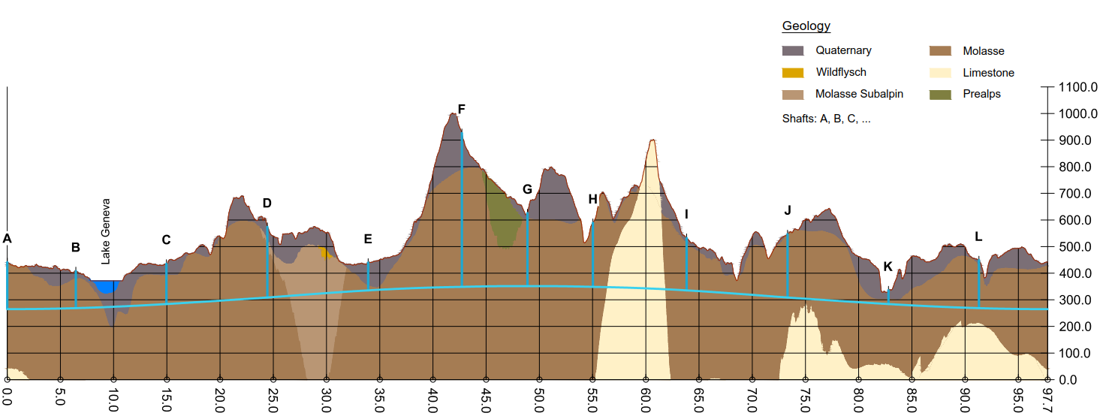
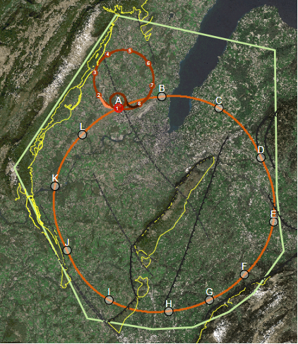
Alignment Update
Following another round of geological review of the most challenging areas this is the baseline position considering:
Lowest risk for construction
Fastest and cheapest construction
Feasible positions for large span caverns (the most challenging structures)
Not considering:
Results from initial feedback on surface site locations

Slide 10
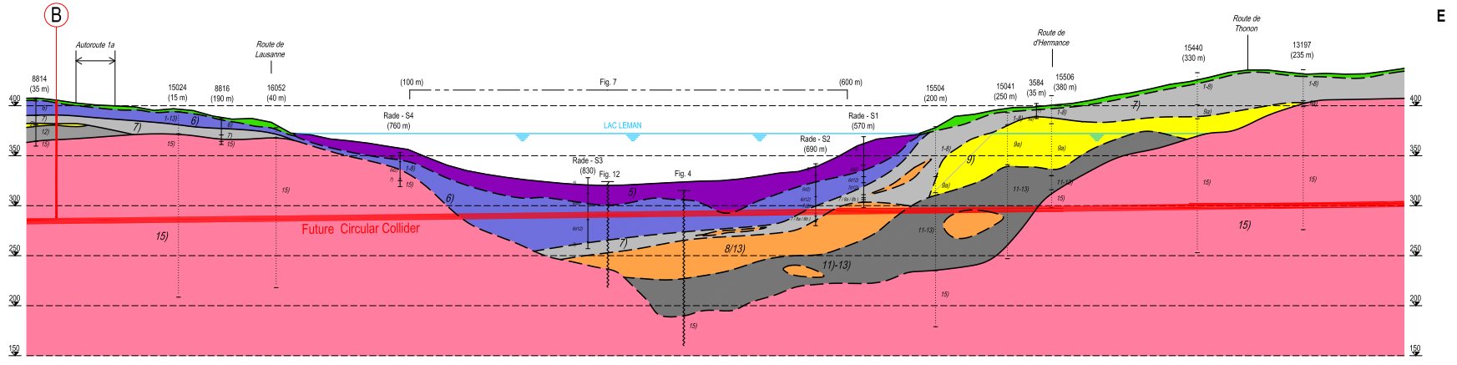
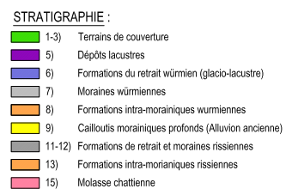
Geology under lake
Data available from boreholes and seismic scans for potential lake road crossing.
Tunnel to cross moraine layer below lake.
Layered moraine types, improving in quality with depth. However, the deeper the tunnel in the moraines, the greater the pressure on the tunnel gaskets.
Conclusion: Lower alignment by 30 m in order for the tunnel to be at a depth with a reduced construction risk and that will not be affected by changes in the lake depth during the operation phase.
Construction method: Slurry TBM

Slide 11
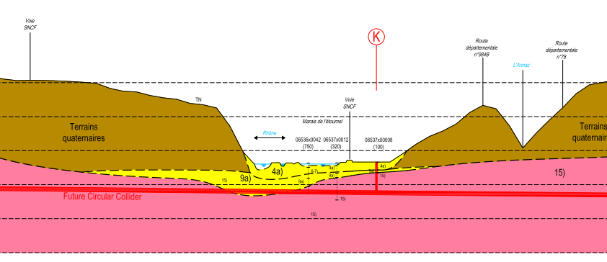
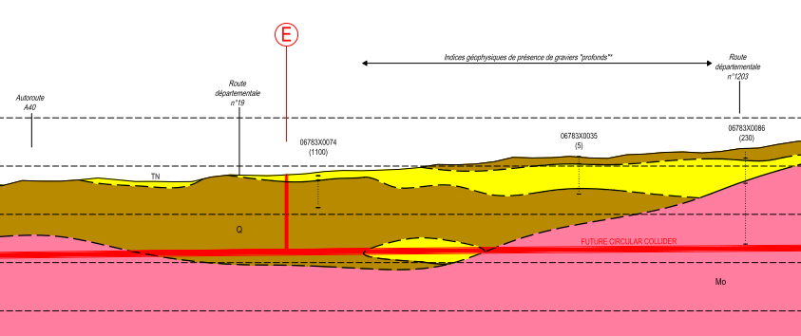
Geology of Rhone and Arve valleys
Data available from deep destructive drillings for water research in the vicinity of the crossing.
Tunnel previously crossing saturated moraines below Rhone in NATURA 2000 protected area.
Data available from oil surveys, destructive drillings and geological maps.
Tunnel previously crossing moraine later, including permeable layers (shown in yellow)
Conclusion: Lower alignment by 20 m so that the TBM mode does not need to be changed and environmental risks are minimised.

Slide 12
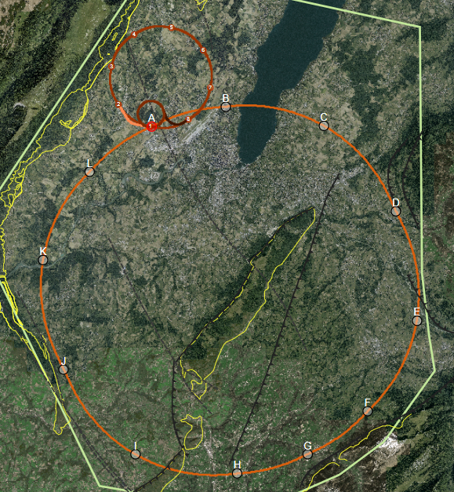
Geological Uncertainty along Alignment
Seismic and borehole information for lake crossing from proposed road tunnel, but layered nature of lake bed leads to uncertainty.
Information near to CERN is strong due to previous experience on LEP/LHC.
Multiple deep boreholes in the area.
B
A
C
Location of the interface between molasse and molasse subalpine not certain, tunnel alignment in proximity.
L
D
K
Moraine/molasse interface not certain, cavern close to interface.
Lack of deep boreholes in area.
Alignment close to limestone rockhead
E
J
No deep borehole information available in the area.
Complex faulted region.
Molasse/limestone interface not certain.
F
Limestone formation known, but characteristics and locations of karsts unknown.
I
G
H

Slide 13
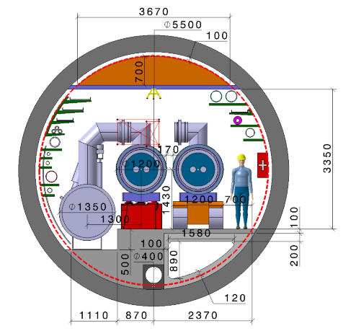
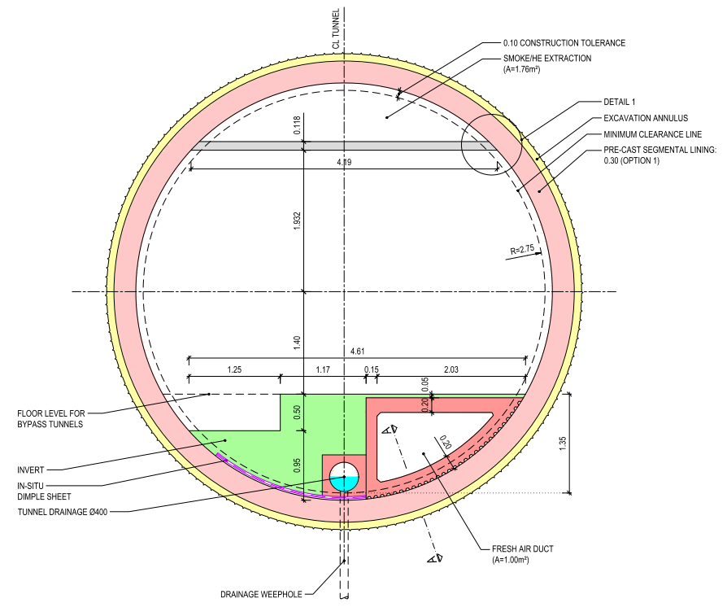
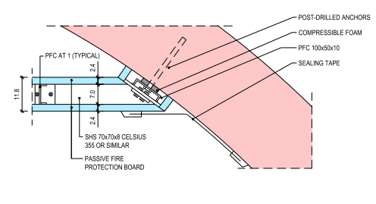
Typical tunnel cross-section
Steel structure with passive fire protection. Connection:
Pre-cast concrete segmental lining
Cast-in-situ concrete invert
Pre-cast concrete element

Slide 14
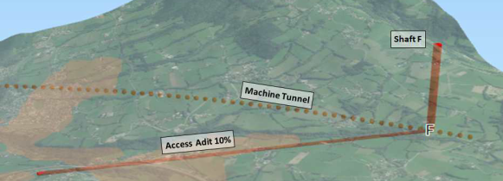
Point F options
Option | 576 m Shaft | 10% inclined access | 15% inclined access
Excavation length | 576 m (12 mID) | 3820 m (9.0mID) | 2750 m (9.0mID)
Total duration (months) | 22.2 | 25.8 | 23.2
Relative CE Cost | 1 | 1.08 | 0.78
Advantages | Shorted length of services | Improved surface site location and access TBM ready in cavern for tunnel excavation | Improved surface site location and access TBM ready in cavern for tunnel excavation
Disadvantages | Baseline lift mechanism not feasible Surface site has difficult access | Increased length of services | Increased length of services Transport method at 15% to be confirmed
Existing LEP transfer tunnel TI18 15% from SPS to LHC
Whole project cost and schedule implications, including transport and services, still to be evaluated.

Slide 15
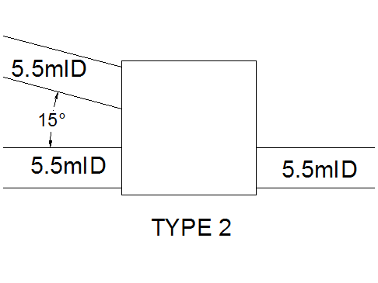
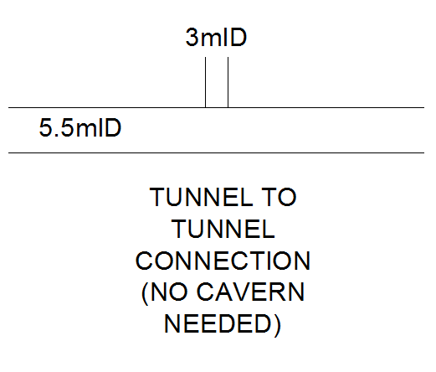
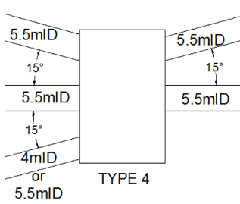
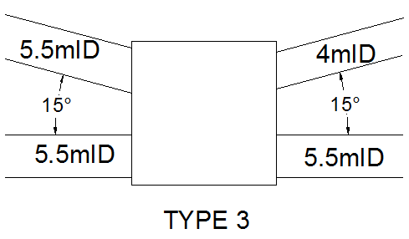
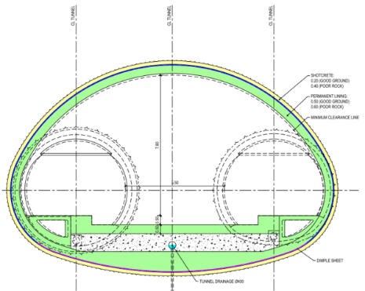
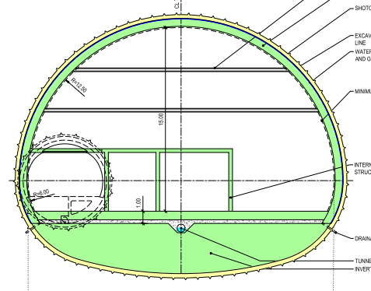
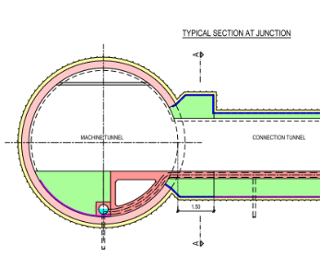
Junction cavern refinement
Junction caverns are required for structural stability when tunnels of similar size connect.
By evaluating each case individually, it was possible to omit some junction caverns
The remaining caverns have been grouped into 3 types. (Type 1 below indicates no cavern is needed)
Seite 15

Slide 16

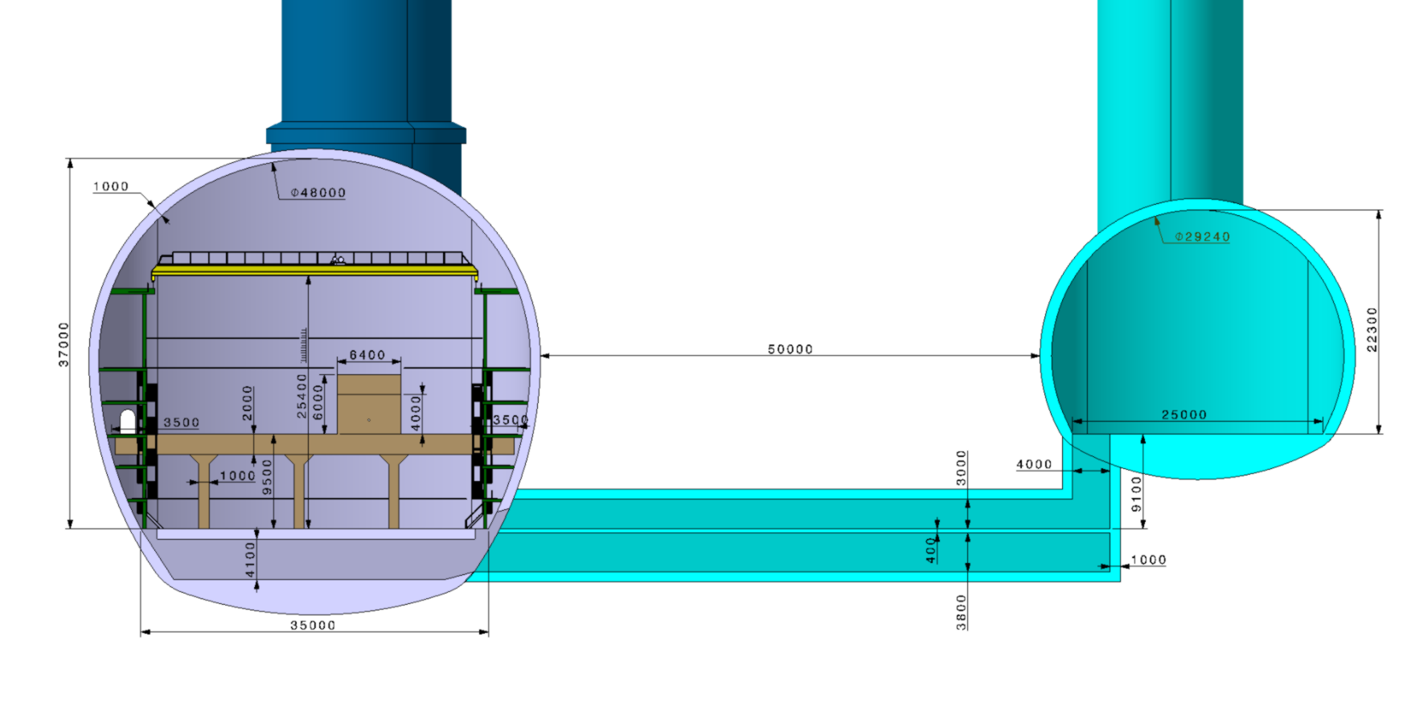
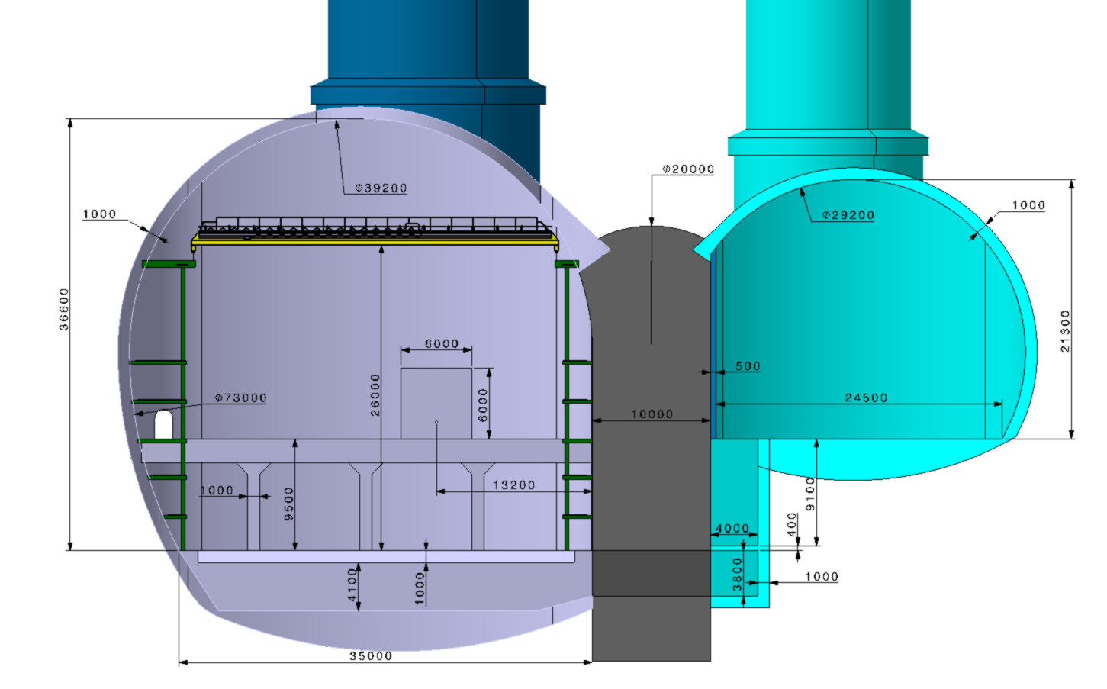
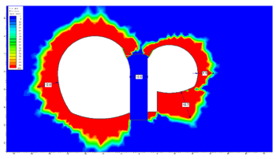
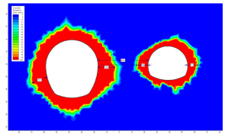
Experimental point layout options
With 45 m spacing in good molasse, the rock pillar alone is sufficient.
Cheapest and lowest risk option for CE
With a 10 m spacing it is feasible but a high strength concrete pillar is required.

Slide 17



Cost and schedule study progress
Phase 1
Cost & Schedule estimate for “baseline” single tunnel design.
Phase 2
Cost & Schedule implications of variations considered:
Phase 3
Refinement of results from Phases 1 and 2:
Double tunnel design
Shallow option
Alternative tunnel diameters
Alternative shaft diameters
Alternative cavern dimensions
ee machine requirements
Alternative schedule + Inclined access tunnels
Review to include updates made to baselined design.
Incorporate desirable variations from Phase 2.

Slide 18
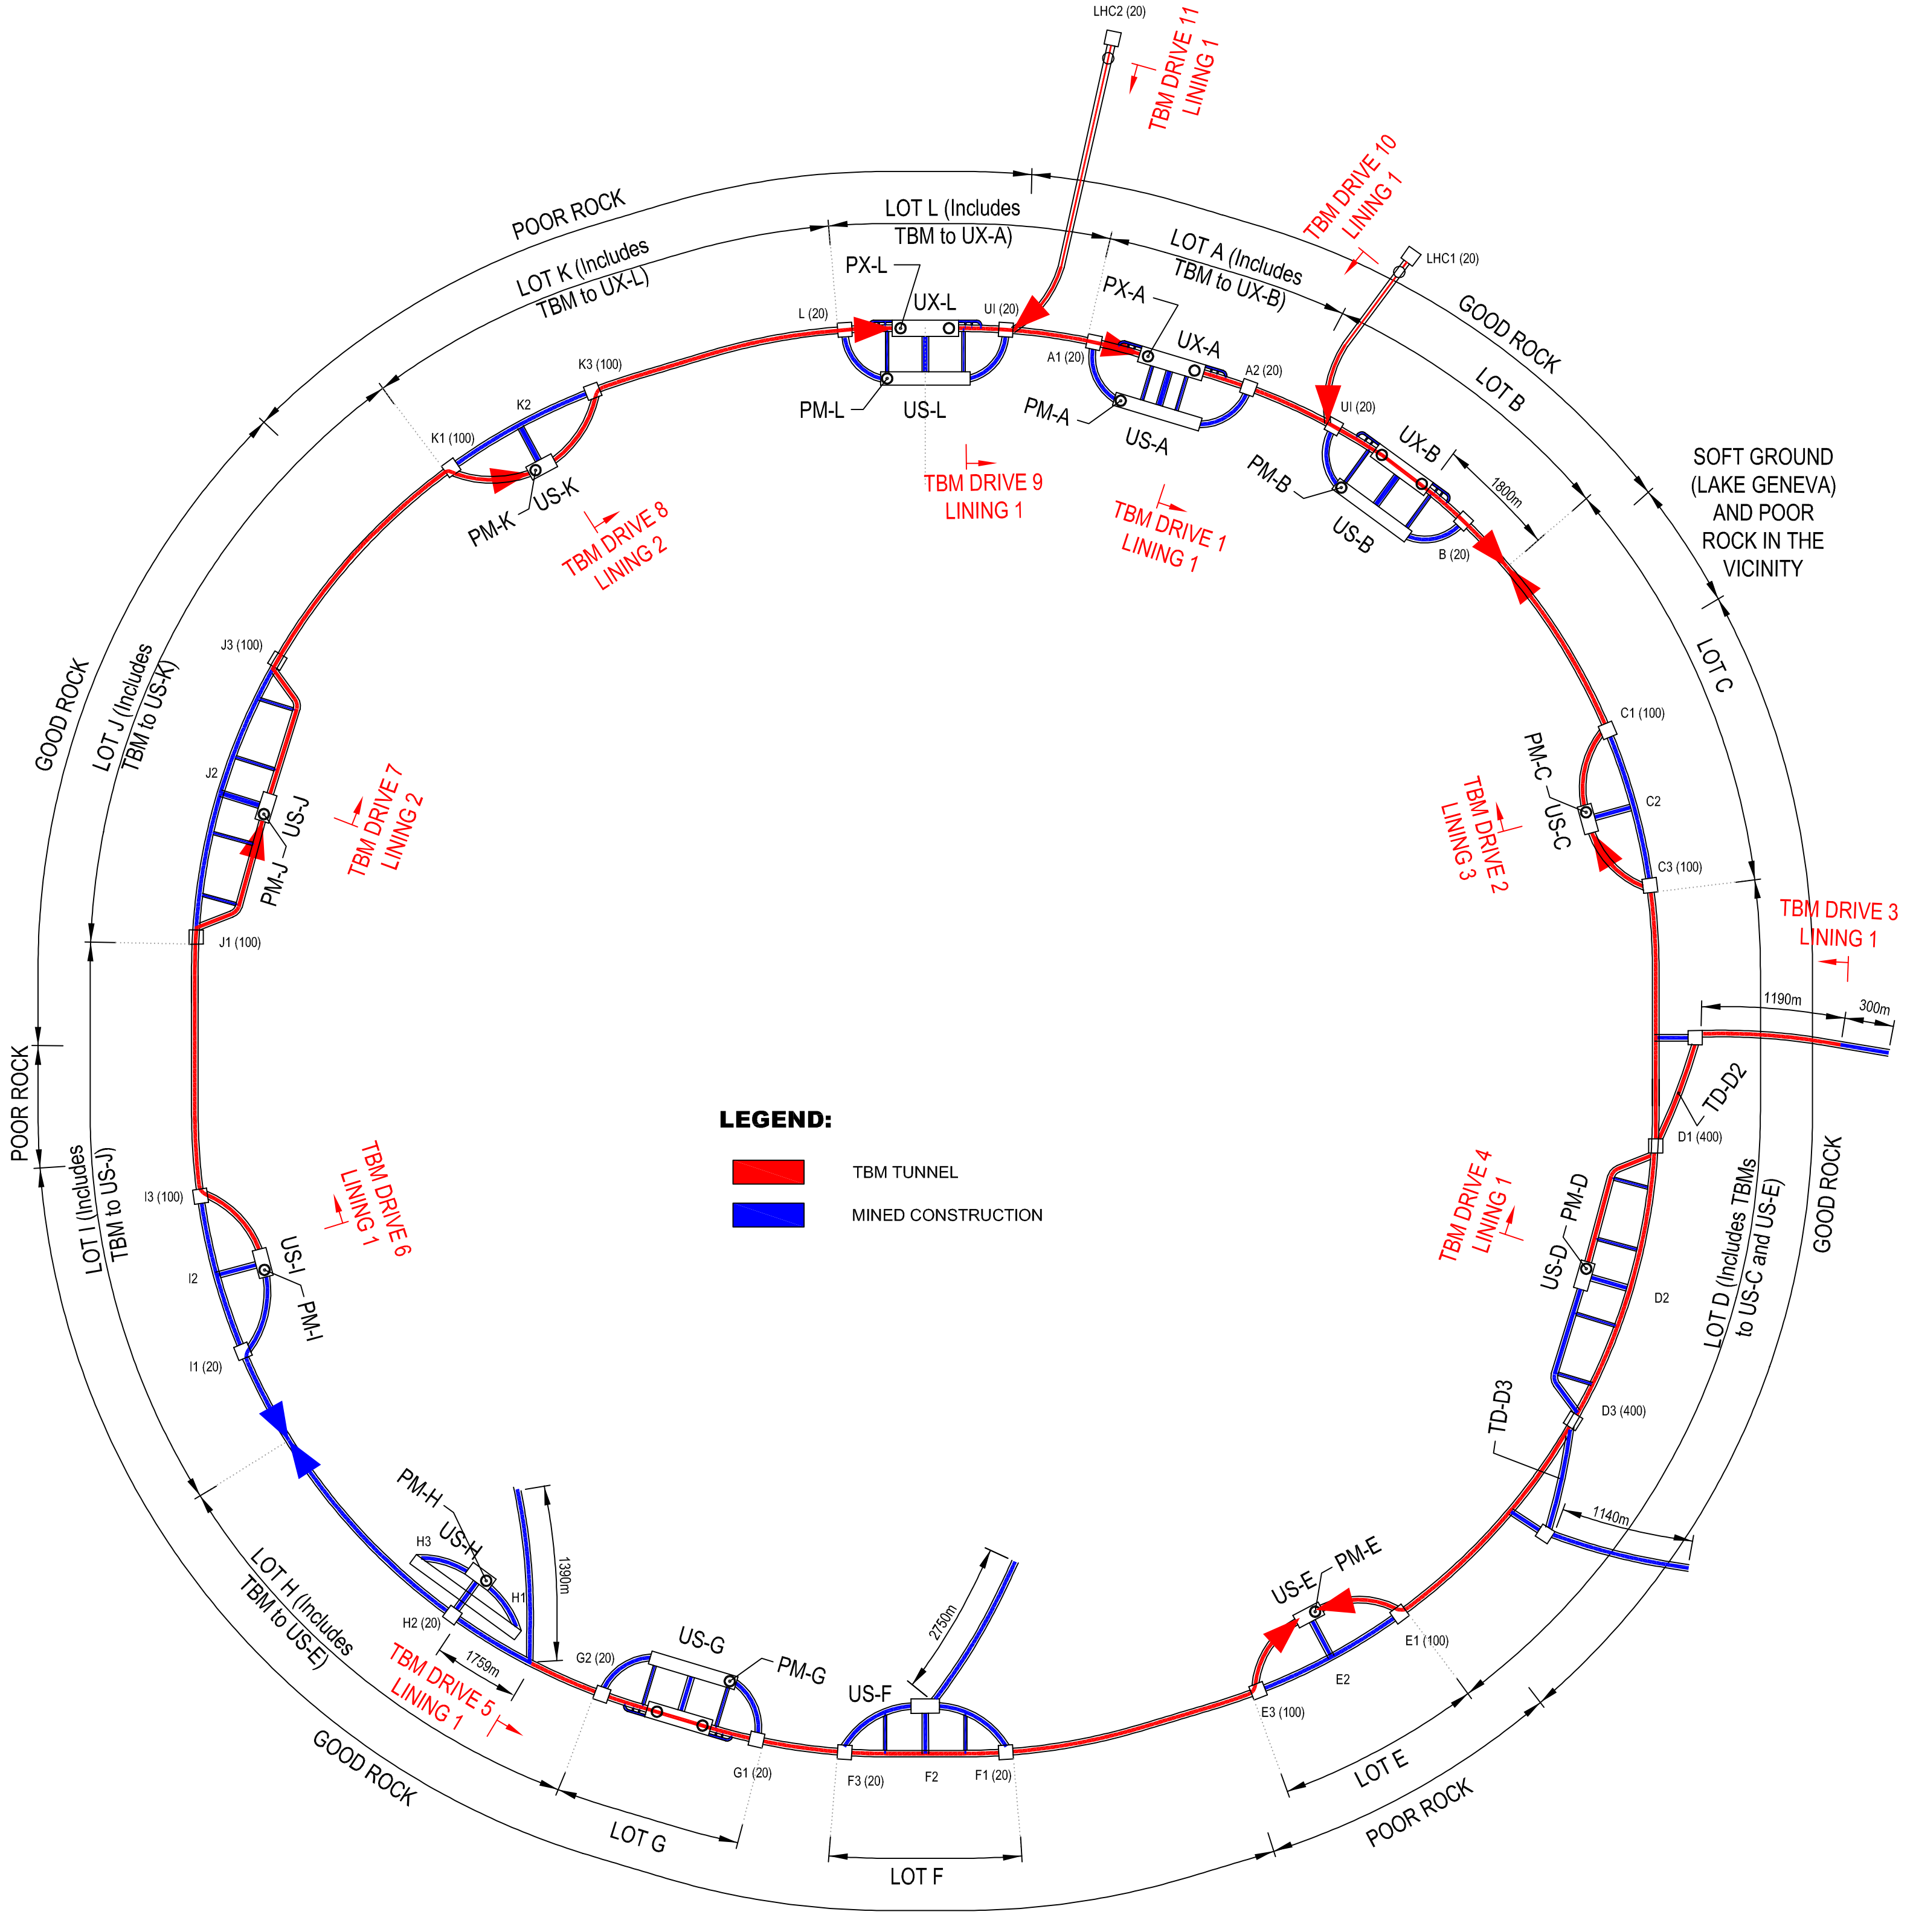
Construction Strategy
  Additional construction lots
  2 no. Shafts near the LHC for the connection tunnels LHC-FCC
  2 Beam transfer tunnels
Access to main tunnel works through:
  Shafts at 11 points
  Sloped Access adit at 1 point
  (instead of 570 m shaft)
  Intermediate Access Adits
  necessary to cope with overall time schedule to meet deadlines for machine installation
Project divided in 12 construction lots
  Construction techniques:
  1) TBM tunnels (red)
  2) Mined tunnels (blue)

Slide 19
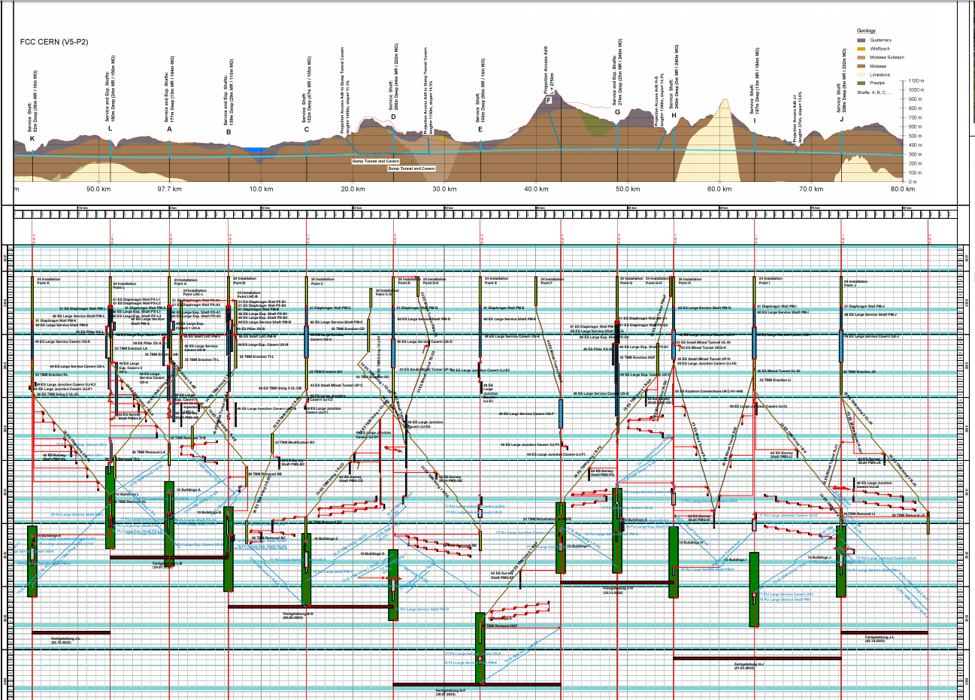
Construction Schedule
Sector L-B : 4.5 years
Sector D-F : 6.5 years

Slide 20
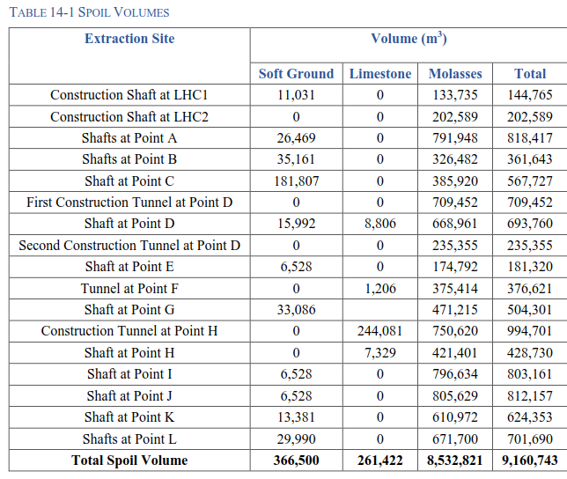
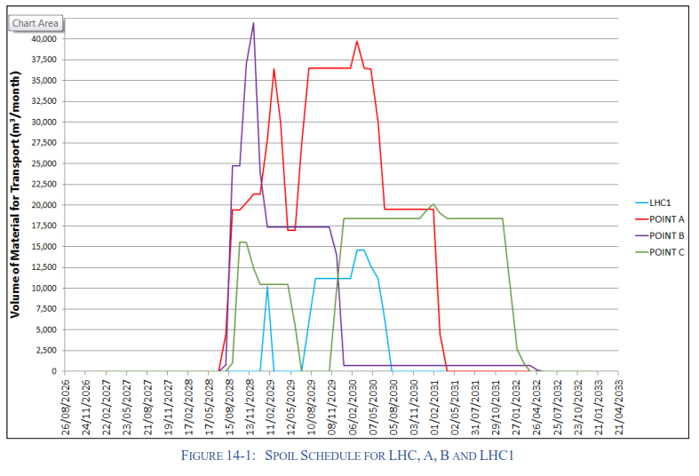
Spoil Management
Production of up to 42,000m³ per month
9million cubic meters to dispose
Can the molasse be re-used?
Assumed bulking factor of 1.3

Slide 21
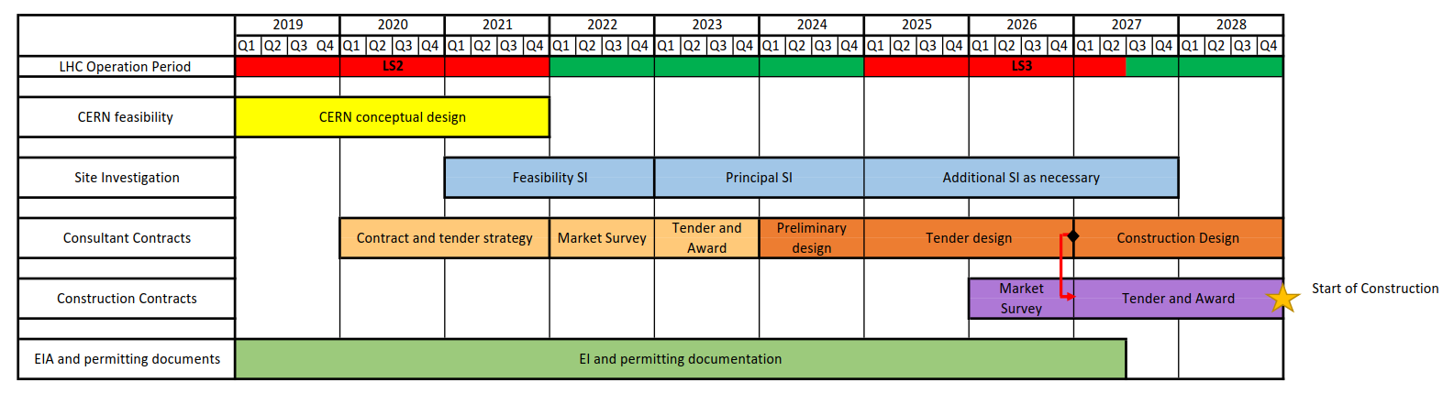
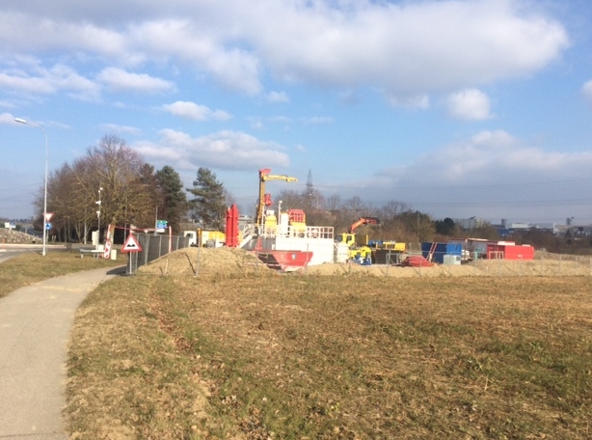
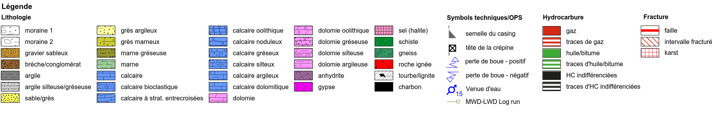
Ground Investigation Planning
Types of site investigation:
Collection of existing information
Walkover survey
Geophysical investigation
Boreholes
Site testing (eg Insitu stress test, point load testing, SPT)
Rock laboratory testing.
Geothermal site investigation in Satigny 2017/2018 (500m deep)

Slide 22
Other Future Steps
A further round of alignment optimisation following input from surface site investigations and potentially ground investigations
Continuing to work with integration to refine designs for all structures
Spoil disposal planning
Development of HE-LHC requirements
Maintenance planning for injection chain.

Slide 23


